Slide 1
Understanding the mode
KS3 Mastery PD Materials: Exemplified Key Ideas
Materials for use in the classroom or to support professional development discussions
(from 5.1 Statistical representations and measures)
Summer 2021

Slide 2
About this resource
These slides are designed to complement the 5.1 Statistical representations and measures core concept document and its associated Statistics and probability theme overview document, both found in the Secondary Mastery Professional Development pages.
These slides re-present the key examples from the Core Concept document so that the examples can be used either directly in the classroom or with a group of teachers. There are prompt questions alongside the examples, and further clarification in the notes.
These slides do not fully replicate the Core Concept document, so should be used alongside it. Reference to specific page numbers, and to other useful NCETM resources, can be found in the notes for each slide.
This slide deck is not designed to be a complete PD session, rather it is a selection of resources that you can adapt and use as needed when planning a session with a group of teachers.

Slide 3
About this resource
The slides are structured as follows:
The big picture:
Where does this fit in?
What do students need to understand?
Why is this key idea important?
Prior learning
Misconceptions
Exemplified key ideas
Reflection questions
Appendices:
Key vocabulary
Representations and structure
Previous and Future learning
Useful links
The exemplified key idea slides have the following symbols to indicate how they have been designed to be used:
Into the classroom
The examples are presented on these slides so that they could be used in PD, but also directly in the classroom. The notes feature suggested questions and things teachers might consider when using with students.
PD discussion prompts
These slides look at the examples in more detail, with question prompts to promote discussion among maths teachers. The notes feature reference to further information and guidance within the Core Concepts document.

Slide 4
Where does this fit in?
The NCETM has identified a set of six ‘mathematical themes’ within Key Stage 3 mathematics that bring together a group of ‘core concepts’.
The fifth of these themes is Statistics and probability, which covers the following interconnected core concepts:
5.1 Statistical representations and measures
5.2 Statistical analysis
5.3 Probability
Notes:
Linked on this slide is the Theme Overview document of Statistics and probability. This document includes why it is important, the key underpinning knowledge and links to prior and future learning. There is also guidance about how the five big ideas of Teaching for Mastery relate specifically to this theme.

Slide 5
Where does this fit in?
Within this core concept, 5.1 Statistical representations and measures, there are two statements of knowledge, skills and understanding.
These, in turn, are broken down into eight key ideas. The highlighted key idea is exemplified in this slide deck.
Notes:
For key ideas marked with an asterisk, we exemplified the common difficulties and misconceptions that students might have and included elements of what teaching for mastery may look like. We have provided examples of possible student tasks and teaching approaches.
Within these slides are ‘classroom-ready’ versions of the examples for the key idea that has been highlighted. There are also slides that may be useful for discussion in a professional development session.

Slide 6
What do students need to understand?
5.1.1.3 Understand what the mode is measuring, how it is measuring it and identify the mode from data presented in a range of different ways
Identify the mode from qualitative data.
Identify the modal value from a grouped frequency representation.
Work confidently with data sets with no mode.
Work confidently with data sets that are bimodal.
What prior knowledge might your students already have?
What language might they use to describe this key idea?
What questions might you want to ask to assess their prior learning?

Slide 7
Why is this key idea important?
We live in an information and data-rich age. The ability to interpret, analyse and critically evaluate all that we are presented with is vitally important if our students are to be engaged, thoughtful and aware citizens.
At Key Stage 2, students encountered the concept of central tendency and learnt how to calculate the (arithmetic) mean.
At Key Stage 3, they will develop their knowledge of calculating measures of central tendency to include the mode and median, will work with grouped data and be introduced to a measure of spread in statistics: range. This will enable students to engage in more sophisticated data analysis.
While calculating measures of central tendency accurately and efficiently is important, this should not be the dominant aspect of the learning and teaching. It is vital that students have a sense of what the measures of central tendency are actually measuring, and engage in activities which prompt questions, such as:
How can we use measures of central tendency to compare sets of data?
What do these measures tell us? For example, ‘On average, who has the most pocket money: class A or class B?’
How do these measures change when particular data points change? For example, ‘When considering the average wage in a company, what difference does it make to the various measures when the company director’s salary is added in, or removed?’
Students should also appreciate how these values, which summarise a set of data in some way, are affected by extra data being added to the whole data set and how such values can be found by comparing averages before and after the inclusion of additional data.
Notes:
A more detailed overview of the core concept of Statistical representations and measures can be found on page 2 of the 5.1 Core Concept document.
The background to each key idea is also explored in more detail on the following pages:
5.1.1 Understand and calculate accurately measures of central tendency and spread – page 7
5.1.2 Construct accurately statistical representations – pages 7 and 8

Slide 8
Prior learning
What prior knowledge might your students already have?
What language might they use to describe this key idea?
What questions might you want to ask to assess their prior learning?
Upper Key Stage 2 Learning Outcome
Calculate and interpret the mean as an average.
Notes:
You may find it useful to speak to your partner schools to see how the above learning outcomes have been covered and the language/representations used.
You can find further details regarding prior learning in the NCETM primary mastery professional development materials:
Year 6: 2.26 Mean average and equal shares
Within the 5 Statistics and probability Theme Overview document, you can also find a broader description of students’ potential previous learning (page 4), alongside further information about key underpinning knowledge (page 2).

Slide 9
Checking prior learning
The following slides contain questions for checking prior learning.
What representations might students use to support their understanding of these questions?
What variation might you put in place for these questions to fully assess students’ understanding of the concept?
How might changing the language of each question change the difficulty?
Why are these such crucial pre-requisites for this key idea?

Slide 10
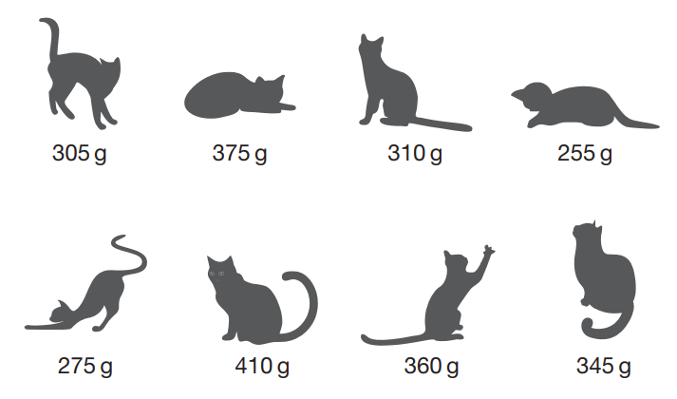
Checking prior learning (1)
The picture shows the masses of eight kittens.
The masses of the kittens are to be put in four groups. Write the missing numbers in the table. One has been done for you.
Mass in g | Number of kittens
250-299
300-349
350-399
400-449 | 1
What is the difference in mass between the heaviest kitten and the lightest kitten?
Notes:
References to the questions (links on final slide):
a) 2019 Key Stage 2 Mathematics Paper 3: Reasoning, question 7

Slide 11
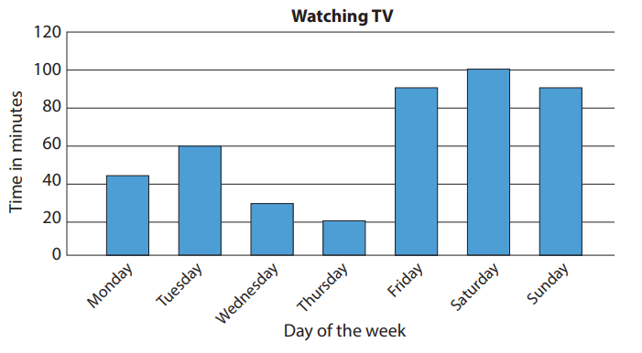
Checking prior learning (2)
The graph shows how many minutes Sam spent watching TV at home last week.
On which day did Sam watch the most TV?
How many minutes of TV did Sam watch on Wednesday?
How many more minutes did Sam watch on Friday than on Tuesday?
How many fewer minutes did Sam watch on Thursday compared to Sunday?
Notes:
References to the questions (links on final slide):
b) NCETM primary assessment materials: Year 4, page 29

Slide 12
Common difficulties and misconceptions
What aspects of this key idea might dtudents find challenging?
What misconceptions might students have?
When teaching this topic, you may find students encounter difficulties with…
Understanding what the mode means
Dealing with ‘multiple modes’
More information, and some suggestions for overcoming these challenges, can be found on the following slides.

Slide 13
Common difficulties and misconceptions (1)
Students may not understand what feature of a set of data they are trying to find when identifying the mode. The aim is to summarise the data by finding the most frequently occurring item. Focusing students’ attention on the question ‘What are we trying to find out about this set of data?’ will help to alleviate any confusion.
Examples 1, 2 and 3 in this slide deck offer some opportunities for discussion about common misconceptions students make when identifying the mode.
Notes:
More detail can be found on page 10 of the 5.1 Core Concept document.

Slide 14
Common difficulties and misconceptions (2)
Some sets of data may have multiple data items that occur the most frequently and students may wish to say that a data set has three or more modes. It is important for students to recognise that this is not helping to get a representative or summarising value for the set and, hence, the mode may be an inappropriate average.
This key idea provides an opportunity for teachers and students to refer to a wide range of statistical representations, both familiar and unfamiliar.
Notes:
More detail can be found on page 10 of the 5.1 Core Concept document

Slide 15
Identify the mode from qualitative data
Example 1
These neighbourhood policing statistics show the types of crime reported in one street in September 2018.
What type of reported crime was the mode?
Crime types
Anti-social behaviour (1) Bicycle theft (1) Burglary (0) Criminal damage and arson (0) Drugs (0) Other crime (0) Other theft (0) | Possession of weapons (0) Public order (4) Robbery (0) Shoplifting (10) Theft from the person (0) Vehicle crime (1) Violence and sexual offences (1)
Source: Data.Police.UK Public sector information licensed under the Open Government Licence v3.0
Notes:
Suggested questioning:
What is the frequency of each type of crime?
Why is 0 NOT the mode?
Things for you to think about:
Students may confuse frequencies with data values. In Example 1, students may report that ‘0’ is the mode, rather than ‘shoplifting’. It is important that students realise that the mode is the most frequent piece of data and not the frequency itself.
The Royal Statistical Society recommends that statistical content be drawn from real-life examples. Example 1 is drawn from actual UK police data. What are the strengths and limitations of using such data? What should you be mindful of if you choose to use it?
Source: Data.Police.UK

Slide 16
Identify the mode from qualitative data
Example 1
These neighbourhood policing statistics show the types of crime reported in one street in September 2018.
What type of reported crime was the mode?
What misconception might this example hope to expose?
What are the strengths and limitations of using real-life data?
What should you be mindful of when using real-life data?
Crime types
Anti-social behaviour (1) Bicycle theft (1) Burglary (0) Criminal damage and arson (0) Drugs (0) Other crime (0) Other theft (0) | Possession of weapons (0) Public order (4) Robbery (0) Shoplifting (10) Theft from the person (0) Vehicle crime (1) Violence and sexual offences (1)
Source: Data.Police.UK Public sector information licensed under the Open Government Licence v3.0
Notes:
Due to space constraints, the image on this PD discussion slide is very small. PD Leads might like to use or print the ‘in the classroom’ version of this slide for teachers to access during discussions.
More detail this question can be found on page 10 of the 5.1 Core Concept document.

Slide 17
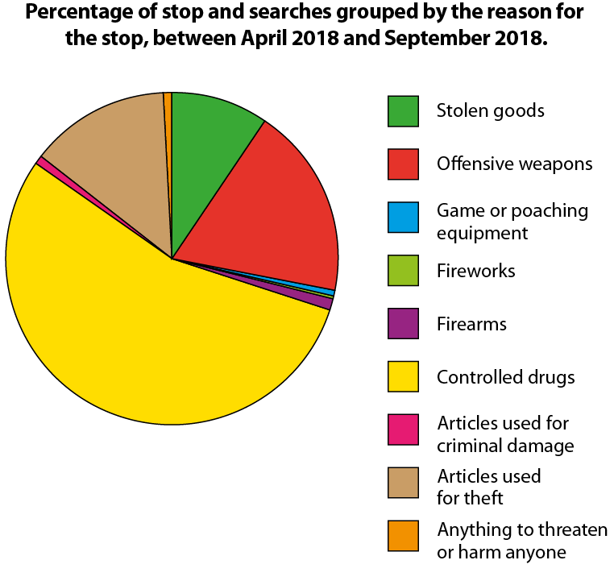
Identify the mode from qualitative data
Example 2
This pie chart also refers to neighbourhood policing statistics.
What was the modal reason for Humberside Police carrying out a stop and search between April 2018 and September 2018?
Source: Data.Police.UK Public sector information licensed under the Open Government Licence v3.0
Notes:
Suggested questioning:
What does ‘modal’ mean?
How do you identify the mode in a pie chart?
Things for you to think about:
It is important to think about the language that students need to be exposed to and ensure they understand different variations of key vocabulary. In Example 2, students need to appreciate that ‘modal’ is an adjective and that ‘mode’ is a noun.
Source: Data.Police.UK

Slide 18
Identify the mode from qualitative data.
Example 2
What language might students need to understand for questions about the mode?
What other representations might students need to be familiar with?
This pie chart also refers to neighbourhood policing statistics.
What was the modal reason for Humberside Police carrying out a stop and search between April 2018 and September 2018?
Source: Data.Police.UK Public sector information licensed under the Open Government Licence v3.0
Notes:
Due to space constraints, the image on this PD discussion slide is very small. PD Leads might like to use or print the ‘in the classroom’ version of this slide for teachers to access during discussions.
More detail about this example can be found on page 11 of the 5.1 Core Concept document.

Slide 19
Identify the mode from qualitative data
Examples 1 and 2
These two data sets have been presented in different ways.
Crime types
Anti-social behaviour (1) Bicycle theft (1) Burglary (0) Criminal damage and arson (0) Drugs (0) Other crime (0) Other theft (0) | Possession of weapons (0) Public order (4) Robbery (0) Shoplifting (10) Theft from the person (0) Vehicle crime (1) Violence and sexual offences (1)
How do you identify the mode in each representation of the data?
What are the benefits and limitations of each representation?
Source: Data.Police.UK Public sector information licensed under the Open Government Licence v3.0
Notes:
Suggested questioning:
What is the total represented in each chart? Why do you not know this?
What would the table look like if it was presented as a pie chart?
When might you use a pie chart? When would a pie chart not be useful?
Things for you to think about:
Comparing and contrasting different representations can be a helpful way students have understood how to interpret them. This can be even more powerful if, unlike the data above, you show students the same data represented in different ways.

Slide 20
Identify the mode from qualitative data
Example 3
This list refers to crimes reported in a hypothetical neighbourhood in one month.
Change one thing so that ‘anti-social behaviour’ becomes the mode.
Crime types
Anti-social behaviour (4) Bicycle theft (2) Burglary (1) Criminal damage (5) Drugs (3) Possession of weapons (3) Vehicle crime (0)
Notes:
Suggested questioning:
Is there more than one way to answer this question?
Things for you to think about:
In Example 3, ensure that students are not confusing frequency values with data values. They should understand that the mode is ‘criminal damage’, not ‘5’.

Slide 21
Identify the mode from qualitative data.
Example 3
What questions might you ask students about this data?
How could you encourage them to more than one solution to the problem?
Crime types
Anti-social behaviour (4) Bicycle theft (2) Burglary (1) Criminal damage (5) Drugs (3) Possession of weapons (3) Vehicle crime (0)
This list refers to crimes reported in a hypothetical neighbourhood in one month.
Change one thing so that ‘anti-social behaviour’ becomes the mode.
Notes:
Due to space constraints, the image on this PD discussion slide is very small. PD Leads might like to use or print the ‘in the classroom’ version of this slide for teachers to access during discussions.
More detail about this question can be found on page 11 of the 5.1 Core Concept document.

Slide 22
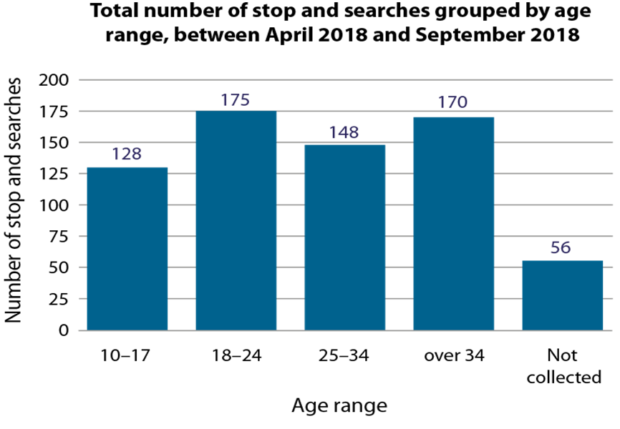
Identify the modal value from a grouped frequency representation
Example 4
This bar chart refers to neighbourhood policing statistics.
Identify the modal age group that Humberside Police carried out a stop and search on between April 2018 and September 2018.
Source: Data.Police.UK Public sector information licensed under the Open Government Licence v3.0
Notes:
Suggested questioning:
How do we identify the modal value or group in a bar chart?
What are the implications of the ‘not collected’ bar? Can we be confident that we still have found the modal group?
What are the implications of the different size of the age intervals?
Do we know the modal age? Why or why not?
What can we learn from this bar chart?
Things for you to think about:
Presenting students with data such as this provides a rich opportunity for discussion. For example, here, the age group intervals differ. Depending upon how the groups were chosen and how they are used, could it be argued that the modal group is misleading? What other questions might you ask?
Source: Data.Police.UK

Slide 23
Identify the modal value from a grouped frequency representation
Example 4
What questions might you ask students to check their understanding of this bar chart?
What questions might you ask students to encourage them to be statistically curious?
This bar chart refers to neighbourhood policing statistics.
Identify the modal age group that Humberside Police carried out a stop and search on between April 2018 and September 2018.
Source: Data.Police.UK Public sector information licensed under the Open Government Licence v3.0
Notes:
Due to space constraints, the image on this PD discussion slide is very small. PD Leads might like to use or print the ‘in the classroom’ version of this slide for teachers to access during discussions.
More detail about this question can be found on page 12 of the 5.1 Core Concept document.

Slide 24
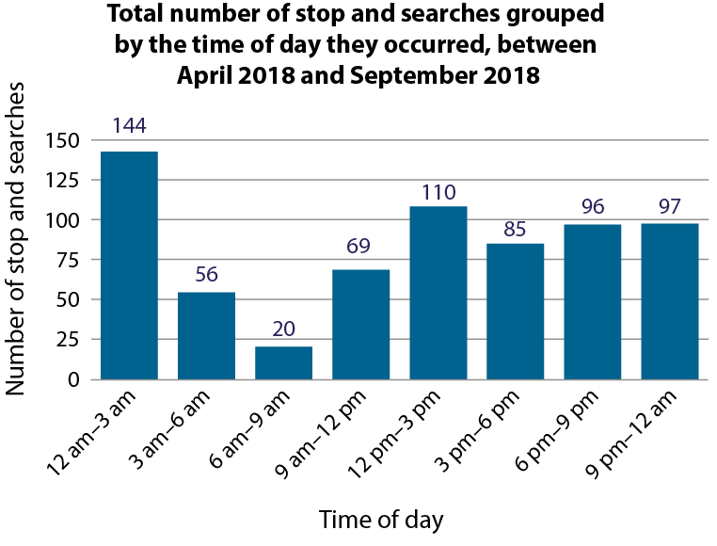
Identify the modal value from a grouped frequency representation.
Example 5
This bar chart refers to neighbourhood policing statistics.
Identify the modal time of day that Humberside Police carried out a stop and search between April 2018 and September 2018.
Source: Data.Police.UK Public sector information licensed under the Open Government Licence v3.0
Notes:
Suggested questioning:
What is the modal time of day? Why might this be?
Would different neighbourhoods have had a different modal time? Why or why not?
Things for you to think about:
How could you encourage a statistical curiosity with students, using the graph in Example 5? For example, why might the modal time interval be between 12 am and 3 am? What neighbourhoods might have a different modal time interval and why?
Source: Data.Police.UK

Slide 25
Identify the modal value from a grouped frequency representation
Example 5
Identifying the modal time is a relatively straightforward task: what other questions might you ask about this data?
This bar chart refers to neighbourhood policing statistics.
Identify the modal time of day that Humberside Police carried out a stop and search between April 2018 and September 2018.
Source: Data.Police.UK Public sector information licensed under the Open Government Licence v3.0
Notes:
Due to space constraints, the image on this PD discussion slide is very small. PD Leads might like to use or print the ‘in the classroom’ version of this slide for teachers to access during discussions.
More detail about this question can be found on page 12 of the 5.1 Core Concept document.

Slide 26
Work confidently with data sets with no mode
Example 6
Crime on or near The Carrs
8 crimes were reported here in September 2018.
Anti-social behaviour (0) Bicycle theft (0) Burglary (2) Criminal damage (0) Drugs (2) Possession of weapons (2) Violent crime (2)
This list refers to a hypothetical neighbourhood.
What was the modal type of crime reported?
Notes:
Suggested questioning:
Why is the mode not a suitable measure of central tendency here?
Why is the mean also not suitable?
Things for you to think about:
Example 6 is an instance of using a non-example to highlight a characteristic. In this case, the data set is too small to enable the identification of a mode.

Slide 27
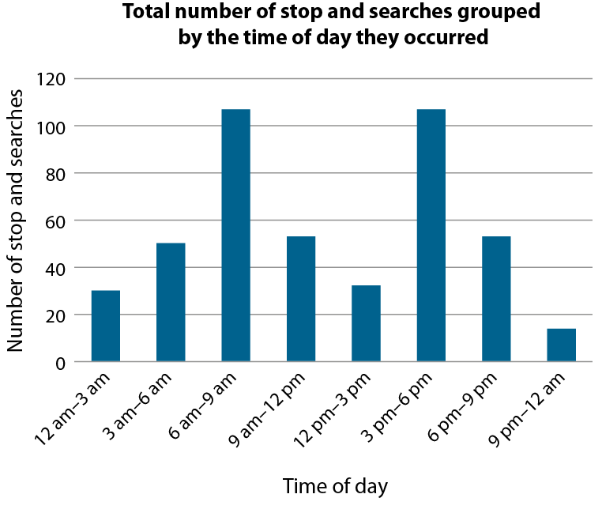
Work confidently with data sets that are bimodal
Example 7
This bar chart refers to a hypothetical neighbourhood.
Identify the modal time of day that neighbourhood police carried out a stop and search.
Notes:
Suggested questioning:
What might ‘bimodal’ mean? If you weren’t sure, what clues are there in the word?
Why might there be two modal groups in this data?
Things for you to think about:
Example 7 is an instance of using a non-example to highlight a characteristic. In this case, the data set is best described as bimodal with modes at, perhaps, peak travel times.

Slide 28
Work confidently with data sets with no mode or that are bimodal
Examples 6 and 7
Crime on or near The Carrs
8 crimes were reported here in September 2018.
Anti-social behaviour (0) Bicycle theft (0) Burglary (2) Criminal damage (0) Drugs (2) Possession of weapons (2) Violent crime (2)
This bar chart refers to a hypothetical neighbourhood.
Identify the modal time of day that neighbourhood police carried out a stop and search.
This list refers to a hypothetical neighbourhood.
What was the modal type of crime reported?
What are these two non-examples being used to highlight?
What other characteristics might you want to draw students’ attention to?
What questions might you ask about each data set?
Notes:
Due to space constraints, the image on this PD discussion slide is very small. PD Leads might like to use or print the ‘in the classroom’ version of this slide for teachers to access during discussions.
More detail about the decisions behind these questions can be found on page 13 of the 5.1 Core Concept document.

Slide 29
Reflection questions
What other mathematical concepts will be supported by students’ stronger understanding of this key idea?
What mathematical language will you continue to use to support pupils to make connections with other areas?
Which representations might you continue to use to further develop students’ understanding?

Slide 31
Appendices
You may choose to use the following slides when planning or delivering a PD session. They cover:
Key vocabulary
Representations and structure
Previous learning
Future learning
Library of links

Slide 32
Key vocabulary
Term | Definition
(arithmetic) mean | The sum of a set of numbers, or quantities, divided by the number of terms in the set. Example: The arithmetic mean of 5, 6, 14, 15 and 45 is (5 + 6 + 14 + 15 + 45) ÷ 5 i.e. 17.
bivariate data | Data that compares the values of two variables by pairing each value of one of the variables with a value of the other.
measure of central tendency | In statistics, a measure of how the values of a particular variable are located in terms of the values collected for a particular sample, or for the relevant population as a whole. In school mathematics up to Key Stage 4, there are three important measures of central tendency: the arithmetic mean, the median and the mode. These are all statistical averages and often one is more useful than another, depending on the spread of the values under consideration.
measures of dispersion | Measures of dispersion describe how much a set of data is spread out or dispersed. They include the range (where you subtract the lowest score from the highest score) and the standard deviation, which calculates the spread of values around the mean.
median | The middle number or value when all values in a set of data are arranged in ascending order. Example: The median of 5, 6, 14, 15 and 45 is 14. When there is an even number of values, the arithmetic mean of the two middle values is calculated. Example: The median of 5, 6, 7, 8, 14 and 45 is (7 + 8) ÷ 2 i.e. 7.5 The median is one example of an average.
mode | The most commonly occurring value or class with the largest frequency. Example: The mode of this set of data: 2, 3, 3, 3, 4, 4, 5, 5, 6, 7, 8 is 3. Some sets of data may have more than one mode.
range | A measure of spread in statistics. The difference between the greatest value and the least value in a set of numerical data.

Slide 33
Representations and structure
There are a number of different statistical representations that students might encounter as part of their exploration of the mode. It will be important that students understand how to identify the modal value or group in each of these representations.
Pie charts
Pie charts allow for comparisons between proportions. They are particularly relevant for students when they are working with populations of different sizes, or for making multiplicative comparisons within the same population.
Bar charts
Bar charts can be used give students a sense of the ‘shape’ of the distribution of the data across a sample, to identify and compare frequencies. They give an opportunity for comparisons to be made using absolute values.
Pictograms
Pictograms are a simple way of recording frequencies, tabulating images that represent a certain frequency.
Notes:
More information about the representations and structure involved in this key idea can be found on pages 5-7 of the Statistics and probability Theme Overview document.

Slide 34
Previous learning
From Upper Key Stage 2, students will bring experience of:
interpreting and presenting discrete and continuous data using appropriate graphical methods, including bar charts, pictograms and time graphs
solving comparison, sum and difference problems using information presented in bar charts, pictograms, tables and other graphs
interpreting and constructing pie charts and line graphs, and using these to solve problems
encountering and drawing graphs relating two variables, arising from their own enquiry and in other subjects (non-statutory guidance)
calculating and interpreting the mean as an average
knowing when it is appropriate to find the mean of a data set (non-statutory guidance).
Notes:
Theme 5 Statistics and probability

Slide 35
Future learning (1)
In KS4, students will build on the core concepts in this mathematical theme to:
infer properties of populations or distributions from a sample, whilst knowing the limitations of sampling
interpret and construct tables and line graphs for time series data
{construct and interpret diagrams for grouped discrete data and continuous data, i.e. histograms with equal and unequal class intervals and cumulative frequency graphs, and know their appropriate use}
Please note: Braces { } indicate additional mathematical content to be taught to more highly attaining students.
Notes:
Theme 5 Statistics and probability

Slide 36
Future learning (2)
In KS4, students will build on the core concepts in this mathematical theme to:
interpret, analyse and compare the distributions of data sets from univariate empirical distributions through:
appropriate graphical representation involving discrete, continuous and grouped data, {including box plots}
appropriate measures of central tendency (including modal class) and spread {including quartiles and inter-quartile range}
apply statistics to describe a population
use and interpret scatter graphs of bivariate data; recognise correlation and know that it does not indicate causation; draw estimated lines of best fit; make predictions; interpolate and extrapolate apparent trends whilst knowing the dangers of so doing
Please note: Braces { } indicate additional mathematical content to be taught to more highly attaining students.
Notes:
Theme 5 Statistics and probability

Slide 37
Library of links
The following resources from the NCETM website have been referred to within this slide deck:
NCETM Secondary Mastery Professional Development
Statistics and probability theme overview document
5.1 Statistical representations and measures core concept guidance document
Using mathematical representations at KS3 | NCETM
NCETM primary mastery professional development materials
NCETM primary assessment materials
There are also references to:
Standards & Testing Agency’s past mathematics papers

