Slide 1
1.29 Using equivalence and the compensation property to calculate
Representations | Year 5
Number, Addition and Subtraction

Slide 2
How to use this presentation
You can find the teacher guide 1.29 Using equivalence and the compensation property to calculate by following the link below.

Slide 3
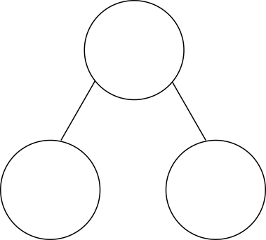


1.29 Equivalence and compensation – step 1:1
27 + 18
= 25 + 20
= 45
45

Slide 4

1.29 Equivalence and compensation – step 1:1
27 + 18
= 25 + 20
= 45
27
+
18
=
45
− 2
+ 2
25
+
20
=
45

Slide 5
1.29 Equivalence and compensation – step 1:2
199,999 + 345,222
= 200,000 + 345,221
= 545,221
1
345,221

Slide 6
1.29 Equivalence and compensation – step 1:2
199,999 + 345,222
= 200,000 + 345,221
= 545,221
199,999
+
345,222
=
545,221
+ 1
− 1
200,000
+
345,221
=
545,221

Slide 7
1.29 Equivalence and compensation – step 1:2
7,656 + 89,994
= 7,650 + 90,000
= 97,650
7,650
6

Slide 8
1.29 Equivalence and compensation – step 1:2
7,656 + 89,994
= 7,650 + 90,000
= 97,650
7,656
+
89,994
=
97,650
− 6
+ 6
7,650
+
90,000
=
97,650

Slide 9
1.29 Equivalence and compensation – step 1:3
5.3 + 3.98
= 5.28 + 4.0
= 9.28
5.3
+
3.98
=
9.28
− 0.02
+ 0.02
5.28
+
4.0
=
9.28

Slide 10
1.29 Equivalence and compensation – step 1:3
5.3 + 3.98
= 5.0 + 4.28
= 9.28
5.3
+
3.98
=
9.28
− 0.3
+ 0.3
5.0
+
4.28
=
9.28

Slide 11
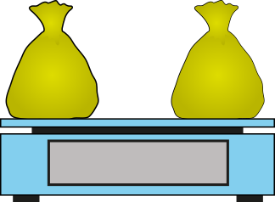

1.29 Equivalence and compensation – step 1:5
45 g

Slide 12
1.29 Equivalence and compensation – step 1:5
5 g
35
+
10
=
45
30 g
15 g
35 g
10 g
− 5
+ 5
45 g
30
+
15
=
45
So 35 + 10 = 30 + 15

Slide 13
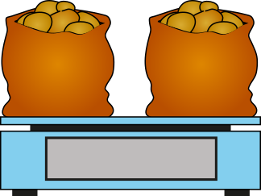
1.29 Equivalence and compensation – step 1:6
340 g
5,300
+
4,700
=
10,000
4,960 g
5,040 g
5,300 g
4,700 g
− 340
+ 340
10,000 g
4,960
+
5,040
=
10,000
So 5,300 + 4,700 = 4,960 + 5,040

Slide 14
1.29 Equivalence and compensation – step 1:6
0.34 kg
5.3
+
4.7
=
10
4.96 kg
5.04 kg
5.3 kg
4.7 kg
− 0.34
+ 0.34
10 kg
4.96
+
5.04
=
10
So 5.3 + 4.7 = 4.96 + 5.04

Slide 15

1.29 Equivalence and compensation – step 1:7
5,300 − 340 + 4,700 + 340
=
10,000

Slide 16



1.29 Equivalence and compensation – step 1:8
28 + 32
=
29 +
31
+ 1
28
+
32
=
29
+
31
− 1
Notes:
There is the same number of children in Year 5 as there is in Year 6. In Year 5, there are 28 boys and 32 girls. In Year 6, there are 29 boys. How many girls are there in Year 6?

Slide 17
1.29 Equivalence and compensation – step 1:8
30 + 25
=
40
+ 15
+ 10
30
+
25
=
40
+
15
− 10
Notes:
Sally plans to buy 30 bottles of cola and 25 bottles of juice for a party. When she gets to the shop, they only have 15 bottles of juice, but she wants to buy the same number of bottles of drink in total. If she buys all 15 bottles of juice, how many bottles of cola will she need to buy?

Slide 18


1.29 Equivalence and compensation – step 1:9
46.25
+ 0.45
=
16.45 + 30.25
+ 16
46.25
+
0.45
=
16.45
+
30.25
− 16

Slide 19
1.29 Equivalence and compensation – step 1:10
 | ✓ or ✗
101 + 99 = 100 + 100 | ✓
27 + 56 = 28 + 57 | ✗
248,000 + 564,000 = 148,000 + 464,000 | ✗
0.27 + 0.56 = 0.23 + 0.6 | ✓
✓
✗
✗
✓

Slide 20
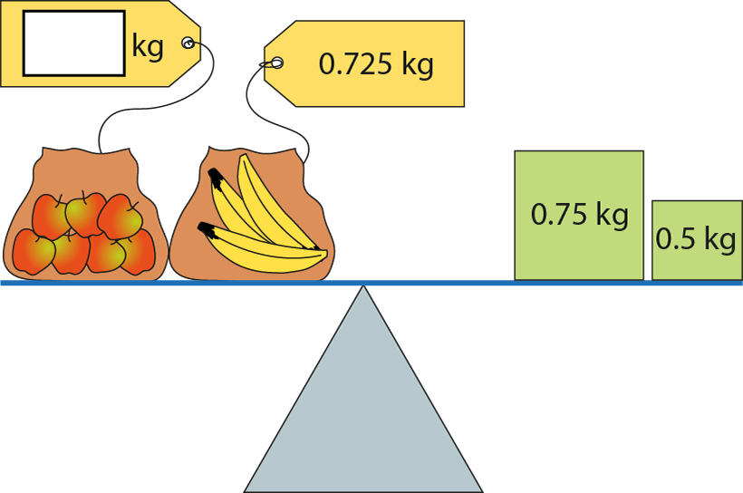
1.29 Equivalence and compensation – step 1:10
0.525

Slide 21

1.29 Equivalence and compensation – step 2:1
3
+
6
=
9
23
+
6
=
29
Notes:
Diego walked for three minutes to get to his friend’s house, and then walked for another six minutes to get to school. His journey took nine minutes altogether.
Dana walked for twenty-three minutes to get to her friend’s house, and then walked for another six minutes to get to school. Her journey took twenty nine minutes altogether.

Slide 22
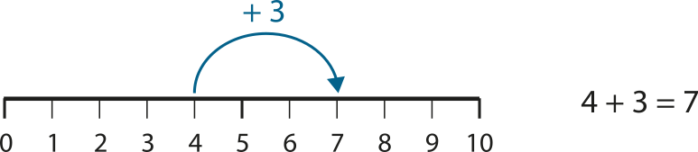
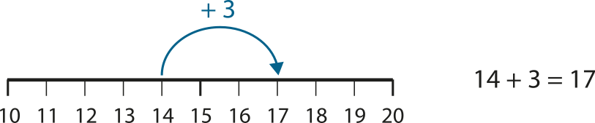
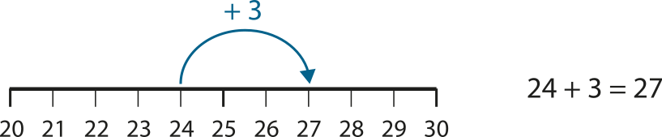
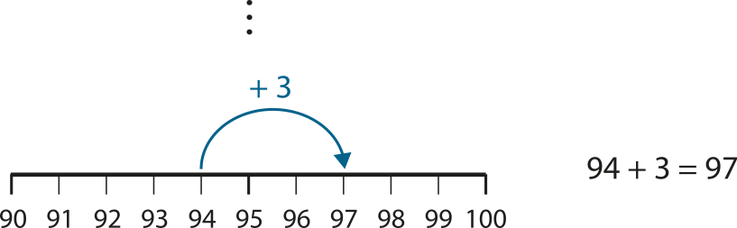
1.29 Equivalence and compensation – step 2:1

Slide 23
1.29 Equivalence and compensation – step 2:1
4
+
3
=
7
+ 10
+ 10
14
+
3
=
17

Slide 24
1.29 Equivalence and compensation – step 2:2
96
+
4
=
100
− 30
− 30
66
+
4
=
70

Slide 25


1.29 Equivalence and compensation – step 2:3
100
57
43
110
57 + 10
43
57
+
43
=
100
+ 10
+ 10
67
+
43
=
110
Notes:
Together two children have saved £100. Yameena has saved £57 and Tom has saved £43. Yameena is given another £10. How much do they have now?

Slide 26
1.29 Equivalence and compensation – step 2:3
16
+
14
=
30
− 1
− 1
15
+
14
=
29
Notes:
There were 30 children in a class: 16 boys and 14 girls. Then a boy left. How many children are there in the class now?

Slide 27
1.29 Equivalence and compensation – step 2:4
10
10.8
+
0.8
4.6
4.6
+
0.8
5.4
5.4
+
0.8
4.6 + 0.8 + 5.4 = 10 + 0.8
+ 0.8
+ 0.8
= 10.8
4.6 + 5.4 + 0.8 = 10 + 0.8
+ 0.8
+ 0.8
= 10.8
Notes:
The combined mass of two cats is 10 kg. The mass of one cat is 4.6 kg and the mass of the other cat is 5.4 kg. One of the cats gains 0.8 kg. What is their combined mass now?

Slide 28
1.29 Equivalence and compensation – step 2:5
0.29
+
28.71
=
29
+ 28
+ 28
0.29
+
0.71
=
1

Slide 29
1.29 Equivalence and compensation – step 2:5
646,000
+
54,000
=
700,000
+ 600,000
+ 600,000
46,000
+
54,000
=
100,000

Slide 30
1.29 Equivalence and compensation – step 2:7
36
+
47
=
83
+ 2
+ 2
36
+
49
=
85

Slide 31
1.29 Equivalence and compensation – step 2:7
83
85
+ 2
36
47
49
+ 2

Slide 32
1.29 Equivalence and compensation – step 2:7
125
+
239
=
364
− 4
− 4
121
+
239
=
360

Slide 33
1.29 Equivalence and compensation – step 2:7
364
360
− 4
125
121
− 4
239

Slide 34

1.29 Equivalence and compensation – step 3:1

Slide 35

1.29 Equivalence and compensation – step 3:1

Slide 36

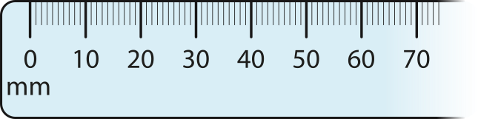
1.29 Equivalence and compensation – step 3:1
45 − 0 = 45
55 − 10 = 45
65 − 20 = 45

Slide 37
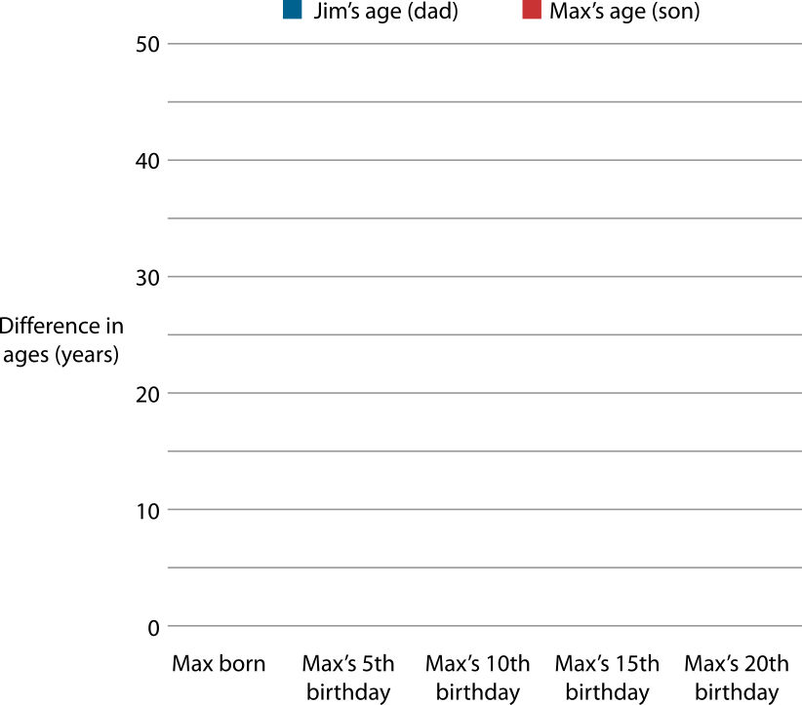
1.29 Equivalence and compensation – step 3:2
Notes:
Jim was 25 years old when his son, Max, was born. What is the difference between their ages?
When Jim is 30, Max is 5. What is the difference between their ages?
When Jim is 35, Max is 10. What is the difference between their ages?
When Jim is 40, Max is 15. What is the difference between their ages?
Is the difference between their ages always going to remain the same?
How old will Max be when Jim is 75?

Slide 38
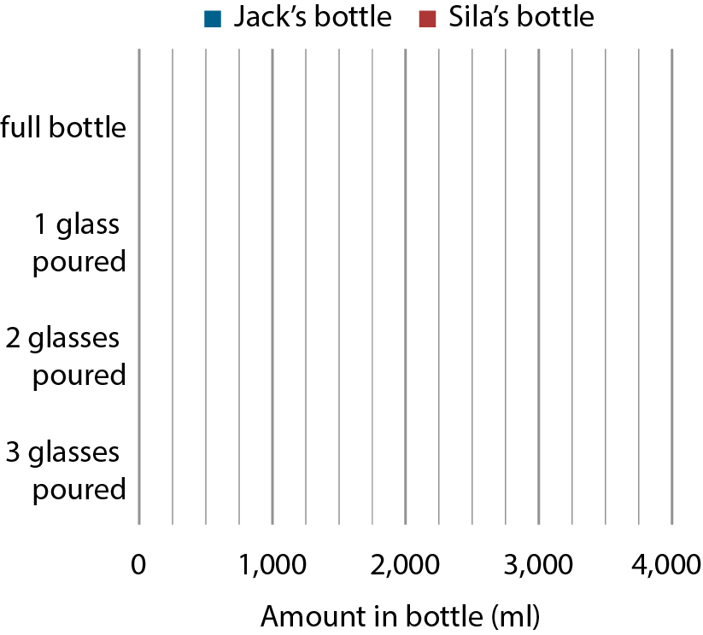
1.29 Equivalence and compensation – step 3:2
Amount in Jack’s bottle (ml) | Amount in Sila’s bottle (ml) | Difference between Jack and Sila’s bottles (ml)
3,000
2,000
1,000
2,750
1,750
1,000
2,500
1,500
1,000
2,250
1,250
1,000
Notes:
Jack has a three-litre bottle of drink and Sila has a two-litre bottle of drink. They both pour out three 250 ml glasses of drink. What is the difference between the amounts in their bottles after each glass is poured?

Slide 39
1.29 Equivalence and compensation – step 3:3
4 | − | 1 | = | 3
↑ minuend |  | ↑ subtrahend |  | ↑ difference

Slide 40
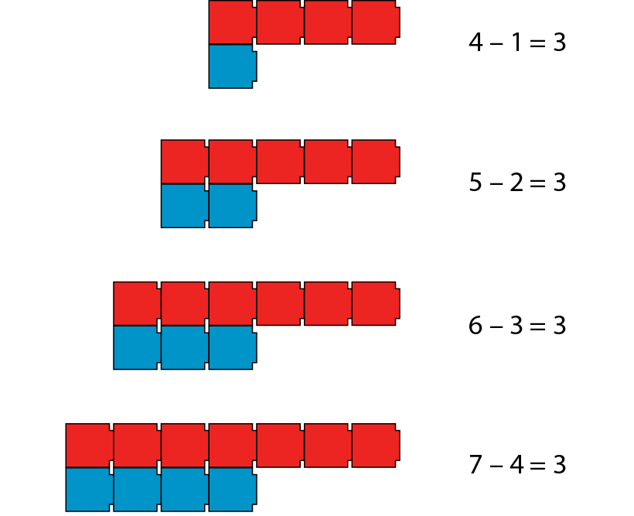


1.29 Equivalence and compensation – step 3:3
4 − 1 = 3
5 − 2 = 3
6 − 3 = 3
7 − 4 = 3

Slide 41
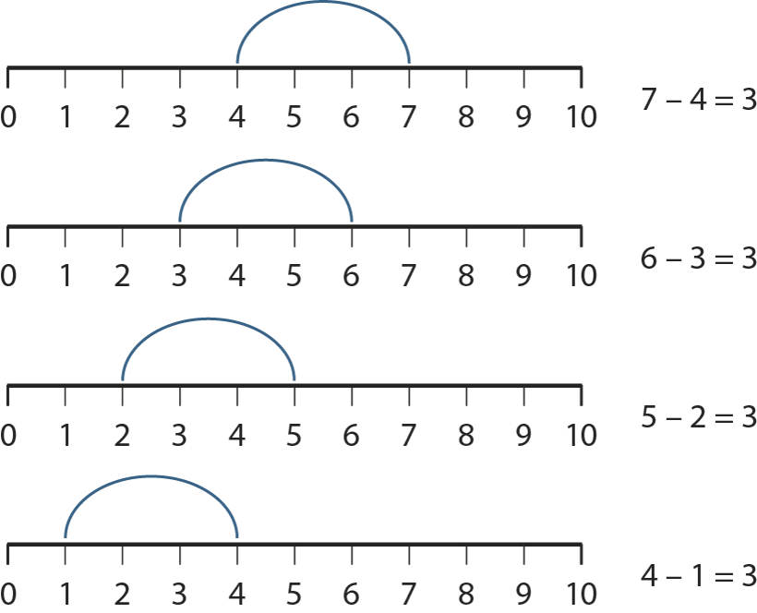


1.29 Equivalence and compensation – step 3:4
7 − 4 = 3
6 − 3 = 3
5 − 2 = 3
4 − 1 = 3

Slide 42


1.29 Equivalence and compensation – step 3:6
53 − 39
= 54 − 40
= 14
14
14

Slide 43
1.29 Equivalence and compensation – step 3:6
53
−
39
=
14
+ 1
+ 1
54
−
40
=
14

Slide 44
1.29 Equivalence and compensation – step 3:7
356
−
289
=
67
+ 11
+ 11
367
−
300
=
67

Slide 45
1.29 Equivalence and compensation – step 3:7
45,228
−
25,203
=
20,025
− 3
− 3
45,225
−
25,200
=
20,025

Slide 46
1.29 Equivalence and compensation – step 3:7
19.72
−
4.94
=
14.78
+ 0.06
+ 0.06
19.78
−
5
=
14.78

Slide 47
1.29 Equivalence and compensation – step 3:9
20,000 − 1,658
1
9
9
9
1
1
1
1
 | 2 | 0 | , | 0 | 0 | 0
− |  | 1 | , | 6 | 5 | 8
1
8
,
3
4
2

Slide 48
1.29 Equivalence and compensation – step 3:9
20,000 − 1,658 = 19,999 − 1,657
20,000 − 1,658
= 18,342
1
9
9
9
1
1
1
1
 | 2 | 0 | , | 0 | 0 | 0
− |  | 1 | , | 6 | 5 | 8
 | 1 | 9 | , | 9 | 9 | 9
− |  | 1 | , | 6 | 5 | 7
1
8
,
3
4
2
1
8
,
3
4
2
18,342
18,342

Slide 49
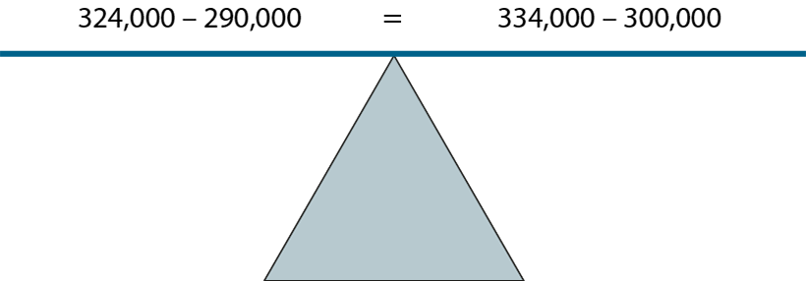
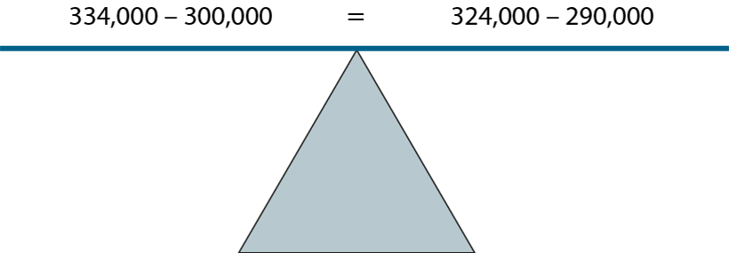
1.29 Equivalence and compensation – step 3:12

Slide 50
1.29 Equivalence and compensation – step 3:13
10 − 3
=
45 −
38
+ 35
10
−
3
=
45
−
38
+ 35

Slide 51
1.29 Equivalence and compensation – step 3:13
10 − 3
=
54
− 47
+ 44
10
−
3
=
54
−
47
+ 44

Slide 52

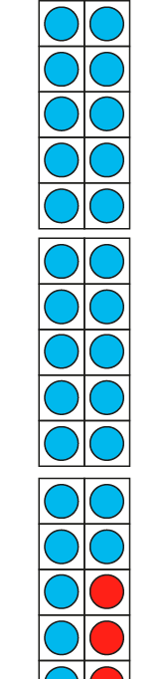
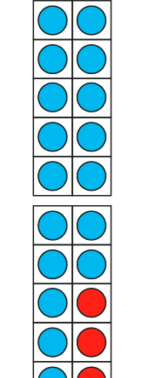
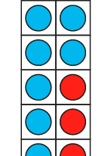

1.29 Equivalence and compensation – step 4:1
10 − 3 = 7
20 − 3 = 17
2
3
1
0
−
3
=
1
2
7
30 − 3 = 27
Notes:
Jon has 10 p in his money box. Misha has 3 p in hers. Jon has 7 p more than Misha.
Jon adds 10 p to his money box. He now has 17 p more than Misha.
Jon adds another 10 p to his money box. He now has 17 p more than Misha.

Slide 53
1.29 Equivalence and compensation – step 4:1
10
−
3
=
7
+ 10
+ 10
20
−
3
=
17
+ 10
+ 10
30
−
3
=
27

Slide 54
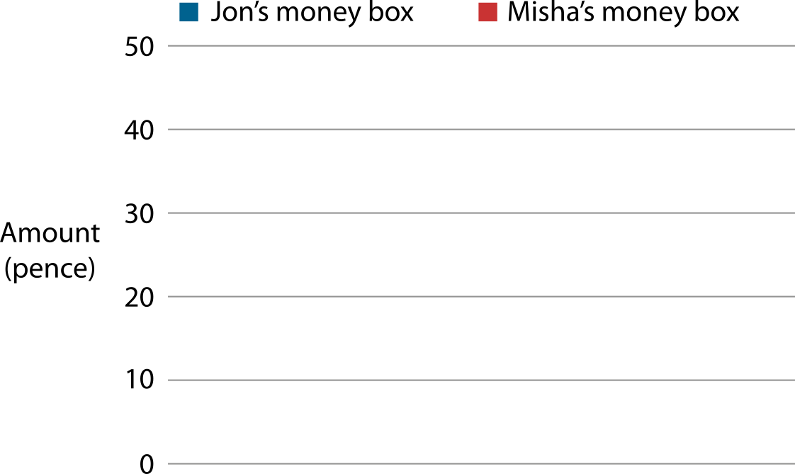
1.29 Equivalence and compensation – step 4:1
30
20
10
7
7
7
7

Slide 55

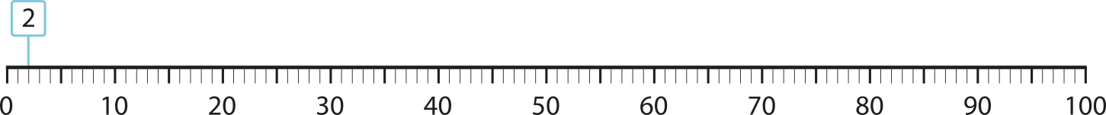
1.29 Equivalence and compensation – step 4:2
78
88
98
100 − 2
90 − 2
80 − 2
= 98
= 88
= 78
Notes:
Evie has 100 p in her money box and Hari has 2 p, so Evie has 98 p more than Hari.
On Monday, Evie spends 10 p. She now has 88 p more than Hari.
On Tuesday, Evie spends another 10 p. She now has 78 p more than Hari.

Slide 56
1.29 Equivalence and compensation – step 4:2
100
−
2
=
98
− 10
− 10
90
−
2
=
88
− 10
− 10
80
−
2
=
78

Slide 57
1.29 Equivalence and compensation – step 4:3
16
−
14
=
2
+ 2
+2
18
−
14
=
4
Notes:
There were 16 boys and 14 girls in a class. The difference between the number of boys and girls was 2. Now there are 18 boys in the class, but the number of girls is the same. How many more boys than girls are there now?

Slide 58
1.29 Equivalence and compensation – step 4:3
172
−
138
=
34
− 20
− 20
152
−
138
=
14
Notes:
A blue ribbon was 1 m 72 cm long and a red ribbon was 1 m 38 cm long; so the blue ribbon was 34 cm longer than the red ribbon. Then the blue ribbon was cut down to 1 m 52 cm. How much longer than the red ribbon is the blue ribbon now?

Slide 59
1.29 Equivalence and compensation – step 4:5
124
−
0.26
=
123.74
− 123
− 123
+ 123
1
−
0.26
=
0.74

Slide 60
1.29 Equivalence and compensation – step 4:5
374,000
−
24,000
=
350,000
− 300,000
− 300,000
+ 300,000
74,000
−
24,000
=
50,000

Slide 61
1.29 Equivalence and compensation – step 4:6
183
−
49
=
134
+ 6
+ 6
− 6
189
−
49
=
140

Slide 62
1.29 Equivalence and compensation – step 4:6
185
−
46
=
139
+ 1
+ 1
− 1
186
−
46
=
140

Slide 63
1.29 Equivalence and compensation – step 4:7
18
−
0.75
=
17.25
+ 17
+
17
1
−
0.75
=
0.25

Slide 64
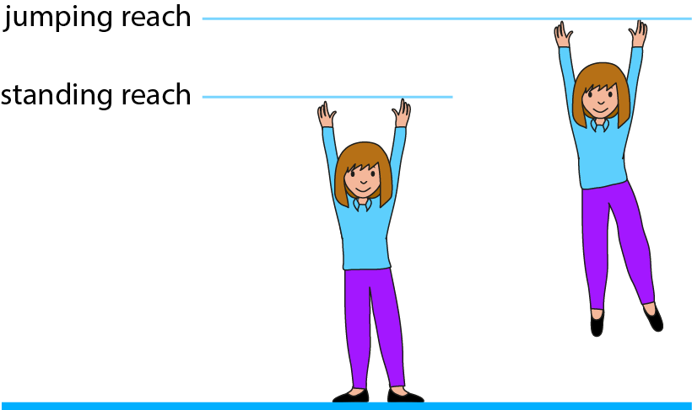
1.29 Equivalence and compensation – step 4:8
Week | Standing reach (cm) | Jumping reach (cm) | Score (difference in cm)
1 |  |  | 9
2 |  |  | 8
3 |  |  | 8
4 |  |  | 10
5 | 143 | 154
143
152
143
151
143
151
143
153
11
Notes:
Stephanie wants to learn to jump higher. She records her standing reach height, then the height she reaches when she jumps, to calculate how high she can jump.
Stephanie tests herself each week for five weeks. Stephanie doesn’t get any taller during the five weeks, so her standing reach doesn’t change. Her results are shown in the table, but some of the values are missing. Fill in the missing information.

Slide 65

1.29 Equivalence and compensation – step 5:1
10 − 4
>
10 − 5
Notes:
Sebastian has 10 marbles. He gives away 4 of them.
Megan also has 10 marbles. If she gives away 5 marbles, will she be left with more or fewer marbles than Sebastian?

Slide 66
1.29 Equivalence and compensation – step 5:1
10 − 4
<
10 − 3
Notes:
Peter also has 10 marbles. If he gives away 3 marbles, will he be left with more or fewer marbles than Sebastian?

Slide 67






1.29 Equivalence and compensation – step 5:2
78
98 − 20
= 78
98 − 30
= 68
68
Notes:
Harvey is buying groceries. The bill is £98, but he thinks he has a voucher for £20 off so will only have to pay £78.
Harvey’s voucher is actually worth £30. How much will he have to pay for his groceries?

Slide 68
1.29 Equivalence and compensation – step 5:2
98
20
30
+ 10
78
68
− 10
98
−
20
=
78
+ 10
− 10
98
−
30
=
68

Slide 69







1.29 Equivalence and compensation – step 5:3
200
350 − 150
= 200
350 − 130
= 220
220
Notes:
Raf has saved £150. He wants to buy a game console that costs £350. How much more does he need to save?
Raf goes out with his friends and spends £20 of his savings. He now has £130. How much does he now need to save before he can buy the game console?

Slide 70
1.29 Equivalence and compensation – step 5:3
350
150
130
− 20
200
220
+ 20
350
−
150
=
200
− 20
+ 20
350
−
130
=
220

Slide 71
1.29 Equivalence and compensation – step 5:4
85
−
45
=
40
85
+ 10
− 10
45
+ 10
40
30
− 10
same
30
Notes:
Ciara has 85 marbles; 45 of them are red and the rest are blue, so she has 40 blue marbles. Arjun also has 85 marbles; some of them are red and some of them are blue. He has ten more red marbles than Ciara. How many blue marbles does Arjun have?

Slide 72
1.29 Equivalence and compensation – step 5:4
£5
−
£3.50
=
£1.50
£5
− 50 p
+ 50 p
£3.50
− 50 p
£1.50
£2
+ 50 p
same
£2
Notes:
Leah gets £5 to spend on lunch each day. On Monday she spends £3.50, so she is left with £1.50 to put in her savings. On Tuesday Leah spends 50 p less than she did on Monday. How much does she have left on Tuesday to put in her savings?

Slide 73
1.29 Equivalence and compensation – step 5:6
375,861
−
300,000
=
75,861
+ 100,000
− 100,000
375,861
−
200,000
=
175,861
− 100,000
+ 100,000
375,861
−
100,000
=
275,861

Slide 74
1.29 Equivalence and compensation – step 6:2
34 + 46
72 +
8
80
=

Slide 75

1.29 Equivalence and compensation – step 6:4
427 − 274
538
− 385
153
=
− 385
3
1
 | 1 | 5 | 3
+ | 3 | 8 | 5
 | 4 | 2 | 7
− | 2 | 7 | 4
153
538
1
5
3
5
3
8
+ 385
1

Slide 76

1.29 Equivalence and compensation – step 6:5
87.36 m
56.16 m
37.44 m
68.64 m
x
Notes:
Both lawns have the same perimeter.
How long is the side marked x?
How many different ways can you find to calculate the value of x?
Which method do you prefer?

Slide 77
1.29 Equivalence and compensation – step 6:7
Month | Rainfall (mm)
Jun | 87
Jul | 67
Aug | 28
Sep | 48
Notes:
True or false? The difference between the amount of rain that fell in July compared to June is the same as the difference between the amount of rain that fell in September compared to August. Write calculations to explain your answer.
Explain which difference shows an increase in rainfall and which shows a decrease.

