Slide 1
Year 3, Unit 3
Right angles

Slide 2
Year 3, Unit 3
These materials heavily reflect the prioritisation approach of the ready-to-progress criteria in the DfE Primary Mathematics Guidance 2020 and on the PPTs that exemplify them on the NCETM website. They also include other relevant National Curriculum content. Related sections of the NCETM Primary Mastery Professional Development Materials provide small-step teaching guidance.
Ready-to-progress criteria addressed by this unit
Teaching of this unit supports the following criteria from the ‘DfE Mathematics Guidance: key stages 1 & 2’ (the 335-page document available as a download)
3G-1 Page 134

Slide 3
Contents
The links below take you to the starting slide of each learning outcome.
1 | Pupils rotate two lines around a fixed point to make different sized angles
2 | Pupils draw triangles and quadrilaterals and identify vertices
3 | Pupils learn that a right angle is a ‘square corner’ and identify them in the environment
4 | Pupils learn that a rectangle is a 4-sided polygon with four right angles
5 | Pupils learn that a square is a rectangle in which the four sides are equal length
6 | Pupils cut rectangles and squares on the diagonal and investigate the shapes they make
7 | Pupils join four right angles at a point using different right-angled polygons
8 | Pupils investigate and draw other polygons with right angles
Click the arrow button to return to this Contents slide.

Slide 4
Year 3, Unit 3, Learning Outcome 1
Learning Outcome 1
Pupils rotate two lines about a fixed point to make different sized angles
The following slides have been collated to support the teaching of this learning outcome.

Slide 5
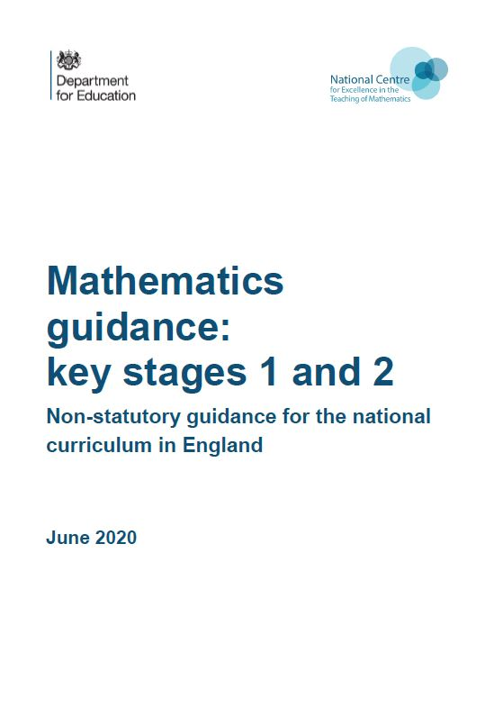
Year 3, Unit 3, Learning Outcome 1
Additional teacher guidance for this outcome should be read first and can be found in the DfE Mathematics guidance. Page references relate to the 335-page document available as a download at the bottom of this web page.
Ready to progress criteria | Pages
3G-1 | 134-137

Slide 6
Year 3, Unit 3, Learning Outcome 1
You will need 2 pieces of card and a split pin:

Slide 7
Year 3, Unit 3, Learning Outcome 1
Starting with the strips on top of one another:
  Turn one strip a very small amount
  Turn it about half way round
  Turn it all of the way around
  Look at the clock on the wall and try to arrange your strips to match the hands on it
We call the amount of turn between the two arms the angle.
Make some big angles.
Make some small angles.

Slide 8
Year 3, Unit 3, Learning Outcome 1
Your original equipment:
Now make two more strips using shorter pieces of card and longer pieces of card.

Slide 9
Year 3, Unit 3, Learning Outcome 1
Turn each of your angle-makers about the same amount.

Slide 10
Year 3, Unit 3, Learning Outcome 1
The pieces of card are different lengths, but all of these angles are the same.

Slide 11
Year 3, Unit 3, Learning Outcome 2
Learning Outcome 2
Pupils draw triangles and quadrilaterals and identify vertices
The following slides have been collated to support the teaching of this learning outcome.

Slide 12
Year 3, Unit 3, Learning Outcome 2
Additional teacher guidance for this outcome should be read first and can be found in the DfE Mathematics guidance. Page references relate to the 335-page document available as a download at the bottom of this web page.
Ready to progress criteria | Pages
3G-1 | 134-137

Slide 13
Year 3, Unit 3, Learning Outcome 2
tri
A shape that is enclosed by 3 straight lines is called a triangle.
three
A shape that is enclosed by 4 straight lines is called a quadrilateral.
quad
lateral
four
side
A triangle has 3 vertices.
A quadrilateral has 4 vertices.

Slide 14
Year 3, Unit 3, Learning Outcome 2
Triangles or not triangles?

Slide 15
Year 3, Unit 3, Learning Outcome 2
Quadrilaterals or not quadrilaterals?

Slide 16
Year 3, Unit 3, Learning Outcome 2
Draw some different triangles and quadrilaterals. Mark 3 or 4 vertices and join them carefully with a ruler, so that your shapes are fully enclosed and the sides are straight.

Slide 17
Year 3, Unit 3, Learning Outcome 3
Learning Outcome 3
Pupils learn that a right angle is a ‘square corner’ and identify them in the environment
The following slides have been collated to support the teaching of this learning outcome.

Slide 18
Year 3, Unit 3, Learning Outcome 3
Additional teacher guidance for this outcome should be read first and can be found in the DfE Mathematics guidance. Page references relate to the 335-page document available as a download at the bottom of this web page.
Ready to progress criteria | Pages
3G-1 | 134-137

Slide 19
Year 3, Unit 3, Learning Outcome 3
Take any scrap of paper
Make sure it lines up along the first fold
Fold again
Fold anywhere on the paper

Slide 20
Year 3, Unit 3, Learning Outcome 3
Open your angle-checker so that your ‘square corner’ fits exactly in side.
The angle at a ‘square corner’ is called a right angle.
It is also a one-quarter turn.
Join your right angle checker with 3 other friends to see.

Slide 21
Year 3, Unit 3, Learning Outcome 3

Slide 22
Year 3, Unit 3, Learning Outcome 3

Slide 23
Year 3, Unit 3, Learning Outcome 3
Right angle
Smaller than a right angle
Larger than a right angle

Slide 24
Year 3, Unit 3, Learning Outcome 3
Take a square or rectangular tile and practice fitting your right angle checker into each vertex.

Slide 25

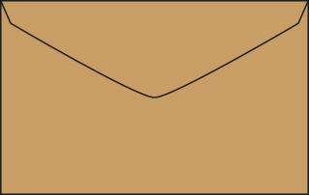
Year 3, Unit 3, Learning Outcome 3
Use your right angle checker to look for right angles in the classroom and the playground.
Look at both natural objects and made objects. What do you notice about the number of right angles in each?

Slide 26
Year 3, Unit 3, Learning Outcome 3
Look back at the triangles and quadrilaterals you drew previously.
Can you find any vertices where the angle is a right angle?
Mark any that you find, with the right angle symbol.

Slide 27
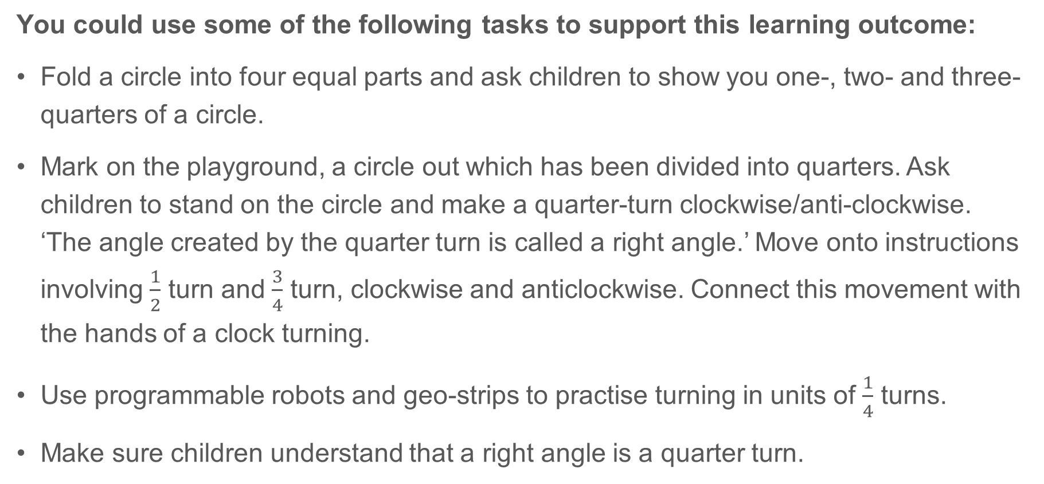
3G-1 Recognise right angles
You could use some of the following tasks to support this learning outcome:
Fold a circle into four equal parts and ask children to show you one-, two- and three-quarters of a circle.
Mark on the playground, a circle out which has been divided into quarters. Ask children to stand on the circle and make a quarter-turn clockwise/anti-clockwise. ‘The angle created by the quarter turn is called a right angle.’ Move onto instructions involving $\frac{1}{2}$ turn and $\frac{3}{4}$ turn, clockwise and anticlockwise. Connect this movement with the hands of a clock turning.
Use programmable robots and geo-strips to practise turning in units of $\frac{1}{4}$ turns.
Make sure children understand that a right angle is a quarter turn.
A right angle is the amount of turn between two lines that creates a quarter of a full turn.

Slide 28
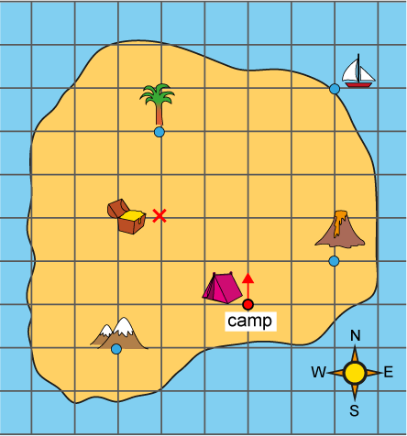
3G-1 Recognise right angles
Give children a copy of the treasure island map shown. Children need to use their finger and start at the camp, facing north.
Ask children to follow a range of instructions, for example:
- Go forwards 4 squares. Make a quarter turn anti-clockwise. Go forwards 2 squares. Where are you?
- Make a three-quarter turn clockwise. Go forward 2 squares. Mark the point and draw a lake.
Draw another feature on the map and write instructions on how to get there from the camp.
Use squared paper and design a map of your own like this. Can you write instructions for someone to find features on your map?

Slide 29
3G-1 Recognise right angles
You could use some of the following tasks to support this learning outcome:
Children should recognise right angles when they look peculiar. The POG ‘Peculiar, Ordinary, General’ activity can be used to encourage children to think about drawing right angles with different length lines and in different orientations. Start by drawing an ordinary right angle and move to drawing peculiar right angles. Children should focus on what the essential features of a right angle are – the turn between two lines creating a square corner, so that one line is perpendicular to the other. Look at all the peculiar right angles and discuss what is the same or general about them all.
Walk around the school environment and practise identifying right angles, e.g. the corner of a book, hands on a clock at 3 o’clock, corners of bricks and paving slabs etc.
Work in pairs. Child A holds a piece of string out straight. Child B uses their finger to move the string to make a right angle. Does your finger always have to be in the same place on the string to make a right angle? Can you shift your finger and the string so the angle is not a right angle any more? Can you make the angle bigger than a right angle? Can you make it smaller than a right angle?

Slide 30
Year 3, Unit 3, Learning Outcome 4
Learning Outcome 4
Pupils learn that a rectangle is a 4-sided polygon with four right angles
The following slides have been collated to support the teaching of this learning outcome.

Slide 31
Year 3, Unit 3, Learning Outcome 4
Additional teacher guidance for this outcome should be read first and can be found in the DfE Mathematics guidance. Page references relate to the 335-page document available as a download at the bottom of this web page.
Ready to progress criteria | Pages
3G-1 | 134-137

Slide 32
Year 3, Unit 3, Learning Outcome 4
Take any scrap of paper
Fold anywhere on the paper
(Write your name on it as we will use it later)

Slide 33
Year 3, Unit 3, Learning Outcome 4
Investigate the angle at each vertex of the shape you have folded using your angle tools.
Our right angle checker confirms that each vertex is a right angle.
A shape with 4 straight sides and 4 right angles is called a rectangle.
Mark each vertex to show you know it is a right angle

Slide 34
Year 3, Unit 3, Learning Outcome 4
Rectangle
Also rectangles
Not rectangles

Slide 35
Year 3, Unit 3, Learning Outcome 5
Learning Outcome 5
Pupils learn that a square is a rectangle in which the four sides are equal length
The following slides have been collated to support the teaching of this learning outcome.

Slide 36
Year 3, Unit 3, Learning Outcome 5
Additional teacher guidance for this outcome should be read first and can be found in the DfE Mathematics guidance. Page references relate to the 335-page document available as a download at the bottom of this web page.
Ready to progress criteria | Pages
3G-1 | 134-137

Slide 37
Year 3, Unit 3, Learning Outcome 5
Take the rectangle you folded yesterday.
Measure each of the sides and write the side lengths on your rectangle.
What do you notice about the length of pairs of opposite sides?
  Rectangles have four right angles
  In rectangles, pairs of opposite sides are equal length
Does anyone’s rectangle have four sides of equal length?
58mm
65mm
65mm
58mm

Slide 38
Year 3, Unit 3, Learning Outcome 5
Rectangles (all of the shapes)
Everybody has made a rectangle, because all your shapes have
  4 straight sides
  and 4 right angles.
Some people’s rectangles are square rectangles, because the 4 sides are all the same length.
58mm
Squares
(some of the shapes)
65mm
65mm
58mm
78mm
78mm
78mm
81mm
78mm
96mm
96mm
81mm

Slide 39
Year 3, Unit 3, Learning Outcome 5
Square
Also squares
Not squares

Slide 40
Year 3, Unit 3, Learning Outcome 5
Draw some different squares on the grid. Check the side length are all the same and the vertices are all right angles. Can you draw some that don’t have horizontal and vertical sides?

Slide 41
Year 3, Unit 3, Learning Outcome 6
Learning Outcome 6
Pupils cut rectangles and squares on the diagonals and investigate the shapes they make
The following slides have been collated to support the teaching of this learning outcome.

Slide 42
Year 3, Unit 3, Learning Outcome 6
Additional teacher guidance for this outcome should be read first and can be found in the DfE Mathematics guidance. Page references relate to the 335-page document available as a download at the bottom of this web page.
Ready to progress criteria | Pages
3G-1 | 134-137

Slide 43
Year 3, Unit 3, Learning Outcome 6
Draw one diagonal on your paper square and paper rectangle.
Cut along the diagonal.

Slide 44
Year 3, Unit 3, Learning Outcome 6
Describe the shapes you have made.
What is the same? What is different?
Can you see any right angles? Convince me that they really are right angles.

Slide 45
Year 3, Unit 3, Learning Outcome 6
Now draw both diagonals on your paper square and paper rectangle.
Cut along the diagonals.

Slide 46
Year 3, Unit 3, Learning Outcome 6
Describe the shapes you have made.
What is the same? What is different?
Can you see any right angles? Convince me that they really are right angles.

Slide 47
Year 3, Unit 3, Learning Outcome 7
Learning Outcome 7
Pupils join four right angles at a point using different right-angled polygons
The following slides have been collated to support the teaching of this learning outcome.

Slide 48
Year 3, Unit 3, Learning Outcome 7
Additional teacher guidance for this outcome should be read first and can be found in the DfE Mathematics guidance. Page references relate to the 335-page document available as a download at the bottom of this web page.
Ready to progress criteria | Pages
3G-1 | 134-137

Slide 49
Print and cut

Slide 50
Year 3, Unit 3, Learning Outcome 7
Take the 4 card strips you have, and cut them along the lines. You will have multiple copies of each of these shapes.
What can you say about each of the angles in these shapes?
Find different ways that you can join four right angles about a point.
Can you make arrangements that have a pattern within them? Can you extend your arrangement to have several places where 4 right angles meet?
Square
(also a rectangle)
Rectangle
Right angled isosceles triangle
(half square)
Right angled scalene triangle
(half rectangle)

Slide 51
Year 3, Unit 3, Learning Outcome 7

Slide 52
Year 3, Unit 3, Learning Outcome 8
Learning Outcome 8
Pupils investigate and draw other polygons with right angles
The following slides have been collated to support the teaching of this learning outcome.

Slide 53
Year 3, Unit 3, Learning Outcome 8
You will need
  a selection of card strips of different lengths
  split pins
  right angle checker (set square or folded paper)

Slide 54
Year 3, Unit 3, Learning Outcome 8
We are going to make polygons with more than 4 sides.
Look at the shape I have made. What can you say about it? Remember to talk about the angles and sides.
It has 5 straight sides and 5 vertices. It is a pentagon.
The angles at the vertices all look about the same size. They are all bigger than a right angle.
If the 5 vertices were exactly the same angle, this would be a regular pentagon.

Slide 55
Year 3, Unit 3, Learning Outcome 8
Now make a pentagon of your own with 5 equal length sides.
  Can you move the sides to try to make it a regular pentagon?
  Can you move the sides of your shape so that it has a right angle?
  More than one right angle?

Slide 56
Year 3, Unit 3, Learning Outcome 8
Pentagon with one right angle
Pentagon with two right angles
Both these pentagons have 5 equal sides, but they are not regular pentagons because they do not also have 5 equal angles.

Slide 57
Year 3, Unit 3, Learning Outcome 8
Now make and explore different polygons.
I wonder whether the following hypothesis is true:
  “The more sides a shape has, the greater the number of right angles it can have.”
What do your investigations show?
Are there any generalisations you can make about the number of right angles polygons can have?

Slide 58
Year 3, Unit 3, Learning Outcome 8
Draw 3 polygons with more than 4 sides, and at least one right angle

Slide 59
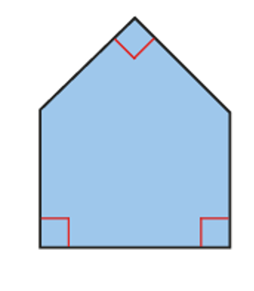
3G-1 Recognise right angles
What do you notice about this shape?
How many sides has the shape got?
How many vertices?
Do you think there are any right angles in the shape? Use a right-angle checker to help you.
Is it a regular shape or an irregular shape? How do you know?
Can you name the shape?
Use squared or dotty paper. Can you draw an irregular pentagon with only two right angles? What about only one right angle?
Repeat this activity with other polygons.

Slide 60
3G-1 Recognise right angles
Further guidance:
Children should be able to identify right angles in polygons.
It will be useful to provide pupils with an assortment of 2D shapes for them to select from, handle, compare and sort. Put shapes into a feely bag and see if children can pick out shapes which have right angles. This helps children to feel and visualise right angles.
Images of shapes should also be used and presented in a variety of orientations. Children should identify, check and mark right angles on images using the standard convention as shown on the previous slide.
Children should use 2D shapes and images and state whether angles are bigger than or smaller than right angles.

Slide 61
Year 3, Unit 3

Slide 62
Year 3, Unit 3

