Slide 1
Series 3 Episode 4
Fruit Salad

Slide 2
Practitioner Notes

Slide 3
Episode Description
Welcome to the fabulous fresh fruit factory, where Three's super fruit-sorting machines aren't giving her the number of fruit she wants to eat. But with some help from her Numberblock friends she finds out how to partition the fruits so she can have the number she wants. The Numberblocks also discover how the lever reverses the process and recombines the fruits again.

Slide 4
Maths in the Episode
Numberbonds up to 5
This episode introduces the part-part-whole model as a fruit machine and demonstrates how the model represents a whole partitioned into 2 parts or how the 2 parts can be recombined to make the whole.

Slide 5
Using Mathematical Language
Use these stem sentences to rehearse the mathematical ideas in the program:
“<5 is the whole, <3> is a part and <2> is a part.”
“<5> can be split/ partitioned into <3> and <2>”
“<5> equals <3> plus <2>
“<2> plus <3> equals 5.”
Notes:
< > indicates what can be changed in the stem sentence.

Slide 6
Talk and Discuss Together

Slide 7
Talk and Discuss Together
Watch the episode of Numberblocks. Use the following picture as a stimulus. First ask the children what they noticed about the fruit machine and allow them to talk to you and each other.
The fruit machine partitioned the fruits.
The following slides are designed to stimulate children and adults to talk about the episode and draw out some key aspects of the mathematics.

Slide 8
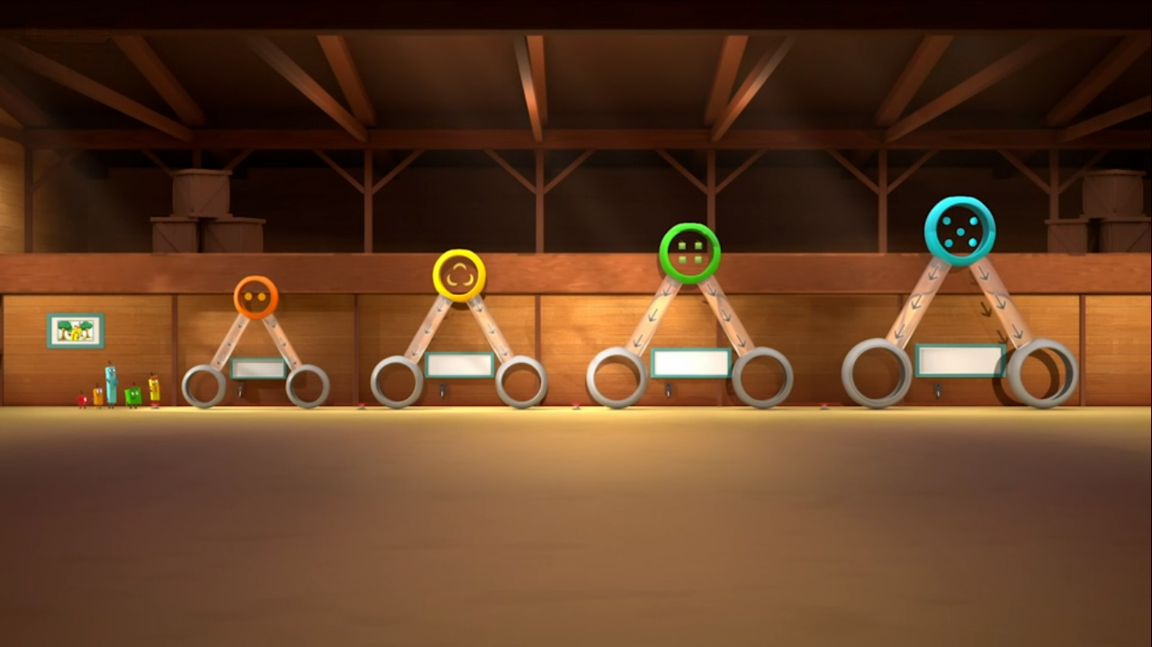
Images © 2017 Alphablocks Ltd. All Rights Reserved.
Notes:
Use this picture as the stimulus for Talk and Discussion (slide 7).

Slide 9
Enabling Environments in Reception

Slide 10
Enabling Environments
Playing and Exploring
Set up a fruit stall with boxes for up to 5 of each different fruits. Provide other baskets to partition the fruits into.
Active Learning
Model playing in the fruit store. “There are five apples in the fruit stall, I can put three apples in your basket and two apples in yours.“ “There are five oranges so I can put four into this basket and one into that basket.”
Creating and Thinking Critically
Play a finding pairs game with 2 children. Turn over cards to find pairs of fruits that combine to make 2,3,4, and 5. Place in the fruit machines (part-part-whole models). See next slides for printouts.

Slide 11


Notes:
Hidden slide.
See instructions on slide 10.
Print off and cut along dotted line to make the set of cards for 2 players to use. If 4 children are playing you will need print off and cut out 2 of these sheets.

Slide 12

Notes:
Hidden slide.
See instructions on slide 10.
Print off as a baseboard for one each child on A3.

Slide 13
Learning Together in Y1

Slide 14




    is the whole.
    is a part.
    is a part.
Images © 2017 Alphablocks Ltd. All Rights Reserved.
Notes:
Use this slide to discuss how 4 can be partitioned.
What value is the whole? 4 is the whole. (Ensure children understand the meaning of ‘whole’ as opposed to ‘hole’.)
If we partition four into two parts, what could the parts be?
Children could explore doing this with counters/ cubes and a part-part-whole diagram.

Slide 15

    is the whole.
    is a part.
    is a part.
Images © 2017 Alphablocks Ltd. All Rights Reserved.
Notes:
What do you notice about this partition? (There is the same number in both parts. It makes a double.)

Slide 16

    is the whole.
    is a part.
    is a part.
Images © 2017 Alphablocks Ltd. All Rights Reserved.
Notes:
What do you notice about the two parts? (Children might remember that this is similar to slide 14 but the parts have changed position.)

Slide 17
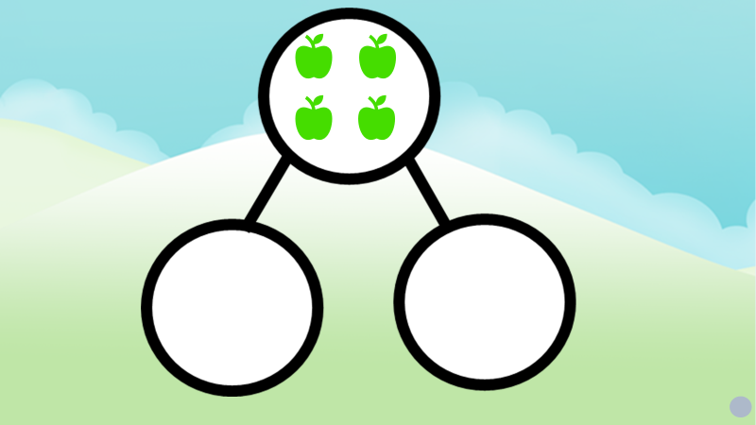

Images © 2017 Alphablocks Ltd. All Rights Reserved.
Notes:
Use the next three slides to identify what is the same and what is different about the pairs of pictures. Children may find it easier to identify differences before things which are the same.
What is the same? There are four apples in each diagram.
What is different? In the first picture the four apples are the whole and in the second picture they are in two parts/ have been partitioned.

Slide 18


Images © 2017 Alphablocks Ltd. All Rights Reserved.
Notes:
What is the same? There are four apples in each diagram. They have been partitioned into the same parts.
What is different? The parts have been swapped around.

Slide 19
Images © 2017 Alphablocks Ltd. All Rights Reserved.
Notes:
What is different? The four apples have been partitioned in different ways.
What is the same? There are four apples in each picture.

Slide 20
Further activities for Y1
Explore different contexts for partitioning, e.g. sets of children/ balloons/ leaves/ biscuits etc. and decide how a set of objects can be partitioned.
Work practically with hoops or large part-part-whole diagrams. Can you think of different ways to partition a set of leaves? e.g. brown leaves/ green leaves; long, thin leaves/ short, wide leaves. Can you record on your paper, with a picture or diagram different ways to partition the leaves?
Using double sided counters, work systematically to find ways of partitioning 1,2,3,4,5. Record the ways using part-part-whole models. How do you know you have found all the ways?
Explore partitioning of these numbers using different concrete representations, e.g. Numicon, tens frames, Cuisenaire, and compare what makes them the same and what makes them different.
Record the partitioning using pictures.

Slide 21
Learning Together in Y2

Slide 22
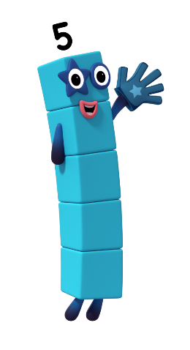
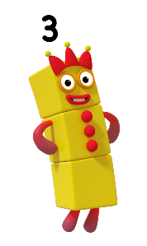
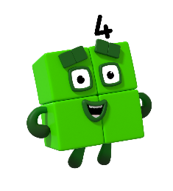
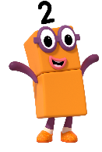




There are 6 ways to partition 5 into 2 parts
There are 3 ways to partition 2 into 2 parts
There are 4 ways to partition 3 into 2 parts
There are 5 ways to partition 4 into 2 parts
Images © 2017 Alphablocks Ltd. All Rights Reserved.
Notes:
Use this slide to explore the number of ways each Numberblock can be partitioned into two parts.
Look at Numberblock Two’s partitions. How many ways are there? What do you notice about these ways? (They include zero, and two equations are similar: 0+2 and 2+0)
Can we predict how many ways there might be to partition 3? Will there be more ways or fewer ways to partition 3 than 2?
What do you notice about how the equations have been recorded? Is there a pattern?
Could we use the same pattern for the next Numberblock and predict how many ways Five can be partitioned into two parts? How would using a pattern help us check that that we have found all the ways?

Slide 23
Further activities for Y2
Explore, by testing some other examples, whether the number of ways we can partition a number into two parts is always one more than the number itself.
Use different representations to test this. How can the representations be arranged so that you know you have them all? e.g. double sided counters can be laid in a line and one turned over at a time.
Explore the numbers of ways of partitioning a number in to 3 parts.

