Slide 1
1.31 Problems with two unknowns
Representations | Year 6
Number, Addition and Subtraction

Slide 2
How to use this presentation
You can find the teacher guide 1.31 Problems with two unknowns by following the link below.

Slide 3



1.31 Problems with two unknowns – step 1:1
B = r + b
Notes:
One unknown; one solution:
I am thinking of two rods that are equivalent to blue. One of them is red. What is the other one?

Slide 4







1.31 Problems with two unknowns – step 1:1
B = g + d
B = w + t
B = r + b
B = p + y
Notes:
Two unknowns; several solutions:
I am thinking of two rods that together are equivalent to blue. What are they?

Slide 5
1.31 Problems with two unknowns – step 1:2
B = g + d
d = 2 × g
Notes:
Two unknowns: one solution (multiplicative relationship between the unknowns):
I am thinking of two rods that together are equivalent to blue. One is twice as long as the other. What are they?

Slide 6
1.31 Problems with two unknowns – step 1:3
B = p + y
y − p = w
p + w = y
Notes:
Two unknowns; one solution (additive relationship between the unknowns):
I am thinking of two rods that together are equivalent to blue. There is a difference of white between the two rods. What are they?

Slide 7
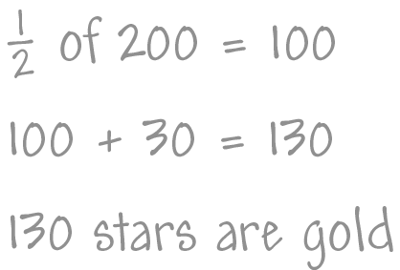
1.31 Problems with two unknowns – step 2:1
Child A
Notes:
Year 6 have earnt 200 stars; the stars are either gold or silver. They have 30 more gold stars than silver. How many are gold?

Slide 8
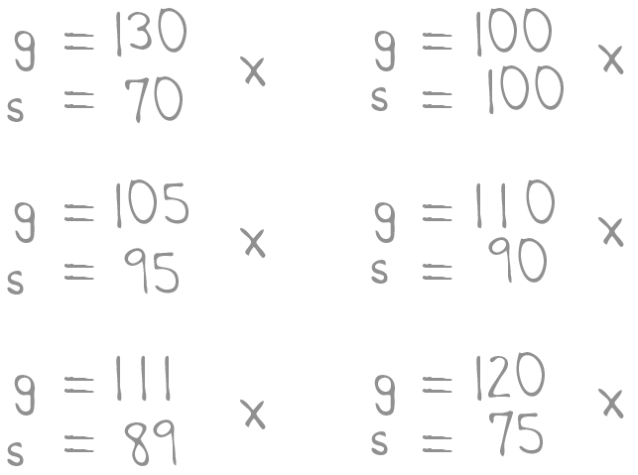
1.31 Problems with two unknowns – step 2:1
Child B
Notes:
Year 6 have earnt 200 stars; the stars are either gold or silver. They have 30 more gold stars than silver. How many are gold?

Slide 9
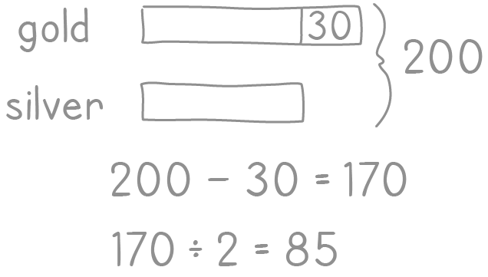
1.31 Problems with two unknowns – step 2:1
Child C
Notes:
Year 6 have earnt 200 stars; the stars are either gold or silver. They have 30 more gold stars than silver. How many are gold?

Slide 10
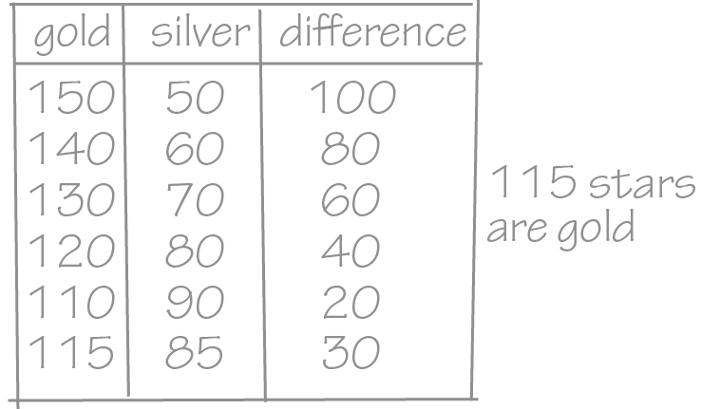
1.31 Problems with two unknowns – step 2:1
Child D
Notes:
Year 6 have earnt 200 stars; the stars are either gold or silver. They have 30 more gold stars than silver. How many are gold?

Slide 11
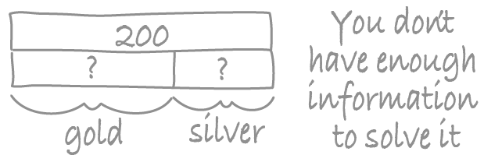
1.31 Problems with two unknowns – step 2:1
Child E
Notes:
Year 6 have earnt 200 stars; the stars are either gold or silver. They have 30 more gold stars than silver. How many are gold?

Slide 12
1.31 Problems with two unknowns – step 2:1
Child A
Child B
Child C
Child D
Child E
Notes:
Year 6 have earnt 200 stars; the stars are either gold or silver. They have 30 more gold stars than silver. How many are gold?

Slide 13
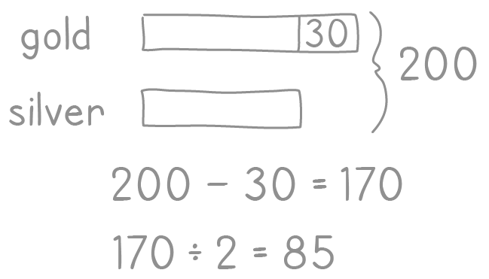


1.31 Problems with two unknowns – step 2:4
Child C
Child D

Slide 14
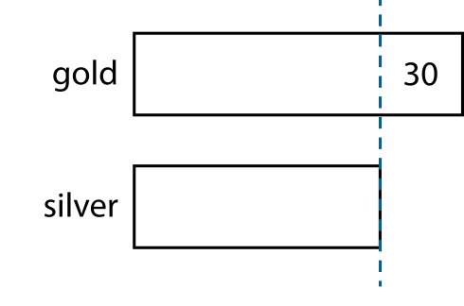


1.31 Problems with two unknowns – step 2:5
Child C
‘So now I know that the number of silver stars is half of 170.’
‘I know that there are 30 more gold stars than silver stars.’
‘I also know that there are 200 stars altogether.’
‘I subtract the “30”.’
170 ÷ 2 = 85
number of silver stars = 85
number of gold stars = 85 + 30 = 115

Slide 15
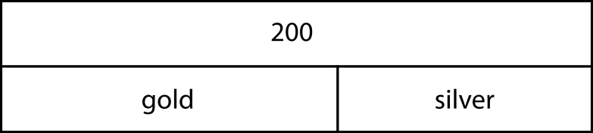


1.31 Problems with two unknowns – step 2:5
Child E
‘I also know that there are 30 more gold stars than silver stars.’
‘I know that the number of gold stars plus the number
of silver stars is equal to 200.’
‘I can fill in the missing part on the bottom row.’
s + 30 + s = 200
or
2s = 200 − 30 = 170
170 ÷ 2 = 85
number of silver stars = 85
number of gold stars = 85 + 30 = 115

Slide 16
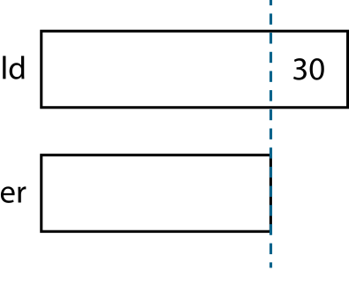
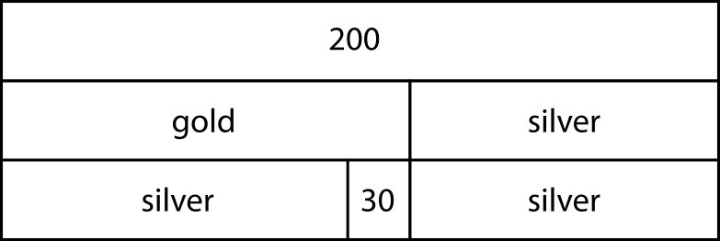
1.31 Problems with two unknowns – step 2:5
Child C
Child E
s + 30 + s = 200
170 ÷ 2 = 85
or
2s = 200 − 30 = 170
number of silver stars = 85
170 ÷ 2 = 85
number of gold stars = 85 + 30 = 115
number of silver stars = 85
number of gold stars = 85 + 30 = 115

Slide 17
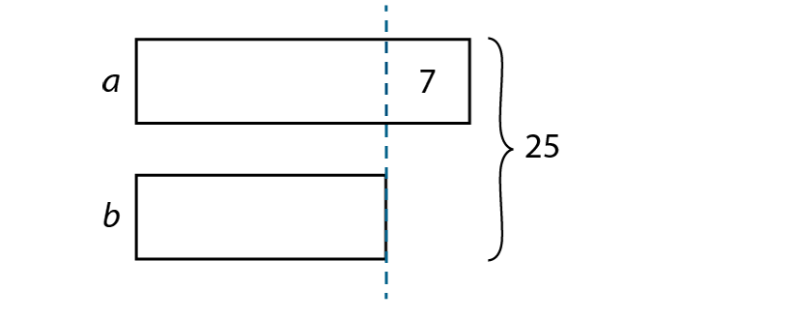
1.31 Problems with two unknowns – step 3:1
b = 18 ÷ 2
= 9
a = 9 + 7
= 16
‘The two numbers are 9 and 16.’
check: 9 + 16 = 25
Notes:
The sum of two numbers, a and b, is 25, and the difference between them is 7. What are the two numbers?

Slide 18
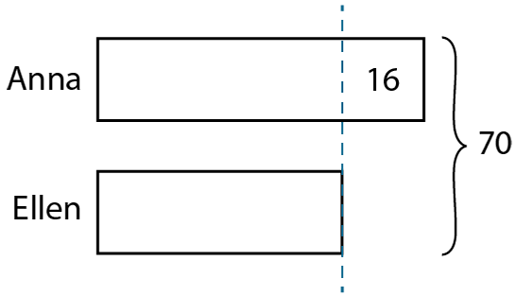
1.31 Problems with two unknowns – step 3:2
this is double Ellen’s
amount of money
70 − 16
= 54
Ellen’s amount = 54 ÷ 2
= 27
Anna’s amount = 27 + 16
= 43
‘Anna has £43 and Ellen has £27.’
check: £43 + £27 = £70
Notes:
Anna and Ellen have £70 in total. Anna has £16 more than Ellen. How much money do they each have?

Slide 19
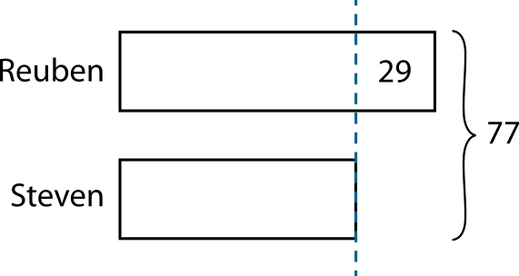
1.31 Problems with two unknowns – step 3:2
77 − 29
= 48
this is double Steven’s age
Steven’s age = 48 ÷ 2
= 24
Reuben’s age = 24 + 29
= 53
‘Steven is 24 years old and Reuben is 53 years old.’
check: 24 + 53 = 77
Notes:
Steven is 29 years younger than Reuben. The sum of their ages is 77 years. How old is each person?

Slide 20


1.31 Problems with two unknowns – step 3:3
‘I know that one number (a) is four times the other number (b).’
‘I also know that the two numbers sum to twenty.’
‘There are five equal parts that sum to twenty.’
a
4
4
4
4
20
b
4
one part = 20 ÷ 5
= 4
b = 4
a = 4 × 4
= 16
‘The two numbers are 16 and 4.’
check: 16 + 4 = 20
Notes:
The sum of two numbers is 20. One number is four times the other number. What are the two numbers?

Slide 21


1.31 Problems with two unknowns – step 3:4
‘There are six equal parts that sum to forty-eight.’
a
8
48
b
8
8
8
8
8
one part = 48 ÷ 6
= 8
a = 8
b = 5 × 8
= 40
‘The two numbers are 8 and 40.’
check: 8 + 40 = 48
Notes:
The sum of two numbers is 48. One number is one-fifth of the other number. What are the two numbers?

Slide 22
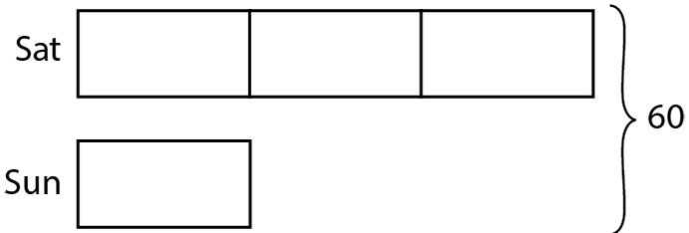
1.31 Problems with two unknowns – step 3:5
‘There are four equal parts that sum to sixty.’
60 ÷ 4
= 15
this is the amount earnt on Sunday
amount earnt on Saturday = 15 × 3
= 45
‘Bill earnt £45 on Saturday and £15 on Sunday.’
check: £45 + £15 = £60
Notes:
Bill earnt £60 doing odd-jobs one weekend. He earnt three times as much on Saturday as he did on Sunday. How much did Bill earn each day?

Slide 23
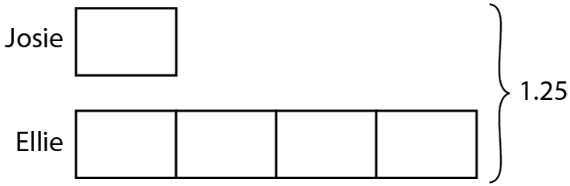
1.31 Problems with two unknowns – step 3:5
‘There are five equal parts that sum to 1.25.’
1.25 ÷ 5
= 0.25
this is the distance Josie swam
distance Ellie swam = 0.25 × 4
= 1
‘Josie swam 0.25 km and Ellie swam 1 km.’
check: 0.25 + 1 = 1.25
Notes:
Between them, Josie and Ellie swam 1.25 km during swimming training. Josie swam ¼ of the distance that Ellie swam. How far did each of them swim?

Slide 24


1.31 Problems with two unknowns – step 3:6
‘The question compares the amounts earnt on Saturday and Sunday, so I’ll draw two bars side by side.’
‘The question also tells us that Bill earns £30 more on Saturday than on Sunday, so I’ll add this difference to my model.’
‘I can see that the difference of 30 corresponds to two equal parts of the “Saturday” bar. So each of these parts must be 15.’
‘Because all of the parts in the model are equal, I know that the other parts must be 15 as well.’
‘So the total amount earnt is four multiplied by £15; that’s £60.’
‘Bill earnt three times as much on Saturday as on Sunday, so the bar for Saturday must be made up of three parts each equal in size to the “Sunday” bar.’
Sat
15
15
15
60
Sun
15
30
Notes:
Bill earnt some money doing odd-jobs one weekend. He earnt 3 times as much on Saturday than he did on Sunday. He earnt £30 more on Saturday than on Sunday. How much did Bill earn in total?

Slide 25
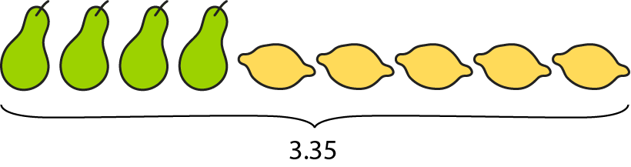
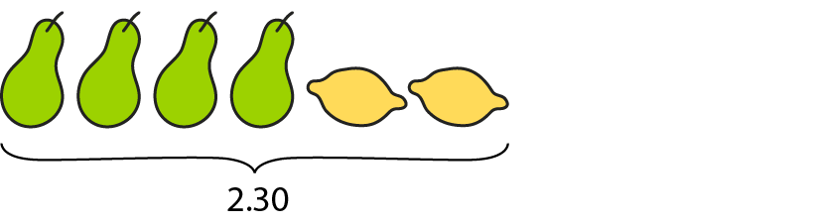
1.31 Problems with two unknowns – step 4:1
‘4 pears and 5 lemons cost £3.35.’
‘4 pears and 2 lemons cost £2.30.’

Slide 26
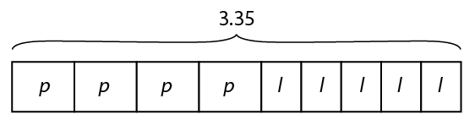
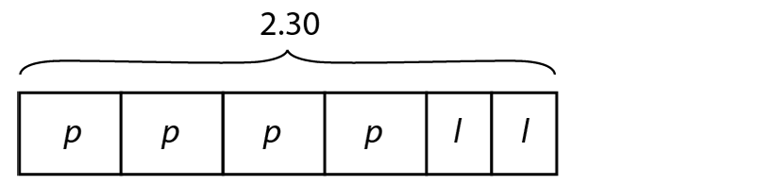
1.31 Problems with two unknowns – step 4:1
‘4 pears and 5 lemons cost £3.35.’
‘4 pears and 2 lemons cost £2.30.’

Slide 27



1.31 Problems with two unknowns – step 4:1
‘4 pears and 5 lemons cost £3.35.’
‘4 pears and 2 lemons cost £2.30.’

Slide 28
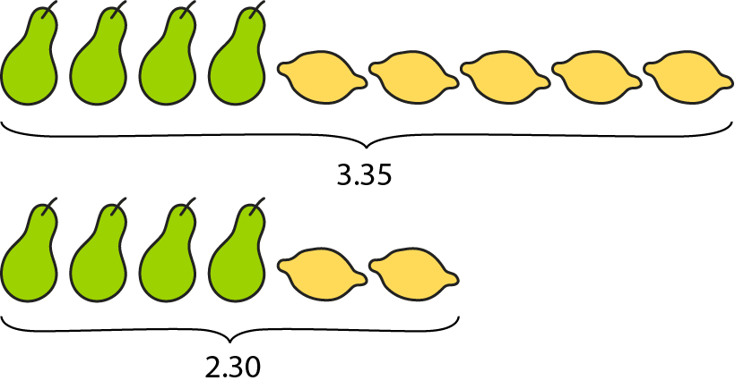
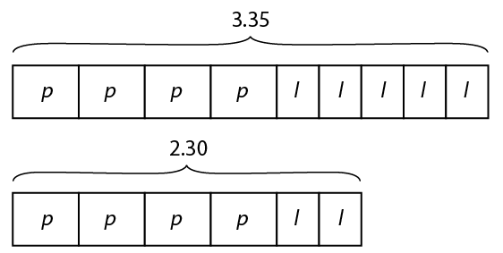
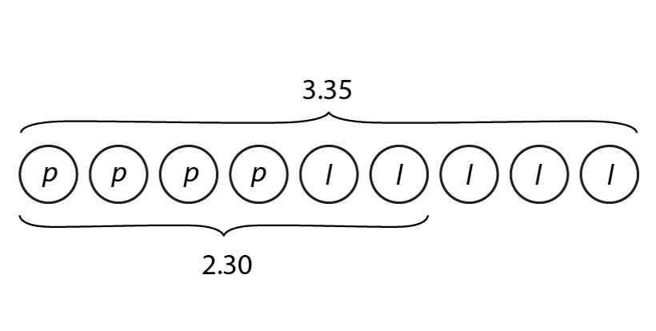
1.31 Problems with two unknowns – step 4:1
‘4 pears and 5 lemons cost £3.35.’
‘4 pears and 2 lemons cost £2.30.’

Slide 29
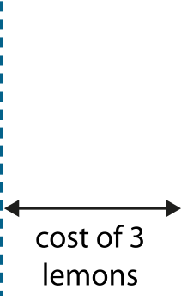
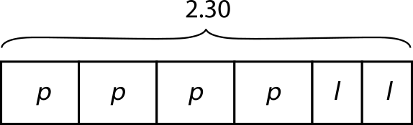
1.31 Problems with two unknowns – step 4:2
‘4 pears and 5 lemons cost £3.35.’
‘4 pears and 2 lemons cost £2.30.’
Step 1 – finding the cost of a lemon
cost of 3 lemons = 3.35 − 2.30
= 1.05
cost of 1 lemon = 1.05 ÷ 3
= 0.35
‘One lemon costs 35 p.’
Notes:
How much does one pear cost? How much does one lemon cost?

Slide 30
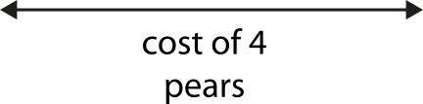

1.31 Problems with two unknowns – step 4:2
‘4 pears and 5 lemons cost £3.35.’
‘4 pears and 2 lemons cost £2.30.’
Step 2 – finding the cost of a pear
35 p
35 p
check: ‘4 pears and 5 lemons cost £3.35.’
cost of 4 pears = 4 × 40 p = £1.60
cost of 4 pears = 2.30 − 0.70
= 1.60
cost of 5 lemons = 5 × 35 p = £1.75
cost of 1 pear = 1.60 ÷ 4
= 0.40
£1.60 + £1.75 = £3.35
‘One pear costs 40 p.’
‘The solution must be correct.’
Notes:
How much does one pear cost? How much does one lemon cost?

Slide 31
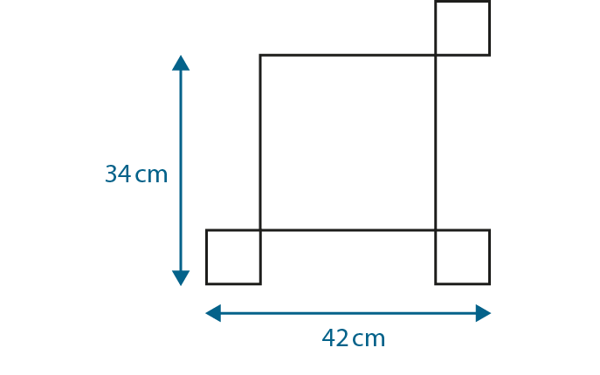
1.31 Problems with two unknowns – step 4:3
Notes:
This pattern is made from two different sized squares. What is the side-length of each type of square?

Slide 32
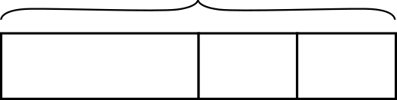
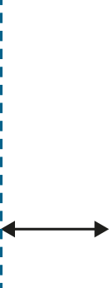
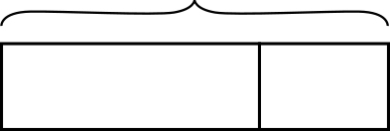
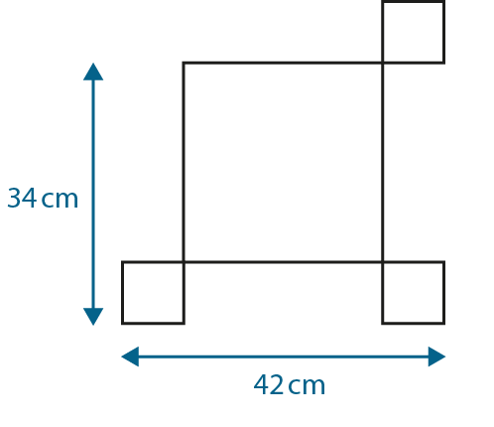
1.31 Problems with two unknowns – step 4:3
42
big
small
small
26
8
8
34
8
big
small
26
8
Notes:
This pattern is made from two different sized squares. What is the side-length of each type of square?

Slide 33
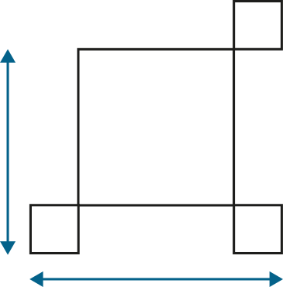
1.31 Problems with two unknowns – step 4:3
8 cm
?
8 cm
26 cm
?
26 cm
42 cm
34 cm
8 cm
8 cm
42 cm
42 cm − 34 cm
= 8 cm
34 cm − 8 cm
= 26 cm
check: 26 cm + 8 cm + 8 cm
= 42 cm
Notes:
This pattern is made from two different sized squares. What is the side-length of each type of square?

Slide 34
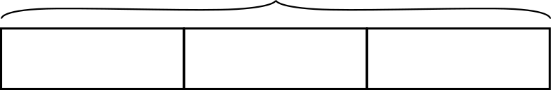
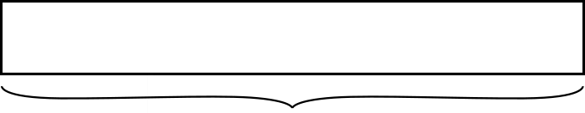
1.31 Problems with two unknowns – step 4:4
3 bananas
£1.30
− 30 p = £1
banana
banana
30 p
2 apples
cost of 5 bananas = £1
cost of 1 banana = £1 ÷ 5
= 20 p
‘An apple costs 15 p more than a banana.’
cost of 1 apple = 20 p + 15 p
= 35 p
Notes:
An apple costs 15 p more than a banana. 2 apples and 3 bananas cost £1.30. How much do apples and bananas cost each?

Slide 35
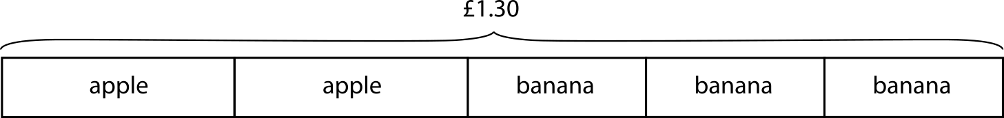


1.31 Problems with two unknowns – step 4:4
check: ‘If a banana costs 20 p and an apple costs 35 p then:’
cost of 2 apples = 2 × 35 p = 70 p
cost of 3 bananas = 3 × 20 p = 60 p
cost of 2 apples and 3 bananas = 70 p + 60 p = £1.30
Notes:
An apple costs 15 p more than a banana. 2 apples and 3 bananas cost £1.30. How much do apples and bananas cost each?

Slide 36
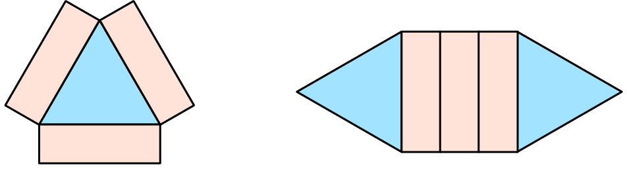
1.31 Problems with two unknowns – step 4:5
total area = 51 cm²
total area = 66 cm²
triangular tile = 15 cm²
rectangular tile = 12 cm²
Notes:
Here are two different designs made with the same rectangular and triangular tiles. What is the area of one triangular tile? What is the area of one rectangular tile?

Slide 37
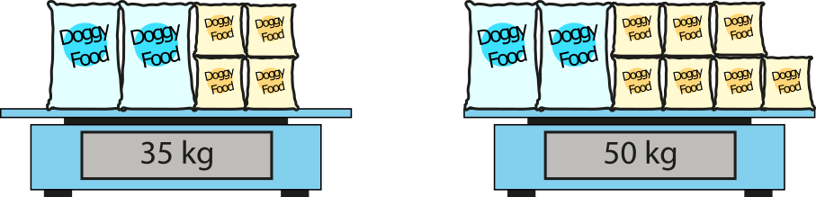
1.31 Problems with two unknowns – step 4:5
large bag = 7.5 kg
small bag = 5 kg
Notes:
The scales show the masses of some large and small bags of dog food. What is the mass of each of the two different sized bags?

Slide 38
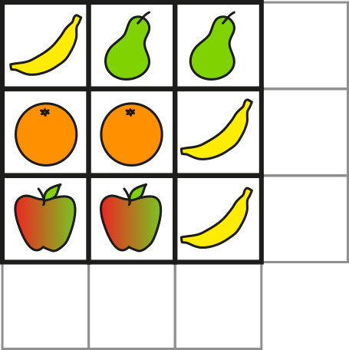
1.31 Problems with two unknowns – step 4:5
£1.15
banana = 25 p
£1.25
pear = 45 p
95 p
orange = 50 p
apple = 35 p
£1.10
£1.30
95 p
Notes:
The diagram shows the total cost of the items in each row and column. Fill in the two missing costs.

Slide 39
1.31 Problems with two unknowns – step 4:5
Menu
Item | Price
Juice | ?
Milk | 50 p more than a juice
Tea | 75 p more than a juice
juice = 80 p
tea = £1.55
milk = £1.30
Notes:
Here is the menu for a very strange café that I visit. I buy two teas and two milks and the price is £5.70. How much does a tea cost? How much does a milk cost?

Slide 40


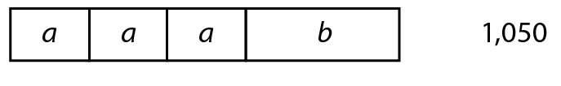
1.31 Problems with two unknowns – step 4:5
a + b + c = 800
2a + b + c = 950
3a + b = 1,050
a = 150
b = 600
c = 50
Notes:
What are the values of a, b and c?

Slide 41



1.31 Problems with two unknowns – step 4:5
‘The mean of r and s is 35.’
‘The mean of t and r is 47.’
r + s + t = 120
r = 44
s = 26
t = 50
Notes:
Calculate the values of r, s and t.

Slide 42
1.31 Problems with two unknowns – step 5:1
Number of portions | Fish | Chips
1 | £3.20 | £1.50
2 | £6.40 | £3.00
3 | £9.60 | £4.50
4 | £12.80 | £6.00
5 | £16.00
6 | £19.20 | £9.00
7 |  | £10.50
8 | £25.60 | £12.00
9 | £28.80 | £13.50
10 | £32.00 | £15.00
£7.50
£7.50
£22.40
£22.40
£22.40 + £7.50 = £29.90
‘Seven portions of fish and five portions of chips were bought.’
Notes:
I spent £29.90 on fish and chips. One fish costs £3.20 and one portion of chips costs £1.50. How many portions of each did I buy?

Slide 43
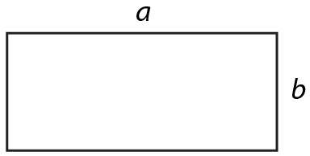
1.31 Problems with two unknowns – step 5:2
a (two-digit) (cm) | b (one-digit) (cm) | a + b (cm)
10
5
15
11
4
15
perimeter = 30 cm
12
3
15
13
2
15
a + b = half of 30 cm
= 15 cm
14
1
15
Notes:
A rectangle with sides a and b has a perimeter of 30 cm. a is a two-digit whole number and b is a one-digit whole number. What are the possible values of a and b?

Slide 44







1.31 Problems with two unknowns – step 5:3
Number of each shape | Squares | Hexagons
0 | 0 | 0
1 | 4 | 6
2 | 8 | 12
3 | 12 | 18
4 | 16 | 24
5 | 20 | 30
6 | 24 | 36
7 | 28 | 42
8 | 32 | 48
9 | 36 | 54
10 | 40 | 60
11 | 44 | 66
12 | 48 | 72
13 | 52
14 | 56
15 | 60
16 | 64
17 | 68
18 | 72
Notes:
Zac has some squares and hexagons. He chooses some of the shapes and when he counts the number of sides, he finds that the total is 72. How many of each shape could he have?
0 squares and 12 hexagons
3 squares and 10 hexagons
6 squares and 8 hexagons
9 squares and 6 hexagons
12 squares and 4 hexagons
15 squares and 2 hexagons
18 squares and 0 hexagons

