Slide 1
Series 3 Episode 8
Building Blocks

Slide 2
Practitioner Notes

Slide 3
Episode Description
The Numberblocks help a friendly alien to get back to his planet by building an amazing tower from the different shapes the alien makes them into. Learn to recognise the Numberblocks, no matter what their shape, and explore how they can fit together to make an amazing colourful patterned tower.

Slide 4
Maths in the Episode
Conservation of number
In this episode the Numberblocks reorganise themselves into different shapes from their most familiar ones (towers or 2-wide shapes or squares). Knowing that the quantity remains the same even if the objects are rearranged is an important step towards calculating with numbers. For example, in understanding commutativity, rearranging 4 and 6 will still give the same total as 6 and 4.

Slide 5
Using Mathematical Language
Use these stem sentences to rehearse the mathematical ideas in the programme:
“Same amount, different shape”
“This is <10> rearranged into <4> and <6>”
Notes:
< > indicates what can be changed in the stem sentence.

Slide 6
Talk and Discuss Together

Slide 7
Talk and Discuss Together
Watch the episode of Numberblocks. Use the following picture as a stimulus. First ask the children what they noticed about the Numberblocks in this episode.
The following slides are designed to stimulate children and adults to talk about the episode and draw out some key aspects of the mathematics.

Slide 8
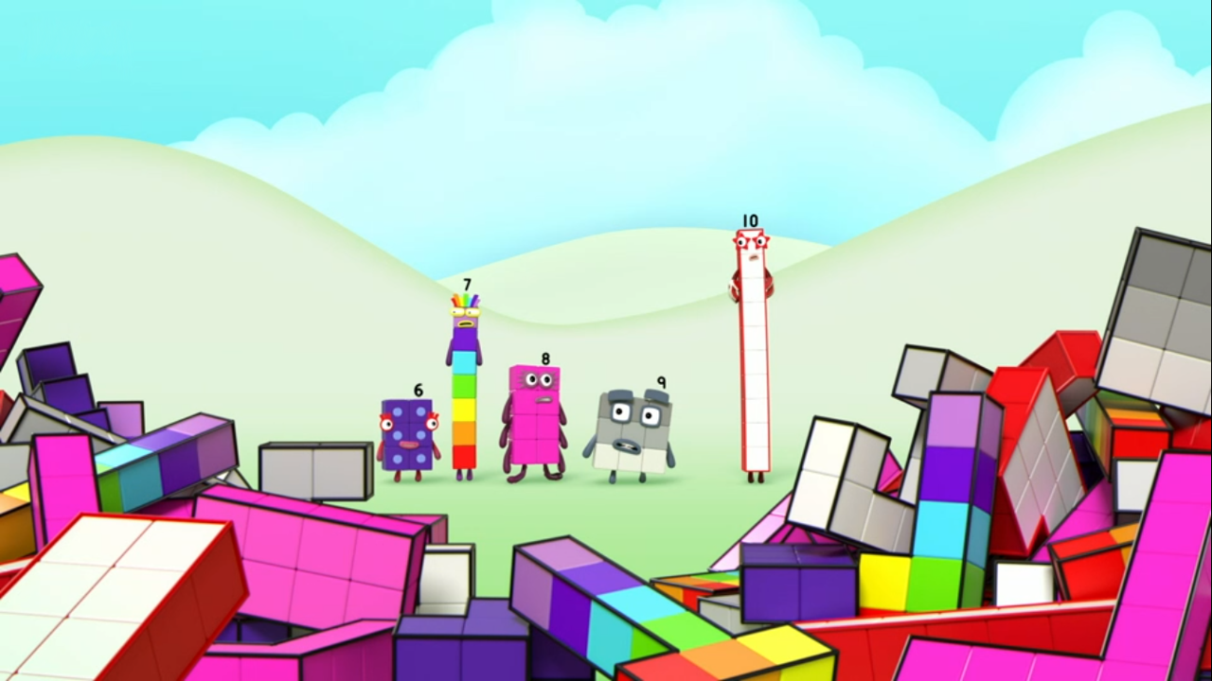
Images © 2017 Alphablocks Ltd. All Rights Reserved.
Notes:
Use this picture as the stimulus for Talk and Discussion (slide 7).

Slide 9
Enabling Environments in Reception

Slide 10
Enabling Environments
Playing and Exploring
Build different arrangements of each of the Numberblocks. Draw around the outside of each of the shapes with a dark marker pen. Leave these outlines with a box of connecting cubes to explore which Numberblocks they could be the shapes of.
Active Learning
Notice whether children recount a quantity when it is rearranged. When counting out pieces of fruit or biscuits or drinks for snack time, arrange the same amount in different patterns.
“I wonder if there is the same amount on each plate”.
Creating and Thinking Critically
Explore different ways to arrange the cubes to make different Numberblocks. Compare them with a partner. Describe them to a partner without saying the Numberblock’s name.

Slide 11
Learning Together in Y1

Slide 12


Can you see me?
Images © 2017 Alphablocks Ltd. All Rights Reserved.
Notes:
Use these slides to let the children look for arrangements of the Numberblocks 1, 2, 3, 4, 5.
Read together: “Can you see me?”
Discuss that One could go anywhere, but can you see a special place that is just for her?

Slide 13
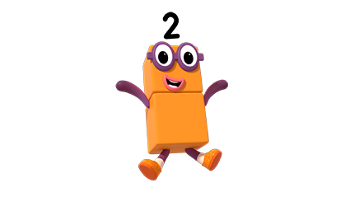
Here I am!
Can you see me?
Images © 2017 Alphablocks Ltd. All Rights Reserved.
Notes:
Click and when Two appears, read together: “Can you see me?”
Where is Two’s special place?
Does Two have to be standing up?

Slide 14
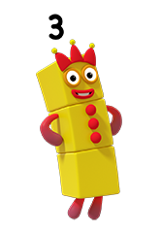
Here I am!
Can you see me?
Images © 2017 Alphablocks Ltd. All Rights Reserved.
Notes:
Was Two where you expected?
Now can you see Three?
What shapes could Three be?
Do all her blocks have to be in a straight line, either standing up or lying down?

Slide 15
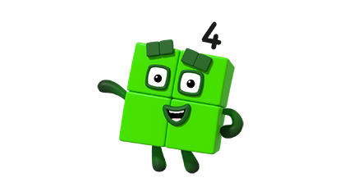
Can you see me?
Here I am!
Images © 2017 Alphablocks Ltd. All Rights Reserved.
Notes:
Use this slide to confirm where Three was.
What is the same and what is different about Three? (Same value, different shape.)
Where could Four be? Four loves being a square: can you see anywhere for him to be square, or does he need to change shape?

Slide 16
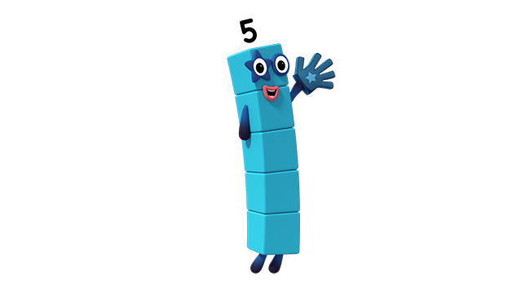
Here I am!
Can you see me?
Images © 2017 Alphablocks Ltd. All Rights Reserved.
Notes:
Were you right about where Four was hiding?
What is the same and what is different about Four? (Same value, different shape.)
Can Five fit in the last space?
Can you convince me that Five can go here? (Children might talk about seeing a line of three and two sticking out or two on the top, two on the bottom and one in the middle.)

Slide 17
Here I am!
Images © 2017 Alphablocks Ltd. All Rights Reserved.
Notes:
Were you right about Five fitting here?

Slide 18
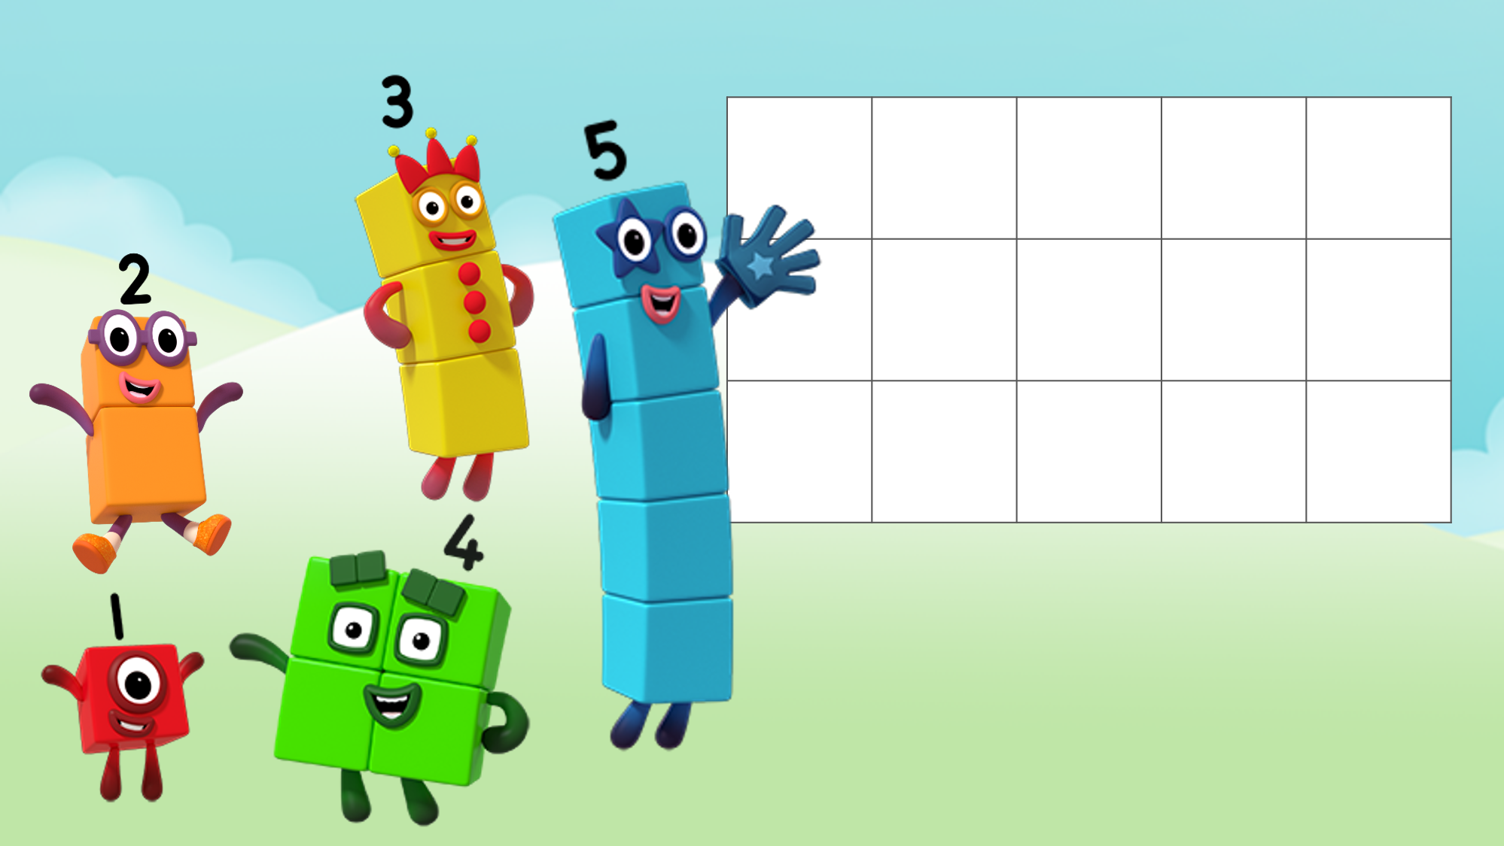
Can you see us?
Images © 2017 Alphablocks Ltd. All Rights Reserved.
Notes:
Use this slide to ask the children to explore how to fill the grid with rearranged Numberblocks. (You can only use a Numberblock once, and the Numberblock must keep its blocks connected).

Slide 19
Further activities for Y1
Explore arranging cubes into different shapes for each of the Numberblocks so that all the shapes are ‘lying down’. Draw around the outside.
How many different ways can you make Four and Five? Which of the Numberblocks has more ways - Four or Five? Can you convince me you have found all the ways to make Five?
Explore combining Numberblocks into other shapes.
Colour in squares on a grid to represent the arrangements of different Numberblocks.
Design patterns with different arrangements of Numberblocks.

Slide 20
Learning Together in Y2

Slide 21
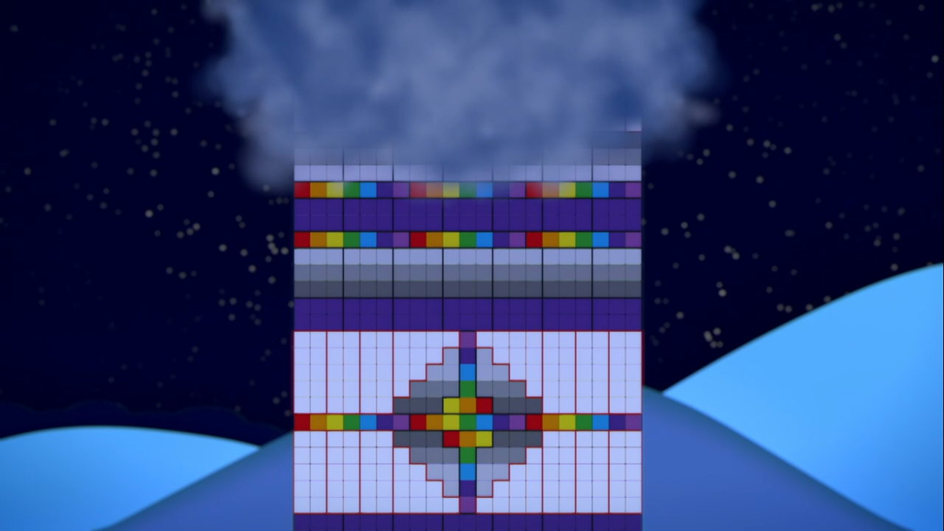
Notes:
Use this slide to describe the pattern that has been made from the different blocks.
What shape has Seven made? What shape has Nine made?

Slide 22
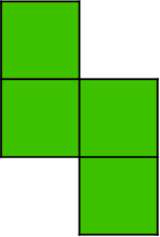
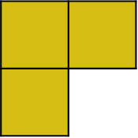
Use these shapes to make a building block pattern.
Notes:
Use this slide to share with the class. (It can also be printed off for the children to colour). Complete the shape including Four and Three in the shown arrangement and choose other arrangements for other Numberblocks to create a pattern.

Slide 23
Further activities for Y2
Investigate the different ‘flat’ arrangements for 5 blocks. Explore different ways to fit them together. Is it possible to fit 3 of them together to make a 3 x 5 rectangle? Another rectangle?
Investigate ‘flat’ arrangements for 6 blocks. Explore different ways to fit them together. Is it possible to fit 5 of them together to make a 5 x 6 rectangle? Another rectangle?
Explore as above for other arrangements.
Use the Maths Is Fun free Tetris HTML game. https://www.mathsisfun.com/games/tetris.html

