Slide 1
3.9 Multiplying fractions and dividing fractions by a whole number
Representations | Year 6
Fractions

Slide 2
How to use this presentation
You can find the teacher guide 3.9 Multiplying fractions and dividing fractions by a whole number by following the link below.

Slide 3
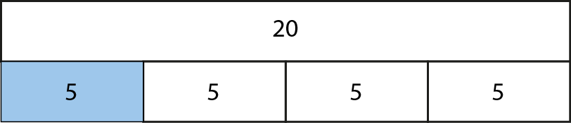

3.9 Multiplying and dividing fractions
Step 1:1

Slide 4
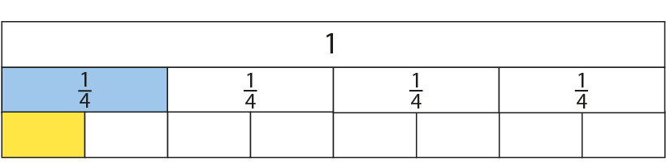
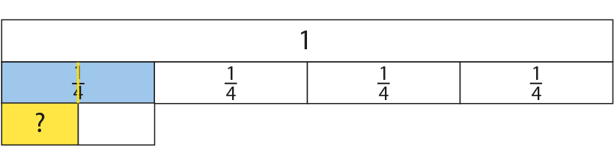
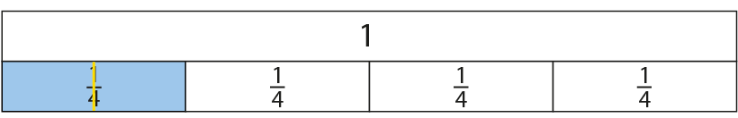
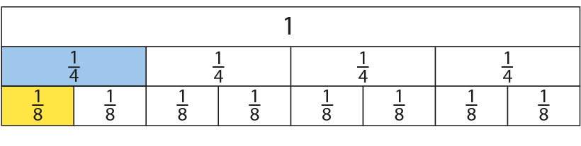
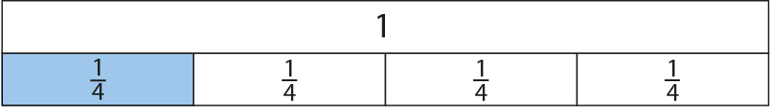
3.9 Multiplying and dividing fractions
Step 1:1
Notes:
If one of the quarters is made half as long (represented by the question mark), what fraction of the whole will one of the new equal parts be?

Slide 5
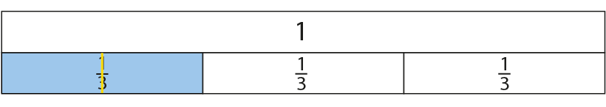
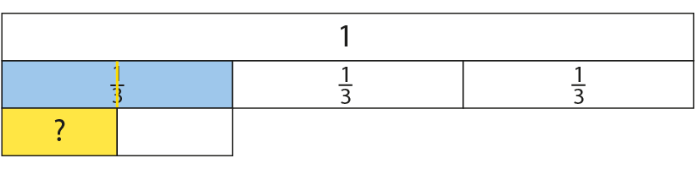
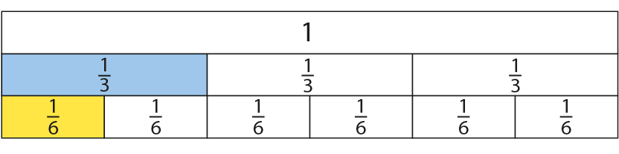
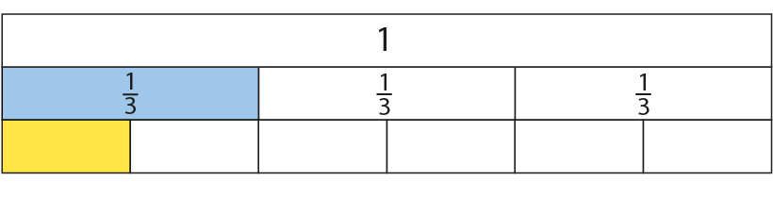
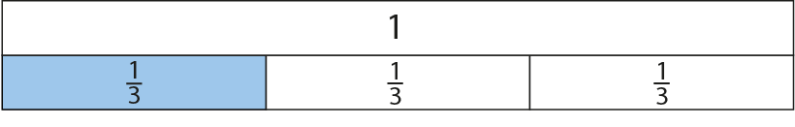
3.9 Multiplying and dividing fractions
Step 1:2
Notes:
If one of the thirds is made half as long, what fraction of the whole will one of the new equal parts be?
There were three equal parts in the whole, each of the three parts was halved, so now we have six equal parts in the whole.

Slide 6
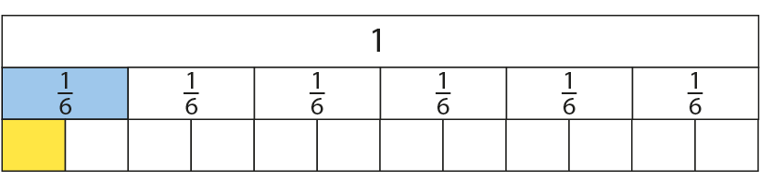
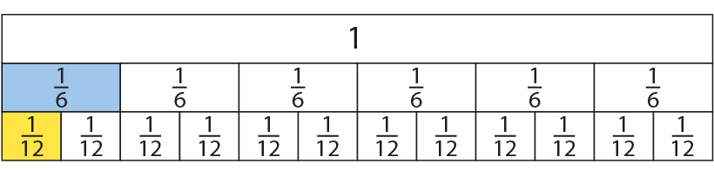
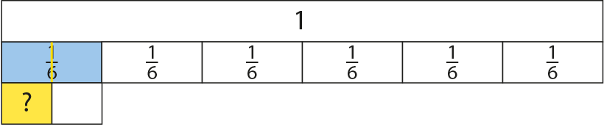
3.9 Multiplying and dividing fractions
Step 1:2
Notes:
What fraction of the whole is represented by the part with the question mark?

Slide 7
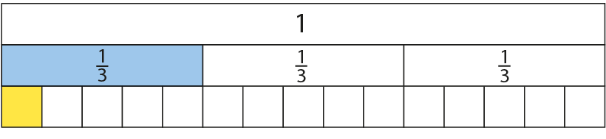
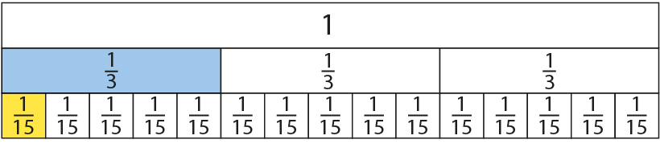
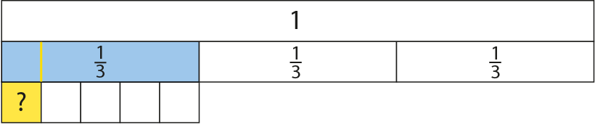
3.9 Multiplying and dividing fractions
Step 1:3

Slide 8
3.9 Multiplying and dividing fractions
Step 1:4
Notes:
When multiplying unit fractions, multiply the denominators.
When multiplying unit fractions, the product is smaller than the fractions being multiplied.

Slide 9
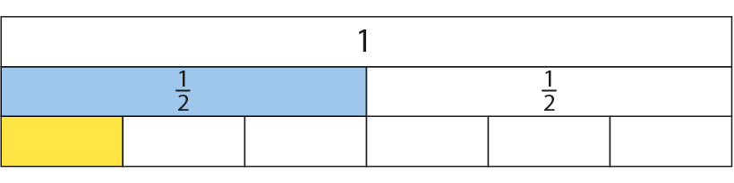
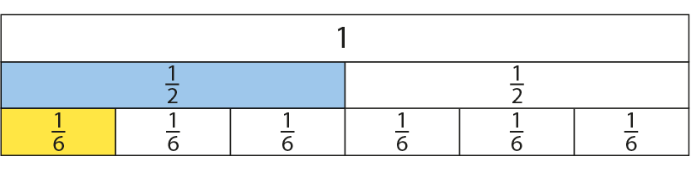
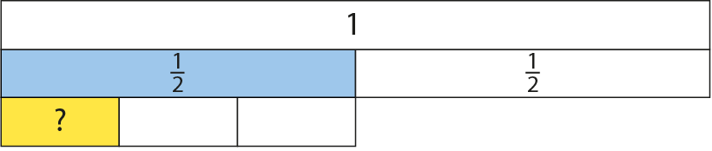
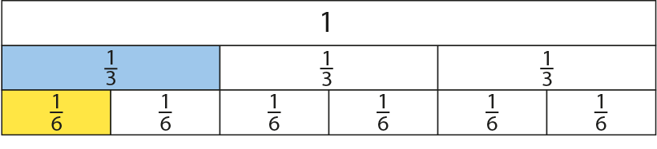
3.9 Multiplying and dividing fractions
Step 1:5
Notes:
What equal part is represented by the question mark?

Slide 10
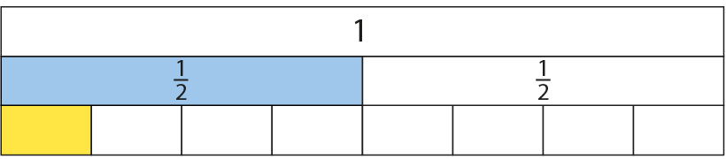
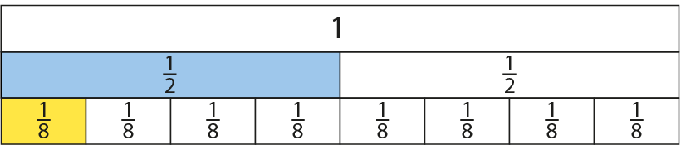
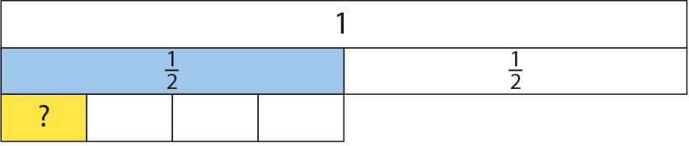
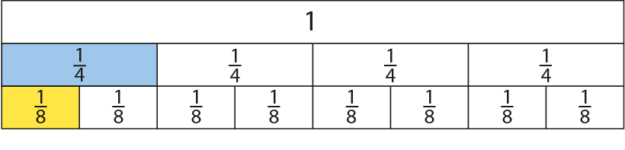
3.9 Multiplying and dividing fractions
Step 1:6

Slide 11
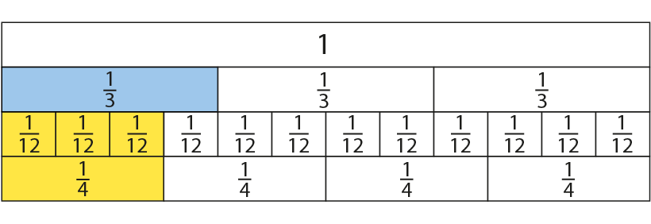
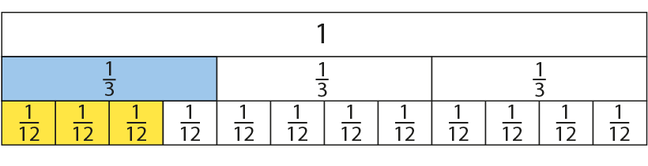
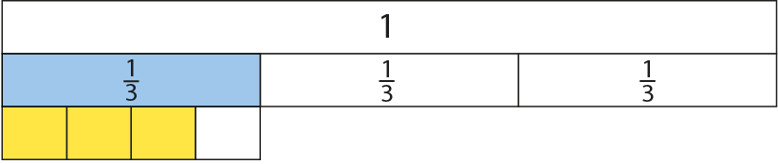
3.9 Multiplying and dividing fractions
Step 1:8
Notes:
Rudi drank $\frac{3}{4}$ of a $\frac{1}{3}$ litre bottle of juice. What fraction of a litre did Rudi drink?

Slide 12
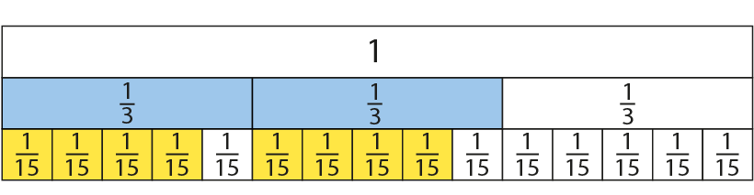
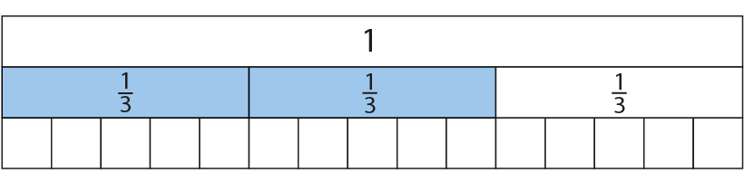
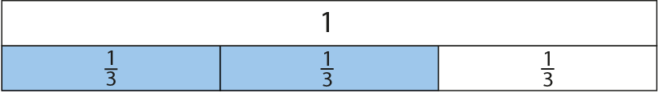
3.9 Multiplying and dividing fractions
Step 1:9
Model 1:
Notes:
How many parts are shaded in total?

Slide 13
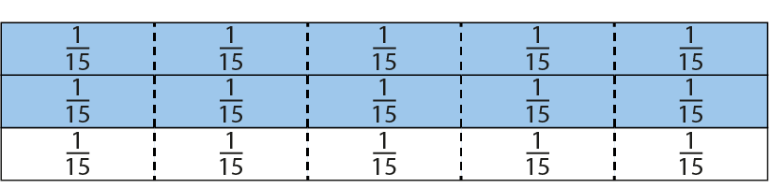
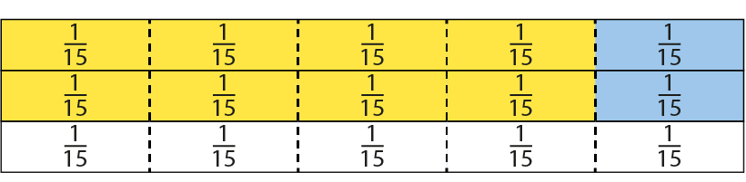
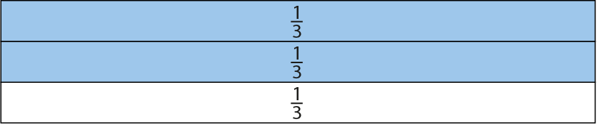
3.9 Multiplying and dividing fractions
Step 1:9
Model 2:

Slide 14
3.9 Multiplying and dividing fractions
Step 1:9

Slide 15
3.9 Multiplying and dividing fractions
Step 1:10

Slide 16
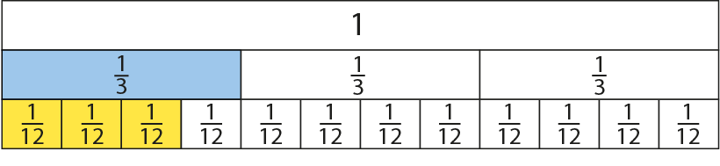
3.9 Multiplying and dividing fractions
Step 1:10

Slide 17
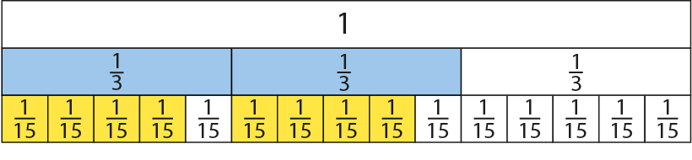
3.9 Multiplying and dividing fractions
Step 1:10
Notes:
To multiply fractions, we can multiply the numerators and multiply the denominators.

Slide 18
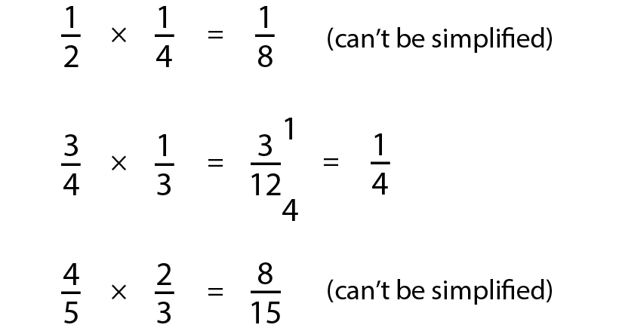
3.9 Multiplying and dividing fractions
Step 1:10

Slide 19
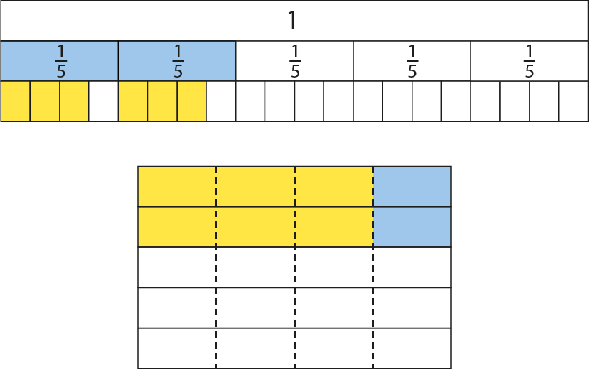
3.9 Multiplying and dividing fractions
Step 1:11
Notes:
Look at these models. What calculations do they represent?

Slide 20
3.9 Multiplying and dividing fractions
Step 2:1

Slide 21
3.9 Multiplying and dividing fractions
Step 2:2
Notes:
What is the same?
What is different?

Slide 22
3.9 Multiplying and dividing fractions
Step 2:3
Notes:
What is the same?
What is different?

Slide 23
3.9 Multiplying and dividing fractions
Step 2:4
Notes:
What division expression can I use to represent this?

Slide 24
3.9 Multiplying and dividing fractions
Step 2:5
➔

Slide 25
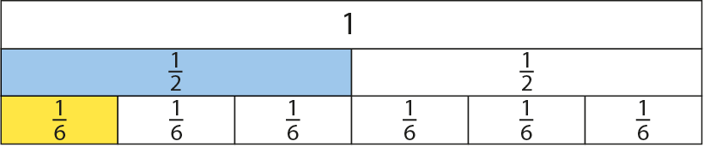
3.9 Multiplying and dividing fractions
Step 2:5
➔

Slide 26
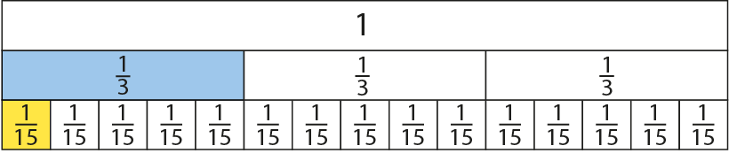
3.9 Multiplying and dividing fractions
Step 2:5
➔
Notes:
To divide a fraction by a whole number, we can change it to an equivalent multiplication. To divide by five, we can multiply by one-fifth.

Slide 27
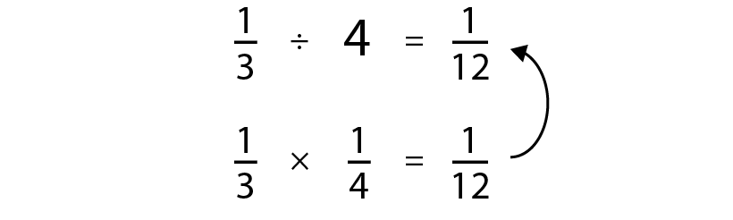
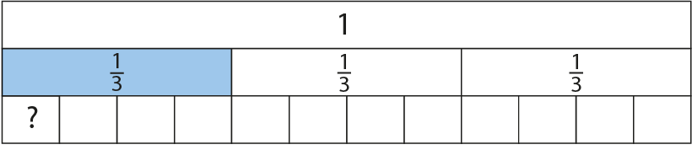
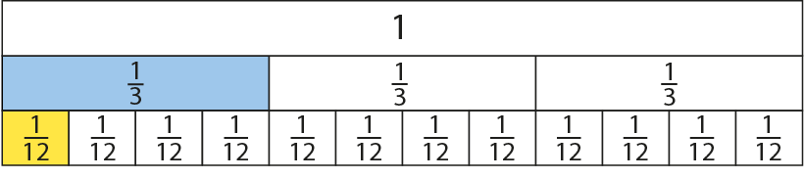

3.9 Multiplying and dividing fractions
Steps 2:6–2:7

Slide 28
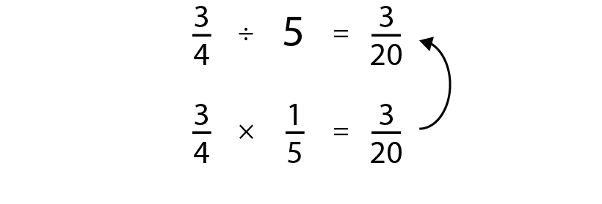
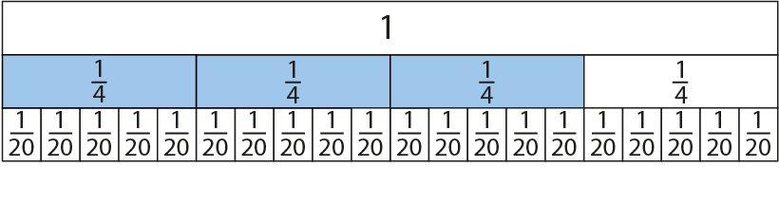

3.9 Multiplying and dividing fractions
Step 2:8

Slide 29
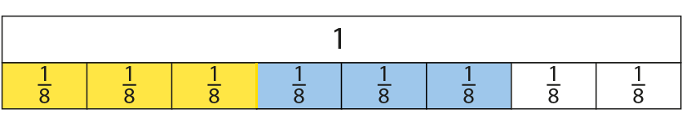
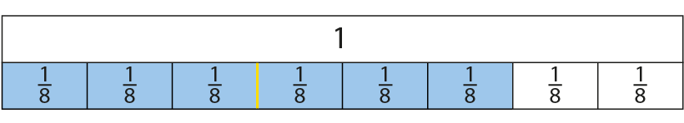
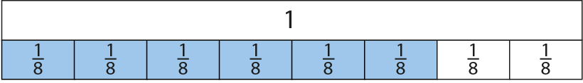
3.9 Multiplying and dividing fractions
Step 3:1
Notes:
$\frac{6}{8}$ is six one-eighths. If we divide six one-eighths into two equal groups, then each of the groups has three one-eighths or $\frac{3}{8}$ in it.

Slide 30
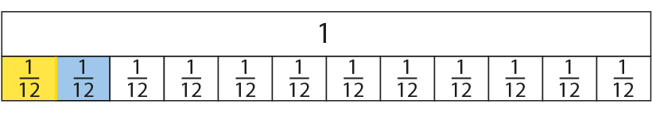
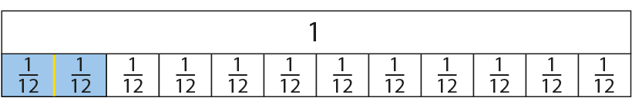

3.9 Multiplying and dividing fractions
Step 3:2

Slide 31



3.9 Multiplying and dividing fractions
Step 3:2

Slide 32



3.9 Multiplying and dividing fractions
Step 3:2

Slide 33



3.9 Multiplying and dividing fractions
Step 3:3
Notes:
Summarise what is happening using the unitising language:
$\frac{4}{12}$ is four one-twelfths. If we divide four one-twelfths into two equal groups, then each of the groups is two one-twelfths, because four divided by two is two.

Slide 34



3.9 Multiplying and dividing fractions
Step 3:3
Notes:
Summarise what is happening using the unitising language:
$\frac{6}{7}$ is six one-sevenths. If we divide six one-sevenths into three equal groups, then each of the groups is two one-sevenths because six divided by three is two.

Slide 35



3.9 Multiplying and dividing fractions
Step 3:4

Slide 36



3.9 Multiplying and dividing fractions
Step 3:4

Slide 37



3.9 Multiplying and dividing fractions
Step 3:4

Slide 38

3.9 Multiplying and dividing fractions
Step 3:5

Slide 39

3.9 Multiplying and dividing fractions
Step 3:6

