Slide 1
Series 3 Episode 23
Ride the Rays

Slide 2
Practitioner Notes

Slide 3
Episode Description
In this episode One, Two, Three, Four, Five and Six have an adventure trying to reach the top of Ray Canyon. It's easy if you can make yourself into a rectangle with the right number of rays but One, Two and Three get left on the bottom level. Working together as a team, the Numberblocks try to ride the rays and with a little help from super-rectangle Twelve, they finally manage to make it to the top.

Slide 4
Maths in the Episode
Introducing factors and multiples
Although the language of factors and multiples is not introduced, the concepts that lead to their understanding are revealed in this episode. The rays represent the factors. For example, it is possible for Two, Four and Six to ride the 2 wave because 2 is a factor of 2, 4 and 6. Or in other words, 2, 4, and 6 are multiples of 2.

Slide 5
Using Mathematical Language
Use this stem sentence to rehearse the mathematical ideas in the programme:
“<8> can make an array that is <2> wide.”
“I am <8>, I am <2> by <4>.”
Notes:
Text inside < > indicates what can be changed in the stem sentence.

Slide 6
Talk and Discuss Together

Slide 7
Talk and Discuss Together
Watch the episode of Numberblocks. First ask the children what they noticed and allow them to talk to you and each other.
How were the Numberblocks able to ride the rays?
The following slides are designed to stimulate children and adults to talk about the episode and draw out some key aspects of the mathematics.

Slide 8
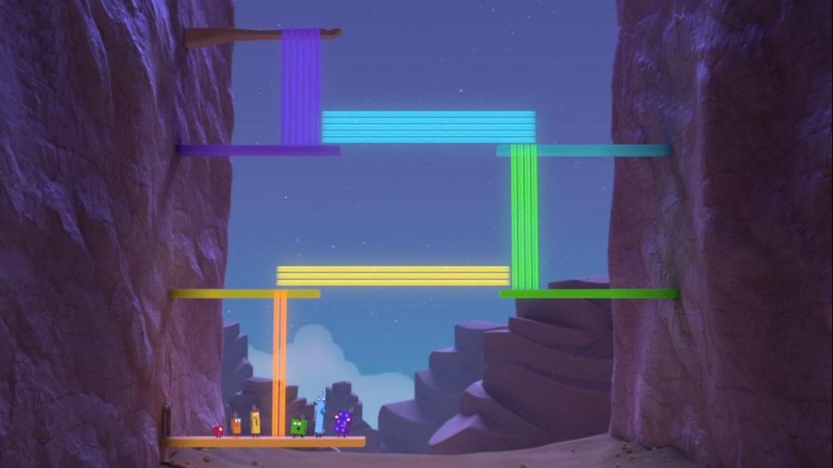
Images © 2017 Alphablocks Ltd. All Rights Reserved.
Notes:
Use this picture as the stimulus for Talk and Discussion (slide 7).

Slide 9
Enabling Environments in Reception

Slide 10
Enabling Environments
Playing and Exploring
Create ‘2-wide’ patterns with construction blocks such as Lego/Duplo on a baseboard using only the blocks that are two lugs wide.
Active Learning
Notice how children re-orientate or pick different sized building blocks to fit a certain gap when building a wall. When playing with the children, express your thinking, for example, “I wonder if this block will fit, if we turn it round?”
Creating and Thinking
Create 2 sorting boxes to sort Numberblock models into models that are 2 blocks wide and ones that aren’t, or build shapes that are 2 blocks wide that will fit through the gap. (See Slide 11 for a picture of the top of the box.)

Slide 11
Box
 | Cut out gap
The gap must be approximately the same dimensions as 2 blocks by 1 block so that any block that is 2 blocks wide can fit into the gap.
Notes:
Hidden slide for teacher info only.

Slide 12
Learning Together in Y1

Slide 13

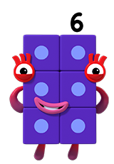
Can I ride the rays?
I am 2 blocks wide and 3 blocks tall.
Images © 2017 Alphablocks Ltd. All Rights Reserved.
Notes:
Use these slides to discuss whether a given Numberblock can ride the rays shown.
Discuss:
What can you say about Six? Is Six showing an array? (Six is 2 blocks wide and 3 blocks tall so IS an array.)
The ray is two wide. Is Six two blocks wide? (Yes, she is 2 blocks wide.)

Slide 14

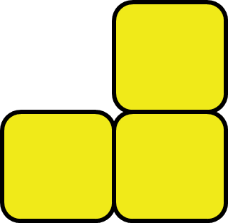
Can I ride the rays?
I am 2 blocks wide and 1 block tall and 2 blocks tall.
That’s odd.
I can’t ride the rays
Images © 2017 Alphablocks Ltd. All Rights Reserved.
Notes:
Discuss:
What can you say about Three?
Is Three showing an array? (No, Three is 2 blocks wide in the bottom row but only 1 block wide in the top row so is NOT an array.)

Slide 15
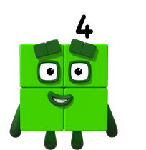
Can I ride the rays?
I am 2 blocks wide and 2 blocks tall.
Images © 2017 Alphablocks Ltd. All Rights Reserved.
Notes:
Discuss:
What can you say about Four? Is Four showing an array? (Four is 2 blocks wide and 2 blocks tall so IS an array.)
The ray is two wide. Is Four two blocks wide? (Yes, he is 2 blocks wide.)

Slide 16
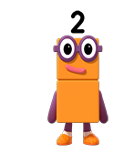

Can I ride the rays?
TURN!
Now I am 2 blocks wide and 1 block tall.
I am 1 block wide and 2 blocks tall.
Images © 2017 Alphablocks Ltd. All Rights Reserved.
Notes:
Discuss:
What can you say about Two? Is Two showing an array? (Two is 1 block wide and 2 blocks tall so IS an array.)
The rays are two wide. What do you think Two needs to do to be able to ride the rays? (Two needs to turn so he is 2 blocks wide.)

Slide 17
Further activities for Y1
Explore other Numberblocks up to 12 that can ride the 2 rays.
Using a bag of cubes, how many different shapes can be made to ride the 2 rays level.
Introduce the language of odd and even to explain that all the even Numberblocks can ride the 2 rays but the odds can’t.

Slide 18
Learning Together in Y2

Slide 19
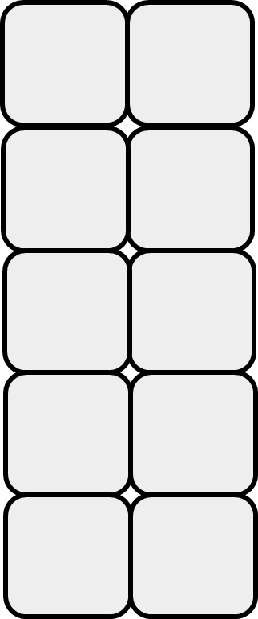
Can all these blocks ride the rays?
Images © 2017 Alphablocks Ltd. All Rights Reserved.
Notes:
Use this slide to set the problem of getting all the blocks to ride the 2 rays.
Provide a sheet with rays that are as wide as two connecting blocks that are available in the classroom.
Provide blocks for the pupils to work in small groups to discuss how to get the all the blocks up the 2 rays.

Slide 20
4 = 2 x 2
I am 2 by 2. I can ride the rays.
Images © 2017 Alphablocks Ltd. All Rights Reserved.
Notes:
Use these slides to identify which Numberblocks can ride the rays which are shown, and to represent each array as __ by __ and __ x __.
Discuss:
What can you say about Four? Is Four showing an array? (Four is 2 blocks wide and 2 blocks tall so IS an array.)
How can you describe Four’s array? (2 by 2.)
How can we represent this using a multiplication equation? (4 = 2 x 2)

Slide 21
2 = 2 x 1
TURN!
Now I am
2 by 1, I can ride the rays.
I am 1 by 2.
I can’t ride the rays.
Images © 2017 Alphablocks Ltd. All Rights Reserved.
Notes:
Discuss:
What can you say about Two? Is Two showing an array? (Two is 1 block wide and 2 blocks tall so IS an array.)
How can you describe Two’s array? (1 by 2.)
Can Two ride the array in this orientation/position? What does he need to do? (He needs to turn.)
How can we represent this using a multiplication equation? (2 = 2 x 1)

Slide 22
4 = 2 x 2
6 = 2 x 3
I am 2 by 3.
I can ride the rays.
Images © 2017 Alphablocks Ltd. All Rights Reserved.
Notes:
Discuss:
What can you say about Six? Is Six showing an array? (Six is 2 blocks wide and 3 blocks tall so IS an array.)
How can you describe Six’s array? (2 by 3.)
How can we represent this using a multiplication equation? (6 = 2 x 3)

Slide 23
4 = 2 x 2
6 = 2 x 3
10 = 2 x 5
I am 2 by 5.
I can ride the rays.
Images © 2017 Alphablocks Ltd. All Rights Reserved.
Notes:
Discuss:
What can you say about Ten? Is Ten showing an array? (Ten is 2 blocks wide and 5 blocks tall so IS an array.)
How can you describe Ten’s array? (2 by 5.)
How can we represent this using a multiplication equation? (10 = 2 x 5)

Slide 24
Now we are a 2 x 5 array.
We can ride the rays.
4 = 2 x 2
We are not arrays.
We can’t ride the rays.
6 = 2 x 3
10 = 2 x 5
3 + 7 = 10
Images © 2017 Alphablocks Ltd. All Rights Reserved.
Notes:
Use this slide to develop the language to justify why 3 blocks and 7 blocks alone cannot ride the rays.
Can these blocks ride the rays? Why not? (3 and 7 are not arrays which are 2 blocks wide.)
If they combine, do you think they can make an array? (Yes, because 3 and 7 make 10 and 10 can be an array.)
How can you describe the array that has been made? Is it the same as an array we have seen before? (Yes, it is a 2 by 5 array.)

Slide 25
Can all these blocks ride the rays?
Images © 2017 Alphablocks Ltd. All Rights Reserved.
Notes:
Use this slide to solve this more challenging version of the problem. This requires more reorganisation of the blocks.
Use real blocks to see which numbers can be made into an array which is 3 wide.
3 can ride the rays by rotating a quarter turn.
4 and 2 can combine into a 3 x 2 array.
5 and 7 combine to make a 6 x 2 array but must then reorganise into a 4 x 3 array.

Slide 26
Further activities for Y2
Given all the blocks from 1 to 10, explore different ways to ride 2, 3, 4, 5 and 6 rays.
Explore which quantities to 20 can ride 2, 3, 4, 5 and 6 rays.
Record findings using stem sentences: “I am __ by __. I can ride the rays.”
Record findings using equations: 6 = 2 x 3.
Find quantities that can’t ride a given ray, and explain why. For example, 7 can’t ride the 3 ray because it is one more than 2 by 3.

