Slide 1
Understanding fractions as divisions (and decimals)
KS3 Mastery PD Materials: Exemplified Key Ideas
Materials for use in the classroom or to support professional development discussions
(From 1.3 Ordering and comparing)
Summer 2021

Slide 2
About this resource
These slides are designed to complement the 1.3 Ordering and comparing Core Concept document and its associated Theme Overview document 1 The Structure of the number system, both found in the Secondary Mastery Professional Development pages.
These slides re-present the key examples from the Core Concept document so that the examples can be used either directly in the classroom or with a group of teachers. There are prompt questions alongside the examples, and further clarification in the notes.
These slides do not fully replicate the Core Concept document, so should be used alongside it. Reference to specific page numbers, and to other useful NCETM resources, can be found in the notes for each slide.
This slide deck is not designed to be a complete PD session, rather it is a selection of resources that you can adapt and use as needed when planning a session with a group of teachers.

Slide 3


About this resource
The slides are structured as follows:
  The big picture:
    Where does this fit in?
    What do students need to understand?
    Why is this key idea important?
  Prior learning
  Misconceptions
  Exemplified key ideas
  Reflection questions
  Appendices:
    Key vocabulary
    Representations and structure
    Previous and Future learning
    Useful links
The exemplified key idea slides have the following symbols to indicate how they have been designed to be used:
Into the classroom
The examples are presented on these slides so that they could be used in PD, but also directly in the classroom. The notes feature suggested questions and things teachers might consider when using with students.
PD discussion prompts
These slides look at the examples in more detail, with question prompts to promote discussion among maths teachers. The notes feature reference to further information and guidance within the Core Concepts document.

Slide 4
Where does this fit in?
The NCETM has identified a set of six ‘mathematical themes’ within Key Stage 3 mathematics that bring together a group of ‘core concepts’.
The first of these themes is The structure of the number system, which covers the following interconnected core concepts:
    1.1 Place value, estimation and rounding
    1.2 Properties of number
    1.3 Ordering and comparing
    1.4 Simplifying and manipulating expressions, equations and formulae
Notes:
Linked on this slide is the Theme Overview document of The structure of the number system. This document includes why it is important, the key underpinning knowledge and links to prior and future learning. There is also guidance about how the five big ideas of Teaching for Mastery relate specifically to this theme.

Slide 5
Where does this fit in?
Within this core concept, 1.3 Ordering and comparing, there are three statements of knowledge, skills and understanding.
These, in turn, are broken down into sixteen key ideas. The highlighted key idea is exemplified in this slide deck.
Notes:
For key ideas marked with an asterisk, we exemplified the common difficulties and misconceptions that students might have and included elements of what teaching for mastery may look like. We have provided examples of possible student tasks and teaching approaches.
Within these slides are ‘classroom-ready’ versions of the examples for the key idea that has been highlighted. There are also slides that may be useful for discussion in a professional development session.

Slide 6
What do students need to understand?
1.3.1.3 Understand that a fraction represents a division and that performing that division results in an equivalent decimal
Understand that fraction notation represents both a division and the result of that division
Use that understanding to write a fraction as an equivalent decimal
  What prior knowledge might your students already have?
  What language might they use to describe this key idea?
  What questions might you want to ask to assess their prior learning?

Slide 7
Why is this key idea important?
Students worked with fractions and decimals at Key Stage 2 and should be able to recall and use equivalences between simple fractions, decimals and percentages.
At Key Stage 3, students will further develop their understanding of the different ways that numbers can be expressed and will become more proficient in changing from one form to another. This will develop their awareness that different representations of the same number can reveal something of its structure and so can be used to compare and order numbers with ease.
For example, students begin to recognise decimals such as 0.13 not just as one tenth and three hundredths, but also as 13 hundredths, which leads to its expression as a single fraction. An awareness that a fraction represents a division is crucial at this stage, as this will allow a deep understanding of the process of changing fractions to decimals.
It is important during Key Stage 3 that students become increasingly fluent when converting between fractions and decimals. This will contribute to a strong sense of number, support flexibility in calculation and students’ ability to make sensible choices as to when to work mentally, use a written method or use a calculator.
Notes:
A more detailed overview of the core concept 1.3 Ordering and comparing can be found on page 2 of the 1.3 Core Concept document.
The background to each key idea is also explored in more detail on the following pages:
1.3.1 Work interchangeably with terminating decimals and their corresponding fractions – page 6
1.3.2 Compare and order positive and negative integers, decimals and fractions – page 7
1.3.3 Interpret and compare numbers in standard form A × 10^{n}, 1 ≤ A < 10 – pages 8 and 9

Slide 8
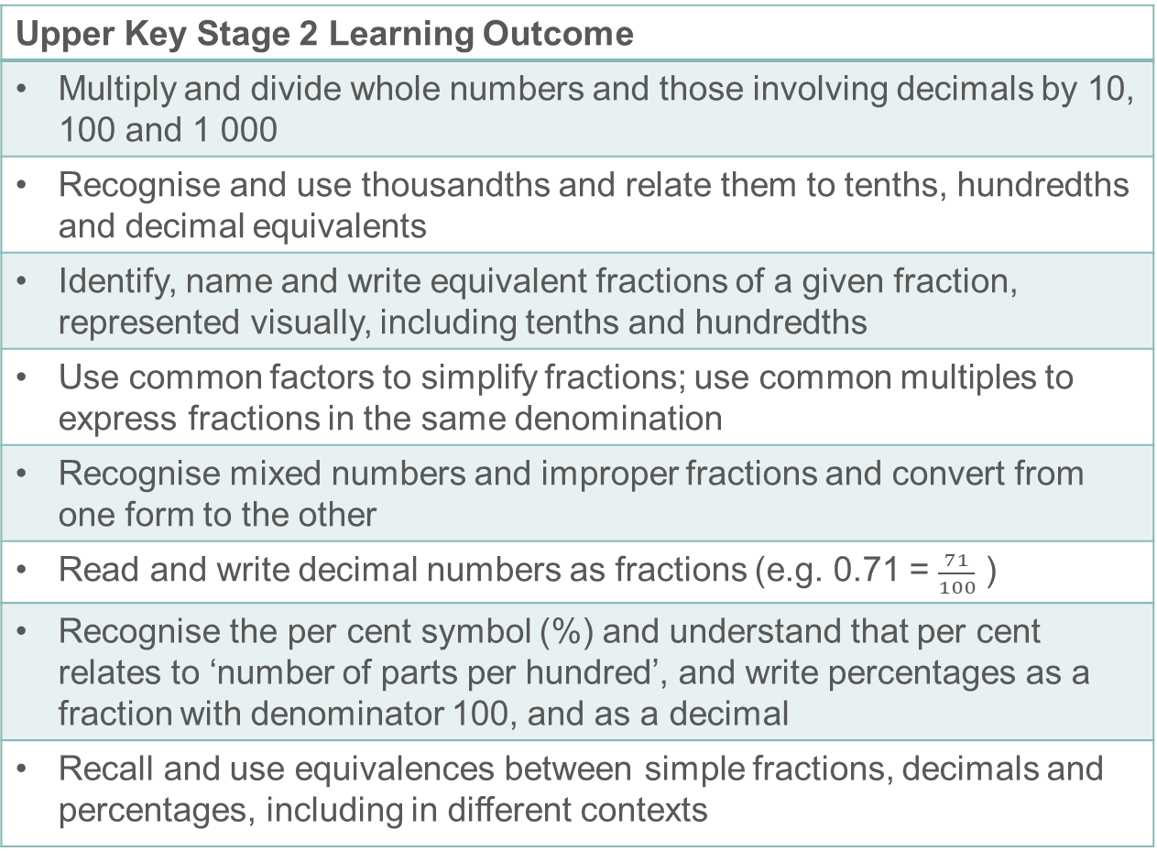
Prior learning
Upper Key Stage 2 Learning Outcome
Multiply and divide whole numbers and those involving decimals by 10, 100 and 1 000
Recognise and use thousandths and relate them to tenths, hundredths and decimal equivalents
Identify, name and write equivalent fractions of a given fraction, represented visually, including tenths and hundredths
Use common factors to simplify fractions; use common multiples to express fractions in the same denomination
Recognise mixed numbers and improper fractions and convert from one form to the other
Read and write decimal numbers as fractions (e.g. 0.71 = $\frac{71}{100}$ )
Recognise the per cent symbol (%) and understand that per cent relates to ‘number of parts per hundred’, and write percentages as a fraction with denominator 100, and as a decimal
Recall and use equivalences between simple fractions, decimals and percentages, including in different contexts
  What prior knowledge might your students already have?
  What language might they use to describe this key idea?
  What questions might you want to ask to assess their prior learning?
Notes:
You may find it useful to speak to your partner schools to see how the above has been covered and the language used.
You can find further details regarding prior learning in the following segments of the NCETM primary mastery professional development materials (linked on final slide):
Year 4: 1.23 Composition and calculation: tenths
Year 4: 1.24 Composition and calculation: hundredths and thousandths
Year 4: 2.13 Calculation: multiplying and dividing by 10 or 100
Year 5: 1.27 Negative numbers: counting, comparing and calculating
Year 5: 2.18 Using equivalence to calculate
Year 5: 3.7 Finding equivalent fractions and simplifying fractions
Year 6: 3.10 Linking fractions, decimals and percentages
Within The structure of the number system Theme Overview document, you can also find a broader description of students’ potential previous learning (page 4), alongside further information about key underpinning knowledge (page 2).

Slide 9
Prior learning
Key Stage 3 Learning Outcome
1.1.1 Understand the value of digits in decimals, measure and integers
1.2.2 Understand integer exponents and roots
1.3.2 Compare and order positive and negative integers, decimals and fractions
Please note: Numerical codes refer to statements of knowledge, skills and understanding in the NCETM breakdown of Key Stage 3 mathematics.
  What representations might your students already be familiar with?
  What language might they use?
  How does this fit in with your curriculum progression?

Slide 10
Checking prior learning
The following slides contain questions for checking prior learning.
  What representations might students use to support their understanding of these questions?
  What variation might you put in place for these questions to fully assess students’ understanding of the concept?
  How might changing the language of each question change the difficulty?
  Why are these such crucial pre-requisites for this key idea?

Slide 11
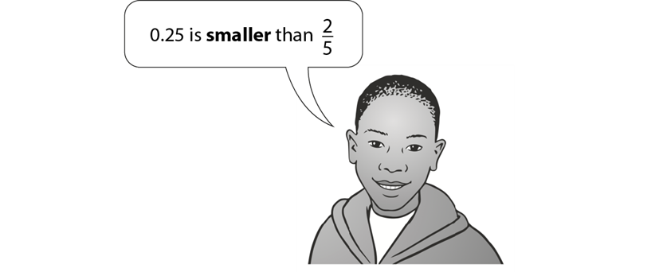

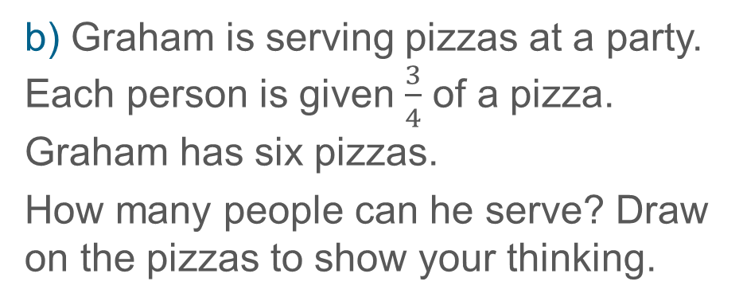
Checking prior learning (1)
a) Adam says,
b) Graham is serving pizzas at a party. Each person is given $\frac{3}{4}$ of a pizza. Graham has six pizzas.
How many people can he serve? Draw on the pizzas to show your thinking.
Explain why he is correct.
Notes:
References to the questions (links on final slide):
a) 2017 Key Stage 2 Mathematics Paper 2: reasoning, Question 20
b) NCETM Primary assessment materials: Year 5, page 19

Slide 12
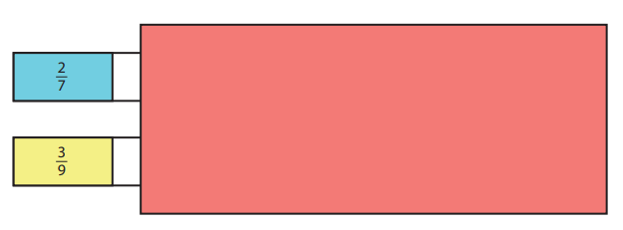
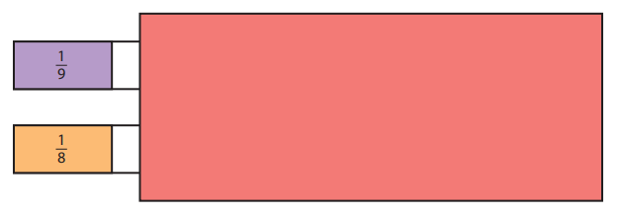
Checking prior learning (2)
c) Only a fraction of each whole rod is shown. Using the given information, identify
which whole rod is longer.
Explain your reasoning.
Notes:
References to the questions (links on final slide):
c) NCETM Primary assessment materials: Year 6, page 19

Slide 13
Common difficulties and misconceptions
What aspects of this key idea might pupils find challenging?
What misconceptions might pupils have?
When teaching this topic, you may find students encounter difficulties with…
Fractions as both part-whole constructs and quotients
Fractions as both a process to calculate an answer, and the answer itself
Confusing the vinculum (fraction bar) and the decimal point
More information, and some suggestions for overcoming these challenges, can be found on the following slides

Slide 14
Common difficulties and misconceptions (1)
Many students, when picturing a fraction such as three-fifths, will imagine a single object split into five equal parts, with three of them selected. This image of a fraction is encouraged by examples such as a cake is cut into five equal parts. Three children each take one part. How much of the cake is eaten? In this interpretation both the numerator and denominator of the fraction represent the same ‘unit’ – in this case, slices of a cake.
While this image, sometimes identified as a part-whole construct (Behr, M., Harel, G., Post, T. R., & Lesh, R. 1992) is accurate, it is incomplete, and a second understanding of fractions (the quotient construct) should also be considered.
In this interpretation of the fraction notation, the numerator and denominator represent different units. For example, in the question three cakes are shared equally between five children. How much cake does each child eat? the numerator represents the number of cakes while the denominator represents the number of children.
Notes:
This can also be found on page 9 of the 1.3 Core Concept document.

Slide 15
Common difficulties and misconceptions (1 cont’d)
Nunes and Bryant (2008) state that most children are introduced to fractions through the part-whole model and have less experience of fractions as a quotient. They also suggest that, although the differences between these models are subtle, it is a ‘crucial distinction’ with at least four implications for students’ understanding of fractions. Briefly summarised these are
  The understanding of improper fractions may be easier when using the quotient construct (five cakes shared between three children makes more sense as a way to understand five-thirds than one child eating five-thirds of a cake)
  Students understand that the way in which a quantity is partitioned doesn’t matter, as long as the sharing is equal. If, for example, five cakes are to be shared among three children then each cake doesn’t have to be cut in five equal parts, with each child getting three of them.
  It is suggested that ordering fractions may be easier when using the quotient construct. It is likely to be easier to reason about which is larger, three fifths or three sixths when considered as three cakes shared between five people or three cakes being shared between six people.
  Understanding the equivalence of fractions may also be easier using the quotient construct as students may be able to reason that doubling the number of cakes and the number of children won’t affect the amount of cake any child eats.
Notes:
This can also be found on page 9 of the 1.3 Core Concept document.

Slide 16
Common difficulties and misconceptions (2)
A challenge that students might face when considering fractions as division is that the fraction is both the process needed to calculate the answer, and the answer itself. When sharing three cakes between five people, the calculation used is 3÷5 and the answer is three-fifths.
This is an example of a ‘procept’, a term coined by Grey and Tall (1994). In their article discussing a ‘proceptual view of simple arithmetic’, the following quotation from Wiliam P Thurston, a Fields Medallist is offered.
  I remember as a child, in fifth grade, coming to the amazing (to me) realization that the answer to 134 divided by 29 is 134/29 (and so forth). What a tremendous labor-saving device! To me, ‘134 divided by 29’ meant a certain tedious chore, while 134/29 was an object with no implicit work. I went excitedly to my father to explain my major discovery. He told me that of course this is so, a/b and a divided by b are just synonyms. To him it was just a small variation in notation.
Notes:
This can also be found on page 9 of the 1.3 Core Concept document.

Slide 17
Common difficulties and misconceptions (3)
In addition to this, a misconception seen with students who may not fully understand decimal and fraction notation is to convert fractions to decimals by replacing the fraction bar with a decimal point (so, for example, write five-thirds as 5.3).
The use of representations such as shading a hundred square may help to overcome this misconception.
Notes:
This can also be found on page 9 of the 1.3 Core Concept document.

Slide 18
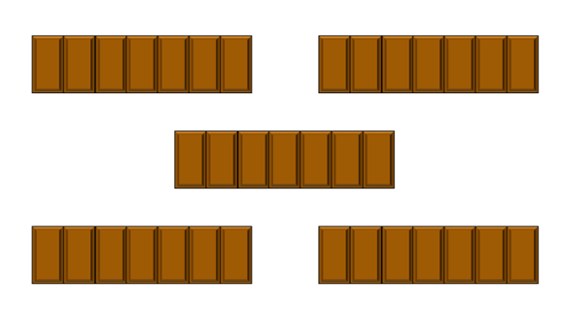

Understand that fraction notation represents both a division and the result of that division
Example 1
b) Five chocolate bars are shared equally between seven children
a) A chocolate bar has seven equal sections like this.
Mark eats five sections of the bar.
Shade this on the diagram.
What fraction of the bar has Mark eaten?
Shade the diagram to show how this sharing might happen.
What fraction of a bar does each child get?
Notes:
A version of example 1, with parts a and b on separate slides, is available over the next two slides. A printable version is found on slide 42.
Suggested questioning:
What fraction have you shaded?
What is the same/different about each of your diagrams?
Things for you to think about:
Here the representation is used to allow an opportunity to explore the difference between partitioning and finding the quotient.
In part b, students might be asked to find different ways to share the bars (for example, how can the bars be shared with the fewest ‘breaks’ of the chocolate) and this would allow for more reasoning around the connection between division and the resulting fraction of $\frac{5}{7}$.

Slide 19
Understand that fraction notation represents both a division and the result of that division
Example 1a
a) A chocolate bar has seven equal sections like this.
Mark eats five sections of the bar.
Shade this on the diagram.
What fraction of the bar has Mark eaten?
Notes:
For suggested questioning and things for you to think about, see slide 18.

Slide 20
Understand that fraction notation represents both a division and the result of that division
Example 1b
b) Five chocolate bars are shared equally between seven children
Shade the diagram to show how this sharing might happen.
What fraction of a bar does each child get?
Notes:
For suggested questioning and things for you to think about, see slide 18.

Slide 21
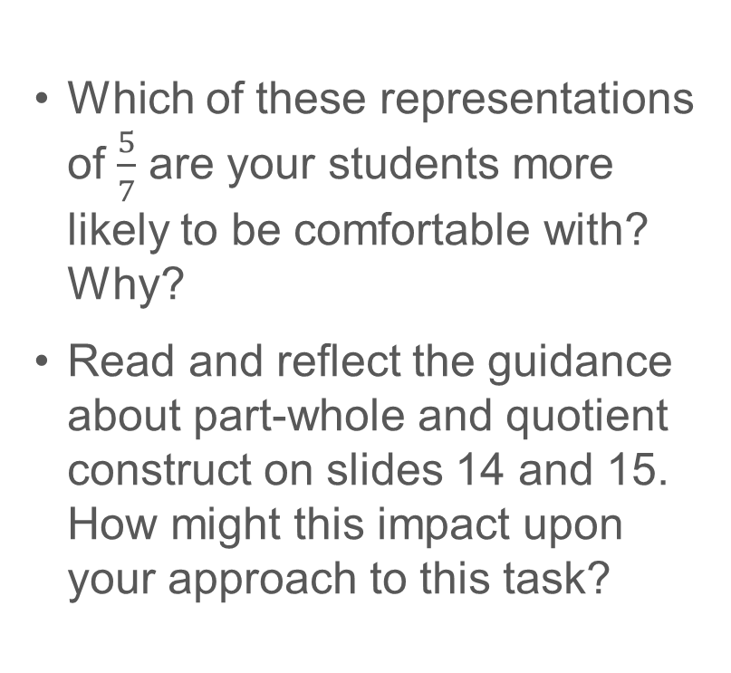
Understand that fraction notation represents both a division and the result of that division
Example 1
  Which of these representations of $\frac{5}{7}$ are your students more likely to be comfortable with? Why?
  Read and reflect the guidance about part-whole and quotient construct on slides 14 and 15. How might this impact upon your approach to this task?
a) A chocolate bar has seven equal sections like this.
Mark eats five sections of the bar.
Shade this on the diagram.
What fraction of the bar has Mark eaten?
b) Five chocolate bars are shared equally between seven children
Shade the diagram to show how this sharing might happen.
What fraction of a bar does each child get?
Notes:
Due to space constraints, the image on this PD discussion slide is very small. PD Leads might like to use or print the ‘in the classroom’ version of this slide, or the printable version on slide 42, for teachers to access during discussions.
This example can be found on page 10 of the 1.3 Core Concept document.

Slide 22
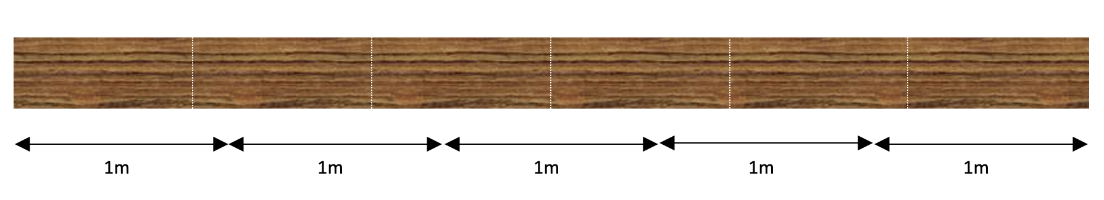
Understand that fraction notation represents both a division and the result of that division
Example 2
A wooden plank is 5 metres long. It is to be cut into 6 equal shelves like this.
Write down the calculation you’d use to work out how long each of the shelves will be.
Fiona says, “Each of the shelves looks like it’s about three quarters of a metre long”. How accurate is Fiona? What fraction of a metre is the length of each shelf?
Notes:
Suggested questioning:
Approximately how long do you think each shelf will be?
What fraction of the whole plan is each shelf?
Look at the first meter length. What fraction of the whole metre is the shelf? What do you notice?
Things for you to think about:
As in Example 1, the common understanding of division as equal sharing is used to consider a situation where the result is written as a fraction. Key to this example is the students’ awareness of the equivalence of the calculation 5÷6 and the resulting quotient $\frac{5}{6}$.
The bar model representation here is used to bridge two different ways of considering fractions. The intention is that the ’plank’ can be considered as both one object being cut into equal pieces (the part-whole) and also as a group of 5 lengths, each 1 metre long (suggesting the quotient model). The move from discrete objects in Example 1, towards a continuous measure here is further developed in Example 3.

Slide 23
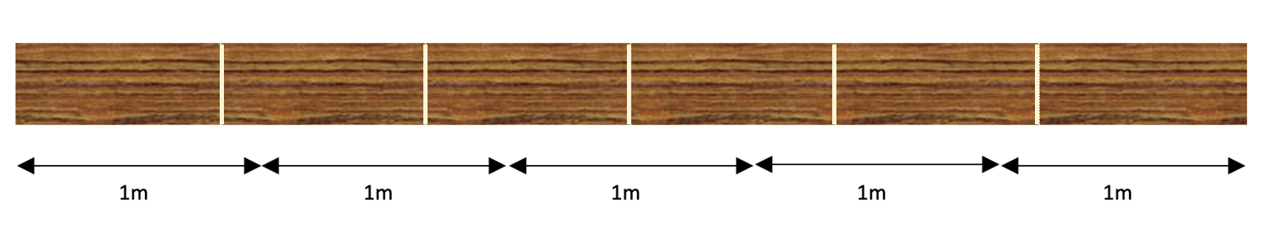
Understand that fraction notation represents both a division and the result of that division
Example 2
A wooden plank is 5 metres long. It is to be cut into 6 equal shelves like this.
  What do you expect students to find most challenging about this example?
  What other questions might you ask alongside these?
  How will you model part b to students?
Write down the calculation you’d use to work out how long each of the shelves will be.
Fiona says, “Each of the shelves looks like it’s about three quarters of a metre long”. How accurate is Fiona? What fraction of a metre is the length of each shelf?
Notes:
Due to space constraints, the image on this PD discussion slide is very small. PD Leads might like to use or print the ‘in the classroom’ version of this slide for teachers to access during discussions.
This example can be found on page 10 of the 1.3 Core Concept document.

Slide 24
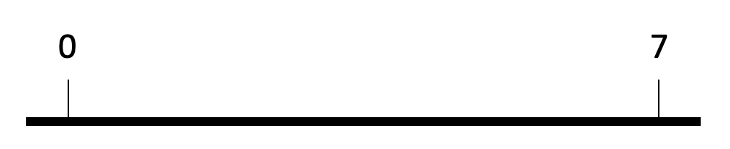
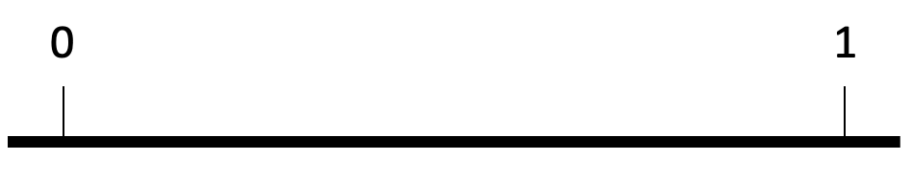
Understand that fraction notation represents both a division and the result of that division
Example 3
a) Mark the number 3 on this number line
b) Mark the number $\frac{3}{7}$ on this number line
c) What’s the same and what’s different about parts a and b?
Notes:
Suggested questioning:
What is the same? What is different?
How did you mark the 3 on the first number line? What was your strategy?
How was your strategy the same/different for the second number line?
How can you use division to help you estimate fractions on a number line?
Things for you to think about:
The representation used here, in this case the number line, is used to give a context for two different ways to interpret a fraction. Although placing a 3 on the 0 to 7 number line, and identifying $\frac{3}{7}$ on the 0 to 1 number line are mathematically the same (they are both $\frac{3}{7}$ of the way along the identified section of the line), the interpretation from pupils may be that part a is connected with division as they are sharing the 7 into seven equal parts in order to identify where 3 goes while they may interpret part b as being about fractions. This task is intended to give a context to make the common language and structure of division and fractions explicit.

Slide 25
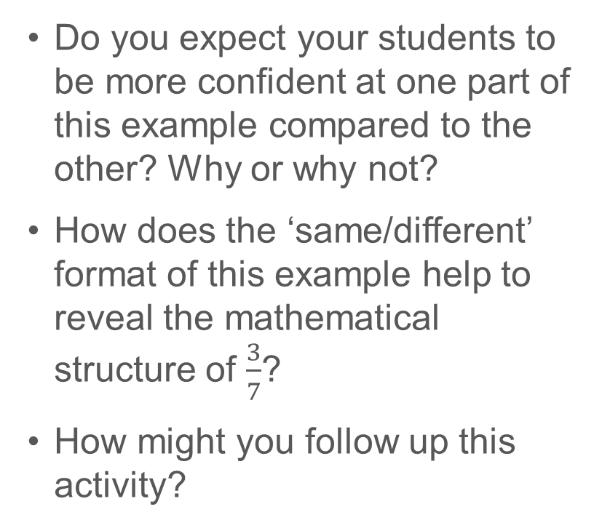
Understand that fraction notation represents both a division and the result of that division
Example 3
  Do you expect your students to be more confident at one part of this example compared to the other? Why or why not?
  How does the ‘same/different’ format of this example help to reveal the mathematical structure of $\frac{3}{7}$?
  How might you follow up this activity?
a) Mark the number 3 on this number line
b) Mark the number $\frac{3}{7}$ on this number line
c) What’s the same and what’s different about parts a and b?
Notes:
This example can be found on page 11 of the 1.3 Core Concept document.

Slide 26
Understand that fraction notation represents both a division and the result of that division
Examples 1, 2 and 3
  Consider this paragraph. To what extent do you agree with the importance of hearing other perspectives on the same mathematical idea?
  Might it lead to pupils being confused?
  What would you do in your classroom to raise students awareness of the different interpretations of fractions discussed in the common difficulties and misconceptions section above?
“Through all of examples 1, 2 and 3 it is important that the pupils have an opportunity to verbalise and discuss their thinking, sharing their understanding and hearing alternative perspectives on each situation in order that they become aware of different ways of visualising and interpreting contexts that are mathematically identical.”

Slide 27

Understand that fraction notation represents both a division and the result of that division
Example 4
Calculate 153 ÷ 617.
Give your answer as a fraction
Notes:
Suggested questioning:
What division will give the answer $\frac{153}{617}$?
How can you rewrite this division?
Things for you to think about:
An alternative to example 4 might be to reverse the task and ask students to write down, for example, a division that gives the answer $\frac{153}{617}$. This might be a part of a more extended sequence of questions such as suggested on slide 29, which is an alternative to this task.

Slide 28
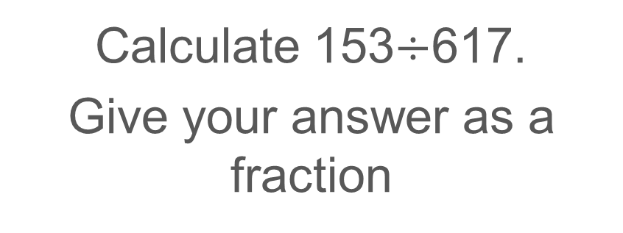
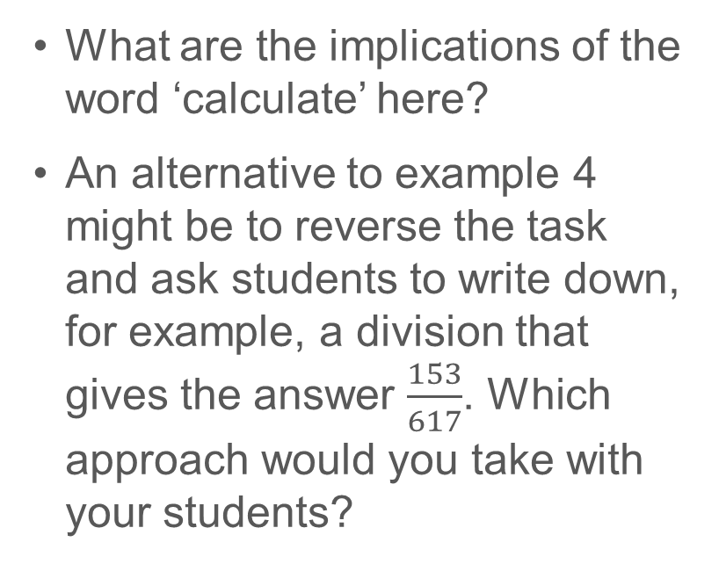
Understand that fraction notation represents both a division and the result of that division
Example 4
  What are the implications of the word ‘calculate’ here?
  An alternative to example 4 might be to reverse the task and ask students to write down, for example, a division that gives the answer $\frac{153}{617}$. Which approach would you take with your students?
Calculate 153$÷$617.
Give your answer as a fraction
Notes:
This example can be found on pages 12 and 13 of the 1.3 Core Concept document.

Slide 29
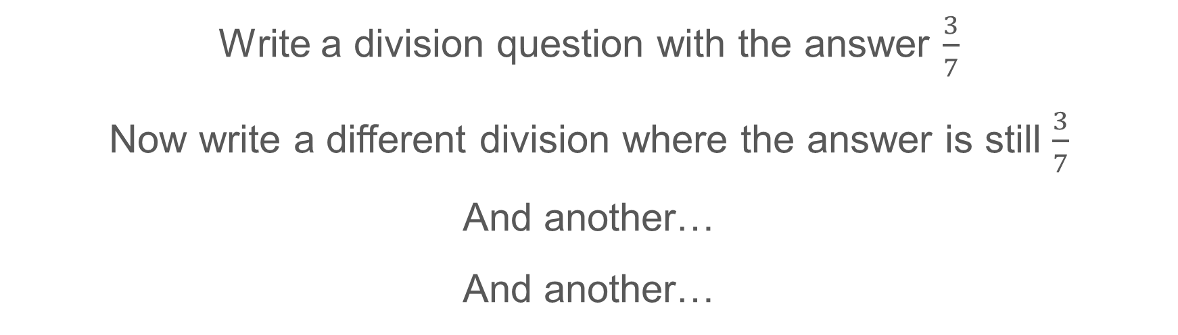
Understand that fraction notation represents both a division and the result of that division
Example 4 (alternative)
Write a division question with the answer $\frac{3}{7}$
Now write a different division where the answer is still $\frac{3}{7}$
And another…
And another…
Notes:
Suggested questioning:
What is the ‘most obvious’ division? What is the ‘least obvious’?
Can you write a division no one else has thought of?
How many different divisions will there be? How do you know?
Things for you to think about:
This is a sequence of questions that might be used as an alternative, or as a lead up to, example 4 on slide 27.

Slide 30

Understand that fraction notation represents both a division and the result of that division
Example 4 (alternative)
  Do you agree that the “and another…” prompt used here has the same focus as the prompt used in example 4 (on slide 27/28)?
  How might the “and another…” prompt be useful in developing students’ understanding of the quotient construct?
Write a division question with the answer $\frac{3}{7}$
Now write a different division where the answer is still $\frac{3}{7}$
And another…
And another…
Notes:
This example can be found on pages 11 and 12 of the 1.3 Core Concept document.

Slide 31
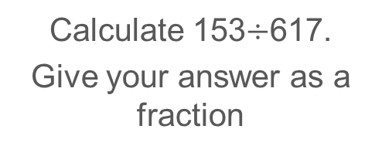
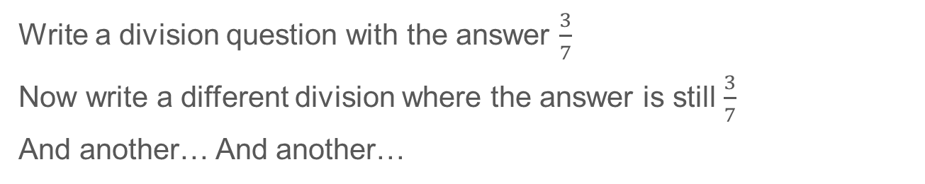
Understand that fraction notation represents both a division and the result of that division
Example 4
Example 4 (alternative)
Write a division question with the answer $\frac{3}{7}$
Now write a different division where the answer is still $\frac{3}{7}$
And another… And another…
Calculate 153$÷$617.
Give your answer as a fraction
  Which is more accessible for students in your class? When might you use one or the other?
  The ‘and another…’ question sequence is described by Bills, Bills, Watson and Mason (2004) and the authors stress the importance of asking students to describe how they created their examples in order that they are able to generalise. How might you support students to generalise from the single example shown in example 4?
Notes:
Due to space constraints, the image on this PD discussion slide is very small. PD Leads might like to use or print the ‘in the classroom’ version of this slide for teachers to access during discussions.
These examples can be found on pages 11 and 12 of the 1.3 Core Concept document.

Slide 32
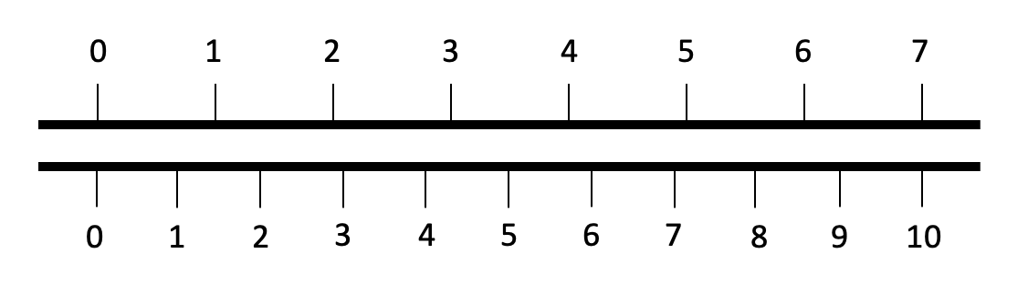
Use that understanding to write a fraction as an equivalent decimal
Example 5
Use this double number line to estimate the value of $\frac{3}{7}$ as a decimal
Notes:
Suggested questioning:
What does ‘estimate’ mean?
How does the lower number line help us to think about decimals?
If 7 represents 1 whole, what are the units on the lower line?
Is 3/7 closer to 4 or 5? What does this mean for our decimal?
Things for you to think about:
Example 6 challenges pupils to connect their understanding of decimals and equivalent fractions. Pupils will know that decimals can be written as tenths, hundredths and so on, but then identifying the equivalence in this context also draws on their awareness of a fraction as a division (as in example 3 above).

Slide 33
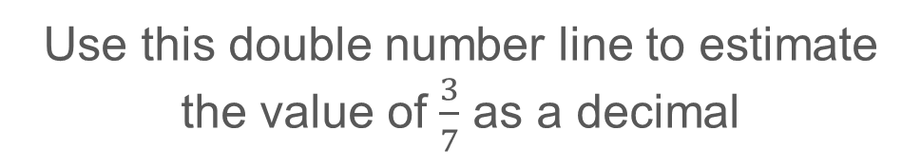
Use that understanding to write a fraction as an equivalent decimal
Example 5
  To what extent do you feel that this double number line adds unnecessary barriers to pupils’ understanding?
  How might the use of different scales on the lower number line make the equivalence more transparent? There are some suggestions on the next slide.
Use this double number line to estimate the value of $\frac{3}{7}$ as a decimal
Notes:
This example can be found on page 12 of the 1.3 Core Concept document.

Slide 34
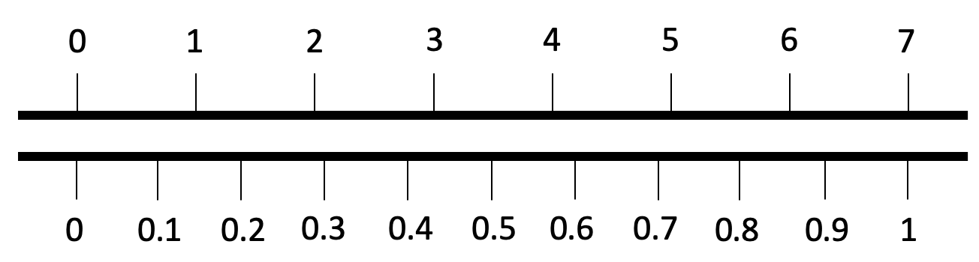
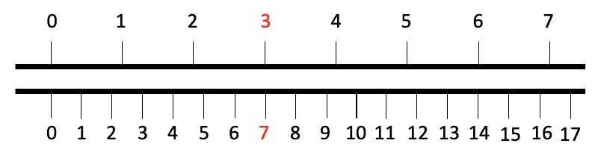
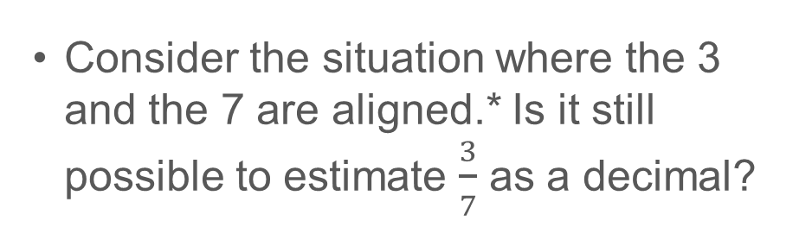
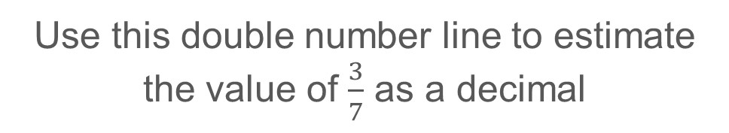
Use that understanding to write a fraction as an equivalent decimal
Example 5 (continued)
Use this double number line to estimate the value of $\frac{3}{7}$ as a decimal
  Consider the situation where the 3 and the 7 are aligned.* Is it still possible to estimate $\frac{3}{7}$ as a decimal?
  Might the use of a decimal scale on the lower number line make the equivalence more transparent? For example:
Notes:
Due to space constraints, the image on this PD discussion slide is very small. PD Leads might like to use or print the version of these number lines from the appendices (slide 43) for teachers to access during discussions.
These examples can be found on page 12 of the 1.3 Core Concept document.
*This situation was suggested by @profsmudge on Twitter

Slide 35
Reflection questions
What other mathematical concepts will be supported by students’ stronger understanding of this key idea?
What mathematical language will you continue to use to support pupils to make connections with other areas?
Which representations might you continue to use to further develop students’ understanding?

Slide 37
Appendices
You may choose to use the following slides when planning or delivering a PD session. They cover:
  Key vocabulary
  Representations and structure
  Previous learning
  Future learning
  Examples 1 and 5 – printable versions
  Library of links

Slide 38
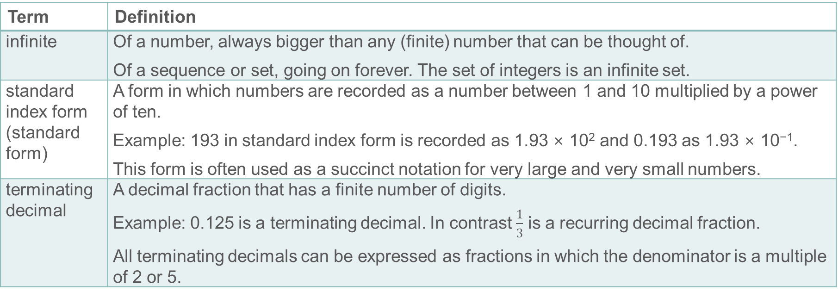
Key vocabulary
Term | Definition
infinite | Of a number, always bigger than any (finite) number that can be thought of. Of a sequence or set, going on forever. The set of integers is an infinite set.
standard index form (standard form) | A form in which numbers are recorded as a number between 1 and 10 multiplied by a power of ten. Example: 193 in standard index form is recorded as 1.93 × 10² and 0.193 as 1.93 × 10⁻¹. This form is often used as a succinct notation for very large and very small numbers.
terminating decimal | A decimal fraction that has a finite number of digits. Example: 0.125 is a terminating decimal. In contrast $\frac{1}{3}$ is a recurring decimal fraction. All terminating decimals can be expressed as fractions in which the denominator is a multiple of 2 or 5.

Slide 39
Representations and structure
There are a number of different representations that you may wish to use to support students’ understanding of this key idea. These might include:
Double number lines (also known as ‘stacked number lines’)
  The comparison of corresponding entries in two different sets of multiples, can be a useful context in which to explore fractions and division.
Bar models
  Bar models can be very useful to support students in representing (literally, re-presenting) problems to reveal multiplicative structures, including those involving fractions.
Fraction wall
  Students should be familiar with finding equivalent fractions using a fraction wall. However, such activities may not allow students to see the multiplicative connection between the numerator and the denominator and appreciate that this will necessarily be the same for any other equivalent fraction.
Notes:
More information about the representations and structure involved in this key idea can be found:
On pages 6-9 of 1 The structure of the number system Theme Overview Document
On pages 5-8 of the 3 Multiplicative reasoning Theme Overview Document
Within the NCETM’s ‘Using mathematical representations at KS3’ resource
Links to all of these can be found on the final slide.

Slide 40
Previous learning
From Upper Key Stage 2, students will bring experience of:
reading, writing, ordering and comparing numbers up to 10 000 000 and determining the value of each digit
rounding any whole number to a required degree of accuracy
using negative numbers in context
identifying the value of each digit in numbers given to three decimal places and multiplying and dividing numbers by 10, 100 and 1 000, giving answers up to three decimal places
using, reading, writing and converting between standard units, converting measurements of length, mass, volume and time from a smaller unit of measure to a larger unit and vice versa, using decimal notation up to three decimal places
using symbols and letters to represent variables and unknowns in mathematical situations that they already understand, such as:
  missing numbers, lengths, coordinates and angles
  formulae in mathematics and science
Notes:
Theme 1 The structure of the number system

Slide 41
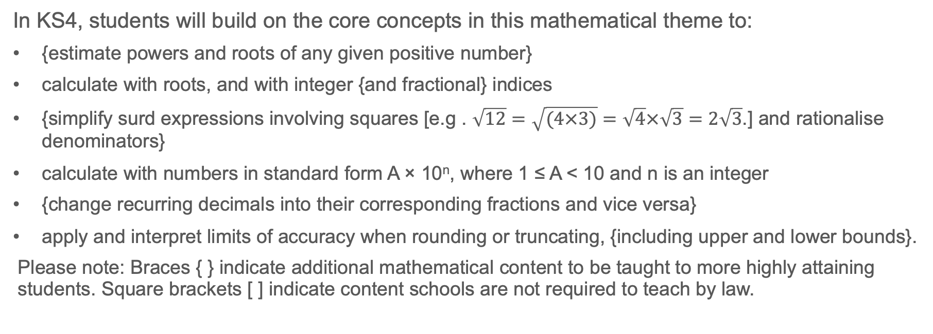
Future learning
In KS4, students will build on the core concepts in this mathematical theme to:
{estimate powers and roots of any given positive number}
calculate with roots, and with integer {and fractional} indices
{simplify surd expressions involving squares [e.g . $\sqrt{12}=\sqrt{(4×3)}=\sqrt{4}×\sqrt{3}=2\sqrt{3}$.] and rationalise denominators}
calculate with numbers in standard form A × 10^{n}, where 1 ≤ A < 10 and n is an integer
{change recurring decimals into their corresponding fractions and vice versa}
apply and interpret limits of accuracy when rounding or truncating, {including upper and lower bounds}.
Please note: Braces { } indicate additional mathematical content to be taught to more highly attaining students. Square brackets [ ] indicate content schools are not required to teach by law.
Notes:
Theme 1 The structure of the number system

Slide 42
Example 1 – printable version
a) A chocolate bar has seven equal sections like this.
b) Five chocolate bars are shared equally between seven children
Mark eats five sections of the bar.
Shade this on the diagram.
What fraction of the bar has Mark eaten?
Shade the diagram to show how this sharing might happen.
What fraction of a bar does each child get?
Notes:
For suggested questioning and things for you to think about, see slide 18.

Slide 43
Example 5 – printable number lines

Slide 44
Library of links
The following resources from the NCETM website have been referred to within this slide deck:
  NCETM Secondary Mastery Professional Development
    1 The Structure of the number system Theme Overview Document
    1.3 Ordering and comparing Core Concept Document
    3 Multiplicative Reasoning Theme Overview Document
  Using mathematical representations at KS3 | NCETM
  NCETM primary mastery professional development materials
  NCETM primary assessment materials
There are also references to:
  Standards & Testing Agency’s past mathematics papers

