Slide 1
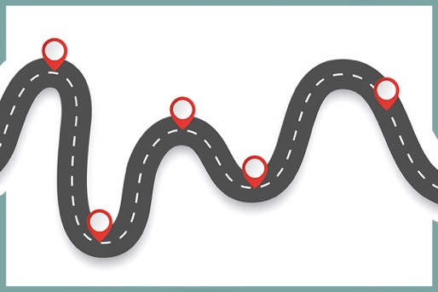
Checkpoints
Year 7 diagnostic mathematics activities
Transformations
Twenty-four Checkpoint activities
Eleven additional activities
Published in 2021/22

Slide 2
About this resource
This resource is designed to be used in the classroom with Year 7 students, although it may be useful for other students.
The Checkpoints are grouped around the key ideas in the core concept document, 6.3 Transforming shapes, part of the NCETM Secondary Mastery Professional Development materials.
Before each set of Checkpoints, context is explored, to help secondary teachers to understand where students may have encountered concepts in primary school.
The 10-minute Checkpoint tasks might be used as assessment activities, ahead of introducing concepts, to help teachers explore what students already know and identify gaps and misconceptions.
Each Checkpoint has an optional question marked . This will provide further thinking for those students who have completed the rest of the activities on the slide.
The notes for each Checkpoint give answers (if appropriate), some suggested questions and things to consider.
After each Checkpoint, a guidance slide explores suggested adaptations, potential misconceptions and follow-up tasks. These may include the additional activities at the end of this deck.

Slide 3
Using these Checkpoints
These Checkpoints are separated into two sections. The first section explores transformations that preserve congruence (Checkpoints 1–21) while the second explores enlargement (Checkpoints 22–24).
Students’ experience of transformations is quite spread out over the primary curriculum. As such, the context for the first section is split over slides 11 and 12 so that the full extent of their learning can be shared. Pedagogically, this might mean that students have not encountered some concepts for quite some time or may not have connected different aspects of their learning.
Some Checkpoints in the first section assess understanding of a specific transformation, while others explore multiple transformations (for example, by asking students to identify which transformation has taken place). The table on slide 7 details which transformations are explored in each Checkpoint.
There are a number of printable resources and animated slides to support your explanations to students. Consider carefully at what stage you provide students with this support. Access to resources, such as a printed resource that they can manipulate, may change the approach that students take.

Slide 4
Checkpoints 1–8
Checkpoint | Underpins | Code
1: The same triangle? | Congruence | 6.3.1 6.3.2 6.3.3
2: Tess-ellation
3: Pentominoes
4: Computer graphics | Understand place value in decimals, including recognising exponent and fractional representations of the column headings | 1.1.1.2
5: Sticker book
6: Headphones
7: Sliding box
8: Two ants move
*This three-digit code refers to the statement of knowledge, skills and understanding in the NCETM’s Sample Key Stage 3 Curriculum Framework (see notes below for more information).
Notes:
In the Sample Key Stage 3 Curriculum Framework, statements of knowledge, skills and understanding are arranged to give an example teaching order. The three-digit code for each statement in the framework is a clickable hyperlink to documents with more detailed information, including the key ideas contained within that statement. These key ideas are also shown on slides 8–9 in this deck.

Slide 5
Checkpoints 9–16
Checkpoint | Underpins | Code
9: Counter rectangle | Congruence | 6.3.1 6.3.2 6.3.3
10: Spinning snails
11: McTwist
12: L-turn John | Understand place value in decimals, including recognising exponent and fractional representations of the column headings | 1.1.1.2
13: Hinges
14: Orcombe Point
15: Flag sort
16: Where’s the line?
*This three-digit code refers to the statement of knowledge, skills and understanding in the NCETM’s Sample Key Stage 3 Curriculum Framework (see notes below for more information).
Notes:
In the Sample Key Stage 3 Curriculum Framework, statements of knowledge, skills and understanding are arranged to give an example teaching order. The three-digit code for each statement in the framework is a clickable hyperlink to documents with more detailed information, including the key ideas contained within that statement. These key ideas are also shown on slides 8–9 in this deck.

Slide 6
Checkpoints 17–24
Checkpoint | Underpins | Code
17: Octagon | Congruence | 6.3.1 6.3.2 6.3.3
18: Counters
19: Tiles
20: Jagged reflection
21: Red kite | Congruence
22: Flagging | Similarity | 6.3.4
23: Scaling up
24: Rectangles
*This three-digit code refers to the statement of knowledge, skills and understanding in the NCETM’s Sample Key Stage 3 Curriculum Framework (see notes below for more information).
Notes:
In the Sample Key Stage 3 Curriculum Framework, statements of knowledge, skills and understanding are arranged to give an example teaching order. The three-digit code for each statement in the framework is a clickable hyperlink to documents with more detailed information, including the key ideas contained within that statement. These key ideas are also shown on slides 8–9 in this deck.

Slide 7
Transformations assessed in Checkpoints/Additional activities
 | 1 | 2 | 3 | 4 | 5 | 6 | 7 | 8 | 9 | 10 | 11 | 12 | 13 | 14 | 15 | 16 | 17 | 18
Translation |  |  |  |  |  |  |  |  | 
Rotation |  |  |  |  |  |  |  |  |  |  |  |  |  | 
Reflection |  |  |  |  |  |  |  |  |  |  |  |  |  |  |  |  |  | 
Enlargement | 
 | 19 | 20 | 21 | 22 | 23 | 24 | A | B | C | D | E | F | G | H | I | J | K
Translation |  |  |  |  |  |  |  |  | 
Rotation |  |  |  |  |  |  |  |  |  |  |  |  | 
Reflection |  |  |  |  |  |  |  |  |  |  |  |  |  |  | 
Enlargement |  |  |  |  |  |  |  |  |  |  |  |  |  |  |  |  | 

Slide 8
Key ideas
Understand and use translations | Code
Understand the nature of a translation and appreciate what changes and what is invariant | 6.3.1.1
Understand the minimum information required to describe a translation (vertical and horizontal displacement) | 6.3.1.2
Translate objects from information given in a variety of forms | 6.3.1.3
Understand and use rotations | Code
Understand the nature of rotations and appreciate what changes and what is invariant | 6.3.2.1
Understand the minimum information required to describe a rotation (centre of rotation, size and direction of rotation) | 6.3.2.2*
Rotate objects using information about centre, size and direction of rotation | 6.3.2.3
*‘There are additional resources exemplifying these key ideas in the Secondary Mastery Professional Development | NCETM.

Slide 9
Key ideas
Understand and use reflections | Code
Understand the nature of reflections and appreciate what changes and what is invariant | 6.3.3.1
Understand the minimum information required to describe a reflection (line of reflection) | 6.3.3.2*
Reflect objects using a range of lines of reflection (including non-vertical and non-horizontal) | 6.3.3.3
Understand and use enlargements | Code
Understand the nature of enlargements and appreciate what changes and what is invariant | 6.3.4.1
Understand the minimum information required to describe an enlargement (centre of enlargement and scale factor) | 6.3.4.2
Enlarge objects using information about the centre of enlargement and scale factor | 6.3.4.3
*‘There are additional resources exemplifying these key ideas in the Secondary Mastery Professional Development | NCETM.

Slide 10
Congruence
Checkpoints 1–21

Slide 11
Congruence
Previous learning
Key Stage 1 curriculum: Year 2: use mathematical vocabulary to describe position, direction and movement, including movement in a straight line and distinguishing between rotation as a turn and in terms of right angles for quarter, half and three-quarter turns (clockwise and anti-clockwise) Key Stage 2 curriculum: Year 3: recognise angles as a property of shape or a description of a turn Year 4: identify lines of symmetry in 2-D shapes presented in different orientations and complete a simple symmetric figure with respect to a specific line of symmetry . Year 4: describe movements between positions as translations of a given unit to the left/right and up/down Year 5: identify, describe and represent the position of a shape following a reflection (in lines parallel to the axes) or translation, using the appropriate language and know that the shape has not changed Year 6: draw and translate simple shapes on the coordinate plane (all four quadrants) and reflect them in the axes Year 6: recognise angles where they meet at a point, are on a straight line, or are vertically opposite, and find missing angles. Further information about how students may have experienced this key idea in Key Stage 2: Teaching mathematics in primary schools 4G–1: Draw polygons, specified by coordinates in the first quadrant, and translate within the first quadrant (pp192– 96); 4G–3 Identify line symmetry in 2D shapes presented in different orientations. Reflect shapes in a line of symmetry and complete a symmetric figure or pattern with respect to a specified line of symmetry (pp201–04) * Page numbers reference the complete Years 1–6 document

Slide 12
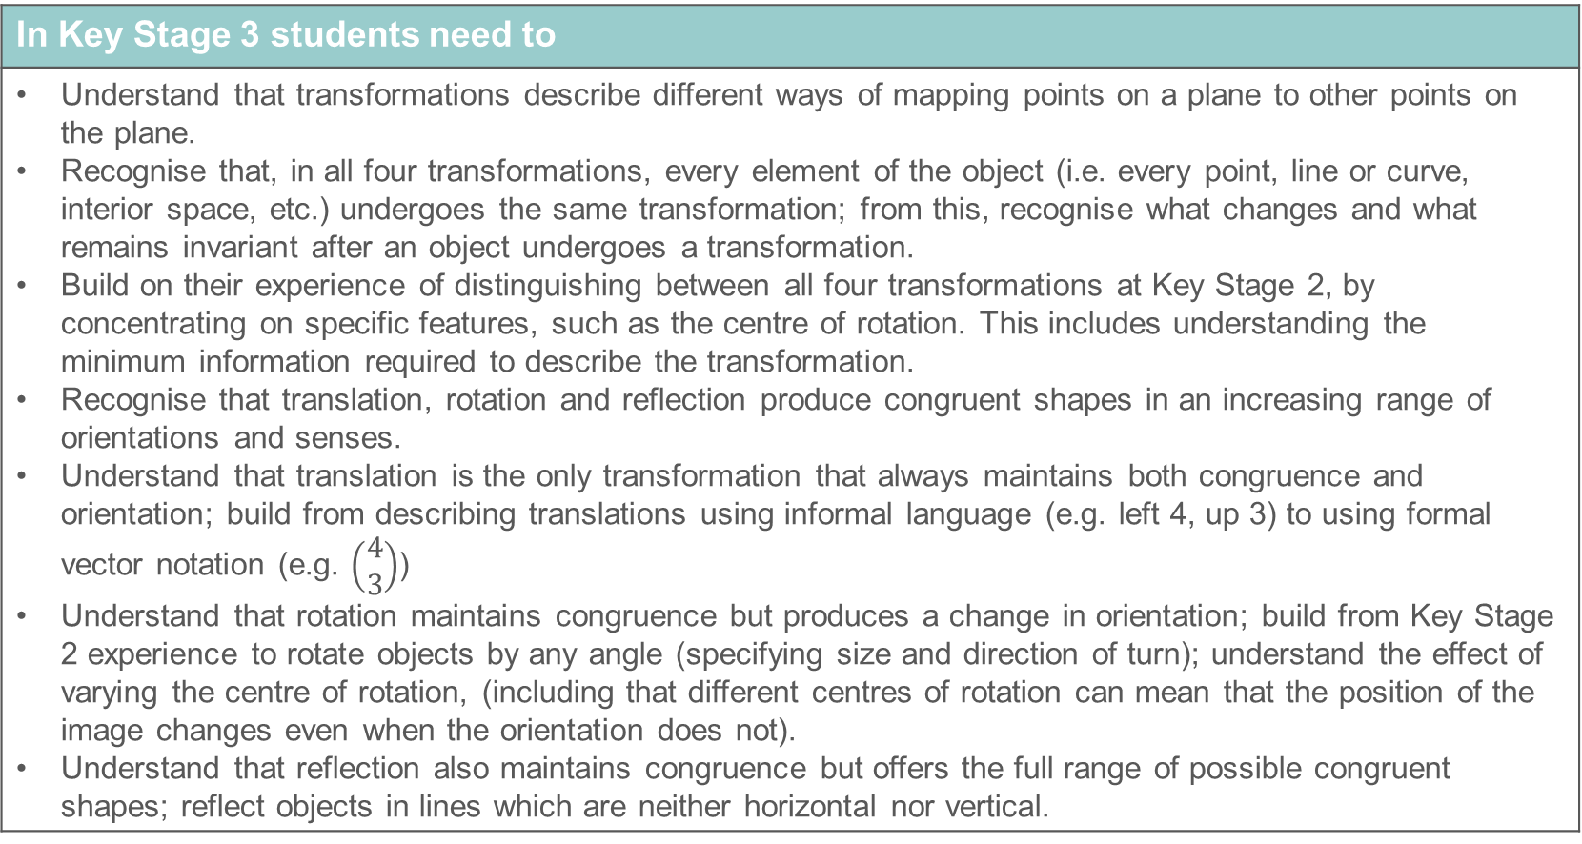
Congruence
In Key Stage 3 students need to
Understand that transformations describe different ways of mapping points on a plane to other points on the plane. Recognise that, in all four transformations, every element of the object (i.e. every point, line or curve, interior space, etc.) undergoes the same transformation; from this, recognise what changes and what remains invariant after an object undergoes a transformation. Build on their experience of distinguishing between all four transformations at Key Stage 2, by concentrating on specific features, such as the centre of rotation. This includes understanding the minimum information required to describe the transformation. Recognise that translation, rotation and reflection produce congruent shapes in an increasing range of orientations and senses. Understand that translation is the only transformation that always maintains both congruence and orientation; build from describing translations using informal language (e.g. left 4, up 3) to using formal vector notation (e.g. $\left(\begin{matrix}4 \\ 3\end{matrix}\right)$) Understand that rotation maintains congruence but produces a change in orientation; build from Key Stage 2 experience to rotate objects by any angle (specifying size and direction of turn); understand the effect of varying the centre of rotation, (including that different centres of rotation can mean that the position of the image changes even when the orientation does not). Understand that reflection also maintains congruence but offers the full range of possible congruent shapes; reflect objects in lines which are neither horizontal nor vertical.

Slide 13
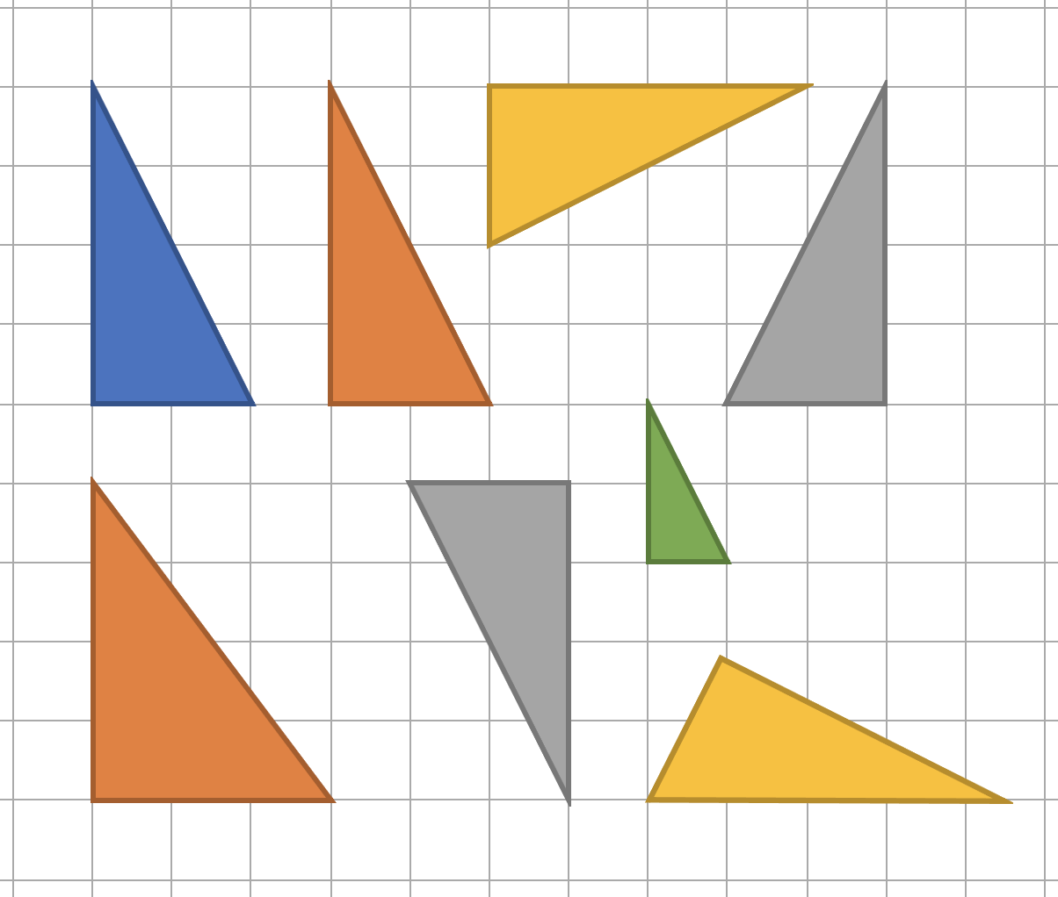
Checkpoint 1: The same triangle?
Which of these triangles are the same?
Are there any that you need to know more about before you can be certain?
C
A
B
D
E
G
Shapes E and H are not the same as shape A. Which of E and H is most like shape A? Explain the reasons for your answer.
H
F
Notes:
This slide is animated. The further thinking question will appear separately so you can choose the pace at which to work with your class.
Answers
a) A, B, C, D, F and G are ‘the same’.
b) Students might need more information about triangle F, as it is not marked that the ‘top’ angle is a right angle and not clear that its perpendicular side lengths are still 2 and 4.
? Students might suggest that E is most like A because it’s the same shape but smaller, or they might suggest that H is most like A because it’s very nearly the same size and only one corner needs to move one square to make it the same.
Suggested questioning
Can two shapes be ‘the same’ if they’re not the same size?
Can two shapes be ‘the same’ if one is turned round?
Can two shapes be ’the same’ if one is flipped over?
Are all squares ‘the same’? All rectangles? All triangles?
How confident can you be that triangle F is ‘the same’? What could you measure that would make you certain?
Things to think about
Checkpoints 1-4 don’t dwell on a specific transformation but offer opportunities for students to talk about various transformations to help you assess their starting points. The focus here is on identifying which shapes are ‘the same’: do students recognise the triangles that are orientated differently as being ‘the same’ shape as triangle A? The colours have been deliberately chosen so that some match, and some do not, as you may wish to have a discussion with students about whether a feature such as colour is relevant when deciding if two shapes are ‘the same’ (for those students with visual impairments, you might like to point out the triangles with the same colour). Note that, here, colour is irrelevant to whether two triangles are mathematically ‘the same’, but that a feature such as colour might be relevant when discussing symmetry (as in the flags for Checkpoint 15).

Slide 14
Checkpoint 1: Guidance
Adaptations | Assessing understanding
Support Ask students to consider particular pairs of triangles and ask, ‘What's the same, what's different?’ Draw attention to features necessary for congruence to support students to justify and compare their solutions. For example, state ‘A and B are the same because they are both 2 by 4 triangles.’ Then ask, ‘Are there other 2 by 4 triangles? Are they the same as A and B?’ Challenge Triangle F is a particular challenge since it doesn’t align with the grid, and so its dimensions are not obvious. Ask students how they could convince themselves that it is 'the same'. Would they be convinced if you said that the angles in F are the same as those in A and B? Would they be convinced if you said that the angles are the same, and that one length is the same? This is not about them having formal knowledge of the properties of congruent shapes, rather about them reasoning with their understandings to draw conclusions. Representations The grid is used to support comparisons between lengths and angles. | Explore with students what they understand 'the same' to mean, to gain an insight into what they know about congruence without yet using that vocabulary. Shape D, which includes a reflection; and F, which is aligned in a way that make it 'longer', may prove interesting to explore more. The alignment of F, where the lengths of the sides are not obvious, offers an opportunity to further discuss lengths of edges and whether having ‘the same’ length is enough to make two triangles the same. Shape E offers further insight into what students understand ‘the same’ to mean. They may describe it as ‘the same but smaller’, offering useful insight into their intuitive understanding of similarity.
Additional resources Additional activity A compares triangles to explore congruence, with the added dimension of students generating the triangles themselves using a pegboard.

Slide 15
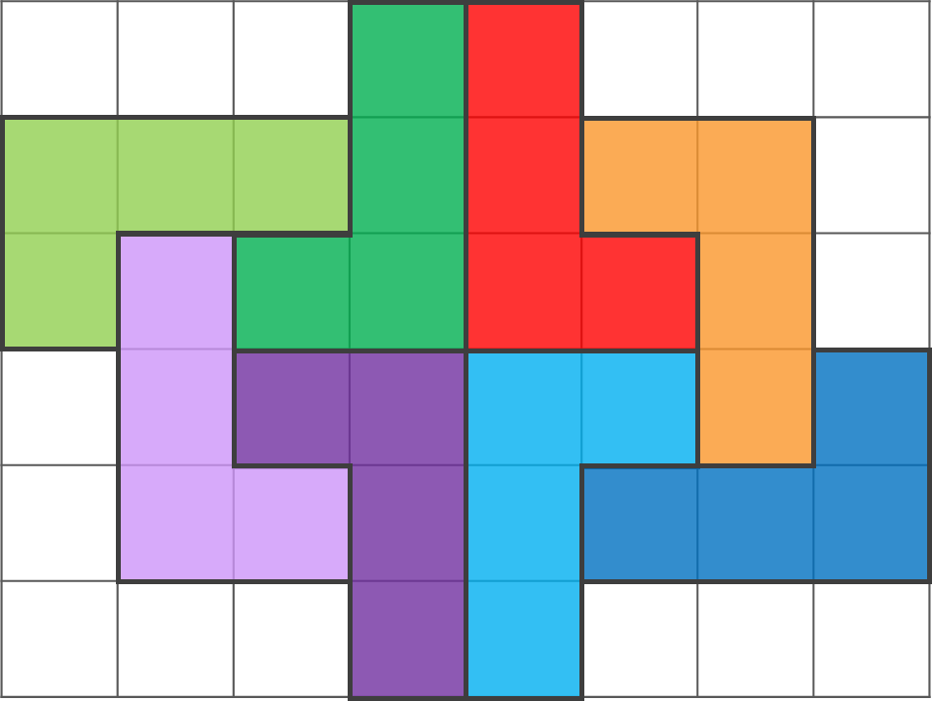
Checkpoint 2: Tess-ellation
Tessa made this pattern by drawing around an L-shaped stencil. She started with the red shape, labelled 1.
Choose an L shape where she could have slid the stencil along the page.
Choose an L shape where she could have flipped the stencil over.
Choose an L shape where she could have turned/spun the stencil.
1
Tessa adds another shape by both flipping and spinning the stencil. What might this shape look like? Could any of the possible shapes fit on this grid?
Notes:
This slide is animated. Each question will appear separately so you can choose the pace at which to work with your class. A printable resource is available on slide 88.
Answers
An animated version of the solutions is provided on the next slide.
a) The light purple shape.
b) The dark green or light blue shapes.
c) The dark purple, dark blue, light green or orange shapes.
? Four possible shapes are created: two are the same as the light blue and dark green shapes, and two are reflections of the light green and dark blue shapes, using a horizontal mirror line. Only the latter two would fit on the grid given. See the animated solutions on slide 16 for images of these shapes.
Suggested questioning
What other words could you use instead of, for example, ‘flipped’?
Is there more than one answer for any of the questions?
How could you give more detail about how Tessa has moved the shape?
Things to think about
Checkpoints 1–4 don’t dwell on a specific transformation, but offer opportunities for students to talk about various transformations to help you assess their starting points. Here, more colloquial language is used rather than the terms translate, reflect and rotate. Consider whether you will introduce these terms if students don’t volunteer them, or just focus on their understanding of the movement. It is also worth considering in advance how students might interpret these words in other contexts. For example, whilst a ‘flip’ here relates strongly to reflection, in other contexts students might associate a ‘flip’ with a rotation (such as a 180° ‘flip’ in board sports). Students might suggest that the reflections in part b are examples of the stencil being flipped 180°, which relies on this task being considered in 3D and might lead to the misconception that reflection and rotation by 180° are the same. In this case, it might be worth exploring more examples in purely 2D contexts (such as Checkpoint 12 or Checkpoint 3) to ensure students understand the difference between the transformations.

Slide 16
Checkpoint 2: Tess-elation (animated solutions to parts a-c)
Tessa made this pattern by drawing around an L-shaped stencil. She started with the red shape, labelled 1.
Choose an L shape where she could have slid the stencil along the page.
Choose an L shape where she could have flipped the stencil over.
Choose an L shape where she could have turned/spun the stencil.
1
Notes:
Animated solutions for parts a to c for Checkpoint 2: click through to reveal the shape/s identified in each part.

Slide 17
Checkpoint 2: Tess-elation (animated solutions to further thinking question)
Tessa made this pattern by drawing around an L-shaped stencil. She started with the red shape, labelled 1.
1
Tessa adds another shape by both flipping and spinning the stencil. What might this shape look like? Could any of the possible shapes fit on this grid?
Notes:
Animated solutions for the further thinking question for Checkpoint 2: click through to reveal the possible shapes.

Slide 18
Checkpoint 2: Guidance
Adaptations | Assessing understanding
Support Give students a physical copy of Tessa’s pattern, and cut out a copy of the L shape so that they can manipulate it to explore the transformations (see the printable resource on slide 88). Challenge For each part, ask students to create the other images that Tessa could have created with the same type of movement. Representations Consider language as a form of representation when using this Checkpoint. Does using more informal language change how students interact with the task? Do they recognise the transformations more or less readily when more mathematical terminology is used? | The intention of Checkpoint 2 is to provide an introduction to transformations so that you can assess students’ familiarity and confidence with moving shapes within the plane. Informal language is used so that the focus is on the transformation, and recognising the effect of the transformation, rather than the mathematical terminology. If students are able to identify the correct images for each part, then you may wish to probe further to see if they can describe any of the movements in more detail. For example, can they describe the direction of a ‘spin’ or use some kind of measurement to say how far around the shape has turned. This is an opportunity to see whether students naturally volunteer terms like ‘clockwise’ or degrees as a measure of turn. If students are confident, this task could easily be extended to compare different pairs of shapes – for example, there are two pairs of shapes where one L shape has been rotated 180°, and two pairs where one L shape has been rotated 90°. Can students identify which are which?
Additional resources Additional activity B is a more open version of this task, which selects pairs of L shapes to compare rather than asking students to look for specific transformations.

Slide 19
Checkpoint 3: Pentominoes
Pentominoes are arrangements of five squares.
Jasmine starts to arrange her squares like this:
Where could Jasmine place her final square?
How many different possibilities are there?
How many of the possibilities create different shapes?
How would your answers be different if your four starting squares were arranged differently?
Notes:
This slide is animated. Each question will appear separately so you can choose the pace at which to work with your class.
A printable resource can be found on slide 89.
Answers
a) and b) There are eight possible positions for the final square – see slide 20 for these.
c) There are four different shapes that can be created – see slide 20 for these.
? There are multiple possible answers to this question:
If the four starting squares were arranged in a 2 × 2 square, there would be eight possible positions for the final square but only one unique shape created.
If the four starting squares were arranged in a line, there would be 10 possible positions for the final square and three unique shapes created.
If the four starting squares were arranged in an L shape, there would be nine possible positions for the final square and nine unique shapes created.
If the four starting squares were arranged as a row of three with a fourth above the centre square, there would be eight possible positions for the final square and five unique shapes created.
Suggested questioning
What is your strategy?
How can you be sure you have found every possible position for the final square?
What is the same and what is different about the shapes you have created?
Can you match any of your shapes to each other?
For the shapes that match, how could you move one shape so it is exactly the same as the other?
Things to think about
This Checkpoint might not at first seem as though it is a transformations task. Using the pentominoes allows students to generate lots of different shapes, which can then be discussed and compared. The eight possible answers can be grouped into four pairs, each of which is a rotation of one another. Do students notice this link? Listen out for the language do they use to describe the relationship between each shape in the pair.

Slide 20
Checkpoint 3: Pentominoes (animated solutions)
How many of these solutions are different shapes?
Notes:
This slide is animated. The green squares will appear and disappear to show the eight possible positions for the final square, with each complete arrangement appearing as the shape changes.

Slide 21
Checkpoint 3: Guidance
Adaptations | Assessing understanding
Support Give students a grid to draw on, or physical tiles to move, so that they are just adding a single tile rather than recreating the image each time. The printable resource on slide 89 could be used for this. Challenge The further thinking question opens the possibility of a different arrangement of four squares. You can probe students’ understanding of this using follow-up questions, such as, ‘Which of your original solutions are not possible with this different rearrangement of squares?’, or, ‘Which starting arrangement gives the most possible solutions?’ Representations Pentominoes are arrangements of five squares connected edge-to-edge, and are a commonly-used puzzle in mathematics. There are 12 distinct pentominoes, of which only four are possible with this starting point – created from the eight possible positions for the fifth tile. | This Checkpoint provides an activity that can act as a springboard to conversations about comparing shapes. Once students have created some pentominoes, they might notice that some of their shapes are the same. Listen to the language that they use to compare their shapes – do they volunteer words such as ‘turned’ or ‘rotated’? If they do talk about a shape being rotated, you might wish to use a prompt question, such as, ‘How much has it been turned?’ See whether they opt for describing in angles or fractions of a whole turn. The structure of the task also helps you to assess students’ reasoning: do they have a systematic approach to making sure they have found all of the solutions? If they find all eight possible arrangements, are they able to successfully match all pairs of congruent shapes and recognise that there are only four unique solutions?
Additional resources Additional activity C is a more open version of this task, with just three rather than four starting squares given. This could be used as the basis for a much longer problem solving activity.

Slide 22
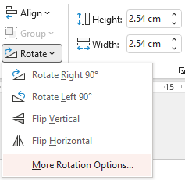
Checkpoint 4: Computer graphics
Monisha is making a poster using a computer.
She has four options for how she can rotate or flip images. You can see them on the menu to the right.
She has the images below on her poster.
For which of the four rotate or flip options would:
The star look the same?
The first sun look the same?
The moon look the same?
The second sun look the same?
What two clicks might Monisha have used to change the moon image to look like this:
Notes:
This slide is animated. Each question will appear separately so you can choose the pace at which to work with your class. Printable versions of the four images can be found on slide 90.
Answers
Note that the terms ‘Flip Vertical’ and ‘Flip Horizontal’ refer to the computer instructions shown but are the opposite way round to the description of the mirror line (i.e. a vertical flip uses a horizontal mirror line). Students may find this a confusing contradiction, so it is worth emphasising the orientation of the mirror line and referring students to the image of the computer menu on the slide.
a) Just for Flip Horizontal
b) For all four options
c) Just for Flip Vertical
d) None of the options would make the second sun look the same.
? She could have clicked Rotate Left 90° and then Flip Vertical, or she could have clicked Flip Horizontal and then Rotate Left 90°.
Suggested questioning
What other language could you use to describe the four options?
What would happen if you pressed each option twice? Three times?
What is the same and different about the two different suns?
Things to think about
As with Checkpoints 1 to 3, Checkpoint 4 explores a combination of transformations, in this case rotation and reflection, rather than one specific transformation. The focus here is on when shapes would look the same after a transformation, and so makes links to symmetry. Note that rotational symmetry is not covered in the primary national curriculum, but students should be able to recognise that the first sun will look the same after the given rotations, but the star and second sun will not.

Slide 23
Checkpoint 4: Guidance
Adaptations | Assessing understanding
Support If students have not used the flip or rotate functions in Microsoft Office before, you can model them using one of the images on the PowerPoint. Challenge Ask students what ‘More Rotation Options’ could mean, and what these options would have to be for the shapes to look the same. What other options could there be for the star and sun? Are there any other options for the moon? Representations As with many of the Checkpoints in this deck, you may find it helpful to give a physical representation of the 2D image for students to manipulate. A printable version can be found on slide 90. | Checkpoint 4 offers a context that may be familiar to students – the rotate and flip tools within Microsoft Office. Much like Checkpoints 2 and 3, the intention is to check students can visualise and imagine the actual transformation, rather than specific mathematical vocabulary. The shapes have been chosen to elicit discussion. The star, for example, could look the same if rotated by a fifth of the turn, but this is not one of the options available. The first sun, however, would look the same for all of the four options given. This contrasts with the second sun which, as it has been tilted slightly, would look different for all four transformations. This Checkpoint does touch upon the concept of rotational symmetry, which is not specifically mentioned in the primary curriculum. Students may still have explored properties of rotational symmetry, but are unlikely to have experience of describing an ‘order’ of rotational symmetry. Listen to their explanations and, if they are confident with the answers to parts a-d, prompt to see if they are able to explain how many times the shape would look like the original image if it was rotated through a whole turn.
Additional resources Additional activity D develops the ideas of the further thinking into a whole task.

Slide 24
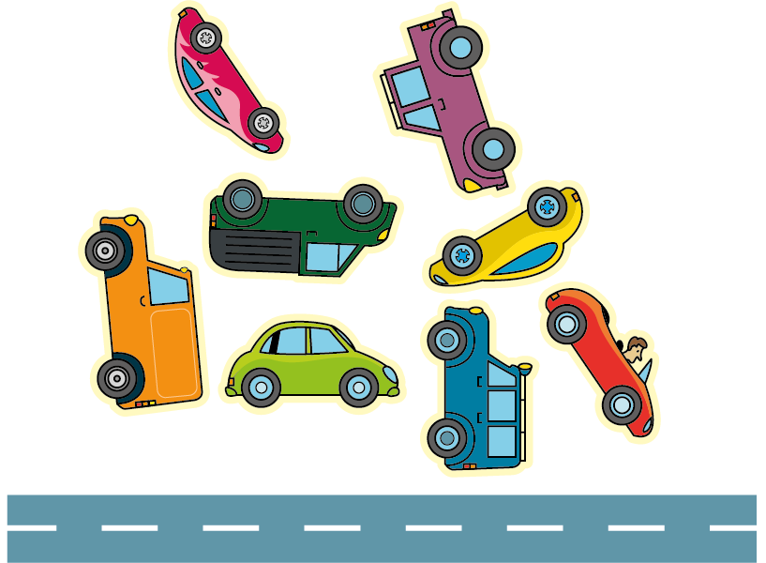
Checkpoint 5: Sticker book
Oscar is helping his little sister Evie to stick some vehicle stickers in her sticker book.
Evie places the stickers into the book so that they are all the right way up with their wheels on the road.
Which vehicles will be facing in the same direction?
B
E
C
F
A
H
D
G
Sketch your own vehicles in different orientations. Can you draw two vehicles that face the same way, even if they are not drawn the same way up?
Notes:
This slide is animated. Each question will appear separately so you can choose the pace at which to work with your class. Once students have tried to visualise the rotation of the cars without a physical image, you may wish to give the printed resource on slide 91 for them to turn and manipulate.
Answers
Students may give one or both groups for their answer:
Facing left: A, B, C, E, G
Facing right: D, F, H
? This will depend on students’ responses.
Suggested questioning
Which vehicles are facing right? Which are facing left? How do you know?
Which vehicle did you find hardest to decide on a direction? Which did you find easiest?
How do you know __ and __ are facing the same way?
How could you change the stickers so that all the vehicles are facing the same way?
Things to think about
Checkpoints 5 and 6 both explore students’ spatial reasoning, without explicitly referencing a transformation (although we are asking students to imagine the cars being rotated to their point of reference on the road). This Checkpoint offers a 2D context, while the following Checkpoint uses a 2D representation of a 3D context. Identify which students find it hard to visualise the movement of objects without having the support of a physical object to manipulate, so that you can plan ahead for how you will support them to understand transformations.

Slide 25
Checkpoint 5: Guidance
Adaptations | Assessing understanding
Support Students may find it easier to access this task with a printable image (see slide 91); and easier still if they can cut out each ‘sticker’ to arrange on a road themselves. As the purpose of this Checkpoint is to identify those students who need this support, make it available to those that ask rather than offering at the start of the task. Challenge Challenge students to recreate this task using digit symbols, but where only one digit is facing the opposite way. Can they ‘hide’ the odd one out within their sketch? Are some numbers easier to identify than others? Are the some numbers where you cannot tell? Representations 2D representations are used here to help students to focus on orientation, where just ‘turning it over’ is not an option. | A key skill that underpins work on transformations is being able to visualise the effect of a transformation. This spatial reasoning can be challenging, and this Checkpoint, much like Checkpoint 6, will help you identify those students who find it harder to imagine a shape or object being transformed without being able to physically manipulate it. How students respond to this task may inform your teaching of transformations at Key Stage 3. Do students need more concrete or pictorial representations to support them to understand how a shape or object is transformed? Are there individuals who find this particularly challenging? Clarify that students understand the word ‘orientation’ before they attempt the further thinking question.
Additional resources Additional activity F offers another opportunity for students to visualise shape from different angles, this time using a 3D context.

Slide 26
Checkpoint 6: Headphones
A phone shop takes a delivery of headphones.
They are meant to fit in a case like the one on the right.
The box splits and the headphones spill all over the floor.
Which are for the right ear (R), and which are for the left (L)?
L
R
One headphone is missing. Is it a left or a right headphone?
Draw the missing headphone. Is there more than one way to do this?
Notes:
This slide is animated. Each headphone will appear separately so you can choose whether to show them all or work through individually. Once students have tried to visualise the rotation of the headphones without a physical image, you may wish to give the printed resource on slide 92 for them to turn and manipulate.
Answers
Working left to right across the page: right, left, right, left, left, right, right, right, left, right, left.
? Any orientation of a left headphone.
Suggested questioning
What are you looking for when you decide?
Can you find a pair that are both for the same ear? How do you know they are for the same ear?
Which was hardest to decide? Why?
Things to think about
Checkpoints 5 and 6 do not explicitly ask students to perform or identify a particular transformation, although all of these images could be described as rotations. Instead, the intention is to identify those students that find it particularly easy or difficult to visualise shapes being transformed without a physical shape to manipulate. We recommend that any physical manipulatives (either images of headphones, or actual headphones) are not provided immediately in this task: some productive struggle will help you to assess students’ spatial reasoning, and give them an opportunity to really think.

Slide 27
Checkpoint 6: Headphones (animated solutions)
L
R
R
R
R
L
L
R
L
R
L
Missing headphone:
L
R
Notes:
These are the solutions to Checkpoint 6.

Slide 28
Checkpoint 6: Guidance
Adaptations | Assessing understanding
Support Show one image at a time and ask students to identify whether it is left or right. You could also use the simplified version in Additional activity E. Challenge Challenge students to recreate this task using paired items of their choice (for example, shoes), but where only one item is facing the opposite way. Can they ‘hide’ the odd one out within their sketch? Representations Using 2D representations of 3D objects adds a layer of challenge that is not present in Checkpoint 6. In this case, you may find it helpful to model this Checkpoint with ‘real’ objects such as actual headphones. We suggest that physical objects are only introduced after some productive struggle, rather than at the outset of the task, so that you are able to assess students’ spatial reasoning more effectively. | Checkpoint 6, similarly to Checkpoint 5, assesses students’ spatial reasoning and ability to mentally manipulate shapes into the same orientation. It uses a real-life example, with an abstract shape that pupils are familiar with, but which doesn't appear on a grid or rely on understanding of shape properties that might commonly feature in transformation questions. There is an additional layer of challenge here as, unlike the stickers from Checkpoint 5, the headphones can be rotated on two axes. There is, in effect, both a front and a back, and then a whole turn of positions on each side. Firstly, the task offers an opportunity to identify which individuals find it particularly challenging to imagine the shapes in different orientations. These students may need more support when working with transformations in later lessons. There is also an opportunity to listen to the language that students use around transformation: pick two headphones and ask students to convince you that they are the same/different.
Additional resources Additional activity E uses fewer images, and removes those that are ‘upside down’, so might provide a more accessible starting point.

Slide 29
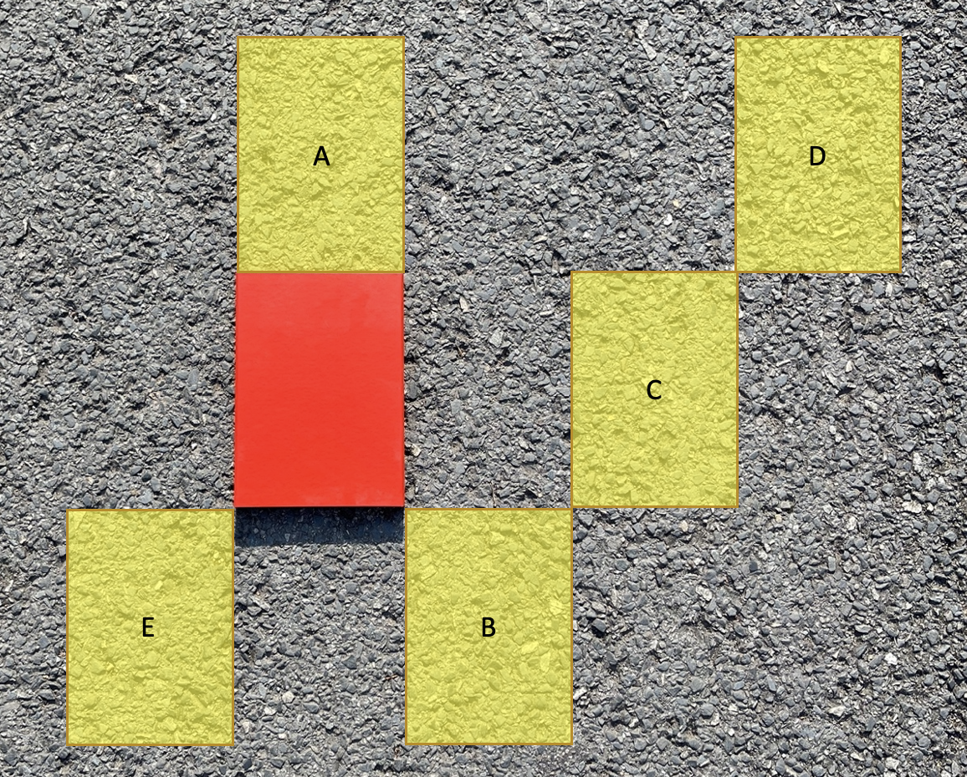
Checkpoint 7: Sliding box
The red box is 15 cm by 20 cm.
Richard slides the box over the floor.
How would Richard slide the box so that it fits into rectangle A?
How would he slide the box from its original position to fit into rectangle B?
How would he slide it from its original position to fit into C then on to D and from there to E?
Which is the greater distance – moving the box to A and back, then to B and back, then C and back, and so on to E; or moving from A to B to C and so on to E?
Notes:
This slide is animated. Each question will appear separately so you can choose the pace at which to work with your class.
Answers
a) Up 20 cm.
b) Right 15 cm and down 20 cm.
c) Right 30 cm, then right 15 cm and up 20 cm to D; finally, left 60 cm and down 40 cm to E.
? It is further to move the box back to the original position each time.
Suggested questioning
How might you record in a shorthand way the movement around the floor?
If moving the red box to B is described as -20 and +15, how would you describe the movement from the original position to A? From the original position to E?
Is moving from the original position to E ‘the same’ as moving the box from C to B? from D to C?
Things to think about
Checkpoint 7 is quite an open task, with the emphasis less on seeking a particular answer and more on exploring the language students use when faced with a translation. How do students describe the movement of the box? The question text on the slide deliberately makes no reference to distance, so that you can see what information students instinctively provide. Notice whether they are able to identify that the distance travelled is indicated by the size of the box and, if they do not, prompt for it. Maybe they can imagine a grid on the floor? If you or a student raise the idea of considering a corner of the box, then you might like to follow up with Checkpoint 9 which explicitly addresses this.

Slide 30
Checkpoint 7: Guidance
Adaptations | Assessing understanding
Support Using the dimensions of the box as a way to identify distance may not be immediately obvious to some students. Encourage them to describe the distance first in terms of 'boxes' and then convert this to cm. Challenge The move to 'negative' positions might offer a useful context to challenge students. For example, how does a student describe the difference between the move from A to B and A to E? You could suggest that A to B is a movement of 15 then –20 and ask students to describe other movements in the same way. Representations This uses a ‘real-life’ example of transformations. You might like to draw a dot on one corner of the box, and ask students to consider the way that the dot moves, to simplify the task to moving a point rather than a whole shape. | The focus of this task is on describing the result of sliding a box across the floor, using its original position as a reference point. The Year 5 Programme of Study says that pupils should identify, describe and represent the position of a shape following a... translation, using the appropriate language, and this Checkpoint gives teachers the chance to hear the language used, and the precision of the descriptions. Consider the importance (or not) of the 'journey' that the box has taken as it moves from one position to the next. Discuss the importance of giving both a direction and a magnitude. Students will not have used column vectors at primary, but you could build towards the awareness needed to understand them. A suitable question might be, ‘Can every position that the box might be slid to be described as a combination of across and up?’ For example, if students describe a diagonal movement can they be prompted to frame it in terms of a horizontal and vertical component?
Additional resources There are examples of the kind of translation questions students might be expected to do in the Key Stage 2 Mathematics papers, particularly 2018 paper 2 (reasoning) question 12 and 2017 paper 3 (reasoning) question 7. Past papers can readily be found online.

Slide 31
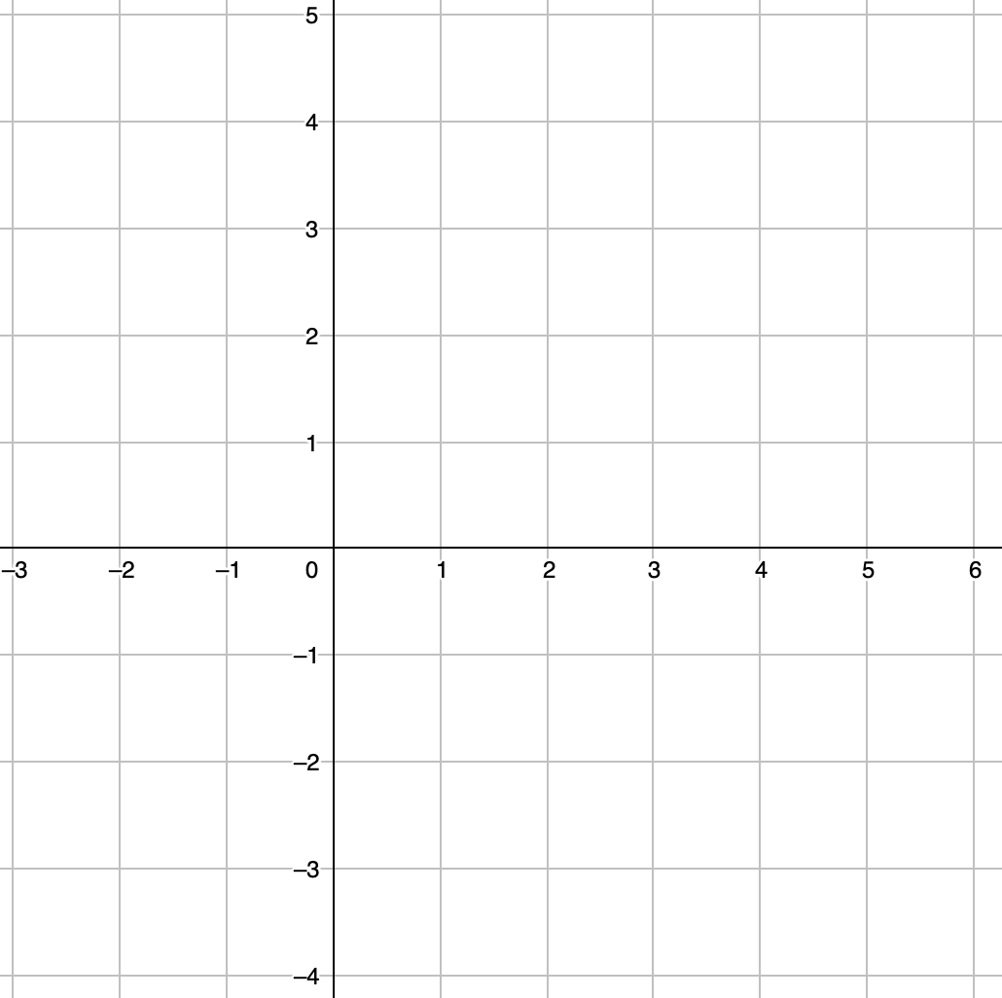

Checkpoint 8: Two ants move
y
Ant
Two ants are on a coordinate grid. They can move only horizontally or vertically, along the grid lines.
Starting from the positions that they are in now, how could they each move so that:
They swap places?
They both end up at (0, 0)?
They end up meeting halfway between their starting points?
They end up closer to Ant’s starting point than Dec’s?
x
Dec
Both ants move five units horizontally and two units vertically. What is the closest they could now be? What is the furthest apart they could now be?
Notes:
This slide is animated. Each question will appear separately so you can choose the pace at which to work with your class. Printable copies of the coordinate grid in this task are available on slide 93.
Answers
For all of the below answers, the most direct route is given. Students might give more complex routes, which will be correct so long as they result in the same overall movement. It is worth drawing attention to the equivalence of these responses, if more complex routes are chosen.
a) Ant: right 6, down 6; Dec: left 6, up 6
b) Ant: right 1, down 4; Dec: left 5, up 2
c) Ant: right 3, down 3; Dec: left 3, up 3
d) Any combination of moves where Ant moves <3 in one or both directions and Dec moves >3 in one or both directions.
? The furthest apart they could be is if Ant travels 5 units left and 2 units up, and Dec travels 5 units right and down, resulting in Ant at (-6, 6) and Dec at (10, -4). The closest they could be is if Ant travels 5 units right and 2 units down, and Dec travels 5 units left and 2 units up, resulting in Ant at (4, 2) and Dec at (0, 0). Students may recognise that, if Ant and Dec both travel their 5 and 2 units in the same direction, then the result is that they will be the same distance apart as they started.
Suggested questioning
Is there more than one route to each of the points where the ants might stop?
How can you describe the ants’ movements? Is there more than one way to do this?
Why is it not helpful to just say ‘across’ to describe movement?
Things to think about
Checkpoint 8 is a follow-up to Checkpoint 1 from the ‘Plotting coordinates’ deck. The constraints given here will require students to describe movement, but will also require some reasoning to deduce where the destination is each time. Students may note the symmetry in their answers to parts a and c. Can they think of any other movements that will be ‘mirrors’ of each other?

Slide 32
Checkpoint 8: Guidance
Adaptations | Assessing understanding
Support If dealing with negative coordinates is causing challenge, move Ant and Dec into the same quadrant. Alternatively, start with one ant and begin by practising movement to specified coordinates before introducing this task. Challenge Build upon the further thinking question by asking students to generate movements for Ant and Dec that would result in specific end points, such as, ‘End up three times as far apart’; or ‘End up the same distance apart’. Representations The image of the ant offers a context to help students visualise movement across the coordinate grid. Students may recognise the context from work on previous Checkpoints: using simple constraints gives students an opportunity to describe movement in the way most comfortable to them. | Checkpoint 8 uses the same starting point as Checkpoint 1 from the ‘Plotting coordinates’ deck, explores movement rather than position on the plane. The task is a prompt for discussion; rather than specifying any particular language, listen for the vocabulary students instinctively use. Do they specify left/right? Do they use words such as horizontal/vertical? Do they link to compass directions? Do they always give the most efficient/direct route? Students will have explored translation across four quadrants, and should be familiar with the term ‘translate’, but they will not have used column vector notation. Pay particular attention to the strategies students use: those more confident may rely less on counting squares and more on addition/subtraction along the axes. The task is structured so that students may notice connections between the parts of each question. For example, they move half as far for part c as they do in part a, and the answer to part d is linked to that of part c.
Additional resources The middle row of questions on p36 of the Year 6 Primary Assessment Materials | NCETM explores reflection and translation on a coordinate grid.

Slide 33
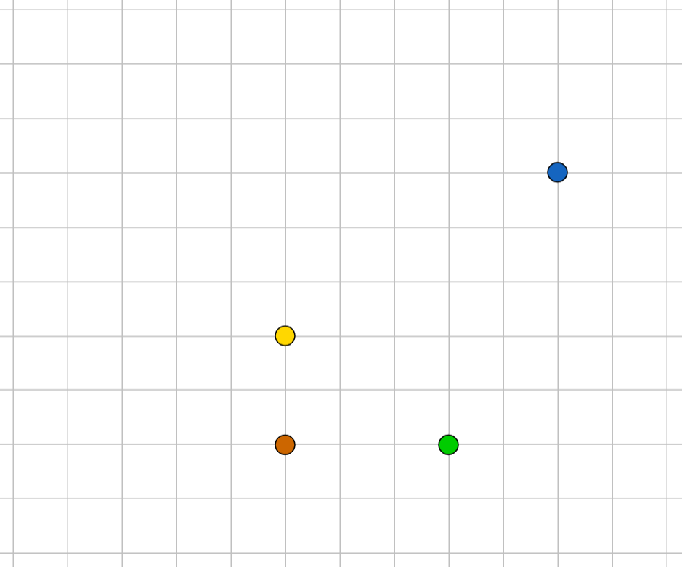
Checkpoint 9: Counter rectangle
Some counters were arranged to make a rectangle.
The blue counter (A) has been moved and stuck down.
Describe how each of the other counters needs to move so that the same rectangle is created again.
What do you notice?
A
D
C
B
Without moving the blue (A) or green (B) counter from where they are in this image, how would you move the red (C) and yellow (D) counters to make a square?
Notes:
This slide is animated. Each question will appear separately so you can choose the pace at which to work with your class.
Answers
To recreate the rectangle so that each counter is in the same position, relative to the others, then they all move right 2 and up 3.
You might also consider situations in which the same 3 by 2 rectangle is created, but with the counters in a different arrangement. For example, green (B) moving left 1 and up 5; yellow (D) moving right 5 and up 1; and red (C) moving right 2 and up 3.
? The red (C) counter moves left 2 and up 2; the yellow (D) counter moves up 5
OR
The red (C) counter moves up 7 and the yellow (D) counter moves left 2
Suggested questioning
Is the shape the same if the counters are arranged differently?
If all of the counters make the same movement, will the same rectangle always be recreated?
How might you write down the movement of the counters efficiently? Can you create a notation?
Things to think about
This Checkpoint builds on the movement of single points in Checkpoint 8, to consider the movement of a whole shape. How do students describe the movement of the counters, and do they see them as a single ‘object’ or as a collection? Do students who answer ‘move them across 2 and up 3’ have a different understanding to those who say, ‘move the green (B) across 2 and up 3, then move the red (C)… ’?

Slide 34
Checkpoint 9: Guidance
Adaptations | Assessing understanding
Support Give students a grid and counters so that they can replicate the situation physically. Challenge Ask students how they would complete the further thinking question with different quadrilaterals. What is the same and what is different if we ask for a rhombus, kite or trapezium? When are there multiple answers and when is there only one? Representations We have chosen to use a grid without coordinates here, to focus the assessment point on the movement rather than the description of position. Axes could be drawn in to add this element if you prefer. | The intention in Checkpoint 9 is to assess whether students can identify that all vertices must move by the same distance in the same direction in order to maintain congruence. Can they identify where the blue dot was originally? Can they describe how the blue dot has moved? From there, can they identify how the other dots must move? An interesting point is whether students move each dot individually, and then notice that the movement is the same, or whether they say that all three dots will move ‘2 right and 3 up’ from the outset. The ‘further thinking’ question asks students to consider a square that does not have horizontal or vertical lines, which offers a good opportunity to check how flexibly students think about shapes and their properties.
Additional resources Another example of a question exploring quadrilaterals and translation can be found in the Key Stage 2 SATs papers: 2019 Paper 3 (reasoning) question 10. Past papers can readily be found online. Checkpoint 8 uses a grid with coordinates if you wish to explore how confident students are with describing position and movement on a coordinate grid.

Slide 35
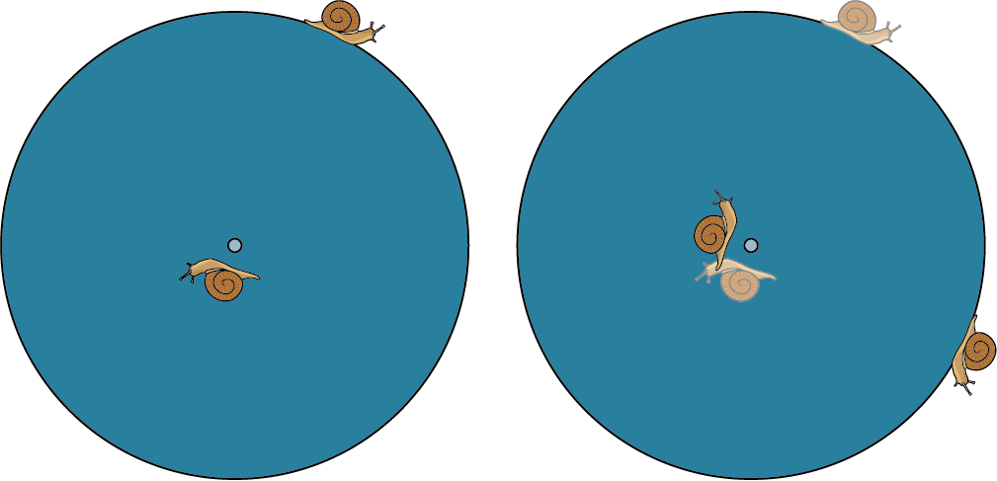
Checkpoint 10: Spinning snails
A
B
Picture A shows two snails sitting on a wheel.
The wheel is rotated a quarter turn.
Picture B shows the new position of the snails (with the faded images showing their original positions).
Which of the following are true?
Both snails moved clockwise.
Both snails moved downwards.
Both snails moved the same distance.
Both snails moved 90°.
Another snail climbs onto the wheel. Three of the above statements are true for this new snail and the snail originally on the outside of the wheel. Where might the new snail be?
Notes:
This slide is animated. Each image and question will appear separately so you can choose the pace at which to work with your class.
Answers
a) True
b) False
c) False
d) True
? Statements a and d are true wherever the snail goes on the wheel. For the snail to move downwards it must be in the upper right quadrant of the wheel. For it to move the same distance it must the on the edge of the wheel, so for three statements to be true it must either be in the upper right quadrant or on the edge of the wheel.
Suggested questioning
Which of the statements are you most certain of? How do you know?
Which of the statements are you least certain of? What might convince you?
Things to think about
This Checkpoint focuses on angles as a measure of turn but might also raise some awareness of the differences between linear and circular movement, and their measures. It may be challenging for students to see that one snail can move up, while the other moves down even thought they are going in the same direction (clockwise)! Explicitly focusing on these differences might provide a useful contrast for students to understand both descriptions of movement more thoroughly (considering what it is, and what it’s not in each case). Note that the same word ‘moved’ has been used deliberately throughout, but you might want to talk to students about where a different word feels more appropriate (such as ‘turned’ for part a or ‘turned through’ for part d).

Slide 36
Checkpoint 10: Guidance
Adaptations | Assessing understanding
Support Some of the statements a to d should be accessible for most students. Ask students to identify each as true or false fairly quickly, asking them what their instinctive answer is, before going on to explore. In most cases, these instinctive answers are likely to be correct; it is part c that may cause a challenge. Using a tape measure or similar might be helpful in showing an answer to be correct, but ensure that sufficient time is given for students to reason before measuring Challenge Ask students to write another statement that is true for both snails, or only true for one. You could also ask them to visualise whether all of their answers are the same, no matter what size the wheel is, or to consider their answers as one snail gets closer to the axis of the wheel. Representations The ‘real-life’ example is intended to give a context for students to visualise rotation; ‘before’ and ‘after’ images are used here. You may find it helpful to print out the first image and model the rotation to support your explanation. | ‘Spinning snails’ gives an opportunity to assess students' understanding of angle as a measure of turn, and the difference between measuring angles and lengths. Statements a to d will give students an opportunity to show what they know, and what they can reason. Do they, for example, know which direction is ‘clockwise’? Do they understand that you can turn through the same angle, but different distances? Key to this task is unpacking the distinction between rotational and linear movement, and the different vocabulary that’s used. This task gives a context for students to informally discuss rotation in preparation for thinking about rotational symmetry.
Additional resources Key idea 6.3.2.2 from Secondary Mastery Professional Development | NCETM explores ‘describing a rotation’ and might give some ideas for where to take this next in Key Stage 3.

Slide 37
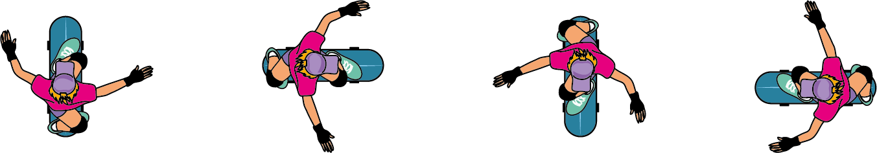
Checkpoint 11: McTwist
A McTwist is a skateboarding move that involves one and a half full turns.
Here are four positions that a skateboarder could be in during a spin.
1
2
3
4
Which two could be a skateboarder before and after a McTwist? How do you know?
What angle has the skateboarder turned through to complete a McTwist?
What other angles could the skateboarder have turned through to end up in the same position?
Skateboarders can also flip upside down. Jenny claims to have completed a 900° flip. Why must she be wrong?
Notes:
This slide is animated. The four images, and then each question, will appear separately so you can choose the pace at which to work with your class.
Answers
a) The first and third, or second and fourth, images (in either order) would be the skateboarder before and after a McTwist. This is because they have completed one-and-a-half full turns, so are in the opposite position to where they started.
b) 540°
c) 180°, or any other angle that is 180° more than a full turn (e.g. 900°)
? Jenny must be wrong as a 900° flip is two-and-a-half full turns, so she would have either have had to have started or landed on her head!
Suggested questioning
Pick two images: what is the same and what is different about these images?
What angle has the skateboarder turned through between each consecutive image?
If picture __ is the skateboarder’s starting point, which picture would be the finishing point?
How would your answers change if the move was a 180° turn? How about a 360° turn?
Things to think about
Much like the snails in Checkpoint 10, the series of static images in Checkpoint 11 support students to conceptualise angles as a measure of turn. The turns in this Checkpoint might be described both in terms of fractions of a whole turn, or degrees. If students are less confident with degrees as a measure of turn, you may wish to follow up with Checkpoints 13 or 14, which more explicitly explore understanding of the protractor.

Slide 38
Checkpoint 11: Guidance
Adaptations | Assessing understanding
Support To build students up to rotation beyond a full turn, this task could initially be completed using 90°, 180°, 270° and 360° angles as a prompt. Challenge Ask students to consider ‘impossible’ spins – give them a large angle (for example, 1 260°) and ask if the skateboarder would be continuing in the same direction as they started by the end of the turn. Representations The static images here capture the sense of an angle as a measure of turn, and link angles to rotation. To help students understand the context, model turning through one-and-a-half turns using either yourself or another student, drawing attention to where in the turn the position matches one of the skateboarder’s images. | Checkpoint 11 uses a context that students are likely to have some awareness of. The task assesses students’ spatial reasoning and whether they are able to visualise the effect of a turn. If students struggle with this, try drawing attention to just one feature of the picture, such as the skateboarder’s baseball cap, and talking about how this has changed. The language of rotation is not specifically used in this task: as with Checkpoint 10, the intention is to check students’ understanding of the effect of the transformation, rather than the language associated with it, although you may wish to introduce the term ‘rotates’ as a synonym for spins or turns. Students might not initially identify that there are two possible answers to part a: any pair of images where the skateboarder is facing in opposite directions could be the ‘before’ and ‘after’ positions for a McTwist. Parts b and c reveal if students connect their work on measuring angles in degrees to their sense of full and part turns.
Additional resources A similar context, that of a rotating diver, can be found in Key Stage 2 SATs papers: 2017 Paper 2 (reasoning) question 12. Past papers can readily be found online.

Slide 39
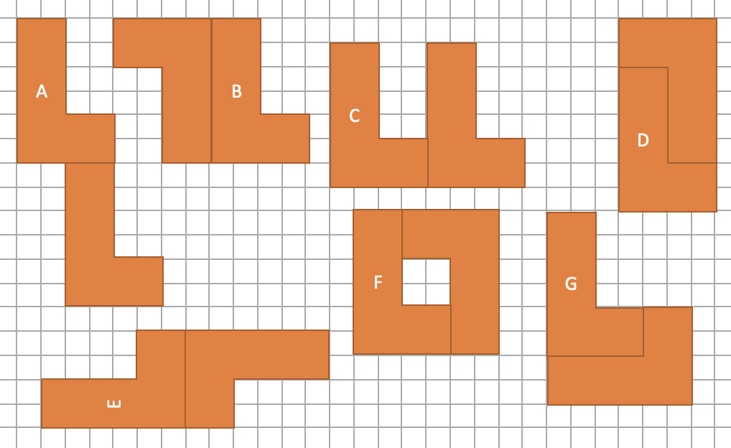
Checkpoint 12: L-turn John
John has two L-shaped tiles.
He turns them and sticks them together to make different shapes.
Do any of John’s shapes have symmetry?
All these shapes are formed by turning or sliding the tiles. Is John able to make more symmetrical shapes if he can flip the tiles over, too?
Notes:
This slide is animated. The instructions, question and then the further thinking question will appear separately so you can choose the pace at which to work with your class. A printable resource for this task can be found on slide 94.
Answers
Line symmetry: D and F
Rotational symmetry: B, D, E and F
? Yes, allowing flipping of the tiles means that more shapes with line symmetry can be created.
Suggested questioning
What do you look for when thinking about symmetry?
Which shapes are you certain of? Which do you think might have symmetry, but you’re not sure?
Do any shapes have more than one line of symmetry?
Why might someone say that shape B has symmetry? Or shape C?
Things to think about
Visualising the symmetries of the shapes is key to this task. Consider carefully when to allow other scaffolding such as mirrors or paper copies of the L shapes. What are the benefits of students predicting and visualising before using representations to complete the task and confirm their predictions?

Slide 40
Checkpoint 12: Guidance
Adaptations | Assessing understanding
Support There is a printable version of the shapes on slide 94. Rather than leading with this, use it as scaffolding if students find visualising from the projected image challenging. The printed grid allows students to sketch lines and to fold or use mirrors. It also enables them to rotate and identify those shapes that look the same ‘upside down’. Challenge Following on from the ‘further thinking’ task, you might ask students to explain why flipping the tiles allows a greater number of symmetrical shapes to be created. Introduce another L-shaped tile and discuss whether this will allow further symmetrical shapes to be created. Representations A printed resource is available, but students might also find it beneficial to cut out two L-shape tiles to allow them to physically rotate and flip the shapes. | This Checkpoint gives an opportunity to observe how students talk about symmetry and reflection. Although rotational symmetry no longer features in the primary Programme of Study, students may have an informal or intuitive understanding that, for example, shape B or shape E have some symmetry. They may, however, not have the language to explain this efficiently. The main assessment focus is to consider what students understand about line symmetry, and the ways in which they describe it. Students might talk about mirror lines, or about folding, when discussing the lines of symmetry in the various shapes. Look for students who are able to reason that shape F has diagonal lines of symmetry, while D does not. Students are likely to have met reflection as a transformation (explored explicitly in Checkpoint 16), but may not have connected it with line symmetry in a shape.
Additional resources Key idea 6.3.3.1 from Secondary Mastery Professional Development | NCETM explores ‘describing a reflection’ and gives ideas for where to take this next in Key Stage 3.

Slide 41
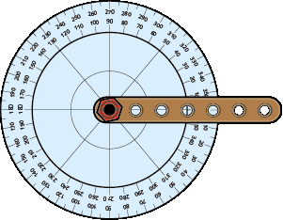
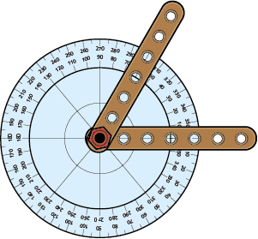
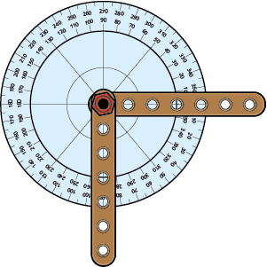
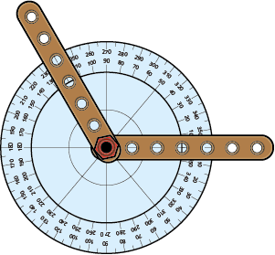
Checkpoint 13: Hinges
Billy is using the protractor on his tool bench to make a hinge.
When the hinge is closed it looks like the picture on the right.
He can open the hinge by turning one part anticlockwise.
Below are three different positions for the hinge.
A
B
C
Billy says he has put the pictures in order from the smallest to the biggest angle. Do you agree? Why or why not?
How could Billy have turned the hinge to move from A to B? How about B to C? What do you notice about your answers?
Notes:
This slide is animated. Each instruction, image and question will appear separately so you can choose the pace at which to work with your class. This printable version of the images on slide 95 might be useful if the scale is too small to read on screen.
Answers
It depends on how Billy measures the angles.
If Billy is just measuring the smallest angle between the two parts of the hinge each time, and not considering direction, then he is correct (60° anticlockwise, 90° clockwise, 135° anticlockwise).
If Billy is using the protractor and measuring consistently in the same direction, then he is incorrect (60° anticlockwise, 270° anticlockwise, 135° anticlockwise). He would need to move the image B to the end.
? A to B: turned one part of the hinge 210° anticlockwise or 150° clockwise.
B to C: turned one arm of the hinge 225° anticlockwise or 135° clockwise.
Each pair of options adds up to 360°.
Suggested questioning
What angles can you see?
How else could you describe these angles? What other language do you know?
Does the direction of the turn matter?
Are there always two ways to describe a turn? How are these two ways related to each other?
Things to think about
Discussing the ordering of angles provides an opportunity to assess whether students are comfortable with angles of any size. Students will have compared and ordered angles in relation to right angles from year 3, using words such as ‘acute’ and ‘obtuse from year 4, and degrees from year 5. This task offers the opportunity for all of these different forms of comparison. Students are potentially likely to have had less experience working with reflex angles. Is this the case for your students?

Slide 42
Checkpoint 13: Guidance
Adaptations | Assessing understanding
Support Give students ‘hinges’ to manipulate alongside protractors. These can be easily made from strips of card joined with a split pin. If you do not have full protractors, print out an image of a 360° protractor to support students to see the reflex angles. Challenge Link to work on time and ask students to imagine the protractor on the toolbench superimposed onto a clock. What is the angle between the hands at various times? Representations A tool bench has been chosen as an example of a real-life context for a protractor. | Checkpoint 13 explores the concept of angles as a measure of turn. The images that students see of angles are often static, and this can make it hard to connect to their sense of turn in a rotation. Explore the language that students use relating to angles, such as acute, obtuse and reflex. Do they automatically use the markings on the protractor and connect these terms to measurement in degrees? The question is worded such that students could argue for Billy to be correct or incorrect, depending on the direction that he is measuring in. If direction is not taken into account, then his order is correct. If it is, then it is incorrect. In particular, spend time on the middle image B, and discuss the different angles that are turned to create the right angle in the image. Those who are most confident might recognise that the two possible turns (270° anticlockwise or 90° clockwise) sum to 360° and talk about the properties of a whole turn.
Additional resources Additional activity G offers another real-life context for seeing angles as turns, using hinges. This might be particularly useful if students struggled to describe reflex angles. The NCETM has produced some resources for year 5, which give an idea of how angles might have been explored at primary: Angles | NCETM

Slide 43
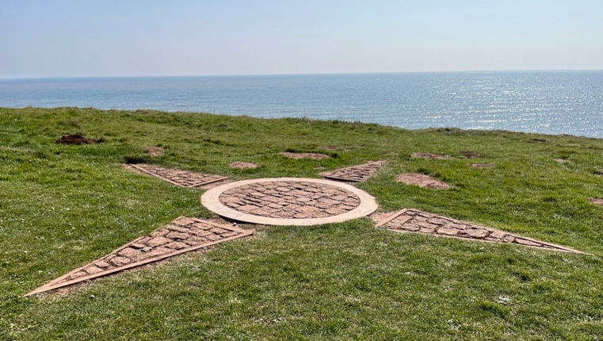
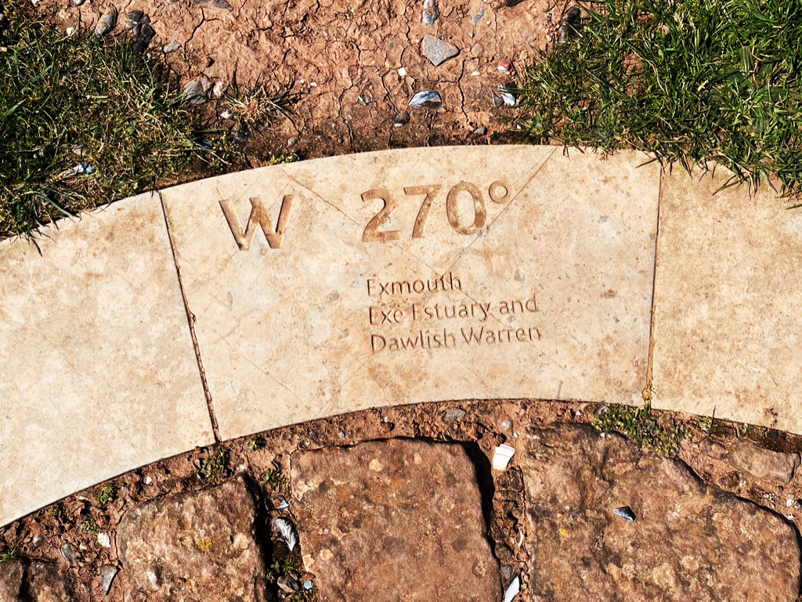
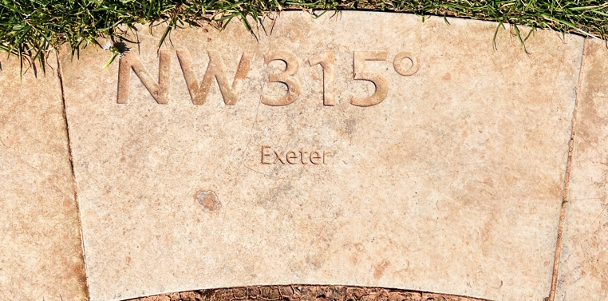
Checkpoint 14: Orcombe Point
At Orcombe Point in Devon there’s a compass on the ground.
Richard stands in the centre of the compass. The tile on the right is directly in front of him.
If he then turns around and faces the opposite direction, what angle is written on the tile in front of him now?
Sarah stands in the centre of the compass with the tile on the right directly in front of her. She turns 90°. What angle might be on the tile in front of her?
Notes:
This slide is animated. Each section will appear separately so you can choose the pace at which to work with your class.
Answers
The tile behind Richard says E 90˚
? The tile in front might say NE 45˚ or SW 225˚.
Suggested questioning
If North is marked by the triangle pointing to the bottom left of the image; which triangle is East/South/West?
Does it matter whether Richard is standing in the centre of the compass or not? How about Sarah?
If Sarah looked over her left shoulder, which of the two options would she be looking at?
How far would Richard have to turn to be looking in the same direction as Sarah?
Things to think about
As with other Checkpoints in this set, visualising is key to this task. Judge when to allow other scaffolding such as sketching out the compass or offering an angle measurer for students to ‘count on’. What are the benefits of students predicting and visualising before using representations to complete the task and confirm their predictions?

Slide 44
Checkpoint 14: Guidance
Adaptations | Assessing understanding
Support Invite students to sketch out (or sketch yourself) the four points of the compass as shown on the slide. (The arrow pointing to the bottom left of the image points North). Use this to build up an image of the compass and then label the angles involved to support students in accessing the task. Challenge The position halfway between NW and N is described as NNW. Ask students to visualise and calculate what the angle needed for this position is, and what the position directly opposite might be called and labelled. Representations A compass and angle measurer may be useful. You might also find that encouraging students to turn (and so develop their understanding of angle as a measure of turn) supports them in accessing the task. | This Checkpoint allows the teacher to see and hear how students visualise and describe position; whether they are familiar with the points of a compass; and whether they can connect this with the understanding that a turn of 360˚ describes a full circle. Familiarity with the eight points of the compass is part of the Key Stage 2 geography curriculum; an awareness that angles are measured in degrees is in the Year 5 mathematics curriculum. Students who are familiar with the points of the compass are likely to identify that East is directly opposite West. Explore how they identify the angle – are they able to say that it’s 90˚ because it’s a quarter turn from 0˚, or have they calculated by subtracting (or adding) 180˚ from or to 270˚? Look for students who are able to visualise and calculate a 90˚ turn from 315˚, and to calculate over the 360˚ barrier. These students may be ready for more challenge than those who struggle with this part of the task.
Additional resources Page 26 of the year 6 Primary Assessment Materials | NCETM has more activities exploring angles and the compass.

Slide 45









Checkpoint 15: Flag sort
No lines of symmetry | Exactly one line of symmetry | More than one line of symmetry
Genna sorts some flags into the table according to their lines of symmetry.
Is she correct?
If she is not correct, which flags would you move and why?
Dominican Republic
Iceland
Venezuela
Belgium
Puerto Rico
Switzerland
Taiwan
Nigeria
Vietnam
How could you change the designs of the flags so that they are in the right place in the columns Genna originally chose?
Notes:
This slide is animated. Each flag will appear separately so you can choose the pace at which to work with your class. A printable table and flag images can be found on slide 96.
Answers
a) She is correct for Taiwan, Venezuela and Switzerland.
b) Iceland, Belgium and Vietnam should move to ‘exactly one line of symmetry’; Nigeria should move to ‘more than one line of symmetry; Dominican Republic and Puerto Rica should move to ‘no lines of symmetry’. See next slide for correct table.
? There are multiple possible answers, but these give some suggestions:
Iceland: there would no longer be a horizontal line of symmetry if you moved the horizontal line so that it is off-centre.
Belgium: there would no longer be a horizontal line of symmetry if the stripes were diagonal, or if the shape of the flag was a trapezium rather than a rectangle.
Puerto Rico: you would create a horizontal line of symmetry if the five-pointed star was a symmetrical six-pointed star.
Nigeria: there would no longer be a vertical line of symmetry if one of the green sections was a different colour.
Dominican Republic: you would create two lines of symmetry if the red sections were swapped for blue (or vice versa), and the image in the centre of the flag was removed.
Vietnam: you would create two lines of symmetry if the five-pointed star was a symmetrical six-pointed star, or if the shape of the flag was a regular pentagon with the points of the star either pointing to a vertex or the centre of a side.
Suggested questioning
For the flags in the incorrect columns, why might Genna have put them there?
How many lines of symmetry does a rectangle have? How is this different to a square?
If you looked at just the blue rectangle in the Taiwan flag, how many lines of symmetry would it have? How about just the sun?
Things to think about
Checkpoint 15 explores symmetry through classifying and comparing flags, which may be a context students have seen before. The incorrect placement of some flags has been designed to promote discussion and expose some common misconceptions; more detail about the specific misconceptions that might be elicited can be found in the ‘Guidance’ slide. What other misconceptions might students have, and what other flags might help you to probe them?

Slide 46
Checkpoint 15: Flag sort (solutions)
No lines of symmetry | Exactly one line of symmetry | More than one line of symmetry
Puerto Rico
Venezuela
Nigeria
Dominican Republic
Vietnam
Switzerland
Taiwan
Iceland
Belgium

Slide 47
Checkpoint 15: Guidance
Adaptations | Assessing understanding
Support Give students physical flags to fold and manipulate. A printable resource of both the table and the flags can be found on slide 96. Challenge Students could be asked to design their own flags for each column with specific constraints, such as to include a triangle shape or to use three different colours. Representations Flags are used here as a familiar image that can be used to explore symmetry. Students may have experienced similar tasks at primary school. | This ‘flag sort’ is designed to elicit misconceptions around reflection and line symmetry. Rather than asking students to place the flags in the table, they need to decide if their positions are correct and explain why. For example, the Nigerian flag is incorrectly in the central column but students might not notice the horizontal line of symmetry as readily as the vertical line of symmetry. A key misconception is likely around the shape of the rectangle. Some students, for example, might recognise that the five-pointed star in the Vietnamese flag has five lines of symmetry, and not realise that only one of these coincides with the two lines of symmetry in the overall rectangle. The square Swiss flag has been included to contrast between the four lines of symmetry in a square and the two in a rectangle: draw attention to this if students don’t make the comparison independently. Some flags that are nearly symmetrical, but for certain features, have been included – such as Puerto Rico and Iceland. Taiwan has features that are symmetrical, although overall it is not. Ask students what would need to be changed or removed in order for them to be symmetrical. The Dominican Republic flag, without the image in the centre, has rotational symmetry. Rotational symmetry is no longer mentioned in the primary curriculum, but students might recognise that the colours of the flag would be correct if it were rotated 180°.
Additional resources There are a number of other symmetry tasks involving flags, which you can be easily found using a search engine. The NCETM has produced some resources for Year 4, which give an idea of how symmetry may have been explored in primary: Symmetry in 2D shapes | NCETM.

Slide 48
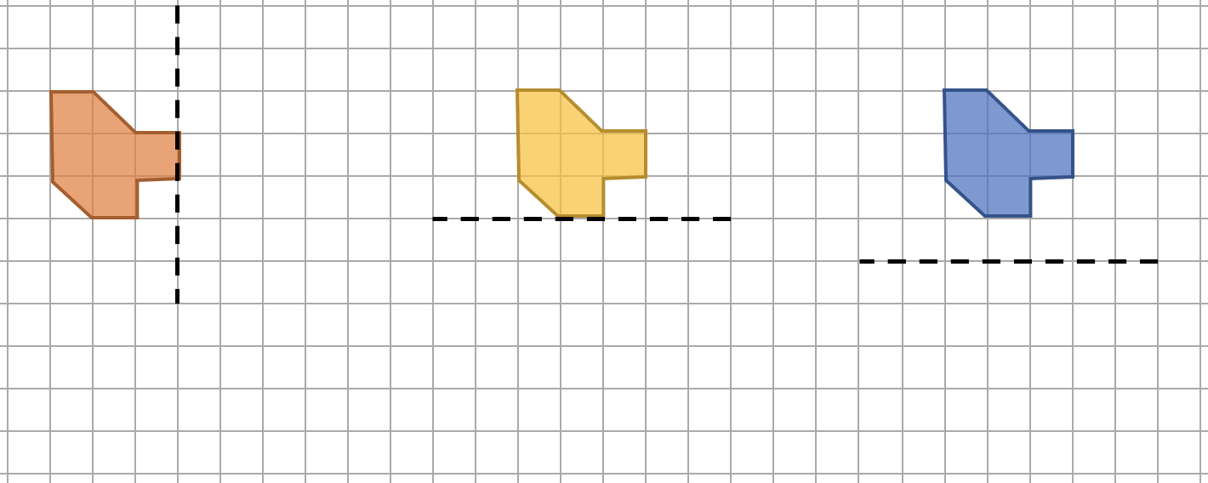
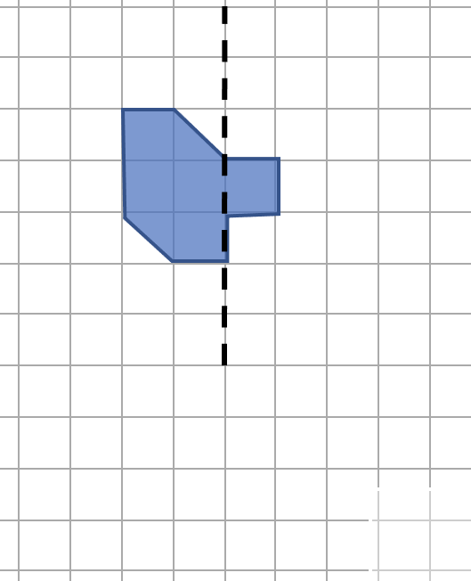
Checkpoint 16: Where’s the line?
Complete each diagram so that the dotted line is a line of symmetry.
a)
b)
c)
d)
Draw each shape and reflect it in a different mirror line to those given. Can you create a reflection that no one else has thought of?
Notes:
This slide is animated. Each question will appear separately so you can choose the pace at which to work with your class. A printable resource can be found on slide 97.
Answers
See the following slide for the solutions. There is a chance that some students may also add additional shading to both sides of the mirror line. If the resultant image is symmetrical, you may choose to allow this, or to specify that one side of the mirror line must remain as shown on the slide.
? Students’ responses will depend upon the mirror lines they choose; if students are confident using them, you may wish to provide a mirror or tracing paper so they can check if their reflections are correct.
Suggested questioning
What is the same and what is different between parts a and b?
What is the same and what is different between parts b and c?
Can you create your own reflection with a different mirror line?
Can you create a reflection that nobody else has thought of?
Which did you find the easiest?
Things to think about
Checkpoint 16 uses the same shape throughout, varying the mirror line. This offers an opportunity for students to think about and discuss what is the same and different about their reflected images each time. What might you wish to draw attention to by comparing, for example, part a with part b? What different learning points might be elicited by comparing part b with part c?

Slide 49
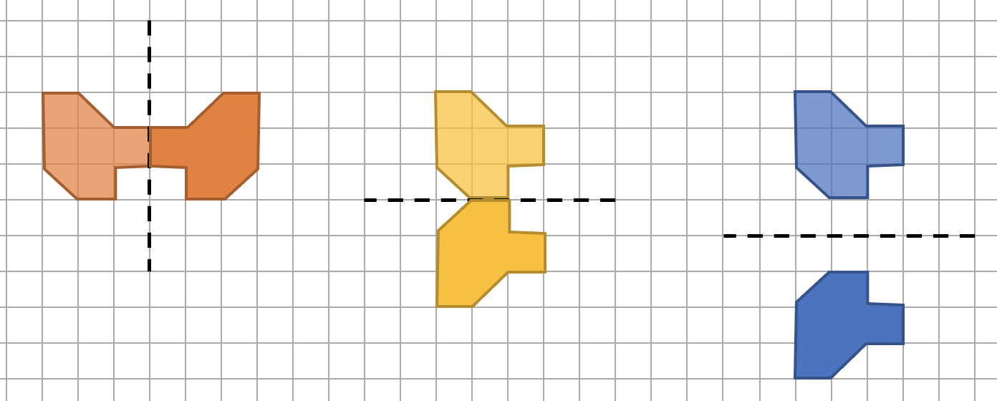
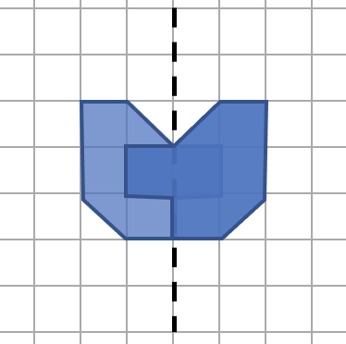
Checkpoint 16: Where’s the line? (solutions)
a)
b)
c)
d)
Notes:
Solutions for Checkpoint 16

Slide 50
Checkpoint 16: Guidance
Adaptations | Assessing understanding
Support Fold a sheet of paper or use a mirror to support students in completing the task. Ask students to visualise in the first instance, then use the support to check their visualisation. You might also ask students to focus on individual points, rather than the whole shape. Challenge Consider a and d: the original shape has moved one square right relative to the mirror line. Ask students to imagine and draw the image as the original shape moves another square right, and another… Representations Exploring reflection using dynamic geometry such as Autograph or GeoGebra allows students the opportunity to visualise and make predictions and then test them using the software. Moving an object through the mirror line (as in the further thinking question) can be particularly enlightening. | The Year 5 programme of study states that Pupils should be taught to identify, describe and represent the position of a shape following a reflection or translation, using the appropriate language, and know that the shape has not changed. Checkpoint 16 gives students an opportunity to show their understanding of this. To align with experience from primary school, all mirror lines are either horizontal or vertical. Initially. In parts a and b, the line can be considered a line of symmetry of one shape. In part c, the line separates from the shape and so students need to shift their awareness to reflection as a transformation. The same is true in part d, where completing the shape ‘symmetrically’ would not necessarily include the vertices that are inside the final shape.
Additional resources There are further examples of questions where students are expected to complete a symmetrical figure or reflection within the Key Stage 2 SATs papers, particularly 2019 Paper 2 (reasoning) question 4, and 2018 Paper 2 (reasoning) question 1. Past papers can readily be found online.

Slide 51
Checkpoint 17: Octagon
Which of these lines is a line of symmetry for this regular octagon?
A
This octagon has eight lines of symmetry. Is it always true that a regular polygon has the same number of lines of symmetry as it has sides?
B
C
D
E
Notes:
This slide is animated. Each line, and then the further thinking question, will appear separately so you can choose the pace at which to work with your class. Printable octagons (without the printed lines) are available on slide 98, and may be helpful for either this Checkpoint or Additional Activity H.
Answers
Lines A, B and E are lines of symmetry
? Yes, but looks slightly different depending on whether the polygon has an odd or even number of edges.
For an odd number it will have a line of symmetry through a vertex and the midpoint of the opposite edge.
For an even number of edges, the lines of symmetry go through the midpoints of opposite edges and through opposite vertices.
Suggested questioning
What do you look for when thinking about symmetry?
Does a line of symmetry always go through the ‘middle’ of a shape?
Does a line of symmetry always cut a shape ‘in half’?
What is a polygon? Can you name some other polygons?
Things to think about
This is a seemingly simple task, but there are some subtle misconceptions to be unpicked. Do students confuse the symmetry of a circle (in which any line through the centre is a line of symmetry) with that of an octagon (where only lines through the centre and either two vertices or two midpoints will be mirror lines)? Are they comfortable with mirror lines that are not aligned to the page, i.e. horizontal or vertical? The further thinking question adds real depth to the thinking, asking students to generalize about all regular shapes.

Slide 52
Checkpoint 17: Guidance
Adaptations | Assessing understanding
Support Provide students with their own octagons to fold along the lines given; a printable resource for this is available on slide 98. Challenge The challenge question asks students to consider line symmetry in regular shapes; you could extend this to irregular shapes. Can they design an octagon with no lines of symmetry? With one line of symmetry? With two? What is the maximum number of lines of symmetry that octagon can have before it becomes regular? Representations A regular octagon is used as an example as a shape with lots of lines of symmetry. Consider how you will model the symmetry, or lack of it. A cutout of the shape could be folded, or a mirror used along the line of symmetry. | Checkpoint 17 has a relatively narrow and straightforward assessment point: understanding lines of symmetry as a precursor to later work on reflection. This relates back to learning in the earlier stages of Key Stage 2: students are likely to have covered this in year 3 or 4. Check retention of key terms such as ‘regular’ and the different names for polygons, particularly if students attempt the further thinking question. Students might suggest the D is a line of symmetry, as it goes through the centre of the shape. You could use this as a prompt to define what is, and what is not, a line of symmetry. Listen for their justifications as to why a line is or isn’t a line of symmetry. Do they talk about the shape being cut exactly in half? Do they use the term reflection? Do they talk about how far the vertices or sides are from the mirror line? This may help you to plan next steps for teaching both properties of shapes and transformations.
Additional resources Additional activity H uses an animated line as a dynamic alternative to the static lines in this Checkpoint.

Slide 53
Checkpoint 18: Counters
A blue counter is placed 10 cm away from a vertical red line. Three more counters are added to make the corners of a quadrilateral.
The vertical red line is a line of symmetry for this quadrilateral.
Can the four counters make:
A square?
A rectangle?
A 30 cm by 40 cm rectangle?
A parallelogram?
10 cm
If two other counters were used instead, could they make an isosceles triangle with the line of symmetry? Where would they go?
Notes:
This slide is animated. Each question will appear separately so you can choose the pace at which to work with your class. A printable resource can be found on slide 99.
Answers
a) Yes. The square(s) that most students identify will have side of 20 cm, as in the first two solutions on the next slide. Students might also create a square of side length approximately 14.14 cm, by placing a counter directly opposite the existing counter and the remaining two counters on the line of symmetry, as in the third solution on the next slide.
b) Yes. The rectangle will be 20 cm across and the height can vary.
c) No, it’s not possible to make a rectangle with those dimensions.
d) No, it’s not possible as a parallelogram has no line of symmetry.
? One counter would be 10 cm on the other side of the line (opposite the original counter) and the other would have to be on the line of symmetry. Alternatively, one counter would be 10 cm on the other side of the line, and the third counter would be 20 cm above or below either of the original two counters.
Suggested questioning
For a and b: is there more than one possible way to do this? How do you know?
For b: is it possible to have a ‘sloped’ rectangle (as with the square in part a)? Can you explain why?
For the further thinking question: is it possible to make a triangle that isn’t isosceles?
Things to think about
There are multiple solutions to this problem, which are arguably incidental to students’ understanding of the key concept that is being assessed. How important is it that students identify all the possible solutions? The assessment focus of the task is around students’ awareness that an object and its image are equidistant from the mirror line. To what extent might questioning on, for example, the multiple possible solutions to part a detract from that focus?

Slide 54
Checkpoint 18: Counters (solutions for part a)
For part b, the green counter must be in the same position as in the first two images. The grey counters could be moved vertically but not horizontally.
20 cm
10 cm
10 cm
10 cm
10 cm
10 cm
10 cm
10 cm
10 cm
20 cm
Notes:
Visual solutions for part a of Checkpoint 18.

Slide 55
Checkpoint 18: Guidance
Adaptations | Assessing understanding
Support Draw a square on the board with a horizontal or vertical mirror line. Give students the length of one side and ask them to work out the distance from the mirror line (or vice versa). You could also recreate the image on a grid, but only if students are struggling to reason with the lengths given, rather than providing it from the outset. Challenge Increase the range of quadrilaterals for students to consider. How about a trapezium? A kite? Is it possible to make different orientations of the same shape? Representations Give students counters to create the shapes, to help them have something concrete to refer to in their explanations. A printable resource is found on slide 99. | Checkpoint 18 looks at students’ understanding of the properties of a line of symmetry and of quadrilaterals. It supports future teaching of reflection, as it focuses on the property that an object and its image are equidistant from the mirror line: in this case, object is the given vertex of a quadrilateral. By being given a distance from the mirror line, rather than a grid to count on, students will need to reason about this length and the resulting lengths of the quadrilaterals. Do they realise that the 10 cm given is only half of the length of the horizontal side? A potential mistake might be to assume the vertical lengths of the square are also 10 cm. Part b and the further thinking question offer the opportunity to ask students how many solutions there are, and which points will be the same and different in each of the solutions. Parts c and d are impossible: listen particularly for students’ reasoning in part c, as this might reveal the depth of their understanding of reflection.
Additional resources Key idea 6.3.3.2 from Secondary Mastery Professional Development | NCETM offers some examples that might be used next to teach ‘describing a reflection’ at Key Stage 3.

Slide 56

Checkpoint 19: Tiles
The vertical red line is a line of symmetry.
Each tile has a length of 1 cm.
How far apart are the two purple tiles, marked B?
How far apart are the two orange tiles, marked E?
Which two tiles are 6 cm apart?
A
A
B
C
C
D
D
The whole pattern is reflected in the green horizontal line. There will now be four green tiles (marked A). Do they form the corners of a square?
How about the purple tiles (B)? The blue (D)? The orange (E)?
E
E
Notes:
This slide is animated. Each question will appear separately so you can choose the pace at which to work with your class. A printable resource can be found on slide 100.
Answers
a) 4 cm apart
b) 7 cm apart
c) The red tiles (marked C)
? Yes, the green tiles (A) form a square that is 4 cm × 4 cm. The purple tiles (B) form a square that is 6 cm × 6 cm. The blue tiles (D) do not form a square, but a rectangle that is 7 cm × 10 cm. The orange tiles (E) also do not form a square, but a rectangle that is 9 cm × 12 cm.
Suggested questioning
What do you know about where the red vertical line sits on the row of three yellow tiles?
What other distances do you know?
What would the reflection of the image in the green horizontal line look like?
Things to think about
As with Checkpoint 18, the assessment focus of the task is students’ awareness that an object and its image are equidistant from the mirror line. Visualising is key to this; consider the benefits and challenges of withholding support (such as the printed resources sheet, or physical or virtual tiles) to assess this.

Slide 57
Checkpoint 19: Guidance
Adaptations | Assessing understanding
Support If students find it hard to visualise the distance between the pairs of tiles, a grid might help. The printable resource on slide 100 features the image on a grid. Challenge Ask students to generate their own symmetrical patterns using constraints such as, ‘There must be exactly 11 yellow tiles,’ and, ‘The green tiles must be 9 cm apart’. Representations While a grid might help those who are struggling, the images are presented without a grid so that students have to reason about the distance from the mirror line rather than counting squares. | The key assessment point from Checkpoint 19 is that the distance from the mirror line is the same for an object and its image. If students find it hard to calculate the whole distance between two tiles, ask them to find the distance to the mirror line as a first step. Do they then realise they need to double that distance to find the total? Students are likely to find part a more straightforward as it is an even value that can be found by counting. The answer for part b is odd which students may not be expecting in a symmetrical image. The line of three squares is key to unlocking this task so, if students have not yet noticed them, draw attention to them and ask about the distance either side of the square that is bisected by the mirror line. Part c asks students to identify which two tiles are 6 cm apart. This is quite straightforward, but students may be distracted by the white half-square gap next to the red tile.
Additional resources Key idea 6.3.3.2 from Secondary Mastery Professional Development | NCETM offers some examples that might be used next to teach ‘describing a reflection’ at Key Stage 3.

Slide 58


Checkpoint 20: Jagged reflection
a)
b)
c)
d)
Which of these are reflections?
How could you correct the images that are not?
Draw your own reflections using the same starting shape. Can you draw a reflection nobody else has?
Notes:
This slide is animated. Each question will appear separately so you can choose the pace at which to work with your class. A printable resource can be found on slide 101.
Answers
a) Is the only correct reflection.
For an image of each of the solutions below, see the next slide.
b) Rotate either shape clockwise by approximately 60°.
c) Move the mirror line right by one column of dots, or the left shape left by two columns of dots, or the right shape left by two columns of dots.
d) Rotate the left shape anticlockwise by approximately 60°, or the right shape anticlockwise by approximately 60.
? Solutions to the further thinking question could vary infinitely; if students are confident using them, you may wish to provide a mirror or tracing paper so they can check if their reflections are correct.
Suggested questioning
What has gone wrong for the incorrect reflections?
Is there more than one way to correct them?
Has a different transformation taken place? If so, what transformation/s have happened?
Does the isometric (‘dotty’) paper change how you approach this?
Things to think about
This Checkpoint focuses on common mistakes and misconceptions when working with reflections. Consider what underpins these misconceptions and to what extent they indicate different understandings of reflections and symmetry. What would be the same and what would be different about the way that you would work with a student who said that b was correct, and one who said that c was correct? For the latter, a Checkpoint exploring the distance of the image from the mirror line (such as Checkpoint 19) might be a useful next step.

Slide 59
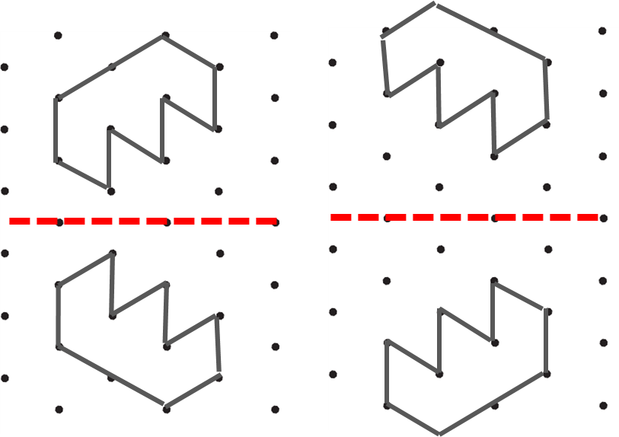
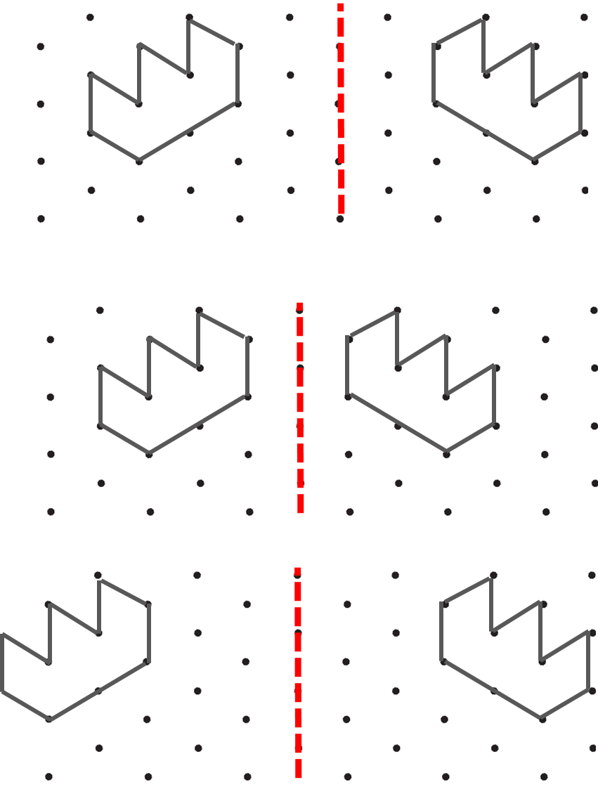
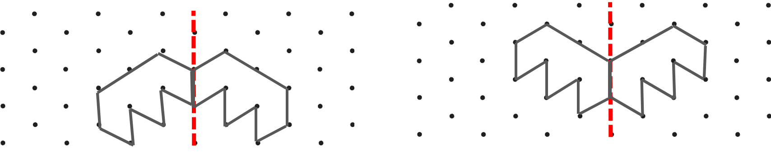
Checkpoint 20: Jagged reflection (solutions)
b) Two possible solutions:
c) Three possible solutions:
d) Two possible solutions:
Notes:
This slide shows possible corrections to the incorrect reflections in Checkpoint 20.

Slide 60
Checkpoint 20: Guidance
Adaptations | Assessing understanding
Support If students are finding it challenging to identify the incorrect reflections, give them a mirror or tracing paper to help them check. If you do give students a resource, consider how you will support them to use it. Model this using the correct image from part a. Challenge Add constraints to the further thinking question, such as, ‘Can you draw a reflection where the mirror line goes through your shape?’ Representations An isometric grid is used here, to bring variety to the presentation of reflections. Students may be less familiar with this, although the use of the isometric grid does not change the difficulty of the task. You could remove the image of the grid and students should still be able to identify whether the reflections are correct or not. | Checkpoint 20 explores some common misconceptions with reflections. Part a is the only correct reflection. In part c, one image is closer than the mirror line than the other. Discuss the property that an object and its image are always the same distance from the mirror line. Students may notice that there are multiple ways to correct this: by moving either of the shapes, or the mirror line so that each image is equidistant from it. Parts b and d offer an opportunity to discuss what transformation has actually taken place. Part b has been rotated by 180° rather than reflected. These are transformations students can occasionally confuse for one another. Part d is actually a translation, so the shape is in the correct position but not the correct orientation.
Additional resources If students need more time to establish the properties of reflection, Additional activity I uses dots rather than shapes so may provide more accessible practice. There are further examples of questions where students are expected to complete a symmetrical figure or reflection in the Key Stage 2 SATs papers, particularly 2019 Paper 2 (reasoning) question 4, and 2018 Paper 2 (reasoning) question 1. Past papers can readily be found online.

Slide 61
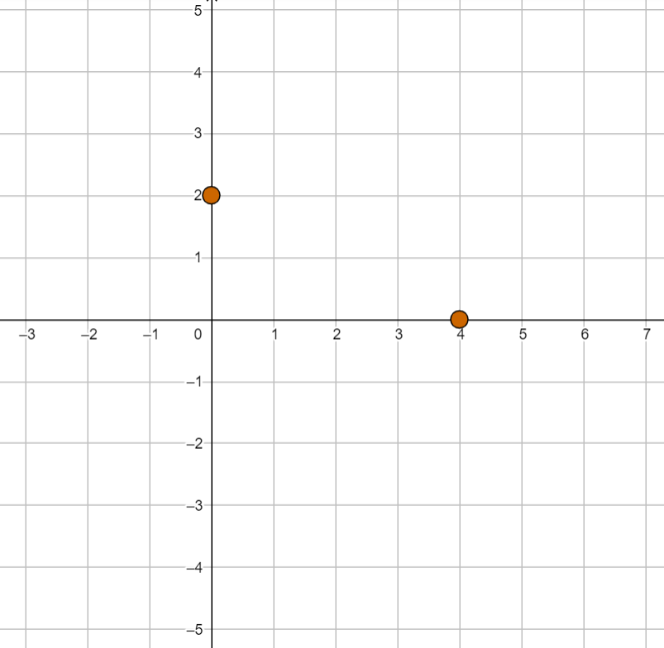
Checkpoint 21: Red kite
y
The points (4, 0) and (0, 2) are marked. They are two of the four coordinates of a kite.
Starting with these two coordinates:
Choose two more coordinates to create a kite that has the x-axis as its line of symmetry.
Choose different coordinates to create a kite with the same line of symmetry. Can they both change?
Choose different coordinates to create a kite that has the y-axis as its line of symmetry.
x
Move your kite from part a so that one of the points is on (1, 1). How many different ways are there to do this?
Notes:
This slide is animated. Each question will appear separately so you can choose the pace at which to work with your class. Printable copies of the coordinate grid in this task are available on slide 102.
Answers
a) (0, -2) and any coordinate of the form (x, 0) where x $≠$ 4 (i.e. a point on the x-axis).
b) (0, -2) must stay the same; the other coordinate can change, provided the y-coordinate remains 0.
c) (-4, 0) and any coordinate of the form (0, y), where y $≠$ 2 (i.e. a point on the y-axis).
? Students could move the kite right 1 and down 1; or left 3 and up 1 (to move the two given coordinates to (1, 1 ).
There will be two other possible answers, which would depend upon the position of the existing coordinates.
Suggested questioning
Is it possible to have (1, 0) as one of your points for part a or b? How about part c?
Can you think of coordinates for a kite that wouldn’t fit on this grid?
Did you find it easier to think of the kite in one or other orientation?
What are all the possible answers to part b? Why must the point (0, -2) remain while the other point can change?
How many possible answers are there for part c? Can both the coordinates change this time? Why not?
Things to think about
The grid in Checkpoint 21 is deliberately too small. How does the fact that the x-axis doesn’t extend far enough in the negative direction impact on students answers to part c? Do students see these axes and the lines of symmetry as extending infinitely in each direction? Might it support generalising if students are encouraged to choose points in part b that are not visible on the slide? It is likely that students tend towards kites where the diagonal which is the line of symmetry is longer than the other diagonal; can you stretch their definition of a kite by prompting them to consider coordinates where the line of symmetry falls on the shorter diagonal?

Slide 62
Checkpoint 21: Guidance
Adaptations | Assessing understanding
Support The printable resource on slide 102 has a longer x-axis than on the Checkpoint, which may be easier for students to use. Challenge Ask students to consider an additional constraint such as area when finding their coordinates. Can they find coordinates so that the area of the kite would be 10 square units? How about 12? Note that they will not know a formula for finding the area of a kite so may do this by counting squares or splitting the shape into two triangles. Representations The coordinate grid is used to explore symmetry. Students may find it challenging to work on part c using the grid given, which does not include the coordinates needed. This is intentional to encourage students to see the axes as infinite and consider solutions beyond the given grid, but longer axes are provided if this creates a barrier to accessing the task (see ‘Support’). | This uses the same starting point as a Checkpoint from the ‘Plotting coordinates’ deck, but focuses instead on assessing understanding of reflection and symmetry. Ask students to sketch a kite (not on axes) and to discuss the properties of a kite. It is likely that students would naturally draw a kite orientated with a vertical line of symmetry, (as in part c), but this Checkpoint explores the potentially less familiar orientation first. As students move from parts a through to c, ask them which of their points can change and which must stay the same. Can they recognise that, when the x-axis is the line of symmetry, the point on the x-axis is fixed? A useful prompt to use throughout might be, ‘How many possible answers are there?’ Students who are more confident might recognise that there are infinite answers, or at least suggest some non-integer coordinates. Encourage this by asking, ‘Can you think of a coordinate no one else has suggested?’
Additional resources Examples of questions around properties of quadrilaterals and symmetry can be found on pp25–26 of the Year 4, and p26 of the Year 5 Primary Assessment Materials | NCETM.

Slide 63
Similarity
Checkpoints 21–24

Slide 64
Enlargements (and scale)
Previous learning | In Key Stage 3 students need to
Key Stage 2 curriculum: Year 6: solve problems involving similar shapes where the scale factor is known or can be found Further information about how students may have experienced this key idea in Key Stage 2: Teaching mathematics in primary schools, 6AS/MD–1 understand that two numbers can be related additively or multiplicatively and quantify additive and multiplicative relationships (pp298–301)* (Note that multiplicative relationships are restricted to multiplication by a whole number.) Primary Mastery Professional Development, Spine 2 Multiplication and Division, Year Segment 2.17 Teaching point 1: a longer length can be described in terms of a shorter length using the language of ‘times’; the longer length can be calculated, if the shorter length is known, using multiplication; Year 6 Spine 2 Segment 2.27 Scale factors, ratio and proportional reasoning * Page numbers reference the complete Years 1–6 document | Build on their work on similar shapes in Key Stage 2 to be able to construct similar shapes** both with and without coordinate grids. Appreciate that enlargement is the only transformation that does not maintain congruence (other than when the scale factor is ±1), but does maintain similarity in any orientation and sense. Understand the idea of a centre of enlargement and that the position of this in relation to the object affects the image’s position. **The focus in Key Stage 3 is on enlargements with a scale factor ≥1; fractional and negative scale factors for enlargement are explored at Key Stage 4.

Slide 65
Checkpoint 22: Flagging
On the left is an image of the Japanese flag.
The image is 4 cm by 6 cm.
Jaya wants to make the image bigger. She stretches it by 2 cm.
Jaya notices that the flag doesn’t look quite right.
What do you think has gone wrong?
Jaya stretches the flag by 2 cm in the other direction. Is this correct now? Explain how you know.
How should Jaya stretch the image so that it looks right again?
Notes:
This slide is animated. Each flag will appear separately with parts a and b, so you can choose the pace at which to work with your class.
Answers
Jaya has only stretched the flag in one direction.
This is not correct. The flag was stretched vertically so that it is 50% longer, so needs to be stretched horizontally in the same way.
? Jaya needs to stretch the image by one more centimetre so that the flag is in the correct proportion. This will make it
6 cm by 9 cm.
Alternatively, notice that the height of the image is two-thirds of its length, so with a new height of 6 cm, the width must be 9 cm
Suggested questioning
Which of the two options looks more like the first flag? Why?
Why are neither of Jaya’s versions correct?
What would Jaya need to do if she stretched the flag by 3 cm in one direction?
Things to think about
Checkpoints 22, 23 and 24 explore enlargement and similarity. Students are likely to enlarge shapes by multiplying both the height and the length by a common scale factor. At primary, integer scale factors are used. They may not also be aware that there is constant multiplier within the shape too, between the base and the height of the flag (in this case the height is two-thirds of the base). Is it important to you that students have an awareness of this relationship at this stage? Is this something you might draw attention to within this task?

Slide 66
Checkpoint 22: Guidance
Adaptations | Assessing understanding
Support Cut out the original circle (trace the outline from the board) and place it on the enlarged ‘circles’ to help students compare and realise that they are not correct enlargements, particularly in part b). Challenge Reverse the challenge: give students dimensions and ask if they are possible enlargements of the flag. This links to the ratio Checkpoints in the ‘Multiplicative reasoning’ deck. Note, students will have mainly used integer scale factors at primary school. Representations The Japanese flag is used as the combination of a circle within a rectangle make the incorrect enlargements fairly clear to see. Students might think that the second enlargement is correct as it looks more right than the first. Use the enlargement tools on PowerPoint to enlarge the first rectangle correctly, and show how this is different to the second given enlargement. | Checkpoint 22 is one of three Checkpoints that check readiness for teaching enlargement. Students will have used scale factors at primary but the term ‘enlargements’ is not used in the primary curriculum. The language of ‘doesn’t look quite right’ is intended to tease out students’ understanding of what a correct enlargement would be, without explicitly using the mathematical language that you will use at Key Stage 3. Do students recognise that it is not a true enlargement as the stretch is not in both dimensions? What language do they use to describe this? In part b, both dimensions have been stretched but additive reasoning has been incorrectly used to enlarge. This is a common misconception, and is explored further using triangles in Checkpoint 23.
Additional resources Additional activity J looks in more detail at additive versus multiplicative reasoning. Similar shapes are explored in teaching point 4 from Topic 2.27 Scale factors, ratio and proportional reasoning | NCETM of Primary Mastery Professional Development | NCETM

Slide 67
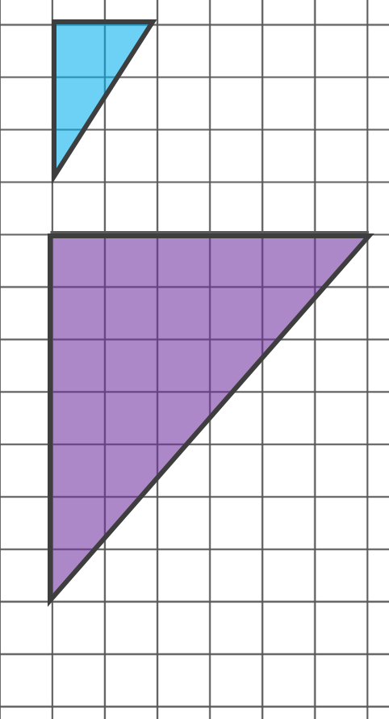
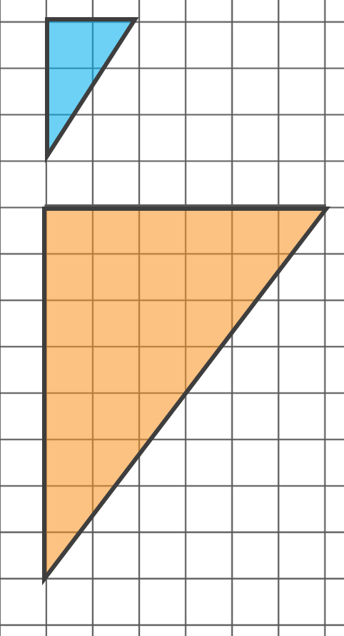
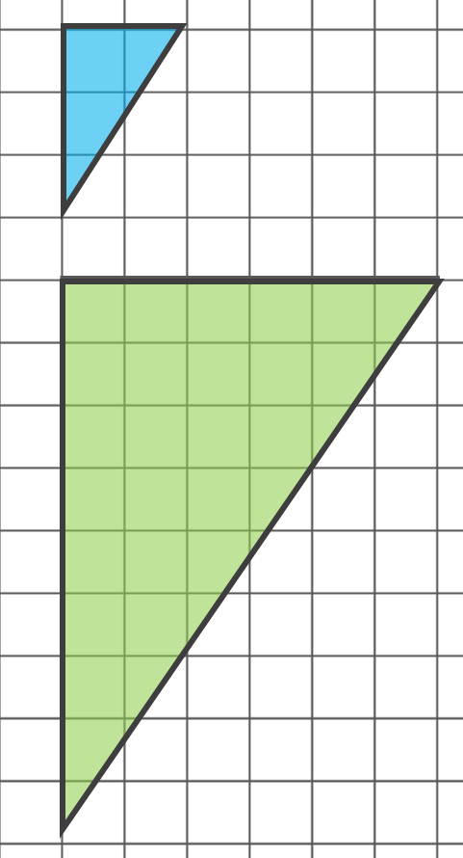
Checkpoint 23: Scaling up
Which of these is a correct enlargement of the small blue triangle?
How do you know?
Samir draws another enlargement of the small blue triangle.
One of the lengths is 12 cm. What could the other length be?
Notes:
This slide is animated. The ‘further thinking’ question will appear separately so you can choose the pace at which to work with your class.
Answers
The green (right) triangle is a correct enlargement of the blue triangle, as both sides have been made three times longer.
? If the horizontal length was 12 cm, the other length would be 18 cm. If the vertical length was 12 cm, the other length would be 8 cm.
Suggested questioning
Which triangle looks most like the blue triangle?
What is the same and what is different about each of the ‘enlargements’?
What has been done to create the enlargements each time?
Which angles are the same? Which angles are different?
Things to think about
Checkpoints 22, 23 and 24 explore enlargement and similarity. Students are likely to enlarge shapes by multiplying both the height and the length by a common scale factor. At primary, integer scale factors are used. They may not have explored the angles in similar shapes. Consider how much you will draw attention to this at this stage. Will you ask students to measure one or more angles?

Slide 68
Checkpoint 23: Guidance
Adaptations | Assessing understanding
Support Delete the middle image to just show the purple (left) and the green (right) triangles Challenge Ask students to change the horizontal lines so that all three images are correct enlargements. Representations A unit square grid is used here to help students make comparisons between the triangles. A plain background with side lengths could also be used, but the squares allow students to see more clearly the difference in their angles in contrast with the right angles of the grid. | Checkpoint 23 explores students’ understanding of enlargement in order to elicit potential misconceptions. Although the Key Stage 2 curriculum does reference similar shapes, students may not be familiar with the term ‘similar’ and its mathematical definition. The three triangles deliberately only have a small difference between the vertical side lengths, so identifying the correct enlargement may cause some debate among students. Encourage this and listen to their justifications. The purple (left) shape is a classic example of where additive rather than multiplicative reasoning has been used: both lengths are four squares longer. If students are fixed on additive reasoning, look at other, non-geometry, multiplicative problems to see it they incorrectly apply additive reasoning there, too. Do they understand that the angles in the blue shape need to be the same in its enlargement? The orange (middle) shape is potentially harder to identify by estimation. You may find it helpful to use a protractor to convince students that the bottom angles in the green (right) and blue triangles are the same, and that the orange (middle) is different.
Additional resources Additional activity J looks in more detail at the additive versus multiplicative reasoning suggested by the purple (left) triangle. Similar shapes are explored in teaching point 4 from Topic 2.27 Scale factors, ratio and proportional reasoning | NCETM of Primary Mastery Professional Development | NCETM

Slide 69
Checkpoint 24: Rectangles
The small rectangle, A, is 2 cm by 3 cm.
Caroline arranges six of these to make another rectangle.
Is the large rectangle just a larger version of rectangle A?
If it isn’t, how is it different? If it is, how do you know?
A
Is it possible to arrange 10 of rectangle A so they they make a larger version of A? How about 12 of rectangle A? What’s the smallest number of tiles you’d need?
Notes:
This slide is animated. Each question will appear separately so you can choose the pace at which to work with your class.
Answers
The rectangle is not just a large version of A. It would need another layer of the rectangular tiles along the bottom for this to be the case, so it is too short.
? It is not possible to arrange exactly 10 rectangles or 12 rectangles so that they are similar to A. It is possible to arrange exactly nine, or 16 or 25 tiles (and so on) so that they are similar. The smallest number of tiles that you would need would be four.
Suggested questioning
How many times longer is the large rectangle than A?
How many times taller is it than A?
Imagine stretching rectangle A out on a screen. Which edge of the big rectangle would it reach first?
Convince me that this is/isn’t a larger version of rectangle A.
Things to think about
Checkpoints 22, 23 and 24 explore enlargement and similarity. Students are likely to enlarge shapes by multiplying both the height and the length by a common scale factor. At primary, integer scale factors are used. Students may be misled in this task that the respective lengths are multiplied by themselves (i.e. there are two 2 cm lengths and three 3 cm lengths). This may lead to some productive debate – consider how you will manage this in your classroom. Will you let students form their own opinions, or assign some students to ‘agree’ and ‘disagree’ and see if they can justify the standpoint they are given?

Slide 70
Checkpoint 24: Guidance
Adaptations | Assessing understanding
Support The focus of this task is similarity and exploring whether and how students understand a shape being ‘the same but bigger’. Explore this by building up shapes using rectangular tiles and asking, ‘Is this the same but bigger?’ Challenge Once students have established that they need nine of rectangle A to make a larger version of it, challenge them to generalise that the number of rectangles will always be a square number. Are they able to say, for example, whether 145 of rectangle A would make a big version? What about 144? 146? Can they give the dimensions of that rectangle? Representations Using tiles and slowly constructing larger rectangles may support students in accessing the task. | This task is designed to act as a prompt for discussion and students may initially disagree about their answer to part a. Some may intuitively think that the large rectangle is just a larger version of rectangle A. In exploring and challenging this, you will gain an insight into what they understand of mathematical similarity, although they may not use the word ‘similarity’ to describe it. Reasoning and justifying that the large shape is, in fact, a longer, narrower version of rectangle A may prove challenging. Students might think that it looks ‘about right’. Can they explain that the large rectangle is three time longer than A, but only double the height? Students might recognise that an additional row would then create a larger version of rectangle A.
Additional resources Additional activity K is another that explores students’ intuitive responses around enlargement.

Slide 71
Additional activities
Activities A–K

Slide 72
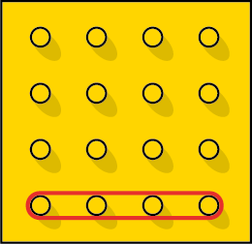
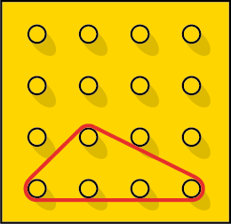
Activity A: Pegboard
This is a 4 × 4 pegboard.
There is an elastic band around the bottom row.
Caleb stretches the elastic band so that it stays around the bottom four pegs, but loops around one more peg to make a triangle. An example is shown in the picture on the right.
How many triangles can he make?
How many of the triangles are the same as each other?
How many different triangles could Caleb make if he didn’t need to keep the band around the bottom four pegs?
Notes:
This slide is animated. Each question will appear separately so you can choose the pace at which to work with your class. A printable version of the 4 × 4 pegboard can be found on slide 103. Give students several copies if they are likely to work on the further thinking question.
Answers
a) Caleb can make 12 triangles (as there are 12 pegs that the top vertex could be ‘looped’ around). See the next slide for visual solutions.
b) Six of the triangles are the same. Students may recognise that there are six pairs of triangles, with each pair reflected in a mirror line between the middle columns of pegs.
? If Caleb didn’t need to keen the band around the bottom four pegs, he could make 21 unique triangles.
Suggested questioning
What is the same and what is different about your triangles?
How can you tell if you’ve found all the triangles?
What do you notice about the pairs of possible triangles you have made?
How would this activity be different if the band was around the second row of four pegs?
Things to think about
Additional activity A, similarly to Checkpoint 1, assesses students’ understanding of congruence without explicitly mentioning the term. In this activity, there is the additional element of generating their own triangles. This activity might need longer than 10 minutes. If you can, give students actual pegboards and bands to work with, or use the printable resource on slide 103. See which students work systematically and are able to identify when all possible triangles have been generated. Once students have generated some examples, compare triangles and listen to the language they use to describe them. Can they recognise that, within the 12 possibilities, there are six pairs that are reflections of each other? Students are not likely to use the term ‘congruent’, but should be able to identify which triangles are the same. You could assess their understanding of types of triangles and their properties, although this is not intended as the main assessment point.

Slide 73
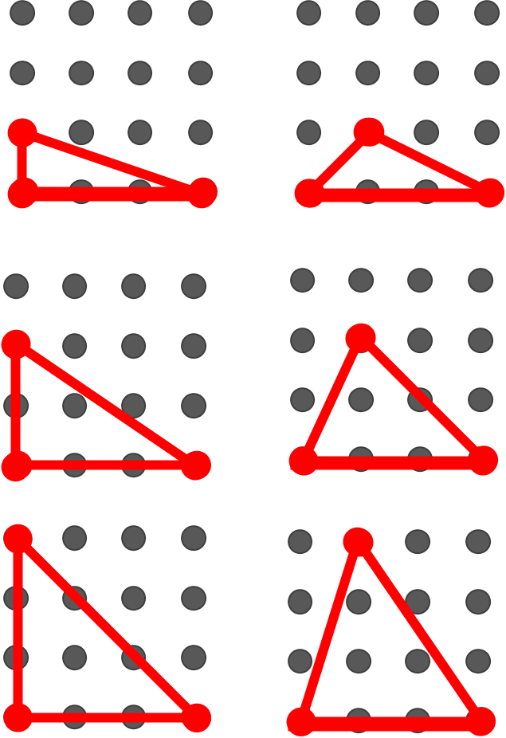
Activity A: Pegboard (solutions for part a)
Notes:
These are the 12 different (and six unique) triangles possible in parts a and b.

Slide 74
Activity B: More Tess-ellation
Tessa made this pattern by drawing around an L-shaped stencil. She started with the red shape marked 1.
Describe how she had to move her stencil to go from the red shape to:
The light purple shape
The light blue shape
The dark green shape
The dark purple shape.
c)
1
a)
d)
b)
Pick two shapes and describe the movement from one to the other. Are there any other pairs with exactly the same movement?
Notes:
This slide is animated. Each question will appear separately so you can choose the pace at which to work with your class. A printable resource is available on slide 88.
Answers
a) The red shape (1) has been moved (or translated) three squares left and two squares down.
b) The red shape (1) has been reflected in a horizontal line.
c) The red shape (1) has been reflected in a vertical line.
d) The red shape (1) has been rotated 180°.
? There are numerous possible answers here. For ease, the possible pairs are grouped by type of transformation:
Translations: orange/dark purple.
Reflections: dark green/dark purple; red/light blue.
Rotations: dark green/light blue; any pair from dark blue, orange, light green and light purple;
Exactly the same movement:
Translation three left and two down: red/light purple; orange/dark purple.
Reflection in the horizontal line: dark green/dark purple; red/light blue.
Reflection in the vertical line: dark green/red; dark purple/light blue.
Rotation 90° (given clockwise, reverse for anti-clockwise): light purple/light green; light green/orange; orange/dark blue; dark blue/light purple.
Rotation 180°: dark purple/red; dark green/light blue; light green/dark blue; orange/light purple.
Rotation 270° (given clockwise, reverse for anti-clockwise): light purple/dark blue; light green/light purple; orange/light green; dark blue/orange.
Suggested questioning
What is the same and what is different about the __ shape and the __ shape?
How can you tell which shapes are translations/reflections/rotations?
Could you add another L shape that is a translation/reflection/rotation of __?
Things to think about
Additional activity B is an alternative to Checkpoint 2; rather than supplying language such as ‘flipped’ or ‘turned’, this task is more open and just asks students how one shape has been transformed onto another. Use this task if you want to see what language students apply without prompting. Alternatively, you could use it as a follow-up to Checkpoint 2 or after some teaching, to see which language has been retained. Note that, for the translation in part a, students will not have been taught vector notation at primary. For the rotation in part d, students will not have discussed a centre of rotation but should be able to talk about how much of a full turn has taken place, either in degrees or fractions of a turn.

Slide 75
Activity C: More pentominoes
Pentominoes are arrangements of five squares.
Jake starts to arrange his squares like this:
Where could Jake place his final two squares?
How many different possibilities are there?
How many of the possibilities create different shapes?
How would your answers be different if your three starting squares were arranged differently?
Notes:
This slide is animated. Each question will appear separately so you can choose the pace at which to work with your class. There is a printable resource on slide 104.
Note that this task is not a short assessment task but a more open-ended problem solving task that is likely to take significantly more time than the 10 minutes a Checkpoint is usually designed for.
Answers
a) and b) There are 33 possible positions for the final square – see the next two slides.
c) There are 11 different shapes that can be created (all of the pentominoes except the straight line) – see the next two slides.
? Unlike the multiple solutions for the further thinking question in Checkpoint 3, there is only one alternative position for the three starting squares: a straight line. From this, there would be three different positions to place the fourth square. These are:
In a line, with 10 possible positions for the final square
In an L shape, with nine possible positions for the final square
In a row of three with a fourth above the centre square, with eight possible positions for the final square.
Overall, there would be 11 unique shapes created, all of the pentominoes except the ‘W’.
Suggested questioning
What is your strategy?
How can you be sure you have found every possible position for the final two squares?
What is the same and what is different about the shapes you have created?
Can you match any of your shapes to each other?
For the shapes that match, how could you move one shape so it is exactly the same as the other?
Things to think about
Additional activity B is an alternative version of Checkpoint 3, using pentominoes to explore possible shapes and their relationship to one another. As there are fewer squares given as a starting point, there are more possible arrangements. This shifts the task from being a shorter assessment activity to a more open-ended, problem-solving activity, likely to take significantly more time than one of the Checkpoints. While still offering opportunities for students to recognise congruent shapes, the emphasis of this version is on problem solving and systematic thinking. Can students find all possible solutions? How do they know? If you do bring the focus back towards the language of transformation, this version of the task has some solutions that are reflected as well as rotated, which is not a feature of Checkpoint 3.

Slide 76
Activity C: More pentominoes (solutions)
How many of these solutions did you find?
How many of these solutions are different shapes?
Notes:
This slide shows all the possible arrangements with the given starting point. The next slide is animated, to show how each shape was generated and which are congruent.
You may wish to use this slide to support with gathering students’ responses to the activity. You could use questions such as:
How many of these are congruent?
How could you change shape __ to be in the same position as shape __?
How many of these did you find?
How many of these could be created more than one way?

Slide 77
Activity C: More pentominoes (animated solutions)
Notes:
This slide is animated. The green squares show the possible positions of a fourth square, and the white dotted squares will appear and disappear to show the eight possible positions for the fifth square. Each complete arrangement appears as the shape changes, colour coded to show which shapes are actually congruent. Exact duplications (i.e. where the positions of the white and green squares are reversed) are not shown.
You may wish to use this slide to support with gathering students’ responses to the activity. You could use questions such as:
Why are some shapes the same colour?
How many of these are congruent?
Why are some positions for the white dotty square not shown?
How could you change shape __ to be in the same position as shape __?
How many of these did you find?

Slide 78
Activity D: More computer graphics
Tina is making a poster on the computer. She uses this image of an arrow:
She then changes the shape, so it looks like this:
Below are the four tools that she chose from when she changed her shape:
What tool might Tina have clicked? Is there more than one possible answer?
Tina used exactly two steps to change her shape. What might they have been?
Can you find a way for Tina to have changed her shape in exactly four clicks? How about five?
Notes:
This slide is animated. Each question will appear separately so you can choose the pace at which to work with your class.
Answers
a) She could have clicked Rotate Left 90° once, or she could have clicked Rotate Right 90° three times.
b) She could have clicked Rotate Right 90° and then Flip Vertical, or she could have clicked Flip Horizontal and then Rotate Right 90°.
?
Examples of four clicks could include: Flip Horizontal then Rotate Left 90° three times; Rotate Right 90° then Flip Horizontal three times.
Examples of five clicks could include: Rotate Right 90° four times then Rotate Left 90°; Flip Vertical four times then Rotate Left 90°.
Suggested questioning
What other language could you use to describe the four options?
How many different options can you think of?
Is any number of clicks always possible?
Things to think about
Additional activity D is an alternative to Checkpoint 4. Instead of varying the shapes and considering the same transformations, this time the task focuses on one shape and the multiple different transformations that might have taken place. Use it as a next step if students were confident with Checkpoint 4, or a few weeks after using Checkpoint 4 to see if students handle the task any differently after some teaching in Key Stage 3. See the Guidance slide for Checkpoint 4 for more information.

Slide 79
Activity E: Fewer headphones
A phone shop takes a delivery of headphones.
They are meant to fit in a case like the one on the right.
The box splits and the headphones spill all over the floor.
Which headphones are for the right ear, and which are for the left?
L
R
Draw the missing headphone. Is there more than one way to do this?
Notes:
This slide is animated. Each headphone will appear separately (in order from left to right) so you can choose whether to show them all or work through individually. Once students have tried to visualise the rotation of the headphones without a physical image, you may wish to give the printed resource on slide 105 for them to turn and manipulate.
Answers
Working left to right across the page: right, left, left, right, right, right, left.
? Any orientation of a left headphone.
Suggested questioning
What are you looking for when you decide?
Can you find a pair that are both for the same ear?
How do you know they are for the same ear?
Which was hardest to decide?
Things to think about
Additional activity E is a simplified version of Checkpoint 6, with fewer items to consider and none that are ‘upside down’. As with Checkpoint 6, we recommend that any physical manipulatives (either images of headphones, or actual headphones) are not provided immediately. The intention is to identify those students that find it particularly easy or difficult to visualise shapes being transformed without a physical shape to manipulate. See the guidance notes to Checkpoint 6 for more details.

Slide 80
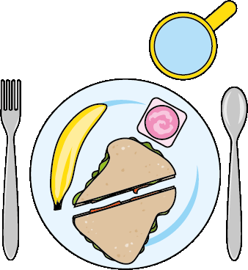
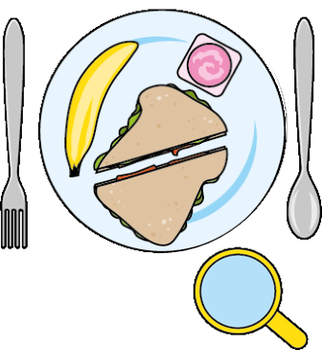
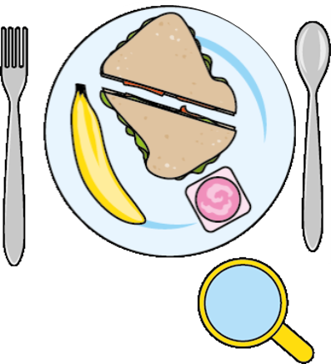
Activity F: Dinner date
Sakthy and Andrea are sitting opposite each other at a table.
Sakthy takes a photo of her plate from above.
Then, Andrea takes a photo of Sakthy’s plate from above.
Which of these images is correct for Andrea’s photo?
a)
b)
c)
What might you need to do to change the incorrect photos so that they show Andrea’s view of Sakthy’s original plate?
Notes:
This slide is animated. Each question will appear separately so you can choose the pace at which to work with your class.
Answers
Image c is correct.
In image a, the plate has been rearranged before Andrea took the photo, meaning that the plate looks like the original image even though the cutlery and cup are correct.
In image a, the cutlery has been rotated 180° before Andrea took the photo, meaning that the cutlery looks like the original image even though the plate and cup are correct.
? In a, The plate would need to be reflected in a horizontal mirror line. In b, the cutlery would need to be rotated another 180°.
Suggested questioning
What has changed between the photos? How do you know?
What would you expect to see?
How do you know the __ has not moved?
How do you know the __ has moved?
Things to think about
Additional activity F, similar to Checkpoints 6–7, is about students’ mental manipulation of shape. Can they imagine what the plate should look like from the other angle, and identify what is wrong with the second image? The activity will help you to see which students are more or less confident with spatial reasoning. Only one items has been moved each time to support students to compare with the rest of the items in the image. Before showing the options for Andrea’s image, you could ask students to describe what Andrea’s photo should look like. Which item should be closest to him? Which should be to his left? His right? Then, the reveal of the photo where everything is not where students will expect might prompt some discussion! Listen to students’ descriptions of how the items have been moved. Do they use ‘rotated’ or more colloquial terms like ‘turned’ or ‘spun’? Do they refer to angles when describing how the plate has been rotated? There is no expectation of particular language, but it may help you to plan future teaching to see what terms students naturally reach for.

Slide 81
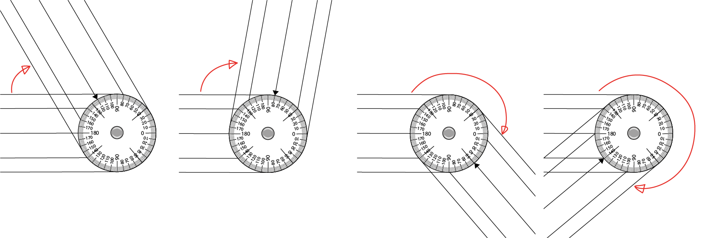
Activity G: Opening
Dan has a special ruler that can also measure angles. You twist one part to open it.
He opens his ruler so that it makes one full turn.
What angle has he turned at each stage?
a)
b)
c)
d)
How much more or less would Dan need to turn to make the ruler a straight line at each stage?
Notes:
This slide is animated. The images will each appear separately so you can choose the pace to work with your class. If the scales are too small to read on the screen, you might like to give students the printable images on slide 106.
Answers
a) 60°
b) 100°
c) 230°
d) 320°
? a) 120° more, b) 70° more c) 50° less d) 140° less
Suggested questioning
Which of these angles are acute/obtuse/reflex?
Which direction has the ruler been opened in?
How did you work this out, given 0 was marked on the opposite side to where the ruler was turned from?
What do you notice about the number opposite the one where the angle was read from?
How did you work out the angle when it was more than 180°?
Things to think about
Additional activity G, like Checkpoints 13 and 14, offers a context for exploring angles as a measure of turn. Dan’s ‘special ruler’ is actually a simplified illustration of a goniometer, which is a device used in medicine to measure the available range of motion at a joint. You might wish to explain this to students after they have had a go at interpreting the diagrams. The idea here is to see if students are able to interpret an angle in an unfamiliar context, and to reason about the answers they give. As the markings read in the opposite way to how the device is opened, students will need to work their answers out from the ‘wrong’ end of the protractor (subtracting the angle from 180° for the first two answers). Do they notice this? Do they realise that the first angle is acute and that 120° is therefore not an appropriate answer? Students may find the latter two images with reflex angles more challenging, as the device does not include markings to 360°, so it offers a good opportunity to assess students’ confidence and experience with angles greater than 180°.

Slide 82
Activity H: Animated octagon
The green line is animated to rotate around the centre of the octagon.
Is the animated line always, sometimes or never a line of symmetry for the regular octagon?
How would your answer differ if the shape was a parallelogram? A square?
Notes:
This slide is animated. All the questions are visible throughout, but the line is animated to continually rotate through 360°. Press enter or click the mouse to stop this animation. A set of printable octagons is available on slide 98.
Answers
The line is not always a line of symmetry.
It is only a line of symmetry when passing through either the midpoint of an edge, or a vertex.
? If the shape was a parallelogram there would be no line of symmetry.
If it was a square there would be four lines of symmetry and they would also be either through the midpoints of an edge, or through two opposite vertices
Suggested questioning
What do you look for when thinking about symmetry?
Does a line of symmetry always go through the ‘middle’ of a shape?
Does a line of symmetry always cut a shape ‘in half’?
Why might someone think that the line is always a line of symmetry? How would you convince them that it isn’t?
How would your answers be different if the octagon was a circle?
Things to think about
Additional activity H is an alternative to Checkpoint 17, with the animated line offering a dynamic representation to help students think about lines of symmetry. It may offer a different prompt for students when thinking about reflection and symmetry. Students might think that the line is always a line of symmetry, as it is in a circle. Can they identify that it is only a line of symmetry when it goes through a vertex or the centre of a side? Do they realise that there are eight not 16 lines of symmetry, as they are duplicated as you go around the shape? The printed sheet of octagons on slide 98 might be a helpful resource to use alongside this task.

Slide 83
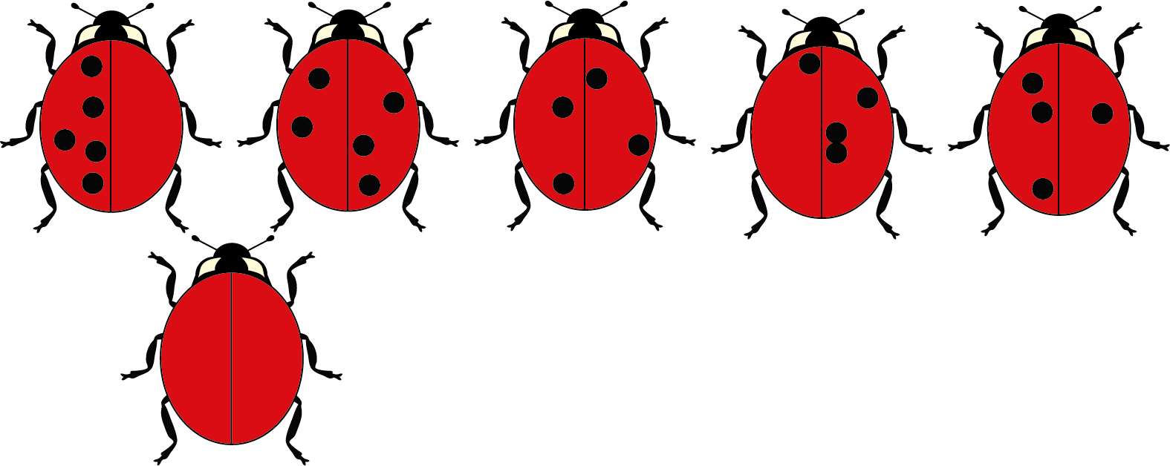
Activity I: Ladybirds
Ladybirds are symmetrical.
Each of these ladybirds is missing exactly five spots.
Where should they be? Is there more than one answer?
a)
b)
c)
d)
e)
Notes:
This slide is animated. Each question will appear separately so you can choose the pace at which to work with your class. A printable version is available on slide 107.
Answers
See the next slide.
Suggested questioning
Will all of the ladybirds have the same number of dots?
Which is the hardest to do? Why?
If the ladybird needs to be symmetrical, how can you draw a fifth dot on for ladybirds c to e?
Things to think about
Additional activity I could be used to check students’ understanding of symmetry, and whether they are clear that a reflection and its image are equidistant from a mirror line. Concentrating on the placement of single dots, rather than more complex shapes as in Checkpoints 18 to 21, may help to isolate the assessment of this specific concept, without other distractions such as properties of shape. It is a simple and accessible context, although the level of complexity does increase quite quickly. In b, for example, students need to add dots on both parts of the shape. In part c onwards, they need to identify that, as they have an even number of dots shown but need to add an odd number of dots to the image, one of the dots must be exactly in the centre of the image. Encourage creativity with the further thinking question by asking students if they can create a ladybird pattern that no one else has.

Slide 84



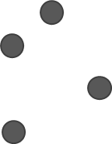
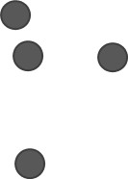
Activity I: Ladybirds (animated solutions)
a)
b)
c)
d)
e)
Add one more spot along the centre line.
Add one more spot along the centre line.
Add one more spot along the centre line.
Any five spots arranged symmetrically, with at least one along the centre line.
Notes:
These are solutions to Additional activity I.

Slide 85
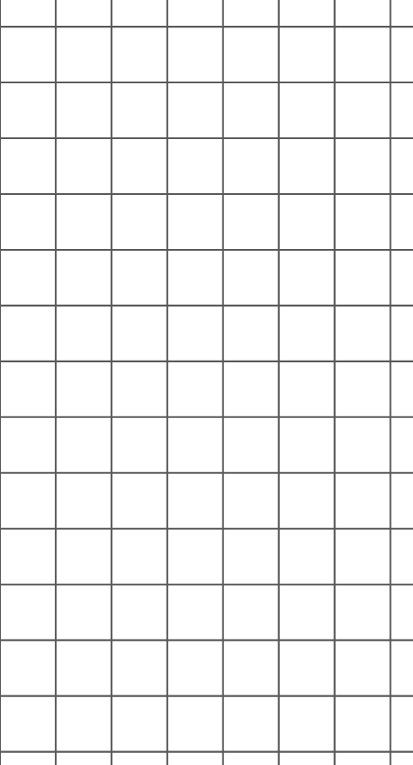
Activity J: Scaling up
Chima and Neung need to make this triangle three times bigger.
They start by drawing a horizontal line.
They cannot agree what length to draw for the vertical line.
2 + 4 = 6, so we need to do 3 + 4 = 7.
2 × 3 = 6, so we need to do 3 × 3 = 9.
Chima
Neung
Who is correct?
What would the students need to do to make the first triangle four times bigger?
Notes:
This slide is animated. Each question will appear separately so you can choose the pace at which to work with your class.
Answers
Neung is correct. They need to multiply the length of the vertical line by the same scale factor as the horizontal line. Chima is incorrect as he has added the same amount each time. This has made the horizontal line three times bigger, but the vertical line only ‘two and a bit’ times bigger.
? They would need to multiply both lengths by four: the horizontal line would be 8 cm and the vertical line 12 cm.
Suggested questioning
What has Chima done? What has Neung done?
How many times bigger is Chima’s vertical length than the original?
If one length was seven, what would the other length need to be?
Things to think about
Additional activity J has a relatively narrow assessment focus, to expose and challenge a common misconception. Students often incorrectly use additive reasoning in enlargement, rather than multiplying by a consistent scale factor as Neung has here. Use Checkpoint 23 first, to see if it is a misconception that is present in your class. Consider how you will frame the activity. Will you ask students to identify how each student has deduced their calculation, before asking them to decide who is right? Will you give students time to discuss the two opinions in small groups or pairs first? Words such as horizontal and vertical are used as they are likely to be familiar from primary, but check understanding of these terms as part of the activity. The animations should support this.

Slide 86
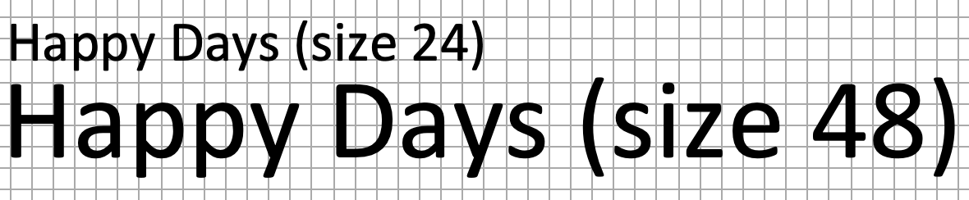
Activity K: The fonts
The font ‘Happy Days’ comes in different sizes.
Size 48 text is twice as big as size 24 text.
If a sheet of paper is full of size 24 text, how many sheets of paper will be needed if the same text is enlarged to size 48?
How many sheets of paper would be needed if it was enlarged to size 96?
Notes:
This slide is animated. Each question will appear separately so you can choose the pace at which to work with your class.
Answers
Because the text is twice as wide and twice as tall, it will need four times the space and so will need four sheets of paper
? Size 96 font is four times as high and four times as wide as size 24, so will need sixteen sheets of paper.
Suggested questioning
If size 48 font was only double the width, but the same height, how many lines would each original line of text take up?
If size 48 font was only double the height, but the same width, how many lines would each original line of text take up
Can you make a general statement about how many sheets of paper are needed as the font gets bigger?
Things to think about
Although students are unlikely to have come across area factors formally, they may be able to reason about the solution to this problem. What prompts and questions might support them in developing this without giving away the solution?

Slide 87
Printable resources

Slide 88
Dark blue
Dark blue
Orange
Orange
1
Red
Light blue
1
Red
Light blue
Dark green
Dark purple
Dark green
Dark purple
Light green
Light purple
Light green
Light purple
Notes:
This printable resource (two per page) could be used with Checkpoint 2 or Additional activity B. The shapes are labelled with colours in case you wish to print in black and white or have students with visual impairments.

Slide 89
Notes:
This printable resource (one per page) may be helpful to support Checkpoint 3.

Slide 90
Notes:
This printable resource (seven per page) might be helpful for Checkpoint 4.

Slide 91
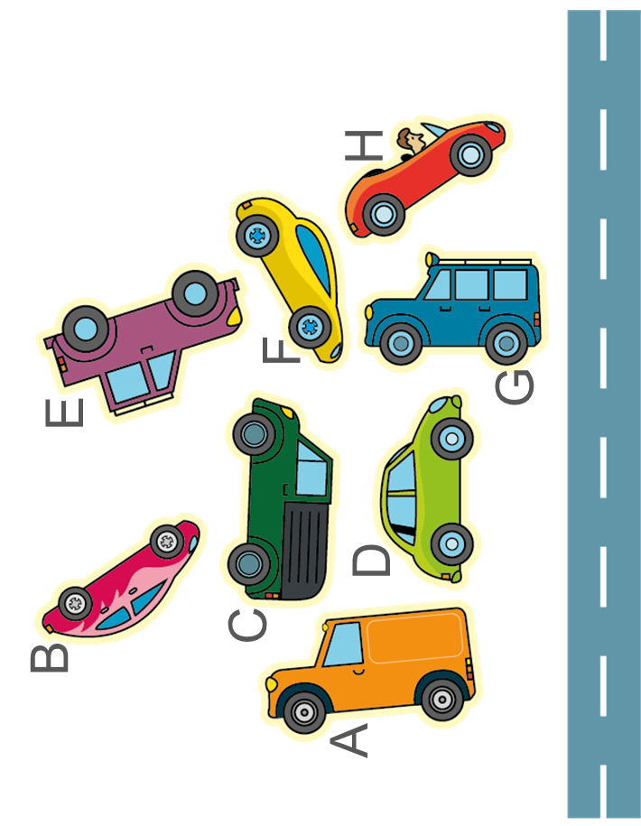
Notes:
This printable resource (two per page) might be helpful to support Checkpoint 5.

Slide 92
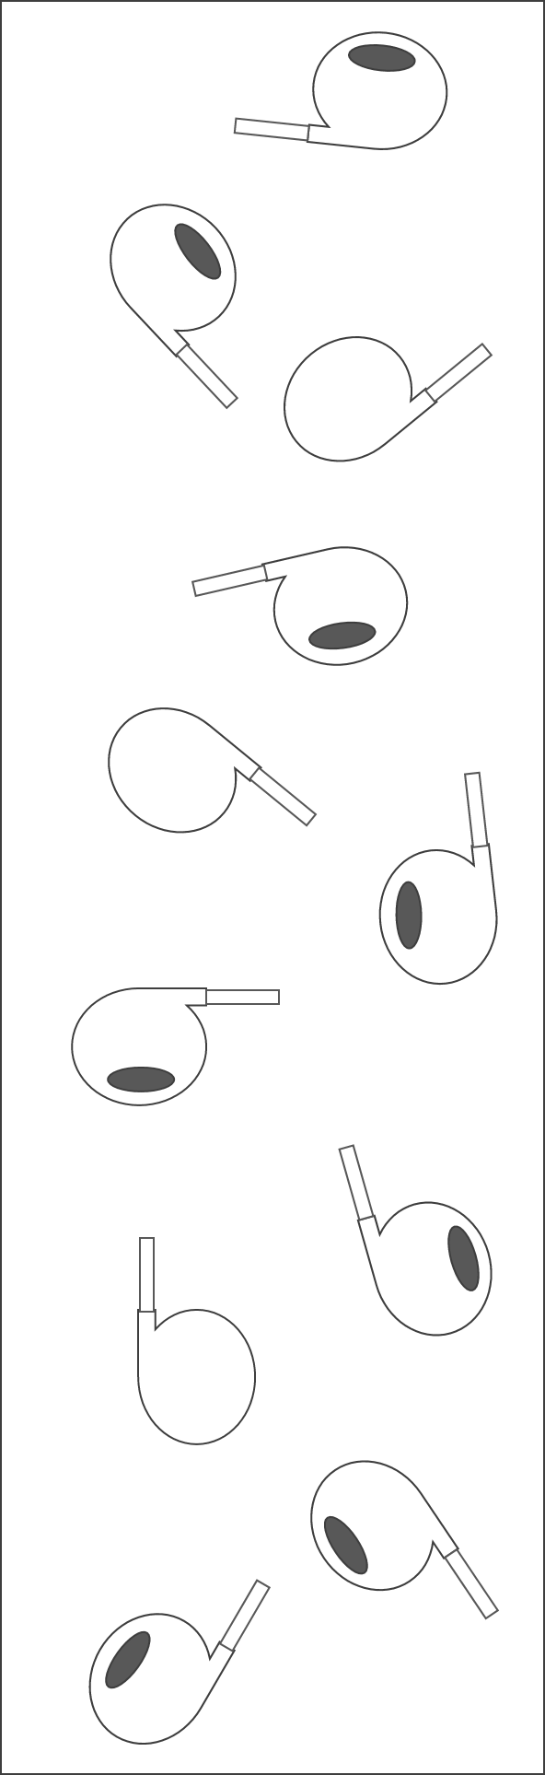
TOP
Notes:
This printable resource (five per page) might be helpful to support Checkpoint 6.

Slide 93
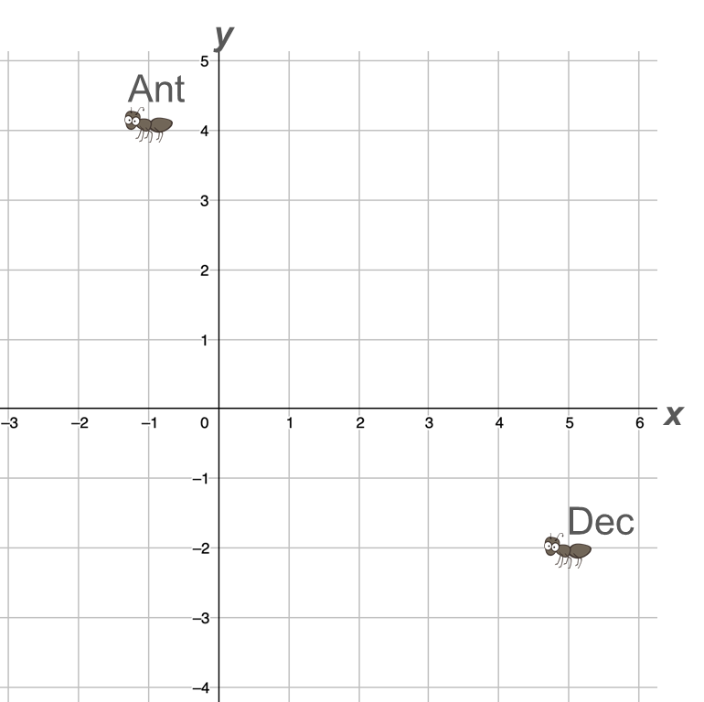
Notes:
This printable resource (six per page) might be helpful for Checkpoint 8.

Slide 94
Notes:
This printable resource (four per page) might be useful for Checkpoint 12.

Slide 95
A
B
C
A
B
C
Notes:
This printable version of the images in Checkpoint 13 (two per page) might be useful if the scale is too small to read on screen.

Slide 96








 | No lines of symmetry
 | Exactly one line of symmetry
 | More than one line of symmetry
Belgium
Dominican Republic
Iceland
Nigeria
Puerto Rico
Switzerland
Taiwan
Venezuela
Vietnam
Notes:
This printable resource (one per page) might be useful to support Checkpoint 15.

Slide 97
a)
b)
c)
d)
a)
b)
c)
d)
Notes:
This printable resource (two per page) might be helpful for Checkpoint 16.

Slide 98
Notes:
You may find it helpful to give students a printout of a hexagon for Additional activity H.

Slide 99
10 cm
10 cm
10 cm
10 cm
Notes:
This printable resource (four per page) might be useful for Checkpoint 18.

Slide 100
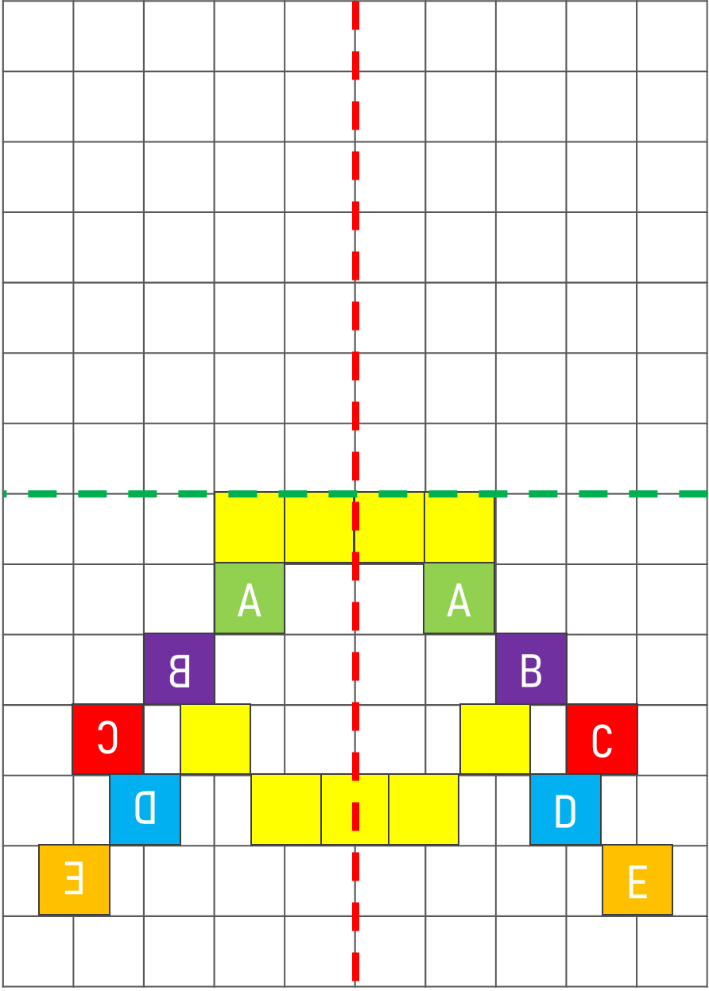
Notes:
This printable resource (two per page) might be helpful to use alongside Checkpoint 19, particularly the ‘further thinking’ question.

Slide 101
Which of these are reflections?
How could you correct the images that are not?
Notes:
This printable resource (one per page) is for use with Checkpoint 20.

Slide 102
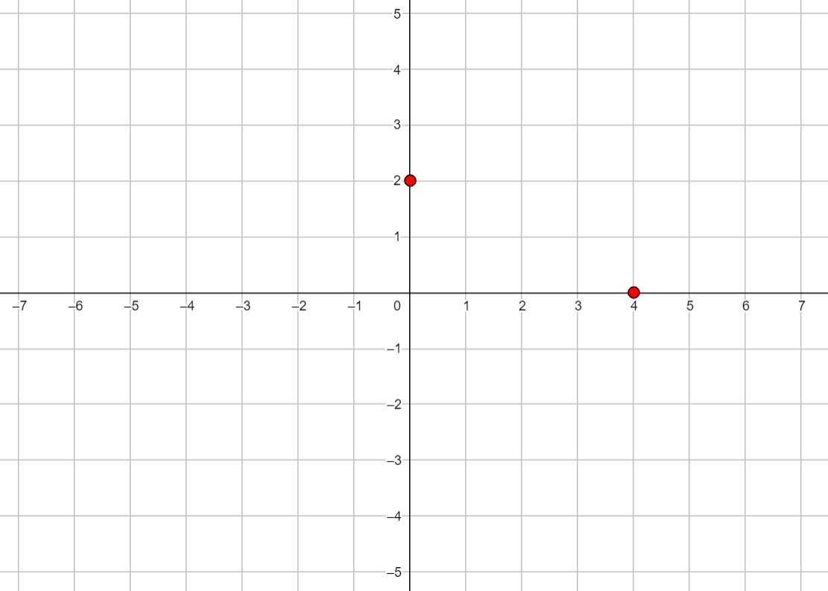
y
y
x
x
y
y
x
x
Notes:
This printable resource (four per page) may be helpful for Checkpoint 21.

Slide 103
Notes:
This printable resource may be helpful to use alongside Additional activity A. Students may require more than one sheet of 4 × 4 dotty grids.

Slide 104
Notes:
This printable resource (one per page) may be helpful for Additional activity C. Students may require more than one sheet.

Slide 105
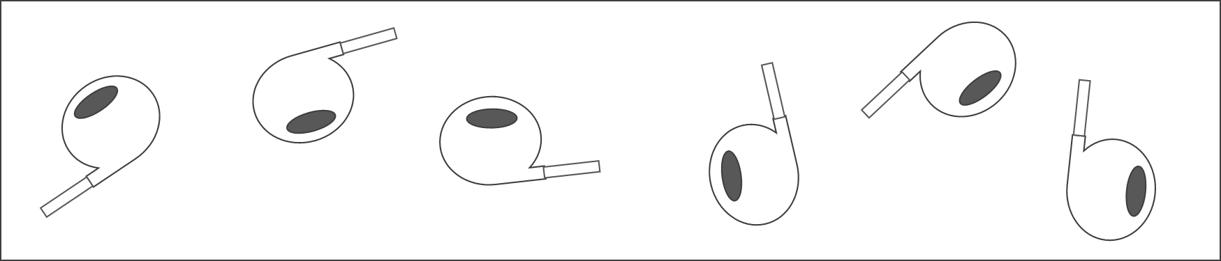
TOP
Notes:
This printable resource (eight per page) may be helpful for use with Additional activity E.

Slide 106
a)
b)
c)
d)
Notes:
This printable version of the images for Additional Activity G might be helpful if the scale is too small to read on screen.

Slide 107
a)
b)
c)
d)
e)
a)
b)
c)
d)
e)
a)
b)
c)
d)
e)
Notes:
This printable resource (three per page) may be helpful for Additional activity I.

