Slide 1
Support Materials
Series 1 Episode 2
Another One

Slide 2
Practitioner Notes

Slide 3
Episode Description
Numberblock One finds a tennis racket, ball and court, and tries to play tennis on her own. She realises tennis is not much fun with one and wanders off, a little sad. She (literally) bumps into a mirror, and briefly thinks she has met a new friend before realising it is only her reflection. However, it turns out to be a magic mirror, and her reflection comes to life as Another One.
One and Another One try to play tennis together, comically sharing a single racket, until One accidentally lands on top of a Another One, number magic happens and they turn into Numberblock Two.
Two is delighted to exist but puzzled that he can't find the two Ones - then he realises they are in him. He splits into the two Ones, who wonder where Two went.
Then the two Ones figure out what to do: Another One runs to the magic mirror, duplicates herself, and they make Numberblock Two. The original One, who has fallen in a patch of flowers, catches up with Two and they finally meet. Two produces a second racket and they play tennis together.

Slide 4
Maths in the Episode
The structure of 2 The mathematics in this episode introduces the part-part-whole structure of number:
One and Another One come together to make Two (combining).
Two can be separated into One and Another One (partitioning).
Two can be represented using other vocabulary such as 'twice as much' and 'pair’.
Counting to 2
Counting involves knowing the order of the number names and assigning one number tag to one object or event. This episode introduces saying “one, two” and using this to tag objects (e.g. tennis rackets) and events (e.g. steps, hitting the ball).

Slide 5
Using Mathematical Language
During this episode Two is made by combining One and Another One. Use the language of combining two objects or events to rehearse this concept.
“One [tennis racket] and another [tennis racket] is two [tennis rackets]”.
Also in this episode Two is partitioned into One and Another One. Use the language of partitioning two objects or events to rehearse this concept.
“Two [tennis rackets] is one [tennis racket] and another [tennis racket]”.

Slide 6
Talk and Discuss Together

Slide 7
Talk and Discuss Together
Watch the episode of Numberblocks. First ask the children what they noticed and allow them to talk to you and each other. The following slides are designed to stimulate children and adults to talk about the episode and draw out some key aspects of the mathematics.

Slide 8
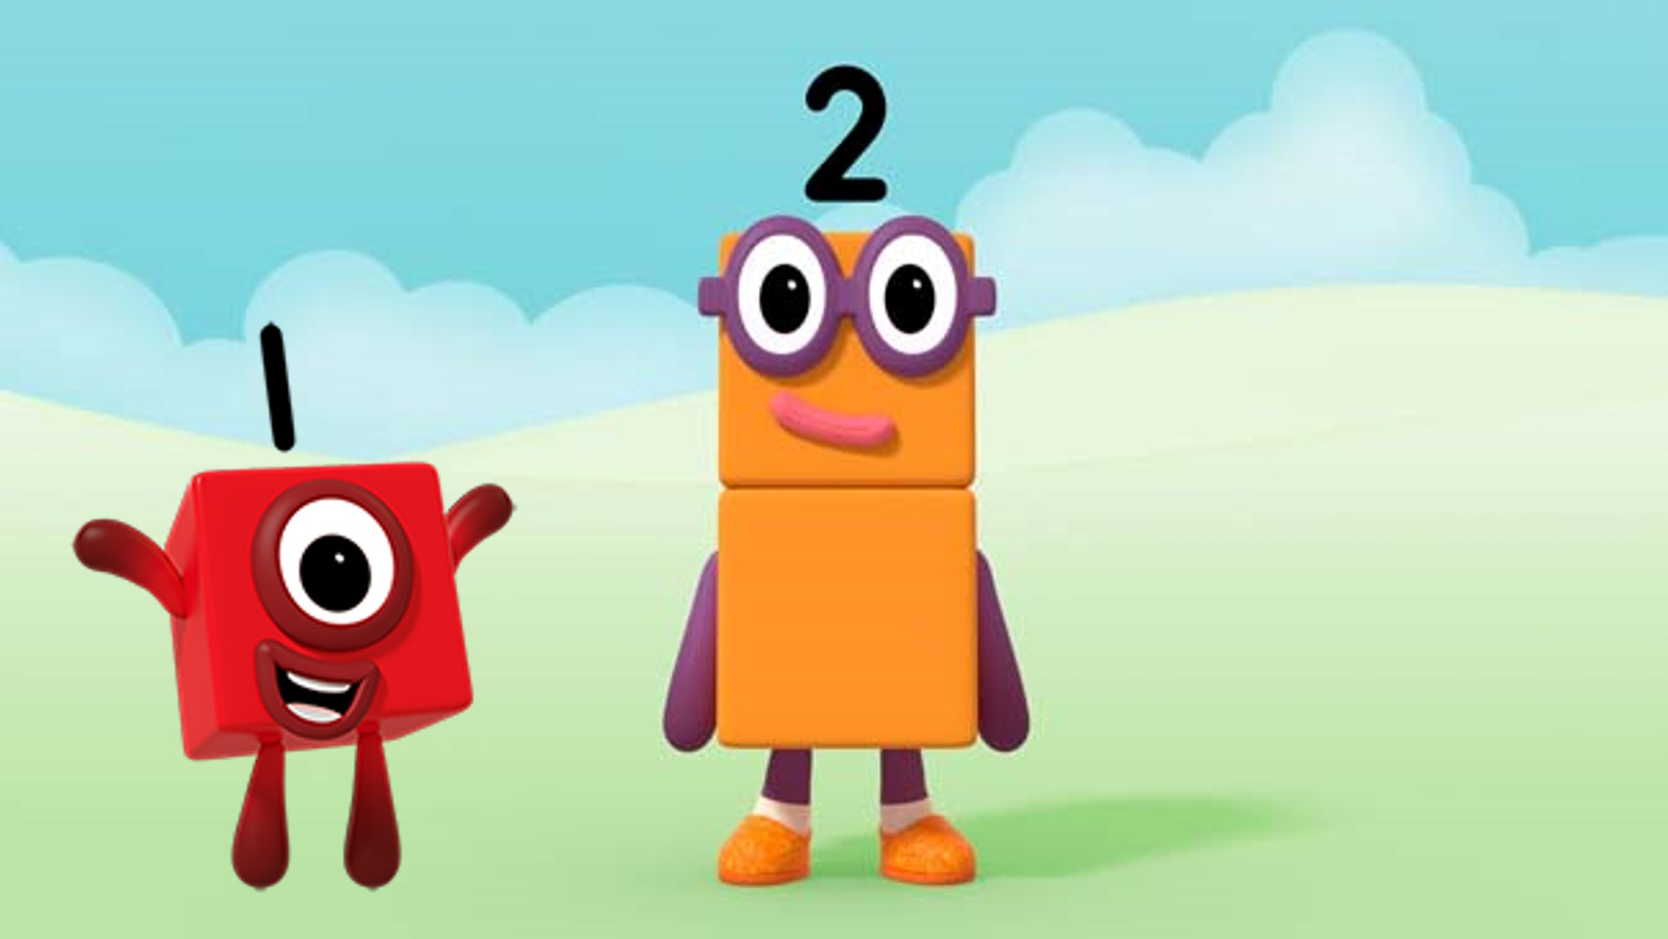
Images © 2017 Alphablocks Ltd. All Rights Reserved.
Notes:
Discuss what the children noticed about the programme. What did they like about it? Has anyone played tennis or seen tennis being played? What do you need ‘one of’ to play tennis?’, What do you need ‘two of’ to play tennis?
Ask “What games can you play on your own?” – what do you need ‘one of’ to play the game?
“What games do you need two people to play?” - what do you need ‘two of’ to play the game?

Slide 9
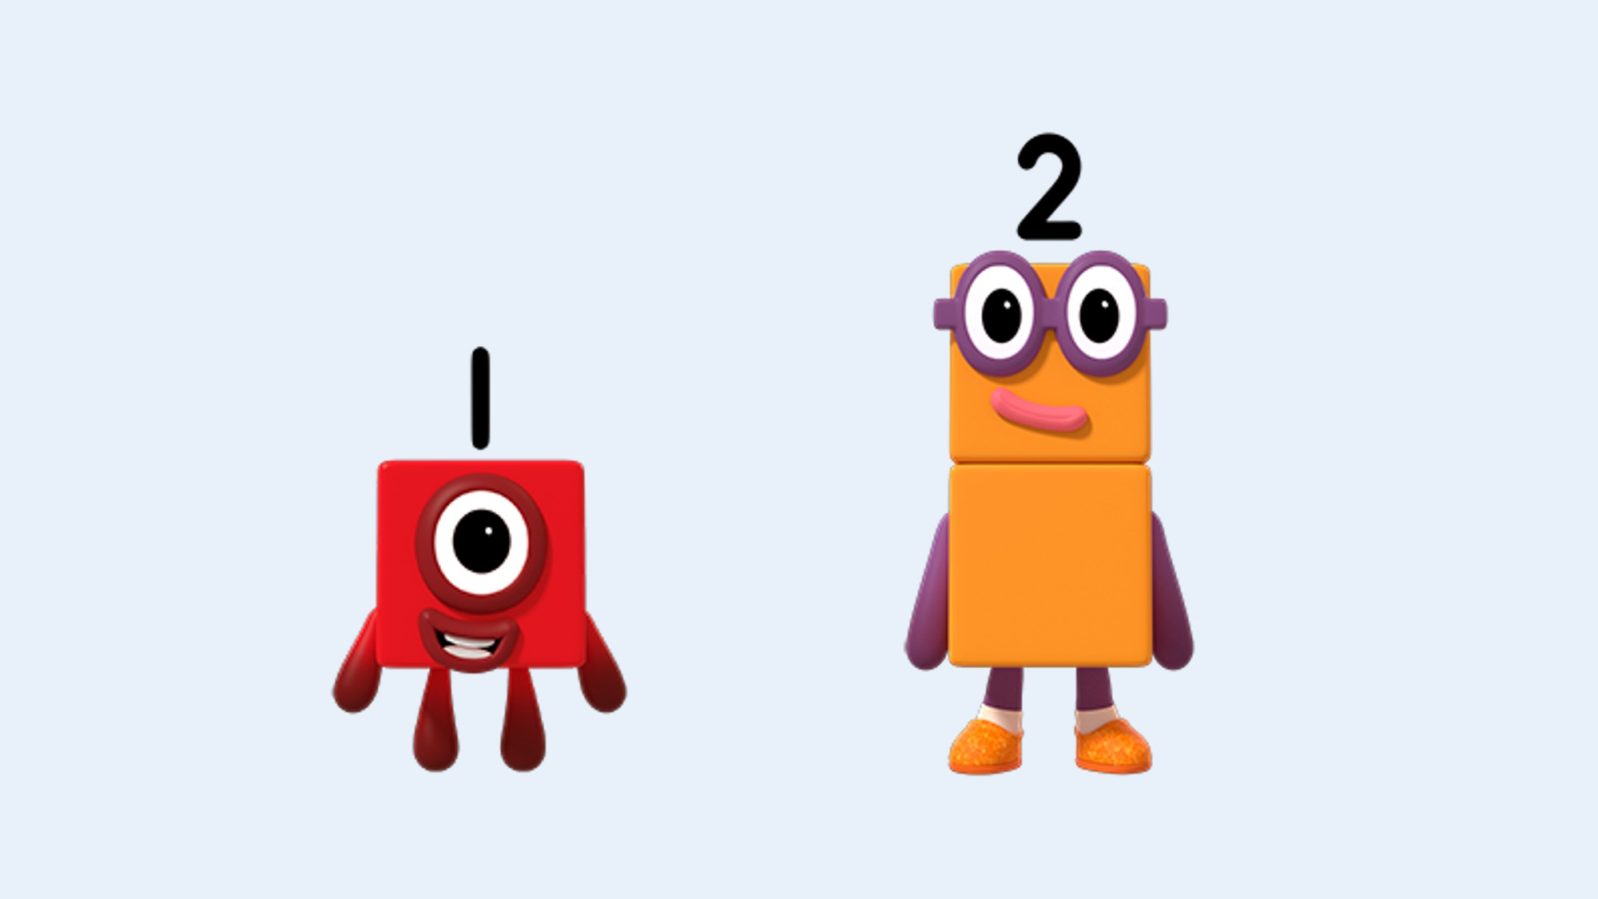
Images © 2017 Alphablocks Ltd. All Rights Reserved.
Notes:
Discuss “What’s the same about One and Two?”
Discuss “What’s different about One and Two?”

Slide 10
Notes:
Prepare in advance a tray of single red connecting cubes and a tray of yellow connecting cubes that have been combined in twos.
Give each child one red cube. Ask them to find a partner and combine their two red cubes.
Each pair holds up their combined red cubes and says “One and Another One is two”.
Each pair can then exchange their 2 ones for 1 two.
In reverse give half of the children in the setting a stick of two yellow cubes. Children have to find a partner that doesn’t have a stick. Each pair takes their yellow stick to the teacher to exchange for two red cubes so that they can each have one red cube.

Slide 11
Enabling Environments

Slide 12
Enabling Environments
Playing and Exploring
Provide a Noah’s Ark small world set to explore pairs of animals.
Provide a basket of socks, or a box of wellies that need sorting into twos.
Active Learning
Make available games that require exactly two children to play (e.g. board games, ball games) encouraging the children to find and ask a friend to play with them.
Make Noah’s Ark masks (two of each) and then sing the song The Animals went in Two by Two.
Creating and Thinking Critically
Encourage the children to be ‘twos detectives’ and collect examples of things that come in twos around the setting for a hands-on display.
Ask children to give out two pieces of fruit per child at snack time.

Slide 13
Learning Together in Y1

Slide 14

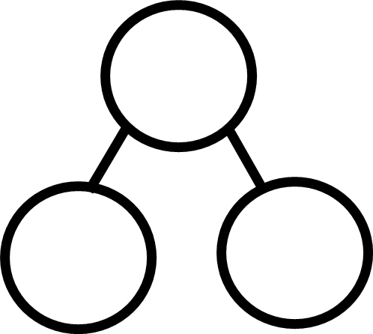
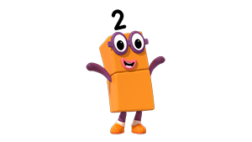

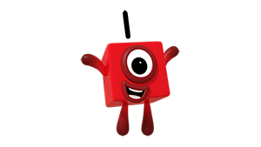



Images © 2017 Alphablocks Ltd. All Rights Reserved.
Notes:
This slide is animated:
Watch the episode and ask the children to comment.
What happened in this episode?
What part did you like?
Have you played tennis or seen tennis being played?
What other games need exactly two people to play?
Click 1: One jumps on top of Another One.
Click 2: Two appears.
Prompt the children to watch what happens. Ask them to describe what is happening.
Use the key phrase “One and Another One is Two”.
Click 3: One and Another One and Two are visible.
Click 4: Part-part-whole model appears.
Click 5: One and Another One appear in the part-part-whole model. Discuss what they see, what is missing in the top circle? (The whole) (Two) Use coloured cubes to act out the problem.
Click 6: Another part-part-whole model appears.
Click 7: 1 and 1 appear in two parts.
Discuss what is whole that is missing from the top circle. (2)
Ask the children to discuss “What’s the same and what’s different about the representations?”

Slide 15




Images © 2017 Alphablocks Ltd. All Rights Reserved.
Notes:
This slide is animated:
Click 1: + appears between One and Another One; = appears next to Two. What can you see? How could we use the symbols to tell a number story about One and Two?
Click 2: Equation appears. How can we read this number sentence? How can we read this equation? What does this 1 mean? What does this 1 mean? What does the 2 mean?
Click 3: The part-part-whole models from the previous slide appear again. What’s the same and what’s different about the representations?

Slide 16
Images © 2017 Alphablocks Ltd. All Rights Reserved.
Notes:
This slide is animated:
Click 1: One on top of Another One appears.
Click 2: One jumps off the top of Another One.
Prompt the children to watch what happens. Ask them to describe what is happening.
Use the key phrase “Two is One and Another One”.
Click 3: One and Another One and Two are visible. Part-part-whole model appears.
Click 4: Two appears in the whole. Discuss what needs to go in the parts. (One and Another One).
Click 5: One and Another One appear in the parts.
Click 6: Another part-part-whole model appears.
Click 7: 2 appears in the whole. Discuss what needs to go in the part. (1 and 1).
Click 8: 1 and 1 appear in the parts.
Discuss: What’s the same and what’s different about the representations?

Slide 17
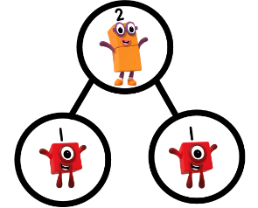




Images © 2017 Alphablocks Ltd. All Rights Reserved.
Notes:
This slide is animated:
Click 1: The equals symbol appears after Two; the addition symbol appear between One and Another One. How can we use these symbols to tell the story about Two, One and Another One?
Click 2: Equation appears. How can we read this number sentence? How can we read this equation? What does the 2 mean? What does this 1 mean? What does this one mean?
Click 3: The part-part-whole models from the previous slide appear again. What’s the same and what’s different about the representations?

Slide 18
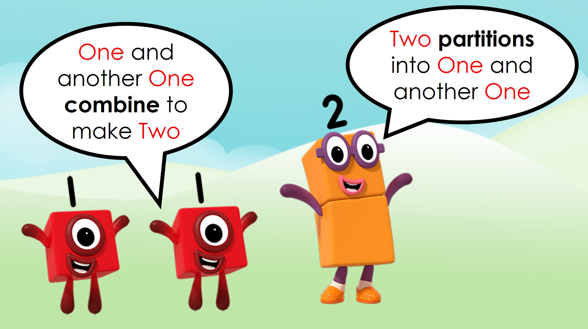
Images © 2017 Alphablocks Ltd. All Rights Reserved.
Notes:
Use this slide to summarise the key learning points about the part-part-whole structure of the number two.

