Slide 1

Checkpoints
Year 8 diagnostic mathematics activities
Solving linear equations
Sixteen Checkpoint activities
Ten additional activities
Published in 2021/22

Slide 2
About this resource
This resource is designed to be used in the classroom with Year 8 students, although it may be useful for other students.
The Checkpoints are grouped around the key ideas in the core concept document, 2.2 Solving linear equations, part of the NCETM Secondary Mastery Professional Development materials.
Before each set of Checkpoints, context is explored, to help secondary teachers to understand where students may have encountered concepts in primary school.
The 10-minute Checkpoint tasks might be used as assessment activities, ahead of introducing concepts, to help teachers explore what students already know and identify gaps and misconceptions.
Each Checkpoint has an optional question marked . This will provide further thinking for those students who have completed the rest of the activities on the slide.
The notes for each Checkpoint give answers (if appropriate), some suggested questions and things to consider.
After each Checkpoint, a guidance slide explores suggested adaptations, potential misconceptions and follow-up tasks. These may include the additional activities at the end of this deck.

Slide 3
Using these Checkpoints
Many of the representations in this deck are likely to be familiar from students’ experience of algebraic thinking in Key Stage 2.
Some formal conventions for algebra are introduced in year 6, and then built upon in Key Stage 3. In the majority of tasks, the algebraic notation used should be familiar from primary school. In some, the learning is mainly from Key Stage 3 (for example Checkpoint 6 uses algebraic expressions to formalise the distributive law). You will need to consider the order of your curriculum to plan how best to use these tasks.
The notes for each slide make it clear how it is best used, and the guidance at the start of each section gives more detail about students’ experience at primary school. We strongly recommend you read each of these first before attempting any tasks with your students.
If students need more practice of writing and interpreting expressions, use the Checkpoints from the ‘Expressions and equations’ deck.
We have tried to build some continuity in representations and structure between different Checkpoints decks: where a Checkpoint uses the word ‘again’ in the title, this indicates a similar task has been used in another deck.

Slide 4
Checkpoints 1–7
Checkpoint | Underpins | Code
1: 2x + 3 | Representing with algebra | 2.2.1 2.2.2 2.2.3 2.2.4
2: Equations for heights again
3: Raisins
4: Balanced scales? | Equality
5: Expressions and equations
6: How far apart?
7: Equal equations
*This three-digit code refers to the statement of knowledge, skills and understanding in the NCETM’s Sample Key Stage 3 Curriculum Framework (see notes below for more information).
Notes:
In the Sample Key Stage 3 Curriculum Framework, statements of knowledge, skills and understanding are arranged to give an example teaching order. The three-digit code for each statement in the framework is a clickable hyperlink to documents with more detailed information, including the key ideas contained within that statement. These key ideas are also shown on slides 6–7 in this deck.

Slide 5
Checkpoints 8–16
Checkpoint | Underpins | Code
8: Back to 20 | Inverse operations | 2.2.1 2.2.2 2.2.3 2.2.4
9a: Make a trail part 1
9b: Make a trail part 2
10: Inverse
11: At the cafe | Solutions to equations
12: Always eight?
13: Might and must
14: Brackets
15: Comparing solutions
16: What do we know about m?
*This three-digit code refers to the statement of knowledge, skills and understanding in the NCETM’s Sample Key Stage 3 Curriculum Framework (see notes below for more information).
Notes:
In the Sample Key Stage 3 Curriculum Framework, statements of knowledge, skills and understanding are arranged to give an example teaching order. The three-digit code for each statement in the framework is a clickable hyperlink to documents with more detailed information, including the key ideas contained within that statement. These key ideas are also shown on slides 6–7 in this deck.

Slide 6
Key ideas
Understand what is meant by finding a solution to a linear equation with one unknown | Code
Recognise that there are many different types of equations of which linear is one type | 2.2.1.1
Understand that in an equation the two sides of the 'equals' sign balance | 2.2.1.2
Understand that a solution is a value that makes the two sides of an equation balance | 2.2.1.3*
Understand that a family of linear equations can all have the same solution | 2.2.1.4
Solve a linear equation with a single unknown on one side where obtaining the solution requires one step | Code
Solve a linear equation requiring a single additive step | 2.2.2.1
Solve a linear equation requiring a single multiplicative step | 2.2.2.2
*‘There are additional resources exemplifying these key ideas in the Secondary Mastery Professional Development | NCETM.

Slide 7
Key ideas
Solve a linear equation with a single unknown where obtaining the solution requires two or more steps (no brackets) | Code
Understand that an equation needs to be in a format to be 'ready' to be solved, through collecting like terms on each side of the equation | 2.2.3.1
Know that when an additive step and a multiplicative step are required, the order of operations will not affect the solution | 2.2.3.2
Recognise that equations with unknowns on both sides of the equation can be manipulated so that the unknowns are on one side | 2.2.3.3*
Solve complex linear equations, including those involving reciprocals | 2.2.3.4
Solve efficiently a linear equation with a single unknown involving brackets | Code
Appreciate the significance of the bracket in an equation | 2.2.4.1
Recognise that there is more than one way to remove a bracket when solving an equation | 2.2.4.2
Solve equations involving brackets where simplification is necessary first | 2.2.4.3
*‘There are additional resources exemplifying these key ideas in the Secondary Mastery Professional Development | NCETM.

Slide 8
Representing with algebra
Checkpoints 1–3

Slide 9
Representing with algebra
Previous learning | In Key Stage 3 students need to
Key Stage 2 curriculum: A thorough understanding of and fluency with the four operations underpins work on algebra, and is built throughout Key stages 1 and 2 Year 6: Express missing number problems algebraically Further information about how students may have experienced this key idea in Key Stage 2: Teaching mathematics in primary schools, 6AS/MD–1: understand that two numbers can be related additively or multiplicatively and quantify additive and multiplicative relationships (multiplicative relationships restricted to multiplication by a whole number) (pp298–301)¹ Primary Mastery Professional Development, Spine 1 Number, Addition and Subtraction, Year 6 Segment 1.31 Problems with two unknowns Key Stage 3 curriculum: 1.4.1.2² Understand that algebraic notation follows particular conventions and that following these aids clear communication 1.4.1.4 Understand and recognise that a letter can be used to represent a specific unknown value or a variable 1.4.1.5 Understand that relationships can be generalised using algebraic statements ¹ Page numbers reference the complete Years 1–6 document ² This four digit code refers to the key ideas in Secondary Mastery Professional Development | NCETM; the KS2 content underpinning these ideas is assessed in the Expressions and equations Checkpoints deck. | Build on the introduction to the language of algebra that began in Key Stage 2; for example, students should be able to express missing-number problems algebraically and find pairs of numbers that satisfy an equation with two unknowns. Understand the difference between an expression and an equation, and the different roles that letters might take. For example, appreciate that letters can represent infinite different values (such as values a variable can take in expressions) or finite values (such as specific solutions to satisfy an equation).

Slide 10
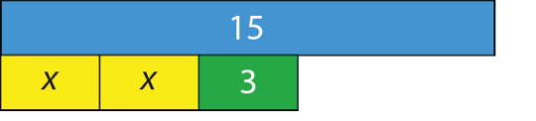
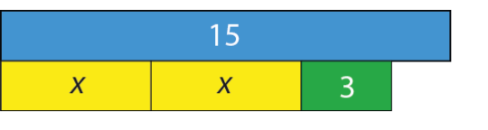
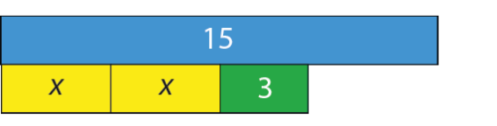
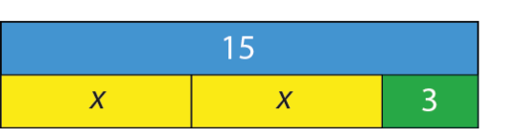
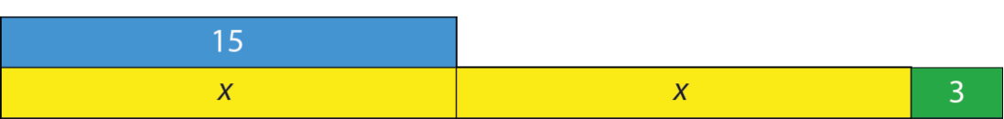
Checkpoint 1: 2x + 3
1
Each image shows a representation of 2x + 3 against a bar. The bar is fixed at 15 units long.
Estimate the value of x in each bar model.
How certain are you that your answer is exact? Why?
2
3
4
5
How would your answers change if the value of the blue (top) bar is doubled? When would the value of x double? When would it be more/less than double?
Notes:
This slide is animated. Each question will appear separately so you can choose the pace at which to work with your class. A printable version of the image can be found on slide 61.
Answers
Students might notice that the bar marked x in the first image is about the same size as the 3, and use this to estimate its value
In the second and third image they should notice that the bar marked x is greater than 3, and maybe compare the two to reason that x is 5 and then 4. Note that x doesn't have to be a whole number. Challenge students to come up with a decimal or fraction that might be a valid answer.
In the fourth image, x = 6.
In the fifth image, x = 15.
? If the value of the blue bar is doubled to 30 there is likely to be some discussion about the scale of the bar (the 3 still has a value of 3), so estimation will give less valid answers.
In summary, the answers are more challenging in the first three parts as these require estimation but the fourth and fifth images can be answered accurately with x being 13.5 and 30 respectively. Explore the fact that one of these is double the original answer and one isn’t.
Suggested questioning
What is the same and what is different about each bar model?
When is your answer exact? When is it not?
Could the x bar be longer than 15? What would the value of the whole equation be then?
Things to think about
Checkpoint 1 explores expressions and equations. In each different image, the same expression is equated to a different value, so the value of x changes. The idea of being able to estimate a solution is revisited in Checkpoints 15 and 16. Students may have used bar models in many different contexts. Consider in advance what is the same and different about their use in solving equations compared to other areas of mathematics. What key features do students need to be aware of?

Slide 11
Checkpoint 1: Guidance
Adaptations | Assessing understanding
Support Start by suggesting particular values that x might be. Scaffold with questions such as, ‘If x = 1, how long is the yellow and green (bottom) set of bars? Does that look right?’ Challenge Challenge students to draw a similar set of bar models for a different relationship. Push their understanding of the representation by suggesting that they draw 2x – 3 instead of 2x + 3 and explore the differences. Representations The bar model here is drawn to scale. This might not always be the case – consider whether this might get in the way of future understanding. Making a decision about whether bar models are drawn approximately to scale or not is important in helping students move from pictorial to symbolic representations of relationships. | In this task students are able to use the lengths of the bars to estimate values of an unknown. Although they are estimating, there is information available for them to reason with – comparing the unknown length to the 3, or to the 15 in the first three examples. In examples 4 and 5, students are able to reason to find an exact value for x. Look for students who are happy discussing 2x + 3 and the ways that they might symbolise the representation. Look also for students who only choose integer values for x, as this may be a misconception. Challenge students to explain how they can be certain in some and not in others – do they understand the importance of equality in manipulating the equations that are offered?
Additional resources Example 6 from key idea 2.2.1.3 from Secondary Mastery Professional Development | NCETM explores the same representation to support students with ‘Understanding solutions balance an equation’. There is more guidance around using bar models in Using mathematical representations at KS3 | NCETM

Slide 12
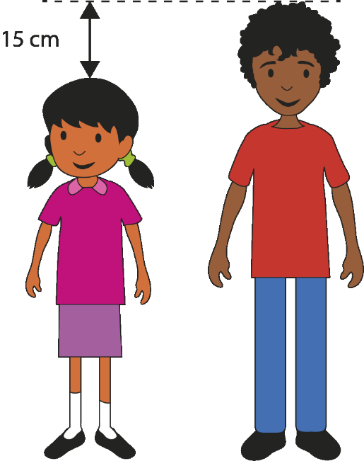
Checkpoint 2: Equations for heights again
Look at the picture of Elinor and Ben.
What do you know about their heights? What do you not know?
Elinor writes an equation for their heights: m + 15 = n.
Which letter represents Elinor’s height? Which represents Ben’s height?
Ben is 145 cm tall. How might Elinor adapt her equation to include this information?
The equation p = n – 20 gives Oscar’s height. Write an equation connecting Oscar and Elinor’s height.
Elinor, Ben and Oscar all lie down head to toe. Write an expression to show all three heights combined in this way. Is there more than one expression you could write?
Notes:
This slide is animated. Each question will appear separately so you can choose the pace at which to work with your class.
Answers
a) We know that Elinor is 15 cm shorter than Ben (or that Ben is 15 cm taller than Elinor). We do not know either of their heights.
b) m represents Elinor’s height and n represents Ben’s height.
c) m + 15 = 145
d) m - 5 = p or p + 5 = m
? There are many different possible solutions, but those that are simplified most are: 3m + 10, 3n - 35, 3p + 25.
NB The name Oscar was chosen because students may be tempted to use ‘o’ either as the first letter of Oscar’s name or as the next letter after m and n. Discuss with students why the letter o is not a sensible choice, as it may be confused with 0, zero. Point out that the letters used are entirely arbitrary.
Suggested questioning
Why is Ben not represented by the letter m?
Which letter represents the taller person? How do you know?
How does the inclusion of values in part c change the equation? What do you now know?
Things to think about
This Checkpoint revisits the context used in Checkpoint 8 of the Expressions and equations deck, to offer both students and teachers a sense of how a mathematical idea progresses. Some of this task is identical, to help you check the prerequisites. The later parts take the task in a different direction, to help you check readiness for new learning. Students may also remember doing the previous task, and the familiar context may help with a sense of coherent small steps.

Slide 13
Checkpoint 2: Guidance
Adaptations | Assessing understanding
Support Consider the relationship m + 15 = n and the different ways that it can be read. For example, ‘m add 15 is equal to n’, or ‘n is 15 bigger than m’. Do the same with the image. For example, ‘Ben is 15 cm taller than Elinor’, or ‘Adding 15 cm to Elinor’s height gives Ben’s height’. This allows the similarities between the two situations to be made apparent . Challenge The further thinking question offers some challenge, and can be extended by asking how much taller than Oscar/Ben/Elinor is the total height, requiring students to write an expression with just one unknown. Representations Abstracting the heights of the children to bar models may make some of the relationships more apparent. | This task uses the same context as Checkpoint 8 from the ‘Expressions and equations’ deck and parts a and b are identical in both checkpoints. Assess how readily students are able to connect symbols with the context that those symbols represent. Note that the letters used are deliberately disconnected from the names of the children (b and e are not used for the heights of Ben and Elinor) so that students independently connect the symbols to the image. Part c fixes the letter symbols by giving a particular to Ben’s height. Look for students who are able to write this as an equation, and also for those who use the information to find Elinor’s height. The final part of the task – part d and the further thinking question – gives an opportunity for students to combine and manipulate expressions symbolically.
Additional resources Key idea 1.4.1.5 from Secondary Mastery Professional Development | NCETM explores ‘Generalising relationships using algebraic statements’ and might give some ideas for where to take this next in Key Stage 3.

Slide 14

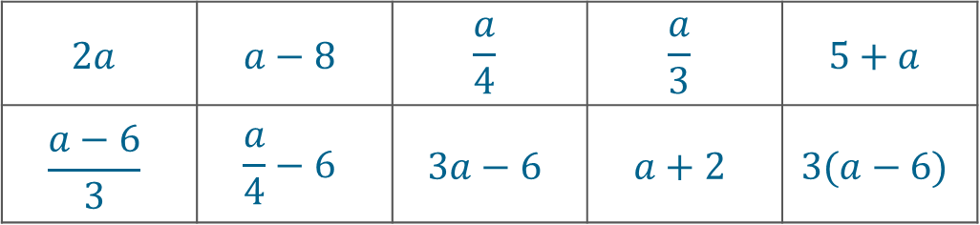
Checkpoint 3: Raisins
Every day, Mazhar takes a box of raisins to school in his lunchbox.
On Monday, he gives some raisins to a friend.
On Tuesday, he shares them equally between the students on his table.
On Wednesday, he is given some raisins by a friend.
On Thursday, he accidentally brings more than one box of raisins.
On Friday, he gives some to a friend and then shares the rest equally with some other students.
Match one of the expressions on the right to each day.
$$2a$$ | $$a−8$$ | $$\frac{a}{4}$$ | $$\frac{a}{3}$$ | $$5+a$$
$$\frac{a−6}{3}$$ | $$\frac{a}{4}−6$$ | $$3a−6$$ | $$a+2$$ | $$3(a−6)$$
For those expressions that you did not use, write a description explaining how the raisins are shared.
Notes:
This slide is animated. Each bullet point will appear separately, followed by the expressions and then the further thinking question, so you can choose the pace at which to work with your class.
Answers
Monday: a – 8
Tuesday: $\frac{a}{4}$ or $\frac{a}{3}$
Wednesday: 5 + a or a + 2
Thursday: 2a
Friday: $\frac{a−6}{3}$
? $\frac{a}{4}−6$: Mazhar shares his raisins equally between himself and three other students (4 students in total) and then takes six raisins out of his portion.
$3a−6$: Mazhar brings three packets of raisins to school, and gives six raisins away.
$3(a−6)$: Mazhar brings three packets of raisins to school, and gives away six raisins from each packet.
Suggested questioning
How many raisins might Mazhar have given/received?
How many students might sit at Mazhar’s table? How do you know?
What does the a stand for?
What other expressions could you write for a?
Things to think about
Students can find it challenging to link abstract algebraic expressions to real-life contexts. Checkpoint 3 offers an opportunity to make sense of what an algebraic expression means in a given context. Consider whether you could use the same set of expressions to interpret a different context, such as a representing the length of time taken to complete a race. Would all of the expressions still be meaningful in this context? How might this deepen students’ understanding? Within the context given here, you might wish to draw attention to the fact that the same letter has been used throughout, which assumes that there is the same number of raisins in the packet each day.

Slide 15
Checkpoint 3: Guidance
Adaptations | Assessing understanding
Support Present students with less information if processing all the expressions and statements is a challenge. You can remove the bottom row of the table, along with Thursday and Friday, and the task will still have a valid assessment purpose. Challenge Present more challenging multi-step situations and see if students can represent them algebraically. For example, ‘Mazhar brought five boxes into school and shared them with everyone on his table but then his friend gave him eight more.’ Representations A box or container with an unknown number of items inside is a common trope for introducing unknowns in algebra. It might be useful to have an actual box with an unknown amount of ‘raisins’ inside so that you can model the real-life situations and help students connect to the algebraic expressions. | Checkpoint 3 checks students’ understanding of algebraic expressions and whether they can interpret what they mean in context. There are no values in the statements, so for some of the days there will be more than one expression that could match. The intention is to dig deeper into students’ understanding of operating with algebra. Where there are multiple answers, a useful follow-up question might be to ask what the situation would be for each number, to see if students can explain what the unknown and the values represent. For example, can they tell you how many students sit at Mazhar’s table for each of the divisions? One common challenge for students is identifying exactly what the ‘a’ represents in this situation. It is not the number of boxes (we know how many boxes there are) but the number of raisins inside the box (as this is not known). Using the language of known/unknown might help students to grasp this – see ‘Representations’ for further suggestions.
Additional resources Key idea 1.4.1.5 from Secondary Mastery Professional Development | NCETM explores ‘Generalising relationships using algebraic statements’ and might give some ideas for where to take this next in Key Stage 3.

Slide 16
Equality
Checkpoints 4–7

Slide 17
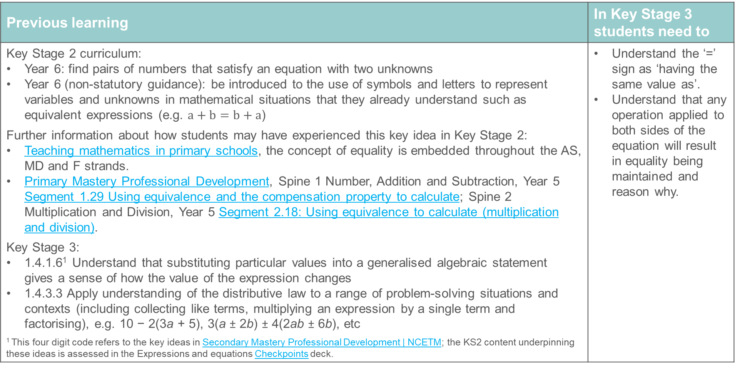
Equality
Previous learning | In Key Stage 3 students need to
Key Stage 2 curriculum: Year 6: find pairs of numbers that satisfy an equation with two unknowns Year 6 (non-statutory guidance): be introduced to the use of symbols and letters to represent variables and unknowns in mathematical situations that they already understand such as equivalent expressions (e.g. $a+b=b+a$) Further information about how students may have experienced this key idea in Key Stage 2: Teaching mathematics in primary schools, the concept of equality is embedded throughout the AS, MD and F strands. Primary Mastery Professional Development, Spine 1 Number, Addition and Subtraction, Year 5 Segment 1.29 Using equivalence and the compensation property to calculate; Spine 2 Multiplication and Division, Year 5 Segment 2.18: Using equivalence to calculate (multiplication and division). Key Stage 3: 1.4.1.6¹ Understand that substituting particular values into a generalised algebraic statement gives a sense of how the value of the expression changes 1.4.3.3 Apply understanding of the distributive law to a range of problem-solving situations and contexts (including collecting like terms, multiplying an expression by a single term and factorising), e.g. 10 − 2(3a + 5), 3(a ± 2b) ± 4(2ab ± 6b), etc ¹ This four digit code refers to the key ideas in Secondary Mastery Professional Development | NCETM; the KS2 content underpinning these ideas is assessed in the Expressions and equations Checkpoints deck. | Understand the ‘=’ sign as ‘having the same value as’. Understand that any operation applied to both sides of the equation will result in equality being maintained and reason why.

Slide 18
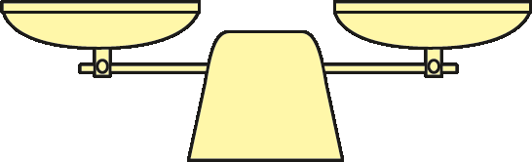

Checkpoint 4: Balanced scales?
These scales are balanced.
If each set of two items in a to d below was placed on either side of the scales, would they balance?
a)
b)
These scales are not balanced.
c)
d)
For the scales that are not balanced, which set of items is heavier? Is a hexagon heavier or lighter than a triangle?
If the scales had a total of three triangles, could you make them balance?
Notes:
This slide is animated. Each question will appear separately so you can choose the pace at which to work with your class.
Answers
a) Yes
b) Yes
c) Conditionally yes – but only if the orange circle has the same weight as a red triangle.
d) Yes
? The triangle is heavier than two hexagons. Continuing with this reasoning, a set of scales with three of these triangles spread across them can’t be balanced.
Suggested questioning
What is the same and what is different about each image?
How could you change the unbalanced scales so that they are balanced.
What do you know about each shape? What do you not know?
Complete the sentence: __ (e.g. triangles) is the same as __.
Things to think about
Checkpoint 4 offers some examples of balanced (and unbalanced) scales to for students to consider. Think about how you might connect this to later work on manipulating equations (see Checkpoint 6). Do students connect the abstraction with the representation? For example, how would your students respond if you modelled the initial image as 2h + c = 2t, and then showed part a as 4h + 2c = 4t? Would they recognise that both ‘sides’ have been doubled? In the example described, the alterations are multiplicative. Contrast these with part d, where the alterations are additive. Do students reason or think differently in these two scenarios?

Slide 19
Checkpoint 4: Guidance
Adaptations | Assessing understanding
Support Use tiles to construct the different situations to offer some clarity to different ways in which equilibrium can be maintained. Challenge Ask students if the scales in a and b were combined, would the result also be balanced? How about if the right-hand scale of b was added to the left-hand scale of a, and vice versa? Situations in which two qualities can be combined to maintain equality provide a rich source of questioning. Representations A balanced scale is a common representation for equality, with the balanced scales used here as a representation of the = sign. It may have been the basis for earlier work on equality, and students’ familiarity with this representation may support work on solving equations. Translating these situations using symbols may also help to support understanding of both representations. | This checkpoint assesses students’ understanding of mathematical equality without the use of symbols (although using symbols to represent each situation might be a useful task to consider). In part a the two ‘sides’ have been doubled, while parts b and d use an additive change while still maintaining equality. Part c offers an opportunity to reason with the different images and assess whether students are able to interpret the necessary conditions for a statement to remain true. Look for students who might use symbols to represent the situation, and students who justify ‘doing the same thing to each side’ to maintain equality.
Additional resources Checkpoints 1 and 2 from the ‘Expressions and equations’ deck also use the representation of a balanced scale to explore equations. Key idea 2.2.1.3 from Secondary Mastery Professional Development | NCETM explores ‘Understanding solutions balance an equation’ and may give some further ideas for how to deepen students’ understanding of solutions.

Slide 20

Checkpoint 5: Expressions and equations
Choose two expressions from the box on the right to make this equation true:
8 + 10 + 12
6 × 5
50 – 20
3 × 10
=
3 × 5 × 2
a
Another expression is added to the box:
3 × 10 + 1
If this expression is used in the equation, which other expressions could be used to make it true?
(7.5 – 2.5) × 6
2a + 1
9 + 10 + 11
Think of your own expression using a. What equations can you create using this expression? What would be the value of a each time?
Notes:
This slide is animated. Each question will appear separately so you can choose the pace at which to work with your class.
Answers
a) Any two expressions from the box could be used, as they all either have a value of 30 or unknowns.
b) Now, only the two expressions with unknowns could be used to be equal to 3 × 10 + 1, as a could represent any number.
? Students’ responses may vary, as there are infinite possibilities for this. Look out for students creating impossible expressions such a + 1 = 2a + 2.
Suggested questioning
What is the same and what is different about the expressions?
Can you write an equation that nobody else has considered?
Things to think about
Checkpoint 5 takes expressions and asks students to use them to make equations. Check that students understand the difference between these two terms. The intention is not to start solving equations through this task, but to check that students have appropriate understanding of the equals sign to be ready to solve equations.

Slide 21
Checkpoint 5: Guidance
Adaptations | Assessing understanding
Support Remove the bottom four expressions, leaving just the top if, if students struggle to think about them simultaneously. Challenge Introduce the inequality symbols and ask students what mathematically true statements they can write with the expressions in parts a and b now. Does this change the possible values of a? Representations The focus is on the symbolic representation of equality. Students need to use ‘=‘ to connect two equivalent expressions, and understand the idea of these two expressions ‘balancing’, before moving on to manipulate and solve equations. | Checkpoint 5 explores equality, and whether students understand that the equals sign connects expressions that are equivalent. A common misconception is that the equals sign represents a stage in a process, indicating that the operation on the left hand side ‘makes’ the value on the right. This misconception is challenged as there are no single values for students to choose – instead, they have to ‘balance’ two expressions. Key to this task is the gradual realisation that there is no wrong answer for part a: all of the expressions either have a value of 30, or have an unknown so could have a value of 30. Look out for students who want to write ‘30’ rather than one of the expressions – do they need more practice working with the equals sign to be ready to manipulate equations to solve them? Part b includes a new expression, to see which students can reason that, since we know this expression has a value of 31, it can no longer be equal to the expressions with a value of 30. It can, however, be equal to the expressions with unknowns, since a can take any value. If students get this, probe readiness for solving by asking them what the value of a might be. Pay attention to the informal strategies that they use, and consider how to build on this when teaching how to solve equations formally.
Additional resources Additional activity A uses the same structure but takes the next step into finding solutions. Key idea 2.2.3.3 from Secondary Mastery Professional Development | NCETM explores ‘Manipulating equations with unknowns on both sides’ and gives ideas of where to go after additional activity A.

Slide 22
Checkpoint 6: How far apart?
The expression 3a + 5 is 4 more than the expression 3a + 1.
Which of the pairs of expressions a to d is furthest apart?
a)
3a + 2
3(a + 2)
b)
3a + 6
3(2 + a)
c)
3a + 20
3(7 + a)
d)
12 + 3a
3(a + 6)
5a + __
5(a + __)
Choose two numbers to complete these two expressions so that they are:
12 apart
3 apart
the same
as close together as possible.
Notes:
This slide is animated. Each question will appear separately so you can choose the pace at which to work with your class.
Answers
3a + 12 and 3(a + 6) because they are 6 apart.
3a + 2 and 3(2 + a) are 4 apart; 3a + 6 and 3(a + 2) are the same; 3a + 20 and 3(7 + a) are 1 apart.
? There are infinite possible answers. Below are some potential examples.
12 apart: any pair of expressions where the difference between the first missing number and 5 times the second missing number is 12, e.g. 5a + 3 and 5(a + 5) or 5a + 18 and 5(a + 6)
3 apart: any pair of expressions where the difference between the first missing number and 5 times the second missing number is 3, e.g. 5a + 2 and 5(a + 1) or 5a + 12 and 5(a + 3).
The same: any pair of expressions where the first missing number is equal to 5 times the second missing number, e.g. 5a + 5 and 5(a + 1) or 5a + 50 and 5(a + 10)
As close together as possible: arguably, this is impossible, since it is always possible to add a greater degree of accuracy to the first missing number. For example, 5a + 9 and 5(a + 2) are 1 apart, so students could write 5a + 9.9 to be 0.1 apart, or 5a + 9.9999 to be 0.0001 apart (and so on). We suggest comparing students’ answers to see who can get the closest pair of expressions.
Suggested questioning
What is the same and what is different about each pair of expressions?
Which terms are being multiplied by three in each case?
How can you write a similar pair of expressions that are further apart?
Things to think about
Checkpoint 6 assesses students’ depth of understanding of the distributive law and what brackets in expressions mean. Students can often be very fluent at rewriting expressions with and without brackets, but do not necessarily think deeply about equivalence and the distributive law. Drawing students’ attention to which terms are being multiplied by three might help them to recognise that the number terms in the brackets are all, actually, three times bigger than written.

Slide 23
Checkpoint 6: Guidance
Adaptations | Assessing understanding
Support Use a blank number line alongside this Checkpoint. Mark 3a in one position, then 3a + 2 (2 to the right) and 3a + 6 (a further 4 to the right). This may help students to see how far apart the two expressions are and support their thinking for the other three pairs. Challenge Ask students to compare two with different coefficients, such as 4(a + 2) and 3a + 10. Do we have enough information to know which is bigger? For what values of a would one be bigger than the other? Representations These expressions are presented without representations; see if students reach towards a representation to support their thinking. A bar model (with a bar of unknown length for a and a square with the same height for every 1) might help students to visualise the differences between each pair. See ‘Support’ and Additional activity C for suggestions on how a number line might also be a useful representation. | Checkpoint 6 explores students’ understanding of the distributive law. Specifically, check if they know that, in the two expressions ab + c and a(b + c), there is one term that is the same (ab) and one term that is not (i.e. in the second expression, the second term is not really c but ac). The approach that students take might tell you about the depth of their algebraic thinking. Do they choose a value for a and use this to compare each pair of expressions? This might suggest that they are more comfortable with thinking in the particular, and not yet confident with generalisation. Do they expand the brackets before comparing? Those most confident might be able to reason without formally expanding, and just compare the numerical terms.
Additional resources Additional activities B and C offer some different ways to explore the same mathematical idea. Key idea 1.4.3.1 from Secondary Mastery Professional Development | NCETM explores Multiplying expressions by terms if students need more time and different representations to explore the distributive law.

Slide 24
Checkpoint 7: Equal equations
If w = 15, fill in the gaps so that each of these equations is true.
___ = 16 | 10w = ___ | ___ = 5
w – 9 = ___ | ___ = 30 | w ÷ 10 = ___
If w + y = 15, fill in the gaps so that each of these equations is true.
___ = 16 | 2(w + y) = ___ | ___ = 3
60 = ___ | 2w + y = ___ | ___ = 15 – y
If 2w = 15, what other equations can you write?
How about if 2w + y = 15?
Notes:
This slide is animated. Part b and the further thinking question will appear separately so you can choose the pace at which to work with your class. A printable resource can be found on slide 62.
Answers
a)
w + 1 = 16 or 31 – w = 16
10w = 150
w ÷ 3 = 5 or w – 10 = 5 or 20 – w = 5
w – 9 = 6
2w = 30 (or equivalent expression that simplifies to this) or w + 15 = 30 or 45 – w = 30 or 450 ÷ w = 30
w ÷ 10 = 1.5
b)
w + y + 1 = 16 or 31 – (w + y) = 16
2(w + y) = 30
(w + y) ÷ 5 = 3 or w + y – 12 = 3
4(w + y) = 60 or w + y + 45 = 60
2w + y = 15 + w
w = 15 – y
? There are an infinite number of solutions. Check that students’ equations still balance, paying particular attention to order of operations with brackets, multiplication and the use of fraction notation for division. For example, it would be incorrect to write 4w + y = 30. Students either need to write 2(2w + y) = 30 or 4w + 2y = 30.
Suggested questioning
Do any of your questions have more than one answer?
Which did you find hardest? Why?
Is there more than one way to think about any of these? Did anyone have a different strategy?
Things to think about
Checkpoint 7 may be a helpful precursor to any teaching on algebraic manipulation, whether it is solving equations or rearranging formulae. Students may be tempted to try and find a value for w: emphasise that this is not the point, and that an answer to a question does not have to be a numerical value – it can be an algebraic expression or equation. On this point, read the note about procepts in the Guidance slide for Checkpoints 9a and 9b.

Slide 25
Checkpoint 7: Guidance
Adaptations | Assessing understanding
Support Draw two columns on the board – one for additive changes, and one for multiplicative changes. Write specific examples in each, starting with those given and adding more if more discussion is needed. Focus just on examples that involve an additive change first before moving onto multiplicative changes. Include examples that could go in both columns (such as __ = 30), and discuss what is the same and what is different. Challenge Ask students to repeat the challenge question for a more complex equation, such as one that has unknowns on both sides. Representations Revisit the representation of balanced scales: draw scales with w on one side and 15 on the other, and model how any change has to be the same on both sides to maintain balance. | Checkpoint 7 explores students’ understanding of equality with algebraic representations. Ascertain students’ confidence with manipulating algebra, and whether any specific operations cause particular problems for them. Rather than go through each one in turn, see how they get on with all six expressions in one part and encourage them to move on if they are struggling. You could ask them to split a mini-whiteboard into a 3 by 2 grid and complete as many gaps as they can from part a - see where they have problems. You could repeat this for part b. There are some parallels between parts a and b to support students to recognise that they can still manipulate an expression that is longer than a single letter. Pay particular attention to the middle column in part b – this explores students’ understanding of brackets and when they have performed an operation on a ‘whole’ expression, which is a common source of mistakes and misconceptions.
Additional resources Additional activities B, C, D and E go further into common misconceptions with brackets, division and order of operations within equations, which may be useful if the middle column of part b posed a particular problem for students. Key idea 2.2.3.3 from Secondary Mastery Professional Development | NCETM explores ‘Manipulating equations with unknowns on both sides’

Slide 26
Inverse operations
Checkpoints 8–10

Slide 27
Inverse operations
Previous learning | In Key Stage 3 students need to
Key Stage 2 curriculum: A thorough understanding of and fluency with the four operations underpins work on algebra, and is built throughout Key stages 1 and 2 Year 4: estimate and use inverse operations to check answers to a calculation Further information about how students may have experienced this key idea in Key Stage 2: Teaching mathematics in primary schools, 6AS/MD–2: use a given additive or multiplicative calculation to derive or complete a related calculation, using arithmetic properties, inverse relationships, and place-value understanding (pp 302–04)¹; 6AS/MD–4: solve problems with 2 unknowns (pp308–12 Primary Mastery Professional Development, Spine 1 Number, Addition and Subtraction, Year 5 Segment 1.29 Using equivalence and the compensation property to calculate; Spine 2 Multiplication and Division, Year 5 Segment 2.18: Using equivalence to calculate (multiplication and division). Key Stage 3 curriculum: 2.1.5.4² Calculate using priority of operations, including brackets, powers, exponents and reciprocals ¹ Page numbers reference the complete Years 1–6 document ² This four digit code refers to the key ideas in Secondary Mastery Professional Development | NCETM; the KS2 content underpinning these ideas is assessed in the Arithmetic procedures Checkpoints deck. | Correctly use order of operations, along with inverse operations Experience doing and undoing in the context of equations to develop their understanding of how to perform the correct inverse operation, in the correct order

Slide 28
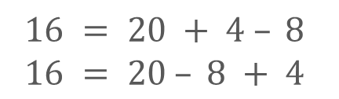
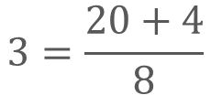
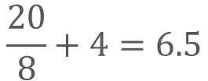
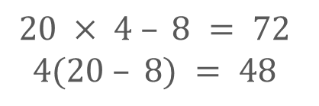
Checkpoint 8: Back to 20
For each of the function machines:
Decide which of the two equations given below it represents.
Work out what would need to go in the machine to ‘get back to 20’.
1
− 8
× 4
2
÷ 8
+ 4
3
− 8
+ 4
20
20
20
$$20 × 4 – 8 = 72$$
$$4(20 – 8) = 48$$
$$\frac{20}{8}+4=6.5$$
$$3=\frac{20+4}{8}$$
$$16 = 20 + 4 – 8$$
$$16 = 20 – 8 + 4$$
Create other function machines using two operations and the numbers 8 and 4. When does order matter? When does it not?
Notes:
This slide is animated. Each function machine, and then the further thinking question, will appear separately so you can choose the pace at which to work with your class. Printable function machines can be found on slide 63.
Answers
1a) 4(20 – 8) = 48
1b) 48 → [÷ 4] → [+ 8] → 20
2a) $\frac{20}{8}+4=6.5$
2b) 6.5 → [+ 4] → [× 8] → 20
3a) 16 = 20 – 8 + 4
3b) 16 → [− 4] → [+ 8] → 20
NB for 3a and 3b, while this is the order given for this particular function machine, students may notice that, as these are equivalent operations, the actual order does not matter.
Suggested questioning
How do you know in which order to ‘undo’ the functions to go back to 20?
Do any have more than one answer?
Co you write an equivalent function machine that would lead to the same number?
Things to think about
An understanding of inverse operations is essential to solving equations. Checkpoint 8 offers an opportunity to explore this. The functions operate on a numerical value, but there is an algebraic version in the Additional activities (F) . The NCETM’s professional development materials embed algebra and number together in two themes: ‘The structure of the number system’ and ‘Operating on number’. It is important that students can make connections between different areas of mathematics, and seeing algebra as structurally the same as number, just with unknowns, can be helpful.

Slide 29
Checkpoint 8: Guidance
Adaptations | Assessing understanding
Support Begin by sharing some one-step function machines with students, so that they can familiarise themselves with this representation and you can check their understanding of inverse operations. Challenge Ask students to write equations from more complex function machines, with multiple multiplicative and additive steps. Do they understand where brackets are needed? Representations A function machine is used here as a representation of the order of operations, specifically to help students consider the steps needed to ‘return’ to a given number (or variable). It might be a representation that you consider using to support your teaching of solving equations, but be aware that it does not support understanding of equality so has some limitations. | Checkpoint 8 looks at inverse operations, specifically the order in which they need to be ‘undone’ to return to the original number. Functions machines are presented alongside equations, so that students see both representations of operating on an unknown. Be aware of students who see the equals sign as indicating a process that goes from left to right (i.e. they see an equation almost as a function machine). While they may be comfortable in identifying inverse operations, they may find it harder to understand the process of balancing equations using inverse operations and struggle to set out their workings correctly. This can cause problems as more complex algebraic ideas are introduced. The last example introduces the idea of commutativity and when order doesn’t matter. Listen out for those students who think that 16 is not the correct answer for 20 – 8 + 4; they may not have a secure understanding of the order of operations and incorrectly think addition has priority over subtraction.
Additional resources The question on page 16 of the Secondary Assessment Materials | NCETM explores the same idea. If students are not secure with the order of operations, try Checkpoints 29 to 32 from the ‘Arithmetic procedures’ deck. Additional activity F introduces an unknown using the same structure, to connect to solving equations.

Slide 30
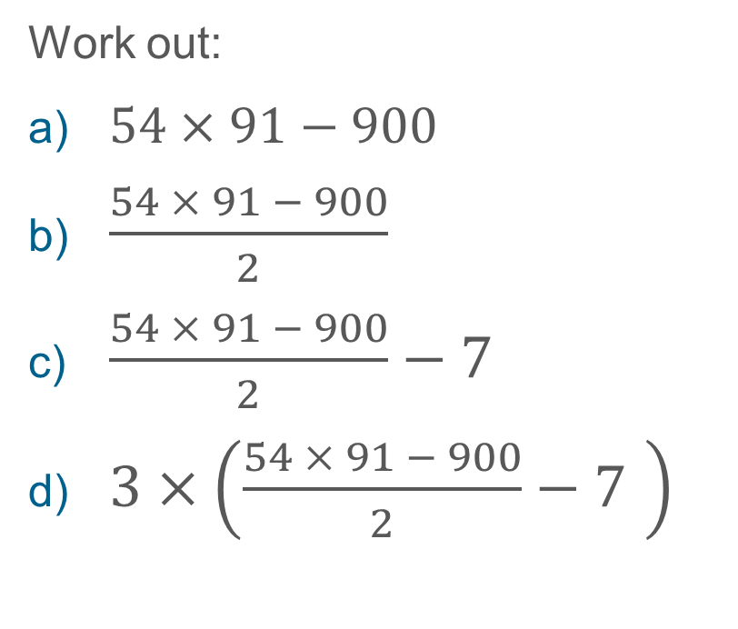

Checkpoint 9a: Make a trail part 1
$$54 × 91 = 4 914$$
Work out:
$54×91−900$
$\frac{54 × 91 − 900}{2}$
$\frac{54 × 91 − 900}{2}−7$
$3×\left(\frac{54 × 91 − 900}{2}−7 \right)$
Make a different trail, starting from 54 × 91, that has the same finishing number as your answer to part d. Can you make three different trails all with the same outcome?
Notes:
This slide is animated. Each question will appear separately so you can choose the pace at which to work with your class. A printable version of Checkpoints 9a and 9b can be found on slide 64.
Answers
a) 4014
b) 2007
c) 2000
d) 6000
? Students’ responses may vary: these routes are likely to be individual and unique.
Suggested questioning
What is the same and what is different about __ compared to the previous equation?
What do you need to ‘do’ to 4914 if 900 has been subtracted from 54 x 91?
What is the same and what is different in each part?
How can you write your own calculation trail?
Things to think about
Checkpoints 9a and 9b are a pair with a single Guidance slide. They both offer slightly different structures for exploring the same idea: a ‘trail’ of operations on a number, getting increasingly more complex. This idea of ‘doing’ and ‘undoing’ is essential for solving equations. Pay particular attention to how students set out their working at each stage: this will tell you how accurately students record their thinking. For example, you may need to clarify the ‘=‘ as a symbol of equality rather than process. Much like with Checkpoint 8, the intention is that hooking students’ attention onto number first will allow you to show that, when algebra is introduced, the structure is actually the same.

Slide 31
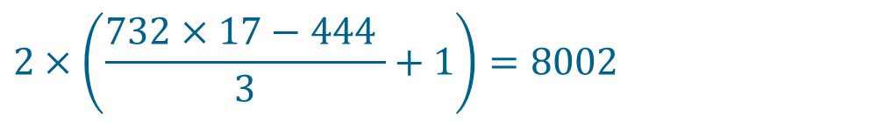
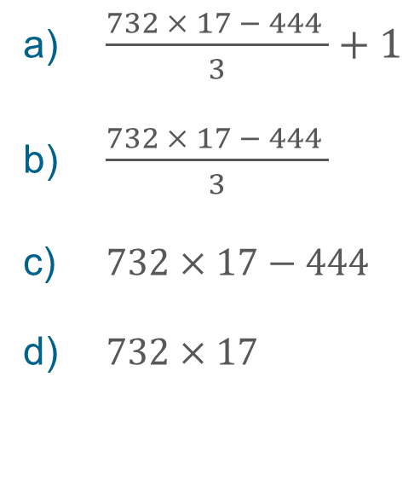
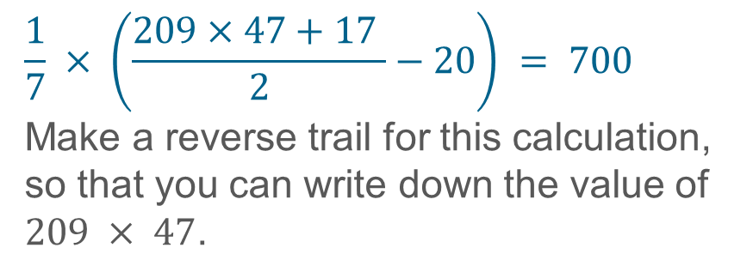
Checkpoint 9b: Make a trail part 2
Becky made the calculation trail below. The result of the trail is 8 002.
$$2×\left(\frac{732×17−444 }{3}+1\right)=8002$$
Use this to work out the answers to:
$\frac{732 × 17 − 444 }{3}+1$
$\frac{732 × 17 − 444 }{3}$
$732×17−444$
$732×17$
$$\frac{1}{7} × \left(\frac{209×47\text{ + 17} }{2}−20\right) = 700$$
Make a reverse trail for this calculation, so that you can write down the value of $209 × 47$.
Notes:
This slide is animated. Each question will appear separately so you can choose the pace at which to work with your class. A printable version of Checkpoints 9a and 9b can be found on slide 64.
Answers
4001
4000
12000
12444
? 209 x 47 = 9823
The route to this solution is likely to be:
(209 x 47 + 17)/2 – 20 = 4900
(209 x 47 + 17)/2 = 4920
209 x 47 + 17 = 9840
209 x 47 = 9823
Suggested questioning
What is the same and what is different about __ compared to the previous equation?
What do you need to ‘do’ to 4914 if 900 has been subtracted from 54 x 91?
What is the same and what is different in each part?
How can you write your own calculation trail?
Things to think about
Checkpoints 9a and 9b are a pair with a single Guidance slide. They both offer slightly different structures for exploring the same idea: a ‘trail’ of operations on a number, getting increasingly more complex. This idea of ‘doing’ and ‘undoing’ is essential for solving equations. Pay particular attention to how students set out their working at each stage: this will tell you how accurately students record their thinking. For example, you may need to clarify the ‘=‘ as a symbol of equality rather than process. Much like with Checkpoint 8, the intention is that hooking students’ attention onto number first will allow you to show that, when algebra is introduced, the structure is actually the same.

Slide 32
Checkpoints 9a and 9b: Guidance
Adaptations | Assessing understanding
Support Identifying what’s the same and what’s different in each line might be enough for students to access the task. Some students may be intimidated by what appear to be lengthy and complex calculations. Deconstructing these using knowledge of the order of operations is the focus here. Challenge Invite students to write their own, to build up ever longer equations for you to solve. You might like to set some conditions such as, there must be at least two divisions or squaring must be included, to challenge the use of notation and order of operations still further. Representations The notation is the key representation here. The use of a function machine may help students to deconstruct and identify the stages and inverse operations necessary. | The expression 3x means ‘multiply whatever x is by three’ and is also the answer to the question, ‘What do you get when you multiply x by 3?’. Giving opportunities for students to show that they can work between these two interpretations, along with an understanding of equality and how it is maintained underpins Checkpoint 9a and 9b. Look for students who are comfortable manipulating the expressions without needing to calculate each step individually and those who are fluent with the order of operations. This fluency may be particularly apparent with the second task which involves identifying inverse operations in the correct order.
Additional resources If students are not secure with the order of operations, try Checkpoints 29 to 32 from the ‘Arithmetic procedures’ deck.

Slide 33
Checkpoint 10: Inverse
Hamsa uses a calculator to work out that 31.5 × 17.2 + 10 = 551.8
Without using a calculator, write down 541.8 ÷ 17.2
Mike uses a calculator to work out that (106.3 + 10.1) × 35.9 = 4178.76
Without using a calculator, write down 4178.76 ÷ 116.4
Alex uses a calculator to work out that (23 × 277 – 1) ÷10 = 637
Without using a calculator, write down 23 × 277
Write your own question like those above. Make sure that it’s easy to work out the final answer without using a calculator.
Notes:
This slide is animated. Each question will appear separately so you can choose the pace at which to work with your class.
Answers
a) 31.5
b) 35.9
c) 6371
? Students’ answers will vary infinitely.
Suggested questioning
What do you notice about the values in bold?
What is the same and what is different about the two calculations in each question?
Things to think about
In Checkpoints 9a and 9b, students were guided through inverse calculations in small steps. Here, they need to make those steps themselves. How might your modelling of the answers draw attention to the learning points that will be most useful for future teaching of solving equations. If students ‘get’ this, it could be a very quick Checkpoint – encourage them to think deeply about how they structure their responses to the further thinking question. Early finishers could challenge each other with the questions they create.

Slide 34
Checkpoint 10: Guidance
Adaptations | Assessing understanding
Support Prompt students to identify what’s the same and what’s different to support them in accessing the task. Noticing those elements that can be easily combined – seeing one expression inside another – is key. To help students recognise these, you could use different colours or underlining/circling to highlight the same expression. Challenge Ask students to add a further layer or two of complexity to the given calculations. For example, dividing both sides of the equation in part a by 2 (so that the calculation becomes equal to 2089.38). Further examples of this layering of complexity can be found in Checkpoint 9a and 9b. Representations Use of function machines to help in seeing the order and structure in each calculation and in identifying what’s the same and what’s different. | Explore the use of inverse operations to maintain equality. Noticing one expression ‘inside’ the other and identifying the necessary inverse operations to easily calculate is the assessment focus. In parts a and b these are supported by bold text. Some students might just see this as a complex calculation and see the instruction of ‘without using a calculator’ as an invitation to use written methods. These students might need more support and practice with choosing efficient methods; encourage them to stop and look more carefully at the values before starting to calculate. Look for students who are comfortable in not ‘closing’ the expressions each time, and those who are able to use the mathematical structures apparent to identify and reverse operations. These students likely have a deeper and more flexible understanding of the structure of calculations that can be built on with algebra.
Additional resources If students are not secure with the order of operations, try Checkpoints 29 to 32 from the ‘Arithmetic procedures’ deck. Checkpoint 15 in the ‘Expressions and equations’ deck similarly asks students to simplify seemingly complex calculations (using the distributive law) and could be explored if students find this idea challenging.

Slide 35
Solutions to equations
Checkpoints 11–16

Slide 36
Solutions to equations
Previous learning | In Key Stage 3 students need to
Key Stage 2 curriculum: Year 6: express missing numbers algebraically Year 6: find pairs of numbers that satisfy an equation with two unknowns Year 6: enumerate possibilities of combinations of two variables. Further information about how students may have experienced this key idea in Key Stage 2: Teaching mathematics in primary schools, 6AS/MD--4: solve problems with 2 unknowns (pp308–12).¹ Primary Mastery Professional Development, Spine 1 Number, Addition and Subtraction, Year 6 Segment 1.31: Problems with two unknowns Key Stage 3 curriculum: 1.4.1.4² Understand and recognise that a letter can be used to represent a specific unknown value or a variable ¹ Page numbers reference the complete Years 1–6 document ² This four digit code refers to the key ideas in Secondary Mastery Professional Development | NCETM; the KS2 content underpinning these ideas is assessed in the Expressions and equations Checkpoints deck. | Appreciate that number and algebra are connected, that linear equations can be the formulation of more than one operation on unknown numbers. Understand that the solving of these equations is concerned with the undoing of these operations in the correct order to find the value of the unknown. Be aware that linear equations have only one solution. Have opportunities to work on examples of equations that lead to a range of solutions, including positive, negative and fractional. Solve linear equations with a single unknown, including with brackets. Appreciate that an equation such as x = 5 is a linear equation (to which the solution is obvious) and that all other linear equations which are a transformation of this have the same solution. Rather than just following a set of procedural rules for solving equations, also have a sense of what a solution means (for example, by exploring a range of examples and non-examples). Understand that, when solving linear equations that have more than one step, solutions can be found in multiple ways if equality is maintained; consider which operations might be most efficient. Be aware that all equations of the type ax + b = cx + d can be reduced to the form fx + g = h.

Slide 37



Checkpoint 11: At the cafe
The pictures show three orders of fruit juice, tea and cookies in a cafe. They also show the cost of each order.
£16.50
£14.00
£14.50
Is it possible to work out the price of one of each item?
Surinder orders two teas, two cookies, two milkshakes and a cake. The total cost is £15. What can you work out? Is it possible to work out the price of a milkshake? A cake?
Notes:
This slide is animated. Each image, the main question and the further thinking question will appear separately so you can choose the pace at which to work with your class.
Answers
It is possible to work out the price of each item.
A tea is £2
A fruit juice is £2.50
A cookie is £3.50
? It is possible to say that the two milkshakes and a cake cost £4 together, but not any more than that.
Suggested questioning
What is the same and what is different about each picture?
What do you know? How do you know this?
Which item is it easiest to work out? Why?
Things to think about
Checkpoint 11 asks students to reason with more than one unknown. Though students will have experienced problems like this at primary school, to secondary teachers this might feel like an introduction to simultaneous equations. We strongly suggest it is not. It is an opportunity to watch and listen to how students engage with algebraic thinking, to help gauge their confidence with reasoning before you introduce more formal solving of equations.

Slide 38
Checkpoint 11: Guidance
Adaptations | Assessing understanding
Support Use structured question prompts, such as, ‘What is the same and what is different?’ to give students access to the task. You could structure this more by focusing on the image and then on the total price in each situation. Challenge Ask students to write down some more orders and their total cost, including using the prices in the further thinking question. Are there any orders for which they can’t work out the total cost? Representations A bar model might be more familiar and make more obvious where situations are equal, and where they are different. | The task gives insight into students’ deductive reasoning and whether they understand that one fact can be drawn from another. The context is familiar and students should be able to reason without using symbolic algebra, but correctly representing each situation symbolically might offer an insight into their understanding. Seeing one situation in another is key to this task. Making structured comparisons such as, ‘There’s one tea more in that picture, and the total is £2 more’, and interpreting these is a skill that underpins symbolic algebraic manipulation. Students will have reasoned about equations with two unknowns in the primary curriculum, and this task assesses that reasoning. It is not a moment to introduce formal solving of simultaneous equations, although you might like to revisit this task to assess students again before teaching simultaneous equations at a later stage in the curriculum.
Additional resources The stamps questions on p29 of the Year 6 Primary Assessment Materials | NCETM offer examples of problems involving two unknowns used at primary school.

Slide 39
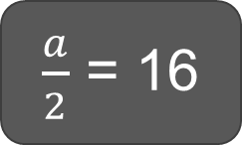
Checkpoint 12: Always eight?
Sort these equations into the correct columns of the table on the right.
a is always 8 | a is sometimes 8 | a is never 8
a + 11 = 19
2a = 4
4a = 32
a + b = 19
a ÷ b = 1
a – 8 = b
32 = a ÷ 4
3a = 24
8a = 16
24 = 3a
$\frac{a}{2}$ = 16
2a = a + 4
3a = b
2a – 20 = 8
Write your own more challenging equations for each column.
Notes:
This slide is animated. Each equation will appear separately so you can choose whether to reveal all at once or work at a more controlled pace with your class. Printable sets of equations can be found on slide 65.
Answers
a is always 8: a + 11 = 19, 4a = 32, 3a = 24, 24 = 3a
a is sometimes 8: a + b = 19, a ÷ b = 1, a – 8 = b, 3a = b
a is never 8: 2a = 4, 32 = a ÷ 4, 8a = 16, $\frac{a}{2}$ = 16, 2a = a + 4, 2a – 20 = 8
? Any valid equation for each column.
Suggested questioning
What do you know about a? What do you not know?
Can you think of a value for a? Can you think of a different value for a? Why or why not?
What is the same and what is different about (e.g. 3a = 24 and 3a = b)?
Things to think about
Classification structures, such as this ‘always, sometimes, never’, can be useful tools for checking the depth of students’ understanding. Here, we assess whether students know when the unknown takes a specific or multiple values, or when a specific value is obviously impossible. You might hear students say things like, ‘a can’t be 8 in 2a = 4 because a is 2. Such comments give insight into whether students already have an understanding of solving.

Slide 40
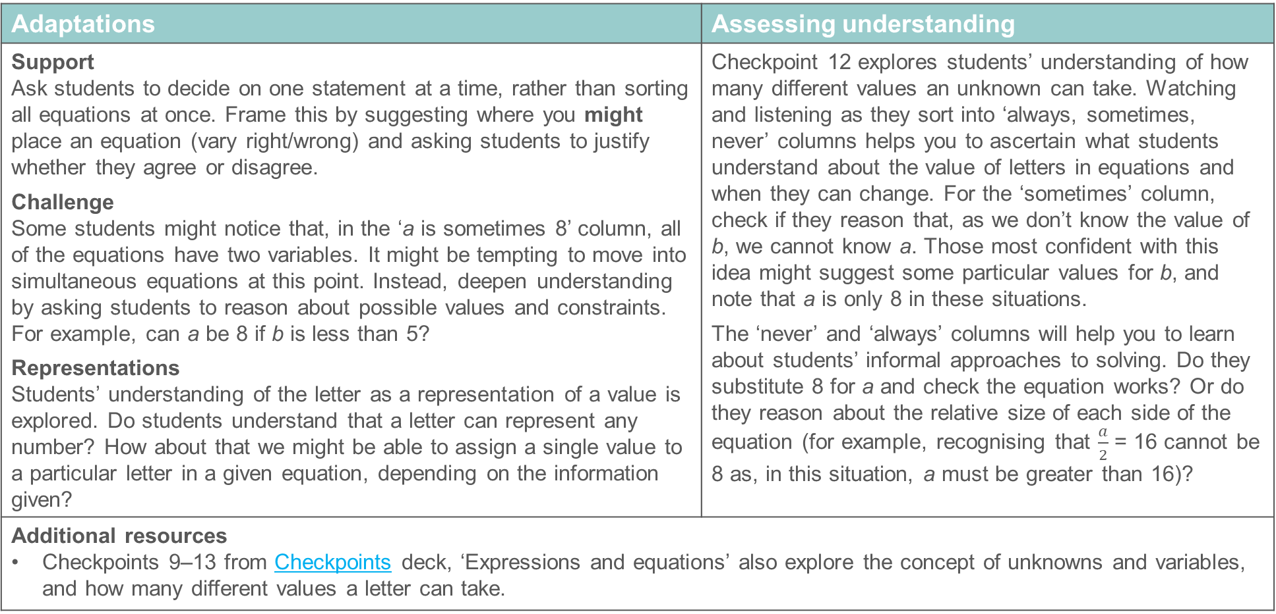
Checkpoint 12: Guidance
Adaptations | Assessing understanding
Support Ask students to decide on one statement at a time, rather than sorting all equations at once. Frame this by suggesting where you might place an equation (vary right/wrong) and asking students to justify whether they agree or disagree. Challenge Some students might notice that, in the ‘a is sometimes 8’ column, all of the equations have two variables. It might be tempting to move into simultaneous equations at this point. Instead, deepen understanding by asking students to reason about possible values and constraints. For example, can a be 8 if b is less than 5? Representations Students’ understanding of the letter as a representation of a value is explored. Do students understand that a letter can represent any number? How about that we might be able to assign a single value to a particular letter in a given equation, depending on the information given? | Checkpoint 12 explores students’ understanding of how many different values an unknown can take. Watching and listening as they sort into ‘always, sometimes, never’ columns helps you to ascertain what students understand about the value of letters in equations and when they can change. For the ‘sometimes’ column, check if they reason that, as we don’t know the value of b, we cannot know a. Those most confident with this idea might suggest some particular values for b, and note that a is only 8 in these situations. The ‘never’ and ‘always’ columns will help you to learn about students’ informal approaches to solving. Do they substitute 8 for a and check the equation works? Or do they reason about the relative size of each side of the equation (for example, recognising that $\frac{a}{2}$ = 16 cannot be 8 as, in this situation, a must be greater than 16)?
Additional resources Checkpoints 9–13 from Checkpoints deck, ‘Expressions and equations’ also explore the concept of unknowns and variables, and how many different values a letter can take.

Slide 41
Checkpoint 13: Might and must
This equation is true: ab = 20.
What might be the values of a and b?
This equation is still true: ab = 20, and this equation is also true: a + b = 9.
Which of your answers to part a must now be the values of a and b?
This equation is true: ab = 10
What might be the values of a and b?
This equation is still true: ab = 10, and this equation is also true: a – b = 1.5
Which of your answers to part c must now be the values of a and b?
Create an equation that might have values of 10 and 2.
Create a pair of equations that must have values of 10 and 2.
Notes:
This slide is animated. Each question will appear separately so you can choose the pace at which to work with your class.
Answers
a) Possible whole number solutions are 1 and 20, 2 and 10 or 4 and 5. Students might include negative solutions such as -1 and -20, -2 and -10 or -4 and -5 and/or decimals such as 2.5 and 8 or 0.2 and 100.
b) 4 and 5 must be the values.
c) 1 and 10, 2 and 5. Students might include negative solutions such as 1 and -10 or -2 and -5 and/or decimals such as 2.5 and 4.
d) 2.5 and 4 must be the values.
Suggested questioning
How many answers can you create for parts a and c? Can you think of an answer that nobody else has?
How many answers can you create for parts b and d? Why is this different from a and c?
Do you know which value is a and which is b? Why or why not?
Things to think about
Checkpoint 13 explores ideas of unknowns as variables and specific solutions. Students will have completed missing box problems from very early in primary school, and so suggesting lots of values for parts a and c is likely to be straightforward. Listen to their reasoning for parts b and d: do they understand why they only have one answer now?

Slide 42
Checkpoint 13: Guidance
Adaptations | Assessing understanding
Support Help students to organise their ideas by providing a framework, such as a table to list values of a and b in part a. Then refer back to this to help students find appropriate values for part b. Challenge Take the further thinking question further by specifying the operations that you want students to include. Representations If your students already find the area model helpful, link to this visual representation by showing a rectangle with sides a and b and saying that the area is 20 for part a, and that the perimeter is 18 for part b. However, this is not an appropriate task to introduce the area model for the first time. | Students will have reasoned about equations with two unknowns in the primary curriculum. Assess that reasoning – particularly that sometimes an unknown might take more than one value (as in parts a and c), and sometimes it must take a specific value (as in parts b and d). This is not a moment to introduce formal solving of simultaneous equations. Revisit this task to assess students again before teaching simultaneous equations at a later stage in the curriculum. A subsidiary assessment point is whether students understand the notation ab refers to the product of a and b. More confident students might, at this point, recognise that they do not need to be limited to the factors of 20 or 10 and suggest some non-integer answers. An interesting point is whether we know which of a and b is which value in parts b and d. Due to the commutativity of the addition we do not know in part b, but the subtraction means that we do in part d. Prompt students to think about this if they do not volunteer it.
Additional resources Checkpoints 9-13 from Checkpoints deck, ‘Expressions and equations’, also explore the concept of unknowns and variables, and how many different values a letter can take.

Slide 43
Checkpoint 14: Brackets
In which equation in each pair will a have the greater value? How do you know?
a)
4a + 8 = 20
4(a + 2) = 20
b)
4a + 1 = 20
4(a + 1) = 20
c)
4a – 3 = 20
4(a – 3) = 20
d)
4a + 5 = 20
4(a – 1) = 20
4a + b = 20
4(a + b) = 20
Notes:
This slide is animated. Each question will appear separately so you can choose the pace at which to work with your class.
Answers
The answers below do not include answers to ‘how do you know?’ as the answer to this will depend on students’ approaches to the question.
a) a has the same value in both equations.
b) a has a greater value in 4a + 1.
c) a has a greater value in 4(a – 3).
d) a has a greater value in 4(a – 1).
? It is not possible to tell, as it would depend on the value of b. For example, if b were less than 0, 4(a + b) would be greater; if b were greater than 0, 4a + b would be greater. Students might reason about the value of b but that is not an expectation as solving the equations is beyond the scope of the activity.
Suggested questioning
What is the same and what is different?
What values are being multiplied by 4 in each equation?
How can you compare these?
How can you write the equation without brackets?
Things to think about
Checkpoint 14 assesses students’ depth of understanding of the distributive law and what brackets in expressions mean. Students can often be very fluent at rewriting expressions with and without brackets, but do not necessarily think deeply about equivalence and the distributive law. As with Checkpoint 6, drawing students’ attention to which terms are being multiplied by 4 might help them to recognise that the number terms in the brackets are all, actually, 4 times bigger than written. In Checkpoint 6, all the brackets were in expressions. Here, they are equations, so there is then the additional reasoning the values in relation to 20, and how this affects the relative size of a.

Slide 44
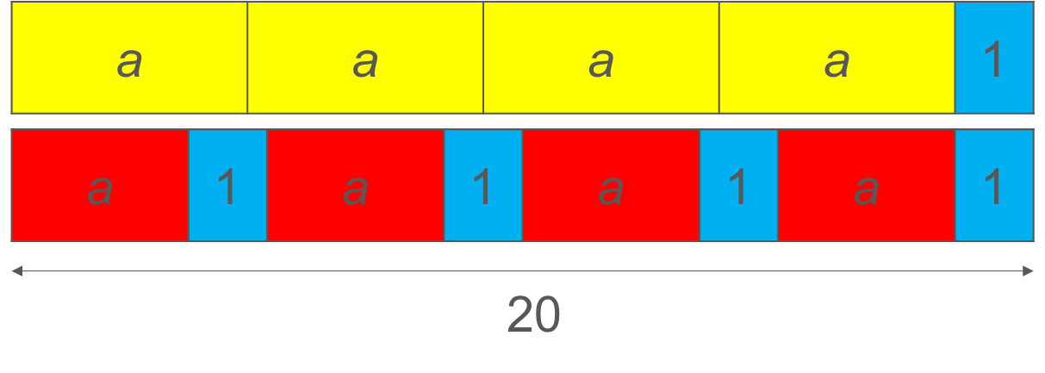
Checkpoint 14: Guidance
Adaptations | Assessing understanding
Support Check students understand when a would have a greater value in two brackets without equations first. For example, 4a + 1 = 20 and 4a + 4 = 20. Challenge Ask students to create their own pairs of equations. Can they work out when the equation with brackets has the greater value, and when the other does? Representations Bar models might usefully be used to represent the different ways that 20 is being created in the two equations. For example, these two bar models show why a is smaller for 4(a + 1) than 4a + 1 in part b: This would be clearer for students for parts a and b, as physical representations of negative numbers can be more challenging. | Explore how deeply students understand bracket notation and the impact that brackets have on an equation. In the answers, we do not provide a suggested response to the question, ‘How do you know?’ as there is no single or preferred way of phrasing this. Instead, listen to students’ approaches and use this to help you plan future work on using brackets in equations. For example, do students rewrite the second equation without brackets first? If they do so, do they accurately expand brackets? Do students then formally solve the equations, or do they feel confident enough to reason about the value of the unknowns without going through the full process of finding a value for a? Those with a deeper understanding of algebraic thinking might not need any formal process at all, instead reasoning that the numerical value in the brackets is always, in these cases, 4 times the value that is written, and then using this to deduce which would result in a greater value for a.
Additional resources Checkpoint 6, and Additional activities B and C, all offer explorations of brackets in expressions (rather than equations) which might be a useful precursor.

Slide 45
Checkpoint 15: Comparing solutions
Without solving the equations on the right, decide for which one a would:
  have the greatest value
  be even
  be a multiple of 3.
3a = 9
a ÷ 3 = 9
a + 3 = 9
a – 3 = 9
Repeat part a for the two sets of equations below. Which of your answers change and which stay the same?
3a = -6
a ÷ 3 = -6
a + 3 = -6
a – 3 = -6
3a = 0.9
a ÷ 3 = 0.9
a + 3 = 0.9
a – 3 = 0.9
Create your own set of equations using all four operations. Can you create a set where the addition has the greatest value of a?
Notes:
This slide is animated. Each question will appear separately so you can choose the pace at which to work with your class.
Answers
a) a has the greatest value in a ÷ 3 = 9 (as a = 27).
a must be even in a + 3 = 9 (a = 6) and a – 3 = 9 (a = 12).
a is a multiple of 3 in all four equations.
d) -6: a has the greatest value in 3a = -6 (a = -2), a must be even in 3a = -6 (a = -2) and a ÷ 3 = -6 (a = -18), a is a negative multiple of 3 in a ÷ 3 = -6 (a = -18), a + 3 = -6 (a = -9) and a – 3 = -6 (a = -3).
0.9: a has the greatest value in a – 3 = 0.9 (a = 3.9), a is not even for any of the equations, a is not a multiple of 3 for any of the equations.
Suggested questioning
What is the same and what is different?
When will a be less than 9, or -6, or 0.9? When would it be greater?
How do you know whether an unknown should be odd or even?
Things to think about
Checkpoint 15 assesses how readily students reason about solutions, and estimate what is ‘sensible’. The numbers are straightforward, and you might find that, for some students, this makes it harder for them to reason in the general. For example, they might only be able to justify the particular examples given (’Because 27 is bigger than 9 for 3a = 9’). In this case, try offering a number like 9423 in place of 9 to encourage them to generalise. Ensure you then also consider a negative and a decimal, as is modelled here, to prevent misconceptions forming.

Slide 46
Checkpoint 15: Guidance
Adaptations | Assessing understanding
Support Introduce the equations in pairs: first multiplication and division; then addition and subtraction; and then a mix, for example, addition and division. Challenge Vary the equations so that the expression is not always equal to the same value, then ask for more challenging categorisations. For example, ‘Which equations will have solutions greater than __?’ Representations Use a bar model to represent the four different operations in each equation. The constant ‘answer’ of 9 will help students to compare how the solutions differ too. | Checkpoint 15 assesses how readily students reason about solutions. Recognising whether a solution is sensible is an important skill in solving equations. This activity should give insight into how explicitly students will need to be taught to reason and think about their answers. For example, do they recognise when a solution will be greater or smaller than the ‘answer’ in the equation? The first set of equations is relatively straightforward. Listen out for their reasoning. Do they generalise that a must be even for the addition/subtraction, as ‘even + odd = odd’, or do they use the specific numbers as examples? Students who are less confident with inverse operations may incorrectly reason that the addition has a larger solution than the subtraction, as ‘addition makes things bigger’. These students are likely to need more support and practice. The introduction of negatives and decimals in part d may challenge students’ definitions of ‘even’ and ‘multiple’, so be prepared for students to falter. These sets of equations also challenge students who make incorrect generalisations, such assuming that the greatest solution will always be linked to the multiplicative operations.
Additional resources Key idea 2.2.1.3 from Secondary Mastery Professional Development | NCETM explores ‘Understanding solutions balance an equation’ and may give some further ideas for how to deepen students’ understanding of solutions. Additional activities G and H also explore reasoning around solutions.

Slide 47
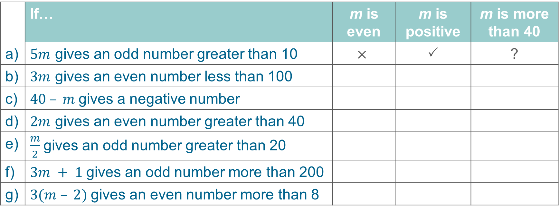
Checkpoint 16: What do we know about m?
Complete the table. The first one has been done for you.
 | If… | m is even | m is positive | m is more than 40
a) | $5m$ gives an odd number greater than 10 | $$×$$ |  | ?
b) | $3m$ gives an even number less than 100
c) | $40 – m$gives a negative number
d) | $2m$ gives an even number greater than 40
e) | $\frac{m}{2}$gives an odd number greater than 20
f) | $3m + 1$gives an odd number more than 200
g) | $3(m – 2)$gives an even number more than 8
  Write your own expression for $m$. Can you write a description for it that will have ‘yes’ in every column? How about ‘no’ or ‘don’t know’?
Notes:
This slide is animated. The further thinking question will appear separately so you can choose the pace at which to work with your class. A printable version can be found on slide 66.
Answers
b) Even: yes, Positive: don’t know, More than 40: no
c) Even: don’t know, Positive: yes, More than 40: yes
d) Even: don’t know, Positive: yes, More than 40: don’t know
e) Even: yes; Positive: yes; More than 40: yes
f) Even: don’t know, Positive: yes, More than 40: yes
g) Even: yes, Positive: yes, More than 40: don’t know
? Students’ responses to this will vary. To give examples of multiplicative expressions, if 5m gives a number greater than 200, there would be a yes in every column; if 5m gives a number less than 0, there would be a no in every column; and if 2m gives a number less than 100, there would be a don’t know in every column. To give examples of additive expressions: if m + 10 gives an even number more than 50, there would be a yes in every column; if m + 10 gives an even number less than 10, there would be a no in every column; and if m + n gives an even number less than 50, there would be a don’t know in every column.
Suggested questioning
What do we know? What do we not know?
Is the product of an odd and even number even or odd?
Is the sum of an odd and odd number even or odd?
Is the sum of an even and even number even or odd?
How can we use our knowledge of odd and even numbers to help us here?
In (e.g. part c), what is the smallest value that m could take?
Things to think about
There is a lot going on in Checkpoint 16, so you could use additional activities I or J first to check students understand the basic idea. Similar ideas were explored in Checkpoint 15, but this time the option of solving as an alternative strategy is removed so students have to estimate and reason instead.

Slide 48
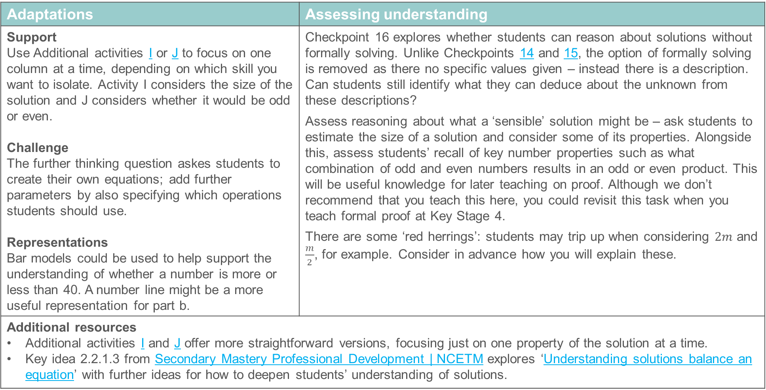
Checkpoint 16: Guidance
Adaptations | Assessing understanding
Support Use Additional activities I or J to focus on one column at a time, depending on which skill you want to isolate. Activity I considers the size of the solution and J considers whether it would be odd or even. Challenge The further thinking question askes students to create their own equations; add further parameters by also specifying which operations students should use. Representations Bar models could be used to help support the understanding of whether a number is more or less than 40. A number line might be a more useful representation for part b. | Checkpoint 16 explores whether students can reason about solutions without formally solving. Unlike Checkpoints 14 and 15, the option of formally solving is removed as there no specific values given – instead there is a description. Can students still identify what they can deduce about the unknown from these descriptions? Assess reasoning about what a ‘sensible’ solution might be – ask students to estimate the size of a solution and consider some of its properties. Alongside this, assess students’ recall of key number properties such as what combination of odd and even numbers results in an odd or even product. This will be useful knowledge for later teaching on proof. Although we don’t recommend that you teach this here, you could revisit this task when you teach formal proof at Key Stage 4. There are some ‘red herrings’: students may trip up when considering $2m$ and $\frac{m}{2}$, for example. Consider in advance how you will explain these.
Additional resources Additional activities I and J offer more straightforward versions, focusing just on one property of the solution at a time. Key idea 2.2.1.3 from Secondary Mastery Professional Development | NCETM explores ‘Understanding solutions balance an equation’ with further ideas for how to deepen students’ understanding of solutions.

Slide 49
Additional activities
Activities A–J

Slide 50
Activity A: More expressions and equations
Choose two expressions from the box to complete the equation below. Are there any pairs of expressions that you cannot use?
What value of a would make the equation true?
50 – a
6 × a
8 + a + 12
3 × a
30
9 + a + 11
=
20 + a
25 + a
3 × a × 2
36
For the pairs of expressions that you could not use, change one thing so that they can now form an equation. What value of a would make that equation true?
Notes:
This slide is animated. Each question will appear separately so you can choose the pace at which to work with your class.
Answers
a) Students can choose any two expressions except 30 = 36; 20 + a = 25 + a; 8 + a + 12 = 25 + a; 9 + a + 11 = 25 + a.
b) There are too many potential combinations to list. Consider when any value of a would make the equation true (where the two expressions are equivalent, for example 3 × a × 2 and 6 × a) and when only a specific value of a would make the equation true (for example, 50 – a = 30, where a must be 20, or 6 × a = 3 × a, where a must be 0).
? There are infinite possibilities, but here are some suggestions:
30 = 36 – a , a must equal 6; 20 + a = 25 – a, a must equal 2.5; 8 + a + 17 = 25 + a, a could equal any number; 9 + a + 11 = 20 + a, a could equal any number.
Suggested questioning
Which of these expressions are equivalent?
Which of these expressions could be equivalent if a was __?
Which of these expressions are not equivalent?
What does the ‘=‘ symbol mean?
Things to think about
Activity A is a more open version of Checkpoint 5, which might be suited as a follow-up once students have some experience of solving equations. There are a few assessment points. Assess whether students are happy to arrange equations with expressions on either side. If students always put the single number on the right hand side (for example, 20 + a = 30), consider varying the examples they experience, to build confidence in working with equations in the form 30 = 20 + a as well. Check whether students recognise where equations are not possible because they do not balance (for example, 20 + a = 25 + a). Check if students understand the $≠$ symbol at this stage. A further point is whether students recognise where an unknown can take any value (so is a variable) and when it must take a specific value (a solution); see the answers for an example of this.

Slide 51
Activity B: Ordering expressions
In each of the expressions below, a is the same positive number.
3a + 2
3(a + 2)
3a + 6
3a + 12
3(a + 5)
3a + 4
3(a + 3)
3a + 3
3(a + 6)
3(a + 1)
Which expression is the biggest? How do you know?
Which expressions have the same value?
Write all ten expressions in order from smallest to largest.
Write an expression in between each of the expressions in your order. Is it always possible to do this using brackets?
Notes:
This slide is animated. Each expression and then each question will appear separately so you can choose the pace at which to work with your class.
Answers
a) 3(a + 6)
b) 3a + 3 = 3(a + 1) and 3(a + 2) = 3a + 6
c) 3a + 2, 3(a + 1) = 3a + 3, 3a + 4, 3a + 6 = 3(a + 2), 3(a + 3), 3a + 12, 3(a + 5), 3(a + 6)
? For example, 3a + 2.5, 3a + 3.3, 3a + 5, 3a + 7, 3a + 10, 3a + 14, 3a + 17. Yes, it is always possible (for example 3a + 3.3. = 3(a + 1.1)) and this is often easiest using fractions (for example 3a + 10 = 3(a + $\frac{10}{3}$)). However, remind students that, conventionally, when you fully factorise an expression, you use the largest integer possible.
Suggested questioning
What is the same and what is different about __ and __?
Which terms are being multiplied by 3 in each expression?
Were you surprised by which is the biggest? Why?
Could you write a bigger expression without brackets? How about with?
Things to think about
Additional activity B explores expressions with and without brackets. It assesses students’ depth of understanding of the distributive law and what brackets in expressions really mean. Students can often be very fluent at rewriting expressions with and without brackets, but do not necessarily think deeply about equivalence and the distributive law. Students might instinctively suggest 3a + 12 is the biggest expression, as 12 is the biggest number on the page. Prompt them to rethink by saying, ‘I can see 18 on the slide; where might I be seeing 18?’ to help them recognise that the values in the brackets are all three times bigger.

Slide 52
Activity C: Expressions on the number line
The number line below is going up in ones.
A
B
C
D
E
F
G
H
I
J
K
L
M
N
O
P
Q
3a + 2
Sarah chooses a value for a and places the expression 3a + 2 on the number line.
Match the expressions below to their places on the number line.
3(a + 2)
3a + 8
3a + 6
3(a + 3)
3(a + 5)
Write expressions for the missing places on the number line.
Is there more than one way to do this?
Notes:
This slide is animated. Each question will appear separately so you can choose the pace at which to work with your class. A printable resource can be found on slide 67.
Answers
3(a + 2): E
3a + 8: G
3a + 6: E
3(a + 3): H
3(a + 5): N
? Where expressions have been given without brackets, it is possible to write the expression with brackets, but these will all involve fractions or decimals, for example, for A: 3(a + $\frac{1}{3})$.
A: 3a + 1, B: 3a + 3, C: 3a + 4, D: 3a +5, F: 3a + 7, I: 3a + 10, J: 3a + 11, K: 3a + 12 = 3(a + 4), L: 3a + 13, M: 3a + 14, O: 3a + 16, P: 3a + 17, Q: 3a + 18 = 3(a + 6).
Suggested questioning
What is the same and what is different about __ and __?
Which terms are being multiplied by 3 in each expression?
Were you surprised by which is the biggest? Why?
Could you write a bigger expression without brackets? How about with?
Things to think about
Additional activity C explores expressions with and without brackets. It assesses students’ depth of understanding of the distributive law and what brackets in expressions really mean. Students can often be very fluent at rewriting expressions with and without brackets, but do not necessarily think deeply about equivalence and the distributive law. The premise of ordering/comparing is very similar to Additional activity B and Checkpoint 6, with the additional representation of the number line to support students to consider the relative size of two expressions. Students might argue that they need to know the value of a to be able to place expressions on a number line. In this case, ask them where they think 3a would go (the marker before A), and model how each letter on the number line can then be written as an expression in relation to this (for example, A as 3a + 1).

Slide 53
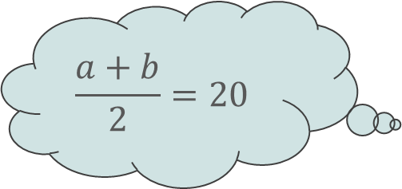
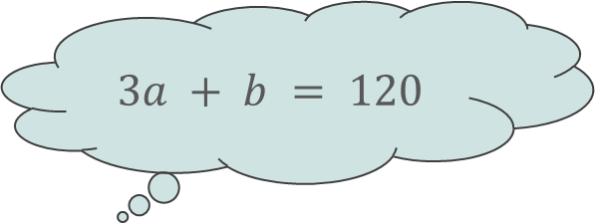
Activity D: If I know…
Nell writes down the equation a + b = 40.
She thinks about some other equations that she now knows using this fact.
Which are true and which are false? Why?
a + b + 10 = 30
a)
$$3a + b = 120$$
b)
$$\frac{a+b}{2}=20$$
c)
d)
e)
a = 40 + b
10(a + b) = 400
Using a + b = 40, write some other equations that you know are true. Can you think of an equation nobody else has?
Notes:
This slide is animated. Each question will appear separately so you can choose the pace at which to work with your class.
Answers
a) False. In this equation, only the a has been multiplied by 3, not the whole expression. We don’t have enough information to know what the value of the right hand side of the equation should be. All we know is 3a + b = 40 + 2a.
b) True. Both sides of the equation have been divided by 2.
c) False. In this equation, one side has been increased by 10 but the other side has been decreased by 10. We could write a + b + 10 = 50 or a + b – 10 = 30.
d) False. In this equation, one side has been decreased by b but the other side has been increased by b. we could write a = 40 – b or a + 2b = 40 + b.
e) True. Both sides of the equation have been multiplied by 10.
? Students’ responses to this will vary – there are infinite possibilities. Check that the same operation has been done to both sides so that the equation still balances.
Suggested questioning
What is the same (as Nell’s equation)? What is different?
What has changed on the left hand side of the equals sign? What has changed on the right hand side of the equals sign?
How could you write __ correctly?
Things to think about
Additional activity D builds upon the ideas in Checkpoint 7, which assesses students understanding of equality and whether they can manipulate equations to maintain equality. Some common misconceptions are dealt with in each part. In part a, Nell has only multiplied part of the expression on the left hand side by 3, not the whole side. In part b, Nell is correct but students may be thrown by division. In part c, Nell has done the opposite operation to each side (+ 10 to one, – 10 to the other), which can be a common misconception once students start using inverse operations to solve. A similar problem is explored in part d, although here the existing terms have been incorrectly rearranged. If students do not identify these misconceptions, they may need to step back and consider some representations to explore why equality has not been maintained, before embarking on further practice.

Slide 54




Activity E: The same or different?
Anil and Bay are finding the mean of their heights. They add their heights together and divide by two.
Anil write the equations down and says, ‘There are four different ways I can write this calculation as an algebraic expression.’
Do you agree? Why or why not?
$$\frac{a+b}{2}$$
$$\frac{a}{2}+b$$
$$\frac{a}{2}+\frac{b}{2}$$
$$a+\frac{b}{2}$$
Is there a value of a and b for which all four expressions are equivalent?
Notes:
This slide is animated. Each expression will appear separately so you can choose the pace at which to work with your class.
Answers
No. Only $\frac{a+b}{2}$ and $\frac{a}{2}+\frac{b}{2}$ are expressions that represent this calculation. In the other two expressions, only one of the ‘heights’ has been divided by two.
? The only way for all four expressions to be equivalent is for a and b to be 0. If a was 1 and b was 0 (or vice versa), then three of the expressions would be equal to $\frac{1}{2}$ but the fourth expression would be equal to 1.
Suggested questioning
What is the same and what is different about the expressions?
Which values are being divided by two each time?
How is this similar to expanding brackets?
Things to think about
Additional activity E is a short prompt for discussion that tackles a specific and common misconception around the distributive law when division is written as a fraction. Use this task if you find that students either aren’t aware of the equivalence of $\frac{a+b}{2}$ and $\frac{a}{2}+\frac{b}{2}$ or mistakenly write a divisor under only part of an expression. The context is familiar – students first encounter finding the mean in Year 6 – to help students identify that all numbers need to be divided by two, which is not the case in the expressions $\frac{a}{2}+b$ and $a+\frac{b}{2}$.

Slide 55


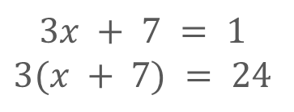
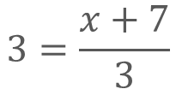
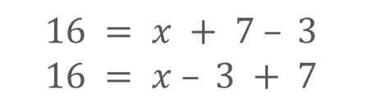








Activity F: Back to x
For each of the function machines below:
Decide which of the two equations given below it represents.
Work out what would need to go in the machine to ‘get back to x’.
1
$$×3$$
$$+ 7$$
2
$$+ 7$$
$$÷ 3$$
3
$$− 3$$
$$+ 7$$
$$x$$
$$x$$
$$x$$
$$3x + 7 = 1$$
$$3(x + 7) = 24$$
$$\frac{x}{3}+7=9$$
$$3=\frac{x+7}{3}$$
$$16 = x + 7 – 3$$
$$16 = x – 3 + 7$$
Create other function machines using two operations and the numbers 7 and 3. When order of operations matter? When does it not?
Notes:
This slide is animated. Each function machine, and then the further thinking question, will appear separately so you can choose the pace at which to work with your class. A printable resource can be found on slide 68.
Answers
1a) 3x + 7 = 1
1b) 1 → [− 7] → [÷ 3] → x
2a) $3=\frac{x+7}{3}$
2b) 3 → [× 3] → [− 7] → x
3a) 16 = x – 3 + 7
3b) 16 → [− 7] → [+ 3] → x
For 3a and 3b, while this is the order given for this particular function machine, students may notice that, as these are equivalent operations, the actual order does not matter.
? Answers will vary according to the operations students choose. Order will matter when two operations of different priority are chosen (for example, when there is both a multiplicative and an additive step). Order will not matter when the operations are of equal priority (for example, addition/subtraction or multiplication/division).
Suggested questioning
Do any of your questions have more than one answer?
What do you need to do to ‘get back to x’?
Does the order matter? What would happen if you did the operations in a different order?
Things to think about
Additional activity F offers an opportunity to link Checkpoint 8 more specifically to solving. Use this once students have some experience of solving. Consider carefully how the use of a function machine representation will interplay with a balance method for solving. See the Guidance slide for Checkpoint 8 for more information.

Slide 56
Activity G: Empty boxes
In the equation on the right, both the missing numbers are less than 10.
+ 9 =
Chloe chooses a number less than nine for her second box. What must that mean for her first box?
Laura chooses a number that is not an integer for her first box. What must that mean for her second box?
Hayley places a 0 in one of her boxes. What could her other box be?
Repeat parts a to c for this equation:
× 9 =
Repeat parts a to c for the equations on the right. What is the same and different about your answers this time?
− 9 =
9 −
=
Notes:
This slide is animated. Each question will appear separately so you can choose the pace at which to work with your class.
Answers
a) The number in the first box must be less than 0.
b) The number in the second box will also not be an integer.
c) If the 0 is in the first box, the other box will be 9. If the 0 is in the second box, the other box will be -9.
d)
a) The number in the first box must either be a decimal between 0 and 1 (if the number is between 0 and 9) or a negative number (if the number is less than 0).
b) The number in the second box will also not be an integer.
c) Regardless of which box has the 0 in, the other box will also have a 0.
?
For the first equation:
a) This will only be possible if the second number is less than 1; the first number must be less than 10. If the second number is more than 1, then the first number could not be less than 10.
b) The number in the second box will also not be an integer; it will also be less than 0.$\dot{9}$.
c) If the 0 is in the first box, the other box will be -9. If the 0 is in the second box, the other box will be 9.
For the second equation:
a) The first number must be positive.
b) The number in the second box will also not be an integer.
c) If the 0 is in the first box, the other box will be 9. If the 0 is in the second box, the other box will also be 9.
Suggested questioning
What do you know? What do you not know?
Will your answer be positive or negative? How do you know?
Could your answer be a non-integer? How do you know?
How would your answers be different for a different operation?
Things to think about
Additional activity G follows a similar theme to Checkpoints 15 and 16, alongside Additional activities H, I and J, in that it ask students to reason about solutions without solving. In this case, students are working with inequalities (although the inequality symbols are not used) to generalise about the size or properties of potential solutions. Listen carefully to the language that they use and how well they can express their ideas. Assess students’ reasoning around negative numbers and decimals, and whether they can reason about when a solution must be less than 0 or a non-integer. It is important that students are exposed to a range of solutions and are aware that a solution could be any number, including a negative number or non-integer. If students struggle with this, they might need a hint that the solutions are not always positive integers. Ensure that the equations students work on in future feature a range of different solutions. If students find it hard to reach a generalisation immediately, support them to try some different values. This offers an opportunity for students to work on strategic approaches and spotting patterns. The further thinking question touches on commutativity, as students are encouraged to consider how the order of the missing numbers affects the answer.

Slide 57


Activity H: Incorrect homework
Barney has done his algebra homework.
Without solving or substituting, can you tell which of his solutions are correct and which are incorrect?
Explain how you know.
a) $\frac{n}{2}$ $= 40$
$$n = 20$$
b) $n – 3.5 = 12$
$$n = 6.5$$
c) $2n – 9 = −8$
$$n = \frac{1}{2}$$
d) $3n = 18 000$
$$n = 60$$
e) $3n = 177$
$$n = 58$$
f) $4n + 10 = 22$
$$n = 8$$
For each of the incorrect answers, write an equation for which that value of n would be the solution.
Notes:
This slide is animated. Each question will appear separately so you can choose whether to give students all the equations to consider at once, or introduce them one at a time. A printable resource can be found on slide 69.
Answers
Only question c is correct. Below, we give examples of justifications for why the other questions are incorrect that do not involve substitution or solving. Students might give more specific detail (for example, for part a, they might state that n needs to be ‘two times’ greater than 40).
a) Incorrect as n needs to be greater than 40 if the answer is 40 when n is divided by 2.
b) Incorrect as n needs to be greater than 12 if the answer is 12 when a number is subtracted from n.
d) Incorrect as n is the wrong order of magnitude (i.e. 3 needs to be multiplied by a far bigger number than 60 to have a product of 18 000).
e) Incorrect as n is even and odd × odd is odd.
f) Incorrect as 4n is equal to 12, so n must be much smaller than 8.
? Students’ answers will vary as there are infinite possible responses. Some examples that use the same operation as given in the original task are given below.
a) $\frac{n}{2}$=10, b) n – -3.5 = 12, d) 3n = 180, e) 3n = 174; 1.5n + 10 = 22
Suggested questioning
How can you do this without solving or substituting?
Will n be bigger or smaller than the ‘answer’ to the equation? How do you know?
Will n be an integer? How do you know?
Will n be odd or even? How do you know?
Things to think about
Additional activity H offers a similar assessment point to Checkpoints 15 and 16, in that they are reasoning about solutions, but this time asking students are asked more explicitly which solutions are likely to be incorrect. The instructions ask students not to solve or substitute, so that they can instead focus on reasoning about the size or properties of the solution. It is worth encouraging this habit ahead of formally teaching solving equations, so that students are able to gauge if their solutions are reasonable. Observe how readily they do this already.

Slide 58
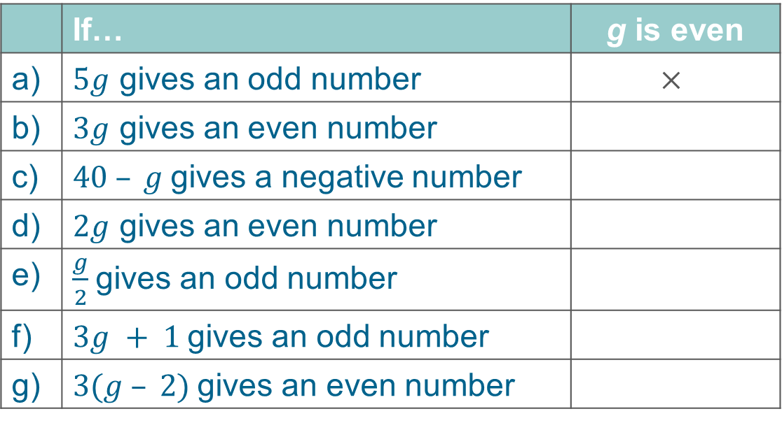

Activity I: Is g even?
Complete the table using , x or ? The first one has been done for you.
 | If… | g is even
a) | $5g$ gives an odd number | $$×$$
b) | $3g$ gives an even number
c) | $40 – g$gives a negative number
d) | $2g$ gives an even number
e) | $\frac{g}{2}$gives an odd number
f) | $3g + 1$gives an odd number
g) | $3(g – 2)$gives an even number
  Write your own expression for $g$. Can you write a description for it where $g$ will be even? How about odd or ‘don’t know’?
Notes:
This slide is animated. The further thinking question will appear separately so you can choose the pace at which to work with your class. A printable version can be found on slide 70.
Answers
a) Yes
b) Don’t know
c) Don’t know
d) Yes
e) Yes
f) Yes
? Students’ responses to this will vary.
Examples of multiplicative expressions: if 3g gives an even number, g would be even; if 3g gives an odd number, g would be odd; and if 4g gives an even number, we don’t know if g is odd or even.
Examples of additive expressions: if g + 2 gives an even number, g would be even; if g + 2 gives an odd number, g would be odd; and if g + 2 gives a negative number, we don’t know if g is odd or even.
Suggested questioning
What do we know? What do we not know?
Is the product of a (for example, odd and even) number even or odd?
Is the sum of a (for example, odd and odd) number even or odd?
How can you use your knowledge of odd and even numbers to help?
In (for example, part c), what is the smallest value that g could take?
Things to think about
Additional activity I is a simplified version of Checkpoint 16, focusing just on whether students can deduce whether a solution is odd or even from a description. This helps you to know if students can not only recall the rules about odd and even numbers in calculation, but can also apply them in context. Encourage this habit ahead of formally teaching solving equations, so that students are able to gauge if their solutions are reasonable. It is also helpful underpinning knowledge for teaching proof at Key Stage 4, so could be a useful task to return to then. See the ‘Guidance’ slide for Checkpoint 16 for more information.

Slide 59
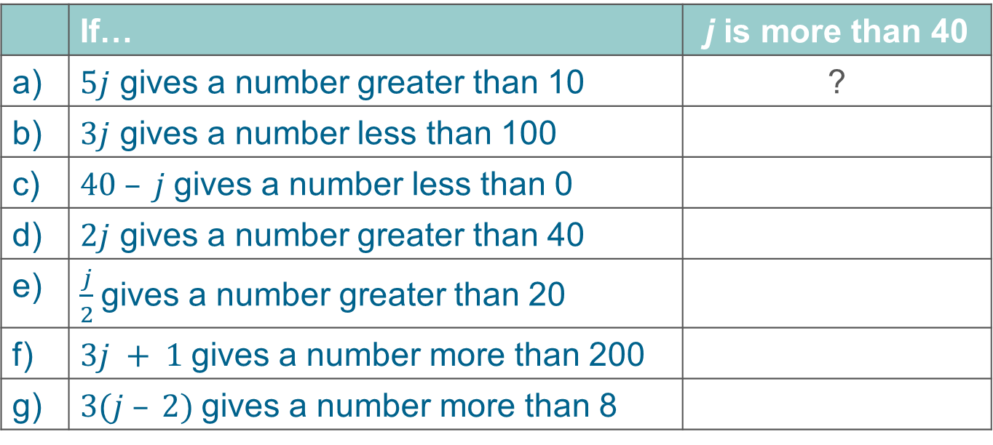
Activity J: Is j more than 40?
Complete the table using , x or ? The first one has been done for you.
 | If… | j is more than 40
a) | $5j$ gives a number greater than 10 | ?
b) | $3j$ gives a number less than 100
c) | $40 – j$gives a number less than 0
d) | $2j$ gives a number greater than 40
e) | $\frac{j}{2}$gives a number greater than 20
f) | $3j + 1$gives a number more than 200
g) | $3(j – 2)$gives a number more than 8
  Write your own expression for $j.$ Can you write a description for it where $j$ will be more than 40? How about less than 40 or ‘don’t know’?
Notes:
This slide is animated. The further thinking question will appear separately so you can choose the pace at which to work with your class. A printable version can be found on slide 71.
Answers
a) No
b) Yes
c) Don’t know
d) Yes
e) Yes
f) Don’t know
? Students’ responses to this will vary.
Examples of multiplicative expressions, if 5j gives a number greater than 200, j would be more than 40; if 5j gives a number less than 200, j would be less than 40; and if 5j gives a number greater than 100, we don’t know if j is greater or less than 40.
Examples of additive expressions: if j + 10 gives a number more than 50, j would be more than 40; if j + 10 gives a number less than 50, j would be less than 40; and if j – 10 gives a positive number, we don’t know if j is greater or less than 40.
Suggested questioning
What do we know? What do we not know?
In (for example, part b), what is the smallest value that j could take?
In (for example, part a), what is the greatest value that j could take?
Things to think about
Additional activity J is a simplified version of Checkpoint 16, focusing on whether students can deduce if a solution is greater or less than a specific number based on the information available. Encourage this habit ahead of formally teaching solving equations, so that students are able to gauge if their solutions are reasonable. See the Guidance slide for Checkpoint 16 for more information.

Slide 60
Printable resources

Slide 61
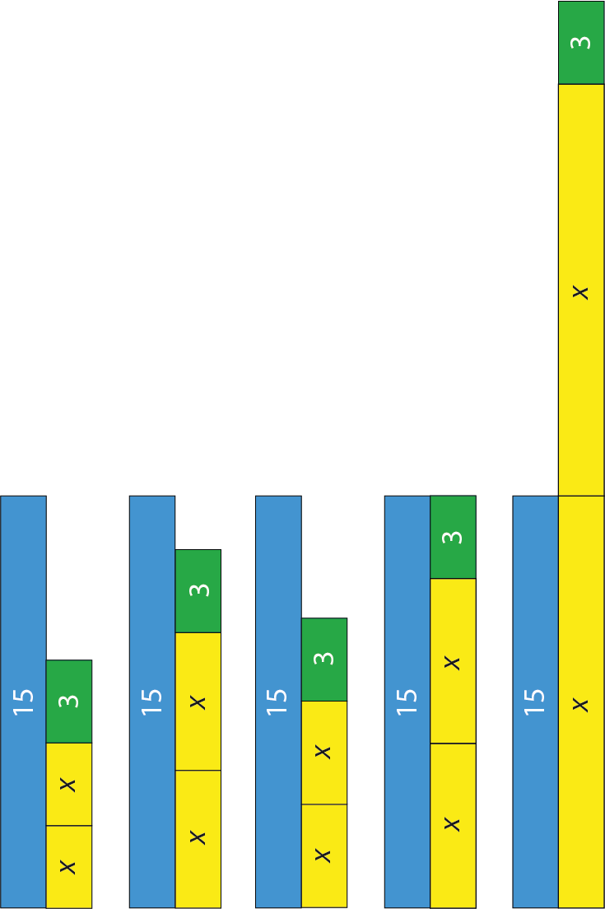
Notes:
This printable resource (two to a page) supports Checkpoint 1.

Slide 62
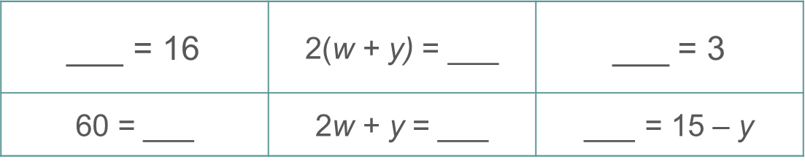
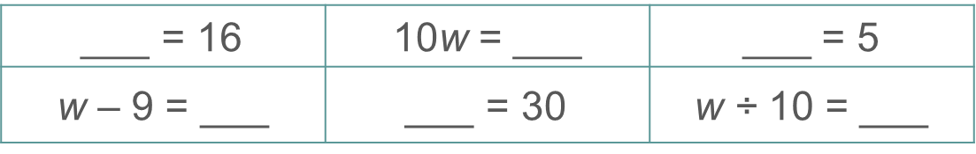
If w + y = 15, fill in the gaps so that each of these equations is true.
If w + y = 15, fill in the gaps so that each of these equations is true.
If w + y = 15, fill in the gaps so that each of these equations is true.
If w = 15, fill in the gaps so that each of these equations is true.
If w = 15, fill in the gaps so that each of these equations is true.
If w = 15, fill in the gaps so that each of these equations is true.
Notes:
This printable resource (three to a page) might be useful with Checkpoint 7.

Slide 63
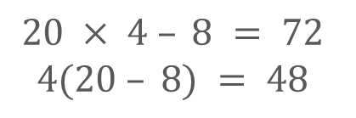
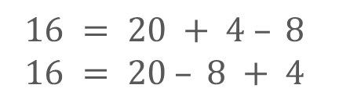
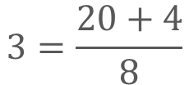
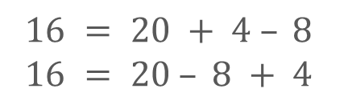
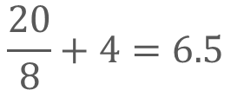
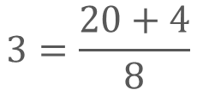

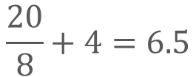
1
− 8
× 4
2
÷ 8
+ 4
3
− 8
+ 4
20
20
20
$$20 × 4 – 8 = 72$$
$$4(20 – 8) = 48$$
$$\frac{20}{8}+4=6.5$$
$$3=\frac{20+4}{8}$$
$$16 = 20 + 4 – 8$$
$$16 = 20 – 8 + 4$$
1
− 8
× 4
2
÷ 8
+ 4
3
− 8
+ 4
20
20
20
$$20 × 4 – 8 = 72$$
$$4(20 – 8) = 48$$
$$\frac{20}{8}+4=6.5$$
$$3=\frac{20+4}{8}$$
$$16 = 20 + 4 – 8$$
$$16 = 20 – 8 + 4$$
Notes:
These printable function machines resource might be useful for Checkpoint 8 (two per page).

Slide 64
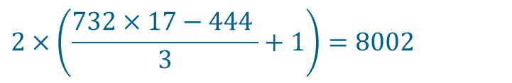

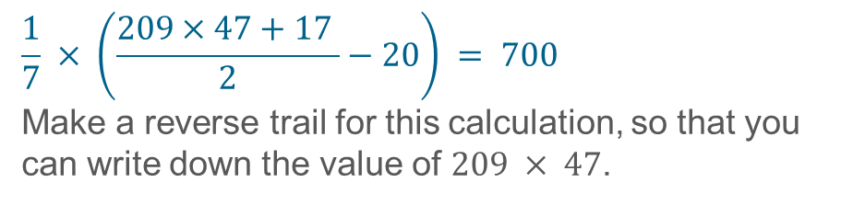


Checkpoint 9a: Make a trail
Checkpoint 9b: Make a trail 2
$$2×\left(\frac{732×17−444 }{3}+1\right)=8002$$
$$54 × 91 = 4 914$$
Work out:
$54×91−900$
$\frac{54 × 91 − 900}{2}$
$\frac{54 × 91 − 900}{2}−7$
$3×\left(\frac{54 × 91 − 900}{2}−7 \right)$
Use this to work out the answer to:
$\frac{732 × 17 − 444 }{3}+1$
$\frac{732 × 17 − 444 }{3}$
$732×17−444$
$732×17$
Make a different trail, starting from 54 × 91, that has the same finishing number as your answer to part d. Can you make three different trails all with the same outcome?
$$\frac{1}{7} × \left(\frac{209×47\text{ + 17} }{2}−20\right) = 700$$
Make a reverse trail for this calculation, so that you can write down the value of $209 × 47$.
Notes:
This is a printable version of the calculations in Checkpoints 9a and 9b.

Slide 65
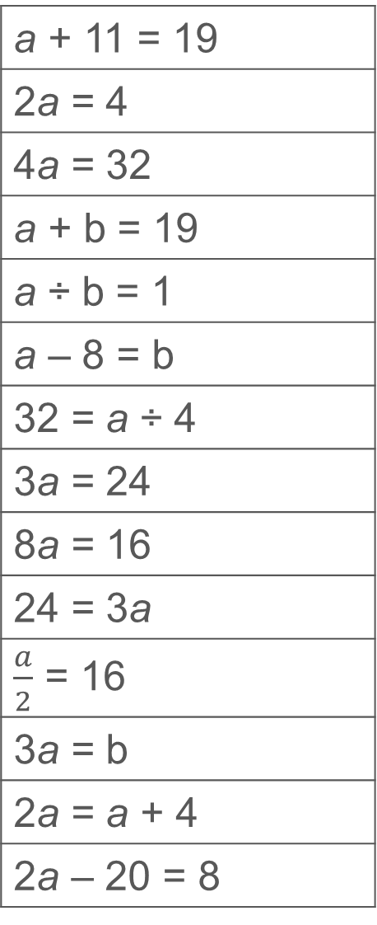



a + 11 = 19
2a = 4
4a = 32
a + b = 19
a ÷ b = 1
a – 8 = b
32 = a ÷ 4
3a = 24
8a = 16
24 = 3a
$\frac{a}{2}$ = 16
3a = b
2a = a + 4
2a – 20 = 8
a + 11 = 19
2a = 4
4a = 32
a + b = 19
a ÷ b = 1
a – 8 = b
32 = a ÷ 4
3a = 24
8a = 16
24 = 3a
$\frac{a}{2}$ = 16
3a = b
2a = a + 4
2a – 20 = 8
a + 11 = 19
2a = 4
4a = 32
a + b = 19
a ÷ b = 1
a – 8 = b
32 = a ÷ 4
3a = 24
8a = 16
24 = 3a
$\frac{a}{2}$ = 16
3a = b
2a = a + 4
2a – 20 = 8
a + 11 = 19
2a = 4
4a = 32
a + b = 19
a ÷ b = 1
a – 8 = b
32 = a ÷ 4
3a = 24
8a = 16
24 = 3a
$\frac{a}{2}$ = 16
3a = b
2a = a + 4
2a – 20 = 8
Notes:
These printable sets of equations (four on a page) can be used alongside Checkpoint 12. You could ask students to sort them into always/sometimes/never piles, or copy the table on slide 39.

Slide 66

Notes:
This is a printable version of the table in Checkpoint 16 (three on a page).

Slide 67
The number line below is going up in ones.
A
B
C
D
E
F
G
H
I
J
K
L
M
N
O
P
Q
3a + 2
Match the expressions below to their places on the number line.
3(a + 2)
3a + 8
3a + 6
3(a + 3)
3(a + 5)
The number line below is going up in ones.
A
B
C
D
E
F
G
H
I
J
K
L
M
N
O
P
Q
3a + 2
Match the expressions below to their places on the number line.
3(a + 2)
3a + 8
3a + 6
3(a + 3)
3(a + 5)
Notes:
You may find this number line (two on a page) useful with Additional activity C.

Slide 68


























1
$$×3$$
$$+ 7$$
2
$$+ 7$$
$$÷ 3$$
3
$$− 3$$
$$+ 7$$
$$x$$
$$x$$
$$x$$
$$3x + 7 = 1$$
$$3(x + 7) = 24$$
$$\frac{x}{3}+7=9$$
$$3=\frac{x+7}{3}$$
$$16 = x + 7 – 3$$
$$16 = x – 3 + 7$$
1
$$×3$$
$$+ 7$$
2
$$+ 7$$
$$÷ 3$$
3
$$− 3$$
$$+ 7$$
$$x$$
$$x$$
$$x$$
$$3x + 7 = 1$$
$$3(x + 7) = 24$$
$$\frac{x}{3}+7=9$$
$$3=\frac{x+7}{3}$$
$$16 = x + 7 – 3$$
$$16 = x – 3 + 7$$
Notes:
These printable function machines resource might be useful for Additional activity F (two on a page).

Slide 69








a) $\frac{n}{2}$ $= 40$
$$n = 20$$
b) $n – 3.5 = 12$
$$n = 6.5$$
c) $2n – 9 = −8$
$$n = \frac{1}{2}$$
d) $3n = 18 000$
$$n = 60$$
e) $3n = 177$
$$n = 58$$
f) $4n + 10 = 22$
$$n = 8$$
a) $\frac{n}{2}$ $= 40$
$$n = 20$$
b) $n – 3.5 = 12$
$$n = 6.5$$
c) $2n – 9 = −8$
$$n = \frac{1}{2}$$
d) $3n = 18 000$
$$n = 60$$
e) $3n = 177$
$$n = 58$$
f) $4n + 10 = 22$
$$n = 8$$
a) $\frac{n}{2}$ $= 40$
$$n = 20$$
b) $n – 3.5 = 12$
$$n = 6.5$$
c) $2n – 9 = −8$
$$n = \frac{1}{2}$$
d) $3n = 18 000$
$$n = 60$$
e) $3n = 177$
$$n = 58$$
f) $4n + 10 = 22$
$$n = 8$$
a) $\frac{n}{2}$ $= 40$
$$n = 20$$
b) $n – 3.5 = 12$
$$n = 6.5$$
c) $2n – 9 = −8$
$$n = \frac{1}{2}$$
d) $3n = 18 000$
$$n = 60$$
e) $3n = 177$
$$n = 58$$
f) $4n + 10 = 22$
$$n = 8$$
Notes:
You may find it helpful to print these questions out (four sets on a page) for use with Additional activity H.

Slide 70




 | If… | g is even
a) | $5g$ gives an odd number | $$×$$
b) | $3g$ gives an even number
c) | $40 – g$gives a negative number
d) | $2g$ gives an even number
e) | $\frac{g}{2}$gives an odd number
f) | $3g + 1$gives an odd number
g) | $3(g – 2)$gives an even number
 | If… | g is even
a) | $5g$ gives an odd number | $$×$$
b) | $3g$ gives an even number
c) | $40 – g$gives a negative number
d) | $2g$ gives an even number
e) | $\frac{g}{2}$gives an odd number
f) | $3g + 1$gives an odd number
g) | $3(g – 2)$gives an even number
 | If… | g is even
a) | $5g$ gives an odd number | $$×$$
b) | $3g$ gives an even number
c) | $40 – g$gives a negative number
d) | $2g$ gives an even number
e) | $\frac{g}{2}$gives an odd number
f) | $3g + 1$gives an odd number
g) | $3(g – 2)$gives an even number
 | If… | g is even
a) | $5g$ gives an odd number | $$×$$
b) | $3g$ gives an even number
c) | $40 – g$gives a negative number
d) | $2g$ gives an even number
e) | $\frac{g}{2}$gives an odd number
f) | $3g + 1$gives an odd number
g) | $3(g – 2)$gives an even number
Notes:
This is a printable version of the table for Additional activity I (four on a page).

Slide 71




 | If… | j is more than 40
a) | $5j$ gives a number greater than 10 | ?
b) | $3j$ gives a number less than 100
c) | $40 – j$gives a number less than 0
d) | $2j$ gives a number greater than 40
e) | $\frac{j}{2}$gives a number greater than 20
f) | $3j + 1$gives a number more than 200
g) | $3(j – 2)$gives a number more than 8
 | If… | j is more than 40
a) | $5j$ gives a number greater than 10 | ?
b) | $3j$ gives a number less than 100
c) | $40 – j$gives a number less than 0
d) | $2j$ gives a number greater than 40
e) | $\frac{j}{2}$gives a number greater than 20
f) | $3j + 1$gives a number more than 200
g) | $3(j – 2)$gives a number more than 8
 | If… | j is more than 40
a) | $5j$ gives a number greater than 10 | ?
b) | $3j$ gives a number less than 100
c) | $40 – j$gives a number less than 0
d) | $2j$ gives a number greater than 40
e) | $\frac{j}{2}$gives a number greater than 20
f) | $3j + 1$gives a number more than 200
g) | $3(j – 2)$gives a number more than 8
 | If… | j is more than 40
a) | $5j$ gives a number greater than 10 | ?
b) | $3j$ gives a number less than 100
c) | $40 – j$gives a number less than 0
d) | $2j$ gives a number greater than 40
e) | $\frac{j}{2}$gives a number greater than 20
f) | $3j + 1$gives a number more than 200
g) | $3(j – 2)$gives a number more than 8
Notes:
This is a printable version of the table for Additional activity J (four on a page).

