Slide 1
Year 4, Unit 3
Perimeter

Slide 2
Year 4, Unit 3
These materials heavily reflect the prioritisation approach of the ready-to-progress criteria in the DfE Primary Mathematics Guidance 2020 and on the PPTs that exemplify them on the NCETM website. They also include other relevant National Curriculum content. Related sections of the NCETM Primary Mastery Professional Development Materials provide small-step teaching guidance.
Ready-to-progress criteria addressed by this unit
Teaching of this unit supports the following criteria from the ‘DfE Mathematics Guidance: key stages 1 & 2’ (the 335-page document available as a download)
4G-2 Page 197

Slide 3
Contents
The links below take you to the starting slide of each learning outcome.
1 | A regular polygon has sides that are all the same length and interior angles that are all equal in size
2 | Perimeter is the distance around the edge of a two-dimensional shape
3 | Different shapes can have the same perimeter
4 | Perimeter is measured in units of length and can be found by counting units
5 | Perimeter can be calculated by adding together the side lengths of a 2D shape
Click the arrow button to return to this Contents slide.

Slide 4
Contents
The links below take you to the starting slide of each learning outcome.
6 | The perimeter of a rectangle can be calculated by addition and multiplication
7 | Unknown side lengths can be calculated from perimeter and known side lengths
8 | The perimeter of a regular polygon can be calculated by multiplication
9 | The side length of a regular polygon can be calculated by division where the perimeter is known
Click the arrow button to return to this Contents slide.

Slide 5
Year 4, Unit 3, Learning Outcome 1
Learning Outcome 1
A regular polygon has sides that are all the same length and interior angles that are all equal in size
The following slides have been collated to support the teaching of this learning outcome.

Slide 6

Year 4, Unit 3, Learning Outcome 1
Additional teacher guidance for this outcome should be read first and can be found in the DfE Mathematics guidance. Page references relate to the 335-page document available as a download at the bottom of this web page.
Ready to progress criteria | Pages
4G-2 | 197-201

Slide 7

4G-2 Perimeter: regular and irregular polygons
All sides equal length
All angles equal size
Not all sides equal length
All angles equal size
Not all sides equal length
Not all angles equal size
All sides equal length
Not all angles equal size
Look at these shapes. What is the same/different about them?
Can you think how we could sort these shapes? Which shapes have equal sides? Which shapes have equal angles? Which shapes have equal sides and equal angles? What do we call these shapes?
Can you draw/find a shape with equal sides and unequal angles? Equal angles but unequal sides? Equal sides and equal angles? Unequal sides and unequal angles?
Irregular
Irregular
Regular
Irregular
This is a regular polygon, because all of the sides are the same length, and all of the interior angles are equal.

Slide 8
Year 4, Unit 3, Learning Outcome 2
Learning Outcome 2
Perimeter is the distance around the edge of a two-dimensional shape
The following slides have been collated to support the teaching of this learning outcome.

Slide 9
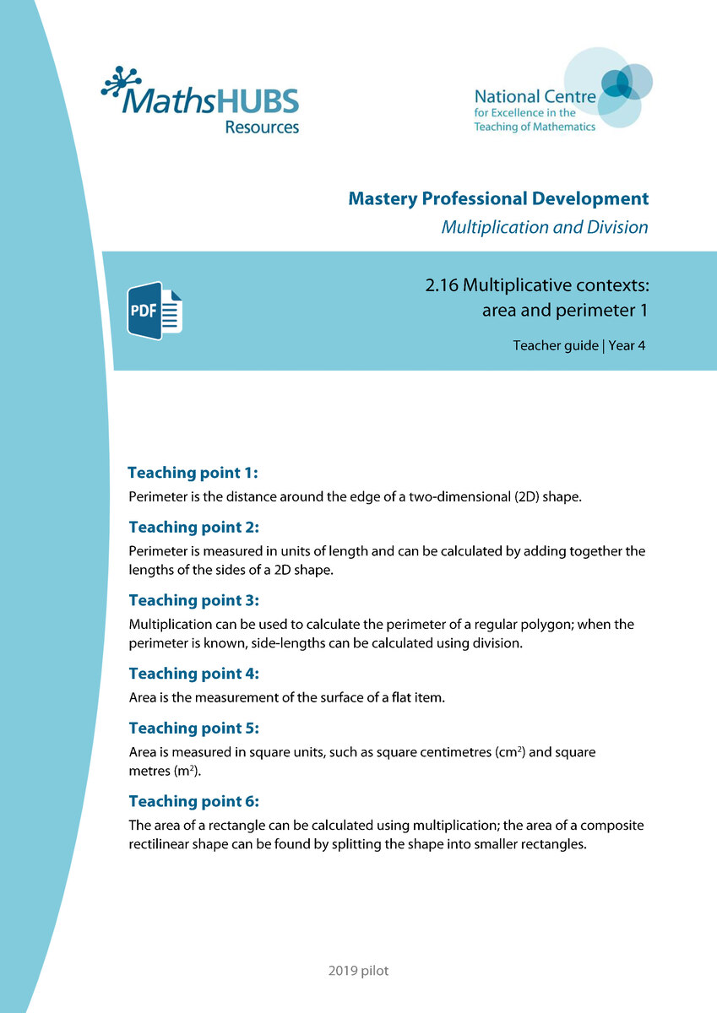
Year 4, Unit 3, Learning Outcome 2
Additional teacher guidance for this outcome should be read first and can be found in this segment of the NCETM Primary Mastery Professional Development Materials:
2.16 Multiplicative contexts: area and perimeter 1
The spine materials are divided into ‘teaching points’ and ‘steps in learning’.
Teaching point | Steps in learning | Pages
1 | 1:1-1:2 | 3-5

Slide 10


2.16 Area and perimeter 1 Step 1:1
Notes:
The caterpillar walks around the edge of the leaf.

Slide 11




2.16 Area and perimeter 1 Step 1:1
Notes:
The distance around the edge of the leaf is its perimeter.

Slide 12





2.16 Area and perimeter 1 Step 1:1

Slide 13
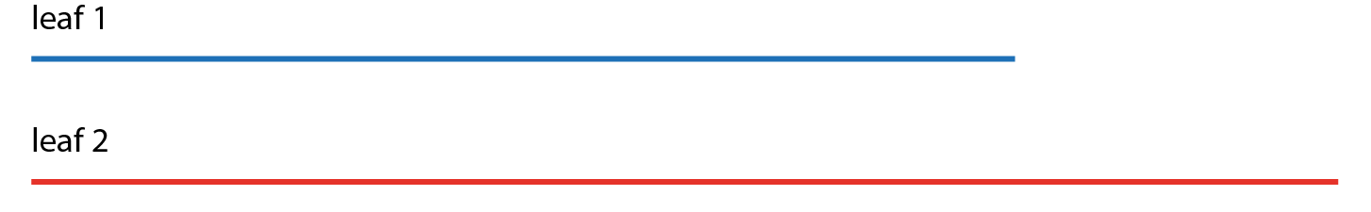
2.16 Area and perimeter 1 Step 1:1
Notes:
Is the distance around the edge of leaf 2 longer, shorter or
the same as the distance around the edge of leaf 1?

Slide 14
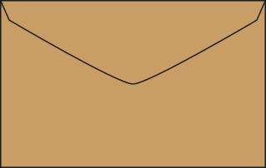
2.16 Area and perimeter 1 Step 1:2
Do the pictures show the perimeters of the envelopes?
✓
✗

Slide 15
Year 4, Unit 3, Learning Outcome 3
Learning Outcome 3
Different shapes can have the same perimeter
The following slides have been collated to support the teaching of this learning outcome.

Slide 16
Year 4, Unit 3, Learning Outcome 3
Additional teacher guidance for this outcome should be read first and can be found in this segment of the NCETM Primary Mastery Professional Development Materials:
2.16 Multiplicative contexts: area and perimeter 1
The spine materials are divided into ‘teaching points’ and ‘steps in learning’.
Teaching point | Steps in learning | Pages
1 | 1:3-1:4 | 5-6

Slide 17

2.16 Area and perimeter 1 Step 1:3
Different shapes with the same perimeter

Slide 18



2.16 Area and perimeter 1 Step 1:4
Whose shape has the longest perimeter?
Bhav
Kirti
Notes:
Bhav says that her shape has the longest perimeter.
Kirti says that her shape has the longest perimeter.
Liz says that both shapes could have the same perimeter.
Who is right?

Slide 19
Year 4, Unit 3, Learning Outcome 4
Learning Outcome 4
Perimeter is measured in units of length and can be found by counting units
The following slides have been collated to support the teaching of this learning outcome.

Slide 20
Year 4, Unit 3, Learning Outcome 4
Additional teacher guidance for this outcome should be read first and can be found in this segment of the NCETM Primary Mastery Professional Development Materials:
2.16 Multiplicative contexts: area and perimeter 1
The spine materials are divided into ‘teaching points’ and ‘steps in learning’.
Teaching point | Steps in learning | Pages
2 | 2:1-2:2 | 7-9

Slide 21
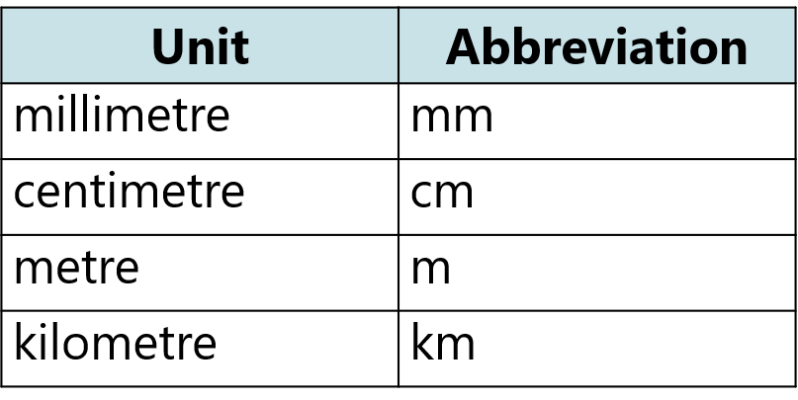
2.16 Area and perimeter 1 Step 2:1

Slide 22

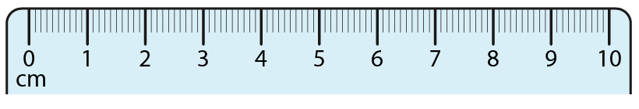
2.16 Area and perimeter 1 Step 2:1
Measuring the perimeter of leaf 1
Notes:
The perimeter of the leaf is 8 cm.

Slide 23

2.16 Area and perimeter 1 Step 2:2
Notes:
What is the perimeter of this rectangle? Count the sticks.

Slide 24
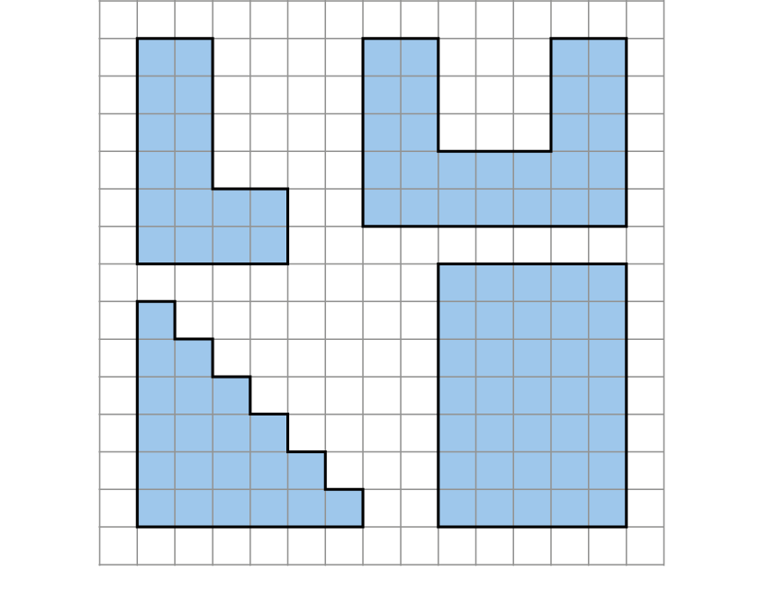
2.16 Area and perimeter 1 Step 2:2
P = 20 cm
P = 30 cm
P = 24 cm
P = 24 cm
Notes:
What is the perimeter of each shape? Count the squares.

Slide 25
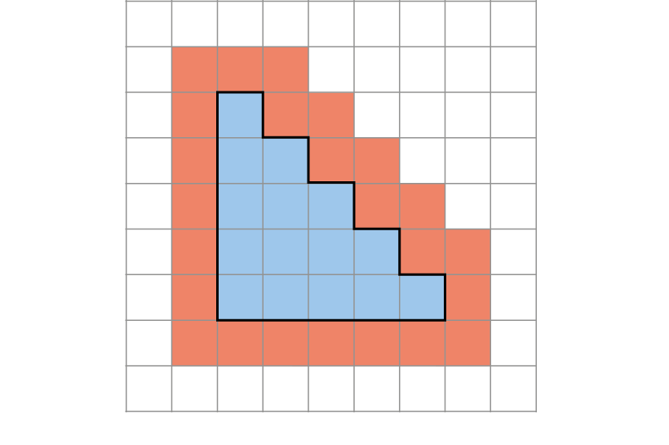
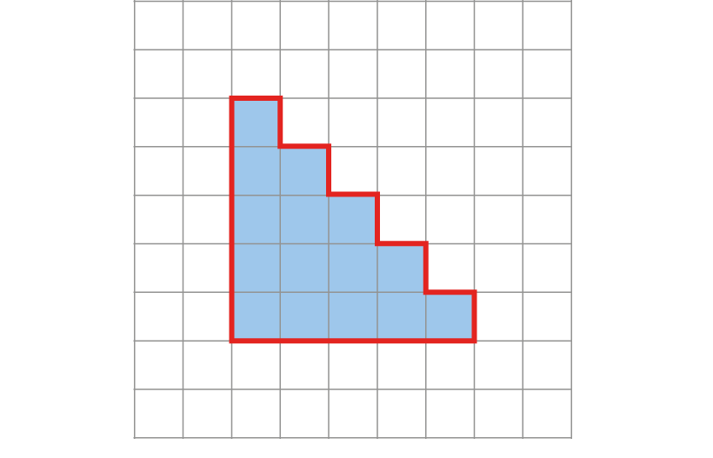
2.16 Area and perimeter 1 Step 2:2
Who is correct?
Sally says the perimeter is 24 units.
Felicity says the perimeter is 20 units.
✓

Slide 26
Year 4, Unit 3, Learning Outcome 5
Learning Outcome 5
Perimeter can be calculated by adding together the side lengths of a 2D shape
The following slides have been collated to support the teaching of this learning outcome.

Slide 27
Year 4, Unit 3, Learning Outcome 5
Additional teacher guidance for this outcome should be read first and can be found in this segment of the NCETM Primary Mastery Professional Development Materials:
2.16 Multiplicative contexts: area and perimeter 1
The spine materials are divided into ‘teaching points’ and ‘steps in learning’.
Teaching point | Steps in learning | Pages
2 | 2:3-2:4 | 10-12

Slide 28
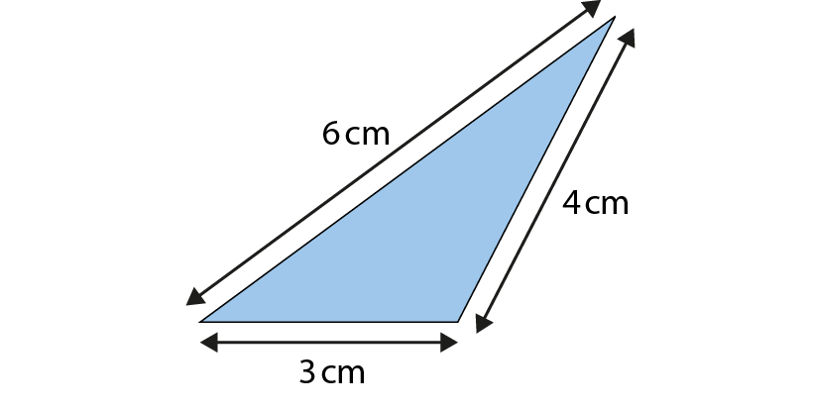
2.16 Area and perimeter 1 Step 2:3
What is the perimeter of this triangle?
P = 13 cm
Notes:
perimeter = 6 cm + 4 cm + 3 cm
= 13 cm
We can write the side lengths in any order.

Slide 29
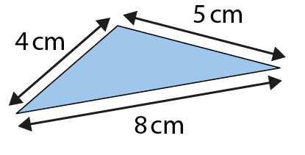
2.16 Area and perimeter 1 Step 2:3
What is the perimeter of this triangle?
P = 17 cm

Slide 30
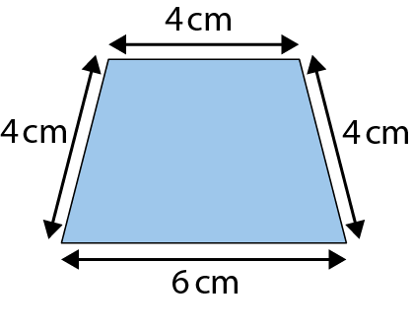
2.16 Area and perimeter 1 Step 2:3
What is the perimeter?
P = 18 cm

Slide 31
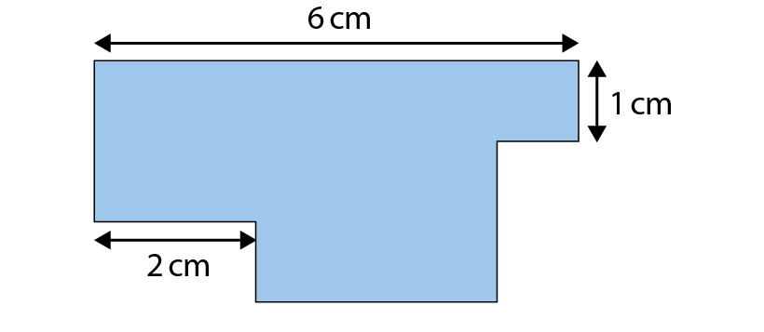
2.16 Area and perimeter 1 Step 2:4
Notes:
Do you have enough information to work out the perimeter of this shape?

Slide 32
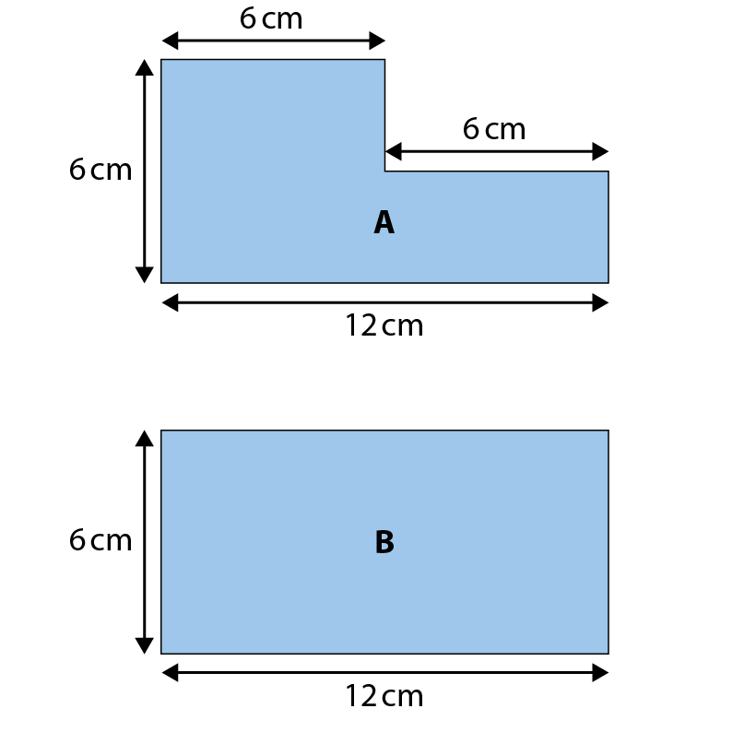
2.16 Area and perimeter 1 Step 2:4
True or false?
The perimeter of shape A is longer than
the perimeter of shape B.
✗
P = 36 cm
P = 36 cm

Slide 33
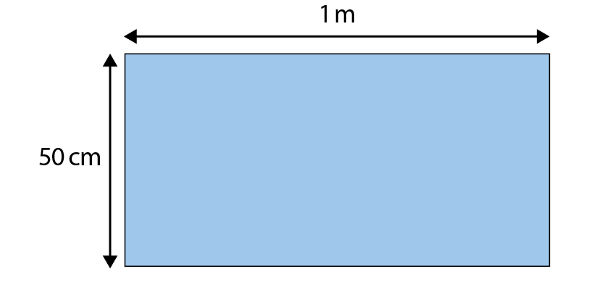
2.16 Area and perimeter 1 Step 2:4
Which answers give the correct perimeter for this shape?
51 cm
3 m
✓
102 cm
300 cm
✓
1 m 50 cm
210 cm

Slide 34
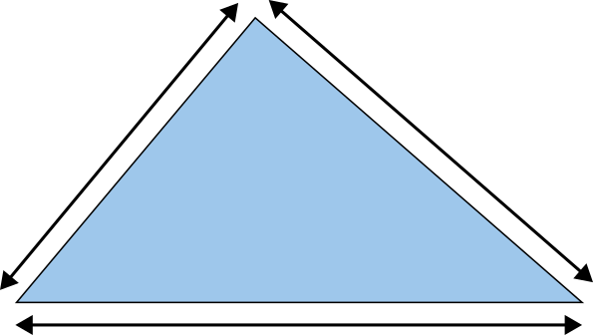
2.16 Area and perimeter 1 Step 2:4
The perimeter of this triangle is 22 cm.
6 cm
7 cm
?
9 cm

Slide 35
Year 4, Unit 3, Learning Outcome 6
Learning Outcome 6
The perimeter of a rectangle can be calculated by addition and multiplication
The following slides have been collated to support the teaching of this learning outcome.

Slide 36
Year 4, Unit 3, Learning Outcome 6
Additional teacher guidance for this outcome should be read first and can be found in this segment of the NCETM Primary Mastery Professional Development Materials:
2.16 Multiplicative contexts: area and perimeter 1
The spine materials are divided into ‘teaching points’ and ‘steps in learning’.
Teaching point | Steps in learning | Pages
3 | 3:1-3:3 | 13-15

Slide 37
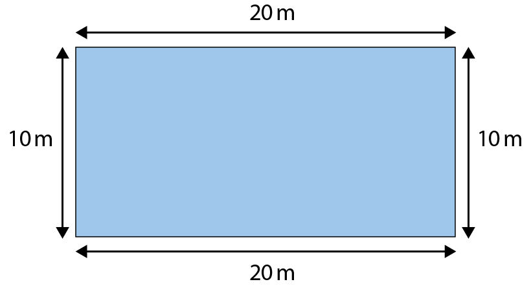
2.16 Area and perimeter 1 Step 3:1
P = 20 m + 10 m + 20 m + 10 m
= 60 m
P = 20 m + 20 m + 10 m + 10 m
= 60 m

Slide 38




2.16 Area and perimeter 1 Step 3:2/3
P = 2 × 20 m + 2 × 10 m
= 40 m + 20 m
= 60 m

Slide 39
2.16 Area and perimeter 1 Step 3:2/3
P = 2 × 20 m + 2 × 10 m
20 + 10 = 30
= 40 m + 20 m
30 × 2 = 60
= 60 m
P = 60 m

Slide 40
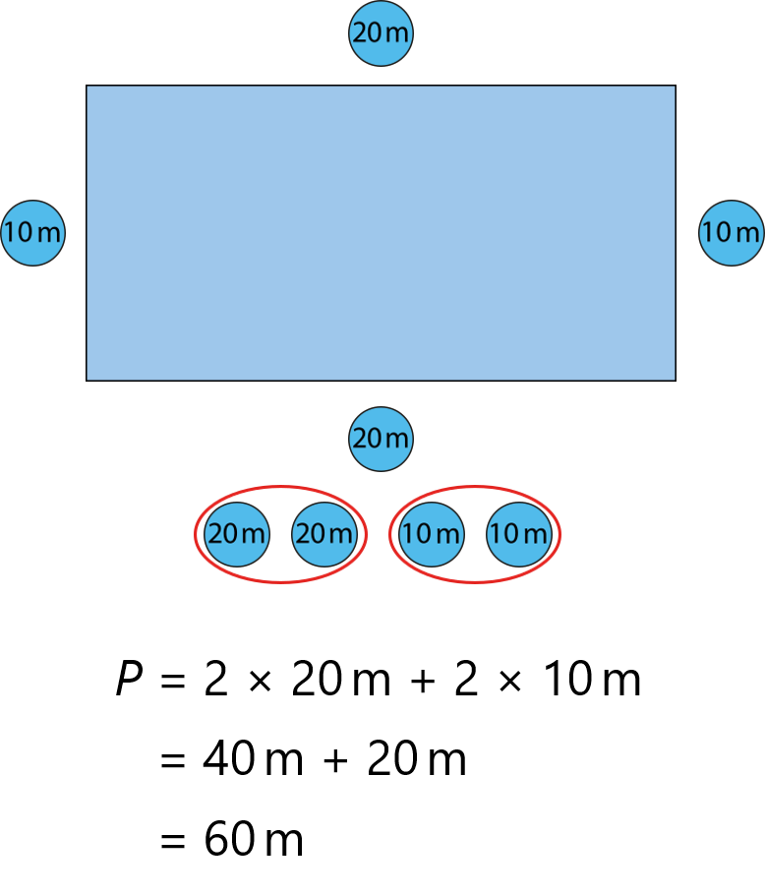
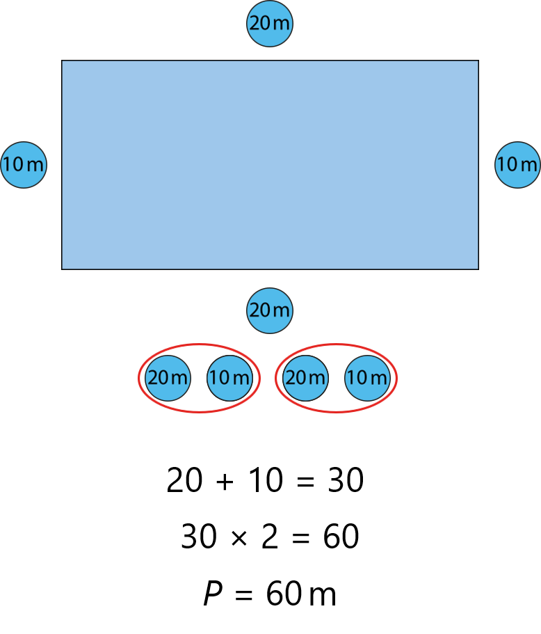
2.16 Area and perimeter 1 Step 3:2/3

Slide 41
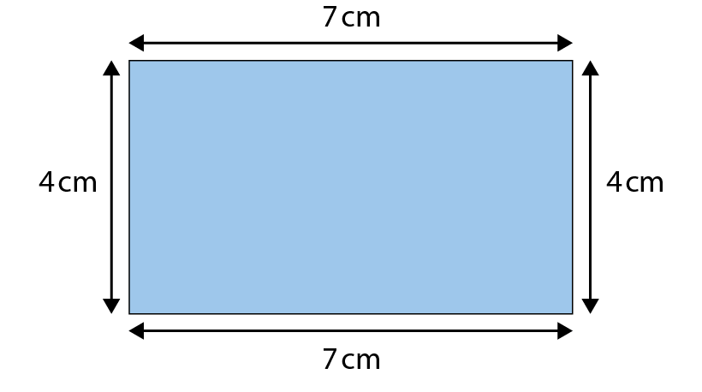
2.16 Area and perimeter 1 Step 3:3
Method 1
Method 2
7 cm + 4 cm = 11 cm
P = 7 cm × 2 + 4 cm × 2
11 cm × 2 = 22 cm
= 14 cm + 8 cm
P = 22 cm
P = 22 cm

Slide 42
Year 4, Unit 3, Learning Outcome 7
Learning Outcome 7
Unknown side lengths can be calculated from perimeter and known side lengths
The following slides have been collated to support the teaching of this learning outcome.

Slide 43
Year 4, Unit 3, Learning Outcome 7
Additional teacher guidance for this outcome should be read first and can be found in this segment of the NCETM Primary Mastery Professional Development Materials:
2.16 Multiplicative contexts: area and perimeter 1
The spine materials are divided into ‘teaching points’ and ‘steps in learning’.
Teaching point | Steps in learning | Pages
3 | 3:4-3:5 | 16-17

Slide 44
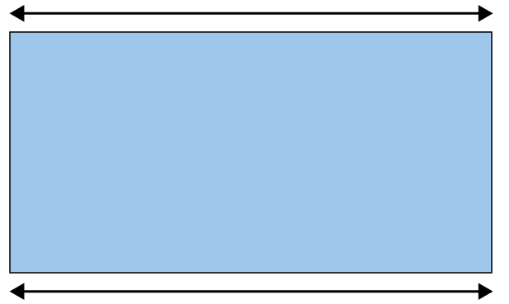
2.16 Area and perimeter 1 Step 3:4
The perimeter of this rectangle is 30 cm.
What is the length of each short side?
10 cm
5 cm
?
5 cm
?
10 cm
30 cm − 2 × 10 cm = 30 cm − 20 cm = 10 cm
10 cm ÷ 2 = 5 cm
short side = 5 cm

Slide 45
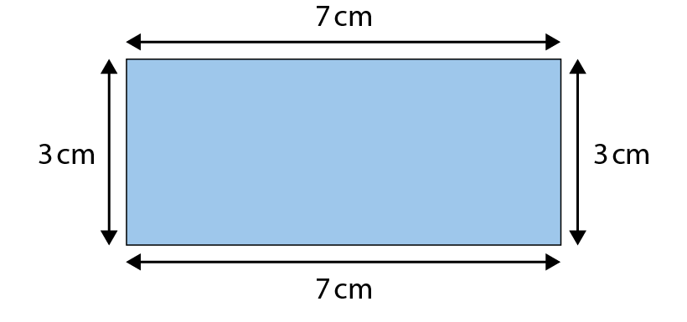
2.16 Area and perimeter 1 Step 3:5
P =
20 cm

Slide 46
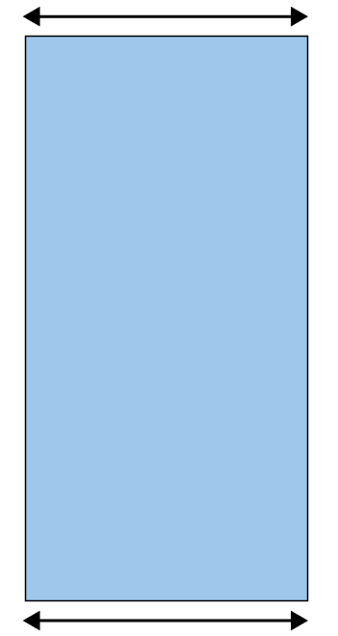
2.16 Area and perimeter 1 Step 3:5
The perimeter of this rectangle is 60 cm.
How long are the long sides?
10 cm
20 cm
?
20 cm
?
10 cm

Slide 47
Year 4, Unit 3, Learning Outcome 8
Learning Outcome 8
The perimeter of a regular polygon can be calculated by multiplication
The following slides have been collated to support the teaching of this learning outcome.

Slide 48
Year 4, Unit 3, Learning Outcome 8
Additional teacher guidance for this outcome should be read first and can be found in this segment of the NCETM Primary Mastery Professional Development Materials:
2.16 Multiplicative contexts: area and perimeter 1
The spine materials are divided into ‘teaching points’ and ‘steps in learning’.
Teaching point | Steps in learning | Pages
3 | 3:6-3:7 | 18-19

Slide 49
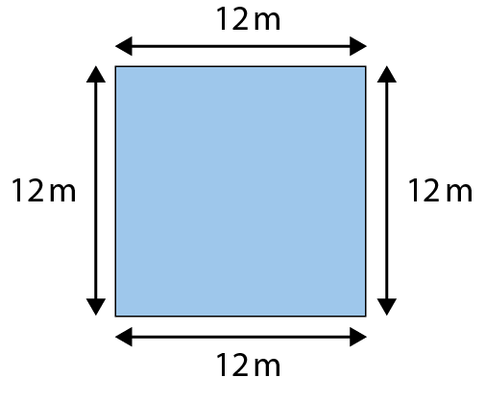
2.16 Area and perimeter 1 Step 3:6
P = 12 m + 12 m + 12 m + 12 m
= 12 m × 4
= 48 m

Slide 50
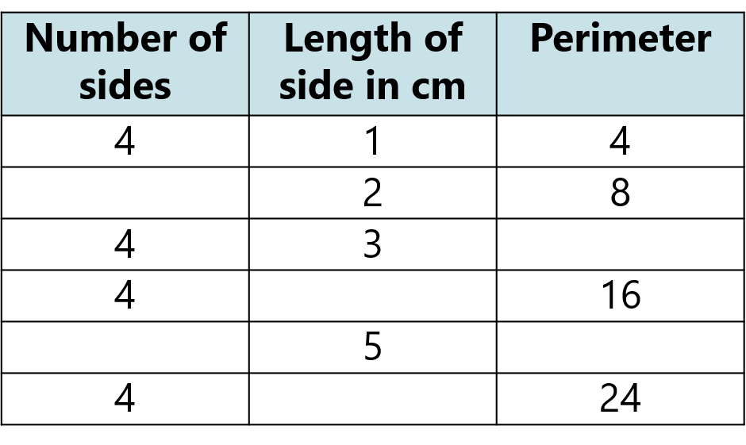

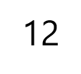
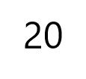

2.16 Area and perimeter 1 Step 3:6

Slide 51
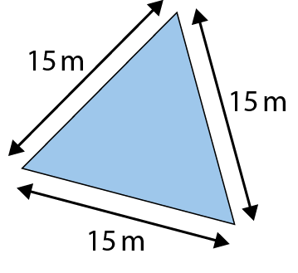
2.16 Area and perimeter 1 Step 3:6
What is the perimeter of this equilateral triangle?
P = 15 m + 15 m + 15 m
= 3 × 15 m
= 45 m

Slide 52
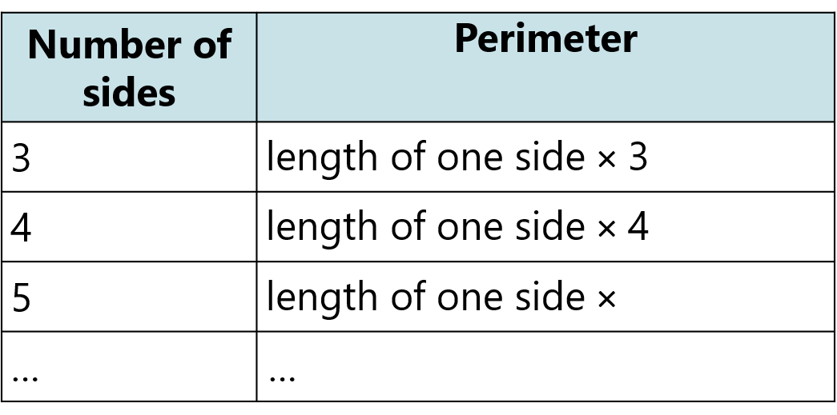


2.16 Area and perimeter 1 Step 3:7
For shapes with equal side lengths…

Slide 53
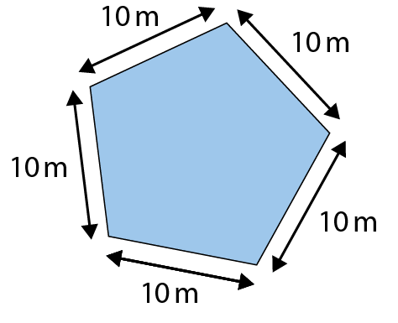
2.16 Area and perimeter 1 Step 3:7
What is the perimeter of this regular pentagon?
P = 10 m + 10 m + 10 m + 10 m + 10 m
= 5 × 10 m
= 50 m

Slide 54
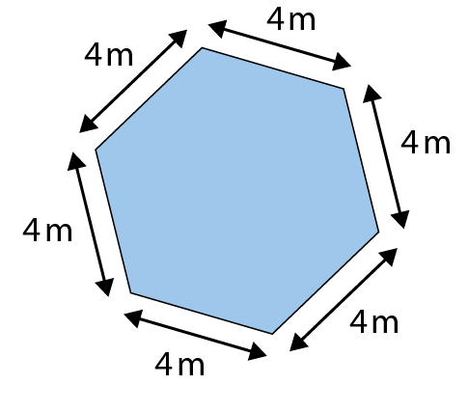
2.16 Area and perimeter 1 Step 3:7
What is the perimeter of this regular hexagon?
P = 4 m + 4 m + 4 m + 4 m + 4 m + 4 m
= 6 × 4 m
= 24 m

Slide 55
Year 4, Unit 3, Learning Outcome 9
Learning Outcome 9
The side length of a regular polygon can be calculated by division where the perimeter is known
The following slides have been collated to support the teaching of this learning outcome.

Slide 56
Year 4, Unit 3, Learning Outcome 9
Additional teacher guidance for this outcome should be read first and can be found in this segment of the NCETM Primary Mastery Professional Development Materials:
2.16 Multiplicative contexts: area and perimeter 1
The spine materials are divided into ‘teaching points’ and ‘steps in learning’.
Teaching point | Steps in learning | Page
3 | 3:8-3:9 | 20

Slide 57
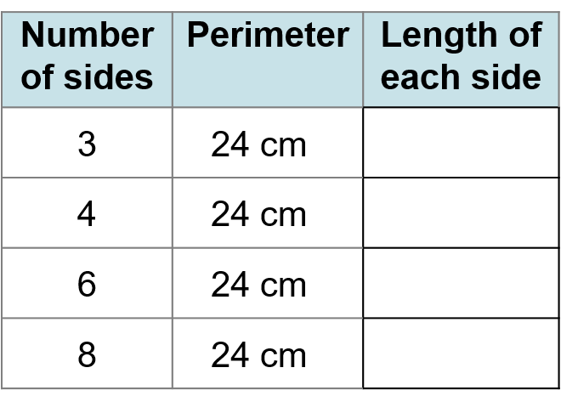
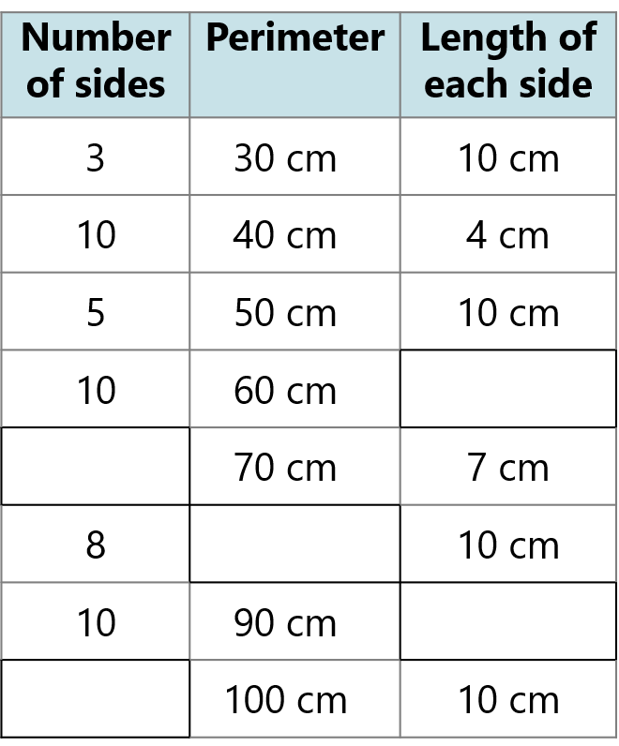







2.16 Area and perimeter 1 Step 3:8

Slide 58
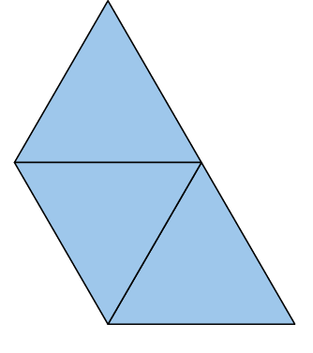
2.16 Area and perimeter 1 Step 3:9
Every side of each triangle is 40 cm.
Joseph writes: P = 40 cm × 9
Becca writes: P = 40 cm × 5
What do you think?
Notes:
There are three triangular paving slabs. Every side of each triangle is 40 cm in length.
Joseph thinks: ‘If I place these paving slabs like this, the perimeter is 40 cm x 9 as
there are three triangles and each has three sides.
Becca thinks: ‘The perimeter is always 40 cm x 5 no matter how you place them.’

