Slide 1
Surface area of 3D shapes
KS3 Mastery PD Materials: Exemplified Key Ideas
Materials for use in the classroom or to support professional development discussions
(from 6.2 Perimeter, area and volume)
Summer 2021

Slide 2
About this resource
These slides are designed to complement the 6.2 Area, perimeter and volume Core Concept document and its associated Theme Overview document 6 Geometry, both found in the Secondary Mastery Professional Development pages.
These slides re-present the key examples from the Core Concept document so that the examples can be used either directly in the classroom or with a group of teachers. There are prompt questions alongside the examples, and further clarification in the notes.
These slides do not fully replicate the Core Concept document, so should be used alongside it. Reference to specific page numbers, and to other useful NCETM resources, can be found in the notes for each slide.
This slide deck is not designed to be a complete PD session, rather it is a selection of resources that you can adapt and use as needed when planning a session with a group of teachers.

Slide 3


About this resource
The slides are structured as follows:
  The big picture:
    Where does this fit in?
    What do students need to understand?
    Why is this key idea important?
  Prior learning
  Misconceptions
  Exemplified key ideas
  Reflection questions
  Appendices:
    Key vocabulary
    Representations and structure
    Previous and Future learning
    Useful links
The exemplified key idea slides have the following symbols to indicate how they have been designed to be used:
Into the classroom
The examples are presented on these slides so that they could be used in PD, but also directly in the classroom. The notes feature suggested questions and things teachers might consider when using with students.
PD discussion prompts
These slides look at the examples in more detail, with question prompts to promote discussion among maths teachers. The notes feature reference to further information and guidance within the Core Concepts document.

Slide 4
Where does this fit in?
The NCETM has identified a set of six ‘mathematical themes’ within Key Stage 3 mathematics that bring together a group of ‘core concepts’.
The sixth of these themes is Geometry, which covers the following interconnected core concepts:
6.1 Geometrical properties
6.2 Perimeter, area and volume
6.3 Transforming shapes
6.4 Constructions
Notes:
Linked on this slide is the Theme Overview document of Geometry. This document includes why it is important, the key underpinning knowledge and links to prior and future learning. There is also guidance about how the five big ideas of Teaching for Mastery relate specifically to this theme.

Slide 5
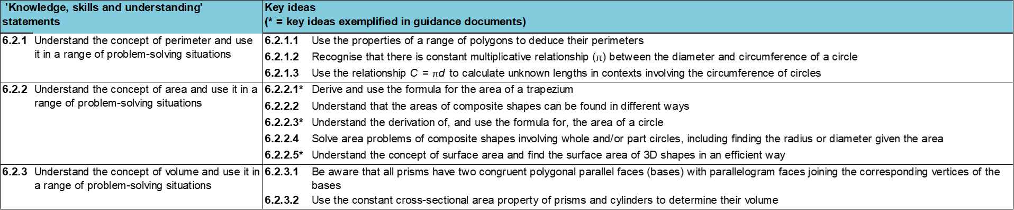
Where does this fit in?
Within this core concept, 6.2 Perimeter, area and volume, there are three statements of knowledge, skills and understanding.
These, in turn, are broken down into ten key ideas. The highlighted key idea is exemplified in this slide deck.
Notes:
For key ideas marked with an asterisk, we exemplified the common difficulties and misconceptions that students might have and included elements of what teaching for mastery may look like. We have provided examples of possible student tasks and teaching approaches.
Within these slides are ‘classroom-ready’ versions of the examples for the key idea that has been highlighted. There are also slides that may be useful for discussion in a professional development session

Slide 6
What do students need to understand?
6.2.2.5 Understand the concept of surface area and find the surface area of 3D shapes in an efficient way
Understand that prisms can have a different number of faces and, therefore, the surface area can be the sum of a different number of areas.
Understand that the surface area of a prism is the sum of the area of all the faces and not just the visible ones.
Understand how to use the correct dimensions to calculate the area of 2D shapes.
There is no standard formula for calculating the surface area of a prism.
The units of surface area are squared.
Solve familiar and unfamiliar problems, including real-life applications.
Solve problems where there is more than one answer and there are elements of experimentation, investigation, checking, reasoning, proof, etc.
  What prior knowledge might your students already have?
  What language might they use to describe this key idea?
  What questions might you want to ask to assess their prior learning?

Slide 7
Why is this key idea important?
Geometrical thinking is a fundamental and often intuitive and accessible way to engage students in mathematical activity.
The study of geometry helps to develop students’ spatial awareness, intuition and visualisation and can help them gain insights and hence solve many types of problems.
There are many applications of geometry relevant to employment and everyday life. Other subjects in the curriculum, such as science and technology, also make use of geometrical ideas and techniques.
Geometry is an important area of the curriculum where students can engage in making conjectures, using logical chains of reasoning and mathematical proof.
Notes:
A more detailed overview of the core concept of Perimeter, area and volume can be found on page 2 of the 6.2 Core Concept document.
The background to each key idea is also explored in more detail on the following pages:
6.2.1 Understand the concept of perimeter and use it in a range of problem-solving situations – pages 9 and 10
6.2.2 Understand the concept of area and use it in a range of problem-solving situations – page 11
6.2.3 Understand the concept of volume and use it in a range of problem-solving situations – pages 12 and 13

Slide 8
Prior learning
Upper Key Stage 2 Learning Outcome
Find the area of rectilinear shapes by counting squares
Calculate and compare the area of rectangles (including squares), and including using standard units, square centimetres (cm²) and square metres (m²) and estimate the area of irregular shapes
Recognise when it is possible to use formulae for area and volume of shapes
Calculate the area of parallelograms and triangles
  What prior knowledge might your students already have?
  What language might they use to describe this key idea?
  What questions might you want to ask to assess their prior learning?
Notes:
You may find it useful to speak to your partner schools to see how the above has been covered and the language used.
You can find further details regarding prior learning in the following segments of the NCETM primary mastery professional development materials (linked on final slide):
Within the Geometry Theme Overview document, you can also find a broader description of students’ potential previous learning (page 4), alongside further information about key underpinning knowledge (page 2).

Slide 9
Checking prior learning
The following slides contain questions for checking prior learning.
  What representations might students use to support their understanding of these questions?
  What variation might you put in place for these questions to fully assess students’ understanding of the concept?
  How might changing the language of each question change the difficulty?
  Why are these such crucial pre-requisites for this key idea?

Slide 10
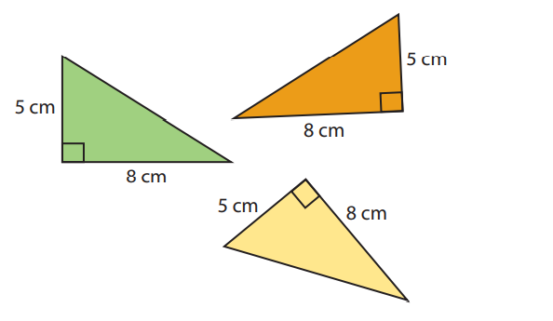
Checking prior learning
Which of these right angled triangles have an area of 20cm²
Notes:
References to the questions (links on final slide):
a) NCETM Primary assessment materials: year 6, page 32

Slide 11
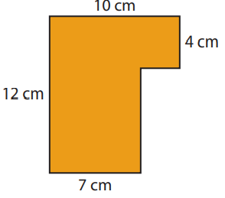
Checking prior learning
Sami worked out the area of the orange shape as 10 x 4 + 8 x 7 = 96cm²
Razina worked out the area as 12 x 7 + 3 x 4 = 96cm²
Lukas worked out the area as 10 x 10 – 2 x 2 = 96cm²
Are you convinced by Sami, Razina or Lukas’s reasoning?
Explain your answer.
Notes:
References to the questions (links on final slide):
b) NCETM Primary Assessment Materials: year 6, page 32

Slide 12
Common difficulties and misconceptions
What aspects of this key idea might pupils find challenging?
What misconceptions might pupils have?
When teaching this topic, you may find students encounter difficulties with…
Visualising how many surfaces certain prisms have
More information, and some suggestions for overcoming these challenges, can be found on the following slides

Slide 13
Common difficulties and misconceptions (1)
Students may have difficulty visualising how many surfaces certain prisms have. They can be supported in this by being given the opportunity to handle 3D models of prisms and to describe how many faces there are and what shape they are.
It is important for students to appreciate the structure of all surface area calculations, so that they correctly generalise that to find the surface area of a prism, they need to identify all of the surfaces (two of which will be the ends and, therefore, have the same area) and a number of rectangular faces depending on the nature of the polygonal ends.
Notes:
More detail can be found on page 26 of the 6.2 Core Concept document.
Unthinking memorisation and use of formulae (e.g. SA = 2(xy + xz + yz) or 2xy + 2xz + 2yz for the surface area of a cuboid, where x, y and z are its dimensions) should be avoided, as this can lead to over-generalising that the surface area of all prisms can be calculated in this way (e.g. as the sum of the area of six rectangular faces).

Slide 14
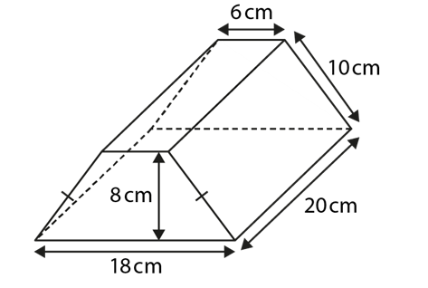
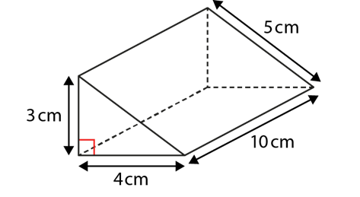
Understand that prisms can have a different number of faces and, therefore, the surface area can be the sum of a different number of areas
Example 1
For each prism:
How many faces does the prism have?
Describe and sketch the shape of each face, including dimensions.
i) ii)
Notes:
Suggested questioning:
What are the names of the faces for each shape?
Things for you to think about:
In Example 1, the prisms have been chosen to support students in noticing that prisms can have a different number of faces and different shaped faces.
The prisms have also been carefully chosen as the dimensions of each face are easy to deduce.

Slide 15
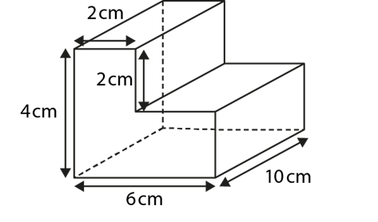
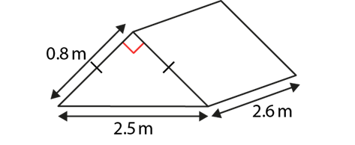
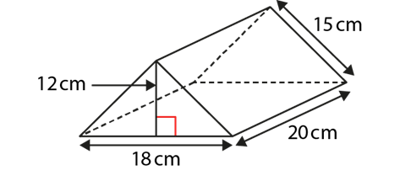
Understand that prisms can have a different number of faces and, therefore, the surface area can be the sum of a different number of areas
Example 2
For each prism:
How many faces does the prism have?
Describe and sketch the shape of each face, including dimensions.
i) ii) iii)
Notes:
Suggested questioning:
What do the lines mean on the sides of the diagram in part i)
Things for you to think about:
In Example 2, the prisms have been carefully chosen to encourage students to not only notice the number of faces, but also that sometimes the dimensions may have to be worked out from the given information, especially when the shape of a face is not a common one, such as the L-shape in prism (iii).

Slide 16
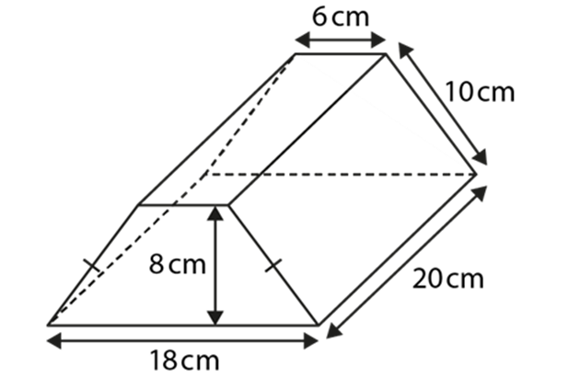
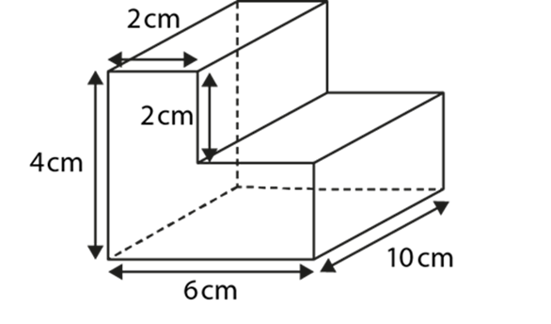
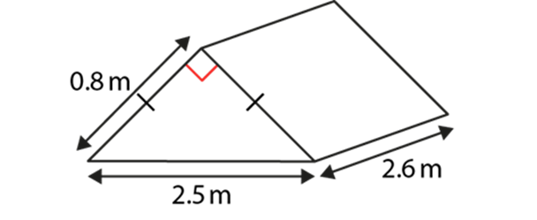
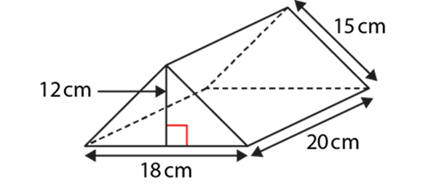
Understand that prisms can have a different number of faces and, therefore, the surface area can be the sum of a different number of areas
  Why do you think students struggle when working with 2D representations of 3D objects?
  What prisms are there readily ‘to hand’ in your classroom or department?
  Are the prisms that they see always in a ‘standard’ orientation (i.e. with a horizontal base)?
  How would presenting them in different orientations help students to identify the shapes of the different faces?
Example 1 and 2
For each prism:
How many faces does the prism have?
Describe and sketch the shape of each face, including dimensions.
Notes:
Due to space constraints, the image on this PD discussion slide is very small. PD Leads might like to use or print the ‘in the classroom’ version of this slide for teachers to access during discussions.
More detail about the sequencing of this example can be found on pages 27-28 of the 6.2 Core Concept document.

Slide 17


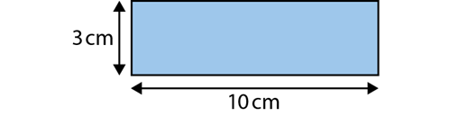
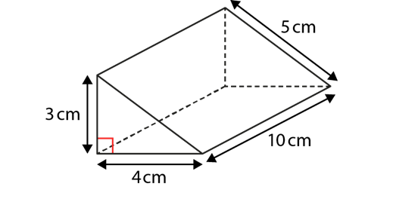
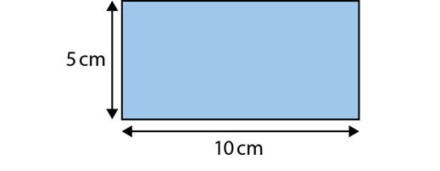
Understand that the surface area of a prism is the sum of the area of all the faces and not just the visible ones
Example 3
Front: Area = ½ × 3 × 4 = 6 cm²
Back: Area = ½ × 3 × 4 = 6 cm²
Side: Area = 3 × 10 = 30 cm²
Sloping side: Area = 5 × 10 = 50 cm²
Surface area = 6 + 6 + 30 + 50 = 92 cm²
Kagendo is calculating the total surface area of the prism:
Do you agree with Kagendo?
Explain your answer.
Notes:
Suggested questioning:
What is surface area? What do you need to calculate it?
Why has Kagendo set out his working like this? What are the benefits of working like this?
What would you do differently?
Things for you to think about:
An aspect of variation is to offer examples of ‘what it’s not’ (as well as ‘what it is’) to help students clarify the idea in their minds.
Consider encouraging students to verbalise the formula using correct terminology, i.e. ‘The surface area of a prism is equal to the sum of the areas of all its faces.’
Example 3 is designed to encourage students to notice that not all the faces have been used in the calculation of the surface area of the prism.

Slide 18
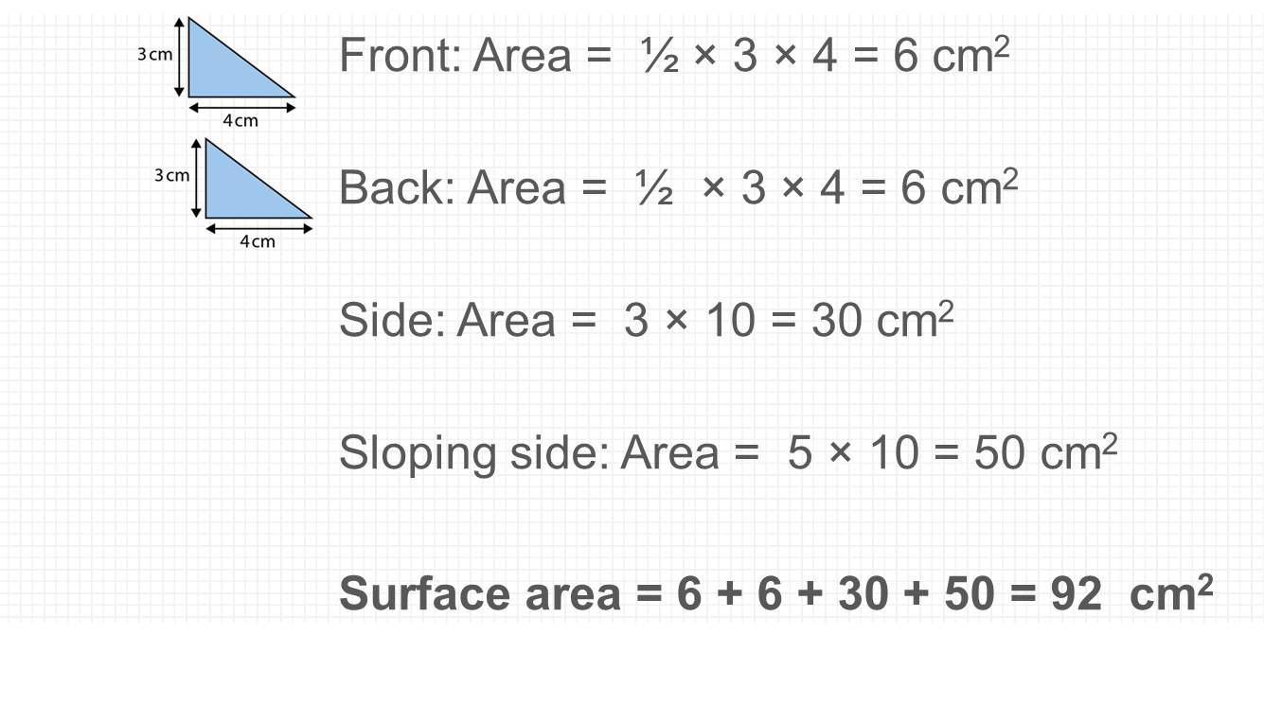

Understand that the surface area of a prism is the sum of the area of all the faces and not just the visible ones
Example 3
  Can you construct other ‘what it’s not’ examples that might highlight the importance of identifying all the faces of a prism?
  How will you model finding surface area: will it be the same or different to this example?
  What terminology will you expect students to use in their explanations?
Kagendo is calculating the total surface area of the prism:
Do you agree with Kagendo?
Explain your answer.
Notes:
Due to space constraints, the image on this PD discussion slide is very small. PD Leads might like to use or print the ‘in the classroom’ version of this slide for teachers to access during discussions.
This example can be found on pages 29-30 of the 6.2 Core Concept document.

Slide 19
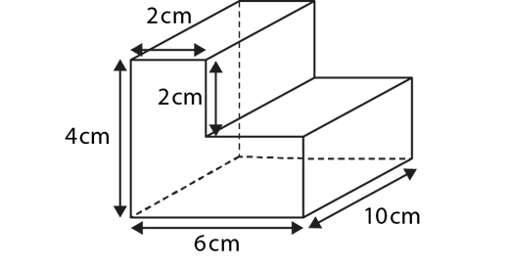
Understand how to use the correct dimensions to calculate the area of 2D shapes
Example 4
Calculate the surface area of this prism.
Notes:
Suggested questioning:
How many faces does this prism have?
What is the shape of each face?
How will you work out the area of the cross-section? How will you work out the area of the other faces?
Things for you to think about:
The choice of what and what not to vary can draw students’ attention to the key ideas.
In Example 4, the prism has been chosen because the L-shaped face may cause difficulties for some students. They may think that the area of each face can be calculated using a standard formula, such as A = l × w or A =1/2 × b × h. Being flexible is an important aspect of fluency.

Slide 20
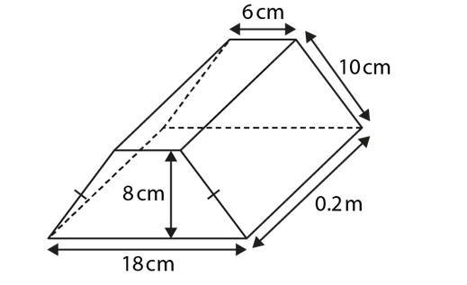
Understand how to use the correct dimensions to calculate the area of 2D shapes
Example 5
Calculate the surface area of this prism.
Notes:
Suggested questioning:
Which lengths are the same as each other?
What do you notice when looking at the lengths in this diagram?
What other facts do you need to be able to calculate the areas?
Things for you to think about:
In Example 5, students need to notice that the unit of one dimension (0.2 m) differs from the units of the other dimensions.
Students should realise that all dimensions must be in the same unit before they can calculate the area of a face.

Slide 21

Understand how to use the correct dimensions to calculate the area of 2D shapes
Example 4 and 5
Calculate the surface area of these prisms.
  What language would you expect students to use to verbalise how to calculate the surface area?
  For the second prism, would you expect students to convert to cm or m? What mistakes might they make?
Notes:
Due to space constraints, the image on this PD discussion slide is very small. PD Leads might like to use or print the ‘in the classroom’ version of this slide for teachers to access during discussions.
These examples can be found on page 30 of the 6.2 Core Concept document.

Slide 22
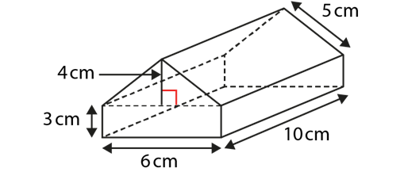
There is no standard formula for calculating the surface area of a prism
Example 6
John thinks the surface area of the prism is:
Surface area = 6 × 3 × 4 × 10 = 720 cm²
Do you agree with John? Explain your answer.
Notes:
Suggested questioning:
How would you describe the prism in the diagram?
What method do you think John has used?
Things for you to think about:
Example 6 is designed to encourage students to notice that there is not a single formula for calculating the surface area of any prism.
Each prism must be considered on its own merits.

Slide 23
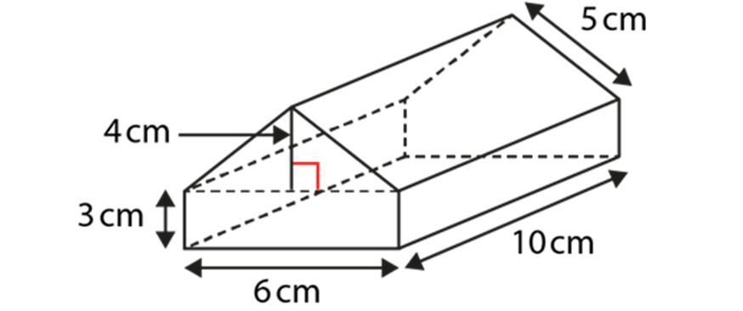
There is no standard formula for calculating the surface area of a prism
Example 6
John thinks the surface area of the prism is:
Surface area = 6 × 3 × 4 × 10 = 720 cm²
Do you agree with John? Explain your answer.
  Can you construct other ‘what it’s not’ examples that might highlight the importance of identifying the number, and type, of faces?
  How might you model the correct way to find this surface area?
Notes:
This example can be found on page 31 of the 6.2 Core Concept document.

Slide 24
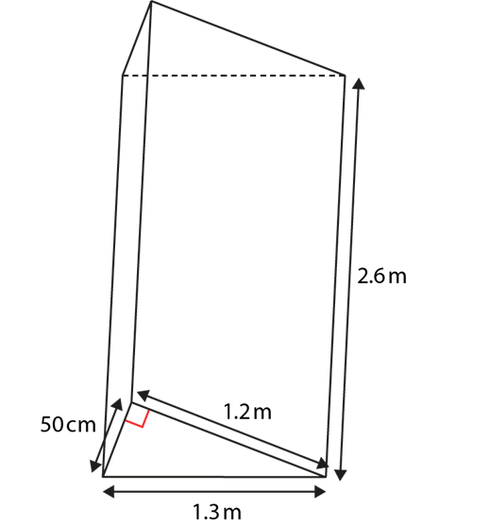
The units of surface area are squared
Example 7
Zarina works out the total surface area of this prism:
Area of front face = ½ × 50 × 1.2 = 30
Area of rear face = ½ × 50 × 1.2 = 30
Area of base = 1.3 × 2.6 = 3.38
Area of sloping face = 1.2 × 2.6 = 3.12
Therefore, total surface area of prism = 11.3 m³
There are three mistakes in Zarina’s working out. Can you find them?
Notes:
Suggested questioning:
In what orientation did Zarina have the shape for her method?
Things for you to think about:
Getting students to discuss and explain why certain statements are wrong is a strategy to encourage reasoning (a fundamental aim of the national curriculum) and explicitly address common mistakes or misconceptions.
The three mistakes in Example 7 are:
not changing all measurements to the same unit
not finding the surface area of every surface
using the incorrect unit (m³) for the total surface area.

Slide 25
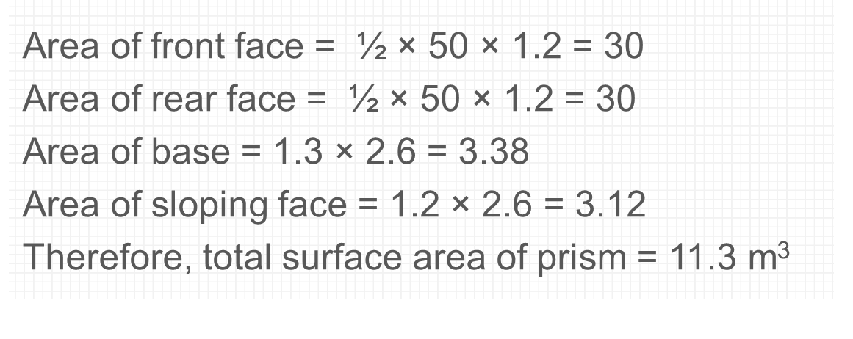
The units of surface area are squared
Example 7
Zarina works out the total surface area of this prism:
There are three mistakes in Zarina’s working out.
Can you find them?
  What are the pros and cons of showing other students work to critique?
  Is there consistency in how we set out these types of questions with students?
  What other misconceptions might you want to highlight through this style of question
Notes:
Due to space constraints, the image on this PD discussion slide is very small. PD Leads might like to use or print the ‘in the classroom’ version of this slide for teachers to access during discussions.
This example can be found on page 31 of the 6.2 Core Concept document.

Slide 26
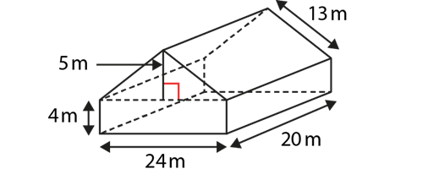
Solve familiar and unfamiliar problems, including real-life applications
Example 8
Roberto is painting his barn. He wants to paint all of the walls and the roof.
One tin of paint covers 15 m².
How many tins of paint are needed?
Notes:
Suggested questioning:
What should your steps be to solve this problem?
Things for you to think about:
Problems provide opportunities for students to intelligently practise their understanding of a concept (rather than mechanical repetition), to focus on relationships – not just the procedure – and make connections.

Slide 27
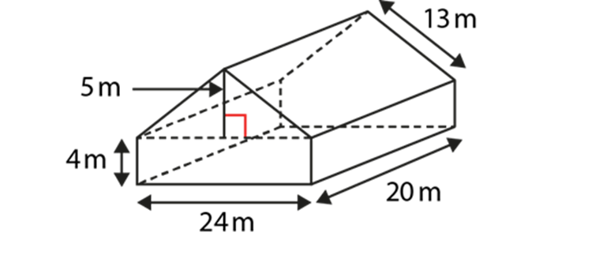
Solve familiar and unfamiliar problems, including real-life applications
Example 8
Roberto is painting his barn. He wants to paint all of the walls and the roof.
One tin of paint covers 15 m².
How many tins of paint are needed?
  How do you encourage students to tackle multi-step unfamiliar problems?
  What contexts of unfamiliar problems are suitable for students in KS3?
Notes:
This example can be found on page 32 of the 6.2 Core Concept document.

Slide 28
Solve familiar and unfamiliar problems, including real-life applications
Example 9
A cuboid is created from 24 linking cubes.
What could its surface area be?
Notes:
Suggested questioning:
What diagrams might you draw to help you solve this?
What properties does the number 24 have?
How many different answers are there?
Things for you to think about:
Students can begin to link volume and surface area, and realise that for constant volume, a range of surface areas is possible, just as a constant area of a rectangle gives rise to a range of possible perimeters.

Slide 29
Solve familiar and unfamiliar problems, including real-life applications
Example 9
A cuboid is created from 24 linking cubes.
What could its surface area be?
  If you were to create a similar but more challenging question what would you change the 24 to? Why?
  How could you support lower attaining students access this problem?
Notes:
This example can be found on page 32 of the 6.2 Core Concept document.

Slide 30
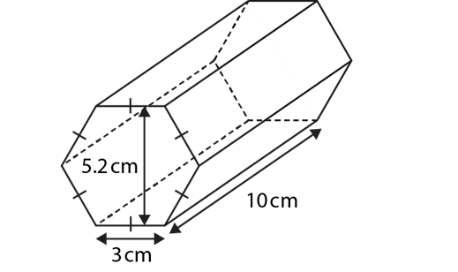
Solve familiar and unfamiliar problems, including real-life applications
Example 10
Explain (with reasons) how you would calculate the surface area of a hexagonal prism.
Notes:
Suggested questioning:
Which shapes are easy to find the area of? Which shapes are more tricky?
Things for you to think about:
The subtle shift involved in asking students to explain how they would calculate something, rather than produce the calculation, often encourages reasoning and the construction of a convincing argument, which all contribute to deeper thinking.

Slide 31
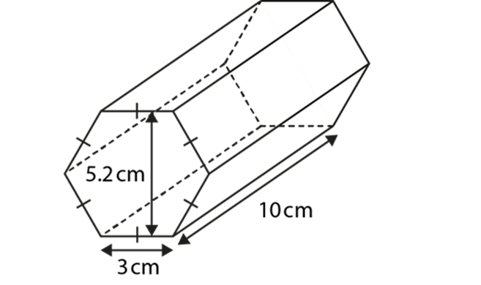
Solve familiar and unfamiliar problems, including real-life applications
Example 10
Explain (with reasons) how you would calculate the surface area of a hexagonal prism.
  Why is important for students to explain how they would calculate?
  What strategies do you think students would come up with to find the area of the hexagon?
  What misconceptions would appear?
Notes:
This example can be found on page 32 of the 6.2 Core Concept document.

Slide 32
Solve problems where there is more than one answer and there are elements of experimentation, investigation, checking, reasoning, proof, etc
Example 11
Sketch a prism with a surface area of 24 cm².
And another, and another.
Notes:
Suggested questioning:
Could you find a cuboid that has the required area? What about a triangular prism?
Can you find an example no one else will find?
Things for you to think about:
Students who have demonstrated a secure understanding of calculating the area of triangles should be encouraged to go deeper by solving more complex problems, such as exploring all possibilities, creating their own examples and testing conjectures.
If students are struggling, you could encourage them to think about 2D representations of prisms.
For problems such as Example 11, encourage students to find non-integer values and ‘unusual’ solutions (i.e. solutions that no one else in the class will find!).

Slide 33
Solve problems where there is more than one answer and there are elements of experimentation, investigation, checking, reasoning, proof, etc
Example 11
Sketch a prism with a surface area of 24 cm².
And another, and another.
  What are the pros and cons of an open task like this?
  What questions might you ask to support students who struggle to access the task?
  How might you extend higher attainers?
Notes:
This example can be found on page 33 of the 6.2 Core Concept document.

Slide 34
Reflection questions
What other mathematical concepts will be supported by students’ stronger understanding of this key idea?
What mathematical language will you continue to use to support pupils to make connections with other areas?
Which representations might you continue to use to further develop students’ understanding?

Slide 36
Appendices
You may choose to use the following slides when planning or delivering a PD session. They cover:
  Key vocabulary
  Representations and structure
  Previous learning
  Future learning
  Library of links

Slide 37
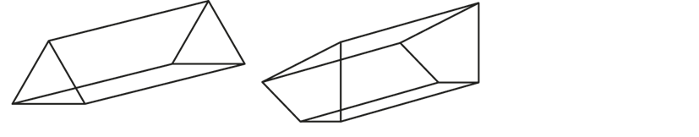
Key vocabulary
Term | Definition
prism | A solid bounded by two congruent polygons that are parallel (the bases) and parallelograms (lateral faces) formed by joining the corresponding vertices of the polygons. Prisms are named according to the base, e.g. triangular prism, quadrangular prism, pentagonal prism, etc. Examples: If the lateral faces are rectangular and perpendicular to the bases, the prism is a right prism.
rectilinear | Bounded by straight lines. A closed rectilinear shape is also a polygon. A rectilinear shape can be divided into rectangles and triangles for the purpose of calculating its area.
surface area | The surface area of a 3D figure is a measure of the area covered by all of the surfaces of the figure.

Slide 38
Representations and structure
There are a number of different representations that you may wish to use to support students’ understanding of this key idea. These might include:
Dynamic geometry software
  The guided use of dynamic geometry software can provide an environment in which students are able to make and test conjectures. By dragging and changing features, they are able to identify variant and invariant properties, leading to a deeper understanding of generalisations.
Mental imagery
  All concrete and pictorial representations have their limitations in the way they are able to represent the abstract world of mathematics. The ultimate purpose of all representations is to support students’ mental construct of an idea or concept. Students do not use the representation to do the mathematics; rather, the representation supports the student in making a mental representation of the idea.
Notes:
More information about the representations and structure involved in this key idea can be found:
On page 6 of the Theme Overview document
Links to all of these can be found on the final slide.

Slide 39
Previous learning
From Upper Key Stage 2, students will bring experience of:
drawing 2D shapes using given dimensions and angles
recognising, describing and building simple 3D shapes, including making nets
comparing and classifying geometric shapes based on their properties and sizes, and finding unknown angles in any triangles, quadrilaterals and regular polygons
illustrating and naming parts of circles, including radius, diameter and circumference, and knowing that the diameter is twice the radius
recognising angles where they meet at a point, are on a straight line or are vertically opposite, and finding missing angles
drawing and translating simple shapes on the coordinate plane and reflecting them in the axes.
Notes:
Theme 6 Geometry

Slide 40
Future learning (1)
In KS4, students will build on the core concepts in this mathematical theme to:
interpret and use fractional {and negative} scale factors for enlargements
{describe the changes and invariance achieved by combinations of rotations, reflections and translations}
identify and apply circle definitions and properties, including: centre, radius, chord, diameter, circumference, tangent, arc, sector and segment
{apply and prove the standard circle theorems concerning angles, radii, tangents and chords, and use them to prove related results}
construct and interpret plans and elevations of 3D shapes
interpret and use bearings
calculate arc lengths, angles and areas of sectors of circles
calculate surface areas and volumes of spheres, pyramids, cones and composite solids
Please note: Braces { } indicate additional mathematical content to be taught to more highly attaining students.

Slide 41
Future learning (2)
In KS4, students will build on the core concepts in this mathematical theme to:
apply the concepts of congruence and similarity, including the relationships between lengths, {areas and volumes} in similar figures
apply Pythagoras’ theorem and trigonometric ratios to find angles and lengths in right-angled triangles {and, where possible, general triangles} in two {and three} dimensional figures
know the exact values of sin θ and cos θ for θ = 30°, 45°, 60° and 90°; know the exact value of tan θ for θ = 30°, 45°, 60°
{know and apply the sine rule, $\frac{a}{SinA}=\frac{b}{SinB}=\frac{c}{SinC}$ , and cosine rule, $a^{2}=b^{2}+c^{2}– 2bc cos⁡A$, to find unknown lengths and angles}
{know and apply Area =$\frac{1}{2}ab\sin{C}$ to calculate the area, sides or angles of any triangle}
describe translations as 2D vectors
apply addition and subtraction of vectors, multiplication of vectors by a scalar, and diagrammatic and column representations of vectors; {use vectors to construct geometric arguments and proofs}.
Please note: Braces { } indicate additional mathematical content to be taught to more highly attaining students.
Notes:
Theme 6 Geometry

Slide 42
Library of Links
The following resources from the NCETM website have been referred to within this slide deck:
  NCETM Secondary Mastery Professional Development
    6 Geometry Theme Overview Document
    6.1 Geometrical properties Core Concept Document
  NCETM primary assessment materials
  NCETM primary mastery professional development materials

