Slide 1
Numberblocks
Support Materials
Episode 12
The Whole of Me

Slide 2
Practitioner Notes

Slide 3
Episode Description
In this episode the Numberblocks 1 to 5 put on a song and dance in which each character shows how their bodies split into parts in different ways. For example, Four takes his two top blocks off and holds them up as he sings – they then do some number magic to split and recombine. There’s a grand finale where they pun about how coming apart, splitting up and falling to pieces are all fine when you are made of parts and the parts make a whole.

Slide 4
Maths in the Episode
Introduction to the part-part-whole structure of number
The part-part-whole structure is a relationship that shows how numbers can split (partition) into parts and the parts can combine again to form the whole. This relationship underpins the concepts of addition and subtraction and is an essential precursor to later work on number and calculation.
Partitioning a whole number into parts and recombining
Breaking numbers apart and putting them back together again is an important activity for young children to gain a deep understanding of the composition of a number.
Conservation of number
A number can be partitioned in different ways but the whole remains the same.

Slide 5
Using Mathematical Language
Encourage children to use full sentences to explain their thinking.
“If the whole is 4 then 1 is a part and 3 is a part.”
“If the whole is 4 then 2 is a part and 2 is a part.”
Children can demonstrate this using a set of connecting cubes and breaking them apart as they say the sentence.

Slide 6
Talk and Discuss Together

Slide 7
Talk and Discuss Together
Watch the episode of Numberblocks. First ask the children what they noticed and allow them to talk to you and each other. The following slides are designed to stimulate children and adults to talk about the episode and draw out some key aspects of the mathematics.

Slide 8
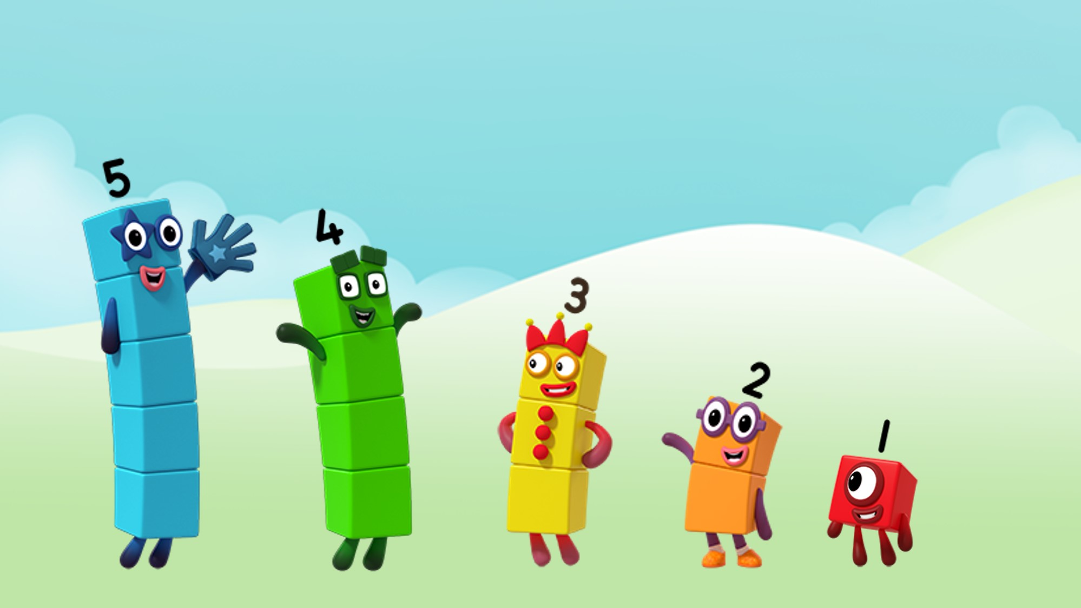
Images © 2017 Alphablocks Ltd. All Rights Reserved.
Notes:
Spend a few minutes discussing what the children noticed, drawing attention to how the Numberblocks ‘split up’ into smaller Numberblocks.
The following slides can be accompanied by the song that is sung in the episode.
The lyrics for each Numberblock’s song are given in the slide notes. Numberblocks can be made using linking cubes.

Slide 9
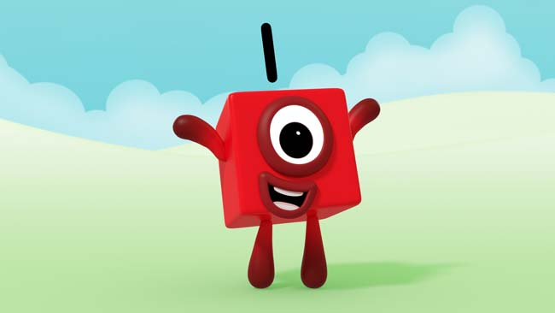
Images © 2017 Alphablocks Ltd. All Rights Reserved.
Notes:
Invite one child up and give him/her one red cube and sing One’s song.
I’m number 1 and this is fun
I’ve got 1 block to play with
And the whole of me is One

Slide 10
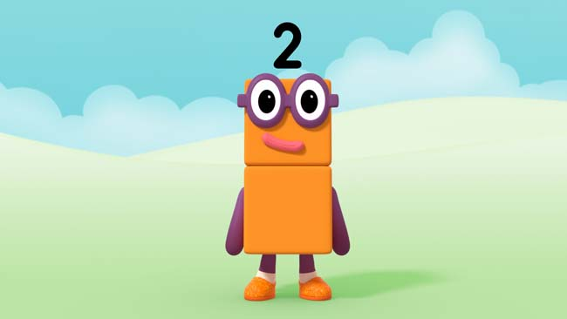
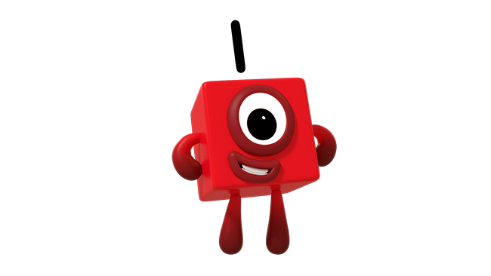
Images © 2017 Alphablocks Ltd. All Rights Reserved.
Notes:
This slide is animated with a single click.
Invite two children up and give each one red cube and sing Two’s song.
When the children sing ‘1 is a part of me’ one child jumps in the air.
When the children sing ‘And 1 is a part of me’ the other child jumps up in the air and then combine their two red cubes to make 2.
‘And the whole of me is 2.’
I’m number 2. How do you do?
I’ve got 2 blocks to play with
And the whole of me is 2.
1 is a part of me
And 1 is a part of me
And the whole of me is Two.

Slide 11
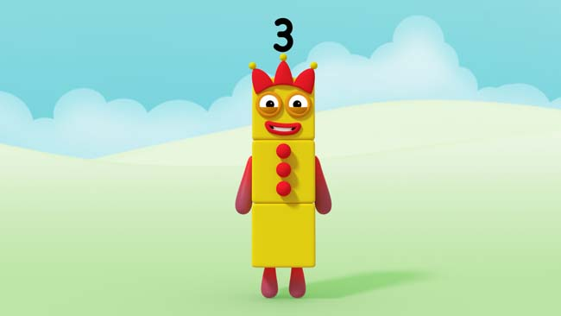
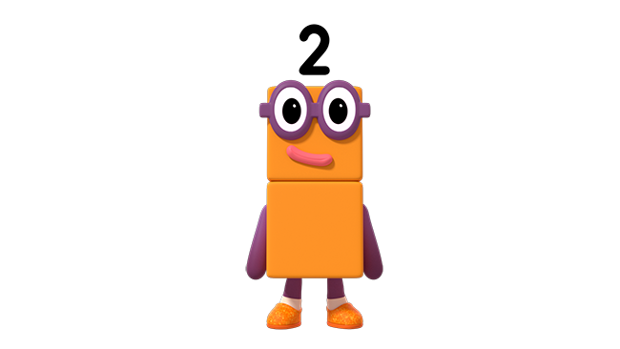
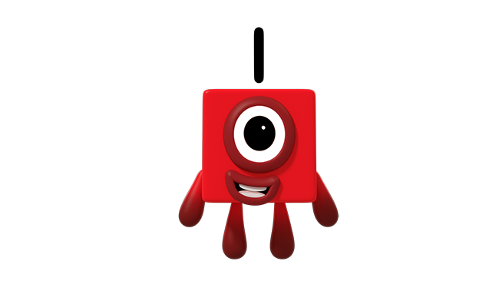
Images © 2017 Alphablocks Ltd. All Rights Reserved.
Notes:
This slide is animated with a single click.
Invite three children up and give one child one red cube and two children a Two Numberblock to share. They link arms.
When the children sing ‘1 is a part of me’ one child jumps in the air.
When the children sing ‘And 2 is a part of me’ the other two children jump up in the air together and then combine the 1 and 2 to make 3.
‘And the whole of me is 3.’
I’m number 3. Now look at me!
I’ve got 3 blocks to play with
And the whole of me is 3.
1 is a part of me
And 2 is a part of me
And the whole of me is 3.

Slide 12
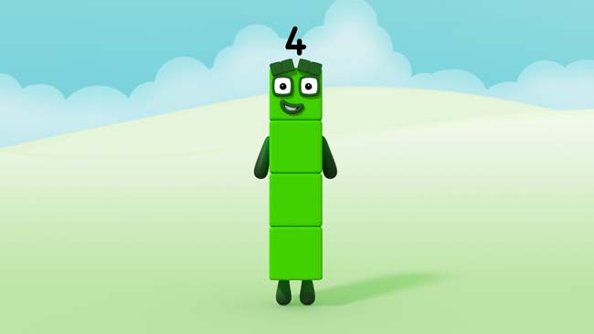
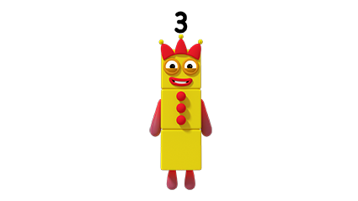

Images © 2017 Alphablocks Ltd. All Rights Reserved.
Notes:
This slide is animated with a single click.
Invite four children up and give one child one red cube and three children a Three Numberblock to share. They link arms.
When the children sing ‘1 is a part of me’ one child jumps in the air.
When the children sing ‘And 3 is a part of me’ the other three children jump up in the air together and then combine the 1 and 3 to make 4.
‘And the whole of me is 4.’
I’m number 4, and I am sure
That I’ve got 4 blocks to play with
And the whole of me is 4.
1 is a part of me
And 3 is a part of me
And the whole of me is 4.

Slide 13

Images © 2017 Alphablocks Ltd. All Rights Reserved.
Notes:
This slide is animated with a single click.
Invite four children up and give two children a Two Numberblock to share. They link arms and give another two children a Two Numberblock to share. They link arms.
When the children sing ‘2 is a part of me’ two children jump in the air together.
When the children sing ‘And 2 is a part of me’ the other two children jump up in the air together and then combine the 2 and 2 to make 4.
‘And the whole of me is 4.’
I’m number 4, and I am sure
That I’ve got 4 blocks to play with
And the whole of me is 4.
1 is a part of me
And 3 is a part of me
And the whole of me is 4.

Slide 14
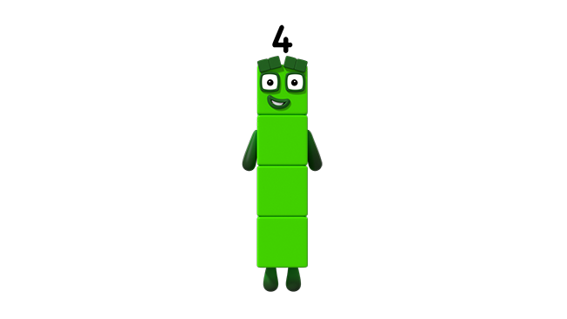
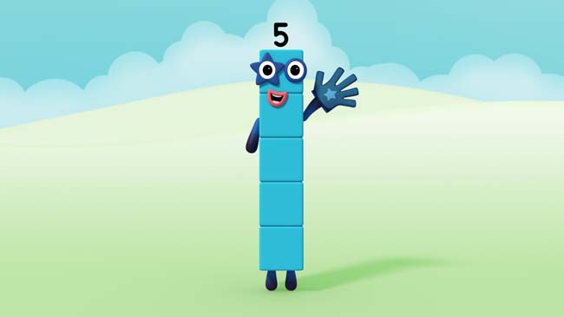
Images © 2017 Alphablocks Ltd. All Rights Reserved.
Notes:
This slide is animated with a single click.
Invite five children up and give one child one red cube and four children a Four Numberblock to share. They link arms.
When the children sing ‘1 is a part of me’ one child jumps in the air.
When the children sing ‘And 4 is a part of me’ the other four children jump up in the air together and then combine the 1 and 4 to make 5.
‘And the whole of me is 5.’
I’m number 5, I am alive
I’ve got 5 blocks to play with
And the whole of me is 5.
1 is a part of me
And 4 is a part of me
And the whole of me is 5.

Slide 15
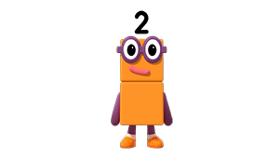
Images © 2017 Alphablocks Ltd. All Rights Reserved.
Notes:
This slide is animated with a single click.
Invite five children up and give two children a Two Numberblock to share and three children, a Three Numberblock to share. They link arms.
When the children sing ‘2 is a part of me’ two children jump in the air together.
When the children sing ‘And 3 is a part of me’ the other three children jump up in the air together and then combine the 2 and 3 to make 5.
‘And the whole of me is 5.’
I’m number 5, I am alive
I’ve got 5 blocks to play with
And the whole of me is 5.
2 is a part of me
And 3 is a part of me
And the whole of me is 5.

Slide 16
Images © 2017 Alphablocks Ltd. All Rights Reserved.
Notes:
Making friends is easy when you can come apart
Splitting up is not so hard
It won’t break your heart
So, when we fall to pieces
We haven’t lost control
A whole is made of all its parts
And the parts they make a whole

Slide 17
Enabling Environments

Slide 18
Enabling Environments
Playing and Exploring
Use the role play area to provide some things that need to be arranged e.g. toys on two shelves, seeds into two pots, boxes onto two lorries. Set an amount of the item e.g. five teddies on the shelves. Children to explore ways of doing this and explain how they have arranged them.
Active Learning
Notice whether children recount known quantities of objects they are playing with when they are partitioned and recombined. Prompt them to notice how the quantity remains the same.
Creating and Thinking Critically
In the water tray place up to five fish and two nets. Children to work together to fish. Encourage the children to identify how many fish there are in each net and how many fish there are altogether.

Slide 19
Learning Together in Y1

Slide 20
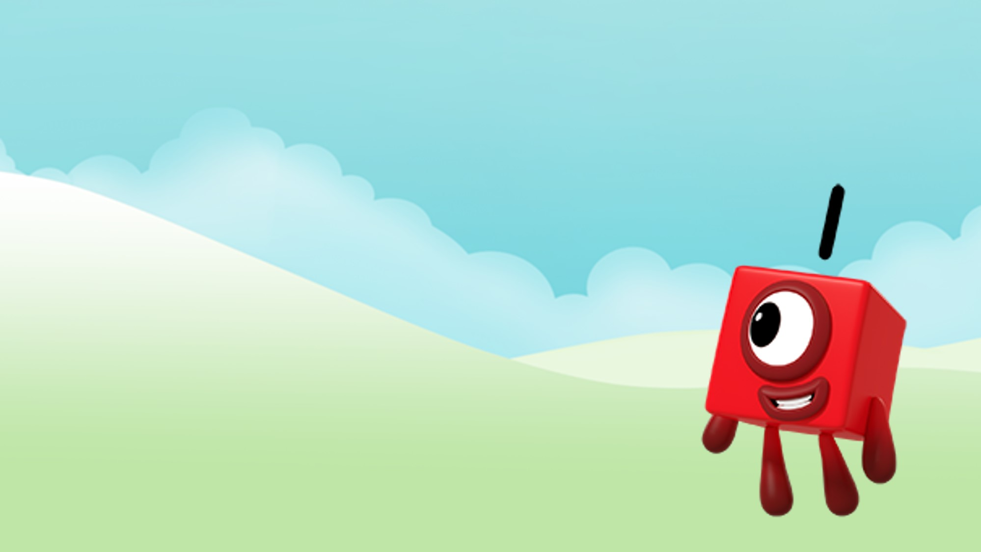

I’m number and this is fun.
I’ve got block to play with
And the whole of me is .
Images © 2017 Alphablocks Ltd. All Rights Reserved.
Notes:
After watching the programme, encourage the children to sing the song. Slides 9-16 include animations, and lyrics for the song are in the ‘notes’ area of the slide.
Throughout the discussion of this slide, ensure that children have their own set of blocks to construct the whole and partition into parts.
Ask the children to suggest what is missing from the empty boxes.
This slide is animated.
Click 1: reveals the 1 in the first sentence.
Click 2: reveals the 1 in the second sentence.
Click 3: reveals the 1 in the third sentence.

Slide 21

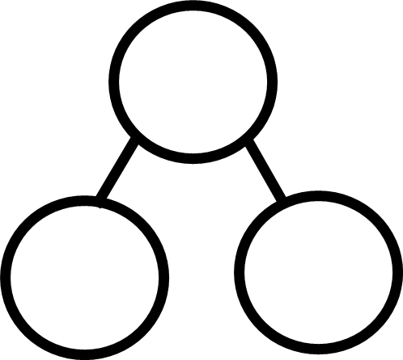
Can I split into two parts?
Images © 2017 Alphablocks Ltd. All Rights Reserved.
Notes:
Discuss that One is unable to partition into two groups as she only has one block.
This slide is animated:
Click 1: one block moves from the whole to the part.

Slide 22
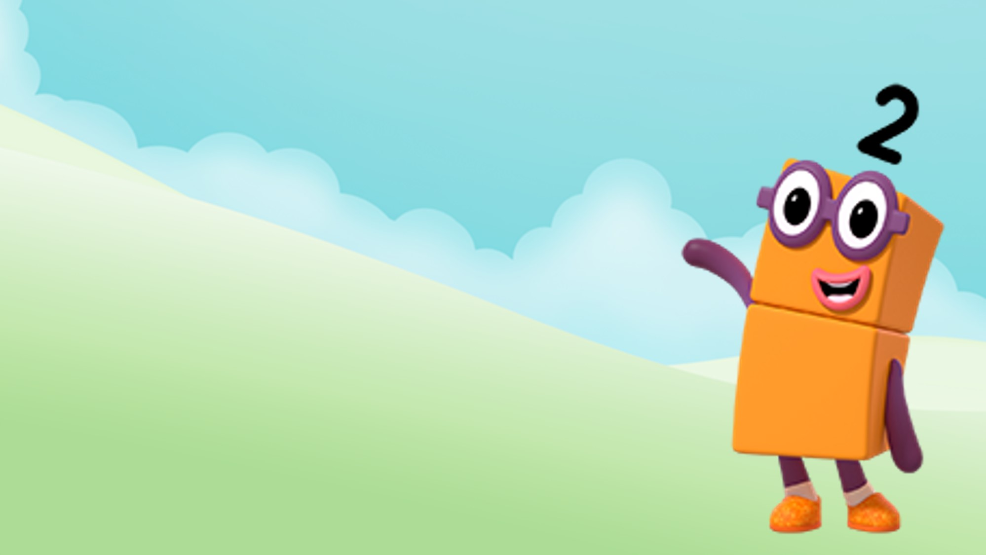

I’m number and this is fun.
I’ve got blocks to play with
And the whole of me is .
Images © 2017 Alphablocks Ltd. All Rights Reserved.
Notes:
Throughout the discussion of this slide, ensure that children have their own set of blocks to construct the whole and partition into parts.
Ask the children to suggest what is missing from the empty boxes.
This slide is animated.

Slide 23
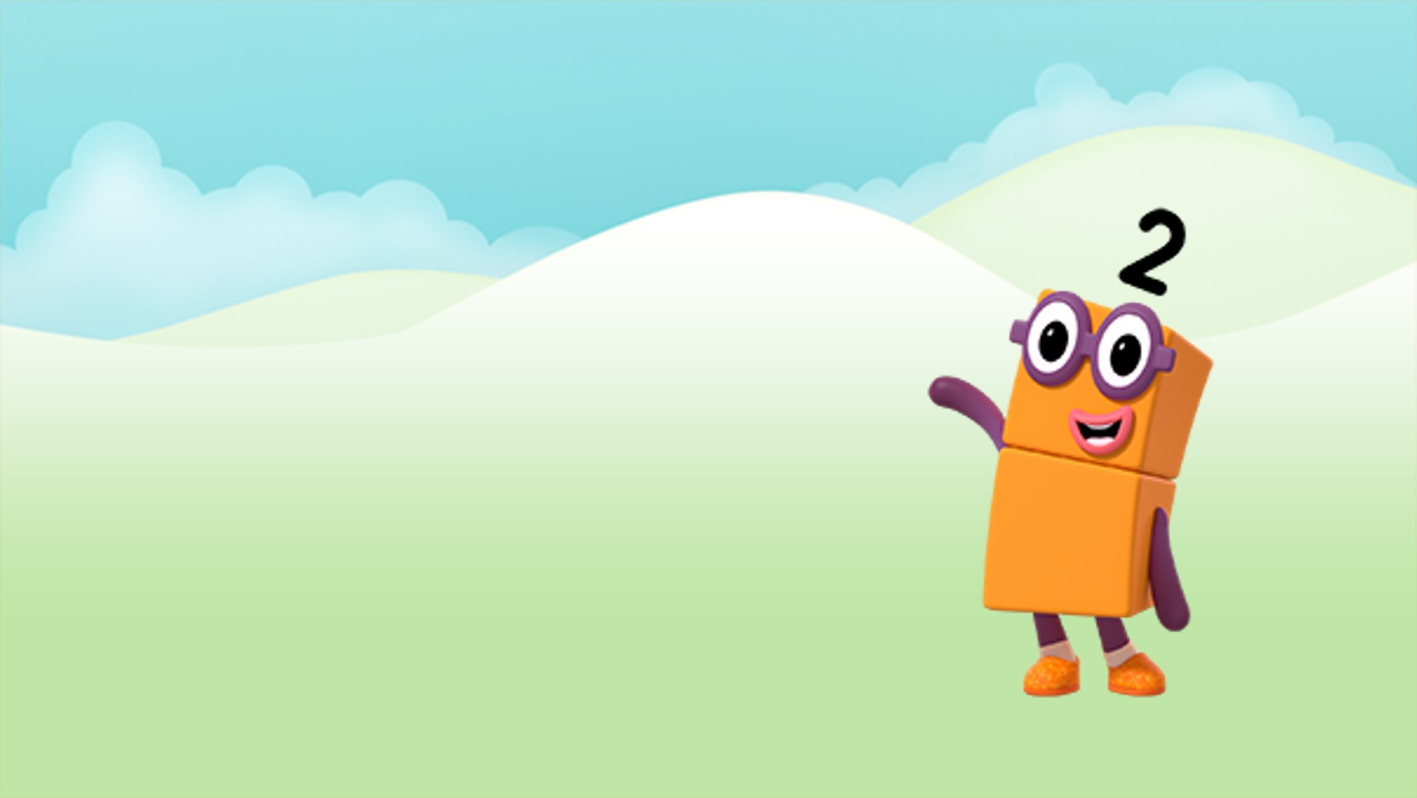
Can I split into two parts?
Images © 2017 Alphablocks Ltd. All Rights Reserved.
Notes:
Children take two linked blocks and break them into two parts. Use the language in slide 5 to explain the relationship between the whole and the parts. If the whole is two, then one is a part and one is a part.
This slide is animated.

Slide 24

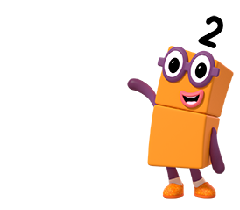
is a part of me.
is a part of me.
And the whole of me is .
Images © 2017 Alphablocks Ltd. All Rights Reserved.
Notes:
Throughout the discussion of this slide ensure that children have their own set of blocks to construct the whole and partition into parts.
Ask the children to suggest what is missing from the empty boxes.
This slide is animated.

Slide 25
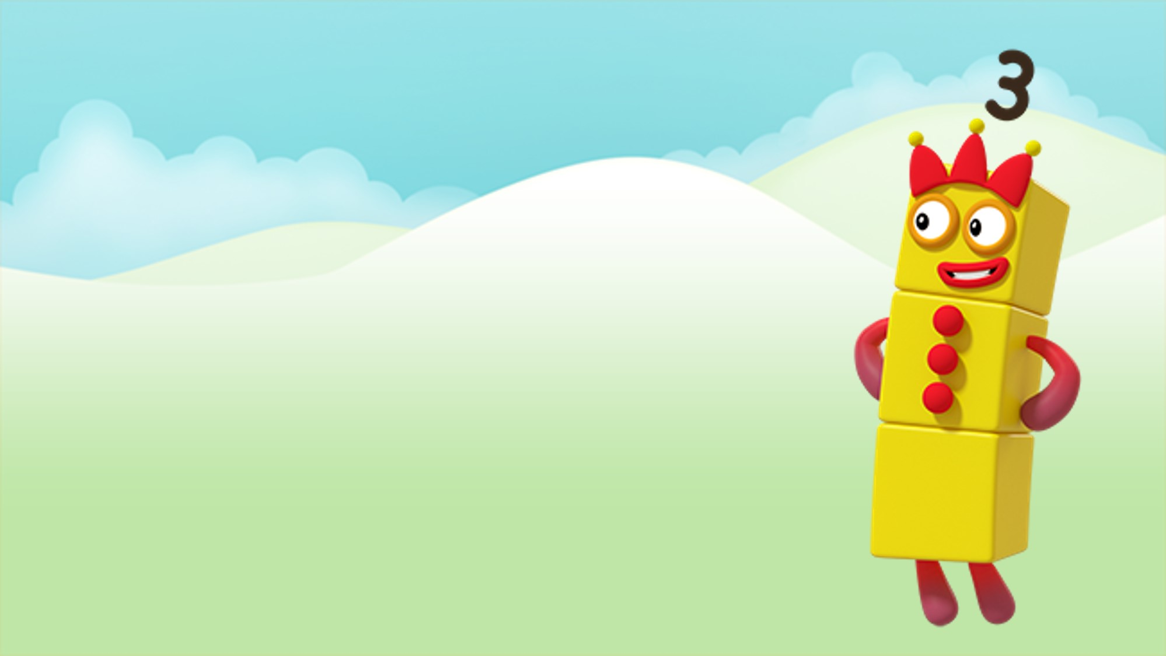
I’m number 3 now look at me!
Can I split into two parts?
\\
Images © 2017 Alphablocks Ltd. All Rights Reserved.
Notes:
Discuss how Three can be partitioned and then complete the verse of the song:
I’ve got 3 blocks to play with and the whole of me is 3
1 is a part of me and 2 is a part of me
And the whole of me is 3
This slide is animated:
Click 1: speech bubble appears.
Click 2: starts animation to partition 3 into 1 and 2.

Slide 26
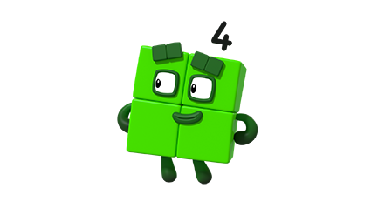
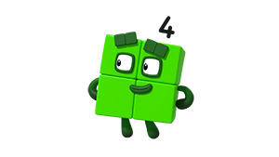
I’m number 4 and I am sure…
Hover over the part-part-whole models and click in turn to reveal. Begin with the left.
Can I split into two parts a different way?
.
Can I split into two parts?
Images © 2017 Alphablocks Ltd. All Rights Reserved.
Notes:
Discuss what the children remember about how Four partitioned. Ask them to demonstrate with connecting cubes.
This slide is animated:
Click 1: LH speech bubble appears.
Click 2: RH speech bubble appears.
Click on the part-part-whole models to reveal the parts.
Sing the song:
1 is a part of me…
Or
2, is a part of me…

Slide 27

Can I partition into two parts?
Images © 2017 Alphablocks Ltd. All Rights Reserved.
Notes:
How can Five be partitioned?
Ask the children to model with cubes.
How many different ways are there?
This slide is animated:
Click 1: starts animation to partition 5 into 1 and 4.
Sing the song:
2, is a part of me…

Slide 28
Can I partition into two parts a different way?
Images © 2017 Alphablocks Ltd. All Rights Reserved.
Notes:
How can Five be partitioned?
Ask the children to model with cubes.
How many different ways are there?
This slide is animated:
Click 1: starts animation to partition 5 into 1 and 4.
Sing the song:
1 is a part of me…

Slide 29
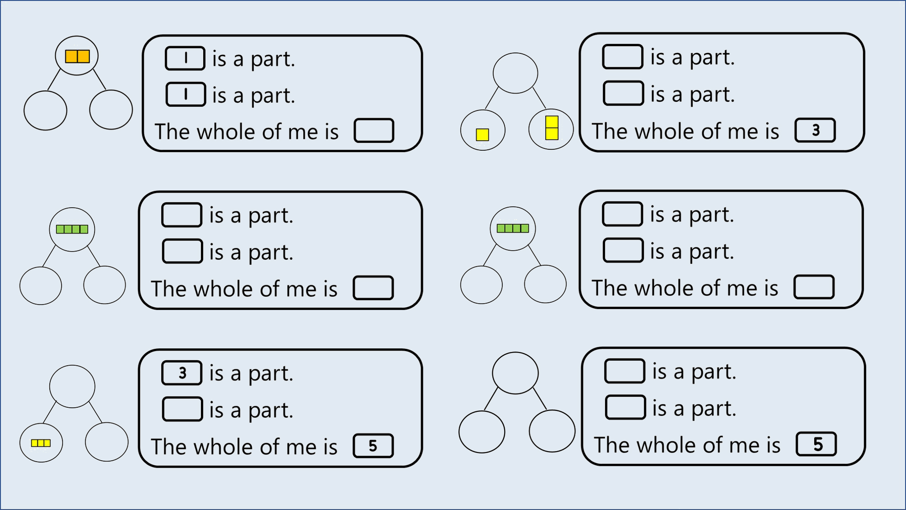
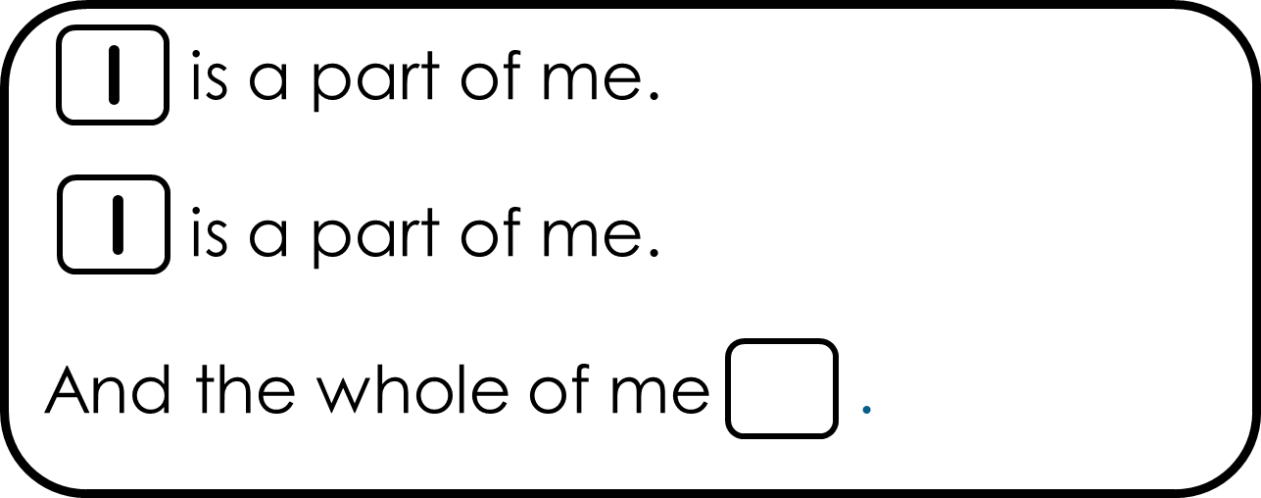
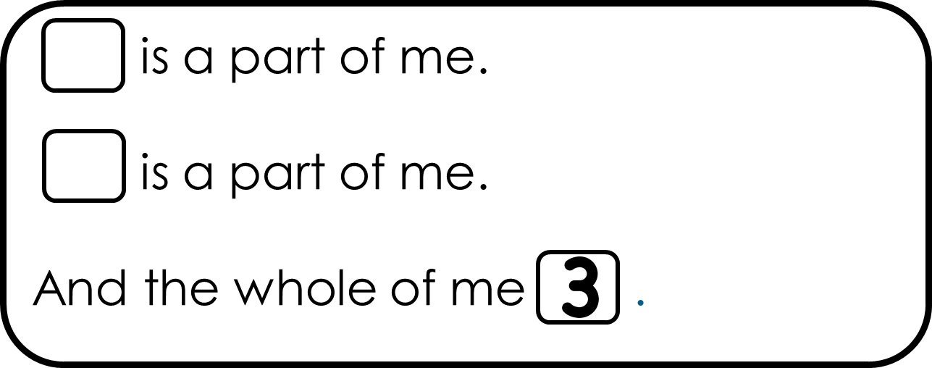
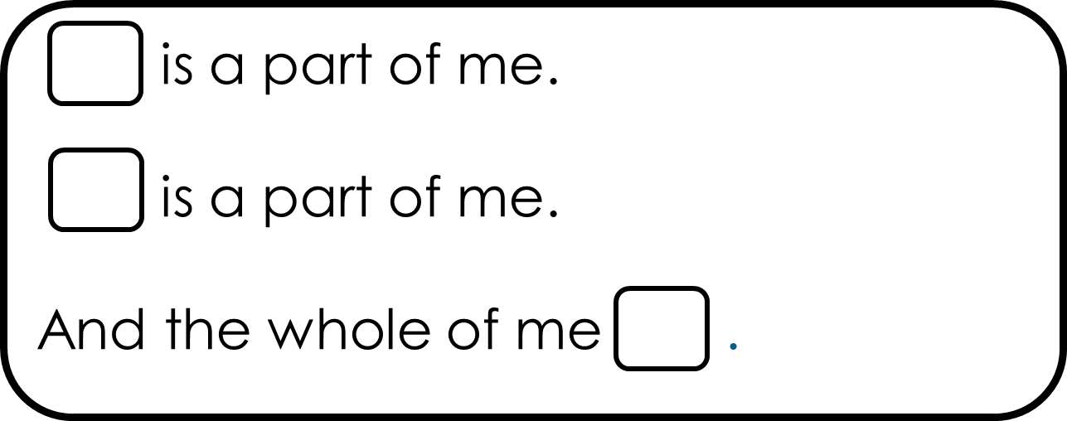
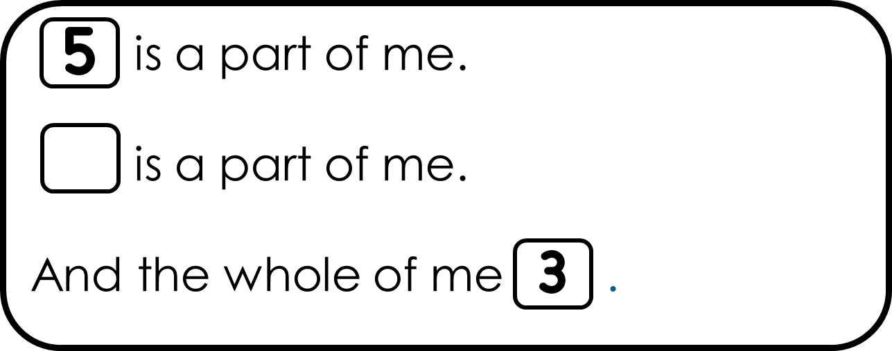
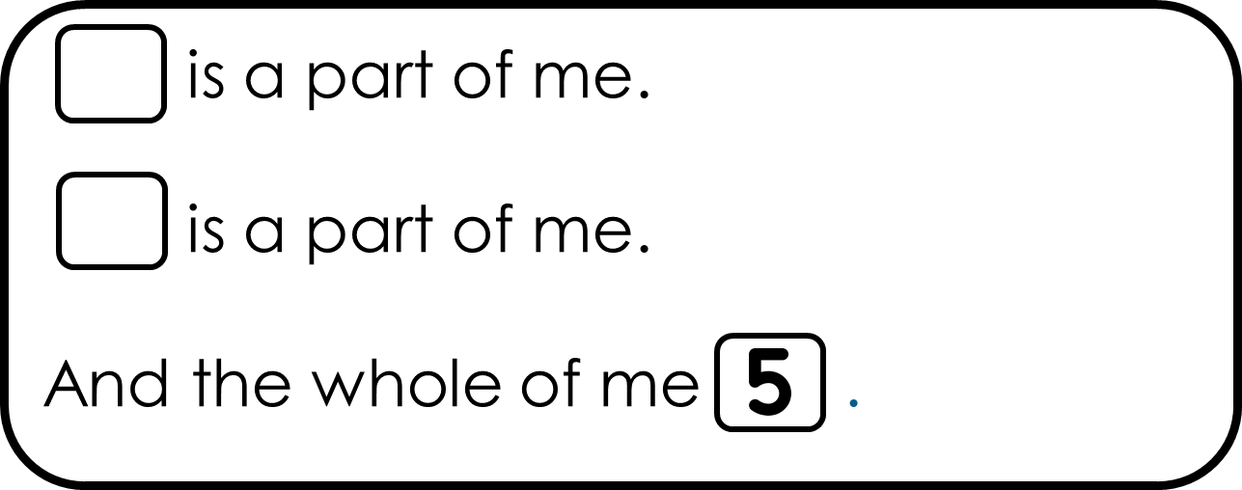
Notes:
Use this slide for individual practice.
Then revisit this to check answers.

