Slide 1
1.25 Addition and subtraction: money
Representations | Year 4
Number, Addition and Subtraction

Slide 2
How to use this presentation
You can find the teacher guide 1.25 Addition and subtraction: money by following the link below.

Slide 3
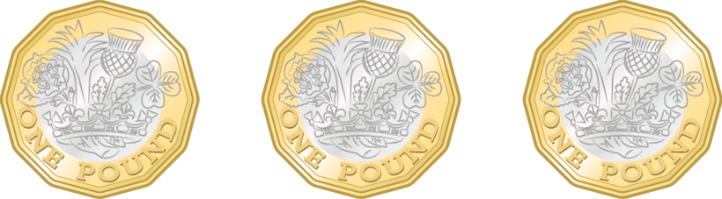
1.25 Calculation: money – step 1:2
£3
or £3.00
three pounds

Slide 4
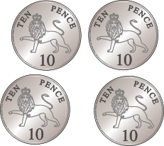
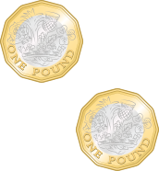
1.25 Calculation: money – step 1:3
£1 (or 100 p) | 10 p | 1 p
2
4
0
£
2
•
4
0
£2.40
two pounds forty
two pounds and forty pence

Slide 5
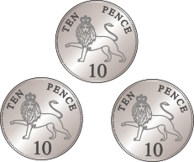


1.25 Calculation: money – step 1:4
£1 (or 100 p) | 10 p | 1 p
1
3
2
£
1
•
3
2
£1.32
one pound thirty-two
one pound and thirty-two pence

Slide 6
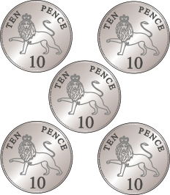
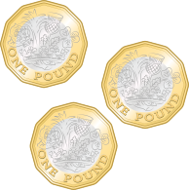
1.25 Calculation: money – step 1:5
£1 (or 100 p) | 10 p | 1 p
3
5
0
£
3
•
5
0
£3.50
three pounds fifty
three pounds and fifty pence

Slide 7
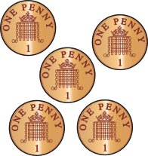
1.25 Calculation: money – step 1:5
£1 (or 100 p) | 10 p | 1 p
3
0
5
£
3
•
0
5
£3.05
three pounds and five pence

Slide 8
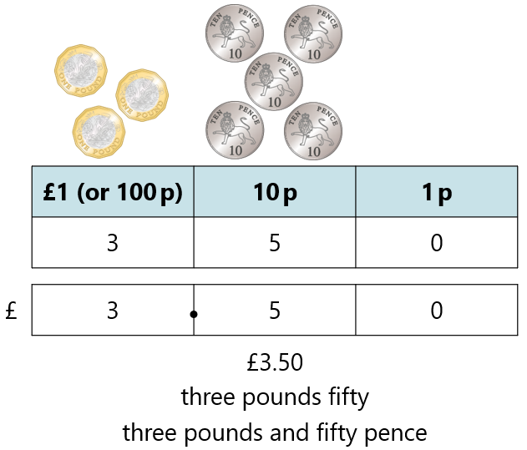
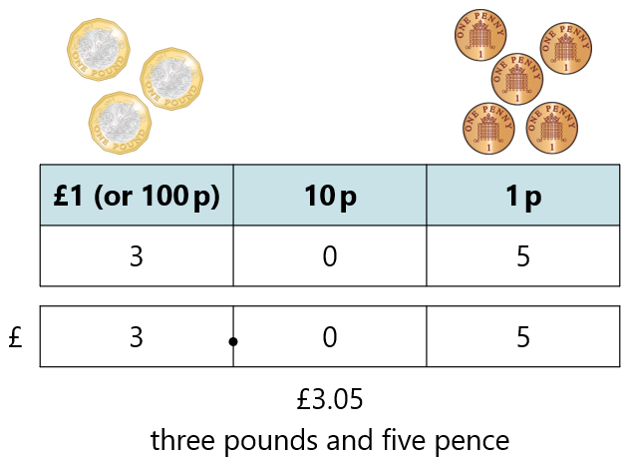
1.25 Calculation: money – step 1:5

Slide 9



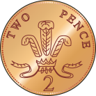
1.25 Calculation: money – step 1:8
£
4
.
2
5
Notes:
How much money is here? Write your answer in decimal notation.

Slide 10
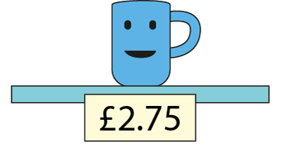
1.25 Calculation: money – step 1:8
Notes:
Felicity wants to buy this mug.
What is the smallest number of coins she can use?

Slide 11

1.25 Calculation: money – step 2:1

Slide 12
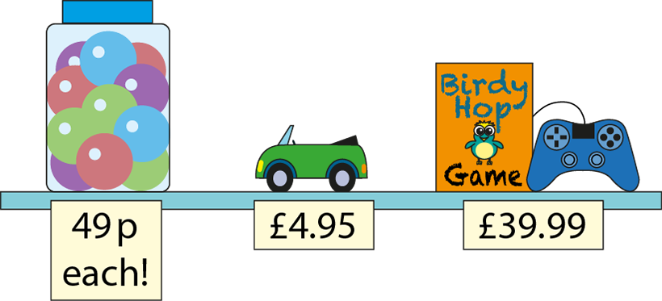
1.25 Calculation: money – step 2:1

Slide 13

1.25 Calculation: money – step 2:2
£3.45 + 99 p
= £4.44
+ £1.00
− 1 p
£3.45
£4.44
£4.45

Slide 14
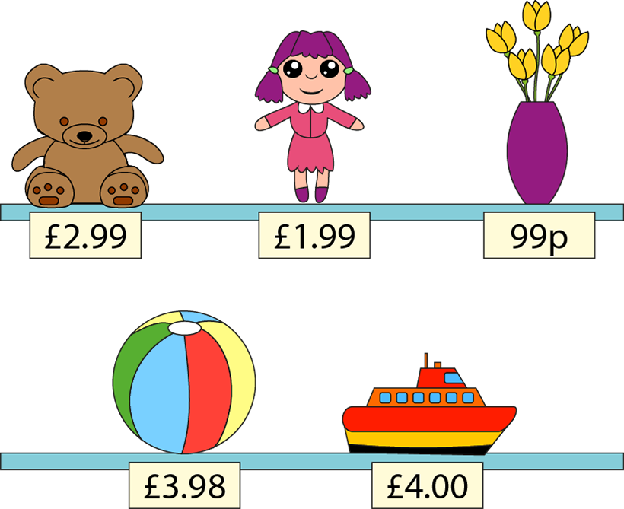
1.25 Calculation: money – step 2:5
Notes:
Choose two items and find the total cost.
Choose another two items and find the total cost.
And another…
Choose three items and find the total cost.
What costs about £1?
Which two items, together, cost about £4?

Slide 15
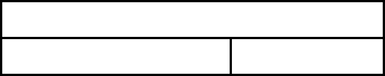
1.25 Calculation: money – step 3:1
Amount paid: £5
Cost of item: £3
?
Change: £2
?
£5
£3
£2
£3
+
£2
=
£5
£5
−
£3
=
£2
Notes:
I buy something that costs three pounds. How much change will I get from a five-pound note?

Slide 16



1.25 Calculation: money – step 3:1
£5.00 − £3.40
= £1.60
£5.00
£3.40
£1.60
?
£1.60
+ 60 p
+ £1
£3.40
£4.00
£5.00
Notes:
What if I spend three pounds and forty pence? How much change will I get from five pounds now?

Slide 17
1.25 Calculation: money – step 3:1
✓
✗
 | or
£5.00 − £2.30 = £3.70
£10.00 − £1.70 = £8.30
£3.90 + £1.10 = £5.00
£7.60 + £3.40 = £10.00
✗
✓
✓
✗

Slide 18


1.25 Calculation: money – step 3:2
£5 − £2.98
= £2.02
£2.02
+ 2 p
+ £2.00
£2.98
£3.00
£5.00
Notes:
I had £5.00 and I spent £2.98 on football cards. How much money did I have left?

Slide 19



1.25 Calculation: money – step 3:2
£10 − £8.48
= £1.52
£1.52
+ 2 p
+ 50 p
+ £1
£8.48
£8.50
£9.00
£10.00
Notes:
I had £10 and I spent £8.48 on books. How much money did I have left?

Slide 20
1.25 Calculation: money – step 3:3
Cost of item | Amount paid | Change
£8 | £10
£7.99 | £10
£7.49 | £10
£7 | £10
£6.49 | £10
£2
£2.01
£2.51
£3
£3.51
Notes:
Find the change I would get from ten pounds if I spent the following amounts.

Slide 21

1.25 Calculation: money – step 4:1
£1.37 + £2.45
= £3.82
£3.82
?
£1.37
£2.45
 | £ | 1 | . | 3 | 7
 | £ | 2 | . | 4 | 5
+
£
3
.
8
2
1
Notes:
I buy two magazines. One costs £1.37 and the other costs £2.45. How much do I spend altogether?

Slide 22
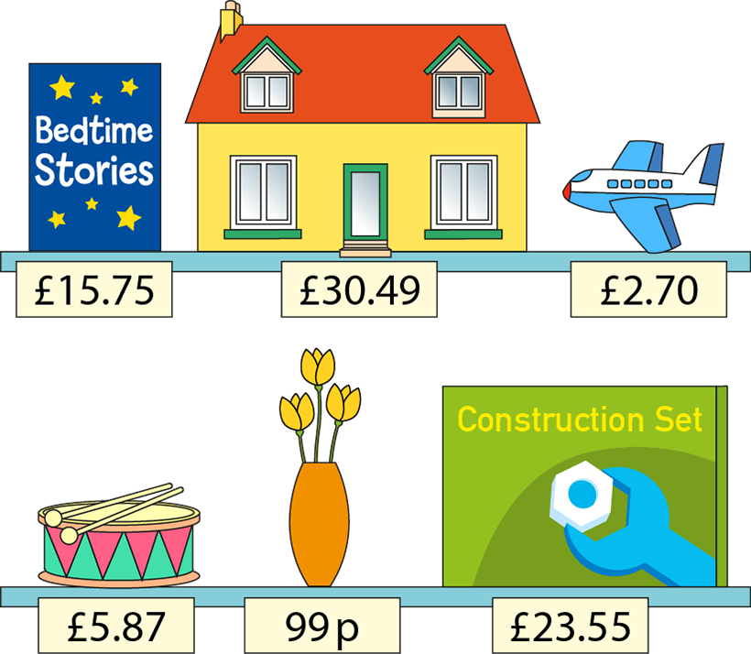
1.25 Calculation: money – step 4:3
Notes:
Choose two items and find the total cost.
Choose another two items and find the total cost.
And another…
Choose three items and find the total cost.

Slide 23

1.25 Calculation: money – step 4:4
£6.53 − £4.38
= £2.15
£6.53
£4.38
£2.15
?
4
1
 | £ | 6 | . | 5 | 3
 | £ | 4 | . | 3 | 8
−
£
2
.
1
5
Notes:
I have saved £6.53 and my brother has saved £4.38. How much more money have I saved than my brother?

Slide 24
1.25 Calculation: money – step 4:4
£29.50 − £18.94
= £10.56
8
1
4
1
 | £ | 2 | 9 | . | 5 | 0
 | £ | 1 | 8 | . | 9 | 4
−
£
1
0
.
5
6
Notes:
The game I want to buy costs £29.50. I have saved £18.94. How much more do I need to save before I can buy the game?

Slide 25
1.25 Calculation: money – step 4:4
£12.50 − £7.08
= £5.42
0
4
1
1
 | £ | 1 | 2 | . | 5 | 0
 | £ |  | 7 | . | 0 | 8
−
£
0
5
.
4
2
Notes:
I need £12.50 to enter a swimming competition, but I only have £7.08. How much more money do I need?

Slide 26





1.25 Calculation: money – step 5:1
£1
30 p
?
50 p
20 p
80 p
Notes:
Tim had £1.00. He bought a pencil for 20 p and a pen for 50 p. How much money does he have left?
(Repeated subtraction)

Slide 27

1.25 Calculation: money – step 5:1
£1
30 p
?
50 p
70 p
+
20 p
Notes:
Tim had £1.00. He bought a pencil for 20 p and a pen for 50 p. How much money does he have left?
(Adding first)

Slide 28


1.25 Calculation: money – step 5:2
£2
55 p
72 p
73 p
?
£1.27
73 p
+ 3 p
+ 70 p
£1.27
£1.30
£2.00
Notes:
An apple costs 55 p and a drink costs 72 p. How much change will I get from £2.00 if I buy both?

Slide 29






1.25 Calculation: money – step 5:2
£100
£25.49
£58.09
£13.85
£18.75
?
£41.91
 | £ | 2 | 5 | . | 4 | 9
 | £ | 1 | 3 | . | 8 | 5
+ | £ | 1 | 8 | . | 7 | 5
 | £ | 5 | 8 | . | 0 | 9
 |  | 1 | 2 |  | 1
£41.91
+ 1 p
+ 90 p
+ £1
+ £40
£58.09
£58.10
£59.00
£60.00
£100.00
Notes:
The class has raised £100 to spend on a party. They spend £25.49 on pizzas, £13.85 on drinks and £18.75 on decorations. How much do they have left to spend on the entertainment?

Slide 30
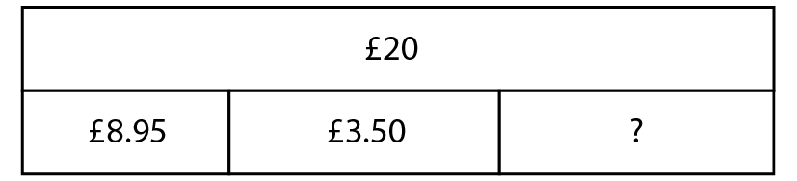
1.25 Calculation: money – step 5:3

Slide 31



1.25 Calculation: money – step 5:3
£20.00 − £8.95
= £11.05
£11.05
+ 5 p
+ £1
+ £10
£8.95
£9.00
£10.00
£20.00
Step 1
Notes:
Joe gets £20 for his birthday on Monday and spends £8.95 on a game. At the weekend, he spends £3.50 on an ice-cream sundae. How much money does Joe have left?
(Repeated subtraction)

Slide 32
1.25 Calculation: money – step 5:3
£11.05 − £3.50
= £7.55
0
1
0
1
 | £ | 1 | 1 | . | 0 | 5
 | £ |  | 3 | . | 5 | 0
−
£
0
7
.
5
5
Step 2
Notes:
Joe gets £20 for his birthday on Monday and spends £8.95 on a game. At the weekend, he spends £3.50 on an ice-cream sundae. How much money does Joe have left?
(Repeated subtraction)

Slide 33
1.25 Calculation: money – step 5:3
£8.95 + £3.50
= £12.45
 | £ |  | 8 | . | 9 | 5
 | £ |  | 3 | . | 5 | 0
+
£
1
2
.
4
5
1
1
Step 1
Notes:
Joe buys a game for £8.95 and some football cards for £3.50. He pays with a £20 note. How much money does Joe have left?
(Adding first)

Slide 34


1.25 Calculation: money – step 5:3
£20.00 − £12.45
= £7.55
£7.55
+ 55 p
+ £7
£12.45
£13.00
£20.00
Step 2
Notes:
Joe buys a game for £8.95 and some football cards for £3.50. He pays with a £20 note. How much money does Joe have left?
(Adding first)

