Slide 1
Numberblocks
Support Materials
Episode 8
Three Little Pigs

Slide 2
Practitioner Notes

Slide 3
Episode Description
Numberblock Five tells the story of the Three Little Pigs, with One to Three dressed as Pigs and Four (in wolf costume) as the Big Bad Square. One lives in a house with one room, one window and a number one on the door, and so on. The Big Bad Square comes and blows the house down. He does the same to Two, also blowing Two into Ones, who recombine using number magic. He does the same to Three, who reacts by blowing Four into Ones. Five interrupts the story and tells Four he wasn't supposed to blow Three's house apart. Where will they live now? Fortunately, Four invites them all to stay in his house, and they all live happily ever after.

Slide 4
Maths in the Episode
Counting up to 4
In this episode children experience counting and partitioning numbers into ones up to 4. One of Gelman and Gallistel’s (1978) counting principles is the ‘cardinal principle’. This means the last number in the count defines the number of items in the set, so long as the numbers have been said in the right order (stable order principle) and the items in the set only counted once (one-one principle). Be aware of these principles while modelling the counting process.
Partitioning into 1s and combining 1s up to 4
In this episode, children will experience a whole Numberblock (Two, Three
and Four) partition in to Ones. The Ones also recombine to make the whole.

Slide 5
Using Mathematical Language
Use these stem sentences to rehearse this principle:
“I can see 1,2,3,4 (while pointing), 4 windows.”
As children begin to experience numbers partitioned, they can use stem sentences of the form:
“3 is the same as 1 and 1 and 1”
Or:
“3 is equal to 1 add 1 add 1”.

Slide 6
Talk and Discuss Together

Slide 7
Talk and Discuss Together
Watch the episode of Numberblocks. First ask the children what they noticed and allow them to talk to you and each other. The following slides are designed to stimulate children and adults to talk about the episode and draw out some key aspects of the mathematics.

Slide 8
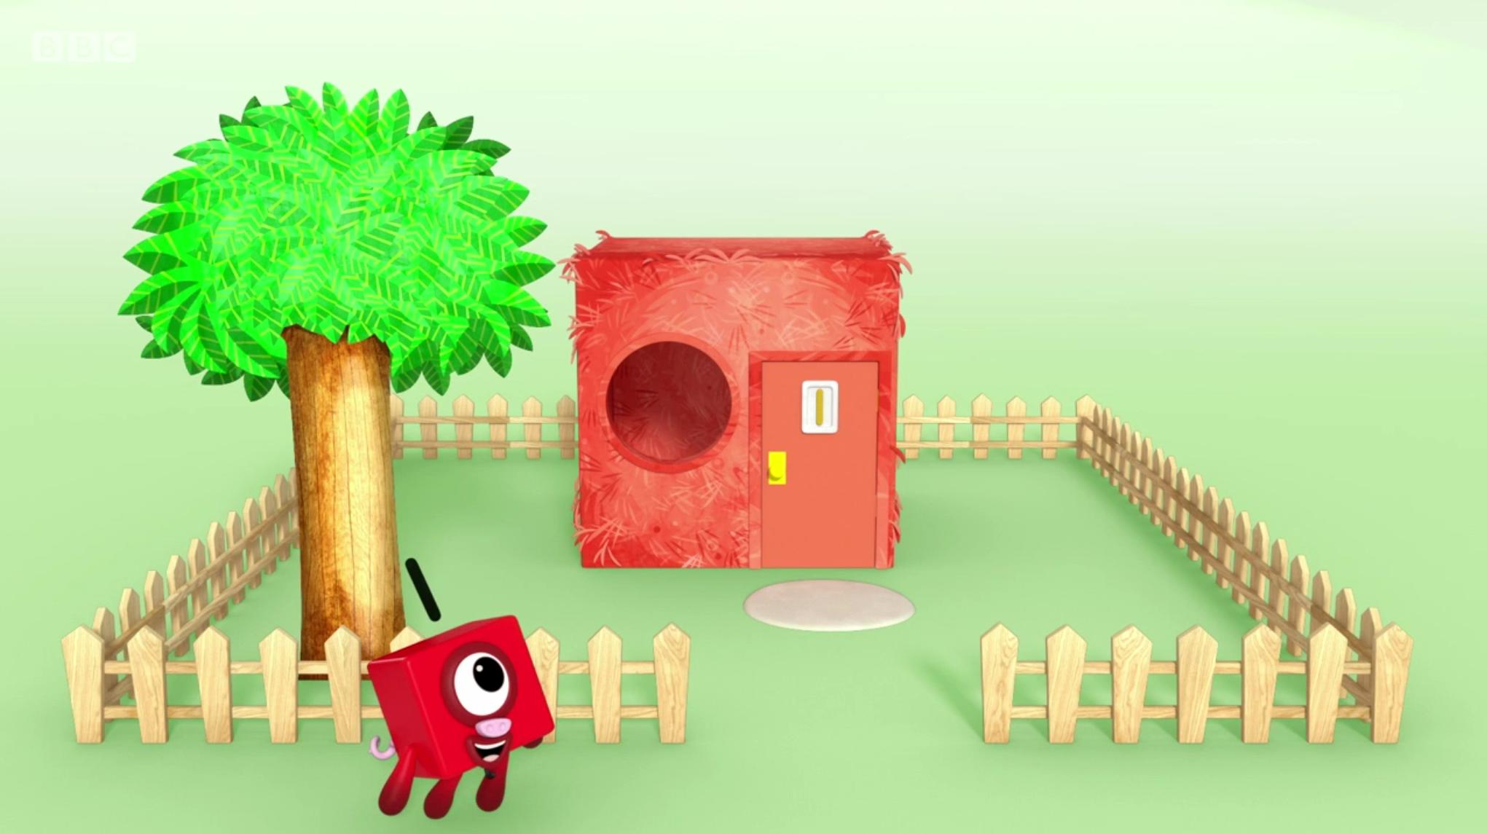
Images © 2017 Alphablocks Ltd. All Rights Reserved.
Notes:
How is the story the same/different from a version you have heard previously?
Look at the picture. What do you notice?
What can you see in the picture that there is one of?

Slide 9
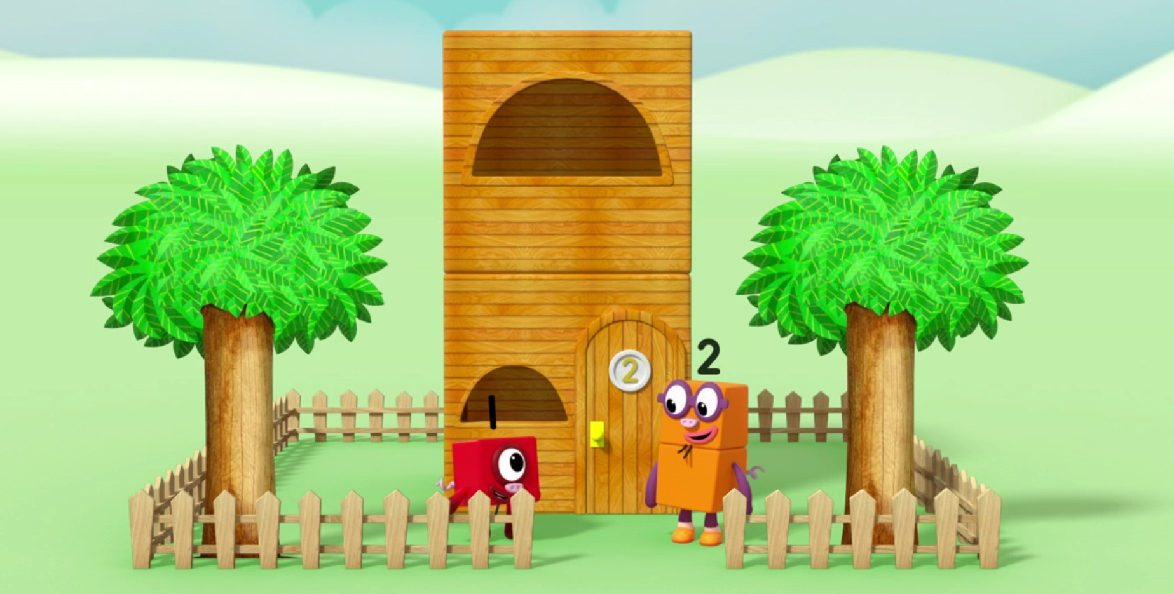
Images © 2017 Alphablocks Ltd. All Rights Reserved.
Notes:
Look at the picture. What do you notice?
What can you see in the picture that there are two of?

Slide 10
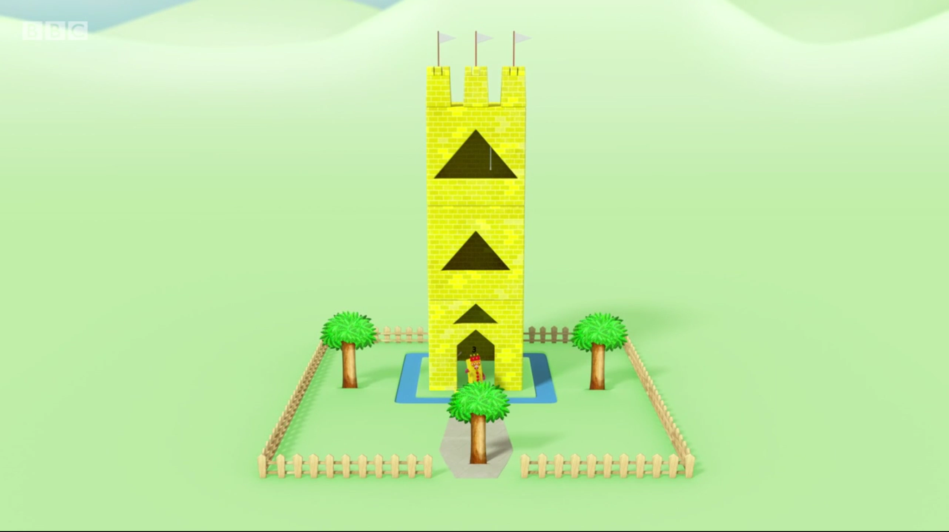
Images © 2017 Alphablocks Ltd. All Rights Reserved.
Notes:
Look at the picture. What do you notice?
What can you see in the picture that there are three of?

Slide 11
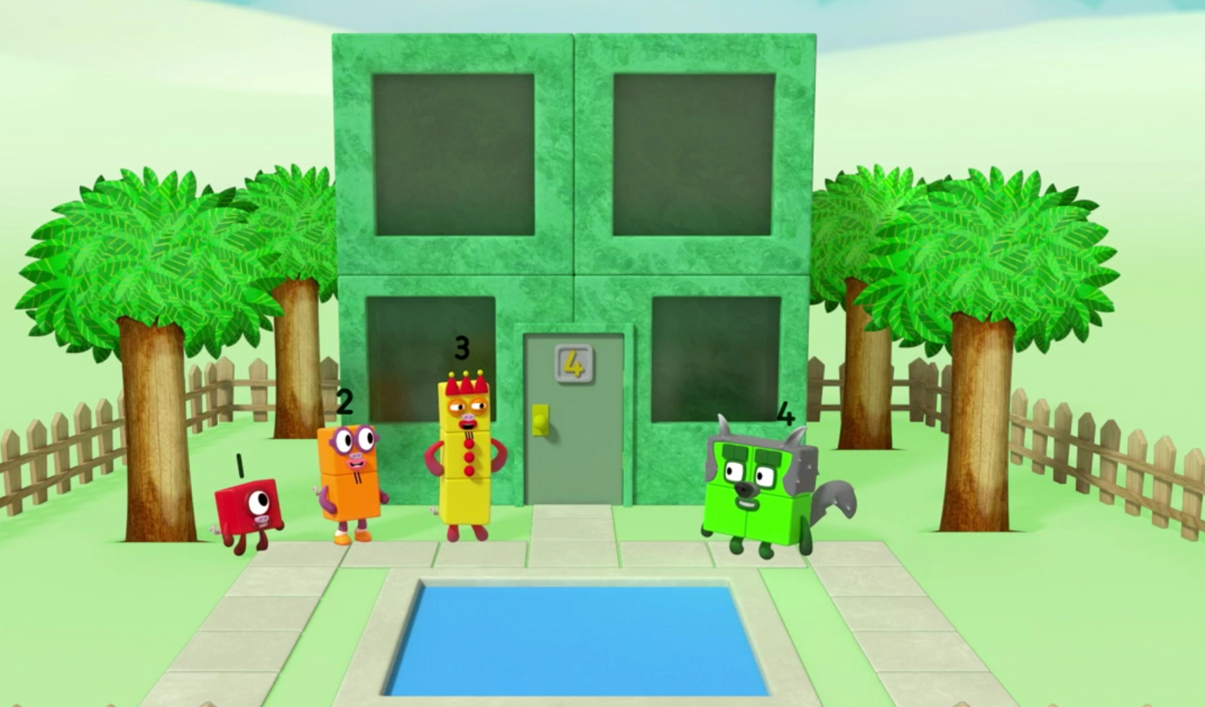
Images © 2017 Alphablocks Ltd. All Rights Reserved.
Notes:
Look at the picture. What do you notice?
What can you see in the picture that there are four of?

Slide 12
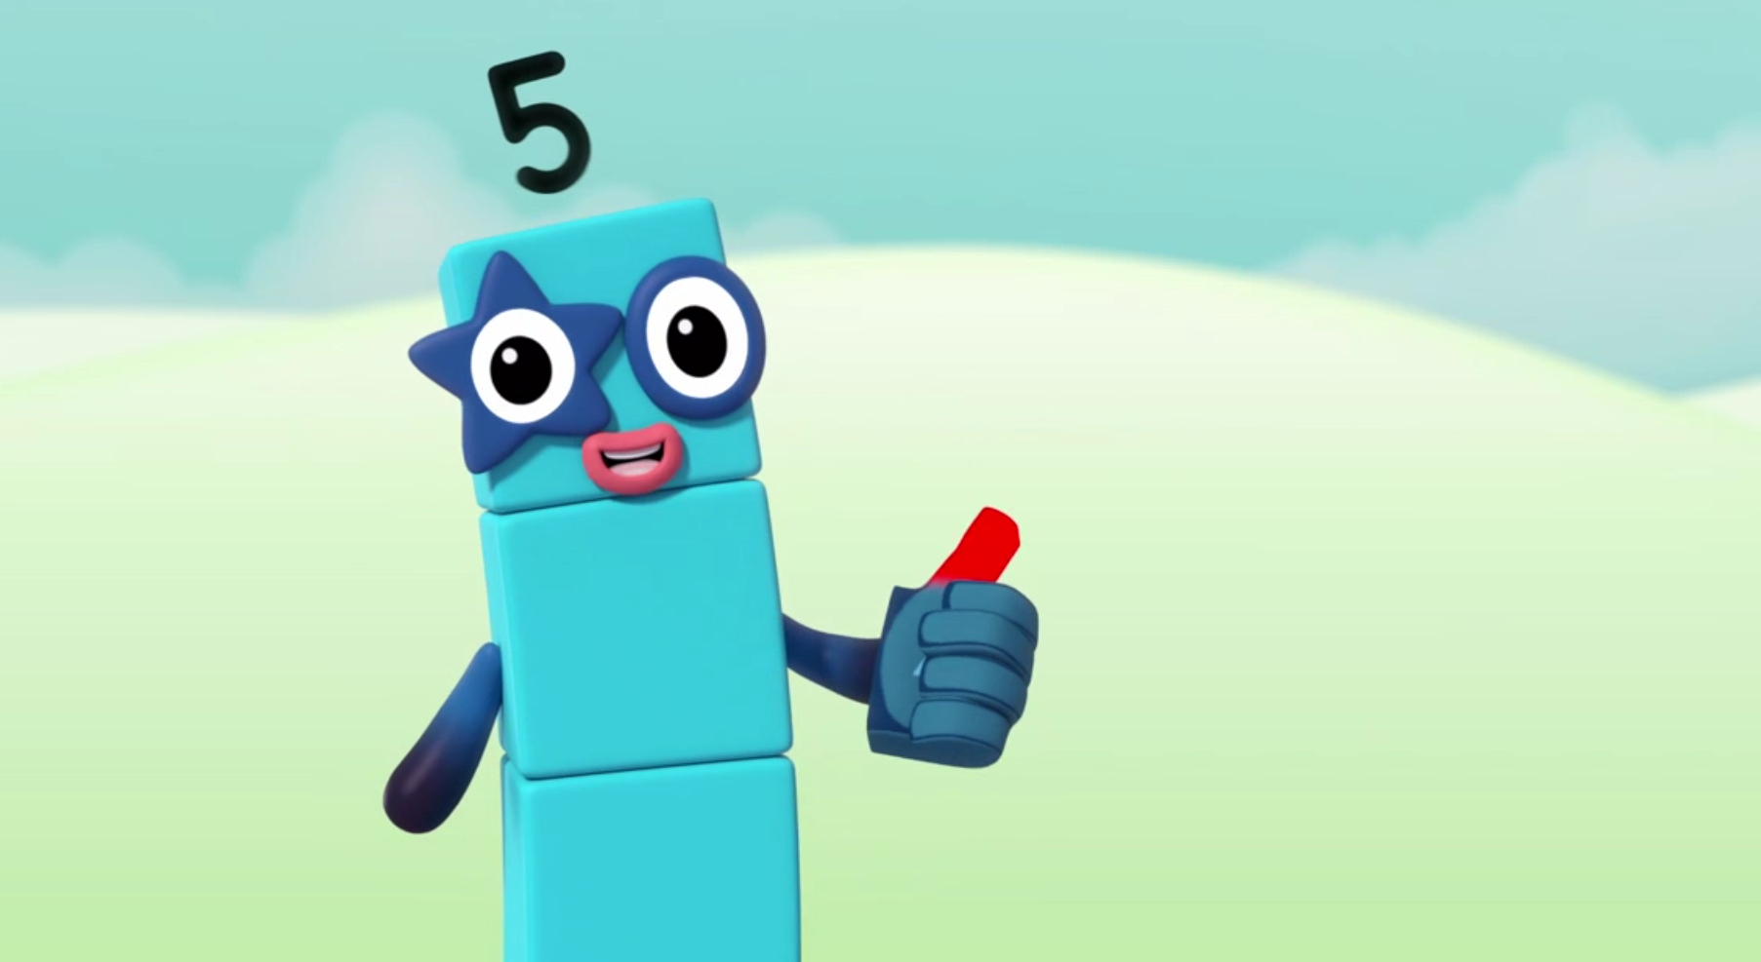

Images © 2017 Alphablocks Ltd. All Rights Reserved.
Notes:
What do you see? (Five is holding up 1 thumb)
Close your eyes and show me one on your hand a different way. Don’t change your mind. Open your eyes and look around you. Has anyone chosen the same way as you?

Slide 13
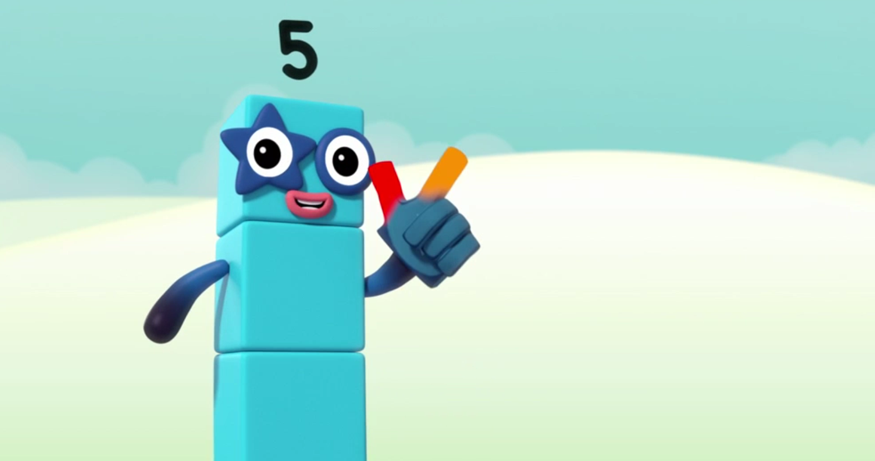

Images © 2017 Alphablocks Ltd. All Rights Reserved.
Notes:
What do you see? (Five is holding up 2)
Close your eyes and show me 2 on one hand a different way. Don’t change. Open your eyes and look around you.
Has anyone chosen the same way as you?

Slide 14
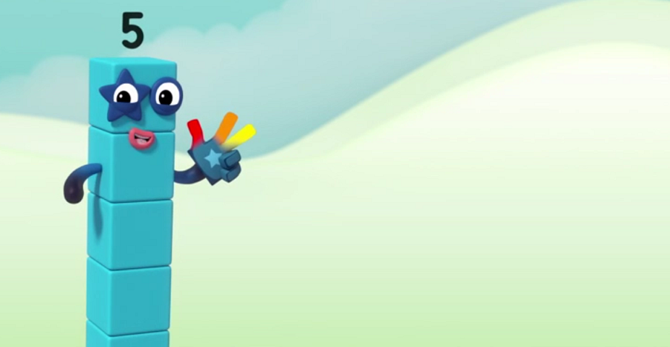

Images © 2017 Alphablocks Ltd. All Rights Reserved.
Notes:
What do you see? (Five is holding up 3)
Close your eyes and show me 3 on one hand a different way. Don’t change. Open your eyes and look around you.
Has anyone chosen the same way as you?
Has anyone chosen a different way to you?

Slide 15
Notes:
Play Rock, Paper, Scissors
Try this version:
Paper – 3 fingers
Scissors – 2 fingers
Rock – fist.
Hand behind back.
Teacher calls ‘1,2,3’.
Two children each draw their hand as rock, paper or scissors.
Paper covers rock (paper wins)
Scissors cut paper (scissor wins)
Rock breaks scissors (rock wins)
Alternatively, the teacher calls a number and the children display the correct number of fingers.

Slide 16
Enabling Environments

Slide 17
Enabling Environments
Playing and Exploring
Go for a walk around the school locality to look for doors with 1,2,3,4 on. Take photos of the doors.
Active Learning
Notice how children use their fingers to keep track of counting. Model different ways with fingers and ask the children to help you to count with your fingers. Also see if children can show you a given number of fingers without counting.
Creating and Thinking Critically
Use junk modelling materials or building blocks to make homes for 1,2,3 and 4. What can we include 1 of?, 2 of?, 3 of?, 4 of? Use the houses to act out the story.

Slide 18
Learning Together in Y1

Slide 19

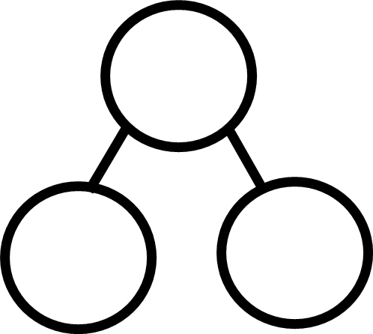




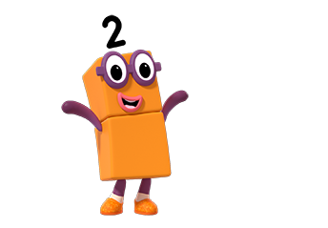
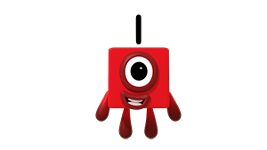
Images © 2017 Alphablocks Ltd. All Rights Reserved.
Notes:
Discuss the episode and what the children noticed. How was the story different from the story of the Three Little Pigs they have heard before?
This slide is animated:
Ask the class to be the big bad wolf and blow towards the screen.
Click 1:
A cloud of breath appears and blows Two into 2 Ones, then they partition.
Click 2: Part-part-whole model appears.
We can use this to tell us the story of 2.
Click 3: 2 blocks appear in the whole and move to the parts. Number 2 appears in the whole:
What has happened? Discuss and draw attention to:
2 blocks have partitioned into 2 parts, each with one block. 2 is made from 1 and 1.
Click 4: Blocks disappear and the number 1 appears in each part.
How can we say this as a number sentence?
Click 5: Number sentence appears. Read it aloud together:
“Two is the same as one and one” or “Two is equal to one added to one”.

Slide 20
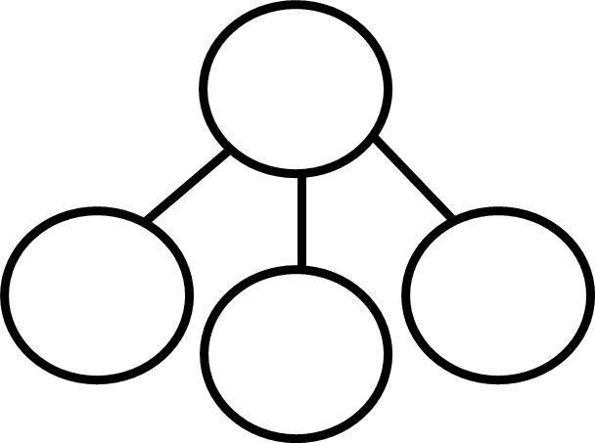

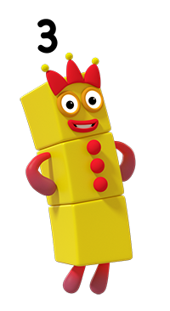
Images © 2017 Alphablocks Ltd. All Rights Reserved.
Notes:
This slide is animated in the same way as the previous slide. Proceed in the same way, finishing with;
Click 5: Number sentence appears. Read it aloud together:
“Three is the same as one and one and one” or “Three is equal to one add one add one”.

Slide 21
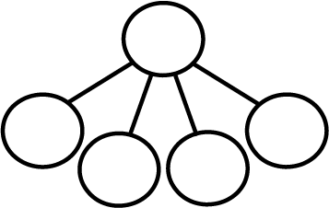

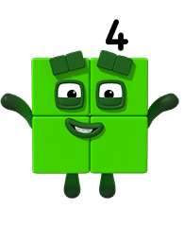
Images © 2017 Alphablocks Ltd. All Rights Reserved.
Notes:
This slide is animated in the same way as the previous slide. Proceed in the same way, finishing with;
Click 5: Number sentence appears. Read it aloud together:
“Four is the same as one and one and one and one” or “Three is equal to one add one add one add one”.

Slide 22
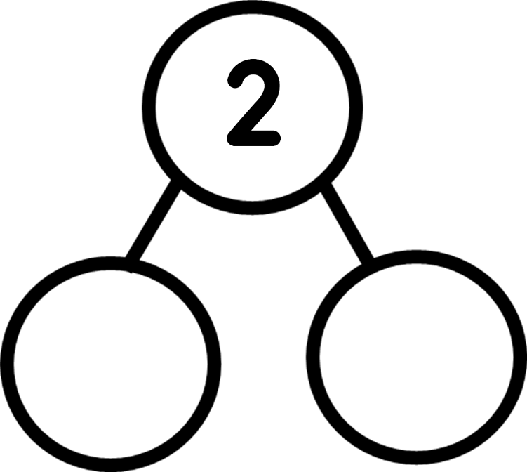
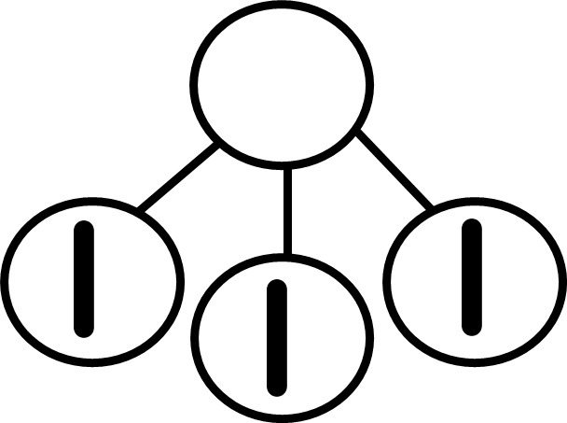




Notes:
Use this for individual work. Children complete the missing pictures or the missing numbers.

Slide 23
Notes:
Use this slide or model with a real beadstring. How you can make a bead string of 4 different colours? Ask the children to work in pairs using a piece of string and 4 beads of the colours shown, to make their own.
Who has made the same as you?
Who has made a different one?
What’s the same about your beads? What’s different?
The children should notice that everyone has the same coloured beads but they might be in a different order, however still have 4. (conservation of number).

