Slide 1
Representing sets of coordinates algebraically
KS3 Mastery PD Materials: Exemplified Key Ideas
Materials for use in the classroom or to support professional development discussions
(from 4.2 Graphical representations)
Summer 2021

Slide 2
About this resource
These slides are designed to complement the 4.2 Graphical representations Core Concept document and its associated Theme Overview document 4 Sequences and Graphs, both found in the Secondary Mastery Professional Development pages.
These slides re-present the key examples from the Core Concept document so that the examples can be used either directly in the classroom or with a group of teachers. There are prompt questions alongside the examples, and further clarification in the notes.
These slides do not fully replicate the Core Concept document, so should be used alongside it. Reference to specific page numbers, and to other useful NCETM resources, can be found in the notes for each slide.
This slide deck is not designed to be a complete PD session, rather it is a selection of resources that you can adapt and use as needed when planning a session with a group of teachers.

Slide 3


About this resource
The slides are structured as follows:
  The big picture:
    Where does this fit in?
    What do students need to understand?
    Why is this key idea important?
  Prior learning
  Misconceptions
  Exemplified key ideas
  Reflection questions
  Appendices:
    Key vocabulary
    Representations and structure
    Previous and Future learning
    Useful links
The exemplified key idea slides have the following symbols to indicate how they have been designed to be used:
Into the classroom
The examples are presented on these slides so that they could be used in PD, but also directly in the classroom. The notes feature suggested questions and things teachers might consider when using with students.
PD discussion prompts
These slides look at the examples in more detail, with question prompts to promote discussion among maths teachers. The notes feature reference to further information and guidance within the Core Concepts document.

Slide 4
Where does this fit in?
The NCETM has identified a set of six ‘mathematical themes’ within Key Stage 3 mathematics that bring together a group of ‘core concepts’.
The fourth of these themes is Sequences and graphs, which covers the following interconnected core concepts:
      4.1 Sequences
      4.2 Graphical representations
Notes:
Linked on this slide is the Theme Overview document of Sequences and graphs. This document includes why it is important, the key underpinning knowledge and links to prior and future learning. There is also guidance about how the five big ideas of Teaching for Mastery relate specifically to this theme.

Slide 5
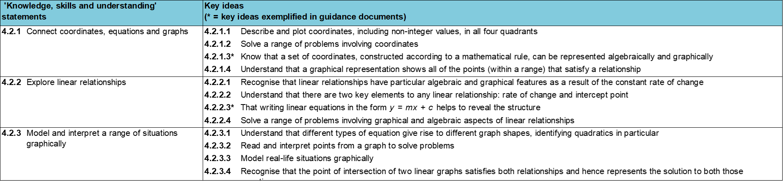
Where does this fit in?
Within this core concept, 4.2 Graphical representations, there are three statements of knowledge, skills and understanding.
These, in turn, are broken down into twelve key ideas. The highlighted key idea is exemplified in this slide deck.
Notes:
For key ideas marked with an asterisk, we exemplified the common difficulties and misconceptions that students might have and included elements of what teaching for mastery may look like. We have provided examples of possible student tasks and teaching approaches.
Within these slides are ‘classroom-ready’ versions of the examples for the key idea that has been highlighted. There are also slides that may be useful for discussion in a professional development session.

Slide 6
What do students need to understand?
4.2.1.3 Know that a set of coordinates, constructed according to a mathematical rule, can be represented algebraically and graphically
Identify an additive relationship from a set of coordinates.
Understand how many points are required to determine a linear relationship.
Identify a multiplicative relationship from a set of coordinates.
Visualise the relationship between sets of coordinates.
Identify a two-step relationship from a set of coordinates.
Solve problems where there is more than one answer and there are elements of experimentation, investigation, checking, reasoning, proof, etc.
  What prior knowledge might your students already have?
  What language might they use to describe this key idea?
  What questions might you want to ask to assess their prior learning?

Slide 7
Why is this key idea important? (1)
In Key Stage 2, students should have become familiar with coordinates in all four quadrants.
In Key Stage 3, a key focus will be thinking about x- and y-coordinates as the input and output respectively of a function or rule, and appreciating that the set of coordinates generated and the line joining them can be thought of as a graphical representation of that function.
The move from seeing a graph as a finite collection of coordinates that satisfy a relationship to a single mathematical object which encapsulates an infinite set of points, is an important one. Being able to move freely between different forms of representation (numerical values, algebraic symbolism and graphs) and to make links between them is an important skill that can support students in clear thinking, reasoning and problem-solving.
In order to develop a deep understanding and achieve fluency, students should explore the connections between equations of lines and their corresponding graphs, including those presented in a non-standard form, such as ax + by = c, as well as the more standard y = mx + c.
Notes:
A more detailed overview of the core concept 4.2 Connect coordinates, equations and graphs can be found on pages 7-8 of the 4.2 Core Concept document.
The background to each key idea is also explored in more detail on the following pages:
4.2.1 Connect coordinates, equations and graphs – pages 7 and 8
4.2.2 Explore linear relationships – pages 8 and 9
4.2.3 Model and interpret a range of situations graphically – page 9

Slide 8
Why is this key idea important? (2)
Students should be fluent at both reading and plotting coordinates involving negative and non-integer x- and y-values in all four quadrants. They should be confident in solving problems that require them to be analytical, and be able to go beyond finding an answer to being able to give clear reasons based on the relationships between the coordinates (a key element in this core concept).
A sound understanding of the relationships between the x- and y-values of pairs of coordinates provides the basis for more sophisticated analysis of the features of linear functions and their graphs, which students will need to develop throughout Key Stage 3.
By graphing sets of coordinates where the x- and y-values are connected by a rule, students will become aware of the connection between a rule expressed algebraically and the graph joining the set of points.
Much of this learning is new and is built upon significantly in Key Stages 4 and 5. It is therefore essential that students are given time to develop a secure and deep understanding of these ideas, concepts and techniques.
Notes:
A more detailed overview of the core concept 4.2 Connect coordinates, equations and graphs can be found on pages 7-8 of the 4.2 Core Concept document.
The background to each key idea is also explored in more detail on the following pages:
4.2.1 Connect coordinates, equations and graphs – pages 7 and 8
4.2.2 Explore linear relationships – pages 8 and 9
4.2.3 Model and interpret a range of situations graphically – page 9

Slide 9
Prior learning
  What prior knowledge might your students already have?
  What language or representations might they use for this key idea?
  What questions might you want to ask to assess their prior learning?
  How does this fit in with your curriculum progression?
Upper Key Stage 2 Learning Outcome
Describe positions on the full coordinate grid (all four quadrants)
Find pairs of numbers that satisfy an equation with two unknowns
Enumerate possibilities of combinations of two variables
Key Stage 3 Learning Outcome
1.4.1 Understand and use the conventions and vocabulary of algebra, including forming and interpreting algebraic expressions and equations
1.4.5 Rearrange formulae to change the subject
Please note: Numerical codes refer to statements of knowledge, skills and understanding in the NCETM breakdown of Key Stage 3 mathematics.
Notes:
You may find it useful to speak to your partner schools to see how the above has been covered and the language used.
You can find further details regarding prior learning in the following segments of the NCETM primary mastery professional development materials (linked on final slide):
Year 5: 1.27 Negative numbers: counting, comparing and calculating
Year 5: 1.28 Common structures and the part–part–whole relationship
Within the 4 Sequences and graphs Theme Overview document, you can also find a broader description of students’ potential previous learning (page 2), alongside further information about key underpinning knowledge (page 3).

Slide 10
Checking prior learning
The following slides contain questions for checking prior learning.
  What representations might students use to support their understanding of these questions?
  What variation might you put in place for these questions to fully assess students’ understanding of the concept?
  How might changing the language of each question change the difficulty?
  Why are these such crucial pre-requisites for this key idea?

Slide 11
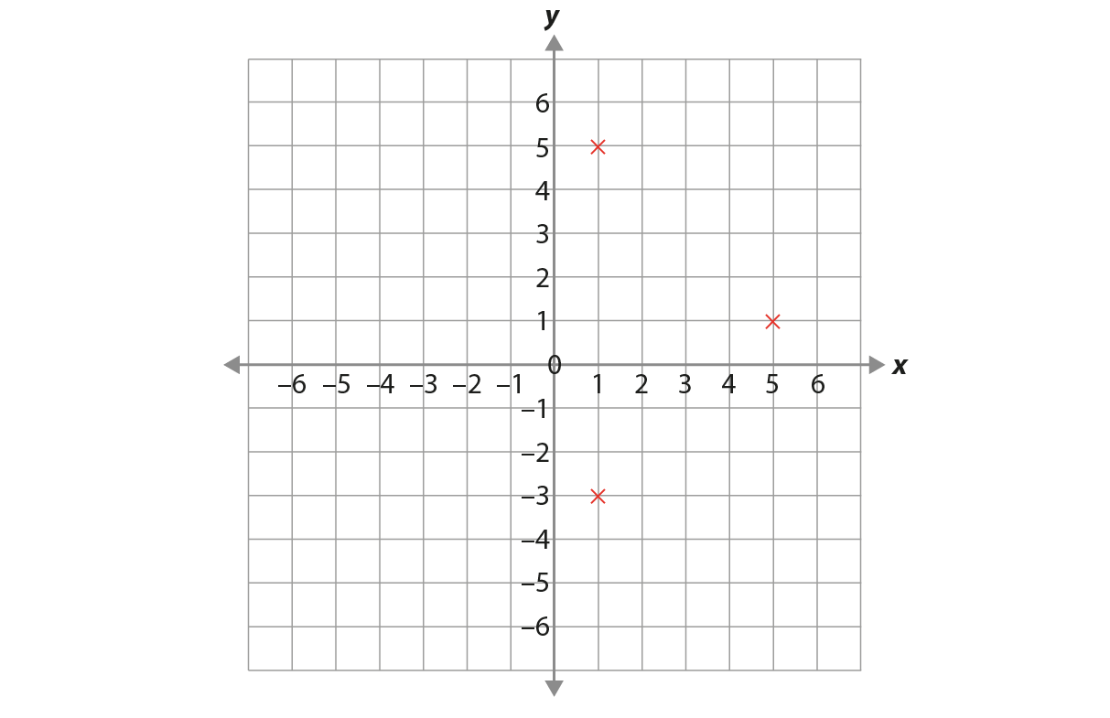
Checking prior learning
The opposite vertices of a rectangle are plotted at (0,2) and (6,3).
Find the coordinates of the other two vertices.
Layla draws a square on this coordinate grid.
Three of the vertices are marked.
What are the coordinates of the missing vertex?
Notes:
References to the questions (links on final slide):
a) NCETM Secondary assessment materials, Page 18
b) 2018 Key Stage 2 Mathematics Paper 3: reasoning, question 10

Slide 12
Common difficulties and misconceptions
What aspects of this key idea might students find challenging?
What misconceptions might students have?
When teaching this topic, you may find students encounter difficulties with…
Understanding that the line represents an infinity of points that fit the rule
Expressing the relationship between x- and y- values algebraically
More information, and some suggestions for overcoming these challenges, can be found on the following slides.

Slide 13
Common difficulties and misconceptions (1)
When working with linear equations and graphs, it is not uncommon for students to accept that integer coordinates fit the rule given by an equation. What students may not appreciate is that the line is representing an infinity of points, all of which fit the rule.
It will be important for students to experiment with coordinates in between integer points they have used to construct the line, and to verify that these coordinates also fit the rule. This should lead students to the important awareness of the key idea that if a set of coordinates lies on the same straight line, then there is a consistent relationship between the x- and y-values that can be expressed algebraically as the equation of the line.
Students should be encouraged to plot the coordinates themselves to confirm that the coordinates do, in fact, lie on a straight line, but also to think deeply about why this is so and not just rely on practical demonstration.
These more probing explorations will support students in reaching two important ‘awarenesses’:
  the line represents the infinity of points satisfying the rule and therefore ‘captures’ or represents that rule in the same way the algebraic equation does
  the line divides the plane into points that fit the rule and points that do not.
Notes:
More detail can be found on page 10 of the 4.2 Core Concept document.

Slide 14
Common difficulties and misconceptions (2)
Some students may find it challenging to express the relationship between the x- and y-values algebraically. Asking students to test a given algebraic relationship by generating another coordinate and testing whether this lies on the same straight line can help them to overcome this difficulty.
Encouraging the use of precise language will also help students to overcome difficulties; establishing the relationship and articulating it using key vocabulary will enable students to discuss and reason with clarity. Prompting students to describe the relationship in words by considering how the x-value is being operated on in order for it to match the y-value, will help students identify the relationship before formally expressing it in algebraic form.
Notes:
More detail can be found on page 10 of the 4.2 Core Concept document.

Slide 15
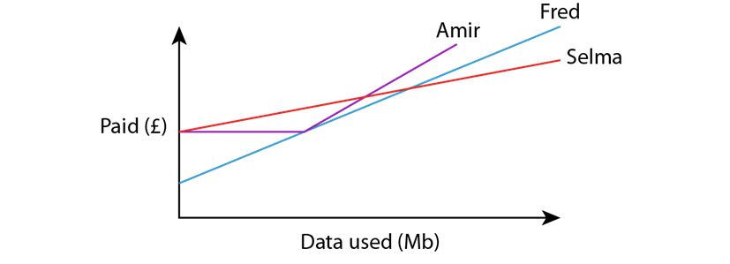
Checking prior learning
Three mobile phone companies each have different monthly pay-as-you-go contracts.
  Phil’s Phones: £5 fee every month and 2p for each Mb of data you use.
  Manish’s Mobiles: £7 fee every month and 1p for each Mb of data you use.
  Harry’s Handsets: £7 fee every month and 200Mb of free data, then 3p for each Mb of data after that.
Amir, Selma and Fred have mobile phones and they have recorded for one month how much data they have used (in Mb) and how much they have paid (in £). They have represented their data on this graph.
With which company do you think they each have contracts?
Explain your choices.
Notes:
References to the questions (links on final slide):
a) NCETM primary assessment materials: Year 6, page 39

Slide 16
Identify an additive relationship from a set of coordinates
Example 1
For each set of coordinates:
Find the relationship between the x- and y-values.
Can you draw a straight line which passes through them?
(i) (0, 2)
(1, 3)
(2, 4)
(ii) (0, 3)
(1, 4)
(2, 5)
(iii) (0, 4)
(1, 5)
(2, 6)
(iv) (−3, −1)
(0, 2)
(3, 5)
(0, −3)
(5, 2)
(−3, −6)
(vi) (−2, −3.5)
(½ , −1)
(9, 7.5)
(vii) (−3, −3)
(1, 1)
(4, 4)
(viii) (2, 6)
(4, 7)
(−1, −3)
Find another point on each line. Do the x- and y-values have the same relationship?
Notes:
Suggested questioning:
How can you describe the relationship?
Will there always be a straight line? Why or why not?
If you know x, how would you find y? If you know y, how would you find x?
Further questions to promote a deeper understanding could include:
‘Can you find another coordinate on the same straight line?’
‘(3, y) also lies on the line. What is the value of y?’
‘(x, 0.5) also lies on the line. What is the value of x?’
Things for you to think about:
In Example 1, students find the relationship between the x- and y-values in sets of coordinates where that relationship is additive.
In parts (i), (ii), (iii) and (iv), the equations are in the form y = x + c. Parts (i), (ii) and (iii) start with a coordinate that has an x-value of zero. Students might find this helpful when starting to identify the relationship between the x- and y-values. Part (iv) starts with a coordinate that has an x-value of −3 to test whether students can accurately identify the relationship without zero as a starting point.
Parts (v) and (vi) have equations in the form y = x − c. In part (v), the first coordinate has an x-value of zero to allow students to more easily identify the relationship, but this is not the case in part (vi), where both a fraction and decimals are used.
In part (vii), the equation is y = x. This part provides an opportunity for students to explore whether this is the same as y = x + 0 or y = x − 0.
Part (viii) has no linear relationship. This part will help to assess whether students are testing the relationship with all the coordinates provided and may help them understand why this is necessary. Plotting the coordinates may support this understanding.
A range of coordinates has been provided, including those with negative and fractional values. The order in which they have been written also varies, as students need to become adept at selecting the easiest coordinates to work with first before testing the relationship with the others. Using the first coordinate listed for each part might not be the most efficient option.
Encourage students to use precise language when describing the relationship between the x- and y-values. In part (i), students may identify that the y-values and the x-values are both increasing by one. It is important, however, that students can verbalise the relationship between the x- and y-values and in multiple ways (i.e. that the y-value is two more than the x-value; y subtract two equals the x-value; two added to the x-value is always the y-value, etc.).
Asking students what the coordinates from each part of Example 1 would look like visually will promote a deeper understanding of the concept and reinforce the idea that if there is a linear relationship, then all coordinates will lie on the same straight line.

Slide 17
Identify an additive relationship from a set of coordinates
Example 1
For each set of coordinates:
Find the relationship between the x- and y-values.
Can you draw a straight line which passes through them?
  What language would you expect students to use when describing the relationships?
  What is the potential benefit of encouraging students to verbalise the relationships in different ways?
  How can you support students to visualise these relationships?
(i) (0, 2)
(1, 3)
(2, 4)
(ii)(0, 3)
(1, 4)
(2, 5)
(iii)(0, 4)
(1, 5)
(2, 6)
(iv)(−3, −1)
(0, 2)
(3, 5)
(v) (0, −3)
(5, 2)
(−3, −6)
(vi) (−2, −3.5)
(½ , −1)
(9, 7.5)
(vii)(−3, −3)
(1, 1)
(4, 4)
(viii)(2, 6)
(4, 7)
(−1, −3)
Find another point on each line. Do the x- and y-values have the same relationship?
Notes:
Due to space constraints, the image on this PD discussion slide is very small. PD Leads might like to use or print the ‘in the classroom’ version of this slide for teachers to access during discussions.
More detail about the sequencing of this example can be found on pages 10-12 of the 4.2 Core Concept document.

Slide 18
Identify an additive relationship from a set of coordinates
Example 2
Here are some coordinates:
(−2, 0) (9, 11) (−4, −2)
Jamila says that the equation of the line passing through these coordinates is y = x + 2.
Kuba says the equation is x = y + 2.
Lillie says the equation is x + 2 = y.
Who is correct? Justify your answer.
Notes:
Suggested questioning:
What is the same/different about their equations?
Is there another way of writing their equations? Is one way preferable to another?
For any of the wrong equations, can you write three co-ordinates that would be on that line?
Things for you to think about:
Example 2 is designed to give students an opportunity to explore and discuss the way in which a verbal relationship is written algebraically. Many students will identify the relationship as ‘+ 2’ and they should be challenged to explain what they mean by this, using key vocabulary. You could ask questions, such as: ‘Does anyone think the relationship is “− 2”?’, ‘Is there more than one way to write the relationship algebraically?’, ‘Is one way preferable to another?’. Discussing these key ideas is important if students are to become fluent at writing equations in multiple forms and to develop a deep and secure understanding.

Slide 19
Identify an additive relationship from a set of coordinates
Example 2
  What misconceptions are these three examples/non-examples designed to address?
  What other examples or non-examples might you want students to discuss?
  What key vocabulary would you want students to include in their answers?
Here are some coordinates:
(−2, 0) (9, 11) (−4, −2)
Jamila says that the equation of the line passing through these coordinates is y = x + 2.
Kuba says the equation is x = y + 2.
Lillie says the equation is x + 2 = y.
Who is correct? Justify your answer.
Notes:
Due to space constraints, the image on this PD discussion slide is very small. PD Leads might like to use or print the ‘in the classroom’ version of this slide for teachers to access during discussions.
More details about this example can be found on page 12 of the 4.2 Core Concept document.

Slide 20
Understand how many points are required to determine a linear relationship
Example 3
Mohammed says that the equation of the straight line going through the point (3, 6) is y = x + 3.
Is he correct?
Do any other straight lines pass through this coordinate?
Are there any other relationships between 3 and 6 which are not ‘Add 3’?
Notes:
Suggested questioning:
Is there only one straight line going through the point (3,6)? Why or why not? What other lines might go through?
How many other co-ordinates would you need to prove that the line is y = x + 3? Give an example of these co-ordinates.
What co-ordinates would convince you that the line is NOT y = x + 3?
Can you use a graph to support your reasoning?
Things for you to think about:
Consider asking students how many points are required to test whether a line is straight or not. Can they reason that y = x + 3 is an equation of a line passing through the given coordinate, but that there are an infinite number of others? Can they come up with other equations of lines? Can they use a graph to support their reasoning? What other activities and questions would help students to understand that there are multiple lines passing through one point, but that two points define a line?

Slide 21
Understand how many points are required to determine a linear relationship
Example 3
  What might your students say here? What prompts would you give if they weren’t initially forthcoming with answers?
  What other activities and questions would help students to understand that there are multiple lines passing through one point, but that two points define a line?
Mohammed says that the equation of the straight line going through the point (3, 6) is y = x + 3.
Is he correct?
Do any other straight lines pass through this coordinate?
Are there any other relationships between 3 and 6 which are not ‘Add 3’?
Notes:
Due to space constraints, the image on this PD discussion slide is very small. PD Leads might like to use or print the ‘in the classroom’ version of this slide for teachers to access during discussions.
More detail about this example can be found on page 13 of the 4.2 Core Concept document.

Slide 22
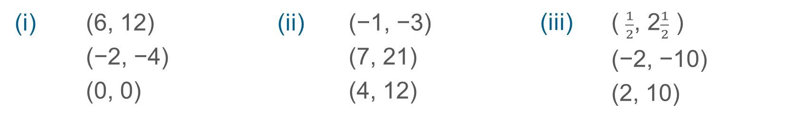
Identify a multiplicative relationship from a set of coordinates
Example 4
For each set of coordinates:
a) Find the relationship between the x- and y-values.
b) Can you draw a straight line which passes through them?
(i) (6, 12)
(−2, −4)
(0, 0)
(ii) (−1, −3)
(7, 21)
(4, 12)
(iii) ( $\frac{1}{2}$, 2$\frac{1}{2}$ )
(−2, −10)
(2, 10)
(iv) (4, 2)
    (−3, −1.5)
    (5, 2.5)
(v) (3, −3)
    (−6, 6)
    (−1.5, 1.5)
(vi) (−3, 6)
    (2, −4)
    (0, 0)
Notes:
Suggested questioning:
What is the relationship between the x and y values?
For part (i), I thought it was ‘add six to the x value’ – why am I wrong?
Is there more than one way to describe the relationship (e.g. for iv)? Can you describe it as a multiplication? Can you describe it as a division? What would the equations look like?
In part (v) and (vi), what do you notice about the signs of the x and y co-ordinate? What does this mean about the multiplier?
Things for you to think about:
In Example 4, students find the relationship between x- and y-values in sets of coordinates where the relationship is multiplicative.
In parts (i), (ii) and (iii), the x-value is multiplied by a positive integer.
In part (iv), the x-value is multiplied by ½ (or divided by two). This provides an opportunity to discuss the different ways in which the equation can be written.
In parts (v) and (vi), the x-value is multiplied by a negative integer.

Slide 23
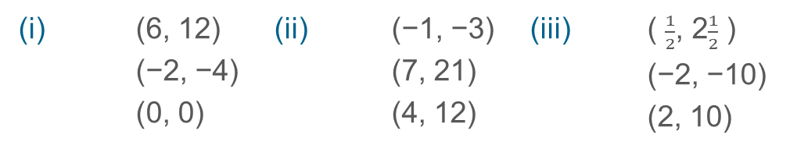
Identify a multiplicative relationship from a set of coordinates
Example 4
For each set of coordinates:
a) Find the relationship between the x- and y-values.
b) Can you draw a straight line which passes through them?
  Consider the variation in this example – why do you think the coordinate groups may have been sequenced in this way?
  What different relationships/numbers are students experiencing?
  What relationships/numbers might you want them to experience next?
(i) (6, 12)
(−2, −4)
(0, 0)
(ii) (−1, −3)
(7, 21)
(4, 12)
(iii) ( $\frac{1}{2}$, 2$\frac{1}{2}$ )
(−2, −10)
(2, 10)
(iv) (4, 2)
    (−3, −1.5)
    (5, 2.5)
(v) (3, −3)
    (−6, 6)
    (−1.5, 1.5)
(vi) (−3, 6)
    (2, −4)
    (0, 0)
Notes:
Due to space constraints, the image on this PD discussion slide is very small. PD Leads might like to use or print the ‘in the classroom’ version of this slide for teachers to access during discussions.
This example can be found on page 13 of the 4.2 Core Concept document.

Slide 24
Identify a multiplicative relationship from a set of coordinates
Example 5
(−10, −2) (−2, 6) (6, 14)
  Charlie thinks the equation of the line passing through these coordinates is x = y + 8.
  Explain why Charlie is wrong.
(10, 2) (1, 5) (−3, −15)
  Mia thinks the equation of the line passing through these coordinates is y = 5x.
  Explain why Mia is wrong.
Notes:
Suggested questioning:
What has Charlie done wrong? What would three co-ordinates for Charlie’s equation be? What equation is correct for our set of three co-ordinates?
What has Mia done wrong? What would three co-ordinates for Mia’s equation be? What equation is correct for our set of three co-ordinates?
Can you represent these on a graph?
Can you show where on the graph you can ‘see’ the features of the equation?
Things for you to think about:
Example 5 gives students an opportunity to explore misconceptions when finding the relationship between x- and y-values in sets of coordinates.
Students often lose sight of the fact that an equation represents a relationship between two values. Asking students to each write down a coordinate where the y-value is three more than the x-value, and then representing all the coordinates generated on a coordinate grid, can help to reconnect them with this idea. When might it be useful to revisit such an activity?

Slide 25
Identify a multiplicative relationship from a set of coordinates
Example 5
  What representations might students use to explain their reasoning?
  Students often lose sight of the fact that an equation represents a relationship between two values. What activities might you use to remind them of this? When might it be useful to revisit these activities?
(−10, −2) (−2, 6) (6, 14)
  Charlie thinks the equation of the line passing through these coordinates is x = y + 8.
  Explain why Charlie is wrong.
(10, 2) (1, 5) (−3, −15)
  Mia thinks the equation of the line passing through these coordinates is y = 5x.
  Explain why Mia is wrong.
Notes:
Due to space constraints, the image on this PD discussion slide is very small. PD Leads might like to use or print the ‘in the classroom’ version of this slide for teachers to access during discussions.
This example can be found on page 13 of the 4.2 Core Concept document.

Slide 26
Identify a multiplicative relationship from a set of coordinates
Example 6
Find the equation of the line which passes through these sets of coordinates.
(10, 5)
(−6, −3)
(4, 2)
(6, 2)
(0, 0)
(9, 3)
(−10, −1)
(6, 0.6)
(−1, −0.1)
(12, -3)
(−4, 1)
(0, 0)
(3, 30)
(-1, -10)
(2.5, 25)
Notes:
Suggested questioning:
What has the x co-ordinate been multiplied or divided by? Do you see this as a multiplication or as a division?
If you see this as a division, can you write this as a multiplication (and vice-versa)?
Is there more than one way to write this relationship?
Do you prefer to think in decimals or fractions? Do you think in the same way for all relationships, or are you more likely to think in decimals/fractions for certain types of number? Why?
If you see this multiplier as a decimal, can you write it as a fraction (and vice-versa)?
Things for you to think about:
In Example 6, students are continuing to identify multiplicative relationships but with more complex equations, some of which can be written in multiple ways. Encouraging students to write the equations in as many ways as possible will help them to develop procedural fluency and a deeper conceptual understanding.
In parts a), b) and c), the x-value is divided by a positive integer (or multiplied by a unit fraction).
In part d), the x-value is divided by a negative integer.
In part e), the x-value is divided by 0.1 (or multiplied by 10).

Slide 27
Identify a multiplicative relationship from a set of coordinates
Example 6
  Are your students likely to see these relationships as multiplications or divisions? How can you support your students to think flexibly about both?
  What are the benefits of introducing fractional or negative multipliers at this stage? What are the challenges?
Find the equation of the line which passes through these sets of coordinates.
(10, 5)
(−6, −3)
(4, 2)
(6, 2)
(0, 0)
(9, 3)
(−10, −1)
(6, 0.6)
(−1, −0.1)
(12, -3)
(−4, 1)
(0, 0)
(3, 30)
(-1, -10)
(2.5, 25)
Notes:
Due to space constraints, the image on this PD discussion slide is very small. PD Leads might like to use or print the ‘in the classroom’ version of this slide for teachers to access during discussions.
This example can be found on page 14 of the 4.2 Core Concept document.

Slide 28
Identify a multiplicative relationship from a set of coordinates
Example 7
(17, 17) (−4, −4) (8, 8)
Ally says that the relationship is ‘+ 0’ each time.
Ben says that the relationship is ‘× 1’ each time.
Cathryn says that the relationship is ‘÷ 1’ each time.
Who is correct? Justify your answer.
Notes:
Suggested questioning:
Who is right? How do you know? How can you ‘test’ the relationship?
Why are they all correct? Is there another way to express this relationship?
Things for you to think about:
Providing students with opportunities to reason using given statements is a useful strategy as it ensures students can engage with a concept without relying on them coming up with the statements themselves. Students often feel more confident discussing ‘fictional’ misconceptions rather than exposing their own. Can you devise some more examples of this use of misconceptions for students to discuss?
Asking students to identify who is correct, when all statements are true, will challenge them to explore all options. Example 7 shows students that there may be more than one way to express the relationship between the x- and y-values, but that all lead to the same equation.

Slide 29
Identify a multiplicative relationship from a set of coordinates
Example 7
  Why might exploring ‘fictional’ misconceptions be a useful strategy in the classroom?
  Can you devise some more examples of this use of misconceptions for students to discuss?
(17, 17) (−4, −4) (8, 8)
Ally says that the relationship is ‘+ 0’ each time.
Ben says that the relationship is ‘× 1’ each time.
Cathryn says that the relationship is ‘÷ 1’ each time.
Who is correct? Justify your answer.
Notes:
Due to space constraints, the image on this PD discussion slide is very small. PD Leads might like to use or print the ‘in the classroom’ version of this slide for teachers to access during discussions.
This example can be found on page 14 of the 4.2 Core Concept document.

Slide 30
Visualise the relationship between sets of coordinates
Example 8
Find the coordinates of the point that is exactly halfway between these pairs of coordinates.
(0, 12) and (0, 16)
(13, 5) and (21, 5)
(13, 12) and (21, 16)
(14, 22) and (18, 10)
Notes:
Suggested questioning:
Which of these is the easiest to do? Which is the hardest?
What do you think ‘midpoint’ might mean? How do you know?
What is your strategy for finding the point that is half way? Does your strategy change for different sets of co-ordinates?
Students could be challenged to think more deeply by asking questions, such as:
•‘What would happen if the second point were the midpoint? What would be the third coordinate in the set?’
•‘Can you find a fourth or fifth coordinate that is also on the line?’
•‘How would you explain to someone else how to find the midpoint of a pair of coordinates?’
Things for you to think about:
In Example 8, the coordinate pairs have been carefully chosen so that they are probably too large to draw accurately (drawing should be discouraged unless absolutely necessary), but not so large that they cannot be visualised by students.
By picturing the midpoint of the coordinates, students will visualise the line joining them and the relative positions of the three points.
Note that in parts a) and b), the pairs of coordinates are parallel to the axes, and that in part c) these pairs of coordinates are combined; part d) offers a negative gradient for students to consider.

Slide 31
Visualise the relationship between sets of coordinates
Example 8
  How have you taught this in the past? How might you teach this differently with this task as the starting point?
  Why might the pairs of co-ordinates have been sequenced in this way?
Find the coordinates of the point that is exactly halfway between these pairs of coordinates.
(0, 12) and (0, 16)
(13, 5) and (21, 5)
(13, 12) and (21, 16)
(14, 22) and (18, 10)
Notes:
This example can be found on pages 14-15 of the 4.2 Core Concept document.

Slide 32
Identify a two-step relationship from a set of coordinates
Example 9
Find the equation of the line which passes through these sets of coordinates.
  (1, 3) (2, 5) (3, 7)
  (1, 2) (4, 11) (0, −1)
  (1, 5.5) (3, 15.5) (−2, −9.5)
  (2, 2) (5, −1) (0, 4)
Notes:
Suggested questioning:
What do you notice each time?
Can you write another set of co-ordinates with the same rule? How can you check?
Is there a way of re-writing these co-ordinates to make the relationship easier to spot?
Things for you to think about:
In Example 9, students are given sets of coordinates, written in a list horizontally instead of vertically. Students might find it more challenging to spot the relationship when the x- and y-values are not lined up visually.
The coordinates all have a linear relationship but, unlike in previous questions, they are two-step relationships (for example, in part a), multiply by two and then add one).
In parts a), b) and c), the initial coordinates all have x-values of one.
In part a), the x-values increase by one each time to support students to see the relationship more easily; part a) has the equation y = 2x + 1
Part b) has the equation y = 3x − 1.
The coordinates in part c) contain decimals; the equation is y = 5x + 0.5.
In part d), the multiplier is negative; the equation is y = −x + 4.

Slide 33
Identify a two-step relationship from a set of coordinates
Example 9
  How might you support students struggling to access this task?
  Students may find it helpful to make connections to sequences here, but they should be made aware of the differences between the discrete nature of sequences versus the continuous nature of equations. Is that a connection you currently explore with your students?
Find the equation of the line which passes through these sets of coordinates.
  (1, 3) (2, 5) (3, 7)
  (1, 2) (4, 11) (0, −1)
  (1, 5.5) (3, 15.5) (−2, −9.5)
  (2, 2) (5, −1) (0, 4)
Notes:
This example can be found on page 15 of the 4.2 Core Concept document.

Slide 34
Identify a two-step relationship from a set of coordinates
Example 10
Which of these equations pass through this set of coordinates?
(−2, −2) (5, 12) (0, 2) (4, 10)
  y = 2x + 2
  y = 2(x + 1)
  y = 3x − 3
  y = x
Notes:
Suggested questioning:
Which is correct? Could any of the others be true? Why or why not?
For the equations that aren’t correct: which co-ordinates are on that line? How could you change the other co-ordinates so that they are also on that line?
For the equations that are correct: can you write another set of co-ordinates for that line?
Things for you to think about:
Examples such as Example 10 are useful in challenging students’ understanding of a concept. Students must check that the equation holds true for all coordinates in the set. Students who consider only one coordinate could select an incorrect equation, as every equation is true for one of the coordinates given.
Students who correctly identify equation a) should be asked whether any of the other equations could also be true. Discussing why both equation a) and b) are correct is useful in exploring the different ways in which equations could be written, making connections to other areas of algebra.

Slide 35
Identify a two-step relationship from a set of coordinates
Example 10
  Why might students select each answer? How will you address the issues raised?
  What discussions might you want to have around each of the options?
  What representations might you use in your discussions?
Which of these equations pass through this set of coordinates?
(−2, −2) (5, 12) (0, 2) (4, 10)
  y = 2x + 2
  y = 2(x + 1)
  y = 3x − 3
  y = x
Notes:
This example can be found on page 16 of the 4.2 Core Concept document.

Slide 36
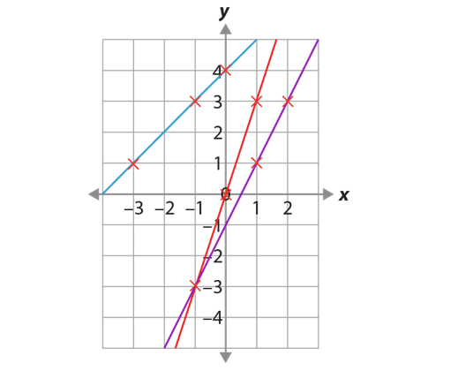
Identify a two-step relationship from a set of coordinates
Example 11
Consider the graph. Look at the three coordinates marked on each line and use them to identify the equation of each line.
Notes:
Suggested questioning:
What are the three co-ordinates for each line? What do you notice about them?
What is the relationship between x and y each time?
What do you notice about the different lines? Which is steepest? What do you notice about the x and y co-ordinates for this line, compared with the other lines.
One co-ordinate is on both the purple and red lines – what are the two ways of describing the relationship? Can you think of another way? What would that line look like?
If x is 10, what is y? How about if y is 10? Did you use the graph or the relationship to work this out?
Things for you to think about:
Example 11 allows students to continue to make connections between the procedure and the concept. It will also support future learning on equations of linear graphs.
Asking students to find other coordinates on the lines outside of the regions of the graph, for example (10, y), will increase students’ awareness of the flexible relationship between coordinates and equations – they can find the equation from coordinates and find coordinates from the equation.

Slide 37
Identify a two-step relationship from a set of coordinates
Example 11
  What questions might you ask here to support students to access this task?
  What questions might you ask to support students to think more deeply about this task?
  Which aspects of the graph might you particularly want to draw students’ attention to? Why?
Consider the graph. Look at the three coordinates marked on each line and use them to identify the equation of each line.
Notes:
Due to space constraints, the image on this PD discussion slide is very small. PD Leads might like to use or print the ‘in the classroom’ version of this slide for teachers to access during discussions.
This example can be found on page 16 of the 4.2 Core Concept document.

Slide 38
Solve problems where there is more than one answer and there are elements of experimentation, investigation, checking, reasoning, proof, etc
Example 12
Find possible values for a and b, a > b, if the equation of the straight line going through the point (a, b) is y = 2x − 3.
Notes:
Suggested questioning:
What does a > b mean for your answers?
How many different values can you find?
Things for you to think about:
Encourage students who have demonstrated a secure understanding to go deeper by solving more complex problems, such as exploring all possibilities, creating their own examples and testing conjectures.

Slide 39
Solve problems where there is more than one answer and there are elements of experimentation, investigation, checking, reasoning, proof, etc
Example 12
  How could you encourage students who have demonstrated a secure understanding to go deeper?
  Could the wording affect students’ access to the task? What aspects of the notation or wording of this question might you need to unpick for some students?
Find possible values for a and b, a > b, if the equation of the straight line going through the point (a, b) is y = 2x − 3.
Notes:
This example can be found on page 17 of the 4.2 Core Concept document.

Slide 40
Solve problems where there is more than one answer and there are elements of experimentation, investigation, checking, reasoning, proof, etc
Example 13
Is it always, sometimes or never true that linear graphs are horizontal?
Is it always, sometimes or never true that linear graphs are vertical?
Notes:
Suggested questioning:
Can you give an example? Can you give a counter example?
Why might someone think this is ‘never’ true?
Give some examples of co-ordinates that are on a horizontal/vertical line: what do you notice?
Things for you to think about:
This has been animated so that the second statement appears ‘on click’: you may wish to choose to just give one statement to students. None of the Examples 1-12 feature horizontal or vertical lines, as they have been focussing on identifying the relationships between x and y co-ordinates. Example 13 provides an opportunity to explicitly discuss horizontal and vertical lines with students to prevent misconceptions.

Slide 41
Solve problems where there is more than one answer and there are elements of experimentation, investigation, checking, reasoning, proof, etc
Example 13
  Why might students think these statements are ‘never’ true? How can you address this in the examples you give?
  Can you create some other ‘missing number’ or ‘Always, Sometimes, Never’-type problems which would be suitable for your students and would allow you to identify key misconceptions?
Is it always, sometimes or never true that linear graphs are horizontal?
Is it always, sometimes or never true that linear graphs are vertical?
Notes:
This example can be found on page 17 of the 4.2 Core Concept document.

Slide 42
Reflection questions
What other mathematical concepts will be supported by students’ stronger understanding of this key idea?
What mathematical language will you continue to use to support pupils to make connections with other areas?
Which representations might you continue to use to further develop students’ understanding?

Slide 44
Appendices
You may choose to use the following slides when planning or delivering a PD session. They cover:
  Key vocabulary
  Representations and structure
  Previous learning
  Future learning
  Library of links

Slide 45
Key vocabulary (1)
Term | Definition
Cartesian coordinate system | A system used to define the position of a point in 2- or 3-dimensional space: Two axes at right angles to each other are used to define the position of a point in a plane. The usual conventions are to label the horizontal axis as the x-axis and the vertical axis as the y-axis, with the origin at the intersection of the axes. The ordered pair of numbers (x, y) that defines the position of a point is the coordinate pair. The origin is the point (0, 0); positive values of x are to the right of the origin and negative values are to the left of the origin; positive values of y are above the origin and negative values below the origin. Each of the numbers is a coordinate. The numbers are also known as ‘Cartesian coordinates’, after the French mathematician, René Descartes (1596–1650). Three mutually perpendicular axes, conventionally labelled x, y and z, and coordinates (x, y, z) can be used to define the position of a point in space.

Slide 46
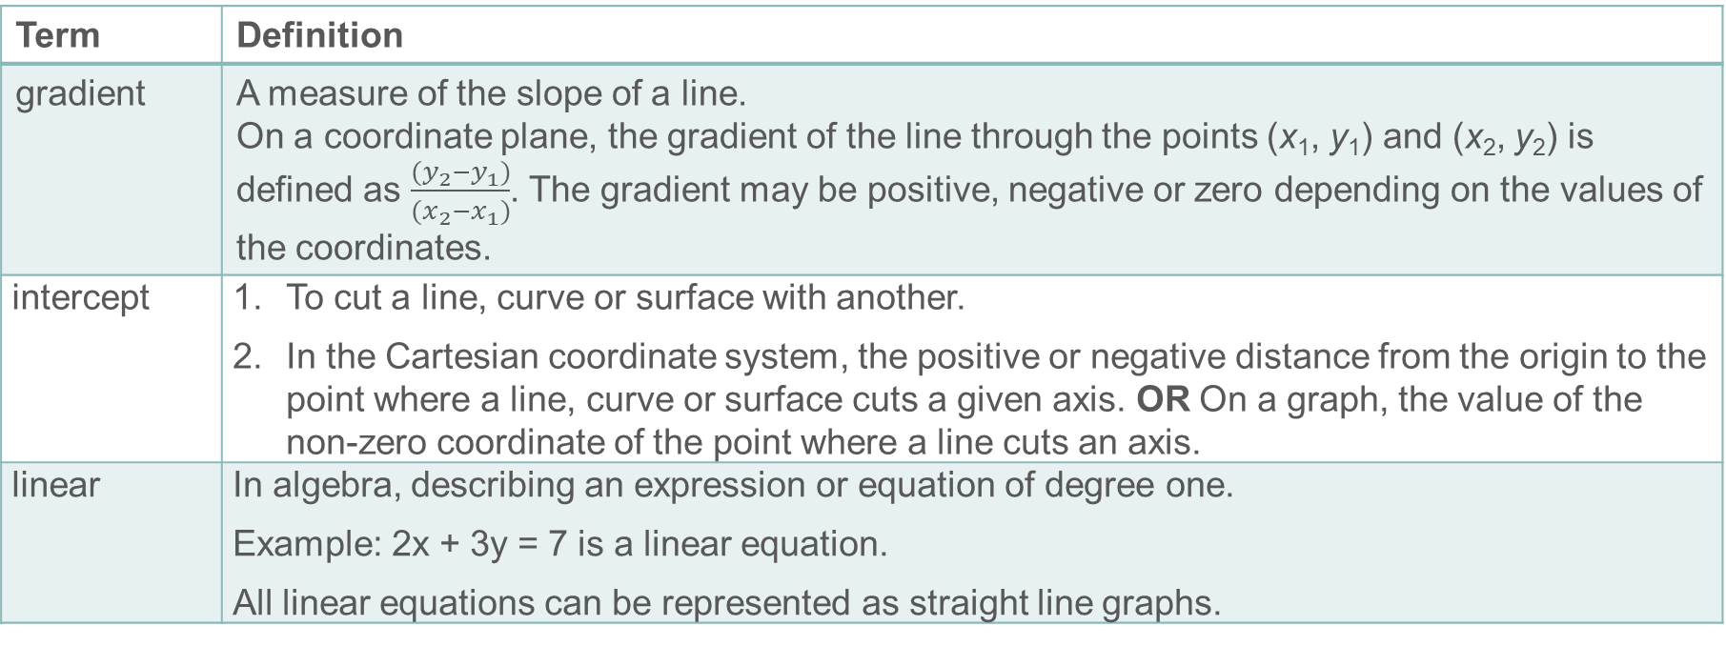
Key vocabulary (2)
Term | Definition
gradient | A measure of the slope of a line. On a coordinate plane, the gradient of the line through the points (x₁, y₁) and (x₂, y₂) is defined as $\frac{(y_{2}−y_{1})}{(x_{2}−x_{1})}$. The gradient may be positive, negative or zero depending on the values of the coordinates.
intercept | To cut a line, curve or surface with another. In the Cartesian coordinate system, the positive or negative distance from the origin to the point where a line, curve or surface cuts a given axis. OR On a graph, the value of the non-zero coordinate of the point where a line cuts an axis.
linear | In algebra, describing an expression or equation of degree one. Example: 2x + 3y = 7 is a linear equation. All linear equations can be represented as straight line graphs.

Slide 47
Key vocabulary (3)
Term | Definition
quadratic | Describing an expression of the form ax² + bx + c where a, b and c are real numbers. The function y = ax² + bx + c is a quadratic function; its graph is a parabola.
simultaneous equations | Two linear equations that apply simultaneously to given variables. The solution to the simultaneous equations is the pair of values for the variables that satisfies both equations. The graphical solution to simultaneous equations is a point where the lines representing the equations intersect. Example: x + y = 6 and y = 2x is a set of simultaneous equations. The solution is the value of x and y which satisfies both simultaneously – i.e. x = 2 and y = 4.

Slide 48
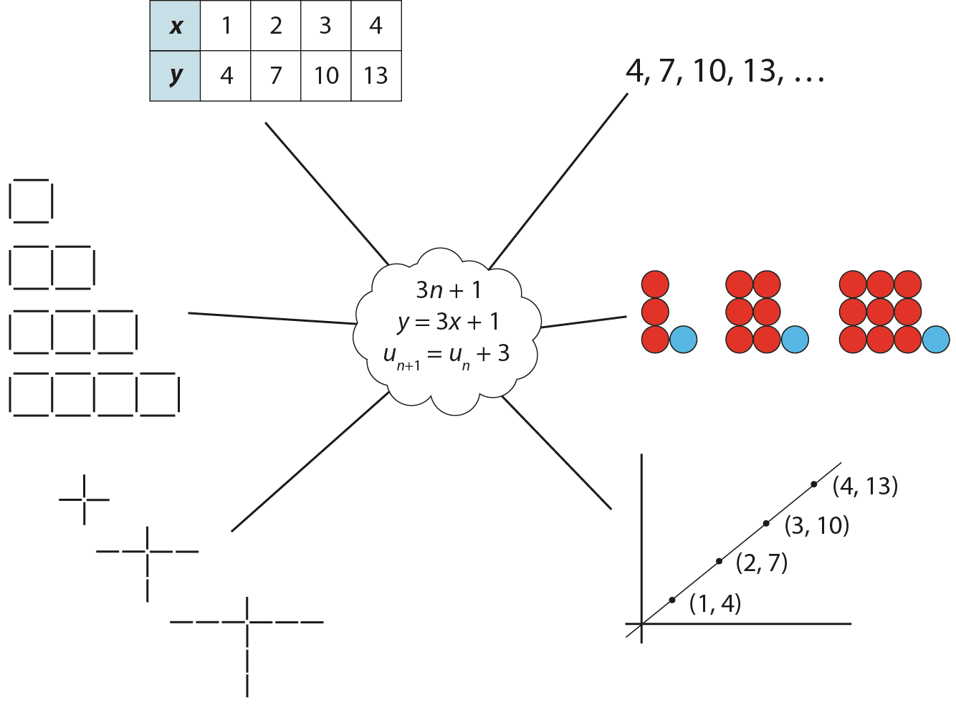
Representations and structure
There are a number of different representations that you may wish to use to support students’ understanding of this key idea. These might include:
Tables of values, graphs, sequences and structured pictorial arrangements
  It is important for students to see multiple representations of the same structure, as in the diagram, and to connect them. Prompts such as ‘Where is the 3 in this representation?’ and ‘Where is the 1?’ can support students in making these connections and understanding that each representation has the same underpinning structure.
Notes:
More information about the representations and structure involved in this key idea can be found:
On page 5 of the 4 Sequences and graphs Theme Overview document
Links to all of these can be found on the final slide.

Slide 49
Previous learning
From Upper Key Stage 2, students will bring experience of:
using simple formulae
generating and describing linear number sequences
describing positions on the full coordinate grid (all four quadrants).
Notes:
Theme 4 Sequences and graphs

Slide 50
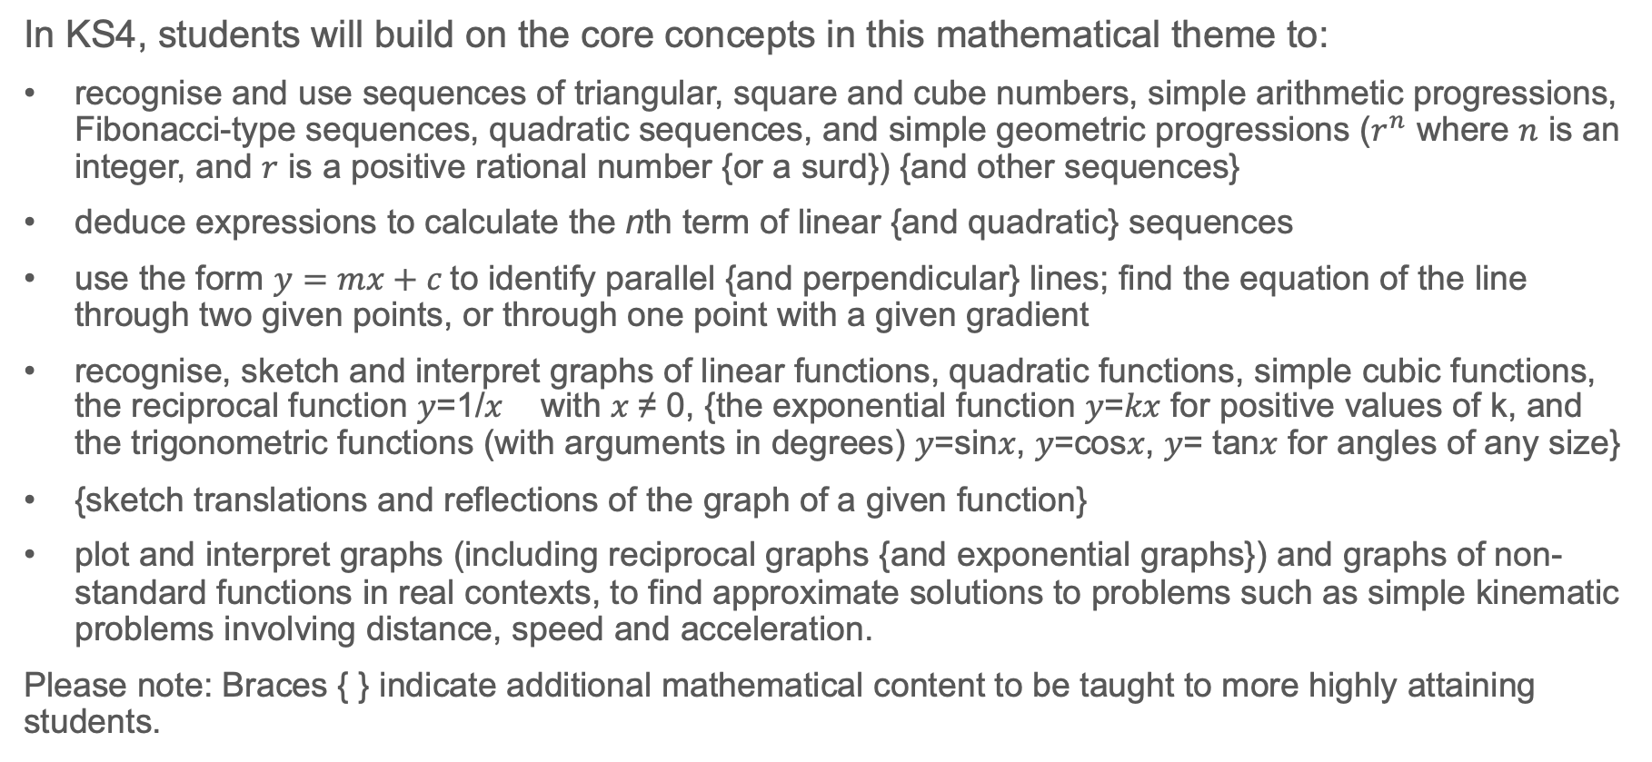
Future learning
In KS4, students will build on the core concepts in this mathematical theme to:
recognise and use sequences of triangular, square and cube numbers, simple arithmetic progressions, Fibonacci-type sequences, quadratic sequences, and simple geometric progressions ($r^{n}$ where $n$ is an integer, and $r$ is a positive rational number {or a surd}) {and other sequences}
deduce expressions to calculate the nth term of linear {and quadratic} sequences
use the form $y=mx+c$to identify parallel {and perpendicular} lines; find the equation of the line through two given points, or through one point with a given gradient
recognise, sketch and interpret graphs of linear functions, quadratic functions, simple cubic functions, the reciprocal function 𝑦=1/𝑥 with 𝑥 ≠ 0, {the exponential function 𝑦=𝑘𝑥 for positive values of k, and the trigonometric functions (with arguments in degrees) 𝑦=sin𝑥, 𝑦=cos𝑥, 𝑦= tan𝑥 for angles of any size}
{sketch translations and reflections of the graph of a given function}
plot and interpret graphs (including reciprocal graphs {and exponential graphs}) and graphs of non-standard functions in real contexts, to find approximate solutions to problems such as simple kinematic problems involving distance, speed and acceleration.
Please note: Braces { } indicate additional mathematical content to be taught to more highly attaining students.
Notes:
Theme 4 Sequences and graphs

Slide 51
Library of links
The following resources from the NCETM website have been referred to within this slide deck:
  NCETM Secondary Mastery Professional Development
    4 Sequences and Graphs Theme Overview Document
    4.2 Graphical representations Core Concept Document
    1.4 Simplifying and manipulating expressions, equations and formluae Core Concept Document
  NCETM primary mastery professional development materials
  NCETM primary assessment materials
There are also references to:
  Standards & Testing Agency’s past mathematics papers

