Slide 1
1.21 Algorithms: column subtraction
Representations | Year 3
Number, Addition and Subtraction

Slide 2
How to use this presentation
You can find the teacher guide 1.21 Algorithms: column subtraction by following the link below.

Slide 3
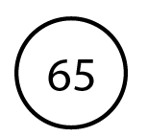


1.21 Algorithms: column subtraction – step 1:2
Notes:
There are 65 books in year 3’s book corner. 23 are fiction. How many are non-fiction?

Slide 4
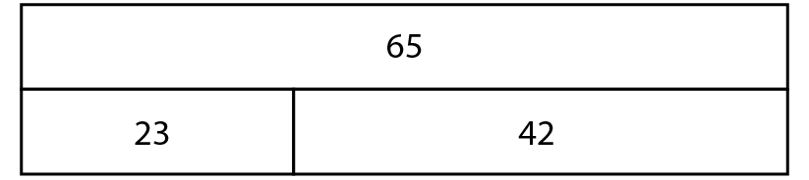
1.21 Algorithms: column subtraction – step 1:2
23
42

Slide 5
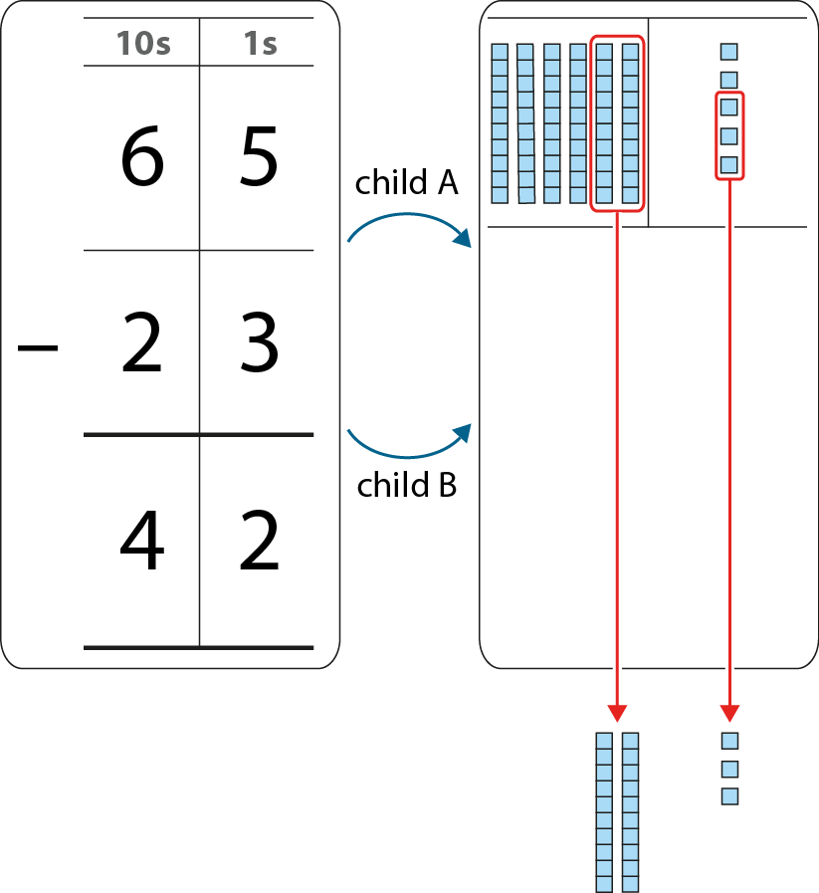
1.21 Algorithms: column subtraction – step 1:4

Slide 6
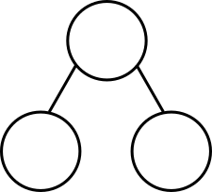
1.21 Algorithms: column subtraction – step 1:6
97
936
52
45
?
511
?
425

Slide 7
1.21 Algorithms: column subtraction – step 1:6
 | 3 |  | 5
− |  | 3
 | 2 | 3 | 4
6
1
1

Slide 8
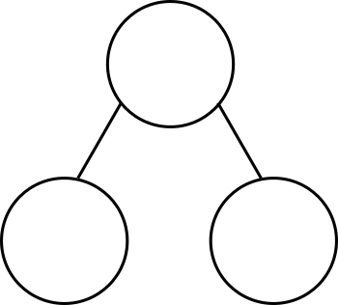
1.21 Algorithms: column subtraction – step 2:1
23
23
2
tens
1
ten
3
ones
13
ones
?
?
?
?

Slide 9

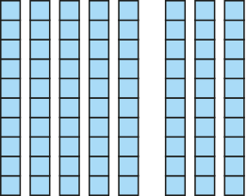

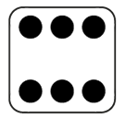
1.21 Algorithms: column subtraction – step 2:2
94
− 6 =
88

Slide 10

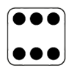
1.21 Algorithms: column subtraction – step 2:3
10s | 1s
9 | 4
 | 6
8
1
−
8
8
94
− 6
= 88

Slide 11
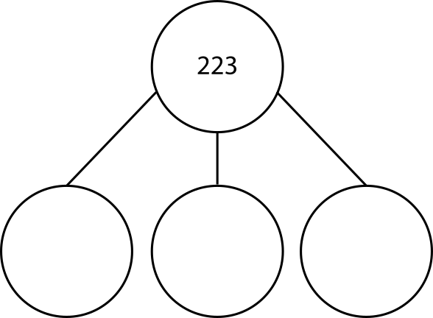

1.21 Algorithms: column subtraction – step 2:4
223 =
200
100
100
+
+
+
20
120
110
+
+
+
3
3
13

Slide 12

1.21 Algorithms: column subtraction – step 2:5
223 − 142
= 81

Slide 13
1.21 Algorithms: column subtraction – step 2:6
100s | 10s | 1s
2 | 2 | 3
1 | 4 | 2
1
1
−
0
8
1

Slide 14

1.21 Algorithms: column subtraction – step 2:7
100s | 10s | 1s
4 | 0 | 4
2 | 5 | 7
3
1
9
1
−
1
4
7

Slide 15
1.21 Algorithms: column subtraction – step 2:8
Which calculations require exchange?
 | 5 | 6 | 3
− | 2 | 1 | 3
 | 4 | 8 | 2
− | 1 | 9 | 7
 | 8 | 2 | 4
− | 3 | 1 | 9
 | 4 | 0 | 5
− | 1 | 2 | 3
 | 3 | 1 | 6
− | 1 | 0 | 3
 | 9 | 0 | 3
− | 1 | 2 | 4

Slide 16
1.21 Algorithms: column subtraction – step 2:8
Which calculations require exchange only once?
 | 5 | 6 | 3
− | 2 | 1 | 3
 | 4 | 8 | 2
− | 1 | 9 | 7
 | 8 | 2 | 4
− | 3 | 1 | 9
 | 4 | 0 | 5
− | 1 | 2 | 3
 | 3 | 1 | 6
− | 1 | 0 | 3
 | 9 | 0 | 3
− | 1 | 2 | 4

Slide 17
1.21 Algorithms: column subtraction – step 2:8
Which calculations require exchange twice?
 | 5 | 6 | 3
− | 2 | 1 | 3
 | 4 | 8 | 2
− | 1 | 9 | 7
 | 8 | 2 | 4
− | 3 | 1 | 9
 | 4 | 0 | 5
− | 1 | 2 | 3
 | 3 | 1 | 6
− | 1 | 0 | 3
 | 9 | 0 | 3
− | 1 | 2 | 4

Slide 18
1.21 Algorithms: column subtraction – step 2:8
Which calculations require exchange through a zero?
 | 5 | 6 | 3
− | 2 | 1 | 3
 | 4 | 8 | 2
− | 1 | 9 | 7
 | 8 | 2 | 4
− | 3 | 1 | 9
 | 4 | 0 | 5
− | 1 | 2 | 3
 | 3 | 1 | 6
− | 1 | 0 | 3
 | 9 | 0 | 3
− | 1 | 2 | 4

Slide 19
1.21 Algorithms: column subtraction – step 2:9
 | 5 |  | 7
− |  | 8
 | 3 | 5 | 4
3
1
3

