Slide 1
Constructing perpendicular bisectors using properties of rhombuses
KS3 Mastery PD Materials: Exemplified Key Ideas
Materials for use in the classroom or to support professional development discussions
(from 6.4 Constructions)
Summer 2021

Slide 2
About this resource
These slides are designed to complement the 6.4 Constructions Core Concept document and its associated Theme Overview document 6 Geometry, both found in the Secondary Mastery Professional Development pages.
These slides re-present the key examples from the Core Concept document so that the examples can be used either directly in the classroom or with a group of teachers. There are prompt questions alongside the examples, and further clarification in the notes.
These slides do not fully replicate the Core Concept document, so should be used alongside it. Reference to specific page numbers, and to other useful NCETM resources, can be found in the notes for each slide.
This slide deck is not designed to be a complete PD session, rather it is a selection of resources that you can adapt and use as needed when planning a session with a group of teachers.

Slide 3


About this resource
The slides are structured as follows:
  The big picture:
    Where does this fit in?
    What do students need to understand?
    Why is this key idea important?
  Prior learning
  Misconceptions
  Exemplified key ideas
  Reflection questions
  Appendices:
    Key vocabulary
    Representations and structure
    Previous and Future learning
    Useful links
The exemplified key idea slides have the following symbols to indicate how they have been designed to be used:
Into the classroom
The examples are presented on these slides so that they could be used in PD, but also directly in the classroom. The notes feature suggested questions and things teachers might consider when using with students.
PD discussion prompts
These slides look at the examples in more detail, with question prompts to promote discussion among maths teachers. The notes feature reference to further information and guidance within the Core Concepts document.

Slide 4
Where does this fit in?
The NCETM has identified a set of six ‘mathematical themes’ within Key Stage 3 mathematics that bring together a group of ‘core concepts’.
The sixth of these themes is Geometry, which covers the following interconnected core concepts:
6.1 Geometrical properties
6.2 Perimeter, area and volume
6.3 Transforming shapes
6.4 Constructions
Notes:
Linked on this slide is the Theme Overview document of Geometry. This document includes why it is important, the key underpinning knowledge and links to prior and future learning. There is also guidance about how the five big ideas of Teaching for Mastery relate specifically to this theme.

Slide 5
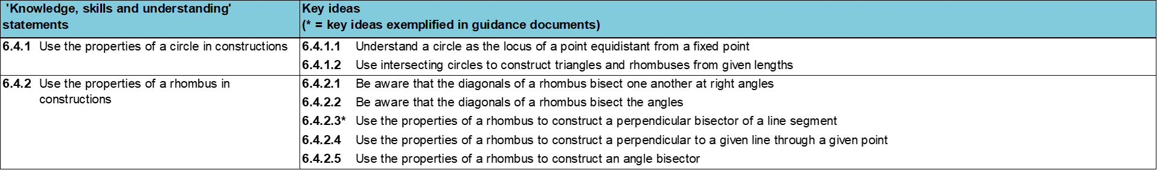
Where does this fit in?
Within this core concept, 6.4 Constructions, there are two statements of knowledge, skills and understanding.
These, in turn, are broken down into seven key ideas. The highlighted key idea is exemplified in this slide deck.
Notes:
For key ideas marked with an asterisk, we exemplified the common difficulties and misconceptions that students might have and included elements of what teaching for mastery may look like. We have provided examples of possible student tasks and teaching approaches.
Within these slides are ‘classroom-ready’ versions of the examples for the key idea that has been highlighted. There are also slides that may be useful for discussion in a professional development session

Slide 6
What do students need to understand?
6.4.2.3 Use the properties of a rhombus to construct a perpendicular bisector of a line segment
Understand key mathematical language associated with constructions.
Understand how the geometric properties of key shapes are used in standard constructions.
Construct the perpendicular bisector of a line segment.
  What prior knowledge might your students already have?
  What language might they use to describe this key idea?
  What questions might you want to ask to assess their prior learning?

Slide 7
Why is this key idea important? (1)
In Key Stage 2, students will have had experience of drawing certain shapes using a ruler and angle measurer, but the use of compasses to construct shapes will be a new idea at Key Stage 3.
Students will learn the ruler and compass constructions of:
  triangles of given lengths
  a perpendicular bisector of a line segment
  a perpendicular to a given line through a given point
  an angle bisector.
An important awareness is that these constructions are based on the geometrical properties of a few key shapes (a circle, an isosceles triangle and a rhombus).
A deep understanding and awareness of these geometrical properties will support students in gaining a conceptual overview of these constructions. It will help guard against constructions being learnt mechanically as a set of procedural steps.
Notes:
A more detailed overview of the core concept of 6.4 Constructions can be found on page 2 of the 6.4 Core Concept document.
The background to each key idea is also explored in more detail on the following pages:
6.4.1 Use the properties of a circle in constructions – pages 4-5
6.4.2 Use the properties of a rhombus in constructions – pages 5-6

Slide 8
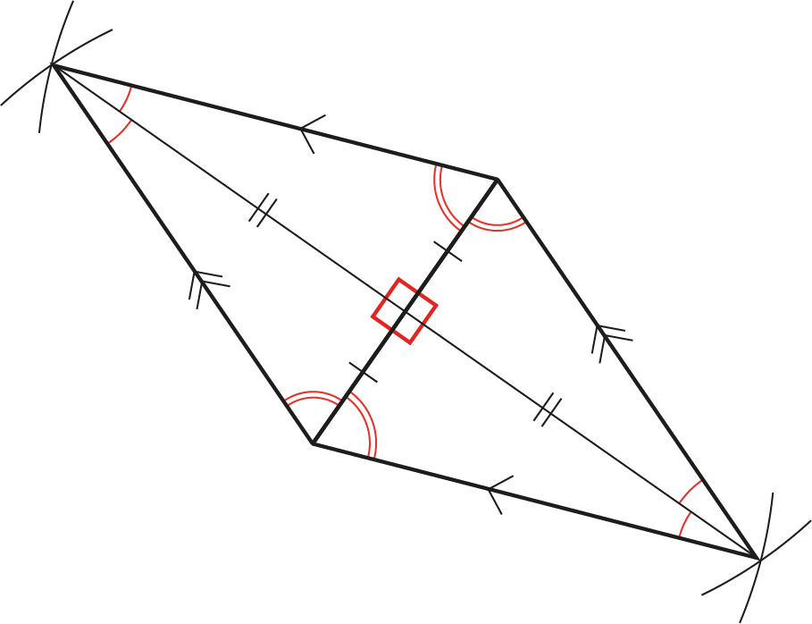
Why is this key idea important? (2)
Using their understanding of how to use arcs of circles to construct isosceles triangles and rhombuses, students can explore more closely the properties of these shapes.
For any isosceles triangle, the altitude of the triangle bisects the base at right angles and bisects the angle at the vertex. So, any rhombus (two isosceles triangles put together) has diagonals which perpendicularly bisect each other and bisect their associated internal angles.
When a rhombus is constructed, other constructions have also necessarily been produced. With this awareness, students can then be challenged to create, for themselves, a method of producing the standard ruler and compass constructions efficiently and fluently.
Notes:
A more detailed overview of the core concept of 6.4 Constructions can be found on page 2 of the 6.4 Core Concept document.
The background to each key idea is also explored in more detail on the following pages:
6.4.1 Use the properties of a circle in constructions – pages 4-5
6.4.2 Use the properties of a rhombus in constructions – pages 5-6

Slide 9
Prior learning
  What prior knowledge might your students already have?
  What language might they use to describe this key idea?
  What questions might you want to ask to assess their prior learning?
Upper Key Stage 2 Learning Outcome
Draw 2D shapes using given dimensions and angles
Compare and classify geometric shapes based on their properties and sizes and find unknown angles in any triangles, quadrilaterals, and regular polygons
Notes:
You may find it useful to speak to your partner schools to see how the above has been covered and the language used.
Within the 6 Geometry Theme Overview document, you can also find a broader description of students’ potential previous learning (page 3), alongside further information about key underpinning knowledge (page 2).

Slide 10
Checking prior learning
The following slides contain questions for checking prior learning.
  What representations might students use to support their understanding of these questions?
  What variation might you put in place for these questions to fully assess students’ understanding of the concept?
  How might changing the language of each question change the difficulty?
  Why are these such crucial pre-requisites for this key idea?

Slide 11
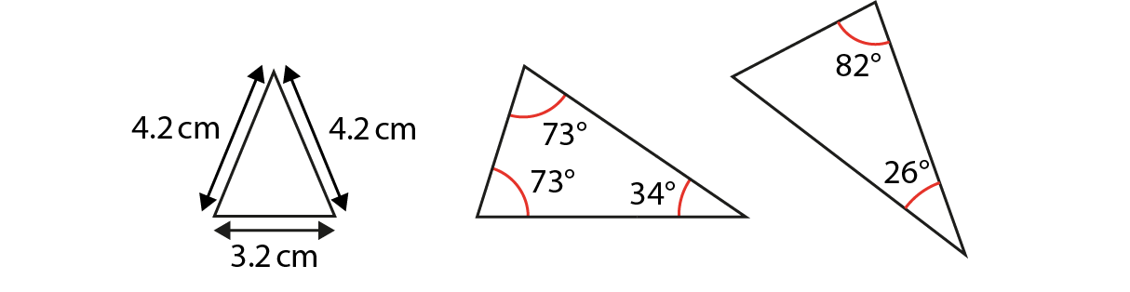
Checking prior learning
a)
Which of these triangles are isosceles?
Explain your decisions.
b)
Accurately draw two right-angled triangles with sides of different lengths.
Compare them and describe what’s the same and what’s different about them.
Notes:
References to the questions (links on final slide):
NCETM Primary assessment materials: Year 6, page 35
NCETM Primary assessment materials: Year 6, page 35

Slide 12
Common difficulties and misconceptions
What aspects of this key idea might pupils find challenging?
What misconceptions might pupils have?
When teaching this topic, you may find students encounter difficulties with…
The accuracy required in constructions
Using the geometric properties of circles and rhombuses
More information, and some suggestions for overcoming these challenges, can be found on the following slides

Slide 13
Common difficulties and misconceptions (1)
Some students may experience difficulties surrounding the mathematical language used in this key idea. They must understand the difference between drawing a figure accurately by eye, and producing a construction based on the geometrical properties of the figure.
It is possible to draw a perpendicular bisector by using a ruler to determine the midpoint of a line and a protractor (or using squared paper) to judge a right angle, but this is not what is required in this key idea. In a construction, it is geometrical properties, not measurement, which are used to produce the required result.
Students should be given time to practise using construction equipment accurately. It is likely that they will not have used a pair of compasses frequently (if at all) during Key Stage 2, and so students often, initially, lack coordination. They may need support in setting up their equipment and should be encouraged to check their working, with the aim to be within ±2 mm and ±2° of the required measurements.
Notes:
More detail can be found on page XX of the X.X Core Concept document.

Slide 14
Common difficulties and misconceptions (2)
This key idea is heavily linked to the geometric properties of both circles and rhombuses. You may wish to consider your schemes of learning as to when this key idea is introduced.
If there is significant time between work on the properties of 2D shapes and these constructions, then it is worthwhile revising the relevant geometric properties before you begin to introduce constructions. Students must be able to identify the geometric properties of circles and rhombuses, and understand how these properties enable key constructions.
Difficulties occur for students when they are trying to memorise the various steps in the construction of circles and rhombuses, with no link to other knowledge they might have about geometrical properties. Students will be helped considerably in this if they are aware that constructing a perpendicular bisector of a line segment is not an isolated concept but linked to the properties of circles and rhombuses.
Notes:
More detail can be found on page XX of the X.X Core Concept document.

Slide 15
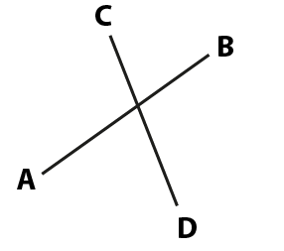
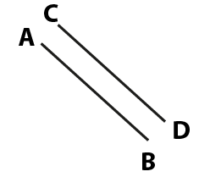
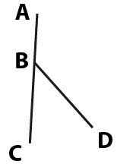

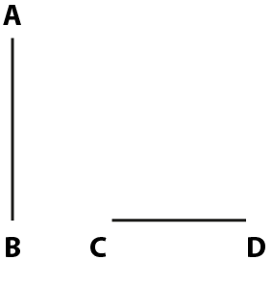
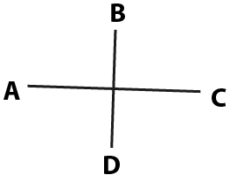
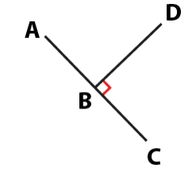
Understand key mathematical language associated with constructions
Example 1
Which lines are perpendicular?
Explain how you know.
a)
b)
c)
d)
e)
f)
g)
Notes:
Suggested questioning:
What does perpendicular mean? What evidence do you need to be convinced two lines are perpendicular to each other?
If they are not perpendicular, can you describe the relationship between the two lines another way?
Complete the sentence using letter notation to identify the lines: “__ is perpendicular to __.” “__ is not perpendicular to __.”
Things for you to think about:
In Example 1, only one pair of lines is marked with a small square to indicate that the lines meet at a right angle and are, therefore, perpendicular. It is likely that students will identify this pair of perpendicular lines first. Asking students whether they can identify another pair may prompt them to eliminate those that they know are definitely not perpendicular and lead them to three further pairs which look like they could be, but this can only be confirmed by measuring.
One pair of lines has been deliberately drawn as parallel to assess a common error, which is the confusion between parallel and perpendicular.
This example provides an opportunity to encourage accurate language when describing geometrical properties, and students should be confident in using letters to describe lines. For example: ‘AC is perpendicular to BD’ and ‘AB and CD are parallel.’

Slide 16
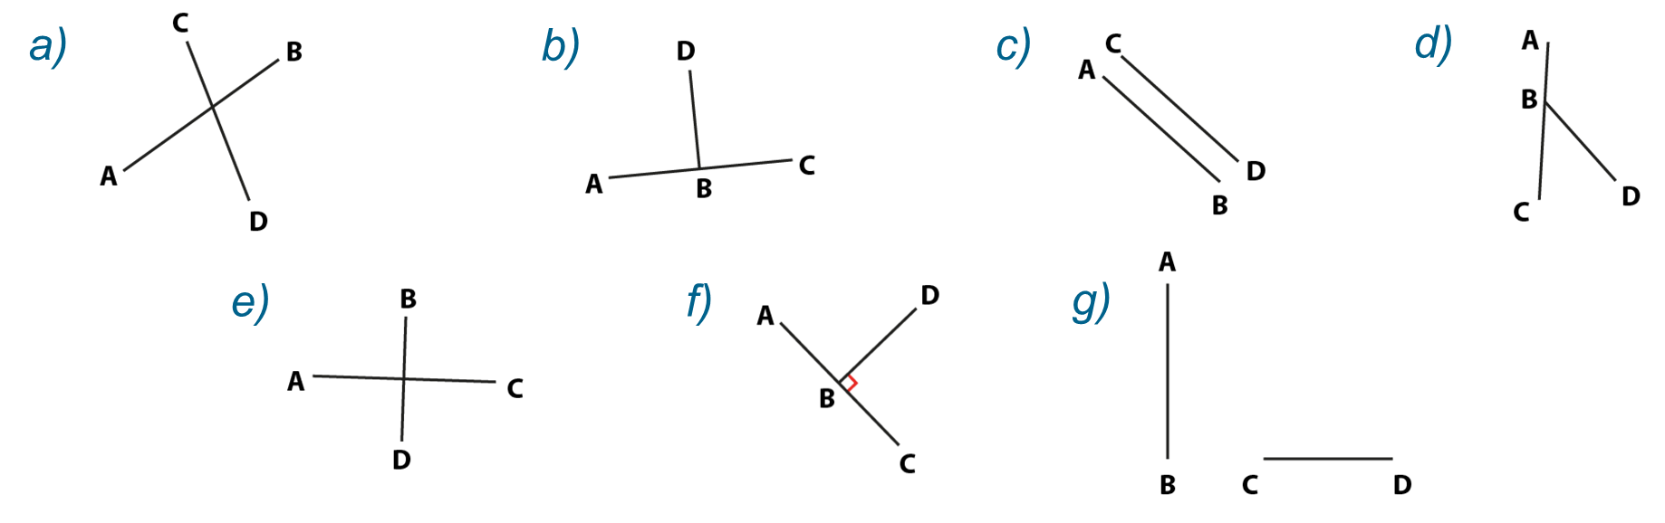
Understand key mathematical language associated with constructions
Example 1
  How confident are your students at using letter notation to describe points, lines and angles? How might this task provide an opportunity to practice this?
  What else would you hope students took away from this task?
Which lines are perpendicular?
Explain how you know.
Notes:
Due to space constraints, the image on this PD discussion slide is very small. PD Leads might like to use or print the ‘in the classroom’ version of this slide for teachers to access during discussions.
This example can be found on page 8 of the 6.4 Core Concept document.

Slide 17
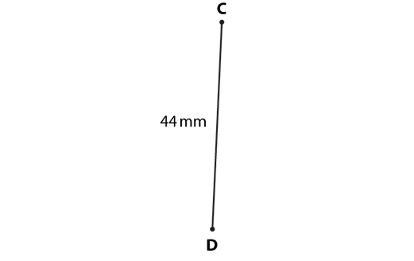

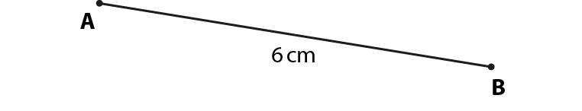
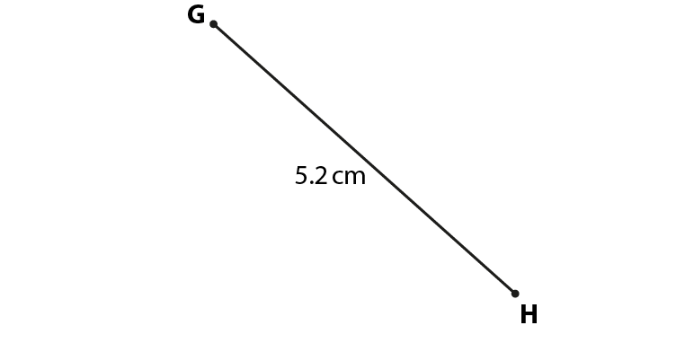
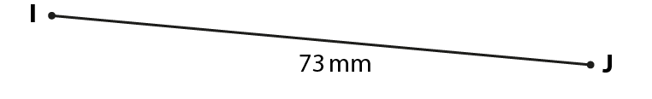
Understand key mathematical language associated with constructions
Example 2
Find the midpoint of each line segment.
Bisect each line segment and mark the midpoint with an ×.
a)
b)
c)
d)
e)
Notes:
Suggested questioning:
What does ‘midpoint’ mean? How might you work out the midpoint for each of these?
What does ‘bisect’ mean?
Which was easiest/hardest to calculate? Why?
Which was easiest/hardest to measure? Why?
Things for you to think about:
A printable version of this slide is available in the appendices; these are not drawn to scale so you may prefer to ask students to draw their own lines.
In Example 2, students are asked to find the midpoint of some line segments, which will provide an introduction to bisecting line segments.
It is likely that students will notice the line segments in parts a) and b) have even measurements, which are easily halved to find the midpoint.
The line segments in parts c), d) and e) need to be measured accurately in order to calculate and mark the midpoint.
The line segment IJ in part e) is 73 mm long, so this may prompt discussions with students about accuracy during constructions.

Slide 18
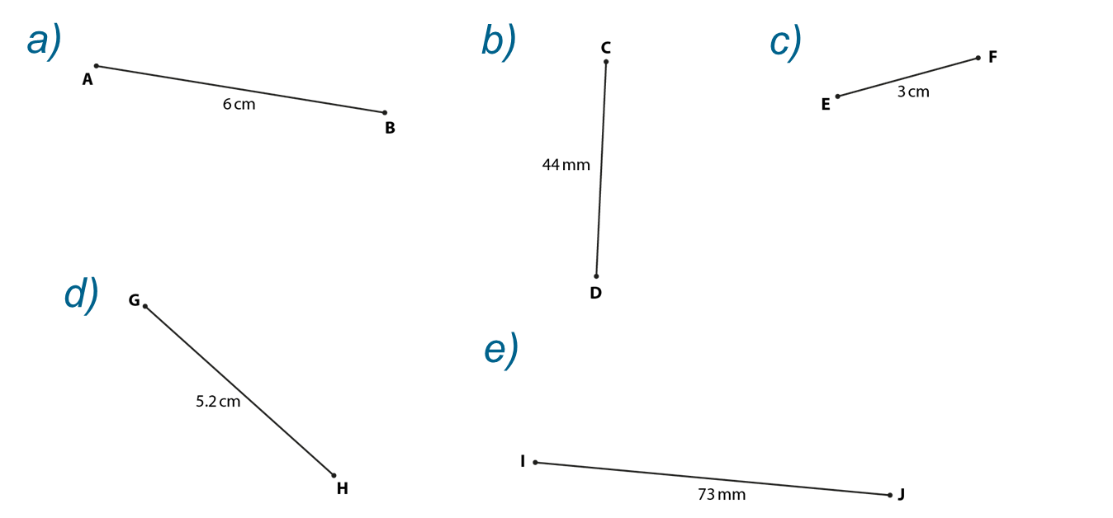
Understand key mathematical language associated with constructions
Example 2
Find the midpoint of each line segment.
Bisect each line segment and mark the midpoint with an ×.
  Why might it be worth investing time exploring midpoints before formally introducing perpendicular bisectors?
  What are the key points you might want to illustrate to students through this example?
Notes:
Due to space constraints, the image on this PD discussion slide is very small. PD Leads might like to use or print the ‘in the classroom’ version of this slide for teachers to access during discussions.
This example can be found on page 9 of the 6.4 Core Concept document.

Slide 19
Understand key mathematical language associated with constructions
Example 3
Accurately construct a rhombus with sides of 6cm.
Explain how you have used the properties of a circle to help produce your construction.
Notes:
Suggested questioning:
What are the properties of a rhombus?
What is a circle? What do you know about all of the points that make up the circumference of a circle?
Things for you to think about:
Example 3 gives students an opportunity to understand the strong connections between the properties of a circle, the construction of a rhombus and the properties of a rhombus, which result in the construction of a perpendicular bisector.
Students may need some support in considering how to construct a rhombus. They should reflect on the properties of a circle that allow them to draw arc lengths, indicating all the points that are equidistant from each end of their starting line.
It is likely that students will construct a range of rhombuses all with sides of 6 cm, but with diagonals of differing lengths. It is worth discussing that the length of the sides is not enough to produce congruent rhombuses, and for students to consider what information would be required for these to be constructed.
Students may realise that the length of their initial line segment (which will end up being a diagonal of their rhombus) is not critical, and they could investigate the maximum and minimum lengths of the initial line segment for which a rhombus of side 6 cm could be constructed.

Slide 20
Understand key mathematical language associated with constructions
Example 3
  Think about your students and their understanding of the properties of a rhombus and a circle.
    How confident are they in using compasses to construct accurately?
    What do they need to understand about the properties of a rhombus and of a circle in order to access this task?
    How might this task further their understanding?
Accurately construct a rhombus with sides of 6cm.
Explain how you have used the properties of a circle to help produce your construction.
Notes:
This example can be found on page 10 of the 6.4 Core Concept document.

Slide 21
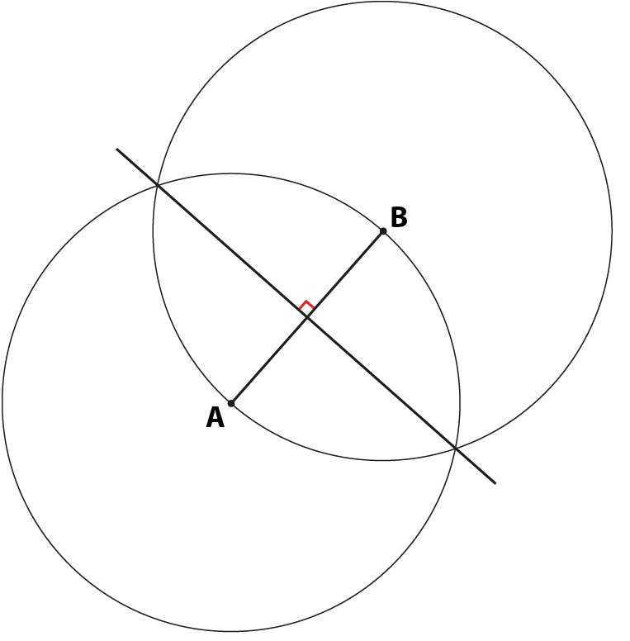
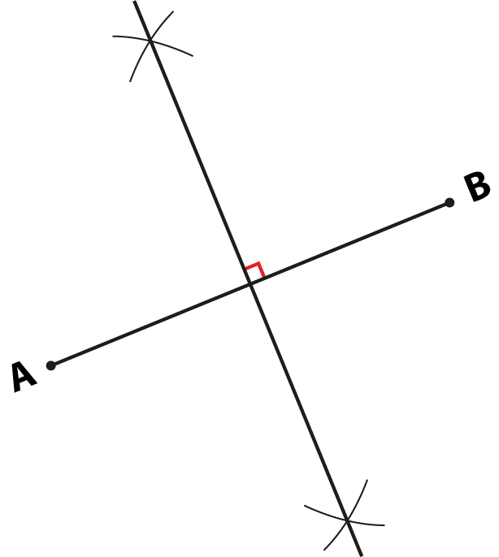
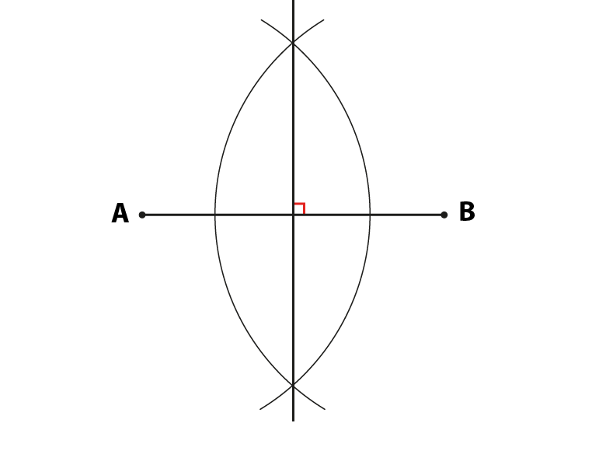
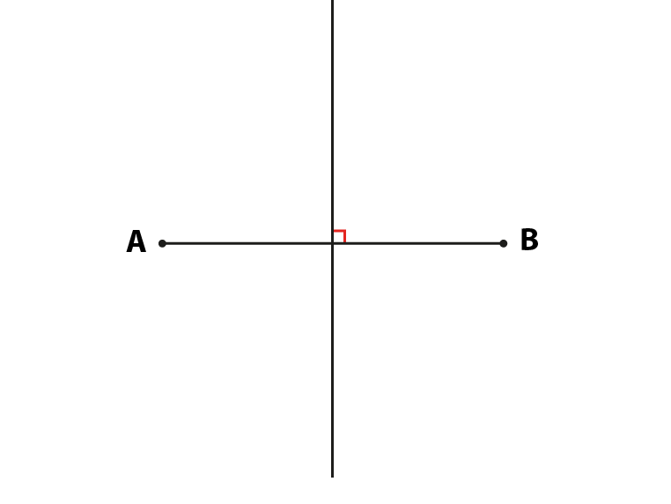
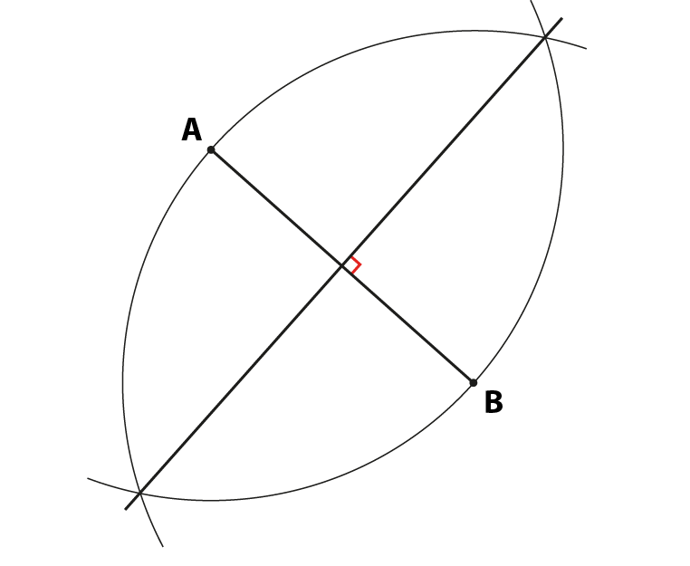
Understand key mathematical language associated with constructions
Example 4
Which of these diagrams show an accurate construction of the perpendicular bisector of the line segment AB?
Explain how you know.
a)
b)
c)
d)
e)
Notes:
Suggested questioning:
What does ‘perpendicular’ mean? What does ‘bisect’ mean? What might ‘perpendicular bisector’ mean?
What is the same/different about each of the diagrams?
Which of these is the neatest? Which is the most efficient?
Things for you to think about:
In Example 4, students are provided with five diagrams and asked to comment on which of them show an accurate construction of a perpendicular bisector.
Students must apply previous learning of the key terms ‘perpendicular’ and ‘bisector’ to identify which diagrams show the perpendicular bisector of line segment AB.
Part b) shows a drawing rather than a mathematical construction. Students must be aware of the difference and understand the need to leave construction markings on their diagrams to show their method.
Parts a), c), d) and e) all show perpendicular bisectors of the line segment AB. These diagrams could support class discussion as to which diagram is the most efficient in terms of space: students should understand that full circles do not need to be drawn, only intersecting arcs.
Students should explore how the diagrams have been constructed (with arcs of the same radius from points A and B). They may need support to notice that the radius of the arc chosen does not need to be the same length as the line segment, but that it does need to be more than half of its length.
Another point of discussion might be the different rhombuses that would be created by joining the points A and B with the points formed by the intersecting arcs in each of these examples (or to the ends of the other line segment in b)). Students are likely to recognise the shapes formed by c) and d) (where the side lengths are longer than the line segment AB) as rhombuses, but may not immediately recognise the shapes formed by a), b) and e) (where the side lengths are shorter than the line segment AB) as rhombuses. This gives an opportunity to emphasise the definition of a rhombus as any quadrilateral that has all sides of equal length.

Slide 22
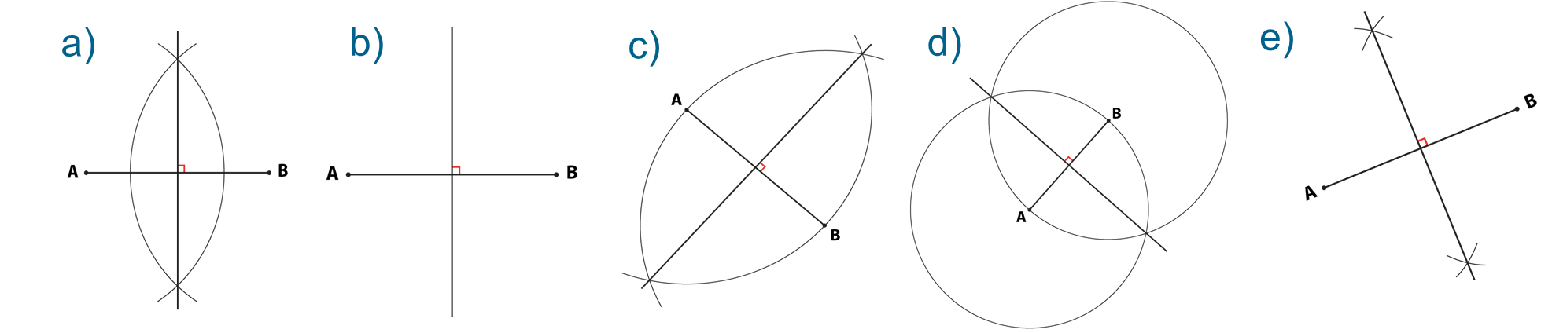
Understand key mathematical language associated with constructions
Example 4
Which of these diagrams show an accurate construction of the perpendicular bisector of the line segment AB?
Explain how you know.
  What language might you need to equip students with ahead of this task? How might you approach this?
  What are the pros and cons of showing students the full circles in part d?
Notes:
Due to space constraints, the image on this PD discussion slide is quite small. PD Leads might like to use or print the ‘in the classroom’ version of this slide for teachers to access during discussions.
This example can be found on pages 11 and 12 of the 6.4 Core Concept document.

Slide 23
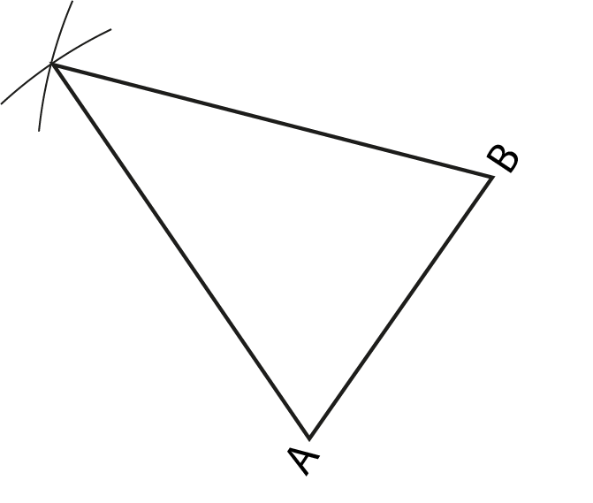
Understand how the geometric properties of key shapes are used in standard constructions
Example 5
This diagram is a construction of an isosceles triangle, drawn from either end of the line segment AB.
Write down (or indicate on the diagram) as many properties of this triangle as you can.
Draw in the altitude of this triangle that would bisect AB. Are there any other properties that you can now state?
Notes:
Suggested questioning:
What do you know about isosceles triangles? How can you show this?
What is an ‘altitude’?
Things for you to think about:
Encourage students to use such symbols as those suggested on page 13 of the 6.4 Core Concept document, as well as written descriptions when completing Example 5.
A printable version of examples 5 and 6 is available in the appendices.

Slide 24
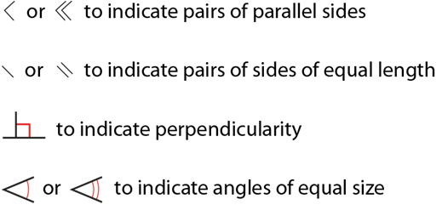
Understand how the geometric properties of key shapes are used in standard constructions
Example 5
  How explicitly have you taught/used this notation in the past?
This diagram is a construction of an isosceles triangle, drawn from either end of the line segment AB.
Write down (or indicate on the diagram) as many properties of this triangle as you can.
Draw in the altitude of this triangle that would bisect AB. Are there any other properties that you can now state?
  Have you used the term ‘altitude’ with students before? Why or why not?
Notes:
This example can be found on page 13 of the 6.4 Core Concept document. Relevant vocabulary, including a definition for the term ‘altitude’ can be found on slide 39.

Slide 25
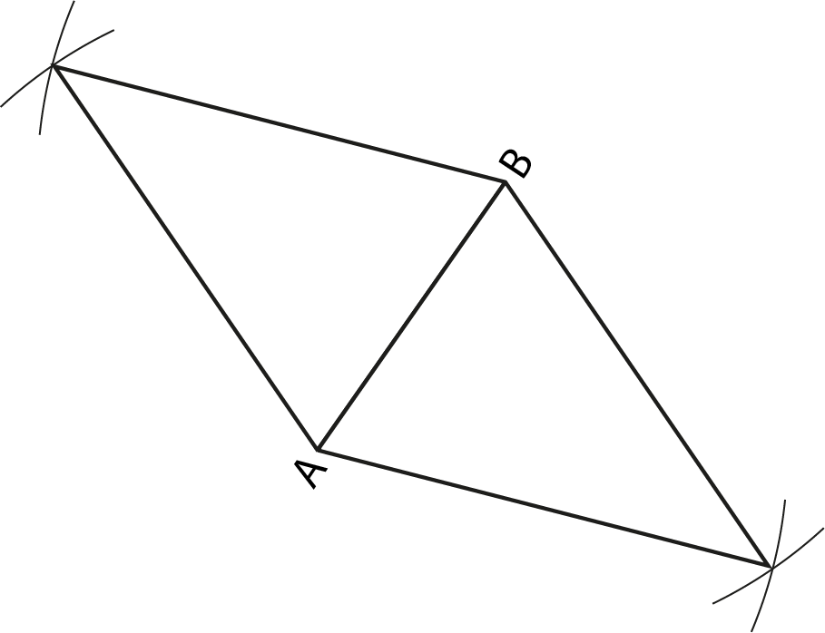
Understand how the geometric properties of key shapes are used in standard constructions
Example 6
Add another identical isosceles triangle to the diagram in Example 5, like this:
What shape have you made?
Write down (or indicate on the diagram) as many properties of this shape as you can.
Draw in the longest diagonal of this shape. Are there any other properties that you can now state?
Notes:
Suggested questioning:
Can you see two lines that bisect each other at right angles?
Can you see an angle that has been bisected? And another, and another, …?
What shape have you made? What do you know about that shape?
Things for you to think about:
The representation in page 13 of the 6.4 Core Concept document (a rhombus with all its properties indicated) is a key image. Once students have constructed this, it will be important to discuss the relationships embedded in this diagram, so that all students appreciate them. You could offer prompts, such as those suggested above.
For a deep and connected understanding of the ruler and compass constructions, students could imagine a rhombus and construct the part of it that will produce the required construction. For example, if required to construct a perpendicular bisector to the line AB, encourage students to imagine the line AB as being a diagonal of a rhombus and then proceed to draw the rhombus (or part thereof).
A printable version of examples 5 and 6 is available in the appendices.

Slide 26
Understand how the geometric properties of key shapes are used in standard constructions
Example 6
  In the past, how clearly have you made the link between constructing perpendicular bisectors and the diagonals of a rhombus?
  What might be the benefits of making this link more explicit?
Add another identical isosceles triangle to the diagram in Example 5, like this:
What shape have you made?
Write down (or indicate on the diagram) as many properties of this shape as you can.
Draw in the longest diagonal of this shape. Are there any other properties that you can now state?
Notes:
This example can be found on pages 13 and 14 of the 6.4 Core Concept document.

Slide 27
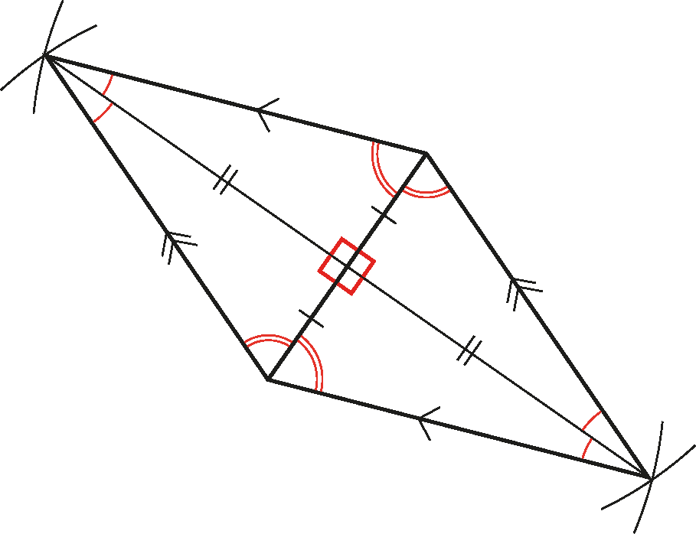
Understand how the geometric properties of key shapes are used in standard constructions
Example 6a
  If you asked students to describe the properties of a rhombus (without showing them this diagram), what might they say?
  What might they say if they did have the diagram to refer to?
  What prompts might you give to support students to identify the properties of a rhombus?
The representation below (a rhombus with all its properties indicated) is a key image.
Notes:
This representation relates to Example 6, and can be found on pages 13 and 14 of the 6.4 Core Concept document.

Slide 28
Construct the perpendicular bisector of a line segment
Example 7
Do this activity in pairs.
Draw a line segment AB.
Use a ruler and a pair of compasses to construct a rhombus with AB as a diagonal.
Mark the remaining diagonal and label it CD.
Notes:
Suggested questioning:
How can you construct a rhombus? What properties of circles are you using?
What do you notice about the diagonal you have drawn?
Things for you to think about:
A key aspect of Example 7 is to support students in visualising the construction of a rhombus around any line AB, and to know that this will result in obtaining the perpendicular bisector of AB by identifying the other diagonal. Having such an image in their mind when producing any of the constructions will support students in seeing the geometrical properties on which the constructions are based, and guard against using a set of routines with no understanding.
It will be important to discuss with students what the minimum number of construction lines is for this to be possible. This will support them in being as efficient as possible.

Slide 29
Construct the perpendicular bisector of a line segment
Example 7
  Compare this example to example 3. What is the same/different? What might students get out of the different emphasis in these two tasks?
  How often do your students work in pairs? How might you structure this task to ensure students work together effectively?
Do this activity in pairs.
Draw a line segment AB.
Use a ruler and a pair of compasses to construct a rhombus with AB as a diagonal.
Mark the remaining diagonal and label it CD.
.
Notes:
This example can be found on page 14 of the 6.4 Core Concept document.

Slide 30
Construct the perpendicular bisector of a line segment
Example 8
The line segment AB is 8cm long.
Which of these methods could be used to construct the perpendicular bisector of AB?
Which is the best method?
Explain your reasoning.
  Constructing arcs which are 3 cm from both A and B
  Constructing arcs which are 4 cm from both A and B
  Constructing arcs which are 5 cm from both A and B
  Constructing arcs which are 8 cm from both A and B
Notes:
Suggested questioning:
Will all of your arcs intersect?
What is the minimum arc length you need? What is the maximum arc length that is practical to use?
Things for you to think about:
In Example 8, students must decide which of the four options could result in the construction of the perpendicular bisector of the line segment AB. The size of the arcs has been carefully chosen to prompt students to consider which would intersect both above and below the line segment AB and allow an accurate construction of the perpendicular bisector.
In part (i), arcs of 3 cm would not intersect.
In part (ii), the arcs of 4 cm would only bisect the line segment at the midpoint.
Parts (iii) and (iv) could both be used, but arcs of 8 cm – part (iv) – are unnecessarily large.
In this task, students should be initially encouraged to consider the construction conceptually, but some may need to actually construct using the options in order to fully understand which will work. Students could be asked to explore other viable options (including arcs with non-integer radii), before generalising the method in terms of the radius of the arc lengths required to construct a perpendicular bisector.

Slide 31
Construct the perpendicular bisector of a line segment
Example 8
  Why might it be useful for students to compare different methods/arc lengths?
  Would you prefer students to attempt these constructions or to try and visualise these? Why?
The line segment AB is 8cm long.
Which of these methods could be used to construct the perpendicular bisector of AB?
Which is the best method?
Explain your reasoning.
  Constructing arcs which are 3 cm from both A and B
  Constructing arcs which are 4 cm from both A and B
  Constructing arcs which are 5 cm from both A and B
  Constructing arcs which are 8 cm from both A and B
Notes:
This example can be found on page 14 and 15 of the 6.4 Core Concept document.

Slide 32
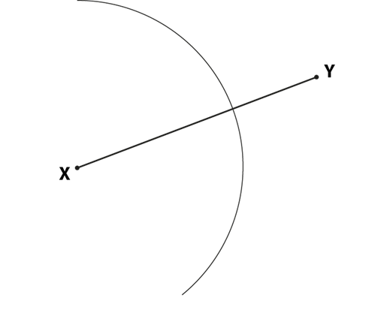
Construct the perpendicular bisector of a line segment
Example 9
Complete this construction of the perpendicular bisector of line segment XY.
Notes:
Suggested questioning:
How has this arc been completed? What do you need to do to complete it?
How can you work out what distance to set your compasses at?
Things for you to think about:
In Example 9, students must apply their awareness of the properties of a rhombus to complete an already started construction. They should understand that to construct a rhombus, and hence the perpendicular bisector, the arcs drawn from X and Y need to be of equal radius. Although a long arc has been drawn here that will encompass both points of intersection, students should be reminded that the arcs only need to be long enough to cross and so two smaller arcs either side of XY will suffice.

Slide 33
Construct the perpendicular bisector of a line segment
Example 9
Complete this construction of the perpendicular bisector of line segment XY.
  What might students learn from completing a perpendicular bisector in this example, that they wouldn’t learn from constructing their own a perpendicular bisector from ‘scratch’?
Notes:
This example can be found on page 15 of the 6.4 Core Concept document.

Slide 34
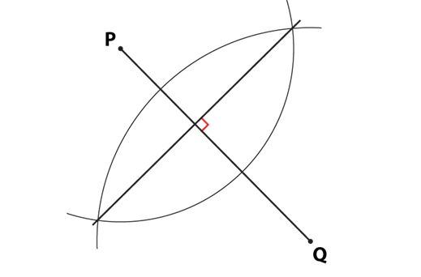
Construct the perpendicular bisector of a line segment
Example 10
Tinashe has attempted to construct the perpendicular bisector of the line segment PQ.
Comment on his construction.
Which quadrilateral has he constructed?
Why might this have happened?
What do the properties of this shape indicate about the diagonals?
Notes:
Suggested questioning:
What is the same/different about this shape and a rhombus?
Why might (a kite) have been created here?
What one thing would you have to change to create a rhombus? Is there more than one answer?
Things for you to think about:
Example 10 shows an incorrect construction. At first glance it may look like the perpendicular bisector has been constructed, but students should identify that the arcs drawn do not have equal radius and so a kite has been constructed instead of a rhombus. The diagonals of a kite are perpendicular but do not bisect each other, so a perpendicular bisector has not been constructed. This reinforces the need to keep the pair of compasses open to the same length in order to construct a rhombus.
It will be important to use non-standard examples of such constructions and not to present students with only prototypical ones, where the line to be bisected is horizontal or vertical.

Slide 35
Construct the perpendicular bisector of a line segment
Example 10
Tinashe has attempted to construct the perpendicular bisector of the line segment PQ.
  What might students gain from some time comparing the construction of a kite with that of a rhombus?
  Do your students see a rhombus as more related to a parallelogram or to a kite? Why might this be? What properties of quadrilaterals are they more familiar with?
Comment on his construction.
Which quadrilateral has he constructed?
Why might this have happened?
What do the properties of this shape indicate about the diagonals?
Notes:
This example can be found on page 15 of the 6.4 Core Concept document.

Slide 36
Reflection questions
What other mathematical concepts will be supported by students’ stronger understanding of this key idea?
What mathematical language will you continue to use to support pupils to make connections with other areas?
Which representations might you continue to use to further develop students’ understanding?

Slide 38
Appendices
You may choose to use the following slides when planning or delivering a PD session. They cover:
  Key vocabulary
  Representations and structure
  Previous learning
  Future learning
  Printable versions of Examples 2, 5, 6 and 9
  Library of links

Slide 39
Key vocabulary
Term | Definition
altitude of a triangle | A line segment through a vertex and perpendicular to the side opposite the vertex.
arc | A portion of a curve. Often used for a portion of a circle.
bisector | A point, line or plane that divides a line, an angle or a solid shape into two equal parts. A perpendicular bisector is a line at right angles to a line-segment that divides it into two equal parts.
construction | A construction in geometry is the act of drawing geometric shapes using only a pair of compasses and a straightedge. No measuring of lengths or angles is permitted.
line | A set of adjacent points that has length but no width. A straight line is completely determined by two of its points, say A and B. (see ‘line segment’)
line segment | The part of a line between any two of its points is a line segment. (see ‘line’)
locus | A locus of points is the set of points, and only those points, that satisfies given conditions. Example: The locus of points at a given distance from a given point is a circle.
perpendicular | A line or plane that is at right angles to another line or plane.

Slide 40
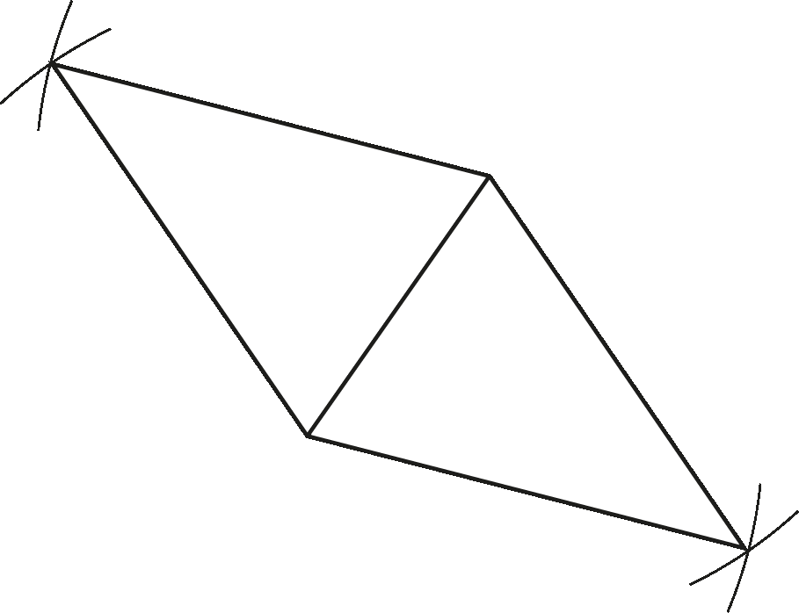
Representations and structure
A key representation that you may wish to use to support students’ understanding of this key idea is that of the rhombus with all of its properties included:
Fig 2: Diagram showing how the diagonals of a rhombus bisect each other at right angles and bisect the internal angles
Fig 1: Construction of a rhombus
Notes:
More information about the representations and structure involved in this key idea can be found:
On page 13 of the 6.4 Core Concept document.
Links to all of these can be found on the final slide.

Slide 41
Previous learning
From Upper Key Stage 2, students will bring experience of:
drawing 2D shapes using given dimensions and angles
recognising, describing and building simple 3D shapes, including making nets
comparing and classifying geometric shapes based on their properties and sizes, and finding unknown angles in any triangles, quadrilaterals and regular polygons
illustrating and naming parts of circles, including radius, diameter and circumference, and knowing that the diameter is twice the radius
recognising angles where they meet at a point, are on a straight line or are vertically opposite, and finding missing angles
drawing and translating simple shapes on the coordinate plane and reflecting them in the axes.
Notes:
Theme 6 Geometry

Slide 42
Future learning (1)
In KS4, students will build on the core concepts in this mathematical theme to:
interpret and use fractional {and negative} scale factors for enlargements
{describe the changes and invariance achieved by combinations of rotations, reflections and translations}
identify and apply circle definitions and properties, including: centre, radius, chord, diameter, circumference, tangent, arc, sector and segment
{apply and prove the standard circle theorems concerning angles, radii, tangents and chords, and use them to prove related results}
construct and interpret plans and elevations of 3D shapes
interpret and use bearings
calculate arc lengths, angles and areas of sectors of circles
calculate surface areas and volumes of spheres, pyramids, cones and composite solids
Please note: Braces { } indicate additional mathematical content to be taught to more highly attaining students.

Slide 43
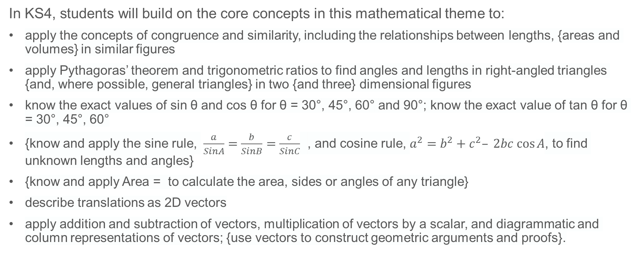
Future learning (2)
In KS4, students will build on the core concepts in this mathematical theme to:
apply the concepts of congruence and similarity, including the relationships between lengths, {areas and volumes} in similar figures
apply Pythagoras’ theorem and trigonometric ratios to find angles and lengths in right-angled triangles {and, where possible, general triangles} in two {and three} dimensional figures
know the exact values of sin θ and cos θ for θ = 30°, 45°, 60° and 90°; know the exact value of tan θ for θ = 30°, 45°, 60°
{know and apply the sine rule, $\frac{a}{SinA}=\frac{b}{SinB}=\frac{c}{SinC}$ , and cosine rule, $a^{2}=b^{2}+c^{2}– 2bc cos⁡A$, to find unknown lengths and angles}
{know and apply Area = to calculate the area, sides or angles of any triangle}
describe translations as 2D vectors
apply addition and subtraction of vectors, multiplication of vectors by a scalar, and diagrammatic and column representations of vectors; {use vectors to construct geometric arguments and proofs}.
Please note: Braces { } indicate additional mathematical content to be taught to more highly attaining students.
Notes:
Theme 6 Geometry

Slide 44
Example 2: printable version
Find the midpoint of each line segment.
Bisect each line segment and mark it with an ×.
c)
F
3cm
b)
E
a)
C
A
6cm
B
44mm
D
d)
G
e)
I
5.2cm
73mm
J
H

Slide 45
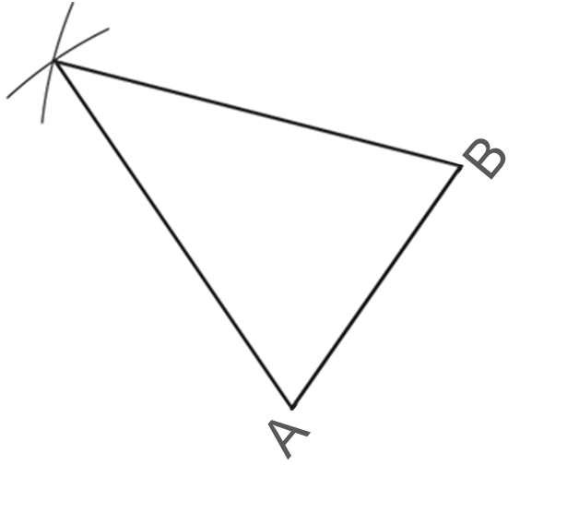
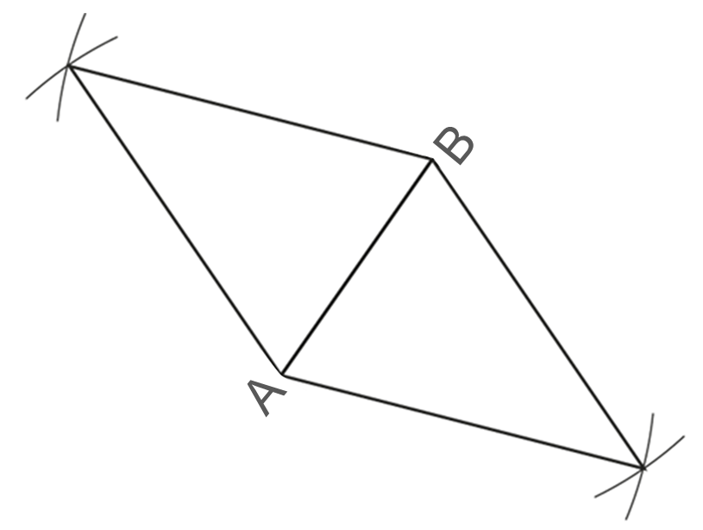
Examples 5 & 6: printable version
This diagram is a construction of an isosceles triangle.
I have added another identical isosceles triangle to the diagram in Example 5, like this:
Write down (or indicate on the diagram) as many properties of this triangle as you can.
Draw in the altitude of this triangle that would bisect AB. Are there any other properties that you can now state?
What shape have I made?
Write down (or indicate on the diagram) as many properties of this shape as you can.
Draw in the longest diagonal of this shape. Are there any other properties that you can now state?

Slide 46
Example 9: printable version (2 per page)
Complete this construction of the perpendicular bisector of line segment XY.
Complete this construction of the perpendicular bisector of line segment XY.

Slide 47
Library of links
The following resources from the NCETM website have been referred to within this slide deck:
  NCETM Secondary Mastery Professional Development
    6 Geometry Theme Overview Document
    6.4 Constructions Core Concept Document
  Using mathematical representations at KS3 | NCETM
  Insights from experienced teachers | NCETM
  NCETM primary mastery professional development materials
  NCETM primary assessment materials

