Slide 1
Year 6, Unit 5
Multiplication and Division

Slide 2
Year 6, Unit 5
These materials heavily reflect the prioritisation approach of the ready-to-progress criteria in the DfE Primary Mathematics Guidance 2020 and on the PPTs that exemplify them on the NCETM website. They also include other relevant National Curriculum content. Related sections of the NCETM Primary Mastery Professional Development Materials provide small-step teaching guidance.
Ready-to-progress criteria addressed by this unit
Teaching of this unit supports the following criteria from the ‘DfE Mathematics Guidance: key stages 1 & 2’ (the 335-page document available as a download)
6AS/MD-2 Page 302
Prior learning for this unit
Make a given number (up to 9,999, including decimal fractions) 10, 100, 1 tenth or 1 hundredth times the size (multiply and divide by 10 and 100). Apply place-value knowledge to known additive and multiplicative number facts (scaling facts by 10, 100, 1 tenth or 1 hundredth). Manipulate additive equations. Manipulate multiplicative equations.

Slide 3
Contents
The links below take you to the starting slide of each learning outcome.
1 | Pupils explain why the product stays the same when one factor is doubled and the other is halved
2 | Pupils explain the effect on the product when scaling the factors by the same amount
3 | Pupils use their knowledge of equivalence when scaling factors to solve problems
4 | Pupils explain the effect on the quotient when scaling the dividend and divisor by 10
5 | Pupils explain the effect on the quotient when scaling the dividend and divisor by the same amount
6 | Pupils explain how to multiply a three-digit by a two-digit number
7 | Pupils explain how to accurately use the method of long multiplication to multiply two, two-digit numbers (no regrouping of ones to tens)
Click the arrow button to return to this Contents slide.

Slide 4
Contents
The links below take you to the starting slide of each learning outcome.
8 | Pupils explain how to accurately use the method of long multiplication (with regrouping of ones to tens)
9 | Pupils explain how to accurately use the method of long multiplication (with regrouping of ones to tens & tens to hundreds)
10 | Pupils explain how to accurately use the method of long multiplication to multiply a three-digit by a two-digit number
11 | Pupils explain how to accurately use the method of long multiplication to multiply a four-digit by a two-digit number
12 | Pupils explain how to use the associative law to multiply efficiently
13 | Pupils explain when it is more efficient to use long multiplication or factorising to multiply by two-digit numbers
Click the arrow button to return to this Contents slide.

Slide 5
Contents
The links below take you to the starting slide of each learning outcome.
14 | Pupils explain how to use accurately the methods of short and long division (two and three-digit number by multiples of 10)
15 | Pupils explain how to use accurately the method of long division with and without remainders (two-digit by two-digit numbers)
16 | Pupils use knowledge of long division to solve problems in a range of contexts (with and without remainders)
17 | Pupils explain how to use a ratio chart to solve efficiently: short division
18 | Pupils explain how to use a ratio chart to solve efficiently: long division
19 | Pupils explain how to use a ratio chart to solve efficiently: long division (II)
20 | Pupils explain how to use accurately the method of long division with and without remainders (three-digit by two-digit, four-digit by two-digit numbers)
Click the arrow button to return to this Contents slide.

Slide 6
Contents
The links below take you to the starting slide of each learning outcome.
21 | Pupils use long division with decimal remainders (1 decimal place)
22 | Pupils use long division with fraction remainders
23 | Pupils use long division with decimal remainders (2 decimal places)
24 | Pupils use knowledge of the best way to interpret and represent remainders from a range of division contexts
25 | Pupils explain how and why a product changes when a factor changes multiplicatively
26 | Pupils use their knowledge of multiplicative change to solve problems efficiently (multiplication)
Click the arrow button to return to this Contents slide.

Slide 7
Contents
The links below take you to the starting slide of each learning outcome.
27 | Pupils explain how and why a quotient changes when a dividend changes multiplicatively (increase or decrease)
28 | Pupils explain how and why a quotient changes when a divisor changes multiplicatively
29 | Pupils identify and explain the relationship between divisors and quotients
Click the arrow button to return to this Contents slide.

Slide 8
Year 6, Unit 5, Learning Outcome 1
Learning Outcome 1
Pupils explain why the product stays the same when one factor is doubled and the other is halved
The following slides have been collated to support the teaching of this learning outcome.

Slide 9
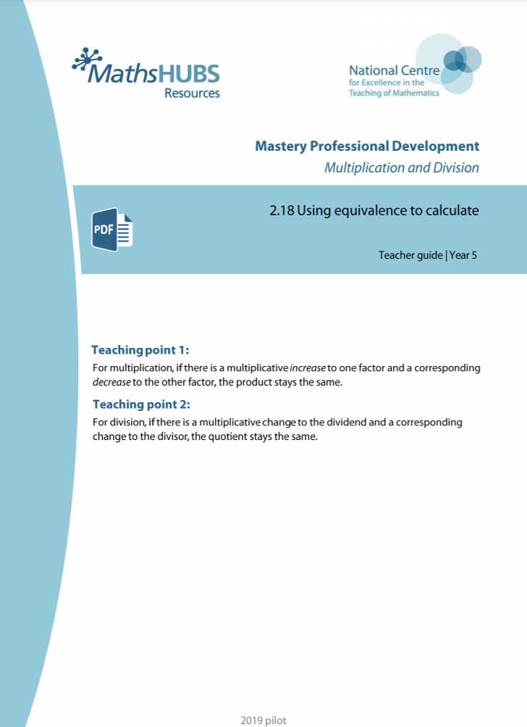
Year 6, Unit 5, Learning Outcome 1
Additional teacher guidance for this outcome should be read first and can be found in this segment of the NCETM Primary Mastery Professional Development Materials:
2.18 Using equivalence to calculate
The spine materials are divided into ‘teaching points’ and ‘steps in learning’.
Teaching point | Steps in learning | Pages
1 | 1:1-1:5 | 2-6

Slide 10
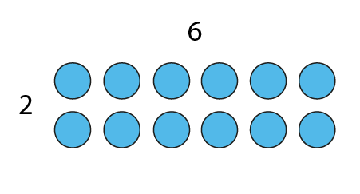
2.18 Equivalence Step 1:1
6 × 2 = 12

Slide 11
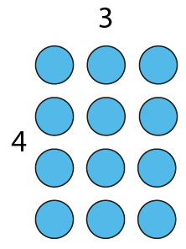
2.18 Equivalence Step 1:1
3 × 4 = 12

Slide 12
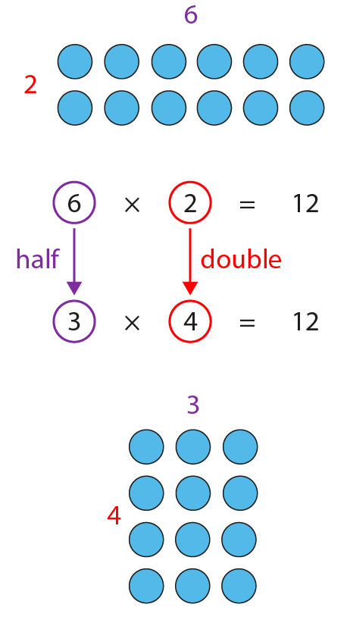
2.18 Equivalence Step 1:1

Slide 13

2.18 Equivalence Step 1:3
9
18
9
5
10
5
5
×
18
=
90
×
2
÷
2
10
×
9
=
90

Slide 14
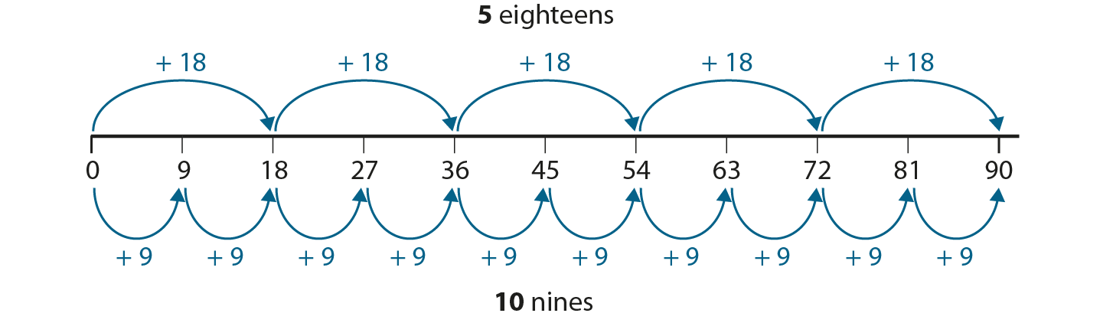
2.18 Equivalence Step 1:3

Slide 15
Year 6, Unit 5, Learning Outcome 2
Learning Outcome 2
Pupils explain the effect on the product when scaling the factors by the same amount
The following slides have been collated to support the teaching of this learning outcome.

Slide 16
Year 6, Unit 5, Learning Outcome 2
Additional teacher guidance for this outcome should be read first and can be found in this segment of the NCETM Primary Mastery Professional Development Materials:
2.18 Using equivalence to calculate
The spine materials are divided into ‘teaching points’ and ‘steps in learning’.
Teaching point | Steps in learning | Pages
1 | 1:6-1:8 | 7-9

Slide 17
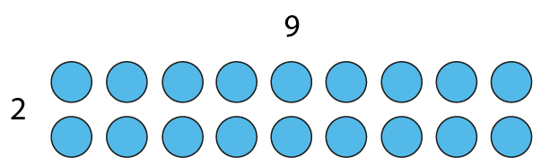
2.18 Equivalence Step 1:6
2 × 9 = 18

Slide 18
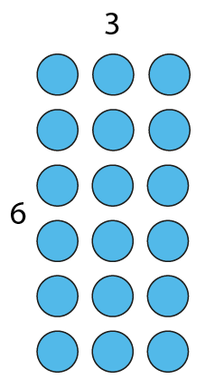
2.18 Equivalence Step 1:6
6 × 3 = 18

Slide 19
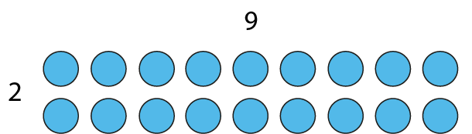
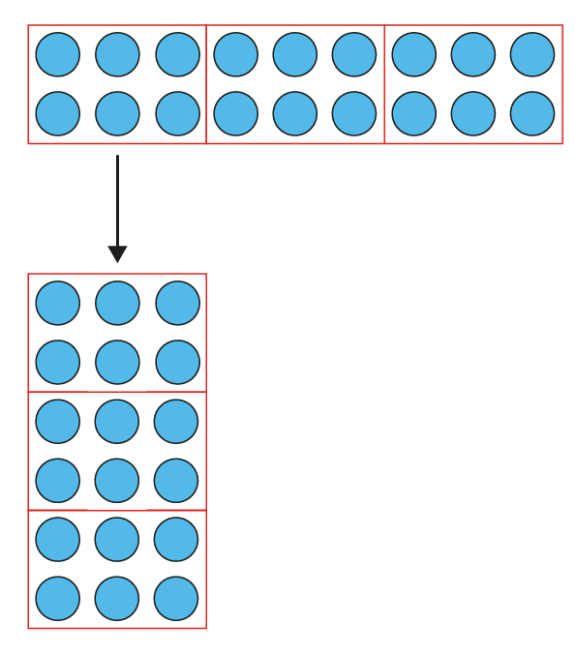
2.18 Equivalence Step 1:6

Slide 20
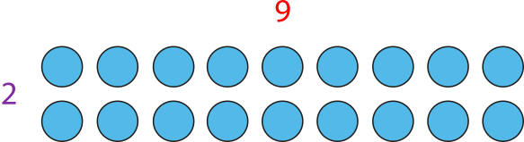
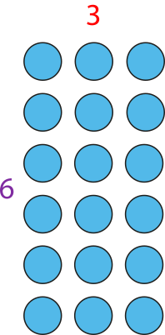
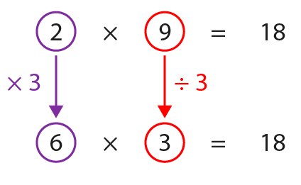
2.18 Equivalence Step 1:6

Slide 21
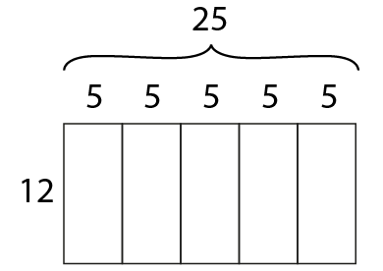
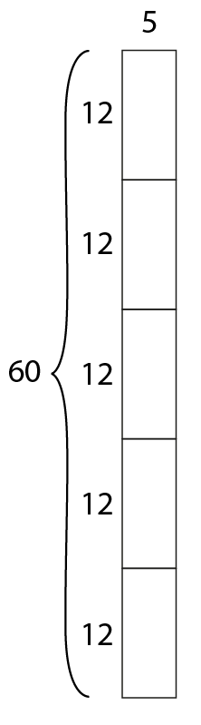
2.18 Equivalence Step 1:7

Slide 22
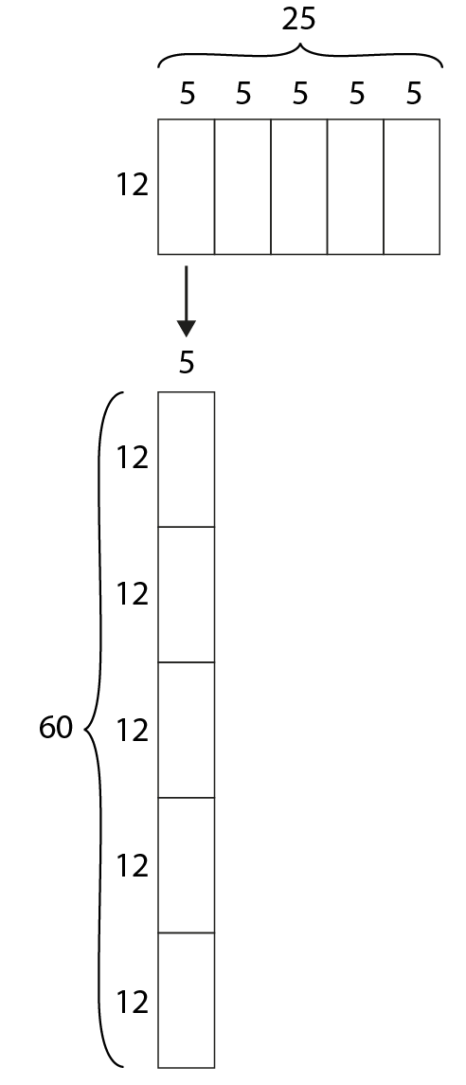
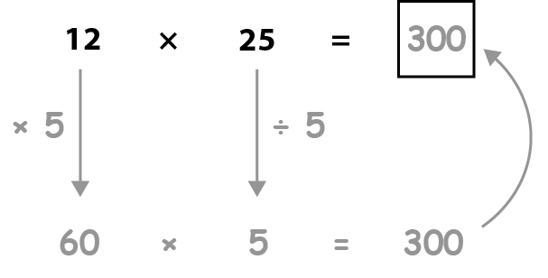
2.18 Equivalence Step 1:7

Slide 23
Year 6, Unit 5, Learning Outcome 3
Learning Outcome 3
Pupils use their knowledge of equivalence when scaling factors to solve problems
The following slides have been collated to support the teaching of this learning outcome.

Slide 24
Year 6, Unit 5, Learning Outcome 3
Additional teacher guidance for this outcome should be read first and can be found in this segment of the NCETM Primary Mastery Professional Development Materials:
2.18 Using equivalence to calculate
The spine materials are divided into ‘teaching points’ and ‘steps in learning’.
Teaching point | Steps in learning | Pages
1 | 1:9 | 9-10

Slide 25
6AS/MD-2 Derive related calculations
Use the first calculation to derive the missing term in the second calculation.
Explain your reasoning.
252 = 3 × 84
2,520 = 30 ×
2,520 = 30 × 84

Slide 26
6AS/MD-2 Derive related calculations
Use the first calculation to derive the missing term in the second calculation.
Explain your reasoning.
252 = 3 × 84
= 3 × 85
255 = 3 x 85

Slide 27
6AS/MD-2 Derive related calculations
Explain how you would use the first equation to complete the second equation.
What equation can you write to link the two?
195 ÷ 13 = 15
13 × 150 =
13 × 15 = 195
1,950

Slide 28
Year 6, Unit 5, Learning Outcome 4
Learning Outcome 4
Pupils explain the effect on the quotient when scaling the dividend and divisor by 10
The following slides have been collated to support the teaching of this learning outcome.

Slide 29
Year 6, Unit 5, Learning Outcome 4
Additional teacher guidance for this outcome should be read first and can be found in this segment of the NCETM Primary Mastery Professional Development Materials:
2.18 Using equivalence to calculate
The spine materials are divided into ‘teaching points’ and ‘steps in learning’.
Teaching point | Steps in learning | Pages
2 | 2:1-2:5 & 2:11 | 11-15 & 19

Slide 30
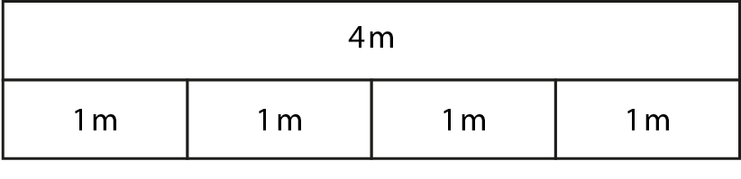
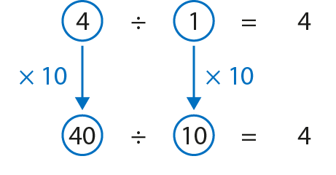
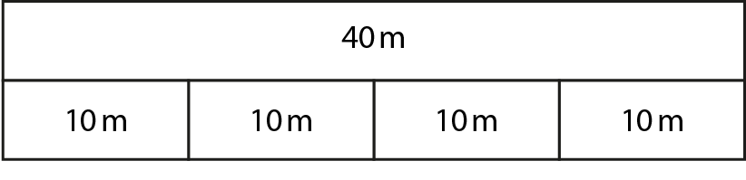
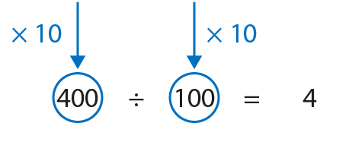
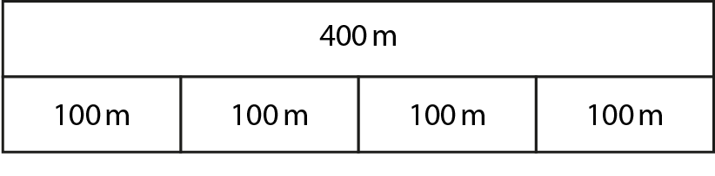
2.18 Equivalence Step 2:1

Slide 31
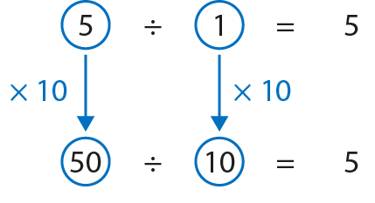
2.18 Equivalence Step 2:2

Slide 32
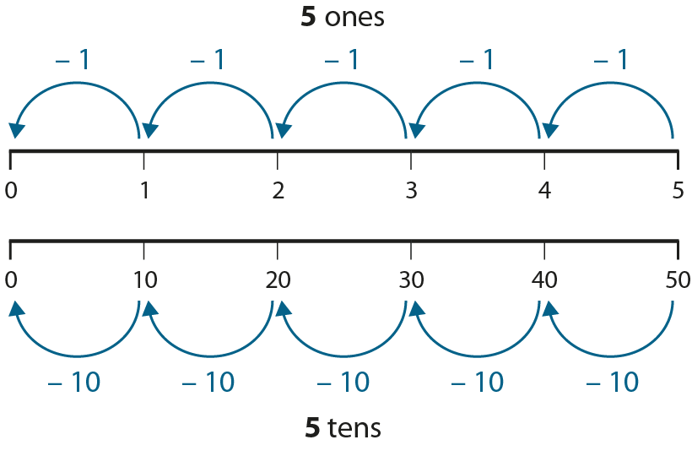
2.18 Equivalence Step 2:2

Slide 33
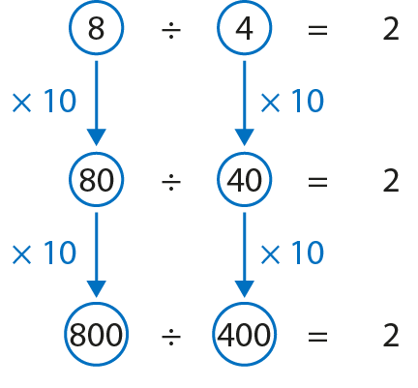
2.18 Equivalence Step 2:3

Slide 34
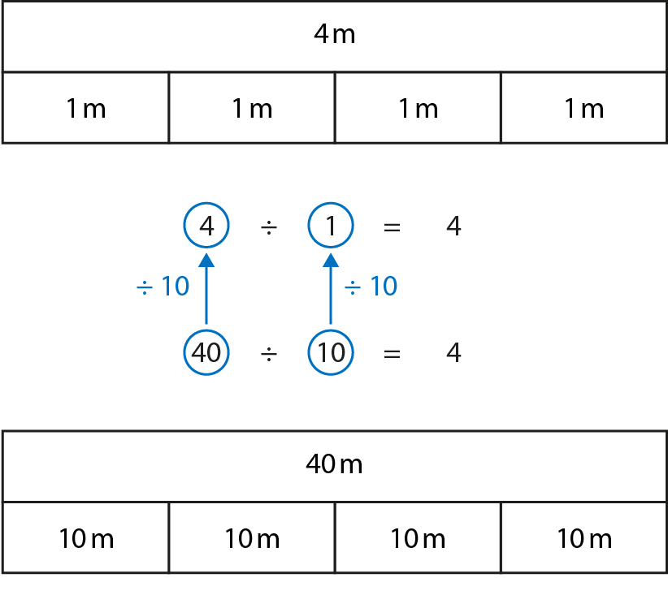
2.18 Equivalence Step 2:4

Slide 35
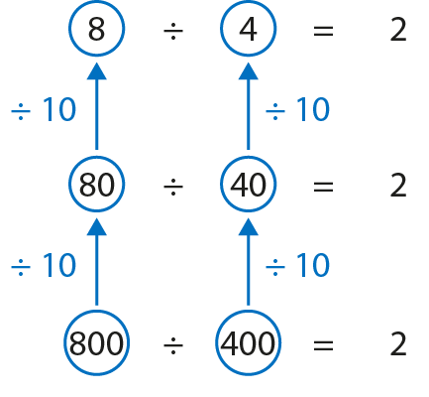
2.18 Equivalence Step 2:4

Slide 36
Year 6, Unit 5, Learning Outcome 5
Learning Outcome 5
Pupils explain the effect on the quotient when scaling the dividend and divisor by the same amount
The following slides have been collated to support the teaching of this learning outcome.

Slide 37
Year 6, Unit 5, Learning Outcome 5
Additional teacher guidance for this outcome should be read first and can be found in this segment of the NCETM Primary Mastery Professional Development Materials:
2.18 Using equivalence to calculate
The spine materials are divided into ‘teaching points’ and ‘steps in learning’.
Teaching point | Steps in learning | Pages
2 | 2:6-2:11 | 15-19

Slide 38

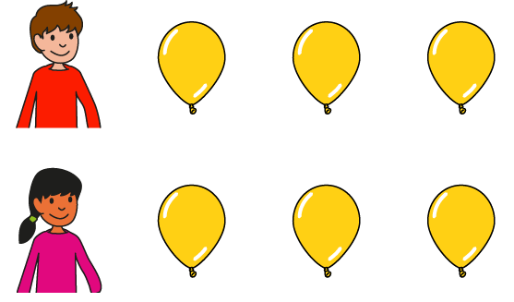

2.18 Equivalence Step 2:6
Notes:
Three balloons are ‘shared’ equally between one child. How many balloons does the child get?
Six balloons are ‘shared’ equally between two children. How many balloons does each child get?

Slide 39
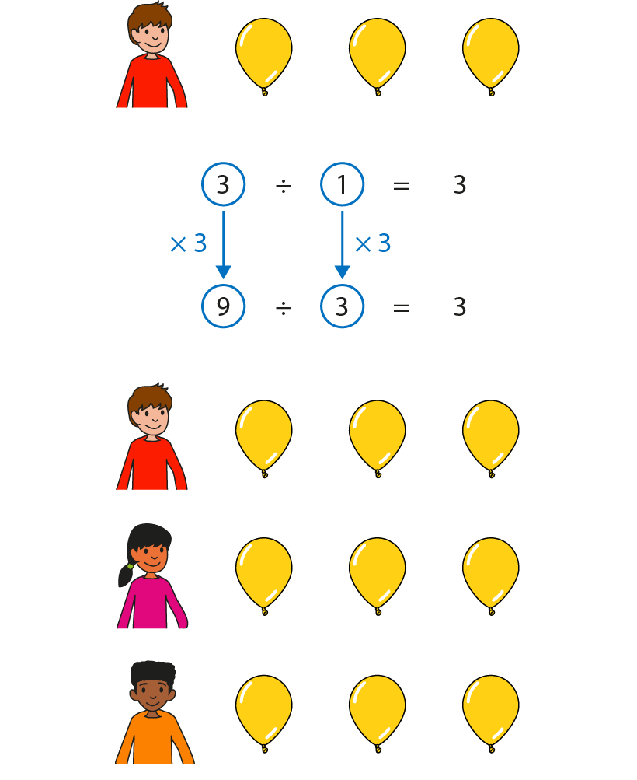
2.18 Equivalence Step 2:7

Slide 40
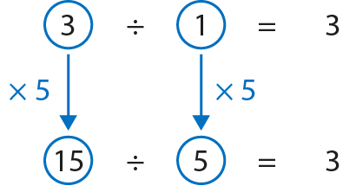
2.18 Equivalence Step 2:8
Notes:
If I multiply the dividend by five I must multiply the divisor by five for the quotient to stay the same.

Slide 41
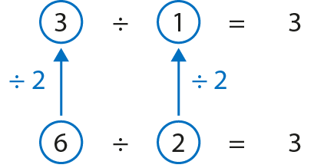
2.18 Equivalence Step 2:9
Notes:
If I divide the dividend by two I must divide the divisor by two for the quotient to stay the same.

Slide 42
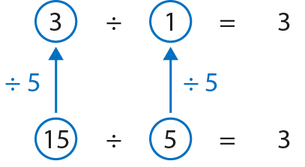
2.18 Equivalence Step 2:9
Notes:
If I divide the dividend by five I must divide the divisor by five for the quotient to stay the same.

Slide 43
Year 6, Unit 5, Learning Outcome 6
Learning Outcome 6
Pupils explain how to multiply a three-digit by a two-digit number
The following slides have been collated to support the teaching of this learning outcome.

Slide 44
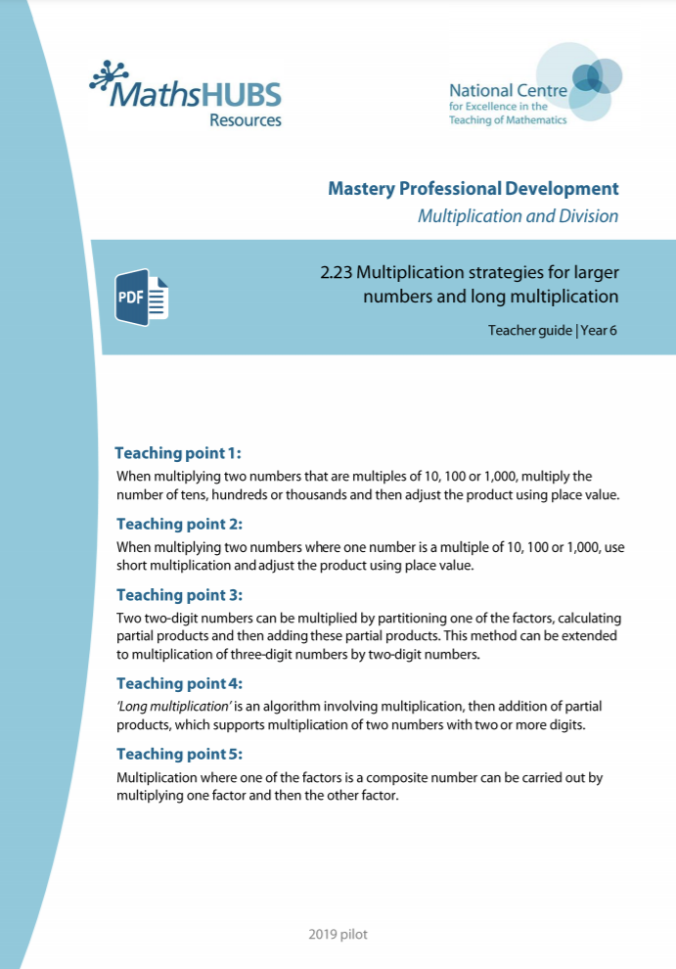
Year 6, Unit 5, Learning Outcome 6
Additional teacher guidance for this outcome should be read first and can be found in this segment of the NCETM Primary Mastery Professional Development Materials:
2.23 Multiplication strategies for larger numbers and long multiplication
The spine materials are divided into ‘teaching points’ and ‘steps in learning’.
Teaching point | Steps in learning | Pages
3 | 3:1-3:3 | 17-20

Slide 45
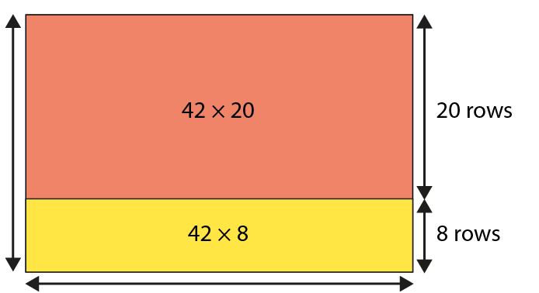
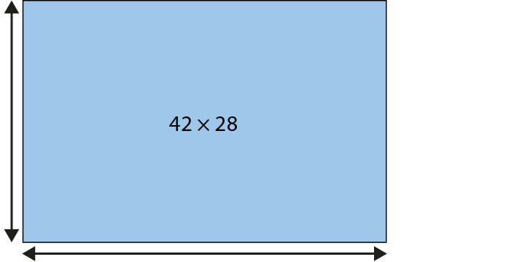
2.23 Strategies and long multiplication Step 3:1
28 rows
42 in each row
Notes:
Seats in one section of a stadium are in rows of forty-two.
If there are twenty-eight rows, how many seats are there in this section?

Slide 46
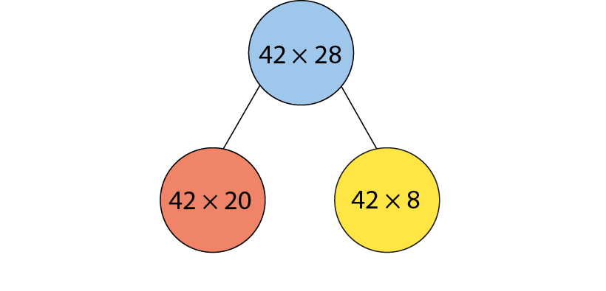
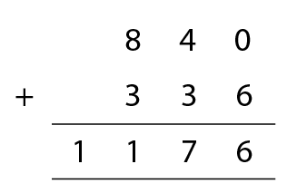
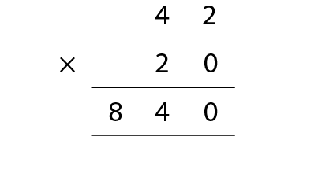
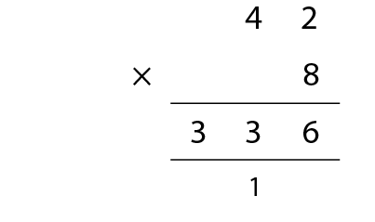
2.23 Strategies and long multiplication Step 3:1
Notes:
Seats in one section of a stadium are in rows of forty-two.
If there are twenty-eight rows, how many seats are there in this section?

Slide 47
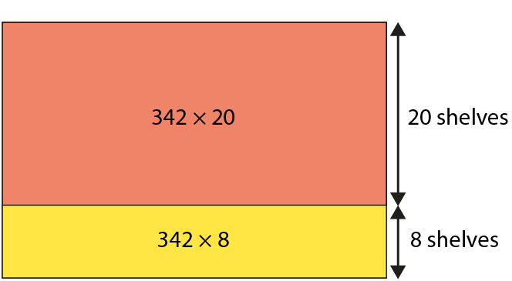
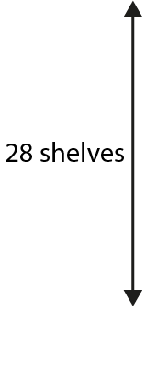
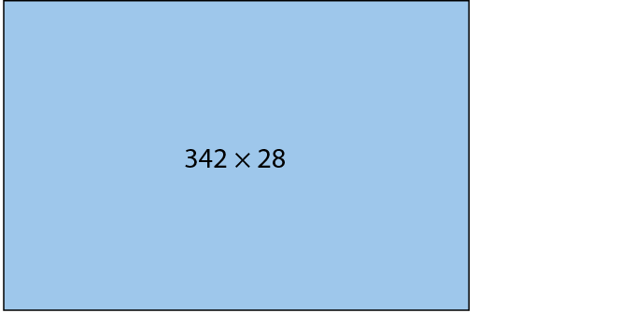

2.23 Strategies and long multiplication Step 3:2
Notes:
A factory can store three hundred and forty-two bottles of juice on one shelf.
If it has twenty-eight full shelves in the storeroom, how many
bottles of juice does it have to sell?

Slide 48
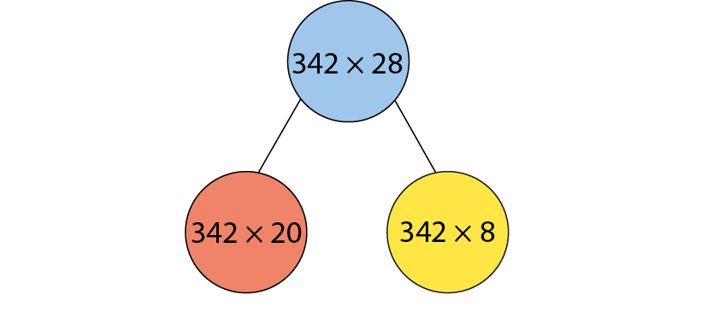
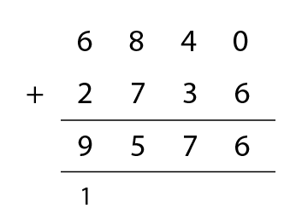
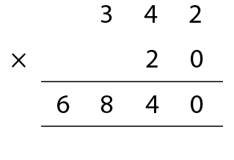
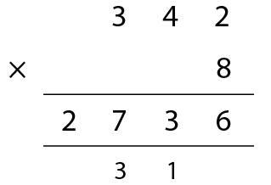
2.23 Strategies and long multiplication Step 3:2
Notes:
A factory can store three hundred and forty-two bottles of juice on one shelf.
If it has twenty-eight full shelves in the storeroom, how many
bottles of juice does it have to sell?

Slide 49
Year 6, Unit 5, Learning Outcome 7
Learning Outcome 7
Pupils explain how to accurately use the method of long multiplication to multiply two, two-digit numbers (no regrouping of ones to tens)
The following slides have been collated to support the teaching of this learning outcome.

Slide 50
Year 6, Unit 5, Learning Outcome 7
Additional teacher guidance for this outcome should be read first and can be found in this segment of the NCETM Primary Mastery Professional Development Materials:
2.23 Multiplication strategies for larger numbers and long multiplication
The spine materials are divided into ‘teaching points’ and ‘steps in learning’.
Teaching point | Steps in learning | Pages
4 | 4:1-4:4 | 21-24

Slide 51
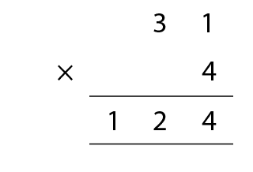
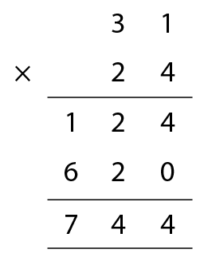
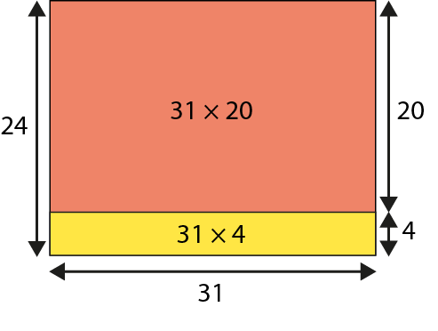
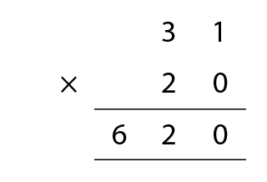
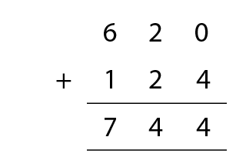
2.23 Strategies and long multiplication Step 4:1
31 × 24
Notes:
Martha wants to calculate how many hours there are in January.

Slide 52

2.23 Strategies and long multiplication Step 4:2
Step 1 – write the factors

Slide 53

2.23 Strategies and long multiplication Step 4:2
Step 2 – multiply the 1s digit by the 1s digit

Slide 54



2.23 Strategies and long multiplication Step 4:2
Step 3 – multiply the 10s digit by the 1s digit and regroup
1
2

Slide 55

2.23 Strategies and long multiplication Step 4:2
Step 4 – place a 0 to show that it’s 10 times the size
1
2

Slide 56


2.23 Strategies and long multiplication Step 4:2
Step 5 – multiply the 1s digit by the 10s digit

Slide 57


2.23 Strategies and long multiplication Step 4:2
Step 6 – multiply the 10s digit by the 10s digit

Slide 58





2.23 Strategies and long multiplication Step 4:2
Step 7 – add the partial products

Slide 59


2.23 Strategies and long multiplication Step 4:3
Notes:
What’s the same? What’s different?

Slide 60
Year 6, Unit 5, Learning Outcome 8
Learning Outcome 8
Pupils explain how to accurately use the method of long multiplication (with regrouping of ones to tens)
The following slides have been collated to support the teaching of this learning outcome.

Slide 61
Year 6, Unit 5, Learning Outcome 8
Additional teacher guidance for this outcome should be read first and can be found in this segment of the NCETM Primary Mastery Professional Development Materials:
2.23 Multiplication strategies for larger numbers and long multiplication
The spine materials are divided into ‘teaching points’ and ‘steps in learning’.
Teaching point | Steps in learning | Pages
4 | 4:5-4:6 | 24-26

Slide 62

2.23 Strategies and long multiplication Step 4:5
Step 1 – write the factors

Slide 63


2.23 Strategies and long multiplication Step 4:5
Step 2 – multiply the 1s digit by the 1s digit and regroup
5

Slide 64




2.23 Strategies and long multiplication Step 4:5
Step 3 – multiply the 10s digit by the 1s digit,
adding the regrouped 10s and regroup again
5

Slide 65

2.23 Strategies and long multiplication Step 4:5
Step 4 – place a 0 to show that it’s 10 times the size

Slide 66



2.23 Strategies and long multiplication Step 4:5
Step 5 – multiply the 1s digit by the 10s digit

Slide 67


2.23 Strategies and long multiplication Step 4:5
Step 6 – multiply the 10s digit by the 10s digit

Slide 68


2.23 Strategies and long multiplication Step 4:5
Step 7 – add the partial products

Slide 69
Year 6, Unit 5, Learning Outcome 9
Learning Outcome 9
Pupils explain how to accurately use the method of long multiplication (with regrouping of ones to tens & tens to hundreds)
The following slides have been collated to support the teaching of this learning outcome.

Slide 70
Year 6, Unit 5, Learning Outcome 9
Additional teacher guidance for this outcome should be read first and can be found in this segment of the NCETM Primary Mastery Professional Development Materials:
2.23 Multiplication strategies for larger numbers and long multiplication
The spine materials are divided into ‘teaching points’ and ‘steps in learning’.
Teaching point | Steps in learning | Pages
4 | 4:7-4:8 | 26-28

Slide 71

2.23 Strategies and long multiplication Step 4:7
27 × 23

Slide 72

2.23 Strategies and long multiplication Step 4:8
Notes:
Lesa has done this calculation but has the incorrect answer.
Explain her mistake.

Slide 73
Year 6, Unit 5, Learning Outcome 10
Learning Outcome 10
Pupils explain how to accurately use the method of long multiplication to multiply a three-digit by a two-digit number
The following slides have been collated to support the teaching of this learning outcome.

Slide 74
Year 6, Unit 5, Learning Outcome 10
Additional teacher guidance for this outcome should be read first and can be found in this segment of the NCETM Primary Mastery Professional Development Materials:
2.23 Multiplication strategies for larger numbers and long multiplication
The spine materials are divided into ‘teaching points’ and ‘steps in learning’.
Teaching point | Steps in learning | Pages
4 | 4:9-4:10 | 28-31

Slide 75




2.23 Strategies and long multiplication Step 4:9

Slide 76
Year 6, Unit 5, Learning Outcome 11
Learning Outcome 11
Pupils explain how to accurately use the method of long multiplication to multiply a four-digit by a two-digit number
The following slides have been collated to support the teaching of this learning outcome.

Slide 77
Year 6, Unit 5, Learning Outcome 11
Additional teacher guidance for this outcome should be read first and can be found in this segment of the NCETM Primary Mastery Professional Development Materials:
2.23 Multiplication strategies for larger numbers and long multiplication
The spine materials are divided into ‘teaching points’ and ‘steps in learning’.
Teaching point | Steps in learning | Pages
4 | 4:11-4:13 | 31-34

Slide 78





2.23 Strategies and long multiplication Step 4:12

Slide 79
Year 6, Unit 5, Learning Outcome 12
Learning Outcome 12
Pupils explain how to use the associative law to multiply efficiently
The following slides have been collated to support the teaching of this learning outcome.

Slide 80
Year 6, Unit 5, Learning Outcome 12
Additional teacher guidance for this outcome should be read first and can be found in this segment of the NCETM Primary Mastery Professional Development Materials:
2.23 Multiplication strategies for larger numbers and long multiplication
The spine materials are divided into ‘teaching points’ and ‘steps in learning’.
Teaching point | Steps in learning | Pages
5 | 5:1-5:3 & 5:6 | 35-37 & 39-40

Slide 81



2.23 Strategies and long multiplication Step 5:2
23 × 14 = 23 × 2 × 7
23 × 14 = 23 × 7 × 2
= 46 × 7
= 161 × 2
= 322
= 322
Notes:
If there are fourteen classes of twenty-three children in a school, how
many children are there in the school?

Slide 82
Year 6, Unit 5, Learning Outcome 13
Learning Outcome 13
Pupils explain when it is more efficient to use long multiplication or factorising to multiply by two-digit numbers
The following slides have been collated to support the teaching of this learning outcome.

Slide 83
Year 6, Unit 5, Learning Outcome 13
Additional teacher guidance for this outcome should be read first and can be found in this segment of the NCETM Primary Mastery Professional Development Materials:
2.23 Multiplication strategies for larger numbers and long multiplication
The spine materials are divided into ‘teaching points’ and ‘steps in learning’.
Teaching point | Steps in learning | Pages
5 | 5:4-5:6 | 37-40

Slide 84

2.23 Strategies and long multiplication Step 5:4
Oliver’s method
Notes:
Water bottles come in boxes of fifteen bottles.
A school has bought three hundred and twenty-four boxes. How many bottles does
the school have?

Slide 85
2.23 Strategies and long multiplication Step 5:4
Tanima’s method
 | 3 | 2 | 4 |  |  |  |  |  | 9 | 7 | 2
× |  |  | 3 |  |  |  | × |  |  |  | 5
 | 9 | 7 | 2 |  |  |  |  | 4 | 8 | 6 | 0
 |  | 1 |  |  |  |  |  |  | 3 | 1
Notes:
Water bottles come in boxes of fifteen bottles.
A school has bought three hundred and twenty-four boxes. How many bottles does
the school have?

Slide 86
Year 6, Unit 5, Learning Outcome 14
Learning Outcome 14
Pupils explain how to use accurately the methods of short and long division (two and three-digit number by multiples of 10)
The following slides have been collated to support the teaching of this learning outcome.

Slide 87

Year 6, Unit 5, Learning Outcome 14
Additional teacher guidance for this outcome should be read first and can be found in this segment of the NCETM Primary Mastery Professional Development Materials:
2.24 Division: dividing by two-digit numbers
The spine materials are divided into ‘teaching points’ and ‘steps in learning’.
Teaching point | Steps in learning | Pages
1 | 1:1-1:3 | 3-6

Slide 88


2.24 Division: 2-digit divisors Step 1:1
Notes:
Sixty children are placed into classes of thirty.
How many classes are there?

Slide 89


2.24 Division: 2-digit divisors Step 1:1

Slide 90

2.24 Division: 2-digit divisors Step 1:2
Notes:
Eighty-five conkers are shared equally between thirty children.
How many conkers does each child get?

Slide 91
Year 6, Unit 5, Learning Outcome 15
Learning Outcome 15
Pupils explain how to use accurately the method of long division with and without remainders (two-digit by two-digit numbers)
The following slide supports the teaching of this learning outcome.

Slide 92
Year 6, Unit 5, Learning Outcome 15
Additional teacher guidance for this outcome should be read first and can be found in this segment of the NCETM Primary Mastery Professional Development Materials:
2.24 Division: dividing by two-digit numbers
The spine materials are divided into ‘teaching points’ and ‘steps in learning’.
Teaching point | Steps in learning | Pages
1 | 1:4-1:6 | 6-8

Slide 93
Year 6, Unit 5, Learning Outcome 16
Learning Outcome 16
Pupils use knowledge of long division to solve problems in a range of contexts (with and without remainders)
The following slides have been collated to support the teaching of this learning outcome.

Slide 94
Year 6, Unit 5, Learning Outcome 16
Additional teacher guidance for this outcome should be read first and can be found in this segment of the NCETM Primary Mastery Professional Development Materials:
2.24 Division: dividing by two-digit numbers
The spine materials are divided into ‘teaching points’ and ‘steps in learning’.
Teaching point | Steps in learning | Pages
1 | 1:7 | 8-9

Slide 95

2.24 Division: 2-digit divisors Step 1:7
Spot the mistakes.
Notes:
Spot the mistakes.
Explain your answers and correct the calculations.

Slide 96
Year 6, Unit 5, Learning Outcome 17
Learning Outcome 17
Pupils explain how to use a ratio chart to solve efficiently: short division
The following slides have been collated to support the teaching of this learning outcome.

Slide 97
Year 6, Unit 5, Learning Outcome 17
Additional teacher guidance for this outcome should be read first and can be found in this segment of the NCETM Primary Mastery Professional Development Materials:
2.24 Division: dividing by two-digit numbers
The spine materials are divided into ‘teaching points’ and ‘steps in learning’.
Teaching point | Steps in learning | Pages
2 | 2:1-2:3 | 10-12

Slide 98

2.24 Division: 2-digit divisors Step 2:1

Slide 99



2.24 Division: 2-digit divisors Step 2:2
434 ÷ 31 =
14
Notes:
Becky has 434 cm of ribbon to wrap up prizes for a school competition.
Each prize needs 31 cm of ribbon.
How many prizes can she wrap?

Slide 100

2.24 Division: 2-digit divisors Step 2:3
4 hundreds ÷ 31 = 0 hundreds r 4 hundreds
Notes:
Write ‘0’ in the hundreds column…

Slide 101
2.24 Division: 2-digit divisors Step 2:3
4 hundreds = 40 tens
4 hundreds ÷ 31 = 0 hundreds r 4 hundreds
Notes:
… and write ‘4’ to the left of the tens digit of the dividend.

Slide 102
2.24 Division: 2-digit divisors Step 2:3
43 tens ÷ 31 = 1 ten r 12 tens
4 hundreds = 40 tens
Notes:
Write ‘1’ in the tens column…

Slide 103
2.24 Division: 2-digit divisors Step 2:3
12 tens = 120 ones
43 tens ÷ 31 = 1 ten r 12 tens
Notes:
… and write ‘12’ to the left of the ones digit of the dividend.

Slide 104
2.24 Division: 2-digit divisors Step 2:3
124 ones ÷ 31 = 4 ones
12 tens = 120 ones
Notes:
Write ‘4’ in the ones column.

Slide 105
Year 6, Unit 5, Learning Outcome 18
Learning Outcome 18
Pupils explain how to use a ratio chart to solve efficiently: long division
The following slides have been collated to support the teaching of this learning outcome.

Slide 106
Year 6, Unit 5, Learning Outcome 18
Additional teacher guidance for this outcome should be read first and can be found in this segment of the NCETM Primary Mastery Professional Development Materials:
2.24 Division: dividing by two-digit numbers
The spine materials are divided into ‘teaching points’ and ‘steps in learning’.
Teaching point | Steps in learning | Pages
2 | 2:4-2:5 | 13-15

Slide 107

2.24 Division: 2-digit divisors Step 2:4
Step 1 – write the divisor, frame and dividend

Slide 108
2.24 Division: 2-digit divisors Step 2:4
Step 1 – write the divisor, frame and dividend
Step 2 – divide the 100s
Notes:
Write ‘0’ in the hundreds column of the answer line.

Slide 109
2.24 Division: 2-digit divisors Step 2:4
Step 3 – exchange 100s for 10s,
combine with the existing 10s and divide…
Step 2 – divide the 100s
1 ten × 31 = 31 tens
Notes:
Write ‘1’ in the tens column of the answer line and write ‘31’ underneath the ‘43’.

Slide 110


2.24 Division: 2-digit divisors Step 2:4
Step 3 – exchange 100s for 10s,
combine with the existing 10s and divide…
Step 4 – subtract to find the remainder
1 ten × 31 = 31 tens
1 ten × 31 = 31 tens
Notes:
Write ‘12’ underneath the ‘31’.

Slide 111
2.24 Division: 2-digit divisors Step 2:4
Step 4 – subtract to find the remainder
Step 5 – exchange 10s for 1s and
combine with the existing 1s
1 ten × 31 = 31 tens
1 ten × 31 = 31 tens
Notes:
Write ‘4’ after the ‘12’.

Slide 112

2.24 Division: 2-digit divisors Step 2:4
Step 5 – exchange 10s for 1s and
combine with the existing 1s
Step 6 – divide the 1s
1 ten × 31 = 31 tens
1 ten × 31 = 31 tens
4 ones × 31 = 124 ones
Notes:
Write ‘4’ in the ones column of the answer line and write ‘124’ underneath the ‘124’, aligning the digits.

Slide 113

2.24 Division: 2-digit divisors Step 2:4
Step 6 – divide the 1s
Step 7 – subtract to show there is no remainder
1 ten × 31 = 31 tens
1 ten × 31 = 31 tens
4 ones × 31 = 124 ones
4 ones
Notes:
Write ‘0’ underneath the ‘124’.

Slide 114

2.24 Division: 2-digit divisors Step 2:5

Slide 115
Year 6, Unit 5, Learning Outcome 19
Learning Outcome 19
Pupils explain how to use a ratio chart to solve efficiently: long division (II)
The following slide supports the teaching of this learning outcome.

Slide 116
Year 6, Unit 5, Learning Outcome 19
Additional teacher guidance for this outcome should be read first and can be found in this segment of the NCETM Primary Mastery Professional Development Materials:
2.24 Division: dividing by two-digit numbers
The spine materials are divided into ‘teaching points’ and ‘steps in learning’.
Teaching point | Steps in learning | Pages
2 | 2:6-2:7 | 15-16

Slide 117
Year 6, Unit 5, Learning Outcome 20
Learning Outcome 20
Pupils explain how to use accurately the method of long division with and without remainders (three-digit by two-digit, four-digit by two-digit numbers)
The following slides have been collated to support the teaching of this learning outcome.

Slide 118
Year 6, Unit 5, Learning Outcome 20
Additional teacher guidance for this outcome should be read first and can be found in this segment of the NCETM Primary Mastery Professional Development Materials:
2.24 Division: dividing by two-digit numbers
The spine materials are divided into ‘teaching points’ and ‘steps in learning’.
Teaching point | Steps in learning | Pages
2 | 2:8-2:9 | 16-17

Slide 119

2.24 Division: 2-digit divisors Step 2:8

Slide 120

2.24 Division: 2-digit divisors Step 2:8

Slide 121

2.24 Division: 2-digit divisors Step 2:9
Spot the mistakes.
Notes:
Spot the mistakes.
Explain your answers and correct the calculations.

Slide 122
Year 6, Unit 5, Learning Outcome 21
Learning Outcome 21
Pupils use long division with decimal remainders (1 decimal place)
The following slides have been collated to support the teaching of this learning outcome.

Slide 123
Year 6, Unit 5, Learning Outcome 21
Additional teacher guidance for this outcome should be read first and can be found in this segment of the NCETM Primary Mastery Professional Development Materials:
2.24 Division: dividing by two-digit numbers
The spine materials are divided into ‘teaching points’ and ‘steps in learning’.
Teaching point | Steps in learning | Pages
3 | 3:1-3:2 | 18-20

Slide 124

2.24 Division: 2-digit divisors Step 3:2
730 ÷ 25
Step 1 – calculate the whole-number quotient
Notes:
Long division – remainder converted to decimal fraction

Slide 125
2.24 Division: 2-digit divisors Step 3:2
730 ÷ 25
Step 1 – calculate the whole-number quotient
Step 2 – introduce the decimal point
Notes:
Long division – remainder converted to decimal fraction
There is a remainder.
To represent this as a decimal fraction, first write a decimal point after the ones digit of both the dividend and the quotient.
Write a place-holder zero in the tenths column of the dividend.

Slide 126
2.24 Division: 2-digit divisors Step 3:2
730 ÷ 25
Step 3 – continue
Step 2 – introduce the decimal point
Notes:
Long division – remainder converted to decimal fraction
Write ‘0’ after the ‘5’.

Slide 127
2.24 Division: 2-digit divisors Step 3:2
730 ÷ 25
Step 3 – continue
Step 4 – complete the calculation
Notes:
Long division – remainder converted to decimal fraction
Write ‘2’ in the tenths column of the answer line and write ‘50’ underneath the ‘50’.
Write ‘0’ underneath the ‘50’.

Slide 128

2.24 Division: 2-digit divisors Step 3:2
730 ÷ 25
Notes:
Short division – remainder converted to decimal fraction

Slide 129
Year 6, Unit 5, Learning Outcome 22
Learning Outcome 22
Pupils use long division with fraction remainders
The following slides have been collated to support the teaching of this learning outcome.

Slide 130
Year 6, Unit 5, Learning Outcome 22
Additional teacher guidance for this outcome should be read first and can be found in this segment of the NCETM Primary Mastery Professional Development Materials:
2.24 Division: dividing by two-digit numbers
The spine materials are divided into ‘teaching points’ and ‘steps in learning’.
Teaching point | Steps in learning | Pages
3 | 3:3-3:4 | 20-22

Slide 131


2.24 Division: 2-digit divisors Step 3:3
Step 1 – calculate the whole-number quotient
Notes:
Long division – remainder converted to proper fraction

Slide 132

2.24 Division: 2-digit divisors Step 3:3
Step 1 – calculate the whole-number quotient
Step 2 – represent the remainder as a fraction
Notes:
Long division – remainder converted to proper fraction
There is a remainder.
To represent this as a fraction, write the remainder as the numerator and the divisor as the denominator.

Slide 133

2.24 Division: 2-digit divisors Step 3:3
Step 2 – represent the remainder as a fraction
Step 3 – simplify the fraction
Notes:
Long division – remainder converted to proper fraction

Slide 134

2.24 Division: 2-digit divisors Step 3:3
r 5
Notes:
Short division – remainder converted to proper fraction

Slide 135

2.24 Division: 2-digit divisors Step 3:4
354 ÷ 15 = ?

Slide 136
Year 6, Unit 5, Learning Outcome 23
Learning Outcome 23
Pupils use long division with decimal remainders (2 decimal places)
The following slides have been collated to support the teaching of this learning outcome.

Slide 137
Year 6, Unit 5, Learning Outcome 23
Additional teacher guidance for this outcome should be read first and can be found in this segment of the NCETM Primary Mastery Professional Development Materials:
2.24 Division: dividing by two-digit numbers
The spine materials are divided into ‘teaching points’ and ‘steps in learning’.
Teaching point | Steps in learning | Pages
3 | 3:5-3:6 | 22-24

Slide 138

2.24 Division: 2-digit divisors Step 3:5
105 ÷ 20 = ?

Slide 139
Year 6, Unit 5, Learning Outcome 24
Learning Outcome 24
Pupils use knowledge of the best way to interpret and represent remainders from a range of division contexts
The following slides have been collated to support the teaching of this learning outcome.

Slide 140
Year 6, Unit 5, Learning Outcome 24
Additional teacher guidance for this outcome should be read first and can be found in this segment of the NCETM Primary Mastery Professional Development Materials:
2.24 Division: dividing by two-digit numbers
The spine materials are divided into ‘teaching points’ and ‘steps in learning’.
Teaching point | Steps in learning | Pages
3 | 3:7 | 24-26

Slide 141




2.24 Division: 2-digit divisors Step 3:7
639 ÷ 12
Notes:
Sammy calculates 639 ÷ 12 using long division.
She realises that this is the same as partitioning 639, but not as 6 hundreds, 3 tens and 9 ones.
Which way has 639 been partitioned?

Slide 142
Year 6, Unit 5, Learning Outcome 25
Learning Outcome 25
Pupils explain how and why a product changes when a factor changes multiplicatively
The following slides have been collated to support the teaching of this learning outcome.

Slide 143

Year 6, Unit 5, Learning Outcome 25
Additional teacher guidance for this outcome should be read first and can be found in this segment of the NCETM Primary Mastery Professional Development Materials:
2.25 Using compensation to calculate
The spine materials are divided into ‘teaching points’ and ‘steps in learning’.
Teaching point | Steps in learning | Pages
1 | 1:1-1:4 | 2-6

Slide 144

2.25 Compensation Step 1:1
20 cm × 3
Notes:
Pip is stacking boxes that are 20 cm × 20 cm × 40 cm.
When she stacks three boxes like this, the height of all three is 60 cm.

Slide 145

2.25 Compensation Step 1:1
20 cm × 3
40 cm × 3
Notes:
When she stacks the same three boxes like this, the height of all three is 120 cm.

Slide 146

2.25 Compensation Step 1:1
20 cm × 3
40 cm × 3
Notes:
If I double one factor, I must double the product.
If I multiply one factor by two, I must multiply the product by two.

Slide 147



2.25 Compensation Step 1:2
20 cm × 3
60 cm × 3
Notes:
Now Pip is stacking boxes that are 20 cm × 20 cm × 60 cm.
If I multiply one factor by three, I must multiply the product by three.

Slide 148




2.25 Compensation Step 1:3
Notes:
If I halve one factor, I must halve the product.
If I divide one factor by two, I must divide the product by two.

Slide 149



2.25 Compensation Step 1:3
Notes:
If I halve one factor, the product will be half the size.
If I divide one factor by two, I must divide the product by two.

Slide 150



2.25 Compensation Step 1:3
Notes:
If I divide one factor by five, I must divide the product by five.

Slide 151
Year 6, Unit 5, Learning Outcome 26
Learning Outcome 26
Pupils use their knowledge of multiplicative change to solve problems efficiently (multiplication)
The following slides have been collated to support the teaching of this learning outcome.

Slide 152
Year 6, Unit 5, Learning Outcome 26
Additional teacher guidance for this outcome should be read first and can be found in this segment of the NCETM Primary Mastery Professional Development Materials:
2.25 Using compensation to calculate
The spine materials are divided into ‘teaching points’ and ‘steps in learning’.
Teaching point | Steps in learning | Pages
1 | 1:5-1:6 | 7-9

Slide 153


2.25 Compensation Step 1:5
42
×
5
=
210
42
×
10
=
420
Notes:
If I double one factor, the problem becomes 42 × 10.
42 × 10 = 420
Now halve the product to find the answer to the original problem.
420 ÷ 2 = 210
42 × 5 = 210

Slide 154
Year 6, Unit 5, Learning Outcome 27
Learning Outcome 27
Pupils explain how and why a quotient changes when a dividend changes multiplicatively (increase or decrease)
The following slides have been collated to support the teaching of this learning outcome.

Slide 155
Year 6, Unit 5, Learning Outcome 27
Additional teacher guidance for this outcome should be read first and can be found in this segment of the NCETM Primary Mastery Professional Development Materials:
2.25 Using compensation to calculate
The spine materials are divided into ‘teaching points’ and ‘steps in learning’.
Teaching point | Steps in learning | Pages
2 | 2:1-2:4 | 10-16

Slide 156



2.25 Compensation Step 2:1
8 ÷ 2 = 4
4 ÷ 2 = 2
2 ÷ 2 = 1

Slide 157

2.25 Compensation Step 2:1
Notes:
If I double the dividend and keep the divisor the same, I must double the quotient.
If I multiply the dividend by two and keep the divisor the same, I must multiply the quotient by two.

Slide 158


2.25 Compensation Step 2:2
3
1
1
1
3 ÷ 3 = 1
12
4
4
4
12 ÷ 3 = 4
Notes:
If I multiply the dividend by four and keep the divisor the same, I must multiply the quotient by four.

Slide 159


2.25 Compensation Step 2:2
5
5
5 ÷ 5 = 1
15
5
5
5
15 ÷ 5 = 3
Notes:
If I multiply the dividend by three and keep the divisor the same, I must multiply the quotient by three.

Slide 160

2.25 Compensation Step 2:2
Notes:
If I multiply the dividend by four and keep the divisor the same, I must multiply the quotient by four.

Slide 161

2.25 Compensation Step 2:3
Notes:
If I divide the dividend by two and keep the divisor the same, I must divide the quotient by two.

Slide 162

2.25 Compensation Step 2:3
Notes:
If I divide the dividend by three and keep the divisor the same, I must divide the quotient by three.

Slide 163

2.25 Compensation Step 2:3
Notes:
If I divide the dividend by five and keep the divisor the same, I must divide the quotient by five.

Slide 164
6AS/MD-2 Derive related calculations
Use the first calculation to derive the missing term in the second calculation.
Explain your reasoning.
4,800 ÷ 25 = 192
4,800 ÷ 250 =
4,800 ÷ 250 = 19.2

Slide 165
Year 6, Unit 5, Learning Outcome 28
Learning Outcome 28
Pupils explain how and why a quotient changes when a divisor changes multiplicatively
The following slides have been collated to support the teaching of this learning outcome.

Slide 166
Year 6, Unit 5, Learning Outcome 28
Additional teacher guidance for this outcome should be read first and can be found in this segment of the NCETM Primary Mastery Professional Development Materials:
2.25 Using compensation to calculate
The spine materials are divided into ‘teaching points’ and ‘steps in learning’.
Teaching point | Steps in learning | Pages
3 | 3:1-3:2 | 17-18

Slide 167



2.25 Compensation Step 3:1
Notes:
If I double the divisor and keep the dividend the same, I must halve the quotient.
If I multiply the divisor by two and keep the dividend the same, I must divide the quotient by two.

Slide 168

2.25 Compensation Step 3:1
Notes:
If I multiply the divisor by three and keep the dividend the same, I must divide the quotient by three.

Slide 169

2.25 Compensation Step 3:1
Notes:
If I multiply the divisor by four and keep the dividend the same, I must divide the quotient by four.

Slide 170

2.25 Compensation Step 3:2
Notes:
If I halve the divisor and keep the dividend the same, I must double the quotient.
If I divide the divisor by two and keep the dividend the same, I must multiply the quotient by two.

Slide 171

2.25 Compensation Step 3:2
Notes:
If I divide the divisor by three and keep the dividend the same, I must multiply the quotient by three.

Slide 172

2.25 Compensation Step 3:2
Notes:
If I divide the divisor by five and keep the dividend the same, I must multiply the quotient by five.

Slide 173
6AS/MD-2 Derive related calculations
Use the first calculation to derive the missing term in the second calculation.
Explain your reasoning.
4,800 ÷ 25 = 192
4,800 ÷ 250 =
4,800 ÷ 250 = 19.2

Slide 174
Year 6, Unit 5, Learning Outcome 29
Learning Outcome 29
Pupils identify and explain the relationship between divisors and quotients
The following slides have been collated to support the teaching of this learning outcome.

Slide 175
Year 6, Unit 5, Learning Outcome 29
Additional teacher guidance for this outcome should be read first and can be found in this segment of the NCETM Primary Mastery Professional Development Materials:
2.25 Using compensation to calculate
The spine materials are divided into ‘teaching points’ and ‘steps in learning’.
Teaching point | Steps in learning | Pages
3 | 3:3-3:4 | 19-20

Slide 176

2.25 Compensation Step 3:4

