Slide 1
1.6 Additive structures: introduction to augmentation and reduction
Representations | Year 1
Number, Addition and Subtraction

Slide 2
How to use this presentation
You can find the teacher guide 1.6 Additive structures: introduction to augmentation and reduction by following the link below.

Slide 3
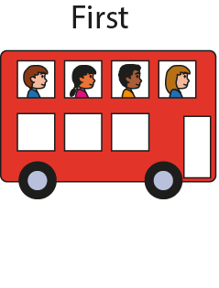
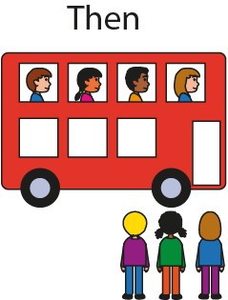




1.6 Augmentation and reduction – steps 1:2–1:3

Slide 4
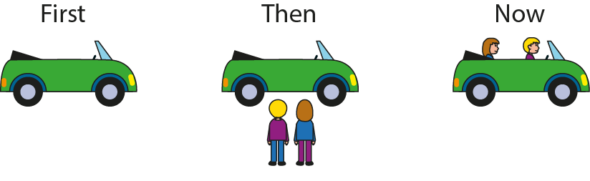


1.6 Augmentation and reduction – step 1:4

Slide 5
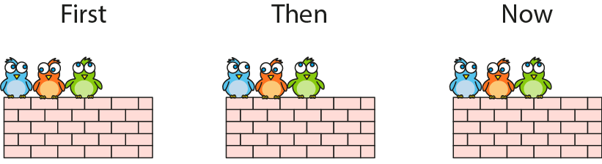

1.6 Augmentation and reduction – step 1:4

Slide 6
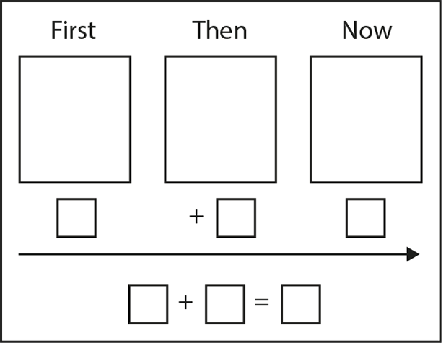
1.6 Augmentation and reduction – step 1:5

Slide 7

1.6 Augmentation and reduction – step 1:5

Slide 8
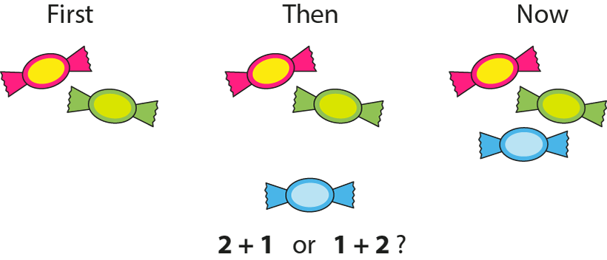
1.6 Augmentation and reduction – step 1:6

Slide 9
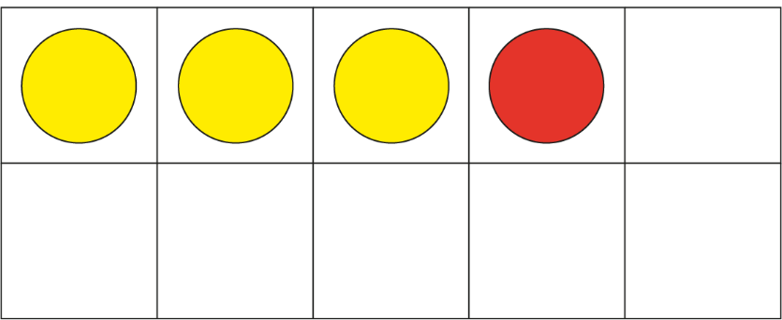




1.6 Augmentation and reduction – step 1:7
3 + 1 = 4
Notes:
First, James wrote three sentences. Then, he wrote one more sentence. Now, he has four sentences written down.

Slide 10
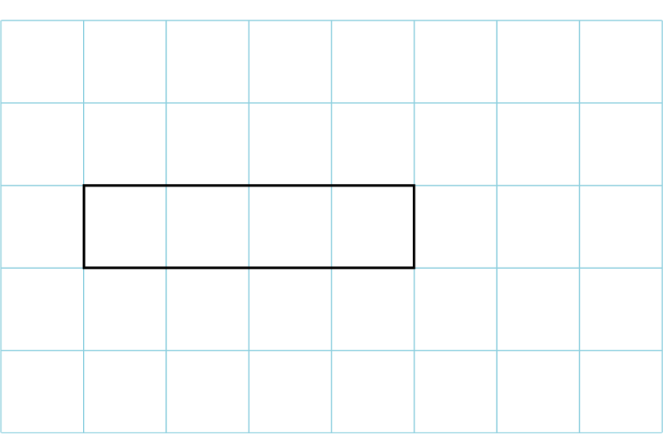



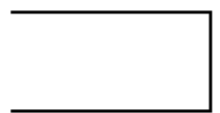

1.6 Augmentation and reduction – step 1:7
4 + 2 = 6
Notes:
First, Sarah had four pounds. Then, she was given two pounds more. Now, she has six pounds.

Slide 11


1.6 Augmentation and reduction – step 1:7
2 + 3 = 5
Notes:
At first, the tower was two bricks tall. Then, three more bricks were added. Now, the tower is five bricks tall.

Slide 12
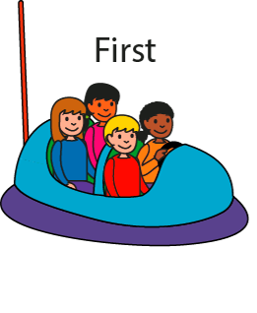
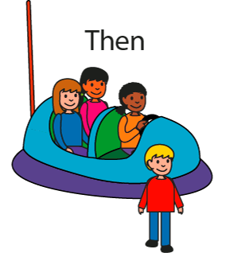

1.6 Augmentation and reduction – step 2:2

Slide 13

1.6 Augmentation and reduction – step 2:3

Slide 14
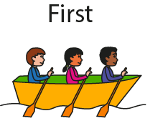
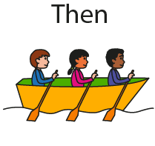
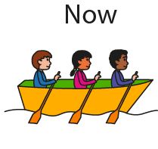
1.6 Augmentation and reduction – step 2:4

Slide 15
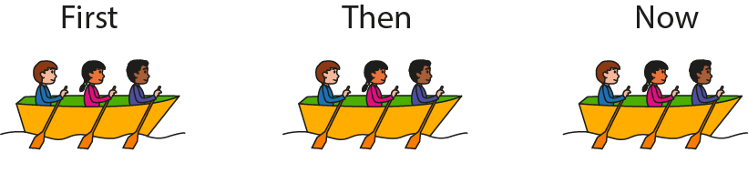



1.6 Augmentation and reduction – step 2:4

Slide 16
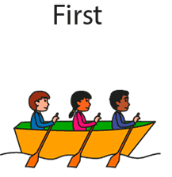
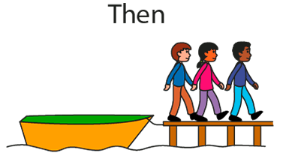
1.6 Augmentation and reduction – step 2:4

Slide 17
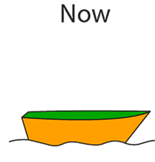


1.6 Augmentation and reduction – step 2:4
3 – 3 = 0

Slide 18
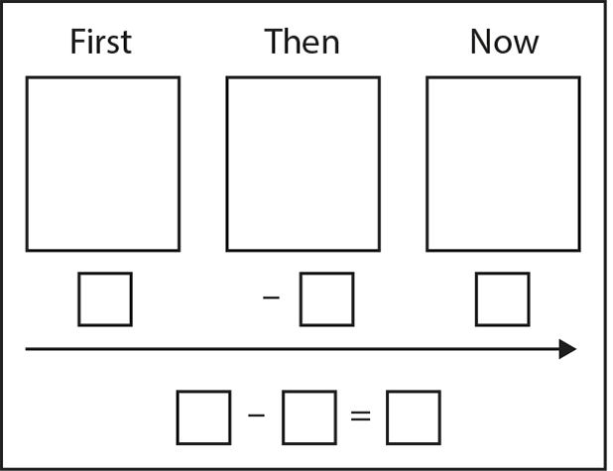
1.6 Augmentation and reduction – step 2:5

Slide 19
1.6 Augmentation and reduction – step 2:5

Slide 20
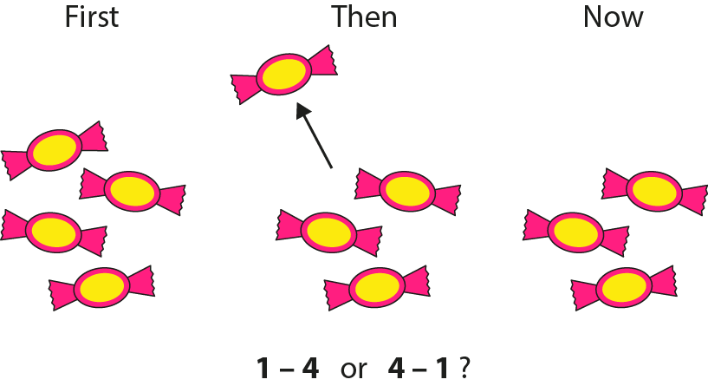
1.6 Augmentation and reduction – step 2:6

Slide 21
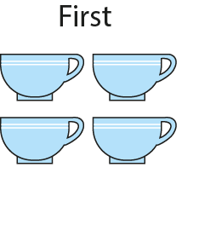
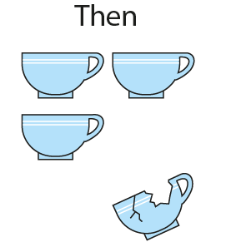
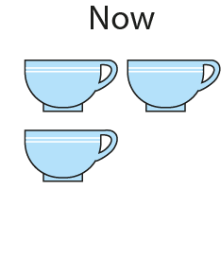


1.6 Augmentation and reduction – step 2:8

Slide 22
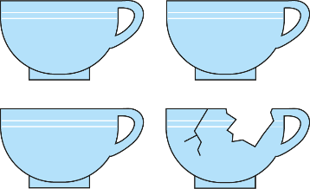
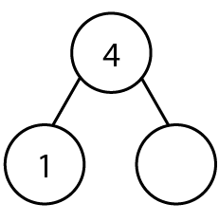


1.6 Augmentation and reduction – step 2:8
3

Slide 23
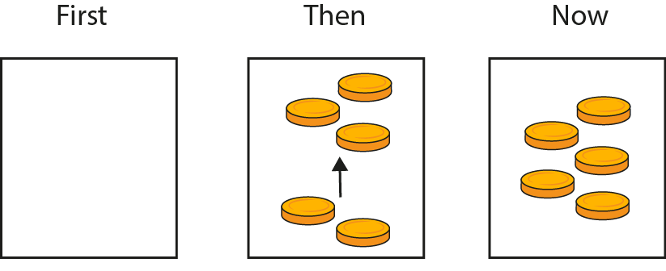




1.6 Augmentation and reduction – step 3:1
?
?
3
?
3

Slide 24
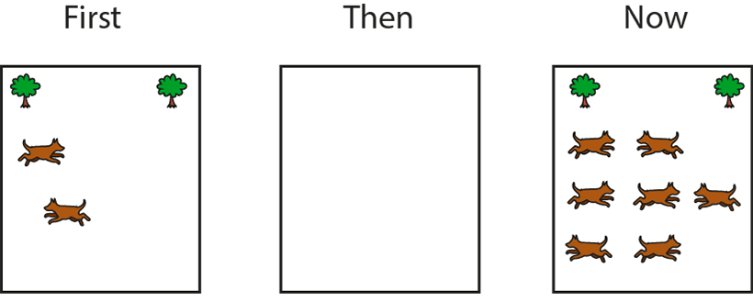






1.6 Augmentation and reduction – step 3:1
?
?
5
?
5

Slide 25
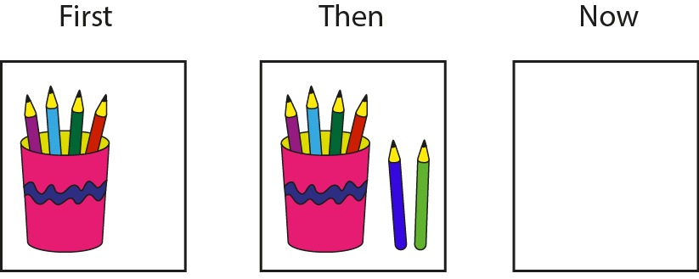





1.6 Augmentation and reduction – step 3:1
?
?
6
?
6

Slide 26
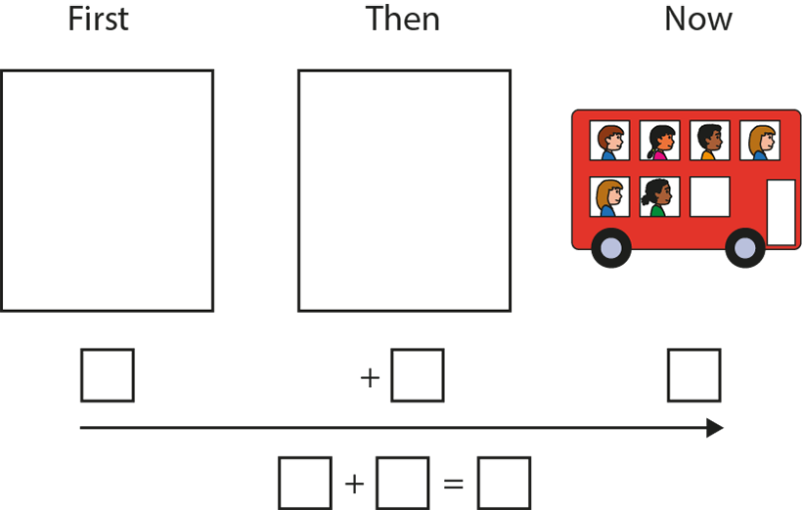
1.6 Augmentation and reduction – step 3:4
Can you write a story that ends with six children on the bus?

Slide 27
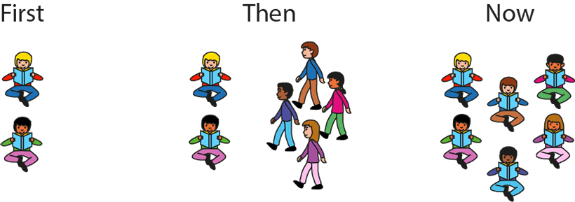
1.6 Augmentation and reduction – step 4:2

Slide 28
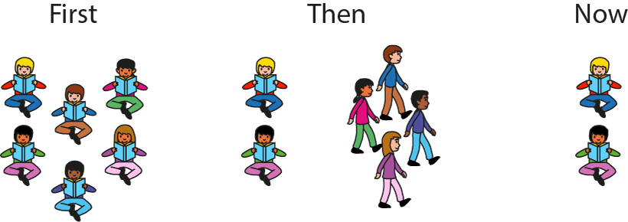
1.6 Augmentation and reduction – step 4:2

Slide 29
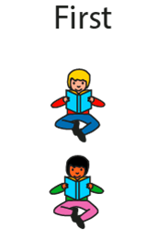
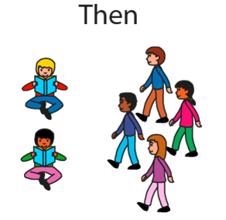
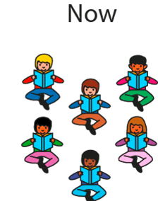


1.6 Augmentation and reduction – step 4:3

Slide 30
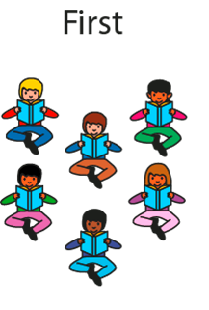
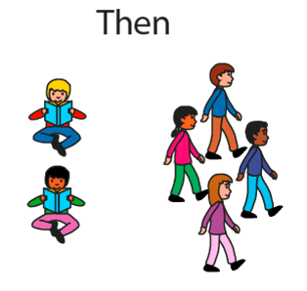





1.6 Augmentation and reduction – step 4:3

Slide 31




1.6 Augmentation and reduction – step 4:3

Slide 32






1.6 Augmentation and reduction – step 4:5
6
8
Notes:
First, there were six apples in the bowl. Then, two apples were added to the bowl. Now, there are eight apples in the bowl. Then, two apples were taken out of the bowl. Now, there are six apples in the bowl.

Slide 33




1.6 Augmentation and reduction – step 4:5
Notes:
First, there were three marbles in the jar. Then, two marbles were put into the jar. Now, there are five marbles in the jar. Then, two marbles were taken out of the jar. Now, there are three marbles in the jar.

Slide 34


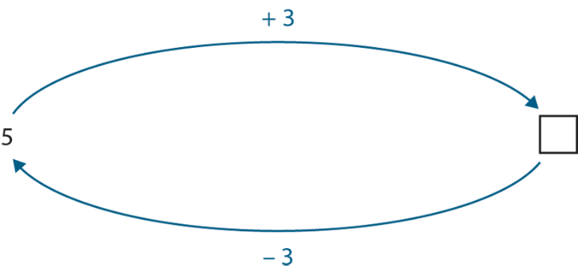
1.6 Augmentation and reduction – step 4:6
8
5
8

