Slide 1
1.10 Composition of numbers: 11–19
Representations | Year 1
Number, Addition and Subtraction

Slide 2
How to use this presentation
You can find the teacher guide 1.10 Composition of numbers: 11–19 by following the link below.

Slide 3
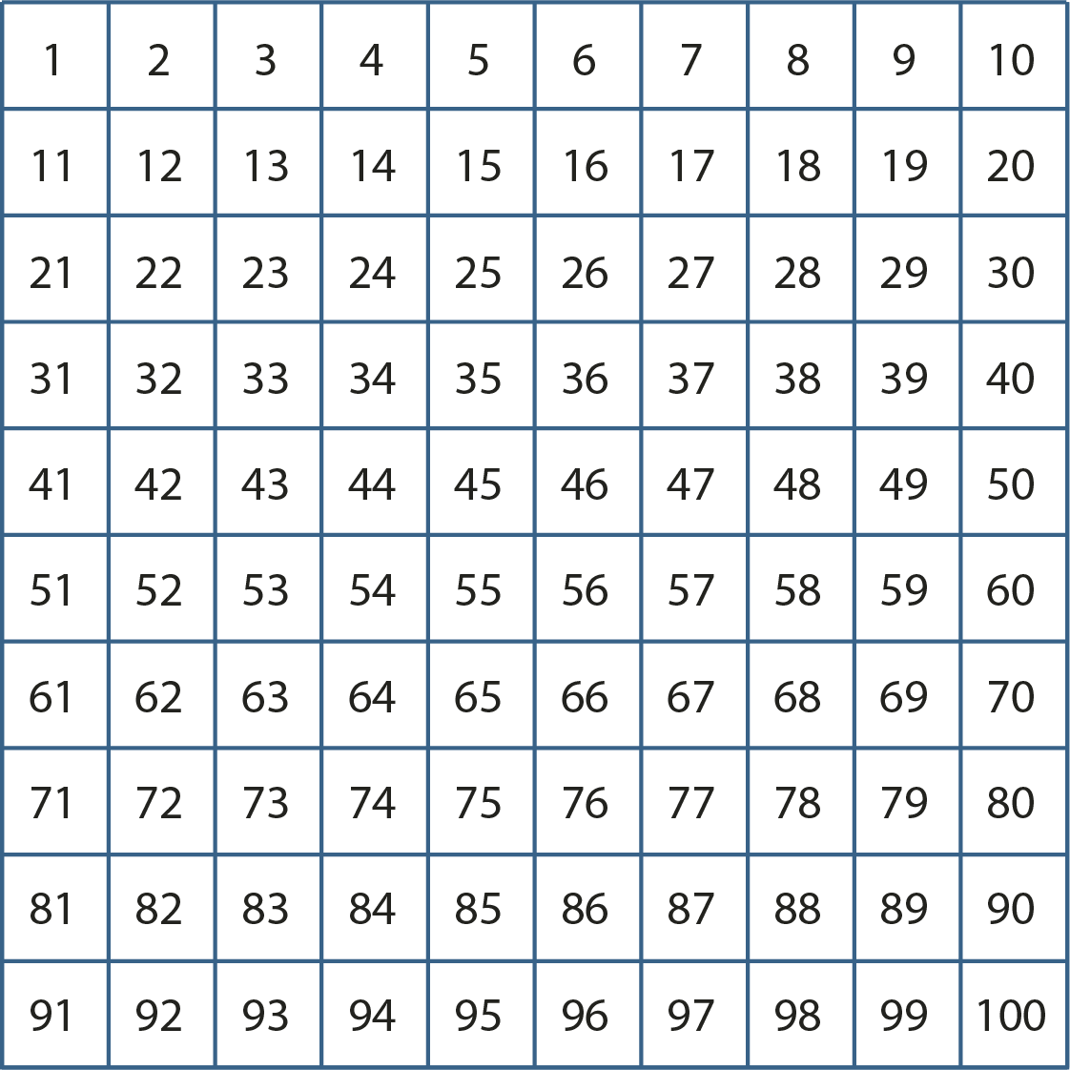
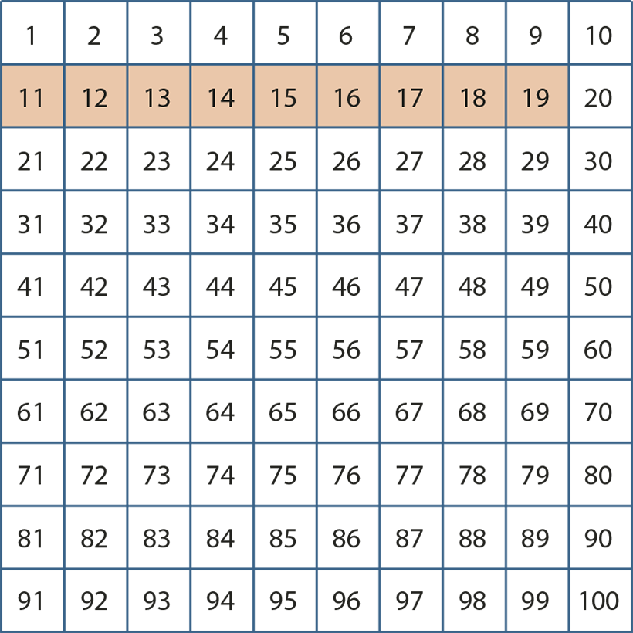
1.10 Composition: 11–19 – step 1:1

Slide 4
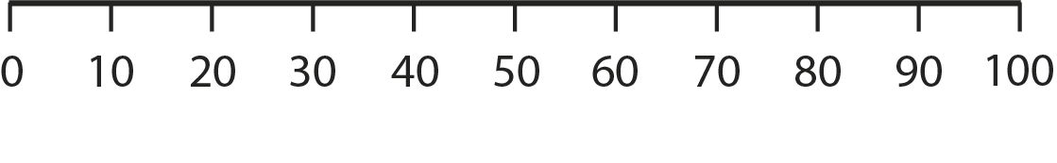

1.10 Composition: 11–19 – step 1:1

Slide 5

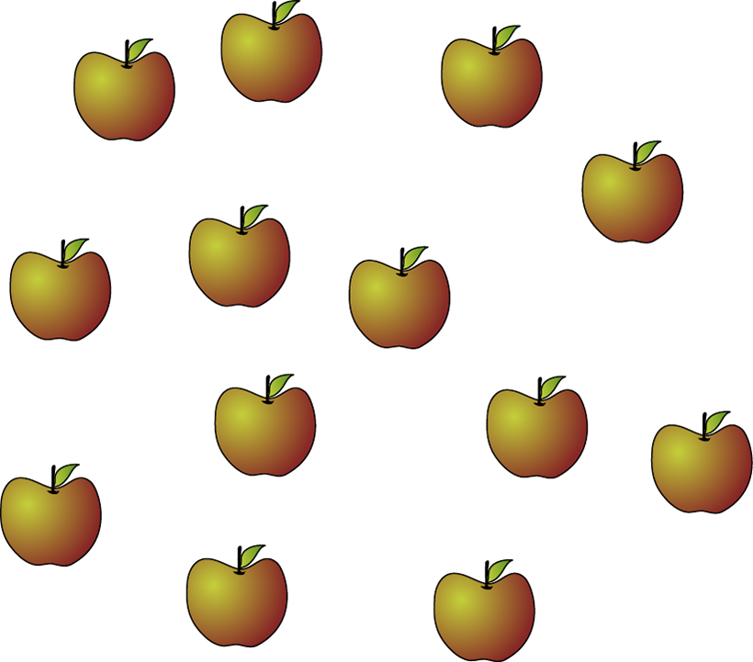
1.10 Composition: 11–19 – step 1:2

Slide 6

1.10 Composition: 11–19 – step 1:3

Slide 7
1.10 Composition: 11–19 – step 1:4
10s | 1s
1 | 5

Slide 8

1.10 Composition: 11–19 – step 1:4
10s | 1s
1 | 4

Slide 9







1.10 Composition: 11–19 – step 1:5

Slide 10











1.10 Composition: 11–19 – step 1:6

Slide 11
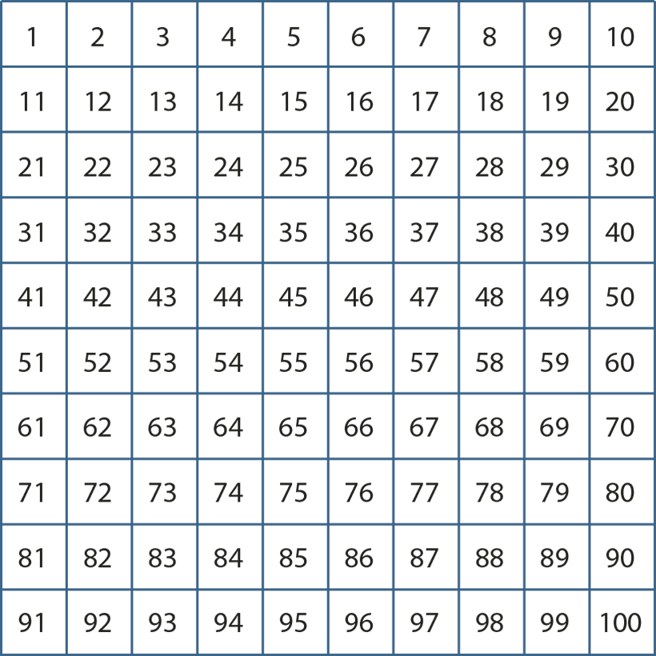
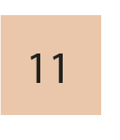
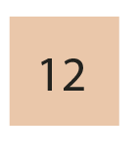
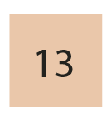
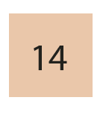
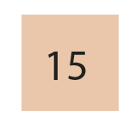
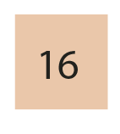
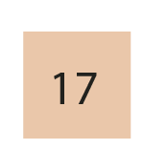
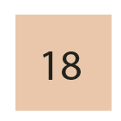

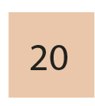
1.10 Composition: 11–19 – step 1:6
10

Slide 12
1.10 Composition: 11–19 – step 1:6
1000 | 2000 | 3000 | 4000 | 5000 | 6000 | 7000 | 8000 | 9000
100 | 200 | 300 | 400 | 500 | 600 | 700 | 800 | 900
10 | 20 | 30 | 40 | 50 | 60 | 70 | 80 | 90
1 | 2 | 3 | 4 | 5 | 6 | 7 | 8 | 9
10
20
1
2
3
4
5
6
7
8
9

Slide 13


1.10 Composition: 11–19 – step 1:8

Slide 14



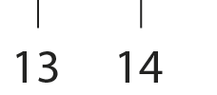


1.10 Composition: 11–19 – step 1:8

Slide 15


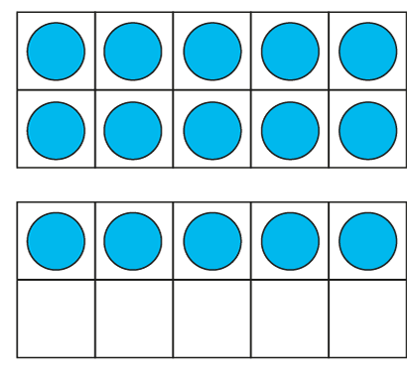
















1.10 Composition: 11–19 – step 2:1

Slide 16
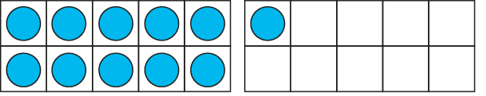
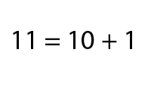
1.10 Composition: 11–19 – step 2:2

Slide 17
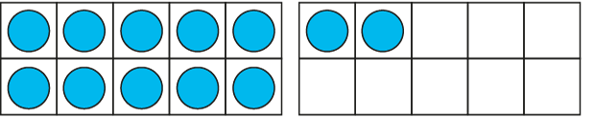
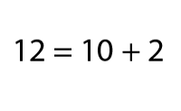
1.10 Composition: 11–19 – step 2:2

Slide 18
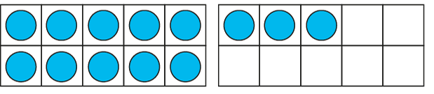
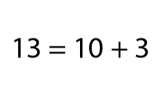
1.10 Composition: 11–19 – step 2:2

Slide 19
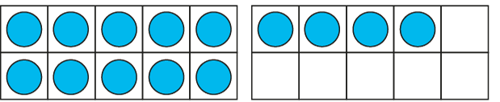
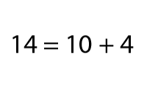
1.10 Composition: 11–19 – step 2:2

Slide 20
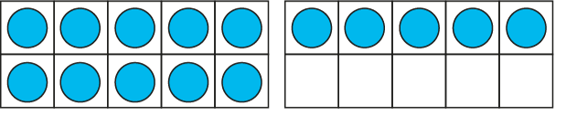
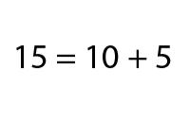
1.10 Composition: 11–19 – step 2:2

Slide 21
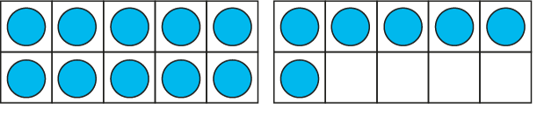
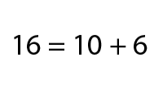
1.10 Composition: 11–19 – step 2:2

Slide 22
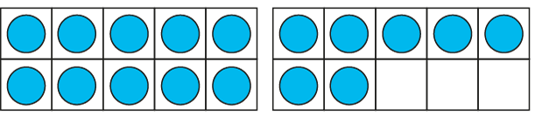
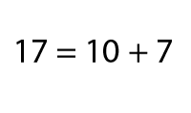
1.10 Composition: 11–19 – step 2:2

Slide 23
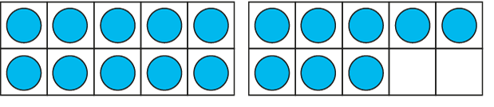
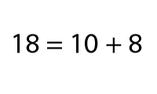
1.10 Composition: 11–19 – step 2:2

Slide 24
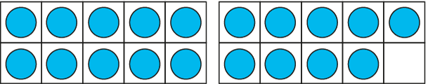
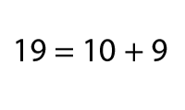
1.10 Composition: 11–19 – step 2:2

Slide 25
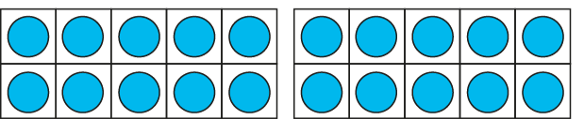
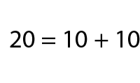
1.10 Composition: 11–19 – step 2:2

Slide 26

1.10 Composition: 11–19 – step 2:3
10
+
7
= 17

Slide 27
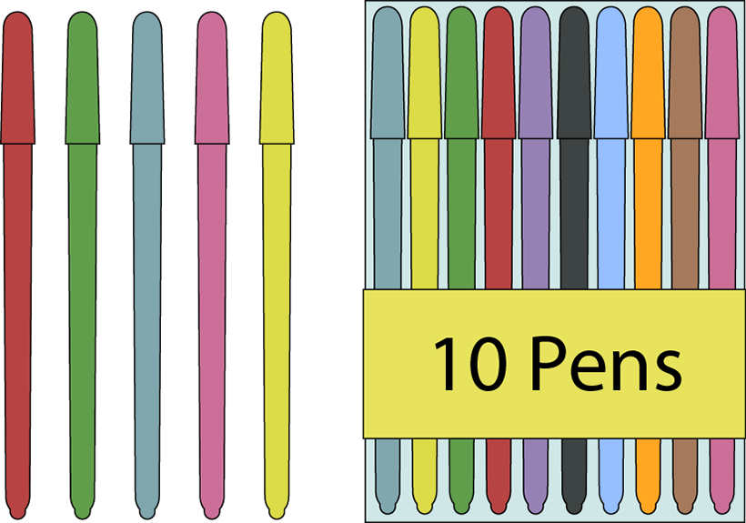
1.10 Composition: 11–19 – step 2:3
5
+
10
= 15

Slide 28
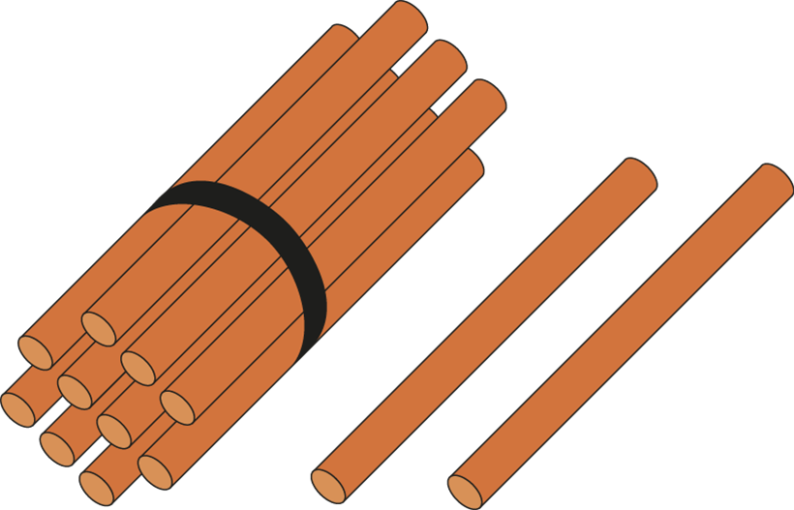
1.10 Composition: 11–19 – step 2:3
10
+
2
= 12

Slide 29

1.10 Composition: 11–19 – step 2:3
8
+
10
= 18

Slide 30


1.10 Composition: 11–19 – step 2:4

Slide 31


1.10 Composition: 11–19 – step 2:4

Slide 32


1.10 Composition: 11–19 – step 2:4

Slide 33

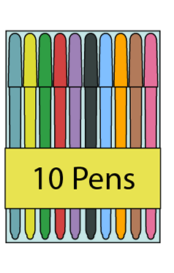
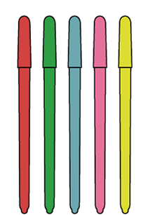
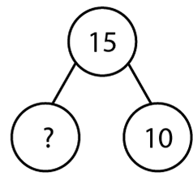
1.10 Composition: 11–19 – step 2:5

Slide 34

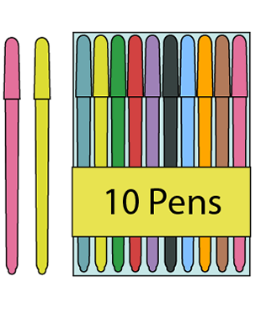
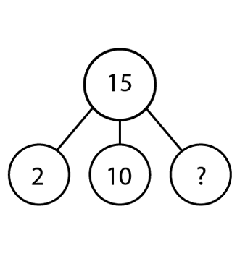
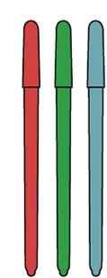
1.10 Composition: 11–19 – step 2:6

Slide 35

1.10 Composition: 11–19 – step 2:7

Slide 36


1.10 Composition: 11–19 – step 2:7

Slide 37


1.10 Composition: 11–19 – step 3:1

Slide 38
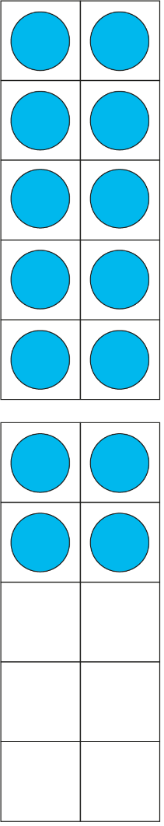
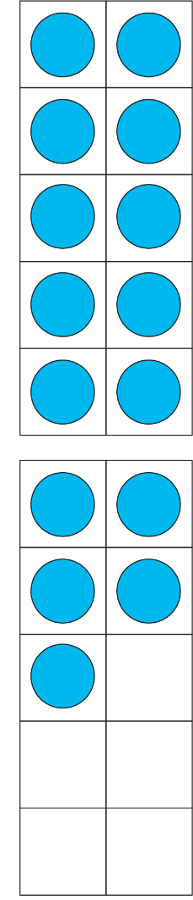






1.10 Composition: 11–19 – step 3:1

Slide 39
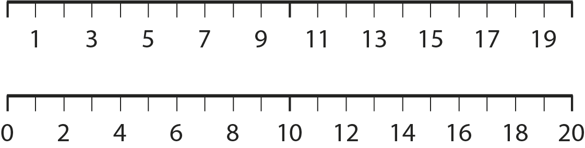
1.10 Composition: 11–19 – step 3:2

Slide 40
1.10 Composition: 11–19 – step 3:3
✓
✗
odd.
This number is
even.

Slide 41
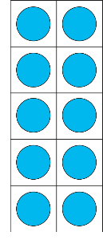
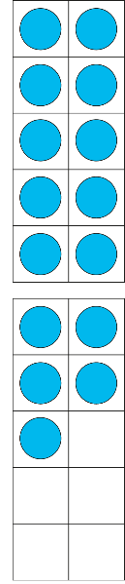

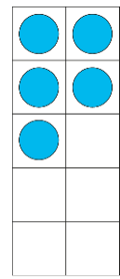






1.10 Composition: 11–19 – step 3:4

Slide 42







1.10 Composition: 11–19 – step 3:4

Slide 43

1.10 Composition: 11–19 – step 4:1

Slide 44


1.10 Composition: 11–19 – step 4:1

Slide 45

1.10 Composition: 11–19 – step 4:1

Slide 46

1.10 Composition: 11–19 – step 4:1

Slide 47



1.10 Composition: 11–19 – step 4:1

Slide 48






1.10 Composition: 11–19 – step 4:1

Slide 49

1.10 Composition: 11–19 – step 4:2
Number of beans at the start
Number of beans at the end
6
12

Slide 50


1.10 Composition: 11–19 – step 4:2
Number of beans at the start
Number of beans at the end
6
7
12
14

Slide 51
1.10 Composition: 11–19 – step 4:2
Number of beans at the start
Number of beans at the end
6
7
8
12
14
16

Slide 52
1.10 Composition: 11–19 – step 4:2
Number of beans at the start
Number of beans at the end
6
7
8
9
12
14
16
18

Slide 53












1.10 Composition: 11–19 – step 4:4

Slide 54




1.10 Composition: 11–19 – step 4:7

Slide 55


1.10 Composition: 11–19 – step 4:7

Slide 56







1.10 Composition: 11–19 – step 5:1

Slide 57












1.10 Composition: 11–19 – step 5:1

Slide 58

1.10 Composition: 11–19 – step 5:1
+ 2 = ?
15
5
10
3

Slide 59





1.10 Composition: 11–19 – step 5:2

Slide 60


1.10 Composition: 11–19 – step 5:2

Slide 61



1.10 Composition: 11–19 – step 5:2

Slide 62







1.10 Composition: 11–19 – step 5:4

Slide 63






1.10 Composition: 11–19 – step 5:4

Slide 64

1.10 Composition: 11–19 – step 5:4
− 3 = ?
16
6
10
9

Slide 65





1.10 Composition: 11–19 – step 5:5

Slide 66




1.10 Composition: 11–19 – step 5:5

Slide 67


1.10 Composition: 11–19 – step 5:5

