Slide 1
2.12 Division with remainders
Representations | Year 4
Multiplication and Division

Slide 2
How to use this presentation
You can find the teacher guide 2.12 Division with remainders by following the link below.

Slide 3
2.12 Division with remainders Step 1:1
9 = 4 × 2 + 1
Notes:
Nine is divided into groups of two. There are four groups and a remainder of one.
The “9” represents the total number of counters.
The “4×2” represents the four groups of two.
The “1” represents the remaining one counter.

Slide 4
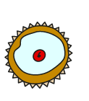
2.12 Division with remainders Step 1:2
12 cakes, in boxes of 4. How can the cakes be boxed?
12 = × 4
3
12 = 4 ×
3
12 ÷ 4 =
3
Notes:
Three boxes of four are twelve.

Slide 5
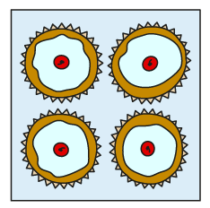
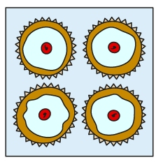
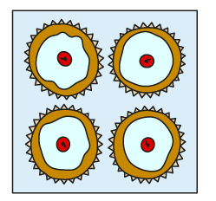
2.12 Division with remainders Step 1:2
– 4
– 4
– 4
12 – 4 – 4 – 4 = 0
12 ÷ 4 = 3
0
1
2
3
4
5
6
7
8
9
10
11
12
Notes:
Twelve divided into groups of four is equal to three.
So, the baker can make three boxes of cakes.

Slide 6
2.12 Division with remainders Step 1:3
14 cakes, in boxes of 4. How can the cakes be boxed?
14 = × 4
3
+ 2
14 = 4 ×
3
+ 2
14 ÷ 4 =
3
r 2
0
1
2
3
4
5
6
7
8
9
10
11
12
13
14
Notes:
Three boxes of four are twelve.
There are two cakes left over.

Slide 7
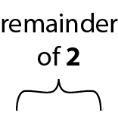
2.12 Division with remainders Step 1:3
– 4
– 4
– 4
0
1
2
3
4
5
6
7
8
9
10
11
12
13
14
14 – 4 – 4 – 4 = 2
14 ÷ 4 = 3 r 2
Notes:
Fourteen divided into groups of four is equal to three, with a remainder of two.
So, the baker can make three boxes of cakes, with two left over.

Slide 8
2.12 Division with remainders Step 1:5
18 cars, shared equally between 3 children. How many cars each?
18 = × 3
18 ÷ 3 =
18 = 3 ×
6
6
6
+ 3
+ 3
+ 3
+ 3
+ 3
+ 3
Notes:
Six threes is six each. That’s eighteen

Slide 9
2.12 Division with remainders Step 1:5
– 3
– 3
– 3
– 3
– 3
– 3
18 – 3 – 3 – 3 – 3 – 3 – 3 = 0
18 ÷ 3 = 6
Notes:
Eighteen divided between three is equal to six each.
So the children get six cars each.

Slide 10
2.12 Division with remainders Step 1:6
19 cars, shared equally between 3 children. How many cars each?
19 = 3 ×
+ 1
6
6
19 = × 3
+ 1
19 ÷ 3 =
6
r 1
+ 3
+ 3
+ 3
+ 3
+ 3
+ 3
Notes:
Six threes is six each. That’s eighteen.
There is one car left over.

Slide 11
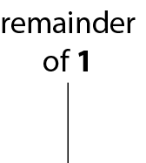
2.12 Division with remainders Step 1:6
– 3
– 3
– 3
– 3
– 3
– 3
0
1
2
3
4
5
6
7
8
9
10
11
12
13
14
15
16
17
18
19
19 – 3 – 3 – 3 – 3 – 3 – 3 = 1
19 ÷ 3 = 6 r 1
Notes:
Nineteen divided between three is equal to six each, with a remainder of one.
So, the children get six cars each; there is one car left over.

Slide 12
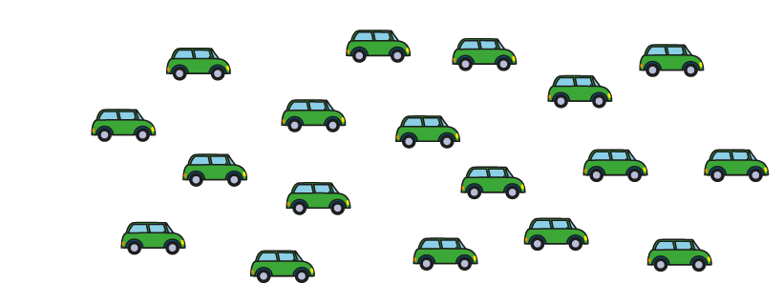
2.12 Division with remainders Step 1:7
19 cars shared equally between 5 children. How many cars each?
19 = 5 ×
19 = × 5
19 ÷ 5 =
0 × 5 = 0 | 5 × 0 = 0
1 × 5 = 5 | 5 × 1 = 5
2 × 5 = 10 | 5 × 2 = 10
3 × 5 = 15 | 5 × 3 = 15
4 × 5 = 20 | 5 × 4 = 20
0 × 5 = 0 | 5 × 0 = 0
1 × 5 = 5 | 5 × 1 = 5
2 × 5 = 10 | 5 × 2 = 10
3 × 5 = 15 | 5 × 3 = 15
4 × 5 = 20 | 5 × 4 = 20
Notes:
The largest multiple of five that is less than or equal to nineteen is fifteen.
Three fives are fifteen.
We can represent this as:
3 x 5 ≤ 19
3 x 5 = 15

Slide 13
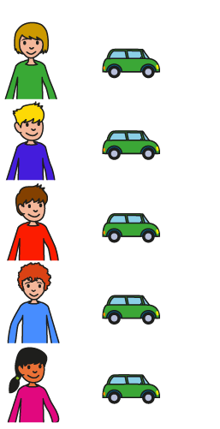
2.12 Division with remainders Step 1:7
19 = 5 ×
+ 4
3
3
19 = × 5
+ 4
19 ÷ 5 =
3
r 4
Notes:
Three fives are fifteen…
and nineteen is four more than fifteen.
So, nineteen divided between five is equal to
three each, with a remainder of four.
So, the children get three cars each; there are four cars left over.

Slide 14
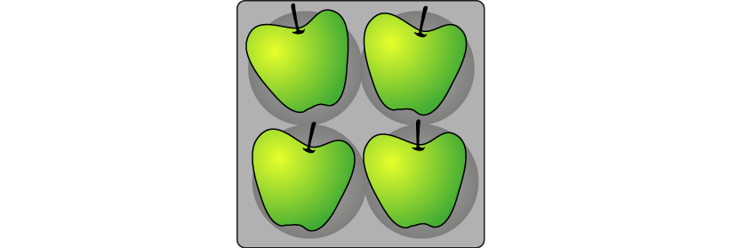
2.12 Division with remainders Step 2:1
Apples in trays of 4. How many trays?
Total number of apples (dividend) | Number of apples in each tray (divisor) | Number of trays (quotient) | Number of apples left over (remainder) | Equation
12
13
14
15
16
17
18
19
20
4
3
0
12 ÷ 4 = 3
3 fours
– 4
– 4
– 4

Slide 15
2.12 Division with remainders Step 2:1
Apples in trays of 4. How many trays?
Total number of apples (dividend) | Number of apples in each tray (divisor) | Number of trays (quotient) | Number of apples left over (remainder) | Equation
12
13
14
15
16
17
18
19
20
4
3
0
12 ÷ 4 = 3
4
3
1
13 ÷ 4 = 3 r 1
3 fours
– 4
– 4
– 4

Slide 16
2.12 Division with remainders Step 2:1
Apples in trays of 4. How many trays?
Total number of apples (dividend) | Number of apples in each tray (divisor) | Number of trays (quotient) | Number of apples left over (remainder) | Equation
12
13
14
15
16
17
18
19
20
4
3
0
12 ÷ 4 = 3
4
3
1
13 ÷ 4 = 3 r 1
4
3
2
14 ÷ 4 = 3 r 2
remainder of 2
3 fours
– 4
– 4
– 4

Slide 17
2.12 Division with remainders Step 2:1
Apples in trays of 4. How many trays?
Total number of apples (dividend) | Number of apples in each tray (divisor) | Number of trays (quotient) | Number of apples left over (remainder) | Equation
12
13
14
15
16
17
18
19
20
4
3
0
12 ÷ 4 = 3
4
3
1
13 ÷ 4 = 3 r 1
4
3
2
14 ÷ 4 = 3 r 2
4
3
3
15 ÷ 4 = 3 r 3
remainder of 3
3 fours
– 4
– 4
– 4

Slide 18
2.12 Division with remainders Step 2:1
Apples in trays of 4. How many trays?
Total number of apples (dividend) | Number of apples in each tray (divisor) | Number of trays (quotient) | Number of apples left over (remainder) | Equation
12
13
14
15
16
17
18
19
20
4
3
0
12 ÷ 4 = 3
4
3
1
13 ÷ 4 = 3 r 1
4
3
2
14 ÷ 4 = 3 r 2
4
3
3
15 ÷ 4 = 3 r 3
4
4
0
16 ÷ 4 = 4
4 fours
– 4
– 4
– 4
– 4

Slide 19
2.12 Division with remainders Step 2:1
Apples in trays of 4. How many trays?
Total number of apples (dividend) | Number of apples in each tray (divisor) | Number of trays (quotient) | Number of apples left over (remainder) | Equation
12
13
14
15
16
17
18
19
20
4
3
0
12 ÷ 4 = 3
4
3
1
13 ÷ 4 = 3 r 1
4
3
2
14 ÷ 4 = 3 r 2
4
3
3
15 ÷ 4 = 3 r 3
4
4
0
16 ÷ 4 = 4
4
4
1
17 ÷ 4 = 4 r 1
4 fours
– 4
– 4
– 4
– 4

Slide 20
2.12 Division with remainders Step 2:1
Apples in trays of 4. How many trays?
Total number of apples (dividend) | Number of apples in each tray (divisor) | Number of trays (quotient) | Number of apples left over (remainder) | Equation
12
13
14
15
16
17
18
19
20
4
3
0
12 ÷ 4 = 3
4
3
1
13 ÷ 4 = 3 r 1
4
3
2
14 ÷ 4 = 3 r 2
4
3
3
15 ÷ 4 = 3 r 3
4
4
0
16 ÷ 4 = 4
4
4
1
17 ÷ 4 = 4 r 1
4
4
2
18 ÷ 4 = 4 r 2
remainder of 2
4 fours
– 4
– 4
– 4
– 4

Slide 21
2.12 Division with remainders Step 2:1
Apples in trays of 4. How many trays?
Total number of apples (dividend) | Number of apples in each tray (divisor) | Number of trays (quotient) | Number of apples left over (remainder) | Equation
12
13
14
15
16
17
18
19
20
4
3
0
12 ÷ 4 = 3
4
3
1
13 ÷ 4 = 3 r 1
4
3
2
14 ÷ 4 = 3 r 2
4
3
3
15 ÷ 4 = 3 r 3
4
4
0
16 ÷ 4 = 4
4
4
1
17 ÷ 4 = 4 r 1
4
4
2
18 ÷ 4 = 4 r 2
4
4
3
19 ÷ 4 = 4 r 3
remainder of 3
4 fours
– 4
– 4
– 4
– 4

Slide 22
2.12 Division with remainders Step 2:1
Apples in trays of 4. How many trays?
Total number of apples (dividend) | Number of apples in each tray (divisor) | Number of trays (quotient) | Number of apples left over (remainder) | Equation
12
13
14
15
16
17
18
19
20
4
3
0
12 ÷ 4 = 3
4
3
1
13 ÷ 4 = 3 r 1
4
3
2
14 ÷ 4 = 3 r 2
4
3
3
15 ÷ 4 = 3 r 3
4
4
0
16 ÷ 4 = 4
4
4
1
17 ÷ 4 = 4 r 1
4
4
2
18 ÷ 4 = 4 r 2
4
4
3
19 ÷ 4 = 4 r 3
4
5
0
20 ÷ 4 = 5
5 fours
– 4
– 4
– 4
– 4
– 4

Slide 23
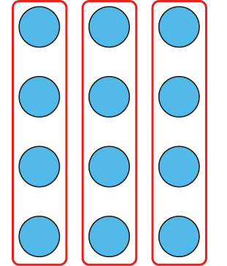
2.12 Division with remainders Step 2:2
Dividend = 12, divisor = 4:
12 ÷ 4 = 3
Notes:
Twelve divided into groups of four is equal to three.

Slide 24
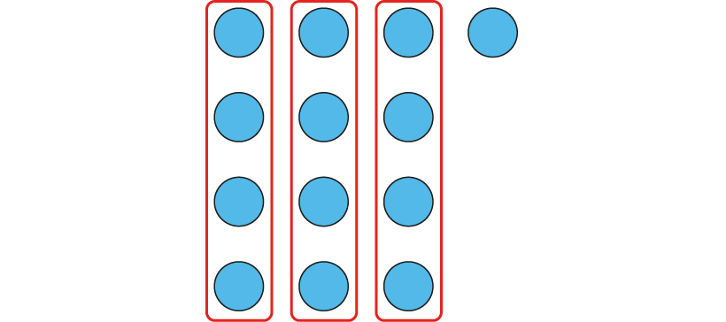
2.12 Division with remainders Step 2:2
Dividend = 13, divisor = 4:
13 ÷ 4 = 3 r 1
Notes:
Thirteen divided into groups of four is equal to three with a remainder of one.

Slide 25
2.12 Division with remainders Step 2:2
Dividend = 14, divisor = 4:
14 ÷ 4 = 3 r 2
Notes:
Fourteen divided into groups of four is equal to three with a remainder of two.

Slide 26
2.12 Division with remainders Step 2:2
Dividend = 15, divisor = 4:
15 ÷ 4 = 3 r 3
Notes:
Fifteen divided into groups of four is equal to three with a remainder of three.

Slide 27
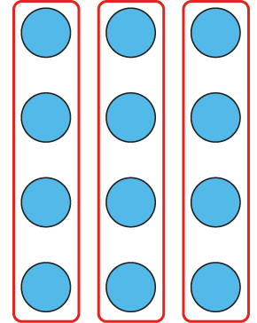
2.12 Division with remainders Step 2:2
Dividend = 16, divisor = 4:
16 ÷ 4 =
3 r 4
4
✓
✗
Notes:
The remainder can’t be equal to four, because we can make another group of four.
Sixteen divided into groups of four is equal to four.

Slide 28
2.12 Division with remainders Step 2:3
Is this correct? 17 ÷ 5 = 2 r 7
✗
Notes:
This is incorrect, because seven is greater than five.
The remainder should be less than the divisor.
We can make another group of five.

Slide 29
2.12 Division with remainders Step 2:3
17 ÷ 5 =
3 r 2
✓
Notes:
This is correct, because two is less than five.
The remainder is less than the divisor.
We can’t make another group of five.

Slide 30
2.12 Division with remainders Step 2:4
Equation | or | If , write the correct equation
✓
✗
✗
18 ÷ 4 = 3 r 6
✗
18 ÷ 4 = 4 r 2
20 ÷ 5 = 3 r 5
✗
20 ÷ 5 = 4
22 ÷ 6 = 3 r 4
✓
23 ÷ 7 = 3 r 2
✓
31 ÷ 8 = 3 r 7
✓

Slide 31
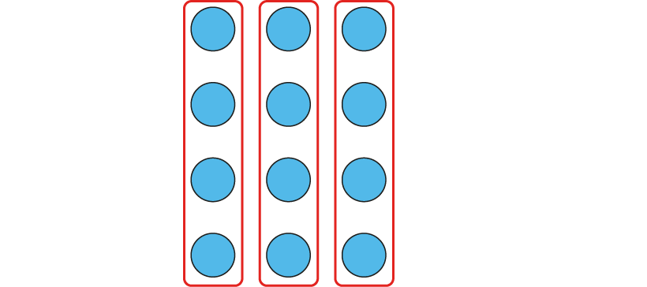
2.12 Division with remainders Step 2:4
Dividend = 12, divisor = 4:
3 fours
+ 4
+ 4
+ 4
multiple of 4
12 = 3 × 4 12 = 4 × 3
12 ÷ 4 = 3
Notes:
Twelve is the largest multiple of four that is
less than or equal to twelve.
Twelve is a multiple of four, so when it is divided into
groups of four there are none left over; there is no remainder.
Twelve divided into groups of four is equal to three.

Slide 32
2.12 Division with remainders Step 2:4
Dividend = 13, divisor = 4:
remainder of 1
3 fours
+ 4
+ 4
+ 4
12 = 3 × 4
13 = 3 × 4 + 1
not a multiple of 4
12 = 4 × 3
13 = 4 × 3 + 1
13 ÷ 4 = 3 r 1
Notes:
Twelve is the largest multiple of four that is
less than or equal to thirteen.
Thirteen is not a multiple of four, so when it
is divided into groups of four there are some
left over; there is a remainder.
Thirteen divided into groups of four is equal
to three with a remainder of one.

Slide 33
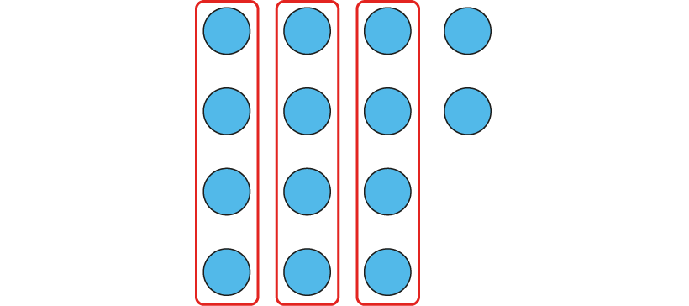
2.12 Division with remainders Step 2:4
Dividend = 14, divisor = 4:
remainder of 2
3 fours
+ 4
+ 4
+ 4
12 = 3 × 4
14 = 3 × 4 + 2
not a multiple of 4
12 = 4 × 3
14 = 4 × 3 + 2
14 ÷ 4 = 3 r 2
Notes:
Twelve is the largest multiple of four that is
less than or equal to fourteen.
Fourteen is not a multiple of four, so when it
is divided into groups of four there are some
left over; there is a remainder.
Fourteen divided into groups of four is equal
to three with a remainder of two.

Slide 34
2.12 Division with remainders Step 2:4
Dividend = 15, divisor = 4:
remainder of 3
3 fours
+ 4
+ 4
+ 4
12 = 3 × 4
15 = 3 × 4 + 3
not a
multiple of 4
12 = 4 × 3
14 = 4 × 3 + 3
15 ÷ 4 = 3 r 3
Notes:
Twelve is the largest multiple of four that is
less than or equal to fifteen.
Fifteen is not a multiple of four, so when it
is divided into groups of four there are some
left over; there is a remainder.
Fifteen divided into groups of four is equal
to three with a remainder of three.

Slide 35
2.12 Division with remainders Step 2:4
Dividend = 16, divisor = 4:
4 fours
+ 4
+ 4
+ 4
+ 4
multiple
of 4
16 = 4 × 4
16 ÷ 4 = 4
Notes:
Sixteen is the largest multiple of four that is
less than or equal to sixteen.
Sixteen is a multiple of four, so when it
is divided into groups of four there are none
left over; there is no remainder.
Sixteen divided into groups of four is equal
to four.

Slide 36
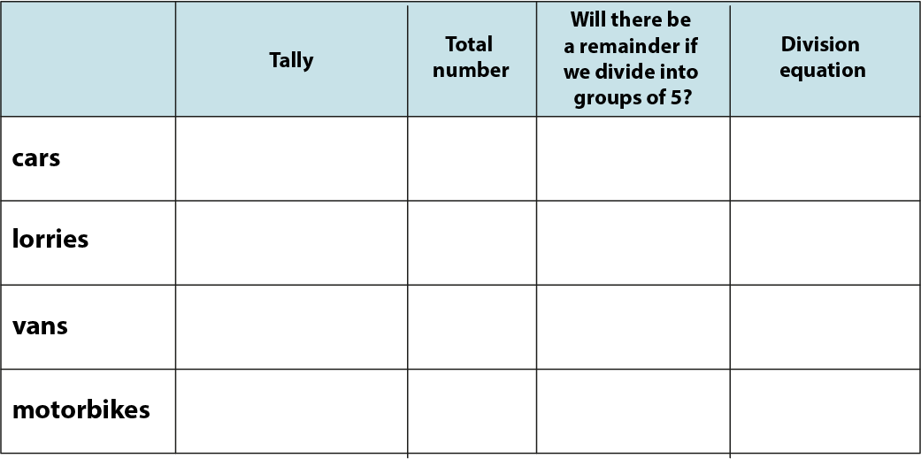
2.12 Division with remainders Step 2:5
Fill in the table.
24
yes
24 ÷ 5 = 4 r 4
12
yes
12 ÷ 5 = 2 r 2
10
no
10 ÷ 5 = 2
6
yes
6 ÷ 5 = 1 r 1
Notes:
Paul records the different numbers of vehicles that drive past the school gate in an hour.
Here are his results. Fill in the rest of the table.

Slide 37
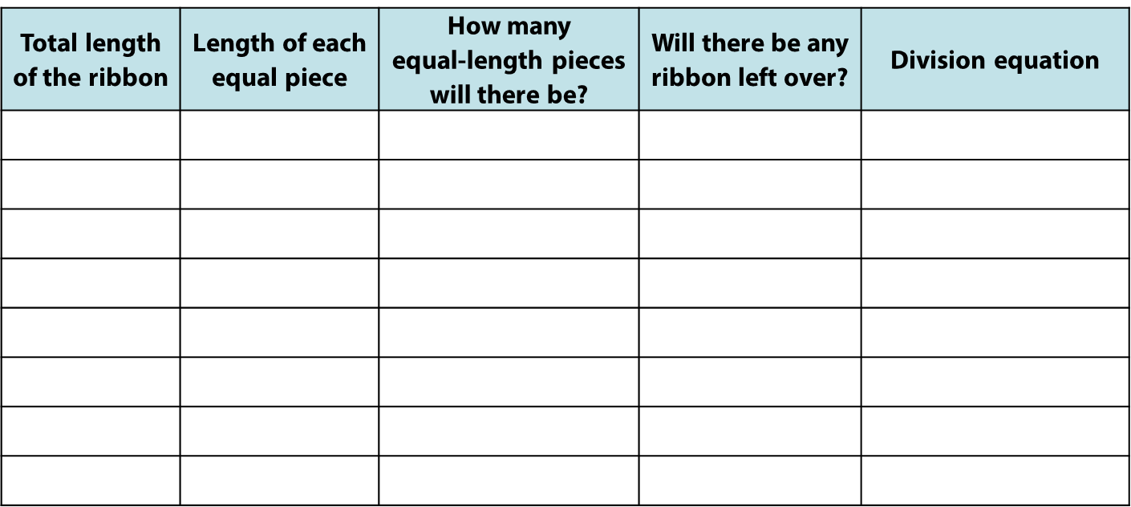
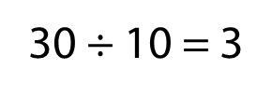
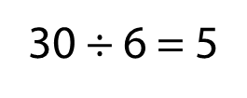
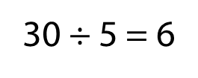
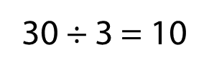
2.12 Division with remainders Step 2:5
30 cm ribbon cut into equal lengths. Fill in the table.
30
3
10
no
30
4
7
yes
30
5
6
no
30
6
5
no
30
7
4
yes
30
8
3
yes
30
9
3
yes
30
10
3
no
Notes:
A dressmaker has a ribbon that is thirty centimetres long. She wants to cut it into equal lengths. Fill in the table to show how many
lengths she could make and whether there will be any ribbon left over.

Slide 38
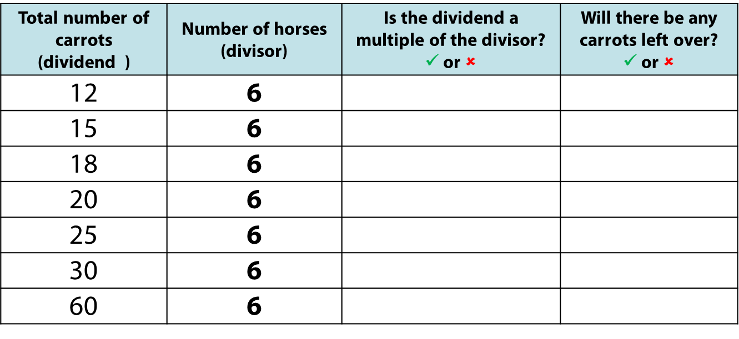
2.12 Division with remainders Step 2:5
Carrots are shared equally between 6 horses. Fill in the table.
✓
✗
✗
✓
✓
✗
✗
✓
✗
✓
✓
✗
✓
✗

Slide 39
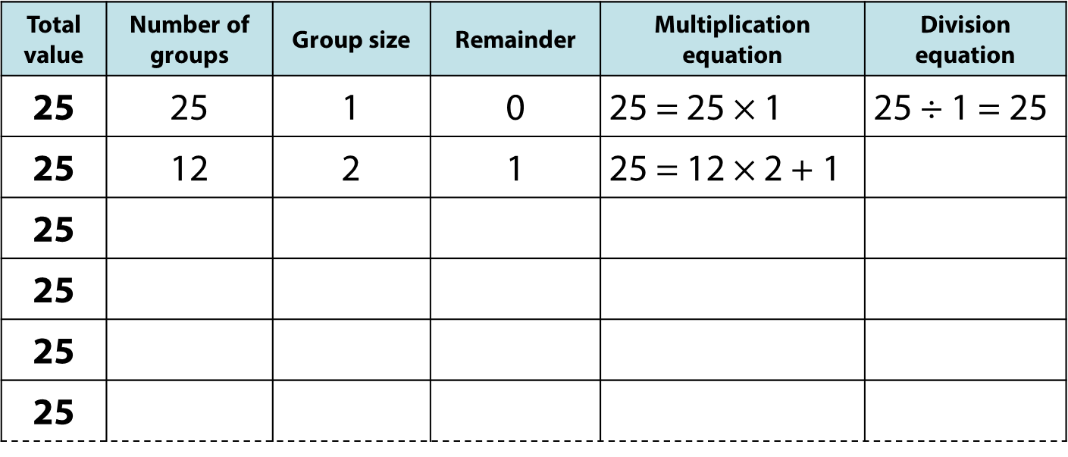
2.12 Division with remainders Step 2:5
Notes:
Find as many ways as you can to divide twenty-five into equal groups.
When will there be a remainder?
Write both a multiplication and a division equation to represent each of your answers. Use the number line to help you.

Slide 40
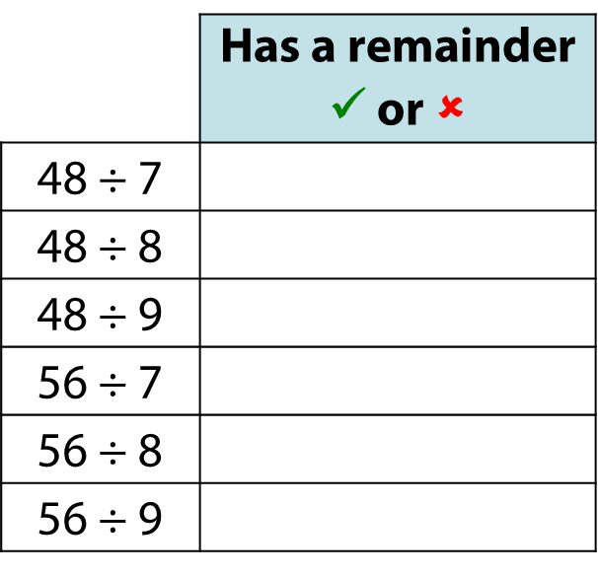
2.12 Division with remainders Step 2:5
✓
✗
✓
✗
✗
✓

Slide 41
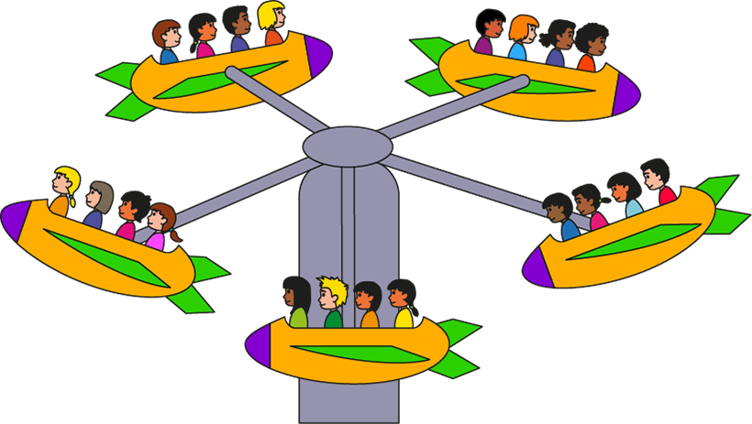
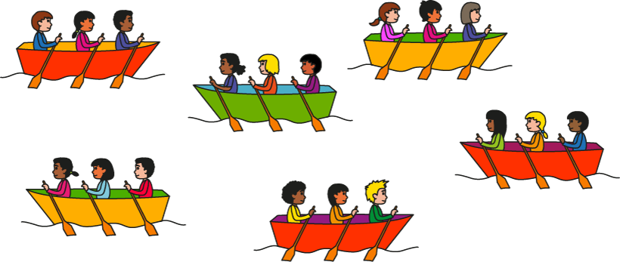
2.12 Division with remainders Step 2:6
Children on the boats swap with children on the ride.
What pair of expressions describe the new situation?
5 × 3 + 5 and 5 × 3 + 3
5 × 3 + 3 and 3 × 6 + 2
6 × 3 + 2 and 4 × 4 + 2
None of these.
✓
Notes:
If the children on the boats swapped with the children on the ride,
what pair of expressions would describe the new situation?

Slide 42
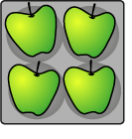
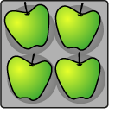
2.12 Division with remainders Step 3:1
23 apples, in trays of 4.
How many trays? How many apples left over?
23 ÷ 4 = 5 r 3
5 trays; 3 apples left over.
Notes:
The “23” represents the total number of apples .
The “4” represents the number of apples in each tray.
The “5” represents the number of full trays that can be made.
The “3” represents the number of apples left over.
So, the grocer can make fill full trays of apples; he
will have three apples left over.

Slide 43
2.12 Division with remainders Step 3:1
23 apples are shared equally between 4 children.
How many apples does each child get? How many apples are left over?
23 ÷ 4 = 5 r 3
5 apples each; 3 left over.
Notes:
The “23” represents the total number of apples.
The “4” represents the number of children the apples are shared between.
The “5” represents the equal number of apples that each child gets.
The “3” represents the number of apples left over.
So, the children get five apples each; there are three apples left over.

Slide 44
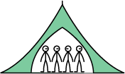
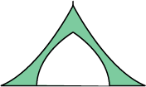
2.12 Division with remainders Step 3:2
4 scouts can fit in each tent. How many tents needed for 30 scouts?
30 ÷ 4 = 7 r 2
8 tents needed.
Notes:
Will all of the scouts fit into seven tents? (No)
Why not? (If there are seven tents, there are two scouts left over.)
So how many tents will we need to fit all of the scouts into tents?
(Eight; we need seven tents of four scouts, and another tent for the two left-over scouts.)
The “30” represents the total number of scouts.
The “4” represents the number of scouts in each tent.
The “7” represents the number of full tents.
The “2” represents the number of scouts left over.

Slide 45
2.12 Division with remainders Step 3:3
34 biscuits, on plates of 6. How many full plates?
34 ÷ 6 = 5 r 4
5 full plates.
Notes:
The “34” represents the total number of biscuits.
The “6” represents the number of biscuits on each plate.
The “5” represents the number of plates of biscuits.
The “4” represents the number of biscuits left over.
So, five full plates of biscuits can be made.

