Slide 1
Series 3 Episode 25
Twelve

Slide 2
Practitioner Notes

Slide 3
Episode Description
Ten and Two have fun combining themselves into Twelve – a Super Rectangle who has a special power with flashing rays. These rays help Twelve to perform an array display along with a catchy song which shows how she can split into rows or columns by switching and turning. Twelve’s amazing performance reveals that there are 8 different ways to arrange herself in an array.

Slide 4
Maths in the Episode
Equal Groups in 12
In this episode, Twelve is shown to be composed from 6 different equal groups when she calls “SWITCH!” The term array (a grid arrangement containing complete rows and columns) is introduced. Arrays are described by the number of rows and columns using the word by – for example, a ‘6 by 2’ array.
Arrays are a powerful way of showing how multiplication is commutative (the product of two factors is the same irrespective of the order in the calculation, so 6 x 2 = 2 x 6). Twelve shows this by calling out “TURN!”, rotating the same array by a quarter turn and then switching.

Slide 5
Using Mathematical Language
Use these stem sentences to rehearse the mathematical ideas in the programme:
“<3> <fours> are 12.”
“<4> <threes> are 12.”
“12 is made from <3> rows of <four>.”
“12 is made from <4> columns of <three>.”
“12 is made with a <3> by <4> array.”
Notes:
Text inside < > indicates what can be changed in the stem sentence.

Slide 6
Talk and Discuss Together

Slide 7
Talk and Discuss Together
Watch the episode of Numberblocks. First ask the children what they noticed and allow them to talk to you and each other.
What do you know about Twelve?
The following slides are designed to stimulate children and adults to talk about the episode and draw out some key aspects of the mathematics.

Slide 8
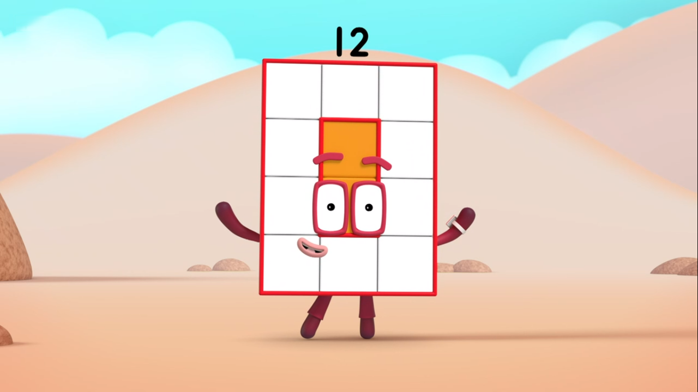
Images © 2017 Alphablocks Ltd. All Rights Reserved.
Notes:
Use this slide for Talk and Discuss together.

Slide 9
Enabling Environments in Reception

Slide 10
Enabling Environments
Playing and Exploring
Draw different sized arrays with chalk on the ground in the outside area to use as a base for noughts and crosses or Connect 4 types of games.
Create a class face register (using pictures of the children’s faces) on a 6 by 5 (or appropriate) array.
Provide real life arrays (for example, bun tins) which children can fill with a variety of objects.
Active Learning
Notice whether children subitise a small group of objects. For example, if they say “3” when they see a row of three biscuits.
Creating and Thinking Critically
Make array boards for 12 (Slide 11) cover them with different coloured or different sized blocks (Slide 12).

Slide 11
Notes:
Print off as a base board to accompany slide 12.

Slide 12
Notes:
Print and cut along dotted lines only. Use for matching to the baseboard in slide 11.

Slide 13
Learning Together in Y1

Slide 14
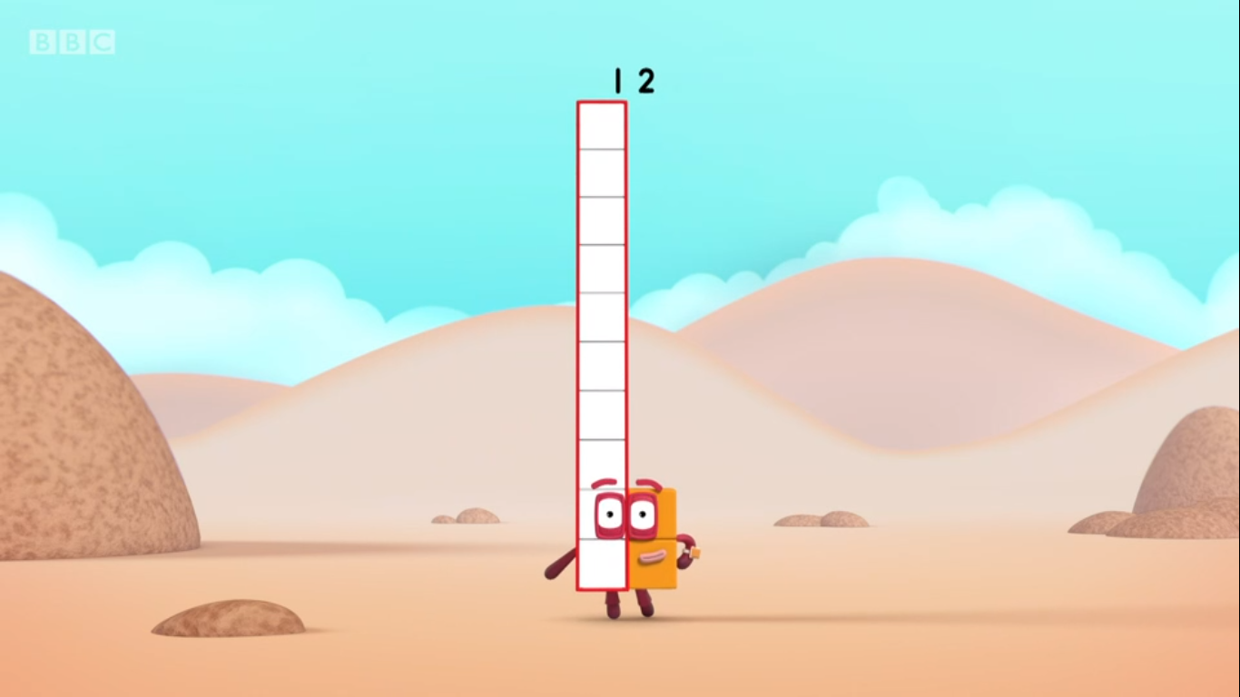
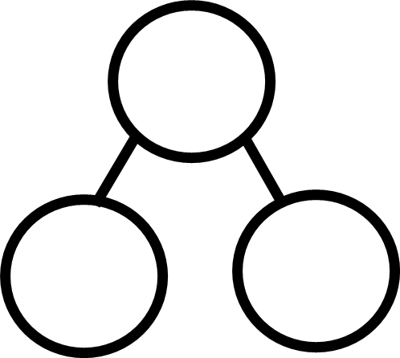






is made from
and .
Images © 2017 Alphablocks Ltd. All Rights Reserved.
Notes:
Use this slide to discuss the composition of 12 as 10 and 2, and that this can be written either as 10 and 2 or 2 and 10.
Discuss:
How can we turn the full tens frame into 12? (12 is made from 10 and 2 so we need 2 more.)
How does the part-part-whole diagram show that 12 is made from 10 and 2? Does it matter in which order we write the parts?
How can we record that 12 can be partitioned into 10 and 2 using numbers and symbols or in an equation?
What’s the same/what’s different about the equations? (The whole or sum is the same, but the parts or addends have changed places.)

Slide 15
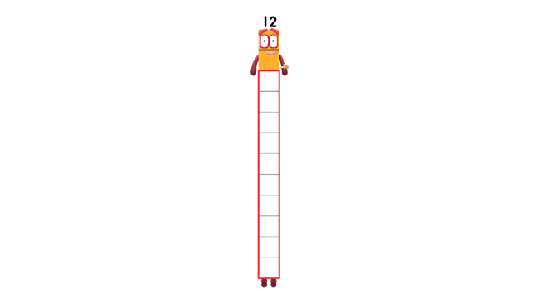
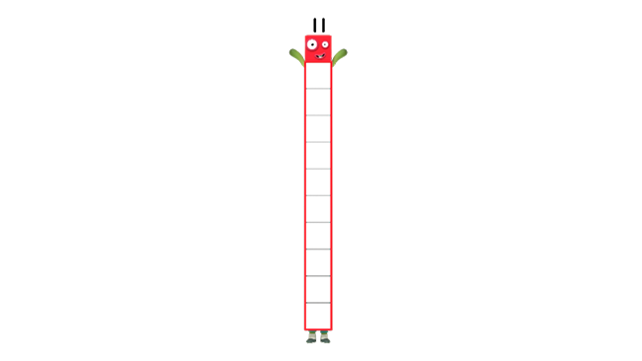
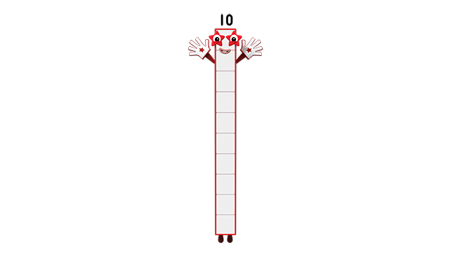
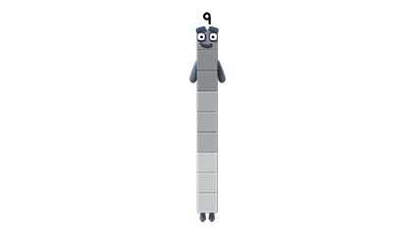
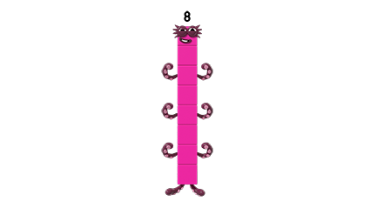
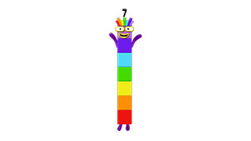
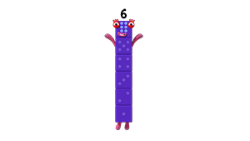
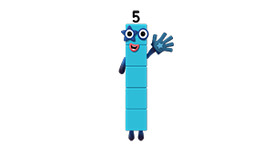
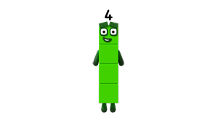
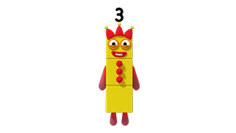
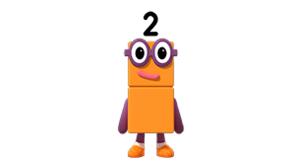









Images © 2017 Alphablocks Ltd. All Rights Reserved.
Notes:
Use this slide to count along the number line to 12 and back again.

Slide 16
Further activities for Y1
Discuss other occurrences of 12 in their experiences. For example, 12 hours on an analogue clock, 12 months in a year, 12 inch pizzas, using ‘dozen’ to represent 12 eggs, Chinese New Year – animal cycles, 12 days of Christmas.
Sort representations of 12 in arrays and not arrays.
When children notice arrays, model using the language of ‘row’ and ‘column’ to describe the array.
Represent 12 on a tens frame in different ways using 10 red and 2 yellow double-sided counters.

Slide 17
Learning Together in Y2

Slide 18
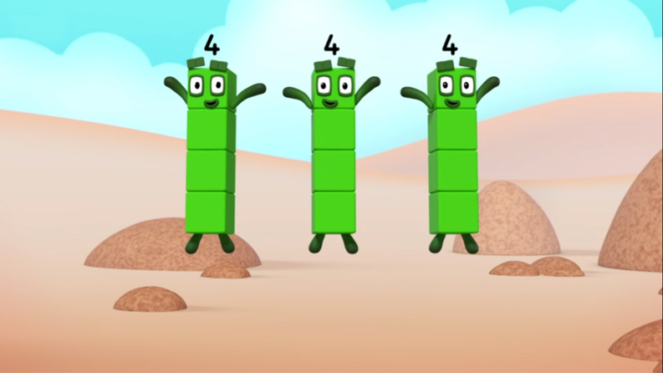
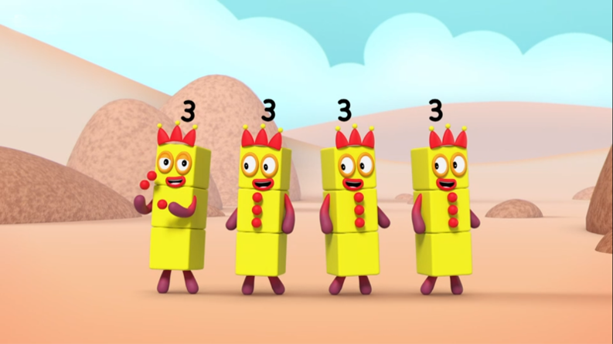
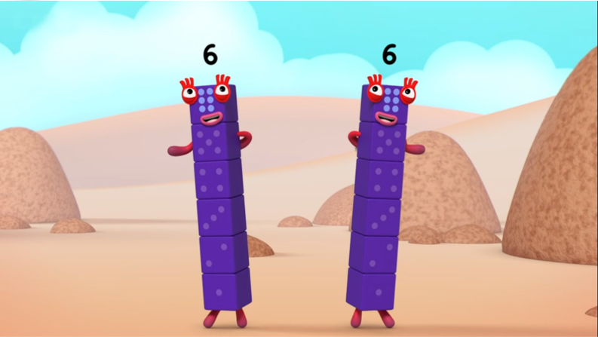
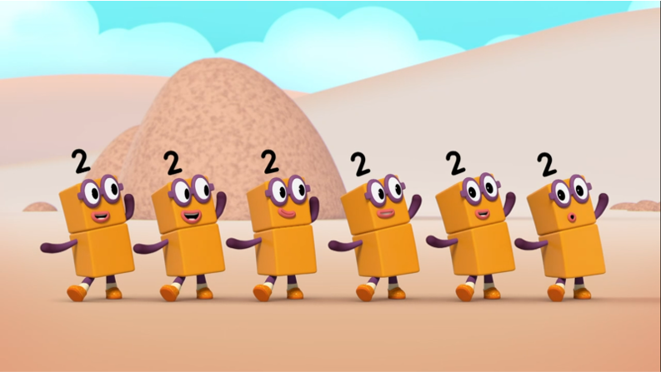
A
B
C
D
Images © 2017 Alphablocks Ltd. All Rights Reserved.
Notes:
Use this slide to rehearse describing what they see.
A: I see 3 Fours.
B: I see 4 Threes.
C: I see 2 Sixes.
D: I see 6 Twos.

Slide 19
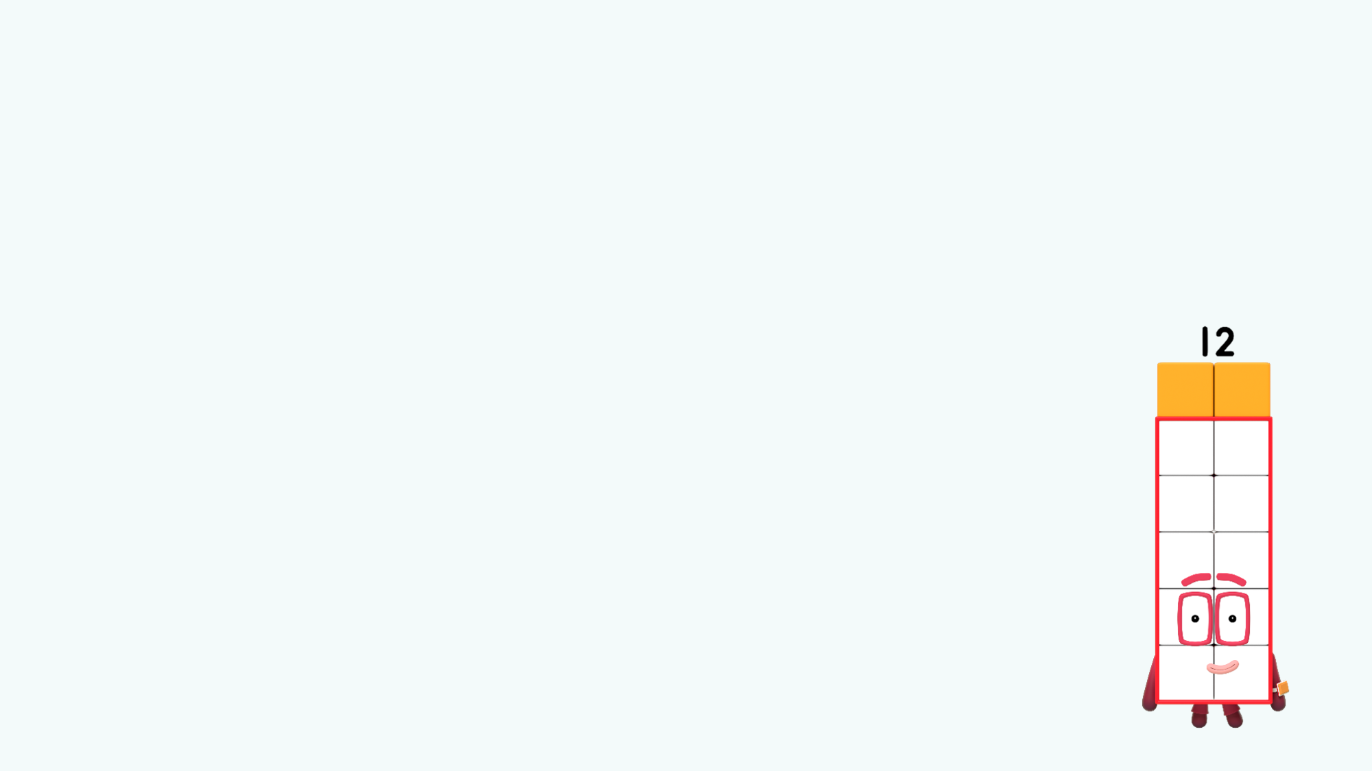
I see six twos.
I see a 2 by 6 array.
TURN!
Images © 2017 Alphablocks Ltd. All Rights Reserved.
Notes:
Ask the children to discuss and build what they see.
As the slide animates, count the number of twos: one two, two twos…
How many twos can you see? (I can see 6 twos.)
Can you run your finger along the rows of two on your model?
How many blocks are there altogether? (There are 12 blocks altogether.)
How can we describe the array using the word “by”? (It is a 2 by 6 array.)

Slide 20
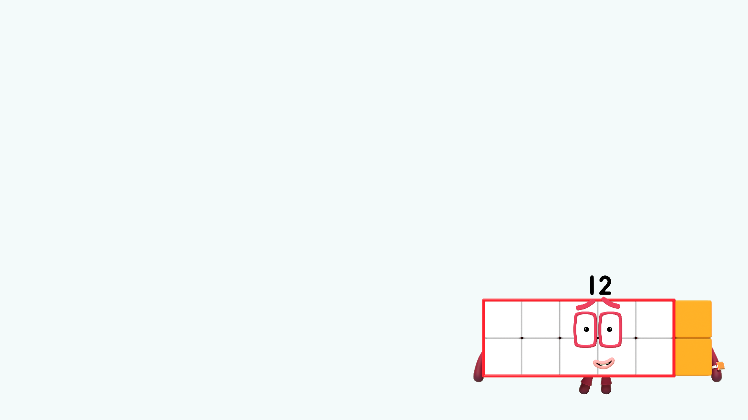
I see two sixes.
SWITCH!
I see a 6 by 2 array.
Images © 2017 Alphablocks Ltd. All Rights Reserved.
Notes:
Can you turn your array around so it looks the same as this one?
As the slide animates, count the number of sixes: one six, two sixes.
How many sixes can you see? (I can see 2 sixes.)
Can you run your finger along the rows of six on your model?
How many blocks are there altogether? (There are 12 blocks altogether.)
How can we describe the array using the word “by”? (It is a 6 by 2 array.)

Slide 21
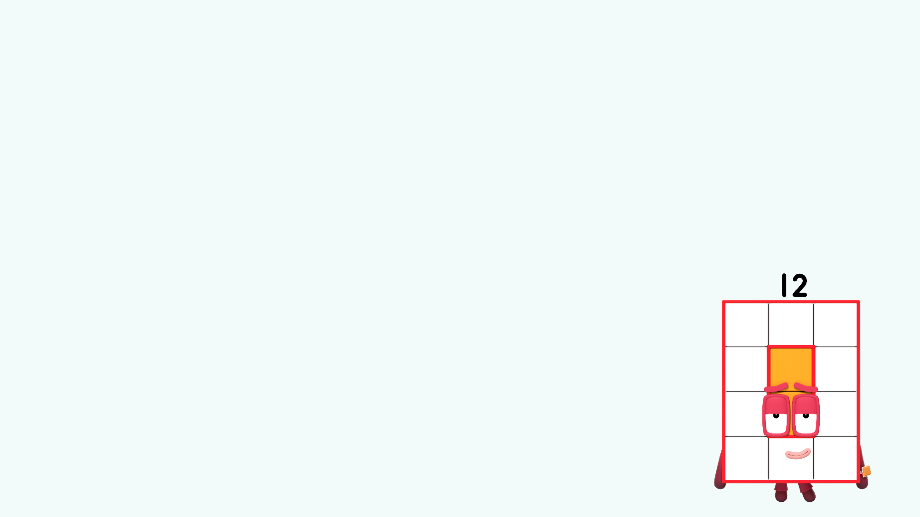
I see a 3 by 4 array.
I see three fours.
TURN!
Images © 2017 Alphablocks Ltd. All Rights Reserved.
Notes:
Ask the children to discuss and build what they see.
As the slide animates, count the number of fours: one four, two fours…
How many fours can you see? (I can see 3 fours.)
Can you run your finger along the rows of three on your model?
How many blocks are there altogether? (There are 12 blocks altogether.)
How can we describe the array using the word “by”? (It is a 3 by 4 array.)

Slide 22
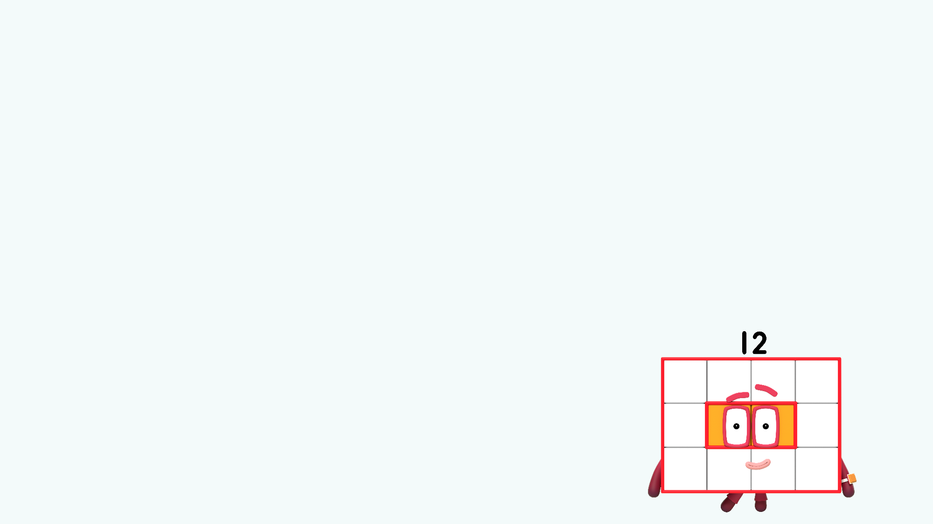
SWITCH!
I see four threes.
I see a 4 by 3 array.
Images © 2017 Alphablocks Ltd. All Rights Reserved.
Notes:
Can you turn your array around so it looks the same as this one?
As the slide animates, count the number of threes: one three, two threes…
How many threes can you see? (I can see 4 threes.)
Can you run your finger along the rows of four on your model?
How many blocks are there altogether? (There are 12 blocks altogether.)
How can we describe the array using the word “by”? (It is a 4 by 3 array.)

Slide 23
Further activities for Y2
Model using the words row and column to describe arrays and encourage the children to begin to use these words. Support their understanding by using your arm, placing it horizontally for ‘row’ and vertically for ‘column’. Ask children to copy you and say the words together.
Find examples of arrays in real life – bun tins, egg boxes, paint tins.
Use uncoloured arrays to identify the number in each row and in each column and describe as (for example) 3 by 4 or 4 by 3.
Complete sentences to describe a given array such as: “There are __ blocks in each row.” “There are __ blocks in each column.” “There are __ rows.” “There are __ columns.”
Match arrays to a description (for example, 3 by 4).
Provide opportunities for children to make their own arrays using 12 small objects. Encourage them to place objects equally spaced in a row and then replicate it underneath.
Draw arrays on squared paper by counting the number of blocks in each row and the number of blocks in each column. Shade rows or columns.

