Slide 1
Series 3 Episode 30
Step Squad

Slide 2
Practitioner Notes

Slide 3
Episode Description
One loses her balloon and needs Step Squad to help her retrieve it. She discovers that there is actually more than one Step Squad. Every time she bumps into a new Numberblock, a new Step Squad is discovered and their balloons fly away too. Thankfully, Super-Special Step-Shaped Secret Agent Fifteen finally helps solve the problem to retrieve everyone's balloons.

Slide 4
Maths in the Episode
Composition of step numbers/triangular numbers
In this episode the children will see how some numbers are made from the sum of consecutive numbers, for example:
3 = 1 + 2
6 = 1 + 2 + 3
10 = 1 + 2 + 3 + 4
15 = 1 + 2 + 3 + 4 + 5
3, 6, 10 and 15 form steps when they are combined in order. These numbers also form a triangular pattern which is evident in the patterns on the trees in the episode.

Slide 5
Using Mathematical Language
Use these stem sentences to rehearse the mathematical ideas in the programme:
“I see a pattern of <1>, <2>, <3> …”
“<3> is made from <1> and <2>.”
“Each step increases by 1.”
Notes:
Text inside < > indicates what can be changed in the stem sentence.

Slide 6
Talk and Discuss Together

Slide 7
Talk and Discuss Together
Watch the episode of Numberblocks. Use the following picture as a stimulus. Have you ever lost a balloon? Did you get it back?
What do you notice about the balloons in the picture?
The following slides are designed to stimulate children and adults to talk about the episode and draw out some key aspects of the mathematics.

Slide 8
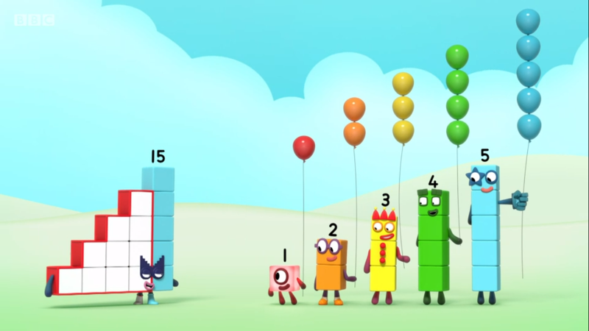
Images © 2017 Alphablocks Ltd. All Rights Reserved.
Notes:
Use this picture as the stimulus for Talk and Discussion (slide 7).

Slide 9
Enabling Environments in Reception

Slide 10
Enabling Environments
Playing and Exploring
Challenge the children to use the block-play area outside to make steps to reach something that is too high for them at ground level. Count the blocks needed in each step.
Active Learning
Notice whether the children use the language of ‘one more’ to compare the different heights of step patterns. Model using language such as “I wonder how many blocks I need to make this step taller?”
Creating and Thinking Critically
Use coloured unmarked rods (for example, Cuisenaire™ rods) that increase in length by 1 cube and put them in order by comparing their lengths. Play a game where one child or adult removes one of the rods and messes up the step pattern. What colour is missing? Where would it go?

Slide 11
Learning Together in Y1

Slide 12
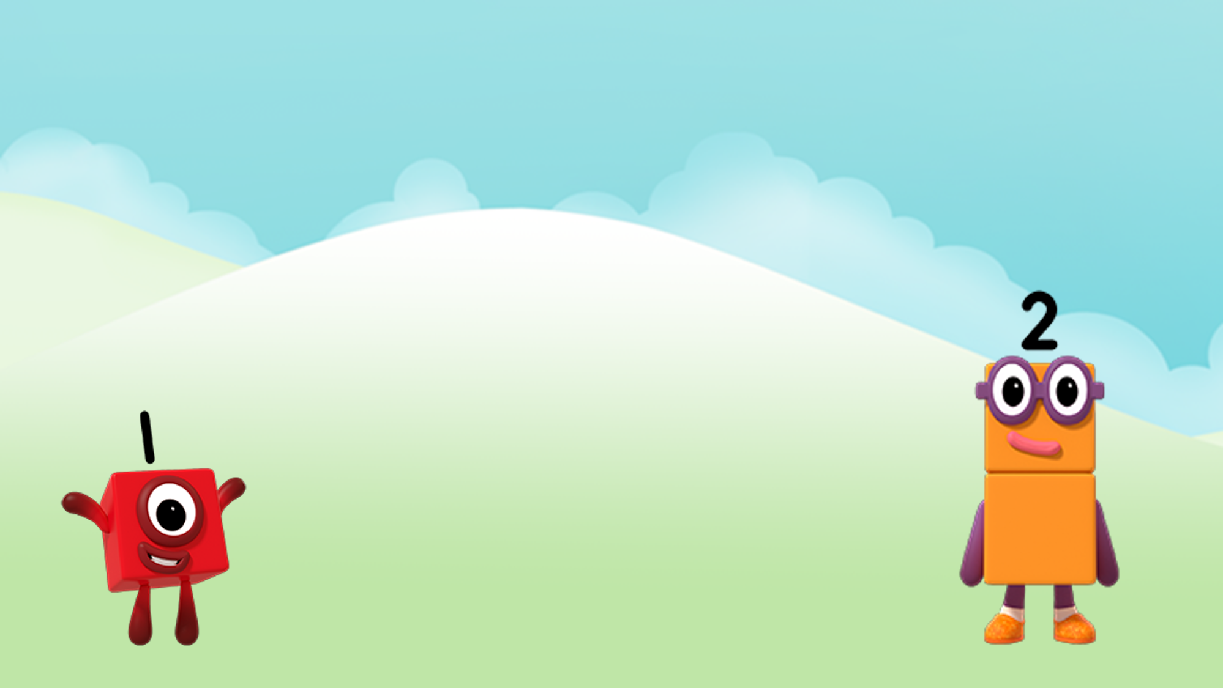

How many balloons?
I see ___ balloons.
Images © 2017 Alphablocks Ltd. All Rights Reserved.
Notes:
Discuss:
How can we work out how many balloons are hiding?
How many balloons do you think each Numberblock is holding? (One and Two are holding the same number of balloons that they each represent: One is holding 1 balloon, and Two is holding 2 balloons.)
What other clues are there in the picture? (One string for each balloon.)
So how many balloons will we see altogether?

Slide 13
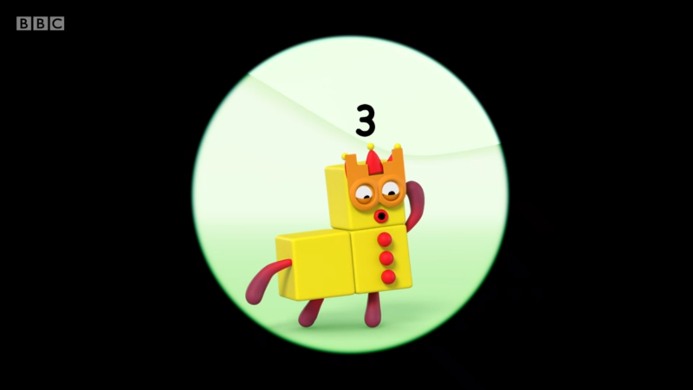
Images © 2017 Alphablocks Ltd. All Rights Reserved.
Notes:
Use this slide to compare the different representations for 1 + 2.
What is different about these representations?
What is the same? (They all represent 1 + 2 = 3)

Slide 14
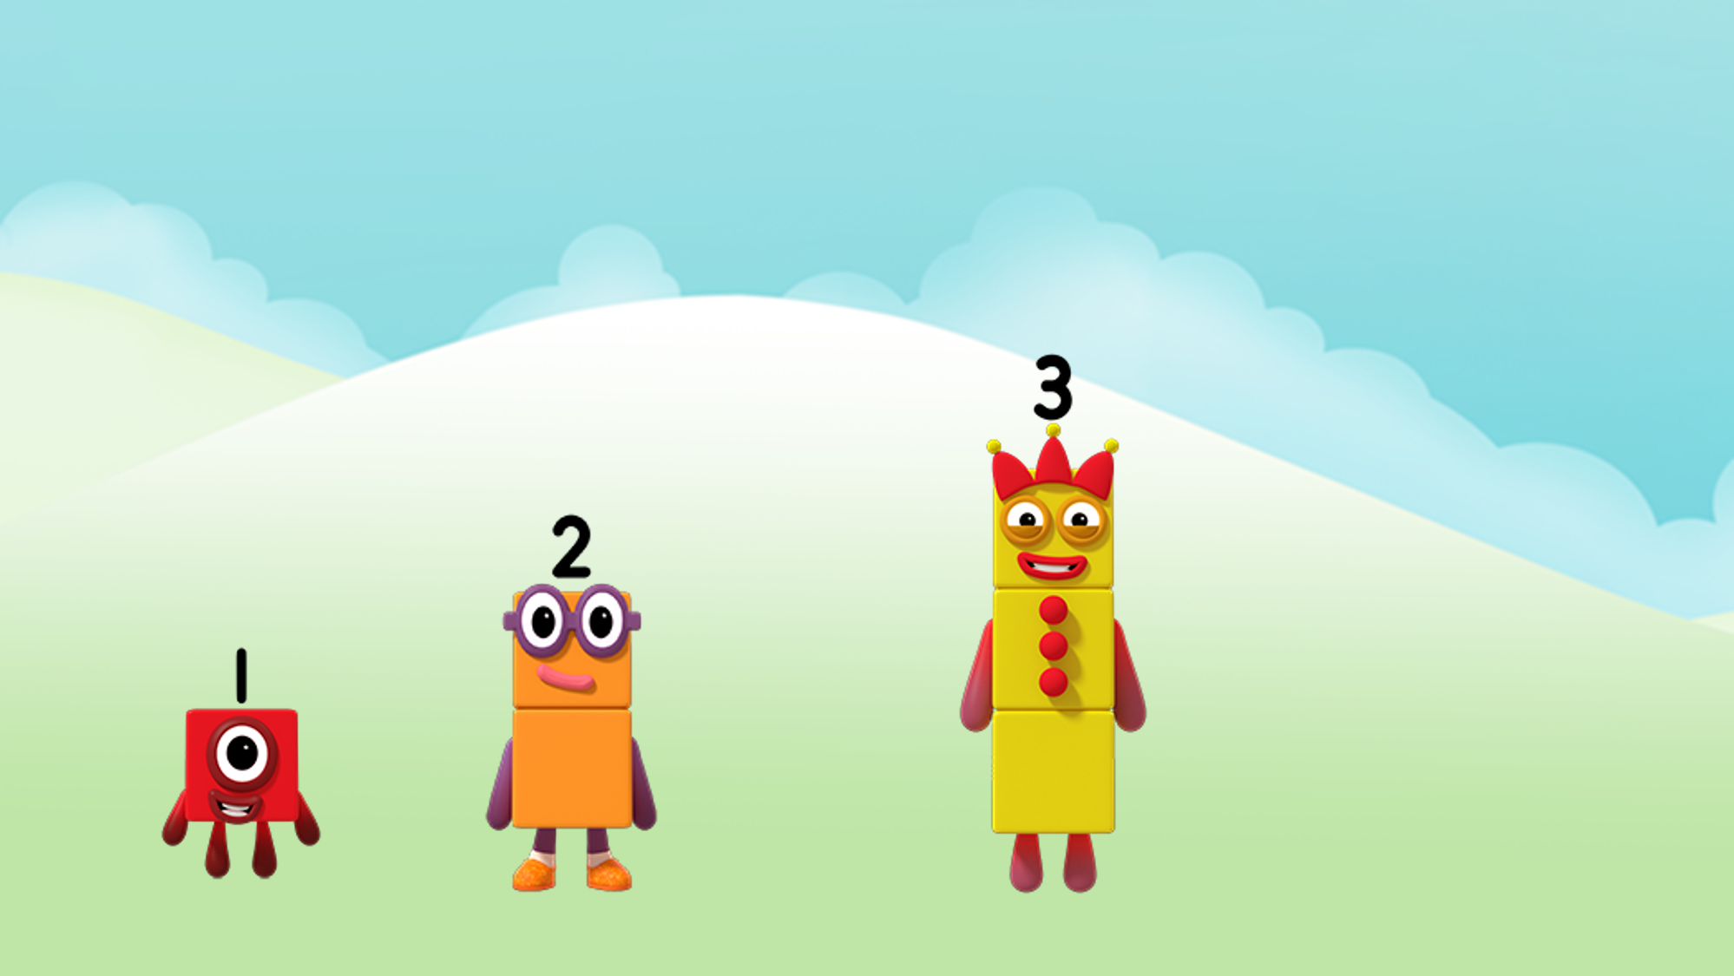

How many balloons?
I see ___balloons.
Images © 2017 Alphablocks Ltd. All Rights Reserved.
Notes:
Discuss:
How can we work out how many balloons are hiding this time?
Can we use any information from the previous slide?
So, if we know that One and Two had 3 balloons altogether, and Three has 3 balloons, how many balloons will we see altogether?

Slide 15
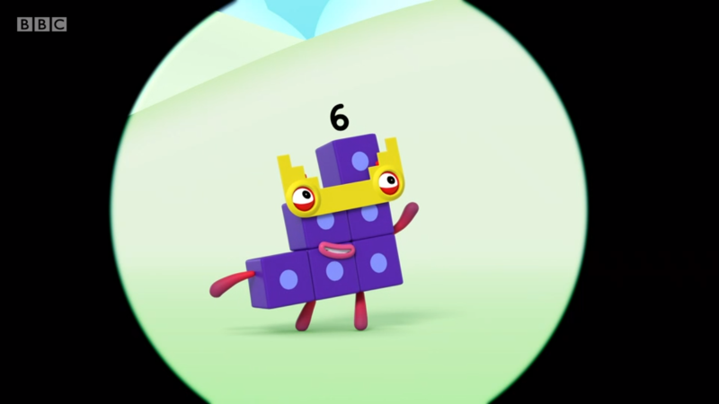
Images © 2017 Alphablocks Ltd. All Rights Reserved.
Notes:
Use this slide to compare the different representations for 1 + 2 + 3.
What is different about these representations?
What is the same? (They all represent 1 + 2 + 3 = 6)

Slide 16
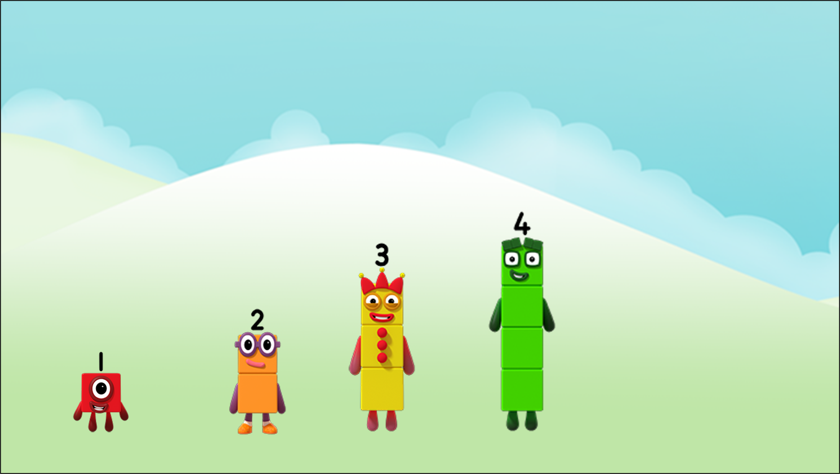

How many balloons?
I see ___ balloons.
Images © 2017 Alphablocks Ltd. All Rights Reserved.
Notes:
Discuss:
How can we work out how many balloons are hiding this time?
Can we use any information from the previous slide?
So, if we know that there were 6 balloons before Four appeared with 4 more balloons, will that help us to find out how many there are now?
(You could make towers of cubes to represent the steps so that children can see the pattern of steps and how it is made up of the different numbers to help them.)

Slide 17
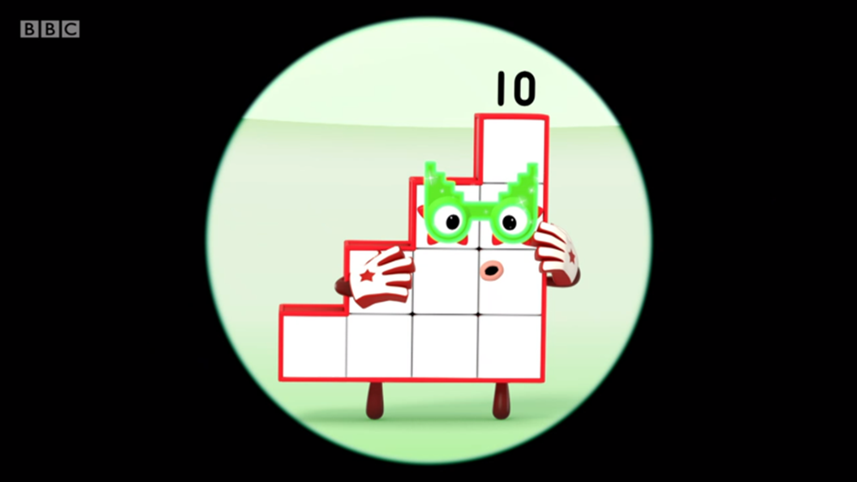
Images © 2017 Alphablocks Ltd. All Rights Reserved.
Notes:
Use this slide to compare the different representations for 1 + 2 + 3 + 4.
What is different about these representations?
What is the same? (They all represent 1 + 2 + 3 + 4 = 10)

Slide 18
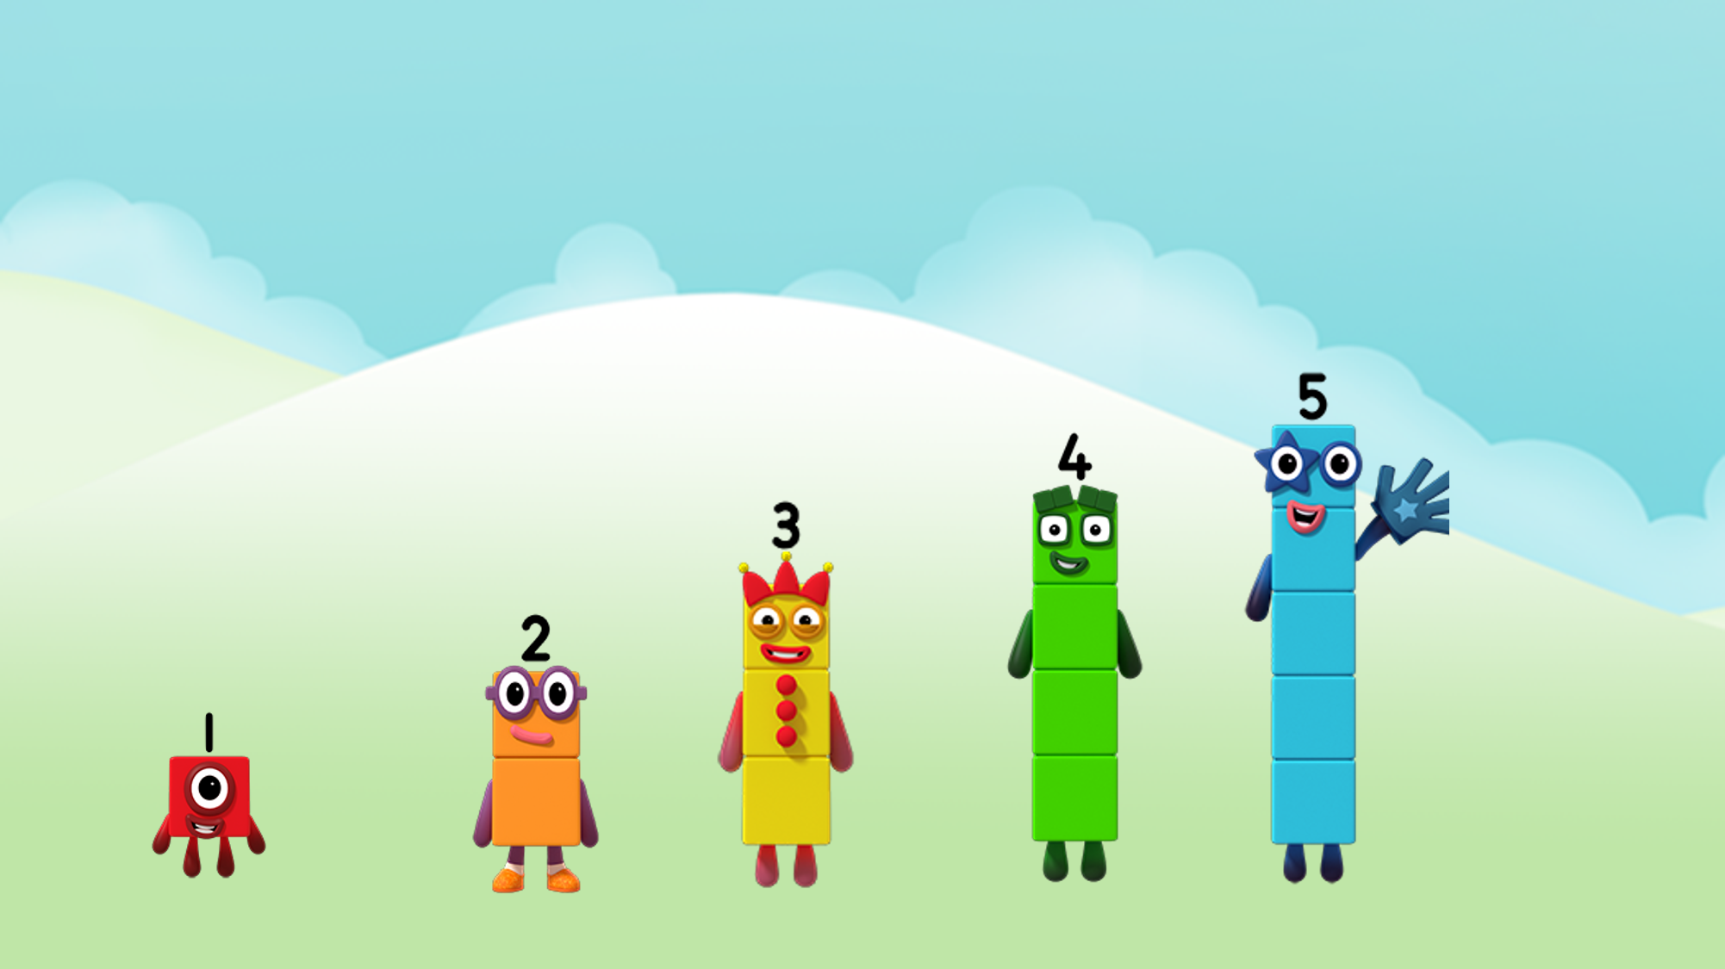

How many balloons?
There are ___ balloons.
Images © 2017 Alphablocks Ltd. All Rights Reserved.
Notes:
Discuss:
How can we work out how many balloons are hiding this time?
Can we use any information from the previous slide?
So, if we know that there were 10 balloons before Five appeared with 5 more balloons, will that help us to find out how many there are now?
Make a tower of five cubes and place it next to the previous steps.

Slide 19
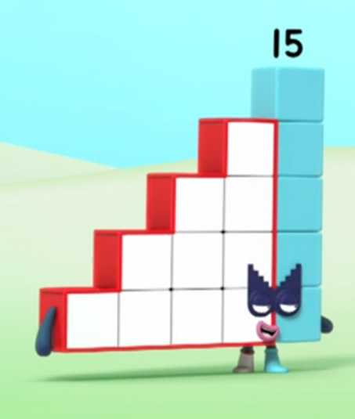
Images © 2017 Alphablocks Ltd. All Rights Reserved.
Notes:
Use this slide to compare the different representations for 1 + 2 + 3 + 4 + 5.
What is different about these representations?
What is the same? (They all represent 1 + 2 + 3 + 4 + 5 = 15)

Slide 20
Further activities for Y1
Provide opportunities for children to use equipment (perhaps using connecting cubes or Cuisenaire™ rods) to create their own step patterns and to talk about what they have made.
Explore ways of representing how consecutive numbers are made of one more than the previous number. (For example, coins, Numicon-type shapes, Dienes blocks, connecting cubes, to show that 13 is one more than 12.)

Slide 21
Learning Together in Y2

Slide 22
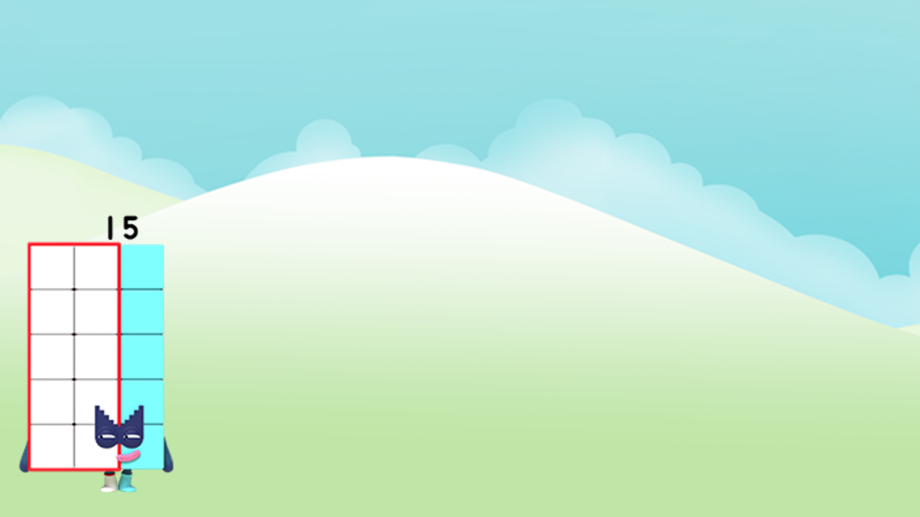
Step Squad or
Sneaky Step Squad?
Step Squad!
Images © 2017 Alphablocks Ltd. All Rights Reserved.
Notes:
Use this slide to prove why Fifteen is a ‘real’ Step Squad member.
How do you know that Fifteen is a member of the Step Squad? Discuss in partners.
Fifteen is made from 1 + 2 + 3 + 4 + 5.

Slide 23

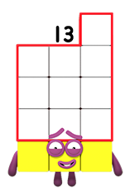
Sneaky Step Squad!
Step Squad or
Sneaky Step Squad?
Images © 2017 Alphablocks Ltd. All Rights Reserved.
Notes:
Discuss:
How can we check if Thirteen is a member of the Step Squad?
Watch the animation:
What do you notice? (Thirteen is not a member of the Step Squad because he isn’t the sum of the first Numberblocks from 1. BUT he can be made from two members of the Step Squad, Ten and Three. So we can say Thirteen is a member of the Sneaky Step Squad.)

Slide 24
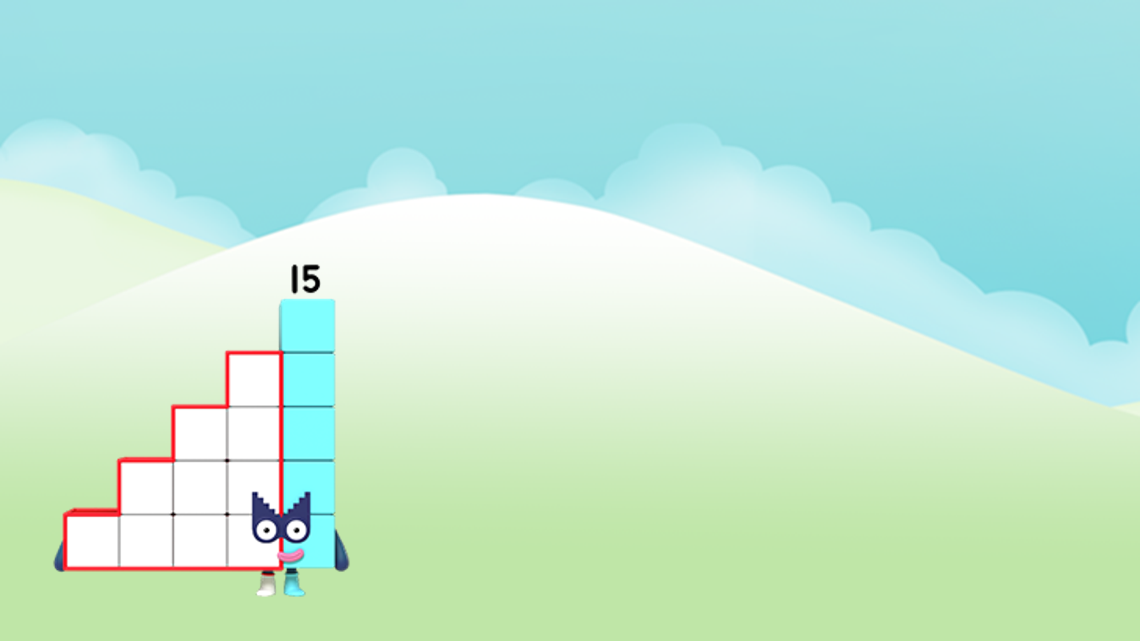
I wonder what
the other Numberblocks are?
Sneaky Step Squad!
Step Squad!
Images © 2017 Alphablocks Ltd. All Rights Reserved.
Notes:
Use this slide to set the children off on an investigation: to explore which Numberblocks are Step Squad members (made from consecutive numbers) and which are Sneaky Step Squad members (made from Step Squad members, including One).
The children could use squared paper and Numberblock colours to prove their findings.
After the children have investigated, sort the numbers under the headings: Step Squad or Sneaky Step Squad.
Ask the children to prove they know they are right (using pictures/ colours/equations).

Slide 25
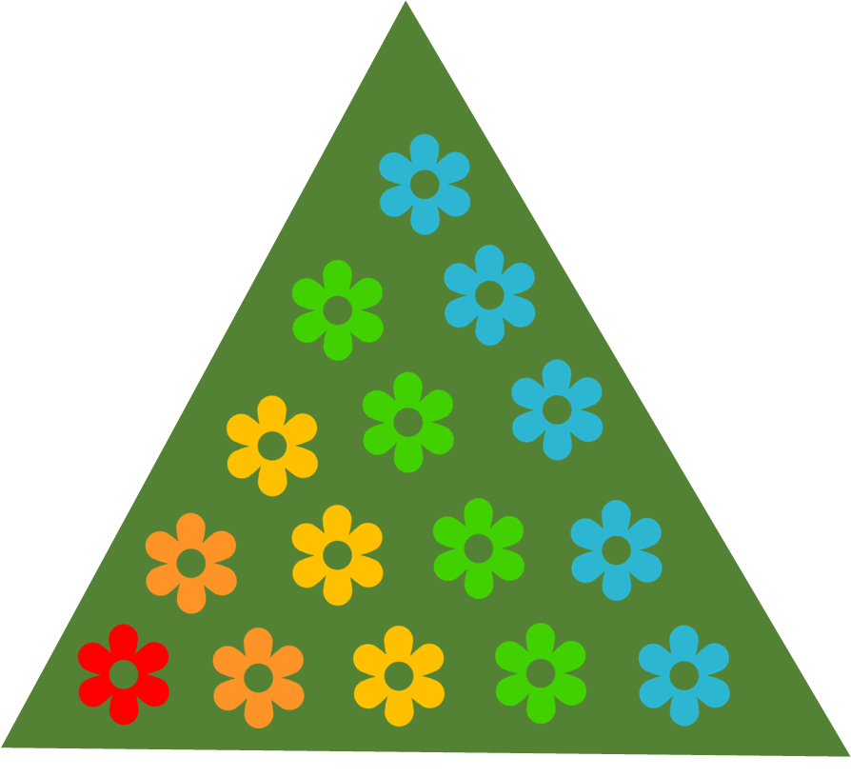
What do you notice about me and the flower pattern?
Images © 2017 Alphablocks Ltd. All Rights Reserved.
Notes:
Use this slide to explore how 15 can be arranged in steps (as in Fifteen) or in a triangular pattern.
Discuss:
What is different about Fifteen and the flower pattern on the tree? (flowers or blocks; step-shaped or triangle shaped)
What is the same about Fifteen and the flower pattern on the tree? (same number of blocks and flowers; both are made from 1+2+3+4+5 with the flowers in diagonals)
After the animation which rotates the tree, discuss what the children notice. (We can see rows of the same colour flowers as 1+2+3+4+5)

Slide 26





How many triangles?
Images © 2017 Alphablocks Ltd. All Rights Reserved.
Notes:
Use this slide as a challenge.
Discuss:
How many different triangles can you see?
How many 1 + 2 triangles? (The animation highlights an example. There are 10 in total.)
How many 1 + 2 + 3 triangles? (The animation highlights another example. There are 6 in total.)
What other arrangements of triangle could you see? How many of each?

Slide 27
Further activities for Y2
Allow opportunities for children to continue looking for larger Step Squad members using equipment and talking about what they notice.
Look for examples where there are step arrangements or triangular arrangements in real life (for example, stacking cans at the fair, red snooker balls, pool, ten-pin bowling)
Draw the different sized steps on square grid paper.
Draw the different sized triangles on isometric dot paper by joining the dots. Check the number of dots in each layer.

