Slide 1
Year 3, Unit 4
Manipulating the additive relationship and securing mental calculation

Slide 2
Year 3, Unit 4
These materials heavily reflect the prioritisation approach of the ready-to-progress criteria in the DfE Primary Mathematics Guidance 2020 and on the PPTs that exemplify them on the NCETM website. They also include other relevant National Curriculum content. Related sections of the NCETM Primary Mastery Professional Development Materials provide small-step teaching guidance.
Ready-to-progress criteria addressed by this unit
Teaching of this unit supports the following criteria from the ‘DfE Mathematics Guidance: key stages 1 & 2’ (the 335-page document available as a download)
3AS-3 Page 113
Prior learning
There are no specific ready-to-progress criteria supporting the prior learning for this unit.

Slide 3
Contents
The links below take you to the starting slide of each learning outcome.
1 | Pupils add two 3-digit numbers using partitioning
2 | Pupils add two 3-digit numbers using adjusting
3 | Pupils add a pair of 2- or 3-digit numbers using redistribution
4 | Pupils subtract a pair of 2- or 3-digit numbers, bridging a multiple of 10, using partitioning
5 | Pupils subtract a pair of 2-digit numbers, crossing a ten or hundreds boundary, by finding the difference between them
6 | Pupils subtract a pair of three-digit multiples of 10 within 1000 by finding the difference between them
Click the arrow button to return to this Contents slide.

Slide 4
Contents
The links below take you to the starting slide of each learning outcome.
7 | Pupils evaluate the efficiency of strategies for subtracting from a 3-digit number
8 | Pupils explain why the order of addition and subtraction steps in a multi-step problem can be chosen
9 | Pupils accurately and efficiently solve multi-step addition and subtraction problems
10 | Pupils understand and can explain that both addition and subtraction equations can be used to describe the same additive relationship (2-digit numbers)
Click the arrow button to return to this Contents slide.

Slide 5
Contents
The links below take you to the starting slide of each learning outcome.
11 | Pupils understand and can explain that both addition and subtraction equations can be used to describe the same additive relationship (3-digit numbers)
12 | Pupils use knowledge of the additive relationship to rearrange equations
13 | Pupils use knowledge of the additive relationship to identify what is known and what is unknown in an equation
14 | Pupils use knowledge of the additive relationship to rearrange equations before solving
Click the arrow button to return to this Contents slide.

Slide 6
Year 3, Unit 4, Learning Outcome 1
Learning Outcome 1
Pupils add two 3-digit numbers using partitioning
The following slides have been collated to support the teaching of this learning outcome.

Slide 7
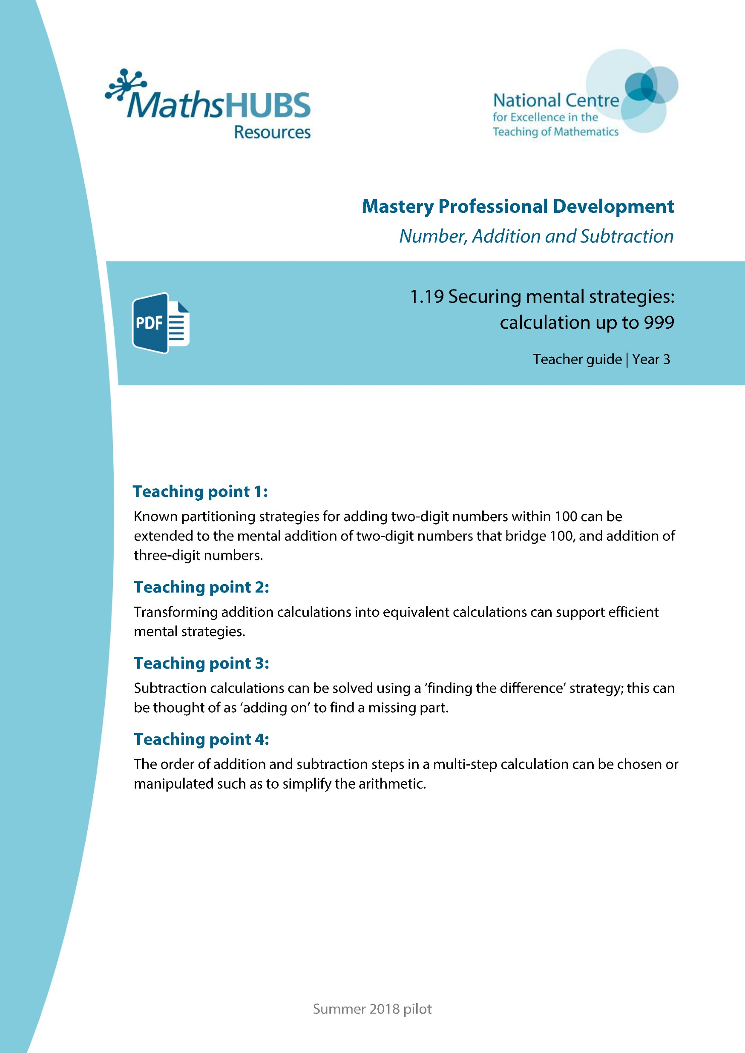
Year 3, Unit 4, Learning Outcome 1
Additional teacher guidance for this outcome should be read first and can be found in this segment of the NCETM Primary Mastery Professional Development Materials:
1.19 Securing Mental Strategies: calculation up to 999
The spine materials are divided into ‘teaching points’ and ‘steps in learning’.
Teaching point | Steps in learning | Pages
1 | 1:1-1:3 | 4-7

Slide 8
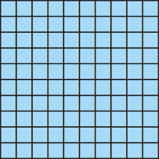
1.19 Securing mental strategies – step 1:1
87 + 56
= 130 + 13
= 143
80
7
50
6
130
13

Slide 9
1.19 Securing mental strategies – step 1:3
111
?
67
44

Slide 10
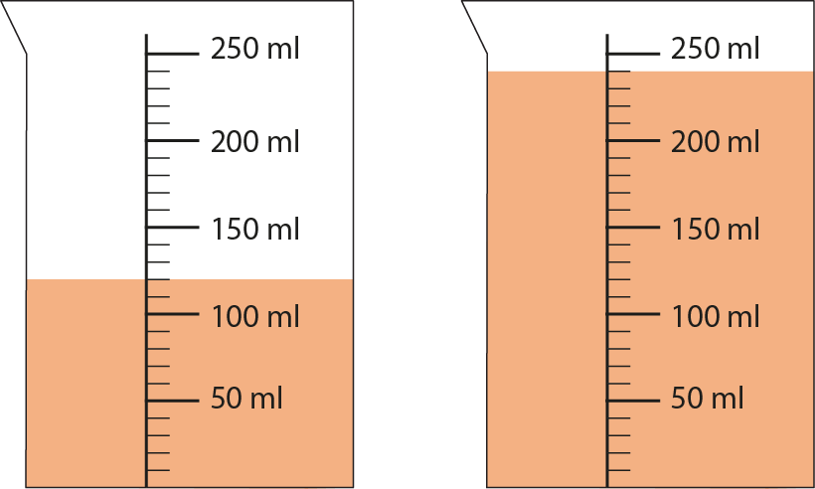
1.19 Securing mental strategies – step 1:3
120 ml
+
240 ml
= 360 ml

Slide 11
Year 3, Unit 4, Learning Outcome 2
Learning Outcome 2
Pupils add two 3-digit numbers using adjusting
The following slides have been collated to support the teaching of this learning outcome.

Slide 12
Year 3, Unit 4, Learning Outcome 2
Additional teacher guidance for this outcome should be read first and can be found in this segment of the NCETM Primary Mastery Professional Development Materials:
1.19 Securing Mental Strategies: calculation up to 999
The spine materials are divided into ‘teaching points’ and ‘steps in learning’.
Teaching point | Steps in learning | Pages
2 | 2:1-2:5 | 8-14

Slide 13
1.19 Securing mental strategies – step 2:1
35 + 49
= 30 + 40 + 5 + 9
= 70 + 14
= 84
Method A

Slide 14

1.19 Securing mental strategies – step 2:1
35 + 49
= 84
+ 50
− 1
35
84
85
+ 49
Method B

Slide 15
1.19 Securing mental strategies – step 2:1
35 + 49
= 34 + 50
= 84
Method C

Slide 16
1.19 Securing mental strategies – step 2:1
35 + 49
= 34 + 50
= 84
34
1
Method C

Slide 17
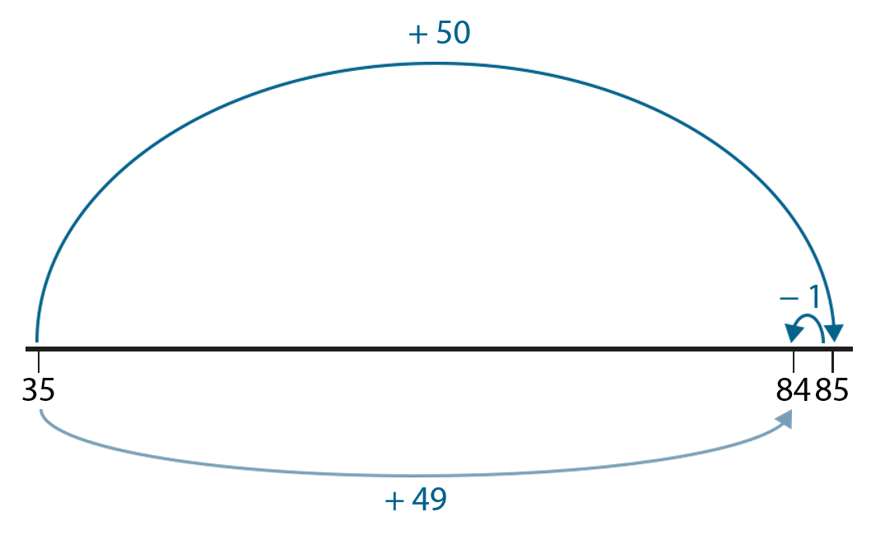
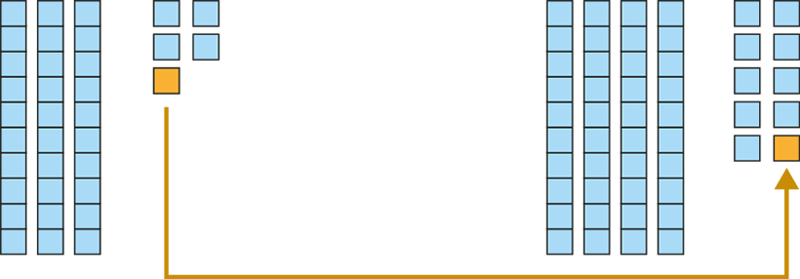
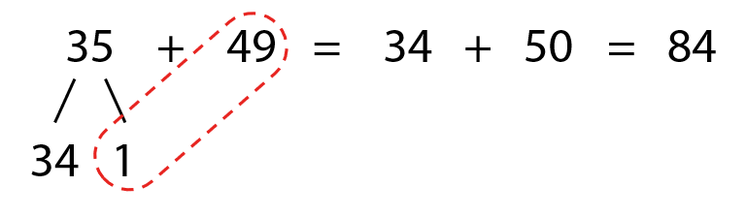
1.19 Securing mental strategies – step 2:1
Method A
Method B
35 + 49
= 30 + 40 + 5 + 9
= 70 + 14
= 84
Method C

Slide 18
1.19 Securing mental strategies – step 2:2
52 + 29
= 81
+ 30
− 1
52
81
82
+ 29

Slide 19
1.19 Securing mental strategies – step 2:4
520 + 290
= 810
+ 300
− 10
520
810
820
+ 290

Slide 20
1.19 Securing mental strategies – step 2:4
520 + 299
= 819
+ 300
− 1
520
819
820
+ 299

Slide 21
Year 3, Unit 4, Learning Outcome 3
Learning Outcome 3
Pupils add a pair of 2- or 3-digit numbers using redistribution
The following slides have been collated to support the teaching of this learning outcome.

Slide 22
Year 3, Unit 4, Learning Outcome 3
Additional teacher guidance for this outcome should be read first and can be found in this segment of the NCETM Primary Mastery Professional Development Materials:
1.19 Securing Mental Strategies: calculation up to 999
The spine materials are divided into ‘teaching points’ and ‘steps in learning’.
Teaching point | Steps in learning | Pages
2 | 2:6-2:12 | 14-19

Slide 23
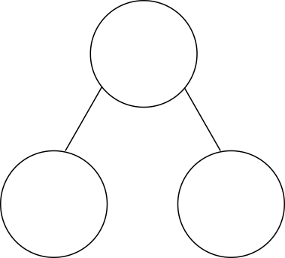

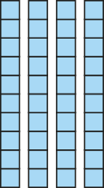

1.19 Securing mental strategies – step 2:6
45 + 29
= 44 + 30
= 74
74

Slide 24

1.19 Securing mental strategies – step 2:9
27 + 18
= 25 + 20
= 45
25
2
45

Slide 25
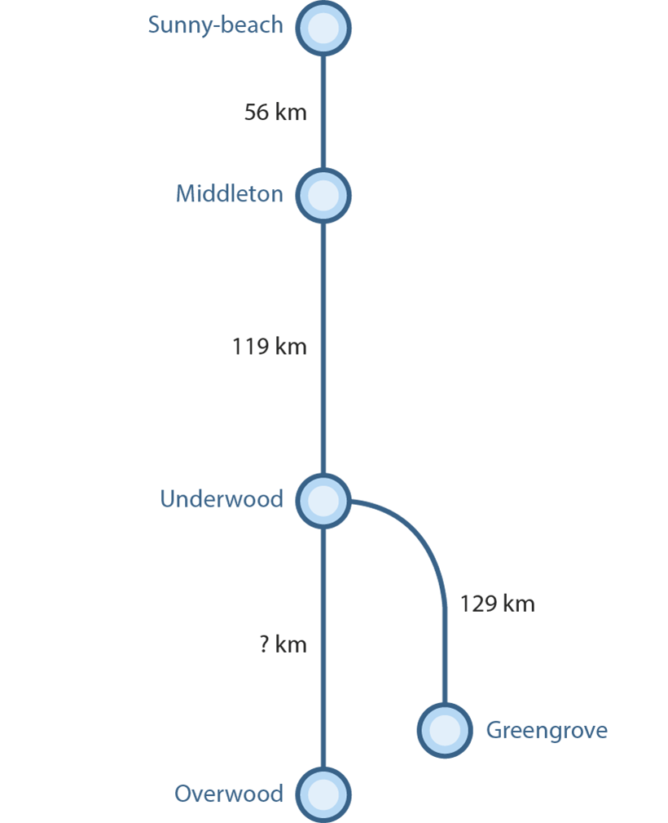
1.19 Securing mental strategies – step 2:12
Notes:
‘How far is it from Sunny-beach to Underwood?’
‘How far is it from Middleton to Greengrove?’
‘The journey from Underwood to Overwood is 44 km longer than from Underwood to Greengrove. How far is it from Underwood to Overwood?’

Slide 26
Year 3, Unit 4, Learning Outcome 4
Learning Outcome 4
Pupils subtract a pair of 2- or 3-digit numbers, bridging a multiple of 10, using partitioning
The following slides have been collated to support the teaching of this learning outcome.

Slide 27
Year 3, Unit 4, Learning Outcome 4
Additional teacher guidance for this outcome should be read first and can be found in this segment of the NCETM Primary Mastery Professional Development Materials:
1.19 Securing Mental Strategies: calculation up to 999
The spine materials are divided into ‘teaching points’ and ‘steps in learning’.
Teaching point | Steps in learning | Pages
3 | 3:1-3:2 | 20-21

Slide 28


1.19 Securing mental strategies – step 3:1
178 − 24
= 154
− 4
− 20
154
158
178

Slide 29
1.19 Securing mental strategies – step 3:1
780 − 240
= 540
− 40
− 200
540
580
780

Slide 30



1.19 Securing mental strategies – step 3:2
44 − 16
= 28
− 2
− 4
− 10
28
30
34
44

Slide 31
1.19 Securing mental strategies – step 3:2
544 − 16
= 528
− 2
− 4
− 10
528
530
534
544

Slide 32
1.19 Securing mental strategies – step 3:2
440 − 160
= 280
− 20
− 40
− 100
280
300
340
440

Slide 33
Year 3, Unit 4, Learning Outcome 5
Learning Outcome 5
Pupils subtract a pair of 2-digit numbers, crossing a ten or hundreds boundary, by finding the difference between them
The following slides have been collated to support the teaching of this learning outcome.

Slide 34
Year 3, Unit 4, Learning Outcome 5
Additional teacher guidance for this outcome should be read first and can be found in this segment of the NCETM Primary Mastery Professional Development Materials:
1.19 Securing Mental Strategies: calculation up to 999
The spine materials are divided into ‘teaching points’ and ‘steps in learning’.
Teaching point | Steps in learning | Pages
3 | 3:3-3:5 | 21-24

Slide 35


1.19 Securing mental strategies – step 3:3
43 − 39
= 4
+ 1
+ 3
0
39
40
43

Slide 36
1.19 Securing mental strategies – step 3:4
43
39
?
4

Slide 37


1.19 Securing mental strategies – step 3:5
61 − 49
= 12
+ 1
+ 11
0
49
50
61

Slide 38
1.19 Securing mental strategies – step 3:5
61
49
?
12

Slide 39


1.19 Securing mental strategies – step 3:5
123 − 97
= 26
+ 3
+ 23
97
100
123

Slide 40
1.19 Securing mental strategies – step 3:5
123
97
?
26

Slide 41
Year 3, Unit 4, Learning Outcome 6
Learning Outcome 6
Pupils subtract a pair of three-digit multiples of 10 within 1000 by finding the difference between them
The following slides have been collated to support the teaching of this learning outcome.

Slide 42
Year 3, Unit 4, Learning Outcome 6
Additional teacher guidance for this outcome should be read first and can be found in this segment of the NCETM Primary Mastery Professional Development Materials:
1.19 Securing Mental Strategies: calculation up to 999
The spine materials are divided into ‘teaching points’ and ‘steps in learning’.
Teaching point | Steps in learning | Pages
3 | 3:6-3:8 | 24-25

Slide 43
1.19 Securing mental strategies – step 3:6
761
749
?

Slide 44

1.19 Securing mental strategies – step 3:6
61 − 49
= 12
+ 1
+ 11
49
50
61
761 − 749
= 12
+ 1
+ 11
749
750
761

Slide 45
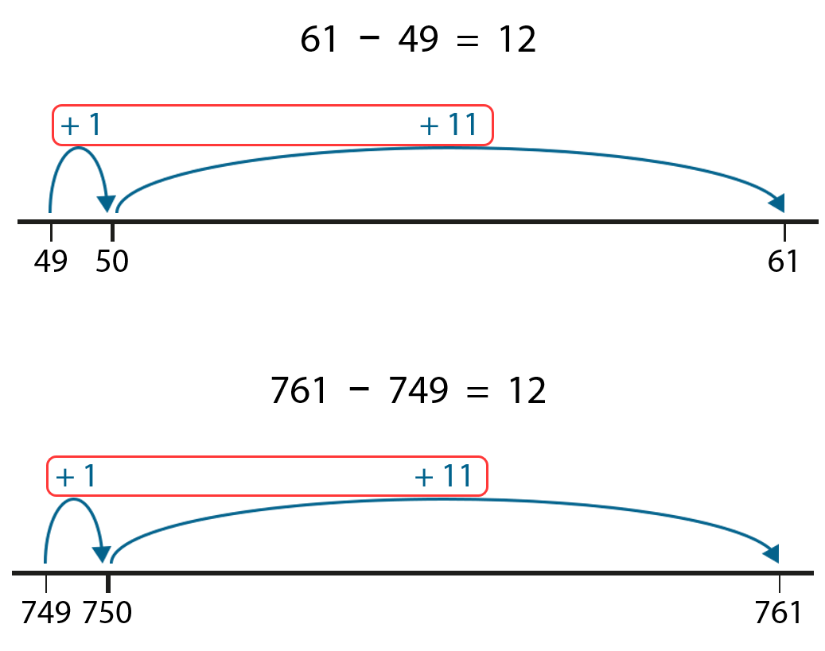
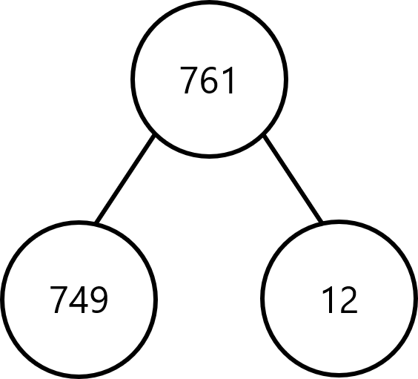
1.19 Securing mental strategies – step 3:6
761
749
12
?

Slide 46
1.19 Securing mental strategies – step 3:6
523
497
?

Slide 47
1.19 Securing mental strategies – step 3:6
123 − 97
= 26
+ 3
+ 23
97
100
123
523 − 497
= 26
+ 3
+ 23
497
500
523

Slide 48
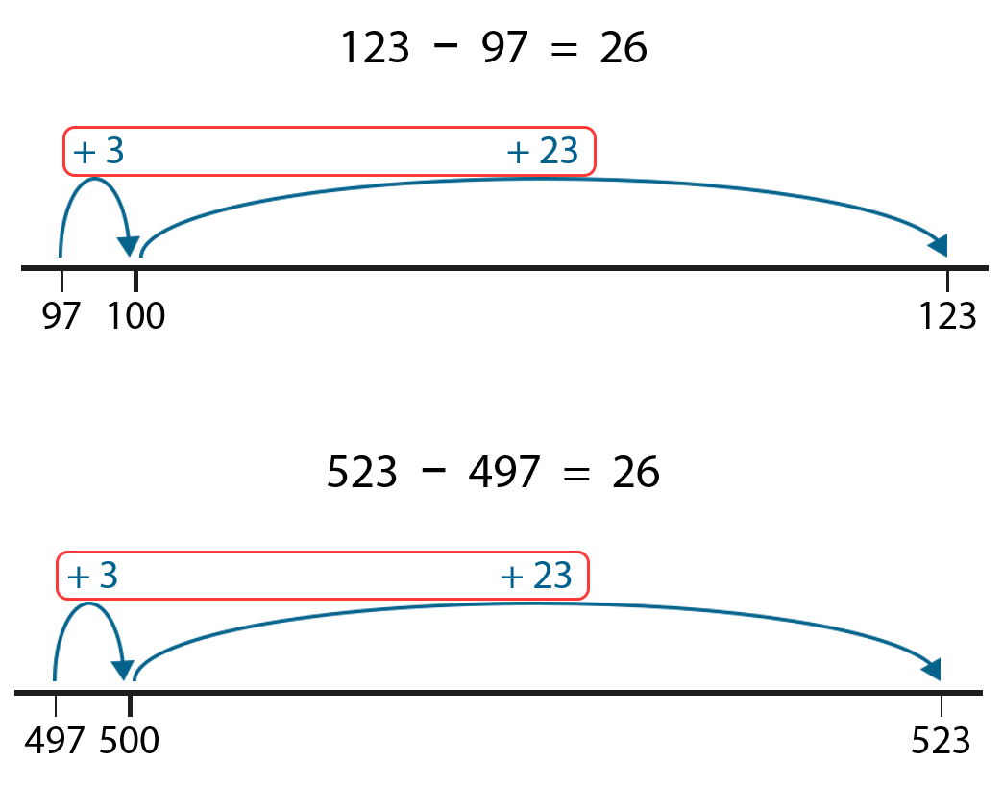
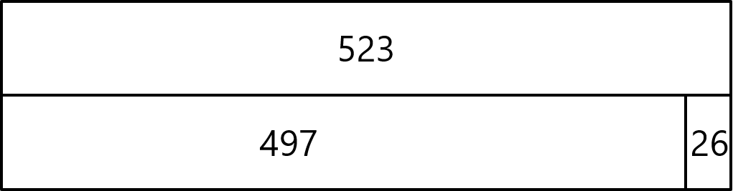
1.19 Securing mental strategies – step 3:6
523
26
497
?

Slide 49


1.19 Securing mental strategies – step 3:7
610 − 590
= 20
610
590
20
?
+ 10
+ 10
590
600
610

Slide 50


1.19 Securing mental strategies – step 3:7
610 − 490
= 120
610
490
?
120
+ 10
+ 100
+ 10
490
500
600
610

Slide 51
Year 3, Unit 4, Learning Outcome 7
Learning Outcome 7
Pupils evaluate the efficiency of strategies for subtracting from a 3-digit number
The following slides have been collated to support the teaching of this learning outcome.

Slide 52
Year 3, Unit 4, Learning Outcome 7
Additional teacher guidance for this outcome should be read first and can be found in this segment of the NCETM Primary Mastery Professional Development Materials:
1.19 Securing Mental Strategies: calculation up to 999
The spine materials are divided into ‘teaching points’ and ‘steps in learning’.
Teaching point | Steps in learning | Pages
3 | 3:9-3:11 | 26-28

Slide 53


1.19 Securing mental strategies – step 3:9
132 − 14
− 4
− 10
118
122
132

Slide 54



1.19 Securing mental strategies – step 3:9
132 − 14
= 118
− 4
− 10
118
122
132
+ 6
+ 80
+ 32
14
20
100
132

Slide 55



1.19 Securing mental strategies – step 3:9
132 − 125
−5
−20
− 100
7
12
32
132

Slide 56


1.19 Securing mental strategies – step 3:9
132 − 125
= 7
−5
−20
− 100
7
12
32
132
+ 5
+ 2
125
130
132

Slide 57
1.19 Securing mental strategies – step 3:10
87
57
?
33
59
24
?
28

Slide 58
Year 3, Unit 4, Learning Outcome 8
Learning Outcome 8
Pupils explain why the order of addition and subtraction steps in a multi-step problem can be chosen
The following slide supports the teaching of this learning outcome

Slide 59
Year 3, Unit 4, Learning Outcome 8
Additional teacher guidance for this outcome should be read first and can be found in this segment of the NCETM Primary Mastery Professional Development Materials:
1.19 Securing Mental Strategies: calculation up to 999
The spine materials are divided into ‘teaching points’ and ‘steps in learning’.
Teaching point | Steps in learning | Pages
4 | 4:1-4:2 | 29-30

Slide 60
Year 3, Unit 4, Learning Outcome 9
Learning Outcome 9
Pupils accurately and efficiently solve multi-step addition and subtraction problems
The following slide supports the teaching of this learning outcome

Slide 61
Year 3, Unit 4, Learning Outcome 9
Additional teacher guidance for this outcome should be read first and can be found in this segment of the NCETM Primary Mastery Professional Development Materials:
1.19 Securing Mental Strategies: calculation up to 999
The spine materials are divided into ‘teaching points’ and ‘steps in learning’.
Teaching point | Steps in learning | Pages
4 | 4:3-4:4 | 31-32

Slide 62
Year 3, Unit 4, Learning Outcome 10
Learning Outcome 10
Pupils understand and can explain that both addition and subtraction equations can be used to describe the same additive relationship (2-digit numbers)
The following slides have been collated to support the teaching of this learning outcome.

Slide 63
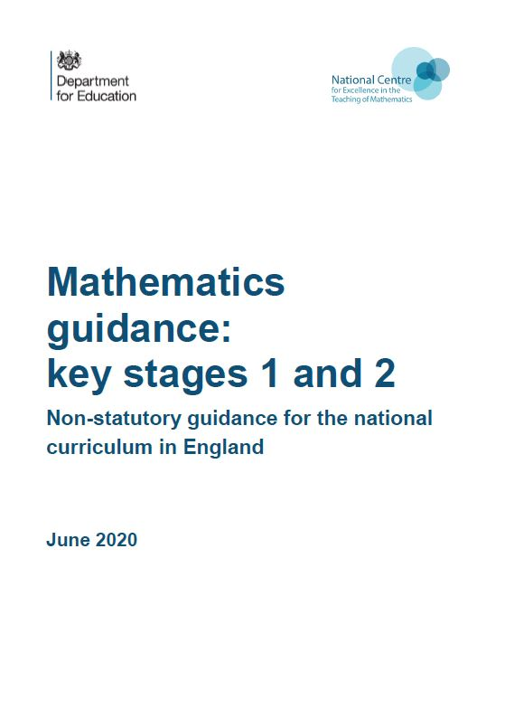
Year 3, Unit 4, Learning Outcome 10
Additional teacher guidance for this outcome should be read first and can be found in the DfE Mathematics guidance. Page references relate to the 335-page document available as a download at the bottom of this web page.
Ready to progress criteria | Pages
3AS-3 | 113-116

Slide 64
3AS-3 Manipulate the additive relationship
Have a look at this part-part-whole diagram and bar model. Which number is the whole? Which numbers are the parts?
Can you write 4 addition equations to match the representations?
Can you write 4 subtraction equations to match the representations?
37
37
25
12
25
12
25 + 12 = 37
12 + 25 = 37
37 – 12 = 25
37 – 25 = 12
37 = 25 + 12
37 = 12 + 25
25 = 37 – 12
12 = 37 – 25

Slide 65
3AS-3 Manipulate the additive relationship
Look at this bar model. The sum of the parts is equal to the whole. Write two addition equations to show this.
Which numbers are addends? Where are they on the bar model?
Which number is the sum? Where is it on the bar model?
Write other numbers in a bar model like this. Write addition equations to match the representation. Identify the addends and the sum.
sum
37
addend
25
12
addend
25 + 12 = 37
12 + 25 = 37
addend + addend = sum

Slide 66
3AS-3 Manipulate the additive relationship
This is the same bar model. The whole subtract a part equals a part. Write two subtraction equations to show this.
For each subtraction equation identify which number is the minuend, subtrahend and difference.
What do you notice about the minuend in each equation? Where is the minuend on the bar model? Is the minuend a whole or a part?
What do you notice about the subtrahend and difference in each equation? Where are they on the bar model? Are they the whole or are they a part?
Write other numbers in a bar model like this. Write subtraction equations to match the representation. Identify the minuend, subtrahend and difference.
minuend
37
subtrahend (or difference)
25
12
subtrahend (or difference)
37 – 25 = 12
37 – 12 = 25
minuend – subtrahend = difference

Slide 67
Year 3, Unit 4, Learning Outcome 11
Learning Outcome 11
Pupils understand and can explain that both addition and subtraction equations can be used to describe the same additive relationship (3-digit numbers)
The following slide supports the teaching of this learning outcome

Slide 68
Year 3, Unit 4, Learning Outcome 11
Additional teacher guidance for this outcome should be read first and can be found in the DfE Mathematics guidance. Page references relate to the 335-page document available as a download at the bottom of this web page.
Ready to progress criteria | Pages
3AS-3 | 113-116

Slide 69
Year 3, Unit 4, Learning Outcome 12
Learning Outcome 12
Pupils use knowledge of the additive relationship to rearrange equations
The following slide supports the teaching of this learning outcome

Slide 70
Year 3, Unit 4, Learning Outcome 12
Additional teacher guidance for this outcome should be read first and can be found in the DfE Mathematics guidance. Page references relate to the 335-page document available as a download at the bottom of this web page.
Ready to progress criteria | Pages
3AS-3 | 113-116

Slide 71
Year 3, Unit 4, Learning Outcome 13
Learning Outcome 13
Pupils use knowledge of the additive relationship to identify what is known and what is unknown in an equation
The following slide supports the teaching of this learning outcome

Slide 72
Year 3, Unit 4, Learning Outcome 13
Additional teacher guidance for this outcome should be read first and can be found in the DfE Mathematics guidance. Page references relate to the 335-page document available as a download at the bottom of this web page.
Ready to progress criteria | Pages
3AS-3 | 113-116

Slide 73
Year 3, Unit 4, Learning Outcome 14
Learning Outcome 14
Pupils use knowledge of the additive relationship to rearrange equations before solving
The following slide supports the teaching of this learning outcome

Slide 74
Year 3, Unit 4, Learning Outcome 14
Additional teacher guidance for this outcome should be read first and can be found in the DfE Mathematics guidance. Page references relate to the 335-page document available as a download at the bottom of this web page.
Ready to progress criteria | Pages
3AS-3 | 113-116

