Slide 1
1.3 Composition of numbers: 0–5
Representations | Year 1
Number, Addition and Subtraction

Slide 2
How to use this presentation
You can find the teacher guide 1.3 Composition of numbers: 0–5 by following the link below.

Slide 3
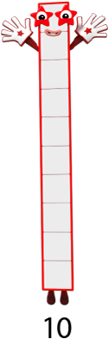









1.3 Composition: 0–5 – step 1:1
Images © 2017 Alphablocks Ltd. All Rights Reserved.

Slide 4









1.3 Composition: 0–5 – step 1:1
1
2
3
4
5
6
7
8
9
10

Slide 5










1.3 Composition: 0–5 – step 1:1

Slide 6
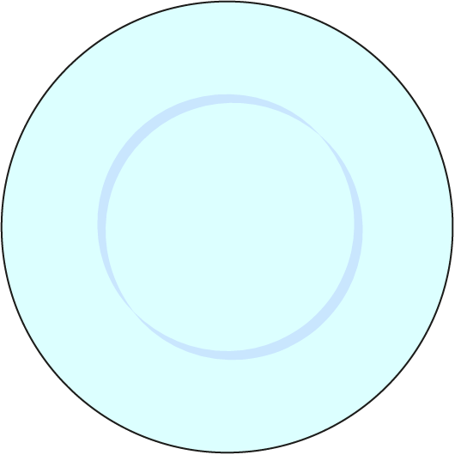


1.3 Composition: 0–5 – step 1:2

Slide 7
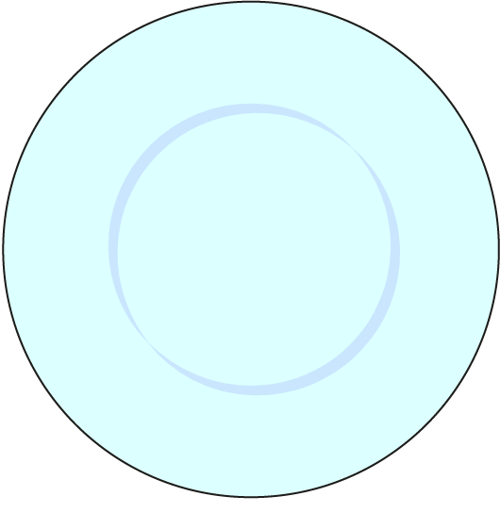





1.3 Composition: 0–5 – step 1:2

Slide 8
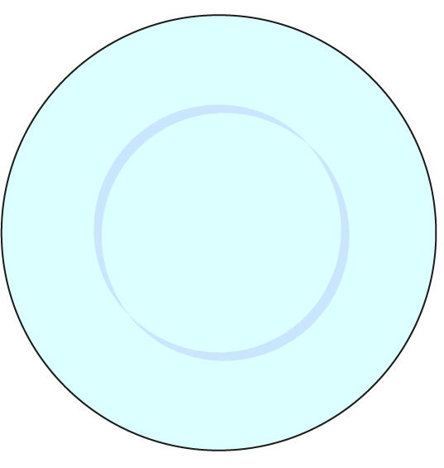




1.3 Composition: 0–5 – step 1:2

Slide 9
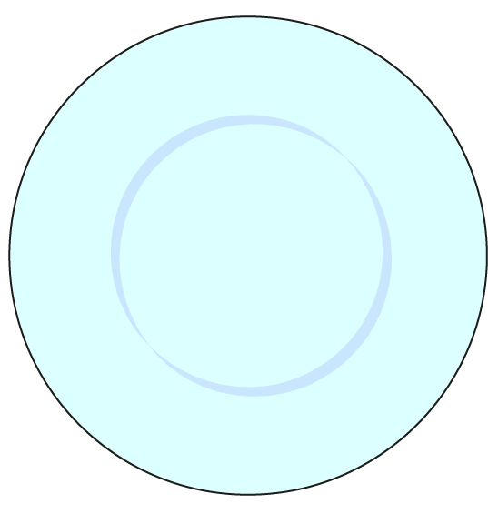
1.3 Composition: 0–5 – step 1:2

Slide 10
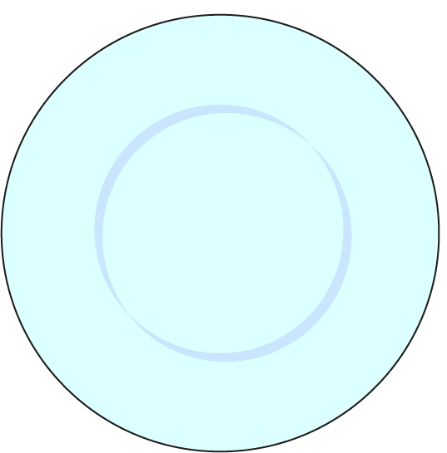

1.3 Composition: 0–5 – step 1:2

Slide 11
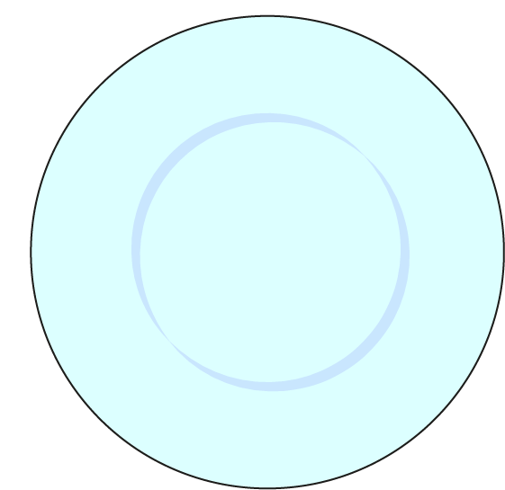



1.3 Composition: 0–5 – step 1:2

Slide 12
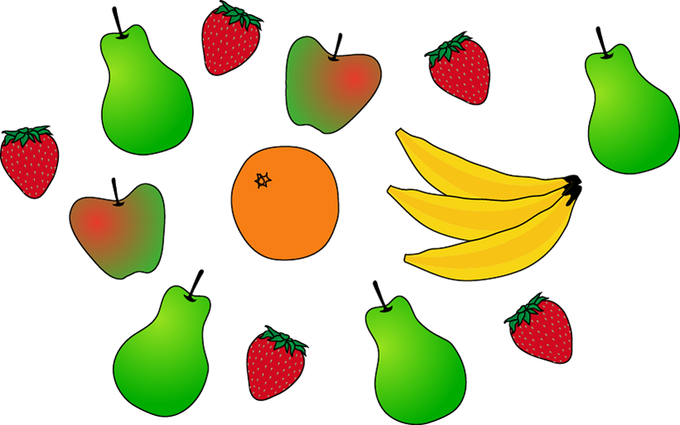
1.3 Composition: 0–5 – step 1:2

Slide 13

1.3 Composition: 0–5 – step 1:3

Slide 14
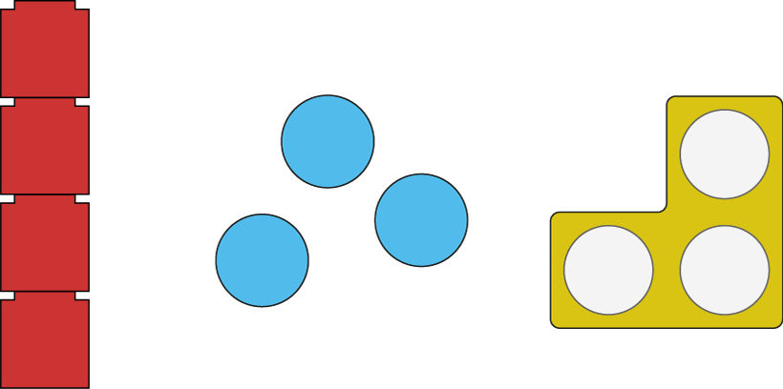
1.3 Composition: 0–5 – step 1:4
4
3
3

Slide 15


1.3 Composition: 0–5 – step 1:4
3
3
4

Slide 16

1.3 Composition: 0–5 – step 1:5
4
four

Slide 17

1.3 Composition: 0–5 – step 1:5
2
two

Slide 18

1.3 Composition: 0–5 – step 1:5
3
three

Slide 19

1.3 Composition: 0–5 – step 2:1
first
second
third
fourth
fifth
1st
2nd
3rd
4th
5th

Slide 20
1.3 Composition: 0–5 – step 2:1
fourth | 5th
first | 3rd
third | 1st
fifth | 4th
second | 2nd

Slide 21
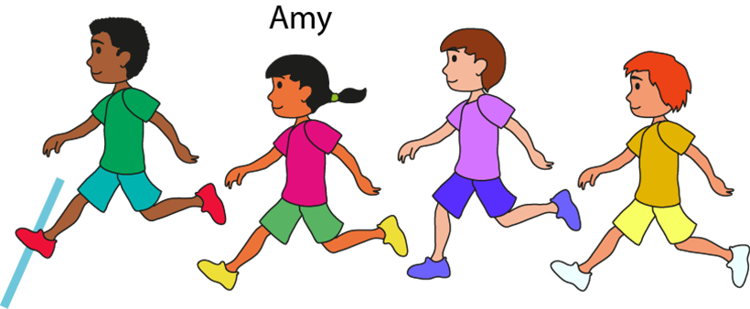
1.3 Composition: 0–5 – step 2:2

Slide 22





1.3 Composition: 0–5 – step 2:3

Slide 23

1.3 Composition: 0–5 – step 3:1

Slide 24

1.3 Composition: 0–5 – step 3:1

Slide 25

1.3 Composition: 0–5 – step 3:1

Slide 26

1.3 Composition: 0–5 – step 3:1

Slide 27
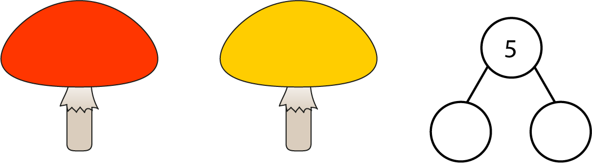
1.3 Composition: 0–5 – step 3:2

Slide 28

1.3 Composition: 0–5 – step 3:2

Slide 29
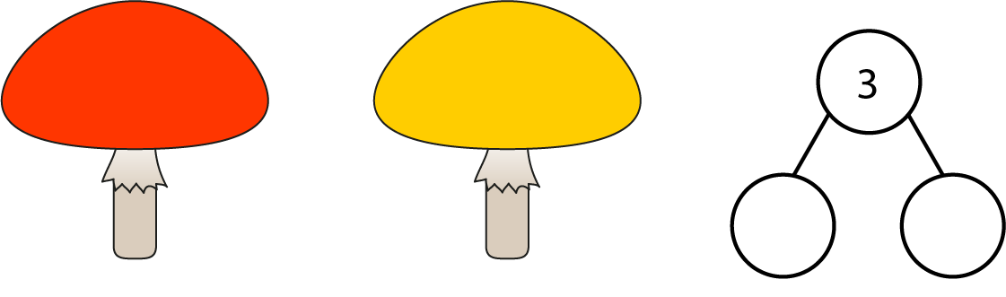
1.3 Composition: 0–5 – step 3:2

Slide 30
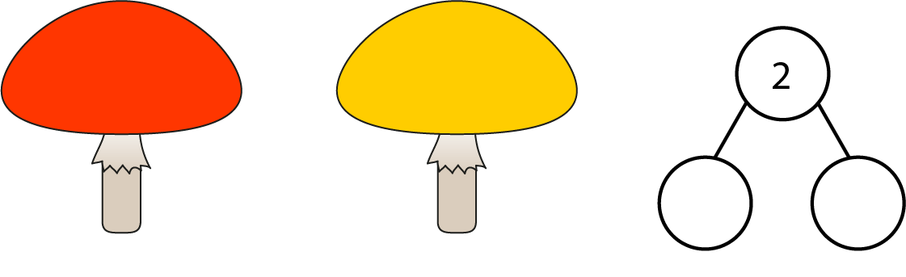
1.3 Composition: 0–5 – step 3:2

Slide 31

1.3 Composition: 0–5 – step 3:2

Slide 32
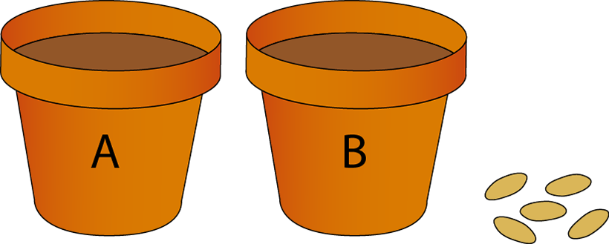
1.3 Composition: 0–5 – step 3:3

Slide 33





1.3 Composition: 0–5 – step 4:1

Slide 34
1.3 Composition: 0–5 – step 4:1

Slide 35


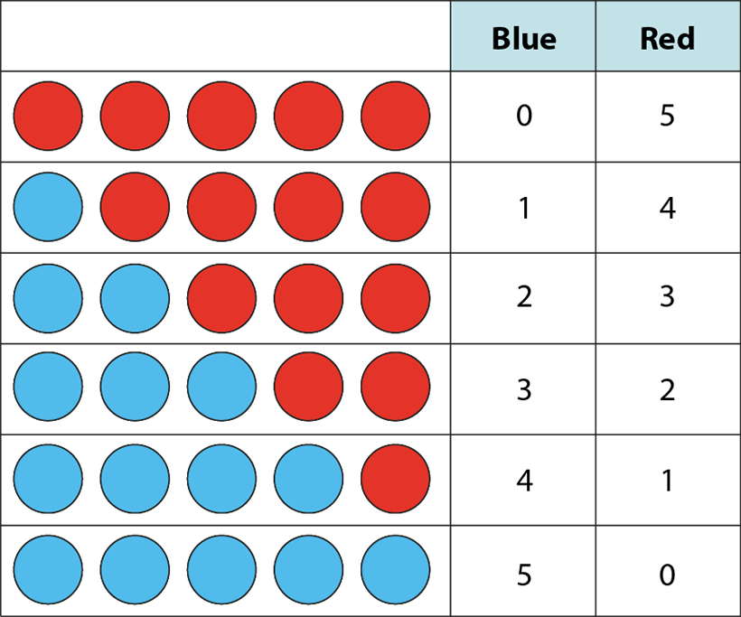
1.3 Composition: 0–5 – step 4:2
0
5
1
4
2
3
3
2
4
1
5
0

Slide 36
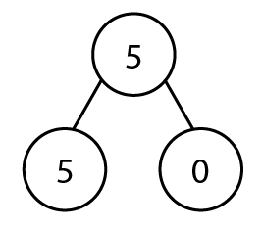
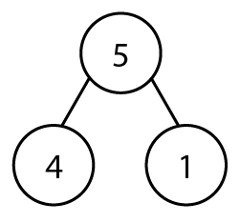
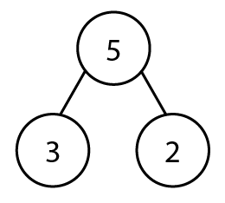
1.3 Composition: 0–5 – step 4:3

Slide 37



1.3 Composition: 0–5 – step 5:1

Slide 38
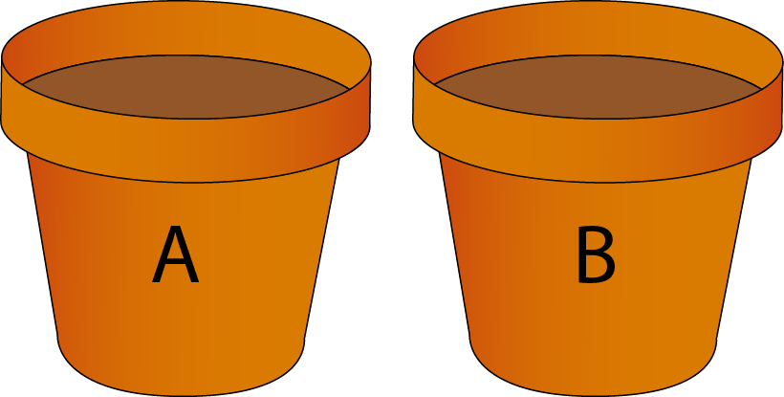
1.3 Composition: 0–5 – step 5:1

Slide 39
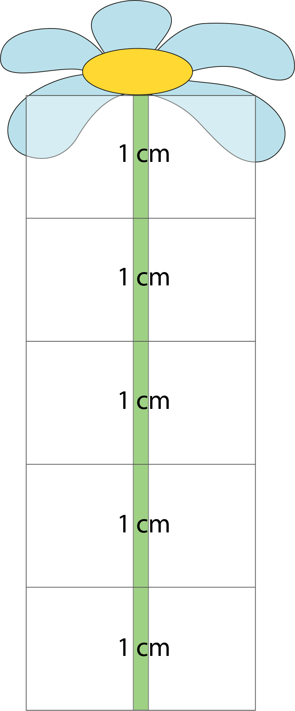

1.3 Composition: 0–5 – step 5:1
3 cm

Slide 40

1.3 Composition: 0–5 – step 5:2
3

Slide 41
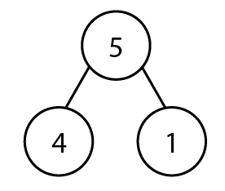

1.3 Composition: 0–5 – step 5:2

Slide 42
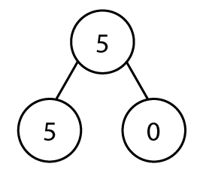
1.3 Composition: 0–5 – step 5:2

Slide 43


1.3 Composition: 0–5 – step 6:1
0
1
1
2
2
3
3
4
4
5
5
6

Slide 44
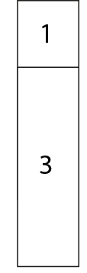
1.3 Composition: 0–5 – step 6:1
0
1
1
2
2
3
3
4
4
5
5
6

Slide 45

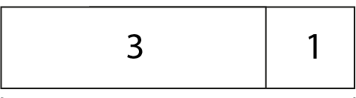

1.3 Composition: 0–5 – step 6:1

Slide 46
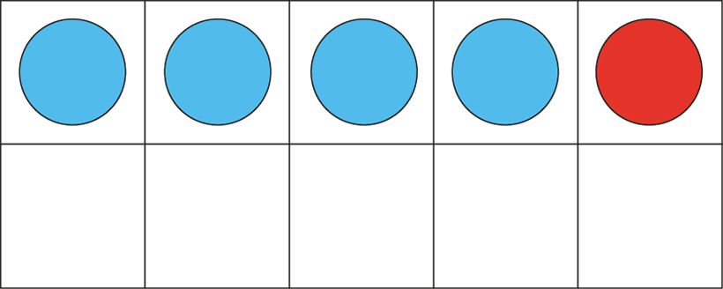
1.3 Composition: 0–5 – step 6:2

Slide 47
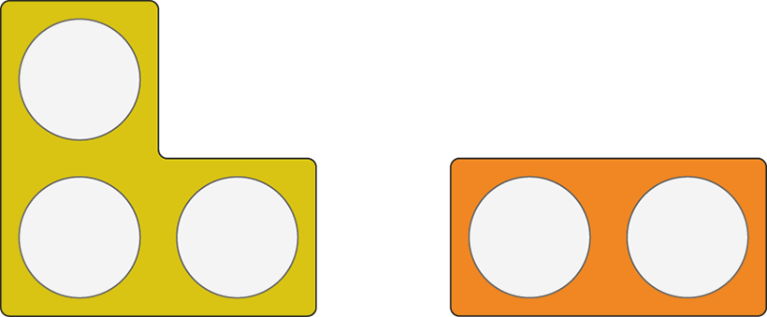
1.3 Composition: 0–5 – step 6:2

Slide 48
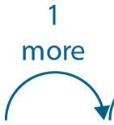






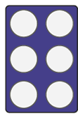

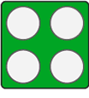


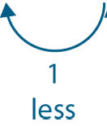
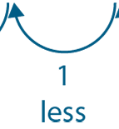
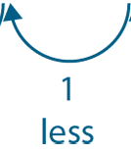
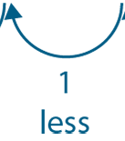
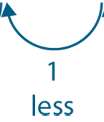
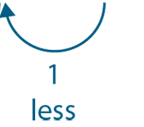
1.3 Composition: 0–5 – step 6:3

Slide 49
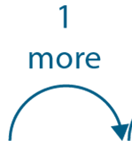






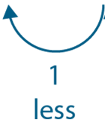
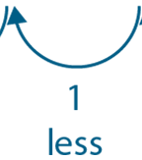


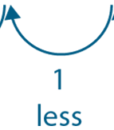
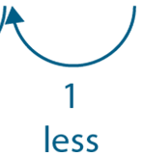
1.3 Composition: 0–5 – step 6:3

Slide 50




1.3 Composition: 0–5 – step 7:1
5

Slide 51

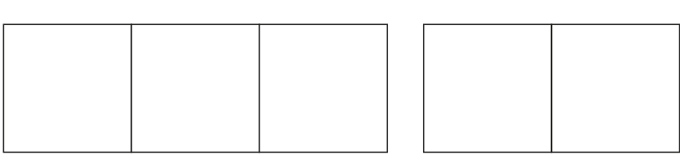



1.3 Composition: 0–5 – step 7:2
3
2

Slide 52
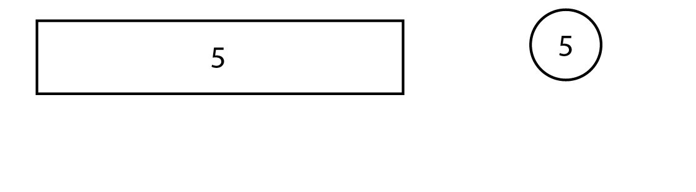
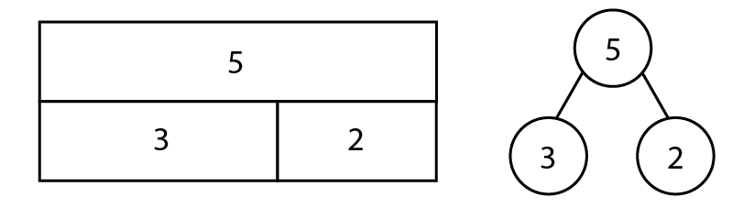
1.3 Composition: 0–5 – step 7:3

