Slide 1
Year 5, Unit 6
Calculating with decimal fractions

Slide 2
Year 5, Unit 6
These materials heavily reflect the prioritisation approach of the ready-to-progress criteria in the DfE Primary Mathematics Guidance 2020 and on the PPTs that exemplify them on the NCETM website. They also include other relevant National Curriculum content. Related sections of the NCETM Primary Mastery Professional Development Materials provide small-step teaching guidance.
Ready-to-progress criteria addressed by this unit
Teaching of this unit supports the following criteria from the ‘DfE Mathematics Guidance: key stages 1 & 2’ (the 335-page document available as a download)
5MD-1 Page 241
Prior learning
If the following ready-to-progress criteria, contained in the same DfE guidance document as above, were secured in Year 4, children will be ready to start on this unit.
4MD-1 Page 170

Slide 3
Contents
The links below take you to the starting slide of each learning outcome.
1 | Pupils explain the effect of multiplying and dividing a number by 10, 100 and 1,000 (1)
2 | Pupils explain the effect of multiplying and dividing a number by 10, 100 and 1,000 (2)
3 | Pupils explain how to multiply and divide a number by 10, 100 and 1,000 (first ‘number’ two or more non-zero digits)
4 | Pupils use their knowledge of multiplication and division by 10/100/1,000 to convert between units of measure (length)
5 | Pupils use their knowledge of multiplication and division by 10/100/1,000 to convert between units of measure (mass and capacity)
6 | Pupils explain how to use known multiplication facts and unitising to multiply decimal fractions by whole numbers (tenths)
Click the arrow button to return to this Contents slide.

Slide 4
Contents
The links below take you to the starting slide of each learning outcome.
7 | Pupils explain how to use known multiplication facts and unitising to multiply decimal fractions by whole numbers (hundredths)
8 | Pupils use their knowledge of multiplying decimal fractions by whole numbers to solve measures problems
9 | Pupils explain the relationship between multiplying by 0.1 dividing by 10
10 | Pupils explain the relationship between multiplying by 0.01 dividing by 100
11 | Pupils explain how to use multiplying by 10 or 100 to multiply one-digit numbers by decimal fractions (1)
12 | Pupils explain how to use multiplying by 10 or 100 to multiply one-digit numbers by decimal fractions (2)
Click the arrow button to return to this Contents slide.

Slide 5
Contents
The links below take you to the starting slide of each learning outcome.
13 | Pupils explain how to use the size of the multiplier to predict the size of the product compared to the multiplicand
14 | Pupils explain how to use multiplying by 10 or 100 to divide decimal fractions by one-digit numbers (1)
15 | Pupils explain how to use multiplying by 10 or 100 to divide decimal fractions by one-digit numbers (2)
Click the arrow button to return to this Contents slide.

Slide 6
Year 5, Unit 6, Learning Outcome 1
Learning Outcome 1
Pupils explain the effect of multiplying and dividing by 10, 100 and 1,000 (1)
The following slides have been collated to support the teaching of this learning outcome.

Slide 7
Year 5, Unit 6, Learning Outcome 1
Additional teacher guidance for this outcome should be read first and can be found in this segment of the NCETM Primary Mastery Professional Development Materials:
2.29 Decimal place value knowledge, multiplication and division
The spine materials are divided into ‘teaching points’ and ‘steps in learning’.
Teaching point | Steps in learning | Pages
1 | 1:1-1:2 | 3-7

Slide 8
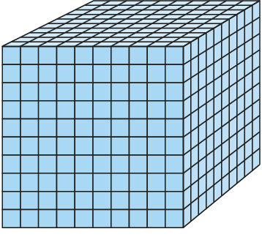
2.29 Extending decimal place-value to ×/÷ Step 1:1
Notes:
One is the whole.

Slide 9
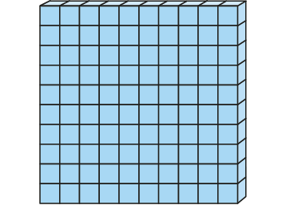
2.29 Extending decimal place-value to ×/÷ Step 1:1
1 ÷ 10 = 0.1 1 × 0.1 = 0.1
Notes:
When a whole is divided into ten equal parts, each part is
one tenth of the whole.
There are ten tenths in one whole.

Slide 10
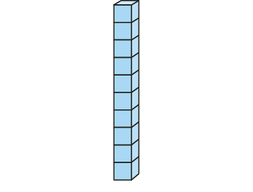
2.29 Extending decimal place-value to ×/÷ Step 1:1
1 ÷ 100 = 0.01 1 × 0.01 = 0.01
Notes:
When a whole is divided into one hundred equal parts, each part is
one hundredth of the whole.
There are one hundred hundredths in one whole.

Slide 11
2.29 Extending decimal place-value to ×/÷ Step 1:1
0.1 ÷ 10 = 0.01 0.1 × 0.1 = 0.01
Notes:
When one tenth of the whole is divided into ten equal parts, each part is
one hundredth of the whole.
There are ten hundredths in one tenth.

Slide 12
2.29 Extending decimal place-value to ×/÷ Step 1:1
1 ÷ 1,000 = 0.001 1 × 0.001 = 0.001
Notes:
When a whole is divided into one thousand equal parts, each part is
one thousandth of the whole.
There are one thousand thousandths in one whole.

Slide 13
2.29 Extending decimal place-value to ×/÷ Step 1:1
0.01 ÷ 10 = 0.001 0.01 × 0.1 = 0.001
Notes:
When one hundredth of the whole is divided into ten equal parts, each part is
one thousandth of the whole.
There are ten thousandths in one hundredth.

Slide 14
2.29 Extending decimal place-value to ×/÷ Step 1:1
0.1 ÷ 100 = 0.001 0.1 × 0.01 = 0.001
Notes:
When one tenth of the whole is divided into one hundred equal parts, each part is
one thousandth of the whole.
There are one hundred thousandths in one tenth.

Slide 15
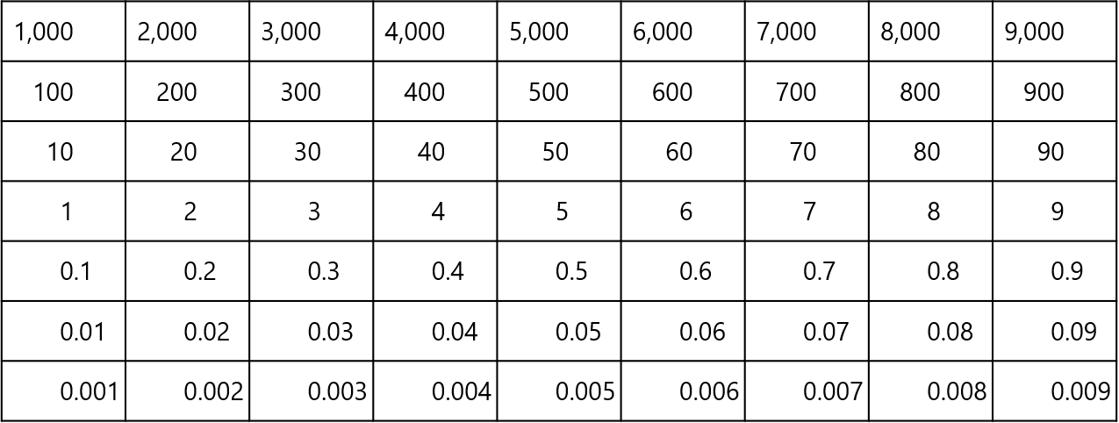
2.29 Extending decimal place-value to ×/÷ Step 1:1

Slide 16
2.29 Extending decimal place-value to ×/÷ Step 1:2
Multiplying by 1,000
Notes:
We had six ones. We now have six thousandths.

Slide 17
2.29 Extending decimal place-value to ×/÷ Step 1:2
Multiplying by 1,000
Dividing by 1,000 / Multiplying by 0.001
Notes:
We had six thousandths. We now have six ones.

Slide 18
2.29 Extending decimal place-value to ×/÷ Step 1:2
Multiplying by 1,000
Dividing by 1,000 / Multiplying by 0.001
Multiplying and dividing by 1,000

Slide 19
5MD-1 Multiplying and dividing by 10 and 100
This guidance is for the following two slides.
Place a counter or your finger on the number that is highlighted on the Gattegno chart.
Move the counter or your finger as shown by the animation and write a division or multiplication equation to describe the movement.
Children should also describe what has been shown by the movement of the counter or their finger and the equations.
Repeat each set of calculations with other single-digit numbers.
8, made one-tenth the size is 0.8.
8 divided by 10 is equal to 0.8.
First we had 8 ones, now we have 8 tenths.
0.8, made 10 times the size is 8.
0.8 multiplied by 10 is equal to 8.
First we had 8 tenths, now we have 8 ones.

Slide 20
5MD-1 Multiplying and dividing by 10 and 100
8 ÷ 10 = 0.8
0.8 ÷ 10 = 0.08
1,000
2,000
3,000
4,000
5,000
6,000
7,000
8,000
9,000
100
200
300
400
500
600
700
800
900
10
20
30
40
50
60
70
80
90
1
2
3
4
5
6
7
8
9
÷ 10
0.1
0.2
0.3
0.4
0.5
0.6
0.7
0.8
0.9
one-tenth the size
÷ 10
0.01
0.02
0.03
0.04
0.05
0.06
0.07
0.08
0.09
one-tenth the size

Slide 21
5MD-1 Multiplying and dividing by 10 and 100
0.08 x 10 = 0.8
0.8 x 10 = 8
1,000
2,000
3,000
4,000
5,000
6,000
7,000
8,000
9,000
100
200
300
400
500
600
700
800
900
10
20
30
40
50
60
70
80
90
1
2
3
4
5
6
7
8
9
× 10
0.1
0.2
0.3
0.4
0.5
0.6
0.7
0.8
0.9
ten times the size
× 10
0.01
0.02
0.03
0.04
0.05
0.06
0.07
0.08
0.09
ten times the size

Slide 22
5MD-1 Multiplying and dividing by 10 and 100
0.8 x 10 = 8
If each of my ones become tenths, what has happened? If each of my tenths become ones, what has happened?
Start with 8 ones, now exchange each for a tenths counter. Can you explain what you have done? Start with 8 tenths counters, then exchange each for a ones counter. Explain what you have done.
8 ÷ 10 = 0.8
0.1
0.1
1
1
0.1
0.1
1
1
0.1
0.1
1
1
0.1
0.1
8, made one-tenth the size is 0.8.
8 divided by 10 is 0.8.
First we had 8 ones, now we have 8 tenths.
1
1
one-tenth of the size
ten times the size

Slide 23
5MD-1 Multiplying and dividing by 10 and 100
0.08 x 100 = 8
If each of my ones become hundredths what has happened? If each of my hundredths become ones, what has happened?
Start with 8 ones, now exchange each for a hundredths counter. Can you explain what you have done? Start with 8 hundredths counters, then exchange each for a ones counter. Explain what you have done.
8 ÷ 100 = 0.08
0.01
0.01
1
1
0.01
0.01
1
1
0.01
0.01
1
1
0.01
0.01
8, made one-hundredth the size is 0.08.
8 divided by 100 is 0.08.
First we had 8 ones, now we have 8 hundredths
1
1
one hundred times the size
one-hundredth of the size

Slide 24
5MD-1 Multiplying and dividing by 10 and 100
0.08 x 10 = 0.8
If each of my tenths become hundredths what has happened? If each of my hundredths become tenths, what has happened?
Start with 8 tenths, now exchange each for a hundredths counter. Can you explain what you have done? Start with 8 hundredths counters, then exchange each for a tenths counter. Explain what you have done.
0.8 ÷ 10 = 0.08
0.01
0.01
0.1
0.1
0.01
0.01
0.1
0.1
0.01
0.01
0.1
0.1
0.01
0.01
0.8, made one-tenth of the size is 0.08.
0.8 divided by 10 is 0.08.
First we had 8 tenths, now we have 8 hundredths.
0.1
0.1
one-tenth of the size
ten times the size

Slide 25
Year 5, Unit 6, Learning Outcome 2
Learning Outcome 2
Pupils explain the effect of multiplying and dividing by 10, 100 and 1,000 (2)
The following slides have been collated to support the teaching of this learning outcome.

Slide 26
Year 5, Unit 6, Learning Outcome 2
Additional teacher guidance for this outcome should be read first and can be found in this segment of the NCETM Primary Mastery Professional Development Materials:
2.29 Decimal place value knowledge, multiplication and division
The spine materials are divided into ‘teaching points’ and ‘steps in learning’.
Teaching point | Steps in learning | Pages
1 | 1:3-1:4 | 7-10

Slide 27
2.29 Extending decimal place-value to ×/÷ Step 1:3
Example 1 – division of a single-digit number by 100 / multiplication by 0.01
Notes:
We are dividing by 100 / multiplying by 0.01, so we need to
move the digits two places to the right.

Slide 28
2.29 Extending decimal place-value to ×/÷ Step 1:3
Example 1 – division of a single-digit number by 100 / multiplication by 0.01
Notes:
We had eight ones. We now have eight hundredths.

Slide 29
2.29 Extending decimal place-value to ×/÷ Step 1:3
Example 1 – division of a single-digit number by 100 / multiplication by 0.01

Slide 30
2.29 Extending decimal place-value to ×/÷ Step 1:3
Example 2 – multiplication of a whole number of hundredths by 1,000
Notes:
We are multiplying by one thousand, so we need to
move the digits three places to the left.

Slide 31
2.29 Extending decimal place-value to ×/÷ Step 1:3
Example 2 – multiplication of a whole number of hundredths by 1,000
Notes:
We had five hundredths. We now have five tens.

Slide 32
2.29 Extending decimal place-value to ×/÷ Step 1:3
Example 2 – multiplication of a whole number of hundredths by 1,000

Slide 33
5MD-1 Multiplying and dividing by 10 and 100
1,000
2,000
3,000
4,000
5,000
6,000
7,000
8,000
9,000
100
200
300
400
500
600
700
800
900
0.27 × 10 = 2.7
10
20
30
40
50
60
70
80
90
2.7 ÷ 10 = 0.27
1
2
3
4
5
6
7
8
9
0.1
0.2
0.3
0.4
0.5
0.6
0.7
0.8
0.9
÷ 10
× 10
0.01
0.02
0.03
0.04
0.05
0.06
0.07
0.08
0.09
one-tenth of the size
ten times the size
What happens to 0.27 when we multiply by 10? What happens when we then divide by 10?
Can you start with 0.36 on your chart and make it 10 times the size? Now make the solution one-tenth of the size. What do you notice?
Think of 8.7 and make it one-tenth of the size. Now make it ten times the size.
Repeat with other numbers using either the Gattegno chart or visualization.

Slide 34
5MD-1 Multiplying and dividing by 10 and 100
4.4 ÷ 10 = 0.44
0.44 × 10 = 4.4
Make 4.4 with your counters. Now make each counter one-tenth of the value. Show me the counters you now have.
Start with 0.44 and make each counter ten times the value. Show me the counters you now have. Write a calculation.
Repeat for other similar numbers.
1
0.01
0.1
0.1
1
0.01
0.1
0.1
1
0.1
0.1
0.01
1
0.01
__ divided by 10 is equal to__.
__ is one-tenth the size of __.
__ multiplied by 10 is equal to__.
__ is 10 times the size of __.
0.1
0.1
one-tenth of the size
ten times of the size

Slide 35
5MD-1 Multiplying and dividing by 10 and 100
4.4 ÷ 10 = 0.44
0.44 × 10 = 4.4
What is the value of the 4 tenths after we multiply by 10? And the 4 hundredths?
What happens to each digit when we divide by 10?
Why is there a zero in the ones place to start with?
What happens to the zero in the ones when we multiply by 10?
ten times the size
x10
x10
x10
10s
1s
0.1s
0.01s
0
0
4
4
4
4
To multiply by 10, move each digit one place to the left.
To divide by 10, move each digit one place to the right.
4
4
÷10
÷10
÷10
one-tenth of the size

Slide 36
Year 5, Unit 6, Learning Outcome 3
Learning Outcome 3
Pupils explain how to multiply and divide a number by 10, 100 and 1,000 (first ‘number’ two or more non-zero digits)
The following slides have been collated to support the teaching of this learning outcome.

Slide 37
Year 5, Unit 6, Learning Outcome 3
Additional teacher guidance for this outcome should be read first and can be found in this segment of the NCETM Primary Mastery Professional Development Materials:
2.29 Decimal place value knowledge, multiplication and division
The spine materials are divided into ‘teaching points’ and ‘steps in learning’.
Teaching point | Steps in learning | Pages
1 | 1:5-1:6 | 10-14

Slide 38
2.29 Extending decimal place-value to ×/÷ Step 1:5
Example 1 – two-digit number divided by 100 / multiplied by 0.01
Notes:
We are dividing by 100 / multiplying by 0.01, so we need to move
the digits two places to the right.

Slide 39
2.29 Extending decimal place-value to ×/÷ Step 1:5
Example 1 – two-digit number divided by 100 / multiplied by 0.01
Notes:
We had twenty-five ones. We now have twenty-five hundredths.

Slide 40
2.29 Extending decimal place-value to ×/÷ Step 1:5
Example 1 – two-digit number divided by 100 / multiplied by 0.01

Slide 41
2.29 Extending decimal place-value to ×/÷ Step 1:5
Example 2 – multiplying a decimal fraction by 1,000
Notes:
We are multiplying by one thousand, so we need to
move the digits three places to the left.

Slide 42
2.29 Extending decimal place-value to ×/÷ Step 1:5
Example 2 – multiplying a decimal fraction by 1,000
Notes:
We had thirty-seven hundredths. We now have thirty-seven tens.

Slide 43
2.29 Extending decimal place-value to ×/÷ Step 1:5
Example 2 – multiplying a decimal fraction by 1,000

Slide 44
5MD-1 Multiplying and dividing by 10 and 100
1,000
2,000
3,000
4,000
5,000
6,000
7,000
8,000
9,000
100
200
300
400
500
600
700
800
900
3.6 × 10 = 36
10
20
30
40
50
60
70
80
90
1
2
3
4
5
6
7
8
9
÷ 10
36 ÷ 10 = 3.6
× 10
0.1
0.2
0.3
0.4
0.5
0.6
0.7
0.8
0.9
one-tenth of the size
ten times the size
0.01
0.02
0.03
0.04
0.05
0.06
0.07
0.08
0.09
What two-digit number can you see on the chart? If we multiply by ten and make the number tens times the size, what happens?
If we start with 36 and move each part down a row, what have we done?
When we multiply a decimal number by 10, do we still add a zero? Can we try some other numbers?

Slide 45
5MD-1 Multiplying and dividing by 10 and 100
1.8 × 10 = 18
18 ÷ 10 = 1.8
If each part is one-tenth the value, show me the counters you will now have. Write a calculation and explain what you have done.
If I then make each counter ten times the value, describe what happens.
Provide children with two-digit numbers to divide by ten and numbers with ones and tenths to multiply by ten, using counters to show their understanding. Ask them to explain their reasoning.
1
0.1
0.1
10
1
1
0.1
0.1
1
1
0.1
0.1
1
1
0.1
0.1
1
1
one-tenth of the size
ten times the size
1.8 is one-tenth the size of 18
18 divided by 10 is 1.8

Slide 46
5MD-1 Multiplying and dividing by 10 and 100
1.8 × 10 = 180
18 ÷ 10 = 1.8
If we start with 1.8 and make this ten times the value, what has happened to the ones digit? The tenths digit?
What was the value of the 1 before? And now? What was the value of the 8 before? And now?
ten times the size
x10
x10
100s
10s
1s
0.1s
1
8
To multiply by 10, move each digit one place to the left.
To divide by 10, move each digit one place to the right.
1
8
1
8
0
÷10
÷10
one-tenth of the size

Slide 47
5MD-1 Multiplying and dividing by 10 and 100
1,000
2,000
3,000
4,000
5,000
6,000
7,000
8,000
9,000
100
200
300
400
500
600
700
800
900
0.95 × 100 = 95
10
20
30
40
50
60
70
80
90
1
2
3
4
5
6
7
8
9
÷ 100
95 ÷ 100 = 0.95
× 100
one-hundredth of the size
0.1
0.2
0.3
0.4
0.5
0.6
0.7
0.8
0.9
one hundred times the size
0.01
0.02
0.03
0.04
0.05
0.06
0.07
0.08
0.09
When we multiply 0.95 by 100, what is the new value of the 9 digit? The 5 digit?
What happens when we then divide by 100? What is the new value of each digit?
Provide further opportunities to multiply different number of hundredths by 100 and divide different two-digit numbers by 100.

Slide 48
5MD-1 Multiplying and dividing by 10 and 100
Complete the calculations using your understanding of place value. Click for each new calculation.
If required, use place value counters or a Gattegno chart to check or correct each solution before clicking for each answer.
0.72 × 10 = 7.2
4.82 × 10 = 48.2
0.91 × 100 = 91

Slide 49
5MD-1 Multiplying and dividing by 10 and 100
Complete the calculations using your understanding of place value. Click for each new calculation.
If required, use place value counters or a Gattegno chart to check or correct each solution before clicking for each answer.
57 ÷ 10 = 5.7
61.2 ÷ 10 = 6.12
75 ÷ 100 = 0.75

Slide 50
Year 5, Unit 6, Learning Outcome 4
Learning Outcome 4
Pupils use their knowledge of multiplication and division by 10/100/1,000 to convert between units of measure (length)
The following slides have been collated to support the teaching of this learning outcome.

Slide 51
Year 5, Unit 6, Learning Outcome 4
Additional teacher guidance for this outcome should be read first and can be found in this segment of the NCETM Primary Mastery Professional Development Materials:
2.29 Decimal place value knowledge, multiplication and division
The spine materials are divided into ‘teaching points’ and ‘steps in learning’.
Teaching point | Steps in learning | Pages
2 | 2:1-2:2 and 2:5 | 15-17 and 21

Slide 52
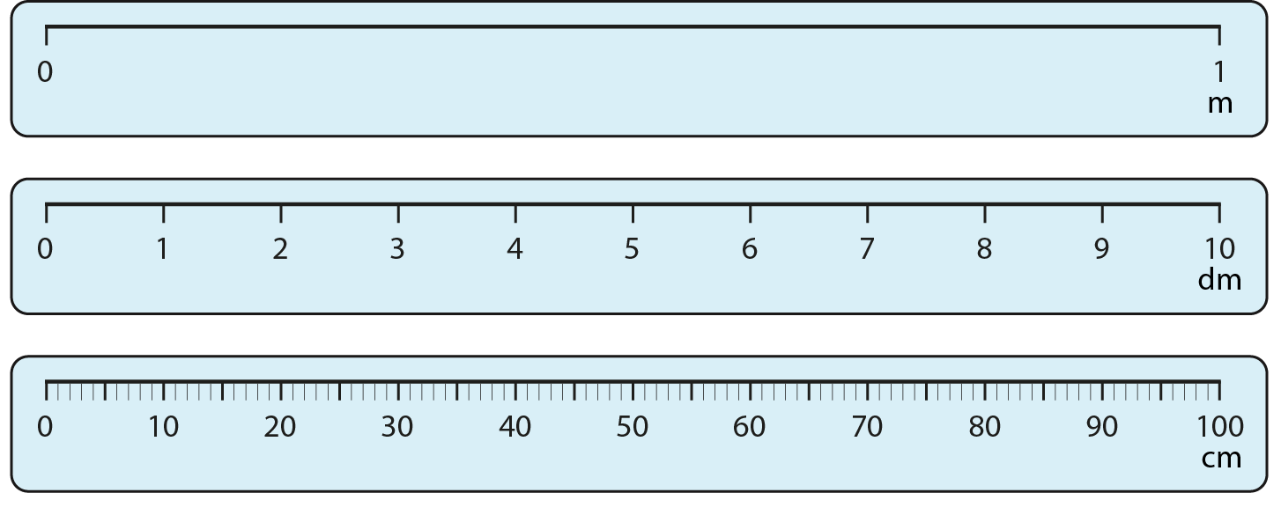
2.29 Extending decimal place-value to ×/÷ Step 2:1
Not to scale.
Notes:
What’s the same?
What’s different?

Slide 53
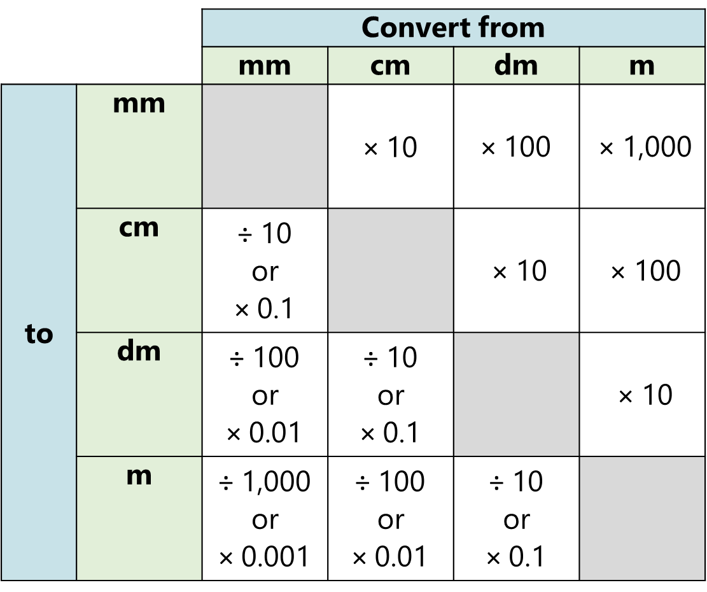
2.29 Extending decimal place-value to ×/÷ Step 2:1

Slide 54
Year 5, Unit 6, Learning Outcome 5
Learning Outcome 5
Pupils use their knowledge of multiplication and division by 10/100/1,000 to convert between units of measure (mass and capacity)
The following slides have been collated to support the teaching of this learning outcome.

Slide 55
Year 5, Unit 6, Learning Outcome 5
Additional teacher guidance for this outcome should be read first and can be found in this segment of the NCETM Primary Mastery Professional Development Materials:
2.29 Decimal place value knowledge, multiplication and division
The spine materials are divided into ‘teaching points’ and ‘steps in learning’.
Teaching point | Steps in learning | Pages
2 | 2:3-2:5 | 18-21

Slide 56
2.29 Extending decimal place-value to ×/÷ Step 2:4

Slide 57
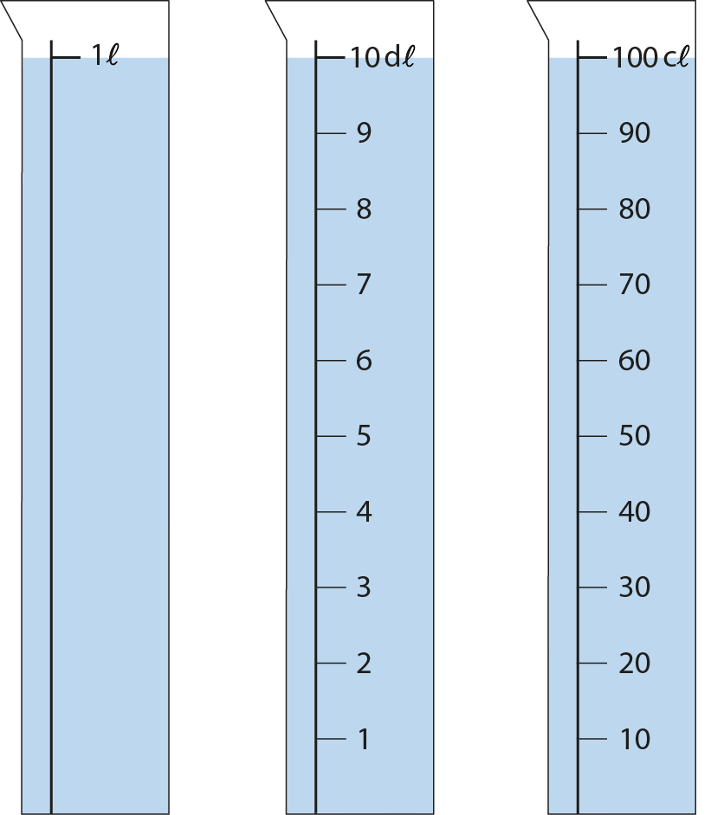
2.29 Extending decimal place-value to ×/÷ Step 2:4
Notes:
What’s the same?
What’s different?

Slide 58
Year 5, Unit 6, Learning Outcome 6
Learning Outcome 6
Pupils explain how to use known multiplication facts and unitising to multiply decimal fractions by whole numbers (tenths)
The following slides have been collated to support the teaching of this learning outcome.

Slide 59
Year 5, Unit 6, Learning Outcome 6
Additional teacher guidance for this outcome should be read first and can be found in this segment of the NCETM Primary Mastery Professional Development Materials:
2.19 Calculation: x/÷ decimal fractions by whole numbers
The spine materials are divided into ‘teaching points’ and ‘steps in learning’.
Teaching point | Steps in learning | Pages
1 | 1:1-1:6 | 4-9

Slide 60
2.19 Calculation: ×/÷ decimal fractions Step 1:1

Slide 61
2.19 Calculation: ×/÷ decimal fractions Step 1:1

Slide 62
2.19 Calculation: ×/÷ decimal fractions Step 1:2

Slide 63
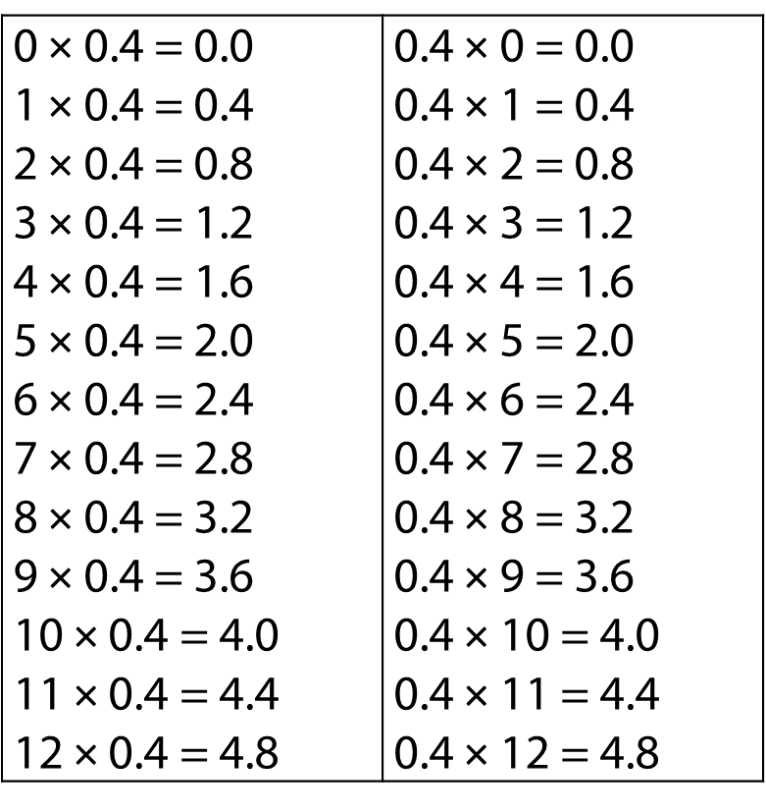
2.19 Calculation: ×/÷ decimal fractions Step 1:3

Slide 64
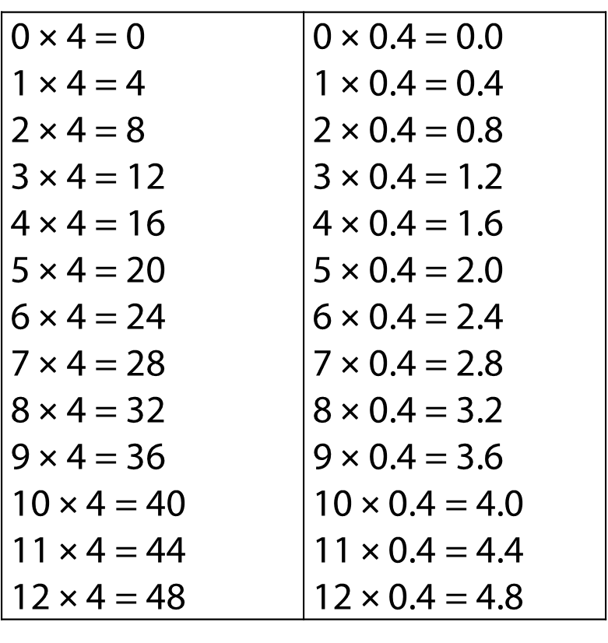
2.19 Calculation: ×/÷ decimal fractions Step 1:3

Slide 65
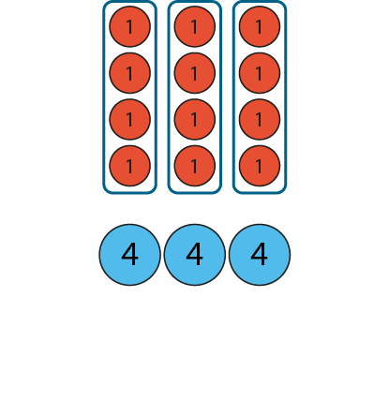
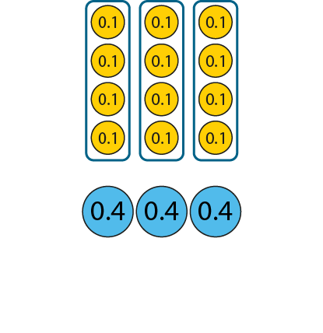
2.19 Calculation: ×/÷ decimal fractions Step 1:4
3 × 4 = 12
3 × 0.4 = 1.2
3 × 4 ones = 12 ones
3 × 4 tenths = 12 tenths
Notes:
Three times four ones is equal to twelve ones, so three times four tenths is equal to twelve tenths.

Slide 66
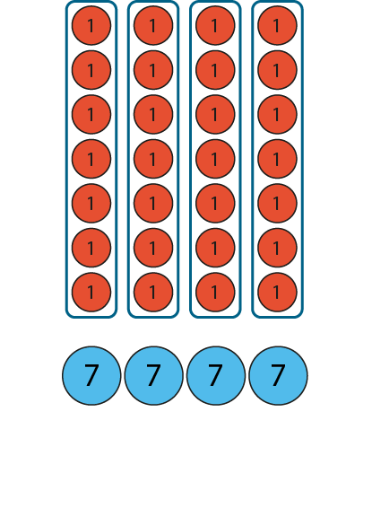
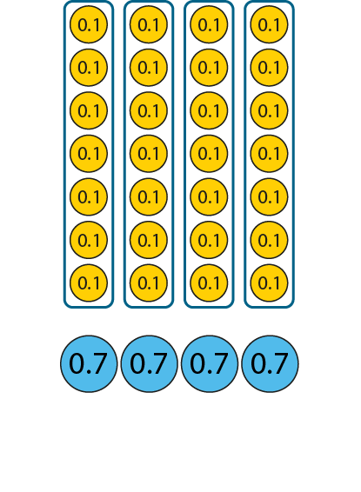
2.19 Calculation: ×/÷ decimal fractions Step 1:5
4 × 7 = 28
4 × 0.7 = 2.8
4 × 7 ones = 28 ones
4 × 7 tenths = 28 tenths
Notes:
Four times seven ones is equal to twenty-eight ones, so four times seven tenths is equal to twenty-eight tenths.

Slide 67
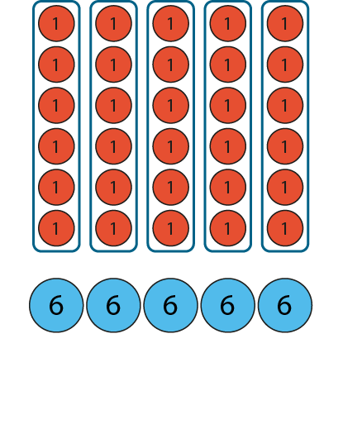
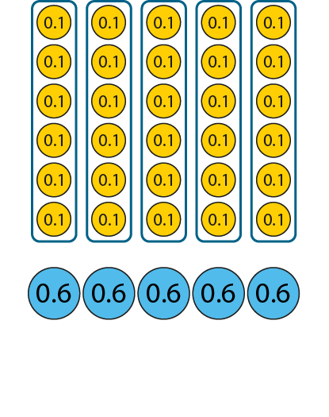
2.19 Calculation: ×/÷ decimal fractions Step 1:5
6 × 5 = 30
6 × 0.5 = 3.0
6 ones × 5 = 30 ones
6 tenths × 5 = 30 tenths
Notes:
Six ones times five is equal to thirty ones, so six tenths times five is equal to thirty tenths.

Slide 68
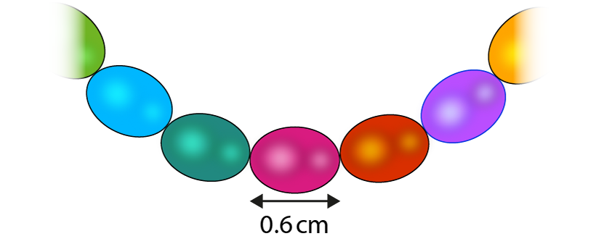
2.19 Calculation: ×/÷ decimal fractions Step 1:6
How long could the necklace be?
3.6 cm
4.6 cm
6.0 cm
3.2 cm
48 cm

Slide 69
Year 5, Unit 6, Learning Outcome 7
Learning Outcome 7
Pupils explain how to use known multiplication facts and unitising to multiply decimal fractions by whole numbers (hundredths)
The following slides have been collated to support the teaching of this learning outcome.

Slide 70
Year 5, Unit 6, Learning Outcome 7
Additional teacher guidance for this outcome should be read first and can be found in this segment of the NCETM Primary Mastery Professional Development Materials:
2.19 Calculation: x/÷ decimal fractions by whole numbers
The spine materials are divided into ‘teaching points’ and ‘steps in learning’.
Teaching point | Steps in learning | Pages
1 | 1:7-1:12 | 10-13

Slide 71
2.19 Calculation: ×/÷ decimal fractions Step 1:7

Slide 72
2.19 Calculation: ×/÷ decimal fractions Step 1:7

Slide 73
2.19 Calculation: ×/÷ decimal fractions Step 1:8

Slide 74
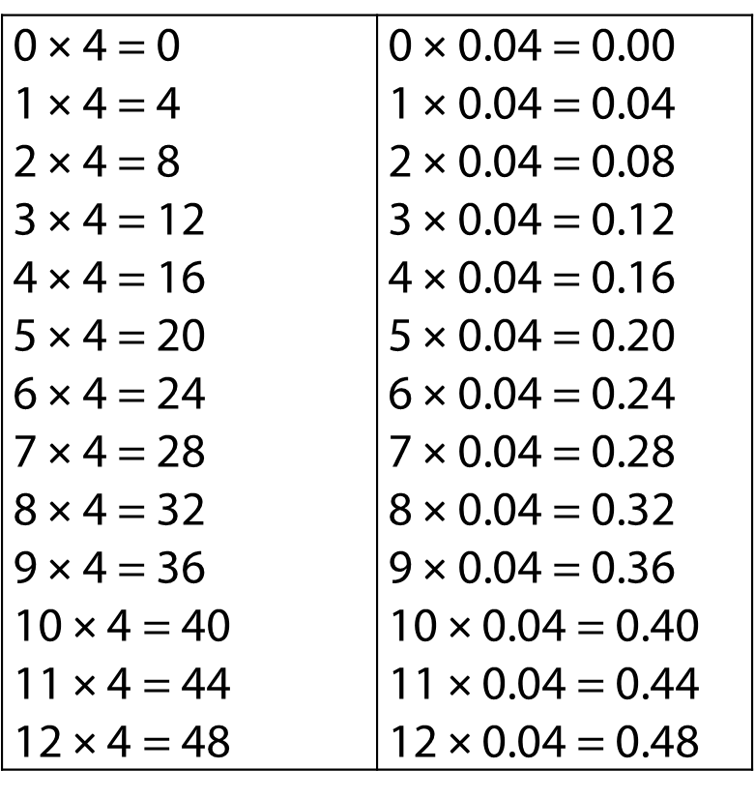
2.19 Calculation: ×/÷ decimal fractions Step 1:9

Slide 75
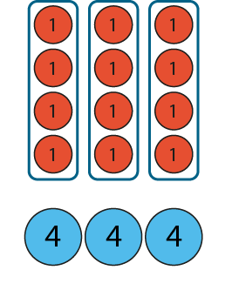
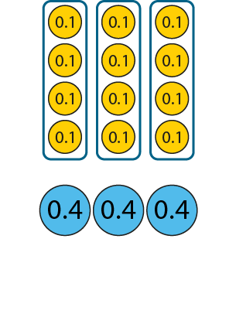
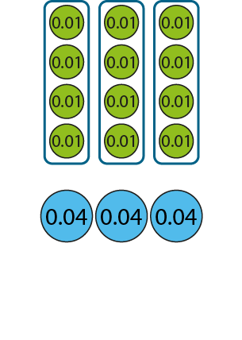
2.19 Calculation: ×/÷ decimal fractions Step 1:10
3 × 4 = 12
3 × 0.4 = 1.2
3 × 0.04 = 0.12
3 × 4 ones = 12 ones
3 × 4 tenths = 12 tenths
3 × 4 = 12
hundredths
hundredths
Notes:
Three times four ones is equal to twelve ones, so three times four hundredths is equal to twelve hundredths.

Slide 76
Year 5, Unit 6, Learning Outcome 8
Learning Outcome 8
Pupils use their knowledge of multiplying decimal fractions by whole numbers to solve measures problems
The following slides have been collated to support the teaching of this learning outcome.

Slide 77
Year 5, Unit 6, Learning Outcome 8
Additional teacher guidance for this outcome should be read first and can be found in this segment of the NCETM Primary Mastery Professional Development Materials:
2.19 Calculation: x/÷ decimal fractions by whole numbers
The spine materials are divided into ‘teaching points’ and ‘steps in learning’.
Teaching point | Steps in learning | Pages
1 | 1:13 | 13-14

Slide 78
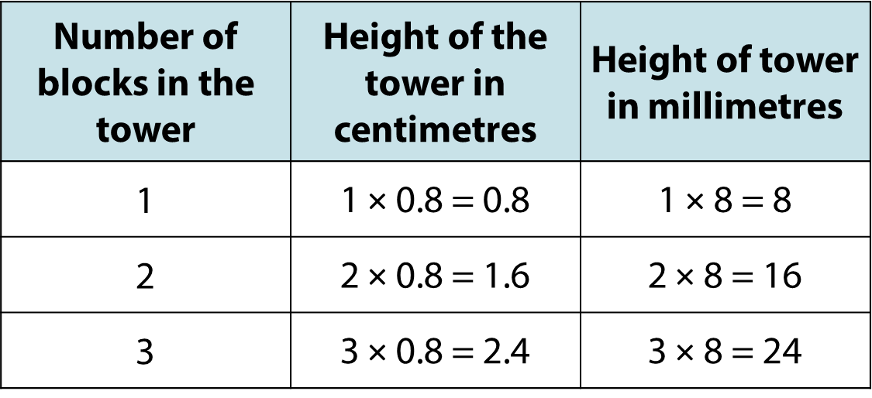
2.19 Calculation: ×/÷ decimal fractions Step 1:13
Notes:
I am building a tower out of blocks. Each block is 0.8 cm tall.
How tall could the tower be?

Slide 79
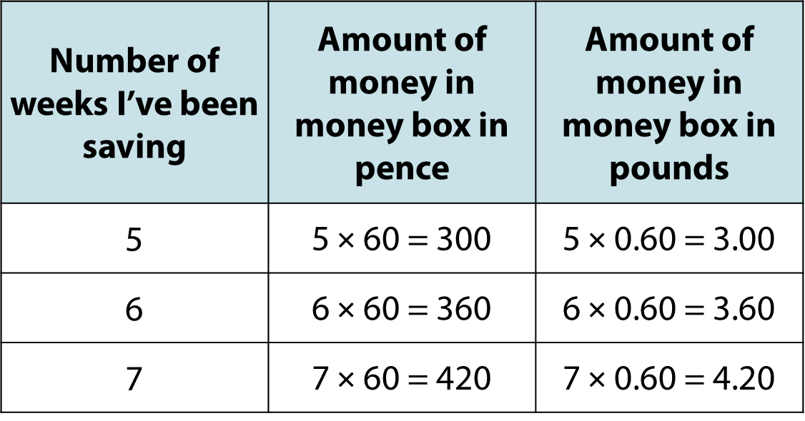
2.19 Calculation: ×/÷ decimal fractions Step 1:13
Notes:
I put 60 p in my money box each week.
How much money could there be in my money box?

Slide 80
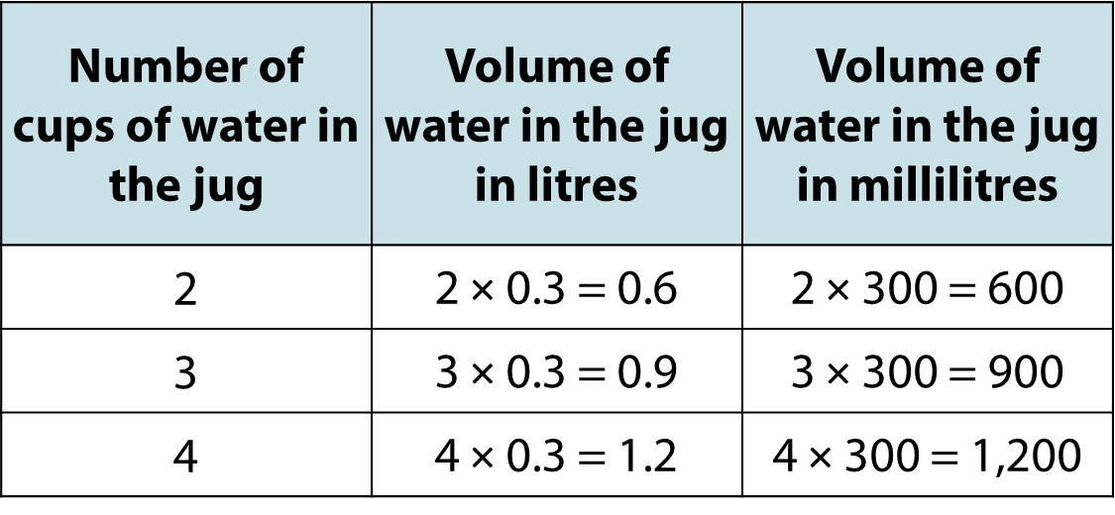
2.19 Calculation: ×/÷ decimal fractions Step 1:13
Notes:
I fill a jug with water using 0.3 litre cups.
How much water could be in the jug.

Slide 81
Year 5, Unit 6, Learning Outcome 9
Learning Outcome 9
Pupils explain the relationship between multiplying by 0.1 dividing by 10
The following slides have been collated to support the teaching of this learning outcome.

Slide 82
Year 5, Unit 6, Learning Outcome 9
Additional teacher guidance for this outcome should be read first and can be found in this segment of the NCETM Primary Mastery Professional Development Materials:
2.19 Calculation: x/÷ decimal fractions by whole numbers
The spine materials are divided into ‘teaching points’ and ‘steps in learning’.
Teaching point | Steps in learning | Pages
2 | 2:1-2:3 and 2:5 | 15-18 and 20

Slide 83
2.19 Calculation: ×/÷ decimal fractions Step 2:1
Mary’s string is one-tenth the length of William’s string.
How long is Mary’s string?
William’s string: 1 m
Mary’s string:
1 m × 0.1 = 0.1 m
?
Notes:
One tenth of one metre is zero-point-one metres.
One tenth of one metre is one-tenth of a metre.

Slide 84
2.19 Calculation: ×/÷ decimal fractions Step 2:1
Mary’s string is one-tenth the length of William’s string.
How long is Mary’s string?
William’s string: 2 m
Mary’s string:
2 m × 0.1 = 0.2 m
?
Notes:
One tenth of two metres is zero-point-two metres.
One tenth of two metres is two-tenths of a metre.

Slide 85
2.19 Calculation: ×/÷ decimal fractions Step 2:1
Mary’s string is one-tenth the length of William’s string.
How long is Mary’s string?
William’s string: 12 m
12 m × 0.1 = 1.2 m
?
Mary’s string:
Notes:
One tenth of twelve metres is one-point-two metres.
One tenth of twelve metres is twelve-tenths of a metre.

Slide 86
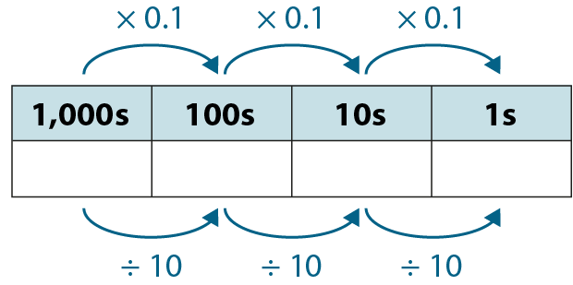
2.19 Calculation: ×/÷ decimal fractions Step 2:2
2
0
20 × 0.1
= 2
20 ÷ 10
= 2

Slide 87
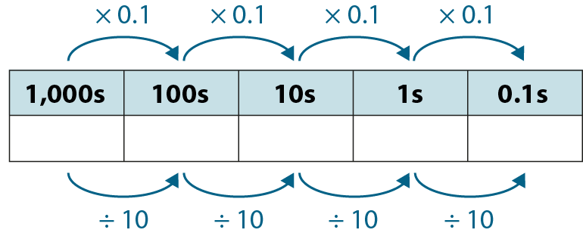
2.19 Calculation: ×/÷ decimal fractions Step 2:2
1
2
12 × 0.1
= 1.2
12 ÷ 10
= 1.2

Slide 88
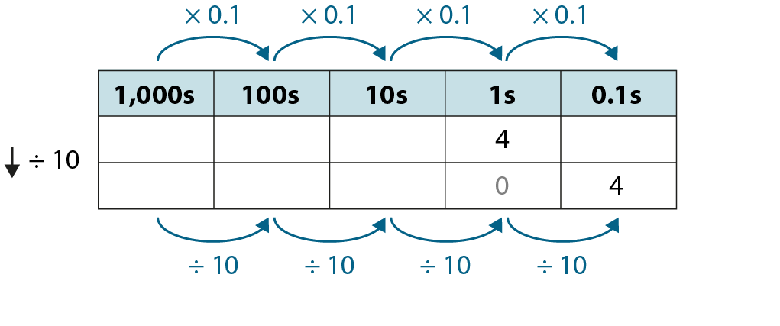
2.19 Calculation: ×/÷ decimal fractions Step 2:2
4 × 0.1 = 0.4
4 ÷ 10 = 0.4

Slide 89
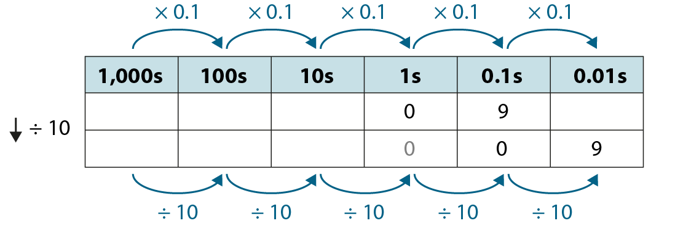
2.19 Calculation: ×/÷ decimal fractions Step 2:3
0.9 × 0.1 = 0.09
0.9 ÷ 10 = 0.09

Slide 90
Year 5, Unit 6, Learning Outcome 10
Learning Outcome 10
Pupils explain the relationship between multiplying by 0.01 dividing by 100
The following slides have been collated to support the teaching of this learning outcome.

Slide 91
Year 5, Unit 6, Learning Outcome 10
Additional teacher guidance for this outcome should be read first and can be found in this segment of the NCETM Primary Mastery Professional Development Materials:
2.19 Calculation: x/÷ decimal fractions by whole numbers
The spine materials are divided into ‘teaching points’ and ‘steps in learning’.
Teaching point | Steps in learning | Pages
2 | 2:4-2:5 | 18-20

Slide 92
2.19 Calculation: ×/÷ decimal fractions Step 2:4
Mary’s string is one-hundredth the length of William’s string.
Notes:
Mary’s string is one-hundredth the length of William’s string.
How long is Mary’s string?

Slide 93
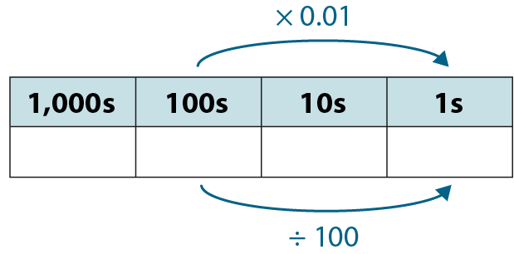
2.19 Calculation: ×/÷ decimal fractions Step 2:4
2
0
0
= 2
200 ÷ 100
= 2
200 × 0.01

Slide 94
2.19 Calculation: ×/÷ decimal fractions Step 2:4
120 × 0.01 = 1.2
120 ÷ 100 = 1.2

Slide 95
2.19 Calculation: ×/÷ decimal fractions Step 2:4
12 × 0.01 = 0.12
12 ÷ 100 = 0.12

Slide 96
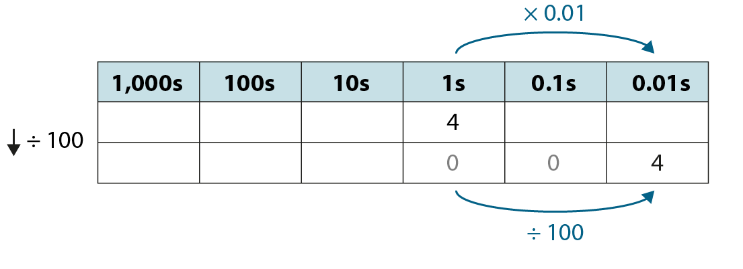
2.19 Calculation: ×/÷ decimal fractions Step 2:4
4 × 0.01 = 0.04
4 ÷ 100 = 0.04

Slide 97
Year 5, Unit 6, Learning Outcome 11
Learning Outcome 11
Pupils explain how to use multiplying by 10 or 100 to multiply one-digit numbers by decimal fractions (1) (for which the relevant whole-number calculation can be solved using known facts or mental strategies)
The following slides have been collated to support the teaching of this learning outcome.

Slide 98
Year 5, Unit 6, Learning Outcome 11
Additional teacher guidance for this outcome should be read first and can be found in this segment of the NCETM Primary Mastery Professional Development Materials:
2.19 Calculation: x/÷ decimal fractions by whole numbers
The spine materials are divided into ‘teaching points’ and ‘steps in learning’.
Teaching point | Steps in learning | Pages
3 | 3:1-3:4 and 3:10 | 21-24 and 31

Slide 99
2.19 Calculation: ×/÷ decimal fractions Step 3:1
Notes:
Two-point-five is one-tenth the size of twenty-five,
so four times two-point-five is one tenth the size of four times twenty-five.

Slide 100
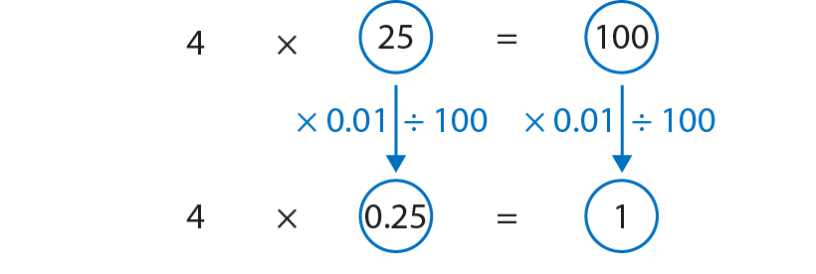
2.19 Calculation: ×/÷ decimal fractions Step 3:1
Notes:
Zero-point-two-five is one-hundredth the size of twenty-five,
so four times zero-point-five is one hundredth the size of four times twenty-five.

Slide 101
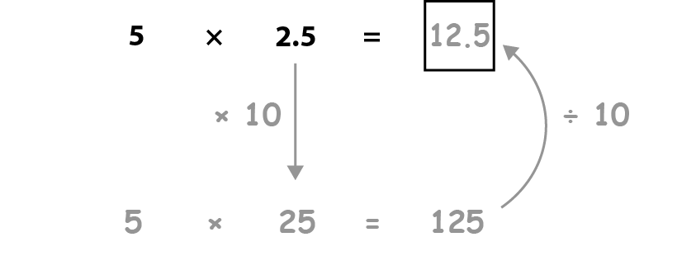
2.19 Calculation: ×/÷ decimal fractions Step 3:2
Notes:
For detailed progression and more examples to use in class, please refer to the teacher guide for 2.19 Calculation: ×/÷ decimal fractions by whole numbers.

Slide 102
Year 5, Unit 6, Learning Outcome 12
Learning Outcome 12
Pupils explain how to use multiplying by 10 or 100 to multiply one-digit numbers by decimal fractions (2) (for which the relevant whole-number calculation can be solved using short multiplication)
The following slides have been collated to support the teaching of this learning outcome.

Slide 103
Year 5, Unit 6, Learning Outcome 12
Additional teacher guidance for this outcome should be read first and can be found in this segment of the NCETM Primary Mastery Professional Development Materials:
2.19 Calculation: x/÷ decimal fractions by whole numbers
The spine materials are divided into ‘teaching points’ and ‘steps in learning’.
Teaching point | Steps in learning | Pages
3 | 3:5-3:10 | 25-31

Slide 104
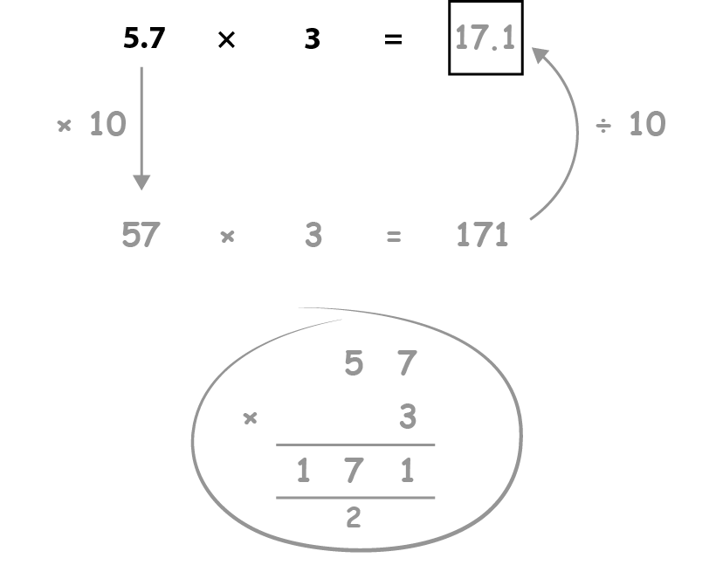
2.19 Calculation: ×/÷ decimal fractions Step 3:5
Notes:
For detailed progression and more examples to use in class, please refer to the teacher guide for 2.19 Calculation: ×/÷ decimal fractions by whole numbers.

Slide 105
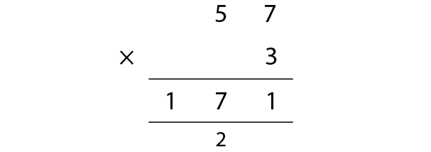
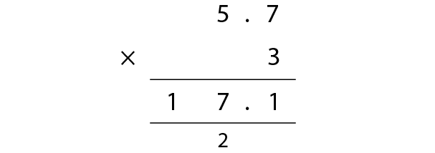
2.19 Calculation: ×/÷ decimal fractions Step 3:7
57 ones × 3 = 171 ones
so
57 tenths × 3 = 171 tenths
5.7 × 3 = 17.1

Slide 106
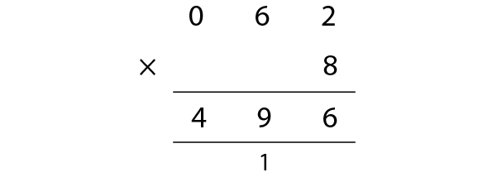
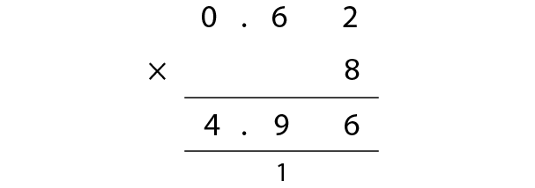
2.19 Calculation: ×/÷ decimal fractions Step 3:7
62 ones × 8 = 496 ones
so
62 hundredths × 8 = 496 hundredths
0.62 × 8 = 4.96

Slide 107
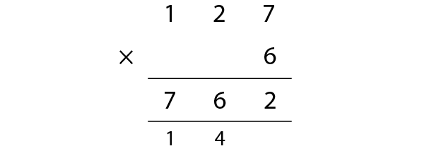
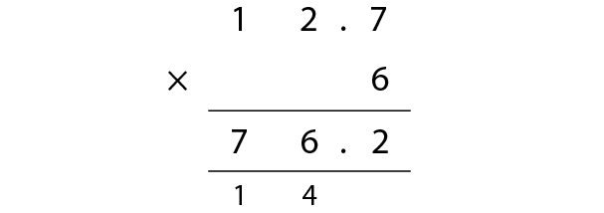
2.19 Calculation: ×/÷ decimal fractions Step 3:7
127 ones × 6 = 762 ones
so
127 tenths × 6 = 762 tenths
12.7 × 6 = 76.2

Slide 108
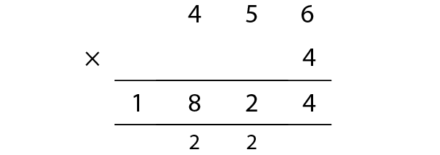
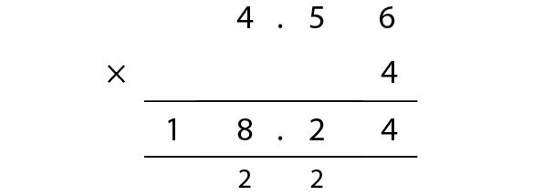
2.19 Calculation: ×/÷ decimal fractions Step 3:7
456 ones × 4 = 1,824 ones
so
456 hundredths × 4 = 1,824 hundredths
4.56 × 4 = 18.24

Slide 109
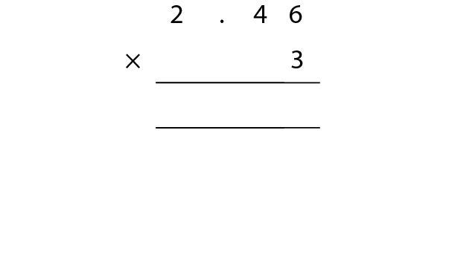
2.19 Calculation: ×/÷ decimal fractions Step 3:8
2.46 × 3
Step 1 – lay out the calculation
.

Slide 110
2.19 Calculation: ×/÷ decimal fractions Step 3:8
2.46 × 3
Step 1 – lay out the calculation
Step 2 – write the decimal point for the product
.
.

Slide 111
2.19 Calculation: ×/÷ decimal fractions Step 3:8
2.46 × 3
Step 3 – perform the calculation with unitising
Step 2 – write the decimal point for the product
6
3
8
1
Notes:
3 × 6 hundredths = 18 hundredths
18 hundredths = 1 tenth + 8 hundredths
Write ‘1’ below the tenths column and ‘8’ in the hundredths column.

Slide 112
2.19 Calculation: ×/÷ decimal fractions Step 3:8
2.46 × 3
Step 3 – perform the calculation with unitising
4
6
3
3
8
1
1
Notes:
3 × 4 tenths = 12 tenths
12 tenths + 1 tenth = 13 tenths
13 tenths = 1 one + 3 tenths
Write ‘1’ below the ones column and ‘3’ in the tenths column.

Slide 113
2.19 Calculation: ×/÷ decimal fractions Step 3:8
2.46 × 3
Step 3 – perform the calculation with unitising
2
4
6
3
7
3
8
1
1
Notes:
3 × 2 ones = 6 ones
6 ones + 1 one = 7 ones
Write ‘7’ in the ones column.

Slide 114
Year 5, Unit 6, Learning Outcome 13
Learning Outcome 13
Pupils explain how to use the size of the multiplier to predict the size of the product compared to the multiplicand
The following slides have been collated to support the teaching of this learning outcome.

Slide 115
Year 5, Unit 6, Learning Outcome 13
Additional teacher guidance for this outcome should be read first and can be found in this segment of the NCETM Primary Mastery Professional Development Materials:
2.19 Calculation: x/÷ decimal fractions by whole numbers
The spine materials are divided into ‘teaching points’ and ‘steps in learning’.
Teaching point | Steps in learning | Pages
4 | 4:1-4:4 | 32-34

Slide 116
2.19 Calculation: ×/÷ decimal fractions Step 4:1

Slide 117
2.19 Calculation: ×/÷ decimal fractions Step 4:1

Slide 118
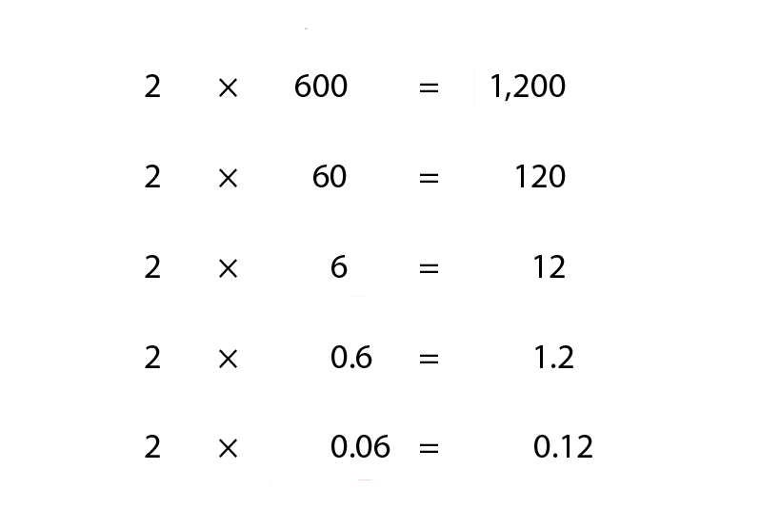
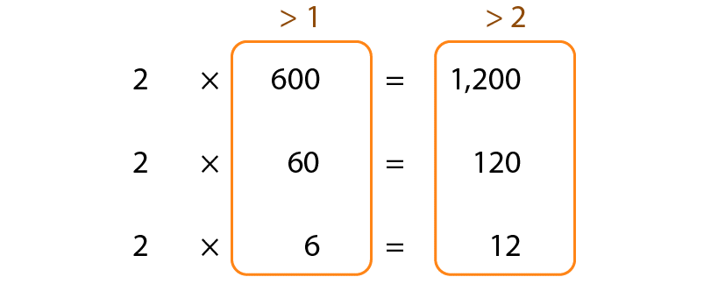
2.19 Calculation: ×/÷ decimal fractions Step 4:2

Slide 119
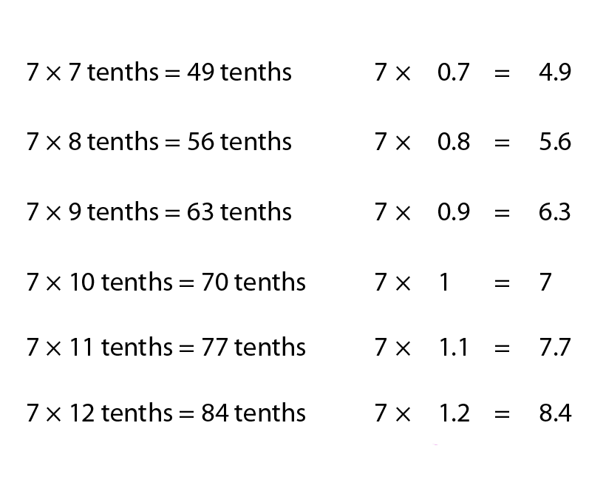
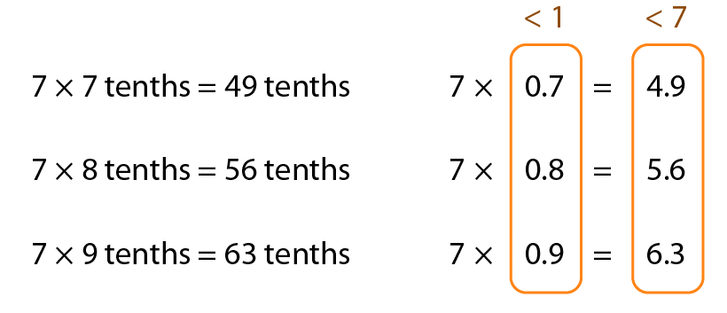
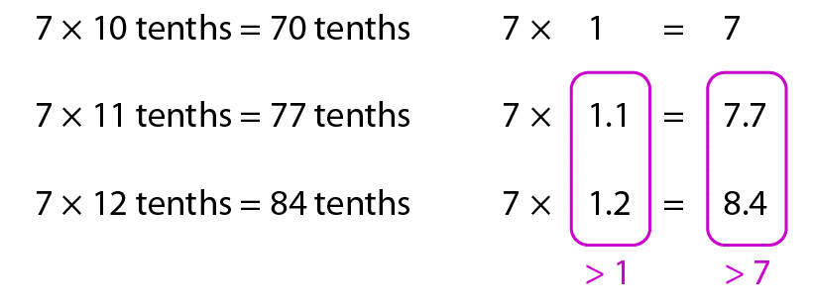
2.19 Calculation: ×/÷ decimal fractions Step 4:3

Slide 120
Year 5, Unit 6, Learning Outcome 14
Learning Outcome 14
Pupils explain how to use multiplying by 10 or 100 to divide decimal fractions by one-digit numbers (1) (for which the relevant whole-number calculation can be solved using known facts or mental strategies)
The following slides have been collated to support the teaching of this learning outcome.

Slide 121
Year 5, Unit 6, Learning Outcome 14
Additional teacher guidance for this outcome should be read first and can be found in this segment of the NCETM Primary Mastery Professional Development Materials:
2.19 Calculation: x/÷ decimal fractions by whole numbers
The spine materials are divided into ‘teaching points’ and ‘steps in learning’.
Teaching point | Steps in learning | Pages
5 | 5:1-5:4 and 5:10 | 35-37 and 42

Slide 122
2.19 Calculation: ×/÷ decimal fractions Step 5:1
Notes:
One-point-two is one-tenth the size of twelve, so one-point-two divided by three is one-tenth the size of twelve divided by three.

Slide 123
2.19 Calculation: ×/÷ decimal fractions Step 5:1
Notes:
Zero-point-one-two is one-hundredth the size of twelve, so zero-point-one-two divided by three is one-hundredth the size of twelve divided by three.

Slide 124
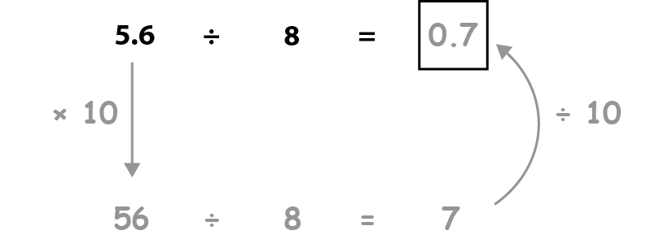
2.19 Calculation: ×/÷ decimal fractions Step 5:2
Notes:
For detailed progression and more examples to use in class, please refer to the teacher guide for 2.19 Calculation: ×/÷ decimal fractions by whole numbers.

Slide 125
Year 5, Unit 6, Learning Outcome 15
Learning Outcome 15
Pupils explain how to use multiplying by 10 or 100 to divide decimal fractions by two-digit numbers (2) (for which the relevant whole-number calculation can be solved using short multiplication)
The following slides have been collated to support the teaching of this learning outcome.

Slide 126
Year 5, Unit 6, Learning Outcome 15
Additional teacher guidance for this outcome should be read first and can be found in this segment of the NCETM Primary Mastery Professional Development Materials:
2.19 Calculation: x/÷ decimal fractions by whole numbers
The spine materials are divided into ‘teaching points’ and ‘steps in learning’.
Teaching point | Steps in learning | Pages
5 | 5:5-5:10 | 38-42

Slide 127
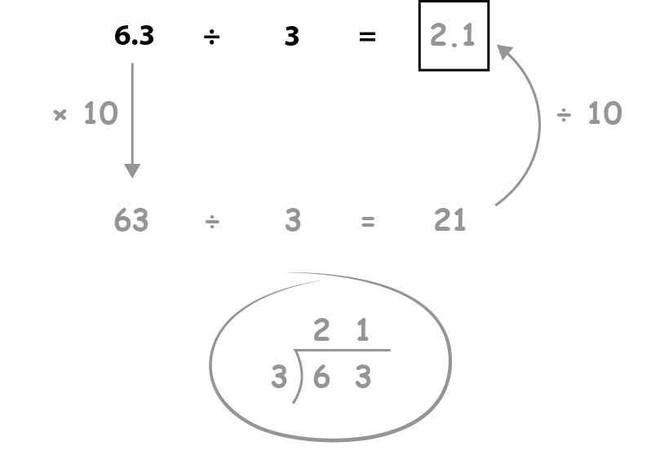
2.19 Calculation: ×/÷ decimal fractions Step 5:5
Notes:
For detailed progression and more examples to use in class, please refer to the teacher guide for 2.19 Calculation: ×/÷ decimal fractions by whole numbers.

Slide 128
2.19 Calculation: ×/÷ decimal fractions Step 5:7
2 1
2 . 1
3
6 3
3
6 . 3
63 ones ÷ 3 = 21 ones
so
63 tenths ÷ 3 = 21 tenths
6.3 ÷ 3 = 2.1

Slide 129
2.19 Calculation: ×/÷ decimal fractions Step 5:7
0 1 7
0 . 1 7
5
0 8 5
3
5
0 . 8 5
3
85 ones ÷ 5 = 17 ones
so
85 hundredths ÷ 5 = 17 hundredths
0.85 ÷ 5 = 0.17

Slide 130
2.19 Calculation: ×/÷ decimal fractions Step 5:7
0 5 1
0 5 . 1
5
2 5 5
2
5
2 5 . 5
2
255 ones ÷ 5 = 51 ones
so
255 tenths ÷ 5 = 51 tenths
25.5 ÷ 5 = 5.1

Slide 131
2.19 Calculation: ×/÷ decimal fractions Step 5:7
0 8 9
0 . 8 9
4
3 5 6
3
3
4
3 . 5 6
3
3
356 ones ÷ 4 = 89 ones
so
356 hundredths ÷ 4 = 89 hundredths
3.56 ÷ 4 = 0.89

Slide 132
2.19 Calculation: ×/÷ decimal fractions Step 5:8
2.46 ÷ 6
Step 1 – write the divisor, dividend and frame
6
2
.
4
6

Slide 133
2.19 Calculation: ×/÷ decimal fractions Step 5:8
2.46 ÷ 6
Step 2 – write the decimal point for the quotient
Step 1 – write the divisor, dividend and frame
.
6
2
.
4
6

Slide 134
2.19 Calculation: ×/÷ decimal fractions Step 5:8
2.46 ÷ 6
Step 2 – write the decimal point for the quotient
Step 3 – perform the calculation, with unitising
0
.
6
2
.
4
6
2
Notes:
2 ones ÷ 6 = 0 ones remainder 2 ones
Write ‘0’ in the ones column, and write ‘2’ to the left of the tenths column to make 24 tenths.

Slide 135
2.19 Calculation: ×/÷ decimal fractions Step 5:8
2.46 ÷ 6
Step 3 – perform the calculation, with unitising
0
.
4
6
2
.
4
6
2
Notes:
24 tenths ÷ 6 = 4 tenths
Write ‘4’ in the tenths column.

Slide 136
2.19 Calculation: ×/÷ decimal fractions Step 5:8
2.46 ÷ 6
Step 3 – perform the calculation, with unitising
0
.
4
1
6
2
.
4
6
2
Notes:
6 hundredths ÷ 6 = 1 hundredth
Write ‘1’ in the hundredths column.

