Slide 1
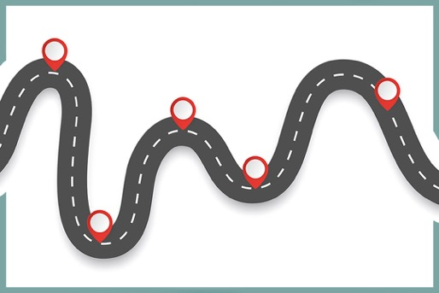
Checkpoints
Year 8 diagnostic mathematics activities
Perimeter, area and volume 2
Twenty-eight Checkpoint activities
Eleven additional activities
Published in 2022/23

Slide 2
About this resource
This resource is designed to be used in the classroom with Year 8 students, although it may be useful for other students.
The Checkpoints are grouped around the key ideas in the core concept documents, 6.1 Perimeter, area and volume, part of the NCETM Secondary Mastery Professional Development materials.
Before each set of Checkpoints, context is explored, to help secondary teachers to understand where students may have encountered concepts in primary school.
The 10-minute Checkpoint tasks might be used as assessment activities, ahead of introducing concepts, to help teachers explore what students already know and identify gaps and misconceptions.
Each Checkpoint has an optional question marked . This will provide further thinking for those students who have completed the rest of the activities on the slide.
The notes for each Checkpoint give answers (if appropriate), some suggested questions and things to consider.
After each Checkpoint, a guidance slide explores suggested adaptations, potential misconceptions and follow-up tasks. These may include the additional activities at the end of this deck.

Slide 3
Using these Checkpoints
This deck contains a mixture of concepts that students will have first have met in Key Stage 2, and some that are part of the Key Stage 3 curriculum.
For example, although this is the first time we have explored volume within the Checkpoints materials, volume as a concept is explored throughout EYFS and Key Stage 1, before volume of a cuboid is taught in Key Stage 2. In contrast, the area of a trapezium is not taught in primary school but is included as an assessment point here as it appears in the Year 7 section of the NCETM’s sample curriculum framework.
The notes for each slide make it clear how it is best used, and the guidance at the start of each section gives more detail about students’ experience at primary school. We strongly recommend you read each of these first before attempting any tasks with your students.
If students need more practice of perimeter and area of triangles, rectangles or parallelograms, use the Checkpoints from the ‘Perimeter and area 1’ deck.
Continuity is built in representations and structure between different Checkpoints decks: where a Checkpoint uses the word ‘again’ in the title, this indicates a similar task has been used in another deck.

Slide 4
Checkpoints 1–8
Checkpoint | Underpins | Code
1: Bricks | Area and perimeter | 6.2.1, 6.2.2
2: Swedishish
3: Line drawings
4: Trapezia
5: Most agreeable | Understand place value in decimals, including recognising exponent and fractional representations of the column headings | 1.1.1.2
6: Ants on a clock | Circles | 6.2.1, 6.2.2
7: Semi-circular path
8: Not full circle
*This three-digit code refers to the statement of knowledge, skills and understanding in the NCETM’s Sample Key Stage 3 Curriculum Framework (see notes below for more information).
Notes:
In the Sample Key Stage 3 Curriculum Framework, statements of knowledge, skills and understanding are arranged to give an example teaching order. The three-digit code for each statement in the framework is a clickable hyperlink to documents with more detailed information, including the key ideas contained within that statement. These key ideas are also shown on slides 7–8 in this deck.

Slide 5
Checkpoints 9–17
Checkpoint | Underpins | Code
9: Inside out? | 3D Shapes | 6.2.3
10: Hole in the wall
11: Bird’s-eye view
12: 3D three ways | Understand place value in decimals, including recognising exponent and fractional representations of the column headings | 1.1.1.2
13: Wrong ’uns
14: Six faced
15: Four, five, six prisms
16: Prism break
17: Cubist
18: Dienes
*This three-digit code refers to the statement of knowledge, skills and understanding in the NCETM’s Sample Key Stage 3 Curriculum Framework (see notes below for more information).
Notes:
In the Sample Key Stage 3 Curriculum Framework, statements of knowledge, skills and understanding are arranged to give an example teaching order. The three-digit code for each statement in the framework is a clickable hyperlink to documents with more detailed information, including the key ideas contained within that statement. These key ideas are also shown on slides 7–8 in this deck.

Slide 6
Checkpoints 19–28
Checkpoint | Underpins | Code
19: Twenty-eight cubes | Concept of volume | 6.2.3
20: Lunchboxes
21: Cold as ice
22: Blocks
23: Swimming pool | Calculating volume | 6.2.3
24: Cubes in a glass
25: Marshall’s parcel
26: Same volume
27: Remembering rules
28: Twice as wide, twice as tall
*This three-digit code refers to the statement of knowledge, skills and understanding in the NCETM’s Sample Key Stage 3 Curriculum Framework (see notes below for more information).
Notes:
In the Sample Key Stage 3 Curriculum Framework, statements of knowledge, skills and understanding are arranged to give an example teaching order. The three-digit code for each statement in the framework is a clickable hyperlink to documents with more detailed information, including the key ideas contained within that statement. These key ideas are also shown on slides 7–8 in this deck.

Slide 7
Key ideas
Understand the concept of perimeter and use it in a range of problem-solving situations | Code
Recognise that there is constant multiplicative relationship (π) between the diameter and circumference of a circle | 6.2.1.2
Use the relationship C = πd to calculate unknown lengths in contexts involving the circumference of circles | 6.2.1.3
Understand the concept of area and use it in a range of problem-solving situations
Understand the derivation of, and use the formula for, the area of a circle | 6.2.2.3*
Solve area problems of composite shapes involving whole and/or part circles, including finding the radius or diameter given the area | 6.2.2.4
Understand the concept of surface area and find the surface area of 3D shapes in an efficient way | 6.2.2.5*
*‘There are additional resources exemplifying these key ideas in the Secondary Mastery Professional Development | NCETM.

Slide 8
Key ideas
Understand the concept of volume and use it in a range of problem-solving situations | Code
Be aware that all prisms have two congruent polygonal parallel faces (bases) with parallelogram faces joining the corresponding vertices of the bases | 6.2.3.1
Use the constant cross-sectional area property of prisms and cylinders to determine their volume | 6.2.3.2
*‘There are additional resources exemplifying these key ideas in the Secondary Mastery Professional Development | NCETM.

Slide 9
Area and perimeter
Checkpoints 1–5

Slide 10
Area and perimeter
Previous learning
Key Stage 2 curriculum: Year 4: measure and calculate the perimeter of a rectilinear figure (including squares) in centimetres and metres Year 4: find the area of rectilinear shapes by counting squares Year 5: measure and calculate the perimeter of composite rectilinear shapes in centimetres and metres Year 5: calculate and compare the area of rectangles (including squares), and including using standard units, cm², m² and estimate the area of irregular shapes Year 6: recognise that shapes with the same areas can have different perimeters and vice versa Year 6: recognise when it is possible to use formulae for area and volume of shapes Year 6: calculate the area of parallelograms and triangles Further information about how students may have experienced this key idea in Key Stage 2: Teaching mathematics in primary schools, 4G–2:… find the perimeter of regular and irregular polygons (pp197–201¹); 5G-2: compare areas and calculate the area of rectangles (including squares) using standard measures (pp269–74); 6G-1: draw, compose and decompose shapes according to given properties, including dimensions angles and area and solve related problem (pp322–26). Key Stage 3 curriculum: 6.2.1.1² Use the properties of a range of polygons to deduce their perimeters 6.2.2.1 Derive and use the formula for the area of a trapezium 6.2.2.2 Understand that the areas of composite shapes can be found in different ways ¹ Page numbers reference the complete Years 1–6 document ² This four-digit code refers to the key ideas in Secondary Mastery Professional Development | NCETM; the Key Stage 2 content underpinning these ideas is assessed in the ‘Plotting coordinates’ Checkpoints deck.

Slide 11
Area and perimeter
In Key Stage 3 students need to
Understand that perimeter is a one dimensional measure and be able to distinguish it from area, which is two-dimensional (two ideas that are often confused). When calculating perimeter, use the properties of parallelograms, isosceles triangles and trapezia, as well as non-standard shapes, and reason mathematically to deduce missing information. Appreciate the reasoning behind the formula for the perimeter of the rectangle – P = 2(l + w) or P = 2l + 2w – and know that it cannot be used for finding the perimeter of other shapes. Be aware that any parallelogram has the same area as a rectangle with the same base and perpendicular height and that any triangle has an area that is half the area of a parallelogram with the same base and perpendicular height. Calculate the area of a triangle, parallelogram and trapezium using the relevant formulae, and understand how these formulae are derived from other known facts.

Slide 12
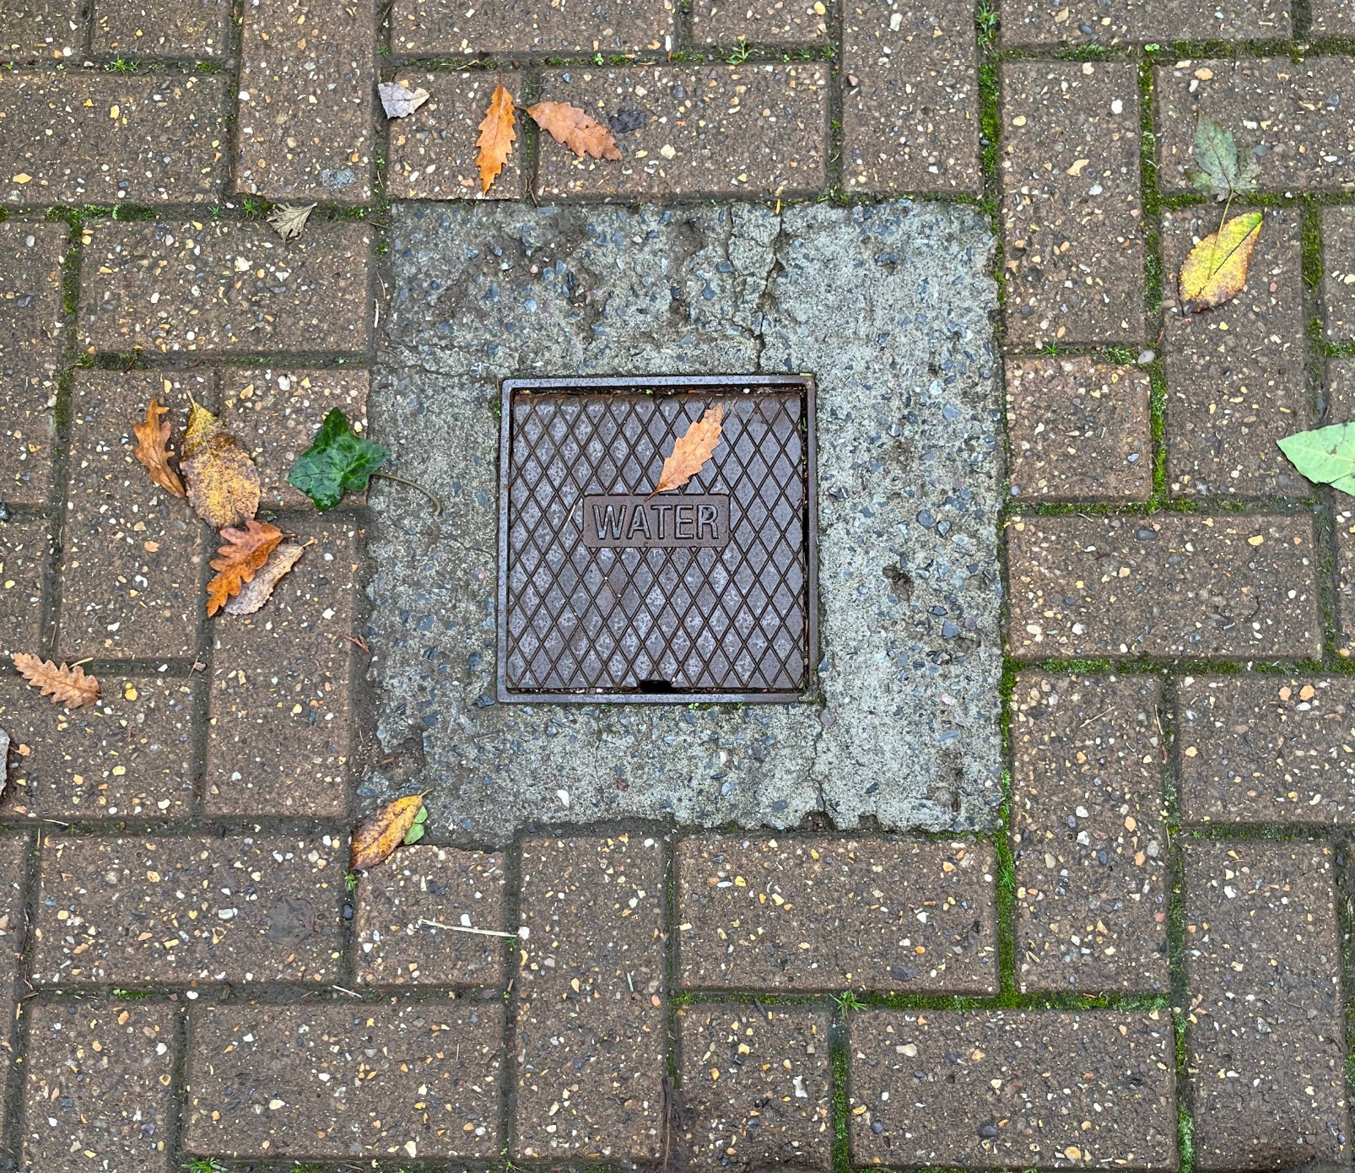
Checkpoint 1: Bricks
How many bricks have been removed to allow the square of concrete and drain cover to be put in?
How did you work this out? Is there more than one way to show this?
If the shortest side length of one brick is 15 cm, estimate the perimeter and area of the smaller metal drain cover square.
Notes:
This slide is animated. Each question will appear separately so you can choose the pace at which to work with your class.
Answers
a) Eight bricks have been removed for the whole space (concrete and drain cover).
b) Students’ answers may vary. They might, for example, work out how many bricks would fit along one edge, and then how many rows of these bricks would fit along the edge that is perpendicular to this.
? If the shortest side length of one brick is 15 cm, then the metal square has sides of approximately 30 cm. So a sensible estimate for perimeter is 120 cm and for area is 900 cm². Students should be clear that these are approximations, as the sides of the metal square do not align exactly with the sides of the bricks.
Suggested questioning
What do you know from this image? What do you not know?
What is the relationship between the shorter and longer lengths of the rectangle?
Is the metal shape a square? How do you know?
Things to think about
Checkpoint 1 does not mention the words area or perimeter in the main body of the task, so students may not immediately realise that you are checking their reasoning around these. Collect different responses to part b; share them with students, and suggest some of your own. You might, for example, label the sides a and 2a to start to encourage algebraic thinking and look forward to algebraic geometry problems. Or, looking back at the roots of students’ understanding of area, split the rectangles up to create an array of squares. Ask students which explanations make most sense to them, and consider how their responses reveal how their reasoning with perimeter and area has developed. The use of a ‘real’ image rather than a diagram is to help you to see whether students can view a real situation from a mathematical perspective. Can students connect their mathematical learning to the real world, and make use of it to interpret the situation?

Slide 13
Checkpoint 1: Guidance
Adaptations | Assessing understanding
Support Initially the task is accessible, but students may need support in reasoning more deeply and justifying how they know – beyond, ‘It looks like about six bricks’. Students could have a print out of the image and draw a grid of the blocks over it, but only after spending time visualising so that the way in which students are able to ‘see’ and deconstruct the image mentally has become apparent. Challenge The question states that the concrete forms a square – ask students to convince you that this is true, and to justify what their reasoning is. Representations Offer students the opportunity to draw a grid on the image (after spending time visualising) to support them and also offer further insight into their understanding. | Checkpoint 1 offers a chance for students to visualise and reason with area, giving insight into their current knowledge and understanding. In this task, the ‘area’ is described by the number of rectangular bricks rather than the more familiar squares. While the reasoning is similar, students are less likely to have a ready-made method for finding the area and so their reasoning might become more apparent. Students who understand area as a formula rather than having a conceptual understanding are likely to look for two numbers to multiply together, or to not realise that the task is assessing area, as that terminology is not used in the main part of the task. Ask what measurement of the space they have found and whether there is another way to measure and describe the same space.
Additional resources Further assessment tasks exploring area can be found in the ‘Perimeter and area1’ deck in Checkpoints | NCETM. You can explore students’ primary journey for perimeter and area in Curriculum prioritisation in primary maths | NCETM – beginning with perimeter in Unit 3 of Year 4 and area and scaling in Unit 5 of Year 5. Additional activities A and B offer other real-life contexts to explore understanding of perimeter and area.

Slide 14
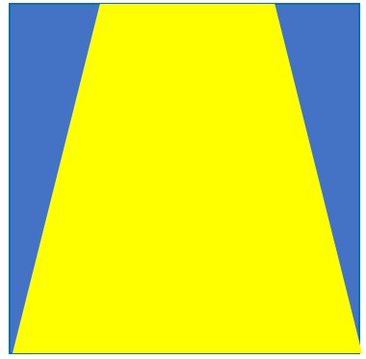
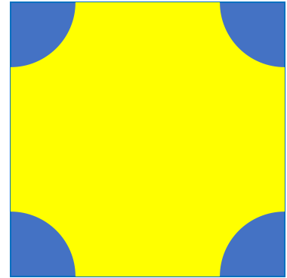
Checkpoint 2: Swedishish
Some yellow shapes are drawn inside a blue square.
For each yellow shape, decide whether its perimeter is greater or less than the perimeter of the blue square.
a)
b)
c)
d)
e)
f)
Is it possible to arrange the shapes in order of perimeter, shortest to longest?
Notes:
This slide is animated. Each question will appear separately so you can choose the pace at which to work with your class. A printable version of the shapes can be found on slide 100.
Answers
a) The yellow shape perimeter is less than the blue square perimeter.
b) The yellow shape perimeter is less than the blue square perimeter.
c) The yellow shape perimeter is greater than the blue square perimeter.
d) The yellow shape perimeter is less than the blue square perimeter.
e) The yellow perimeter is less than the blue square perimeter
f) The yellow perimeter is the same as the blue square perimeter.
? It is not possible to do this exactly without knowing some dimensions, but it is possible to group them. So the perimeters for a, b, d and e are all less than the perimeter than f, which in turn is greater than the perimeter for c.
Suggested questioning
What do you know about the lengths in the diagram? What do you not know?
Is __ length shorter/longer than __ length?
Are there any that you are not sure about? Why? What information would you need to be sure?
Things to think about
Rather than asking students to calculate perimeter, Checkpoint 2 asks them to reason with perimeter. As well as offering insight into their understanding, it is a good opportunity to discuss assumptions in geometry problems. No dimensions or identifying information has been given, so that you can discuss with students what they can and cannot assume about the lengths and angles shown. Do they know that certain pairs of lines are parallel or perpendicular? Can they approximate any of the angles? How would their answers change if exact values were given?

Slide 15
Checkpoint 2: Guidance
Adaptations | Assessing understanding
Support Carefully selecting two or three of the shapes to compare offers an opportunity to hear students' thinking, while making the task more accessible. For example, start with f, then e, followed by c and ask students what is the same and what is different; this will support them to focus on what changes and how this affects the perimeter. Challenge The further thinking question is quite challenging, particularly if students are used to having a definite answer to maths questions. After some time working on the task, share with students that the top length of each yellow shape is half the length of that edge of the blue square. Ask whether they are now able to offer any more details. Representations Encourage students to sketch the diagram and mark equal lengths to help them to reduce the apparent complexity of the comparisons. You could offer printed versions for them to work on. | Checkpoint 2 offers a context to discuss perimeter without the need to calculate. For this reason, dimensions are not given in the task (although they might offer an extension – see ‘Challenge’). Remind students that you are comparing to the whole blue square, not the blue shapes that remain when the yellow is drawn on. Look for students who can offer clear reasoning in situations where the blue and yellow shapes may have similar perimeters (such as in parts a or d). Students who identify the assumptions that they make are likely to be most secure. For example, can students explain that the perimeter of the yellow cross in part f is only the same as the square if all angles are right angles? Part e offers greater challenge, with the introduction of circles, offering further insight into students' understanding.
Additional resources To see how perimeter might have first been explored at primary, look at Year 4 Unit 3 of the Curriculum prioritisation in primary maths | NCETM. An example of a perimeter question can be found on p31 of the Year 6 Primary Assessment Materials | NCETM. Additional activity C explores perimeter before exploring nets.

Slide 16
Checkpoint 3: Line drawings
Four students use the line on the right as one side of a 2D shape.
Each student tries to draw a different shape with the same area.
Levi draws a rectangle.
Which of the statements below are true and which are false?
I need to make my triangle twice as tall as Levi’s rectangle.
My parallelogram needs to have the same length sides as Levi’s rectangle.
My trapezium needs to be the same height as Cassie's triangle
Cassie
Nico
Salma
Draw a rectangle, a triangle, a parallelogram and a trapezium that all have the same base length and area.
Notes:
This slide is animated. Each statement will appear separately so you can choose the pace at which to work with your class.
Answers
Cassie: true
Nico: false. The parallelogram needs to have one length the same as the rectangle, but the perpendicular height from this side needs to be the same as the other length of the rectangle. This means the other length will be longer.
Salma: false. The trapezium will have a larger area than the triangle. The trapezium needs to be shorter than the triangle, but taller than the rectangle.
? Various answers are possible; check students’ individual solutions work. The triangle would need a perpendicular height that is twice that of the rectangle. The parallelogram would need a perpendicular height that is the same as that of the rectangle. The trapezium would need a perpendicular height that compensates for the additional length added by the second parallel side, and division by two – substitute into the formula area = $\frac{1}{2}$(a + b)h to check.
Suggested questioning
What is the same and what is different about how you find the area of each shape?
How can you show whether the area is the same or different?
Which statement is easiest to agree/disagree with? Why?
Could you change the false statements to be true?
Things to think about
To build a deep and connected understanding of geometry, students should appreciate that the formulae for area are connected and derived from the properties of shapes. Students who have learnt the formulae ‘by rote’ without appreciating these connections will find this task challenging. Consider what information about student understanding can be gleaned from this task, as an alternative or in addition to more standard practice tasks.

Slide 17
Checkpoint 3: Guidance
Adaptations | Assessing understanding
Support The line is given without a length to check students' reasoning, but students may find it easier to discuss with some values. Give the line a value of 8 cm or draw it on squared paper. If students need further support, draw Levi's rectangle as a starting point. Challenge Work backwards: ask students to sketch a trapezium with a certain area and then ask how they would describe other shapes with the same area if they were to share a length. Representations No representations are given, to check students can reason without a visual prompt. If they are struggling, draw the shapes involved; drawing them on a grid might make it easier to compare areas. | There are many resources available that ask students to find the area of rectilinear shapes. Checkpoint 3 offers an alternative way to assess students’ understanding of the formulae for area. Students are asked to think and reason about what lengths must be involved if shapes were to have the same area. The intention is to check if they understand how the formulae are related. The expectation is that many students should have an awareness of how the formula for the area of rectangles has some similarities – and key differences – with the formulae for both triangles and parallelograms. For the parallelogram, the choice of language is deliberate: students need to be specific that it is the perpendicular height that is the same, not the length. The trapezium is tricky! This is the least familiar of the formulae, first introduced in Key Stage 3, and has the most complex relationship. Look for an appreciation that, although the formulae for both trapezia and triangles involve division by two, a trapezium with the same base and height as a triangle will have a greater area.
Additional resources Year 6 Unit 4 from Curriculum prioritisation in primary maths | NCETM, includes slides exploring relationships between triangles, rectangles and parallelograms. ‘Perimeter and area 1’ from Checkpoints | NCETM has tasks checking understanding of finding the area of rectilinear shapes. Key idea 6.2.2.1 from Secondary Mastery Professional Development | NCETM explores ‘The area of a trapezium’.

Slide 18
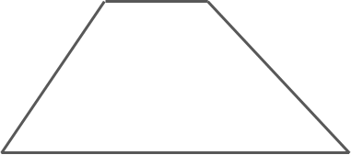
Checkpoint 4: Trapezia
George wants to find the area of some trapezia using the formula area = $\frac{1}{2}$(a + b)h.
He measures three sides and labels them a, b and h.
Has he done this correctly for each trapezium below?
a
b
34 cm
37 cm
a
h
12 cm
A
h
C
14 cm
b
21 cm
h
35 cm
b
9 cm
a
28 cm
16 cm
h
38 cm
E
a
b
D
22 cm
B
19 cm
a
61 cm
h
29 cm
9 cm
b
Estimate the area of each trapezium. Is it possible to calculate any of them accurately?
Notes:
This slide is animated. Each question will appear separately so you can choose the pace at which to work with your class. A printable version of the trapezia (two to a page) can be found on slide 101.
Answers
A No
B No
C Yes
D No
E No
? A The area must be less than $\frac{1}{2}$ × (37 + 9) × 21 as the vertical height is less than 21, so the area is less than 483 cm². It is not possible to calculate this accurately, but a sensible estimate might be approximately 400 cm².
B This is even more challenging to estimate as only one of the sides is usable. The other horizontal side must be less than 61 cm, and the perpendicular height must be less than 19 cm. An example estimate might be: $\frac{1}{2}$ × (61 + 49) × 18 = 990 cm².
C The area is exactly $\frac{1}{2}$ × (34 + 28) × 14 = 434 cm².
D The area must be less than $\frac{1}{2}$ × (35 + 29) × 16 as the vertical height is less than 16, so the area is less than 512 cm². It is possible to calculate this accurately using Pythagoras' theorem to find the vertical height of 14.8 cm (1 d.p.), although students are not likely to have covered this at this point in the Key Stage 3 curriculum. This gives an area of $\frac{1}{2}$ × (35 + 29) × 14.8 = 474.6 cm² (1 d.p.)
E A sensible estimate might be in the region of 300 cm². The other vertical side is approximately three-quarters of the height of the 38 cm length, leading to $\frac{1}{2}$ × (38 + 28.5) × 9 = 299.5 cm².
Suggested questioning
What is a trapezium?
Do any of these shapes look different from your ‘mental image’ of a trapezium? Which ones and why?
What is the most important feature of the part that you label a/b/h?
How would this task change if there were no right angles marked?
Things to think about
Checkpoint 4 checks students’ understanding of the formula, and which lengths are required. The intention is that students will already be familiar with the formula and may have linked the formula to the formulae for other 2D shapes. Where in your scheme of learning do you teach area of a trapezium? How is it introduced? How do you explain what each part of the formula represents? There are suggestions for different ways to introduce the formula in ‘Additional resources’ on the Guidance slide for this Checkpoint.

Slide 19
Checkpoint 4: Guidance
Adaptations | Assessing understanding
Support Ask students to focus on one aspect of the formula at a time, for example by identifying the parallel lines in each trapezium first. Highlight these on the printable version. Challenge Build on the further thinking question – give an area and ask students to sketch trapezia with that area. Representations Students should experience a range of representations of trapezia. Their understanding of what a trapezium is (and isn’t) will be shaped by the examples (and non-examples) they have seen. If they have primarily experienced a ‘classic’ image such as the one in part a (rotated 180°), this may shape their understanding of the area formula. | Students will not have studied the area of a trapezium at primary school – only use this Checkpoint if you have taught it earlier in your Key Stage 3 curriculum. Rather than focusing on recall of the formula, which is given in the rubric, this task checks students understand the information that is required to use the formula successfully. There are three variables in the formula, so for each example three values are given – but it is only in example C that they are correctly labelled. Several misconceptions are handled in each example. In example A, the trapezium looks similar to the ‘classic’ trapezium example students will be familiar with, but a side length is given rather than the perpendicular height. Discuss why a and b can be either of the two parallel sides. In example B, none of the sides are correctly labelled; students might also question whether this is a trapezium, as both of the non-parallel slides ‘tilt’ in the same direction. In example D, a vertical length is given but this is not at right angles to the two parallel sides. In example E, the top and bottom are labelled, but they are not the parallel sides.
Additional resources Key idea 6.2.2.1 from Secondary Mastery Professional Development | NCETM explores ‘the area of a trapezium’. Checkpoint 5 gives another way of assessing students understand what information they need to find the area of a trapezium.

Slide 20
Checkpoint 5: Most agreeable
‘To find the area of a trapezium, you need…’.
Three students say how they would complete this sentence.
… a horizontal length.
… the lengths of three sides.
… the lengths of the parallel sides.
Flavian
Joris
Shahzeb
Whose answer is most correct? Why?
Think of a better statement than the three given.
Sketch an example of a trapezium where each person’s rule could be used. Is it possible to sketch an example where their rule could not be used?
Notes:
This slide is animated. Each statement and then each question will appear separately so you can choose the pace at which to work with your class.
Answers
a) None of the answers are completely correct; all would need further information or clarification.
Flavian’s, ‘… a horizontal length’ will only be true if the horizontal length is one of the parallel sides, or if the parallel sides are vertical and one of the other lengths is at 90°.
Joris’s, ‘…the lengths of three sides’ will only be true if the perpendicular height is also one of the sides (i.e. the two parallel sides are at right angles to one of the remaining sides).
Shahzeb’s, ‘…the lengths of the parallel sides’, is always true, although it is incomplete as the perpendicular height is also required.
b) Students may not phrase their answers in exactly the same way, but they should include reference to the lengths of the two parallel sides and the perpendicular height (not side length). For example, ‘To find the area of a trapezium, you will always need the lengths of the parallel sides and the length of the line that connects them at right angles’, would be acceptable. However, ‘To find the area of a trapezium you will always need the parallel sides and one other side’, would not.
? See the following slide for examples.
Suggested questioning
What do you always need to find the area of a trapezium? What do you sometimes need? What do you never need?
Why might Joris think that you need the length of three sides? When is this true/not true?
What is the maximum number of sides you need to know to find the area of a trapezium? What is the minimum?
How does the formula work? Can you compare it to another area formula?
Things to think about
Like Checkpoint 4, this task explores whether students really appreciate what the formula for the area of a trapezium really means. There are also links to Checkpoint 3 as, rather than giving students examples of trapezia and asking them to apply the formula to find the area, students are asked to reason and generalise about what information they will need. This might worth exploring with staff as well as students: can your team identify all the possible ways that each statement is correct in part a, or create a better statement in part b? Reflect on how area of a trapezium is introduced in the scheme of work in the light of this. Would you change anything about your approach or the examples you use?

Slide 21
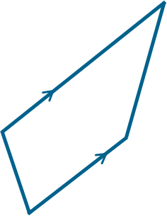
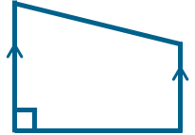
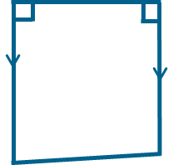
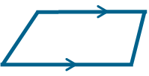
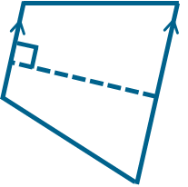
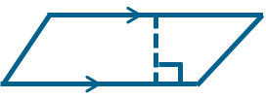
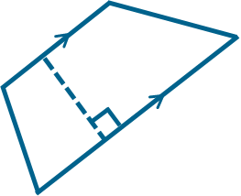
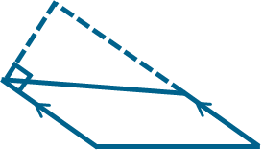
Checkpoint 5: Most agreeable (solutions to the further thinking question)
‘To find the area of a trapezium, you need…’
Examples
Non-examples |  |  | Not possible – you always need the lengths of the parallel sides.
… a horizontal length.
… the length of three sides.
… the lengths of the parallel sides.

Slide 22
Checkpoint 5: Guidance
Adaptations | Assessing understanding
Support Draw different examples of trapezia on the board (you could use the ones in Checkpoint 4) and interrogate one statement at a time. Ask if each statement gives the right information for each of the trapezia you have drawn. Record correct answers, to help students draw their own conclusions. Challenge Ask students to create statements that are always, sometimes or never true. Representations Students’ understanding of the properties of a trapezium is key, and will be shaped by the images that they have seen. More detail is given in Representations on the Guidance slide for Checkpoint 4. | Checkpoint 5 interrogates students’ understanding of the area of a trapezium without relying on recall or application of the formula. Students will not have studied this at primary, so use this task to assess understanding after teaching in Key Stage 3. None of the three statements is entirely true, which is why part a uses the wording ‘most agree with’. For each one, more information and/or a specific set of circumstances are required. The intention is that students’ reasoning will be revealed if they have understood which measurements are needed. For example, Flavian’s statement is only true if the parallel lines are horizontal and vertical. Joris’s statement only works if the parallel sides are at right angles to one of the other lengths. If students find it hard to articulate their thinking, ask them to sketch examples of when each statement would work. Shahzeb’s is arguably the most true as the lengths of the pair of parallel lines are always needed. Here the intention is to check how students describe the other measurement required. Do they use precise and transferrable terms such as perpendicular? Using a term such as vertical might suggest that are they fixed on a particular image/orientation of the trapezium. Note that, in giving students incomplete definitions to grapple with, there is a risk that students might remember these instead! Make sure the task concludes with a clear, better response in part b and emphasise to students that this is correct.
Additional resources Key idea 6.2.2.1 from Secondary Mastery Professional Development | NCETM explores ‘The area of a trapezium’.

Slide 23
Circles
Checkpoints 6–8

Slide 24
Circles
Previous learning | In Key Stage 3 students need to
Key Stage 2 curriculum: Year 6: illustrate and name parts of circles, including radius, diameter and circumference and know that the diameter is twice the radius There are no explicit references to properties of a circle in either Teaching mathematics in primary schools or Primary Mastery Professional Development. Note that, if primary schools are using the Curriculum prioritisation in primary maths | NCETM to support curriculum planning, then this may have impacted on the depth to which they have explored properties of a circle with students. | Continue to accurately use the terminology learnt in Key Stage 2 (radius, diameter and circumference) and to understand the relationship between radius and diameter. Be aware of the classic multiplicative relationship within every circle (i.e. no matter how large or small the circle, the ratio between its circumference and its diameter is always the same: $\text{π}$ = $\frac{\text{C}}{\text{d}}$ .) Apply this understanding to using the formula C = $π$d to find the perimeter (circumference) of the circle. Also be aware of the corresponding multiplicative relationship between any two circles (i.e. if one circle has a diameter n times the length of another, then its circumference will be n times the circumference of the other.) Use the formula A = $π$r² to find the area of a circle$.$

Slide 25
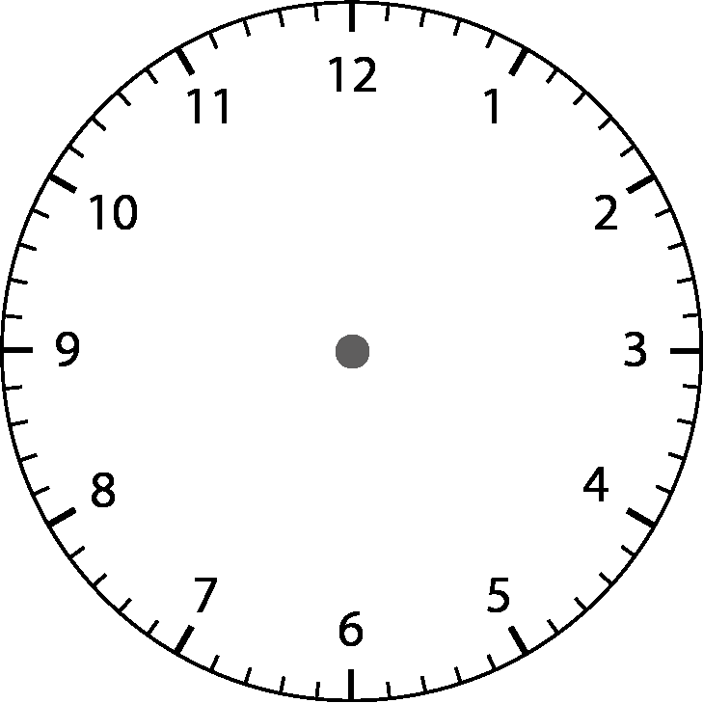
Checkpoint 6: Ants on a clock
A
Two ants are sitting on a clock.
Ant A walks in a straight line to 6.
Ant B walks in a straight line to 4.
What can you say about the distances each ant walks?
If they reach their new numbers in the same time, what can you say about the speed of the ants?
Both ants walk back to where they started and then ant B also walks to join ant A at 12.
Which ant walks the furthest this time?
Which ant has walked the furthest in total?
B
Ant A walks around the circumference of the clock.
Ant B walks from 12 to 6 and back again.
If they walk at the same speed, which ant will get back to 12 first?
Notes:
This slide is animated. The first (single) click animates both ants to move as the rubric describes, then each question will appear separately so you can choose the pace at which to work with your class. After the rubric between parts b and c appears, the ants also move as described (no click required). A blank printable version of the clockface (two to a page) can be found on slide 102.
Answers
a) Ant A has walked twice as far as ant B, as the diameter is twice the radius
b) Ant A must walk twice as fast as ant B, as it has walked twice as far in the same time.
b) This time, they walk the same distance. B’s two radii is the same as A’s one diameter.
c) Ant A walks the furthest. It has walked the equivalent of four radii, while ant B has walked three.
? Ant B will get back to 12 first, as the circumference is greater than twice the diameter.
Suggested questioning
What is the same and what is different about ant A and ant B’s journeys?
Imagine the ants’ journeys were marked by a line. Is there a mathematical term that describes the line of either ant?
What is the relationship between the radius and the diameter?
How many times further has ant __ travelled compared to ant __? (This could be asked at various stages of the task.)
Things to think about
At Key Stage 2, students learn the terms radius, diameter and circumference, which are then built on in Key Stage 3. Checkpoint 6 explores not only whether students remember those terms, but also whether they can use the relationship between diameter and radius. In this example, no lines are drawn so students need to make a connection between the images that they may be familiar with, and the paths that the ants take.

Slide 26
Checkpoint 6: Guidance
Adaptations | Assessing understanding
Support Give students a blank printed clockface so that they can model the journeys the ants take. It may help them to physically draw these lines in, so that they can see that they are a radius and diameter. Alternatively, use string to replicate the distances travelled. Challenge Ask students to think about distance in terms of units of radius/diameter. For example, if an ant walks from the centre to a number and back, and repeats it for every number on the clock, how many ‘diameters’ would they walk? Representations A clock face is used as a familiar representation to explore radius and diameter. Do students recognise that the distance from the centre to each number is always the same, and that this is a radius? Can they find pairs of numbers that are connected by a diameter? | Checkpoint 6 asks students to use their understanding of the properties of a circle to reason about distance. Terminology, such as radius or diameter, is not used, so that you can ascertain whether students are fluent enough to volunteer these terms in context. Students should know both of these terms, as well as circumference. In part a, ant A has walked twice as far as ant B so must be walking twice as fast. If this comparison of rate adds confusion, you can simplify the question by asking which ant has walked further, and by how much. The relationship between the radius and diameter is in the Year 6 curriculum statements, but is not in the Ready to progress criteria, so the amount of time students spent on this may be variable. The further thinking question asks students to think about the circumference in relation to the diameter. At this stage in their learning, check that they understand that the circumference is more than twice the diameter, rather than any specific relationship between them.
Additional resources Pages 32 and 36 of the Year 6 Primary Assessment Materials | NCETM gives some examples of reasoning questions involving radius and diameter of circles. Several Checkpoints in the ‘Constructions’ deck explore the concept of a circle as a locus of a point.

Slide 27
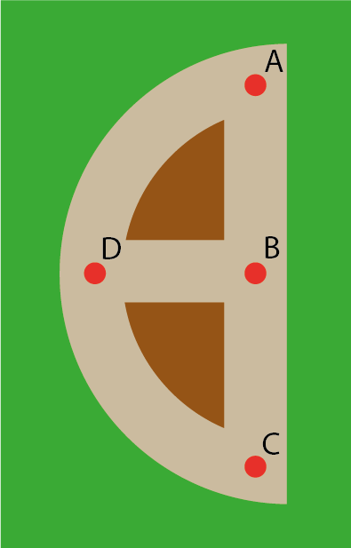
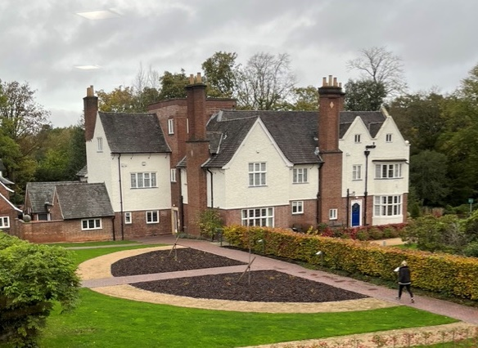
Checkpoint 7: Semi-circular path
A garden has a semi-circular path.
Alex walks from A to B to C.
Brian walks from B to D to A.
Colin walks from C to D to A.
Dave walks from D to B to A.
Put their four journeys in order from shortest to longest.
How did you decide?
Estimate how many times further Colin's journey was compared to Alex’s journey.
Notes:
This slide is animated. Each journey description and then the question will appear separately so you can choose the pace at which to work with your class.
Answers
Shortest to longest: Alex and Dave equally shortest, Brian, Colin. Students’ justifications will vary, and offer some insight into their understanding of the relationships between key measures in a circle.
? Students’ answers will vary. It is hoped that they recognise that the curved lengths are longer that the straight lengths, but that the journey is not twice as far. A reasonable estimate would be one-and-a-half times as long.
Suggested questioning
What mathematical terms are used to describe parts of the circle? Can you describe these journeys using those terms?
What do you know about the distance from B to all of the other points?
Is the direct journey from A to D shorter or longer than from A to B? Can you estimate by how much?
Things to think about
As with Checkpoint 6, students are expected to use their understanding of radius and diameter to reason, without explicit reference to these terms or a diagram where these lengths are labelled. Instead, see whether students are able to apply what they know in context. Where part of the circumference is used, get a sense of whether students appreciate how much bigger this length is than the straight lengths. Do they have a sense of it being approximately half as far again as the radius? This may help when introducing the relationship between diameter and circumference.

Slide 28
Checkpoint 7: Guidance
Adaptations | Assessing understanding
Support Ask students to identify two points that are an equal distance from point B. Are there more? Then ask them if they can also identify two points that are an equal distance from point D. Point A? Giving students an opportunity to reason with the diagram allows them access to the properties needed to answer the questions, as well as offering insight into their understanding. Challenge Although unlikely to be formalised, the task offers a context to begin thinking about the relationship between radius and circumference. Ask students to explore and justify their estimate. Representations Offer students a pair of compasses and ask them to reconstruct the diagram as accurately as they are able. Alternatively, give a copy of the diagram and ask them to annotate equal distances (as in the Support prompts above). | The semi-circular path gives a context for students to identify and reason with the properties of a circle – particularly that the radius of any circle has a constant length, that the diameter is made of two radii and that a curve between two points is a longer path than a straight line. Although drawn accurately, with the points marked in the centre of the given paths, the context moves away from the perfection of a mathematical circle. This muddying of the mathematical waters offers further opportunities for students to reason. Probe their understanding by, for example, asking whether it’s possible to walk a different distance from A to D and C to D
Additional resources Pages 32 and 36 of the Year 6 Primary Assessment Materials | NCETM gives some examples of reasoning questions involving radius and diameter of circles. Page 37 of the Secondary Assessment Materials | NCETM offer examples of where this learning goes next at Key Stage 3. Key idea 6.2.2.5 from Secondary Mastery Professional Development | NCETM explores ‘The area of a circle’.

Slide 29
Checkpoint 8: Not full circle
Beau has a semi-circle. Halle has a quarter-circle.
Both of their shapes are cut from the same circle.
Halle says, ‘The area of my quarter-circle is half the area of your semi-circle.’
Is Halle correct? Why or why not?
Beau says, ‘The perimeter of my semi-circle is twice the perimeter of your quarter-circle.’
Is Beau correct? Why or why not?
Beau
Halle
Beau
Halle cuts her quarter-circle into five equal pieces. What can you say about the area and perimeter of one of these sectors compared to Beau’s semi-circle?
Notes:
This slide is animated. Each question will appear separately so you can choose the pace at which to work with your class.
Answers
a) Halle is correct because the space within the shape has been halved.
b) Beau is not correct. The length of the arc has doubled, but the total length of the straight sides has stayed the same (as the diameter is equal to two radii), so overall the perimeter of the semi-circle is less than double that of the quarter-circle.
? The area is one-tenth of the area of Beau’s semi-circle. The length of the arc is one-tenth of the length of Beau’s arc, but the total length of the straight sides is again the same. So overall the perimeter of the sector is more than one-tenth of the area of the semi-circle.
Suggested questioning
What is the same and what is different about the curved/straight lines in Beau and Halle’s shapes?
What would happen to the area/perimeter if you halved Halle’s shape?
What would happen to the area/perimeter if you doubled Beau’s shape?
Things to think about
Checkpoint 8 asks students to reason about how the area and perimeter are affected when the circle is cut through the centre. Although explicitly calculating ‘arc lengths… and areas of sectors of circles’ is in the Key Stage 4 rather than Key Stage 3 curriculum, the reasoning needed for this task only uses Key Stage 2 knowledge. Part b only uses students’ understanding of radius and diameter, but students may be surprised to realise that total of straight lengths is the same in both Halle’s and Beau’s part circle – and will be the same for angle of circle that remains when it is cut through the centre of the circle.

Slide 30
Checkpoint 8: Guidance
Adaptations | Assessing understanding
Support Part b is likely harder for students to reason. Use highlighters to simultaneously draw along the edges of Beau and Halle’s shapes, showing the two radii being the same as the diameter, but the arc of the quarter-circle being shorter than the arc of the semi-circle. Challenge The further thinking question could be developed with other fractions of whole circles. Representations Have physical circles to cut and manipulate: for example you could draw along the lengths of the semi-circle/quarter-circle, but rotating the shape so that it forms a line, to model the similarities and differences between each shape’s perimeter. | Checkpoint 8 offers an opportunity to reason with the area and perimeter of part-circles. See whether students can use their knowledge of fractions, and of radius and diameter, to compare the area and perimeter of shapes. Also check students connect the terms perimeter and circumference. You should use this task before any teaching on the area or circumference of a circle, and so values are not given. We want to know whether students can recognise what will happen to the area and perimeter as the shape changes. Part a is likely to be quite instinctive – the shape has been halved, and therefore so has the area – but part b may pose more challenge. Do students recognise the equivalence of Beau’s diameter and Halle’s two radii? Can they generalise about the sector of any circle? Although calculation is not the purpose, you might revisit it after some teaching on area and circumference, to see how students’ explanations change. If you use the task in this way, introduce some values for students to work with.
Additional resources Key idea 6.2.2.3 from Secondary Mastery Professional Development | NCETM explores how you might approach ‘The area of a circle’ in Key Stage 3 teaching. Question 19 of Paper 2 reasoning, from the Key Stage 2 SATs, gives an example of students reasoning with part circles. Past papers can be readily found online. Page 37 of the Secondary Assessment Materials | NCETM offer some examples of this learning at Key Stage 3.

Slide 31
3D shapes
Checkpoints 9–18

Slide 32
3D shapes
Previous learning | In Key Stage 3 students need to
Key Stage 2 curriculum: Year 5: identify 3D shapes, including cubes and other cuboids, from 2D representations Year 6: Recognise , describe and build simple 3D shapes, including making nets (Note that naming 3D shapes is first encountered within the Early Years Foundation Stage and Key Stage 1.) Further information about how students may have experienced this key idea in Key Stage 2: 3D shapes are not referenced in the Key Stage 2 sections of Teaching mathematics in primary schools, although 3D shapes are mentioned within the Year 1 and 2 criteria. Primary Mastery Professional Development, Spine 2 Multiplication and division, Year 5 Segment 2.20 Multiplication with three factors and volume. Key Stage 3 curriculum: 6.2.2.1^{1:} Derive and use the formula for the area of a trapezium. 6.2.2.2: Understand that the areas of composite shapes can be found in different ways. ¹ This four-digit code refers to the key ideas in Secondary Mastery Professional Development | NCETM; the Key Stage 2 content underpinning these ideas is assessed in the ‘Plotting coordinates’ Checkpoints deck. | Use the properties of faces, surfaces, edges and vertices of cubes, cuboids, prisms, cylinders, pyramids, cones and spheres to solve problems in 3D. Make connections between two and three dimensions by beginning to consider surface area (which will be formalised in Key Stage 4); this provides an ideal opportunity to apply and consolidate understanding of the area and properties of 3D shapes from Key Stage 2.

Slide 33
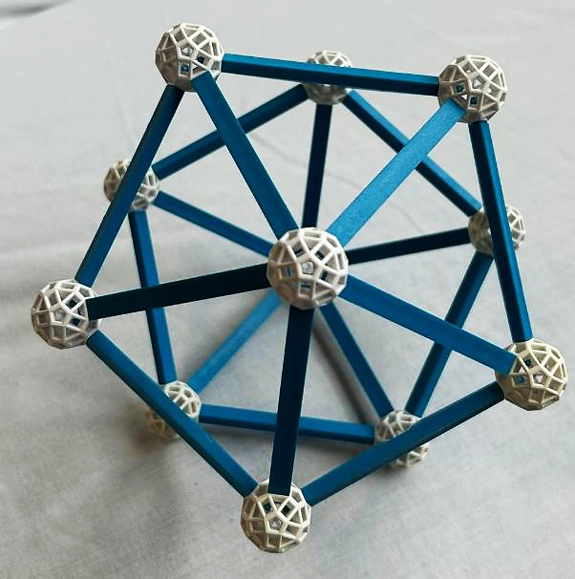
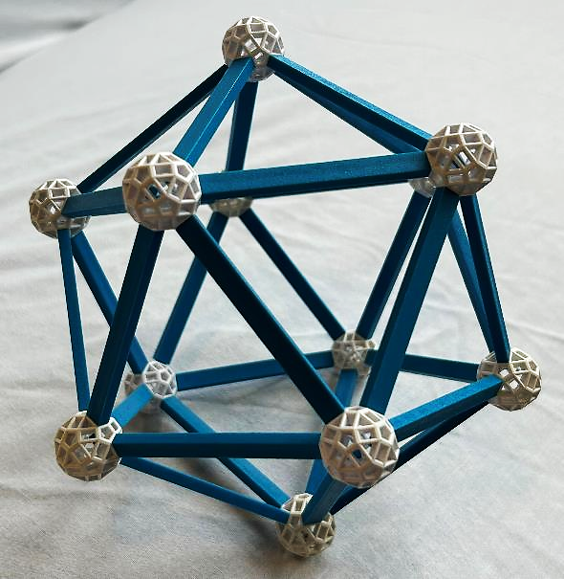
Checkpoint 9: Inside out?
Are these two pictures of the same shape? How do you know?
How many vertices are there on each shape?
How many blue rods make up each shape?
Richard cuts out shapes to cover the gaps. How many will he need? Will they all be the same shape and size?
Design another 3D shape with triangular faces. How many vertices, edges and faces does it have?
Notes:
This slide is animated. Each question will appear separately so you can choose the pace at which to work with your class.
Answers
a) Yes; they are different angles of the same shape. Students’ reasoning for why may vary but might include recognition of the number of rods that comes from each white ball, the triangular shapes formed in the spaces between rods, or the number of features (white balls, blue rods or triangular spaces) in total.
b) There are 12 vertices on each shape, represented by the white balls.
c) There are 30 blue rods, or edges, of the shape.
d) There would be 20 triangular faces, which would all be the same size.
? Students’ answers will vary. If students use the same equilateral triangle for each face, they may make one of the other two examples of Platonic solids with triangular faces: a tetrahedron or an octahedron.
Suggested questioning
What is the same and what is different about the two images?
What colour are the faces/edges/vertices? How many are there?
What shape are the faces? Are they all the same? How do you know?
What angles can you see? Are they all the same? How do you know?
Compare this 3D shape to another 3D shape that you know. What properties do they both share? What properties are unique to this shape?
Things to think about
Students will have been naming 3D shapes since their very earliest experiences of maths in EYFS settings. By presenting them with an unfamiliar polyhedron, one which they are unlikely to be able to name, check how confident they are with reasoning in 3D. For example, can they visualise and imagine 3D shapes from different angles? Can they apply the terminology they have used with familiar shapes to one that is new to them? You might like to share with students that this shape is an icosahedron, which is an example of a Platonic solid (a convex regular polyhedron).

Slide 34
Checkpoint 9: Guidance
Adaptations | Assessing understanding
Support As a goal-free way to gain access to the task, ask students to describe what they can see. This still allows insight into their awareness of, and the language they use to describe, the properties of polyhedra. Challenge Appreciating the structure of the shape is key to this task. Probe students’ understanding by making false statements such as, ‘As each vertex has five edges coming out of it, so there are five times more blues than whites.’ Ask students to explain why this is incorrect and how they might use this information to find the correct relationship between the blues and whites. Representations Use materials as in the image to construct an icosahedron, or use a set of solid polyhedra or some tiles to make some. Ask students whether your set includes the shape in the picture to offer further opportunities to visualise and draw attention to the key properties of a polyhedron. | ‘Inside out’ offers a context for students to discuss vertices, edges and use other vocabulary associated with polyhedra. Listen for those who are able to identify and describe the structure of the two shapes, and concisely reason that the two images are of the same object. Parts b, c and d move towards the vocabulary used with 3D shapes. Check students recognise that the vertices are marked by the white circles. The words edge and face are not used, to see if students volunteer these terms when they are described in other ways.
Additional resources Questions exploring the key terminology of vertex, edge and face can be found in the Key Stage 2 SATS papers, such as 2022 Paper 2 reasoning, question 1 and 2018 Paper 2 reasoning question 11. Past papers can be found online. Additional activities D and F offer other starting points for open discussions about 3D shapes.

Slide 35
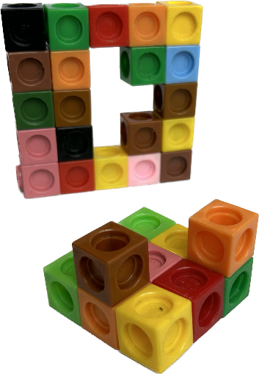
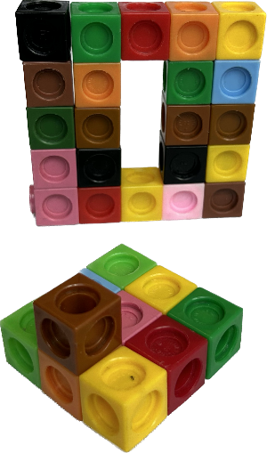
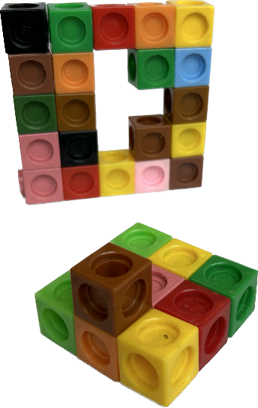
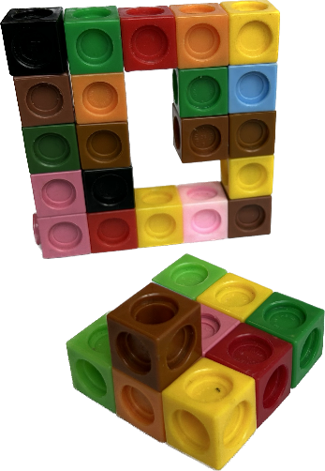
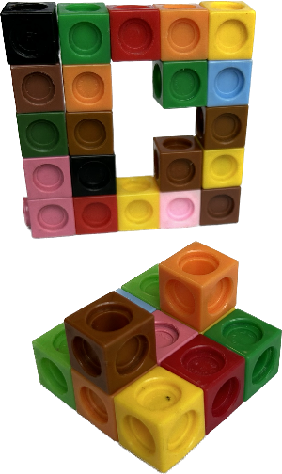
Checkpoint 10: Hole in the wall
Will the block fit through the hole in the wall in each of these situations?
e)
a)
c)
d)
b)
Design a different shape that would fit through each hole.
Notes:
This slide is animated. Each question will appear separately so you can choose the pace at which to work with your class.
Answers
a) No
b) Yes
c) Yes
d) Yes
e) No
? Students’ answers will vary.
Suggested questioning
How do you know if a block will/will not fit?
What is the same and what is different about the hole/block in part __ compared with part __?
Can you imagine the block orientated a different way? What would it look like then?
How could you change your block so that it would fit?
Things to think about
One of the biggest challenges for teaching shape, particularly 3D shape, is that students need to be able to visually manipulate images. Some students – and teachers – can find this tricky. This Checkpoint offers a way of identifying which students find it more challenging to imagine a 3D shape from a different angle, so that you can think about how to support them with topics such as plans and elevations. See Representations on the Guidance slide for some thoughts about whether and when it is helpful to use physical manipulatives with this task.

Slide 36
Checkpoint 10: Guidance
Adaptations | Assessing understanding
Support Prompt students to sketch or draw accurately some elevations for the objects – squared paper may support their sketches and offer insight into how readily they are able to picture the objects from different viewpoints. Challenge Ask students to draw objects that will fit through all the holes in all the walls. How many are there? Can they draw a shape that looks like it will go through two but will only go through one? Through none? Can they draw a wall that all of the given shapes will fit through? Is there more than one correct solution? Representations Multilink cubes may be available in your classroom, to construct the objects and walls. However, the focus of the task is visualising so consider when and whether you use physical blocks as scaffolding. Prompting students to sketch some elevations of the blocks will offer a representation while still allowing students the chance to show their visualising skills. | Visualising the two-dimensional surfaces that make up a three-dimensional object, and appreciating that different views of a 3D object will result in different 2D images, underpins fluency with 3D shape. ‘Hole in the wall’ offers an accessible way for students to demonstrate how well they can imagine these 2D views for a rectilinear shape. Asking students if there is only one way that a given object will fit through the wall is likely to offer further insight into how readily they are able to mentally manipulate and visualise 3D objects. The skills needed for this task underpin many aspects of Key Stage 3 and 4 work with 3D shapes, including plans and elevations and surface area, and so there will be many different appropriate times to use it in your scheme of work.
Additional resources Checkpoints 11 and 12, and additional activity E, explore different views of shapes

Slide 37
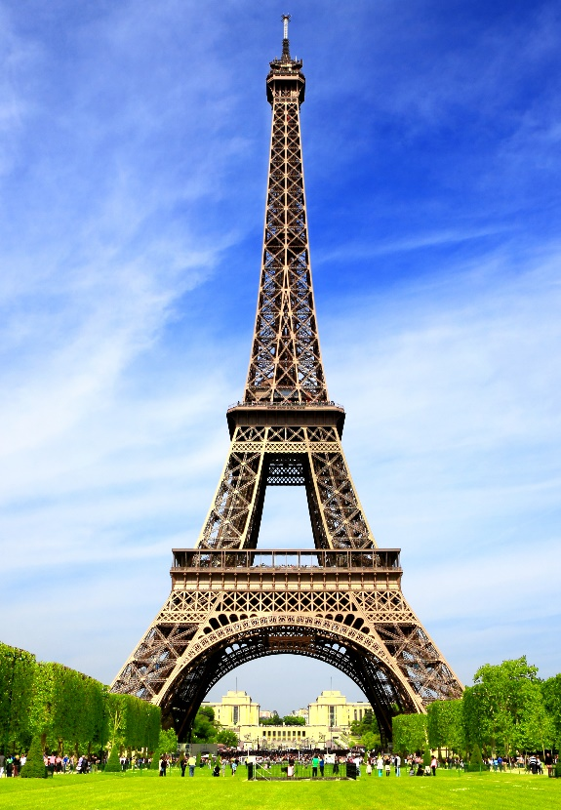
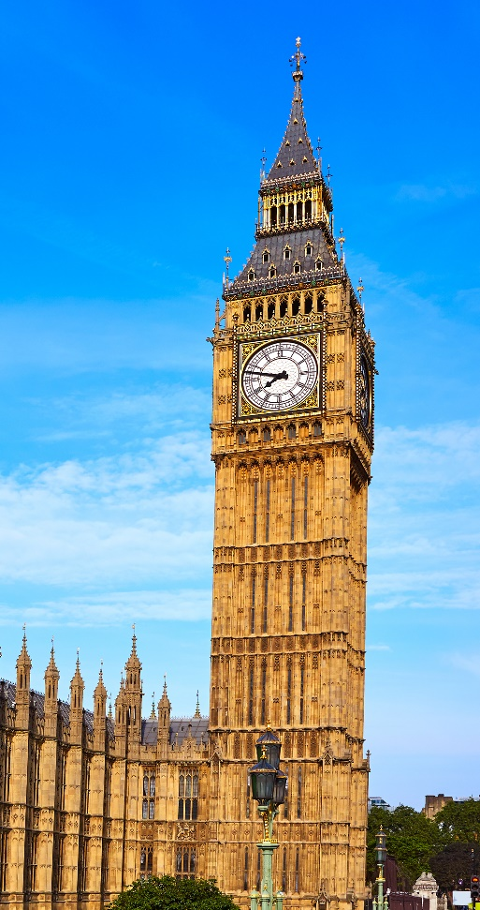
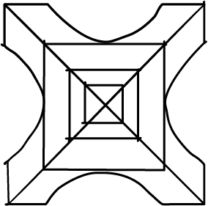
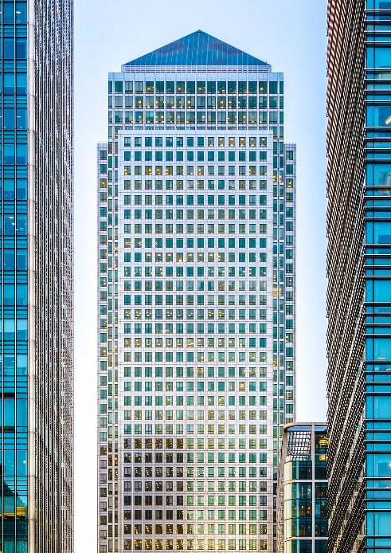
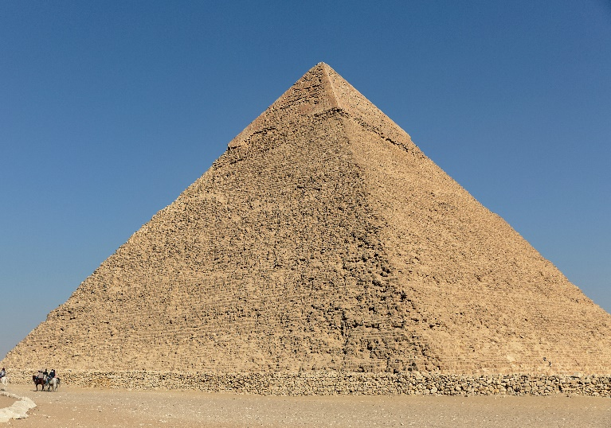
Checkpoint 11: Bird’s-eye view
Viewed from directly above, in 2D, which of the four buildings could the sketch on the right represent?
How did you decide?
How about the sketch below?
Eiffel Tower, Paris
Elizabeth Tower, London
Choose one of the other buildings and sketch what it might look like from above.
One Canada Square, London
Great Pyramid, Egypt
Notes:
This slide is animated. Each question will appear separately so you can choose the pace at which to work with your class.
Answers
a) The Great Pyramid (some students might argue for Elizabeth Tower or One Canada Square – see below)​
b) Students’ responses will vary but might include recognising that the point of all four buildings would appear as a cross in the centre of a square, but that only the Great Pyramid has no other visible details. Elizabeth Tower or One Canada Square would form a square (from their four vertical faces) with a point in the centre, but there are other features that should be detailed in the plan view – see the following Solution slide.​
c) Eiffel Tower. This is the only one of the four buildings that would not form a square when seen from above.​
? See the following Solution slide for suggestions.
Suggested questioning
What is the same and what is different about each building?
What would be in the middle of each building when viewed from above?
How many faces does each landmark have? Which one is easiest to count? Which is hardest?
Which faces will not be visible from above?
Things to think about
Checkpoint 11 uses landmarks that may be familiar to students in order to explore their understanding of different viewpoints how 3D objects can be represented in 2D. Here, particularly, we are focusing on the ‘plan’ or ‘bird’s-eye’ view; check students are familiar with both terms. Note that students might know Elizabeth Tower as ‘Big Ben’ (which is the name of the bell) or One Canada Square as Canary Wharf (which is the area of London where the tower is located).

Slide 38
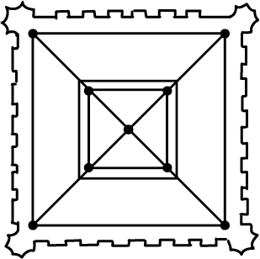
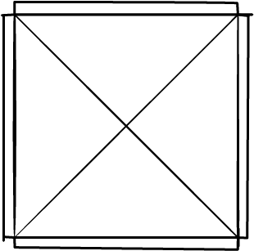
Checkpoint 11: Bird’s eye view (solution to further thinking question)
Choose one of the other buildings and sketch what it might look like from above.
Elizabeth Tower, London
One Canada Square, London
Notes:
This slide is animated. Each sketch will appear separately so you can choose the pace you work with your class.

Slide 39
Checkpoint 11: Guidance
Adaptations | Assessing understanding
Support The context encourages students to imagine what a shape might look like using cues seen from a different angle. Use a range of 3D shapes and ask students to identify which of your shapes the image might represent. Support them by rotating your solids to show different alignments. Challenge Reverse the problem: show students a plan view and ask them to imagine the building and draw a side elevation. How many different buildings can they create with the same plan view? Representations Use blocks or multilink cubes to construct multiple shapes that might look the same when viewed from above, to support the understanding that the plan offers only a limited picture of what the object might be. You could also use an online map tool, and compare the different perspectives offered by a satellite image and street view image. | Checkpoint 11 offers the outline of some landmark buildings as if seen from above. The assessment point is whether students can visualise an object from a different perspective – and particularly, the way that the 2D representation does not offer perspective to give the illusion of depth. Students should be aware that 3D objects can be visualised in this way in advance of their work on 3D shape in Key Stage 3. They will need to be able to identify and visualise the shape of the constant cross section of prisms and cuboids when finding volume, and to imagine every face when finding surface area.
Additional resources Checkpoint 12 explores the different ways we can represent 3D objects in 2D. Additional activity E explores plans and elevations of familiar objects.

Slide 40
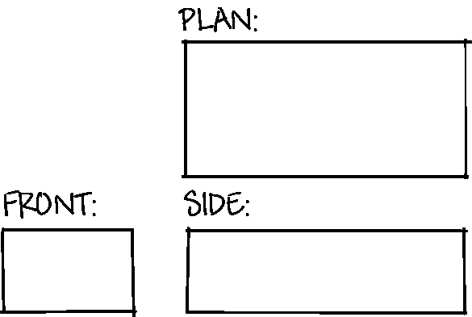
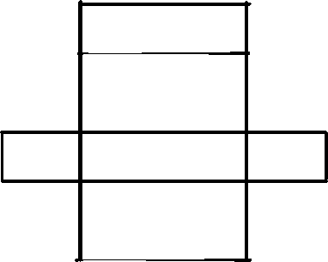
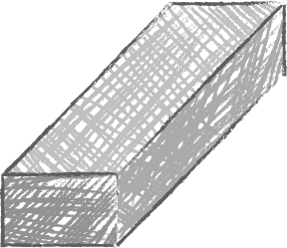
Checkpoint 12: 3D three ways
Three students represent the same cuboid but in three different ways.
Neesha
Beth
Finlay
What is the same and what is different about each drawing?
When might each drawing be a useful way to represent a 3D shape?
Imagine a square-based pyramid. What would each student’s representation of this shape look like?
Notes:
This slide is animated. Each question will appear separately so you can choose the pace at which to work with your class.
Answers
a) Students’ answers will vary. Some examples include:
All of the responses are 2D representations of the same 3D shape.
Finlay’s and Beth’s are similar because they both only show three of the six faces; Neesha’s is different as it is the only one that shows all six faces.
Finlay’s is different as it is the only one that uses different angles to try and show the shape is 3D.
Neesha’s is different as you could cut it out and fold it to make the 3D shape.
Beth’s is different as it imagines looking at the shape from different angles.
b) Students’ answers will vary. Some examples include:
Finlay’s representation might be useful if your cuboid was in a drawing, to look more realistic.
Neesha’s representation might be useful if you wanted to make the 3D shape.
Beth’s representation might be useful if you wanted to recreate the shape, or if it was part of a design that was being built, such as an architect’s plan of a house.
? See the solutions slide for some suggestions.
Suggested questioning
Which representations have you seen before?
Where is this face/side/vertex on the other diagrams?
When might each representation be useful?
Would __ be useful for an architect? Why?
Things to think about
This task plays with students’ understanding of dimension. Some might suggest that Finlay’s image is the only one that is 3D: in fact, all of these representations are 2D. It is a challenge that there is often some ambiguity with the representations used in the classroom. A 3D object, such a multilink cubes, might be used to build an array to support understanding of area. Or we might cut out a cardboard 2D shape so students can ‘feel’ a square, and not acknowledge that this shape is actually 3D. Talk to your students about what they understand by the terms 3D and 2D, and whether they appreciate how the addition of depth – no matter how small – creates a 3D object.

Slide 41
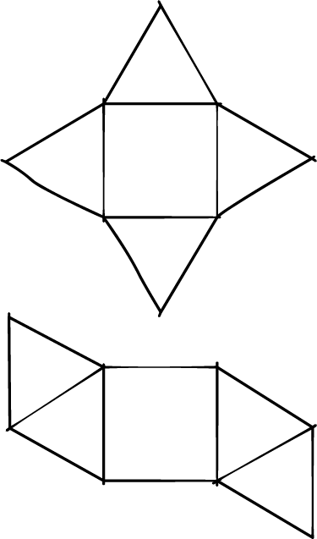
Checkpoint 12: 3D three ways (possible solutions to further thinking question)
Imagine a square-based pyramid. What would each student’s representation of this shape look like?
Finlay
Neesha
Beth
Notes:
This slide shows some possible solutions to the further thinking question. There are more versions of Finlay’s and Neesha’s that students could suggest.

Slide 42
Checkpoint 12: Guidance
Adaptations | Assessing understanding
Support Show only Finlay’s response and one other, so that students can explore each representation in more depth. Challenge Offer students one representation of a different 3D shape, and ask them to draw it the other two ways. Representations A challenge with working with 3D shapes is that all 2D drawings are representations. If you have access to actual 3D shapes, or can make a cuboid to use with this task, it might help to make connections between these representations and the ‘real’ thing. | The purpose of Checkpoint 12 is to explore students’ understanding of the different ways that we represent 3D shapes in 2D. There are no particular answers to try to elicit – instead, the three images act as a prompt for class discussion. The intention is to understand how confidently students can interpret different diagrams, to help you plan how you will use these different diagrams in work on 3D shapes at Key Stage 3. You might discover whether students can relate different representations to each other. Are they able to identify the same face/side/vertex on all three diagrams? You may also find out if they understand when these different representations might be useful: for example, do they know which is most likely to be used to design and build something? Students will have explored nets as part of their work on 3D shapes in upper Key Stage 2. They are less likely to be familiar with plans and elevations as these are not in the primary mathematics curriculum and are also not explicitly in the primary DT curriculum, although they may have seen other representations of 3D shapes, such as cross-sectional diagrams.
Additional resources Questions about nets can be found on p36 of the year 6 and p27 of the Year 5 Primary Assessment Materials | NCETM; the question on p29 of the Year 2 materials may also be of interest. Examples of Key Stage 2 SATs questions involving the net of a cube can be found in 2018 Paper 2 reasoning (question 22) and 2018 paper 3 reasoning (question 17). Past papers can be found online.

Slide 43
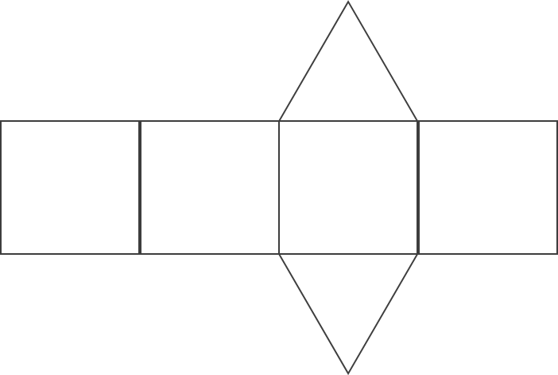
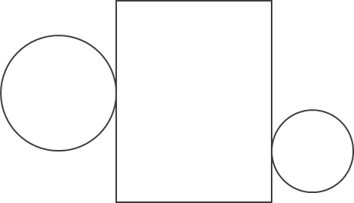
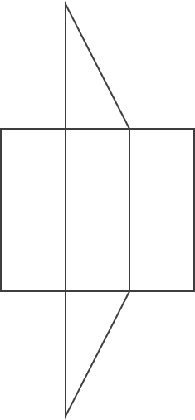
Checkpoint 13: Wrong ’uns
What is wrong with these nets? How could you correct them?
a)
Cuboid
b)
c)
Cube
Triangular prism
e)
Cylinder
f)
Cylinder
d)
Triangular prism
Draw a different correct net for each 3D shape.
Notes:
This slide is animated. Each question will appear separately so you can choose the pace at which to work with your class. Printable versions of the nets can be found on slides 103–05.
Answers
a) The wrong faces are adjacent, so the sides will not match. You could swap the large rectangle at the top for the smaller rectangle that is just below it.
b) There is the correct number of faces to make a cube, but they are not arranged correctly. You could move one of the squares in the row of five, so that it is ‘below’ any of the four remaining squares in that row.
c) There are too many faces. You could remove one of the square faces (or fold the extra face inside the shape so that is not external) or replace the two triangular faces with square faces.
d) The three rectangular faces are the same size – they each need to have a different shorter length that matches each one of the lengths of the triangles.
e) The two circles are different sizes, so will not make a cylinder. You need to reduce the size of the larger circle so that it is the same as the smaller one.
f) The length of the rectangle that is attached to the circumference is not long enough – it will not wrap all the way around the circle. This length needs to be at least three times bigger.
? Students’ responses will vary.. Check that each of their different nets does not have any of the misconceptions given here.
Suggested questioning
Which edge will this edge match to? How do you know?
How many faces does this shape have?
Which faces will be next to each other?
What is the same and what is different about the nets of the same shapes?
Things to think about
Checkpoint 13 is a good example of when the need to visualise and imagine in 3D, as described in Checkpoint 10, comes into play. Students need to be able to identify which of the edges will meet, and which of the faces will then be adjacent or opposite to each other, to work out why each of these nets will not work. Be aware of the language that you use with students: make sure you are reinforcing the language of vertex, edge and face when working with nets as well as when working with ‘complete’ shapes. Printable nets are available, but the intention is that these are used to support your explanations rather than to help students work out the answers. Using an actual net would significantly change the demand of the task, and prevent you from seeing which students struggle to imagine the nets coming together. If students need more time to practise working with nets of 3D shapes, this Checkpoint could easily form the basis of a much longer task where students create nets of a cuboid with card and explore how many different ways this can be done. Ask them to show their partner one that is a net and one that isn’t, and see if their partner can identify which is which and why.

Slide 44
Checkpoint 13: Guidance
Adaptations | Assessing understanding
Support If students find it challenging to consider so many nets simultaneously, explore the same misconceptions with a single net – for example, using a cube as the basis for the misconceptions in parts a and c. Challenge Ask students for alternative ways to adapt the nets, if the shape names were not there. For example, could the five consecutive squares remain in part b? What 3D shapes could you make with that arrangement, if you can change the other faces? Representations The most obvious way to support with this task is to physically cut out the printable nets on slides 103-05 and model how the lengths or arrangement of faces does not work. Consider carefully at what stage you do this: offer students this too soon, and you might not glean as much from their explanations. | Students will have encountered nets as part of their primary mathematics curriculum, and this Checkpoint gives them a chance to demonstrate their understanding. The names of the intended shapes are given. This draws attention away from naming shapes or drawing their own nets (which they may be more used to) to allow you to see how deeply they can think about nets. Are they able to identify the important features of each net by analysing these non-examples? Some of the errors in the nets are more obvious than others – students might notice the extra face in part c more readily than the incorrect arrangement of faces in parts a and b. This might suggest a more surface level understanding of nets. Students who find it hard to imagine and visualise shapes may find this task challenging. Identify these students so that you can support them with 3D shape topics such as surface area. If you have already covered Pythagoras’ theorem and the formula for the circumference of a circle within Key Stage 3, parts d and f could be used to make links to these areas of learning. Can students suggest some potential lengths for the corrected rectangles?
Additional resources Examples of questions about nets can be found on p36 of the Year 6 and p27 of the Year 5 Primary Assessment Materials | NCETM. Additional activity C also explores nets.

Slide 45
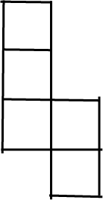
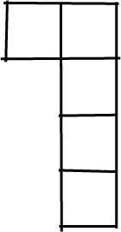
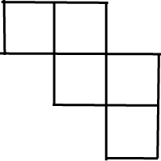
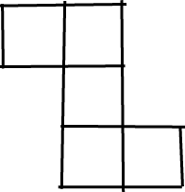
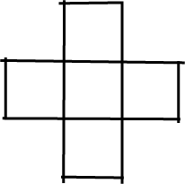
Checkpoint 14: Six faced
A teacher asks her class to draw the net of a cube. Study the first five faces that five students draw in turn.
Where could they put their sixth face? Is there more than one answer?
Arun
Logan
Phoebe
Fred
Niamh
Is there a different net that doesn’t use these starting points?
Notes:
This slide is animated. Each net will appear separately so you can choose the pace at which to work with your class.
Answers
Each person’s net would currently make an ‘open’ cube, and so there are four possible positions for the fourth face, one next to each of the four faces that surround the ‘gap’. See the solutions slide for the possible positions.
? There is one more possible net (the slide); this could be orientated different ways, so check students’ answers carefully. See the solutions slide.
Suggested questioning
What is the same and what is different about each net?
Which edge will this edge meet?
Which face will this face be opposite?
Which vertex will this vertex meet?
Is there more than one possible answer?
How do you know when a face cannot be positioned in a particular place?
Things to think about
Students are likely to have worked with the nets of cubes more than other nets, and there are some lovely reasoning tasks involving cube nets. A classic task, for example, is numbering the faces so that opposite faces add to seven as on dice. Here, students are asked to place the sixth face. A key element of this task is working out when all possible solutions have been captured; consider how you will gather students’ responses and how you will convince them that one does or doesn’t work. See Representations on the Guidance slide for some suggestions.

Slide 46
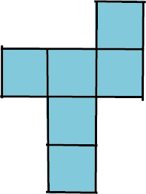
Checkpoint 14: Six faced (animated solutions)
Phoebe
Logan
Fred
Niamh
Arun
There is one more net which doesn’t use these starting points.
Notes:
This slide is animated. With each click, a different possible position for the sixth face will appear in turn. The net for the further thinking question appears last.

Slide 47
Checkpoint 14: Guidance
Adaptations | Assessing understanding
Support Offer one net at a time, but with two versions of a sixth face, one correct and one incorrect. Can students identify the correct one? Can they suggest other correct ones? Challenge Ask students to turn each net into a cuboid. Can they identify which faces will be opposite each other, and therefore need to be the same dimensions? Representations Have nets to cut out, with spare faces to tape on, to help students who find it hard to visualise how the flat representations fold. Intersecting squares or magnet tiles could also be used to represent the task physically. | Nets are part of the Year 6 curriculum and students may have seen tasks that ask them to identify possible nets of cubes. Checkpoint 14 asks them to reason with some ‘part nets’ and complete them with the sixth face. The intention is not so much to see if they have remembered the cube nets, but whether than can visualise and reason with a 2D representation of the 3D shape. Prompt them by asking if they can identify where a sixth face could not go, and explain why. For example, for Fred’s net, ask why the face can’t go to the left of the column of four. All the nets are possible, but some have more solutions than others. Niamh’s and Phoebe’s nets are likely to be the most challenging, with Logan’s and Fred’s the most familiar.
Additional resources Additional activity K links nets of a cube with volume. Examples of Key Stage 2 SATs questions involving the net of a cube can be found in 2018 Paper 2 reasoning (question 22) and 2018 paper 3 reasoning (question 17). Past papers can readily be found online. An example of questions involving nets of cubes can be found on p36 of Primary Assessment Materials | NCETM.

Slide 48
Checkpoint 15: Four, five, six prisms
Phil has four cubes.
Using all his cubes, how many different prisms can he make?
Rose-Marie has five cubes.
Using all her cubes, how many different prisms can she make?
Sachin has six cubes.
Has he made a prism? If not, which cube(s) should he move?
How many prisms could Sachin make with his six cubes?
Notes:
This slide is animated. Each question will appear separately so you can choose the pace at which to work with your class.
Answers
The different possible prisms are described below and represented visually on the following two slides. Assuming the use of connecting cubes such as multilink, all the cubes shown align exactly rather than being placed part way along each other.
a) Phil can make five different prisms, two of which can be viewed as prisms in two different ways (one with a cross-sectional area of one and a length of four, or vice-versa; one with a cross-sectional area of two and a length of two, or vice versa; three with a cross-sectional area of four and a length of one).
b) Rose-Marie can make 12 different prisms, only one of which can be viewed as a prism in two different ways (the cross section is one of the twelve pentomino arrangements so has an area of five, and the length is one. Only the cuboid could also be thought of as a cross-sectional area of one and a length of five.)
c) No, Sachin has not made a prism as, no matter how it is viewed, there is not a constant length perpendicular to any cross section. Sachin needs to move the cubes so that there is an arrangement with either a cross-sectional area of six and a length of one (or vice versa) or a cross-sectional area of three and a length of two. He can do this a number of ways, but the simplest way is to just move the one cube that is ‘behind’ the other five so that the prism has a length of one. See the solutions to the further thinking question to help you check students’ solutions.
? Sachin can make a total of 36 different prisms (there are 35 different arrangement of six cubes, creating a prism with cross-sectional area of six and length of one, which includes two cuboids that can be described as having different lengths/areas, and an ‘L’ shape with a cross-sectional area of three and a length of two.)
Suggested questioning
What is a prism?
Can a prism have a length of one?
What shape is the cross-section of your prism?
Does it matter which way round your prism is orientated?
Things to think about
This task will be very different if students have access to physical cubes to create their prisms – it is envisaged as a practical task where concrete manipulatives are used. This should enable you to draw attention to the key features of the prisms (i.e. the constant cross section and length) more easily. Think also about how students record their different answers: will you give them enough cubes so that they can make several different prisms and have all their different answers on their desk? Easy for part a; less so for the 36 possible solutions in part c! To get around this, you could ask students to sketch their prisms (although this may be a barrier for some) or record unique solutions on the board and ask students to create more with their cubes. If you have access to a visualiser, you could collect unique prisms to display to the class and challenge them to add to the set.

Slide 49
Checkpoint 15: Four, five, six prisms (solutions to parts a and b)

Slide 50
Checkpoint 15: Four, five, six prisms (solutions to further thinking question)
There are thirty-seven possible prisms.
One is two ‘rows’ of three cubes, as shown below.
Thirty-six are different arrangements of six cubes, creating a prism with cross-sectional area of six and length of one. Seven of the thirty-six examples are shown below.

Slide 51
Checkpoint 15: Guidance
Adaptations | Assessing understanding
Support Part of the challenge of this task is likely to come from students’ experience of prisms offered in printed materials, with the constant cross section orientated at the front. Starting with a shape they identify as a prism, and then rotating it to a less familiar orientation, may support students in mentally manipulating the shapes as they construct them. Challenge Challenge can come from different elements, either asking students to predict the number of possible prisms for more (or fewer) starting cubes, or to describe how they worked to ensure that all possible prisms have been found. Representations As discussed throughout this deck, using multilink or other cubes is likely to benefit both the students and teachers in this task. For more information about the limitations of this representation, see the Guidance to Checkpoint 19 on slide 62. | The assessment focus here is the ways that students understand prisms and are able to use this understanding to reason with their properties. It might also be enlightening to look at the systematic ways that students work to identify whether they have found all possibilities for each situation. Using multilink cubes for this task will not only support students to model their thinking, but also give insight into students’ understanding. Do they, for example, always position their prisms so that the cross section is a side view, or can they think about the cross section at the top/bottom of their prism too? This is particularly interesting for part b, where all the prisms have a length of only one (except the cuboid, which can be seen as a prism in two ways). While not explicitly about volume, it is important that students understand that all their shapes made with, for example, four cubes will have equal volume. Question and probe this understanding.
Additional resources Checkpoint 16, as well as Additional activities G and H, further explore the definition of prisms.

Slide 52
Checkpoint 16: Prism break
A prism is broken into three identical pieces.
4 cm
1 cm
10 cm
Sketch the original prism. What are the dimensions of your sketch?
Is there more than one possible answer to part a?
Sketch and label your own congruent pieces for a different prism. How many different prisms could they be for?
Notes:
This slide is animated. Each question will appear separately so you can choose the pace at which to work with your class.
Answers
a) Students could sketch one of multiple possible prisms, depending on which faces they choose to be the constant cross section. The possible cuboids are given using their three dimensions below; any one of the faces could be considered the cross-section.
4 × 1 × 30 (i.e. connecting the smallest face).
12 × 1 × 10 (i.e. connecting the middle-sized face).
10 × 4 × 3 (i.e. connecting the largest face).
Students could also arrange their pieces to form cross-sections in various L-shapes, with lengths of either 1 cm, 4 cm or 10 cm. See the following slide for some suggestions.
b) See part a for the other potential solutions students could identify.
? Students’ answers to this will vary; ask them to swap solutions to see if they have found all the possible prisms for their congruent pieces.
Suggested questioning
Is there more than one way to make a prism?
How many different cuboids can you make?
What is the volume of each of your shapes?
What is the same and what is different about each of your shapes?
Things to think about
The introduction to this task describes how the prism is broken into ‘identical’ pieces; in the further thinking question, students are asked to sketch ‘congruent’ pieces. The mathematical language is modelled on the slide but is not necessary to access the beginning of the task, so it could be used at any time in Key Stage 3, depending on your scheme of work. Decide how much attention to draw to the language at this stage of students’ learning.

Slide 53
Checkpoint 16: Prism break (animated solutions)
10 cm
4 cm
30 cm
1 cm
12 cm
4 cm
10 cm
8 cm
3 cm
4 cm
10 cm
1 cm
1 cm
20 cm
1 cm
20 cm
2 cm
8 cm
4 cm
4 cm
1 cm
10 cm
2cm
10 cm
Notes:
This slide is animated. Each possible prism will appear separately so you can choose the pace at which to work with your class.

Slide 54
Checkpoint 16: Guidance
Adaptations | Assessing understanding
Support Students may conflate ‘prism’ and ‘cuboid’. Explore students’ understanding of the properties of a prism to give access to the task. Challenge Offer students a fourth identical piece and ask how many more different prisms they can make now. Representations Use a set of congruent cuboids – perhaps made from multilink cubes – to support students in accessing the task. Consider when to introduce this scaffold and the impact that any blocks will have on the level of challenge. | Checkpoint 16 lets students show their understanding of the definition of a prism. Assess whether students understand what a prism is, and if can they visualise and reason with the properties of a prism. The key understanding here is that the prism has a constant cross section along its length. Students are likely to choose a cuboid for their prism: assess whether they can appreciate that a cuboid can be considered a rectangular prism in three different ways, depending on which face they take to be the constant cross section. Students with deeper understanding of prisms, who understand that the cross section can take any shape, might realise that they can arrange their cuboids so that they have L-shaped cross sections. There are also assessment opportunities to consider around volume and surface area. By showing the dimensions of one of the cuboids, students might then be asked to write down calculations to find the volume of each of their prisms. The focus of this task should be on the multiple ways to find the volume, since all shapes will have equal volume. Check that students understand this!
Additional resources Additional activities G and H explore the definition of prisms, if students need a reminder about their properties.

Slide 55
Checkpoint 17: Cubist
Pablo has exactly enough paint to cover all the faces of eight small cubes.
Before he paints them, he makes a bigger cube from the small cubes.
Does he have enough paint to cover the six faces of the big cube?
Will he have enough paint left over to cover another big cube of the same size?
Pablo makes an even bigger cube from small cubes. What is the least number of cubes he can use?
How would your answers to parts a–c change?
Notes:
This slide is animated. Each question will appear separately so you can choose the pace at which to work with your class.
Answers
a) Yes he does. This is because there are six faces on each of the smaller cubes (totalling 48 faces). However, each of the faces on the bigger cube is the same size as four of the faces on the smaller cube, so there are the equivalent of 6 × 4 = 24 of the small faces.
b) Yes, half of his paint will be left over so he could paint one more big cube.
? The smallest number of cubes he can use is 27 (3 × 3 ×3). There are now nine of the smaller faces on each side, so a total of 6 × 9 = 54 to paint. This means he does not have enough paint to cover the whole larger cube: five faces would be completely painted (9 × 5 = 45) and the final face would be one-third painted.
Suggested questioning
What is the area of one face of a small cube? How about every face?
What are the lengths of the larger cube? How do you know?
What is the area of one face of the larger cube? How about every face?
If you put all of the smaller cubes together to make a bigger cube, would every face be showing?
Things to think about
Checkpoint 17 is one of many (including Checkpoints 18 and 22) where the concept of surface area is touched on without being formally referred to. In each of these Checkpoints, the mathematics that students are expected to do does not go beyond the content at the boundary of Key Stages 2 and 3. The tasks should help you understand how readily students can visualise and work with 3D shape. You will need to decide whether to just listen to students’ reasoning, accepting any language that they use, or whether it is an appropriate moment to use terminology such as surface area. This will depend on the needs and current attainment of each class, as well as your scheme of work.

Slide 56
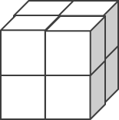
Checkpoint 17: Guidance
Adaptations | Assessing understanding
Support Give students cubes so that they can count the faces that are on the ‘outside’. Challenge Build on the further thinking question by considering even bigger cubes. For example, Pablo paints the outside of a large cube made of 64 smaller cubes. How many small cubes could he completely paint with the same amount of paint? Representations The larger cube is represented on the slide without any lines to denote the smaller cubes that it comprises. Consider how the task might change if you included these lines, like the image on the right. At what stage would you draw them to help students to understand the task? See also Support. | Checkpoint 17 asks students to reason about the areas of the faces of cubes, without explicitly referring to surface area, which is not taught at Key Stage 2. As with Checkpoint 18, assess students’ reasoning and visualising with 3D shape so you can plan how to approach topics such as surface area more formally. Much of the mathematics used here is from much earlier in the primary curriculum. To approach part a, students need to identify that there are six faces for each small cube (so a total of 48 faces to paint), and to imagine which of these faces are visible when the cubes are arranged to make a bigger cube. Students might do this by matching the different faces of the small cubes to those in the big cube and so realising that not all will be visible.
Additional resources Key idea 6.2.2.5 from Secondary Mastery Professional Development | NCETM explores how ‘Surface area of 3D shapes might be explored at Key Stage 3.

Slide 57
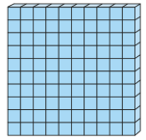
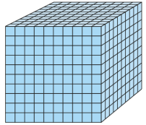
Checkpoint 18: Dienes
Jimmi has some Dienes blocks. The length of the smallest cube is 1 cm.
What is the volume of each different block?
What lengths have you used to calculate each volume?
Jimmi notices that each block has six faces. He writes the area of each face in a table.
Complete Jimmi’s table. What do you notice?
 | Face 1 | Face 2 | Face 3 | Face 4 | Face 5 | Face 6
Ones | 1 cm²
Tens | 1 cm² |  | 10 cm²
Hundreds | 10 cm²
Thousands
Imagine a ten thousands block. Sketch what it might look like. What could be the area of each face then? How about a hundred thousands block?
Notes:
This slide is animated. Each question will appear separately so you can choose the pace at which to work with your class.
Answers
a) 1 cm³, 10 cm³, 100 cm³, 1000 cm³
b) 1 cm³: 1 cm, 1 cm, 1 cm, 10 cm³: 10 cm, 1 cm, 1 cm; 100 cm³: 10 cm, 10 cm, 1 cm; 1000 cm³: 10 cm, 10 cm, 10 cm.
c) Ones: 1 cm², 1 cm², 1 cm², 1 cm², 1 cm², 1 cm².
Tens: 1 cm², 1 cm², 10 cm², 10 cm², 10 cm², 10 cm².
Hundreds: 10 cm², 10 cm², 10 cm², 10 cm², 100 cm², 100 cm².
Thousands: 100 cm², 100 cm², 100 cm², 100 cm², 100 cm², 100 cm².
Students’ answers to what they notice may vary, but may include:
The ones and thousands all have the same area for their faces (because they are cubes).
The hundreds has two faces with a larger area (because it is wide and flat) but the tens has four faces with a larger area (because it is long and thin).
The value for length, area and volume is the same for the ones block.
The area of at least two faces says the same as the blocks increase.
? See the solutions slide for some suggested sketches. A ten thousands block would be made from ten thousands blocks, but the area of each face would depend on the arrangement of the blocks. If students follow the pattern of the ones, tens and hundreds blocks by stacking the ten thousands blocks on top of each other, then the areas of the faces would be: 100 cm², 100 cm², 1000 cm², 1000 cm², 1000 cm², 1000 cm². For the hundred thousand block, if the ten thousands blocks are laid out next to each other, then the areas of the faces would be: 1000 cm², 1000 cm², 10000 cm², 10000cm², 10000 cm², 10000 cm².
Suggested questioning
What is the same and what is different about the __ block compared with the __ block?
How many __ blocks would be needed to make a __ block?
Imagine two __ blocks stuck together. What would be the volume? What might be the lengths of the edges? What might be the area of the faces? Is there more than one answer for this?
Things to think about
Dienes blocks are a common classroom resource. Use this Checkpoint to check whether students have made the connection between Dienes blocks and volume: it is the volume of each block that represents its value. The task could act as a springboard to different directions, depending on students’ responses. If part b reveals that students are not confident with the dimensions needed to find volume, then you might like to leave part c (which touches on surface area) until their understanding of volume is more secure. As different brands of Dienes blocks have different lengths, a particular length is specified here. When teaching decimals, it is common to assign different values to the blocks (for example identifying the thousands block as ‘one’), and so you may need to clarify that the names of each block in part c refer to the ‘classic’ use of Dienes to teach integer place value. To support this, the order of rows in the table reflects the order in which the images are shown.

Slide 58
Checkpoint 18: Dienes (solution to further thinking question)
Imagine a ten thousands block exists. Sketch what it might look like. What could be the area of each face then? How about a hundred thousands block?

Slide 59
Checkpoint 18: Guidance
Adaptations | Assessing understanding
Support Rather than asking students to complete the table, focus on one block and ask them to identify the area of one face and then work out how many faces have the same area. Challenge The further thinking question can be extended to consider millions, tens of millions etc. Representations Dienes blocks are most commonly used to represent place value; this might be the first time students have been asked about them in terms of volume. They might have understood that there are 1000 small ones blocks in the thousands block, but do they also appreciate this means it has a volume of 1000? | Checkpoint 18 uses a familiar representation to probe students’ understanding of the relationship between length, area and volume. Parts a and b check students appreciate that volume is key to the use of Dienes blocks as a representation, and understand the lengths that are required to calculate such volumes. Look out for students who do not offer three dimensions for any of the blocks, as they may need more support with volume. For example, confusion may arise because the value of the volume of the ones cube is the same as the value for each of its lengths/areas, and students may not appreciate that three dimensions are still needed to calculate its volume. Part c starts to nudge students’ thinking towards surface area, which is not specified in the curriculum until Key Stage 4. At this stage, just see whether students can recognise the area of different faces and invite them to share what they notice. The question is open so that students can offer any observation, to help you identify those who are most and least confident with manipulating and visualising 3D shape. See the answers in the notes for slide 57 for some suggestions of what students might say.
Additional resources Units of volume and Dienes blocks are referred to in Segment 2.20 Multiplication with three factors and volume in the Primary Mastery Professional Development materials. The guidance Using mathematical representations at KS3 | NCETM explains how Dienes blocks might be used to support understanding of place value in Key Stage 3. Key idea 6.2.2.5 from Secondary Mastery Professional Development | NCETM explores ‘Surface area of 3D shapes’.

Slide 60
Concept of volume
Checkpoints 19–22

Slide 61
Concept of volume
Previous learning | In Key Stage 3 students need to
Key Stage 2 curriculum: Year 5: estimate volume [for example using 1 cm³ blocks to build cuboids (including cubes)] and capacity [for example, using water] Year 6: recognise when it is possible to use formulae for the area and volume of shapes Year 6: calculate, estimate and compare volume of cubes and cuboids using standard units including cm³, m³, and extending to other units [for example mm³, km³] Further information about how students may have experienced this key idea in Key Stage 2: Teaching mathematics in primary schools Although not specifically referenced in the Ready to progress criteria, volume is used as a context in both place value and fractions. Primary Mastery Professional Development, Spine 2 Multiplication and division, Year 5 Segment 2.20 Multiplication with three factors and volume. | Understand that volume is a three-dimensional measure that quantifies the space inside a 3D shape, and be able to distinguish it from the one-dimensional measure of perimeter and two-dimensional measure of area (ideas that are often confused).

Slide 62
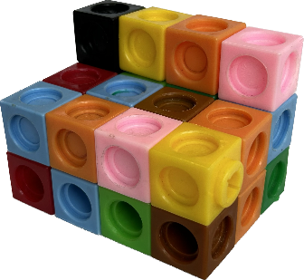
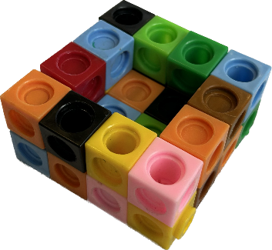
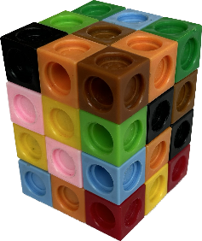
Checkpoint 19: Twenty-eight cubes
Guz makes a shape out of 28 multilink cubes.
Callum breaks it apart and makes a different shape using all 28 cubes.
Do you agree that the volume of the shapes is the same?
Gabriel breaks it apart and makes a different shape using all 28 cubes.
Do you agree that the volume of the shapes is the same?
Is it possible to make this shape using exactly 28 cubes? Explain your thinking.
Notes:
This slide is animated. Each question will appear separately so you can choose the pace at which to work with your class.
Answers
a) Yes, it is the same volume as it contains the same number of cubes.
b) Yes, it is the same volume as it contains the same number of cubes. There is also a space in this shape that has a volume of four cubes.
? If it is a solid cuboid, then it is not possible. One face is made up of nine cubes, and 28 is not divisible by nine. Students might think that it is not possible to make 28 with layers of nines. The same argument could be made by looking at one of the 12-cube faces. Students might identify that we cannot see all the faces, so it is possible if the shape is hollow or if the remaining two vertical faces are not complete rectangles.
Suggested questioning
What is the same and what is different about Guz, Callum and Gabriel’s shapes?
Which is the ‘biggest’ shape? How do you know? What measurements are you using to decide this?
What other shapes can you make with exactly 28 cubes?
Can you be sure that all of the shapes have 28 cubes from the pictures?
Things to think about
Preservation of volume is an interesting concept to explore with students, as it will allow you to probe what assumptions they make and whether they really understand what volume is. Can students appreciate that the same 28 cubes, when rearranged, have the same volume? How about the same amount of water poured into different shaped containers? Do they see a difference between the representations, or do they understand that the same concept is being modelled?

Slide 63
Checkpoint 19: Guidance
Adaptations | Assessing understanding
Support The task uses 28 cubes, enough that visualising is challenging and so students are perhaps working in a more generalised way. Some students might benefit by thinking first about four cubes (the minimum which allows for more ‘dimensions’ to be worked in), and considering whether the different arrangements of these blocks leads to different volumes. Challenge The further thinking question offers the idea of a hollow, though incomplete, shape. Challenge students to use 28 cubes to make a shape that displaces the greatest volume – are they able to make a hollow cuboid? Representations Cubes are a helpful representation, but be aware of their limitations when thinking about volume of non-rectilinear 3D shapes. It is important to explore other representations as well to ensure you can assess students’ full awareness of volume, and what volume is. For example, representations such as measuring jugs and ‘melted cubes’ might support deeper understanding. | Checkpoint 19 gives a context for students to discuss and demonstrate their understanding of volume and capacity without the need to calculate. You will gain insight into whether they have an understanding of what volume is, and whether that understanding is based on a formula or method Intuitively, students may feel that the original shape has a different volume from that shown in part a, and their reasoning is worth exploring. Part b allows for a greater discussion around the words volume and capacity. While a definitive answer may not be forthcoming, listening to students’ conversations should offer insight into their understanding.
Additional resources Additional activity I offers a clarification of the terms capacity and volume; additional activity J explores volume using cubes. An example of a Key Stage 2 SATs question which uses cubes to probe understanding of volume can be found in 2019 Paper 2 reasoning, question 23. Past papers can readily be found online. If students struggle with the concept of volume as the amount of space that something occupies, look at teaching point 1 of Segment 2.20 Multiplication with three factors and volume in the Primary Mastery Professional Development materials.

Slide 64
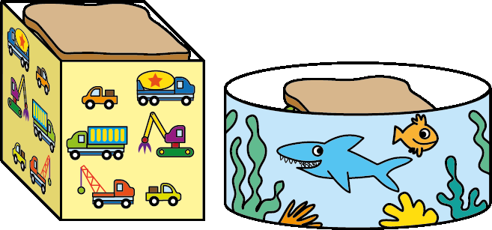
Checkpoint 20: Lunchboxes
Which of these containers has the greatest capacity?
How do you know? How might you check?
Fran counts the sandwiches in the containers.
She says, ‘I can only fit two sandwiches into the cylindrical box but three into the cuboid box. So the cylinder must have a smaller capacity than the cuboid.’
Is Fran correct? Why or why not?
Both containers have the same volume. A third container also has the same volume. It is exactly wide and high enough to fit one sandwich. Sketch what this container could look like.
Notes:
This slide is animated. Each question will appear separately so you can choose the pace at which to work with your class. The images of sandwiches described in part c only appear when this question is shown, so you will need to show this slide in ‘present’ mode to not reveal the sandwiches too soon.
Answers
a) Students’ answers will vary. Without more information about the dimensions or what might fit inside them, we cannot know for sure.
b) Students’ justifications will vary. For example, they might argue that the cuboid is taller or the cylinder wider. They could check by filling one container with water, and pouring it into the other, to see if it has the same capacity, or by using a measuring jug to measure the amount of liquid that fits into each container. Or by measuring the dimensions and calculating. (At this stage, students will only know how to do this for the cuboid and not the cylinder.)
c) Fran is not correct. In the cylinder, there are segments around the edge where there is space to put parts of more sandwiches if you cut them. We do not have enough information to know whether the cylinder or the cuboid is bigger.
? There are infinite possible answers, depending on how creative students are with their container designs!
Suggested questioning
What is the same and what is different about the containers?
Can you compare the capacity of two containers just by looking?
What might you use (instead of sandwiches) to measure the volume of the containers?
Things to think about
Students’ experience of volume begins far before they learn how to estimate volume in Year 5 and calculate volume of cuboids in Year 6. Indeed, it is likely to precede formal education entirely, as students may have played with water, sand and containers as very young children. This Checkpoint plays on something they may have discovered in these very early experiences: that containers can be deceptive and it is not easy to estimate their volume based on a single dimension, i.e. whether one container is shorter or taller than the other.

Slide 65
Checkpoint 20: Guidance
Adaptations | Assessing understanding
Support Provide physical containers to help students access the problem. Consider whether using sandwiches (or water, pasta etc.) might help convince them about the relative volumes. Challenge Give students some dimensions for sandwiches, and ask them to design different boxes to fit a certain number of sandwiches. How do their answers change when you cut the sandwiches different way? Representations Cubes are a common representation to help visualise the space inside a 3D shape. While this helps make the connection to cubic units of volume, it can be hard to imagine how they fit into non-cuboidal spaces. Sandwiches are used to represent the space inside the containers as they are familiar and malleable – students can imagine them being broken apart and fitted into different shaped spaces. | Checkpoint 20 gives students a familiar context to reason about volume. It can be challenging to think about the volume of spaces where cubes won’t fit, and so sandwiches are used as something that students will be used to seeing cut into different shapes to fit a space (see Representations). Listen for students’ justifications for which of the containers is bigger. Those with a less strong understanding of volume might be swayed by a single dimension and think that one container has a greater volume because it is taller/wider. Those with stronger understanding of volume should recognise in part a that there is not enough information to know. Students’ answers to, ‘How might you check?’ in part b will be illuminating. As they will not yet know a calculation for the volume of a cylinder, encourage them to think of strategies that don’t involve measurement. This might remind them of the practical maths of their very earliest days in school!
Additional resources Additional activity I looks at the definitions of volume and capacity.

Slide 66
Checkpoint 21: Cold as ice
Becky fills this cup of water.
Becky then pours the water into an ice cube tray, without spilling any, and puts the tray in the freezer.
Finally, Becky tips the frozen ice cubes from the tray back into the cup.
Will the ice cubes fit? Why or why not?
How about if the ice cubes were smaller?
How about if the cup was a cylinder? Or a cuboid?
Each space in the tray is cubic and has a length of 3 cm.
When the water is poured into the tray, it fills two-thirds of the spaces. Does the cup have a volume greater than 100 cm³?
Notes:
This slide is animated. Each question will appear separately so you can choose the pace at which to work with your class.
Answers
a) No. They will not fit as now there will be gaps between the cubes.
b) Smaller cubes would mean more could fit into the space, but they would still not fit perfectly.
c) If the cup was a cylinder, then depending on the diameter of the circular face, more or fewer cubes might fit. If the circular face was the same size or larger than the top of the cup, then more would fit. If it was the same size as the bottom of the cup, then fewer would fit. If the cup was a cuboid, then it is possible that more ice cubes could be stacked in as they could be arranged in layers of arrays. Again, this would also depend on the dimensions.
? Yes, the cup has a volume greater than 100 cm³. Each cube has a volume of 3 × 3 × 3 = 27 cm³.
$\frac{2}{3}$ of the 15 spaces means the equivalent of 10 cubes are created, so the total volume is 27 × 10 = 270 cm³.
Suggested questioning
Are ice cubes a sensible way to measure the volume of the cup? What would be a better way?
If all the water fitted into the tray, what would this tell you about the volumes of the cup and the tray?
Things to think about
This Checkpoint considers the volume of the same space by filling it with both a liquid and then with cube-shaped solids. This is based on a simplification of the actual science: when water freezes, the nature of the bonds between water molecules means that its volume in fact increases by approximately nine per cent. The chemistry of this is not covered until A Level, although students may have discussions about the fact that ice floats on water (as it is less dense) during their science lessons. For the purpose of this Checkpoint, you can assume that the ice cubes have the same volume as the water. Any particularly eager scientists among your students may point out this inaccuracy. You could explain that this is a simplified model to explore volume, or ask them to anticipate how that fact might change their answers (i.e. that even less of the water would fit in the glass when frozen).

Slide 67
Checkpoint 21: Guidance
Adaptations | Assessing understanding
Support If you have the resources, this task is likely to be more accessible if modelled live. You will need two identical ice cube trays, so that you can have one to pour the water into and one pre-frozen. You could also use different-sized cubes (as in Checkpoint 24) to model the situation. Challenge Build on the further thinking question by asking students how many cubes would be created with ice cube trays of different dimensions. Representations In the early stages of learning about area, it is common to draw irregular shapes onto square grids to help students appreciate how square units can be used to describe spaces even when they are not bound by rectilinear shapes. This task attempts to create an equivalent experience for cubic units and volume. | Checkpoint 21 explores the concept of volume by using water in two states: liquid and solid. See how readily students handle the tricky concept of cubic units. Much like square units for area, these can be challenging to fully comprehend: how do we think about volume measured in cubes when 3D space is so rarely cube-shaped? Students should appreciate that the water will not fit into the cup in the same way when it is frozen into cubes. Question to check that they understand that the total amount of water is the same, and so the cup and the cubes still have the same volume. There are some scientific details that are glossed over to ensure the premise of the task works – see ‘Things to think about’ in the notes for more information.
Additional resources Checkpoint 24 explores a similar idea using classroom resources, but extends to thinking about actual estimates for volume.

Slide 68
Checkpoint 22: Blocks
This cube is made from 27 blocks
Each of the corner blocks (coloured white) is removed.
Does the volume of the shape increase, decrease or stay the same?
How about the number of faces?
How about the total area of the faces?
Is it possible to make a shape with a greater volume but the same surface area? How about the same volume but a greater surface area? Justify your answers.
Notes:
This slide is animated. Each question will appear separately so you can choose the pace at which to work with your class.
Answers
a) The volume decreases, as there are fewer cubes.​
b) The number of faces increases from 6 to 30. This is because there are now 6 cross-shaped faces, plus three faces where each corner block has been removed (6 + 3 × 8 = 30).
c) The total area on the outside of the shape stays the same. For each cube that has been removed, there are three external red faces; these are replaced by the three black faces that are now visible.
? Using the blocks here, it is not possible to make a shape with a greater volume but the same surface area, as the 3 × 3 × 3 cube is the biggest volume for the surface area given. It is possible to keep the volume the same but increase the surface area, by arranging all the cubes into one row, so that as many of their faces as possible are on the outside.
Suggested questioning
What is the same and what is different about the cube and the cube with the white blocks removed?
Does decreasing the volume always mean the surface area stays the same?
Things to think about
As with the words ‘identical’ and ‘congruent’ in Checkpoint 16, the task refers to the ‘area of the faces’, and the further thinking question to ‘surface area’. This is so that the mathematical language is modelled on the slide but is not necessary to access the beginning of the task. The task could be used with students at any time in Key Stage 3, depending on your scheme of work. Decide whether to begin to use the technical terminology of ‘surface area’ at this stage, or not.

Slide 69
Checkpoint 22: Guidance
Adaptations | Assessing understanding
Support Using blocks to construct and transform the shapes described in the task can be beneficial. Since the focus of the task is not visualising, the blocks can be introduced early without impacting on the assessment focus. Challenge Challenge students to work with both surface area and volume. For example, is it possible to create a block with double the surface area and double the volume of this one? Or half the surface area and volume of this one? How about surface area and volume increased by two? By four? Representations Multilink cubes or other blocks will be particularly helpful here (see Support). Encourage students to represent the shape in other ways. For example, by sketching elevations of the objects on squared paper. | As in Checkpoint 19, this task allows students to show what they understand by volume without calculating. They should recognise that, as cubes are removed, the volume decreases. Part b extends this to consider understanding of surface area. This has not been taught at Key Stage 2 and so the task refers instead to ‘the area on the outside of the shape. Students can respond to this without the need to calculate, thinking only about the concept. For example, they can recognise that for every cube that is removed, removing the three faces that make up the vertex, there are still three visible faces on the ‘outside’. This keeps the level of mathematics at Key Stage 2 to 3. Encourage students to think about plans and elevations of the original and transformed shape. Checkpoints 10, 11 and 12 assess these skills and may support their reasoning to justify why the surface area remains constant when the white cubes are removed.
Additional resources Paper 3 reasoning, Question 12, from the 2022 Key Stage 2 SATs papers asks students to reason about the lengths in a 3D shape, and might be an interesting counterpoint to this focus on area and volume. Key idea 6.2.2.5 from Secondary Mastery Professional Development | NCETM explores how ‘Surface area of 3D shapes’, hinted at in part b, might be explored at Key Stage 3.

Slide 70
Calculating volume
Checkpoints 23–28

Slide 71
Calculating volume
Previous learning | In Key Stage 3 students need to
Key Stage 2 curriculum: Year 6: recognise when it is possible to use formulae for the area and volume of shapes Year 6: calculate, estimate and compare volume of cubes and cuboids using standard units including cm³, m³, and extending to other units [for example mm³, km³] Further information about how students may have experienced this key idea in Key Stage 2: Teaching mathematics in primary schools Volume calculations are not specifically referenced in the Ready to progress criteria. Primary Mastery Professional Development, Spine 2 Multiplication and division, Year 5 Segment 2.20 Multiplication with three factors and volume. | Develop their understanding of finding the volume of cubes and cuboids (using the formula Volume = width × height × length or similar) to include the volume of prisms more generally. For example, realise that the volume of a cuboid is actually the area of one of the faces multiplied by the other dimension and then generalise to other prisms with the formula Volume of a prism = area of cross-section × length. Use and apply their knowledge of the area of 2D shapes to calculate the cross-sectional area of a variety of prisms. Appreciate that, although a cylinder is not strictly a prism (a prism has a polygonal uniform cross section), it has the same structure as a prism (with the uniform cross section being a circle) and its volume can be calculated in a similar way.

Slide 72
Checkpoint 23: Swimming pool
Russell is renovating an old outdoor swimming pool. It has a rectangular surface and is the same depth at all points.
What does he need to measure to ensure he has the items listed in parts a to c?
Enough fencing to go around the perimeter of the pool.
A big enough cover to go over the top of the pool.
Enough water to fill the pool.
Russell measures one dimension to be 25 m. Which dimension of the pool is this likely to be? What would be a reasonable estimate for the perimeter, area and volume?
Notes:
This slide is animated. Each question will appear separately so you can choose the pace at which to work with your class.
Answers
a) Russell needs to measure the lengths of two different sides of the rectangular surface (i.e. two adjacent sides).
b) Again, he needs to measure the lengths of two different sides of the rectangular surface (i.e. two adjacent sides).
c) He needs to know the lengths of two different sides of the rectangular surface (i.e. two adjacent sides) and the depth of the pool.
? Students’ answers will vary. Check their overall estimates for perimeter, area and volume individually. Twenty-five metres is only likely to be the length. It is far too great a value to be the depth and if it were the width then it would be an Olympic-size pool! Students should suggest a reasonable value for the other two measurements. For example, between 1 and 2 m for the depth and between 10 and 15 m for the width.
Suggested questioning
How would your answers change if the swimming pool was a square shape?
Why might your answers to parts a, b and c be different to the measurements of the cuboid?
When will you need to use a greater measurement? When will you need to use a shorter one?
Things to think about
Students are likely to have built a concept of volume even before perimeter and area. Some of their earliest experiences in the classroom and before will have involved pouring water or sand into different sized containers. However, they may not have connected these experiences with their later learning on perimeter, area and volume in Key Stage 2. Here, we use a context where all three measures are needed in order to explore how embedded their understanding is. Finding a context in which perimeter, area and volume can be legitimately explored is challenging; discuss with your department what other contexts might be used.

Slide 73
Checkpoint 23: Guidance
Adaptations | Assessing understanding
Support Rather than asking which lengths are needed, ask directly whether a specific length is required each time. For example, sketch the swimming pool on the board, point to a line and ask, ‘Is this length needed? Does Russell need to measure it?’. Challenge The situation here has been simplified; challenge students to think about how these simplifications have made the problem more accessible. Would they need the same lengths if the pool’s surface was not a rectangle or if, like most pools, it had variable depths? Representations Sketch a cuboid and highlight the relevant lengths and/or spaces for each part of the question. Similarly, ‘making’ the pool out of multilink cubes may help students visualise. | Often, students are given the information that they need in perimeter, area and volume problems. This task gives checks that they understand what dimensions are really required. A swimming pool is a context where perimeter, area and volume can all be feasibly and usefully calculated. Students might identify that all four lengths are needed to calculate the perimeter but should recognise that they only need to measure two different lengths for both this and the area. It is worth asking students to generalise at this stage. Ask, ‘How do I find the perimeter/area of any rectangle?’. A connection could be made between area and volume – imagine ‘layers’ of areas stacked on top of each other until the depth of the pool is achieved; model this with multilink cubes (see Representations). Some debate might ensue as to whether the measurements needed would be exactly the same as the lengths of the cuboid. Realistically, the volume of water would be less than the cuboid as the pool would not be full to the brim, and the perimeter of the fence would be greater than the perimeter of the pool as you would not build a fence right on the edge. These are valid points – accept them, but still encourage students to generalise about which lengths you need to work out for each measurement.
Additional resources Checkpoints 26 and 27 also explore the dimensions needed to calculate volume in cuboids.

Slide 74
Checkpoint 24: Cubes in a glass
Shona fills a glass with cubes of length 2 cm.
Courtney fills an identical glass with cubes of length 1 cm.
Estimate how many of each type of cube are in the glasses.
There are 14 in Shona’s glass and 160 in Courtney’s.
Why are these numbers so different?
Shona and Courtney use their cubes to estimate the volume of their glasses.
Whose estimate is most likely to be accurate? Why?
Shona estimates her glass has a volume of 28 cm³.
Courtney estimates her glass has a volume of 160 cm³.
Do you agree with these estimates? Why? How could they be improved?
Notes:
This slide is animated. Each question will appear separately so you can choose the pace at which to work with your class. You will need to ensure that you do not reveal the next part of the text until students have discussed part a and then part b.
Answers
a) Students’ answers may vary. Check that students guess a greater number for Courtney than Shona. Students with less secure understanding might not have a big enough difference between their two estimates. For example, their guess for Courtney’s only being twice their guess for Shona’s.
b) These are so different as, for every one of Shona’s cubes there are four of Courtney’s (so at least 56). As Courtney’s cubes are smaller, they fit into the gaps that Shona’s larger cubes cannot fit into. This means that a much larger number of smaller cubes can fit into the glass.
c) Courtney’s estimate is most likely to be accurate as there are fewer gaps when her cubes fill the glass, so the amount of space the cubes take up is closer to the actual space within the glass.
? Shona’s estimate is far too low. She has multiplied the number of cubes by two, but it is the length that is 2 cm, not the volume. Each cube has a volume of 2 × 2 × 2 = 8 cm³, so a better estimate would be 14 × 8 = 112 cm³. Students might suggest that this estimate is still too low, because of the gaps.
Courtney’s estimate is closer to the real estimate but students might still suggest that it is an underestimate as there are some small gaps. The students could improve their estimates by using even smaller cubes or, ideally, a liquid.
Suggested questioning
What is the same and what is different about the arrangement of cubes in each glass?
Were you surprised by the number of cubes in each glass?
How else could you estimate the volume?
How would your answers be different if the glass was a cuboid?
Things to think about
This offers a similar premise to Checkpoint 21 in the ‘Concept of volume’ section, which considered whether a volume of water would fit into a cup when it was frozen into ice cubes. The ideas are developed further here, and this Checkpoint is included here in the ‘Calculating volume’ section as actual lengths are given for the cubes, so students can start to think about the actual volumes suggested by the number of cubes.

Slide 75
Checkpoint 24: Guidance
Adaptations | Assessing understanding
Support If students find it hard to accept that there are eight smaller cubes for every one bigger cube in this example, then model it, using a cuboid so that it is more obvious. Challenge Challenge students to think about how many cubes of length 0.5 cm will fit in the glass. Each 1 cm cube is worth eight of the 0.5cm cubes, so there would be at least 160 × 8. Representations The images offered as prompts here could be recreated with equipment from the classroom. Consider whether students might interpret the situation more readily if they see the cylinders filled ‘live’ rather than as pictures. | Sometimes, volume can be counterintuitive! It is unlikely that students will anticipate quite how different the two values will be. Collect several responses to part a so you can get a sense of understanding across the class. Are they surprised when the actual values are revealed? In part b, students are likely to recognise that the gaps in Shona’s glass will be largely filled by Courtney’s smaller cubes, accounting for some of the difference in the number of cubes. Listen for those that also appreciate that, for every one of Shona’s cubes there are eight of Courtney’s – they are likely to have a deeper understanding of calculating volume to build on. A common misconception is that Courtney’s cubes are worth two of Shona’s – this is not the main focus of the task, but is unpicked in the further thinking question. In part c, see that students can effectively explain why Courtney’s estimate is more accurate. The language they use is likely to indicate how they understand volume, and how confident they are to reason about it. Do they refer specifically to the 3D space within the cylinder? Do they understand that the true volume cannot be measured using cubes, but will be given in cubic units? If their responses are secure, prompt further and ask how Courtney’s estimate can be improved.
Additional resources Additional activity I looks at the definitions of volume and capacity.

Slide 76
Checkpoint 25: Marshall’s parcel
Marshall is sending a parcel and needs a box with a minimum volume of 420 cm³.
Which of these boxes could he use?
D
E
A
8 cm
5 cm
2 cm
C
42 cm
8 cm
10 cm
B
8 cm
10 cm
6 cm
10 cm
2 cm
8 cm
20 cm
22 cm
2 cm
The item in Marshall’s parcel is a book 21 cm long. Does this information change your answer to part a?
Sketch some other boxes that Marshall could use.
Notes:
This slide is animated. Each box and each question will appear separately so you can choose the pace at which to work with your class.
Answers
a) He could arguably use A (420 cm³), C (480 cm³), D (440 cm³) or E (512 cm³). The only one he definitely can’t use is B (400cm³). However, as we do not know the dimensions of what he is trying to send, we cannot know for certain that the other boxes are suitable, even though their volume is sufficient.
b) Yes, now we know that boxes C and E are unsuitable shapes as they are not long enough. Box A also cannot be used as, although length is twice the length of the book, it had exactly the right volume, so we know the book must be either twice as tall or twice as wide as the box to compensate. Box D is the only one that is has three sufficient dimensions.
? Students’ answers will vary. They must have a minimum length of 21 for one dimension, and two other dimensions that multiply to 20 and are ‘sensible’ dimensions for a book.
Suggested questioning
What other boxes would have a volume of at least 420 cm³?
If a box is greater than the minimum volume, can you be sure it is the correct size for the parcel?
How do you know you have been given the correct lengths to multiply together?
Things to think about
Checkpoint 25 is a reminder that there is more to a contextual area or volume problem than just having the ‘right’ numbers; the space has to be appropriate too! Ask students to think of an example of another box that would be the right volume but wrong shape. Or can they suggest what items might be able to fit into the other boxes.

Slide 77
Checkpoint 25: Guidance
Adaptations | Assessing understanding
Support Look at fewer boxes to discuss the same point. Use just boxes A, B and C (so only A and C would be possible for part a, and no boxes for part b) then ask students to design their own box to fit Marshall’s book. Challenge Ask students to create their own problems, where there are several boxes with the right volume but only one with the right dimensions. Representations The parcels are represented as 2D images and as nets. Students should be familiar with both, but are more likely to have used the former to calculate volume. | Understanding that volume represents the space inside a 3D shape, but that the same volume can involve very differently shaped spaces, is important for being able to solve problems and understand volume in real-life contexts. Look out for students who anticipate in part a that we cannot be sure that the boxes are the correct size; they are likely to have more secure understanding. In part b, the reasoning is more obvious for some boxes than others. For example, it is obvious that none of the lengths for C or E are long enough. However, it takes more thinking to realise that the total volume for A was exactly right, so if the parcel is twice as long as the book, at least one of the remaining dimensions must be half what is required. Students who reason this without prompting are likely to have a more secure starting point. As described in ‘Representations’, students may be more familiar with calculating volume from a 2D image of a box than a net: can they make connections between the two representations, for example by sketching the net as a box first? In this example, the assessment point is focused on whether the boxes are the right volume/size, so the three required dimensions are given. Solely relying on examples like this can lead to misconceptions, such as, ‘You multiply all the sides,’ rather than an understanding of the three dimensions needed to find the volume. Other Checkpoints assess this directly; see ‘Additional resources’ below.
Additional resources In this example, only the values that are needed for the calculation are labelled. This can lead to misconceptions, so it is advised that you also check understanding with Checkpoint 26 or 27 too.

Slide 78
Checkpoint 26: Same volume
A
What is the volume of cuboid A?
4 cm
4 cm
5 cm
6 cm
Cuboids B to E all have the same volume as cuboid A. What are the missing lengths?
D
E
2 cm
B
C
? cm
? cm
10 cm
8 cm
5 cm
10 cm
3 cm
? cm
6 cm
? cm
? cm
12 cm
Sketch some other boxes with the same volume. Can you sketch a cube? Why or why not?
Notes:
This slide is animated. The text for part b, followed by cuboids B–E and then the further thinking question, will appear separately so you can choose the pace at which to work with your class.
Answers
a) Cuboid A: 4 × 5 × 6 = 120 cm³.
b) Cuboid B: 120 ÷ (2 × 10) = 6 cm.
Cuboid C: 120 ÷ (3 × 5) = 8 cm.
Cuboid D: 120 ÷ (12 × 10) = 1 cm.
Cuboid E: Missing depth 120 ÷ (8 × 6) = 2.5 cm. Missing vertical height: 8 cm.
? Any cuboids with three different lengths that multiply to 120 cm³. It is not possible to create a cube with integer lengths as 120 is not a cube number; it is possible to do so with decimal or fractional lengths. This goes beyond expected understanding at this stage, but in case students do volunteer a suggested value, the cube root of 120 is 4.93 (2 d.p.). A possible way in to thinking of this is that a 4 × 4 × 4 cube has a volume of 64 cm³ and a 5 × 5 × 5 cube has a volume of 125 cm³, so a cube with volume 120 cm³ would need to have lengths between 4 cm and 5 cm.
Suggested questioning
What lengths do you need to find the volume of a cuboid?
How can you find a missing length? What operation might you need?
Does it matter if you divide by each other length separately, or multiply the two given lengths first and then divide? Why or why not?
Things to think about
When are you satisfied that students have mastered a concept such as finding the volume of a cuboid? When they have completed lots of questions? When they have used the concept in context? In Checkpoint 26, students work backwards to find lengths given the volume. If they can do this, it might indicate a certain depth of understanding beyond just completing questions featuring straightforward examples.

Slide 79
Checkpoint 26: Guidance
Adaptations | Assessing understanding
Support You could support students to link part b to the volume of a cuboid by providing a structure for the first: _ × _ × _ = 120 cm³. Ask students to write in the lengths they know and suggest values for the missing length. Challenge Delve deeper into the further thinking question by adding constraints, such as, ‘One length must be x times the other length’, ‘One length must be less than 1 cm’, or, ‘Give each length in different units’. Representations Consider the variation in the representations that students see for cuboids within your scheme of work. For example, do students see cuboids with one much longer length, or three very similar lengths (so nearly a cube)? Do they see cuboids with varying numbers of labelled sides? | Part a of this task assesses a very specific and common misconception. Sometimes, students are so used to working with examples where the information they need is given, that they misinterpret the process for finding volume. Rather than recognising that they need to multiply the three relevant dimensions together, they multiply all the numbers given. So, look out for students who multiply all four given dimensions together as they may need grounding in the concept of volume and how to find the volume of a cuboid before moving on to other 3D shapes. Look out also for students who know they need three values but struggle to identify which three they need. Support them to assign the terms length, width and depth to different dimensions consistently. Part b checks depth of understanding of volume of a cuboid by seeing if students can work backwards to find lengths once they know the total volume.
Additional resources The misconception addressed in part a is handled more thoroughly in Checkpoint 27. Additional activity K looks at volume in the context of cubes, if students need to practise thinking in terms of counting cubes to make the link with multiplying dimensions. An example of a Key Stage 2 SATs question that checks the same understanding as part b is question 24 of 2017 paper 3 reasoning. Past papers are readily available online.

Slide 80
Checkpoint 27: Remembering rules
Billy says, ‘To find the volume of a shape you just need to multiply the lengths together.’
Which of these shapes does Billy’s rule work for?
A
B
C
D
5 m
1 m
5 m
3 m
4 m
2 m
3 m
1 m
5 m
60 cm
2 m
3 m
4 m
3 m
4 m
4 m
1 m
5 m
20 cm
Can you improve Billy’s rule?
Find the volume of each of the shapes. Are they all possible?
Can you estimate the volume of any that are not?
Notes:
This slide is animated. Each shape in part a, and then part b and the further thinking question, will appear separately so you can choose the pace at which to work with your class.
Answers
a) This rule only works for shape B. Too many sides are labelled in shape A. Shape C is not a cuboid. Shape D is also not a cuboid but a composite shape.
b) Students’ improvements may vary but should refer specifically to cuboids, rather than shapes, and may refer to specific dimensions rather than lengths. For example, ‘To find the volume of a cuboid, you just need to multiply the three different dimensions together.’
? Shape A has a volume of 5 × 2 × 3 = 30 m³.
Shape B has a volume of 20 × 60 × 100 = 120000 cm³, or 0.2 × 0.6 × 1 = 0.12 m³ (students may be caught out by the different units).
Shape C is not possible with the prior learning that students have at this stage; it is a prism with a trapezium cross section, so you would need to find the area of the trapezium and multiply by the length. A cuboid with the same dimensions would have a volume of 4 × 4 × 3 = 48 m³, so students might reasonably estimate just less than this (somewhere in the region of 40 m³ – 44 m³).
There are many different ways to calculate the volume of D as 8 m³, including (1 × 1 × 3) + (1 × 1 × 5) or (1 × 1 × 4) + (1 × 1 × 4) or (5 × 4 × 1) − (4 × 3 × 1).
Suggested questioning
What information have you been given? When is it too much? When is it not enough?
Would any three dimensions of a cuboid be useful? Why or why not?
How might you find the volume of a different shape, such as a triangular prism? Could you multiply the lengths together? Why or why not?
Things to think about
While the focus of this task is on identifying which lengths are needed to find the volume, and whether students have really understood the method for finding the volume of a cuboid, there is a skill lying underneath that is also worth drawing out. Students need to be able to identify which lengths are parallel, and which lengths are the same. Spend some time thinking about this, particularly with a composite shape such as D. Can students identify which lengths are equivalent, or use the information given to find missing lengths? This is an important skill for working with both 2D and 3D composite shapes, but students who are not confident with identifying parallel sides will find this less accessible.

Slide 81
Checkpoint 27: Guidance
Adaptations | Assessing understanding
Support Work with just A and B at first, and focus on which lengths are needed: draw students’ attention by highlighting them. Then look at C, to remind students that this rule only applies to cuboids. Challenge Show students a volume calculation and ask them to sketch the shape that the calculation might refer to. For example, what shape might the calculation 7 × 4 × 3 give the volume for? How about 7 × 4 × 3 + 1? 7 × 4 × 3 + 2 × 2 × 2? Representations Understanding the ‘multiply the lengths together’ rule might be supported using arrays. By constructing shapes from multilink cubes, students can build and identify that, for example, Shape A consists of a 5 by 3 array of cubes on the base, with two layers of these cubes leading to the calculation 5 × 3 × 2. | Checkpoint 27 devotes more time to the misconception that might have arisen in part a of Checkpoint 26. It allows students to show not just how well they remember a rule, but how well they understand it. It is common for students to recall that, to find the volume, you ‘multiply the numbers together’. This is likely to have arisen from always working with examples where the information they need is given. Here, they consider which numbers are multiplied, and when this rule is valid. Look for students who can identify the key features of the shapes being worked on. There is some ambiguity in shape A where some of the numbers need to be multiplied; and in shape B where the numbers need to be changed so that all measurements are given in the same unit. Students who apply Billy’s method to shapes C and D are likely to have not understood that their method for finding volume only applies to cuboids, not to all 3D shapes. Clarify this and then ask if they can still find the volume of either shape. Until they have learnt how to find the volume of prisms more generally, C is likely to be inaccessible, but they can break D down into smaller cuboids.
Additional resources Examples of Key Stage 2 SATs questions featuring calculating volume can be found in 2019 Paper 2 reasoning (question 23), 2018 Paper 2 reasoning (question 22) and 2017 Paper 3 reasoning (question 24). Past papers can readily be found online.

Slide 82
Checkpoint 28: Twice as wide, twice as tall
On the right are three cylinders.
Cylinder B is twice as wide as cylinder A.
Cylinder C is twice as tall as cylinder A.
Does B or C have the greater volume, or do they have the same volume?
On the right now are three cuboids.
Cuboid E is twice as wide as cuboid D.
Cuboid F is twice as tall as cuboid D.
Does E or F have the greater volume, or do they have the same volume?
C
A
B
F
D
E
How would your answers change if the shapes were triangular prisms?
Notes:
This slide is animated. Each question will appear separately so you can choose the pace at which to work with your class.
Answers
See the solutions slide for a visual representation of the answers.
a) B has a greater volume. C is the equivalent of two of A stacked on top of each other, but B is bigger than two of A next to each other.
b) Both E and F have the same volume, regardless of which length has been doubled.
? If the shapes were triangular prisms, the answer would be the same as part b and a shape that was twice as tall would have the same volume as a shape that was twice as wide.
Suggested questioning
Has the volume of the cylinder/cuboid doubled? Why or why not?
How could you tell if the volume of B and C (or E and F) are the same?
Things to think about
Checkpoint 28 encourages reasoning rather than working with the formulae. You might find, if you give students this task after they have worked with the formula for the volume of a cylinder, that their reasoning changes. For example, they might be able to follow an explanation that doubling r results in (2r)² and so has the effect of 4r. Consider how students might be able to reason instead with physical or visual images, and therefore not need to work with the formula – some ideas are given on the solutions slide.

Slide 83
Checkpoint 28: Twice as wide, twice as tall (solutions)
B
C
A
A
A
A
A
D
E
F
D
D
D
D

Slide 84
Checkpoint 28: Guidance
Adaptations | Assessing understanding
Support The assessment focus here is visualising so try to resist offering cylinders or cubes to work with. Instead, support students to step through the visualisation, perhaps by doubling the shape in one direction, then another. Challenge Ask students to imagine repeated transformations – maybe doubling the height of the cuboid, stretching it so that it’s three times as long and five times as deep – and ask them to visualise how many of the original cuboids could fit in that new block. Representations The focus of the task is to visualise, but some students may find sketching is a support for this. Invite them to sketch the enlarged shapes and the original shapes inside them | Checkpoint 28 explores how students visualise and manipulate 3D shapes, imagining the changes that will take place when objects are enlarged. The focus is not to calculate the volume, or to manipulate formulae. Year 8 students may not be familiar with the formula for the volume of a cylinder. Rather, the doubling of the dimensions is to give a chance to see how well students can mentally manipulate and combine images. The order of the tasks, with what might be considered the more challenging cylinder first, is to encourage this manipulation rather than generalising from a cuboid. Change that order to better fit your class if necessary. Student justifications for the cylinder might include that they can imagine fitting four of the blue cylinder in the red, but only two in the yellow. Encourage them to justify their statements, and to describe the arrangements of the cylinders to further probe their understanding.
Additional resources Additional activity H looks at cuboids and cylinders, and might be a useful precursor. Question 23 from 2019 Key Stage 2 SATs Paper 2 reasoning also looks at volume when the dimensions of a 3D shape change. Past papers can readily be found online.

Slide 85
Additional activities
Activities A–K

Slide 86
Activity A: Tiles
The picture shows a tiled doorstep.
The yellow square is 20 tiles across and 20 tiles high.
Jake says 20$×$20 = 400, so there are 400 tiles in the square.
Vanessa says that 400 is a good estimate, but not an accurate answer.
Who is correct? Explain why.
Do you think that Jake’s answer is likely to over- or under-estimate? Explain why.
Notes:
This slide is animated. Each question will appear separately so you can choose the pace at which to work with your class.
Answers
a) Vanessa is correct as the tiles are not arranged in an array where all the columns and rows are aligned, so we cannot be sure that there are exactly 20$×$20 within the marked space.
? It is likely to be an over-estimate as many columns of tiles have fewer than 20 tiles, and one of the tiles in the very first column is much smaller than the rest so not a ‘whole’ tile.
Suggested questioning
What is an array?
Why is this an estimate? How could you rearrange the tiles so that it is an accurate answer?
What would you estimate to be the area of this space?
Things to think about
Students will be accustomed to seeing arrays from their very earliest experiences of area and of multiplication in primary school. However, they may not have defined some of the properties of an array. This Additional activity can be used to check students understand the assumptions that we make when using an array to calculate area, and particularly that the alignment is crucial. The tiles here are therefore an example of ‘what it’s not’ and could be used in comparison with a true array to check students have a secure definition.

Slide 87
Activity B: Cups
A tray of cups is placed in the staffroom for breaktime.
How many more cups are needed to fill the tray? How do you know?
Each cup has a radius of 5 cm.
Use this to estimate the perimeter and area of the tray the cups are on.
Trays of cups are stacked on top of each other for a school event. How many trays are needed if there are 211 attendees? How many attendees might there be if four trays are provided?
Notes:
This slide is animated. Each question will appear separately so you can choose the pace at which to work with your class.
Answers
a) Ten cups are needed to fill the tray. This is because there are 1 + 2 + 3 + 4 = 10 missing. Students could also work out how many cups would be in the array when full (5 × 7 = 35 cups) and subtract the 25 cups that are there.
b) If the radius is 5 cm, then the diameter is 10 cm. As the cups touch each other, this suggests a width of 5 × 10 = 50 cm, and a length of 7 × 10 = 70 cm. Students might also add a small amount, such as 3 cm, to account for the gap at the end of the tray where there are no cups. So a reasonable estimate for the perimeter of the tray might be 2 × 50 + 2 × 70 = 240 cm or 2 × 50 + 2 × 73 = 246 cm, and for the area of the tray might be 50 × 70 = 3500 cm², or 50 × 73 = 3650 cm² .
? If there are 211 attendees, seven trays are needed, since 211 ÷ 35 = 6.0857, and we need to round up to ensure there are enough cups. Another way of thinking of this is that 6 × 35 = 210, and even though we only need a cup for one more person, we will need an extra tray. If there are four trays, there would be any number between 106 and 140 attendees because 3 × 35 = 105, and 4 × 35 = 140.
Suggested questioning
What do you notice about the arrangement of cups?
How many different ways can you count them?
What is the relationship between the radius of the cups and the lengths of the tray?
Things to think about
Activity B explores arrays using a real-life image. Part a is relatively straightforward, but students might need prompting to recognise the relationship between the radius of the circles and the lengths of the tray. If so, sketch out the situation, and draw squares around the circles that represent the cups.

Slide 88
Activity C: Nets
Priya uses some smaller shapes to make bigger shapes, A to E.
Each length in the smaller shapes is 1 cm.
A
B
C
D
E
Put shapes A to E in ascending order of perimeter. What do you notice?
Put the shapes in ascending order of area. What do you notice?
Priya uses her shapes as nets. She cuts out around the perimeters and folds along the internal lines
Which 3D shapes has she made nets for?
Can you make any other nets for the same shapes? Where would they go in your orders for part a and b?
Notes:
This slide is animated. Each question will appear separately so you can choose the pace at which to work with your class.
Answers
a) B and D have the smallest perimeter (6 cm), followed by C and E (8 cm), and then A (10 cm). Students might notice that there are only two different perimeters; or that the shapes made up of just triangles have the same perimeter as each other; and the shapes made up of one square and four triangles also have the same perimeter as each other.
b) B and D have the smallest area, followed by D and E, and then A. Students will not be able to calculate these exactly without knowledge of Pythagoras’ theorem.
c) A: triangular prism; C and E: square based pyramid; B and D: tetrahedron.
? See the solutions slide for some suggestions. More nets are possible, so check students’ answers carefully. Regardless of the arrangement of faces, they would all fit into the order for part a in the same position as the other nets for the same shapes. This is because the same number of edges would need to be exposed/touching for the net to work.
Suggested questioning
Will a shape with the smallest area always have the smallest perimeter too? Why or why not?
What is the same and what is different about each arrangement of shapes?
Can you arrange the triangle and squares to create a bigger/smaller perimeter?
What is a net? Which sides will meet when the net is folded?
Things to think about
Additional activity C assesses several things within one task, which will be help you to get a broad sense of where students are at before embarking on a geometry unit at Key Stage 3. Parts a and b check basic understanding of perimeter and area. Part c checks understanding of nets and some common names for 3D shapes. Although in part a students are able to calculate to create their order for perimeter, in part b students are able to reason rather than calculate. Using only the fact that the area of the triangle is less than the area of the square, it is still possible to create an order. Watch out for students who attempt to calculate, as they may not be so secure on how to find the area of a triangle, which requires the perpendicular height (not given here). Although the combination of questions provides some efficiency in terms of the breadth of content covered, there is a danger of a misconception forming as the orders for perimeter and area are the same, which will not always be the case. Ask students to create some shapes where the order for perimeter and area is different, or show them a set that you have already created, to tackle this.

Slide 89
Activity C: Nets (animated solutions to further thinking question)
Can you make any other nets for the same shapes? Where would they go in your order for part a?
There are no other nets for a tetrahedron.
C
B
A
D
E
Notes:
This slide is animated. Where there are more possible nets, three more examples are animated to appear. These are not exhaustive; more nets are possible so check students’ answers carefully.

Slide 90
Activity D: Magnet tiles
Lucy is working with some magnetic tiles.
She has two equilateral triangle tiles and two square tiles
Lucy says, ‘I can make a 3D shape out of these tiles.’
Is she correct? Why or why not?
Lucy adds one more tile. She can now make a 3D shape.
What must the tile have been? What shape can she make?
How would your answer to part b have changed if she’d added two tiles?
What other 3D shapes could Lucy make if she added more square or triangle tiles?
Notes:
This slide is animated. Each question will appear separately so you can choose the pace at which to work with your class. To reduce the text on the slide, it is not specified that the equilateral triangles have the same lengths as the squares; you may need to clarify this with your class.
Answers
a) Lucy is not correct. While she can put the tiles together to create some sides of a 3D shape, this will not create a solid as there will be gaps not covered by the tile faces.
b) The tile must have been another square, creating a triangular prism.
c) If she had added two tiles, she could have made a square-based pyramid (using four triangles and one of the two squares) or a tetrahedron (just using four triangles).
? There are multiple possible answers.
Suggested questioning
What might Lucy’s shape look like?
How many faces/edges/vertices would it have?
Which side could connect to which side? What other tiles will you need?
What other shapes could you make with unlimited tiles? How about different shaped tiles?
Things to think about
Additional activity D explores students’ understanding of 3D shape, as well as whether they know some common 3D shape names and properties. You can also assess how readily they can imagine and visualise 3D shape without a concrete manipulative. Can students imagine the shapes connecting? Can they work out which edges will connect, and why the shape will not be whole? If you have access to magnetic tiles – or even cardboard cut-outs and some tape – this may support your own or students’ explanations. However, do not introduce these at the outset of the task as some productive struggle will result in useful assessment information.

Slide 91
Activity E: Lolly
Three students each draw the outline of an ice lolly from a different angle.
Mike draws:
Najma draws:
What would Mike, Najma and Ollie draw for each of the three ice lollies below?
Ollie draws:
Is it possible they are all correct? If not, who has made a mistake?
From what perspective did they each draw their picture?
Notes:
This slide is animated. Each drawing, then each question, will appear separately so you can choose the pace at which to work with your class.
Answers
a) Yes, they can all be correct as they are drawing from different angles.
b) Mike must have been looking down at the ice lolly from above; Najma had a front view of the lolly, looking at the label, with the lolly orientated horizontally; Ollie had a side view of the lolly, again with the lolly orientated horizontally.
? See the solutions slide.
Suggested questioning
How can they all be right?
From which direction might someone else draw the same view as __?
Are there any other different viewpoints that would result in a different outline?
Things to think about
Additional activity E is a simple task, about how 3D shapes look different from different angles. Use it as a precursor or alternative to Checkpoint 11 if thinking about complex landmarks proves challenging. The ice lolly here is likely to be a familiar shape to students. Discuss with your colleagues what other items might be effective to elicit the same learning point.

Slide 92
Activity E: Lolly (solutions to further thinking question)
What would Mike, Najma and Ollie draw for each of these lollies?
Mike:
Najma:
Ollie:

Slide 93
Activity F: The Cube
This building in Birmingham is called The Cube.
Can you see any cubes within the picture?
Is this shape the net of a cube? Why or why not?
What other 2D shapes can you see?
What other 3D shapes can you see?
What 2D and 3D shapes can you see around you?
Notes:
This slide is animated. Each question will appear separately so you can choose the pace at which to work with your class.
Answers
a) The main part of the building (excluding the roof) is a cube shape.
b) No, this is not the net of a cube as it only has five faces; it should have six.
c) Students’ answers will vary. For example, they might draw attention to more crosses (dodecagons); the rectangles on the adjacent building; or the square tiles on the roof.
d) Students’ answers will vary. For example, they might identify the roof as being a 3D shape made up of lots of triangular faces.
? Students’ answers will vary depending on their classroom environment.
Suggested questioning
Why might this building be called The Cube?
What shapes can you see? Are they 2D or 3D? How do you know?
Can you see a __?
Things to think about
Additional activity F is intended as a conversation starter. Use the image to generate discussion about 2D and 3D shape, so that you can see what information students volunteer. Their responses will vary, and it is the richness of the dialogue that will determine the assessment information. You could prompt further by offering a statement to agree with or argue against, such as, ‘Is The Cube a good name for this building?’. Students might, for example, argue that it is not a good name for the building as the roof means that it is not cube shaped, and the nets on the sides are not complete cubes. Such lines of argument would demonstrate a sound understanding of the properties of cubes. If students are offering spurious answers or finding it hard to work with the whole image, draw a box around part of the building (such as the top-right corner and roof) to help students focus on a smaller part of the image.

Slide 94
Activity G: Pandora’s boxes
Pandora is making boxes from rectangles of card.
When she uses three rectangles of card, she then cuts out two triangles for either end of her box.
What shapes would she have needed for the ends of her box if she had used:
five rectangles
six rectangles
eight rectangles
twelve rectangles?
How many faces will her box have if she uses:
seven rectangles
nine rectangles
twenty rectangles
one hundred rectangles?
What is the same and what is different about all her boxes?
Pandora cuts out a circle for the top and bottom.
How many rectangles might she have used?
Notes:
This slide is animated. Each question will appear separately so you can choose the pace at which to work with your class.
Answers
a) The shape will have the same number of sides as there are rectangles. Five rectangles: pentagons; six rectangles: hexagons; eight rectangles: octagons; 12 rectangles: dodecagons.
b) The box will have two more faces than rectangular faces. Seven rectangles: nine faces; nine rectangles: 11 faces; 20 rectangles: 22 faces; 100 rectangles: 102 faces.
c) Students’ answers will vary but may include:
Same: all the boxes have two faces that are not rectangles and the rest are rectangles. All the rectangles are joined along the longest edge. All the boxes are prisms.
Different: all the boxes have different ‘end’ faces. All the boxes have different numbers of rectangular faces.
? A very large number! As the number of rectangles tends to infinity, the faces at the end tend towards becoming circles.
Suggested questioning
What is the name of the shape of the first box pictured?
Can you name any other of the shapes in this activity?
What term could describe all Pandora’s boxes?
Things to think about
Activity G explores the depth of students’ understanding of prisms. Students will have likely used the word prism to describe 3D shapes (particularly triangular prisms) from their earliest days in school but may not have generalised what the properties of all prisms are. The questions may seem repetitive – look for the students who groan! Can they explain why the answers are so predictable? These students are likely to be most secure in their understanding, but can they articulate this clearly in the answer to part c?

Slide 95
Activity H: Slices of cake
Rosie and Marie each have a cake that is shaped like a cuboid.
Rosie cuts her cake into horizontal slices.
Marie cuts her cake into vertical slices.
What can you say about the size and shape of their slices?
How would your answers change if their cakes were cylindrical?
Here is one of Marie’s slices from a different cake. What will Rosie’s slices look like?
Notes:
This slide is animated. Each question will appear separately so you can choose the pace at which to work with your class.
Answers
a) Rosie will have fewer (or thinner) slices, each of which will be an identical long rectangle. If she cuts parallel to the shortest side, Marie could cut more (or wider) slices, each of which will be an identical rectangle (almost square, but it is not specified that one of the faces is square). ​Alternatively, Marie could cut parallel to the longest side, and cut fewer/thinner slices, each of which will be similar to Rosie’s long rectangles. We cannot say that they are the same, as no dimensions are given).
b) Rosie would now not have identical slices – hers would now not be uniform depth and would vary in their width depending on where in the cake they were cut. This would also be the case for Marie if she cuts parallel to the longest side. If she cuts parallel to the circular face, Marie could still have identical slices, but these would now be circular.
? All but one of Rosie’s slices will be prisms with trapezium-shaped cross-sections (with the lengths of the parallel sides getting smaller as she slices further up the cake.) The final slice would be a triangular prism.
Suggested questioning
What is a prism?
Why are these shapes prisms? How would your answers be different if the prism had a __ shaped cross-section instead?
Can you think of any other cakes or food items that are prisms?
Things to think about
The intention of Additional activity H is to further explore the depth of students’ understanding of prisms. The cuboid is a particularly interesting prism as it can be considered a prism in any one of the three different directions that you might slice it (so there are three different potential cross sections to choose from). A cylinder is not, strictly, a prism as it does not have a polygonal cross-section, but it shares the same properties as it has a constant cross-section along its length. It is therefore useful to consider cylinders alongside prisms, to support students to make connections when they come to learn how to calculate their volume.

Slide 96
Activity I: Capacity
This tanker has a capacity of 90 000.
This stadium has a capacity of 90 000.
Does the word capacity mean the same thing in both these statements?
Could you replace the word capacity with volume in both statements? Why or why not?
Create other examples of statements that use the word capacity. Can you think of an example that could also use the word volume?
Notes:
This slide is animated. Each question will appear separately so you can choose the pace at which to work with your class.
Answers
a) No. In the case of the tanker, it is referring to the volume of the tank, i.e. how much space there is inside that could be filled with liquid or gas. In the case of the stadium, it is referring to the number of people that can safely be seated there. This is not the same as the volume inside the stadium, which will not be ‘filled’ with people.​
b) Yes, for the tanker, but not for the stadium.​
? Students’ answers will vary and should be sense-checked individually.
Suggested questioning
What is the same and what is different about the terms volume and capacity?
When do you use each term in real life? Is this usage always the same as how you use it in maths?
Things to think about
It is important to consider the language we use, and where terms can and cannot be used interchangeably. This additional activity is an opportunity to explore students’ understanding of capacity and volume to check they will not be confused if, for example, they see the word capacity in place of volume in a worded problem. You might find it helpful to look up definitions for each word and compare them – perhaps even as part of the lesson to model how to do this with students. Another good example to explore is a bus or coach – which has capacity for both passengers and fuel!

Slide 97
Activity J: Cube frame
Robbie has built a frame out of cubes.
How many cubes will he need to completely fill the space inside the frame? How do you know?
How many cubes will he need to put a lid on the frame?
Imagine Robbie took the top layer of his frame and used it to make the frame two cubes high, but longer and wider. Would your answers change?
Notes:
This slide is animated. Each question will appear separately so you can choose the pace at which to work with your class.
Answers
a) He would need 72 cubes to fill the frame. This is because the space is six cubes long, four cubes wide and three cubes deep and 6 × 4 × 3 = 72.​
b) Robbie will need 6 × 8 = 48 cubes to make a lid that could sit on top of the frame.​
​
? A challenge with explaining the solutions to the further thinking question is that, when describing the frame in terms of the lengths of the sides, the corner cubes are counted twice. For example, 72 cubes were used to make the frame above: three layers of 24 cubes. The shorter sides have a length of six and the longer sides have a length of eight, which would total 28, as the corner cubes are counted twice.​
​
If the frame were two cubes high, that would be two layers of 36 cubes. There are only two possible frames that are both longer and wider. For example, a rectangle that is nine wide and 11 long (remembering that the corner cubes are counted twice) would create a space that is 7 × 9 × 2 = 116 cubes. A rectangle that is 10 wide and 10 long would create a space that is 8 × 8 × 2 = 128 cubes. In both cases, the answer to part a has increased. The answers to part b would also both increase: 99 and 64 respectively.
Suggested questioning
What lengths/areas/volumes can you see in this cube frame?
How many cubes can you see in the frame? How could you check?
What is the volume of the frame? What is the capacity inside the frame? How can you make it clear which you mean?
Things to think about
Writing the answers to this Checkpoint was challenging! When you count cubes for area, you count each individual cube; but when you work out perimeter, two lengths of the cubes at the vertex are included, so these cubes can be double counted. Be very careful when explaining the answers to your students, and make sure you are explicit about whether you are asking for the perimeter or the number of cubes.

Slide 98
Activity K: Cube 8
Which of A to F are nets for a cube with volume 8 cm³?
For those that are not, what would need to change so that they are?
E
A
C
D
B
F
Draw three more different possible nets for a cube of volume 8 cm³.
Notes:
This slide is animated. Each net, and then the further thinking question, will appear separately so you can choose the pace at which to work with your class.
Answers
a) A, B, E and F are not nets for a cube with volume 8 cm³; C and D are.
b) Net A has the correct length but needs one more face (positioned at the end of any one of the four ‘arms’).
Net B has the correct lengths but two of the faces need to be positioned differently (for example, one above and one below any of the run of four squares).
Net E is a viable net but the lengths of the squares are 4 cm when they need to be 2 cm.
Net F is not a viable net (one of the two squares above the row of four needs to be below) and the lengths are too long, so need to be 2 cm rather than 8 cm.
? Students’ answers may vary. Check the lengths of each square face are 2 cm. See the solutions slide for examples of possible cube nets.
Suggested questioning
How do you know the length of each face on the net?
What are the lengths of a cube with volume 8 cm³?
What is the same and what is different about each net?
Which nets are possible cubes, even if they are not the right size? How do you know?
Things to think about
Additional activity K explores nets of cubes, but this time making a connection to volume. See if students can apply their understanding of volume to a less familiar context. Although they will have worked with nets before, they are likely to have only calculated volume from representations of complete shapes rather than nets.

Slide 99
Printable resources

Slide 100
a)
b)
c)
d)
e)
f)
Notes:
This is a printable version of the images in Checkpoint 2.

Slide 101
Notes:
This printable resource (two on a page) can be used with Checkpoint 4.

Slide 102
Notes:
This is a printable version (two on a page) of the clockface from Checkpoints 6.

Slide 103
Notes:
These printable nets can be used to explain the solutions to parts a and b in Checkpoint 13.

Slide 104
Notes:
These printable nets can be used to explain the solutions to parts c and d in Checkpoint 13

Slide 105
Notes:
These printable nets can be used to explain the solutions to parts e and f in Checkpoint 13

Slide 106
Image acknowledgements
Images on slides 25, 27 (diagram only), 37/38 (diagram only), 40/41, 45/46, 57/58, 64, 66, 72, 91/92, 95, 96 and 102: credit – Steve Evans.
Images on slides 37/38 (photo only) and 96: credit – Shutterstock.
Image on slide 93: credit – John Bennetts.
All other images taken or created by Richard Perring and Becky Donaldson.

