Slide 1
1.20 Algorithms: column addition
Representations | Year 3
Number, Addition and Subtraction

Slide 2
How to use this presentation
You can find the teacher guide 1.20 Algorithms: column addition by following the link below.

Slide 3
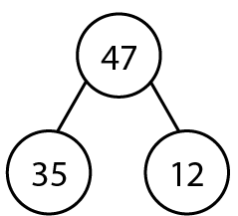
1.20 Column addition – step 1:2
Notes:
Jamal has collected 35 stickers. He gets 12 more for his birthday. He now has 47 stickers.

Slide 4
1.20 Column addition – step 1:2
Notes:
Jamal has collected 35 stickers. He gets 12 more for his birthday. He now has 47 stickers.

Slide 5
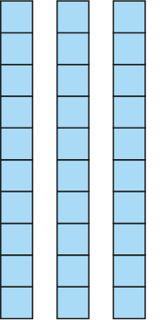
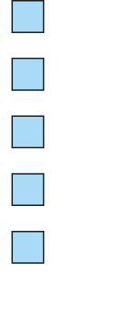
1.20 Column addition – step 1:2
 |  | 3 | 5
 | + | 1 | 2
 |  | 4 | 7
Notes:
Jamal has collected 35 stickers. He gets 12 more for his birthday. He now has 47 stickers.

Slide 6
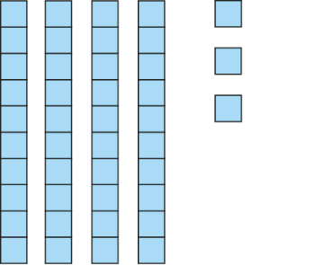
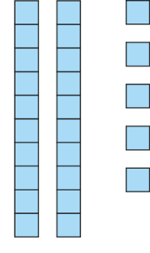
1.20 Column addition – step 2:1

Slide 7
1.20 Column addition – step 2:1
+

Slide 8
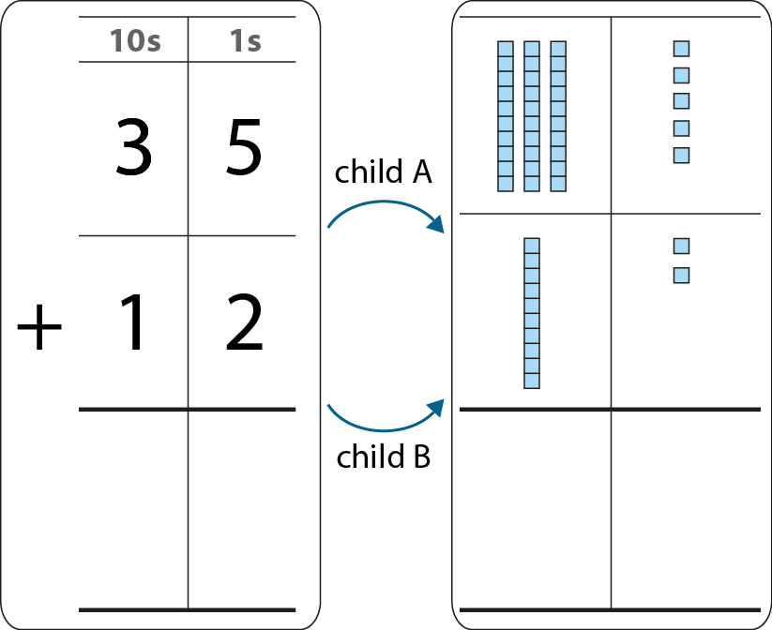
1.20 Column addition – step 2:2

Slide 9
1.20 Column addition – step 2:4
Which place-value chart correctly shows thirty-five plus twelve?
100s | 10s | 1s
1
3
5
1
2
100s | 10s | 1s
3
5
1
2

Slide 10
1.20 Column addition – step 2:4
Which place-value chart correctly shows three hundred and five plus forty?
100s | 10s | 1s
3
0
5
40
100s | 10s | 1s
3
0
5
4
0

Slide 11
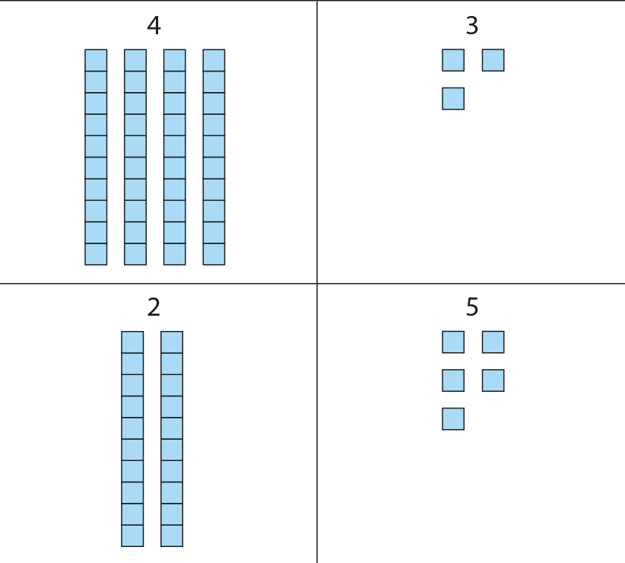
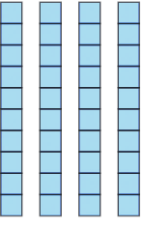
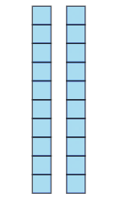
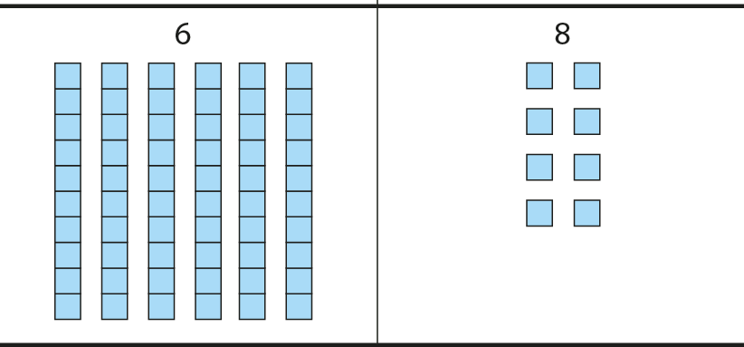
1.20 Column addition – step 3:1
 |  | 4 | 3
 |  | 6 | 8
 |  | 2 | 5
 |  | 6 | 8
 |  | 4 | 3
 | + | 2 | 5
 |  | 6 | 8

Slide 12
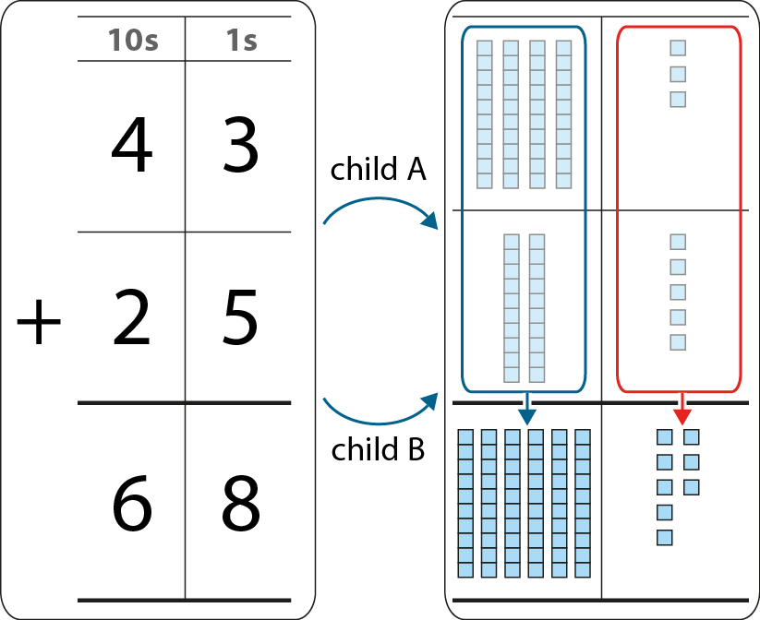
1.20 Column addition – step 3:2

Slide 13
1.20 Column addition – step 3:5
Write these as column addition calculations.
635 + 24
326 + 441 + 210
532 + 43 + 114

Slide 14
1.20 Column addition – step 4:1

Slide 15
1.20 Column addition – step 4:2
+
7
=
12
=
10
+
5
2

Slide 16
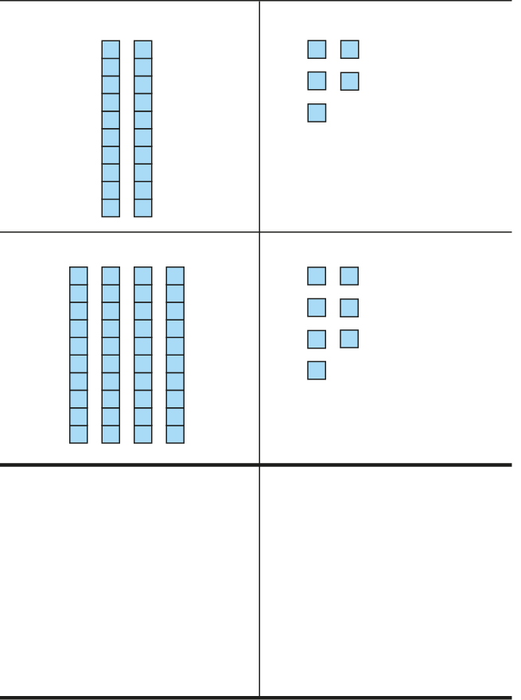
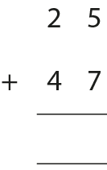
1.20 Column addition – steps 4:3
7
1
2
2
1

Slide 17
1.20 Column addition – step 4:6
Which calculations require regrouping?
Which calculations require regrouping only once?
Which calculations require regrouping twice?
 | 1 | 2 | 4
+ | 2 | 3 | 3
 | 6 | 4 | 4
+ | 1 | 7 | 2
 | 3 | 6 | 6
+ | 2 | 7 | 7
 | 5 | 7 | 9
+ | 2 | 2 | 1
 | 7 | 9 | 1
+ | 1 | 6 | 3
 | 5 | 6 | 7
+ | 2 | 3 | 3

Slide 18
1.20 Column addition – step 5:1
164 + 36
237 + 156
349 + 84
120 + 130
Use column addition | Use mental strategies

Slide 19
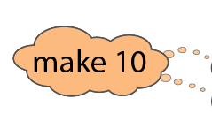
1.20 Column addition – step 5:2
416
+
223
+
184
=
823

Slide 20
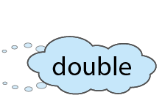
1.20 Column addition – step 5:2
15
+
57
+
27
=
99

Slide 21
1.20 Column addition – step 5:2
172
+
234
+
54
=
460

