Slide 1
Numberblocks
Support Materials
Series 2, Episode 9
Double Trouble

Slide 2
Practitioner Notes

Slide 3
Episode Description
One finds a stone temple in the jungle. To get in, she has to copy herself in a magic mirror and the two Ones double up to make Two. They discover snakes in a tunnel - but they are rubber snakes. They find a boulder blocking a door and double up to make Four. He finds a chamber with a suspended swinging bridge. He steps on it and falls into a ball pit. To get to the middle, he has to copy himself and they balance on the bridge then double up to make Eight. Eight climbs the rope, finds the golden apples, and takes one, which makes the temple start to collapse. He falls off the rope onto the bridge and splits into two Fours, who have to run from the rolling boulder. They split into Twos who run past the snakes, split again and eight Ones run under the closing stone door to escape. Several tame Indiana Jones references, including the famous hat and quotes.

Slide 4
Maths in the Episode
Doubling and halving
In this episode the children will experience ‘doubling’ and ‘halving’ by observing how the Numberblocks 1, 2 and 4 double up to make their respective doubles, 2, 4 and 8.
This episode also addresses the successive halving of Numberblock Eight to give the factors of 8 (1, 2, 4 and 8).
Combining and partitioning into equal groups
2 Ones combine to make Two, and Two partitions into 2 Ones. This is repeated for Two, Four and Eight. This combining and partitioning reveals the halves and doubles.

Slide 5
Using Mathematical Language
The children will experience the use of the words ‘double’ and ‘half’.
These can be used in the following phrases:
“Two doubled is four” and “Double two is four”
“One half of 2 is 1”
“One half of 4 is 2.”

Slide 6
Talk and Discuss Together

Slide 7
Talk and Discuss Together
Watch the episode of Numberblocks. First ask the children what they noticed and allow them to talk to you and each other. The following slides are designed to stimulate children and adults to talk about the episode and draw out some key aspects of the mathematics.

Slide 8
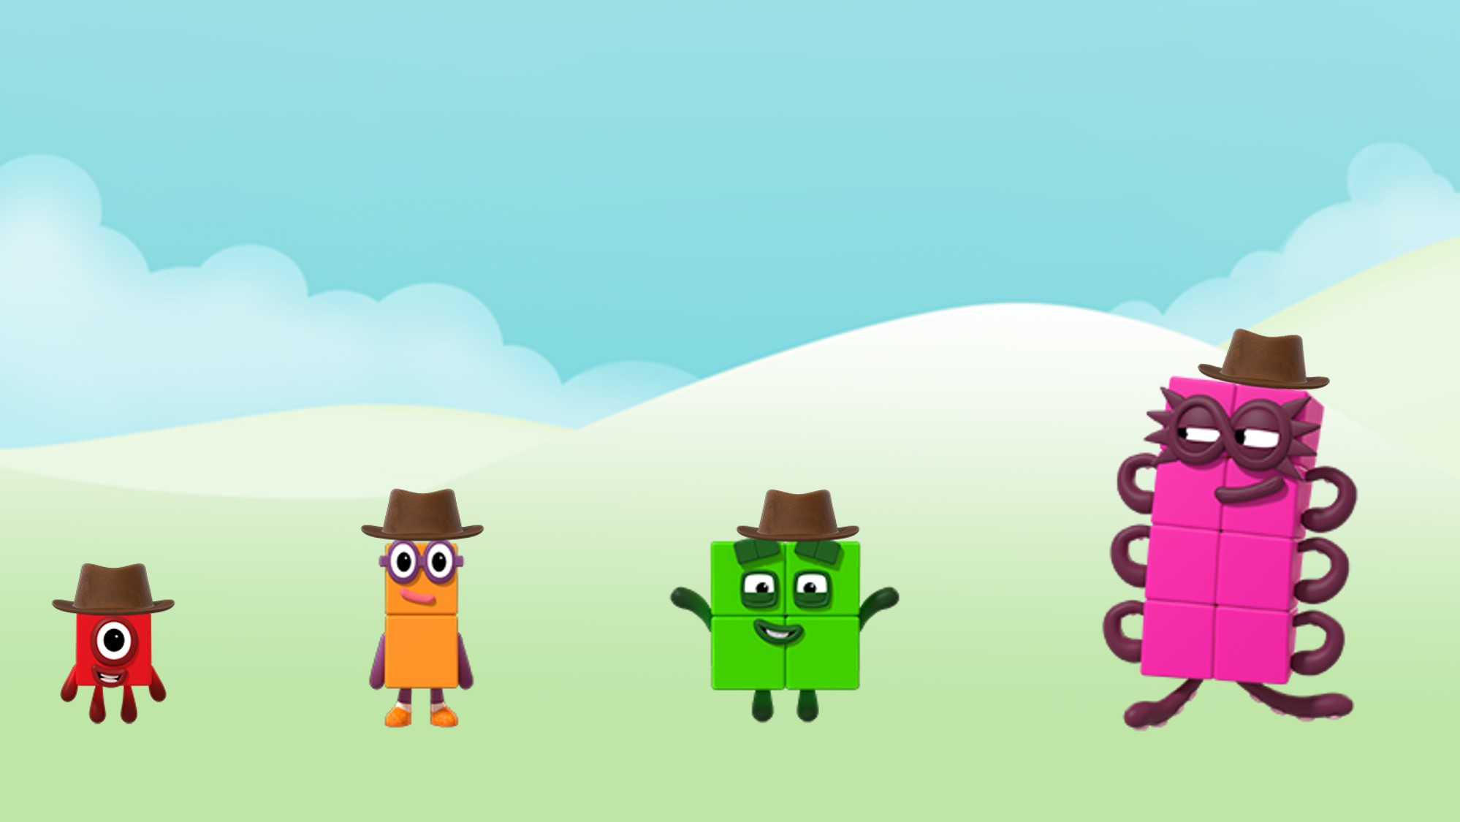
Images © 2017 Alphablocks Ltd. All Rights Reserved.
Notes:
After the episode discuss what the children noticed about the programme. Who appeared in the programme? Who didn’t?
Ask the children to stand in a space. Play some music. When the music stops shout ‘Double up’. Children should find a partner.
Play the music again. When the music stops shout ‘Double up’. This time pairs should come together.
Repeat one more time.
What do they notice about the picture on the screen?
Double One is Two, double Two is Four and double Four is Eight.

Slide 9


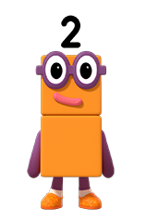
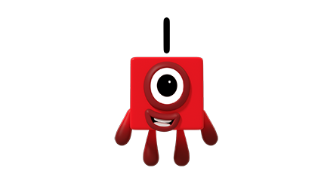
double up!
Images © 2017 Alphablocks Ltd. All Rights Reserved.
Notes:
This slide is animated.
Click 1 reveals “double up!” in a speech bubble. Encourage the children to say it when they see it.
Watch the animation.
Can the children say who will appear next (Two)?
Shout: “Double One is Two”.
Click 2: Two appears.

Slide 10

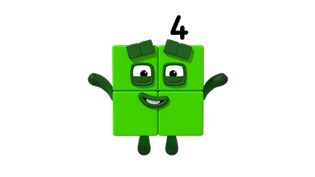
double up!
Images © 2017 Alphablocks Ltd. All Rights Reserved.
Notes:
This slide is animated.
Click 1 reveals “double up!” in a speech bubble. Encourage the children to say it when they see it.
Watch the animation.
Can the children say who will appear next (Four)?
Shout: “Double Two is Four”.
Click 2: Four appears.

Slide 11


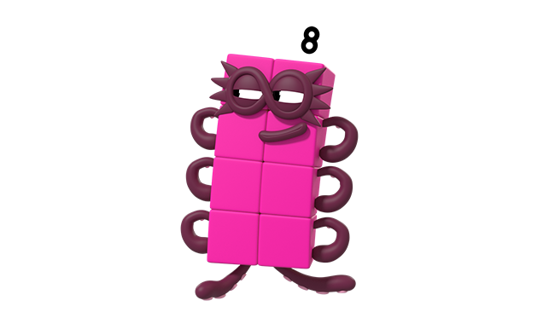
double up!
Images © 2017 Alphablocks Ltd. All Rights Reserved.
Notes:
This slide is animated.
Click 1 reveals “double up!” in a speech bubble. Encourage the children to say it when they see it.
Watch the animation.
Can the children say who will appear next (Eight)?
Shout: “Double Four is Eight”.
Click 2: Eight appears.

Slide 12
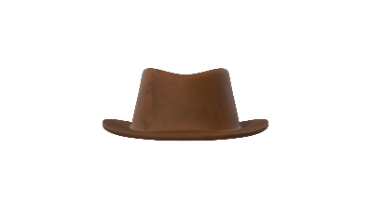
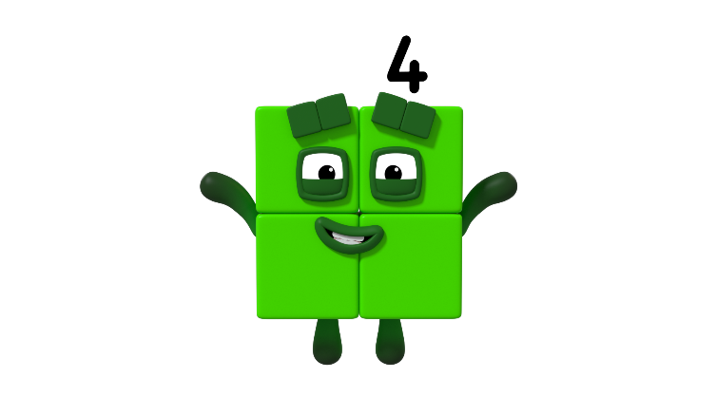

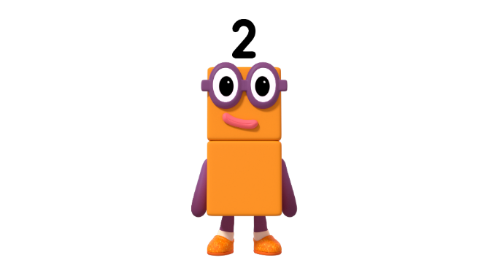
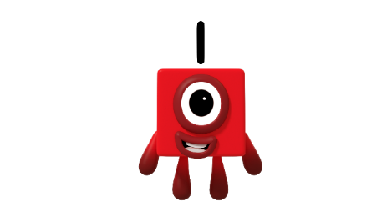

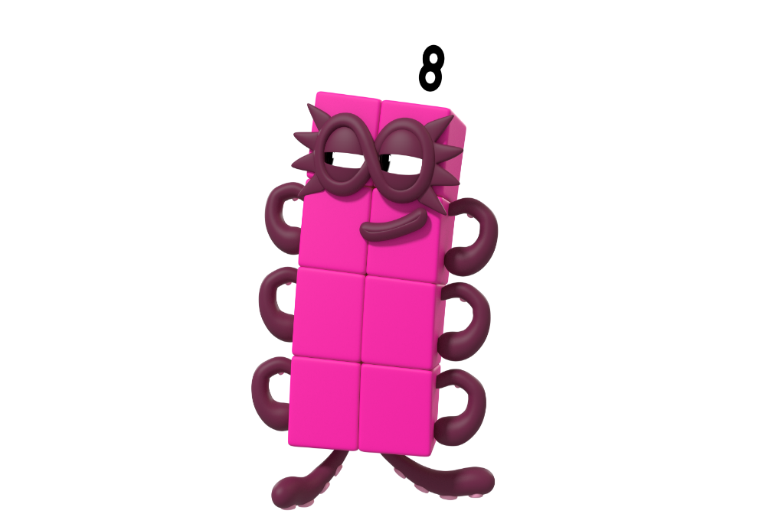
doubled up is
Click on Four
Click on Two
Click on Eight
Images © 2017 Alphablocks Ltd. All Rights Reserved.
Notes:
Discuss which Numberblocks map together when the left-hand side is doubled up.
Practise saying:
“Four doubled up is Eight”, “One doubled up is Two”
“Two doubled up is Four”
This slide is animated:
Click characters on right-hand side for connecting arrows to appear.

Slide 13
Enabling Environments

Slide 14
Enabling Environments
Playing and Exploring
Make butterflies and stick dots or craft pom-poms in ones, twos and fours on each wing. Encourage the children to think about where to place the dots/pom-poms.
Active Learning
Notice how children choose to use doubling in their play, e.g. if another child comes to join them when they are playing alone.
Creating and Thinking Critically
Using a six-faced dice labelled with the dice patterns for 1, 2 and 4 (each number appears twice), encourage the children to make up a game that involves finding doubles when rolling the dice. Provide equipment and resources such as empty number tracks, empty 10 x 10 grids, empty jars and craft pom-poms or counters. Notice the language that the children use when designing and playing the game.

Slide 15
Learning Together in Y1

Slide 16
Images © 2017 Alphablocks Ltd. All Rights Reserved.
Notes:
Discuss the episode. What did you notice? Emphasise key vocabulary that the children use involving doubling and halving.
Ask what they notice about the picture on the screen.

Slide 17










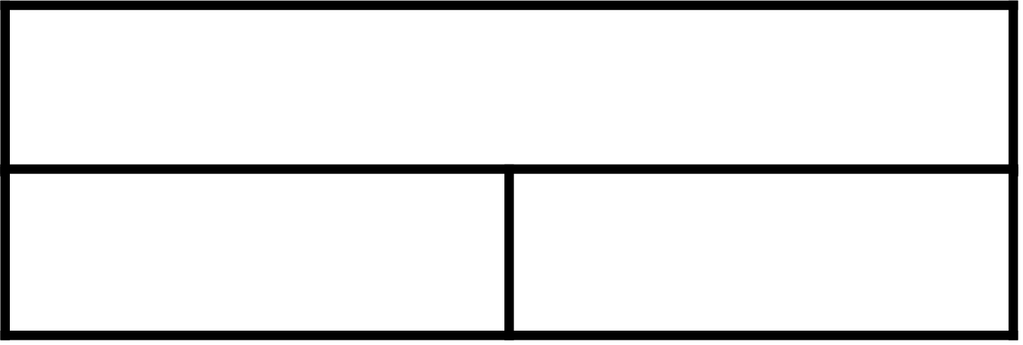
Half of 2 is 1.
Images © 2017 Alphablocks Ltd. All Rights Reserved.
Notes:
Use the animation to observe how Two partitions to make 2 Ones.
The animation unfolds the different representations. Use the question:
What’s the same about this and this representation?
The animation provides concrete, pictorial, verbal and abstract representations.
Discuss each one and help children to make connections between them.
Read the speech bubble together.

Slide 18


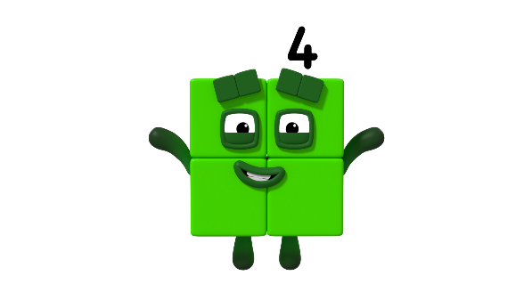





Half of 4 is 2.
Images © 2017 Alphablocks Ltd. All Rights Reserved.
Notes:
Use the animation to observe how Four partitions to make 2 Twos.
The animation unfolds the different representations. Use the question:
What’s the same about this and this representation?
The animation provides concrete, pictorial, verbal and abstract representations.
Discuss each one and help children to make connections between them.
Read the speech bubble together.

Slide 19




Half of 8 is 4.
Images © 2017 Alphablocks Ltd. All Rights Reserved.
Notes:
Use the animation to observe how Eight partitions to make 2 Fours.
The animation unfolds the different representations. Use the questions
‘What’s the same about this and this representation?’ and
‘What’s different between this and this representation?’ when the animation shifts from one to another.
The animation provides concrete, pictorial, verbal and abstract representations.
Discuss each one and help children to make connections between them.
Read the speech bubble together.

Slide 20
Click on the right-hand side circles.
Notes:
Ask children to consider the pictures. What do they notice?
This slide takes the children’s conceptual understanding deeper because only one half is represented not both halves as in the previous slides.
As you follow the arrow ensure that the children describe the mapping as
“--- is double---”.
Discuss 4 on the left. Which picture on the right represents one half of this picture (pointing to 4)?
Discuss 8 on the left. Which picture on the right represents one half of this picture (pointing to 8)?
Discuss the empty circle. What is missing from this circle?
Use the mappings to repeat the phrases:
“One half of four is two.”
“One half of eight is four.”
“One half of two is one.”

Slide 21


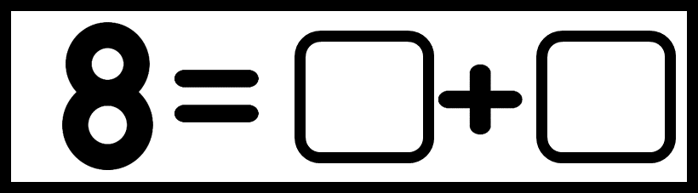
half of 2 is
half of is
of is
Notes:
Ask the children to work individually on this activity. Use this slide to complete together to check responses.

