Slide 1
Numberblocks
Support Materials
Series 1 Episode 5
One, Two, Three

Slide 2
Practitioner Notes

Slide 3
Episode Description
Numberblocks One and Two find some apple trees but can't reach the apples.
Three arrives, picks three apples and suggests they play games to win them. She hides the first apple under numbered cups for the others to guess where it is, but Three wins. They balance the second apple on their heads and try to take it from each other - and Three, being tallest, wins again. The final game is to surprise each other: One and Two do number magic and turn into another Three, which surprises the original Three so much she splits into One and Two. Three has won again, and eaten all the apples, but she finds more apples for the others so everyone is happy.

Slide 4
Maths in the Episode
Comparing
In this episode One, Two and Three compare themselves with respect to their heights using the language of comparatives and superlatives. E.g. ‘bigger than' and 'biggest'.
Ordering
The Numberblocks use the language of ordinal number (first, second, third) to describe who will guess where the apple is when Three performs her magic trick. The numerals are visible on the cups that Three uses.

Slide 5
Using Mathematical Language
During this episode children will experience the ordinal relationship between One, Two and Three.
Encourage the children to use a stem sentence to capture these relationships, e.g.:
“Two is bigger than One”.
“Three is the biggest”.
“One is first”.
“Two is second”.
“Three is third”.
This can be extended to use the same vocabulary to compare other objects. Children should go on to develop other more accurate and precise comparative language, such as 'taller than', 'shorter than', 'greater than', and 'less than'.

Slide 6
Talk and Discuss Together

Slide 7
Talk and Discuss Together
Watch the episode of Numberblocks. First ask the children what they noticed and allow them to talk to you and each other. The following slides are designed to stimulate children and adults to talk about the episode and draw out some key aspects of the mathematics.

Slide 8

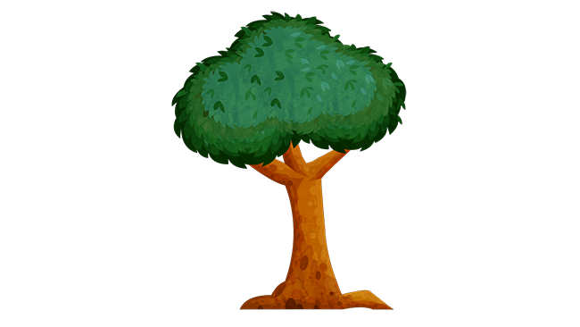
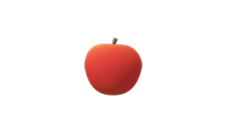
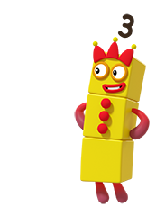
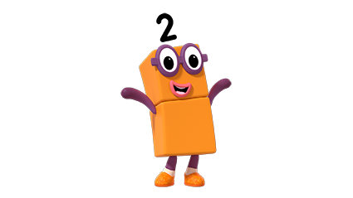
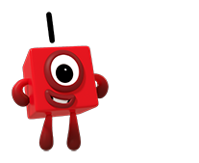
Images © 2017 Alphablocks Ltd. All Rights Reserved.
Notes:
This slide is animated:
Discuss the programme, what was One and Two’s problem at the beginning?
Click 1: One jumps up and down twice. Two jumps up and down twice. This demonstrates that they can’t reach.
What happens when you can’t reach something? What do you do? Why?
Ask one of the children to place a picture of an apple on a nearby wall where everyone can see. Who can reach it? Who can’t? Why?
Use this discussion to develop the language of bigger than/taller than, smaller than/shorter than.

Slide 9
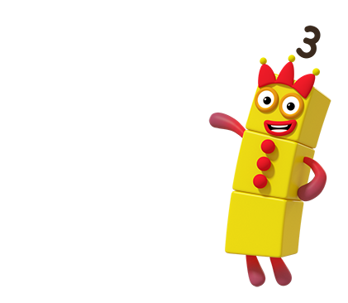



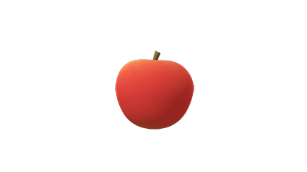
Images © 2017 Alphablocks Ltd. All Rights Reserved.
Notes:
Prepare 3 buckets or cups of different colours and label them with the numerals 1, 2, 3.
Choose 4 children. 1 hides the apple under the bucket while the others cover their eyes.
Choose which child will go first, second, and third.
Each child takes it in turns to choose a number to guess where the apple is.
If a child guesses correctly, he/she gets to choose where to hide the apple next for the remaining children to guess.
The game can also be played using the following three slides.

Slide 10
Images © 2017 Alphablocks Ltd. All Rights Reserved.
Notes:
The apple is hidden under cup 1. A child selects a cup. Click on the cup and it will rise to reveal whether or not the apple is hidden beneath. Encourage children to use full sentences, e.g.:
"The apple is under cup 1."
Or, " The apple is under the first cup."

Slide 11
Images © 2017 Alphablocks Ltd. All Rights Reserved.
Notes:
The apple is hidden under cup 2. A child selects a cup. Click on the cup and it will rise to reveal whether or not the apple is hidden beneath. Encourage children to use full sentences, e.g.:
"The apple is under cup 2."
Or, "The apple is under the second cup."

Slide 12
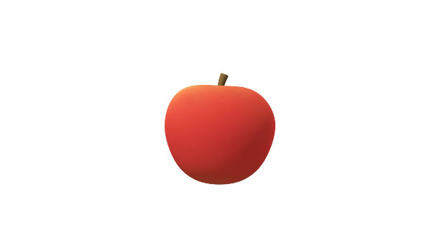
Images © 2017 Alphablocks Ltd. All Rights Reserved.
Notes:
The apple is hidden under cup 3. A child selects a cup. Click on the cup and it will rise to reveal whether or not the apple is hidden beneath. Encourage children to use full sentences, e.g.:
"The apple is under cup 3."
Or, "The apple is under the third cup."

Slide 13
Enabling Environments

Slide 14
Enabling Environments
Playing and Exploring
Create a ‘magic maths’ area for children to explore and create their own games with the buckets or cups with the numbers on. Provide something that can be hidden inside/under them. Prompt their ideas with comments such as “I wonder how could we trick your friend?”
Active Learning
Notice when children take time to compare objects when ordering them. Notice when they choose to compare objects for particular purpose, e.g. finding the right sized block to add to a tower.
Creating and Thinking Critically
Hang objects/pictures out of reach and in reach. Ask the children to find out which they can reach and can’t reach. How could they reach the ones that are out of reach?

Slide 15
Learning Together in Y1

Slide 16
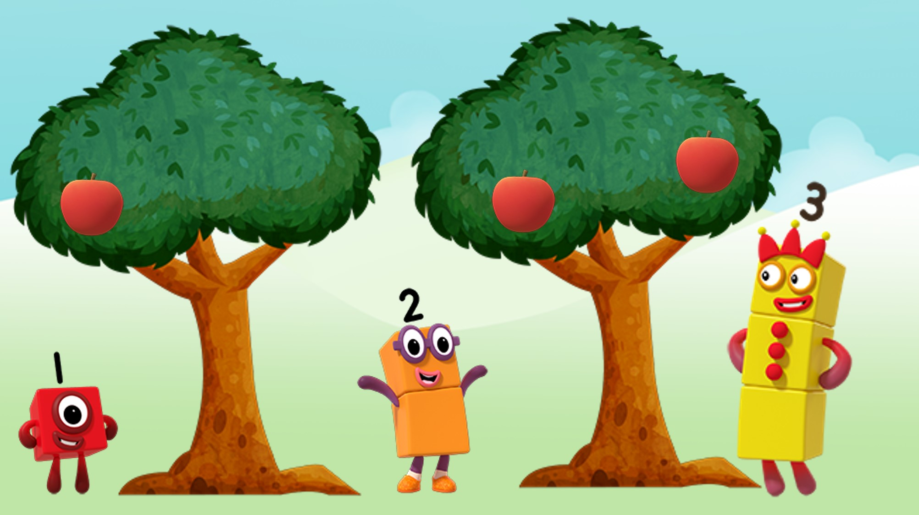
Images © 2017 Alphablocks Ltd. All Rights Reserved.
Notes:
Discuss the programme: what was One and Two’s problem at the beginning?

Slide 17

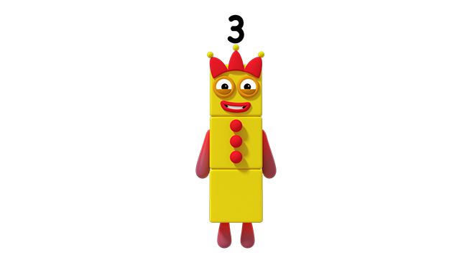
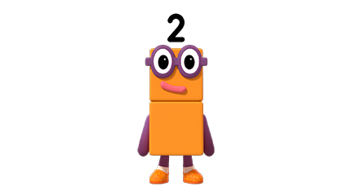
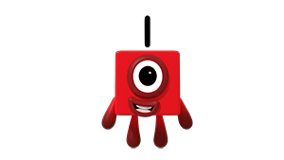
I am ________ than _____.
I am ________ than _____.
I am smaller than Two.
Images © 2017 Alphablocks Ltd. All Rights Reserved.
Notes:
This slide is animated.
Click 1: One says “I am smaller than Two”. Ask the children to find someone that they are smaller than and ask them to share the stem sentence.
“I am smaller than…”. Ask the other child to say the reverse: “____ is smaller than me”.
Click 2: Three’s speech bubble appears. Ask the children to consider what words could be missing. “I am bigger than One”; “I am bigger than Two”. Ask the children to use the stem sentence using ‘bigger’.
Click 3: Two’s speech bubble appears . Ask the children to consider what words could be missing? “ I am bigger than One”, “I am smaller than Three”.

Slide 18


I am smaller than Two.
<
1 is less than 2.
<
Images © 2017 Alphablocks Ltd. All Rights Reserved.
Notes:
This slide is animated:
What is One saying?
Click 1: Speech bubble disappears and 1 red block and 2 orange blocks appear. What do you notice. How could we compare 1 with 2? Ask children to build One and Two.
Click 2: Speech bubble appears “1 is less than 2”; < appears between the blocks. Explain that the symbol means “is less than”. We can use it to write expressions about numbers when we compare them.
Click 3: 1 < 2 appears, to illustrate this. Practise reading the expression, using their own One and Two blocks as they speak and holding them together to illustrate the difference in height.

Slide 19
I am bigger than One.
>
2 is greater than 1.
>
Images © 2017 Alphablocks Ltd. All Rights Reserved.
Notes:
This slide is animated:
What is Two saying?
Click 1: Speech bubble disappears and 2 orange blocks and 1 red block appear. What do you notice? How could we compare 2 with 1?
Click 2: Speech bubble appears “2 is greater than 1”; > appears between the blocks. Explain that the symbol means “is greater than”. We can use it to write expressions about numbers when we compare them.
Click 3: 2 > 1 appears, to illustrate this. Practise reading the expression.

Slide 20
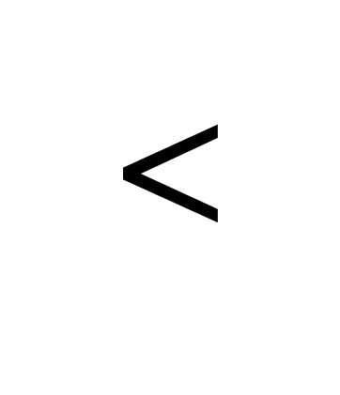
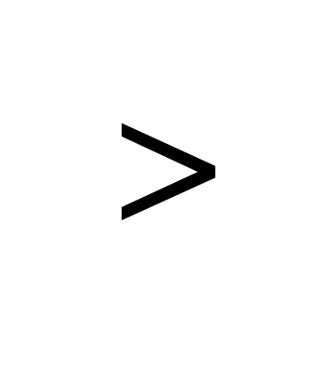
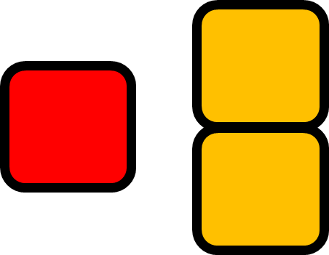

1 is less than 2.
2 is greater than 1.
Images © 2017 Alphablocks Ltd. All Rights Reserved.
Notes:
This image can be used to help remember the direction of the inequality symbols.
The callouts are animated. Ask children what they think the symbols mean first and then click for each callout explanation.

Slide 21

I am ______ than Three.
__ is less than ___.
<
<
Images © 2017 Alphablocks Ltd. All Rights Reserved.
Notes:
This slide is animated:
What is One saying? What is the missing word?
Click 1: Speech bubble disappears and 1 red block and 3 yellow blocks appear. What do you notice? How could we compare 1 with 3?
Click 2: Speech bubble appears “__ is less than __”; < appears between the blocks. Explain that the symbol means “is less than”. We can use it to write expressions about numbers when we compare them. What words are missing from the speech bubble? All children build a Three block and practise comparing One with Three.
Click 3: 1 < 3 appears to illustrate this. Practise reading the expression while holding up the One and Three blocks.

Slide 22
I am ______ than One.
__ is greater than ___.
>
>
Images © 2017 Alphablocks Ltd. All Rights Reserved.
Notes:
This slide is animated:
What is One saying? What are the missing words?
Click 1: Speech bubble disappears and 1 red block and 3 yellow blocks appear. What do you notice? How could we compare 3 with 1?
Click 2: Speech bubble appears “__ is greater than __”; > appears between the blocks. Explain that the symbol means “is greater than”. We can use it to write expressions about numbers when we compare them. What words are missing from the speech bubble? All children build a Three block and practise comparing Three with One.
Click 3: 3 < 1 appears, to illustrate this. Practise reading the expression while holding up the Three and One blocks.

Slide 23
>
<
Images © 2017 Alphablocks Ltd. All Rights Reserved.
Notes:
Use this slide to invite the children to make further comparisons between One, Two and Three, and ask them to record the expressions using the inequality symbols.

