Slide 1
Year 6, Unit 12
Order of operations

Slide 2
Year 6, Unit 12
These materials heavily reflect the prioritisation approach of the ready-to-progress criteria in the DfE Primary Mathematics Guidance 2020 and on the PPTs that exemplify them on the NCETM website. They also include other relevant National Curriculum content. Related sections of the NCETM Primary Mastery Professional Development Materials provide small-step teaching guidance.
There are no specific ready-to-progress criteria supported by this unit.

Slide 3
Contents
The links below take you to the starting slide of each learning outcome.
1 | Pupils explain how addition and subtraction can help to solve multiplication problems efficiently (I)
2 | Pupils explain how addition and subtraction can help to solve multiplication problems efficiently (II)
3 | Pupils explain how the distributive law applies to multiplication expressions with a common factor (addition)
4 | Pupils use their knowledge of the distributive law to solve equations including multiplication, addition and subtraction
5 | Pupils explain how addition and subtraction can help to solve division problems efficiently
Click the arrow button to return to this Contents slide.

Slide 4
Contents
The links below take you to the starting slide of each learning outcome.
6 | Pupils explain how the distributive law applies to division expressions with a common divisor (addition)
7 | Pupils explain how the distributive law applies to division expressions with a common divisor (subtraction)
8 | Pupils use their knowledge of the distributive law to solve equations including division, addition and subtraction
Click the arrow button to return to this Contents slide.

Slide 5
Year 6, Unit 12, Learning Outcome 1
Learning Outcome 1
Pupils explain how addition and subtraction can help to solve multiplication problems efficiently (I)
The following slides have been collated to support the teaching of this learning outcome.

Slide 6
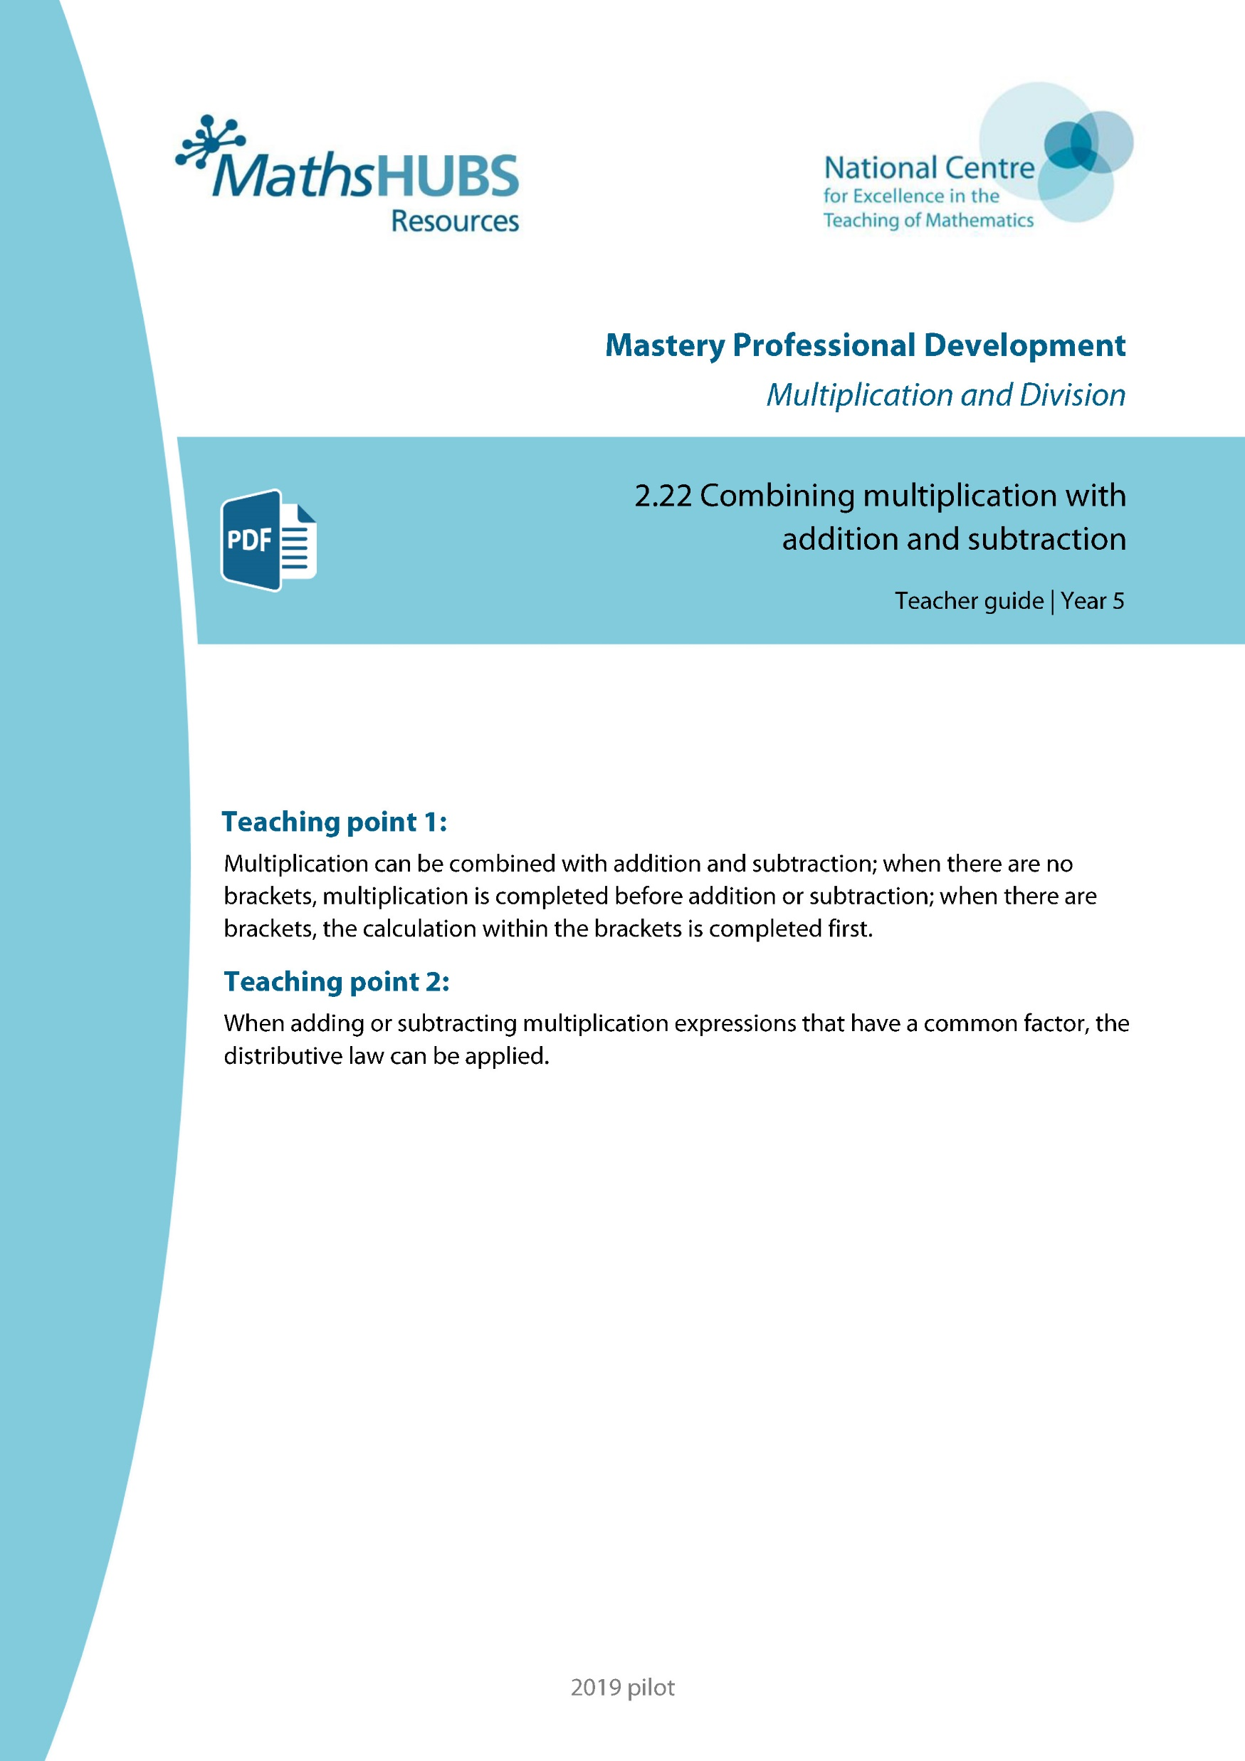
Year 6, Unit 12, Learning Outcome 1
Additional teacher guidance for this outcome should be read first and can be found in this segment of the NCETM Primary Mastery Professional Development Materials:
2.22 Combining multiplication with addition and subtraction
The spine materials are divided into ‘teaching points’ and ‘steps in learning’.
Teaching point | Steps in learning | Pages
1 | 1:1-1:3 | 2-7

Slide 7




2.22 Combining operations: ×, + and − Step 1:1
How many children altogether?
5
5
5
4 × 5
5
5
3
5
+
5
3
2 × 3
3
3
5
= 20 + 6 = 26

Slide 8
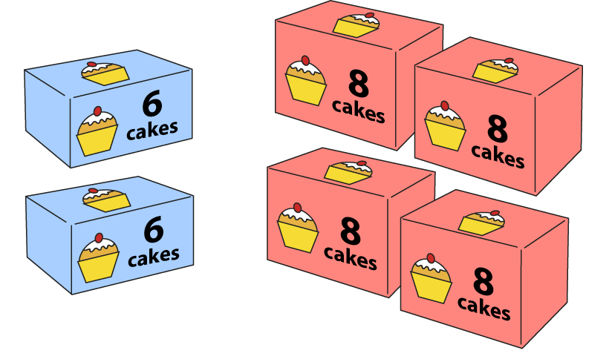
2.22 Combining operations: ×, + and − Step 1:1
2 boxes each contain 6 cakes; 4 boxes each contain 8 cakes.
How many cakes altogether?
2 × 6 + 4 × 8
12
+
32
= 44

Slide 9
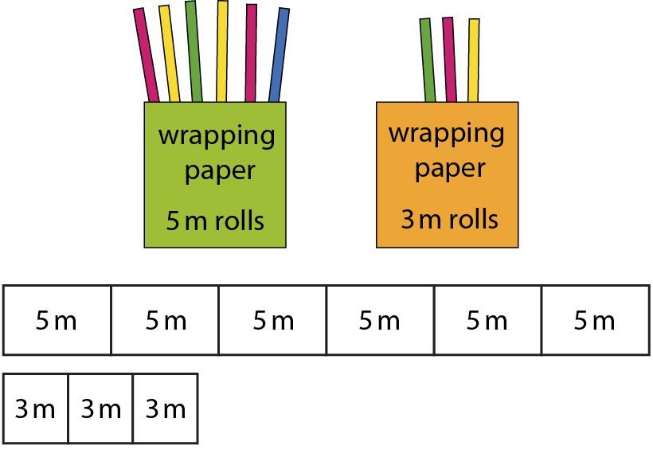
2.22 Combining operations: ×, + and − Step 1:1
30 m
9 m
30 m + 9 m = 39 m
Notes:
I buy six 5 m rolls of wrapping paper and three 3 m rolls of wrapping paper.
How much paper will I have altogether?

Slide 10

2.22 Combining operations: ×, + and − Step 1:1
Notes:
A class is organised into three teams of five children and two teams of four children.
How many children are in the class?

Slide 11
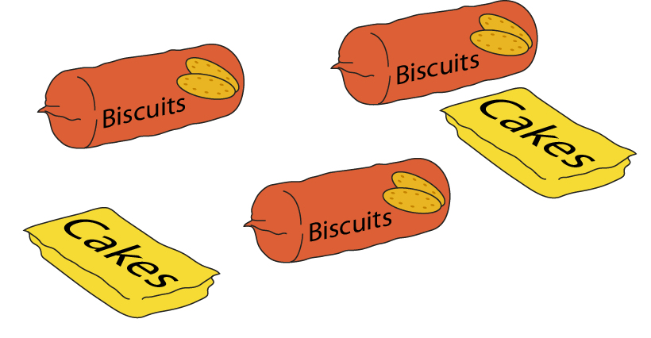
2.22 Combining operations: ×, + and − Step 1:1
Notes:
A pack of biscuits weighs 260 g. A pack of cakes weighs half this amount.
What is the total weight of this shopping?

Slide 12
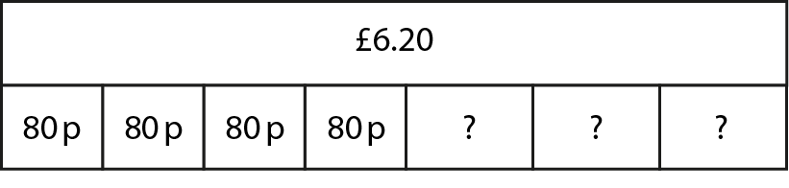
2.22 Combining operations: ×, + and − Step 1:1
Notes:
I buy four cherry cakes and three chocolate cakes. I spend £6.20 in total.
The cherry cakes cost 80 p each. How much does each chocolate cake cost?

Slide 13

2.22 Combining operations: ×, + and − Step 1:2
20 × 2 − 10 × 3 = 40 − 30 = 10
Notes:
I have three packs of ten stickers. You have two packs of twenty stickers.
How many more stickers do you have?

Slide 14
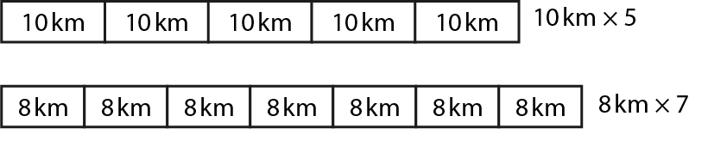
2.22 Combining operations: ×, + and − Step 1:2
10 × 5 = 50
8 × 7 = 56
56 − 50 = 6
Notes:
Miss Grey runs 10 km a day for five days.
Mr Green runs 8 km a day for seven days.
Who has run further and by how much?

Slide 15
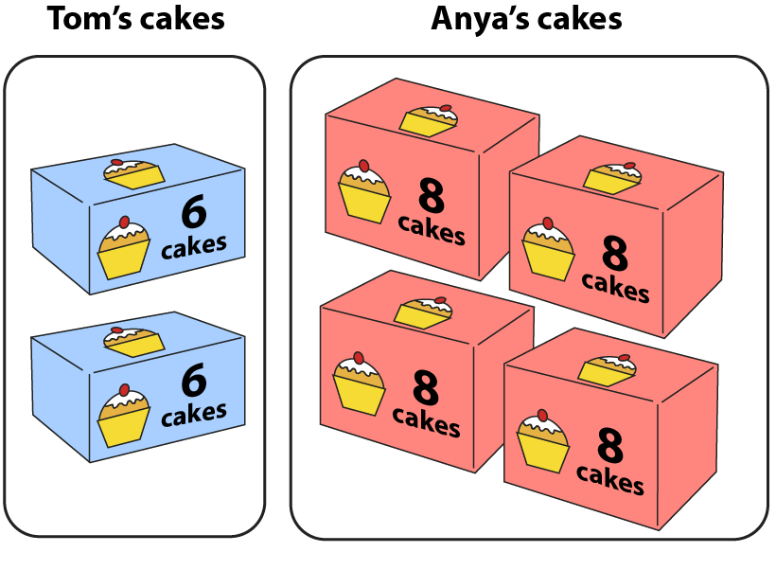
2.22 Combining operations: ×, + and − Step 1:2
6 × 2 = 12
8 × 4 = 32
32 − 12 = 20
Notes:
Who has the most cakes, and by how many?

Slide 16
Year 6, Unit 12, Learning Outcome 2
Learning Outcome 2
Pupils explain how addition and subtraction can help to solve multiplication problems efficiently (II)
The following slides have been collated to support the teaching of this learning outcome.

Slide 17
Year 6, Unit 12, Learning Outcome 2
Additional teacher guidance for this outcome should be read first and can be found in this segment of the NCETM Primary Mastery Professional Development Materials:
2.22 Combining multiplication with addition and subtraction
The spine materials are divided into ‘teaching points’ and ‘steps in learning’.
Teaching point | Steps in learning | Pages
1 | 1:4 – 1:5 | 7-8

Slide 18

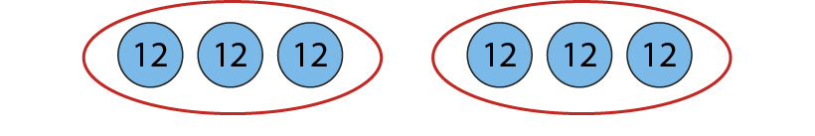
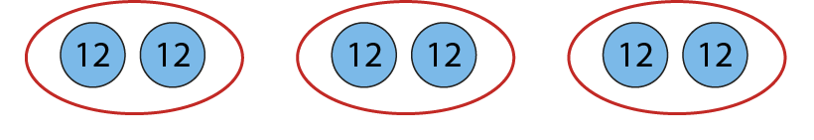
2.22 Combining operations: ×, + and − Step 1:4
3 × 5 + 7 × 2 =
29
Joseph:
Megan:
Becca:
Notes:
Joseph says: 3 × 5 + 7 × 2 = 15 + 14 = 29
Megan says: 3 × 5 + 7 × 2 = 36 × 2 = 72
Becca says: 3 × 5 + 7 × 2 = 3 × 24 = 72
Joseph is correct, because he has multiplied before adding as there are no brackets.

Slide 19
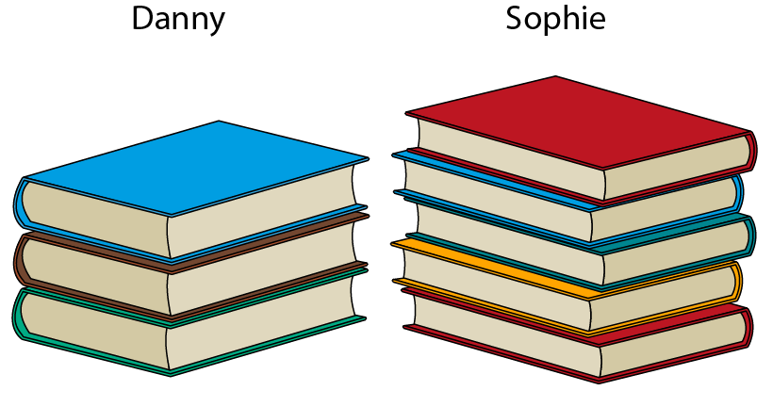
2.22 Combining operations: ×, + and − Step 1:5
Notes:
Each of Danny’s books have fifty pages. Each of Sophie’s books have thirty pages.
Whose books have the most pages in total, and by how many?

Slide 20
Year 6, Unit 12, Learning Outcome 3
Learning Outcome 3
Pupils explain how the distributive law applies to multiplication expressions with a common factor (addition)
The following slides have been collated to support the teaching of this learning outcome.

Slide 21
Year 6, Unit 12, Learning Outcome 3
Additional teacher guidance for this outcome should be read first and can be found in this segment of the NCETM Primary Mastery Professional Development Materials:
2.22 Combining multiplication with addition and subtraction
The spine materials are divided into ‘teaching points’ and ‘steps in learning’.
Teaching point | Steps in learning | Pages
2 | 2:1 – 2:3 | 9 -11

Slide 22
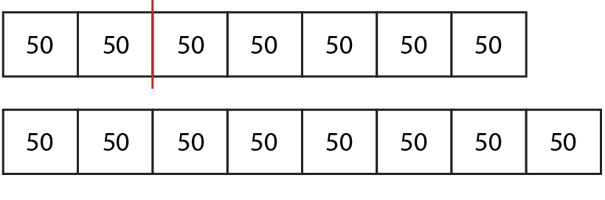
2.22 Combining operations: ×, + and − Step 2:1
50 × 2 + 50 × 5
<
50 × 8

Slide 23


2.22 Combining operations: ×, + and − Step 2:2
How much money in total?
Method 1:
Method 2:
80 p × 4 + 80 p × 3
80 p ×
(
4 + 3
)
£3.20 + £2.40
80 p × 7
= £5.60
= £5.60
Notes:
Apples cost 80p each. Amelia buy four apples at first. Then she goes back and buys three more apples.
How could you work out how much money Amelia has spent in total?
Which method is correct? Explain your answer.

Slide 24


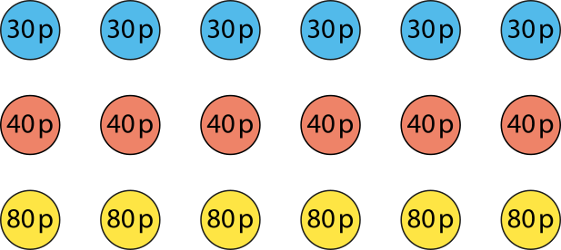
2.22 Combining operations: ×, + and − Step 2:3
Method 1:
Method 2:
30 p × 6 = £1.80
40 p × 6 = £2.40
80 p × 6 = £4.80
30 p + 40 p + 80 p
= £1.50
£1.80 + £2.40 + £4.80 = £9
£1.50 × 6 = £9
Notes:
Robyn needs to make six party bags.
She buys six pencils costing 30 p each, six erasers costing 40 p each and six notebooks costing 80 p each.
How much has she spent altogether?

Slide 25
Year 6, Unit 12, Learning Outcome 4
Learning Outcome 4
Pupils use their knowledge of the distributive law to solve equations including multiplication, addition and subtraction
The following slides have been collated to support the teaching of this learning outcome.

Slide 26
Year 6, Unit 12, Learning Outcome 4
Additional teacher guidance for this outcome should be read first and can be found in this segment of the NCETM Primary Mastery Professional Development Materials:
2.22 Combining multiplication with addition and subtraction
The spine materials are divided into ‘teaching points’ and ‘steps in learning’.
Teaching point | Steps in learning | Pages
2 | 2:4 – 2:5 | 12-13

Slide 27
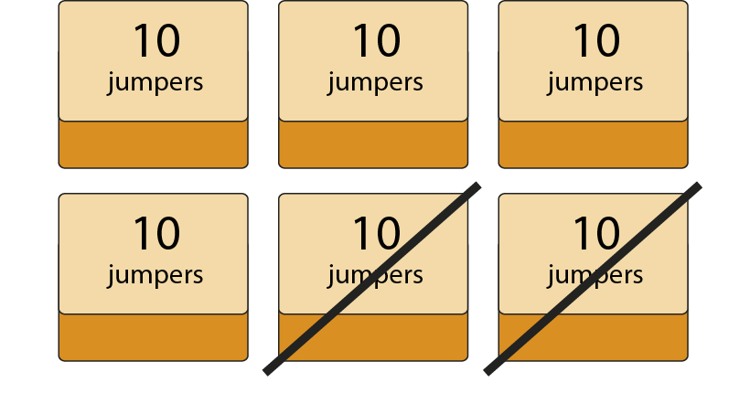
2.22 Combining operations: ×, + and − Step 2:4
10 × 6 − 10 × 2
= 10 × (6 − 2)
= 10 × 4 = 40
Notes:
There are six boxes of jumpers in the school office with ten jumpers in each box.
Two of the boxes are sold.
How many jumpers are left?

Slide 28
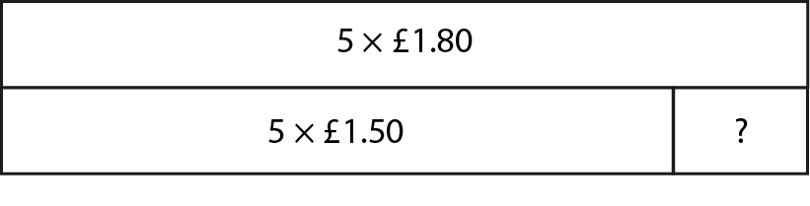
2.22 Combining operations: ×, + and − Step 2:4
£1.80 × 5 − £1.50 × 5
= (£1.80 − £1.50) × 5
= 30 p × 5 = £1.50
Notes:
Easter eggs cost £1.80 each. Katya buys five Easter eggs. After Easter, the same eggs are reduced to £1.50 each.
How much would she have saved if she had bought the eggs after Easter?

Slide 29
Year 6, Unit 12, Learning Outcome 5
Learning Outcome 5
Pupils explain how addition and subtraction can help to solve division problems efficiently
The following slides have been collated to support the teaching of this learning outcome.

Slide 30

Year 6, Unit 12, Learning Outcome 5
Additional teacher guidance for this outcome should be read first and can be found in this segment of the NCETM Primary Mastery Professional Development Materials:
2.28 Combining division with addition and subtraction
The spine materials are divided into ‘teaching points’ and ‘steps in learning’.
Teaching point | Steps in learning | Pages
1 | 1:1 - 1:5 | 2-7

Slide 31
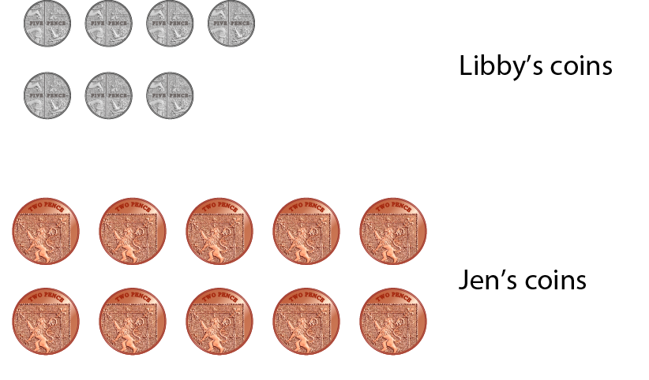
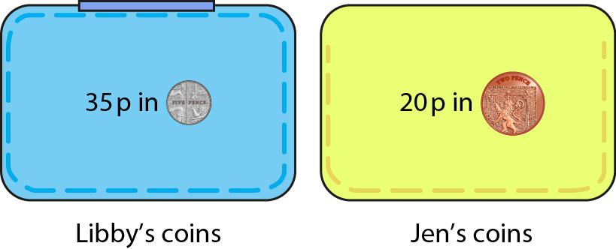
2.28 Combining operations: ÷, + and − Step 1:1
35 p in 5 p coins and 20 p in 2 p coins.
How many coins altogether?
35 p ÷ 5 p + 20 p ÷ 2 p
= 7 + 10
= 17
Notes:
Libby has 35 p in 5 p coins and Jen has 20 p in 2 p coins.
How many coins do they have altogether?

Slide 32
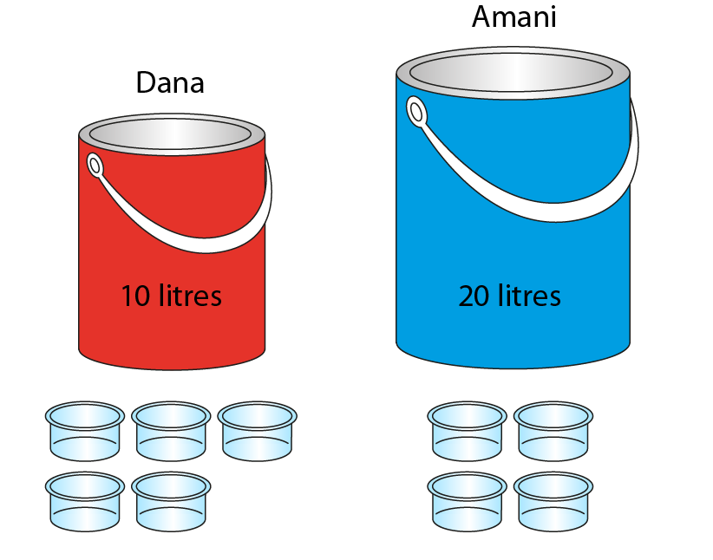
2.28 Combining operations: ÷, + and − Step 1:1
10 litres of red paint, poured into 5 pots;
20 litres of blue paint, poured into 4 pots.
1 pot of red paint and 1 pot of blue paint –
how much paint in total?
10 ÷ 5 + 20 ÷ 4
= 2 + 5
= 7
Notes:
Dana has ten litres of red paint, which she pours into five pots.
Amani has twenty litres of blue paint, which she pours into four pots. They give a pot of red paint and a pot of blue paint to Nathan.
How much paint does Nathan have in total?

Slide 33
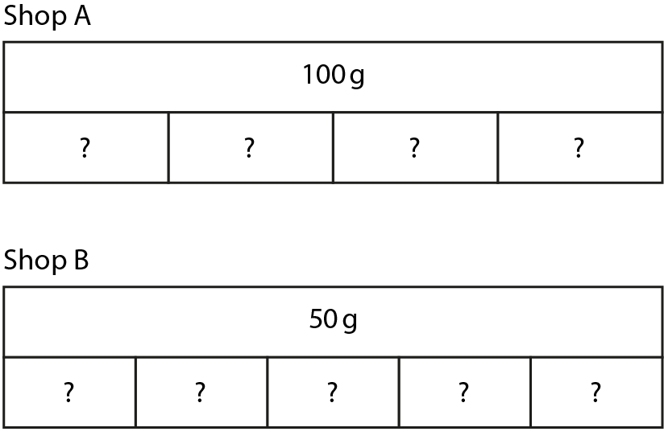
2.28 Combining operations: ÷, + and − Step 1:1
Shop A sells 100 g of cereal shared into 4 packs.
Shop B sells 50 g of cereal shared into 5 packs.
A pack from Shop A and a pack from Shop B –
how much cereal altogether?
Notes:
Shop A sells 100 g of cereal shared into four small packs.
Shop B sells 50 g of cereal shared into five small packs.
If I buy a small pack from Shop A and a small pack from Shop B, how much cereal will I have altogether?

Slide 34

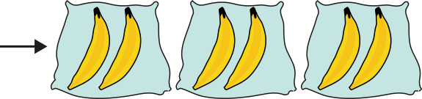

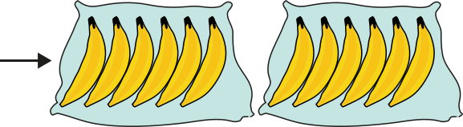
2.28 Combining operations: ÷, + and − Step 1:2
Leila puts 6 bananas into bags of 2.
James puts 12 bananas into bags of 6.
Who has more bags, and by how many?
6 ÷ 2 − 12 ÷ 6
= 3 − 2
= 1

Slide 35
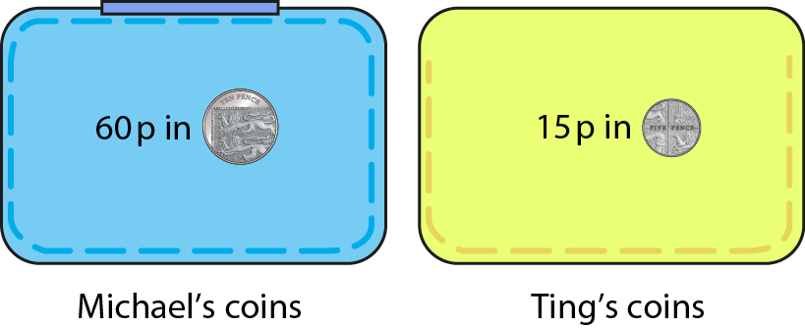
2.28 Combining operations: ÷, + and − Step 1:2
60 p in 10 p coins and 15 p in 5 p coins.
Who has more coins, and by how many?
Notes:
Michael has 60 p in 10 p coins and Ting has 15 p in 5 p coins.
Who has more coins, and by how many?

Slide 36
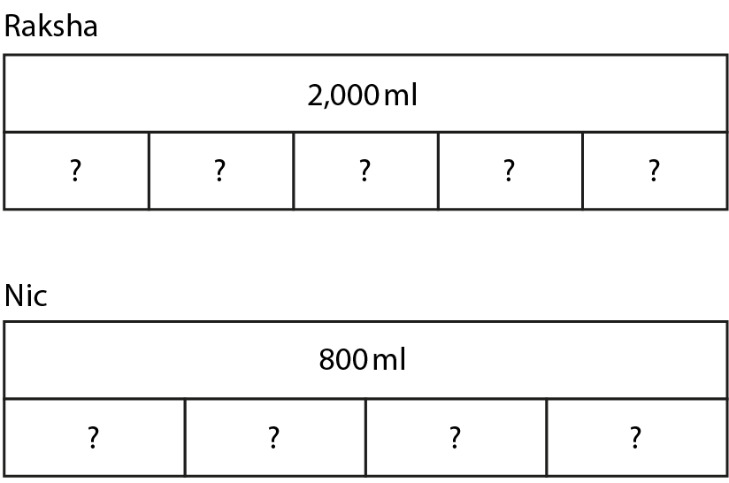
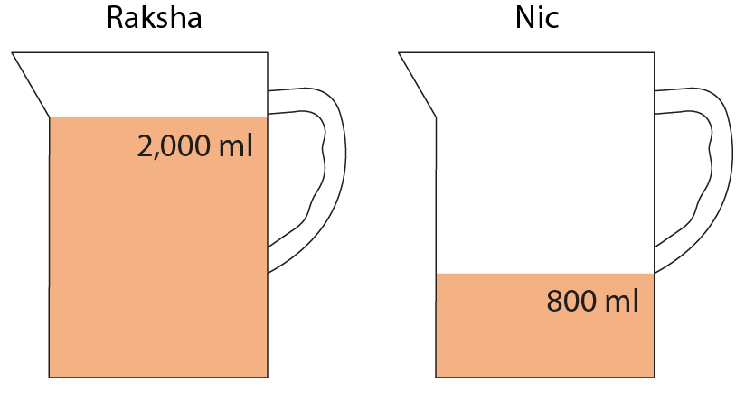
2.28 Combining operations: ÷, + and − Step 1:2
Raksha – 2,000 ml of water, poured into 5 glasses.
Nic – 800 ml of water, poured into 4 glasses.
Who has more water per glass, and by how much?
Notes:
Raksha has 2,000 ml of water, which she pours into five glasses.
Nic has 800 ml of water, which she pours into four glasses.
Who has more water per glass, and by how much?

Slide 37
Year 6, Unit 12, Learning Outcome 6
Learning Outcome 6
Pupils explain how the distributive law applies to division expressions with a common divisor (addition)
The following slides have been collated to support the teaching of this learning outcome.

Slide 38
Year 6, Unit 12, Learning Outcome 6
Additional teacher guidance for this outcome should be read first and can be found in this segment of the NCETM Primary Mastery Professional Development Materials:
2.28 Combining division with addition and subtraction
The spine materials are divided into ‘teaching points’ and ‘steps in learning’.
Teaching point | Steps in learning | Pages
2 | 2:1 – 2:2 | 8 - 12

Slide 39
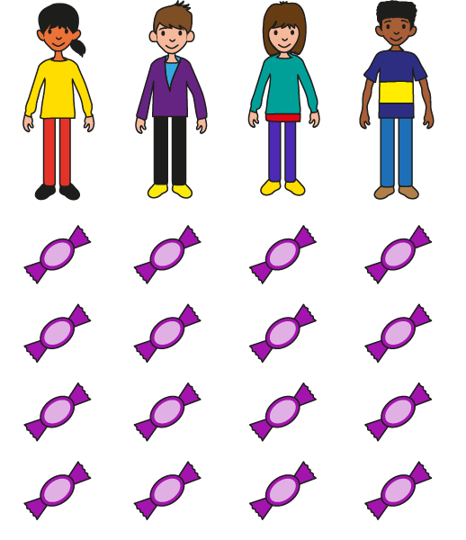
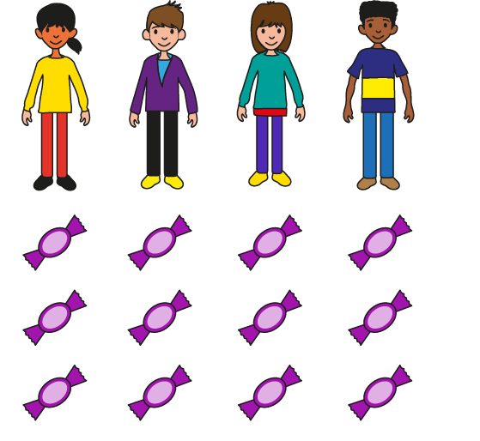
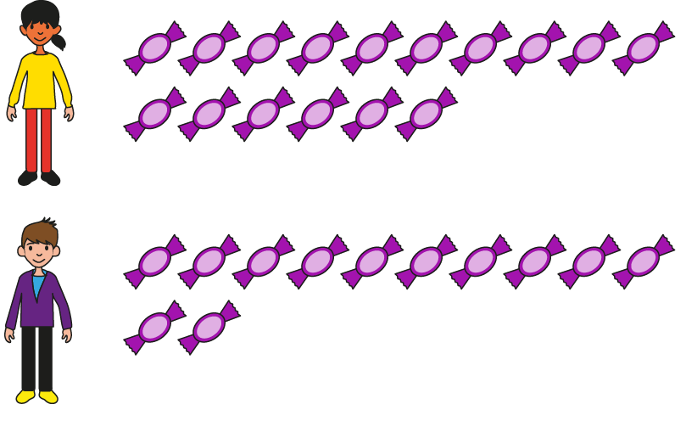
2.28 Combining operations: ÷, + and − Step 2:1
Ann – 16 sweets; Brett – 12 sweets. The sweets are shared between
themselves and two other friends. How many does each person get?
Method 1:
16 ÷ 4
12 ÷ 4
16 ÷ 4 + 12 ÷ 4
= 4 + 3
= 7
Notes:
Ann has sixteen sweets and Brett has twelve sweets.
They share the sweets between themselves and two other friends.
How many does each person get?

Slide 40
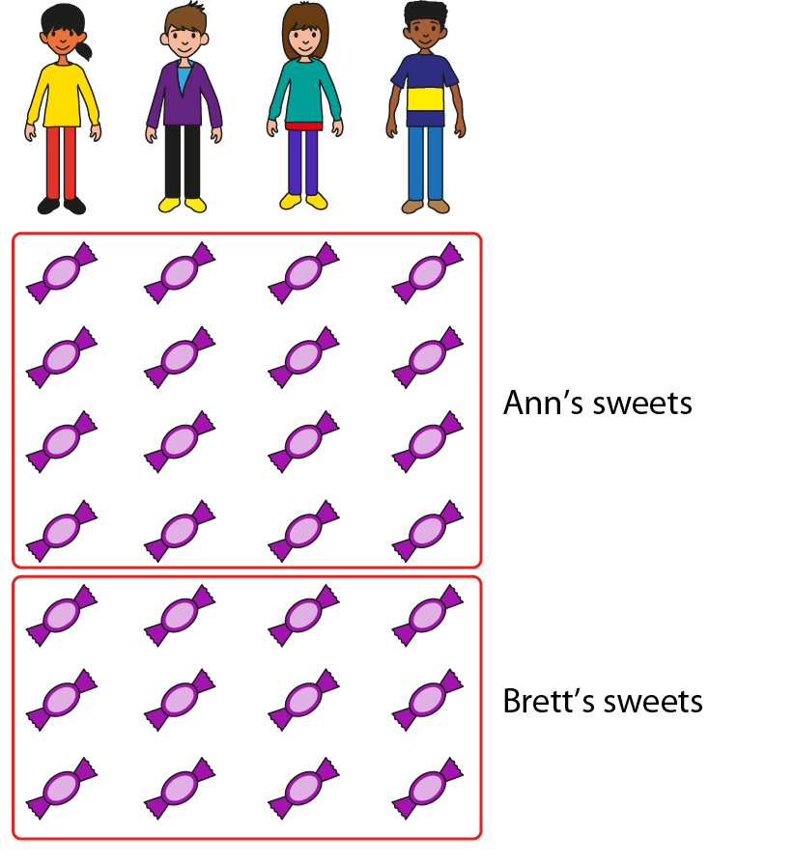
2.28 Combining operations: ÷, + and − Step 2:1
Ann – 16 sweets; Brett – 12 sweets. The sweets are shared between
themselves and two other friends. How many does each person get?
Method 2:
16 ÷ 4
+ 12 ÷ 4
= (16 + 12)
÷
4
= 28
÷
4
= 7
Notes:
Ann has sixteen sweets and Brett has twelve sweets.
They share the sweets between themselves and two other friends.
How many does each person get?

Slide 41
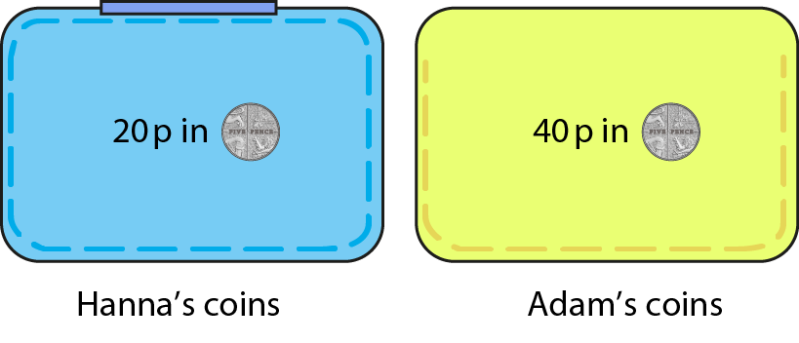
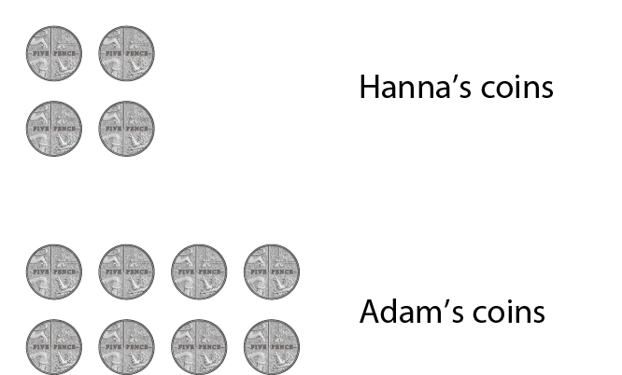
2.28 Combining operations: ÷, + and − Step 2:1
Hanna – 20 p in 5 p coins; Adam – 40 p in 5 p coins.
How many coins altogether?
Method 1:
Method 2:
20 ÷ 5 + 40 ÷ 5
20 ÷ 5 + 40 ÷ 5
= 4 + 8
= (20 + 40) ÷ 5
= 12
= 60 ÷ 5
= 12
Notes:
Hanna has 20 p in 5 p coins and Adam has 40 p in 5 p coins.
How many coins do they have altogether?

Slide 42
Year 6, Unit 12, Learning Outcome 7
Learning Outcome 7
Pupils explain how the distributive law applies to division expressions with a common divisor (subtraction)
The following slides have been collated to support the teaching of this learning outcome.

Slide 43
Year 6, Unit 12, Learning Outcome 7
Additional teacher guidance for this outcome should be read first and can be found in this segment of the NCETM Primary Mastery Professional Development Materials:
2.28 Combining division with addition and subtraction
The spine materials are divided into ‘teaching points’ and ‘steps in learning’.
Teaching point | Steps in learning | Pages
2 | 2:3 - 2:4 | 13-15

Slide 44


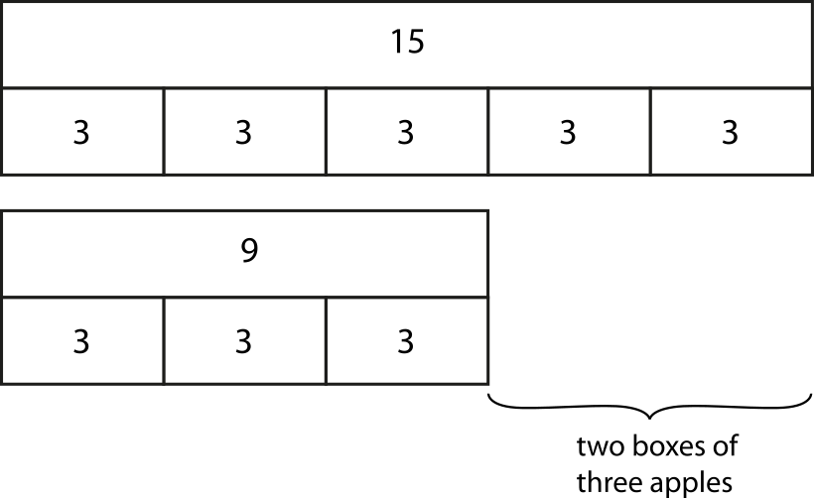

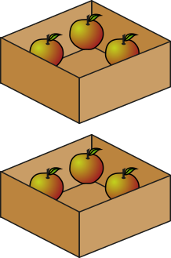


2.28 Combining operations: ÷, + and − Step 2:3
Kish – 15 apples in boxes of 3; Jess – 9 apples in boxes of 3.
Who has more boxes, and by how many?
15 ÷ 3 − 9 ÷ 3
= (15 − 9) ÷ 3
= 6 ÷ 3
= 2
Notes:
Kish puts fifteen apples into boxes of three.
Jess puts nine apples into boxes of three.
Who has more boxes, and by how many?

Slide 45
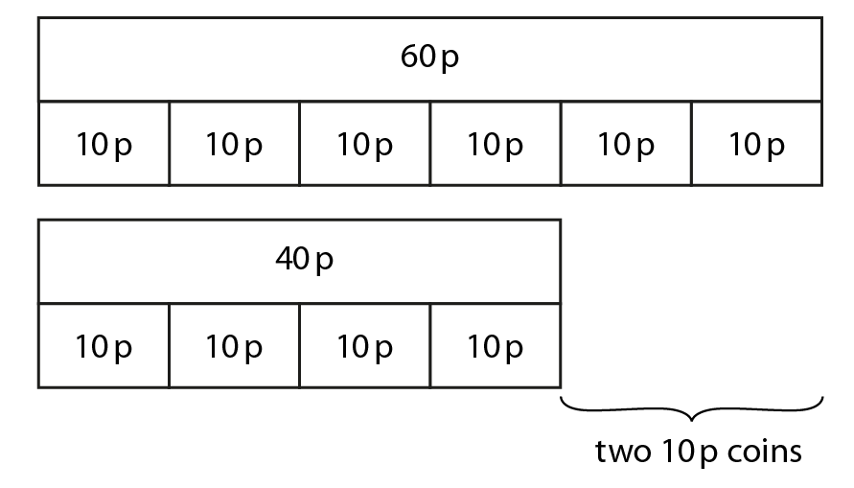
2.28 Combining operations: ÷, + and − Step 2:3
Mr H – 60 p in 10 p coins; Mr J – 40 p in 10 p coins.
Who has more coins, and by how many?
60 ÷ 10 − 40 ÷ 10
= (60 − 40) ÷ 10
= 20 ÷ 10
= 2
Notes:
Mr H has 60 p in 10 p coins. Mr J has 40 p in 10 p coins.
Who has more coins, and by how many?

Slide 46
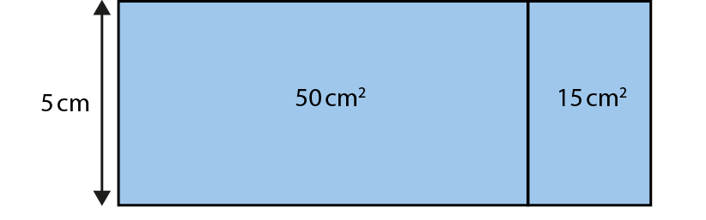
2.28 Combining operations: ÷, + and − Step 2:4
Notes:
A rectangular piece of paper has been cut into two smaller rectangles. One of the smaller pieces of paper has an area of 50 cm² and the other has an area of 15cm².
If the width is 5 cm, what was the length of the piece of paper before it was cut?

Slide 47
Year 6, Unit 12, Learning Outcome 8
Learning Outcome 8
Pupils use their knowledge of the distributive law to solve equations including division, addition and subtraction
The following slide supports the teaching of this learning outcome.

Slide 48
Year 6, Unit 12, Learning Outcome 8
Additional teacher guidance for this outcome should be read first and can be found in this segment of the NCETM Primary Mastery Professional Development Materials:
2.28 Combining division with addition and subtraction
The spine materials are divided into ‘teaching points’ and ‘steps in learning’.
Teaching point | Steps in learning | Pages
2 | 2:5 | 15

