Slide 1
1.26 Composition and calculation: multiples of 1,000 up to 1,000,000
Representations | Year 5
Number, Addition and Subtraction

Slide 2
How to use this presentation
You can find the teacher guide 1.26 Composition and calculation: multiples of 1,000 up to 1,000,000 by following the link below.

Slide 3
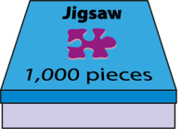
1.26 Multiples of 1,000 up to 1,000,000 – step 1:1
1,000
2,000
3,000
4,000
5,000
6,000
7,000
8,000
9,000
10,000
one thousand
two thousand
three thousand
four thousand
five thousand
six thousand
seven thousand
eight thousand
nine thousand
ten thousand

Slide 4

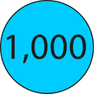
1.26 Multiples of 1,000 up to 1,000,000 – step 1:2

Slide 5
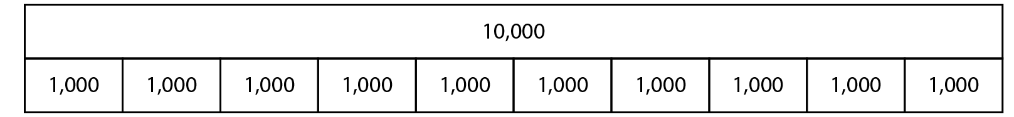
1.26 Multiples of 1,000 up to 1,000,000 – step 1:2

Slide 6

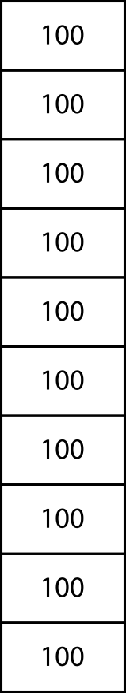
1.26 Multiples of 1,000 up to 1,000,000 – step 1:2

Slide 7
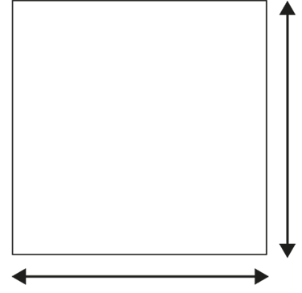
1.26 Multiples of 1,000 up to 1,000,000 – step 1:3
100 cm
1 m
100 cm
1 m
100 cm × 100 cm = 10,000 cm²
1 m × 1 m = 1 m²

Slide 8
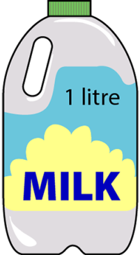
1.26 Multiples of 1,000 up to 1,000,000 – step 1:3
1 litre × 10 bottles
= 10 litres
= 10,000 ml

Slide 9
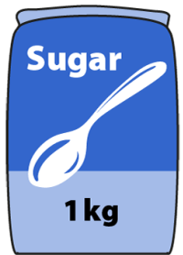
1.26 Multiples of 1,000 up to 1,000,000 – step 1:3
1 kg × 10 bags
= 10 kg
= 10,000 g

Slide 10
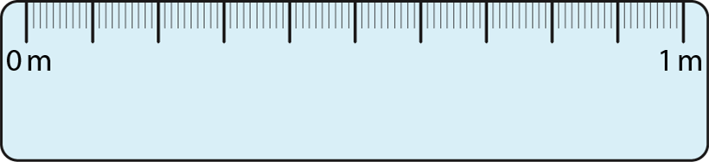
1.26 Multiples of 1,000 up to 1,000,000 – step 1:3
× 100
1 m × 100
= 100 m
= 10,000 cm

Slide 11
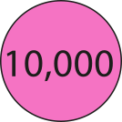
1.26 Multiples of 1,000 up to 1,000,000 – step 1:4

Slide 12
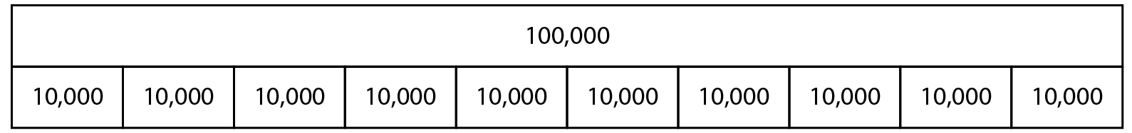
1.26 Multiples of 1,000 up to 1,000,000 – step 1:4

Slide 13

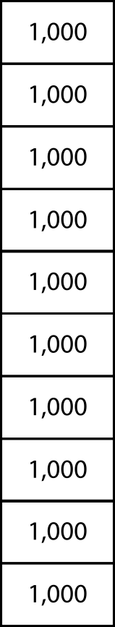
1.26 Multiples of 1,000 up to 1,000,000 – step 1:4

Slide 14
1.26 Multiples of 1,000 up to 1,000,000 – step 1:6
Millions |  |  | Thousands |  |  | Ones
100s | 10s | 1s | 100s | 10s | 1s | 100s | 10s | 1s
 |  |  |  |  |  |  |  | 1
 |  |  |  |  |  |  | 1 | 0
 |  |  |  |  |  | 1 | 0 | 0
 |  |  |  |  | 1 | 0 | 0 | 0
 |  |  |  | 1 | 0 | 0 | 0 | 0
 |  |  | 1 | 0 | 0 | 0 | 0 | 0
 |  | 1 | 0 | 0 | 0 | 0 | 0 | 0

Slide 15
1.26 Multiples of 1,000 up to 1,000,000 – step 1:6
 |  |  |  |  |  |  |  |  | 1 |  |  |  |  | one
 |  |  |  |  |  |  |  | 1 | 0 |  |  |  |  | ten
 |  |  |  |  |  |  | 1 | 0 | 0 |  |  |  |  | one hundred
 |  |  |  |  | 1 | , | 0 | 0 | 0 |  |  |  |  | one thousand
 |  |  |  | 1 | 0 | , | 0 | 0 | 0 |  |  |  |  | ten thousand
 |  |  | 1 | 0 | 0 | , | 0 | 0 | 0 |  |  |  |  | one hundred thousand
 | 1 | , | 0 | 0 | 0 | , | 0 | 0 | 0 |  |  |  |  | one million

Slide 16

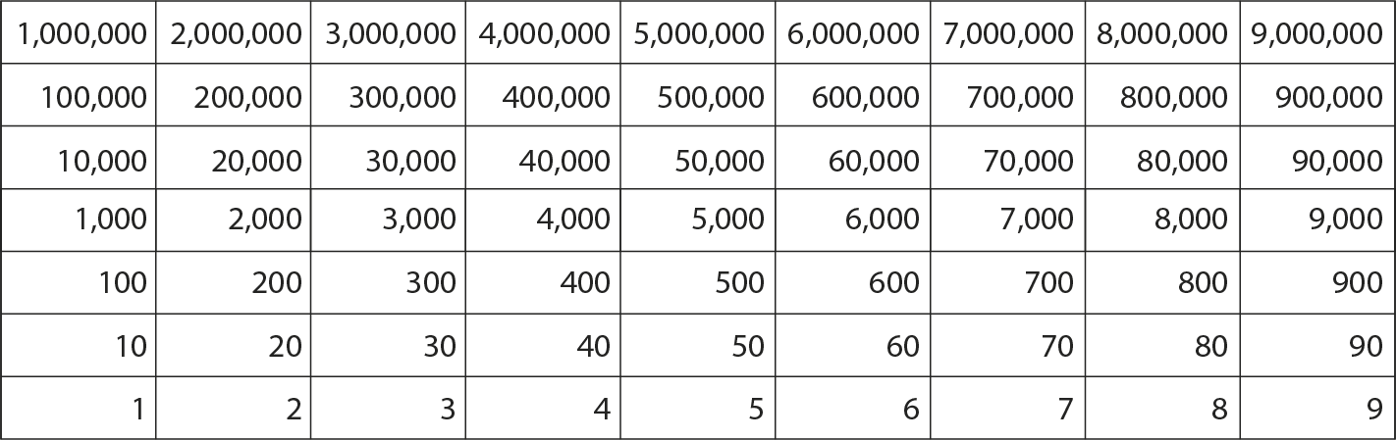



1.26 Multiples of 1,000 up to 1,000,000 – step 1:7

Slide 17


1.26 Multiples of 1,000 up to 1,000,000 – step 1:9
400 + 80 + 5 =
485

Slide 18


1.26 Multiples of 1,000 up to 1,000,000 – step 1:9
400,000 + 80,000 + 5,000 =
485,000

Slide 19
1.26 Multiples of 1,000 up to 1,000,000 – step 1:9
400
+
80
+
5
=
485
400 thousand
+
80 thousand
+
5 thousand
=
485 thousand
400,000
+
80,000
+
5,000
=
485,000

Slide 20
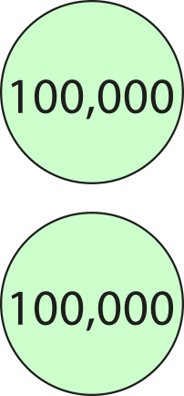
1.26 Multiples of 1,000 up to 1,000,000 – step 1:10
200,000

Slide 21
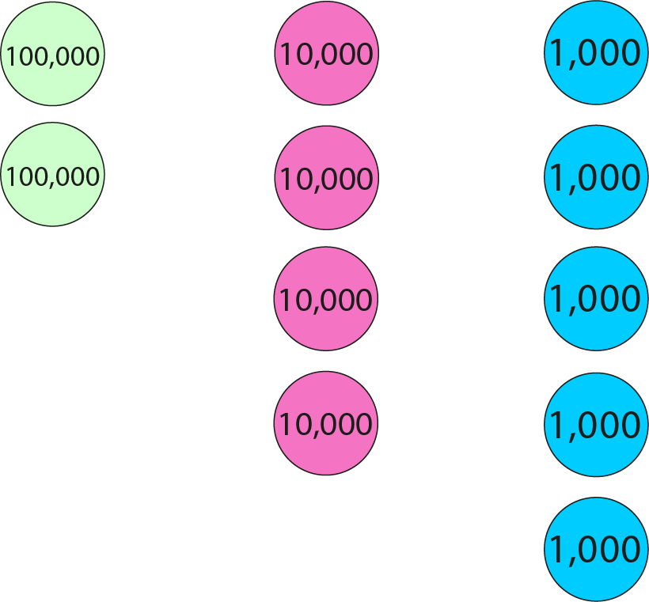
1.26 Multiples of 1,000 up to 1,000,000 – step 1:10
245,000

Slide 22
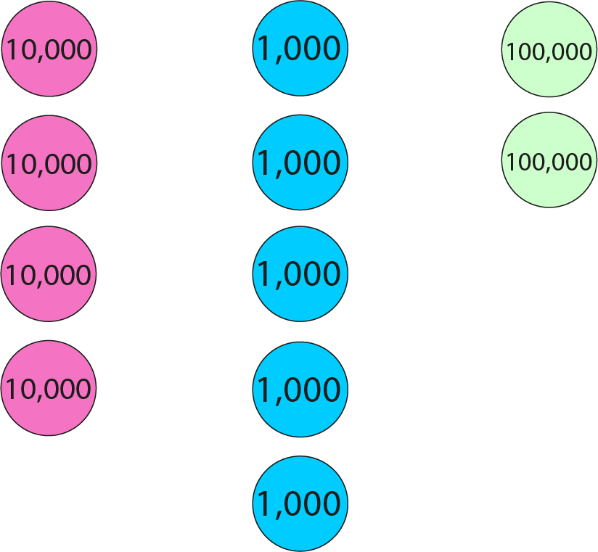
1.26 Multiples of 1,000 up to 1,000,000 – step 1:10
245,000

Slide 23
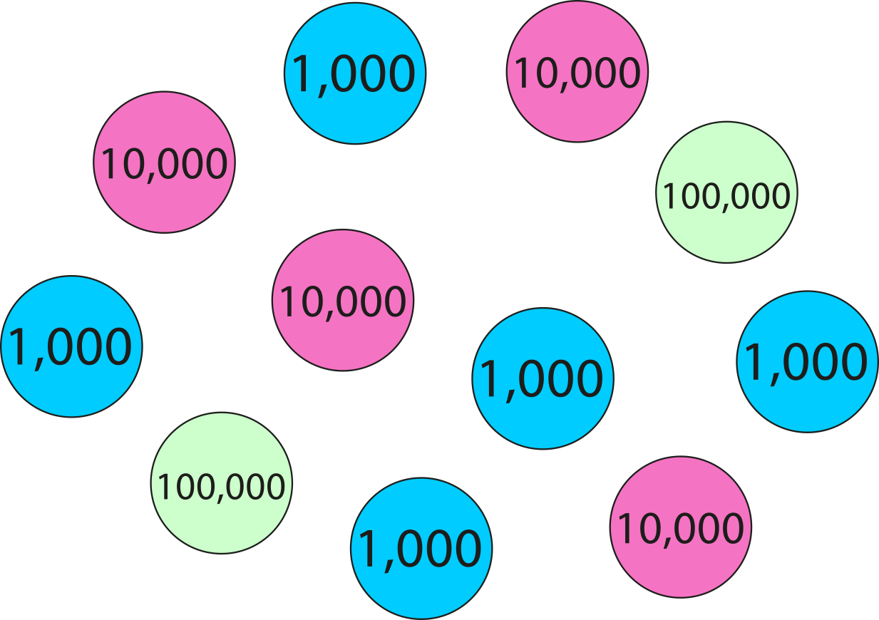
1.26 Multiples of 1,000 up to 1,000,000 – step 1:10
245,000

Slide 24
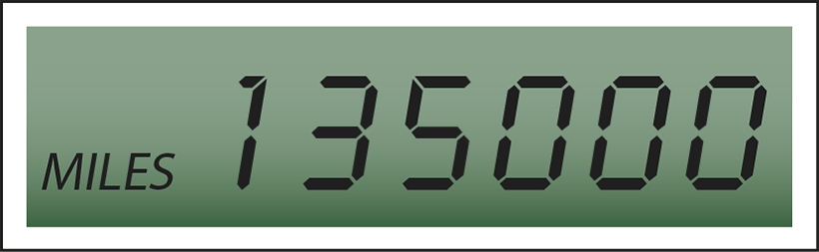
1.26 Multiples of 1,000 up to 1,000,000 – step 1:11
135 000

Slide 25
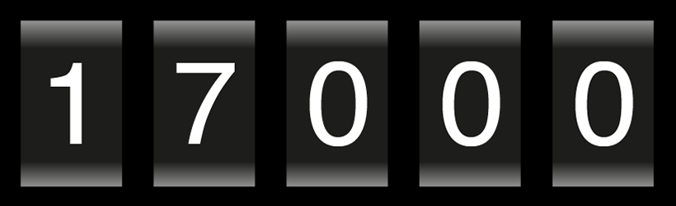
1.26 Multiples of 1,000 up to 1,000,000 – step 1:11
17 000

Slide 26
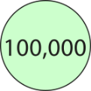
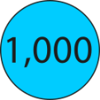

1.26 Multiples of 1,000 up to 1,000,000 – step 1:12
300,000
+
20,000
+
4,000
=
324,000

Slide 27




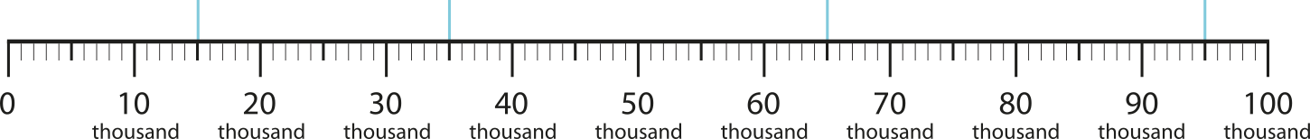
1.26 Multiples of 1,000 up to 1,000,000 – step 2:1
15
35
65
95
15
thousand
35
thousand
65
thousand
95
thousand
15,000
35,000
65,000
95,000

Slide 28






1.26 Multiples of 1,000 up to 1,000,000 – step 2:2
13,000
26,000
38,000
54,000
72,000
89,000

Slide 29
1.26 Multiples of 1,000 up to 1,000,000 – step 2:2
43,000
12,000
98,000
61,000

Slide 30
1.26 Multiples of 1,000 up to 1,000,000 – step 2:3
450
450 thousand
450,000

Slide 31



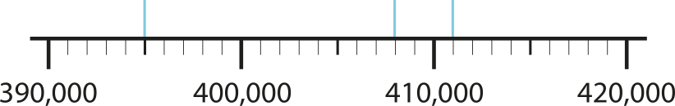
1.26 Multiples of 1,000 up to 1,000,000 – step 2:4
395,000
408,000
411,000

Slide 32
1.26 Multiples of 1,000 up to 1,000,000 – step 2:4
158,000
159,000
160,000
161,000
162,000

Slide 33
1.26 Multiples of 1,000 up to 1,000,000 – step 2:4
780,000
790,000
800,000
810,000
820,000
830,000

Slide 34
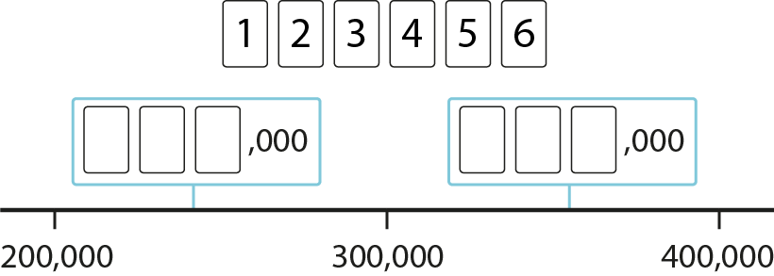






1.26 Multiples of 1,000 up to 1,000,000 – step 2:4
,000
,000
,000
,000
,000
,000
,000
,000
Notes:
‘Use the digit cards 1–6 to complete the missing values on the number line.’

Slide 35


1.26 Multiples of 1,000 up to 1,000,000 – step 2:5
28,000
20,000
30,000
40,000

Slide 36

1.26 Multiples of 1,000 up to 1,000,000 – step 2:5
320,000
0
100
thousand
200
thousand
300
thousand
400
thousand

Slide 37
1.26 Multiples of 1,000 up to 1,000,000 – step 3:1
Which is less, 54,000 or 58,000?
54
,000
(54 thousand)
58
,000
(58 thousand)
54 < 58
54,000 < 58,000

Slide 38
1.26 Multiples of 1,000 up to 1,000,000 – step 3:2
Which is greater, 820,000 or 690,000?
820
,000
(820 thousand)
690
,000
(690 thousand)
820 > 690
820,000 > 690,000

Slide 39
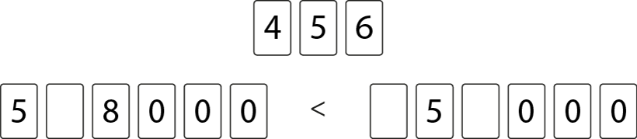





1.26 Multiples of 1,000 up to 1,000,000 – step 3:3
Notes:
‘How many ways can you arrange these digit cards so that the inequality is true?’

Slide 40
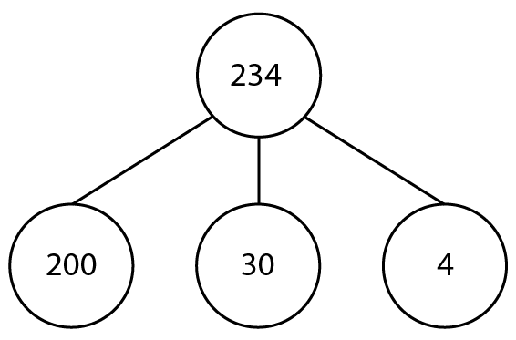
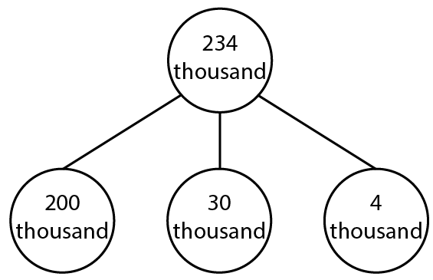
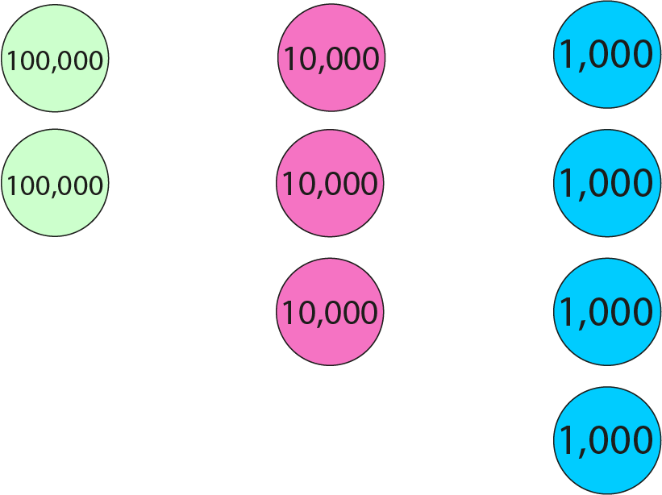
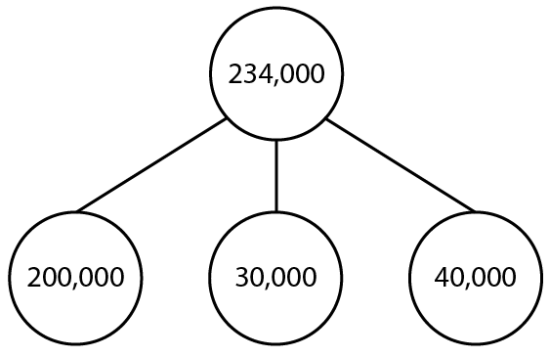
1.26 Multiples of 1,000 up to 1,000,000 – step 4:1
234
=
200
+
30
+
4
234
thousand
200
thousand
30
thousand
4
thousand
=
+
+
234,000
=
200,000
+
30,000
+
4,000

Slide 41
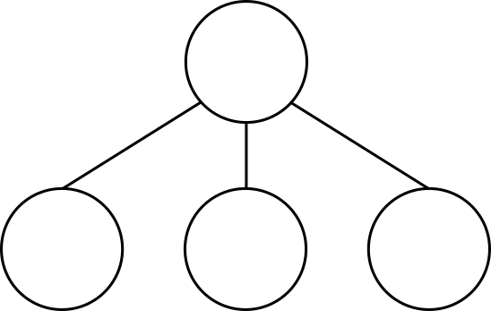
1.26 Multiples of 1,000 up to 1,000,000 – step 4:1
234,000
200,000
30,000
?
4,000

Slide 42
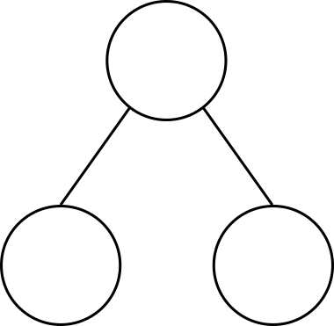
1.26 Multiples of 1,000 up to 1,000,000 – step 4:2
10,000
1,000
?
9,000

Slide 43
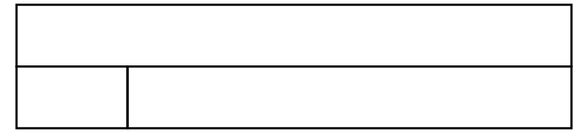
1.26 Multiples of 1,000 up to 1,000,000 – step 4:2
10,000
2,000
8,000
?

Slide 44
1.26 Multiples of 1,000 up to 1,000,000 – step 4:2
100,000
1,000
?
99,000

Slide 45
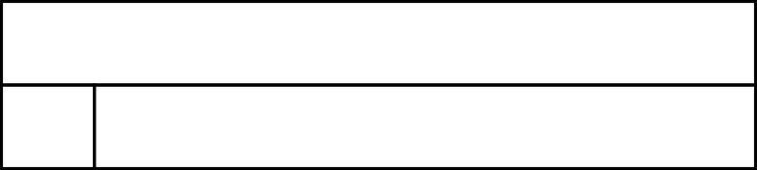
1.26 Multiples of 1,000 up to 1,000,000 – step 4:2
100,000
2,000
98,000
?

Slide 46

1.26 Multiples of 1,000 up to 1,000,000 – step 4:3
100,000
23,000
77,000
?
✗
✓
23,000
+
87,000
= 110,000
23,000
+
77,000
= 100,000
20,000
3,000
7,000
80,000
20,000
3,000
7,000
70,000
10,000
10,000

Slide 47
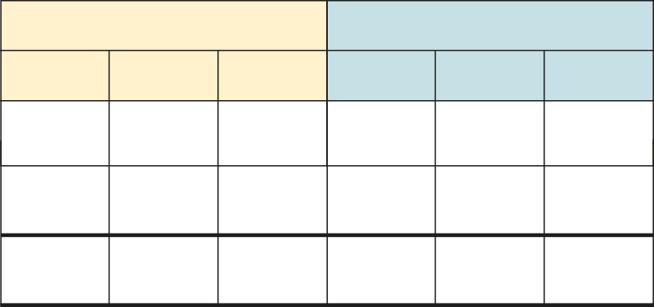
1.26 Multiples of 1,000 up to 1,000,000 – step 4:5
365,000 + 214,000
= 579,000
Thousands
Ones
100s
10s
1s
100s
10s
1s
3
3
6
6
5
5
,
0
0
0
0
0
0
+
2
2
1
1
4
4
,
0
0
0
0
0
0
5
5
7
7
9
9
,
0
0
0
0
0
0

Slide 48

1.26 Multiples of 1,000 up to 1,000,000 – step 4:6
437,000
168,000
269,000
?

Slide 49
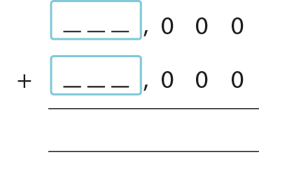
1.26 Multiples of 1,000 up to 1,000,000 – step 4:7

Slide 50
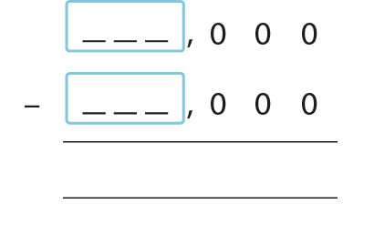
1.26 Multiples of 1,000 up to 1,000,000 – step 4:7

Slide 51
1.26 Multiples of 1,000 up to 1,000,000 – step 4:8
Name | Mid-2016 population
London | 8,770,000
Birmingham | 1,128,000
Leeds | 781,000
Glasgow | 615,000
Sheffield | 574,000
Manchester | 541,000
Edinburgh | 507,000
Liverpool | 488,000
Bristol | 456,000
Cardiff | 361,000
Leicester | 350,000
Nottingham | 325,000
Source: Office for National Statistics
Public sector information licensed under the
Open Government Licence v3.0
Notes:
Source: Office for National Statistics
Public sector information licensed under the Open Government Licence v3.0
http://www.nationalarchives.gov.uk/doc/open-government-licence/version/3/

Slide 52
1.26 Multiples of 1,000 up to 1,000,000 – step 4:8
Venue | Sport | Capacity
Olympic Stadium | Athletics | 80,000
Eton Dorney | Rowing, Canoe sprint | 30,000
Wimbledon | Tennis | 30,000
Greenwich Park | Equestrian, Modern pentathlon | 23,000
North Greenwich Arena | Basketball, Gymnastics | 20,000
Aquatics Centre | Diving, Swimming | 18,000
Riverbank Arena | Hockey | 16,000
Earls Court | Volleyball | 15,000
Horse Guards Parade | Beach volleyball | 15,000
Lee Valley White Water Centre | Canoe slalom | 12,000
Source: London 2012 Venues Guide
Public sector information licensed under the
Open Government Licence v3.0
Notes:
Source: London 2012 Venues Guide
Public sector information licensed under the Open Government Licence v3.0
http://www.nationalarchives.gov.uk/doc/open-government-licence/version/3/

Slide 53
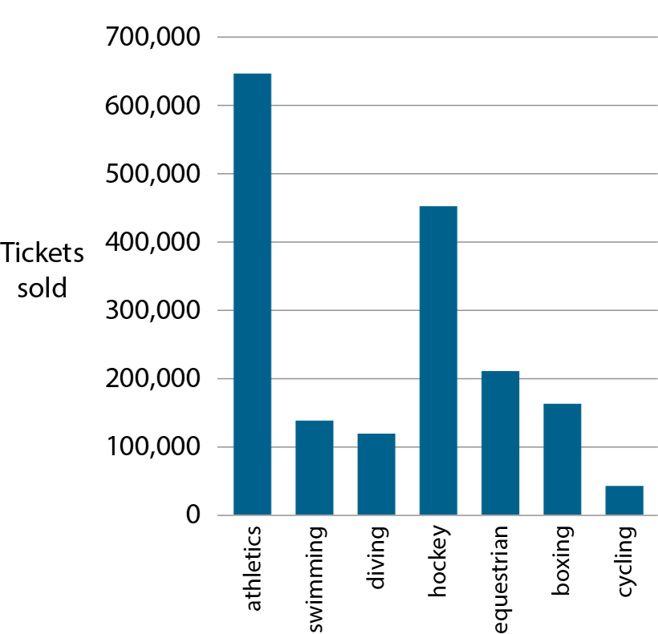
1.26 Multiples of 1,000 up to 1,000,000 – step 5:1
Source: London Datastore
Public sector information licensed under the
Open Government Licence v2.0
Notes:
Source: London Datastore
Public sector information licensed under the Open Government Licence v2.0
http://www.nationalarchives.gov.uk/doc/open-government-licence/version/2/

Slide 54
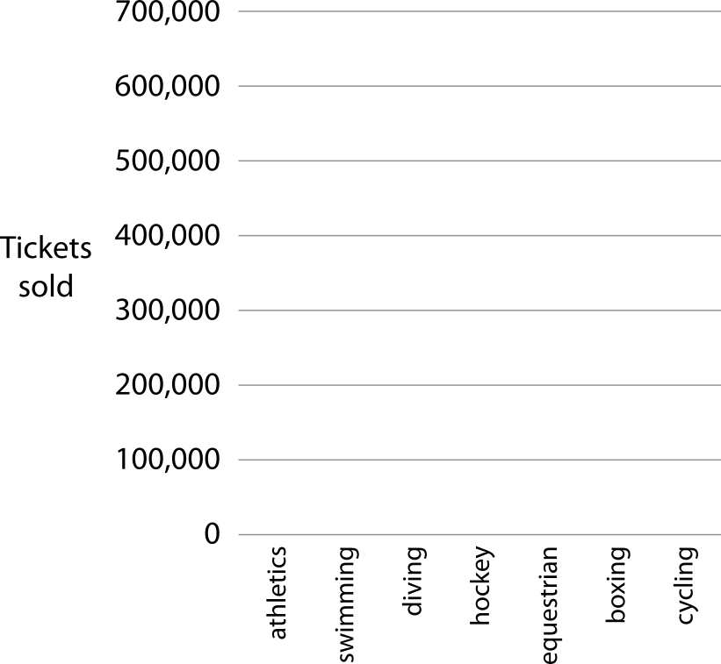
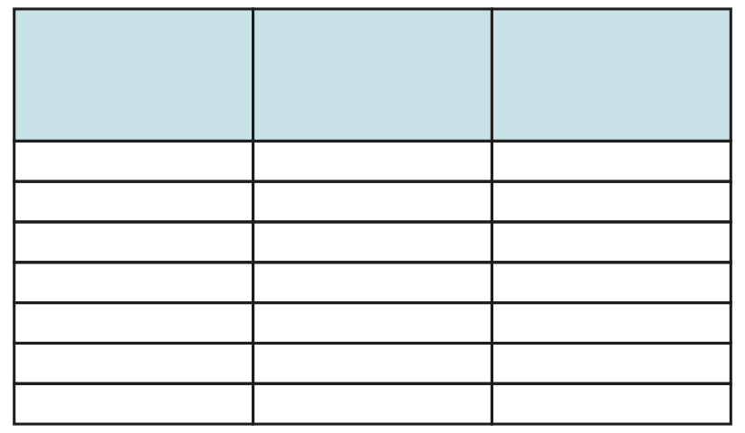
1.26 Multiples of 1,000 up to 1,000,000 – step 5:1
Previous multiple of 100,000
Sport
Next multiple of 100,000
600,000
Athletics
700,000
100,000
Swimming
200,000
100,000
Diving
200,000
400,000
Hockey
500,000
200,000
Equestrian
300,000
100,000
Boxing
200,000
0
Cycling
100,000
Source: London Datastore
Public sector information licensed under the
Open Government Licence v2.0
Notes:
Source: London Datastore
Public sector information licensed under the Open Government Licence v2.0
http://www.nationalarchives.gov.uk/doc/open-government-licence/version/2/

Slide 55
1.26 Multiples of 1,000 up to 1,000,000 – step 5:2
Previous multiple of 100,000
Sport
Next multiple of 100,000
600,000
Athletics
700,000
100,000
Swimming
200,000
100,000
Diving
200,000
400,000
Hockey
500,000
200,000
Equestrian
300,000
100,000
Boxing
200,000
0
Cycling
100,000
Source: London Datastore
Public sector information licensed under the
Open Government Licence v2.0
Notes:
Source: London Datastore
Public sector information licensed under the Open Government Licence v2.0
http://www.nationalarchives.gov.uk/doc/open-government-licence/version/2/

Slide 56
1.26 Multiples of 1,000 up to 1,000,000 – step 5:3
Sport | Ticket sales
Athletics | 645,000
Swimming | 141,000
Diving | 114,000
Hockey | 458,000
Equestrian | 205,000
Boxing | 163,000
Cycling | 44,000
previous
multiple of
100,000
next
multiple of
100,000
600,000
< 645,000 <
700,000
Source: London Datastore
Public sector information licensed under the
Open Government Licence v2.0
Notes:
Source: London Datastore
Public sector information licensed under the Open Government Licence v2.0
http://www.nationalarchives.gov.uk/doc/open-government-licence/version/2/

Slide 57
1.26 Multiples of 1,000 up to 1,000,000 – step 5:4
150,000
0
100,000
200,000
300,000

Slide 58
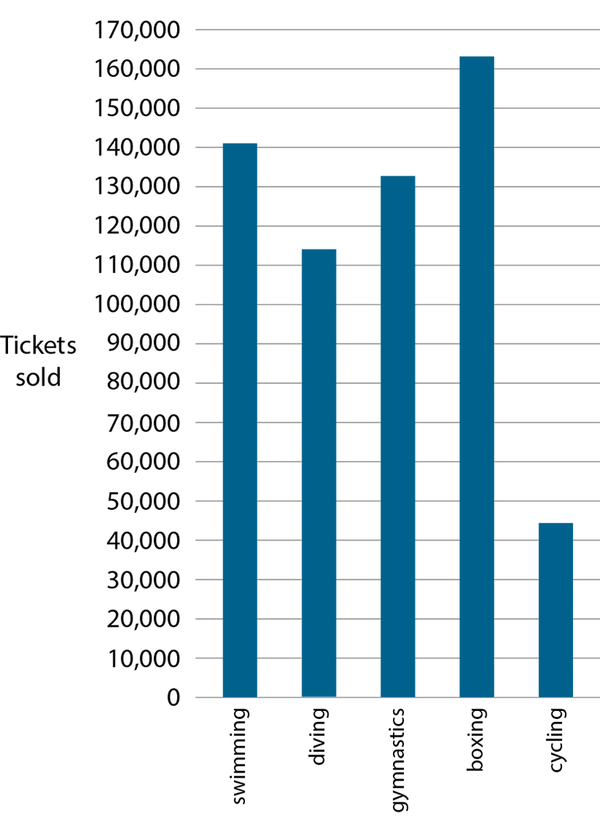
1.26 Multiples of 1,000 up to 1,000,000 – step 5:5
Source: London Datastore
Public sector information licensed under the
Open Government Licence v2.0
Notes:
Source: London Datastore
Public sector information licensed under the Open Government Licence v2.0
http://www.nationalarchives.gov.uk/doc/open-government-licence/version/2/

Slide 59
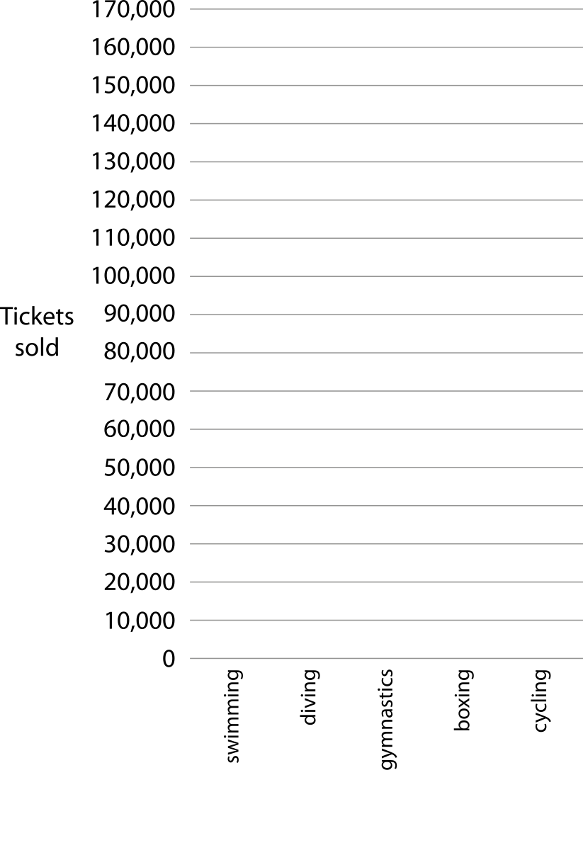
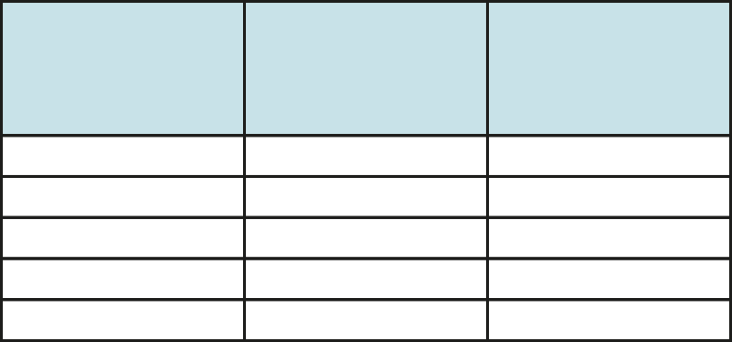
1.26 Multiples of 1,000 up to 1,000,000 – step 5:5
Previous multiple of 10,000
Sport
Next multiple of 10,000
140,000
Swimming
150,000
110,000
Diving
120,000
130,000
Gymnastics
140,000
160,000
Boxing
170,000
40,000
Cycling
50,000
Source: London Datastore
Public sector information licensed under the
Open Government Licence v2.0
Notes:
Source: London Datastore
Public sector information licensed under the Open Government Licence v2.0
http://www.nationalarchives.gov.uk/doc/open-government-licence/version/2/

Slide 60
1.26 Multiples of 1,000 up to 1,000,000 – step 5:5
Previous multiple of 10,000
Sport
Next multiple of 10,000
140,000
Swimming
150,000
110,000
Diving
120,000
130,000
Gymnastics
140,000
160,000
Boxing
170,000
40,000
Cycling
50,000
Source: London Datastore
Public sector information licensed under the
Open Government Licence v2.0
Notes:
Source: London Datastore
Public sector information licensed under the Open Government Licence v2.0
http://www.nationalarchives.gov.uk/doc/open-government-licence/version/2/

Slide 61
1.26 Multiples of 1,000 up to 1,000,000 – step 5:6
Sport | Ticket sales
Swimming | 141,000
Diving | 114,000
Gymnastics | 133,000
Boxing | 163,000
Cycling | 44,000
previous
multiple of
10,000
next
multiple of
10,000
140,000
< 141,000 <
150,000
Source: London Datastore
Public sector information licensed under the
Open Government Licence v2.0
Notes:
Source: London Datastore
Public sector information licensed under the Open Government Licence v2.0
http://www.nationalarchives.gov.uk/doc/open-government-licence/version/2/

Slide 62
1.26 Multiples of 1,000 up to 1,000,000 – step 5:7
133,000
3
3
130,000
(nearest 10,000)
100,000
(nearest 100,000)

Slide 63
1.26 Multiples of 1,000 up to 1,000,000 – step 5:7
633,000
4
0
640,000
(nearest 10,000)
600,000
(nearest 100,000)

Slide 64
1.26 Multiples of 1,000 up to 1,000,000 – step 5:8
 | Rounded to nearest 10,000 | Rounded to nearest 100,000
361,000
316,000
136,000
163,000
613,000
631,000
360,000
400,000
320,000
300,000
140,000
100,000
160,000
200,000
610,000
600,000
630,000
600,000

Slide 65

1.26 Multiples of 1,000 up to 1,000,000 – step 6:1
10,000
5,000
?
5,000
?

Slide 66

1.26 Multiples of 1,000 up to 1,000,000 – step 6:1
10,000
2,500
?
2,500
?
2,500
?
2,500
?

Slide 67
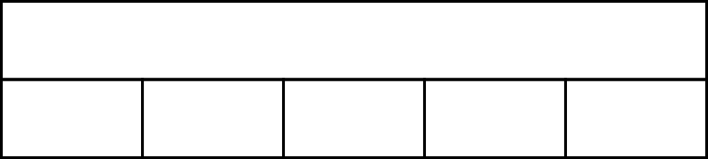
1.26 Multiples of 1,000 up to 1,000,000 – step 6:1
10,000
2,000
?
2,000
?
2,000
?
2,000
?
2,000
?

Slide 68
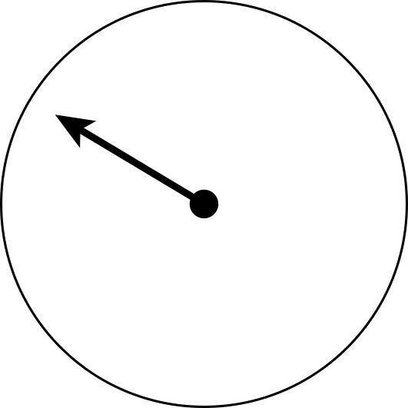
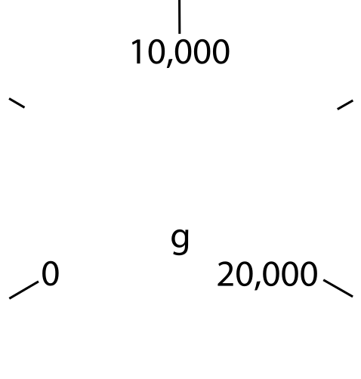
1.26 Multiples of 1,000 up to 1,000,000 – step 6:1
5,000 g

Slide 69
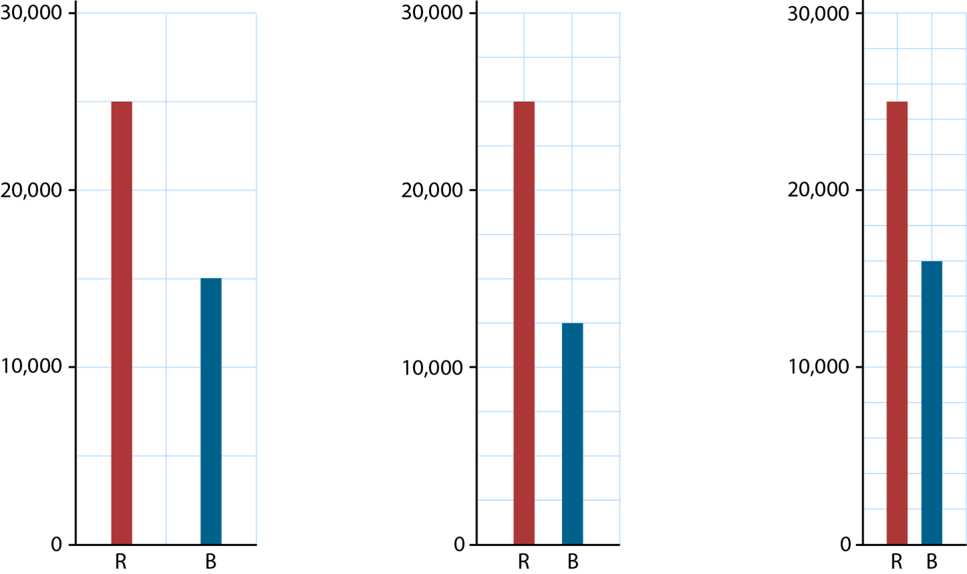
1.26 Multiples of 1,000 up to 1,000,000 – step 6:1

Slide 70
1.26 Multiples of 1,000 up to 1,000,000 – step 6:2
100,000
50,000
?
50,000
?

Slide 71
1.26 Multiples of 1,000 up to 1,000,000 – step 6:2
100,000
25,000
?
25,000
?
25,000
?
25,000
?

Slide 72
1.26 Multiples of 1,000 up to 1,000,000 – step 6:2
100,000
20,000
?
20,000
?
20,000
?
20,000
?
20,000
?

Slide 73
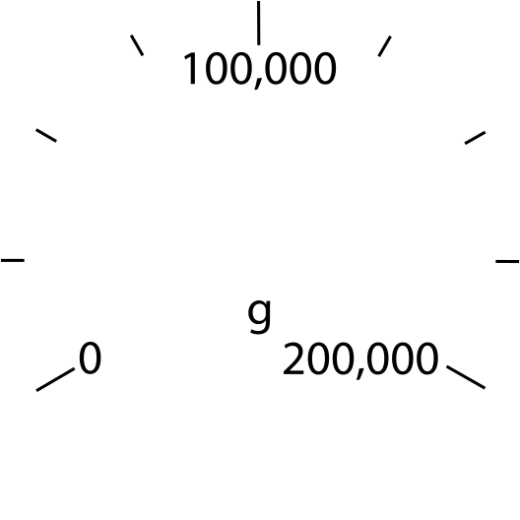
1.26 Multiples of 1,000 up to 1,000,000 – step 6:2
75,000 g

Slide 74
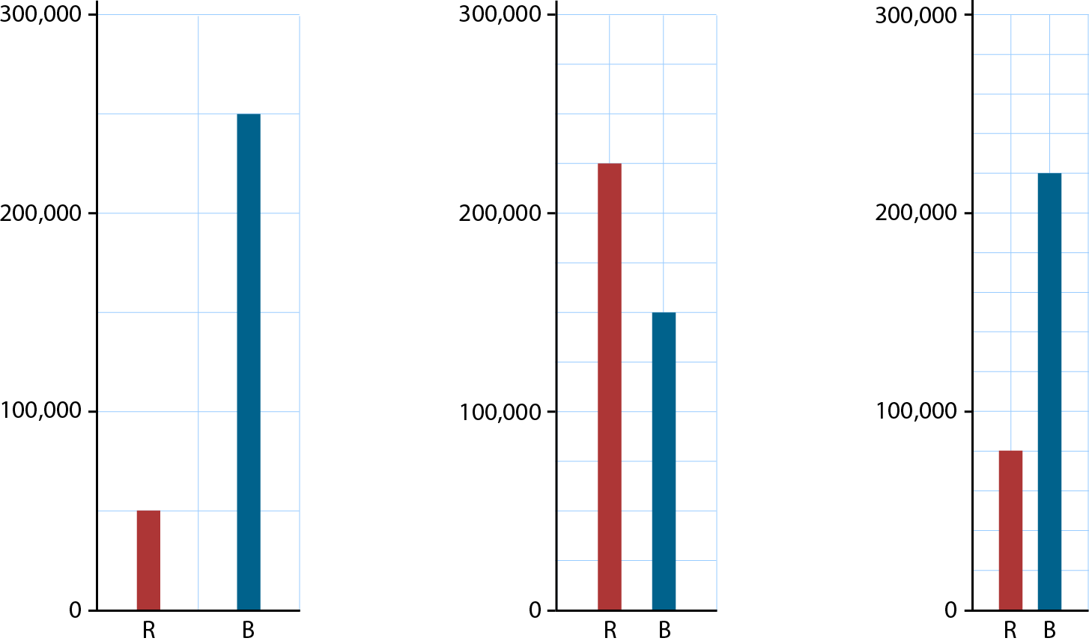
1.26 Multiples of 1,000 up to 1,000,000 – step 6:2

Slide 75
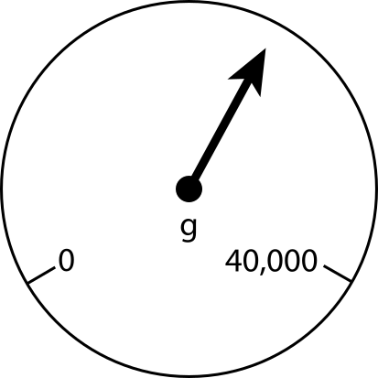
1.26 Multiples of 1,000 up to 1,000,000 – step 6:3

Slide 76
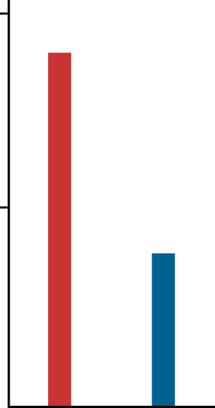
1.26 Multiples of 1,000 up to 1,000,000 – step 6:3
200,000
100,000
0
R
B

Slide 77

1.26 Multiples of 1,000 up to 1,000,000 – step 6:3
R
B

