Slide 1
Year 5, Unit 8
Fractions

Slide 2
Year 5, Unit 8
These materials heavily reflect the prioritisation approach of the ready-to-progress criteria in the DfE Primary Mathematics Guidance 2020 and on the PPTs that exemplify them on the NCETM website. They also include other relevant National Curriculum content. Related sections of the NCETM Primary Mastery Professional Development Materials provide small-step teaching guidance.
Ready-to-progress criteria addressed by this unit
Teaching of this unit supports the following criteria from the ‘DfE Mathematics Guidance: key stages 1 & 2’ (the 335-page document available as a download)
5NPV-5 Page 229
5F-1 Page 255
5F-2 Page 258
5F-3 Page 262
Prior learning
If the following ready-to-progress criteria, contained in the same DfE guidance document as above, were secured in Year 3, children will be ready to start on this unit.
3F-2 Page 124

Slide 3
Contents
The links below take you to the starting slide of each learning outcome.
1 | Pupils explain the relationship between repeated addition of a proper fraction and multiplication of fractions (unit fractions)
2 | Pupils explain the relationship between repeated addition of a proper fraction and multiplication of fractions (non-unit fractions)
3 | Pupils multiply a proper fraction by a whole number (within a whole)
4 | Pupils multiply a proper fraction by a whole number (greater than a whole)
5 | Pupils multiply an improper fraction by a whole number
Click the arrow button to return to this Contents slide.

Slide 4
Contents
The links below take you to the starting slide of each learning outcome.
6 | Pupils multiply a mixed number by a whole number (product is within a whole)
7 | Pupils multiply a mixed number by a whole number (product is greater than a whole)
8 | Pupils find a unit fraction of a quantity
9 | Pupils explain the relationship between finding a fraction of a quantity and multiplying a whole number by a unit fraction
10 | Pupils explain the relationship between dividing by a whole number and multiplying a whole number by a unit fraction
Click the arrow button to return to this Contents slide.

Slide 5
Contents
The links below take you to the starting slide of each learning outcome.
11 | Pupils use their knowledge of multiplying a whole number by a unit fraction to solve problems
12 | Pupils find a non-unit fraction of a quantity (mental calculation)
13 | Pupils find a non-unit fraction of a quantity (written calculation)
14 | Pupils multiply a whole number by a proper fraction
15 | Pupils explain when a calculation represents scaling down and when it represents repeated addition
Click the arrow button to return to this Contents slide.

Slide 6
Contents
The links below take you to the starting slide of each learning outcome.
16 | Pupils find the whole when the size of a unit fraction is known
17 | Pupils find a unit fraction when the size of a non-unit fraction is known
18 | Pupils find the whole when the size of a non-unit fraction is known
19 | Pupils find the unit fraction when the size of a non-unit fraction is known
20 | Pupils use representations to describe and compare two fractions (1/4 and 3/12)
Click the arrow button to return to this Contents slide.

Slide 7
Contents
The links below take you to the starting slide of each learning outcome.
21 | Pupils use representations to describe and compare two fractions (1/5 and 5/10)
22 | Pupils use representations to describe and compare two fractions (pouring context)
23 | Pupils correctly use the language of equivalent fractions
24 | Pupils explain the vertical relationship between numerators and denominators within equivalent fractions (1/5, 1/3 and equivalent)
25 | Pupils use their knowledge of the vertical relationship to solve equivalent fractions problems
Click the arrow button to return to this Contents slide.

Slide 8
Contents
The links below take you to the starting slide of each learning outcome.
26 | Pupils explain the horizontal relationship between numerators and denominators across equivalent fractions (1/5, 1/3 and equivalent)
27 | Pupils explain the relationship within families of equivalent fractions
28 | Pupils use their knowledge of equivalent fractions to solve problems
29 | Pupils explain and represent how to divide 1 into different amounts of equal parts
30 | Pupils identify and describe patterns within the number system
Click the arrow button to return to this Contents slide.

Slide 9
Contents
The links below take you to the starting slide of each learning outcome.
31 | Pupils use their knowledge of common equivalents to compare fractions with decimals
32 | Pupils practise recalling common fraction-decimal equivalents
33 | Pupils use their knowledge of common fraction-decimal equivalents to solve conversion problems in a range of contexts
34 | Pupils use their knowledge of common equivalents to compare fractions with decimals beyond one
35 | Pupils use their knowledge of simplifying calculations by substitution to solve problems in a range of contexts
Click the arrow button to return to this Contents slide.

Slide 10
Year 5, Unit 8, Learning Outcome 1
Learning Outcome 1
Pupils explain the relationship between repeated addition of a proper fraction and multiplication of fractions (unit fractions)
The following slides have been collated to support the teaching of this learning outcome.

Slide 11
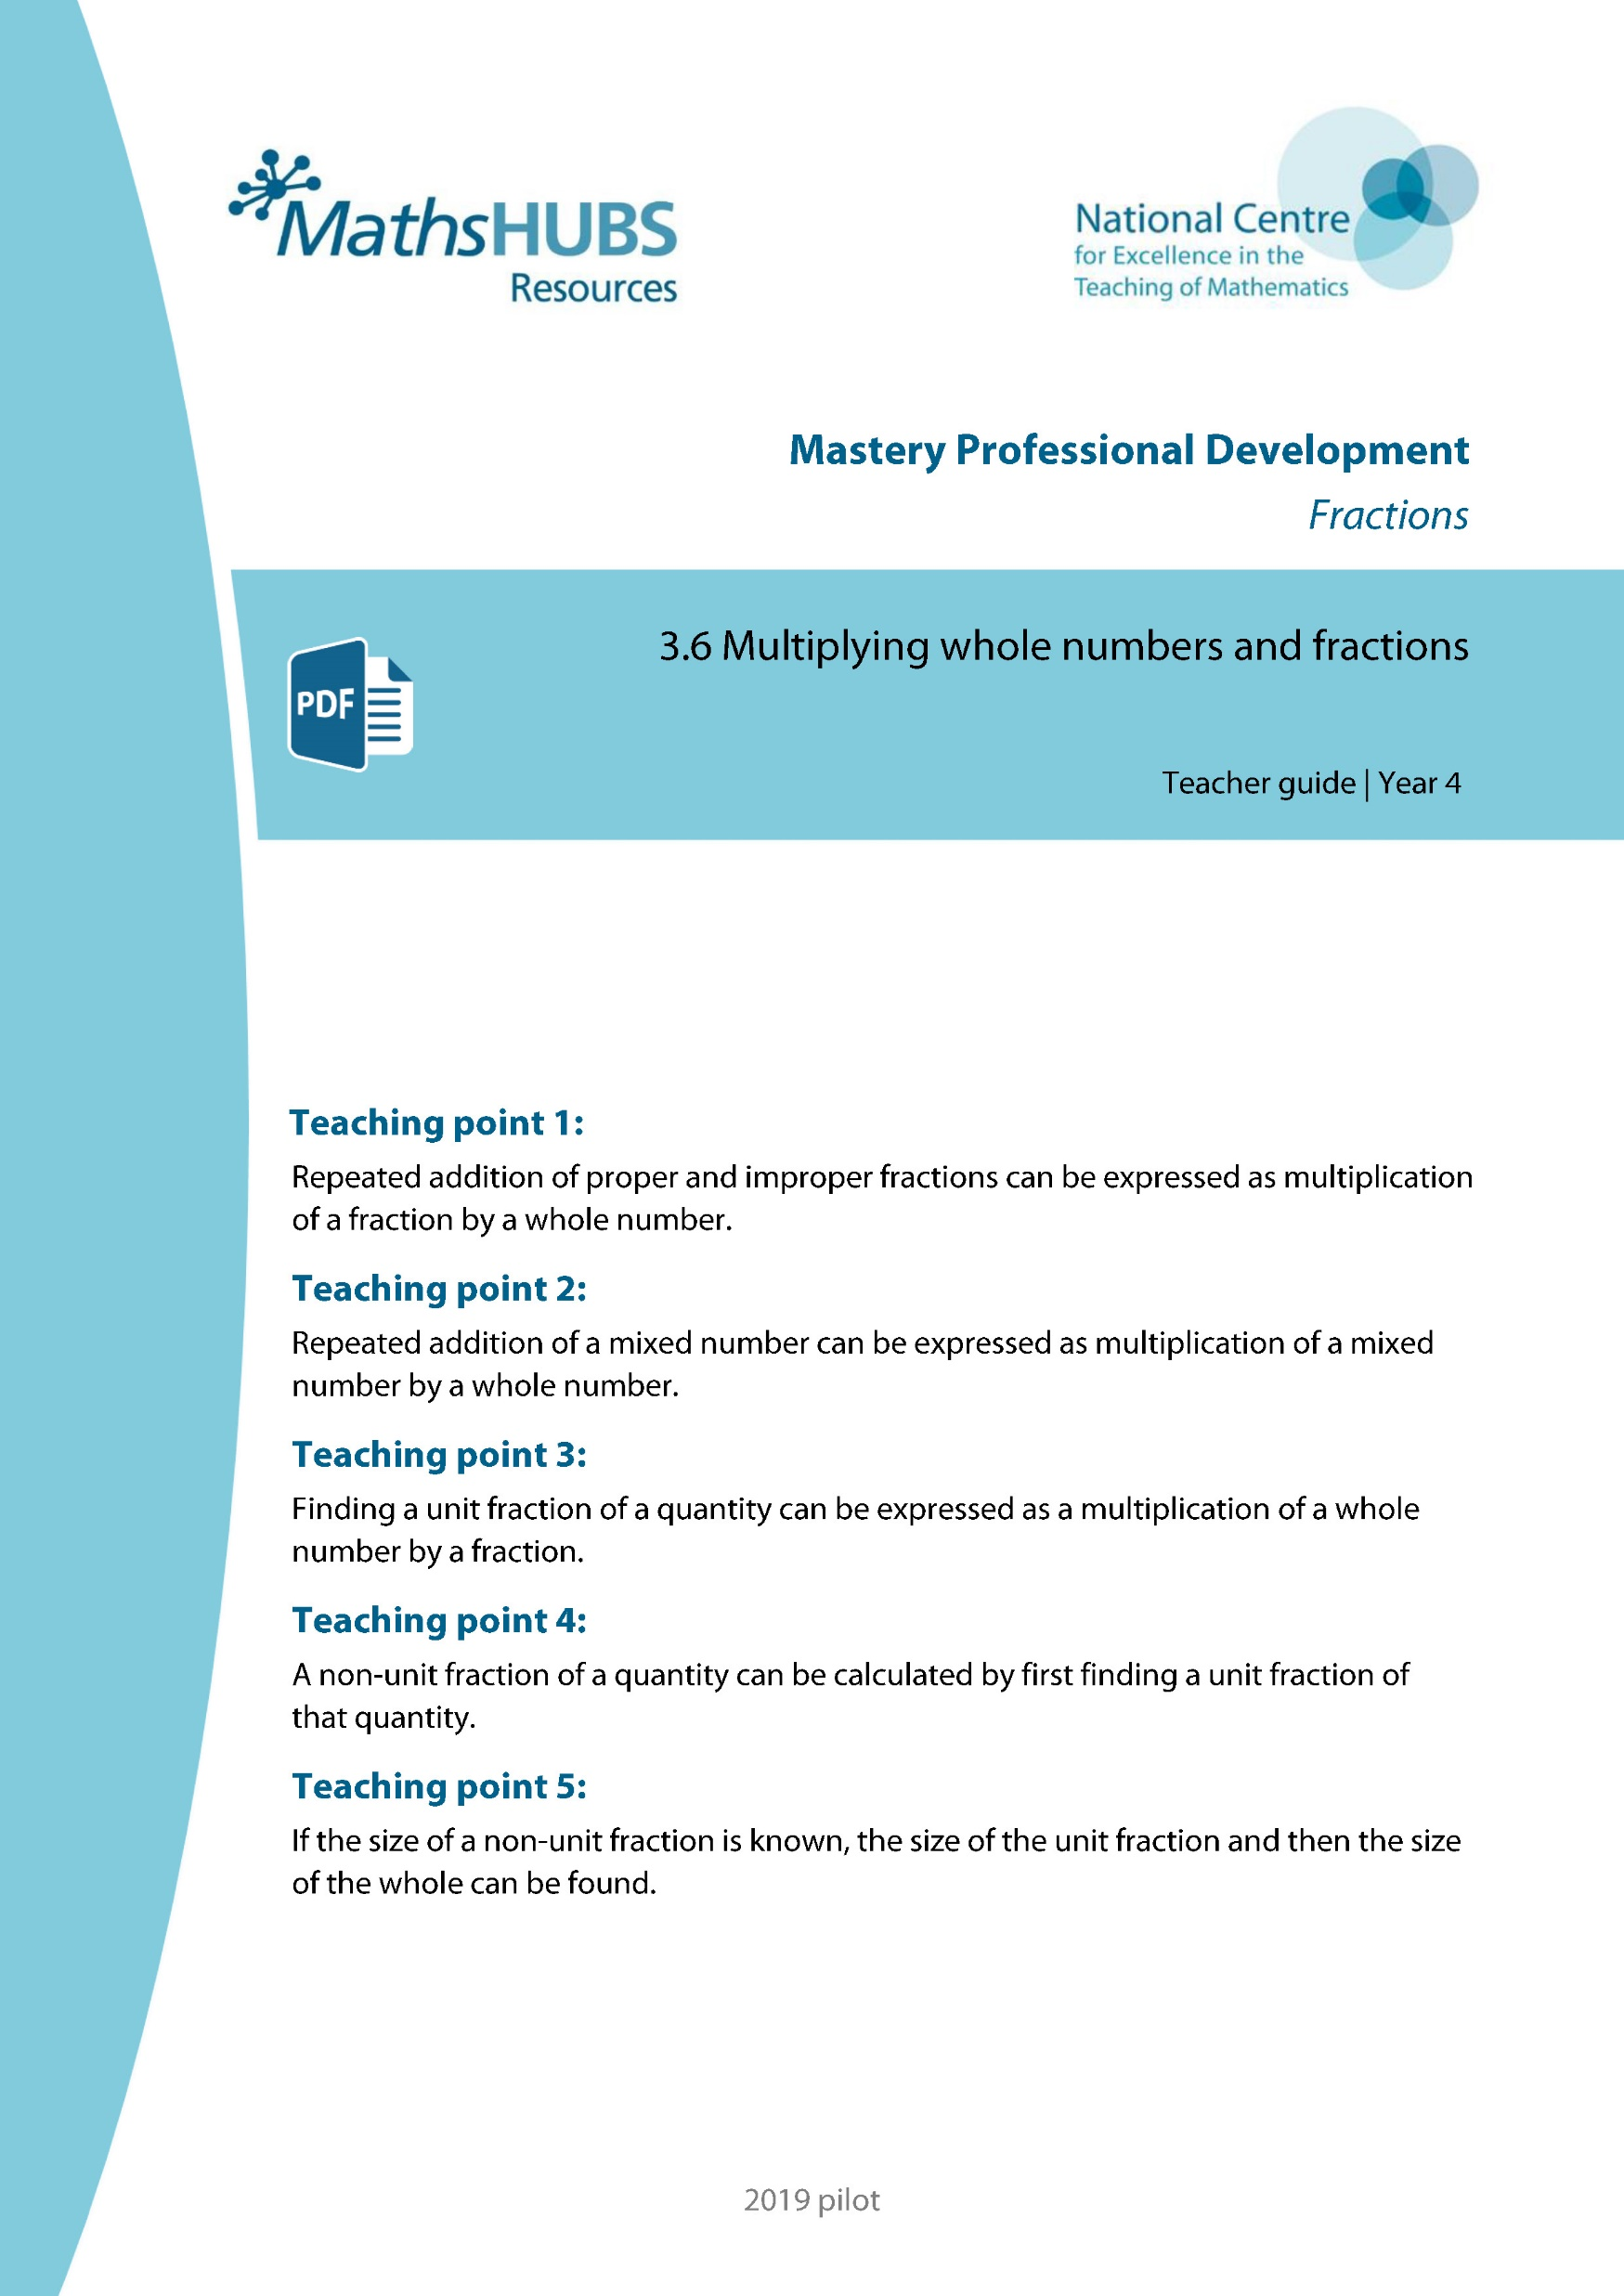
Year 5, Unit 8, Learning Outcome 1
Additional teacher guidance for this outcome should be read first and can be found in this segment of the NCETM Primary Mastery Professional Development Materials:
3.6 Multiplying whole numbers and fractions
The spine materials are divided into ‘teaching points’ and ‘steps in learning’.
Teaching point | Steps in learning | Pages
1 | 1:1-1:4 | 4-6

Slide 12
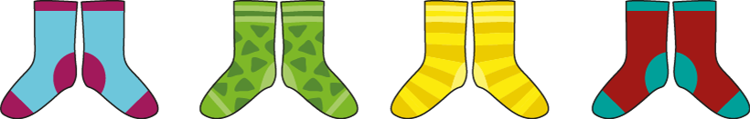
3.6 Multiplying whole numbers and fractions
Step 1:1
Notes:
Write addition and multiplication expressions to represent this image.
What does each number represent? (The ‘4’ represents the number of groups, and the ‘2’ represents the size of each group.)

Slide 13


3.6 Multiplying whole numbers and fractions
Step 1:2
Notes:
Write addition and multiplication expressions to represent this image.
What does each number represent? (The ‘$\frac{1}{8}$’ represents the size of each part – an eighth of an orange. The ‘4’ represents the number of parts.)

Slide 14
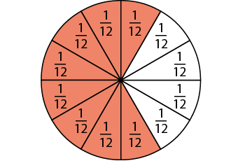
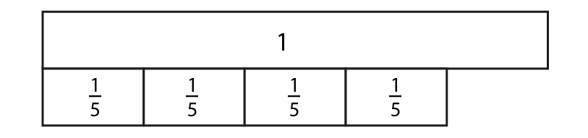
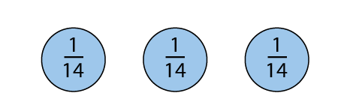
3.6 Multiplying whole numbers and fractions
Step 1:3
Notes:
Use these images to practise writing addition and multiplication expressions.

Slide 15
Year 5, Unit 8, Learning Outcome 2
Learning Outcome 2
Pupils explain the relationship between repeated addition of a proper fraction and multiplication of fractions (non-unit fractions)
The following slides have been collated to support the teaching of this learning outcome.

Slide 16
Year 5, Unit 8, Learning Outcome 2
Additional teacher guidance for this outcome should be read first and can be found in this segment of the NCETM Primary Mastery Professional Development Materials:
3.6 Multiplying whole numbers and fractions
The spine materials are divided into ‘teaching points’ and ‘steps in learning’.
Teaching point | Steps in learning | Pages
1 | 1:5-1:7 | 6-8

Slide 17
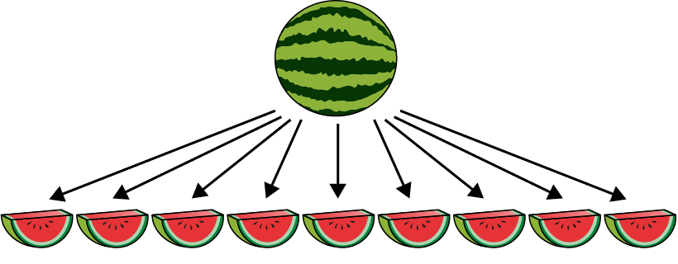

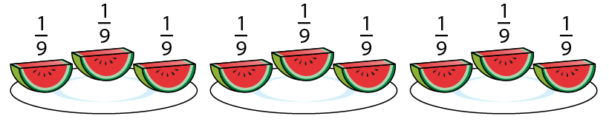
3.6 Multiplying whole numbers and fractions
Step 1:5
Notes:
The whole has been divided into nine equal parts, and one of these parts is $\frac{1}{9}$ .
The slices are arranged into three groups.
What fraction of the whole does each group represent?
Write addition and multiplication expressions to match the image.

Slide 18
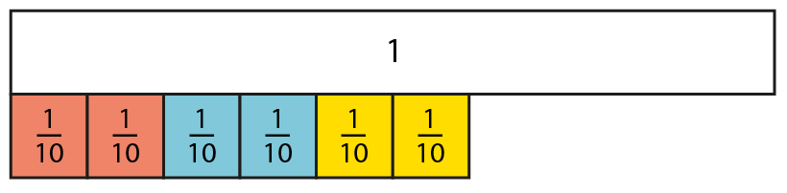
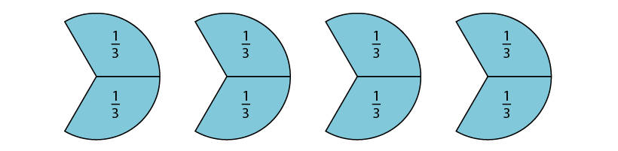


3.6 Multiplying whole numbers and fractions
Step 1:6

Slide 19
Year 5, Unit 8, Learning Outcome 3
Learning Outcome 3
Pupils multiply a proper fraction by a whole number (within a whole)
The following slides have been collated to support the teaching of this learning outcome.

Slide 20
Year 5, Unit 8, Learning Outcome 3
Additional teacher guidance for this outcome should be read first and can be found in this segment of the NCETM Primary Mastery Professional Development Materials:
3.6 Multiplying whole numbers and fractions
The spine materials are divided into ‘teaching points’ and ‘steps in learning’.
Teaching point | Steps in learning | Pages
1 | 1:8-1:13 | 8-12

Slide 21







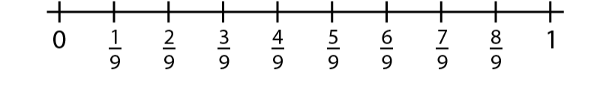
3.6 Multiplying whole numberand
3.6 Multiplying whole numbers and fractions
Steps1:8-1:9
Notes:
Think about how many ninths there are in four lots of $\frac{2}{9}$.
How many ninths is this in total?
Count: ‘Two-ninths, four-ninths, six-ninths, eight-ninths.’
Four lots of $\frac{2}{9}$ is equal to $\frac{8}{9}$.

Slide 22

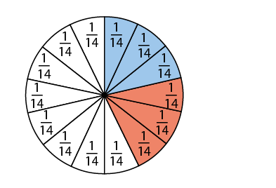
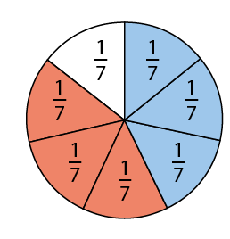
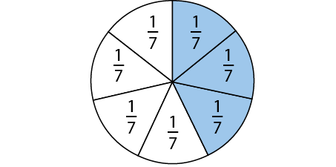
3.6 Multiplying whole numbers and fractions
Step 1:10
✓
✓
Notes:
Imagine: what would it look like if $\frac{3}{7}$ was multiplied by 2?

Slide 23

3.6 Multiplying whole numbers and fractions
Step 1:11

Slide 24
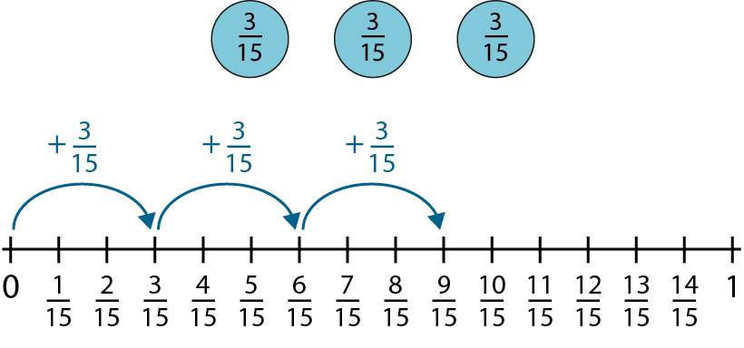


3.6 Multiplying whole numbers and fractions
Step 1:12
Notes:
Three lots of $\frac{3}{15}$ is equal to$\frac{9}{15}$.

Slide 25
Year 5, Unit 8, Learning Outcome 4
Learning Outcome 4
Pupils multiply a proper fraction by a whole number (greater than a whole)
The following slides have been collated to support the teaching of this learning outcome.

Slide 26
Year 5, Unit 8, Learning Outcome 4
Additional teacher guidance for this outcome should be read first and can be found in this segment of the NCETM Primary Mastery Professional Development Materials:
3.6 Multiplying whole numbers and fractions
The spine materials are divided into ‘teaching points’ and ‘steps in learning’.
Teaching point | Steps in learning | Pages
1 | 1:14-1:16 | 12-15

Slide 27
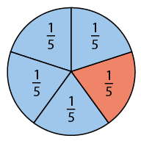
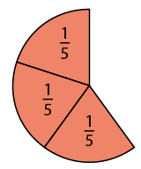
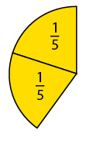
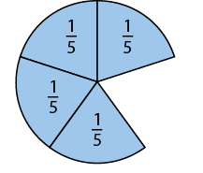
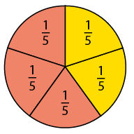

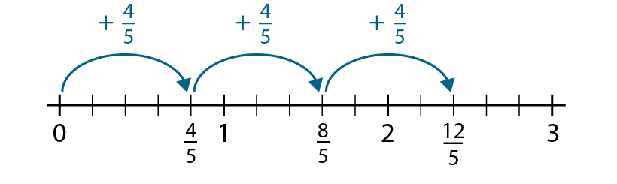


3.6 Multiplying whole numbers and fractions
Step 1:14

Slide 28


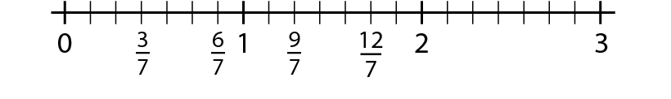

3.6 Multiplying whole numbers and fractions
Step 1:15

Slide 29
Year 5, Unit 8, Learning Outcome 5
Learning Outcome 5
Pupils multiply an improper fraction by a whole number
The following slides have been collated to support the teaching of this learning outcome.

Slide 30
Year 5, Unit 8, Learning Outcome 5
Additional teacher guidance for this outcome should be read first and can be found in this segment of the NCETM Primary Mastery Professional Development Materials:
3.6 Multiplying whole numbers and fractions
The spine materials are divided into ‘teaching points’ and ‘steps in learning’.
Teaching point | Steps in learning | Pages
1 | 1:17-1:18 | 15-16

Slide 31


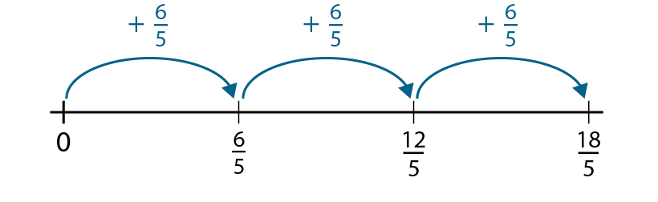

3.6 Multiplying whole numbers and fractions
Step 1:17

Slide 32
Year 5, Unit 8, Learning Outcome 6
Learning Outcome 6
Pupils multiply a mixed number by a whole number (product is within a whole)
The following slides have been collated to support the teaching of this learning outcome.

Slide 33
Year 5, Unit 8, Learning Outcome 6
Additional teacher guidance for this outcome should be read first and can be found in this segment of the NCETM Primary Mastery Professional Development Materials:
3.6 Multiplying whole numbers and fractions
The spine materials are divided into ‘teaching points’ and ‘steps in learning’.
Teaching point | Steps in learning | Pages
2 | 2:1-2:4 | 17-20

Slide 34
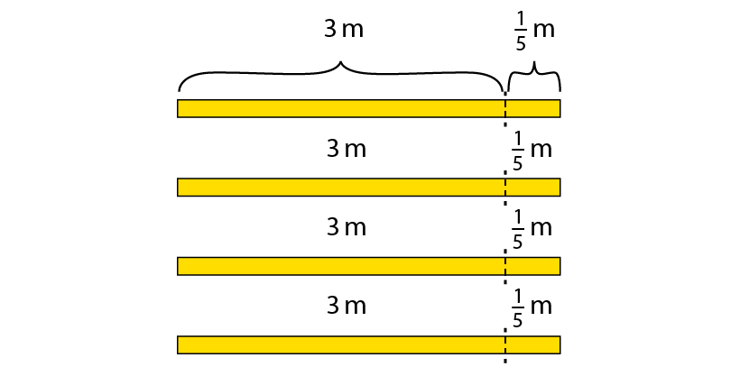
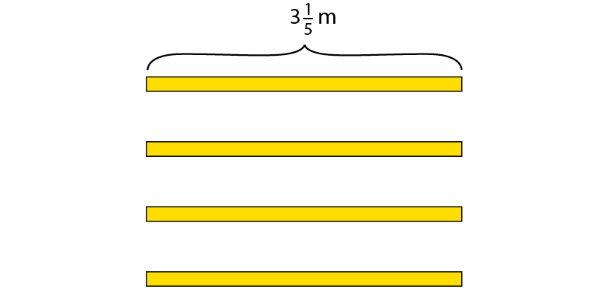
3.6 Multiplying whole numbers and fractions
Step 2:1
Notes:
To decorate a wedding cake, a baker needs 3 $\frac{1}{5}$ m of ribbon. The baker needs to make 4 wedding cakes. How much ribbon does the baker need?
How many 3 m lengths of ribbon are there?
How many $\frac{1}{5}$ m lengths?
What calculation can we do to find the total length?’

Slide 35
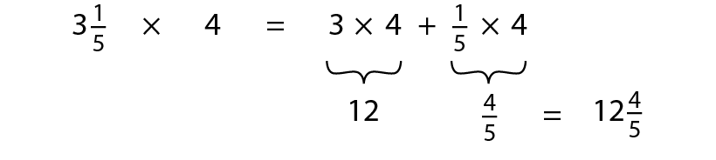
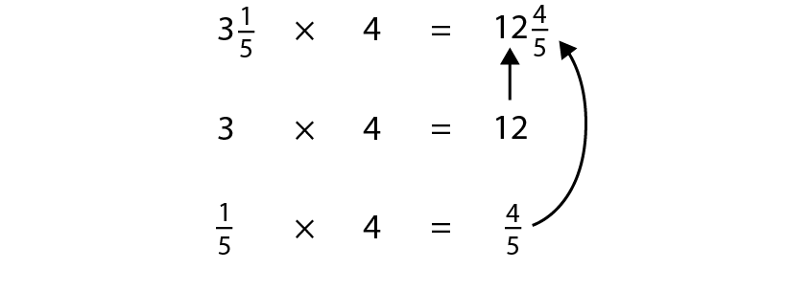

3.6 Multiplying whole numbers and fractions
Step 2:2
Notes:
What is the same?
What is different?

Slide 36
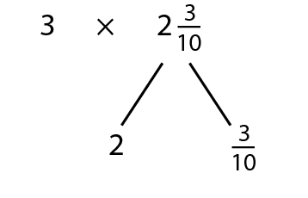
3.6 Multiplying whole numbers and fractions
Step 2:3

Slide 37
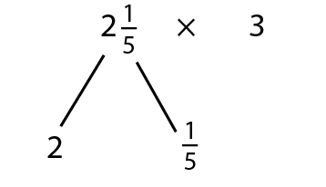
3.6 Multiplying whole numbers and fractions
Step 2:3

Slide 38
Year 5, Unit 8, Learning Outcome 7
Learning Outcome 7
Pupils multiply a mixed number by a whole number (product is greater than a whole)
The following slides have been collated to support the teaching of this learning outcome.

Slide 39
Year 5, Unit 8, Learning Outcome 7
Additional teacher guidance for this outcome should be read first and can be found in this segment of the NCETM Primary Mastery Professional Development Materials:
3.6 Multiplying whole numbers and fractions
The spine materials are divided into ‘teaching points’ and ‘steps in learning’.
Teaching point | Steps in learning | Pages
2 | 2:5-2:6 | 20-21

Slide 40
Year 5, Unit 8, Learning Outcome 8
Learning Outcome 8
Pupils find a unit fraction of a quantity
The following slides have been collated to support the teaching of this learning outcome.

Slide 41
Year 5, Unit 8, Learning Outcome 8
Additional teacher guidance for this outcome should be read first and can be found in this segment of the NCETM Primary Mastery Professional Development Materials:
3.6 Multiplying whole numbers and fractions
The spine materials are divided into ‘teaching points’ and ‘steps in learning’.
Teaching point | Steps in learning | Pages
3 | 3:1-3:5 | 22-28

Slide 42
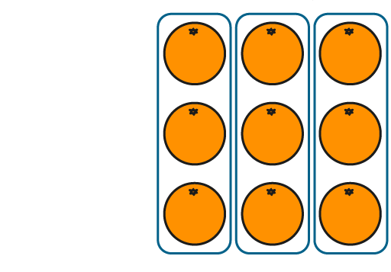
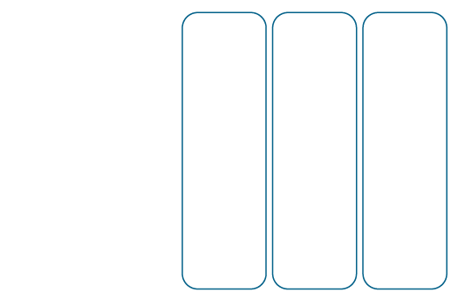
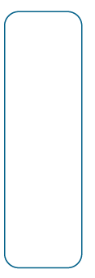
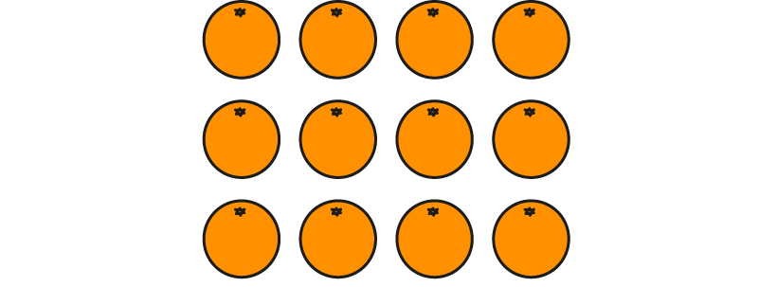
3.6 Multiplying whole numbers and fractions
Step 3:1
Notes:
The whole is divided into four equal parts and we have three of them.

Slide 43
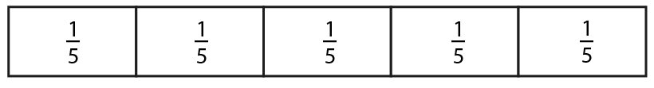
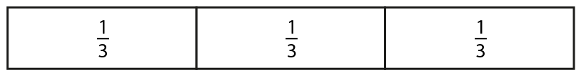
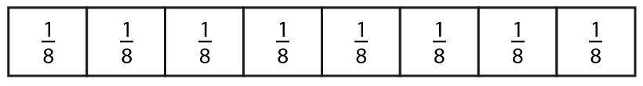
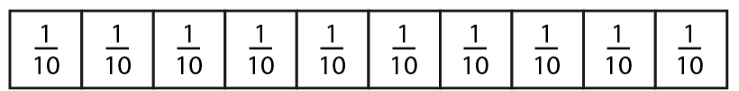
3.6 Multiplying whole numbers and fractions
Step 3:1

Slide 44
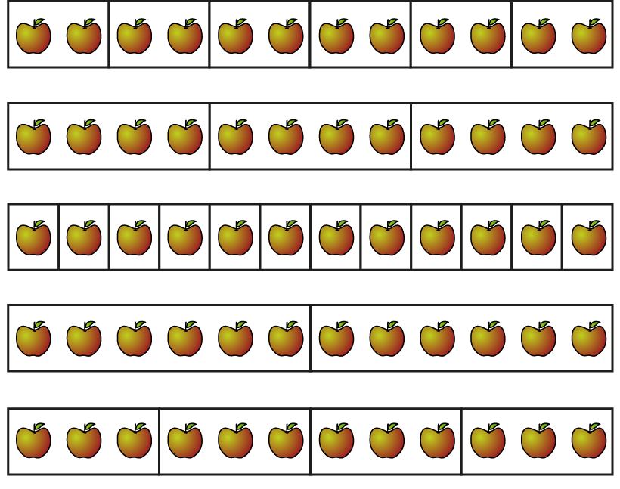
3.6 Multiplying whole numbers and fractions
Step 3:2
Notes:
Use the following stem sentence to identify the fraction that each part is of the whole.
The whole is divided into ___ equal parts.
Each part is ___of the whole.

Slide 45





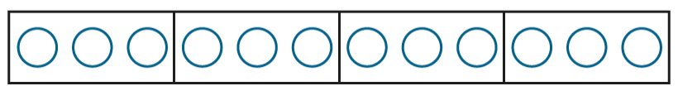
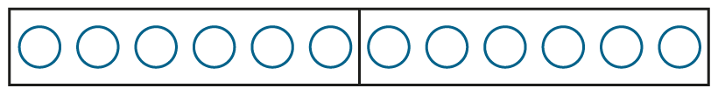
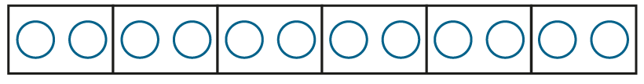

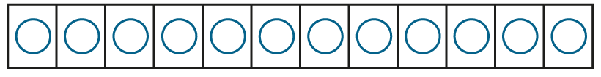

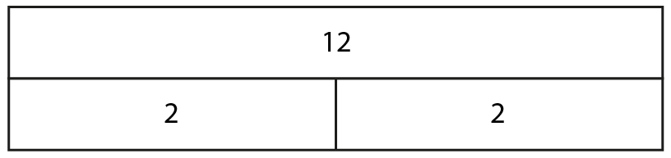
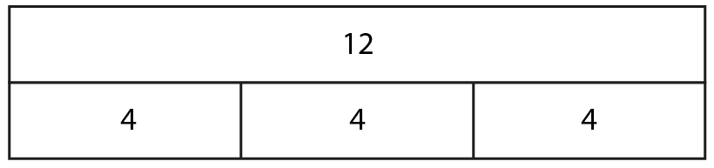
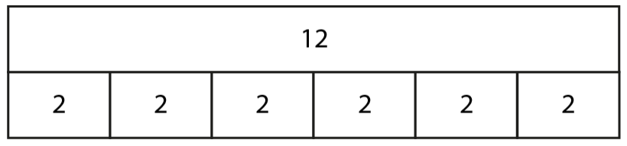
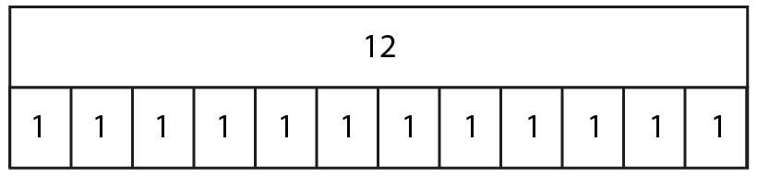
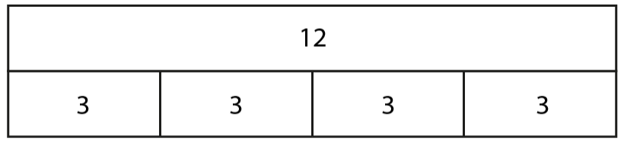
3.6 Multiplying whole numbers and fractions
Step 3:2
Notes:
What is the whole number of apples in each representation?
What is the number of apples in each part?
Use the stem sentence: When ___ apples are split into ___equal parts, there are ___ apples in each part.

Slide 46
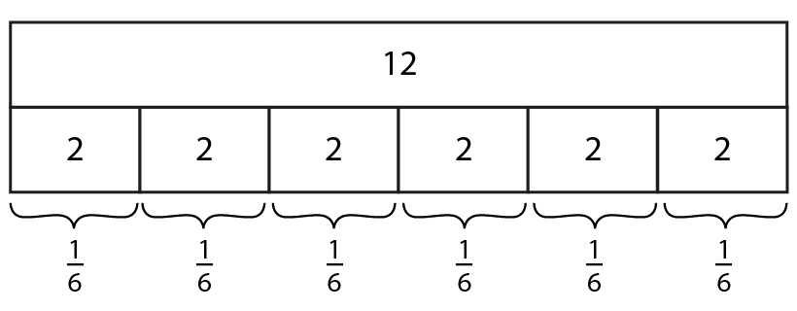
3.6 Multiplying whole numbers and fractions
Step 3:3
Notes:
How many parts has the whole been split into?
What fraction of the whole does each part represent?
Each part is $\frac{1}{6}$ of the whole; $\frac{1}{6}$ of twelve apples is two apples.

Slide 47
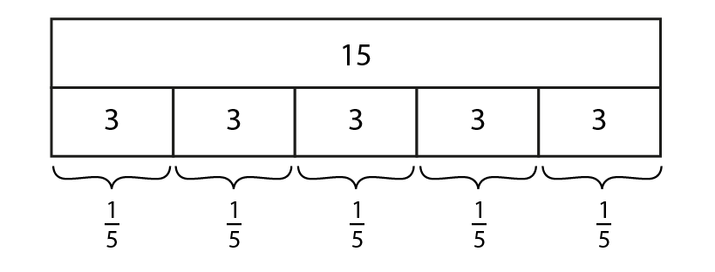
3.6 Multiplying whole numbers and fractions
Step 3:4
Notes:
Each part is $\frac{1}{5}$ of the whole; $\frac{1}{5}$ of 15 is 3.

Slide 48
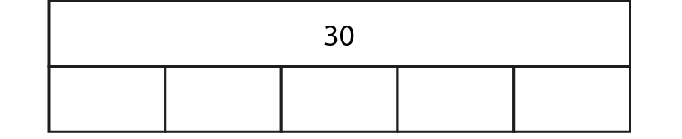
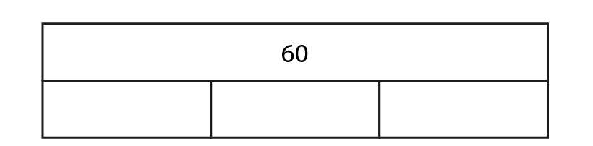





3.6 Multiplying whole numbers and fractions
Step 3:5
Notes:
Use the stem sentence:
__ is divided into __equal parts; each part is __ of the whole.

Slide 49




3.6 Multiplying whole numbers and fractions
Step 3:5

Slide 50


5F-1 Find non-unit fractions of quantities
Use 15 counters to represent the 15 apples.
Divide the counters into 5 equal groups and identify that each group represents one-fifth of the whole.
Skip count in one-fifths of the whole, using the counters to help, to find non-unit fractions of 15.
of
of
of
2 one-fifths of 15 is equal to 6, 3 one-fifths of 15 is equal to 9…
of
of

Slide 51



5F-1 Find non-unit fractions of quantities
40
What fraction of 40 is 8? How do you know?
Identify how to find $\frac{1}{5}$ of 40 and how this can be used to find non fractional quantities of the same whole.
Repeat with other amounts where the whole is a multiple of the denominator of the fraction.
8
8
8
8
8
1
1
1
1
1
3
5
5
5
5
5
5
To find 3 one-fifths of 40, first find one-fifth of 40 by dividing by 5, and then multiply by 3.
40 ÷ 5 = 8
1
so of 40 = 8
5
3
of 40 = 24
5

Slide 52


5F-1 Find non-unit fractions of quantities
How can the information given be used to calculate the unknown value of the whole?
What is $\frac{6}{6}$equal to?
180
30
30
30
30
30
30
1
1
1
1
1
1
6
6
6
6
6
6
One-sixth of a number is equal to thirty. 6 one-sixths is equal to one whole.
To find the whole, multiply the value of 1 one-sixth by 6.
30 x 6 = 180
1
of a number is 30
6
6 × 30 = 180

Slide 53



5F-1 Find non-unit fractions of quantities
How many parts has the whole been split into?
How can we use the fact $\frac{1}{5}$ of 285 = 57 to help us calculate $\frac{2}{5}$, $\frac{3}{5}$ and $\frac{4}{5}$ of the same amount?
2 one-fifths is equal to two lots of one-fifth.
57 x 2 = ___

Slide 54



5F-1 Find non-unit fractions of quantities
Why has 90 been recorded as the value of one of the parts and not the whole?
Why are we able to record 90 in each of the parts?
What do you notice about the value of the denominator and the value that 90 has been multiplied by? Why is this the case?
What is $\frac{2}{3}$ f 90?
?
270

Slide 55
Year 5, Unit 8, Learning Outcome 9
Learning Outcome 9
Pupils explain the relationship between finding a fraction of a quantity and multiplying a whole number by a unit fraction
The following slides have been collated to support the teaching of this learning outcome.

Slide 56
Year 5, Unit 8, Learning Outcome 9
Additional teacher guidance for this outcome should be read first and can be found in this segment of the NCETM Primary Mastery Professional Development Materials:
3.6 Multiplying whole numbers and fractions
The spine materials are divided into ‘teaching points’ and ‘steps in learning’.
Teaching point | Steps in learning | Pages
3 | 3:6-3:7 | 28-30

Slide 57

3.6 Multiplying whole numbers and fractions
Step 3:6
Notes:
$\frac{1}{2}$of 10 = 5
2 lots of 5 = 10

Slide 58

3.6 Multiplying whole numbers and fractions
Step 3:6
Notes:
___of ___ = ____
___lots of ___ = ____

Slide 59

3.6 Multiplying whole numbers and fractions
Step 3:6
Notes:
___of ___ = ____
___lots of ___ = ____

Slide 60
3.6 Multiplying whole numbers and fractions
Step 3:7

Slide 61
3.6 Multiplying whole numbers and fractions
Step 3:7

Slide 62
3.6 Multiplying whole numbers and fractions
Step 3:7

Slide 63

3.6 Multiplying whole numbers and fractions
Step 3:7
Notes:
When a whole number is multiplied by a unit fraction, it makes the whole number smaller.

Slide 64
Year 5, Unit 8, Learning Outcome 10
Learning Outcome 10
Pupils explain the relationship between dividing by a whole number and multiplying a whole number by a unit fraction
The following slides have been collated to support the teaching of this learning outcome.

Slide 65
Year 5, Unit 8, Learning Outcome 10
Additional teacher guidance for this outcome should be read first and can be found in this segment of the NCETM Primary Mastery Professional Development Materials:
3.6 Multiplying whole numbers and fractions
The spine materials are divided into ‘teaching points’ and ‘steps in learning’.
Teaching point | Steps in learning | Pages
3 | 3:8-3:10 | 31-32

Slide 66

3.6 Multiplying whole numbers and fractions
Step 3:8

Slide 67
Year 5, Unit 8, Learning Outcome 11
Learning Outcome 11
Pupils use their knowledge of multiplying a whole number by a unit fraction to solve problems
The following slides have been collated to support the teaching of this learning outcome.

Slide 68
Year 5, Unit 8, Learning Outcome 11
Additional teacher guidance for this outcome should be read first and can be found in this segment of the NCETM Primary Mastery Professional Development Materials:
3.6 Multiplying whole numbers and fractions
The spine materials are divided into ‘teaching points’ and ‘steps in learning’.
Teaching point | Steps in learning | Pages
3 | 3:11-3:12 | 33

Slide 69
3.6 Multiplying whole numbers and fractions
Step 3:11

Slide 70
3.6 Multiplying whole numbers and fractions
Step 3:12
Notes:
There are 90 children in $\frac{1}{3}$ of the playground.
How many children are in the whole playground, if there are an equal number of children in each part?

Slide 71


3.6 Multiplying whole numbers and fractions
Step 3:12
Notes:
60 children choose their favourite sport.
12 children choose swimming.
What fraction of the children is this?

Slide 72
Year 5, Unit 8, Learning Outcome 12
Learning Outcome 12
Pupils find a non-unit fraction of a quantity (mental calculation)
The following slides have been collated to support the teaching of this learning outcome.

Slide 73
Year 5, Unit 8, Learning Outcome 12
Additional teacher guidance for this outcome should be read first and can be found in this segment of the NCETM Primary Mastery Professional Development Materials:
3.6 Multiplying whole numbers and fractions
The spine materials are divided into ‘teaching points’ and ‘steps in learning’.
Teaching point | Steps in learning | Pages
4 | 4:1-4:4 | 34-37

Slide 74
3.6 Multiplying whole numbers and fractions
Step 4:1
Notes:
How could I find $\frac{3}{5}$ of fifteen?
(To calculate $\frac{3}{5}$ ×15 = 9, find $\frac{1}{5}$ of fifteen and then multiply by three.)

Slide 75

3.6 Multiplying whole numbers and fractions
Step 4:2
Notes:
To calculate a fraction of a quantity, find the unit fraction of the quantity. Then multiply the unit fraction by the numerator.

Slide 76

3.6 Multiplying whole numbers and fractions
Step 4:3
Notes:
To calculate $\frac{3}{4}$ × 24, find $\frac{1}{4}$ of twenty-four and then multiply by three.

Slide 77
Year 5, Unit 8, Learning Outcome 13
Learning Outcome 13
Pupils find a non-unit fraction of a quantity (written calculation)
The following slides have been collated to support the teaching of this learning outcome.

Slide 78
Year 5, Unit 8, Learning Outcome 13
Additional teacher guidance for this outcome should be read first and can be found in this segment of the NCETM Primary Mastery Professional Development Materials:
3.6 Multiplying whole numbers and fractions
The spine materials are divided into ‘teaching points’ and ‘steps in learning’.
Teaching point | Steps in learning | Pages
4 | 4:5 | 37-38

Slide 79

3.6 Multiplying whole numbers and fractions
Step 4:5
Notes:
A school are trying to raise £750 to send Year 5 on school camp.
They have raised $\frac{5}{6}$ of the total.
How much have they raised so far?

Slide 80
Year 5, Unit 8, Learning Outcome 14
Learning Outcome 14
Pupils multiply a whole number by a proper fraction
The following slides have been collated to support the teaching of this learning outcome.

Slide 81
Year 5, Unit 8, Learning Outcome 14
Additional teacher guidance for this outcome should be read first and can be found in this segment of the NCETM Primary Mastery Professional Development Materials:
3.6 Multiplying whole numbers and fractions
The spine materials are divided into ‘teaching points’ and ‘steps in learning’.
Teaching point | Steps in learning | Pages
4 | 4:6 | 38-39

Slide 82
3.6 Multiplying whole numbers and fractions
Step 4:6
Notes:
When a whole number is multiplied by a unit fraction, it makes the whole number smaller.

Slide 83
3.6 Multiplying whole numbers and fractions
Step 4:6
Notes:
When a whole number is multiplied by a proper fraction, it makes the whole number smaller.

Slide 84
Year 5, Unit 8, Learning Outcome 15
Learning Outcome 15
Pupils explain when a calculation represents scaling down and when it represents repeated addition
The following slides have been collated to support the teaching of this learning outcome.

Slide 85
Year 5, Unit 8, Learning Outcome 15
Additional teacher guidance for this outcome should be read first and can be found in this segment of the NCETM Primary Mastery Professional Development Materials:
3.6 Multiplying whole numbers and fractions
The spine materials are divided into ‘teaching points’ and ‘steps in learning’.
Teaching point | Steps in learning | Pages
4 | 4:7-4:8 | 39 - 41

Slide 86

3.6 Multiplying whole numbers and fractions
Step 4:7
Notes:
Discuss the different ways that 8 × $\frac{3}{4}$ could be interpreted and represented pictorially and in written form.

Slide 87
Year 5, Unit 8, Learning Outcome 16
Learning Outcome 16
Pupils find the whole when the size of a unit fraction is known
The following slides have been collated to support the teaching of this learning outcome.

Slide 88
Year 5, Unit 8, Learning Outcome 16
Additional teacher guidance for this outcome should be read first and can be found in this segment of the NCETM Primary Mastery Professional Development Materials:
3.6 Multiplying whole numbers and fractions
The spine materials are divided into ‘teaching points’ and ‘steps in learning’.
Teaching point | Steps in learning | Pages
5 | 5:1-5:2 | 42-43

Slide 89

3.6 Multiplying whole numbers and fractions
Step 5:1
Notes:
If we know the size of a unit fraction, we can work out the size of the whole.

Slide 90





3.6 Multiplying whole numbers and fractions
Step 5:1
Notes:
If we know the size of a unit fraction, we can work out the size of the whole.

Slide 91






3.6 Multiplying whole numbers and fractions
Step 5:2

Slide 92

3.6 Multiplying whole numbers and fractions
Step 5:2

Slide 93


3.6 Multiplying whole numbers and fractions
Step 5:2

Slide 94
Year 5, Unit 8, Learning Outcome 17
Learning Outcome 17
Pupils find a unit fraction when the size of a non-unit fraction is known
The following slides have been collated to support the teaching of this learning outcome.

Slide 95
Year 5, Unit 8, Learning Outcome 17
Additional teacher guidance for this outcome should be read first and can be found in this segment of the NCETM Primary Mastery Professional Development Materials:
3.6 Multiplying whole numbers and fractions
The spine materials are divided into ‘teaching points’ and ‘steps in learning’.
Teaching point | Steps in learning | Pages
5 | 5:3-5:5 | 43-44

Slide 96

3.6 Multiplying whole numbers and fractions
Step 5:3

Slide 97


3.6 Multiplying whole numbers and fractions
Step 5:3

Slide 98

3.6 Multiplying whole numbers and fractions
Step 5:3
Notes:
Five stars represent $\frac{5}{8}$ .
$\frac{1}{8}$ must be one star.

Slide 99
3.6 Multiplying whole numbers and fractions
Step 5:4

Slide 100

3.6 Multiplying whole numbers and fractions
Step 5:5

Slide 101
Year 5, Unit 8, Learning Outcome 18
Learning Outcome 18
Pupils find the whole when the size of a non-unit fraction is known
The following slides have been collated to support the teaching of this learning outcome.

Slide 102
Year 5, Unit 8, Learning Outcome 18
Additional teacher guidance for this outcome should be read first and can be found in this segment of the NCETM Primary Mastery Professional Development Materials:
3.6 Multiplying whole numbers and fractions
The spine materials are divided into ‘teaching points’ and ‘steps in learning’.
Teaching point | Steps in learning | Pages
5 | 5:6-5:8 | 45-47

Slide 103


3.6 Multiplying whole numbers and fractions
Step 5:6

Slide 104



3.6 Multiplying whole numbers and fractions
Step 5:7

Slide 105


3.6 Multiplying whole numbers and fractions
Step 5:7

Slide 106


3.6 Multiplying whole numbers and fractions
Step 5:7

Slide 107


3.6 Multiplying whole numbers and fractions
Step 5:8

Slide 108



3.6 Multiplying whole numbers and fractions
Step 5:8
Notes:
Jack collects marbles. Here is $\frac{5}{7}$ of his marble collection. Draw the rest of Jack’s marble collection to represent the whole collection.

Slide 109

3.6 Multiplying whole numbers and fractions
Step 5:8

Slide 110



3.6 Multiplying whole numbers and fractions
Step 5:8
Notes:
The yellow hexagon represents $\frac{6}{8}$ of the whole. Recreate the whole using your pattern blocks.

Slide 111




3.6 Multiplying whole numbers and fractions
Step 5:8

Slide 112
Year 5, Unit 8, Learning Outcome 19
Learning Outcome 19
Pupils find the unit fraction when the size of a non-unit fraction is known
The following slides have been collated to support the teaching of this learning outcome.

Slide 113
Year 5, Unit 8, Learning Outcome 19
Additional teacher guidance for this outcome should be read first and can be found in this segment of the NCETM Primary Mastery Professional Development Materials:
3.6 Multiplying whole numbers and fractions
The spine materials are divided into ‘teaching points’ and ‘steps in learning’.
Teaching point | Steps in learning | Pages
5 | 5:9-5:12 | 47-50

Slide 114


3.6 Multiplying whole numbers and fractions
Step 5:9

Slide 115






3.6 Multiplying whole numbers and fractions
Step 5:10
Notes:
$\frac{1}{3}$ of my number is 5. What is the number I am thinking of?

Slide 116











3.6 Multiplying whole numbers and fractions
Step 5:11
Notes:
Link to the bar model and written fraction notation. Say:
‘The whole is divided into 3 equal parts…’ (Point to the denominator.)
‘…and this is 2 of those parts.’ (Point to the numerator.)
‘We know that 8 is 2 parts of 3 equal parts. If 8 is 2 parts, then 1 part must be half of 8. That is 4. So, 3 parts must be 12.’

Slide 117
Year 5, Unit 8, Learning Outcome 20
Learning Outcome 20
Pupils use representations to describe and compare two fractions (1/4 and 3/12)
The following slides have been collated to support the teaching of this learning outcome.

Slide 118

Year 5, Unit 8, Learning Outcome 20
Additional teacher guidance for this outcome should be read first and can be found in this segment of the NCETM Primary Mastery Professional Development Materials:
3.7 Finding equivalent fractions and simplifying fractions
The spine materials are divided into ‘teaching points’ and ‘steps in learning’.
Teaching point | Steps in learning | Pages
1 | 1:1-1:5 | 5-10

Slide 119




3.7 Equivalent fractions and simplifying
Step 1:1
Notes:
Sabijah and Jess go to the café. They share some cakes. Sabijah eats $\frac{1}{4}$ of the cakes.
The whole is divided into four equal parts and one of the parts is circled. (Sabijah)
Where is the four?
Where is the one?
Jess eats $\frac{3}{12}$ of the cakes.
The whole is divided into twelve equal parts and three of the parts are circled. (Jess)
Where is the twelve?
Where is the three?

Slide 120
3.7 Equivalent fractions and simplifying
Step 1:2

Slide 121



3.7 Equivalent fractions and simplifying
Step 1:3
Notes:
The whole is divided into four equal parts and we have one of those parts.
The whole is divided into twelve equal parts and we have three of those parts.

Slide 122



3.7 Equivalent fractions and simplifying
Step 1:4

Slide 123

3.7 Equivalent fractions and simplifying
Step 1:5

Slide 124



5F-2 Find equivalent fractions
What do you notice about the two representations?
Explain why $\frac{1}{4}$ and $\frac{3}{12}$ are equivalent fractions.
The whole is divided into 4 equal parts and 1 of those parts is circled.
The whole is divided into 12 equal parts and 3 of those parts are circled.
1
3
4
12

Slide 125


5F-2 Find equivalent fractions
What do you notice about the two representations?
Explain why $\frac{1}{4}$ and $\frac{3}{4}$ are equivalent fractions.
If the two circles were pizza, would they represent the same portion of pizza?
The whole is divided into 4 equal parts and 1 of those parts is shaded.
The whole is divided into 12 equal parts and 3 of those parts are shaded.
$\frac{1}{4}$and $\frac{3}{12}$ are equivalent because 1 is the same portion of 4 as 3 is of 12.

Slide 126

5F-2 Find equivalent fractions
What do you notice about where 0 and 1 are located on both number lines?
What is the same about both fractions shown in red on the number lines?
Why are the two fractions located at the same point on the number lines?
Identify other equivalent fractions on the number lines. Explain how you know that they are equivalent.
$\frac{1}{4}$and $\frac{3}{12}$ are equivalent because they are located at the same point on the number lines.

Slide 127
Year 5, Unit 8, Learning Outcome 21
Learning Outcome 21
Pupils use representations to describe and compare two fractions (1/5 and 5/10)
The following slides have been collated to support the teaching of this learning outcome.

Slide 128
Year 5, Unit 8, Learning Outcome 21
Additional teacher guidance for this outcome should be read first and can be found in this segment of the NCETM Primary Mastery Professional Development Materials:
3.7 Finding equivalent fractions and simplifying fractions
The spine materials are divided into ‘teaching points’ and ‘steps in learning’.
Teaching point | Steps in learning | Pages
1 | 1:6 | 11

Slide 129

3.7 Equivalent fractions and simplifying
Step 1:6
Notes:
The whole is divided into two equal parts and we have one of those parts.
The whole is divided into ten equal parts and we have five of those parts.

Slide 130

3.7 Equivalent fractions and simplifying
Step 1:6
Notes:
The whole is divided into two equal parts and we have one of those parts.
The whole is divided into ten equal parts and we have five of those parts.

Slide 131



3.7 Equivalent fractions and simplifying
Step 1:6

Slide 132
3.7 Equivalent fractions and simplifying
Step 1:6
Notes:
The whole is divided into two equal parts and we have one of those parts.
The whole is divided into ten equal parts and we have five of those parts.

Slide 133


5F-2 Find equivalent fractions
What do you notice about the representations shown?
What is the same and what is different in each representation?
Identify $\frac{1}{2}$ and $\frac{5}{10}$ in each representation.
What can be said about the fractions $\frac{1}{2}$ and $\frac{5}{10}$? Why is this the case?
$\frac{1}{2}$ and $\frac{5}{10}$ are equivalent because 1 is the same portion of 2 as 5 is of 10.

Slide 134

5F-2 Find equivalent fractions
× 3
× 5
What do you notice about the vertical relationship between the numerator and denominator of each fraction?
What do you notice about the horizontal relationship between the numerators and denominators of both fractions?
1
1
3
5
=
× 4
=
× 2
× 4
× 2
4
2
12
10
× 3
× 5

Slide 135







5F-2 Find equivalent fractions
How many equal parts make the whole? How many of these parts are blue? What fraction of the whole is shaded?
How can we describe the fraction of the whole that is shaded if we change the number of parts that are found in the same- sized whole?
Keep your attention on the blue part ($\frac{1}{5}).$For each change in the number of parts can you still see $\frac{1}{5}$?
What can be said about all of the fractions that have been identified?

Slide 136




5F-2 Find equivalent fractions
How can you describe the vertical relationship between the numerator and the denominator?
If the vertical relationship is the same for all fractions, what can be said about these fractions?
Create a set of equivalent fractions for $\frac{1}{3}$.
The denominator is five times larger than the numerator.
$\frac{1}{5}$and $\frac{2}{10}$ are equivalent because 1 is the same portion of 5 as 2 is of 10.
1 is $\frac{1}{5}$of 5 and 2 is $\frac{1}{5}$of 10 so both represent $\frac{1}{5}$.

Slide 137
Year 5, Unit 8, Learning Outcome 22
Learning Outcome 22
Pupils use representations to describe and compare two fractions (pouring context)
The following slides have been collated to support the teaching of this learning outcome.

Slide 138
Year 5, Unit 8, Learning Outcome 22
Additional teacher guidance for this outcome should be read first and can be found in this segment of the NCETM Primary Mastery Professional Development Materials:
3.7 Finding equivalent fractions and simplifying fractions
The spine materials are divided into ‘teaching points’ and ‘steps in learning’.
Teaching point | Steps in learning | Pages
1 | 1:7-1:8 | 11-13

Slide 139






3.7 Equivalent fractions and simplifying
Step 1:7

Slide 140






3.7 Equivalent fractions and simplifying
Step 1:8

Slide 141


3.7 Equivalent fractions and simplifying
Step 1:8

Slide 142
5F-2 Find equivalent fractions
Which of these fractions are equivalent? How do you know?
Does each representation of water in the glass match each fraction? How do you know?
How does each representation help to show which fractions are equivalent to each other?

Slide 143
Year 5, Unit 8, Learning Outcome 23
Learning Outcome 23
Pupils correctly use the language of equivalent fractions
The following slides have been collated to support the teaching of this learning outcome.

Slide 144
Year 5, Unit 8, Learning Outcome 23
Additional teacher guidance for this outcome should be read first and can be found in this segment of the NCETM Primary Mastery Professional Development Materials:
3.7 Finding equivalent fractions and simplifying fractions
The spine materials are divided into ‘teaching points’ and ‘steps in learning’.
Teaching point | Steps in learning | Pages
1 | 1:9-1:10 | 13-14

Slide 145

3.7 Equivalent fractions and simplifying
Step 1:10

Slide 146
Year 5, Unit 8, Learning Outcome 24
Learning Outcome 24
Pupils explain the vertical relationship between numerators and denominators within equivalent fractions (1/5, 1/3 and equivalent)
The following slides have been collated to support the teaching of this learning outcome.

Slide 147
Year 5, Unit 8, Learning Outcome 24
Additional teacher guidance for this outcome should be read first and can be found in this segment of the NCETM Primary Mastery Professional Development Materials:
3.7 Finding equivalent fractions and simplifying fractions
The spine materials are divided into ‘teaching points’ and ‘steps in learning’.
Teaching point | Steps in learning | Pages
2 | 2:1-2:9 | 15-21

Slide 148
3.7 Equivalent fractions and simplifying
Steps 2:1–2:3
Notes:
Use the stem sentence:
The whole is divided into ___ equal parts, and ___ of these parts is/are shaded.
Where are the five parts?
Where is the one part?
Can you still see the one-fifth?
What other fractions can you see? ($\frac{2}{10}$ $\frac{3}{10}$ , $\frac{4}{20 }$ , $\frac{5}{25}$ and $\frac{6}{30}$)

Slide 149
3.7 Equivalent fractions and simplifying
Step 2:4

Slide 150






3.7 Equivalent fractions and simplifying
Step 2:5
Notes:
So which number is bigger, one-fifth or two-tenths?

Slide 151
3.7 Equivalent fractions and simplifying
Step 2:6
Notes:
How does the denominator change each time?

Slide 152
3.7 Equivalent fractions and simplifying
Step 2:7

Slide 153









3.7 Equivalent fractions and simplifying
Step 2:9

Slide 154





3.7 Equivalent fractions and simplifying
Step 2:9

Slide 155
3.7 Equivalent fractions and simplifying
Step 2:9

Slide 156

3.7 Equivalent fractions and simplifying
Step 2:9
Notes:
The denominator is always three times the numerator.
The numerator is one-third of the denominator.

Slide 157
Year 5, Unit 8, Learning Outcome 25
Learning Outcome 25
Pupils use their knowledge of the vertical relationship to solve equivalent fractions problems
The following slides have been collated to support the teaching of this learning outcome.

Slide 158
Year 5, Unit 8, Learning Outcome 25
Additional teacher guidance for this outcome should be read first and can be found in this segment of the NCETM Primary Mastery Professional Development Materials:
3.7 Finding equivalent fractions and simplifying fractions
The spine materials are divided into ‘teaching points’ and ‘steps in learning’.
Teaching point | Steps in learning | Pages
2 | 2:10-2:11 | 21-23

Slide 159

3.7 Equivalent fractions and simplifying
Step 2:11
Write the equivalent fractions to match each image.

Slide 160

3.7 Equivalent fractions and simplifying
Step 2:11
Write the equivalent fractions to match each image.

Slide 161

3.7 Equivalent fractions and simplifying
Step 2:11
Write the equivalent fractions to match each image.

Slide 162
Year 5, Unit 8, Learning Outcome 26
Learning Outcome 26
Pupils explain the horizontal relationship between numerators and denominators across equivalent fractions (1/5, 1/3 and equivalent)
The following slides have been collated to support the teaching of this learning outcome.

Slide 163
Year 5, Unit 8, Learning Outcome 26
Additional teacher guidance for this outcome should be read first and can be found in this segment of the NCETM Primary Mastery Professional Development Materials:
3.7 Finding equivalent fractions and simplifying fractions
The spine materials are divided into ‘teaching points’ and ‘steps in learning’.
Teaching point | Steps in learning | Pages
2 | 2:12-2:14 | 24-25

Slide 164


3.7 Equivalent fractions and simplifying
Step 2:12

Slide 165





3.7 Equivalent fractions and simplifying
Step 2:13

Slide 166






3.7 Equivalent fractions and simplifying
Step 2:14

Slide 167
Year 5, Unit 8, Learning Outcome 27
Learning Outcome 27
Pupils explain the relationship within families of equivalent fractions
The following slides have been collated to support the teaching of this learning outcome.

Slide 168
Year 5, Unit 8, Learning Outcome 27
Additional teacher guidance for this outcome should be read first and can be found in this segment of the NCETM Primary Mastery Professional Development Materials:
3.7 Finding equivalent fractions and simplifying fractions
The spine materials are divided into ‘teaching points’ and ‘steps in learning’.
Teaching point | Steps in learning | Pages
2 | 2:15-2:21 | 26-31

Slide 169










3.7 Equivalent fractions and simplifying
3.7 Equivalent fractions and simplifying
Steps 2:15–2:17
Notes:
What fraction is shaded?
Where are the five parts?
Where are the two parts?
What other fractions can you see?

Slide 170
3.7 Equivalent fractions and simplifying
Step 2:18

Slide 171





3.7 Equivalent fractions and simplifying
Step 2:18

Slide 172
3.7 Equivalent fractions and simplifying
Step 2:19

Slide 173


3.7 Equivalent fractions and simplifying
Step 2:20
Notes:
Which of these is the largest number?

Slide 174

3.7 Equivalent fractions and simplifying
Step 2:21

Slide 175

3.7 Equivalent fractions and simplifying
Step 2:21
Notes:
When the numerator and denominator are multiplied or divided by the same number, the value of the fraction remains the same.

Slide 176
5F-2 Find equivalent fractions
What fraction of the whole is shaded?
Where would this fraction be located on a number line?
Identify the fraction and its location on the number line when the same-sized whole is split into a different number of parts.

Slide 177

5F-2 Find equivalent fractions
Describe the horizontal relationship between the numerators and denominators to help explain how we know the following fractions are equivalent.
How do we know that these fractions are equivalent? Describe the vertical and horizontal relationships within your explanation.
Create a set of equivalent fractions for $\frac{2}{3}$.
The numerator and denominator of the second fraction are both __ times greater than the first fraction. This means that the fractions are equivalent.

Slide 178
Year 5, Unit 8, Learning Outcome 28
Learning Outcome 28
Pupils use their knowledge of equivalent fractions to solve problems
The following slides have been collated to support the teaching of this learning outcome.

Slide 179
Year 5, Unit 8, Learning Outcome 28
Additional teacher guidance for this outcome should be read first and can be found in this segment of the NCETM Primary Mastery Professional Development Materials:
3.7 Finding equivalent fractions and simplifying fractions
The spine materials are divided into ‘teaching points’ and ‘steps in learning’.
Teaching point | Steps in learning | Pages
2 | 2:22-2:23 | 31-34

Slide 180


3.7 Equivalent fractions and simplifying
Step 2:23

Slide 181

3.7 Equivalent fractions and simplifying
Step 2:23

Slide 182

3.7 Equivalent fractions and simplifying
Step 2:23

Slide 183






5F-2 Find equivalent fractions
Equivalent fractions can be written for each of the representations.
Can you see each of the pairs of equivalent fractions by looking at the whole in different ways?
Explain why they are equivalent fractions – why they represent the same value?

Slide 184












5F-2 Find equivalent fractions
Practise identifying equivalent fractions to build fluency.
$$\frac{1}{4}$$
$$\frac{1}{2}$$
$$\frac{50}{60}$$
$$\frac{1}{2}$$
$$\frac{1}{2}$$
$$\frac{2}{10}$$
$$\frac{4}{8}$$
$$\frac{25}{100}$$
$$\frac{9}{10}$$
$$\frac{5}{6}$$
$$\frac{5}{10}$$
$$\frac{4}{20}$$
✓
✓
✓
✓

Slide 185
Year 5, Unit 8, Learning Outcome 29
Learning Outcome 29
Pupils explain and represent how to divide 1 into different amounts of equal parts
The following slides have been collated to support the teaching of this learning outcome.

Slide 186

Year 5, Unit 8, Learning Outcome 29
Additional teacher guidance for this outcome should be read first and can be found in this segment of the NCETM Primary Mastery Professional Development Materials:
3.10 Linking fractions, decimals and percentages
The spine materials are divided into ‘teaching points’ and ‘steps in learning’.
Teaching point | Steps in learning | Pages
1 | 1:1-1:5 | 2-6

Slide 187

3.10 Fractions, decimals and percentages
Step 1:1

Slide 188

3.10 Fractions, decimals and percentages
Step 1:1

Slide 189

3.10 Fractions, decimals and percentages
Step 1:1

Slide 190



3.10 Fractions, decimals and percentages
Steps 1:2–1:3

Slide 191





3.10 Fractions, decimals and percentages
Step 1:4
Notes:
What do you notice about these decimals in the ‘4 parts’ number line?

Slide 192

3.10 Fractions, decimals and percentages
Step 1:5

Slide 193

3.10 Fractions, decimals and percentages
Step 1:5

Slide 194

3.10 Fractions, decimals and percentages
Step 1:5

Slide 195

3.10 Fractions, decimals and percentages
Step 1:5

Slide 196


5F-3 Recall decimal equivalents for common fractions
Allow children to use Dienes to represent each image shown to identify the fraction of the hundred grid that is shaded.
Skip count in tenths as a new part is added each time using the fraction name, fractional notation and decimal notation.
One-tenth, two-tenths, three-tenths…
$\frac{1}{10} ,\frac{2}{10} ,\frac{3}{10}$…
0.1, 0.2, 0.3…

Slide 197
5F-3 Recall decimal equivalents for common fractions
Allow children to use Dienes to represent each image shown.
How many equal parts has the hundred grid been divided into?
What fraction of the whole does each part represent?
How many hundredths are found within each shaded part?
What decimal notation can be used to describe each shaded part?

Slide 198
5F-3 Recall decimal equivalents for common fractions
Allow children to use Dienes to represent each image shown.
How many equal parts has the hundred grid been divided into?
What fraction of the whole does each part represent?
How many hundredths are found within each shaded part?
What decimal notation can be used to describe each shaded part?

Slide 199
5F-3 Recall decimal equivalents for common fractions
Allow children to use Dienes to represent each image shown.
How many equal parts has the hundred grid been divided into?
What fraction of the whole does each part represent?
How many hundredths are found within each shaded part?
What decimal notation can be used to describe each shaded part?

Slide 200
5F-3 Recall decimal equivalents for common fractions
10
2
4
5
5
10
2
1
1
1
4
1
1
1
10
1
1
2
4
5
5
10
2
4
Count up and back along each vertical number line in decimal and fractional notation.
Why are different fractions shown on the different number lines? What is the link between the denominator of each fraction and the number of intervals on each number line?
0.9
9
0.9
9
10
10
8
0.8
4
0.8
4
8
0.8
10
0.8
3
5
5
10
0.75
0.75
3
4
4
0.7
7
0.7
7
10
10
0, 0.5, 1 1, 0.5, 0
Zero, one-half, two-halves.
Two-halves, one-half, zero.
6
0.6
3
3
6
0.6
10
0.6
0.6
5
5
10
1
2
1
2
0.5
0.5
0.5
5
5
0.5
2
0.5
0.5
4
2
4
10
10
4
0.4
2
2
4
0.4
10
0.4
0.4
5
5
10
0.3
3
0.3
3
1
10
10
0.25
0.25
1
4
4
2
0.2
1
1
2
0.2
10
0.2
0.2
5
5
10
0.1
1
0.1
1
10
10
0
0
0
0
0
0
0
0
0
0
0
0
0
0
0
0

Slide 201
5F-3 Recall decimal equivalents for common fractions
How many parts has each container been split into between 0 and 1 litre?
Complete the missing fractional notations using the decimal notations to help you.
Complete the missing decimal notations using the fractional notations to help you.
Count forwards and backwards on each number line in fractional and decimal notations.

Slide 202
5F-3 Recall decimal equivalents for common fractions
Unit fraction
Decimal fraction
True or false? 0.5, 0.2 and 0.1 could also be written as 0.50, 0.20 and 0.10
How do you know each unit and decimal fraction are equivalent to each other? The Dienes could be used to help children’s explanations.
1
0.5
2
1
0.25
4
1
0.2
5
1
I know __ and __ are equivalent because if the hundred grid is split into __ equal parts there would be __ hundredths in each part.
0.1
10

Slide 203

5F-3 Recall decimal equivalents for common fractions
Unit fraction
Decimal fraction
It would be useful to memorise these key fraction and decimal equivalents.
Make a set of cards with the fraction on one side and the decimal equivalent on the other.
If you know what $\frac{1}{5}$is as a decimal, can you work out what $\frac{2}{5}$is?
1
0.5
2
1
0.25
4
1
0.2
5
1
0.1
$\frac{1}{5 }$is equivalent to 0.2,so $\frac{2}{5}$ is equivalent to 0.4
10

Slide 204

5F-3 Recall decimal equivalents for common fractions
Give each pupil one of each of the Dienes shown.
If the flat Diene represents 1 one, why does one stick represent 1 tenth and one cube represent 1 hundredth?
Why is one-tenth recorded in decimal notation as 0.1 and as a fraction as $\frac{1}{10}$?
Why is one-hundredth recorded in decimal notation as 0.01 and as a fraction as $\frac{1}{100}?$

Slide 205
Year 5, Unit 8, Learning Outcome 30
Learning Outcome 30
Pupils identify and describe patterns within the number system
The following slides have been collated to support the teaching of this learning outcome.

Slide 206
Year 5, Unit 8, Learning Outcome 30
Additional teacher guidance for this outcome should be read first and can be found in this segment of the NCETM Primary Mastery Professional Development Materials:
3.10 Linking fractions, decimals and percentages
The spine materials are divided into ‘teaching points’ and ‘steps in learning’.
Teaching point | Steps in learning | Pages
1 | 1:6-1:8 | 6-10

Slide 207


3.10 Fractions, decimals and percentages
Step 1:6
Notes:
What patterns can you see?
Why are these repeated through the number system?

Slide 208


3.10 Fractions, decimals and percentages
Step 1:6
Notes:
What patterns can you see?
Why are these repeated through the number system?

Slide 209


3.10 Fractions, decimals and percentages
Step 1:6
Notes:
What patterns can you see?
Why are these repeated through the number system?

Slide 210


3.10 Fractions, decimals and percentages
Step 1:6
Notes:
What patterns can you see?
Why are these repeated through the number system?

Slide 211

3.10 Fractions, decimals and percentages
Step 1:6
Notes:
What patterns can you see?
Why are these repeated through the number system?

Slide 212


3.10 Fractions, decimals and percentages
Step 1:7

Slide 213


3.10 Fractions, decimals and percentages
Step 1:7

Slide 214


3.10 Fractions, decimals and percentages
Step 1:7

Slide 215


3.10 Fractions, decimals and percentages
Step 1:7

Slide 216

3.10 Fractions, decimals and percentages
Step 1:7

Slide 217

3.10 Fractions, decimals and percentages
Step 1:7

Slide 218

3.10 Fractions, decimals and percentages
Step 1:7

Slide 219

3.10 Fractions, decimals and percentages
Step 1:7

Slide 220

3.10 Fractions, decimals and percentages
Step 1:7

Slide 221

3.10 Fractions, decimals and percentages
Step 1:7

Slide 222
5F-3 Recall decimal equivalents for common fractions
Allow children to use Dienes to represent each image shown to identify the fraction of the hundred grid that is shaded.
Skip count in tenths as a new part is added each time using the fraction name, fractional notation and decimal notation.
One-tenth, two-tenths, three-tenths…
$\frac{1}{10} ,\frac{2}{10} ,\frac{3}{10}$…
0.1, 0.2, 0.3…

Slide 223
5F-3 Recall decimal equivalents for common fractions
Allow children to use Dienes to represent each image shown.
How many equal parts has the hundred grid been divided into?
What fraction of the whole does each part represent?
How many hundredths are found within each shaded part?
What decimal notation can be used to describe each shaded part?

Slide 224
5F-3 Recall decimal equivalents for common fractions
Allow children to use Dienes to represent each image shown.
How many equal parts has the hundred grid been divided into?
What fraction of the whole does each part represent?
How many hundredths are found within each shaded part?
What decimal notation can be used to describe each shaded part?

Slide 225
5F-3 Recall decimal equivalents for common fractions
Allow children to use Dienes to represent each image shown.
How many equal parts has the hundred grid been divided into?
What fraction of the whole does each part represent?
How many hundredths are found within each shaded part?
What decimal notation can be used to describe each shaded part?

Slide 226
5F-3 Recall decimal equivalents for common fractions
10
2
4
5
5
10
2
1
1
1
4
1
1
1
10
1
1
2
4
5
5
10
2
4
Count up and back along each vertical number line in decimal and fractional notation.
Why are different fractions shown on the different number lines? What is the link between the denominator of each fraction and the number of intervals on each number line?
0.9
9
0.9
9
10
10
8
0.8
4
0.8
4
8
0.8
10
0.8
3
5
5
10
0.75
0.75
3
4
4
0.7
7
0.7
7
10
10
0, 0.5, 1 1, 0.5, 0
Zero, one-half, two-halves.
Two-halves, one-half, zero.
6
0.6
3
3
6
0.6
10
0.6
0.6
5
5
10
1
2
1
2
0.5
0.5
0.5
5
5
0.5
2
0.5
0.5
4
2
4
10
10
4
0.4
2
2
4
0.4
10
0.4
0.4
5
5
10
0.3
3
0.3
3
1
10
10
0.25
0.25
1
4
4
2
0.2
1
1
2
0.2
10
0.2
0.2
5
5
10
0.1
1
0.1
1
10
10
0
0
0
0
0
0
0
0
0
0
0
0
0
0
0
0

Slide 227
5F-3 Recall decimal equivalents for common fractions
How many parts has each container been split into between 0 and 1 litre?
Complete the missing fractional notations using the decimal notations to help you.
Complete the missing decimal notations using the fractional notations to help you.
Count forwards and backwards on each number line in fractional and decimal notations.

Slide 228
5F-3 Recall decimal equivalents for common fractions
Unit fraction
Decimal fraction
True or false? 0.5, 0.2 and 0.1 could also be written as 0.50, 0.20 and 0.10
How do you know each unit and decimal fraction are equivalent to each other? The Dienes could be used to help children’s explanations.
1
0.5
2
1
0.25
4
1
0.2
5
1
I know __ and __ are equivalent because if the hundred grid is split into __ equal parts there would be __ hundredths in each part.
0.1
10

Slide 229
5F-3 Recall decimal equivalents for common fractions
Unit fraction
Decimal fraction
It would be useful to memorise these key fraction and decimal equivalents.
Make a set of cards with the fraction on one side and the decimal equivalent on the other.
If you know what $\frac{1}{5}$is as a decimal, can you work out what $\frac{2}{5}$is?
1
0.5
2
1
0.25
4
1
0.2
5
1
0.1
$\frac{1}{5 }$is equivalent to 0.2,so $\frac{2}{5}$ is equivalent to 0.4
10

Slide 230
Year 5, Unit 8, Learning Outcome 31
Learning Outcome 31
Pupils use their knowledge of common equivalents to compare fractions with decimals
The following slides have been collated to support the teaching of this learning outcome.

Slide 231
Year 5, Unit 8, Learning Outcome 31
Additional teacher guidance for this outcome should be read first and can be found in this segment of the NCETM Primary Mastery Professional Development Materials:
3.10 Linking fractions, decimals and percentages
The spine materials are divided into ‘teaching points’ and ‘steps in learning’.
Teaching point | Steps in learning | Pages
1 | 1:9-1:10 | 10-11

Slide 232

3.10 Fractions, decimals and percentages
Step 1:9

Slide 233

3.10 Fractions, decimals and percentages
Step 1:9

Slide 234
Year 5, Unit 8, Learning Outcome 32
Learning Outcome 32
Pupils practise recalling common fraction-decimal equivalents
The following slide has been collated to support the teaching of this learning outcome.

Slide 235
Year 5, Unit 8, Learning Outcome 32
Additional teacher guidance for this outcome should be read first and can be found in this segment of the NCETM Primary Mastery Professional Development Materials:
3.10 Linking fractions, decimals and percentages
The spine materials are divided into ‘teaching points’ and ‘steps in learning’.
Teaching point | Steps in learning | Pages
1 | 1:11 | 11-12

Slide 236
Year 5, Unit 8, Learning Outcome 33
Learning Outcome 33
Pupils use their knowledge of common fraction-decimal equivalents to solve conversion problems in a range of contexts
The following slides have been collated to support the teaching of this learning outcome.

Slide 237
Year 5, Unit 8, Learning Outcome 33
Additional teacher guidance for this outcome should be read first and can be found in this segment of the NCETM Primary Mastery Professional Development Materials:
3.10 Linking fractions, decimals and percentages
The spine materials are divided into ‘teaching points’ and ‘steps in learning’.
Teaching point | Steps in learning | Pages
2 | 2:1-2:5 | 13-14

Slide 238



3.10 Fractions, decimals and percentages
Step 2:1

Slide 239



3.10 Fractions, decimals and percentages
Step 2:2

Slide 240

3.10 Fractions, decimals and percentages
Step 2:3

Slide 241

3.10 Fractions, decimals and percentages
Step 2:5
Notes:
What is the total combined weight of the parcels?

Slide 242
5F-3 Recall decimal equivalents for common fractions
What is different about the two scales shown?
How many intervals are there between zero and one for each scale? So, what interval do we need to count up in for each scale?
Do we need to start at zero on each scale when we count up? Why/why not?
What is the mass of Parcel A and Parcel B? Give your answers in fractional and decimal notations.
Which parcel is heavier? How do you know?

Slide 243

5F-3 Recall decimal equivalents for common fractions
4
4
How many parts on the vertical number line are there between 3 and 4?
How does this help us to identify the missing decimal value on the number line?
3.5 and 3$\frac{1}{2}$ are found at the same point on the number line. What does this mean about these two numbers?
What is the same and what is different in the notations 3.5 and 3$\frac{1}{2}$?
How do we know they are equivalent?
1
3.5
3
2
3

Slide 244
5F-3 Recall decimal equivalents for common fractions
10
10
How many parts on the vertical number line are there between 9 and 10?
How does this help us to identify the missing decimal values on the number line?
Identify the decimal and fractional notations that are equivalent to each other. How do you know these numbers are equivalent?
3
9.75
9
4
2
9.5
9
4
1
9.25
9
4
9
9

Slide 245
5F-3 Recall decimal equivalents for common fractions
7
7
How many parts in the vertical number line are there between 6 and 7?
How does this help us to identify the missing decimal values on the number line?
Identify the decimal and fractional notations that are equivalent to each other. How do you know these numbers are equivalent?
4
6.8
6
5
3
6.6
6
5
2
6.4
6
5
1
6.2
6
5
6
6

Slide 246
5F-3 Recall decimal equivalents for common fractions
2
2
How many parts in the vertical number line are there between 1 and 2?
How does this help us to identify the missing decimal values on the number line?
Identify the decimal and fractional notations that are equivalent to each other. How do you know these numbers are equivalent?
9
1.9
1
10
8
1.8
1
10
7
1.7
1
10
6
1.6
1
10
5
1.5
1
10
4
1.4
1
10
3
1.3
1
10
2
1.2
1
10
1.1
1
1
10
1
1

Slide 247
Year 5, Unit 8, Learning Outcome 34
Learning Outcome 34
Pupils use their knowledge of common equivalents to compare fractions with decimals beyond one
The following slides have been collated to support the teaching of this learning outcome.

Slide 248
Year 5, Unit 8, Learning Outcome 34
Additional teacher guidance for this outcome should be read first and can be found in this segment of the NCETM Primary Mastery Professional Development Materials:
3.10 Linking fractions, decimals and percentages
The spine materials are divided into ‘teaching points’ and ‘steps in learning’.
Teaching point | Steps in learning | Pages
2 | 2:6-2:7 | 15-16

Slide 249

3.10 Fractions, decimals and percentages
Step 2:6
Notes:
Method 1 – Convert to decimals

Slide 250

3.10 Fractions, decimals and percentages
Step 2:6
Notes:
Method 2 – Convert to fractions with a common denominator

Slide 251

3.10 Fractions, decimals and percentages
Step 2:6
Notes:
Method 3 – Position on number line

Slide 252

3.10 Fractions, decimals and percentages
Step 2:6

Slide 253

3.10 Fractions, decimals and percentages
Step 2:7

Slide 254

5F-3 Recall decimal equivalents for common fractions
Should the expression given be completed with <, > or =?
How does the given equality help us to complete the original expression?
If I know 0.6 = $\frac{3}{5}$
and I know $\frac{3}{5}$< $\frac{4}{5}$,
then I know 0.6 < $\frac{4}{5}.$

Slide 255

5F-3 Recall decimal equivalents for common fractions
Should the expression given be completed with <, > or =?
How does the given equality help us to complete the original expression?
If I know $\frac{4}{5}$ = 0.8
and I know 0.6 < 0.8,
then I know 0.6 < $\frac{4}{5}.$

Slide 256
Year 5, Unit 8, Learning Outcome 35
Learning Outcome 35
Pupils use their knowledge of simplifying calculations by substitution to solve problems in a range of contexts
The following slides have been collated to support the teaching of this learning outcome.

Slide 257
Year 5, Unit 8, Learning Outcome 35
Additional teacher guidance for this outcome should be read first and can be found in this segment of the NCETM Primary Mastery Professional Development Materials:
3.10 Linking fractions, decimals and percentages
The spine materials are divided into ‘teaching points’ and ‘steps in learning’.
Teaching point | Steps in learning | Pages
3 | 3:1-3:6 | 17-20

Slide 258




3.10 Fractions, decimals and percentages
Steps 3:1–3:2
Notes:
What is the whole?
How many equal parts is 476 being divided into?
How many parts do we have?

Slide 259


3.10 Fractions, decimals and percentages
Step 3:4

Slide 260


3.10 Fractions, decimals and percentages
Step 3:6

