Slide 1
Year 6, Unit 4
Draw, compose and decompose shapes

Slide 2
Year 6, Unit 4
These materials heavily reflect the prioritisation approach of the ready-to-progress criteria in the DfE Primary Mathematics Guidance 2020 and on the PPTs that exemplify them on the NCETM website. They also include other relevant National Curriculum content. Related sections of the NCETM Primary Mastery Professional Development Materials provide small-step teaching guidance.
Ready-to-progress criteria addressed by this unit
Teaching of this unit supports the following criteria from the ‘DfE Mathematics Guidance: key stages 1 & 2’ (the 335-page document available as a download)
6G-1 Page 322
Prior learning
If the following ready-to-progress criteria, contained in the same DfE guidance document as above, were secured in Year 4 and 5, children will be ready to start on this unit.
4G-2 Page 197
5G-1 Page 265
5G-2 Page 269

Slide 3
Contents
The links below take you to the starting slide of each learning outcome.
1 | Use knowledge of shape properties to draw, sketch and identify shapes.
2 | The same 3D shape can be composed from different 2D nets.
3 | When a 2D shape is decomposed and the parts rearranged, the area remains the same. The area of a compound shape is therefore equal to the total of the areas of the constituent parts.
4 | Any parallelogram can be decomposed and the parts rearranged to form a rectangular parallelogram.
5 | Two congruent triangles can be composed to form a parallelogram.
Click the arrow button to return to this Contents slide.

Slide 4




Contents
The links below take you to the starting slide of each learning outcome.
6 | Shapes with the same area can have different perimeters. Shapes with the same perimeters can have different areas.
7 | We can use the relationship between area and side length, and perimeter and side length, to reason about measurements of shapes, including compound shapes.
The final four slides will assist teachers with geometric drawing on the whiteboard. Click on the image to find the slide.
Click the arrow button to return to this Contents slide.

Slide 5
Year 6, Unit 4, Learning Outcome 1
Learning Outcome 1
Use knowledge of shape properties to draw, sketch and identify shapes.
The following slides have been collated to support the teaching of this learning outcome.

Slide 6
Year 6, Unit 4
Spatial reasoning starter
Look at this cuboid made from 4 cubes. What makes it an example of a cuboid?
Imagine walking around to the ‘back’ of this cuboid. Describe the face that you can now see (each cube has the same colour all over it).
Come back to the front again! Imagine repositioning two of the cubes to make a new cuboid. Describe the front face of your new cuboid.
What other ways can you reposition two cubes to give a new cuboid?

Slide 7
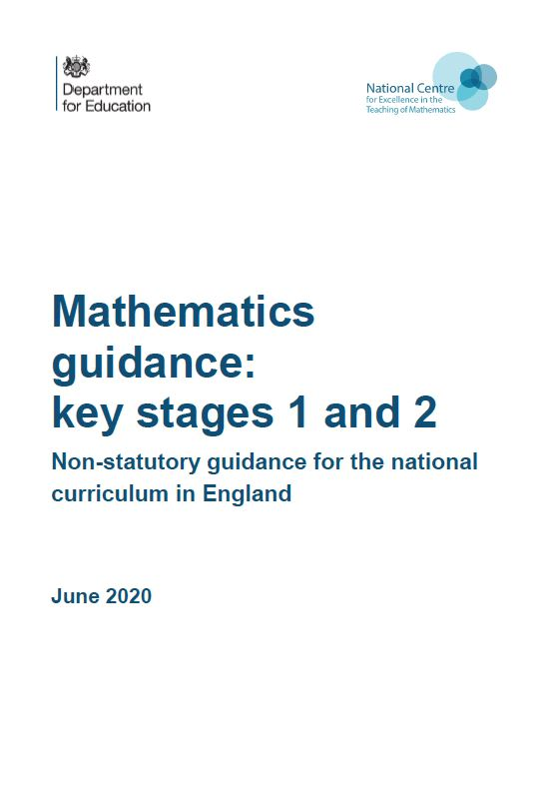
Year 6, Unit 4, Learning Outcome 1
Additional teacher guidance for this outcome should be read first and can be found in the DfE Mathematics guidance. Page references relate to the 335-page document available as a download at the bottom of this web page.
Ready to progress criteria | Pages
6G-1 | 322-326

Slide 8
Year 6, Unit 4, Learning Outcome 1
You could use some of the following tasks to support this learning outcome:
Sketch a range of shapes: standard and non-standard examples. Sketch a hexagon. Now sketch a hexagon that you don’t think anyone else in the class will have drawn.
Sketch shapes with different given properties - for example, a pentagon with 3 right angles, a triangle in which one of the angles is 80°, a quadrilateral with diagonals that meet at right angles. Teach pupils to start with the given property (for example, the 3 right angles) and then complete the rest of the shape.
Accurately draw shapes. Pupils practise drawing lines of a given length, and angles of a given size. Then combine skills to, for example, draw a triangle that has one angle of 19° and one side of length 10cm.

Slide 9
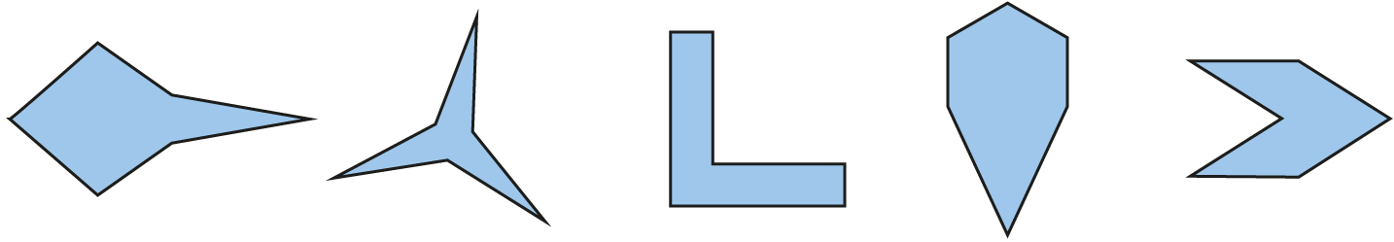
Year 6, Unit 4, Learning Outcome 1
Not all sides equal length
Not all angles equal size
All sides equal length
Not all angles equal size
All sides equal length
All angles equal size
Not all sides equal length
All angles equal size
Irregular
Irregular
Regular
Irregular

Slide 10
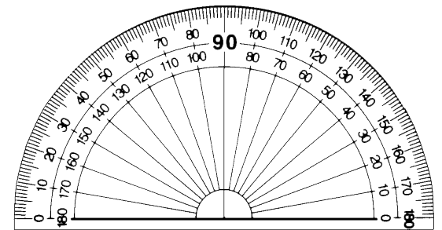
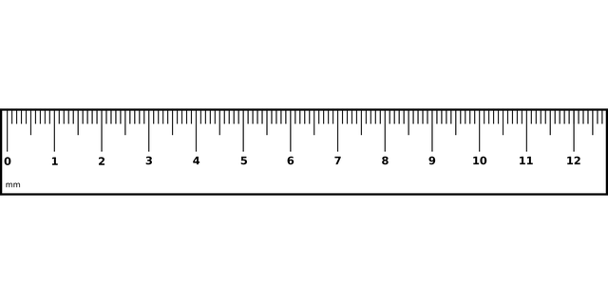
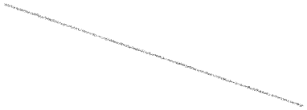
6G-1 Draw compose and decompose shapes
What apparatus would be needed to accurately draw the triangle shown?
What would be the first step?
What important part of the angle measurer (protractor) needs to be positioned accurately?
What do you notice about the scales on the protractor? Which should be used? Why?
Repeat giving children the opportunity to draw different triangles in different orientations.
Not drawn to scale
19°
10 cm

Slide 11
6G-1 Draw, compose and decompose shapes
Shape Draw
https://nrich.maths.org/10368

Slide 12
Year 6, Unit 4, Learning Outcome 2
Learning Outcome 2
The same 3D shape can be composed from different 2D nets
The following slides have been collated to support the teaching of this learning outcome.

Slide 13
Year 6, Unit 4
Spatial reasoning starter
What makes this shape an example of a hexagonal prism?
Imagine making a vertical cut through it. Describe the two new shapes that you have created. How does where you make your vertical cut change the two shapes that you make?
Imagine making a horizontal cut through the prism so that you cut the shape into a ‘top half’ and ‘bottom half’. Describe the two new shapes that you have made.
Can you think about how you could make cuts through the shape to make one (or more) triangular prisms? What type of triangle is the face? Are there other triangular faces you can make on a prism you cut from this shape?

Slide 14
Year 6, Unit 4, Learning Outcome 2
You could use some of the following tasks to support this learning outcome:
Make 3D shapes from linking construction shapes and unfold them in different ways to see the nets that can be made. Sketch more than one net you can unfold each 3D shape into.
Look at different arrangements of 6 squares and imagine them being folded to see which form nets of cubes. Encourage pupils to visualise first, then check with the linking construction shapes. Draw out generalisations about nets which do or don’t fold to make cubes.
Starting with 3D shapes, pupils place one face on a piece of paper and mark the vertices of that face. Teach pupils to imagine the other faces of the shape unfolding and sketch the rest of the net on the paper.

Slide 15
Year 6, Unit 4, Learning Outcome 2
The 11 different nets of cubes

Slide 16
Year 6, Unit 4, Learning Outcome 3
Learning Outcome 3
When a 2D shape is decomposed and the parts rearranged, the area remains the same. The area of a compound shape is therefore equal to the total of the areas of the constituent parts.
The following slides have been collated to support the teaching of this learning outcome.

Slide 17
Year 6, Unit 4
Spatial reasoning starter
Imagine a rectangular piece of paper. The length is twice as long as the height.
Fold it down its vertical centre. What shape do you get?
Imagine that you cut off the corner of the square, as shown.
  How has the number of sides changed?
  How has the perimeter changed?
  How has the area changed?
fold

Slide 18
Year 6, Unit 4
Spatial reasoning starter continued…
Now imagine unfolding this shape so you see the full sheet of paper again. Describe what you can see.
  Is the perimeter longer or shorter than the perimeter of the original rectangle?
  Is the area bigger or smaller than the area of the original rectangle?
How would this differ if you cut off this corner instead?
fold

Slide 19
Year 6, Unit 4, Learning Outcome 3
Additional teacher guidance for this outcome should be read first and can be found in the DfE Mathematics guidance. Page references relate to the 335-page document available as a download at the bottom of this web page.
Ready to progress criteria | Pages
6G-1 | 322-326

Slide 20
Year 6, Unit 4, Learning Outcome 3
You could use some of the following tasks to support this learning outcome:
Draw copies of a rectilinear shape on squared grid paper, decomposing it in different ways, then calculating the area of the parts within it.
Use pattern blocks to make up compound shapes with a given area in different ways – for example, ways to make compound shapes with an area equivalent to two hexagons.
Rearrange parts of a composite shape in different ways to notice that the overall size does not change.

Slide 21
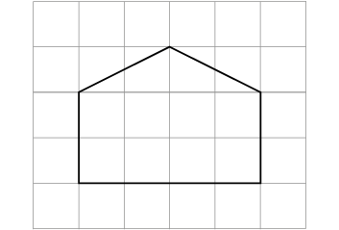
6G-1 Draw compose and decompose shapes
What is the area of one square on the grid shown? How is it calculated?
What is the area of the pentagon shown? How many different ways can this area be calculated?
Draw a different shape with the same area.
Repeat, asking pupils to calculate the area of different shapes and draw different shapes with different areas. This could include using squared and isometric paper.
1cm
1cm

Slide 22
Year 6, Unit 4, Learning Outcome 3

Slide 23
Year 6, Unit 4, Learning Outcome 3
Look at one of each of the shapes. Discuss their area relative to one another. Can you order them from largest to smallest?
Using the four shapes shown here, find different ways to make a shape with an area equivalent to the area of two hexagons.
What other compound shapes can you make that have the area of two hexagons, but not the shape of two hexagons?

Slide 24
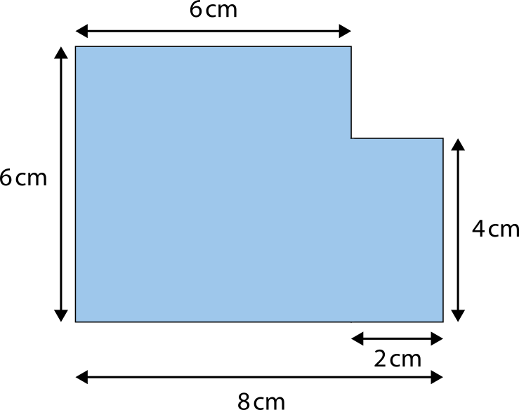
Year 6, Unit 4, Learning Outcome 3
What is the area of this shape?
A = 6 cm × 6 cm + 2 cm × 4 cm
= 44 cm²

Slide 25


Year 6, Unit 4, Learning Outcome 3
What is the area of this shape?
A = 8 cm × 6 cm − 2 cm × 2 cm
= 44 cm²

Slide 26
Year 6, Unit 4, Learning Outcome 4
Learning Outcome 4
Any parallelogram can be decomposed and the parts rearranged to form a rectangular parallelogram.
The following slides have been collated to support the teaching of this learning outcome.

Slide 27
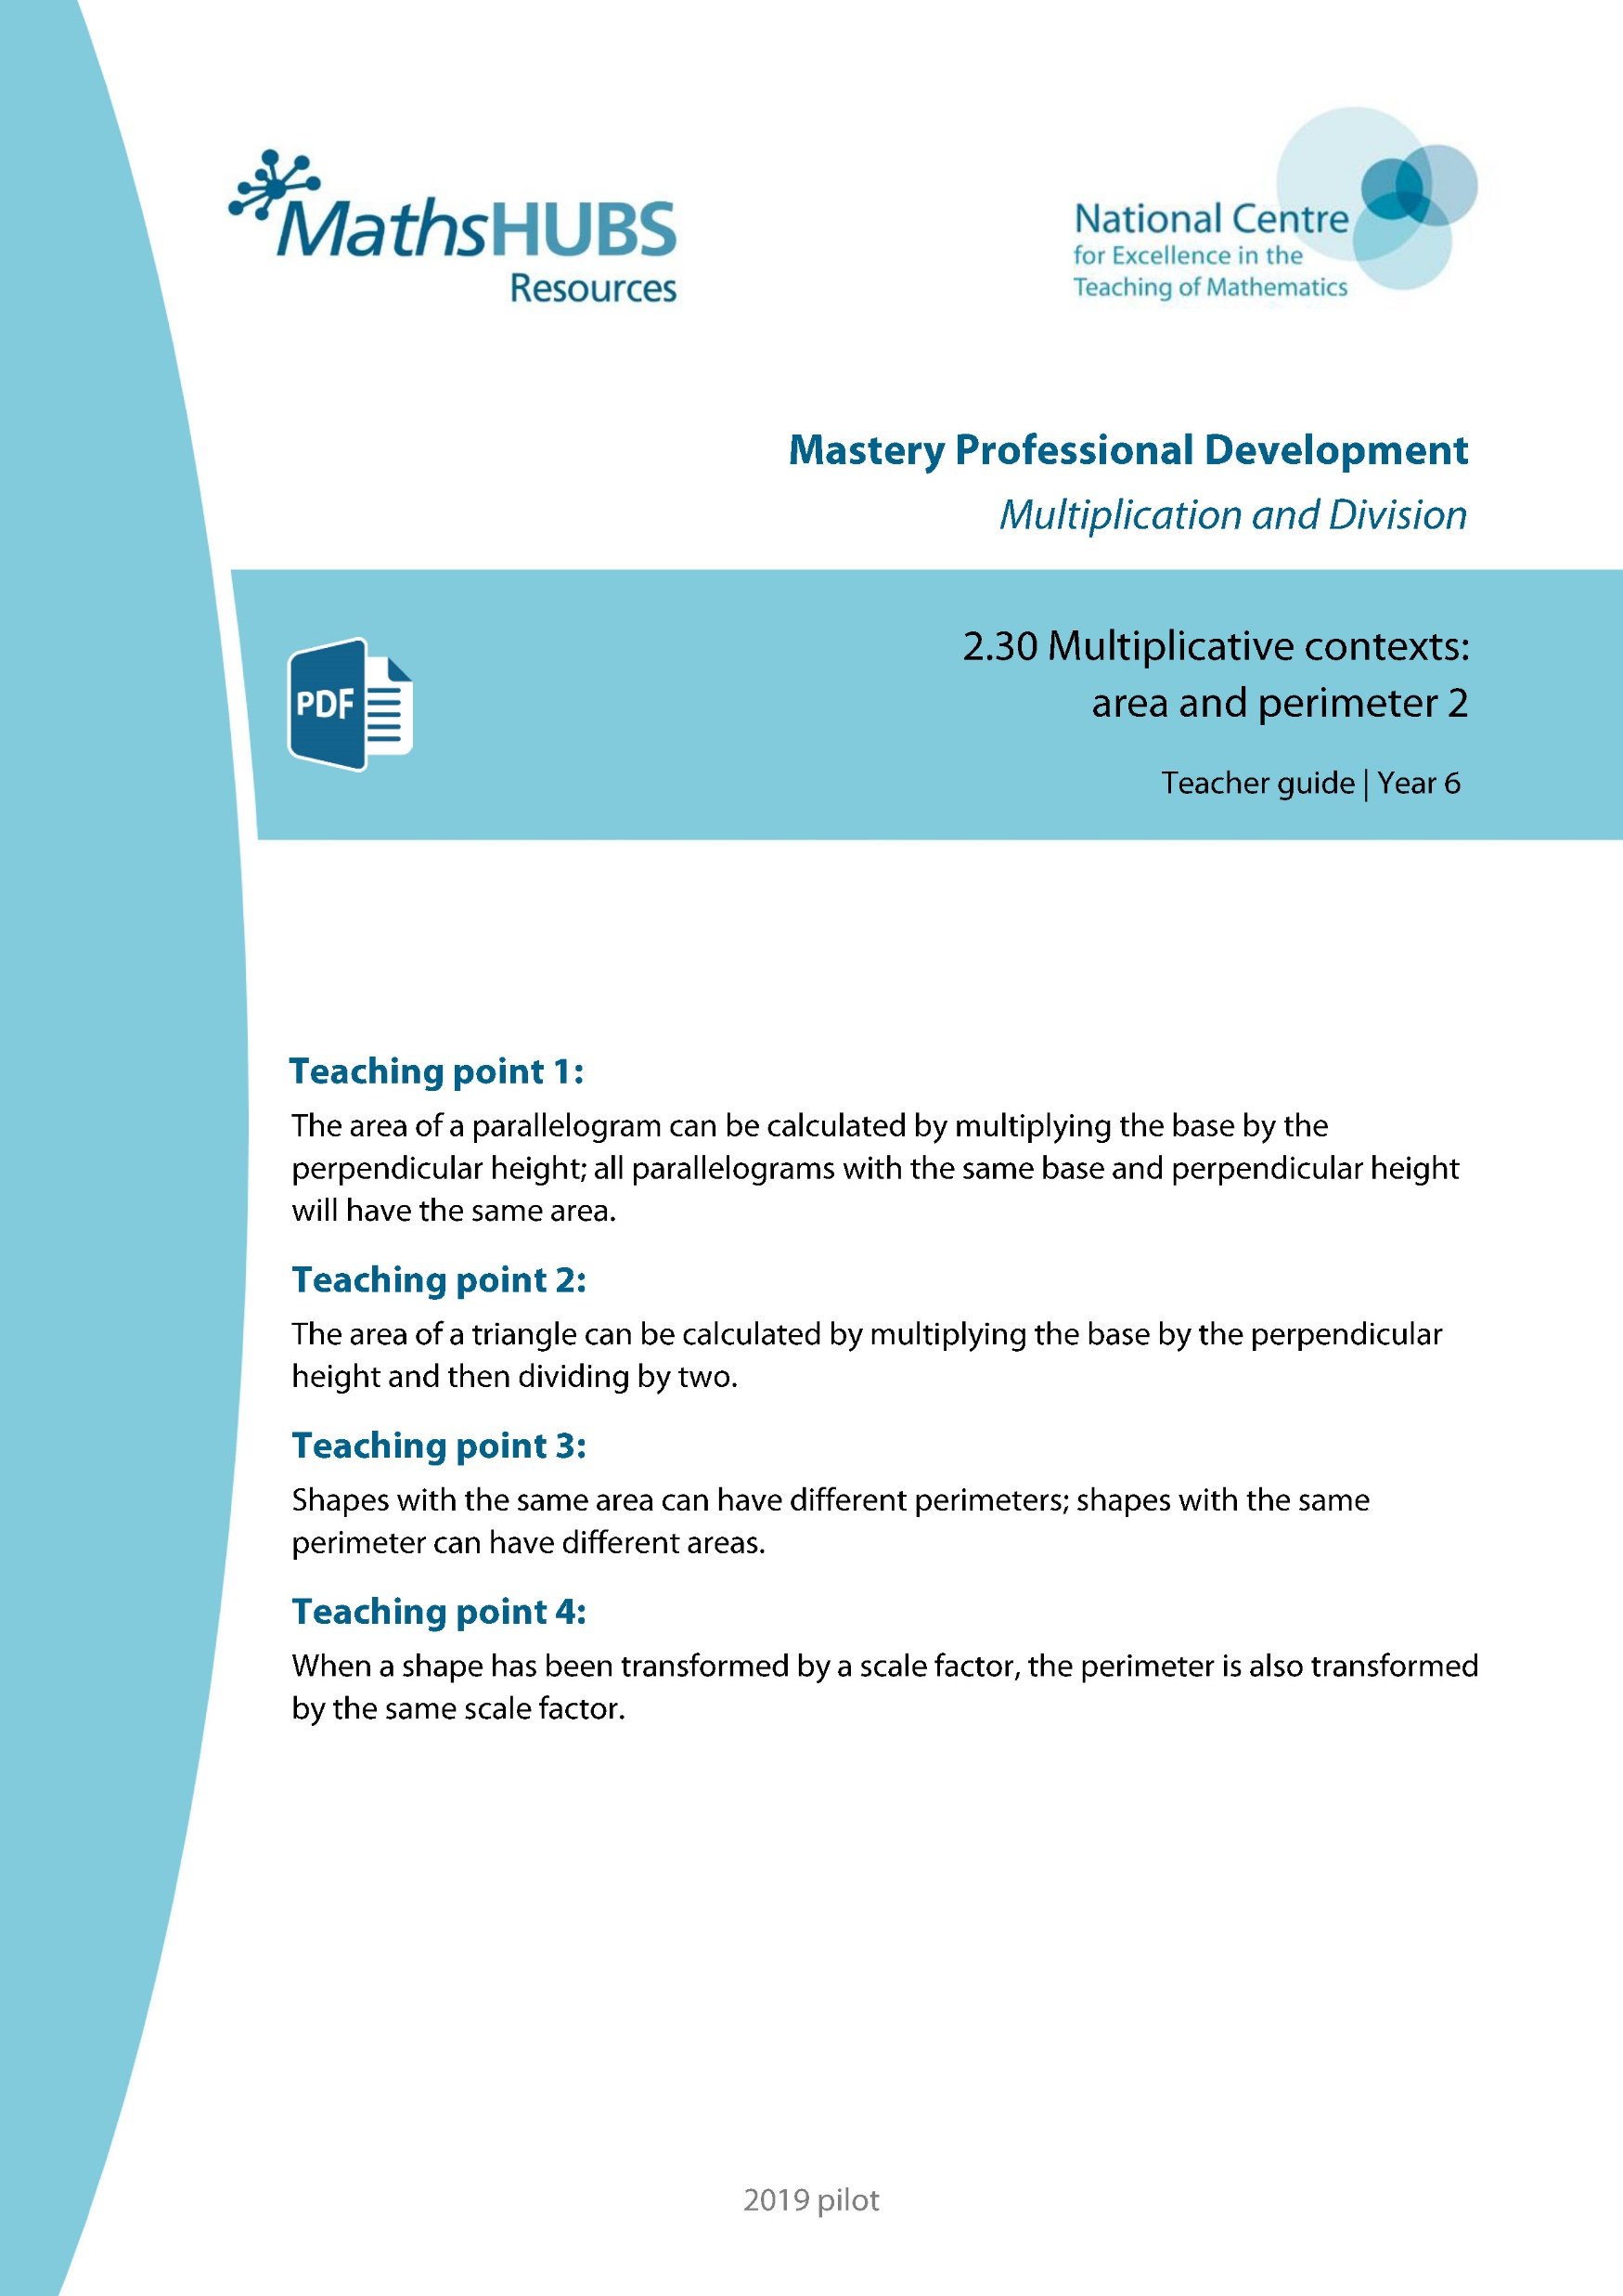
Year 6, Unit 4, Learning Outcome 4
Additional teacher guidance for this outcome should be read first and can be found in this segment of the NCETM Primary Mastery Professional Development Materials:
2.30 Multiplicative contexts: area and perimeter 2
The spine materials are divided into ‘teaching points’ and ‘steps in learning’.
Teaching point | Steps in learning | Pages
1 | 1:1 - 1:7 | 3-9

Slide 28
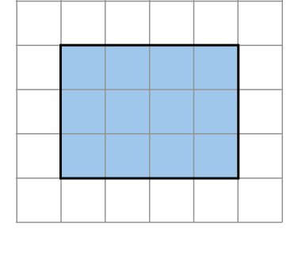
2.30 Area and perimeter 2 – step 1:1
2.30 Area and perimeter 2 – step 1:1
Shape A
Notes:
The area is twelve square units.
You could count the squares.
You could multiply the length by the width.
3 × 4 = 12
You could multiply the width by the length.
4 × 3 = 12

Slide 29
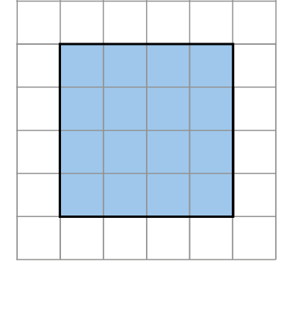
2.30 Area and perimeter 2
2.30 Area and perimeter 2 – step 1:1
Shape A
Shape B
Notes:
The area of shape B is sixteen square units.
This shape has a larger area than shape A.
You could count the squares.
You could multiply the length by the width.
4 × 4 = 12

Slide 30
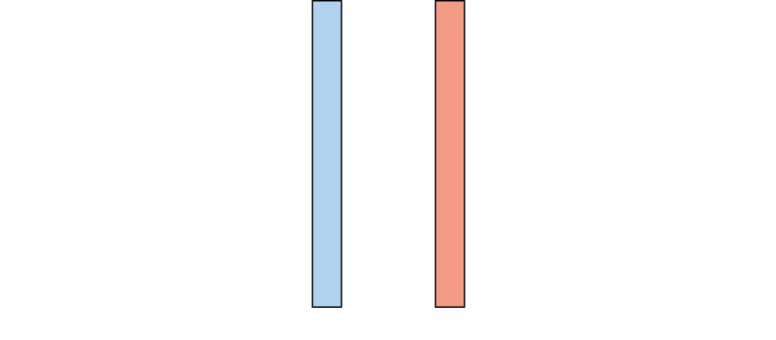
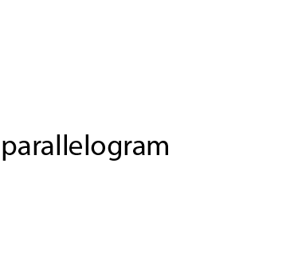
2.30 Area and perimeter 2
2.30 Area and perimeter 2 – step 1:2

Slide 31
2.30 Area and perimeter 2
2.30 Area and perimeter 2 – step 1:2

Slide 32
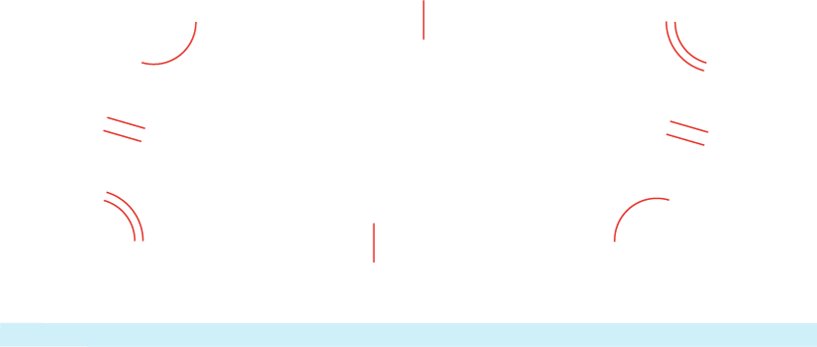
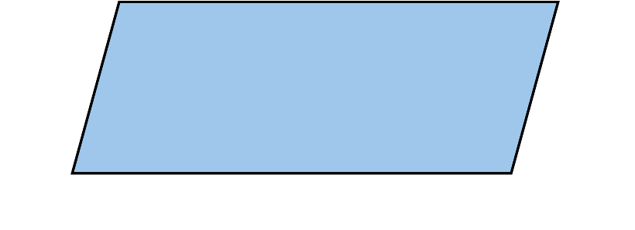
2.30 Area and perimeter 2 – step 1:2

Slide 33
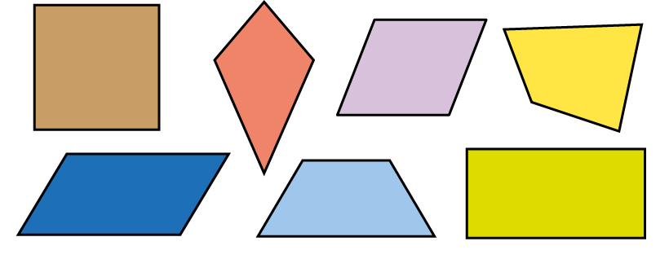
2.30 Area and perimeter 2
2.30 Area and perimeter 2 – step 1:2
Notes:
Which shapes are parallelograms?
How do you know?
A square is a parallelogram because it has opposite sides that are parallel and equal in length.

Slide 34
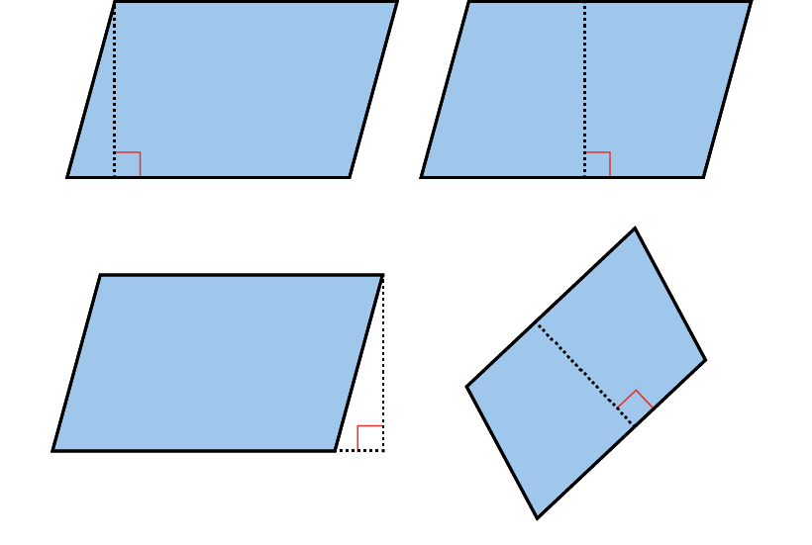
2.30 Area and perimeter 2
2.30 Area and perimeter 2 – step 1:3
The perpendicular height of parallelograms:

Slide 35
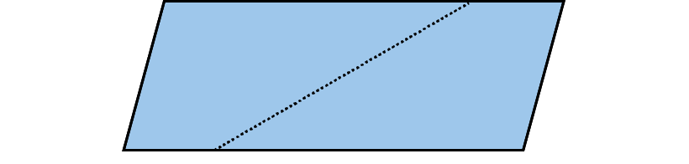
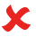
2.30 Area and perimeter 2
2.30 Area and perimeter 2 – step 1:3
Does this show the perpendicular height?

Slide 36
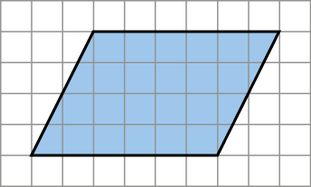
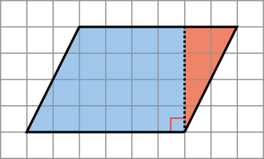
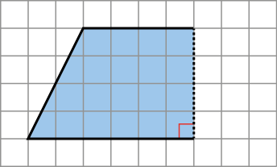

2.30 Area and perimeter 2
2.30 Area and perimeter 2 – step 1:4
Changing a parallelogram into a rectangle by cutting shapes:

Slide 37
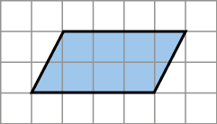
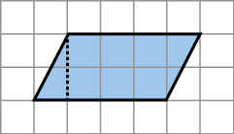
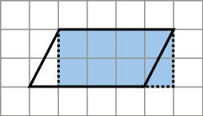
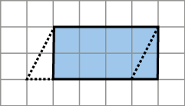
2.30 Area and perimeter 2
2.30 Area and perimeter 2 – step 1:4
Changing a parallelogram into a rectangle by drawing lines:

Slide 38
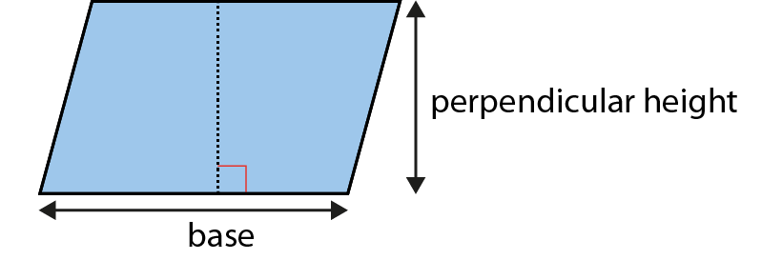
2.30 Area and perimeter 2
2.30 Area and perimeter 2 – step 1:5
Finding the area of a parallelogram:
Notes:
Multiply the base by the perpendicular height.

Slide 39
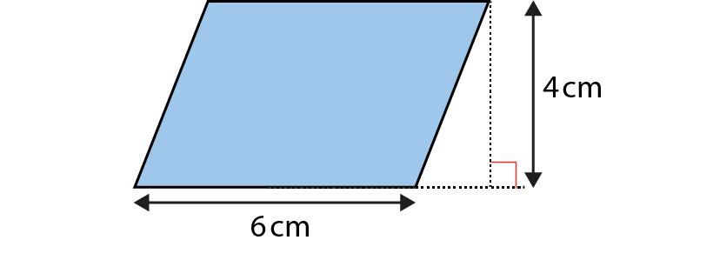
2.30 Area and perimeter 2
2.30 Area and perimeter 2 – step 1:5
Notes:
Find the area of this parallelogram.
The base is 6 cm.
The perpendicular height is 4 cm.
The area is 6 × 4 = 24 cm².

Slide 40
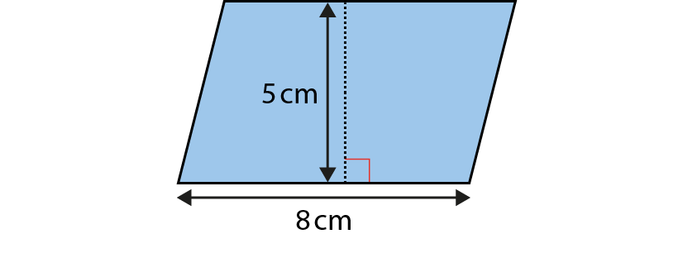
2.30 Area and perimeter 2
2.30 Area and perimeter 2 – step 1:5
Notes:
Find the area of this parallelogram.
The base is 8 cm.
The perpendicular height is 5 cm.
The area is 8 × 5 = 40 cm².

Slide 41
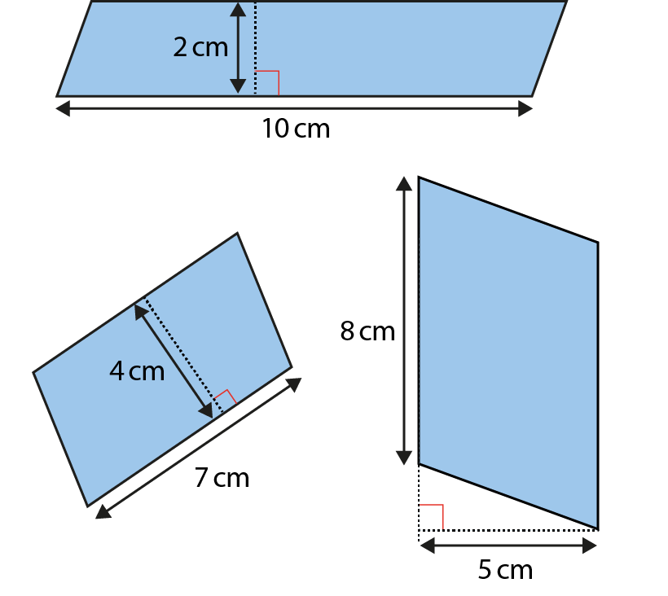
2.30 Area and perimeter 2
2.30 Area and perimeter 2 – step 1:6
Notes:
Find the area of these parallelograms.

Slide 42
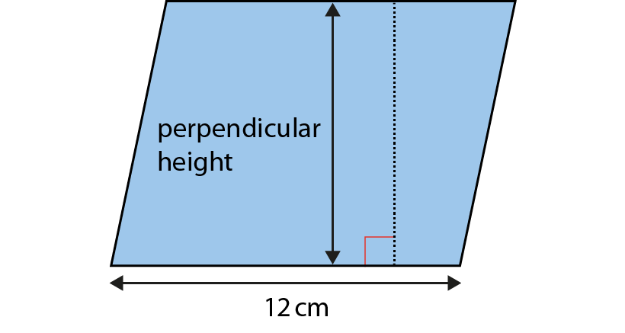
2.30 Area and perimeter 2
2.30 Area and perimeter 2 – step 1:7
A = 108 cm². What is the perpendicular height?
Notes:
area ÷ base = perpendicular height
108 ÷ 12 = 9
The perpendicular height is 9 cm.

Slide 43
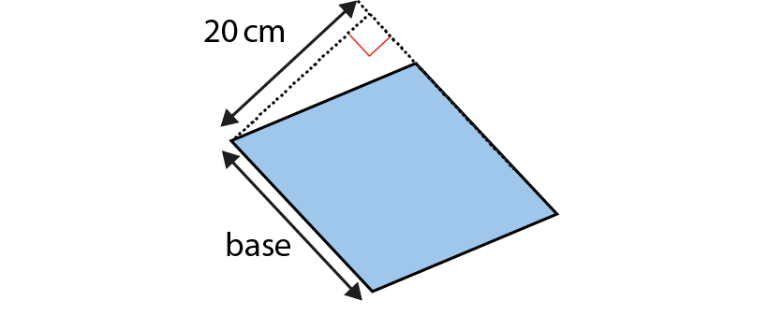
2.30 Area and perimeter 2
2.30 Area and perimeter 2 – step 1:7
A = 440 cm². What is the length of the base?
Notes:
area ÷ perpendicular height = base
440 ÷ 20 = 22
The base is 22 cm.

Slide 44
Year 6, Unit 4, Learning Outcome 5
Learning Outcome 5
Two congruent triangles can be composed to form a parallelogram.
The following slides have been collated to support the teaching of this learning outcome.

Slide 45
Year 6, Unit 4, Learning Outcome 5
Additional teacher guidance for this outcome should be read first and can be found in this segment of the NCETM Primary Mastery Professional Development Materials:
2.30 Multiplicative contexts: area and perimeter 2
The spine materials are divided into ‘teaching points’ and ‘steps in learning’.
Teaching point | Steps in learning | Pages
2 | 2:1 - 2:9 | 10-19

Slide 46
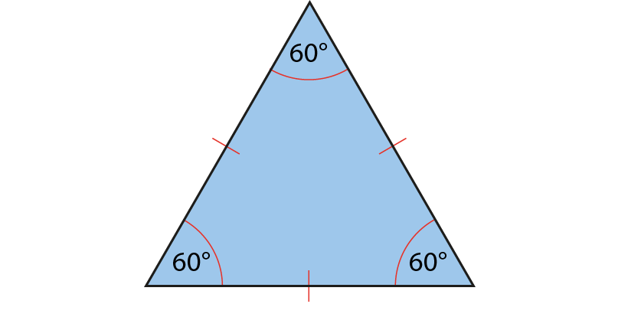
2.30 Area and perimeter 2
2.30 Area and perimeter 2 – step 2:1
Notes:
Equilateral triangles have three equal sides and three equal angles.

Slide 47
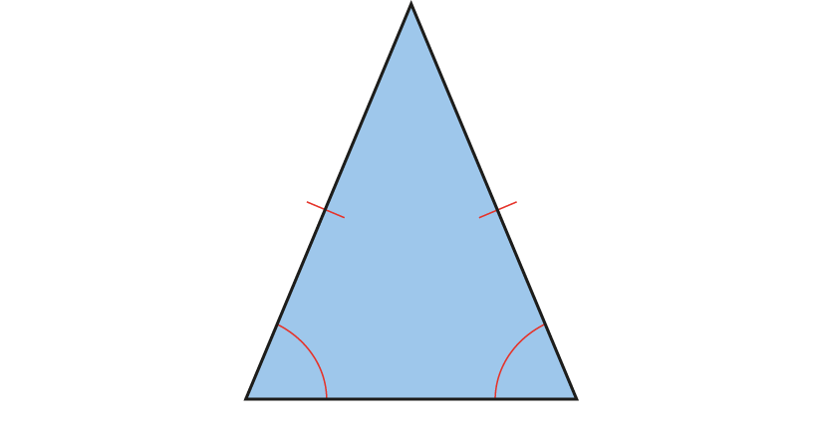
2.30 Area and perimeter 2
2.30 Area and perimeter 2 – step 2:1
Notes:
Isosceles triangles have two equal sides and two equal angles.

Slide 48

2.30 Area and perimeter 2
2.30 Area and perimeter 2 – step 2:1
Notes:
Scalene triangles have no equal sides and no equal angles.

Slide 49
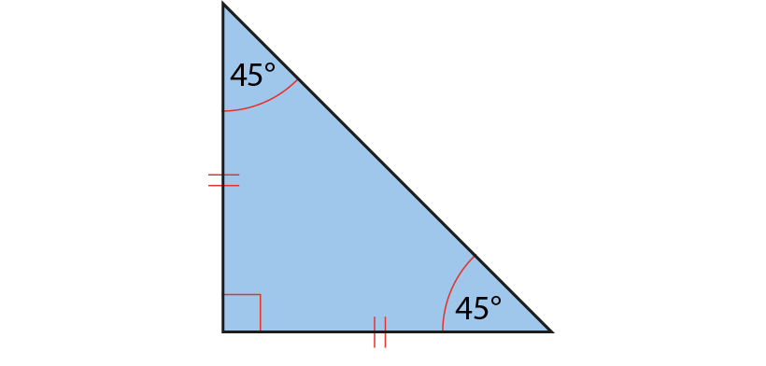
2.30 Area and perimeter 2
2.30 Area and perimeter 2 – step 2:1
Notes:
Right-angled isosceles triangles have two equal sides, two equal angles and a right angle.

Slide 50
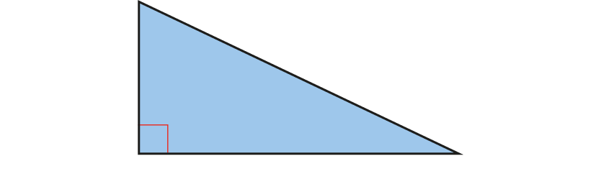
2.30 Area and perimeter 2
2.30 Area and perimeter 2 – step 2:1
Notes:
Right-angled scalene triangles have no equal sides, no equal angles and a right angle.

Slide 51
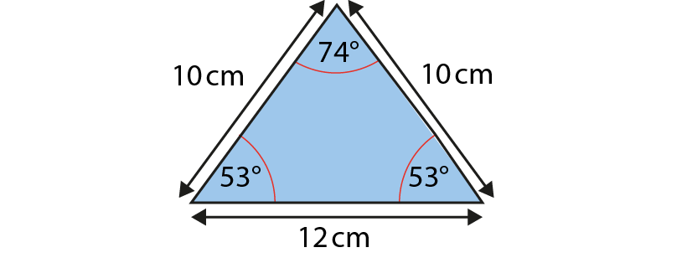
2.30 Area and perimeter 2
2.30 Area and perimeter 2 – step 2:1
Notes:
This is an isosceles triangle because it has two equal sides and two equal angles.

Slide 52
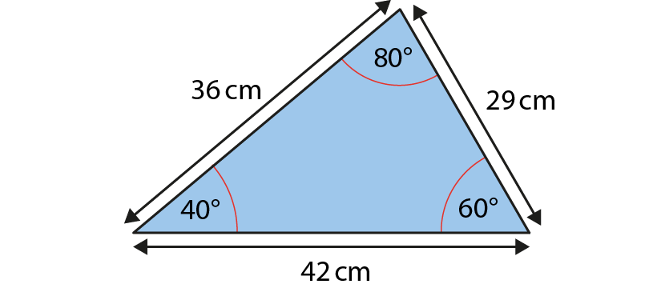
2.30 Area and perimeter 2
2.30 Area and perimeter 2 – step 2:1
Notes:
This is a scalene triangle because it has no equal sides and no equal angles.

Slide 53

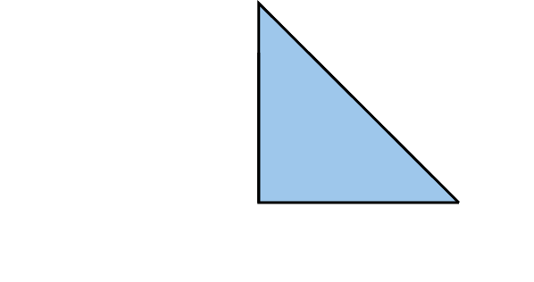
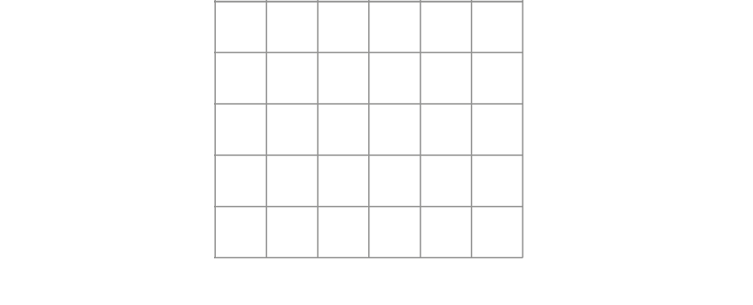
2.30 Area and perimeter 2
2.30 Area and perimeter 2 – step 2:2
Find the area of the triangle:
Notes:
The area is eight square units.

Slide 54
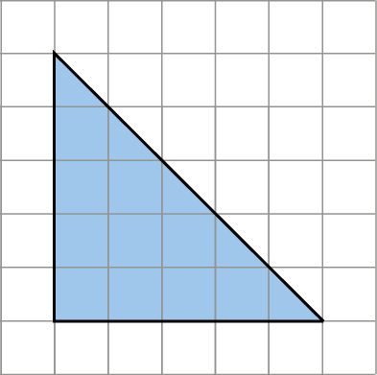
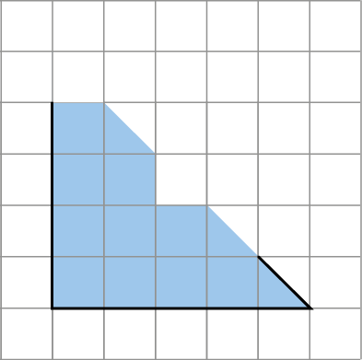
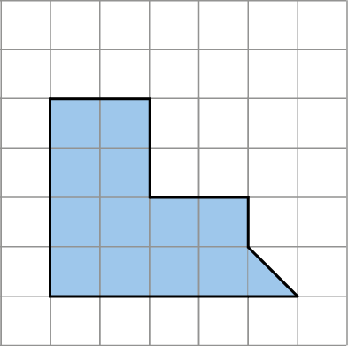

2.30 Area and perimeter 2
2.30 Area and perimeter 2 – step 2:2
Find the area of the triangle:
Notes:
The area is twelve and a half square units.

Slide 55
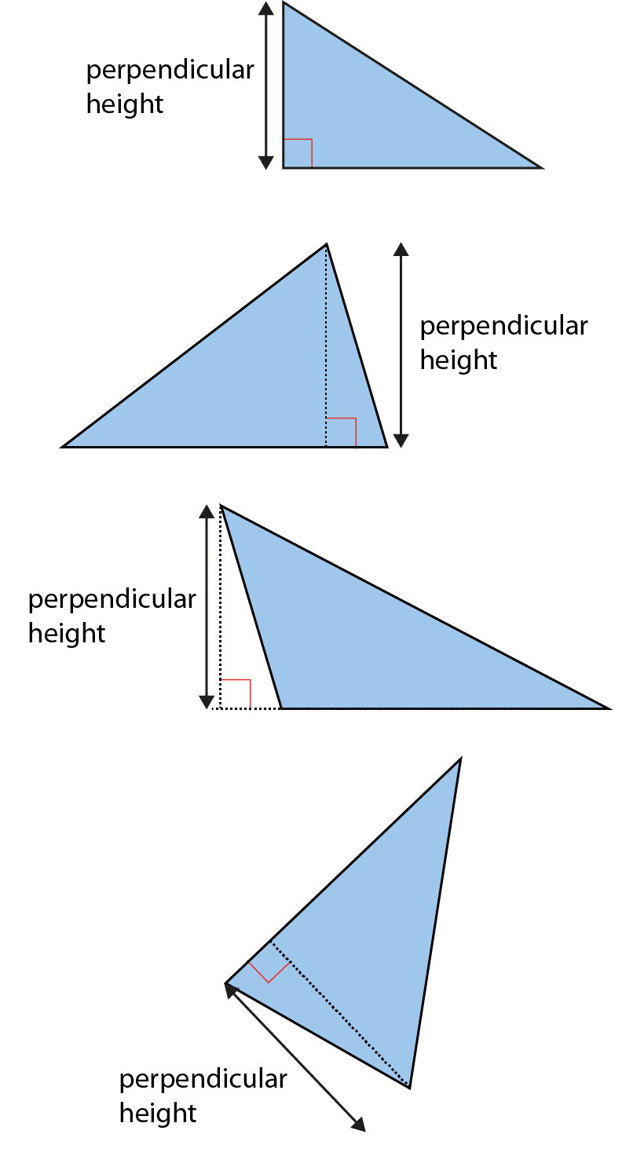
2.30 Area and perimeter 2
2.30 Area and perimeter 2 – step 2:2
The perpendicular height of triangles:

Slide 56
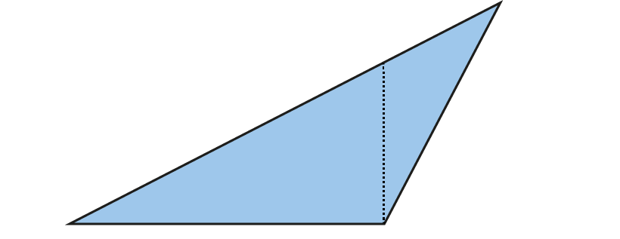
2.30 Area and perimeter 2
2.30 Area and perimeter 2 – step 2:3
Does this show the perpendicular height?

Slide 57
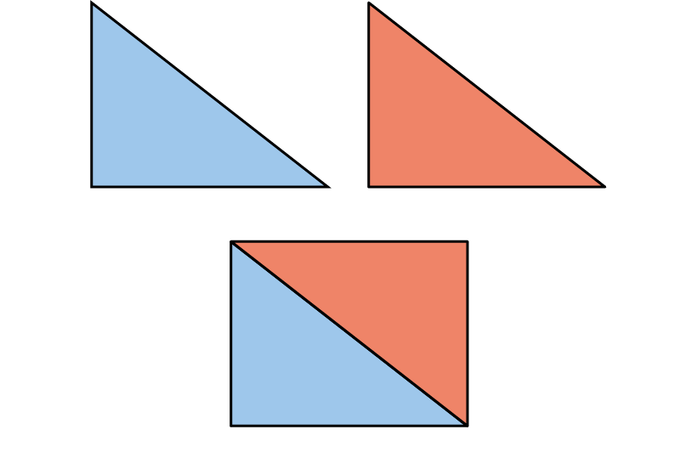
2.30 Area and perimeter 2
2.30 Area and perimeter 2 – step 2:4
Combining two triangles to make a rectangle:

Slide 58
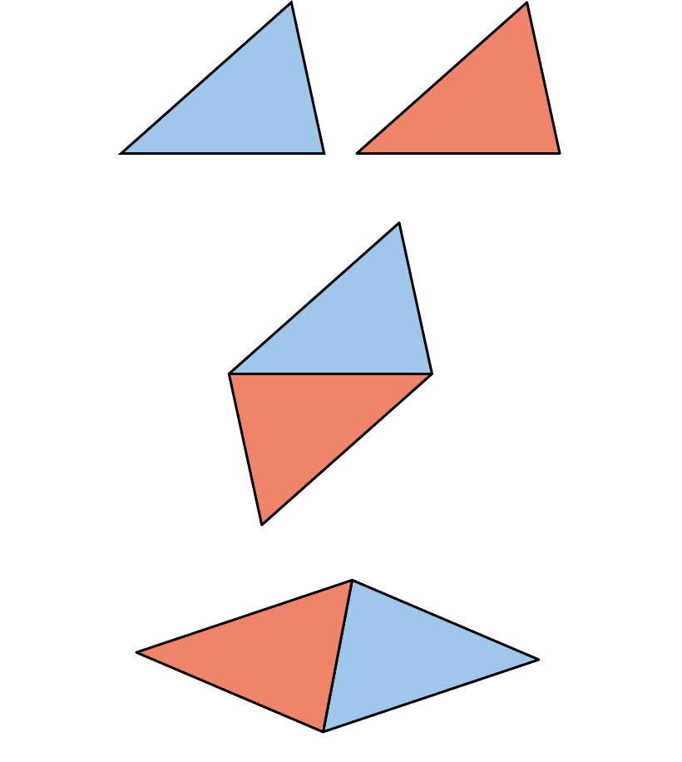
2.30 Area and perimeter 2
2.30 Area and perimeter 2 – step 2:5
Combining two triangles to make a parallelogram:

Slide 59
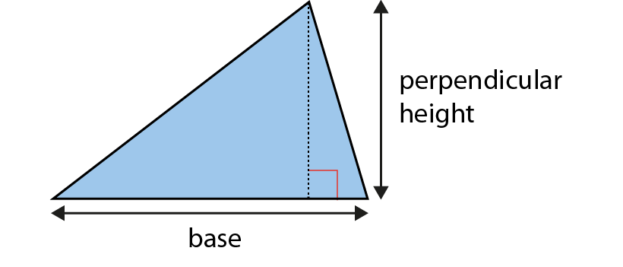
2.30 Area and perimeter 2
2.30 Area and perimeter 2 – step 2:6
Finding the area of a triangle:
Notes:
area = base × perpendicular height ÷ 2

Slide 60
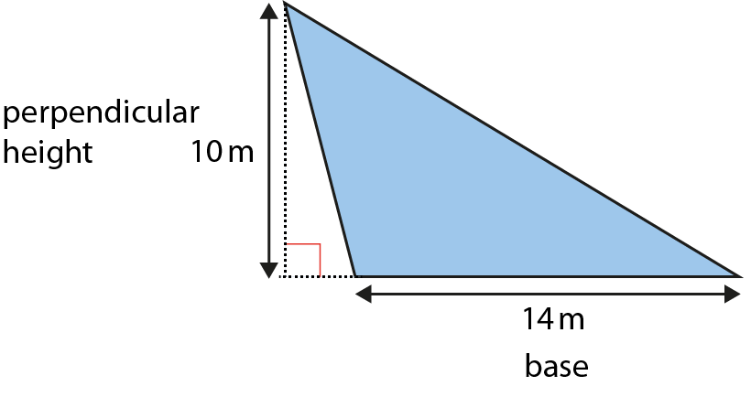
2.30 Area and perimeter 2
2.30 Area and perimeter 2 – step 2:6
Notes:
Find the area of this triangle.
The base is 14 m.
The perpendicular height is 10 m.
The area is 14 × 10 ÷ 2 = 140 ÷ 2 = 70 m².

Slide 61
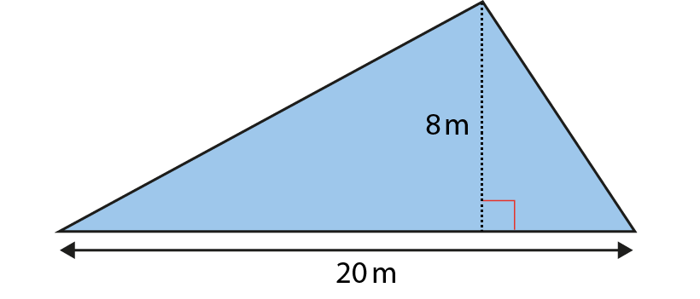
2.30 Area and perimeter 2
2.30 Area and perimeter 2 – step 2:6
Notes:
Find the area of this triangle.
The base is 20 m.
The perpendicular height is 8 m.
The area is 20 × 8 ÷ 2 = 160 ÷ 2 = 80 m².

Slide 62
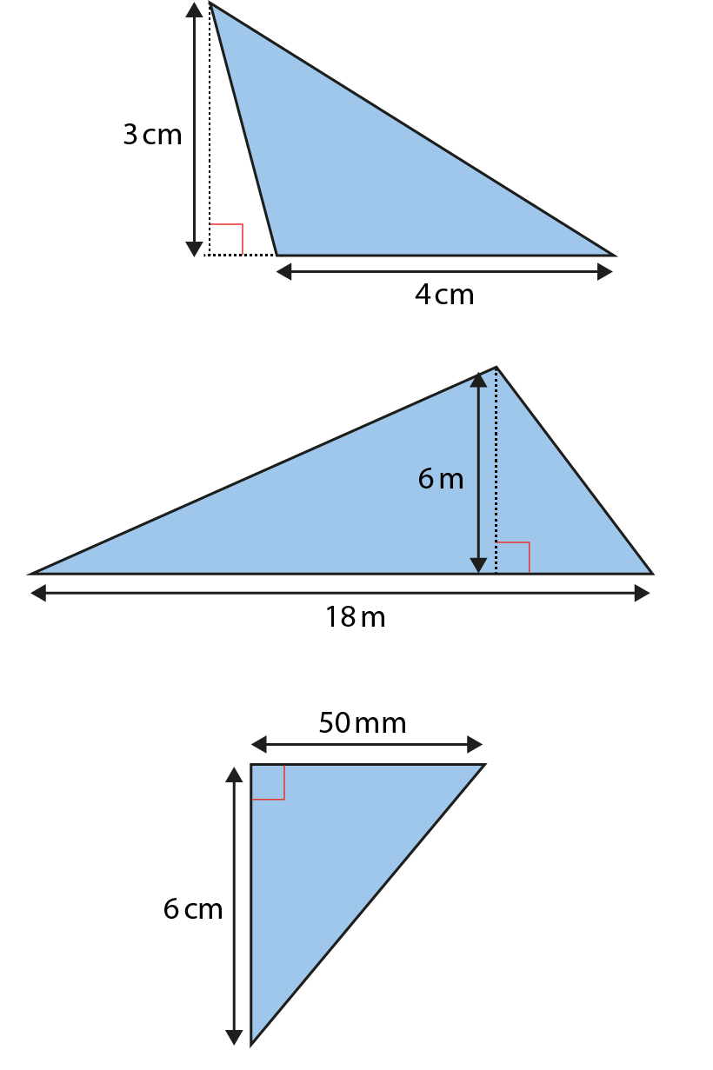
2.30 Area and perimeter 2
2.30 Area and perimeter 2 – step 2:7
Notes:
Find the area of these triangles.

Slide 63

2.30 Area and perimeter 2
2.30 Area and perimeter 2 – step 2:8
A = 42 m². What is the perpendicular height?
Notes:
42 m² × 2 = 84 m²
84 ÷ 12 = 7
The perpendicular height of the triangle is 7 m.

Slide 64

2.30 Area and perimeter 2
2.30 Area and perimeter 2 – step 2:8
A = 44 m². How long is the base?
Notes:
44 m² × 2 = 88 m²
88 ÷ 8 = 11
The base of the triangle is 11 m.

Slide 65

2.30 Area and perimeter 2
2.30 Area and perimeter 2 – step 2:8
A = 54 cm². What could the base and height be?

Slide 66

2.30 Area and perimeter 2
2.30 Area and perimeter 2 – step 2:8
Notes:
Sonnie says the area of this triangle is 40 cm².
Brittany says the area of the triangle is 30 cm².
Tom says the area of the triangle is 24 cm².
Who is right? Explain your answer.

Slide 67

2.30 Area and perimeter 2
2.30 Area and perimeter 2 – step 2:9
Notes:
What is the total area of this shape?

Slide 68

2.30 Area and perimeter 2
2.30 Area and perimeter 2 – step 2:9
Notes:
What is the total area of the shaded sections?

Slide 69
Year 6, Unit 4, Learning Outcome 6
Learning Outcome 6
Shapes with the same area can have different perimeters. Shapes with the same perimeters can have different areas.
The following slides have been collated to support the teaching of this learning outcome.

Slide 70
Year 6, Unit 4, Learning Outcome 6
Additional teacher guidance for this outcome should be read first and can be found in this segment of the NCETM Primary Mastery Professional Development Materials:
2.30 Multiplicative contexts: area and perimeter 2
The spine materials are divided into ‘teaching points’ and ‘steps in learning’.
Teaching point | Steps in learning | Pages
3 | 3:1 - 3:5 | 20-24

Slide 71

2.30 Area and perimeter 2
2.30 Area and perimeter 2 – step 3:1
Comparing perimeter and area:
Notes:
The distance around the edge of the rectangle is its perimeter.
P = (10 × 2) + (8 × 2) = 20 + 16 = 36 cm
A = 10 × 8 = 80 cm²

Slide 72

2.30 Area and perimeter 2
2.30 Area and perimeter 2 – step 3:1
Comparing perimeter and area:
Notes:
The distance around the edge of the triangle is its perimeter.
P = 3 + 4 + 5 = 12 cm
A = 4 × 3 ÷ 2 = 6 cm²

Slide 73

2.30 Area and perimeter 2
2.30 Area and perimeter 2 – step 3:1
Comparing perimeter and area:
Notes:
The distance around the edge of the parallelogram is its perimeter.
P = (7 × 2) + (8 × 2) = 14 + 16 = 30 cm
A = 8 × 4 = 32 cm²

Slide 74

2.30 Area and perimeter 2
2.30 Area and perimeter 2 – step 3:1
Notes:
Find the area and perimeter of this shape.

Slide 75

2.30 Area and perimeter 2
2.30 Area and perimeter 2 – step 3:1
Notes:
Find the area and perimeter of this shape.

Slide 76

2.30 Area and perimeter 2
2.30 Area and perimeter 2 – step 3:2
Same perimeter, different area:
Notes:
P = 12 units
A = 5 units²

Slide 77

2.30 Area and perimeter 2
2.30 Area and perimeter 2 – step 3:2
Same perimeter, different area:
Notes:
P = 12 units
A = 8 units²

Slide 78

2.30 Area and perimeter 2
2.30 Area and perimeter 2 – step 3:2
Same perimeter, different area:
Notes:
P = 12 units
A = 9 units²

Slide 79

2.30 Area and perimeter 2
2.30 Area and perimeter 2 – step 3:2
Same perimeter, different area:
Notes:
P = 12 units
A = 5 units²

Slide 80

2.30 Area and perimeter 2
2.30 Area and perimeter 2 – step 3:4
Same area, different perimeter:
Notes:
P = 34 units
A = 16 units²

Slide 81

2.30 Area and perimeter 2
2.30 Area and perimeter 2 – step 3:4
Same area, different perimeter:
Notes:
P = 20 units
A = 16 units²

Slide 82

2.30 Area and perimeter 2
2.30 Area and perimeter 2 – step 3:4
Same area, different perimeter:
Notes:
P = 16 units
A = 16 units²

Slide 83

2.30 Area and perimeter 2
2.30 Area and perimeter 2 – step 3:4
Same area, different perimeter:
Notes:
P = 26 units
A = 16 units²

Slide 84

6G-1 Draw compose and decompose shapes
Label the dimensions of this rectangle.
What is the perimeter of the rectangle?
Is it possible to draw a different rectangle with the same perimeter? Why/why not?
Draw other rectangles with different dimensions with the same perimeter.
Is it possible to draw a square with a perimeter of 14cm? Why/why not?
1cm
1cm

Slide 85
Year 6, Unit 4, Learning Outcome 7
Learning Outcome 7
We can use the relationship between area and side length, and perimeter and side length, to reason about measurements of shapes, including compound shapes.
The following slides have been collated to support the teaching of this learning outcome.

Slide 86
Year 6, Unit 4
Spatial reasoning starter
Imagine a blue cube. Now imagine that the bottom half of the cube is dipped in green paint. Is this what you saw?
Look at the nets on the left. Which of them fold to give a cube that looks like the one below?
Now sketch out these two nets. Which bits would need to be green to give the same cube?

Slide 87
Year 6, Unit 4, Learning Outcome 7
Additional teacher guidance for this outcome should be read first and can be found in the DfE Mathematics guidance. Page references relate to the 335-page document available as a download at the bottom of this web page.
Ready to progress criteria | Pages
6G-1 | 322-326

Slide 88
6G-1 Draw compose and decompose shapes
This is additional guidance for the next three slides.
Pupils need to understand the difference between area and perimeter, including the different units of measure for each.
Pupils will benefit from hands-on experience manipulating the shapes shown to understand how the shapes can be decomposed into parts.
Pupils need to understand what unknown information can be added to diagrams without calculation and what cannot, explaining the reasons for this. Within this process it is important for pupils to know that they cannot estimate the unknown values from sight, but instead must use their understanding of the properties of shape to calculate the unknowns – for example, that opposite sides of a rectangle are equal in length.

Slide 89

6G-1 Draw compose and decompose shapes
Here is a T-shape made from 3 identical rectangles. The area of the shape is 90cm². What is the missing side-length?
What do we know about the area of each rectangle if they are identical?
How can we calculate the length of each rectangle? How can this be used to calculate the unknown width?
Repeat with other compound shapes.
6 cm
6 cm
5 cm
A = 30 cm²
A = 30 cm²
5 cm
A = 30 cm²
The area of each rectangle is the same and can be found by dividing the total area by three.
90 ÷ 3 = 30. The area of each rectangle is 30cm².
A = 90 cm²
5
6 x ? = 30

Slide 90

6G-1 Draw compose and decompose shapes
Look at the two shapes. What is the same? What is different?
Each square has a side-length of 6cm. What are the area (A) and perimeter (P) of shape A and shape B?
What do you notice about the area and perimeter of both shapes? Why is this the case?
Give children the opportunity to use cut-out squares to investigate when the area and perimeter of different compound shapes would stay the same and change.
8 x 6cm = 48 cm
Perimeter = 48cm
6 cm
6 cm
6 cm
3 x 36cm² = 108cm²
6 cm
36cm²
36cm²
36cm²
6 cm
Area = 108cm²
6 cm
6 cm
6 cm
6 cm
6 cm
8 x 6cm = 48 cm
Perimeter = 48cm
6 cm
36cm²
36cm²
6 cm
3 x 36cm² = 108cm²
6 cm
36cm²
6 cm
6 cm
Area = 108cm²
6 cm

Slide 91

6G-1 Draw compose and decompose shapes
The area of this shape is 176cm². Find the missing side-length.
What information is known? What information is unknown?
How can the given area be used to calculate the missing side-length?
What expression can be written to show that the sum of the parts are equal to the known area?
How can the unknown value be calculated from this expression?
A = 144 cm²
A =
32 cm²
A = 176 cm²
4
12 × 12 + × 8 = 176 cm²

Slide 92
Year 6, Unit 4

Slide 93
Year 6, Unit 4

Slide 94
Year 6, Unit 4

Slide 95
Year 6, Unit 4

