Slide 1
Series 3 Episode 29
Thirteen

Slide 2
Practitioner Notes

Slide 3
Episode Description
Three is trying to show Ten her new trick, but when it goes wrong she collides with Ten to make Thirteen. Thirteen sings a song about how unlucky he always is every time he says “thirteen“. He ends up changing into new arrangements of Ten and Three but it always seems a bit clumsy until he realises he can make it into a game and that really he is lucky to be unlucky.

Slide 4
Maths in the Episode
Composition and properties of 13
In this episode the Thirteen is made by combining Ten and Three. Thirteen can also be partitioned into 1 ten and 1 three. Counting to thirteen is also experienced so that it is possible to understand the position of 13 in the number system as 1 more than 12.

Slide 5
Using Mathematical Language
Use these stem sentences to rehearse the mathematical ideas in the programme:
<13> is made from one <10> and one <3>.”
<10> add <3> is <13>.”
<13> is one more than <12>.”
Notes:
Text inside < > indicates what can be changed in the stem sentence.

Slide 6
Talk and Discuss Together

Slide 7
Talk and Discuss Together
Watch the episode of Numberblocks. First ask the children what they noticed and allow them to talk to you and each other.
What does it mean to be unlucky? Can you think of a time when you have been lucky or unlucky?
The following slides are designed to stimulate children and adults to talk about the episode and draw out some key aspects of the mathematics.

Slide 8
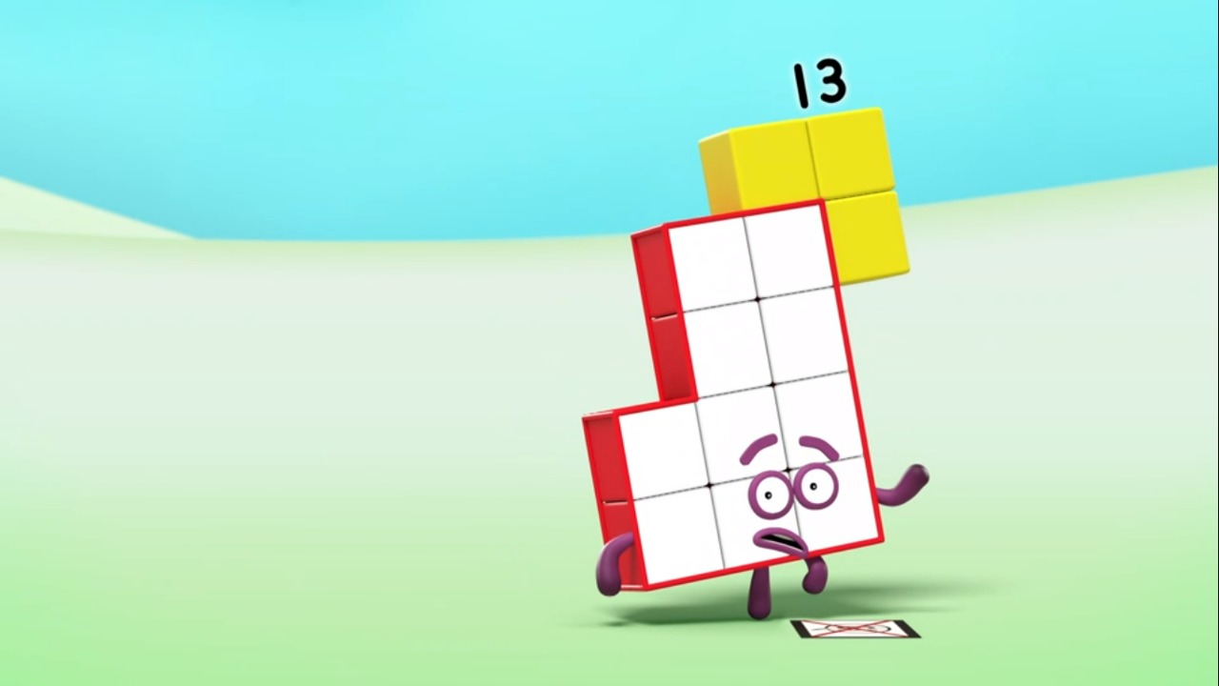
Images © 2017 Alphablocks Ltd. All Rights Reserved.
Notes:
Use this picture as the stimulus for Talk and Discussion (slide 7).

Slide 9
Enabling Environments in Reception

Slide 10
Enabling Environments
Playing and Exploring
Look out for unlucky moments when the children are playing. Take photos of unlucky moments, for example, missing a goal, running out of time for a turn. Display photos of the children’s unlucky moments on an ‘unlucky thirteen’ board.
Active Learning
Listen in to whether children can count consistently beyond twelve and use ‘-teen’ not ‘-ty’ when counting. Model counting to thirteen and over-emphasise the ‘-teen’.
Creating and Thinking Critically
Build different representations of 13 as a quantity using one ten and three ones using different concrete resources.

Slide 11
Learning Together in Y1

Slide 12
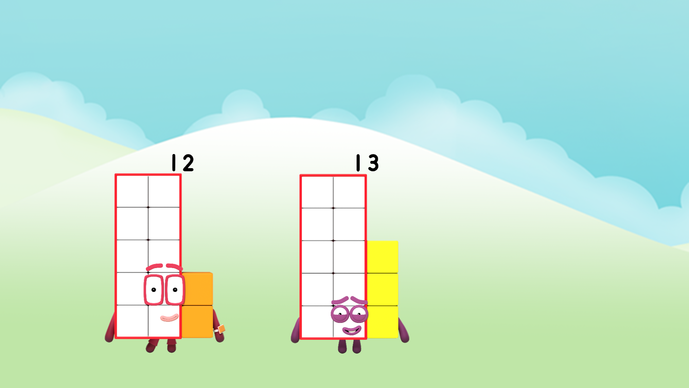
I am more than 12.
Images © 2017 Alphablocks Ltd. All Rights Reserved.
Notes:
Use this slide to discuss Twelve and Thirteen.
What is the same about Twelve and Thirteen? What is different about Twelve and Thirteen?

Slide 13
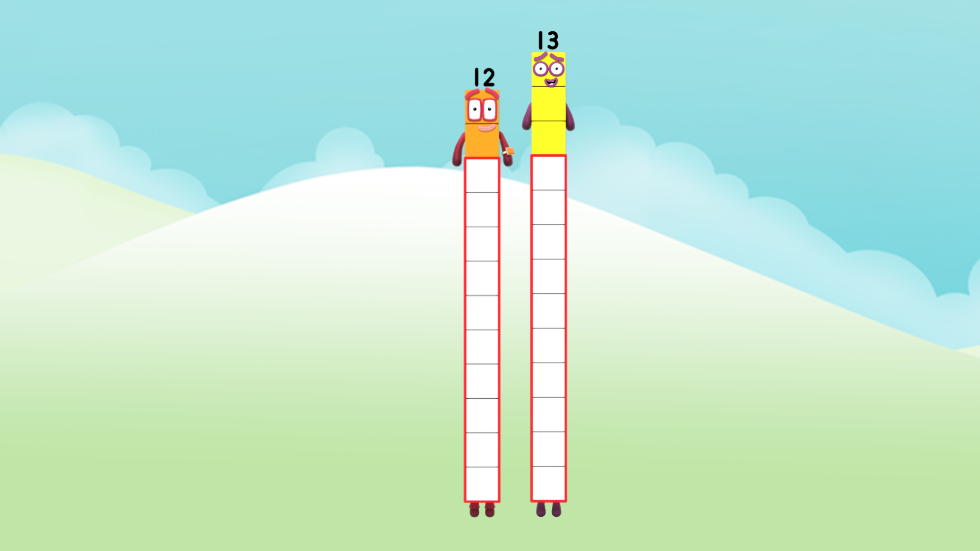
I am one block taller than Twelve.
I am one block shorter than Thirteen.
Images © 2017 Alphablocks Ltd. All Rights Reserved.
Notes:
How can we compare 12 and 13 using this picture? (Children might suggest that Thirteen is taller/ higher/ more than Thirteen or that Twelve is shorter/ less.)
How much taller is Thirteen than Twelve?
What does Thirteen mean when he says he is ‘one block taller than Twelve’? (He has one extra block/ he is one block more than Twelve.)
What could Twelve say about herself if she compares herself to Thirteen? (She is one block shorter/ she is one block less than Thirteen.)

Slide 14

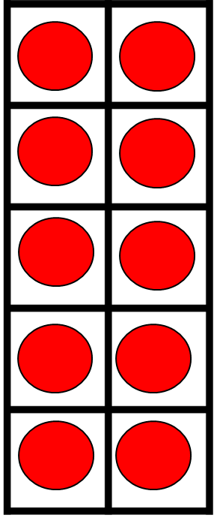
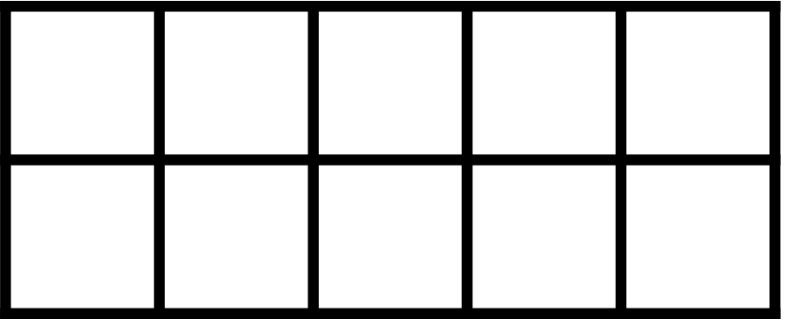


13 is 1 more than 12.
Images © 2017 Alphablocks Ltd. All Rights Reserved.
Notes:
Use this slide to compare 12 and 13 represented on tens frames.
What do you notice about the red star tens frames and the orange star tens frames? (They both represent 12).
How can we change the red star ten frame into 13? (We need to add one more counter.)
(The extra counter can be animated to emphasise it is ‘one more’ by clicking on it.)
How many in each tens frame now?
What can we say about 13 in relation to 12? (13 is 1 more than 12.)

Slide 15
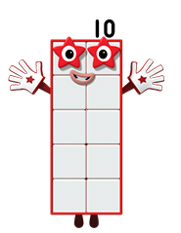
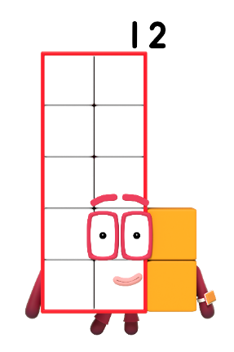
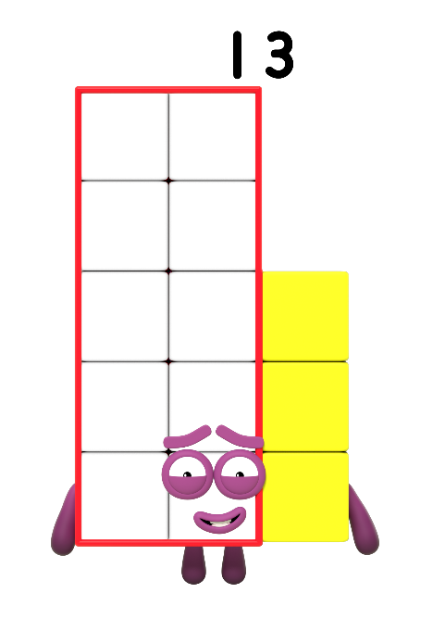
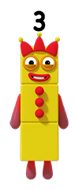
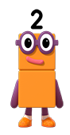
I am Ten
and Three.
I am Ten
and Two.
Images © 2017 Alphablocks Ltd. All Rights Reserved.
Notes:
Use this slide to discuss how Twelve and Thirteen are composed.
Discuss:
What do you notice about each pair of Numberblocks? (Ten and Two are standing together and Ten and Three are standing together.)
What do you think will happen if Ten and Two combine? (They will make Twelve.)
Why does Twelve say she is ‘ten and two’? (Because she is made of 10 and 2.)
What do you think will happen if Ten and Three combine? (They will make Thirteen.)
Why does Thirteen say he is ‘ten and three’? (Because he is made of 10 and 3.)

Slide 16

13 fills one ten frame and 3 on another.
The 3 means _____.
ones
The 1 means ____.
-teen!
ten
Images © 2017 Alphablocks Ltd. All Rights Reserved.
Notes:
Use this slide to begin thinking about how 13 is partitioned into 1 ten and 3 ones.
Ask the children to build the same model with 2 tens frames and double-sided counters.
Discuss:
How many counters can you see? How do you know? Can you say how many without counting?
What do you think each digit in 13 means?
Can you explain what the ‘teen’ part of ‘thirteen’ means? (It means ten.)

Slide 17
Further activities for Y1
Compare the heights of each other using “taller than” and “shorter than”.
Compare quantities that are 1 more/1 less than each other using “more than” or “less than”.
Explore ways of representing 12 and 13 so that it is possible to see that 13 is one more than 12. (For example, coins, Numicon-type shapes, Dienes blocks, connecting cubes).
Explore ways to arrange 13 on a tens frame. (Keep 10 counters on one complete tens frame and rearrange the 3 counters in different places.)
Explore ways to make 13 with red and yellow counters.

Slide 18
Learning Together in Y2

Slide 19

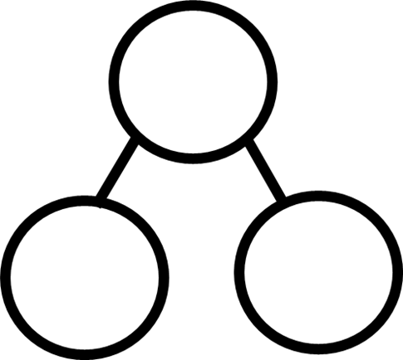






Images © 2017 Alphablocks Ltd. All Rights Reserved.
Notes:
Use these slide to explore the additive relationship between 13, 10 and 3.
Discuss:
If the parts are 10 and 3, what is the whole? (The whole is 13.)
How can we represent this with an equation? (10+3=13)
What do you notice when the parts change position? (There are still 13 counters, the whole is still 13.)
How could we write an equation which shows that the position of the parts has changed? (3+10=13)
What happens if the yellow or the red counters are taken away? How can we represent this with an equation? (13-3=10; 13-10=3)

Slide 20
Further activities for Y2
Use crossing out of tens frames to represent subtraction as a pictorial representation for other numbers to 20.
Match pictorial representations to part-part-whole diagrams and equations.
Draw missing parts on tens frames from information on part-part-whole diagrams or equations.

