Slide 1

Checkpoints
Year 8 diagnostic mathematics activities
Geometrical properties – polygons
Twenty-nine Checkpoint activities
Twelve additional activities
Published in 2022/23

Slide 2
About this resource
This resource is designed to be used in the classroom with Year 8 students, although it may be useful for other students.
The Checkpoints are grouped around the key ideas in the core concept documents, 6.1 Geometrical properties, part of the NCETM Secondary Mastery Professional Development materials.
Before each set of Checkpoints, context is explored, to help secondary teachers to understand where students may have encountered concepts in primary school.
The 10-minute Checkpoint tasks might be used as assessment activities, ahead of introducing concepts, to help teachers explore what students already know and identify gaps and misconceptions.
Each Checkpoint has an optional question marked . This will provide further thinking for those students who have completed the rest of the activities on the slide.
The notes for each Checkpoint give answers (if appropriate), some suggested questions and things to consider.
After each Checkpoint, a guidance slide explores suggested adaptations, potential misconceptions and follow-up tasks. These may include the additional activities at the end of this deck.

Slide 3
Using these Checkpoints
This deck is split into two sections: the first explores students’ understanding of the definitions of angles, and the second explores angle rules.
The angle rules section of the deck starts with rules that are part of the primary curriculum and leads into the pre-requisite knowledge needed for new rules taught at Key Stage 3. While no Checkpoint uses knowledge beyond Key Stage 2 teaching, some tasks (for example Checkpoints 23 and 24) might be used both to assess understanding and also as a starting point for introducing new content.
Angle rules are not explored in depth in the NCETM’s Curriculum Prioritisation Materials, which may affect the depth to which students have explored them. We have therefore included a wide range of tasks to support teachers to assess the extent of students’ experience and recall. Further supplementary tasks can be found in the Additional activities.
The notes for each slide make it clear how it is best used, and the guidance at the start of each section gives more detail about students’ experience at primary school. We strongly recommend you read each of these first before attempting any tasks with your students.

Slide 4
Checkpoints 1–10
Checkpoint | Underpins | Code
1: 400 degrees | What is an angle? | 6.1.1
2: Bottled up
3: What is an angle?
4: Pairs of line segments | Understand place value in decimals, including recognising exponent and fractional representations of the column headings | 1.1.1.2
5: Line segments
6: Open books
7: Angle (in)equalities
8: Seating plan
9: Perranporth compass
10: About time
*This three-digit code refers to the statement of knowledge, skills and understanding in the NCETM’s Sample Key Stage 3 Curriculum Framework (see notes below for more information).
Notes:
In the Sample Key Stage 3 Curriculum Framework, statements of knowledge, skills and understanding are arranged to give an example teaching order. The three-digit code for each statement in the framework is a clickable hyperlink to documents with more detailed information, including the key ideas contained within that statement. These key ideas are also shown on slide 7 in this deck.

Slide 5
Checkpoints 11–20
Checkpoint | Underpins | Code
11: Slice of pie | What is an angle? | 6.1.1
12: Protractor placement
13: Two line segments | Angle rules | 6.1.1
14: New Street Station
15: Big and red
16: Seating plan 2
17: Triangle flowers
18: Paper cuts
19: Triangle tiles
20: Isosceles
*This three-digit code refers to the statement of knowledge, skills and understanding in the NCETM’s Sample Key Stage 3 Curriculum Framework (see notes below for more information).
Notes:
In the Sample Key Stage 3 Curriculum Framework, statements of knowledge, skills and understanding are arranged to give an example teaching order. The three-digit code for each statement in the framework is a clickable hyperlink to documents with more detailed information, including the key ideas contained within that statement. These key ideas are also shown on slide 7 in this deck.

Slide 6
Checkpoints 21–29
Checkpoint | Underpins | Code
21: Angle tangle | Angle rules | 6.1.1
22: Initial reaction
23: Parallel pencils
24: Sketchy
25: Sliding lines
26: Decagon diagonals
27: More triangle tiles
28: External an(t)gles
29: Is it a shape?
*This three-digit code refers to the statement of knowledge, skills and understanding in the NCETM’s Sample Key Stage 3 Curriculum Framework (see notes below for more information).
Notes:
In the Sample Key Stage 3 Curriculum Framework, statements of knowledge, skills and understanding are arranged to give an example teaching order. The three-digit code for each statement in the framework is a clickable hyperlink to documents with more detailed information, including the key ideas contained within that statement. These key ideas are also shown on slide 7 in this deck.

Slide 7
Key ideas
Understand and use angle properties | Code
Understand that a pair of parallel lines traversed by a straight line produces sets of equal and supplementary angles | 6.1.1.1*
Know and understand proofs that in a triangle, the sum of interior angles is 180 degrees | 6.1.1.2*
Know and understand proofs for finding the interior and exterior angle of any regular polygon | 6.1.1.3
Solve problems that require use of a combination of angle facts to identify values of missing angles, providing explanations of reasoning and logic used | 6.1.1.4
*There are additional resources exemplifying these key ideas in the Secondary Mastery Professional Development | NCETM.

Slide 8
What is an angle?
Checkpoints 1–12

Slide 9
What is an angle?
Previous learning | In Key Stage 3 students need to
Key Stage 2 curriculum: Year 3: recognise angles as a property of shape or a description of turn Year 3: identify right angles, recognise that two right angles make a half-turn, three make three-quarters of a turn; identify whether angles are greater than or less than a right angle Year 4: identify acute and obtuse angles and compare and order angles up to two right angles by size Year 5: know angles are measured in degrees: estimate and compare acute, obtuse and reflex angles Year 5: draw given angles and measure them in degrees Year 5: identify angles at a point and one whole turn (total 360°); angles at a point on a straight line and half a turn (total 180°); other multiples of 90°. Further information about how students may have experienced this key idea in Key Stage 2: Teaching mathematics in primary schools, 3G–1 recognise right angles as a property of shape or a description of a turn (pp134–37*); 5G–1 compare angles, estimate and measure angles in degrees and draw angles of a given size (pp265–68); 6G–1 draw, compose and decompose shapes according to given properties including dimensions, angles and area and solve related problems (pp322–26). * Page numbers reference the complete Years 1–6 document | Further develop the spatial awareness and geometrical intuition that was explored in Key Stage 2 through situations involving angles and similar shapes. Understand angles both as a measure of turn and as a geometric figure formed by intersecting lines. Begin to develop a narrative (leading to proof) by connecting and combining known facts in order to generate further mathematical truths.

Slide 10
Checkpoint 1: 400 degrees
Is it possible to turn through an angle of 400˚?
Is it possible to draw an angle of 400˚?
How might you show that a drawn angle is 400˚?
How might you show that it is 800˚?
Notes:
This slide is animated. Each question will appear separately so you can choose whether to show both to your students or one at a time
Answers
Turn an angle of 400°: yes, this would be 40° more than a full turn so, if you were spinning round, you would end up just past where you started.
Draw an angle of 400°: this may cause some debate! Arguably the answer is no, and the greatest angle you can show using two line segments is 360° (by drawing the two line segments in the same position, and indicating the reflex angle). Students may suggest their own ways to model 400° using a diagram.
? Students may come up with their own suggestions, such as drawing a spiral or concentric circles to indicate that the angle shown is greater than 360°.
Suggested questioning
What is the biggest angle you can show with your arms/draw on a page? What is the smallest?
What is the biggest angle you can turn? What is the smallest?
What is the same/different about an angle that you draw and an angle that you turn?
Where is 0° on the drawn/turned angle?
Things to think about
One challenge with assessing students’ understanding of angles is the duality of the concept: an angle is both a measure of turn, and therefore dynamic, and a measure of the relationship between two intersecting line segments, and therefore static. We tend to focus on one of these concepts at a time within Key Stage 3 mathematics. When learning about angle rules, we are thinking of the static image of line segments intersecting. When describing rotations, we are thinking about the movement of an object about a point. Reflect on your students: do they connect these ideas? Reflect also on your curriculum: are these connections made explicit? This Checkpoint offers an opportunity to see whether your class can think about angles both ways, and to discuss the ways in which we define and describe angles.

Slide 11
Checkpoint 1: Guidance
Adaptations | Assessing understanding
Support An object to turn may be useful here. Do students know that 360˚ is one full turn? Ask students to make an object (or themselves) turn through some common angles to scaffold the move to an angle greater than 360˚. Challenge Challenge students to consider situations where a turn greater than 360˚ might be described. How would they describe this to a novice mathematician? How would they describe it to an expert mathematician? Representations A 360˚ angle measurer may be helpful here – turn 360˚ then another 40˚ and ask for the total angle turned. You could also create a dynamic image: join two ‘sticks’ of card with a split pin and model the angle both as one stick turning and as the angle created where the two sticks meet. Or, cut out two different coloured circles, make a straight slit from the edge to the centre and rotate one card behind the other. | This Checkpoint aims to give insight into students’ understanding of what an angle is. For students who only understand an angle as an intersection of two lines (explored in Checkpoints 3 and 4), the task may prove challenging. Students who have a connected understanding of an angle as a turn and as an intersection of two lines are likely to make more sense of the different questions. When talking about turn, it’s important that students also have an awareness that a centre of rotation also needs to be given – and that this can be positioned within the object (for example if they model turning 400° by turning their own bodies). As with many of the Checkpoint tasks, the ‘correct answer’ may not be the focus. Rather, the intention is to offer a context for students to discuss and expose what they understand so that the teacher can move forward, building on their current knowledge and understanding. While it may seem like a short task, offering students the chance to disagree with one another – or assuming the role of ‘devil’s advocate’ yourself to stimulate debate – will provide opportunity to assess their thinking around angles.
Additional resources Checkpoint 2 and Additional activity A explore turn. Checkpoints 3 and 4 explore two line segments meeting. An example of a real-life context for angles greater than 360° can be found in the Key Stage 2 SATs papers: question 16 from the 2017 Paper 2 reasoning. Past papers can readily be found online.

Slide 12


Checkpoint 2: Bottled up
This is a bottle that is tightly closed, viewed from above.
Pictures 1 to 3 show the bottle lid being turned.
Is the lid being turned clockwise or anti-clockwise?
Use your answer to part a to estimate how many degrees the lid has turned between each picture.
What is the total angle that the lid has turned by picture 3?
1
2
3
How would your answers change if the lid needed to be turned more than three full turns for the bottle to be open?
Notes:
This slide is animated. Pictures 1, 2 and 3, and then each question, will appear separately so you can choose the pace at which to work with your class.
Answers
a) It could be either. Students may disagree here; use their answers to part b to assess how well they understand. Note that, conventionally, bottle tops are turned anti-clockwise to open. However, the purpose of this task is to assess understanding of turn, not knowledge of this, and so we provide answers below for either direction of turn.
b) Note that, as no information is given about the number of turns required to open the bottle, any of the below angles $+$ a multiple of 360° would also be correct.
If students say anti-clockwise in part b: original picture to picture 1 is approximately 160°, picture 1 to picture 2 is approximately 140°, picture 2 to picture 3 is approximately 200°.
If students say clockwise in part a: original picture to picture 1 is approximately 200°, picture 1 to picture 2 is approximately 220°, picture 2 to picture 3 is approximately 160°.
c) In total, the lid has turned 500° anti-clockwise or 580° clockwise ($+$ a multiple of 360°).
? The total of the angles would need to be greater than 1080°, so at least two multiples of 360° (i.e. 720° or any subsequent multiple of 360°) would need to be added across the answers to part b.
Suggested questioning
Is it possible to know if the lid is being turned anti-clockwise or clockwise? Why or why not?
What is the same and what is different about your answers to b and c if you change your answer to part a?
Is there more than one possible answer to part b?
Things to think about
Checkpoint 2 picks up on one aspect of the duality of angles explored in Checkpoint 1: angles as turns. There is no definitive answer to part a, which means that there are multiple possible answers for the subsequent questions. Consider how you will handle this ambiguity. Will you ask students to give answers for part a first, and immediately discuss that both options are correct, or will you ask them to work through the questions and then compare answers? If the latter, divide the board into two parts and record the answers for clockwise and anti-clockwise separately.

Slide 13


Checkpoint 2: Bottled up (animated solutions)
1
2
3
Turning anti-clockwise
Turning clockwise
An example where one step is more than a whole turn
Notes:
This slide is animated. Each click will start the rotation of each bottle top in turn (left to right, top row to bottom row).

Slide 14
Checkpoint 2: Guidance
Adaptations | Assessing understanding
Support Draw attention to the image of the building on the lid: the spire at the centre of the roof provides a helpful reference point to identify an angle of turn. For students who find the task challenging, stay within 360˚ in the first instance, focussing on estimation of angle, to develop your awareness of their understanding. Challenge Reduce the scaffolding by offering the task without the text in parts a to c and ask students to describe the turn. This will increase the challenge for students who may already have a sound understanding. Identify whether the bottle is being tightened or loosened, and explore that ambiguity. Representations If students have water bottles, encourage them to undo the lids and consider the turn made. A 360˚ angle measurer, or a printed version of one, may also be helpful. | Checkpoint 2 offers a familiar context for students to consider and discuss angles as a measure of turn, with a particular focus on estimation and understanding that one complete turn consists of 360˚. Each turn is deliberately ‘near 180˚’ to aid estimation: listen for whether students use this as an ‘anchor point’ to compare to. Those whose angle sense is less strong may not have a strategy and just guess. As well as considering the accuracy of estimate of turn, look for students who realise that the bottle top may have turned an angle greater than 360˚. These students should be able to identify and explain that adding an original estimate to 360˚ will produce a valid answer. As students progress through the task, watch for those that understand the importance of multiples of 360˚. For example, when students work on the further thinking question, look for those who are comfortable that three full turns is 1080˚ and are able to add this (or greater multiples of 360˚) to their original estimate.
Additional resources Additional activity A uses the same context to further explore angles as turns. An example of a real-life context for angles greater than 360° can be found in the Key Stage 2 SATs papers: question 16 from the 2017 Paper 2 reasoning. Past papers can readily be found online. It may be useful to make links to rotations tasks in the Transformations deck from Checkpoints | NCETM.

Slide 15
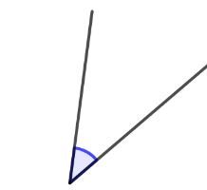
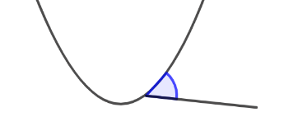
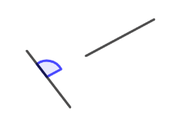
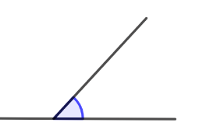
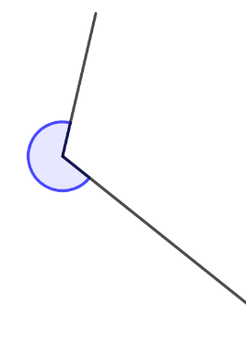
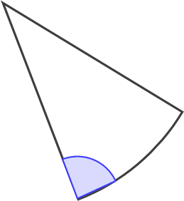

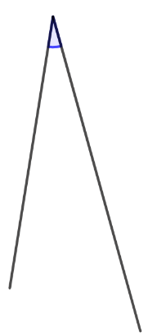
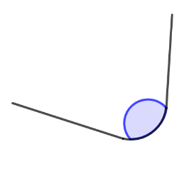
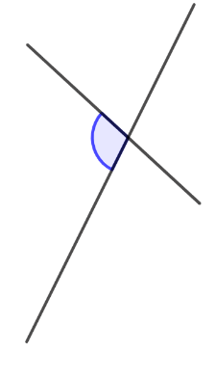

Checkpoint 3: What is an angle?
C
Which of these are angles?
For those that are angles, list the angles in order from smallest to largest.
For those that are not angles, what would have to change to make them angles?
A
B
D
E
G
F
For each one that is an angle, can you find a real-life example of the angle that is approximately the same size? Which is the hardest to find? Why?
J
H
I
K
Notes:
This slide is animated. Each question, and each angle, will appear separately so you can choose the pace at which to work with your class. A printable card sort, so that students can physically order and group the angles, can be found on slides 109-112.
Answers
a) Angles: C, D, E, G, H, I
Not angles: A, B, F, J, K
b) H, C, D, I, E, G
c) A: the parabola would have to be a straight line; B: one line segment would have to be extended to meet or cross the other line segment; F: the sector could be changed to a triangle, so the curved line is straight; J: the two straight lines would have to be extended to meet at a point; K: the two curves would have to be straight lines.
? Students’ answers to this will vary. If they use examples from the classroom, they might look to hinged objects such as doors to create the acute angles and (depending on the door) obtuse angles. A book could be used to model most angles. It is likely that students find a real-life reflex angle the hardest to identify, because some situations where angles appear do not extend to reflex angles (for example, a door opening) or because students are more accustomed to identifying the acute/obtuse angles (for example, when considering the angle made by the hour and minute hands of a clock).
Suggested questioning
What is an angle? Are there any other ways of thinking about it?
Why is one of the examples, such as F, not an angle?
When you think of an angle, which of these images is closest to what you picture?
Things to think about
Exposing students to both examples and non-examples supports them to build up their definition of the ‘edges’ of a concept. Some of these non-examples include shapes they might encounter in real life, where mathematical language might be used in an imprecise way. For example, students might be likely refer to slices of pizza, like the shape in F, as triangles rather than sectors. Are there any other non-examples that you can think of, where students might be tempted to suggest there is an angle?

Slide 16
Checkpoint 3: Guidance
Adaptations | Assessing understanding
Support Rather than asking students to sort the whole set of angles, ask them to focus on one or two at a time and ask more directed questions, such as, ‘Are A and C both angles?’ It might also be helpful to print the card sort version of this task so that students can physically group and order the angles. Challenge Challenge students to articulate their definition of an angle and reason with it. Take a boundary case – such as B – and ask students to do a standpoint exercise in pairs: one student must argue that it is an angle and one must argue that it isn’t. Representations Various static representations of angles are given. The inclusion of both examples and non-examples is intended to help students consider the ‘edges’ of their definition of what an angle is. | Throughout this deck, angles are referred to both as turns and as the geometrical figure formed when two straight line segments, rays or lines meet at a common point. Unpicking students’ appreciation of both ways of thinking is a focus of many of the Checkpoints in the first section of this deck, particularly in Checkpoints 1–4. Checkpoint 3 is an opportunity to explore students’ understanding of the latter definition. Can students define angles as being formed when two line segments meet? Do they understand that the lines must be straight? Listen carefully to the language that students use: do they reach for technical vocabulary, such as ‘vertex’, or more informal language such as ‘point’? Many of the examples – such as the sector – are ‘nearly angles’ where students might be tempted to use the language of angles to describe them. It is important to address such misconceptions before building students’ angle knowledge further in Key Stage 3.
Additional resources For examples of how students build up their experience of angles at primary school, see Unit 3 of Year 3 and Unit 10 of Year 5 in Curriculum prioritisation in primary maths | NCETM.

Slide 17
Checkpoint 4: Pairs of line segments
A
C
David draws a vertical line segment (left).
Matty draws three different diagonal line segments (right).
G
F
E
H
D
Which, if any, of Matty’s diagonal line segments could be moved onto David’s line segment to make:
an obtuse angle
an angle of approximately 80°
a right angle
a reflex angle?
B
Matty puts two of the line segments together. He creates an angle of approximately 300°. Which line segments did he put together?
Notes:
This slide is animated. Each question will appear separately so you can choose the pace at which to work with your class.
Answers
All answers use conventional two-letter notation for line segments. Students are unlikely to have experienced this at primary school as it is not part of the National Curriculum. You may wish to use alternative ways to discuss answers if you have not yet taught this notation within your Key Stage 3 curriculum, or use this as an opportunity to practise.
a) Any of the line segments could be placed on AB to create an obtuse angle. They could be placed almost anywhere along AB, either with an end point on AB or intersecting AB. The exceptions are: CD cannot be placed with D on B or C on A; EF cannot be placed with E on B or F on A; GH cannot be placed with G on A or H on B.
b) EF makes an angle of approximately 80° when: EF intersects AB, E is placed anywhere along AB (except at A) or F is placed anywhere along AB (except at B).
c) None of the line segments could be placed on AB to create a right angle.
d) Any of the line segments could be placed on AB to create a reflex angle if they are placed so that one end of the line segment is on either point A or point B.
? Matty could have used line segments AB and GH: placing point H on point B, or point G on point A, would create an angle of 300°. He could also have used line segments CD and EF: placing point E on point D or point F on point C would also create an angle of 300°.
Suggested questioning
What is the same and what is different about Matty’s line segments?
Which of Matty’s line segments is the steepest? Which will make the smallest angle? Which will make the biggest?
How would your answers change if David’s line segment, AB, was horizontal?
Things to think about
In Checkpoint 4, students consider combining pairs of line segments and what angles are created by different combinations. Clarify with students that Matty’s diagonal line segments cannot be rotated: students might like to think of the instructions in terms of translating one of Matty’s line segments so that it intersects with or meets David’s line segment. Consider how you might best model this to the class, for example using tracing paper or acetate sheets. There are some further suggestions on the ‘Guidance’ slide. Note that, in this context, ‘diagonal’ refers to the common usage of the word (i.e. at an angle). Later in the deck, we review students’ understanding the more specific mathematical usage (i.e. a line segment connecting two vertices in a polygon) – see Checkpoint 26 and Additional activities J and K.

Slide 18
Checkpoint 4: Pairs of line segments (animated solution for part a)
An obtuse angle is created when CD is positioned anywhere along AB*.
The exception is where points B and D align, or where points A and C align. In these cases, reflex angles are created.
C
A
A
A
A
C
D
C
C
D
B
B
B
D
B
D
*The same rationale can be applied to line segments EF and GH.
Notes:
This slide is animated. The line segment CD is animated to appear and move to model the various positions that it can take. The exception statement (including diagrams) also appears separately.

Slide 19
Checkpoint 4: Pairs of line segments (animated solutions for part b)
An 80° angle is created when:
EF intersects AB
E is placed anywhere along AB (except at A)
F is placed anywhere along AB (except at B).
F
A
F
A
A
E
F
E
E
B
B
B
Notes:
This slide is animated. The line segment EF is animated to repeatedly move to model the various positions that it can take. Note that there is another 80° vertically opposite the one marked for most of the possible positions of EF when it intersects AB.

Slide 20
Checkpoint 4: Pairs of line segments (animated solutions for part d)
Each line segment can make four possible reflex angles.
A
G
A
C
A
A
A
F
H
E
D
A
G
F
B
C
E
B
B
H
B
B
A
A
A
A
B
A
F
G
A
D
E
C
C
H
G
F
D
E
B
H
D
B
B
B
B
B
Notes:
This slide is animated. Each angle is visible throughout but the markings identifying the reflex angle appear separately (top then bottom left to top then bottom right across the whole screen, so BAC then ABC etc). Ask students, ‘Where is the reflex angle?’ as a useful assessment question.

Slide 21
Checkpoint 4: Guidance
Adaptations | Assessing understanding
Support Demonstrate how one line segment can translate/slide and intersect with the vertical to support students in visualising other translations. Cut out strips of paper to represent the line segments, or show the screen out of present mode: the line segments on the slide are individual images so can be manipulated (but take care not stretch or rotate the line segments). Challenge Ask students to think about the structure of the task. Ask, ‘What is the minimum number of line segments needed to be able to answer all of the questions a to d? Do you need to add any line segments? Can any of the existing line segments be deleted?’ Representations This Checkpoint relies on the students being able to visualise line segments being translated, and so consider the angles created when they intersect. Dynamic images – whether physical or visual (see ‘Support’) – may be needed. | Checkpoint 6 offers a useful insight into how students are able to visualise and reason with angles. It looks at angles as formed by the intersection of two line segments and it is therefore important to be clear that the line segments in the task can move but not rotate, to avoid confusion. Look for students who are familiar with the vocabulary of angles. Pay attention to the way that they work and the efficiency and elegance of their solutions – can they find a way that summarises all possible solutions? Are they aware of when there are exceptions, such as when a line segment is placed at the end of another, and so creates a reflex angle rather than a pair of obtuse/acute angles? Discussion might be had about how this angle can be measured. By placing the line segments so that they intersect at different points, there are multiple solutions to many of these tasks. Sharing different solutions with the class, or encouraging students to find multiple solutions, is likely to provoke more discussion and reveal more about students’ understanding.
Additional resources For examples of how students build up their experience of angles at primary school, see Unit 3 of Year 3 and Unit 10 of Year 5 in Curriculum prioritisation in primary maths | NCETM.

Slide 22
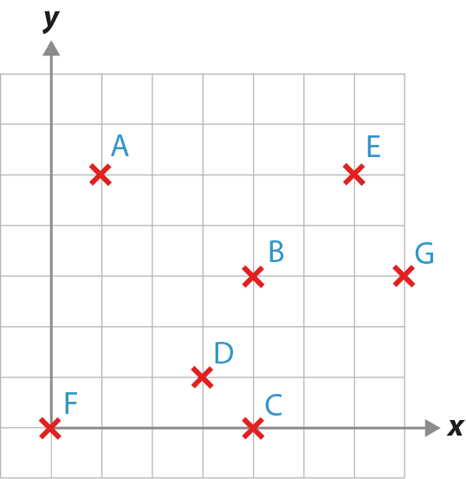
Checkpoint 5: Line segments
Choose two letters and join them to make a line segment.
Can you pick two more letters to make another line segment that is:
  parallel to your original line segment
  perpendicular to your original line segment?
Would part b be easier if you had chosen a different line segment in part a? Why or why not?
Mark another point so that there is a line segment perpendicular to the line segment joining B and D.
Notes:
This slide is animated. Each question will appear separately so you can choose the pace at which to work with your class. A printable version of this task can be found on slide 98.
Answers
All answers use conventional two-letter notation for line segments. Students are unlikely to have experienced this at primary school as it is not part of the National Curriculum. You may wish to use alternative ways to discuss answers if you have not yet taught this notation within your Key Stage 3 curriculum, or use this as an opportunity to practise.
a) Students’ answers will vary. Not all line segments that students choose will be possible in part b.
b) AE, BG and FC are all parallel; BC is perpendicular to these.
AD and EG are parallel; DG is perpendicular to them.
EB and CG are all parallel; DC is perpendicular to them.
c) Students’ answers will very depending on there choices for part a.
? Any point that can be joined to another point with a gradient of $−\frac{1}{2}$. For example, adding the point H one square to the right of C would make DH perpendicular to BD. Similarly, adding a point I one square below G would make AI perpendicular to BD.
Suggested questioning
What does parallel mean? What does perpendicular mean?
How do you know when two line segments are parallel or perpendicular?
Which of your line segments are horizontal? Which are vertical?
Which of your diagonal line segments is the steepest? How do you know?
Things to think about
Students might be more accustomed to using terms like parallel and perpendicular to describe the relationship between sides in 2D shapes. This Checkpoint examines whether they can apply this vocabulary in the context of line segments. This links to Key Stage 3 work on linear graphs as well as polygons. There is some debate within the mathematics community as to whether line segments need to intersect to be defined as perpendicular. For this task, where the focus is on relationship, we have included line segments that would make a right angle were they to be extended, rather than just line segments that intersect.

Slide 23
Checkpoint 5: Guidance
Adaptations | Assessing understanding
Support Rather than students choosing a line segment for part a, provide a line segment for them: AE or BG would make a helpful starting point. Challenge Line segments that intersect (or don’t) can be considered boundary cases and raise interesting questions around definitions of angles. For example, are the line segments FB and BE parallel? How about FE and BE? Line segments AE and CB don’t meet – can they be considered to be perpendicular? See ‘Things to think about’ in the notes for Checkpoint 5 for more detail. Representations Use geoboard or square dotted paper to explore line segments further. | Checkpoint 5 checks students can use vocabulary associated with lines: parallel and perpendicular. Watch how they work with the given points to gain insight into how they understand these. For example, do they understand that line segments do not have to be the same length for them to be parallel? The term ‘line segment’ is used throughout for accuracy, as this will be the vocabulary used in later Key Stage 3 work. It is likely that students called these ‘lines’ at primary school, so this may need to be clarified. Similarly, there is the potential to use two-letter notation: see answers in the notes for Checkpoint 5 for information about this. Printable versions of the image on the slide are available. Students who are able to visualise and reason before drawing the line segments are likely to have a better understanding. Similarly, those able to work with pairs of line segments that are not aligned to the vertical/horizontal axes are likely to be more secure. Challenge students to explain how they know that the segments they’ve drawn are perpendicular or parallel to see whether they can reason beyond, ‘it looks like they are’. Check for vocabulary like horizontal and vertical, as well as an awareness of gradient.
Additional resources Additional activity B offers a more structured version of this task, to facilitate more focussed discussion. Additional activity C offers another exploration of parallel line segments. Year 3 Unit 10 from Curriculum prioritisation in primary maths | NCETM demonstrates the first time students explore parallel and perpendicular line segments (slide 15 onwards). This might be of interest, particularly if students are very unclear.

Slide 24





Checkpoint 6: Open books
A
B
C
D
E
Five books are opened different amounts. Their covers are shown above.
Put the books in order from the most to the least open.
How does your order compare to others in your class? What is the same and what is different?
The largest angle that one of the books is open is 300°. Is this enough information to order the books? Why or why not?
Notes:
This slide is animated. Each question will appear separately so you can choose the pace at which to work with your class.
Answers
a) Without knowing where the pages are, it’s impossible to order these accurately as some books may have been opened ‘beyond’ flat. For example, book B could be open the least if you assume the acute angle is the amount it is open; or the most if you use the reflex angle, i.e. it is open to the extent that the front and back covers are almost touching.
b) Students who have not considered the possibility of reflex angles here are likely to use the order B, C, A, E, D, and assume that book D is ‘upside down’ compared to the rest. Invite alternative responses, for example, placing E before D and assuming the ‘top’ angle is the amount that is open in each case.
? No, this is not enough information as the reflex angles of A, B and D are less than 300°. It does mean that we know that the order (from smallest to largest) starts with B then C, but we do not know the order to place A, E or D.
Suggested questioning
What have you assumed to create your order? Why have you done this?
Is there more than one possible answer? Why or why not?
Compare your order with a partner. What is the same and what is different about your orders?
Things to think about
Checkpoint 6 is a good example of a task where we anticipate students thinking in a particular way. In this case, we expect students to consider only the smaller possible angle (obtuse or acute) in each case. Ensure students understand that, when two line segments meet, two different possible angles are created – one will be reflex, and the other acute or obtuse. Get students into good habits for recognising this, for example, specifying whether they mean reflex or acute/obtuse when describing an angle with three letter notation. This will be useful for recording their workings precisely in more complex angle problems later in Key Stages 3 and 4.

Slide 25
Checkpoint 6: Guidance
Adaptations | Assessing understanding
Support Help students connect the context, which is dynamic, to the static representation on the board. Model the reflex angle both physically (for example, by opening an exercise book beyond 180˚) and pictorially (for example, by marking the reflex angle on the slide). Challenge Ask students whether it’s possible to really have an angle of, say, 270˚ between the front and back cover? How about 360˚? Do the covers meet at a point? Can they think of other real-life contexts for angles: is there always a reflex angle? Representations Use online tools which show both the angle and a measure of its magnitude to represent the books. Various tools can be found using search terms such as ‘dynamic angle tool’ or ‘interactive angle maker’. | Students who complete this task quickly may not have considered the complexity of it! Look for those who only consider the acute and obtuse angles, rather than also thinking about the reflex angles that might be present in this context. The order is difficult to judge. There’s no indication of whether the books have been folded back on themselves – you could model this with an exercise book. The intention is not to get to a specific answer, but to enable a discussion and hear the justifications that students offer. A prompt such as, ‘Is it true that the more open a book, the greater the angle between its covers?’ may generate some of this discussion.
Additional resources Examples of questions that require classifying angles can be found within the Key Stage 2 SATS papers (for example, question 13 of 2017 Paper 3 reasoning and question 7 of 2016 Paper 3 reasoning). Past papers can readily be found online.

Slide 26
Checkpoint 7: Angle (in)equalities
Which angle goes where? You can only use each angle once.
t
u
v
>
w
x
<
y
=
+
z
Create some more angle inequalities and equations with the given angles.
Notes:
This slide is animated. The further thinking question will appear separately so you can choose the pace at which to work with your class.
Answers
Any two angles from, and in, this order: z > v > t > u
Any two different angles from, and in, this order: u < t < v < z
x = w + y
? v + w = z
Any of the given additive relationships could also be written as subtractions (for example, z – v = w).
Suggested questioning
How many possible inequalities can you make?
Which two angles definitely do not add to create another one shown here?
Can you find two angles that add to make an obtuse angle? How about an acute angle?
Things to think about
Students may be used to comparing angles, and using inequalities, but not using inequalities to express these comparisons. Explore how flexibly they can work between areas of mathematics they might have assumed to be distinct. Being able to think about expression angle equivalence as equations is important for understanding and recording work on angle rules.

Slide 27
Checkpoint 7: Guidance
Adaptations | Assessing understanding
Support If students find it hard to order and compare angles, start by sorting the angles into categories (acute, right, obtuse etc) and then use this information to compare them using the inequality symbols. Challenge The further thinking question asks students to create their own calculations. Add restraints to add challenge, such as specifying that the calculation must start with 3 × __ = __. Representations Students should be familiar with ordering/comparing angles, but may not have represented the angles within inequalities and equation; consider how this might support their work on calculating missing angles. You could trace the angles onto a translucent or transparent material (such as tracing paper, acetate sheets or plastic wallets). Then students can overlay the angles to help them to compare; being able to manipulate drawn angles in this way may help students’ appreciation of angles as geometric figures formed by intersecting line segments. | As with Checkpoint 6, the focus here is on angles formed by two line segments meeting at a point and being able to compare the size of these figures. Students may realise that there are a number of different options for arranging the angles in the two inequalities, but only one solution for the addition. Placing three angles in the calculation first is therefore key to successfully completing this task. While it is helpful to observe this logical reasoning, it is not the main focus. Instead, the intention is to listen to students’ reasoning and justifications. Do they classify their angles into groups using angle terminology? Do they use estimation? Those who are able to estimate or select reference points, such as comparing how close angles are to a right angle or half a right angle, are likely to have a more secure understanding.
Additional resources Additional activity D offers a version of this task with fewer angles but the same number of blanks, so students can focus on the comparison rather than completion to find a specific solution. An example of a question with similar reasoning is in the Key Stage 2 SATs papers (question 13 of 2019 Paper 3 reasoning). Past papers can be found online.

Slide 28
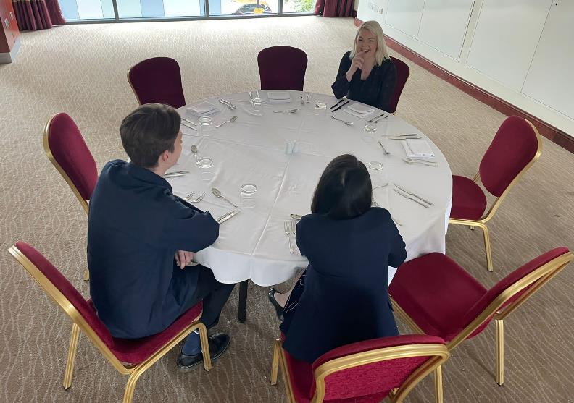
Checkpoint 8: Seating plan
Eight chairs are equally spaced around a circular table.
Imagine a line segment is drawn from each person to the centre of the table.
What would be the angle between:
Jake’s and Jodie’s line segments
Jake’s and Vanessa’s line segments
Vanessa’s and Jodie’s line segments?
Jodie
Jake
Vanessa
Two extra chairs are placed between Jake and Vanessa, and all the chairs are adjusted so the spacing is equal.
Are Jake and Jodie still opposite each other? What is the angle between Jake’s and Vanessa’s line segments now?
Notes:
This slide is animated. Each question will appear separately so you can choose the pace at which to work with your class.
Answers
For parts b and c, either answer is valid, thought students may be more likely to give the acute/obtuse angle.
a) 180°
b) 45° or 315°
c) 135° or 225°
? No, Jake and Jodie are no longer opposite each other as more chairs have been added to one side of the ‘semicircle’ than the other, so Jodie will have had to move round the circumference. Although the question does not explicitly ask this, students might state that there is now an angle of 144° between them. The angle between Jake’s and Vanessa’s line segments is now 108°.
Suggested questioning
What do you know about the angles created at the centre?
What shape would be created if you drew line segments from one chair to the next?
How would this change if there were __ more/fewer seats?
Things to think about
Considering angles on a circle may seem like the beginnings of Key Stage 4 work on circle theorems. Instead, it is designed to check Key Stage 2 knowledge and assess some of the understanding that sits behind the measurement of angles. This is the first of three Checkpoints exploring angles within circles, leading to checking for understanding of the use of a protractor to measure angles in Checkpoint 12. They are included here, rather than in the angle rules section, as measurement of angles brings together the dual understanding of angles as intersecting line segments and as turns. This is inextricably linked to the fact that angles around a point sum to 360°, making it impossible to separate this concept in the angle rules section.

Slide 29
Checkpoint 8: Guidance
Adaptations | Assessing understanding
Support Sketch out a circle and mark the positions of the chairs. The 3D nature of the image reduces the possibility of estimating as a method and so a sketch may support with this as well as offering a way to annotate the image with known angle facts. Challenge Extend the further thinking question by placing just one additional chair around the table. If all the chairs are adjusted so they are equally spaced, how would that affect students’ answers to parts a, b and c? Would it matter where the extra chair was placed? Representations An eight-pin circular geoboard or printout may be helpful. There are templates for this and other divisions of circles readily available online. | Checkpoint 8 gives insight into students’ understanding of angles as an intersection of two line segments, and the use of degrees as a measure of this. It is important that students are clear that the angle is created at the centre, where two line segments extending from different people meet. Do not accept inaccurate statements such as, ‘The angle between Jodie and Jake’. Students may shift in their reasoning between the questions. For example, in part a they may state that they ‘just know’ the angle between Jake, the centre and Jodie as 180˚ rather than relying on dividing the circle into equal segments. This familiarity suggests the beginnings of real fluency with angle facts, so ask if there are any other angles that they ‘just know’. This task lends itself to finding multiple ways to reach the solution; seeing the different methods used may prove. Students might, for example, divide 180˚ by four to find the angle between Jake, the centre and Vanessa, rather than dividing 360˚ by eight. Ask students to describe, for example, three different ways to find an answer to part c.
Additional resources Checkpoint 16 offers the same context, but models using the representation to explore properties of triangles instead. The task on p26 of the Year 5 Primary Assessment Materials | NCETM also uses a structure of angles created at the centre of a circle and might be a more accessible starting point.

Slide 30
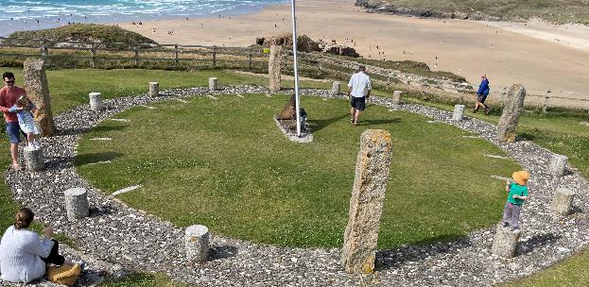
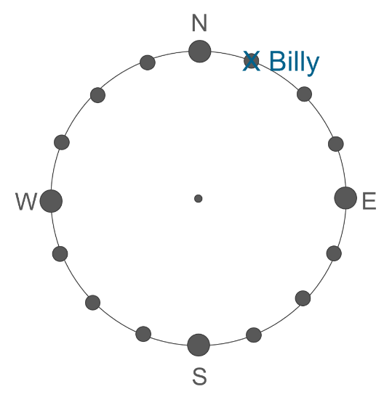
Checkpoint 9: Perranporth compass
This picture shows a big compass that people can move around.
Imagine Billy and his friends are playing on and around the compass. Billy’s position is shown on the diagram.
The angle between Billy, the centre and Tom is 90°.
Mark four different positions where Tom could be standing.
The angle between Tom, the centre and Oscar is also 90°.
Mark four different positions where Oscar could be standing.
What is the angle between Billy, the centre and Oscar?
Hannah comes to stand on the line through east and west. What might the angle be between her, the centre, and each of the other children?
Notes:
This slide is animated. Each question will appear separately so you can choose the pace at which to work with your class. Note that the picture is intended to help students understand the context, and doesn’t depict the situation modelled in this question. You will need the printable resource on slide 99 to use this task with students.
Answers
See the next slide for a visual representation of the solutions to parts a and b. Note that, throughout, sixteen points of the compass are used for teacher reference only. Students only work with eight points of the compass at primary school. It is anticipated that students’ responses will be visual, using the printable, rather than relying on descriptions that involve compass directions.
a) Tom could be anywhere on the line that goes through WNW, the centre and ESE.
b) Oscar could be anywhere on the line that goes through NNE, the centre and SSW.
c) The angle is either 0 (if Oscar is standing between Billy and the centre) or 180° (if the centre is between Billy and Oscar).
? If Hannah stands between the centre and East, then the angle between:
Hannah and Billy would be 67.5°
Hannah and Tom would be either 22.5° (if Tom is on the line from centre towards ESE) or 157.5° (if Tom on the line from the centre towards WNW)
Hannah and Oscar would be 112.5° (if Oscar is on the line from the centre towards SSW) or 67.5° (if Oscar is on the line from the centre towards NNE).
If Hannah stands between the centre and West, then the angle between:
Hannah and Billy would be 112.5°
Hannah and Tom would be either 157.5° (if Tom is on the line from centre towards ESE) or 22.5° (if Tom on the line from the centre towards WNW)
Hannah and Oscar would be 67.5° (if Oscar is on the line from the centre towards SSW) or 112.5° (if Oscar is on the line from the centre towards NNE).
Suggested questioning
Why have we asked for more than two positions? How is this possible?
Compare your positions for Tom, Oscar and Hannah with a partner. What is the same and what is different?
Things to think about
Students may initially find this task frustrating. Give students counters to represent possible positions of the children so that they can experiment and ‘go wrong’ without marking their printed compass and creating a confusing number of extra points. Once they have identified a right angle at the centre, they are likely to suggest Tom could be at two positions on the circumference: NNW or ESE. Prompt them to look at the picture and notice that one of the children is playing on the grass: does this change how they think about the problem? The intention here is to help them recognise that the angle of 90° relates to the position of the lines, and that the lengths can vary infinitely. Drawing lots of right angles with different lengths of line segment may help to reiterate this point.

Slide 31
Checkpoint 9: Perranporth compass (solutions)
N
X Billy
W
E
Hannah could be anywhere on this dotted line.
Tom could be anywhere on this solid line.
Oscar could be anywhere on this dashed line.
S
Notes:
This slide is animated. Hannah’s line appears separately so that you have the opportunity to discuss the main task with students first.

Slide 32
Checkpoint 9: Guidance
Adaptations | Assessing understanding
Support At primary school, students may have made 90° angles by folding a piece of paper and then folding it along the crease. Placing folded paper on a printed compass may support them to ‘see’ the right angle and understand that the length of the lines does not determine the angle. Challenge Although the 16-point compass references in the answers are for teacher reference only, you could offer them to students and ask them to reason about what they might mean. Representations A compass is a key representation for angles; exploring the eight-point compass is specified in the Key Stage 2 geography curriculum, although not explicitly in the mathematics curriculum. Later work such as bearings at Key Stage 4 relies on students being able to connect their understanding of the compass with angles. | This Checkpoint, like 8 and 16, uses a circle to explore understanding of angles. The language is explicit to ensure students are clear that the angle is created by two ‘lines’ connecting three points, and that in each case the middle point is the centre of the circle. Do not accept inaccurate statements, such as, ‘The angle between Billy and Tom’. A fact for assessment is that the angles around a point total 360°. Consider how you will respond to statements such as, ‘The angles in a circle total 360°’, which may show incomplete understanding. Are students clear that the angles are created at the centre point? A further assessment point, which goes further than Checkpoint 8 did, is that the length of the lines is irrelevant: what matters is the position of the points relative to the centre. Students are likely to suggest points on the circumference (for example, NNW or ENE for part a). Some might suggest that it is impossible to find more than two points. Those who have the most secure understanding might draw lines from the centre through NNW and ENE and reason that Tom could be standing anywhere along those lines.
Additional resources 2022 Paper 3 reasoning, question 15, from the Key Stage 2 SATs materials, uses a compass structure but no compass directions to assess understanding of turn. Past papers can readily be found online. Page 26 of the Year 5 Primary Assessment Materials | NCETM also uses the context of a compass.

Slide 33
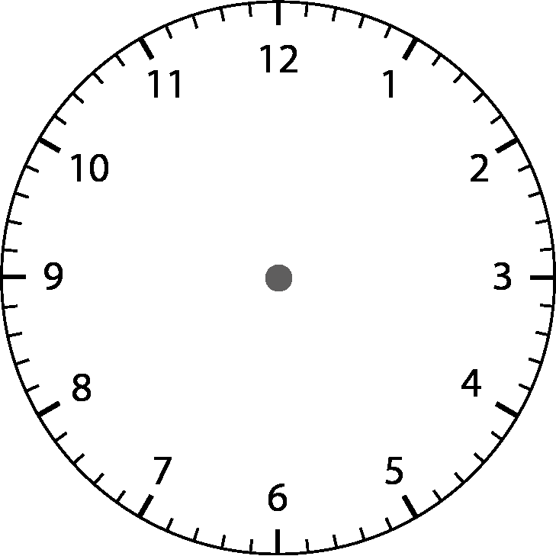
Checkpoint 10: About time
What angles can you see on this clock?
What is the angle between the minute and hour hands of this clock?
What other times would have the same angle?
The angle between two hands is 180°. What might the time be? How about if the angle is 120°?
Notes:
This slide is animated. Each question will appear separately so you can choose the pace at which to work with your class. Printable clock faces can be found on slide 100.
Answers
a) Students might talk about the angles created between different pairs of hands, such as the acute angle created between the hour hand and the second hand, the obtuse angle created between the minute hand and the second hand, or either of the reflex angles also created by these pairs of hands. Students might also talk about the total of the angles created at the centre being 360°.
b) 90°.
c) 3 o’clock and 9 o’clock are the most obvious answers (given in bold below). The point of this task is to generate a discussion about right angles, and so there is no expectation that students will give more solutions than this – or that any other solutions that they give will be completely precise. However, students might recognise that, in most hours, there are two occasions where the hands are at 90°; in case they do offer further answers, we have detailed these solutions below for your information:
12:17 and 12:49, 1:21 and 1:55, 2:27, 3:00 and 3:33, 4:05 and 4:37, 5:11 and 5:44, 6:17 and 6:49, 7:21 and 7:54, 8:27, 9:00 and 9:33, 10:06 and 10:38, 11:11 and 11:44. (NB calculating the movement of the hour hand over the hour is challenging, so although we have given more precise times, accept approximations of any of the above).
? There are multiple answers that students can give, as this angle is created twice in most hours, but the answers students are potentially more likely to offer are given in bold below.
For 180°: 12:33, 1:38, 2:44, 3:49, 5:55, 6:00, 7:05, 8:11, 9:16, 10:22, 11:27.
For 120°: 12:22 and 12:42, 1:27 and 1:49, 2:32 and 2:54, 3:38, 4:00 and 4:39, 5:06 and 5:49, 6:11 and 6:54, 7:16, 8:00 and 8:22, 9:06 and 9:27, 10:11 and 10:33, 11:17 and 11:38
(NB Calculating the movement of the hour hand over the hour is challenging, so accept approximations of any of the above),
Suggested questioning
What is the angle between __?
Can you see an acute/obtuse/reflex angle?
What is the biggest angle you can see? What is the smallest?
What angle will the __ hand turn in __ seconds/minutes/hours?
How many times will the __ hand rotate through 360° in __?
Things to think about
Time is a very useful context for exploring angles deeply. It is also a concept that can still cause problems for some students even at Key Stage 3, despite best efforts throughout Key Stage 1 and 2. While it might be tempting to avoid using the clockface for this reason, it is important to identify any students who might still struggle with reading analogue clocks and ensure those students who can read time but do not use it regularly keep this knowledge ‘fresh’. Consider how you might strike a balance between accessibility and a need to assess understanding of time. Some suggestions are given on the Guidance slide.

Slide 34
Checkpoint 10: Guidance
Adaptations | Assessing understanding
Support Give students clocks to manipulate; if you do not have these in your department, then use printed blank clock faces to allow them to draw the hands and then measure the angles. Challenge Asking students to find other times with the same angles offers a good degree of challenge, as there are so many possible answers. Take this further by asking them to be more precise, giving the exact time, including seconds. Representations Analogue clocks are a context in which students might see angles in everyday life, but they may not think about them. Here, students are asked to consider the angles made between the hands of a clock: this conflates both the idea of angles as a measure of turn (as the hands rotate) and as the figure formed by two line segments (as we consider ‘snapshots’ of the hands’ positions). Use a physical clock, or search online for interactive simulations of analogue clocks, to support your explanations. | The first two questions are deliberately accessible. For part a, look to see whether students can identify that there are several different angles formed at the centre and what language they use to describe them. If students use terms like ‘acute’ and ‘obtuse’, encourage them to estimate the size of the angle as well. Listen out for whether students identify the reflex angles – these are often less well understood. The choice of context means there is a secondary assessment point of checking that students are familiar with the analogue clock. You may uncover some students who are still not confident with telling the time, and will need further teaching to secure this concept. If this is the case, parts a and b should still be accessible but you may wish to ask students to draw right angles on the clock rather than identifying times for part c.
Additional resources Additional activity E offers a more straightforward and structured version of this task. If students struggle with analogue time, this article from the NCETM website suggests an alternative approach. There are also time units throughout Curriculum prioritisation in primary maths | NCETM: unit 11 of Years 1, 2, 3 and 4.

Slide 35
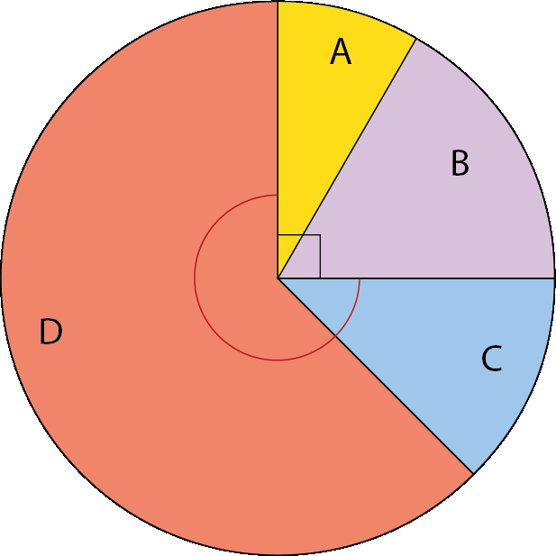
Checkpoint 11: Slice of pie
There are four sectors in this pie chart.
Sector B is twice the size of sector A.
Sector C is one-fifth of the size of sector D.
What are the sizes of the angles of each sector?
Use your angles to complete these sentences.
    Angle __ is one-and-a-half times the size of angle __.
    Angle C is ____________ the size of angle B.
    Angle D is ____________ the size of angle ___.
Create your own pie chart with comparison sentences about the sizes of the sectors.
Notes:
This slide is animated. Each question will appear separately so you can choose the pace at which to work with your class.
Answers
a) Angle A is 30°, B is 60°, C is 45° and D is 225°.
b) Angle C is one-and-a-half times the size of angle A.
Angle C is three-quarters the size of angle B.
Angle D is five times the size of angle C or angle D is three-and-three-quarters the size of angle B or angle D is seven-and-a-half times the size of angle A.
Suggested questioning
What do you know? How can you use this to work out other angles?
‘Angle B is twice the size of angle A so I need to divide 90° by two.’ Why is this statement incorrect? How many ‘parts’ do you need to divide 90° into?
What do you estimate the size of angles A/B/C/D to be? How close is this to your calculated answer?
Things to think about
As with the previous three Checkpoints, Checkpoint 11 could belong in either part of this deck. It is the last of a sequence of Checkpoints involving circles as a context for exploring angles and therefore checking understanding of angles around a point. Checkpoints 9 and 10 linked to the compass and the clockface, and this Checkpoint links to pie charts. Ensuring students are able to connect their understanding of different areas of mathematics becomes increasingly important as the boundaries between different strands become blurred throughout Key Stages 3 and 4. So, while this Checkpoint may focus more strongly on multiplicative relationships than using addition and subtraction to find missing angles (which might be more expected), we felt it was important to include as part of this deck.

Slide 36
Checkpoint 11: Guidance
Adaptations | Assessing understanding
Support Build on primary experience of using the circle as a representation for the whole: cut out a sector the same size as A and iterate it over B, modelling that there are two As that are equivalent to B; repeat for other pairs of sectors. Challenge Encourage students to make links to their work on algebra by asking if they can represent the size of the sectors as equations. Representations Consider which other representations of multiplicative relationships students might use to help them make connections. For example, representing 90° on a bar model that is split into two parts (one twice the size of the other) might help students to recognise the division by three. | Checkpoint 11 has been included as the final Checkpoint in the sequence relating to angles around a point and the size and measurement of angles. It is important to include a context for angles that will be familiar from primary school: the sectors of a pie chart. Pie charts, while an example of an application of angles, rely more heavily upon students’ multiplicative reasoning skills. The angle facts required here are simple: students need only to recognise that A + B forms a right angle and therefore deduce that C + D forms 270°. The multiplicative reasoning is more challenging but builds gradually in difficulty, so that you can identify easily where students come unstuck. If students cannot recognise, for part a, that B being twice the size of A requires dividing 90° by three, they may need more support in multiplicative thinking, including recognising ratios and multiplicative relationships in context. Part b is significantly more challenging, particularly the last sentence, and it might be that the majority of students do not complete it. Consider how you will further stretch and deepen the understanding of those that do.
Additional resources The two ‘Multiplicative relationships’ Checkpoints | NCETM decks offer more opportunities to explore students’ understanding, including more tasks involving pie charts. In the Key Stage 2 SATs materials, question 6 of 2018 Paper 3 reasoning also explores pie charts. Past papers can be readily found online.

Slide 37
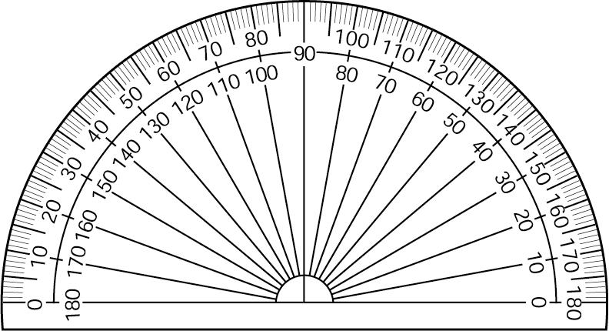
Checkpoint 12: Protractor placement
Pat
Sim
Do you need to move Bea’s protractor to know the size of the angle below ?
Whose protractor do you need to move to measure the angle?
What is the size of the angle?
Wes
Bea
Notes:
This slide is animated. Each protractor will appear separately so you can choose the pace at which to work with your class. Printable angles (with no protractors shown) can be found on slide 101.
Answers
a) We need to move Pat’s and Sim’s protractors. Pat, as if using a ruler, has placed the angle at the very edge of the protractor. Sim has recognised that the vertex of the angle needs to be in the centre but has incorrectly used the edge rather than the 0 line to align his. Wes has a correct placement.
b) The angle is 58° (accept 2° either side of this).
? No, we don’t necessarily need to move it as we can find the difference between the two values indicated by each line segment (i.e. 162 – 39 = 123° or 141 – 18 = 123°.) However, it is worth noting with students that it is significantly easier to rotate the protractor so that one of the line segments aligns with 0°.
Suggested questioning
What is the same and what is different about each picture?
Where do you ‘start’ measuring an angle from?
Why is the centre of the protractor important?
Are you reading this angle clockwise or anti-clockwise?
Things to think about
There are many potential protractor pitfalls targeted in this task, such as the positioning of the protractor relative to the line segment and the direction in which the angle is read. One thing to consider is that, although these are static images of angles (i.e. figures generated by the intersection of two line segments), understanding the protractor also requires a sense of angles as turn – in a sense, it brings both understandings of angles together. You could describe the measurement of the angle in terms of transformation: the amount of turn that one line segment would need to rotate through to be aligned with the other. How do you describe using a protractor to your students? Do you talk about the line segments rotating? Consider how the language used might reflect yours and their understanding of what an angle is.

Slide 38
Checkpoint 12: Guidance
Adaptations | Assessing understanding
Support Give students protractors and a printable version of the angle. Ask them to replicate each incorrect placement then physically move the protractor to correct it. Challenge Ask students to suggest pairs of values that the line segments of an angle might point to on a protractor, with various constraints such as, ‘The angle is reflex,’ or, ‘The angle is in an equilateral triangle’. Representations A protractor brings together two ways of thinking about angles. The scale relies on an understanding of angles as a measure of turn, while the positioning of the protractor relies on an understanding of the angle being created by the intersection of two line segments. Thinking about one line segment as a rotation of the other line can help: represent using two thin pieces of cardboard connected using a split pin. | This Checkpoint deals with some common misconceptions around using a protractor, particularly its position in relation to the angle. Students may have first used protractors to measure angles from Year 4, and by Year 6 are expected to draw shapes accurately. Students who replicate Pat’s error may be less secure in their understanding of what an angle is, and be attempting to apply their knowledge of rulers. Revisit the definition of what an angle is to support their understanding (see ‘Representations’). Wes’s correctly placed protractor is positioned to use a different scale from those Pat and Sim are attempting to use. Draw attention to this and discuss that protractors can be read both clockwise and anti-clockwise. The further thinking question offers an opportunity to deepen students’ understanding. Although neither of the angle’s line segments are aligned with the 0 line on the protractor, it is still possible to measure the angle. This stresses that measurement scales are about difference. Use it as a springboard to discuss what is necessary to read an angle (i.e. the vertex aligning with the centre point) and what is not necessary, but is helpful (i.e. one line segment aligning with the 0 line).
Additional resources Students need to use a protractor in the Key Stage 2 2019 Paper 2 reasoning, question 13. Past papers are available online.

Slide 39
Angle rules
Checkpoints 13–29

Slide 40

Angle rules
Previous learning | In Key Stage 3 students need to
Key Stage 2 curriculum: Year 6: compare and classify geometric shapes based on their properties and sizes and find unknown angles in any triangles, quadrilaterals and regular polygons Year 6: recognise angles where they meet at a point, are on a straight line, or are vertically opposite and find missing angles Further information about how students may have experienced this key idea in Key Stage 2: Teaching mathematics in primary schools, 6G–1 Draw, compose and decompose shapes according to given properties including dimensions, angles and area and solve related problems (pp 322–26*). Note that the Ready to progress criteria do not focus on finding missing angles so angle rules may not have been looked at in depth, but may have used been as a context for addition and subtraction. * Page numbers reference the complete Years 1–6 document | Use the fact that vertically opposite angles are equal (learned in Key Stage 2) to deduce that a translation of one of the lines will create a second, equivalent pair of vertically opposite angles. Use this knowledge to identify pairs of equal angles (some of which are named alternate or corresponding) and other relationships, such as pairs of supplementary angles (i.e. with a sum of 180°). Use what they know to construct a logical argument and deduce other facts; reason and construct proofs for why such facts and properties hold. Know and understand proofs for finding the interior and exterior angle of any regular polygon. Solve problems that require use of a combination of angle facts to identify values of missing angles, providing explanations of reasoning and logic used

Slide 41
Checkpoint 13: Two line segments
Two straight line segments intersect.
Is it always, sometimes or never true that the two line segments form:
four angles
four different angles
four equal angles?
A line is parallel to one of the line segments. What can you say about the angles it forms with the other line segments?
Notes:
This slide is animated. Each question will appear separately so you can choose the pace at which to work with your class.
Answers
a) Sometimes true – they will form four angles if the line segments cross, but three angles if they meet.
b) Never true – if the line segments meet, three different angles are formed (unless the line segments are perpendicular). If the line segments cross, two pairs of equal angles are formed. The four angles will never all be different.
c) Sometimes true – if the line segments are perpendicular to each other, four 90° angles are formed.
? They will be the same as the angles formed by the line segment it is parallel to.
Suggested questioning
Can you draw an example to show your answers?
If it is never true, how could you prove it?
How would these questions change if three straight lines intersected?
Things to think about
Checkpoint 13 is the first of three that particularly assess vertically opposite angles – and, like the first in the previous section, is one of the few in this deck where there is no image for students to respond to. Pay attention to how students respond to the prompt: can they imagine the scenario? Do they try to sketch it to help them visualise? Perhaps they draw in the air with their fingers? Consider whether there are other angle rules that you might like to assess in a similar way, by asking students to think about the relationship without a visual prompt.

Slide 42
Checkpoint 13: Guidance
Adaptations | Assessing understanding
Support Give students two straight sticks, or very thin strips of card, to physically create the situation and explore the possibilities. Consider when to do this – is there a value in some productive struggle? See also ‘Representations’. Challenge Ask students to create their own ‘always, sometimes, never’ statements for other angle rules. Can they create three statements that use all three answers? Representations This task is presented without a representation, so that the assessment focus is on students’ reasoning and visualisation. It would be helpful to know whether students need to sketch the situation to support their reasoning. It is no bad thing if they do – indeed, those students that struggle and do not reach for a pencil to help them visualise might need encouragement to try. | ‘Always, sometimes, never’ questions are a great way to challenge students to explore the ‘edges’ of their own mathematical definitions. This Checkpoint checks students’ understanding of vertically opposite angles without mentioning them by name. Listen out for those students who identify this. There is some ambiguity with part a, in that ‘intersect’ can be interpreted as ‘meet’ as well as ‘cross’. If students suggest it is ‘always’ true, then check whether they are taking ‘intersect’ to mean ‘cross’. Exploring how language can be ambiguous, even in mathematics, is a useful teaching point. For part b, never true, ask students who are not convinced to try to draw a counter example: can they create four different angles? Part c is a special case and might require some prompting for students to consider this. For those that quickly recognise that the lines could meet at 90°, consider deepening their thinking by asking them to relate this to properties of shapes. Imagine connecting the ends of the lines with four straight lines. What shape have they made? Is there more than one possible answer? (Yes: rhombus and kite.)
Additional resources 2016 Paper 2 reasoning, question 17, from the Key Stage 2 SATs materials, uses vertically opposite angles. Past papers can readily be found online. Additional activity G discusses vertically opposite angles; activity F explores misconceptions with angles on a straight line.

Slide 43
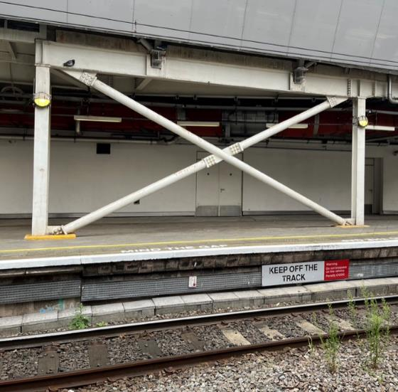
Checkpoint 14: New Street Station
Hidaayah and Alex are waiting for a train.
Hidaayah notices two metal bars crossing between two vertical pillars.
She points and says, ‘Those two angles are equal, and those two angles are equal.’
Which angles do you think Hidaayah is pointing at?
Alex says, ‘I don’t think they are equal.’
How could you convince him that they are?
One of the angles at the centre is three times the size of another angle at the centre. Which angle must this be? Can you work out the values of any of the angles now?
Notes:
This slide is animated. Each question will appear separately so you can choose the pace at which to work with your class.
Answers
a) Hidaayah could be pointing at the vertically opposite angles formed by the crossing point (angles a or b on the diagram on the next slide), or the two base angles of any of the isosceles triangles formed by the bars (angles c or d on the diagram).
b) Students’ answers will vary. This is an opportunity to check their recall of vertically opposite angles (if they refer to angles a or b in part a); or isosceles triangles (if they refer to angles c or d).
? Using this, students can work out that the four angles at the centre must be two 135° angles and two 45° angles. From this, they could work out that the base angles of the two different isosceles triangles would be 22.5° and 67.5° respectively. See the next slide for clearer identification of each angle.
Suggested questioning
What angles can you see? What relationships can you see?
If you knew one angle, what other angles could you work out?
Where else might you see similar angle relationships in real life?
Things to think about
Checkpoint 14, alongside 13 and 15, offers an opportunity to discuss some of the angle rules students are likely to have experienced at primary school: particularly, vertically opposite angles. Unlike the other Checkpoints, this offers a real-life image of angles, so that they can see the relationships in context. Note that, as with the triangular tiles in Checkpoint 17, there are some parts of the diagram where ‘seeing’ an angle requires a simplification of the image (for example, in the bottom left vertex of the rectangle, angle d is only created if you ignore the horizontal concrete behind the bar). It is worth discussing with your department the range of examples that students are exposed to: do they always see angles as diagrams constructed from line segments? What other contexts might be useful?

Slide 44
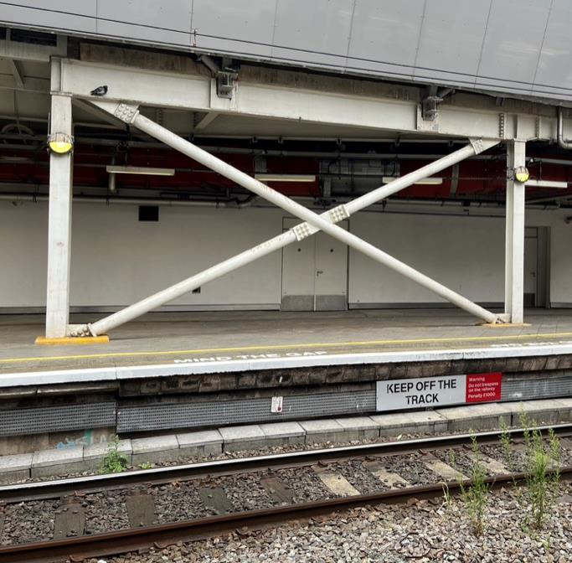
Checkpoint 14: New Street (solutions)
a = 45°
b = 135°
c = 22.5°
d = 67.5°
d
c
c
d
b
a
a
b
d
d
c
c

Slide 45
Checkpoint 14: Guidance
Adaptations | Assessing understanding
Support Encourage students to sketch a diagram to annotate, first identifying the rectangle and its parallel sides to support them. Then they can identify and discuss with a partner any sets of angles that they think might be equal, or know to not be equal. Challenge Students could consider the 3D element of the situation; ask whether the rods are intersecting or just next to each other. Is it possible for the two metal rods to make an angle? Would they still make an angle if viewed from a different direction? Representations Sketching a diagram may help. It can be tempting to measure to ‘prove’ that a pair of angles are equal. Consider whether this is a legitimate demonstration, or whether reasoning using known facts is more valid. | Checkpoint 14 explores which angle facts students already know, and gives a context to discuss angles in two or three dimensions. While the angle rules referenced are within the primary curriculum, they are not explicitly referenced in the NCETM’s Curriculum Prioritisation Materials so some students may not have looked at them in depth. Students are likely to know that the angles at the intersection of the two diagonal lines are equal; they should have used the term ‘vertically opposite angles’ to describe this relationship. If they have not remembered this from primary school, they may be able to reason that they are using their understanding of straight lines. Students might also suggest that some of the angles made between the frame or floor and the diagonal bars are equal, possibly using their knowledge of isosceles triangles and/or symmetry. Discuss boundary cases for angle facts, for example, are the ceiling and floor parallel? Students may also notice that the ends of the diagonals are slightly different from the bars: check that students are aware that they cannot make assumptions in geometric problems, and must always use the information given.
Additional resources 2016 Paper 2 reasoning, question 17, from the Key Stage 2 SATs materials, uses vertically opposite angles. Past papers can readily be found online. Additional activity G discusses vertically opposite angles; activity F explores misconceptions with angles on a straight line.

Slide 46
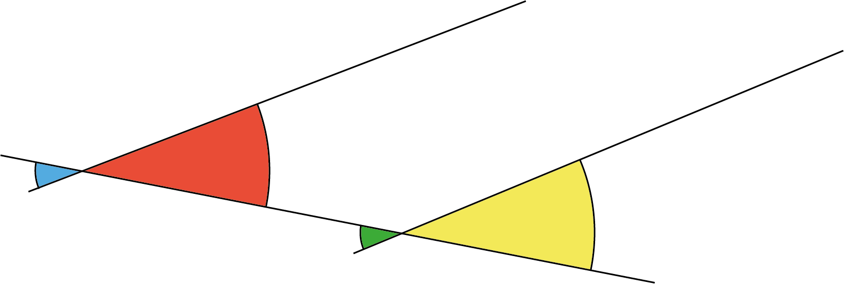
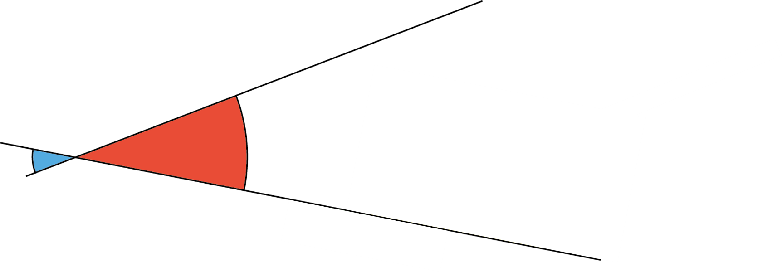
Checkpoint 15: Big and red
Which is larger, the red angle (r) or the blue angle (b)?
r
b
y
g
Another line is drawn in. The yellow angle (y) is a little bigger than the red angle (r).
Is the green angle (g) larger or smaller than the red angle (r)?
Do you think the lines are parallel? If not, will they meet above the screen or below it?
Notes:
This slide is animated. The yellow and green angles (y and g), alongside part b, will appear separately (as will the further thinking question) so you can choose the pace at which to work with your class. Note that you will need to view this task in present mode so that the angles for part b are not initially visible.
Answers
a) Both angles are the same.
b) The green angle (g) is larger than the red (r).
? The lines are not parallel as they are at different angles to the line that crosses them both. (This is the transversal, although this is not terminology students will know.) The lines will meet above the screen as the lower line (creating the yellow/green angles y/g) is slightly steeper than the upper line (creating the red/blue angles r/b).
Suggested questioning
What is the same and what is different about the red/blue/green/yellow angles? (Use labels r/b/g/y rather than colours if students have visual impairment).
What do you know about the angles shown?
Do you know any angle rules that describe these relationships?
If you knew the size of the __ angle, how could you work out the __ angle?
Things to think about
Checkpoint 15 could go in a few directions, so be responsive to the needs of the class. It might be that students are familiar with vertically opposite angles, and so immediately look past the distraction of the larger red space and smaller blue space. In this case, you might know whether they have fully understood what constitutes the ‘size’ of an angle. Show them another example where the length of the lines/arc is designed to act as a distractor – perhaps an 80° angle with short lines next to a 60° angle with long lines – to fully check understanding. Checkpoint 20 could also be used. If students have not fully understood vertically opposite angles, trace the red angle onto a piece of paper and then rotate it 180 degrees about the point where the two lines meet. Ask students what they notice, and whether they can connect this to their understanding about angles on straight lines.

Slide 47
Checkpoint 15: Guidance
Adaptations | Assessing understanding
Support Work with students to identify straight lines and the angles at a point on those lines. You might cover the blue angle and ask students to estimate or otherwise label the angles they can see. Giving them a sketch of the diagram to write on to support them in building a chain of reasoning. Challenge Ask students to imagine the angles change so that the red/yellow angles are equal, and to consider what happens to the lines. Where will they meet? Can they be sure of their answer? Representations Representing the angles in this way focuses students’ attention on what is important when thinking about the size of the angle. Something that is irrelevant (the circumference of the arc marking the angle) is made really big to encourage students to recognise that this doesn’t matter, but the size of the turn (if one line is rotated onto the other) does. | Checkpoint 15 reveals whether students hold misconceptions that a larger arc or longer lines mean a greater angle. Look for students who can explain how they know that the red and blue angles are the same size, and for those who use vocabulary such as ‘vertically opposite’. Explore with students whether the use of this vocabulary is an indicator of understanding, or whether it’s a learnt phrase. This might be indicated if students know the terminology but do not recognise the angles as equal (because they are distracted by the different sizes of arc). The task doesn’t give an opportunity for students to say that the angles are equal. The intention is to give an indication of students’ confidence with their reasoning. It might be argued that a student who states that the angles are equal using this prompt is more confident than a student who decides that they are equal having been offered the prompt, ‘Which is larger, the red angle or the blue angle, or are they the same size?’
Additional resources The potential misconception around angle size is also explored in Checkpoint 20. Additional activity G explicitly discusses vertically opposite angles; activity F explores misconceptions with angles on a straight line.

Slide 48
Checkpoint 16: Seating plan 2
Eight chairs are equally spaced around a circular table. Three people sit on the chairs.
Imagine three line segments join the three people.
What type of triangle would the line segments form?
Is it possible for the people to move so that they form an isosceles triangle?
Is it possible for the people to move so that they form an equilateral triangle?
Jodie
Jake
Vanessa
Two extra chairs are placed at the table, and all the chairs are adjusted so the spacing is equal. How many different isosceles triangles can the line segments form now? How many chairs would need to be around the table to form an equilateral triangle?
Notes:
This slide is animated. Each question will appear separately so you can choose the pace at which to work with your class.
Answers
a) Scalene
b) Yes – for example, if Vanessa moved one seat anti-clockwise, then there would be an isosceles triangle with two line segments of equal length connecting Vanessa and Jodie to Jake. This is one of many possible solutions: the triangle is isosceles so long as there are the same number of chairs between two of the people and the third person.
c) No – it is not possible
? No, Jake and Jodie are no longer opposite each other as more chairs have been added to one side of the ‘semicircle’ than the other, so Jodie will have had to move round the circumference. There is now an angle of 144° between them. The angle between Jake and Vanessa’s line segments is now 108°. To form an equilateral triangle, the number of chairs would need to be a multiple of three.
Suggested questioning
Why are some triangles possible and some triangles not?
Is there an arrangement of chairs where all types of triangle would be possible?
How would this task change if there were four people at the table? What quadrilaterals could you make?
Things to think about
Considering angles on a circle may seem like the beginnings of Key Stage 4 work on circle theorems: instead, here, it is designed to explore Key Stage 2 knowledge of properties of triangles. Checkpoint 16 sees a return of Jodie, Jake and Vanessa around their table: the use of the same image is intentional, as it demonstrates how the same prompt can be explored differently to elicit different mathematical thinking. Why not discuss this in a departmental meeting – what other questions could you ask using the same image? What areas of mathematics could you explore? Could you, for example, use this in Key Stage 4 as part of an introduction to circle theorems? How might linking so explicitly back to Key Stage 3 work support students to make connections within the curriculum?

Slide 49
Checkpoint 16: Guidance
Adaptations | Assessing understanding
Support Sketch a circle and mark the positions of the chairs. The 3D nature of the image reduces the possibility of estimating as a method and so a sketch may support with this as well as offering a way to annotate the image with known angle facts. Challenge Extend the further thinking question by discussing the placing of just one additional chair at the table. If all the chairs are adjusted so they are equally spaced, how would that affect their answers to parts a, b and c? Would it matter where the extra chair was placed? Representations An eight-pin circular geoboard or printout may be helpful. There are templates for this and other divisions of circles readily available online. | Checkpoint 16 uses the same image as Checkpoint 8, but explores the angle properties of triangles. If you use both Checkpoints in quick succession, clarify with students the different ways that the angles are constructed. In Checkpoint 8, the line segments connect to the centre, and so the angles are formed there. In this Checkpoint, the line segments do not necessarily even pass through the centre, so the angles are formed at the circumference. This task checks if students know the names for different types of triangle and can reason with their properties. Listen for their reasoning – are they as comfortable discussing the relationships between the angles of triangles as their lengths? Of particular interest are the multiple solutions for part b – can students identify different isosceles triangles? Part c is not possible, but students’ may need some support with their reasoning around this. Offer images of circles with different numbers of divisions (for example, 8, 9 and 10) and ask which would be possible to help them to articulate and model their thinking.
Additional resources For examples of students’ experience of triangles at Key Stage 2, look at the Primary Assessment Materials | NCETM: from Year 3 (p27) through to Year 6 (p35). There are questions relating to properties of triangles in the Key Stage 2 SATs papers, including 2022 Paper 2 reasoning, question 24 and 2018 Paper 3 reasoning, question 14. Past papers can readily be found online.

Slide 50
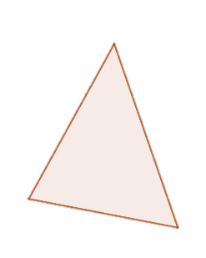
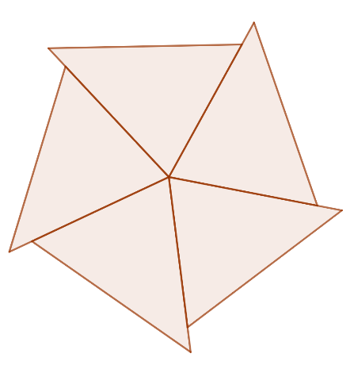
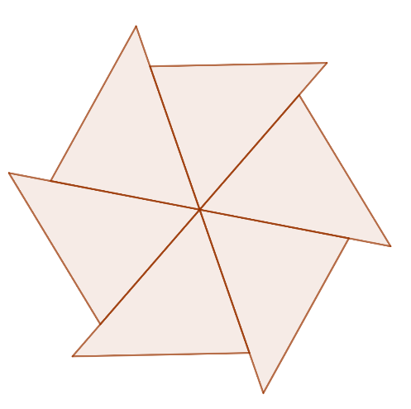
Checkpoint 17: Triangle flowers
Nicola has a stack of identical triangular tiles, like this one.
If she arranges them to make a flower like the one below, do you know any of the angles in the tiles?
She can also arrange them to make a flower like this one – do you know any more of the angles in the tiles now?
b
b
c
b
b
c
a
b
a
a
c
a
a
a
a
c
c
a
a
c
b
c
b
b
c
c
b
c
c
a
c
a
b
b
a
b
Can Nicola arrange her triangular tiles to make another flower? How do you know?
Notes:
This slide is animated. Each question will appear separately so you can choose the pace at which to work with your class. Printable tiles can be found on slide 102.
Answers
a) We know angle a must be 72° as there are five of them at the centre and 360° ÷ 5 = 72°.
b) We know angle c must be 60° as there are six of them at the centre and 360° ÷ 6 = 60°. We now also know that angle b must be 48° as angles in a triangle add up to 180° and 180° − (72° + 60°) = 48°.
? We cannot arrange the triangles with just angle b at the centre as 48 is not a factor of 360 and 360° ÷ 48 = 7.5, so we would either have a gap of 24° or an overlap of 24°. We could arrange the triangles so that there is a combination of different angles in the centre – for example three of angle a and three of angle b, since 72° + 48° = 120° and 120° × 3 = 360°; or two each of angles a, b and c ,since 72° + 48°+ 60° = 180° and 180° × 2 = 360°). See the solutions slide for a visualisation of this.
Suggested questioning
What do you know about angles around a point?
Is it possible for Nicola’s triangles to be isosceles? Why or why not?
How would your answers change if four angles met around the point?
Things to think about
Although this is a triangles task, it is not until the end of part b that any knowledge of the interior angle sum of triangles is required. Instead, part a and the beginnings of part b rely on students recognising that they need to divide the total angles around a point by the number of tiles that touch to complete 360°. Notice how much prompting students need to get there: are they able to recognise this angle relationship through the ‘distractions’ of the triangles? Observe how readily students can keep track of the multiple parts of this question, perhaps by recording each stage of their workings, to gain an indication of how much support they will need to handle multi-step angle problems in future. A printable version of these triangular tiles is provided; this might also be a useful representation for supporting students to ‘see’ that angles that form a straight line total 180°, as joining one of each angles a, b and c will form a straight line.

Slide 51

Checkpoint 17: Triangle flowers (solution to further thinking question)
Can Nicola arrange her triangular tiles to make another flower? How do you know?
b
b
b
b
b
b
b
b
b
a
a
c
a
c
a
b
c
b
c
a
b
a
b
a
a
b
c
b
c
c
a
b
c
b
b
c
a
c
b
a
a
c
a
a
c
a
c
a
c
a
a
c
c
a
c
c
c
Nicola can arrange her triangle tiles with different combinations of a, b and c at the centre, as in the examples above, so long as they total 360°. The order of the tiles does not matter.
Nicola cannot arrange her triangle tiles with b at the centre.
Notes:
This slide is animated. The first ‘non-flower’ and explanation appear first, and then the second two flowers and explanations appear separately.

Slide 52
Checkpoint 17: Guidance
Adaptations | Assessing understanding
Support Discuss with students which angle facts they know or can see within the diagram. Draw attention to any that they might have missed, flagging the point where the triangles all meet. Do they know that a full turn around this point is 360°? If needed, link back to their understanding of 90° as a right angle and that four of these make a full turn. Challenge Can all triangles be arranged so that they make three ‘flowers’ in this way? Are there any others? If so, what angles would they have? How many can you find? Representations Triangle tiles are included in the printable resources section. Consider at what stage these might be useful. Having a physical resource to manipulate may help to convince students that the flowers ‘work’, but will they also support them to use the angle rules required? They might be of most use to help generate solutions for the further thinking question. | Checkpoint 17 gives insight into whether students understand and can reason with the fact that angles at a point sum to 360˚, and also that angles in a triangle sum to 180˚. While the angle rules referenced are within the primary curriculum, they are not in the NCETM’s Curriculum Prioritisation Materials so some students may not have looked at them in depth. The animation revealing parts a and b is intended to scaffold the reasoning for students, building through finding each of the interior angles individually. Depending on your class, you could remove this scaffolding and reveal the whole task, allowing students more freedom to construct their own chain of reasoning. Listen to whether students know which angle facts are helpful and which are not, to understand how well they can apply their knowledge to solve problems. Students might, for example, use the angle sum in a triangle to deduce that the angles in all five of the triangles sum to 900˚ which, while true, will not lead towards a solution. Listen out for inaccurate or incomplete recall of angle facts, such as, ‘Angles in a circle add to 360°’, and address these misconceptions in your teaching.
Additional resources Key idea 6.1.1.2 from the Secondary Mastery Professional Development | NCETM looks at deepening students’ understanding of ‘proving the interior angle sum of a triangle’ by connecting it to their new learning on parallel lines

Slide 53
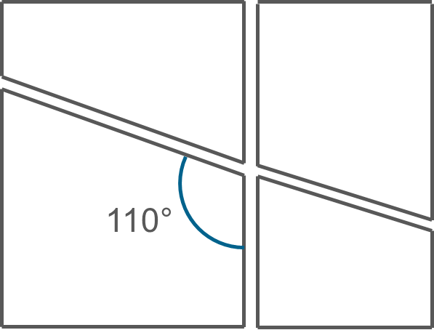
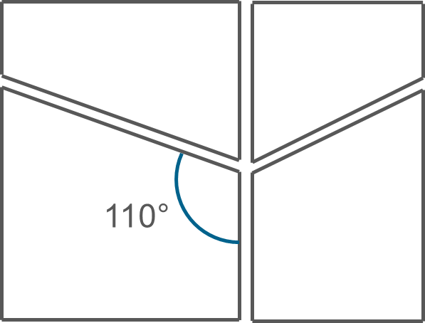
Checkpoint 18: Paper cuts
Josie cuts a rectangular piece of paper into two pieces with a diagonal cut.
She then cuts the pieces in two again with a single vertical cut.
She measures one of the angles she has created.
What other angles do you know?
Paul cuts his paper vertically first, then uses a different diagonal cut on each piece.
He also measures one angle to be 110°.
What other angles do you know for his shapes?
Notes:
This slide is animated. Each question will appear separately so you can choose the pace at which to work with your class.
Answers
We know the measurements of all of the other vertices. In the piece that is labelled, the two base angles are 90° and the obtuse angle is 70°. All four pieces will have two angles of 90°, an angle of 110° and an angle of 90°.
? We still know that the four angles in the labelled piece are 90°, 90°, 70° and 110°. The piece above it also has angles of 90°, 90°, 70° and 110°. We do not know the angle at which Paul makes the other diagonal cut, so we cannot deduce the obtuse and acute angles of the other two pieces, although we do know that each piece also has two angles of 90°.
Suggested questioning
How would this task change if the paper was not rectangular? Would you still be able to work out as many angles from just the one given?
What angle rules have you used?
What order did you work the angles out in? Did anyone do it differently?
Which angles would change if the cut was at a different angle?
Things to think about
Checkpoint 18 is deceptively simple, as it is possible to work out all of the angles despite only being given one. This is because, although they are not labelled, we know there are four right angles as the original piece of paper was rectangular. Check students’ are aware of the importance of not making assumptions within geometric problems, and also whether they notice that some information is given within the text rather than the diagram. This will help you to know how explicit you need to be about these habits within future teaching.

Slide 54
Checkpoint 18: Guidance
Adaptations | Assessing understanding
Support Ask students to first identify and label all the right angles to get them started. Challenge Ask students to consider further cuts to the paper. When will they know the angles? When will they not know? Asking them to articulate the information that they need may consolidate and even deepen their understanding of angle rules. Representations Cutting paper is offered as a simple representation of angles that is easy to replicate in the classroom. You could easily cut a piece of paper in this way, stick it on the board and annotate it as students generate their answers. | Checkpoint 18 explores several key angle rules covered at primary school: angles meeting on a straight line; angles in a quadrilateral; and vertically opposite angles. While these angle rules are in the primary curriculum, they are not explicitly in the NCETM’s Curriculum Prioritisation Materials so some students may not have looked at them in depth. Do students recognise that, in cutting the paper like this, vertically opposite angles have been created? Prompt them to associate this situation with the diagrams they are more accustomed to. A key role for the teacher here is probing understanding. Students may have an instinctive sense of when angles are equal without having the mathematical reasoning to back this up. Encourage students to justify their answers and prompt beyond simplistic answers such as, ‘Because it looks the same’. Listen out for the mathematical language they use and how precisely they refer to the angle rules that they do know. Students may be surprised that all the angles can be calculated in the main task, given that only one is marked. Not making assumptions is a key principle in geometry, so make sure they are clear that, although the right angles are not marked, we can be certain that they exist because the cut is vertical and the overall shape is a rectangle.
Additional resources Additional activity G offers a chance to explicitly discuss vertically opposite angles; activity F explores misconceptions with angles on a straight line.

Slide 55
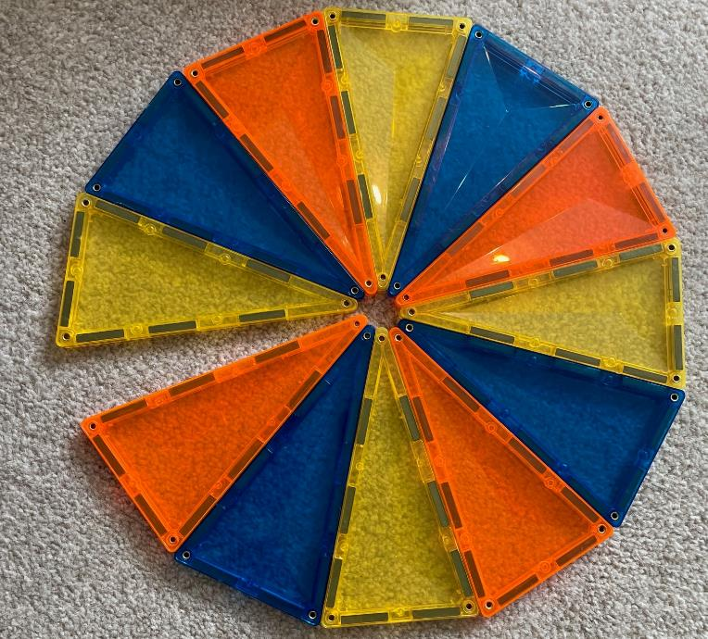
Checkpoint 19: Triangle tiles
Ollie is making a shape with identically sized isosceles triangle tiles.
What do you know about the angle marked a? What do you not know?
Ollie says that the angle marked b could be 70°. Is he correct?
The missing angle, c, is 12°. What must the size of angles a and b be now?
a
c
b
What other values could the missing angle take if angles a and b are integers?
Notes:
This slide is animated. Each question will appear separately so you can choose the pace at which to work with your class.
Answers
a) Students’ answers may vary, but might include: we know that it is acute; we know that it is smaller than the other angles in each triangle; we know that it is the same as all of the other angles that meet at the centre; we know it is less than 30° (as 360 ÷ 12 = 30), but these 12 triangles total less than 360°.
b) Ollie is not correct. If the angle is 70°, then the other base angle of the triangle must also be 70° (totalling 140°). Angles in a triangle sum to 180°, which would make the third angle 40°. We already know (from part a) that it is less than 30°.
c) 29°. If the missing angle is 12°, then the twelve identical angles meeting at the centre must total 360 – 12 = 348°; 348 ÷ 12 = 29°.
? The missing angle needs to be a multiple of 12 so that the remaining angles around the point can be divided by 12 and the result (angle a) be an integer. So, 24° and possibly even 36° are possible answers; 48° or higher seems unrealistic based on the image above, as angle c is clearly much less than half of a right angle.
Suggested questioning
Could angle a be __°? Why or why not?
If Ollie is right that angle b is 70°, what other angles could you now know?
What is the biggest that angle a/b/c could be? What is the smallest?
Things to think about
Checkpoint 19 is a classic low-floor high-ceiling task, so be guided by your class as to the depth of discussion that takes place. Let students tell you what they know. This might range from basic angle descriptions such as classifying the angles or comparing them to a right angle, to being able to suggest minimum or maximum values for each of the missing angles – although eliciting this may require some structured questioning. Eagle-eyed students may spot that the tiles do not actually meet at the centre as there is a hole; assure them that for the purposes of this task you can assume that they meet to form a point at the centre. A sketched diagram may help support this.

Slide 56
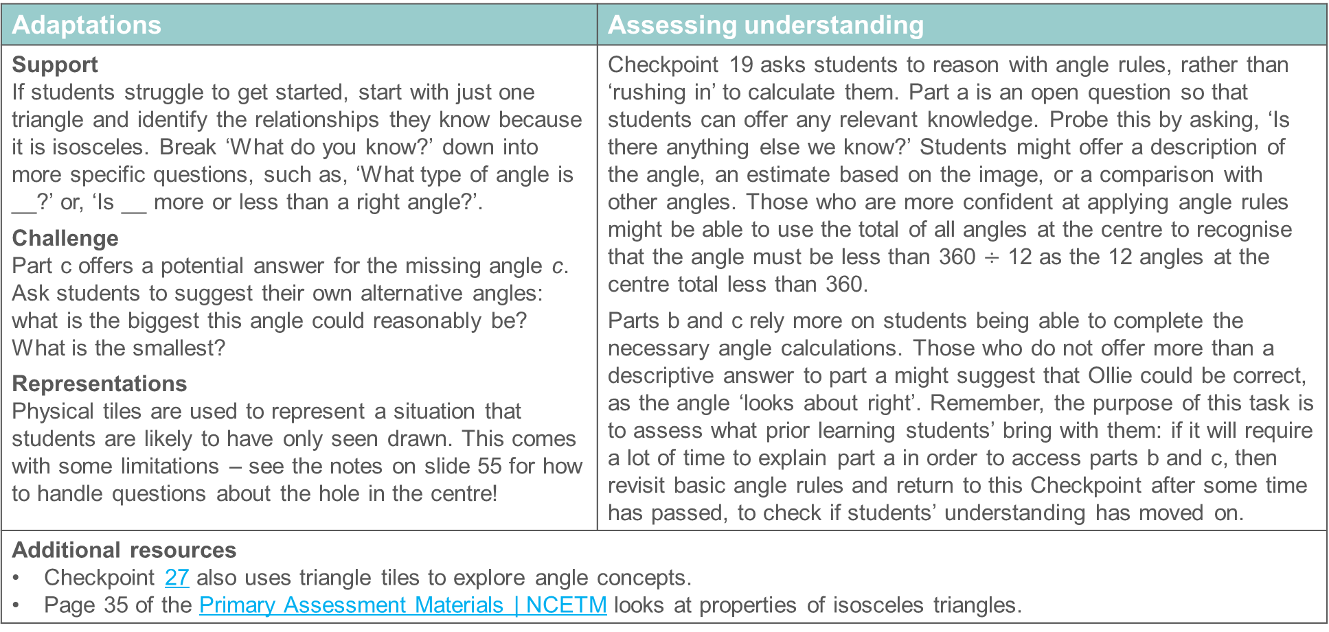
Checkpoint 19: Guidance
Adaptations | Assessing understanding
Support If students struggle to get started, start with just one triangle and identify the relationships they know because it is isosceles. Break ‘What do you know?’ down into more specific questions, such as, ‘What type of angle is __?’ or, ‘Is __ more or less than a right angle?’. Challenge Part c offers a potential answer for the missing angle c. Ask students to suggest their own alternative angles: what is the biggest this angle could reasonably be? What is the smallest? Representations Physical tiles are used to represent a situation that students are likely to have only seen drawn. This comes with some limitations – see the notes on slide 55 for how to handle questions about the hole in the centre! | Checkpoint 19 asks students to reason with angle rules, rather than ‘rushing in’ to calculate them. Part a is an open question so that students can offer any relevant knowledge. Probe this by asking, ‘Is there anything else we know?’ Students might offer a description of the angle, an estimate based on the image, or a comparison with other angles. Those who are more confident at applying angle rules might be able to use the total of all angles at the centre to recognise that the angle must be less than 360 $÷$ 12 as the 12 angles at the centre total less than 360. Parts b and c rely more on students being able to complete the necessary angle calculations. Those who do not offer more than a descriptive answer to part a might suggest that Ollie could be correct, as the angle ‘looks about right’. Remember, the purpose of this task is to assess what prior learning students’ bring with them: if it will require a lot of time to explain part a in order to access parts b and c, then revisit basic angle rules and return to this Checkpoint after some time has passed, to check if students’ understanding has moved on.
Additional resources Checkpoint 27 also uses triangle tiles to explore angle concepts. Page 35 of the Primary Assessment Materials | NCETM looks at properties of isosceles triangles.

Slide 57
Checkpoint 20: Isosceles
80°
Helen cuts out an isosceles triangle.
What are the missing angles a and b?
Helen makes her triangle smaller with a horizontal cut.
What are the missing angles c and d?
Helen repeats this with another triangle but makes her horizontal cut in a different place.
She says, ‘My triangle is smaller so my angles are smaller too.’
Is she correct? Why or why not?
c
d
a
b
80°
c
d
a
b
What is the shape of the other piece remaining in part b? What are the angles in this shape? Are your answers the same or different for other piece in part c?
Notes:
This slide is animated. Each question will appear separately so you can choose the pace at which to work with your class.
Answers
a) The missing angles a and b are both 50°.
b) The missing angles c and d are still 50°.
c) No, she is not correct. Although the triangle has a smaller area, the angles are the same size as in the previous diagram as the relationships between the sides have not changed.
? The shape in part b is an isosceles trapezium; angles a and b are both 50° , with the remaining angles both being 130°. The answers are exactly the same for the shape in part c: it is an isosceles trapezium with two angles of 50° and two angles of 130°.
Suggested questioning
How can you work out the missing angles of the triangle?
What is the total of the angles in the triangle?
What is the same and what is different about each triangles?
What is the shape that is cut from the triangle? What are the angles in this shape?
Things to think about
As with Checkpoint 15, this Checkpoint ascertains whether students have any misconceptions around equality with angles, particularly where a shape is smaller but the angles are the same. It might feel counter-intuitive that angles c and d are the same in both diagrams. There is a further assessment point around the use of angle rules to find missing angles in isosceles triangles and quadrilaterals; be guided by your class as to whether you also explore the angles in the isosceles trapezium created when the original triangle is cut.

Slide 58
Checkpoint 20: Guidance
Adaptations | Assessing understanding
Support Students may be unconvinced that the angles are the same in both diagrams, given the different sizes of the triangles. Cut out an angle of 50° and model how it fits exactly into the base angles each time. Challenge Ask students to consider a different triangle (for example, a scalene) and repeat the same process of cutting parallel to the base. What is the same and what is different about the angles? Representations This Checkpoint uses a pictorial representation but states that Helen physically cuts her triangle. This may be clearer to students if you model it physically as well. | There are two assessment purposes to Checkpoint 20. Part a assesses students’ understanding of missing angles in isosceles triangles; parts b and c reinforce this but also look at how they reason around angles. How do they justify that angles c and d are the same as angles a and b? Part c particularly explores a common misconception around smaller shapes not having smaller angles. It may be counter-intuitive for some that the angles are preserved in all three triangles, which links to later learning on angles on parallel lines. Those who particularly struggle with this concept may find it easier to access further work on angle rules if they have some more support with understanding the basic concept of angles first. The further thinking task explores the trapezium left at the base of the original triangle. Pay attention to how students calculate the missing angles – do they use the properties of a quadrilateral (specifically one with symmetry such as this) or the properties of a straight line? Can they recognise the alternative approach if you prompt them? Be careful that students do not associate the term ‘trapezium’ just with an isosceles trapezium (which can happen as it is the most common image of this shape). Clarify that the trapezia here are special cases of the more general shape.
Additional resources The ‘Perimeter, area and volume’ deck from Checkpoints | NCETM has tasks that explore trapezia. Additional activity G discusses vertically opposite angles; activity F explores misconceptions with angles on a straight line.

Slide 59
Checkpoint 21: Angle tangle
How many angles can you work out if you know the values of:
d
angle b
angles b and f
angles b, f and e?
h
c
g
l
k
b
f
j
a
i
n
e
m
After part c, you want to work out all the angles in the diagram. Which of the unknown angles do you ask for next? Why?
Notes:
This slide is animated. Each question will appear separately so you can choose the pace at which to work with your class. A printable version can be found on slide 103.
Answers
a) If you know the value of angle b, you can work out that of one angle (c)
b) If you know the values of angles b and f, you can work out four angles (c, g, k and j).
c) If you know the values of angles b, f and e, you can work out seven angles (c, g, i, k, j, m and a).
? To work out the values of all the angles, you could ask for any of the remaining angles d, h, l or n, and you will have enough information to calculate the rest.
Suggested questioning
What do you know? What do you need to know?
Which is the most useful angle to know? Which is the least useful?
Which angles in the diagram are the same? Which sum to 180°? 360°?
Things to think about
Students’ experience of more complex angle problems, where they need to follow through multiple steps, is likely to be quite varied. Offering an example such as this – where students cannot actually calculate anything, so have to reason and justify – is intended to help you identify which students are more familiar with applying angle rules in multi-step problems, or can ‘see’ the relationships easily, and which might need more support with this step.

Slide 60
Checkpoint 21: Guidance
Adaptations | Assessing understanding
Support If students need help isolating specific parts of the complex diagram, highlight the line segments involved on the printable version, and then re-draw just that part. Or use a piece of paper to cover over aspects of the diagram to focus on specific parts. Challenge Ask students to create their own complex angle-chasing diagram. What is the minimum information they need to give to make their problem solvable? Representations Students can become accustomed to simple representations of angle rules (such as seeing a horizontal line segment split into two angles more than other representations of angles on a straight line). Over Key Stages 3 and 4, they will experience many more complex problems such as this, and need to build familiarity with identifying angle rules from within them. | Checkpoint 21 does not give any angles: we are not preoccupied here with the calculations, but with students’ recognition of what information is necessary to do the calculations. Like Checkpoint 22, this task assesses whether students can isolate simple instances of angle rules from within a bigger and more complex diagram. All the angle rules here are in the primary curriculum, but the complexity of the diagram is likely beyond what they have seen. See how well they cope with identifying angle rules, to understand how much teaching is needed to support them to separate ‘basic graphics’ from within complex diagrams. It may be helpful to use a different colour pen for each stage of the question so that you can mark which angles you now know each time. Ask students if they are surprised by how many angles you can discover each time – would they have found more or less with a different given angle?
Additional resources Additional activity H is a simpler version of this task. Examples of more complex angle problems encountered within the Key Stage 2 assessments can be found in question 24 of 2022 Paper 2 reasoning and question 17 of 2016 Paper 2 reasoning. Past papers are readily available online. The ‘mastery with greater depth’ question on p35 of the Year 6 Primary Assessment Materials | NCETM demonstrates a more challenging example of a complex angle problem for Key Stage 2.

Slide 61
Checkpoint 22: Initial reaction
Thomas and Fiona are looking for their initials in this diagram. They might be upside-down, back to front or even a bit wonky!
Thomas says, ‘I can find my initial once.’
How many times can you find it?
Fiona says, ‘I can find my initial twice.’
How many times can you find it?
What other letters can you find?
What do you notice about the angles in the letters you found for parts a and b? Are any of them the same?
Notes:
This slide is animated. Each question and the highlighting of each ‘letter’ on the diagram will appear separately so you can choose the pace at which to work with your class. A printable version can be found on slide 104.
Answers
See the animated solutions slides (next three slides) for illustrations of the different initials.
a) There are 24 different T shapes formed by the intersecting line segments.
b) There are 36 different F shapes formed by the intersecting line segments.
c) Students’ responses will vary, and the number of different letters will depend on their ‘initial reaction’ to the image and so which letter shape seems most obvious to them. Students could argue for ‘seeing’ almost any letter shape within the diagram. For example, removing one of the bars on the F shapes shown could be seen as an L, or reducing the length of the longest line on the F shape could be seen as a C.
? The two angles that make up the T shapes total 180°, as do the two angles formed by the T shape within the F. Where the top and bottom ‘bars’ of the F shape are formed by parallel lines, two equal angles are formed. (Note that ‘conventional markings’ for parallel lines are included in the non-statutory curriculum guidance for Year 5, but it is worth questioning to check all students have recognised the arrow notation and remembered its significance.)
Suggested questioning
What is your definition of an F shape or a T shape?
Which letter shape can you find more of?
How many different orientations are there of each letter shape?
Things to think about
Checkpoint 22 does not refer to angles explicitly (except in the further thinking question) but asks students to spot shapes made by the intersection of line segments. This is a crucial skill for identifying angles within more complex graphics, but one that we do not always isolate. It can be hard to ascertain whether students are struggling because they do not remember an angle rule, or because they find it challenging to ‘see’ an instance of an angle rule within a diagram. This task enables you to identify those students who might struggle to recognise these relationships before they have been explicitly named and taught at Key Stage 3. Although this task asks students to identify letter shapes, note that this is because these are recognisable and easy to describe and not because there is any intention for letter names to be used to refer to particular angle relationships. When you come to teach angle relationships in Key Stage 3, students should be encouraged to use reasoning based on the inherent geometrical structure; we strongly discourage memorising standard diagrams or using phrases such as ‘F’ and ‘Z’ angles, which do not support reasoning and mathematical thinking.

Slide 62
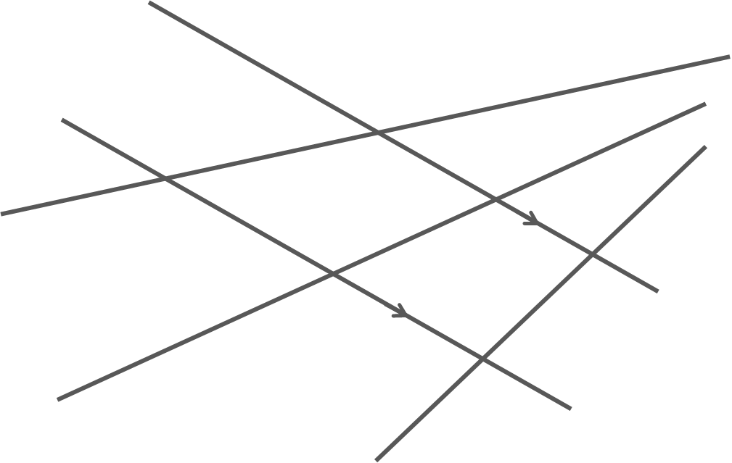
Checkpoint 22: Initial reaction (animated solutions to part a)
Notes:
This slide is animated. The highlighting of each ‘letter’ on the diagram will appear separately so you can choose the pace at which to work with your class.

Slide 63
Checkpoint 22: Initial reaction (animated partial solutions to part b)
There are also 12 more F shapes (see next slide).
Notes:
This slide is animated. The highlighting of each ‘letter’ on the diagram will appear separately so you can choose the pace at which to work with your class.

Slide 64
Checkpoint 22: Initial reaction (further solutions to part b and the further thinking question)
a
a
a
b
a
b
Where the top and bottom ‘bars’ of the F are formed by parallel line segments, two equal angles are formed.
c
c
b
b
c
c
d
d
e
d
f
d
e
e
e
f
f
f
Notes:
This slide is animated. The highlighting of each ‘letter’ on the diagram, as well as the labels for matching angles, will appear separately so you can choose the pace at which to work with your class.

Slide 65
Checkpoint 22: Guidance
Adaptations | Assessing understanding
Support Give students a printable version to highlight, with multiple copies and colours as the diagram can get confusing. Or simplify additional activity J further by drawing an example with two (non-parallel) line segments intersected by a third line segment. Challenge Ask students to draw their own intersecting line segments to deepen understanding of the geometric figures being created. Can they create exactly two or six T shapes? How about two F shapes? Why is it not possible to create exactly three F shapes? Representations Consider how you intend to introduce and represent the angle relationships that are alluded to. Will students always see alternate and corresponding angles represented on parallel lines? They may benefit from seeing these relationships represented on non-parallel lines, so that they understand the equality when the lines are parallel as a special feature connected to the relationship between the lines. | Checkpoint 22 isolates a particular skill needed for students to work with angles: identifying a ‘basic graphic’ from within a more complex one. Here, we use the idea of finding letter shapes within intersecting lines to assess how readily students can do this (note that letter names are not used to describe the angles – see ‘things to think about’ on slide 61). The focus is on whether students can recognise these shapes in different orientations; whilst there is no expectation that students will find all of the examples of each letter, you should notice which students can only find a few. If students find this challenging, that may be a barrier to teaching angles on parallel lines and you will need to think about how to support students to identify these relationships as part of your planning. The inclusion of three non-parallel lines offers the opportunity to think about relationships between the positions of the angles, without considering their values. The further thinking question considers when the angles formed are equal; this might offer a starting point for new teaching.
Additional resources Additional activity J offers a simpler version of this task, with fewer intersecting line segments. Key idea 6.1.1.1 from the Secondary Mastery Professional Development | NCETM gives ideas for how you might go on to explore ‘equal and supplementary angles in parallel lines’ at Key Stage 3.

Slide 66

Checkpoint 23: Parallel pencils
Millie arranges some pencils on their desk.
What angles do you notice?
Fill the gap to compare the angles: angle x is ______ than angle y.
How could you move the pencils so that angle x is bigger than angle y?
How could you move the pencils so that angle x is equal to angle y?
PENCIL 2
PENCIL 1
y
z
PENCIL 3
Repeat parts a to c, but replace angle x with angle z. What do you notice?
x
Notes:
This slide is animated. Each question will appear separately so you can choose the pace at which to work with your class.
Answers
a) Students’ answers will vary but might include observing that there are eight angles formed, noticing that there are four pairs of vertically opposite angles, or comparing the size of two or more angles.
b) Angle x is smaller than angle y.
c) You could: rotate pencil 1 clockwise until y is an acute angle smaller than x; rotate pencil 3 anti-clockwise until x is an obtuse angle bigger than y; or rotate pencil 2 clockwise until angle x is greater than angle y.
d) Rotate either pencil 1 or pencil 3 until y and x are equal.
? All the answers are exactly the same.
Suggested questioning
Which is the biggest angle? Which is the smallest?
Describe the relationship between pencils 1, 2 and 3.
After parts b to d, draw a diagram with line segments to represent the pencils. What do you notice?
Things to think about
Checkpoints 23, 24 and 25 are all intended to be used to check understanding before teaching angles on parallel lines. You will need to think about how you might use the information gained from the task to inform planning. Do you want to know it a few weeks in advance of teaching, so that you can think about the sequence of learning? Or would you be happy to know within the learning sequence, so that you can adapt ‘on your feet’? The intention is to check whether students are able to make comparisons between the angles given, and start to reason about when one is greater than, less than, or equal to another.

Slide 67
Checkpoint 23: Guidance
Adaptations | Assessing understanding
Support Spend time playing with the representation. Can students position the pencils so that y is greater than x? How many different positions are there where this is the case? Challenge Offer constraints that test students’ estimation skills: can they position the pencils so that angle y is three times the size of angle x? How about three-quarters of the size? Representations Dynamic representations can be useful for exploring geometric structures. Students could recreate and manipulate the image shown to recognise the conditions where corresponding and alternate angles are equal. Other options may be readily available online, but using items readily to hand has the advantage of being easy to create again if students need future reminders. | Checkpoint 23 offers an easily created context to explore the relationships between angles created by a transversal. The static image shown in the Checkpoint does not start with any parallel lines. Start by seeing what observations students offer more generally, and then begin to focus in on the relationship between angles x and y. Assess whether students can confidently compare angles, but also reason about how a change to a diagram will affect the angles shown. Can they predict their answer to part b without moving the pencils? While the task does not require any knowledge beyond Key Stage 2, part d could act as a springboard for new learning on equal angles. If you choose to do this, ask students what they notice as the questions build towards angles x and y being equal. How can they describe the position of the pencils for part c? Will this still be the case if the transversal pencil is tilted differently?
Additional resources Key idea 6.1.1.1 from the Secondary Mastery Professional Development | NCETM gives ideas for how you might go on to explore ‘equal and supplementary angles in parallel lines’ at Key Stage 3. The questions on p42 of the Secondary Assessment Materials | NCETM offer some examples of where you might go next in Key Stage 3 and how you might check understanding of this topic after some teaching.

Slide 68
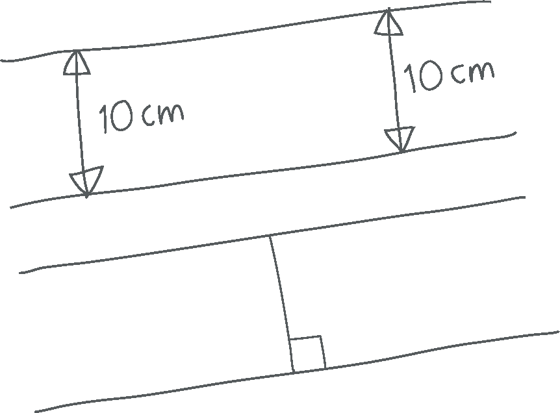
Checkpoint 24: Sketchy
Sarah sketches a diagram. She says, ‘I think these line segments would be parallel if I drew this accurately.’
Can you be certain that the line segments are parallel? What assumptions have you made?
Sarah sketches another diagram.
Can you be certain that these new line segments are parallel? How do you know?
How would the diagram for part b be different if the angle was 80°? How about 10°?
Notes:
This slide is animated. Each question will appear separately so you can choose the pace at which to work with your class.
Answers
a) Yes. The line segments are the same distance apart (10 cm), so they are parallel. We have assumed that the line segments are straight and that both 10 cm measurement are perpendicular (or at the same angle) to the line segments.
b) Yes. The line segments are connected by a perpendicular line, so they are both at 90° to this line and therefore parallel to each other. Students might use their knowledge of properties of rectangles and squares to justify this.
? The line segment connecting the two parallel lines would be at a different angle (and therefore a different length). For 80°, it would be close to vertical; for 10° it would be close to horizontal. The line segment creating the 80° angle would be longer than the one in part b, and the line segment creating the 10° angle would be longer still. Note that the reasoning around why the lines are still parallel is new learning at Key Stage 3. At this stage, see whether students have a sense that this property of the diagram will not change rather than expecting a recognition of which angles will be the same.
Suggested questioning
What does it mean for lines or line segments to be parallel? Can you refine your definition?
How can I mark the line segments to show that they are parallel?
Do parallel lines need to be straight?
Point to a line segment and ask, ‘Imagine moving this line segment – how could you move it so the diagram is still accurate? Or so the diagram is no longer accurate?’
Things to think about
Think about the way that students work on this task – using a mini-whiteboard or scrap paper may prompt them to sketch and annotate differently than in work they know is going to be kept. Use the ambiguity offered by a sketch to explore students' understanding, and offer an opportunity for them to see how helpful a rough diagram can be in capturing their thinking and supporting a chain of reasoning.

Slide 69
Checkpoint 24: Guidance
Adaptations | Assessing understanding
Support This task explores students' understanding of parallel lines; any support should not make assumptions around this. If you offer an assumption to start a discussion, use something that does not close down an opportunity for exposing understanding. For example, ‘I assumed that the 10 cm measurements are accurate – how would this help me decide whether the line segments are parallel?’ Challenge The reasoning involved in the second task is challenging, and the prompts in the further thinking question move towards a generalisation. Ask what could change in the diagram (for example, the angle of the transversal, the orientation of the parallel line segments or the lengths of the line segments shown) while still giving enough information to decide whether the line segments are parallel or will challenge this generalisation. Representations Students should feel happy to sketch and annotate diagrams to support their thinking in mathematics – give permission to not use a ruler to focus them on reasoning rather than precision drawing. | Checkpoint 24 gives an opportunity for students to reason with parallel lines. Although non-statutory, conventional markings for parallel lines and right angles are a part of the Year 5 Programme of Study. As well as notation, look for students' understanding of 'parallel'. Is their understanding that parallel lines must be straight? That the distance between parallel lines should be constant? Encourage students to annotate with as much information as they are able to as this will offer insight into their current understanding. The further thinking question focuses on imagining how the diagram changes with different angles of transversal – at this stage, the focus here is on their visualisation and reasoning (for example, around how the line segment lengths will change) rather than leading into angle rules on parallel lines.
Additional resources Additional activity C offers a prompt to discuss definitions of parallel lines. Key idea 6.1.1.1 from the Secondary Mastery Professional Development | NCETM gives ideas for how you might go on to explore ‘equal and supplementary angles in parallel lines’ at Key Stage 3.

Slide 70
Checkpoint 25: Sliding lines
A
B
The red lines in diagram A are parallel.
What happens to the angles a and b as the line moves?
Does the size of a change?
Does the size of b change?
Is one bigger than the other? Does that change?
a
b
c
d
The blue lines in diagram B are parallel.
What happens to the angles c and d as the line moves?
Does the size of c change?
Does the size of d change?
Is one bigger than the other? Does that change?
How would your answers be different if it was one of the vertical lines that moved each time?
Notes:
This slide is animated. Each set of questions and its related diagram will appear separately so you can choose the pace at which to work with your class. As you click through the slide the transversal is animated so that it gives a dynamic image for students to work with.
Answers
a) No, the size of angle a does not change.
b) No, the size of angle b does not change.
c) No, angles a and b are equal and this does not change.
d) Yes, angle c gets smaller as that end of the black (intersecting) line rotates downwards (and vice versa).
e) Yes, angle d gets smaller as that end of the black (intersecting) line rotates upwards (and vice versa).
f) No, angles c and d are equal and this does not change.
? If the parallel lines moved like the a/b example (i.e. sliding vertically on horizontally) then the answers to parts a, b and c would not change. If the parallel lines moved like the c/d example (i.e. rotating so that their angle changes) then the answers to parts d and e would change; the lines would no longer be parallel, so the size of c and d would no longer be preserved. The answer to part f would also change as c and d would no longer be equal.
Suggested questioning
How can I mark the lines to show that they are parallel?
What is the same and what is different about the two angles in diagram A (or B)?
What is the same and what is different about the two diagrams?
Would your answers be the same if the lines were not parallel?
How could you describe the relationship between the two angles?
Things to think about
Checkpoint 25 sits on the borderline between Key Stage 2 and Key Stage 3. The intention here is to see how students instinctively react to the image, to help you decide what approach you will take to introducing the relationships between angles on parallel lines. Giving time for students to explore the static image is key, but consider what the animation offers. The intention is that the dynamic image moves students towards a generalisation by offering certain allowable changes. Consider whether this is a successful strategy and in what other situations a dynamic image might be helpful in generalising.

Slide 71
Checkpoint 25: Guidance
Adaptations | Assessing understanding
Support The slide is animated to help students understand the general situation rather than focus on one particular case. However, you could work on a static situation first before starting the animation, asking students to compare the sizes of angles a and b, so that they are more familiar with the context when the animation is started. Challenge Challenge students by asking them to consider the situation if the lines were not parallel. How would their answers change? What assumptions would they need to make? Representations Although a diagram is offered, students may find it helpful (particularly for questions d–f) to sketch a diagram and annotate it to support their reasoning. | Checkpoint 25 can be used to inform teaching of angles on parallel lines, which is new learning at Key Stage 3. Students will have met parallel lines as early as Year 3, and vertically opposite angles are a part of the Year 6 Programme of Study. This Checkpoint offers a context in which understanding of these can be bought together. Some students may not have looked at angle rules in depth as they are not explicitly referenced in the NCETM’s curriculum prioritisation materials. The animation supports students in generalising rather than working on one particular static case; familiarise students with the static image before starting the animation. Ask students, ‘How do you know that's true for the whole animation?’ when they offer an answer, for insight into how deeply they have understood the key ideas covered in the primary curriculum.
Additional resources Additional activity I is identical to this task, but draws attention to the corresponding rather than alternate angles in the diagram. Key idea 6.1.1.1 from the Secondary Mastery Professional Development | NCETM gives ideas for how you might go on to explore ‘equal and supplementary angles in parallel lines’ at Key Stage 3.

Slide 72
Checkpoint 26: Decagon diagonals
Jessie draws a diagonal from one vertex of her decagon.
How many different diagonals can she draw from this vertex?
How would your answer change if the shape was a nonagon?
Jessie draws another shape. She draws every possible diagonal from one vertex.
If there were four diagonals, what shape did she draw?
How about if there was only one diagonal?
What do you notice about the shapes created by the diagonals? What might this mean for the total angles?
Notes:
This slide is animated. Each question will appear separately so you can choose the pace at which to work with your class. Printable decagons can be found on slide 105.
Answers
a) She can draw seven different diagonals, including her original diagonal.
b) She would be able to draw six different diagonals.
c) If she draws four diagonals, she would have drawn a heptagon.
d) If she drew one diagonal, she would have drawn a quadrilateral. Do not accept a specific quadrilateral such as ‘square’ as the only solution here; prompt to check students understand that it could be any four-sided shape.
? All the shapes are triangles formed by either two edges of the original shape and one diagonal, or two diagonals and one edge. This means the total angles will be 180° × the number of triangles.
Suggested questioning
What is a diagonal?
How can a diagonal be vertical?
Can you create a rule for the number of diagonals you can draw from one vertex in a shape?
How many triangles can you see when we draw the diagonals in?
Things to think about
A common strategy for teaching the interior angle sum of polygons is to divide the polygons into triangles from a single vertex. For students to be able to access this, they need to understand diagonals but also that you are specifically referring to the set of diagonals created from one vertex. This task explores this, without straying into new teaching, although this is hinted at in the further thinking question: students are likely to recognise that all the shapes are triangles, and could infer that this means the angle sum is 180° per triangle. This helps you to check students have the knowledge they need to fully comprehend the formula for the sum of interior angles, which is the new learning at Key Stage 3.

Slide 73
Checkpoint 26: Guidance
Adaptations | Assessing understanding
Support Give students a printed decagon to draw their diagonals on. Consider using a hexagon for part a and a pentagon for part b, leading more directly to parts c and d. Challenge Extend students’ understanding of diagonals by considering irregular polygons with reflex interior angles. Can they still identify the seven diagonals from one vertex of, for example, a star-shaped decagon, like on slide 79? Representations Be aware of the range of examples that students see and how this can limit their understanding of the definitions of a shape. A regular decagon is used here – do students understand that it is representative of all decagons? Consider re-presenting part a with an irregular decagon to show that the number of diagonals will be the same. | Checkpoint 26 checks some basic understanding for teaching interior angles of polygons. None of the main part of the task uses knowledge beyond Key Stage 2. The intention is that the focus is narrow so be careful not to stray beyond the scope of the task. Primarily, check that students understand the terminology of diagonals and vertices, as well as the names of some polygons, and that they are able to follow the instruction of drawing a diagonals from a single vertex. Parts c and d offer them the opportunity to generalise – can they identify that there is a relationship between the number of possible diagonals and the number of sides? This understanding will support the later use of angles in a triangle to find the interior angle sum of polygons. The further thinking question strays into new teaching: do not dwell on this, but do notice if there are students who find it straightforward. These students might need some extra challenge when you do come to teach angles in polygons.
Additional resources Additional activity K offers a more structured version of this task, exploring some specific misconceptions around diagonals. Additional activity L explores diagonals further, particularly their properties in quadrilaterals. Diagonal properties of quadrilaterals is assessed in the Key Stage 2 SATs papers, for example question 18 of 2016 Paper 3 reasoning. Past papers are readily found online.

Slide 74
Checkpoint 27: More triangle tiles
Bashaar is making shapes with identically sized triangle tiles.
He puts two together like the top picture on the right, matching the vertices with the same angles.
What shape has he made? What do you know about its properties?
He adds another triangle in the same way.
What shape has he made now?
What shape would be made if he added another triangle?
How many triangles would he need to create an octagon?
Could he carry on adding triangles like this to make a shape with 14 sides? Why or why not?
Notes:
This slide is animated. Each question will appear separately so you can choose the pace at which to work with your class.
Answers
a) A kite: we know that it is symmetrical, and that it has one pair of identical angles. Students might also know that its diagonals intersect at right angles.
b) A pentagon
c) A hexagon
d) Six triangles would create an octagon.
? No, he could not. To create a shape with 14 sides, he would need to use 12 triangles where the acute angles add up to less than 360° (so that the two longer sides of the triangle are still external sides of the polygon). As three triangles add up to greater than 90°, 12 triangles will be greater than 360°. Alternatively, he could use 14 triangles that fitted exactly around the centre point (to create a regular shape) but, as we already know that we cannot fit 12 triangles around this centre point, we know we cannot fit 14 either.
Suggested questioning
Does a pentagon have to have five sides? Five equal sides? Five angles? Five equal angles?
Is it possible to change a pentagon to a hexagon without making an additional triangle? An octagon to a nonagon?
How would your answers change if you matched sides with the same length, rather than angles? Would you always make the same shapes?
Things to think about
In Checkpoint 27, the constraint of matching vertices is essential: if you didn’t have to match the vertices with the same angles, you could create an infinite number of shapes, rather than the answers specified. For part a, for example, you could rotate one triangle to create a parallelogram. You might like to explore adding triangles without this constraint, although it would take significantly longer, and have more ambiguous answers, than the task as it is designed! If you do choose to do this, there are several different ways that this task could go, and the degrees of freedom that you offer to the class will influence where your students’ awareness is directed. The further thinking question also hints at another direction that could be explored: considering when the acute angles ‘complete’ 360° to make a shape with the intersection at the centre (as in Checkpoint 17) rather than at a vertex (as in parts a–d ). In this case, then the insertion of the final tile will reduce the number of edges while increasing the number of tiles used. For example, nine triangles would create an irregular 11-sided shape but the addition of the 10th triangle creates a regular 10-sided shape as the point that was a vertex becomes the centre, and the two longer sides are now ‘inside’ the shape. Reasoning and thinking about this might be interesting, but may distract from the intended object of learning for the lesson.

Slide 75
Checkpoint 27: Guidance
Adaptations | Assessing understanding
Support Ensure that students are not looking for a regular pentagon (part b) or octagon (part d) but understand that these terms refer to any five- or eight-sided polygon. For part b, for example, you could offer an image of a regular pentagon and ask what is the same and what is different. Challenge Ask students how the task would change if you did not have to use identical triangles each time. When would your answers be the same? When would they be different? Representations Manipulate physical or virtual tiles to support students in accessing and reasoning with the task. We do not suggest this representation is used to introduce interior angles in a polygon: the formula, (n – 2) × 180, relies upon an awareness that any polygon can be split into triangles from a common vertex. This representation only replicates this in the specific circumstance that the acute angles add together to form a single vertex and so may lead to misconceptions. See ‘Things to think about’ in the notes on slide 74 for more information. | By exploring how students visualise triangles used to create a polygon, Checkpoint 27 begins an exploration of interior angles of polygons, new learning at Key Stage 3. This task might be used to assess prior learning around polygons and begin to explore the ways in which polygons can be constructed and deconstructed. Look for students who struggle to recognise and name polygons: they may need more support before embarking on this topic. A common misconception for part d might be to answer eight tiles rather than six (confusing the number of sides for the number of triangles). Model how eight triangles would make a ten-sided shape. More confident students might realise that it is in fact possible to make a regular octagon with different isosceles triangles, if they each have a single acute angle of 45°. Be aware of this special case before you introduce the task. Of course, if students then were to draw triangles from a single vertex of their octagon, there would only be six.
Additional resources The questions on p43 of the Secondary Assessment Materials | NCETM offer examples of where you might go next in Key Stage 3 and how you might check understanding of this topic after some teaching.

Slide 76

Checkpoint 28: External an(t)gles
A
B
An ant walks along the dotted red line to point O.
It then turns 30˚and continues walking to a new point.
Which of the points A, B, C or D might it reach?
To reach the other points, what angle would the ant have turned?
O
D
C
If the ant continues to walk and then turns 30˚, how many turns would it need to take to be facing in the same direction as it originally started? Would it be back in its starting point?
Notes:
This slide is animated. Each question will appear separately so you can choose the pace at which to work with your class.
Answers
Note that we have been careful to be consistent that single letters refer to points, and not paths. To refer to the paths, it would be conventional to use two-letter notation (i.e. path OA leads to point A). Students are unlikely to have experienced this at primary school as it is not part of the National Curriculum, so you may wish to use alternative ways to discuss answers (such as colours) if you have not yet taught this notation within your Key Stage 3 curriculum. Alternatively, it could be used as an opportunity to practise the notation.
a) Point A (if the ant turned anti-clockwise) or point B (if it turned clockwise).
b) Point C would be a 150° clockwise turn and point D would be a 150° anti-clockwise turn.
? The ant would take 12 turns to be facing back in the direction it started. This would result in the ant returning to where it started in certain circumstances. For example, if all the distances the ant travelled were equal, resulting in a regular dodecagon. This would also be the case, but far beyond the scope of the Key Stage 3 activity, if the horizontal and vertical displacement totalled 0.
Suggested questioning
If the ant has just arrived at O, what would a turn of 'zero' mean? What would a turn of 90° mean?
If you're facing forward then turn 30°, what/who would you walk into in this classroom?
If the ant were at O facing toward B, what angle would it turn to face towards C?
Things to think about
Exterior angles are new learning at Key Stage 3 and have real potential to confuse. A common misconception is that, as the interior angle is the angle ‘inside’ the shape, the exterior angle is the rest of the 360° at that vertex. This is arguably a natural assumption for students to make! A common teaching strategy is to model walking ‘around’ the shape to generate all the exterior angles. Before teaching exterior angles, a task like this might give a sense of whether students can appreciate angle in relation to direction, and therefore whether that strategy will make sense to students without more explanation.

Slide 77
Checkpoint 28: Guidance
Adaptations | Assessing understanding
Support Ask students to turn an angle of 30˚ (or to imagine themselves doing so) and use this to visualise the path that the ant will take. The difference in language between ‘turning’ and ‘making’ an angle might be useful to explore. Do students interpret these terms differently? Does a preference for one term over another indicate a narrower understanding of angles? Challenge Extend the further thinking question by asking how their answer would be different if the ant turned 45˚ or 90˚. Will it be the same no matter how many degrees the ant turns? Representations The use of dynamic geometry software (readily available online) will help with the exploration and visualisation of the ant’s journey. You might also invite a student to walk the ant's journey in the classroom to get a sense of the angles involved. | Checkpoint 28 gives insight into how students interpret angle, and to expose misconceptions and misunderstanding around turning from a given direction. This is important prerequisite knowledge for the exterior angles that they will be taught at Key Stage 3. Students are likely to suggest that the ant will turn towards C or D, making a 30˚ angle with the line, rather than the correct option of making a 30˚ turn towards A or B. This gives an opportunity for you and the students to explore whether there is an implicit direction of turn when angles are discussed. Some students may have previously engaged with work on bearings, where angles are always assumed to be clockwise. Understanding turn in this way is key for students to understand external angle as a property of shape as well as for them to fully understand bearings. This is an example of the dual understanding of angles as a measure of turn and as a geometric figure formed by intersecting lines – and where it can become confusing. The ant has turned 30˚ (as it is measured from an imaginary line in the direction it is facing) but the angle between the vertical line and path OA or OB is 150˚. Students who find this hard may need more support in future work on external angles and bearings.
Additional resources Page 41 of the Secondary Assessment Materials | NCETM offers another, similar question.

Slide 78
Checkpoint 29: Is it a shape?
Draw a line segment 10 cm long in the middle of a blank page. Imagine an ant walking along your line segment.
When it reaches the end, it turns 144˚ clockwise, then walks 10 cm in a straight line. When it reaches the end, it turns 144˚ clockwise, then walks 10 cm in a straight line again. It keeps walking and turning like this.
Try to imagine the ant’s path. What shape do you think it will be?
Draw the ant’s path. What do you notice? What can you say about the angles inside the shape?
What would happen if the ant turned 36˚ each time?
How about 45˚ each time?
Will any given angle always form a shape eventually?
Notes:
This slide is animated. The instructions and then each question will appear separately so you can choose the pace at which to work with your class. You may find it helpful to read the instructions out in stages instead or as well as having the rubric on the board. You may also need to reinforce that students need to work in the middle and not near the edge of the page.
Answers
a) Students’ responses to this will vary. They may not be able to visualise the correct answer (see below) but their reasoning will give you insight into their understanding of angles. They might, for example, realise that as the ant has turned through an obtuse angle, the interior angles of the shape that it is creating will be acute (although they will not yet have been taught the language of interior/exterior angles unless you have covered it within your Key Stage 3 curriculum).
b) After five turns, the ant’s crossing paths will create a star shape (see next slide). Each of the acute vertices have an interior angle of 36°; each of the reflex vertices have an interior angle of 324°.
? If the ant turned 36°, it would create a decagon. If it turned 45°, it would create a hexagon.
Suggested questioning
Will this shape have acute or obtuse interior angles?
What does clockwise mean? How would your answer be different if the instructions were all anti-clockwise?
Will the ant get back to its starting point? If so, how many line segments will the ant make before it gets there?
Things to think about
The intention of this task is to provide an interesting context to check students’ proficiency with a protractor. If you have time, there are several different ways that this task could go, and the degrees of freedom that you offer will influence where your students’ awareness is directed. Reasoning and thinking the different possible outcomes and exploring and testing rules will offer a context for students to engage in mathematical behaviours such as conjecturing and generalising.

Slide 79
Checkpoint 29: Is it a shape? (animated solution)

Slide 80
Checkpoint 29: Guidance
Adaptations | Assessing understanding
Support A scaffold that includes the first 10 cm line segment and the start of the second line segment at the correct angle might encourage students to start, while not diminishing the opportunity to assess their understanding of angle. Challenge Students might understand that a ‘regular shape’ means that all sides are of equal length and all angles are equal. Invite students to explain why some people might consider the shapes drawn in the task to be ‘regular’ and others that they are not. What do your students think? Representations The use of dynamic geometry software (readily available online) will help with the exploration and visualisation of the ant’s journey. You could invite a student to walk the ant's journey to get a sense of the shape that might be made. | Checkpoint 27 is a useful complement or follow-on from Checkpoint 26. Checkpoint 26 focuses on students’ understanding of angle as a measure of turn. Checkpoint 27 uses this idea to allow them to show that they can accurately and efficiently use a protractor to draw an angle. Accurate use of a protractor is also likely to include a ‘sense’ of angle, and whether a drawing is reasonable. Structuring the task so that students visualise and predict the pattern before drawing it may support the development of this habit. Students will need to use a blank page and, ideally, start just above the middle of the page to ensure the shape will fit!
Additional resources A context where students are asked to use a protractor in the Key Stage 2 SATs papers can be found in 2019 Paper 2 reasoning, question 13. Past papers are readily available online. Page 41 of the Secondary Assessment Materials | NCETM offers another, similar question.

Slide 81
Additional activities
Activities A–K

Slide 82

Activity A: About turn
Amin
Bella
Amin and Bella each turn the lid of a bottle.
What is the same and what is different about Amin and Bella’s turns?
Charlie
Charlie also turns the lid.
What is the same and what is different about Charlie’s turn?
How could you draw the angles created by each turn? What would be the same and different about the drawings?
Notes:
This slide is animated. Amin and Bella’s turns are animated to happen in sequence: click once to start both of these. The next click will reveal the rubric for part b, followed by Charlie’s turn. The further thinking question will also appear separately.
Answers
a) Same: they both turn through more than 90° (a quarter turn); the top is in the same position before the turn and after the turn; the centre of rotation is the centre of the bottle lid.
Different: Amin turns clockwise and Bella turns anti-clockwise; Amin turns through a larger angle than Bella; only Amin turns through more than 180°.
b) Same: the top is in the same position before the turn and after the turn; like Bella, Charlie turns clockwise; the centre of rotation is the centre of the bottle lid.
Different: the top has rotated through more than 360 degrees.
? To draw all of the angles, you would to pick a line segment to represent the original orientation (likely vertical) and a line segment to represent the final position. The angle turned between these two line segments would be shown with an arc. The line segments of Amin and Charlie’s angles will be in identical positions (200° measured clockwise) but might be indicated differently (both could be drawn with a single arc or, to indicate that Charlie’s turn is more than 360°, you might draw his arc showing a full turn and then an arc with a different radius showing the remaining 200°); Bella’s line segments would be in the same position but her arc would be the opposite side of the line segments (160° measured anticlockwise).
Suggested questioning
Which lids turn in the same direction?
Do any of the lids turn the same amount?
Could another turn have the same start and finish point?
How could you show this turn using a diagram?
What is the difference between 0° and 360°?
Things to think about
Additional activity A explores angle as turn using a dynamic image similar to the solutions slide for Checkpoint 2. The intention here is to support you to work with students to identify what is the same and what is different about angles that are static and angles that are dynamic. Here, the line segments in a static representation of all three angles would look the same, but the dynamic images show clearly how they are different. Much of students’ work on angles in Key Stages 3 and 4 will involve static images, so it is important to check at the outset that the understanding of the dynamic representation is also in place.

Slide 83
Activity B: Line segments
Becky joins point A to point E to make a line segment.
She then joins point B to point C.
Are her line segments perpendicular to each other?
Richard joins point C to point E to make a line segment.
He then joins point F to point A.
Are his line segments parallel to each other?
Find other pairs of line segments that are parallel and perpendicular.
Notes:
This slide is animated. Each question will appear separately so you can choose the pace at which to work with your class. A printable version can be found on slide 98.
Answers
All answers use conventional two-letter notation for line segments. Students are unlikely to have experienced this at primary school as it is not part of the National Curriculum. You may wish to use alternative ways to discuss answers if you have not yet taught this notation within your Key Stage 3 curriculum, or use this as an opportunity to practise.
a) Yes: the line segments have a perpendicular relationship, although they do not meet.
b) No: AF and CE are not parallel as they have a different gradient/slope – although there is a vertical distance of five separating them both, the horizontal distance is one for AF and two for CE, meaning AF is steeper. Line segments AF and CE would meet if you extended them beyond the grid.
? Line segments AE, BG and FC are all parallel; BC is perpendicular to these.
Line segments AD and EG are parallel; there are no line segments perpendicular to them.
Line segments EB and CG are parallel; DC is perpendicular to them.
Suggested questioning
What does it mean for lines to be perpendicular? Do they need to meet?
How do you know that these pairs of line segments are or are not perpendicular?
What does it mean for lines to be parallel?
How do you know that these line segments are or are not parallel?
What's the difference between a line and a line segment? Is that important here?
Things to think about
If appropriate for your students, you might like to consider the distinction between lines and line segments here, and focus on the precision of the vocabulary. You might also like to explore other knowledge and assumptions that are made. Why, for example, is it reasonable to assume that the grid is constructed of vertical and horizontal lines even though this is not stated?

Slide 84
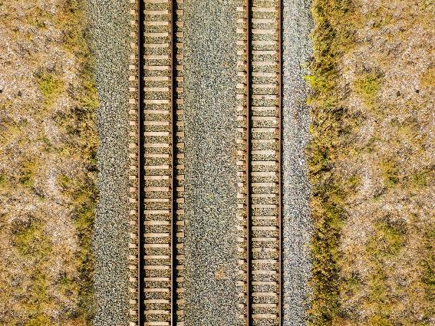
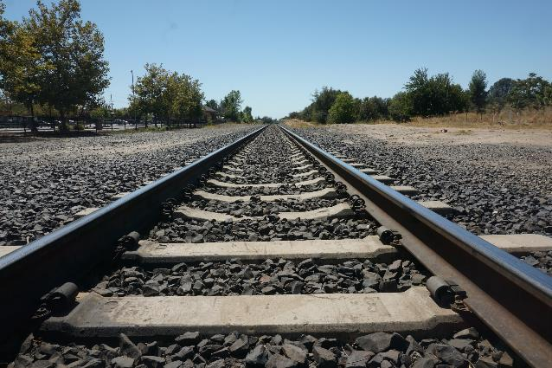
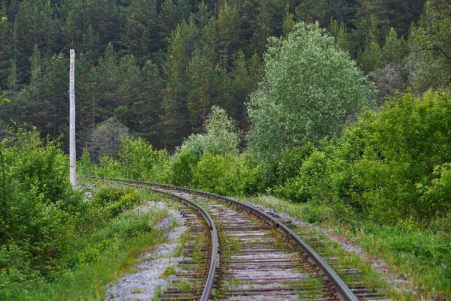
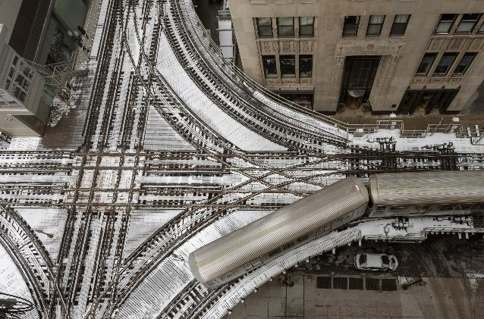
Activity C: Keeping track
Do you agree that these three pictures of train tracks show parallel lines?
How many sets of parallel lines can you identify in the picture on the left?
What other line relationships can you see in the image on the left?
Notes:
This slide is animated. Each question will appear separately so you can choose the pace at which to work with your class.
Answers
a) Students’ justifications may vary (see below in ‘things to think about’ for more guidance). Check that they can recognise that the train tracks remain parallel even when the perspective in the photograph may suggest they are meeting. Students might also notice that the sleepers (perpendicular to the tracks) are all parallel on the first and second photos, which feature straight sections of track.
b) There are nine sets of train tracks in this picture. Students might also recognise that some pairs of parallel lines are parallel with each other. There are two different groups of parallel lines: horizontal and vertical. There are also three different sets of curved tracks – see below for a discussion of this.
? Students’ answers will vary. They might notice the right angles/perpendicular relationships created by the near-vertical and horizontal tracks.
Suggested questioning
How would you define the term parallel?
What is meant by a 'line' in maths?
Is it possible for parallel lines to be curved? How would you define parallel curves?
Things to think about
A student’s definition of a line may be looser than the mathematical definition. In mathematics, a line or line segment is a one-dimensional figure with no curvature. Students might expand their definition to include ‘wiggly lines’ or ‘curved lines’. This is an opportunity to explain that, in mathematics, we distinguish between lines and curves. It is not necessary to delve into the complex arguments about ‘parallel curves’ at this stage of students’ education, although you might like to let them know that there is some ambiguity in this debate. Mathematics does not always deal in certainties and absolutes, which may surprise them!

Slide 85
Activity D: Angle (in)equalities
Which angle goes where? Is there more than one possible answer each time?
w
x
>
a)
<
y
b)
z
c)
=
+
Draw your own set of angles and arrange them in the boxes.
Notes:
This slide is animated. Each question will appear separately so you can choose the pace at which to work with your class.
Answers
a) Any two angles in this order: z > x > w > y.
b) Any two angles in this order: y < w < x < z.
c) x = w + y
? Students’ responses will vary and will need to be checked individually.
Suggested questioning
What makes an angle bigger than another? What are you looking for? How would describe a 'big' angle?
How do you know that one angle is bigger than another?
Is there another possible answer?
How might you test that your answer to part c is correct?
Things to think about
This is a version of Checkpoint 7 that removes the need for each angle having a specific ‘home’. The Guidance for that Checkpoint may be useful in preparing this task. Estimating and comparing angles can be challenging and you might like to reflect on your own strategies for comparing. Do you, for example, mentally rotate the images so they are facing the same way? Do you use a reference point such as 90˚ to support your comparison? How might you share these strategies with your students and encourage them to share their own strategies with the rest of the class?

Slide 86
Activity E: About time 2
What is the angle between the hands at each of these times?
  3 o’clock
  1 o’clock
  2 o’clock
  5 o’clock
How did you work this out each time?
What other times would have the same angle as each of your answers to parts a to d?
Notes:
This slide is animated. Each question will appear separately so you can choose the pace at which to work with your class. Printable clock faces can be found on slide 100.
Answers
a) 3 o’clock: 90° (or 270°)
1 o’clock: 30° (or 330°)
2 o’clock: 60° (or 300°)
5 o’clock: 150° (or 210°)
b) 3 o’clock: students are likely to recognise a right angle, or divide 180° by two.
1 o’clock: students might use their answer to 3 o’clock, and divide this by three, or divide 360° by twelve.
2 o’clock: again, students’ strategies may vary, but they might double their answer to 1 o’clock or divide 360° by six.
5 o’clock: students may have found this using a range of strategies, such as multiplying their answer to 1 o’clock by five, adding their answer to 2 o’clock to their answer to 3 o’clock, or subtracting their answer to 1 o’clock from 180°.
? There are multiple answers that students can give, as this angle is created twice in most hours. However, the answers students are potentially more likely to offer are given in bold below. Calculating the movement of the hour hand over the hour is challenging, so accept approximations of any of the below:
3 o’clock: 12:17 and 12:49, 1:21 and 1:55, 2:27, 3:00 and 3:33, 4:05 and 4:37, 5:11 and 5:44, 6:17 and 6:49, 7:21 and 7:54, 8:27, 9:00 and 9:33, 10:06 and 10:38, 11:11 and 11:44.
1 o’clock: 12:06, 1:00 and 1:11, 2:05 and 2:17, 3:11 and 3:22, 4:16 and 4:27, 5:22 and 5:34, 6:27 and 6:38, 7:33 and 7:43, 8:38 and 8:49, 9:43 and 9:54, 10:54, 11:00 and 11:54.
2 o’clock: 12:11 and 12:54, 1:17, 2:00 and 2:22, 3:06 and 3:27, 4:11 and 4:33, 5:17 and 5:38, 6:22 and 6:44, 7:27 and 7:49, 8:33 and 8:54, 9:38, 10:00 and 10:44, 11:06 and 11:49.
5 o’clock: 12:27 and 12:38, 1:32 and 1:38, 2:38 and 2:49, 3:44 and 3:54, 4:39, 5:00 and 5:54, 6:05, 7:00 and 7:11, 8:06 and 8:16, 9:11 and 9:22, 10:17 and 10:27, 11:22 and 11:32.
Suggested questioning
Can you see an acute/obtuse/reflex angle?
How else could you work out the angle at different times?
How do you know what other times have the same angles?
How many degrees does the hour hand move every hour? How many degrees would it move in half an hour?
Things to think about
Additional activity E is a more straightforward alternative to Checkpoint 10. The structure and focus on finding suggested angles (rather than other times with the same angle) makes this a more accessible task. See the Guidance slide to Checkpoint 10 for more information about the assessment intent.

Slide 87
Activity F: Angles on a straight line
Angle c must be 150° because angles on a straight line add up to 180°.
b
c
a
30°
Tyrhys
Do you agree with Tyrhys? Why or why not?
Which angles do you have enough information to calculate?
Estimate the angles that you do not know.
The diagram is redrawn so that angle b is now three times bigger than angle c. How will the diagram change? What are the sizes of angles b and c now?
Notes:
This slide is animated. Each question, including Tyrhys’s statement, will appear separately so you can choose the pace at which to work with your class.
Answers
a) This is not correct as only angles that meet to create a straight line add to 180°. Angle c does not meet the angle that is labelled as 30°.
b) There is only enough information to calculate angle a (which is 150°). You would need to either know angle b or angle c to work out the other angles.
c) Angle b is approximately 121° (accept answers in range 110°–130°). Angle c is approximately 59° (accept answers in range 50°–70°).
? The line separating b and c will change angle. Students might suggest that it will now be less steep, or that it will be more similar to the other line. Angle b would increase to 135° and angle c would reduce to 45°.
Suggested questioning
What angles can we work out?
Why might Tyrhys think this? Why is he wrong?
How could you improve Tyrhys’s definition of angles on a straight line?
If you want to make the diagram symmetrical, how many times bigger than angle c will angle b be?
Things to think about
Activity F supplements a review of angle rules taught at primary school, and is useful to check students fully understand angles on a straight line. The idea that angles on a straight line equal 180°, without specifying that it is the angles that meet to form a straight line, can lead to the common misconception that is expressed by Tyrhys. You could precede the task by just showing the angle diagram and asking, ‘What angles can we work out? For this reason Tyrhys’s speech bubble is animated and will not appear straight away. If students do hold this misconception, spend time re-defining the angle rule and focusing on both the precision of language and the diagrams that represent it. Pay attention to the conceptual variation that you use, including examples and non-examples, to ensure that students can identify where it is appropriate to use this rule.

Slide 88
Activity G: Who’s wrong?
Four students are practising using a protractor. They each measure a different angle in this diagram.
Aled says, ‘My angle is 42°.’
Ben says, ‘My angle is 40°.’
Cassidy says, ‘My angle is 107°.’
Dietmar says, ‘My angle is 140°.’
Without measuring, say which one of the students you think needs help with using a protractor.
Explain how you know.
Create your own version of this task using a different angle rule.
Notes:
This slide is animated. Each statement will appear separately so you can choose the pace at which to work with your class.
Answers
a) Cassidy needs help.
b) Aled and Ben’s angles are close enough to be the same (generally angles are read $±$2°) and Dietmar’s angle plus one of Aled and Ben’s totals approximately 180° so these could be the two angles that form a straight line. Cassidy’s angle of 107° would not form a straight line with any of the possible remaining angles.
? Students’ answers to this will vary and will need to be checked individually.
Suggested questioning
Why might two students have similar but different values?
What makes you say that __ needs help?
What clues did you look for?
What instructions would you give Cassidy to help them use a protractor accurately? Can you write some key points?
Things to think about
Additional activity G focuses on vertically opposite angles and angles on a straight line. You might use this task as an alternative or addition to Checkpoints 13, 14 or 15. Discuss accuracy when reading a protractor: do students understand that there might be a small range in given answers?
This task originally appeared in the NCETM’s secondary assessment materials.

Slide 89
Activity H: Angle tangle 2
How many angles can you work out if you know the value of:
b
c
angle b
angles b and f
angles b, f and e?
d
e
a
f
You want to work out all the angles in the diagram. Which unknown angles do you ask for next?
Notes:
This slide is animated. Each question will appear separately so you can choose the pace at which to work with your class. A printable version can be found on slide 106.
Answers
a) If you know angle b, you cannot work out any angles.
b) If you know angles b and f, you can work out one angle (a).
c) If you know angles b, f and e, you can still only work out one angle (a).
? To work out all of the angles, you could ask for any two of the remaining angles. If you only ask for one angle, this is not enough information.
Suggested questioning
What angle facts do you know that might help?
What assumptions, if any, are you making?
I can write a + b + f = 180˚. Are there any other equations that I can write?
Things to think about
Students may not be used to the answer to a question in a maths class being, 'I can't work anything out’. Their experience of maths lessons is that enough information is given to reach an answer. Give some thought to how you will manage these expectations. There are assumptions that students might make; consider how to work with these. It is likely, for example, that students will assume the lengths cd and de are equal because they 'look the same'. You might then ask, ‘If cd = de, what else do we know to be true?'. Is it the case that, if cd = de, then angles at c and e must be equal? If the angles at c and e are equal then must cd = de? See the Guidance slide to Checkpoint 21 for more information about the assessment intent.

Slide 90
Activity I: Sliding lines 2
A
B
The red lines in diagram A are parallel.
What happens to the angles at a and b as the line moves?
Does the size of a change?
Does the size of b change?
Is one bigger than the other? Does that change?
a
c
b
d
The blue lines in diagram B are parallel.
What happens to the angles at c and d as the line moves?
Does the size of c change?
Does the size of d change?
Is one bigger than the other? Does that change?
How would your answers be different if it was one of the vertical lines that moved each time?
Notes:
This slide is animated. Each set of questions and its related diagram will appear separately so you can choose the pace at which to work with your class. As you click through the slide the transversal is animated so that it gives a dynamic image for students to work with.
Answers
a) No, the size of angle a does not change.
b) No, the size of angle b does not change.
c) No, angles a and b are equal and this does not change.
d) Angle c gets smaller as that end of the black (intersecting) line rotates downwards (and vice versa).
e) Angle d gets smaller as that end of the black (intersecting) line rotates upwards (and vice versa).
f) No, angles c and d are equal and this does not change.
? If the parallel lines moved like the a/b example (i.e. sliding vertically on horizontally) then the answers to parts a, b and c would not change. If the parallel lines moved like the c/d example (i.e. rotating so that their angle changes) then the answers to parts d and e would change as the lines would no longer be parallel, so the size of c and d would no longer be preserved. The answer to part f would also change as c and d would no longer be equal.
Suggested questioning
What is the same and what is different about the two angles in diagram A (or B)?
What is the same and what is different about the two diagrams?
Would your answers be the same if the lines were not parallel?
How could you describe the relationship between the two angles?
Things to think about
Activity I follows the same structure as Checkpoint 25, but highlights the relationships between corresponding rather than alternate angles. It might be repetitive to use both as an initial assessment task, but you may find this useful for teaching. Refer to the Guidance slide for Checkpoint 25 for more information.

Slide 91
Activity J: Initial reaction 2
Tina and Freddie are looking for their initials in this diagram. They might be upside-down, back to front or a bit wonky!
Tina says, ‘I can find my initial once.’
How many times can you find it?
Freddie says, ‘I can find my initial once.’
How many times can you find it?
What other letters can you find?
What do you notice about the angles in the letters you found for parts a and b? Are any of them the same?
Notes:
This slide is animated. Each question will appear separately so you can choose the pace at which to work with your class. A printable version can be found on slide 107.
Answers
See the animated solutions slides (next two slides) for illustrations of the different initials.
a) There are 16 different T shapes formed by the intersecting line segments.
b) There are also 16 different F shapes formed by the intersecting line segments.
c) Students’ responses will vary, and the number of different letter shapes will depend on their ‘initial reaction’ to the image and so which letter shape seems most obvious to them. Students could argue for ‘seeing’ almost any letter shape within the diagram. For example, removing one of the bars on the F shapes shown could be seen as an L, or reducing the length of the longest line on the F shape could be seen as a C.
? The two angles that make up the T shapes total 180°, as do the two angles formed by the ‘T’ shape within the F. Where the top and bottom ‘bars’ of the F shape are formed by parallel lines, two equal angles are formed. (Note that ‘conventional markings’ for parallel lines are included in the non-statutory curriculum guidance for Year 5, but it is worth questioning to check all students have recognised the arrow notation and remembered its significance.)
Suggested questioning
What's the strangest F shape that Freddie could accept? Can you draw it?
What's the strangest T shape that Tina could accept? Can you draw it?
Does it matter that there's a pair of parallel lines in the diagram? Does it change anything?
Things to think about
Additional activity J offers a slightly simpler version of the diagram from Checkpoint 22, with one line segment fewer – so two intersections fewer. See the Guidance slide for Checkpoint 22 for more information.

Slide 92
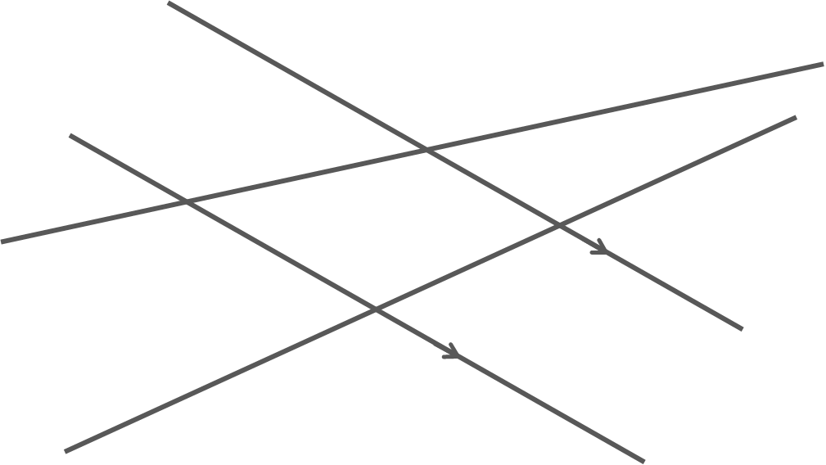
Activity J: Initial reaction 2 (animated solutions to part a)
Notes:
This slide is animated. The highlighting of each ‘letter’ on the diagram will appear separately so you can choose the pace at which to work with your class. The labels for matching angles will appear in pairs after the text for the further thinking question.

Slide 93
Activity J: Initial reaction 2 (animated solutions to part b and further thinking)
a
a
a
a
b
b
Where the top and bottom ‘bars’ of the F shape are formed by parallel line segments, two equal angles are formed.
b
b
c
c
c
d
c
d
d
d
Notes:
This slide is animated. The highlighting of each ‘letter’ on the diagram will appear separately so you can choose the pace at which to work with your class. The labels for matching angles will appear in pairs after the text for the further thinking question.

Slide 94
Activity K: Diagonal
A
B
Darrell draws a line segment from vertex A of his hexagon.
He says, ‘I’ve drawn a diagonal.’
Gorka says, ‘That’s not a diagonal line – it’s a vertical line.’
Why are they both right?
How many other diagonals can you draw from vertex A?
How many other diagonals can you draw from different vertices in this shape?
F
C
The hexagon has a vertical and a horizontal line of symmetry. The obtuse angle at F is 140°. Use this to work out the other angles in the hexagon.
E
D
Notes:
This slide is animated. Each question will appear separately so you can choose the pace at which to work with your class. Printable hexagons can be found on slide 108.
Answers
a) They are both right because they are using the word ‘diagonal’ in different contexts. Darrell is using the mathematical definition of a diagonal – a straight line connecting two vertices of a polygon. Gorka is using the common usage of the word ‘diagonal’ to describe the orientation of a straight line – in this case, the diagonal is not diagonal as it is vertical.
b) There are two other diagonals that can be drawn from A (making three in total): the line segments connecting A to D and A to C.
c) There are three other diagonals that can be drawn from the other vertices: the line segments connecting C to F and B to E. This makes a total of five diagonals: AC, AD, AE, BE, CF.
? Conventional three-letter notation is used throughout this answer, but this is not in the primary curriculum so you may wish to use an alternative labelling system if you have not yet explicitly taught it.
If AFE is 140°, then FAE and AEF must both be 20° (since we know there is a horizontal line of symmetry, so AEF must be isosceles: 180° - 140° = 40°; 40° ÷ 2 = 20°).
We know AE is a vertical line, so BAE is a right angle. This means FAB must be 90° + 20° = 110°.
Using the lines of symmetry, we can summarise:
FAB = FED = ABC = BCD = 110°
EFA = BCD = 140°
Suggested questioning
What does ‘diagonal’ mean? Does it have any other meanings?
What usage of the word ‘diagonal’ might you use in __ context? Which do you most commonly use?
Can you think of another example for Darrell’s definition of ‘diagonal’? How about Gorka’s?
Draw all the diagonals from A. What shapes have you made inside your hexagon? What might this mean for the angles?
Things to think about
Activity K checks students’ understanding of the word ‘diagonal’ and whether they understand that it has a very specific meaning when used in the mathematical context of polygons. It is intended to be used as part of a sequence of teaching on the interior angles of a polygon at Key Stage 3, and might be helpful to clear up any misunderstandings around vocabulary before taking the ideas further. Parts b and c are juxtaposed to allow you to draw comparisons between the number of diagonals drawn from a single vertex (necessary for proving the interior angle sum of a polygon as (n – 2) × 180°) and the number of diagonals it is possible to draw. Students need to understand that it is only when you use diagonals from one vertex that you divide the polygon into triangles for this proof, as then the angles involved are all part of the polygon as well.

Slide 95
Activity L: More diagonals
What shapes are created by diagonals in parts a to g? How do you know?
e)
a)
b)
d)
g)
c)
f)
The diagonals on the right are all drawn from one vertex. What might the shapes be?
Notes:
This slide is animated. Each shape and the further thinking question will appear separately so you can choose the pace at which to work with your class.
Answers
a) Rectangle
b) Square
c) Trapezium
d) Rhombus
e) Kite
f) Arrowhead (kite)
g) Pentagon
? As these are the diagonals, and not the sides, these shapes must be (left to right) a pentagon, a heptagon and a nonagon. See the solutions slide for some example shapes. The dotted sides on the solutions slide could have a multitude of different lengths and angles, as they meet at a vertex that does not also meet one of the given diagonals so is not indicated in the diagrams. Compare the different solutions that students offer to check they have an appreciation of this.
Suggested questioning
What would happen if you ‘joined the dots’ at the end of each line segment?
What is the same and what is different about each set of diagonals?
Which quadrilaterals have diagonals that cross at right angles?
Can you draw some other examples of diagonals?
Things to think about
Additional activity L offers another exploration of diagonals, this time looking at the different properties of diagonals in various shapes. Parts a to e explore quadrilaterals, to check whether students have remembered that some of the properties of quadrilaterals are associated with their diagonals. Specifically compare those with similar properties, for example parts b, d and e all cross at right angles, but only part b (the square) has equal diagonals. While both diagonals are bisected in part d (the rhombus), only one is in part e (the kite). Shape c may cause some problems, with kite and parallelogram two likely wrong answers. Part f shows all of the possible diagonals of a regular pentagon. This offers a direct comparison with the first shape in the further thinking question, which is also a pentagon – do students notice the same diagonals in both shapes? The further thinking question explores diagonals from one vertex only, which is a key understanding needed to access the interior angles of a polygon at Key Stage 3. It requires students to ignore some diagonals, which can be a challenge.

Slide 96
Activity L: More diagonals (animated solutions)
b)
e)
a)
d)
g)
c)
f)
One possible example given for each set of diagonals. The dotted sides could take many other lengths or positions.
Notes:
This slide is animated. Each shape will appear separately so you can choose the pace at which to work with your class.

Slide 97
Printable resources

Slide 98
Notes:
This is a printable version of the grid in Checkpoint 5 (six on a page).

Slide 99
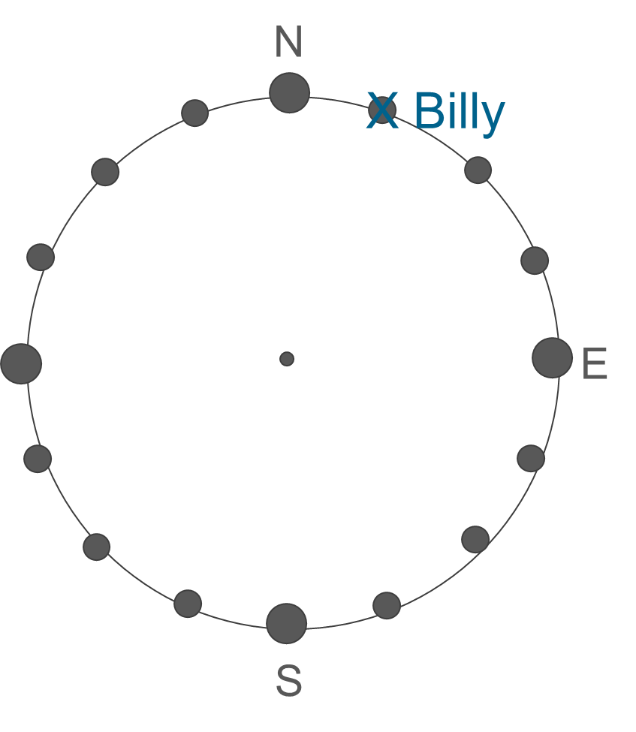
Notes:
This printable version of the compass will be needed for students to complete Checkpoint 9. There are two on a page, but you may wish to give students more than one copy to draw on.

Slide 100
Notes:
These blank clock faces (six on a page) might be useful for Checkpoint 10 or Additional activity E.

Slide 101
Notes:
These angles (2 on a page) might be useful for Checkpoint 12. Note that each angle is given with lots of blank space around it to allow students to manipulate their protractor into different positions.

Slide 102
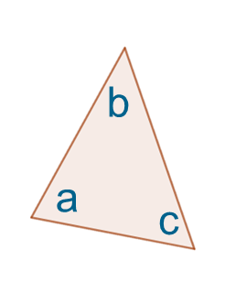
Notes:
Students may find it helpful to print and cut out these triangle tiles (two sets of ten on a page) to support with Checkpoint 17.

Slide 103
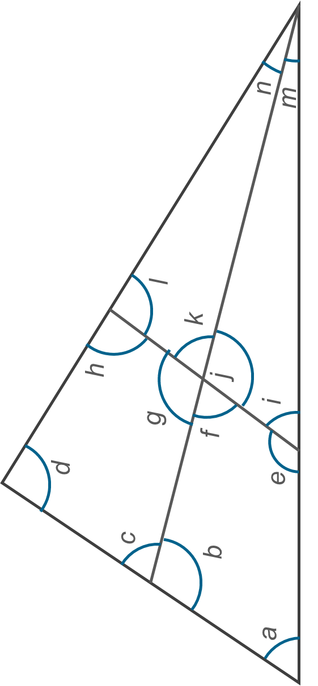
Notes:
These are printable versions (three on a page) of the diagram from Checkpoint 21.

Slide 104
Notes:
These are printable versions (two on a page) of the diagram for Checkpoint 22.

Slide 105
Notes:
These printable decagons (six on a page) may be useful for Checkpoint 26.

Slide 106
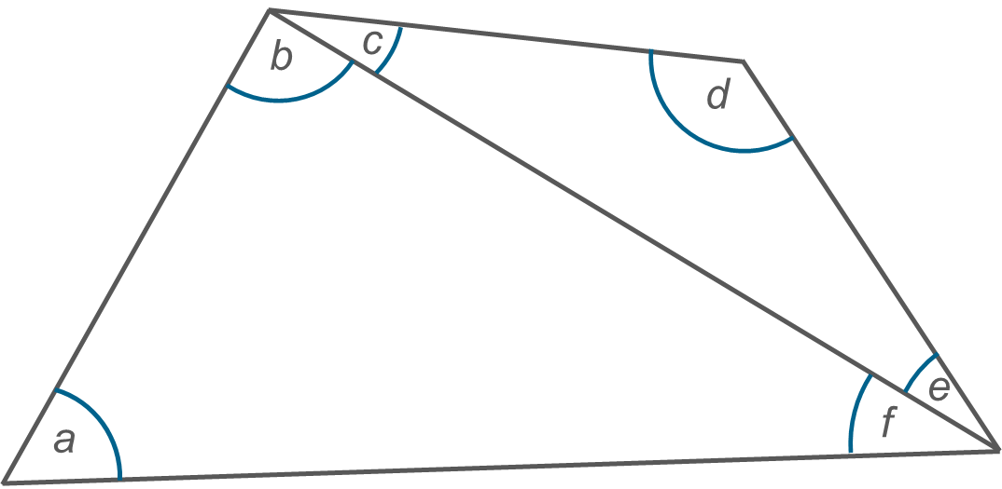
Notes:
These are printable versions (four on a page) of the diagram from Additional activity H.

Slide 107
Notes:
These are printable versions (two on a page) of the diagram for Additional activity J.

Slide 108
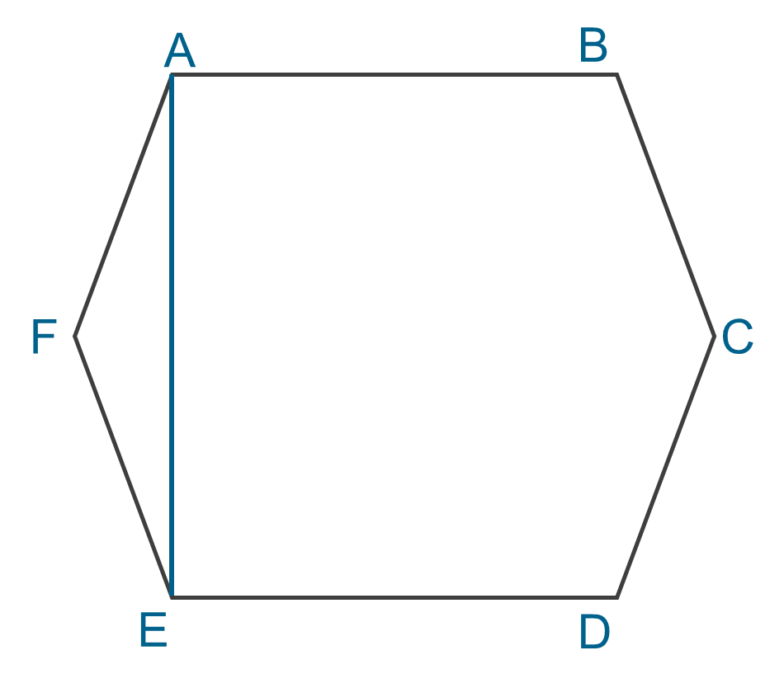
Notes:
These printable hexagons (six on a page) are for use with Additional activity K.

Slide 109
Printable angles card sort
You may wish to print slides 110-122 to create sets of angles to sort for Checkpoint 3. Stack and clip the set of 13 pages and cut along the lines to produce 12 sets.

Slide 110

A
A
A
A
A
A
A
A
A
A
A
A

Slide 111

B
B
B
B
B
B
B
B
B
B
B
B

Slide 112

C
C
C
C
C
C
C
C
C
C
C
C

Slide 113

D
D
D
D
D
D
D
D
D
D
D
D

Slide 114
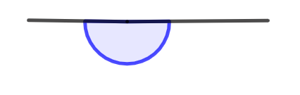
E
E
E
E
E
E
E
E
E
E
E
E

Slide 115
F
F
F
F
F
F
F
F
F
F
F
F

Slide 116

G
G
G
G
G
G
G
G
G
G
G
G

Slide 117

H
H
H
H
H
H
H
H
H
H
H
H

Slide 118
I
I
I
I
I
I
I
I
I
I
I
I

Slide 119

J
J
J
J
J
J
J
J
J
J
J
J

Slide 120
K
K
K
K
K
K
K
K
K
K
K
K

Slide 121
Image acknowledgements
Images on slides 12/13, 22, 33, 35, 37, 43/44, 46, 68, 70, 82, 83, 86, 100: credit – Steve Evans.
Images on slide 84: credit – Shutterstock.
All other images taken or created by Richard Perring and Becky Donaldson.

