Slide 1
Year 5, Unit 9
Converting units

Slide 2
Year 5, Unit 9
These materials heavily reflect the prioritisation approach of the ready-to-progress criteria in the DfE Primary Mathematics Guidance 2020 and on the PPTs that exemplify them on the NCETM website. They also include other relevant National Curriculum content. Related sections of the NCETM Primary Mastery Professional Development Materials provide small-step teaching guidance.
Ready-to-progress criteria addressed by this unit
Teaching of this unit supports the following criteria from the ‘DfE Mathematics Guidance: key stages 1 & 2’ (the 335-page document available as a download)
5NPV-5 Page 229

Slide 3
Contents
The links below take you to the starting slide of each learning outcome.
1 | Pupils apply memorised unit conversions to convert between units of measure (larger to smaller units - whole number conversions)
2 | Pupils apply memorised unit conversions to convert between units of measure (smaller to larger units - whole number conversions)
3 | Pupils convert from and to fraction and decimal fraction quantities of larger units
4 | Pupils derive common conversions over 1
5 | Pupils carry out conversions that correspond to 100 parts
6 | Pupils solve measures problems involving different units
Click the arrow button to return to this Contents slide.

Slide 4
Contents
The links below take you to the starting slide of each learning outcome.
7 | Pupils understand and use approximate equivalences between metric units and common imperial units such as inches, pounds and pints
8 | Pupils convert between miles and kilometres
9 | Pupils solve problems involving converting between units of time
Click the arrow button to return to this Contents slide.

Slide 5
Year 5, Unit 9, Learning Outcome 1
Learning Outcome 1
Pupils apply memorised unit conversions to convert between units of measure (larger to smaller units - whole number conversions)
The following slides have been collated to support the teaching of this learning outcome.

Slide 6
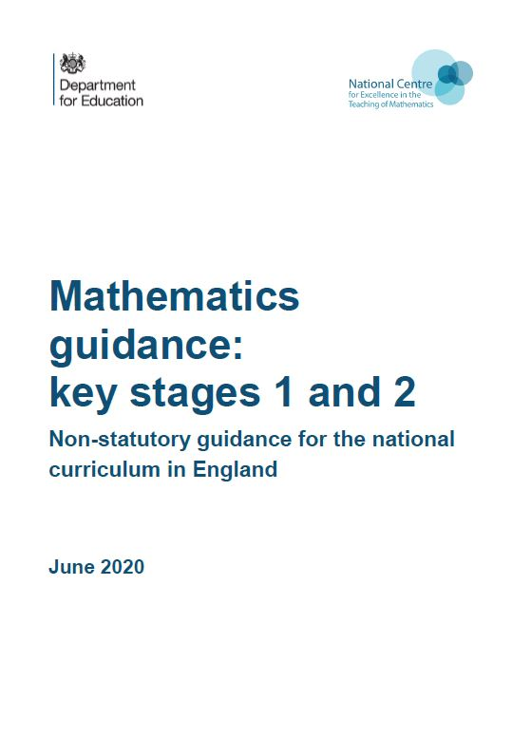
Year 5, Unit 9, Learning Outcome 1
Additional teacher guidance for this outcome should be read first and can be found in the DfE Mathematics guidance. Page references relate to the 335-page document available as a download at the bottom of this web page.
Ready to progress criteria | Pages
5NPV-5 | 229-233

Slide 7













5NPV-5 Convert between units of measure
100 cm
1 metre
Give children 10 strips of paper, each 10cm in length.
Ask them to place the pieces of paper end to end.
What is the total length of all of the strips of paper?
Is there more than one way that we can describe the length?
1m = 100cm
One metre is equivalent to 100cm.

Slide 8

5NPV-5 Convert between units of measure
How many pennies are in each row?
How many rows are there?
How many pennies are there altogether?
The amount shown is equivalent to £1. What is £1 equivalent to?
£1 is equivalent to 100p.
£1 = 100p

Slide 9
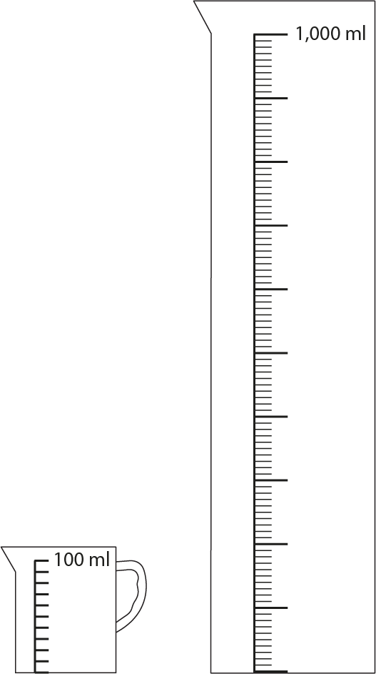
5NPV-5 Convert between units of measure
What measurement is written at the top of the measuring cylinder?
How many large intervals are there between the bottom and top of the container?
Count upwards from the bottom of the container in 100ml steps.
Is there another way to say the volume show at the top of the container?
Practise counting forwards and backwards along the scale.
1 litre = 1,000ml
1 litre is equivalent to 1,000ml.

Slide 10
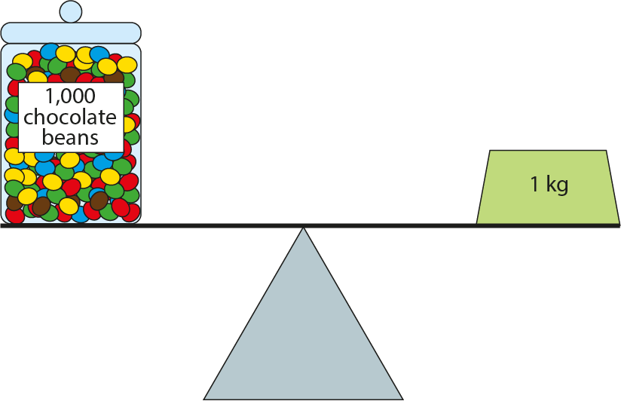
5NPV-5 Convert between units of measure
What do you notice about the balance scale in the diagram?
What do you estimate the mass of each chocolate bean to be?
If possible, find a balance scale and put a 1kg weight on one side and pour Dienes cubes into the other side until the scales are balanced. If a Dienes cube has a mass of 1g, how many cubes would there be to balance the scales?
1kg is equivalent to 1,000g.
1kg = 1,000g

Slide 11
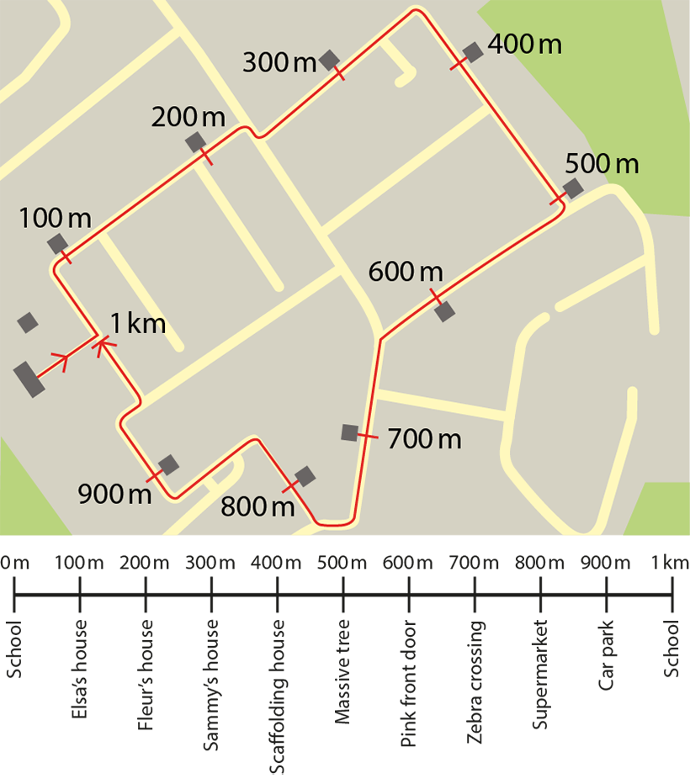
5NPV-5 Convert between units of measure
What do you notice about the values shown below the map?
Why is the school written twice in the list of places? Why is one measurement in metres and the other in kilometres?
Use a metre ruler as a counting stick. Move your finger forwards and backwards along the ruler as children skip count forwards and backwards in 100m steps. Prompt children to say 1km each time the end
of the ruler is selected.
1km is equivalent to 1,000m.
1km = 1,000m

Slide 12
Year 5, Unit 9, Learning Outcome 2
Learning Outcome 2
Pupils apply memorised unit conversions to convert between units of measure (smaller to larger units - whole number conversions)
The following slides have been collated to support the teaching of this learning outcome.

Slide 13
Year 5, Unit 9, Learning Outcome 2
Additional teacher guidance for this outcome should be read first and can be found in the DfE Mathematics guidance. Page references relate to the 335-page document available as a download at the bottom of this web page.
Ready to progress criteria | Pages
5NPV-5 | 229-233

Slide 14
5NPV-5 Convert between units of measure
100 cm
1 metre
Give children 10 strips of paper, each 10cm in length.
Ask them to place the pieces of paper end to end.
What is the total length of all of the strips of paper?
Is there more than one way that we can describe the length?
1m = 100cm
One metre is equivalent to 100cm.

Slide 15
5NPV-5 Convert between units of measure
How many pennies are in each row?
How many rows are there?
How many pennies are there altogether?
The amount shown is equivalent to £1. What is £1 equivalent to?
£1 is equivalent to 100p.
£1 = 100p

Slide 16
5NPV-5 Convert between units of measure
What measurement is written at the top of the measuring cylinder?
How many large intervals are there between the bottom and top of the container?
Count upwards from the bottom of the container in 100ml steps.
Is there another way to say the volume show at the top of the container?
Practise counting forwards and backwards along the scale.
1 litre = 1,000ml
1 litre is equivalent to 1,000ml.

Slide 17
5NPV-5 Convert between units of measure
What do you notice about the balance scale in the diagram?
What do you estimate the mass of each chocolate bean to be?
If possible, find a balance scale and put a 1kg weight on one side and pour Dienes cubes into the other side until the scales are balanced. If a Dienes cube has a mass of 1g, how many cubes would there be to balance the scales?
1kg is equivalent to 1,000g.
1kg = 1,000g

Slide 18
5NPV-5 Convert between units of measure
What do you notice about the values shown below the map?
Why is the school written twice in the list of places? Why is one measurement in metres and the other in kilometres?
Use a metre ruler as a counting stick. Move your finger forwards and backwards along the ruler as children skip count forwards and backwards in 100m steps. Prompt children to say 1km each time the end of the ruler is selected.
1km is equivalent to 1,000m.
1km = 1,000m

Slide 19
Year 5, Unit 9, Learning Outcome 3
Learning Outcome 3
Pupils convert from and to fraction and decimal fraction quantities of larger units
The following slides have been collated to support the teaching of this learning outcome.

Slide 20
Year 5, Unit 9, Learning Outcome 3
Additional teacher guidance for this outcome should be read first and can be found in the DfE Mathematics guidance. Page references relate to the 335-page document available as a download at the bottom of this web page.
Ready to progress criteria | Pages
5NPV-5 | 229-233

Slide 21
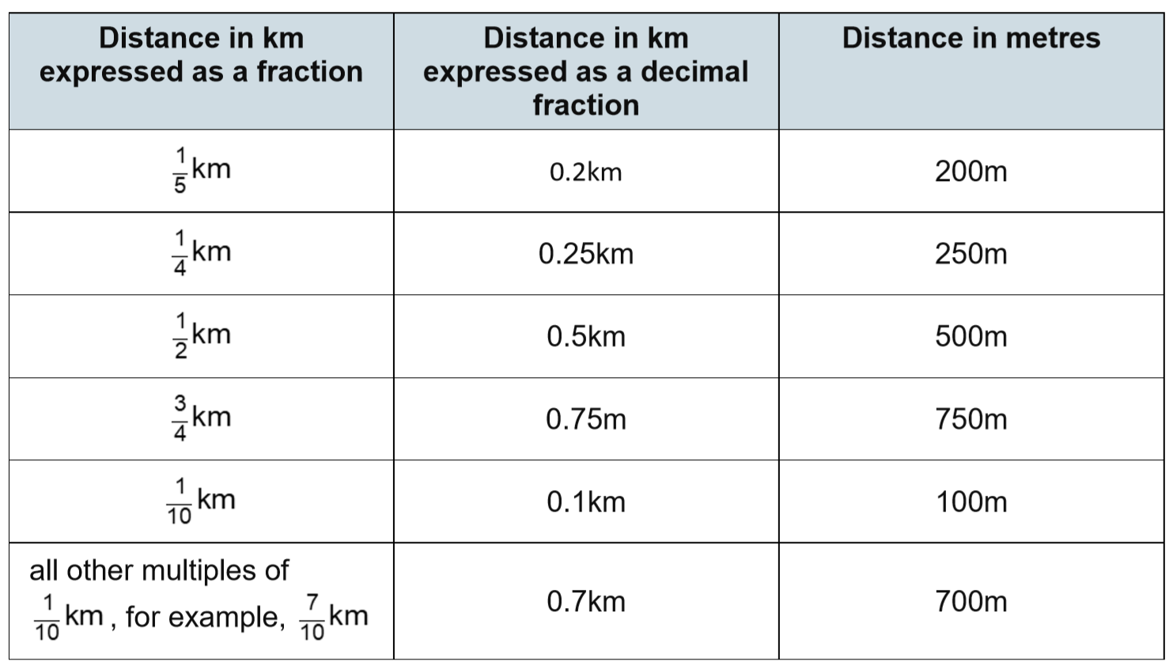
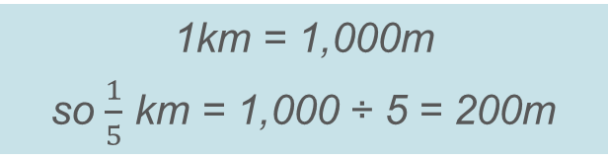

5NPV-5 Convert between units of measure
What do you notice about the first row of the table?
How has the decimal fraction been calculated?
How has the distance in metres been calculated?
Find all other missing values in the table.
$\frac{1}{5}$ = 0.2 so $\frac{1}{5}$ km = 0.2km
1km = 1,000m
so $\frac{1}{5}$ km = 1,000 ÷ 5 = 200m

Slide 22
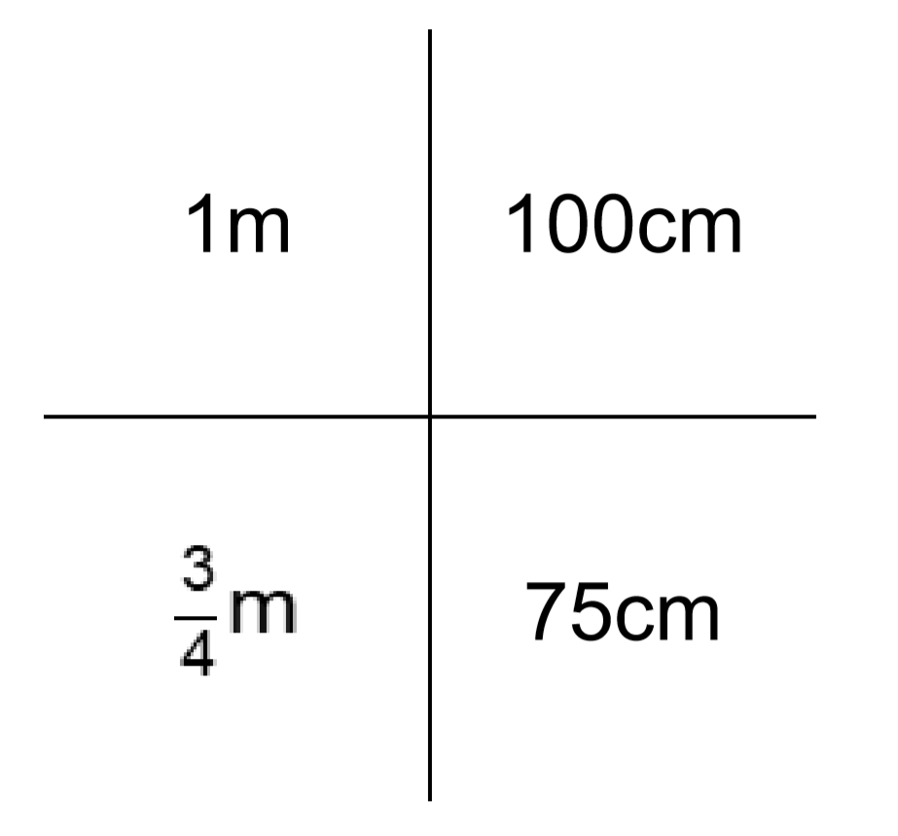

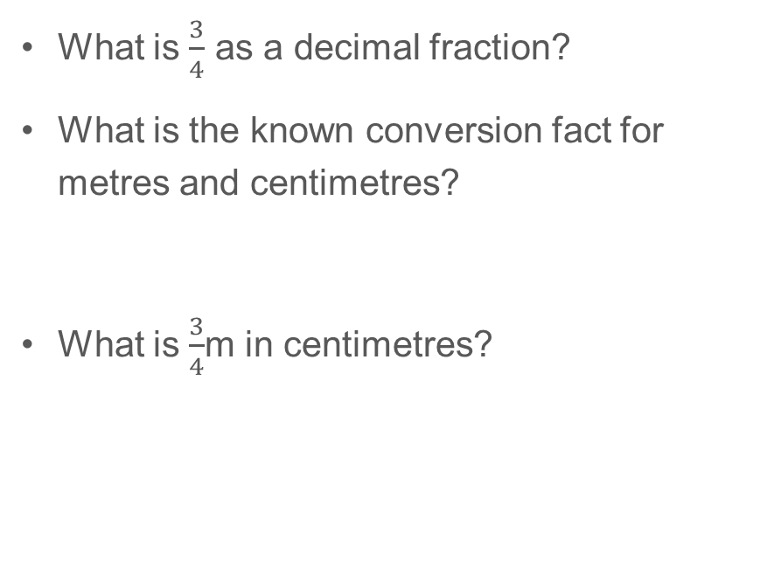
5NPV-5 Convert between units of measure
What is $\frac{3}{4}$ as a decimal fraction?
What is the known conversion fact for metres and centimetres?
What is $\frac{3}{4}$m in centimetres?
1m = 100 cm
$\frac{3}{4}$m = 75 cm

Slide 23

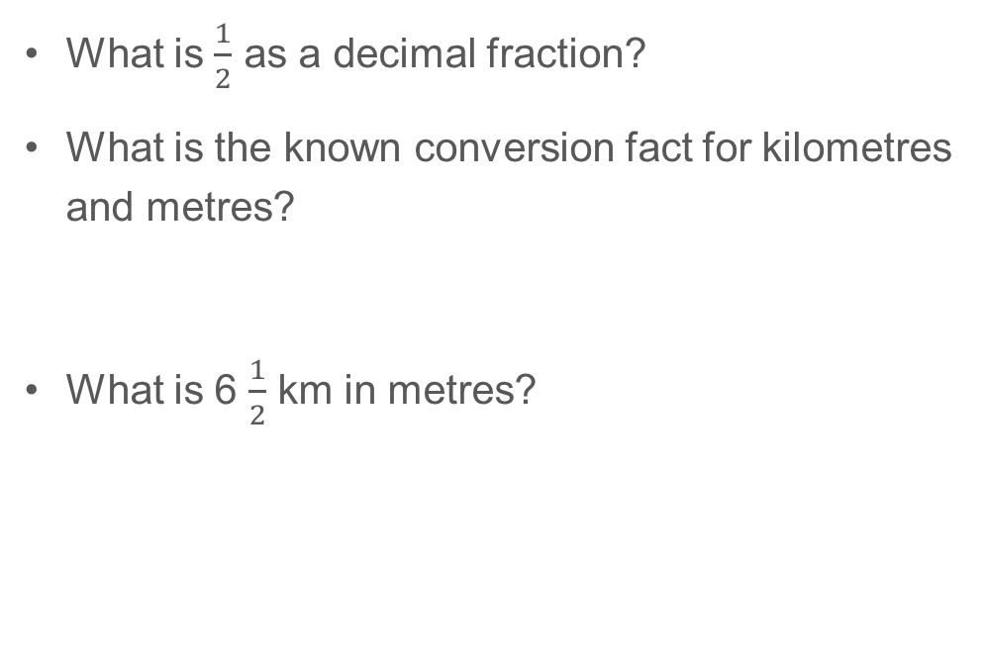

5NPV-5 Convert between units of measure
What is $\frac{1}{2}$ as a decimal fraction?
What is the known conversion fact for kilometres and metres?
What is 6 $\frac{1}{2}$ km in metres?
1km
1,000m
1km = 1,000m
6 $\frac{1}{2}$ km
6,500m
6km is 6,000m
so 6$\frac{1}{2}$ km = 6,500m

Slide 24
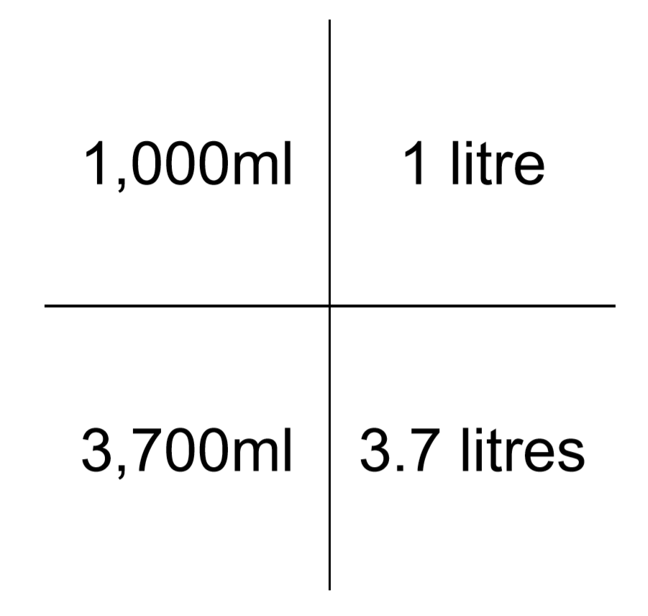



5NPV-5 Convert between units of measure
What is the known conversion fact for millilitres and litres?
What is 500ml in litres?
What is 700ml in litres?
What is 3,700ml in litres?
500ml = 0.5 litres or $\frac{1}{2} l$
700ml is 0.7 litres or $\frac{7}{10} l$
3,000ml is 3 litres
so 3,700ml is 3.7 litres or 3$\frac{7}{10}l$

Slide 25
Year 5, Unit 9, Learning Outcome 4
Learning Outcome 4
Pupils derive common conversions over 1
The following slides have been collated to support the teaching of this learning outcome.

Slide 26
Year 5, Unit 9, Learning Outcome 4
Additional teacher guidance for this outcome should be read first and can be found in the DfE Mathematics guidance. Page references relate to the 335-page document available as a download at the bottom of this web page.
Ready to progress criteria | Pages
5NPV-5 | 229-233

Slide 27
5NPV-5 Convert between units of measure
Complete the following conversions.
If 1kg = 1,000g, 3kg = _____g
Repeat for all other units of measure with up to 9 of any larger unit.
These are key conversions that should be memorised. Make a card game with the units written on one side and its equivalence on the other side, e.g. 1m and 100cm and practise recall over a period of time.
1km = 1,000m
1 litre = 1,000ml
1m = 100cm
1kg = 1,000g
1cm = 10mm
£1 = 100p

Slide 28
5NPV-5 Convert between units of measure
What is $\frac{1}{2}$ as a decimal fraction?
What is the known conversion fact for kilometres and metres?
What is 6 $\frac{1}{2}$ km in metres?
1km
1,000m
1km = 1,000m
6 $\frac{1}{2}$ km
6,500m
6km is 6,000m
so 6$\frac{1}{2}$ km = 6,500m

Slide 29
5NPV-5 Convert between units of measure
What is the known conversion fact for millilitres and litres?
What is 500ml in litres?
What is 700ml in litres?
What is 3,700ml in litres?
500ml = 0.5 litres or $\frac{1}{2} l$
700ml is 0.7 litres or $\frac{7}{10} l$
3,000ml is 3 litres
so 3,700ml is 3.7 litres or 3$\frac{7}{10}l$

Slide 30
Year 5, Unit 9, Learning Outcome 5
Learning Outcome 5
Pupils carry out conversions that correspond to 100 parts
The following slides have been collated to support the teaching of this learning outcome.

Slide 31
Year 5, Unit 9, Learning Outcome 5
Additional teacher guidance for this outcome should be read first and can be found in the DfE Mathematics guidance. Page references relate to the 335-page document available as a download at the bottom of this web page.
Ready to progress criteria | Pages
5NPV-5 | 229-233

Slide 32
5NPV-5 Convert between units of measure
100 cm
1 metre
Give children 10 strips of paper, each 10cm in length.
Ask them to place the pieces of paper end to end.
What is the total length of all of the strips of paper?
Is there more than one way that we can describe the length?
1m = 100cm
One metre is equivalent to 100cm.

Slide 33
5NPV-5 Convert between units of measure
How many pennies are in each row?
How many rows are there?
How many pennies are there altogether?
The amount shown is equivalent to £1. What is £1 equivalent to?
£1 is equivalent to 100p.
£1 = 100p

Slide 34
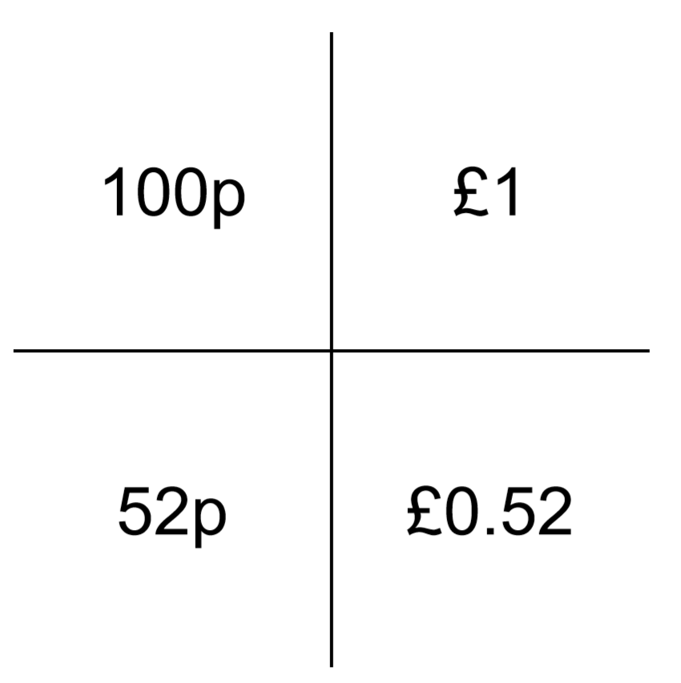
5NPV-5 Convert between units of measure
What is the known conversion fact for pence and pounds?
What is 50p in pounds?
What is 52p in pounds?
100p = £1
50p = £0.50
52p is £0.52

Slide 35
Year 5, Unit 9, Learning Outcome 6
Learning Outcome 6
Pupils solve measures problems involving different units
The following slides have been collated to support the teaching of this learning outcome.

Slide 36
Year 5, Unit 9, Learning Outcome 6
Additional teacher guidance for this outcome should be read first and can be found in the DfE Mathematics guidance. Page references relate to the 335-page document available as a download at the bottom of this web page.
Ready to progress criteria | Pages
5NPV-5 | 229-233

Slide 37
Year 5, Unit 9, Learning Outcome 7
Learning Outcome 7
Pupils understand and use approximate equivalences between metric units and common imperial units such as inches, pounds and pints
The following slides have been collated to support the teaching of this learning outcome.

Slide 38

Year 5, Unit 9, Learning Outcome 7
For support with lesson and task design, refer to:
the NCETM National Curriculum Resource Tool
additional planning resources or high-quality textbooks used by your school.

Slide 39
Year 5, Unit 9, Learning Outcome 8
Learning Outcome 8
Pupils convert between miles and kilometres
The following slides have been collated to support the teaching of this learning outcome.

Slide 40
Year 5, Unit 9, Learning Outcome 8
For support with lesson and task design, refer to:
the NCETM National Curriculum Resource Tool
additional planning resources or high-quality textbooks used by your school.

Slide 41
Year 5, Unit 9, Learning Outcome 9
Learning Outcome 9
Pupils solve problems involving converting between units of time
The following slides have been collated to support the teaching of this learning outcome.

Slide 42
Year 5, Unit 9, Learning Outcome 9
For support with lesson and task design, refer to:
the NCETM National Curriculum Resource Tool
additional planning resources or high-quality textbooks used by your school.

