Slide 1
Introduction to the
DfE Primary National Curriculum Guidance
DfE Primary National Curriculum Guidance 2020
Training Materials

Slide 2
Introduction to the session
This introduction to the DfE Primary National Curriculum Guidance will create lots of discussion and decisions to be made regarding the development of mathematics in your school. Many of these will take time and will be ongoing beyond this session. At the end of the session, there may be things that you have identified as needing more discussion, actions that you wish to take immediately and areas you wish to develop over time.
It would be useful to have your school curriculum map, examples of long-, medium- and short-term planning, and any schemes of work or textbooks that you currently use.

Slide 3
Aims of the session:
To become more familiar with the guidance.
To provide support on how the guidance can be used in school and create a to-do list of actions.
To reflect on how a school teaches the core concepts so they are taught coherently with clear progression.
To consider some of the frequently asked questions.

Slide 4
Let’s remind ourselves of the aims of the national curriculum
The national curriculum for mathematics aims to ensure that all pupils:
become fluent in the fundamentals of mathematics, including through varied and frequent practice with increasingly complex problems over time, so that pupils develop conceptual understanding and the ability to recall and apply knowledge rapidly and accurately
reason mathematically by following a line of enquiry, conjecturing relationships and generalisations, and developing an argument, justification or proof using mathematical language
can solve problems by applying their mathematics to a variety of routine and non-routine problems with increasing sophistication, including breaking down problems into a series of simpler steps and persevering in seeking solutions.

Slide 5
Can all our pupils apply knowledge rapidly and accurately, reason mathematically and solve problems, including breaking down problems into a series of simpler steps?
If not, what are the barriers?
All pupils require fluency, flexibility and deep conceptual knowledge of the content of the national curriculum in order to achieve its aims. This is what the guidance is seeking to do.

Slide 6
Watch the introduction video
Click on the link
As you watch:
Consider how you might use the guidance document to support all pupils to leave a year group ready to progress to the next.

Slide 7
FAQs
Is our school curriculum coherent?
Do we focus enough on core concepts and give them sufficient time?
Do we make enough connections between mathematical topics within and across year groups?
Q: Why has the guidance been produced?
A: To support teachers to deliver the NC more effectively, bringing greater clarity and coherence to it.
Q Is the guidance different to the NC?
A: There is nothing in the guidance that is not in the NC. However there is:
more detail to support teacher subject and pedagogical knowledge
different wording to aid clarity
the movement of some content between year groups to aid coherence .
The guidance can be found here

Slide 8
Aims of the guidance document
So if these are the aims, how are we going to use the guidance to maximise impact in our school?
This publication aims to:
• bring greater coherence to the national curriculum by exposing core concepts in the national curriculum and demonstrating progression from Year 1 to Year 6
• summarise the most important knowledge and understanding within each year group and important connections between these mathematical topics.
Page 5 of the guidance

Slide 9
Ready-to-progress criteria
The guidance identifies the most important conceptual knowledge and understanding that pupils need as they progress from Year 1 to Year 6. These important concepts are referred to as ready-to-progress (RTP) criteria and provide a coherent, linked framework to support pupils’ mastery of the primary mathematics curriculum.
To help us develop familiarity with the RTP criteria, let’s play a game!
Can you guess which year group the following ready-to-progress RTP criteria come from?
They are all taken from NPV-1.
Page 5 of the guidance

Slide 10


Higher or lower?
When you see each ready-to-progress criterion, say which year group you consider it is from.
See if you are correct.
Before the next slide is shown, predict if the criterion will be from a higher or lower year group.

Slide 11
NPV-1 Year 3
Which year group?
Know that 10 tens are equivalent to 1 hundred, and that 100 is 10 times the size of 10; apply this to identify and work out how many 10s there are in other three-digit multiples of 10.
Will the next slide show a criterion from a higher or lower year group?
Predict higher or lower now!

Slide 12

NPV-1 Year 1
Which year group?
Count within 100, forwards and backwards, starting with any number.
It was lower!
Will the next slide show a criterion from a higher or lower year group?
Predict higher or lower now!

Slide 13
NPV-1 Year 4
Which year group?
Know that 10 hundreds are equivalent to 1 thousand, and that 1,000 is 10 times the size of 100; apply this to identify and work out how many 100s there are in other four-digit multiples of 100.
It was higher!
Will the next slide show a criterion from a higher or lower year group?
Predict higher or lower now!

Slide 14
NPV-1 Year 5
Which year group?
Know that 10 tenths are equivalent to 1 one, and that 1 is 10 times the size of 0.1. Know that 100 hundredths are equivalent to 1 one, and that 1 is 100 times the size of 0.01. Know that 10 hundredths are equivalent to 1 tenth, and that 0.1 is 10 times the size of 0.01.
It was higher!
Predict higher or lower now!

Slide 15
NPV-1 Year 6
Which year group?
Understand the relationship between powers of 10 from 1 hundredth to 10 million, and use this to make a given number 10, 100, 1,000, 1 tenth, 1 hundredth or 1 thousandth times the size (multiply and divide by 10, 100 and 1,000).
It was higher!
Predict higher or lower now!

Slide 16
Conceptual prerequisite Year 2
Which year group?
Know that 10 ones are equivalent to 1 ten, and that 40 (for example) can be composed from 40 ones or 4 tens. Know how many tens there are in multiples of 10 up to 100.
It was lower!

Slide 17

Did anyone predict correctly all the way through?
Did anyone think that the maths was in a different year group to what was shown?
The group placement of some of the maths may be different from your school. The POS statements do not need to be taught in the year group in which they appear in the national curriculum, and some have been moved to bring greater coherence to the curriculum.

Slide 18
These criteria were all from…NPV-1 – Number and Place Value 1
Why is there a gap in
year 2?
1NPV–1 Count within 100, forwards and backwards, starting with any number. |  | 3NPV–1 Know that 10 tens are equivalent to 1 hundred, and that 100 is 10 times the size of 10; apply this to identify and work out how many 10s there are in other three-digit multiples of 10.
4NPV–1 Know that 10 hundreds are equivalent to 1 thousand, and that 1,000 is 10 times the size of 100; apply this to identify and work out how many 100s there are in other four-digit multiples of 100. | 5NPV–1 Know that 10 tenths are equivalent to 1 one, and that 1 is 10 times the size of 0.1. Know that 100 hundredths are equivalent to 1 one, and that 1 is 100 times the size of 0.01. Know that 10 hundredths are equivalent to 1 tenth, and that 0.1 is 10 times the size of 0.01. | 6NPV–1 Understand the relationship between powers of 10 from 1 hundredth to 10 million, and use this to make a given number 10, 100, 1,000, 1 tenth, 1 hundredth or 1 thousandth times the size (multiply and divide by 10, 100 and 1,000).

Slide 19
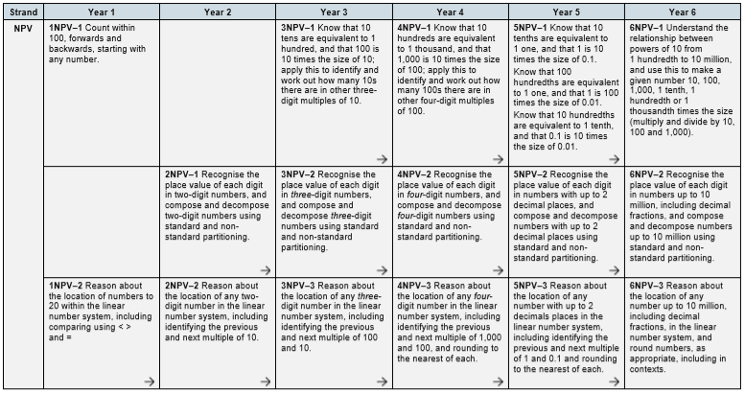
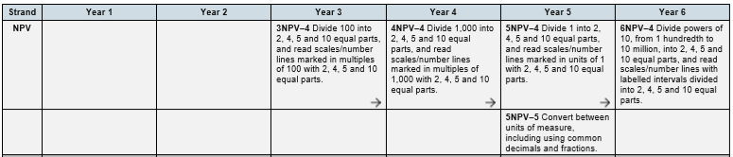
There are just two NPV criteria in Year 2 in order to give time to build firm foundations of these two key ideas. Once these are established other ideas are added in KS2.
Notice the arrows for connection and progression.
There are four common foci in the place value strand across KS2 - what are they?
Page 9 of the guidance

Slide 20
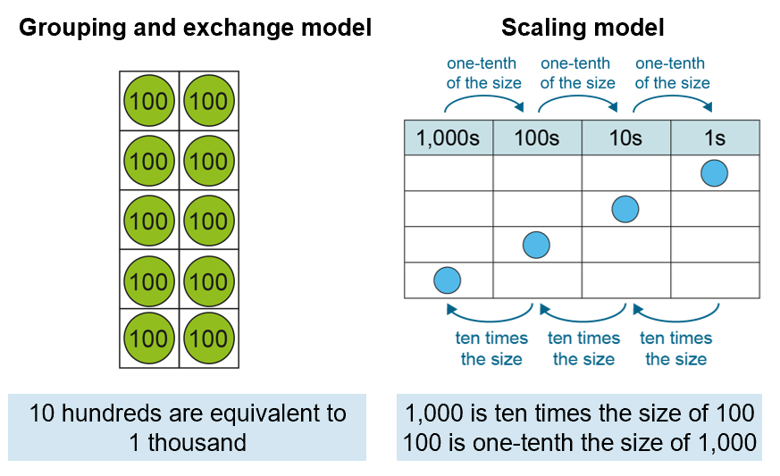
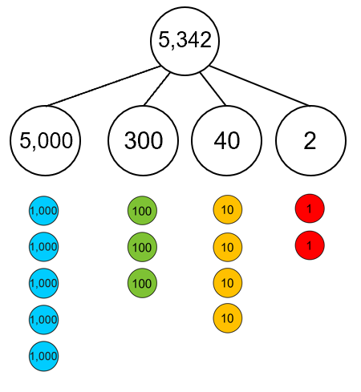
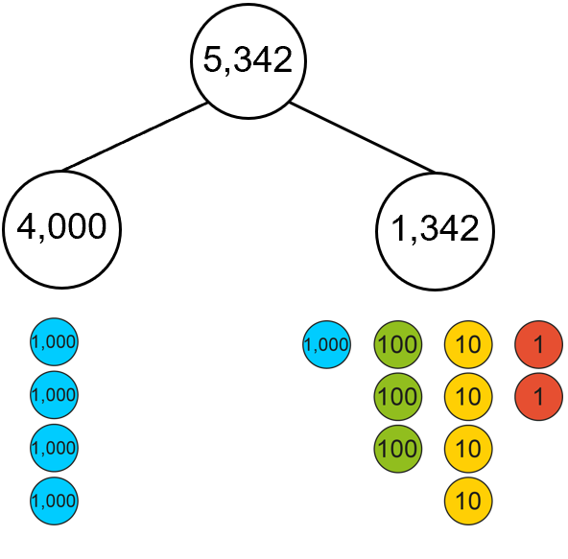
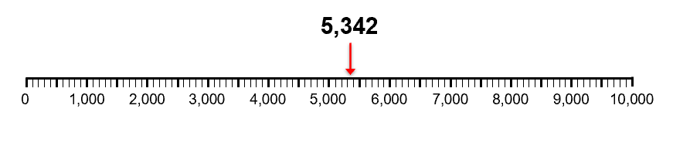
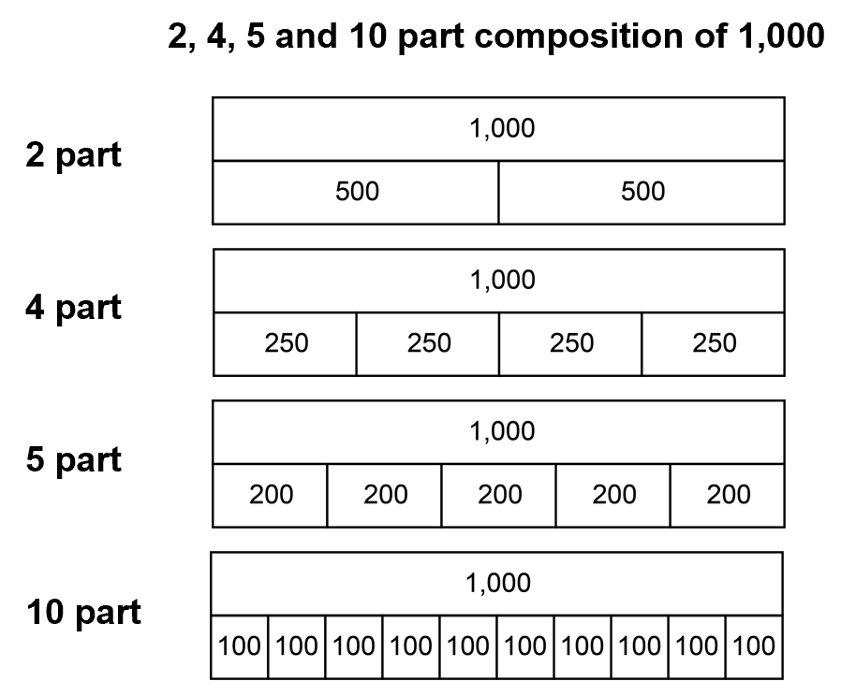
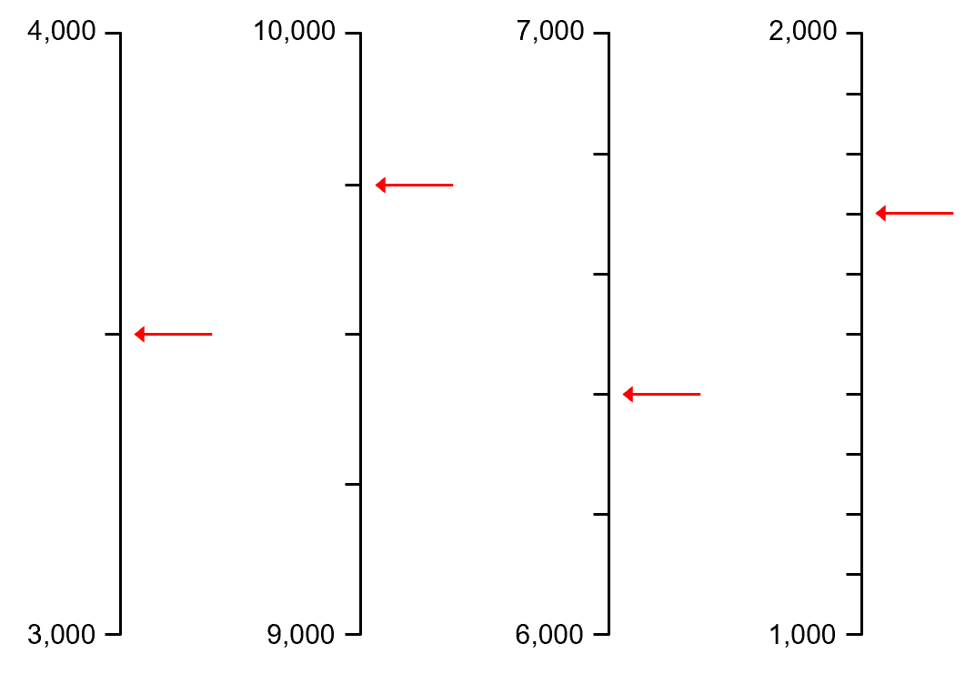
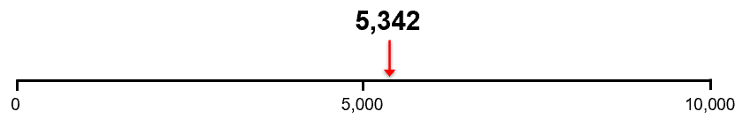
If you were to give titles to the four NPV criteria what would they be?
Do we cover all of these in enough depth?
Consider and summarise each of these aspects. Then click for the titles to appear.
NPV1:
Relationship between adjacent place value units
NPV2:
Standard and non-standard partitioning
NPV3:
Place in the linear number system
NPV4:
Common partitions of place value units

Slide 21
How to use the guidance
The guidance can support long-term, medium-term and short-term planning, and assessment.
Let’s look at the planning stage
Page 7 of the guidance

Slide 22


For the next set of slides, create yourself a to-do list
Where you see this symbol note down any actions that you will take.

Slide 23
Long-term planning
The guidance can be used to ensure that the most important elements that underpin the curriculum are covered at the right time, and to ensure that there is continuity and consistency for pupils as they progress from one year group to the next.
School curriculum map – where should we start?
Insert the ready-to-progress into the school curriculum map.
Consider the use of representations across the school. Is there consistency?
Map out the progression in recall of number facts using the appendix in the guidance. Is there a clear school policy?

Slide 24
FAQs
Q: Does the guidance document cover the whole of the primary curriculum?
A: Please note that the publication does not address the whole of the primary curriculum, only the areas that have been identified as a priority. It is still a statutory requirement that the whole of the curriculum is taught. However, by meeting the ready-to-progress criteria, pupils will be able to more easily access many of the elements of the curriculum that are not covered by the guidance.
Page 5 of the guidance

Slide 25
Medium-term planning
Teachers can use the guidance to inform decisions on how much teaching time to set aside for the different parts of the curriculum. Teaching time can be weighted towards the ready-to-progress criteria. The ready-to-progress tables at the start of each year group and the ‘Making connections’ features support medium-term planning by demonstrating how to make connections between mathematical ideas and develop understanding based on logical progression.
Medium-term planning – where should we start?
Allocate more time to the core concepts – ensure that all the RTP criteria are given priority and are covered in depth – allocate enough time to teach them well and provide practice and consolidation.
Allocate additional time to practise multiplicative and additive facts.
Use the ‘Making connections’ information to improve the sequencing of lessons.

Slide 26
FAQs
Q: How can the guidance document be used with textbooks/existing resources?
Map the ready-to-progress criteria to your textbooks/existing resources.
Highlight the ready-to-progress criteria and consider whether you have allocated enough time to teach in sufficient depth, practise and consolidate.
Consider whether you want to adapt the order of the concepts that you teach and whether you need to create additional lessons.

Slide 27
Short-term planning
The guidance can be used to inform teaching strategy, and the representations and ‘Language focus’ features can be used to make concepts more accessible to pupils.
Short term planning – where should we start?
Read the relevant section from the year-group chapter before planning a sequence of lessons.
Use the RTP criteria review, practice and consolidation resources (link coming soon) from the year group or previous year group as pre-teaching for those pupils who might need additional support.
Use the PD materials to see the small steps alongside the representations and incorporate slides into lessons.
Use some of the assessment questions from the year below to check that pupils have the pre-requisite knowledge and skills.
Use language focus features to support language development.

Slide 28
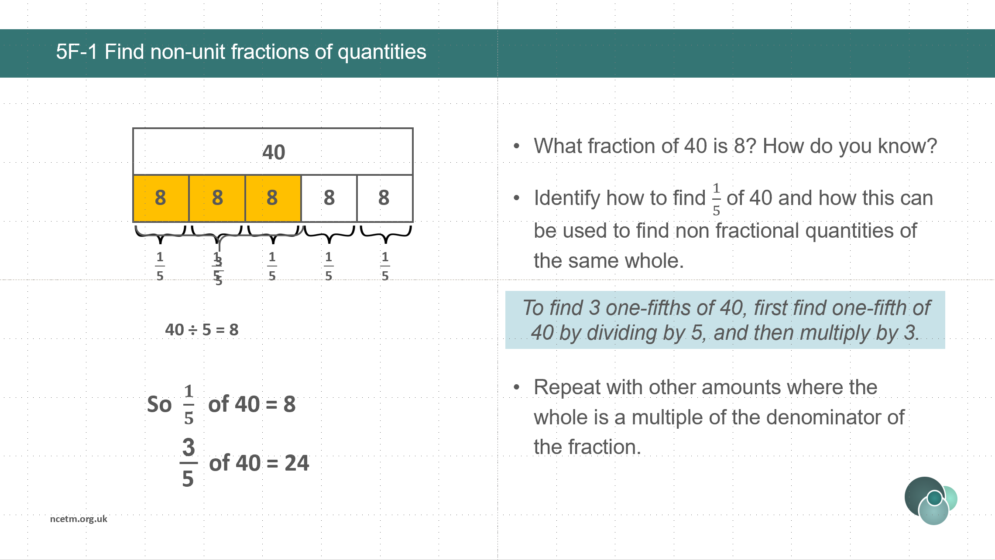
Ready-to-progress criteria resources
There is a set of resources for each of the RTP criteria.
Their main intention is for use with small groups of children who require additional review, practice and consolidation. They can also be incorporated into main teaching activity.

Slide 29
Language focus features
Language focus “If the numerators are both 1, then the larger the denominator, the smaller the fraction.”
These occur in every year group chapter and capture key features of the maths, the things that are crucial for pupils to understand and remember. After having developed the ideas, capturing them in a sentence and repeating them together and individually will draw attention to their importance and help embed in the long-term memory.

Slide 30
True or false?
Discuss and then click to reveal comment
Calculation and fluency
B: Knowing number facts is useful because it frees working memory.
A: Children must practise procedures and know their number facts before they can move on to reason mathematically and solve problems.
B: TRUE. The working memory has limited capacity and knowing core facts will reduce the load. Knowing facts can also build confidence.
A: FALSE. Applying reasoning to the learning of facts will aid memorisation and opportunities to apply will provide context and additional practice.
D: FALSE. This has been chosen to challenge the idea that mathematics is only about being quick and able to remember facts. The dualism of knowing facts and procedures and developing deep conceptual understanding provides for a successful mathematician.
C: Fluency is about applying facts as well as knowing them.
D: Memorising facts and being able to recall them quickly is a way of demonstrating mathematical prowess.
C: TRUE.

Slide 31
Number facts fluency
The guidance, alongside development of deep conceptual understanding, places significant emphasis on procedural and factual fluency.
Why is this important?
In teaching procedural and factual knowledge, ensure that students get to automaticity. Explain to students that automaticity with procedures and facts is important because it frees their minds to think about concepts. (Willingham 2009 p19)
But the point of being fluent in them [times table facts] is to free up the working memory when tackling a more interesting and engaging piece of mathematics. (Askew 2012 p54)
Notes:
Willingham, D. T. (2009) 'Is it true that some people just can't do math?' American Educator, Winter 2009-10 pp. 14-19, 39.
Askew, M. (2012) Transforming primary mathematics. London: Routledge.

Slide 32
FAQs
Q: How does the guidance link to our calculation policy?
A: Each chapter ends with a section on ‘calculation and fluency’. This summarises the core methods and strategies that children should have developed by the end of the year to be ready to move on to the next year group. There is also an appendix at the end of the guidance that identifies core number facts and outlines whole school progression. You may wish to compare this to your current calculation policy.
Page 330 of the guidance

Slide 33
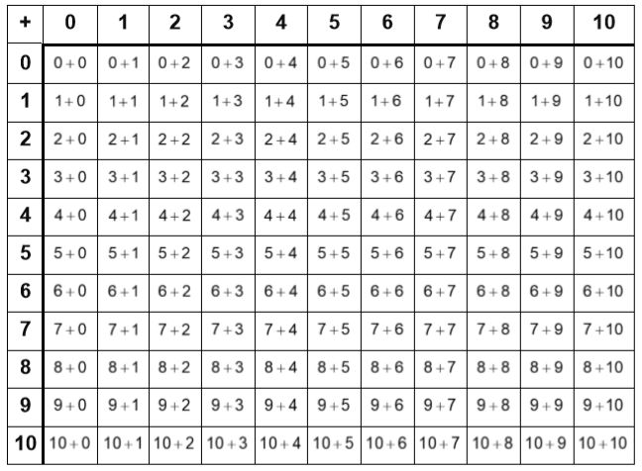
Addition and subtraction facts
The full set of addition calculations that pupils need to be able to solve with automaticity are shown in the table opposite. Pupils must also be able to solve the corresponding subtraction calculations by applying the relationship to addition facts so 5 – 2 = 3
because 3 + 2 = 5
Which year group are these taught in?
When and how are these practised?
Do you know which children have automatic recall?
Page 332 of the guidance

Slide 34

All children need to learn their tables
Where would you place yourself on the line?
Strongly agree
Strongly disagree
The guidance places high importance on children learning number facts to automaticity as this will relieve working memory, build confidence and support progression.

Slide 35
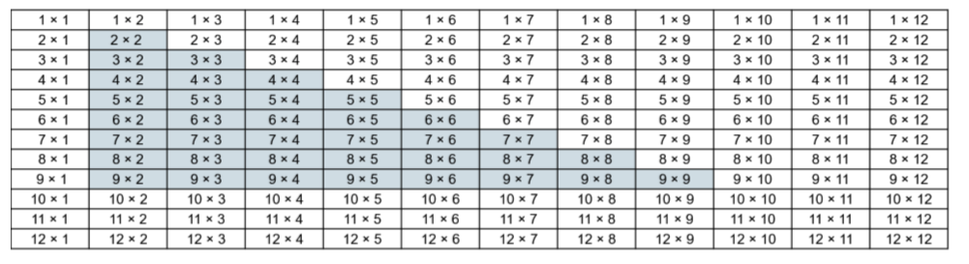
Multiplication and division facts
The full set of multiplication calculations that pupils need to be able to solve by automatic recall are shown in the table below. Pupils should also be able to recall division facts using known multiplication facts.
Which year group are these taught in?
When and how are these practised?
Do you know which children have automatic recall?
The 36 highlighted facts are those required for short and long multiplication.
Page 333 of the guidance

Slide 36
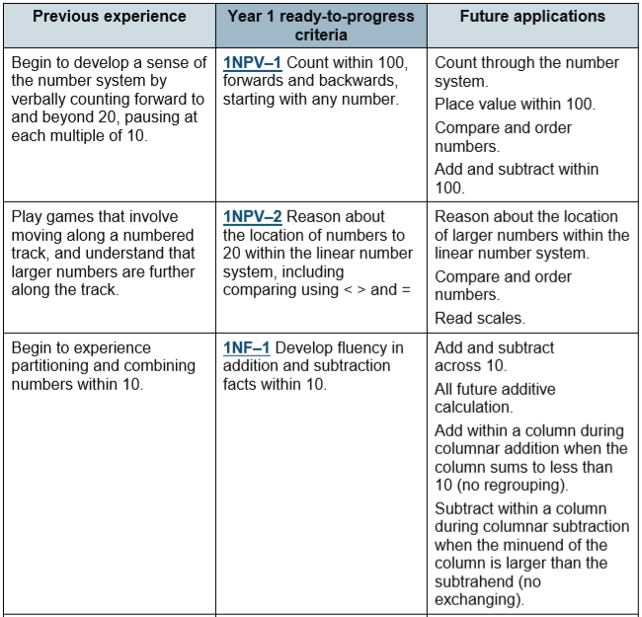

FAQs
Q: Are there any resources for Early Years?
A: All the Y1 RTP criteria have references to pe-requisites that relate to the YR.
Also see the Early Years area of the NCETM website which has progression maps in the six identified core areas of early mathematics.

Slide 37
Find your Maths Hub
The Maths Hubs Network exists to support all schools in England. Each Maths Hub serves schools in a specified group of named local council areas. For schools in every area in England, there is a Maths Hub providing support.
To find your hub click on the following link:
https://www.ncetm.org.uk/maths-hubs/find-your-hub/

Slide 38
How are you going to tick off your to-do list?

Slide 39
Returning to the national curriculum that we started the session with. We are doing all of this so that…
All our pupils can apply knowledge rapidly and accurately, reason mathematically and solve problems, including breaking down problems into a series of simpler steps!

