Slide 1
Secondary Teaching for Mastery
Initial Teacher Education units
Coherence

Slide 2
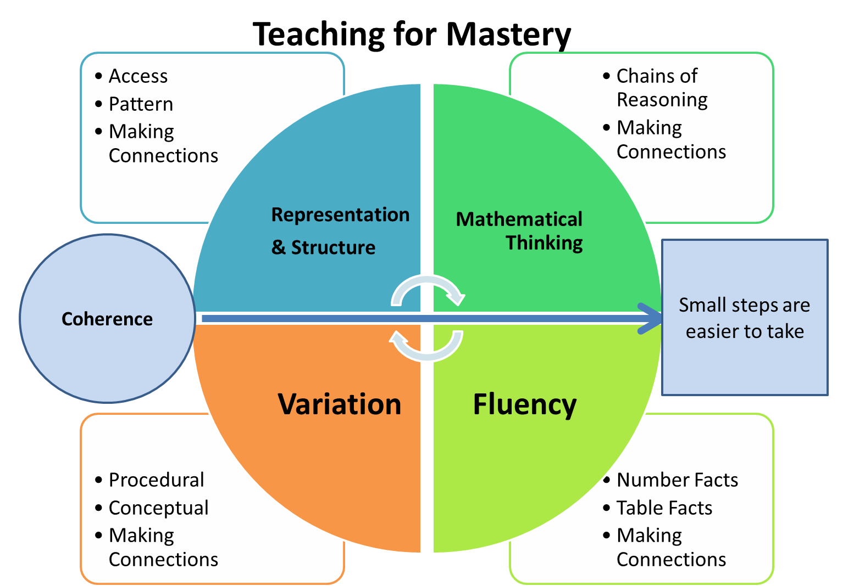
Five Big Ideas
Notes:
https://www.ncetm.org.uk/teaching-for-mastery/mastery-explained/five-big-ideas-in-teaching-for-mastery/

Slide 3
Meaningful learning
When a new concept is encountered, in order for learning to take place, one of two things must happen:
Either
The new idea is connected to and incorporated into the learner’s existing framework of knowledge (assimilation)
Or
Existing knowledge structures must be extended/reorganised (accommodation).
Notes:
Skemp, R. (1986) The Psychology of Learning Mathematics, Penguin
Skemp, R. (1976) Relational Understanding and Instrumental Understanding’ Mathematics Teaching 77: 20-26
Skemp uses the term ‘schema’ to refer to a connected framework of knowledge
Note that ‘accommodation’ can be challenging/uncomfortable! Cognitive conflict.

Slide 4
So, for teaching to result in meaningful learning, we need to know students’ prior knowledge.
Vygotsky’s idea of zone of proximal development (ZPD) is helpful here. ZPD is the distance between where the student is on their own, and where they can get to with the help of a more knowledgeable other…
…learning things that are just beyond where their current understanding is.
Notes:
Vygotsky, L.S. (1962) Thought and Language. Cambridge MA: MIT Press

Slide 5
What this means for coherence
There are implications for curriculum design (macro) and lesson design (micro).
It is the teacher’s role to plan and structure learning experiences and to help the student in conceptual organisation and reorganisation.
It is the student who must do the conceptualising!
Notes:
Implications for scaffolding, small steps, coherence.
Orton, A. (2004) Learning Mathematics: Issues, theory and classroom practice, Continuum

Slide 6
Read this phrase aloud:
我不知道
我
Wǒ bù zhīdào
Notes:
An example of new knowledge being beyond existing knowledge but within grasp.
Ask TTs to pronounce this phrase. Simplify it and ask again. What if we simplify it further by using pinyin (spelling out Chinese phrases with letters from the English alphabet)?
Now that we have tethered this to prior knowledge (knowledge of the English alphabet) it is within the grasp of TTs. Previously, it was beyond our knowledge and was incomprehensible to us.
One of the functions of coherence is that it helps us to avoid situations whereby we ask students to understand things that are beyond their prior knowledge.
PS The phrase means I don’t know.

Slide 7
Big Idea: Coherence
Key Messages
Small steps are easier to take.
Focusing on one key point each lesson allows for deep and sustainable learning.
Certain images, techniques and concepts are important pre-cursors to later ideas. Getting the sequencing of these right is an important skill in planning and teaching for mastery.
When introducing new ideas, it is important to make connections with earlier ones that have already been understood.
When something has been deeply understood and mastered, it can and should be used in the next steps of learning.
Notes:
Give TTs time to read

Slide 8
Breaking down a concept into small steps/key ideas
Imagine breaking trigonometry in right-angled triangles down into small steps.
Notes:
One strategy to support coherence is to break down a concept into small steps. This is sometimes referred to as atomisation or ‘isolate the skill’. It is most effective when done as part of medium term planning i.e. when planning a learning episode/unit of work.
Ask TTs to discuss before sharing next slide.

Slide 9
Identify a right-angled triangle
Calculate the sine, cosine and tangent of a given angle using a calculator
Calculate the inverse sine, cosine and tangent of a given number using a calculator
Rearrange equations (including when the unknown is a denominator)
Rearrange equations that contain a trigonometric function
Label the sides of a right-angled triangle using hypotenuse, opposite and adjacent
Recall the trigonometric ratios
Identify which trigonometric ratio to use
Calculate the length of an unknown side of a right-angled triangle using a trigonometric ratio
Calculate the size of an unknown angle of a right-angled triangle using a trigonometric ratio
Calculate the length of unknown sides or unknown angles of a right-angled triangle embedded within 2D shapes
Calculate the length of unknown sides or unknown angles of a right-angled triangle in word problems
Calculate the length of unknown sides or unknown angles of a right-angled triangle within a 3D shape
Solve unfamiliar problems that require application of trigonometry
Notes:
Small steps/key ideas for trigonometry in right-angled triangles.

Slide 10
Breaking down a concept into small steps/key ideas
In pairs, break down solving simultaneous equations into small steps.

Slide 11
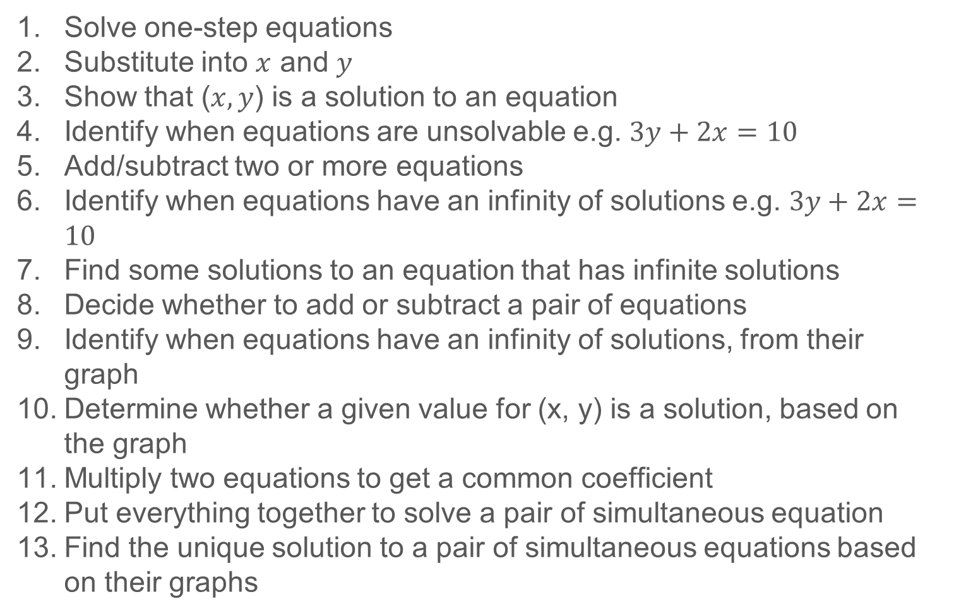
Solve one-step equations
Substitute into $x$ and $y$
Show that ($x, y$) is a solution to an equation
Identify when equations are unsolvable e.g. $3y+2x=10$
Add/subtract two or more equations
Identify when equations have an infinity of solutions e.g. $3y+2x=10$
Find some solutions to an equation that has infinite solutions
Decide whether to add or subtract a pair of equations
Identify when equations have an infinity of solutions, from their graph
Determine whether a given value for (x, y) is a solution, based on the graph
Multiply two equations to get a common coefficient
Put everything together to solve a pair of simultaneous equation
Find the unique solution to a pair of simultaneous equations based on their graphs
Notes:
Taken from Kris Boulton’s blog at https://tothereal.wordpress.com/2017/08/12/my-best-planning-part-1/

Slide 12
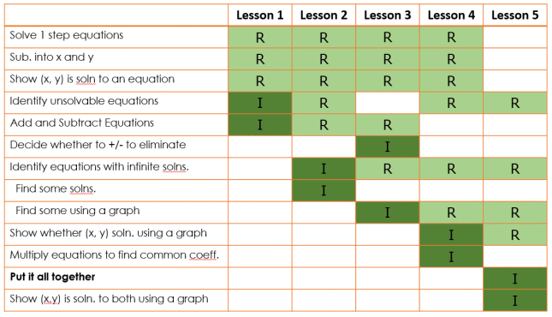
Sequencing
R = Revisit I = Initial instruction
Notes:
Taken from Kris Boulton’s blog https://tothereal.wordpress.com/2017/08/19/my-best-planning-part-2/

Slide 13
Coherence at both macro and micro levels
Caution! We need to avoid a giving students a ‘fragmented’ experience of the curriculum
It’s important to be able to think about the curriculum in a connected way
to understand how key ideas and concepts are linked…
so that you can provide a coherent learning journey for students.

Slide 14
So, whilst it is helpful to analyse topics through a ‘small steps’ process, it’s also vital to keep an overall ‘bird’s eye’ view of the mathematical landscape.
We need to strive for connections and coherence whilst at the same time appreciating the fine-grained distinctions or small steps which make up the learning journey.

Slide 15
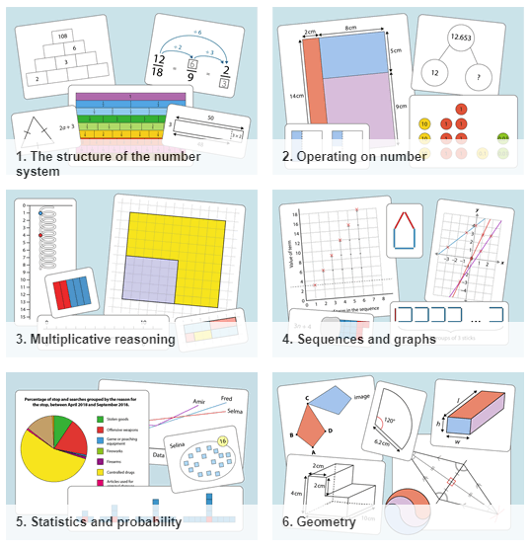
NCETM Secondary Professional Development Materials
Supporting professional development
(PD) in all areas of the
KS3 curriculum
Designed for use in professional
development sessions
Not lesson resources
Support the use of other resources

Slide 16
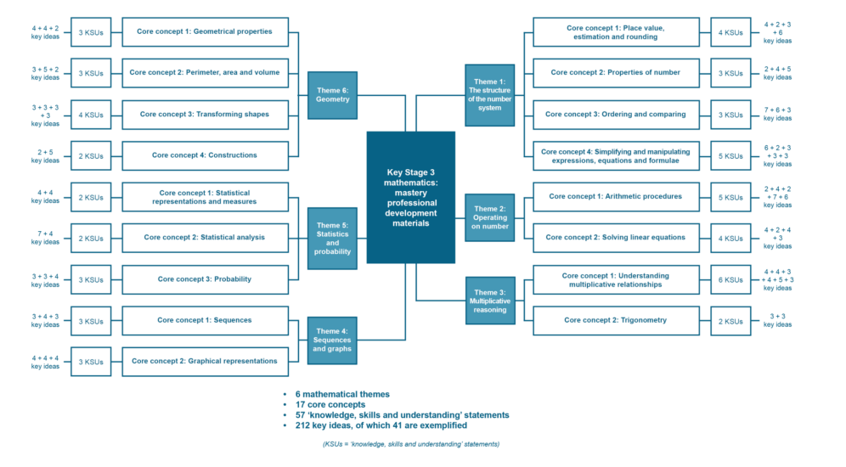
Notes:
https://www.ncetm.org.uk/media/ludm4s3g/ncetm_secondary_mastery_pd_materials_structure.pdf

Slide 17
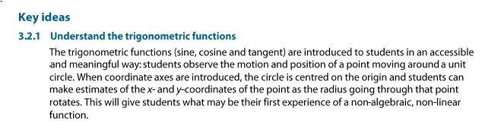
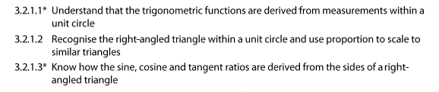
Example from NCETM PD materials
Notes:
https://www.ncetm.org.uk/files/108968565/ncetm_ks3_cc_3_2.pdf

Slide 18

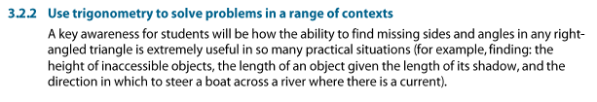
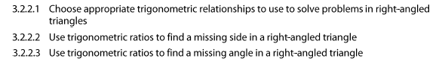

Slide 19
Big Idea: Coherence
Key Messages
Small steps are easier to take.
Focusing on one key point each lesson allows for deep and sustainable learning.
Certain images, techniques and concepts are important pre-cursors to later ideas. Getting the sequencing of these right is an important skill in planning and teaching for mastery.
When introducing new ideas, it is important to make connections with earlier ones that have already been understood.
When something has been deeply understood and mastered, it can and should be used in the next steps of learning.
Notes:
Give TTs time to read

Slide 20
Connect with the NCETM and your local Maths Hub
Check out the NCETM at ncetm.org.uk for full access to all content and resources, plus a monthly mailing – the Secondary Round-up – sent straight to your inbox.
Find your local Maths Hub via ncetm.org.uk/maths-hubs/find-your-hub/. Click through to your local hub’s page to subscribe to their mailing list and follow them on Twitter.

Slide 21

Connect with the NCETM and your local Maths Hub

Slide 22
References and more info…
Boulton, K. (2017) My best planning. https://tothereal.wordpress.com/2017/08/12/my-best-planning-part-1/
Friis, D. & McCrea, E. (forthcoming) Deliberate Maths: Expertly Designed Practice Sets
McCrea, E. (2019) Making Every Maths Lesson Count, Crown House
NCETM Five Big Ideas www.ncetm.org.uk/teaching-for-mastery/mastery-explained/five-big-ideas-in-teaching-for-mastery/
NCETM PD materials www.ncetm.org.uk/teaching-for-mastery/mastery-materials/secondary-mastery-professional-development/
NCETM PD materials: Trigonometry
www.ncetm.org.uk/media/11qbq2zu/ncetm_ks3_cc_3_2.pdf

Slide 23
References and more info…
Skemp, R. (1976) Relational Understanding and Instrumental Understanding’ Mathematics Teaching 77: 20-26
Skemp, R. (1986) The Psychology of Learning Mathematics, Penguin
Orton, A. (2004) Learning Mathematics: Issues, theory and classroom practice, Continuum
Vygotsky, L.S. (1962) Thought and Language. Cambridge MA: MIT Pr
Podcast
www.mrbartonmaths.com/blog/kris-boulton-part-1-planning-lessons-engelmann-and-differentiation/
Blogs
Simultaneous equations https://tothereal.wordpress.com/2017/08/12/my-best-planning-part-1/
Perimeter http://conceptionofthegood.co.uk/?p=660

