Slide 1
Secondary Teaching for Mastery
Initial Teacher
Education units
Representation and
Structure

Slide 2
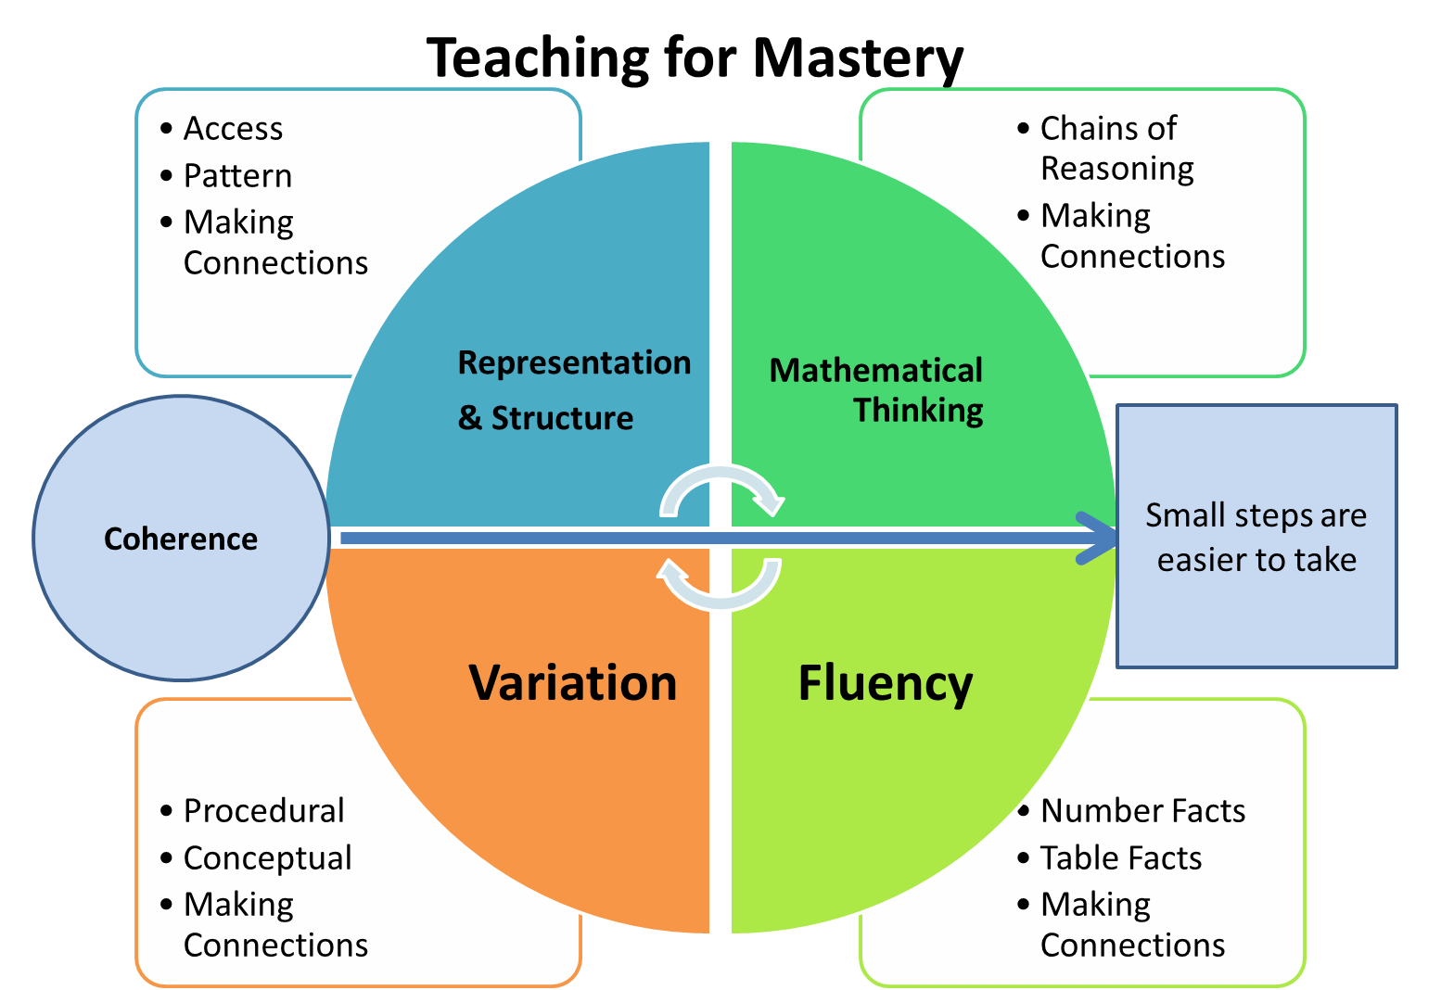
Five Big Ideas
Notes:
https://www.ncetm.org.uk/teaching-for-mastery/mastery-explained/five-big-ideas-in-teaching-for-mastery/

Slide 3
Big Idea: Representation and Structure
Key Messages
The representation needs to clearly show the concept being taught, and in particular the key difficulty point. It exposes the structure.
In the end, the students need to be able to do the maths without the representation.
A stem sentence describes the representation and helps the students move to working in the abstract (“ten tenths is equivalent to one whole”) and could be seen as a representation in itself.
There will be some key representations which the students will meet time and again.
Pattern and structure are related but different: students may have seen a pattern without understanding the structure which causes that pattern.
Notes:
Give TTs time to read

Slide 4
Concrete, Pictorial, Abstract
Bruner’s theory focuses on three models of
Representation of mathematical ideas:
Enactive model
Iconic mode
Symbolic mode.
Learners can access abstract ideas through manipulating objects to derive enactive knowledge. Then diagrams help them acquire iconic knowledge to act as a bridge to formal symbolic knowledge.
Notes:
https://www.hertsforlearning.co.uk/blog/cpa-approach

Slide 5
Representations
Representing mathematics – using objects, diagrams, symbols and words to represent abstract concepts – is essential for deepening understanding.
Making non-arbitrary and substantive connections between different representations helps to develop meaning.
Concepts and techniques need to be represented in ways that provide students with an insight into their underlying structure. Drury (2018) p.144-145
Notes:
Note that language and symbols are themselves representations of abstract ideas

Slide 6
What?
Examples of different representations include:
• two fractions could be represented on a number line
• a quadratic function could be expressed algebraically or presented visually as a graph
• a probability distribution could be presented in a table or represented as a histogram.

Slide 7
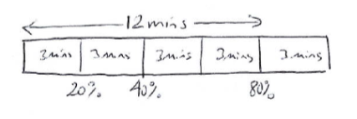
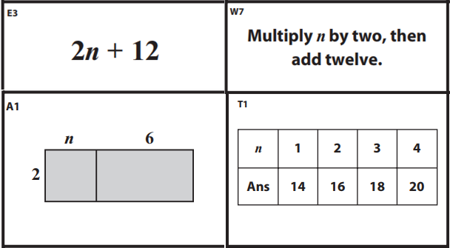
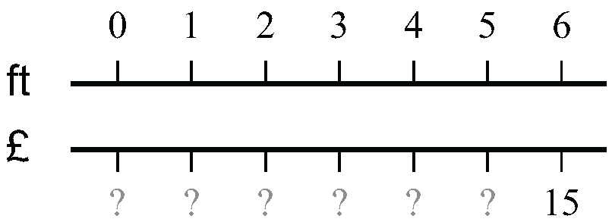
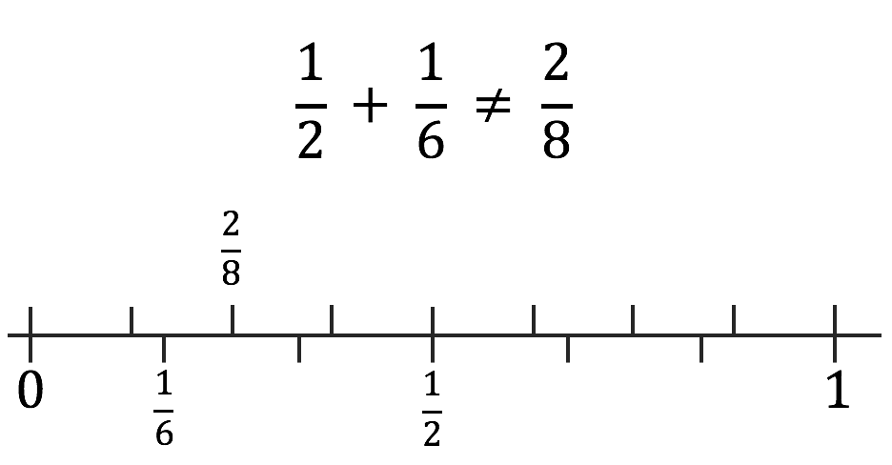
Notes:
Others include: Bar models (algebra tiles are a version of this), double and single number lines
Examples taken from:
Swan, Improving Learning in Mathematics
McCrea, Making Every Maths Lesson Count

Slide 8
“Manipulatives and representations can be powerful tools for supporting pupils to engage with mathematical ideas.”
EEF Improving Mathematics in Key Stages Two and Three Guidance Report (2017)
Notes:
https://educationendowmentfoundation.org.uk/public/files/Support/Links/Campaigns/Maths/KS2_KS3_Maths_Guidance_2017.pdf

Slide 9
NCETM guidance
Although manipulatives and representations are commonly used in primary mathematics or have been historically considered the reserve of lower prior attainers, they can be equally valuable for revealing mathematical structures at secondary level for all students.
Notes:
NCETM has produced guidance on using representations in secondary mathematics, including documents and short ‘explainer’ videos.
https://www.ncetm.org.uk/classroom-resources/secmm-using-mathematical-representations-at-key-stage-3/

Slide 10

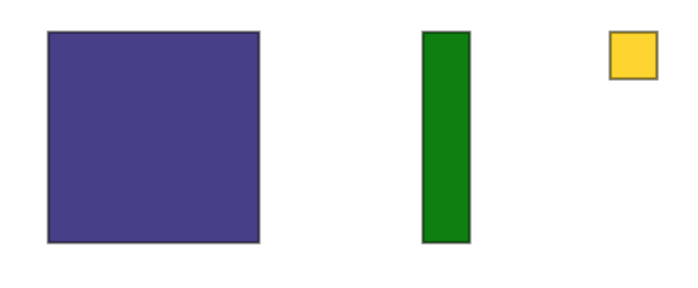
How?
Algebra tiles
1
1
Notes:
One representation TT are less likely to be familiar with is algebra tiles.
The first algebra tile is the yellow unit square with side length 1 and area 1. Red is -1.

Slide 11

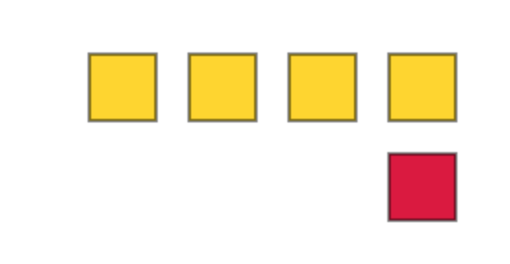
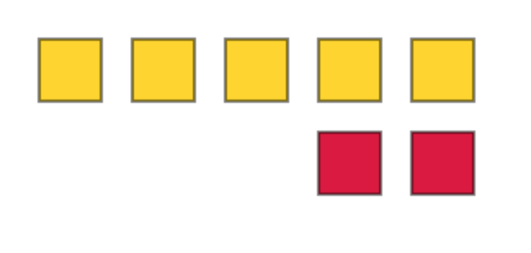
Show me three
Notes:
First big idea is working with directed numbers.
Ask TT to show 3 in another way. And another way, etc… to introduce the idea of zero pairs

Slide 12


Adding and subtracting directed numbers
Represent these calculations with unit squares
$3+2=$
$$4+\left(−3\right)=$$
$$−6+3=$$
$$−1+\left(−2\right)=$$
$$5−1=$$
$$1−\left(−2\right)=$$
$$−3−2=$$
$$−2−\left(−4\right)=$$
Notes:
Which are more difficult to model and why? What difficulties might students encounter? How can you overcome them?
Use https://mathsbot.com/manipulatives/tiles to model answers

Slide 13



How?
Algebra tiles
$$x$$
1
1
1
$$x$$
$$x$$
Notes:
Algebra tiles consist of three tiles:
A blue square with unknown side length with area x²
A green rectangle with an unknown side length x and known side length 1 with area 𝑥.
A yellow unit square with side length 1 representing 1.

Slide 14
How?
Algebra tiles
Notes:
Algebra tiles have positive and negative values. Negatives are red with areas –x², -x and -1 respectively

Slide 15
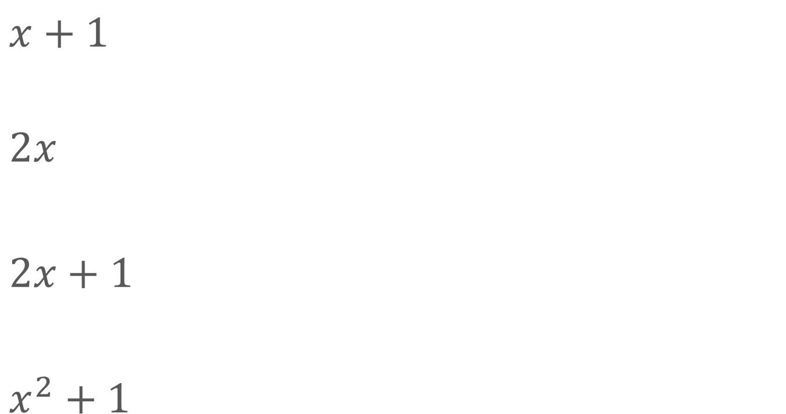

Represent the following expressions using algebra tiles
$x+1$
$$2x$$
$2x+1$
$x^{2}+1$
$$x^{2} +2x+1$$
$$x−1$$
$$\frac{x}{2}$$
Notes:
Discuss second column:
How can first expression help with expanding and factorising? (It is same as (x+1)^2)
Is the second expression best represented as x-1 or x+(-1)?
Use https://mathsbot.com/manipulatives/tiles to model answers

Slide 16
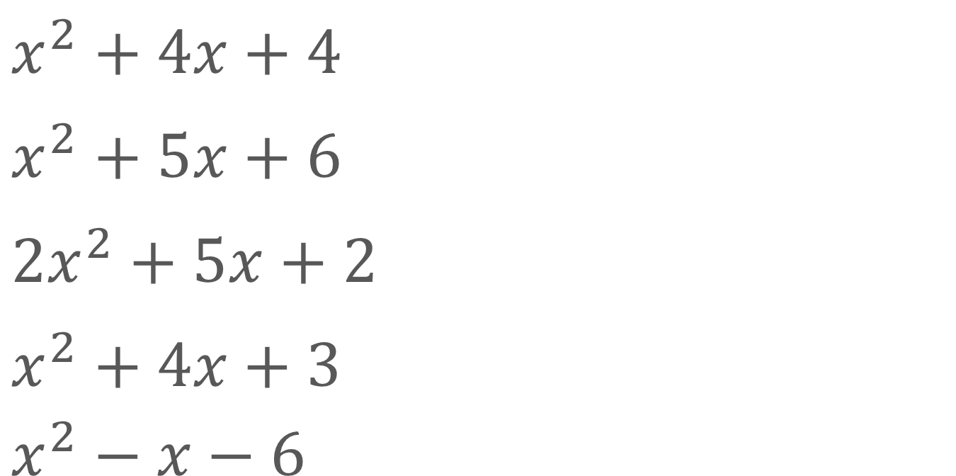
Factorise, using algebra tiles
$$x^{2}+4x+4$$
$$x^{2}+5x+6$$
$${2x}^{2}+5x+2$$
$$x^{2}+4x+3$$
$$x^{2}−x−6$$

Slide 17
How can you use algebra tiles to
solve linear equations?
solve quadratic equations?

Slide 18
NCETM guidance on algebra tiles
Algebra tiles can be used when solving linear equations, providing a ‘bridge’ to support students as they develop their fluency in algebraic symbolism. It is important for the symbolic representation to be used alongside the tiles.
www.ncetm.org.uk/media/dj5o223w/ncetm_ks3_algebra_tiles.pdf
https://vimeo.com/362785569
Notes:
https://www.ncetm.org.uk/classroom-resources/secmm-using-mathematical-representations-at-key-stage-3/

Slide 19
Key considerations
Ensure that there is a clear rationale
Enable pupils to understand the links between the manipulatives and the mathematical ideas they represent.
Try to avoid pupils becoming reliant on manipulatives
Manipulatives should act as a ‘scaffold’, which can be removed
Manipulatives can be used to support pupils of all ages
EEF Improving Mathematics in Key Stages Two and Three Guidance Report (2017)
Notes:
https://educationendowmentfoundation.org.uk/public/files/Support/Links/Campaigns/Maths/KS2_KS3_Maths_Guidance_2017.pdf
Manipulatives can be used across both Key Stages. The evidence suggests some key considerations:
• Ensure that there is a clear rationale for using a particular manipulative or representation to teach a specific mathematical concept. Manipulatives should be used to provide insights into increasingly sophisticated mathematics.
• Enable pupils to understand the links between the manipulatives and the mathematical ideas they represent. This requires teachers to encourage pupils to link the materials (and the actions performed on or with them) to the mathematics of the situation, to appreciate the limitations of concrete materials, and to develop related mathematical images, representations and symbols.
• Try to avoid pupils becoming reliant on manipulatives to do a type of task or question. A manipulative should enable a pupil to understand mathematics by illuminating the underlying general relationships, not just ‘getting them to the right answer’ to a specific problem.
• Manipulatives should act as a ‘scaffold’, which can be removed once independence is achieved. Before using a manipulative, it is important to consider how it can enable pupils to eventually do the maths without it. When moving away from manipulatives, pupils may find it helpful to draw diagrams or imagine using the manipulatives.
• Manipulatives can be used to support pupils of all ages. The decision to remove a manipulative should be made in response to the pupils’ improved knowledge and understanding, not their age.

Slide 20
The wider picture
To solve problems posed for pedagogic purposes, secondary maths learners have to:
• be able to read and understand the problem
• know when they are expected to use formal methods
• know which methods to apply and in what order and how to carry them out
• identify variables and relationships, choosing which variable to treat as independent
• apply appropriate knowledge of situations and operations
• use mental, graphical and diagrammatic imagery
• choose representations and techniques and know how to operate with them
• know a range of useful facts, operations and functions
• decide whether to use statistical, algebraic, logical or ad hoc methods.
(Watson, 2009)
Notes:
Understanding and handling representations is an integral part of mathematical activity

Slide 21
Big Idea: Representation and Structure
Key Messages
The representation needs to clearly show the concept being taught, and in particular the key difficulty point. It exposes the structure.
In the end, the students need to be able to do the maths without the representation.
A stem sentence describes the representation and helps the students move to working in the abstract (“ten tenths is equivalent to one whole”) and could be seen as a representation in itself.
There will be some key representations which the students will meet time and again.
Pattern and structure are related but different: Students may have seen a pattern without understanding the structure which causes that pattern.
Notes:
Give TT time to read

Slide 22
Connect with the NCETM and your local Maths Hub
Check out the NCETM at ncetm.org.uk for full access to all content and resources, plus a monthly mailing – the Secondary Round-up – sent straight to your inbox.
Find your local Maths Hub via ncetm.org.uk/maths-hubs/find-your-hub/. Click through to your local hub’s page to subscribe to their mailing list and follow them on Twitter.

Slide 23

Connect with the NCETM and your local Maths Hub

Slide 24
References and more info…
Drury, H. (2018) How to Teach Mathematics for Mastery. Oxford
Education Endowment Foundation (2017) Improving Mathematics in Key Stages Two and Three Guidance Report https://educationendowmentfoundation.org.uk/public/files/Support/Links/Campaigns/Maths/KS2_KS3_Maths_Guidance_2017.pdf
Hill, C. (2018) ‘Using tokens to teach directed numbers’, Mathematics Teaching 264:13-16
Mattock, P. (2019) Visible Maths: Using representations and structure to enhance mathematics teaching in schools, Crown House
NCETM Five big ideas www.ncetm.org.uk/teaching-for-mastery/mastery-explained/five-big-ideas-in-teaching-for-mastery/
NCETM guidance on representations www.ncetm.org.uk/classroom-resources/secmm-using-mathematical-representations-at-key-stage-3/

Slide 25
References and more info…..
Watson, A. (2009) Paper 7: Modelling, Problem-Solving and Integrating Concepts, in Key Understandings in Mathematics Learning, Nuffield Foundation https://mk0nuffieldfounpg9ee.kinstacdn.com/wp-content/uploads/2019/12/P7.pdf
Willingham (2017) Do Manipulatives Help Students Learn? www.aft.org/sites/default/files/periodicals/ae_fall2017_willingham.pdf
Blog
Will Emeny www.greatmathsteachingideas.com/2015/04/04/algebra-tiles-from-counting-to-completing-the-square/
Podcast
Mr Barton Maths Podcast, Bernie Westacott: Teaching maths with visuals and manipulatives www.mrbartonmaths.com/blog/bernie-westacott-teaching-maths-with-visuals-and-manipulatives/

