Slide 1
Secondary Teaching for Mastery
Initial Teacher Education units
Mathematical Thinking

Slide 2
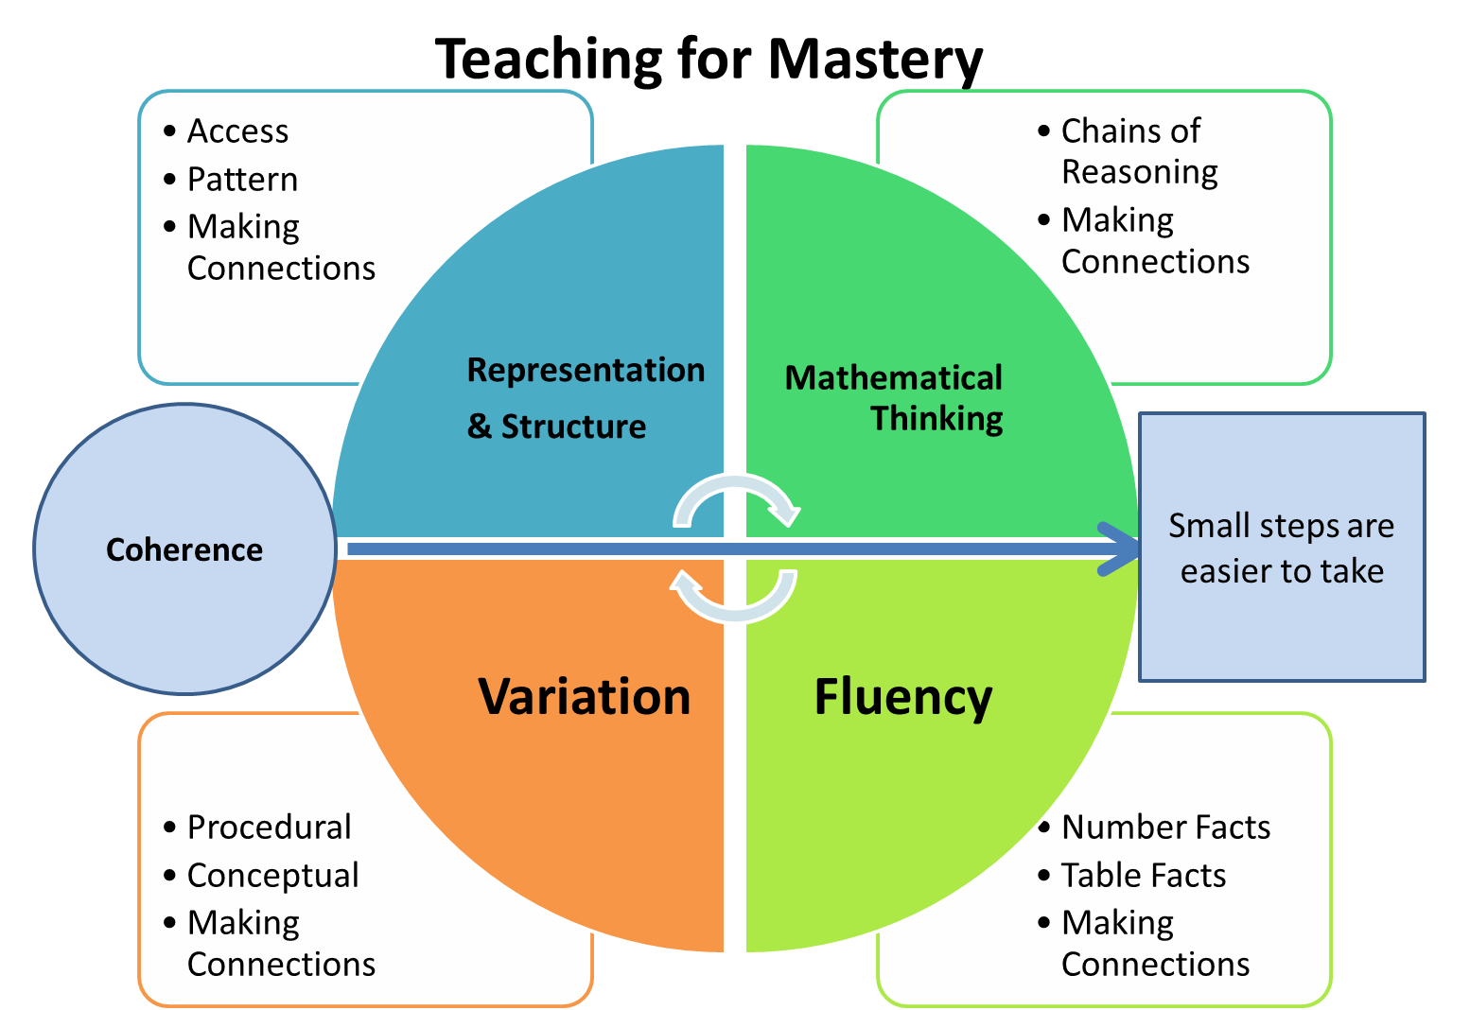
Five Big Ideas
Notes:
https://www.ncetm.org.uk/teaching-for-mastery/mastery-explained/five-big-ideas-in-teaching-for-mastery/

Slide 3
What does it mean to ‘think mathematically’?
Notes:
TTs think-pair-share discussion

Slide 4
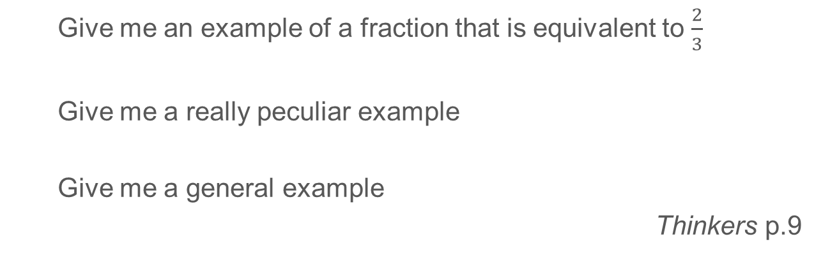
Particular, Peculiar, General
  Give me an example of a fraction that is equivalent to $\frac{2}{3}$
  Give me a really peculiar example
  Give me a general example
Thinkers p.9
Notes:
Thinking about the peculiar can help with thinking about the general. To create more and more peculiar examples we need to double any number for the numerator and treble it for the denominator. For example 2 billion over 3 billion or 2 × 3.22 over 3 × 3.22 or 2π over 3π. In the classroom learners can compete to make the examples more and more peculiar – numerator and denominator can be integers, decimals, fractions, algebraic expressions…
From here it is a short step to an expression of the general: ‘2 times something over 3 times something is a fraction equivalent to 2⁄3’ or ‘2x ⁄3x is equivalent to 2⁄3 for any value of x other than zero’.
Taken from https://www.atm.org.uk/write/MediaUploads/Shop%20Images/Look%20Inside/ATM_Thinkers_blue_look_inside.pdf

Slide 5
“Exploring, questioning, working systematically, visualising, conjecturing, explaining, generalising, justifying, proving... are all at the heart of mathematical thinking.”
https://nrich.maths.org/mathematically
Notes:
https://nrich.maths.org/mathematically

Slide 6
Big Idea: Mathematical Thinking
Key Messages
Mathematical thinking is central to deep and sustainable learning of mathematics.
Taught ideas that are understood deeply are not just ‘received’ passively but worked on by the student. They need to be thought about, reasoned with and discussed.
Mathematical thinking involves
  looking for pattern in order to discern structure
  looking for relationships and connecting ideas
  reasoning logically, explaining, conjecturing and proving.
Notes:
Give TTs time to read

Slide 7
Swan’s Top Tasks
Match the task type (T), description (D) and examples (E) cards.
Select one task type, complete the example task, and then create your own.
Notes:
The late, great, Malcolm Swan led a project that sought to design better learning experiences to foster conceptual understanding. The outcomes of this project were twofold. Firstly, five task ‘types’ were proposed to inform the design of practice tasks. Secondly, a suite of materials, called the Standards Unit: Improving Learning in Mathematics, were created that not only exemplified these task types for various topics but also described how they might be used with students – providing materials that are ripe for use as part of a learning episode. We can also use these five task types to create our own tasks.

Slide 8
Better thinkers
Probing questions… are not only for the students who need ‘stretching’…
‘Higher order mathematical thinking can be provoked and promoted as an integral part of teaching and learning school mathematics’ (p.4)
‘Questions such as ours enable all children to learn mathematics, not by making it easy, relevant, accessible or rote-learnt, but by helping them become better thinkers’ (p.39).
Watson and Mason (1998)
Notes:
This is our ultimate goal – to help students learn to think.

Slide 9
Mathematical prompts for deeper thinking
Which is bigger: 3n or n+3 ?
Video and slides:
www.ncetm.org.uk/classroom-resources/secmm-mathematical-prompts-for-deeper-thinking-videos/
Notes:
Discuss possible student responses to this question.
Watch the short video.
Use the associated PowerPoint slides to explore students’ mathematical thinking.

Slide 10
Big Idea: Mathematical Thinking
Key Messages
Mathematical thinking is central to deep and sustainable learning of mathematics.
Taught ideas that are understood deeply are not just ‘received’ passively but worked on by the student. They need to be thought about, reasoned with and discussed.
Mathematical thinking involves
  looking for pattern in order to discern structure
  looking for relationships and connecting ideas
  reasoning logically, explaining, conjecturing and proving.
Notes:
Give TTs time to read

Slide 11
Connect with the NCETM and your local Maths Hub
Check out the NCETM at ncetm.org.uk for full access to all content and resources, plus a monthly mailing – the Secondary Round-up – sent straight to your inbox.
Find your local Maths Hub via ncetm.org.uk/maths-hubs/find-your-hub/. Click through to your local hub’s page to subscribe to their mailing list and follow them on Twitter.

Slide 12
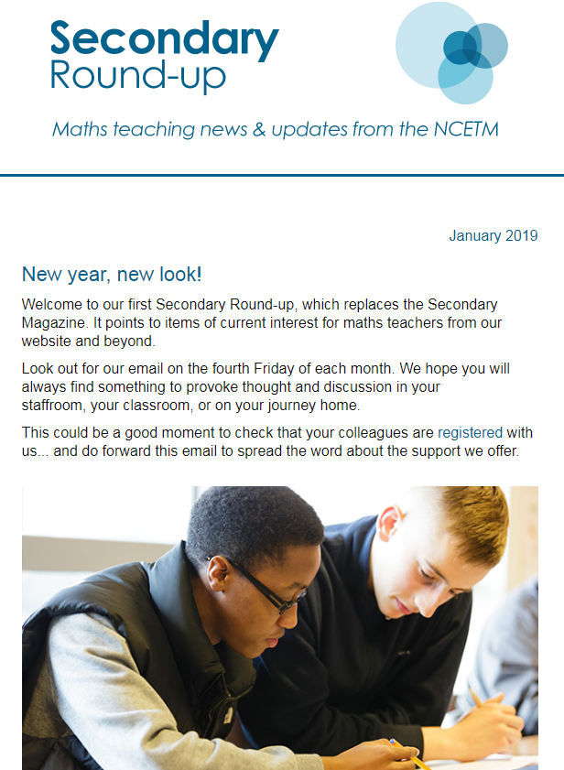
Connect with the NCETM and your local Maths Hub

Slide 13
References and more info…
Bills, C., Bills, L., Watson, A. & Mason, J. (2004) Thinkers: A Collection of Activities to Provoke Mathematical Thinking. Association of Teachers of Mathematics
NCETM Five Big Ideas www.ncetm.org.uk/teaching-for-mastery/mastery-explained/five-big-ideas-in-teaching-for-mastery/
NCETM Mathematical Prompts for Deeper Thinking www.ncetm.org.uk/classroom-resources/secmm-mathematical-prompts-for-deeper-thinking-videos/
NRICH https://nrich.maths.org/mathematically

Slide 14
References and more info…
Swan, M. (2005) Standards Unit Improving learning in mathematics www.stem.org.uk/elibrary/collection/2933
Watson, A. & Mason, J. (1998) Questions and prompts for mathematical thinking. Association of Teachers of Mathematics
Resources
Standards Unit Improving learning in mathematics: resources for teaching https://spiremaths.co.uk/ilim/

