Slide 1
Secondary Teaching for Mastery
Initial Teacher Education units
Fluency

Slide 2
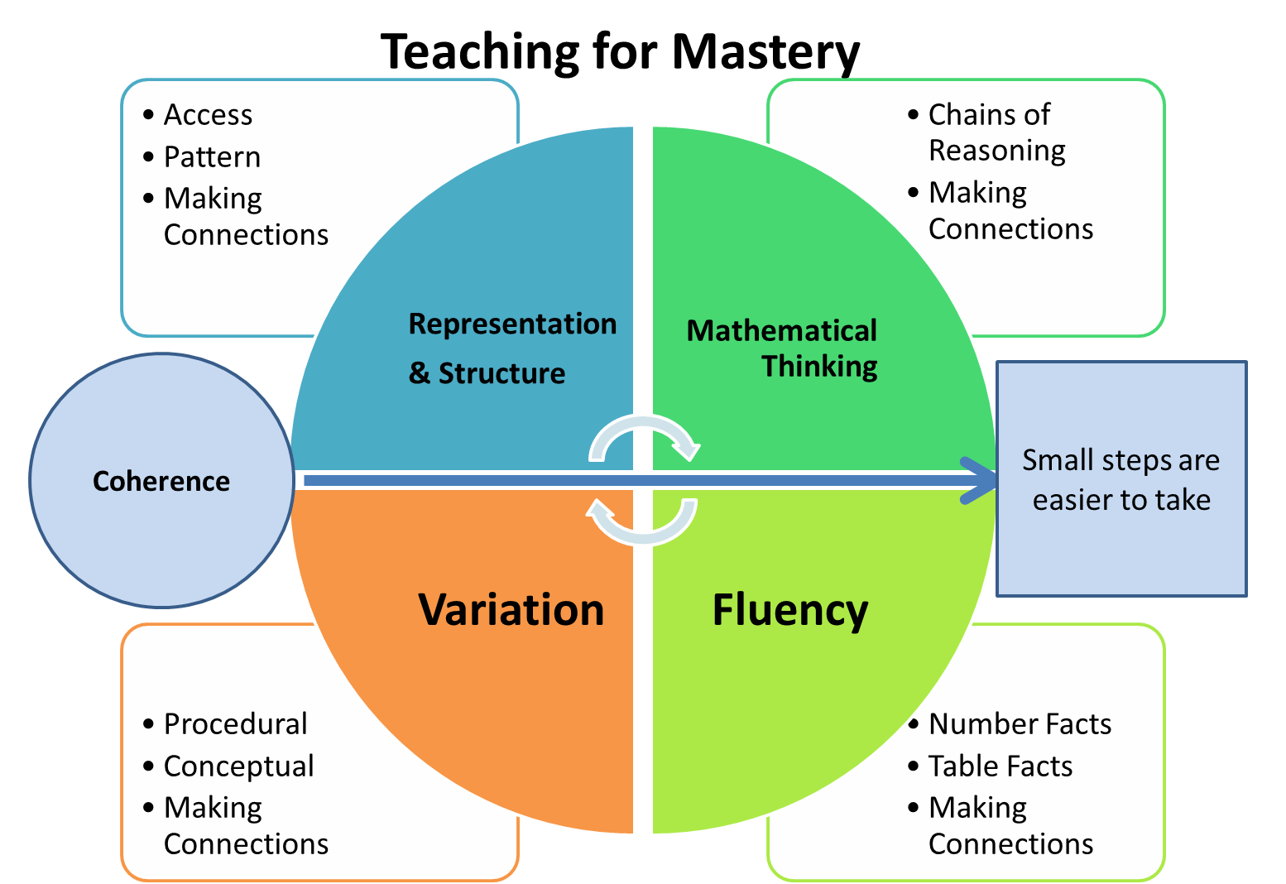
Five Big Ideas
Notes:
https://www.ncetm.org.uk/teaching-for-mastery/mastery-explained/five-big-ideas-in-teaching-for-mastery/

Slide 3
What do you understand by ‘fluency’?
What does it mean to be fluent…
in speaking a language?
in playing a musical instrument?
in working mathematically?
Notes:
Useful to start with an understanding of fluency that is more familiar – e.g. speaking a language.
Someone who is fluent in a spoken language:
uses words and phrases efficiently and ‘automatically’ without having to think hard and give explicit attention
has flexible ways of expressing themselves, knows lots of connections.
Consider the difference between early stages of learning to (play the guitar/ride a bike/drive a car… etc.) and developing fluency and automaticity in these skills.

Slide 4
Fluency in the National Curriculum
Aims
The national curriculum for mathematics aims to ensure that all pupils:
Become fluent in the fundamentals of mathematics, including through varied and frequent practice with increasingly complex problems over time, so that pupils develop conceptual understanding and the ability to recall and apply knowledge rapidly and accurately.
(Department for Education, 2014)

Slide 5
Big Idea: Fluency
Key Messages
Fluency demands more of students than memorisation of a single procedure or collection of facts. It encompasses a mixture of efficiency, accuracy and flexibility.
Quick and efficient recall of facts and procedures is important in order for students to keep track of sub-problems, think strategically and solve problems.
Fluency also demands the flexibility to move between different contexts and representations of mathematics, to recognise relationships and make connections, and to make appropriate choices from a whole toolkit of methods, strategies and approaches.
Notes:
Give TTs time to read. What do we understand by efficiency? Accuracy? Flexibility?

Slide 6
What do we mean by “efficiency, accuracy and flexibility”?
Efficiency – using an appropriate strategy or algorithm (with speed)
Accuracy – finding correct solutions
Flexibility – adapting strategy and transferring across contexts
(Adapted from Bay-William and Stokes-Levine, 2017)
Notes:
Task TTs with discussing this in pairs. Share suggestions from Bay-William & Stokes-Levine.
“By ‘fluency’ we mean the ability to calculate accurately (find correct solutions), efficiently (using an appropriate strategy or algorithm with speed) and flexibly (adapting strategy and transferring across contexts).”

Slide 7
“We consider someone to be fluent in a technique, procedure, idea, concept or facts at the point at which they no longer need to give it attention.”
McCourt, 2019, p.43
Notes:
From McCourt ‘Teaching for Mastery’

Slide 8
Calculate
1) 174 ÷ 3
2) 272 ÷ 8
3) 810 ÷ 10
4) 906 ÷ 6
In pairs, create a similar sequence of questions where students are required to select appropriate strategies.
Notes:
Inform TTs that this is a sequence of questions being posed to students to retrieve and practise the short division algorithm that they have been taught previously. Ask TT to answer the questions using this algorithm.
One method for building fluency is to insert questions into practice question sequences in which a different method is more appropriate.
Ask TT how this sequence might help build fluency i.e. specific selection of an appropriate strategy (e.g. Q2 can be done by repeated halving, Q3 does not require short division algorithm).
(Q4 can be written as a fraction and simplified in two steps – do students think about that? If not, why not? Do they see this representation often enough?)

Slide 9
Selecting an appropriate strategy
1) $\frac{2}{3}$ of 24
2) $\frac{7}{8}$ of 24
3) $\frac{6}{12}$ of 24
4) $\frac{7}{12}$ of 24
Notes:
Another example (Q3 is halving)

Slide 10
‘Best’ strategy?
What do we mean by ‘best’ strategy?
Different strategies might be ‘better’ (i.e. more appropriate/effective/efficient)
for different students
in different contexts
and at different times!
Can you say why, and give examples?

Slide 11
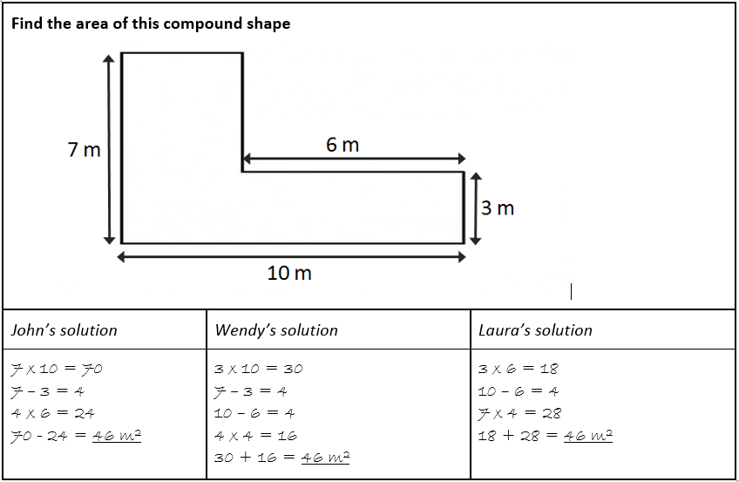
Comparing worked examples
© Making Every Maths Lesson Count, 2019
Whose strategy is better and why?

Slide 12
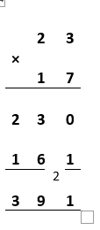
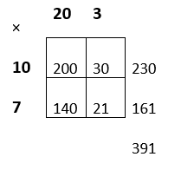
Comparing worked examples
Calculate 23 x 17
What is the same and what is different?

Slide 13
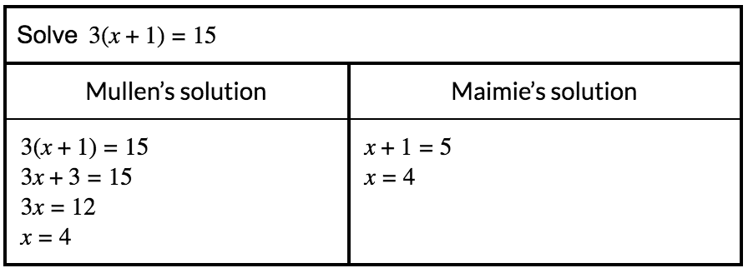
Comparing worked examples
Solve $3(x+1)=15$
Give an example of an equation where it would be better to use Mullen’s strategy.
What makes one strategy better than another?
© Making Every Maths Lesson Count, 2019

Slide 14
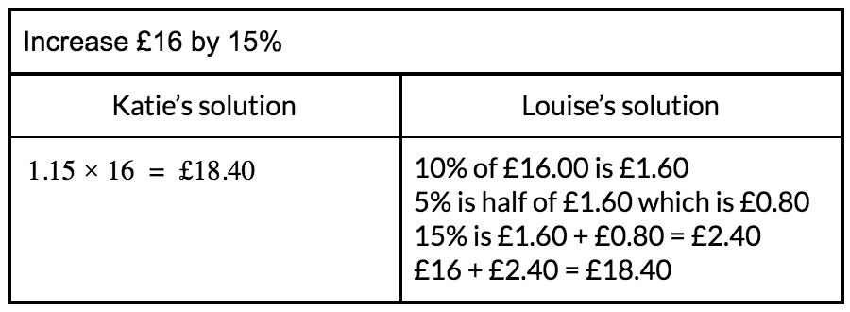
Comparing worked examples
Increase £16 by 15%
Whose strategy is better and why?
Can you think of a scenario when Louise’s strategy might be better?
© Making Every Maths Lesson Count, 2019

Slide 15
How?
Two strategies
Opportunities to select appropriate strategies
Comparing strategies using worked example

Slide 16
Big Idea: Fluency
Key Messages
Fluency demands more of students than memorisation of a single procedure or collection of facts. It encompasses a mixture of efficiency, accuracy and flexibility.
Quick and efficient recall of facts and procedures is important in order for students to keep track of sub-problems, think strategically and solve problems.
Fluency also demands the flexibility to move between different contexts and representations of mathematics, to recognise relationships and make connections, and to make appropriate choices from a whole toolkit of methods, strategies and approaches.
Notes:
How do the two strategies help students build fluency?

Slide 17
Connect with the NCETM and your local Maths Hub
Check out the NCETM at ncetm.org.uk for full access to all content and resources, plus a monthly mailing – the Secondary Round-up – sent straight to your inbox.
Find your local Maths Hub via ncetm.org.uk/maths-hubs/find-your-hub/. Click through to your local hub’s page to subscribe to their mailing list and follow them on Twitter.

Slide 18
Connect with the NCETM and your local Maths Hub

Slide 19
References
Department for Education (2014) Mathematics programmes of study: Key Stage 4 National Curriculum in England https://assets.publishing.service.gov.uk/government/uploads/system/uploads/attachment_data/file/331882/KS4_maths_PoS_FINAL_170714.pdf
Bay-William, J. M. & Stokes-Levine, A. (2017) ‘The Role of Concepts and Procedures in Developing Fluency’. In D. Spangler and J. J. Wanko (eds), Enhancing Professional Practice with Research Behind Principles to Actions NCTM: Reston, VA pp. 61–72.
McCourt, M. (2019) Teaching For Mastery, John Catt
McCrea, E. (2019) Making Every Maths Lesson Count, Crown House
NCETM Five Big Ideas www.ncetm.org.uk/teaching-for-mastery/mastery-explained/five-big-ideas-in-teaching-for-mastery/

