Slide 1
Secondary Teaching for Mastery
Initial Teacher Education units
Variation

Slide 2
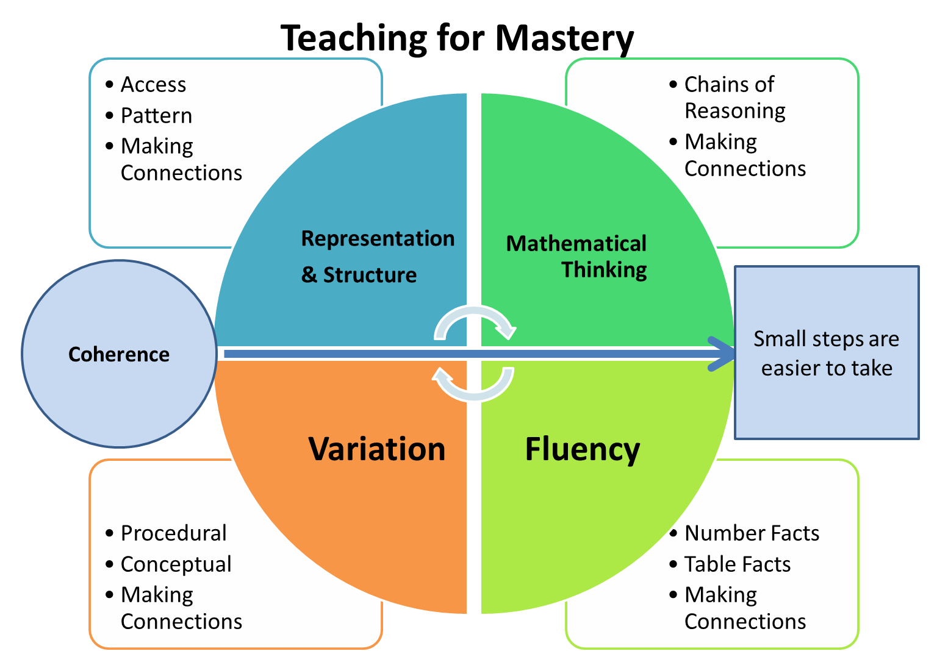
Five Big Ideas
Notes:
https://www.ncetm.org.uk/teaching-for-mastery/mastery-explained/five-big-ideas-in-teaching-for-mastery/

Slide 3
Variation
www.youtube.com/watch?v=IGQmdoK_ZfY
Notes:
Show the ‘monkey business’ enhanced video to provide rationale for variation.
If we do not focus, we miss things.

Slide 4
Variation
“Variation helps us to better focus student attention. Awareness, has a structure to it. By this we mean that the amount of sensory data that we are subject to cannot all be dealt with at once; some things have to be to the foreground of our awareness, others will not. We must try and help learners focus their awareness on critical features.”
Askew, 2011
Notes:
Mike Askew, Transforming Primary Mathematics, 2011, Chapter 6 “Variation Theory”

Slide 5
Variation
“What we attend to is what we learn.”
McCrea, 2017
Notes:
What we attend to is what we learn
Peps McCrea, Memorable Teaching, 2017 https://ift.education/learning-paper/

Slide 6
Big Idea: Variation
Key Messages
The central idea of teaching with variation is to highlight the essential features of a concept or idea through varying the non-essential features.
Variation is not the same as variety – careful attention needs to be paid to what aspects are being varied (and what is not being varied) and for what purpose.
When giving examples of a mathematical concept, it is useful to add variation to emphasise
  What it is (both standard and non-standard examples)
  What it is not.
When constructing a set of activities or questions it is important to consider what connects the examples; what mathematical structures are being highlighted? Students are encouraged to avoid mechanical practice and, instead, to practise the thinking process (intelligent practice).
Notes:
Give TT time to read.

Slide 7
How?
Two strategies
Procedural variation
Concept/non-concept
Notes:
Exploring one aspect of procedural variation (sometimes referred to as variation theory in itself or intelligent practice).
Concept/non-concept is sometimes (incorrectly) referred to as example/non-example.

Slide 8
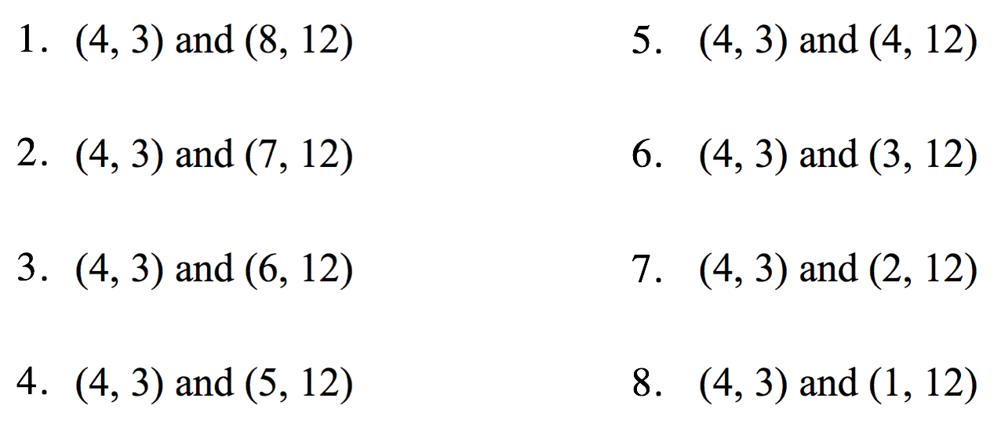
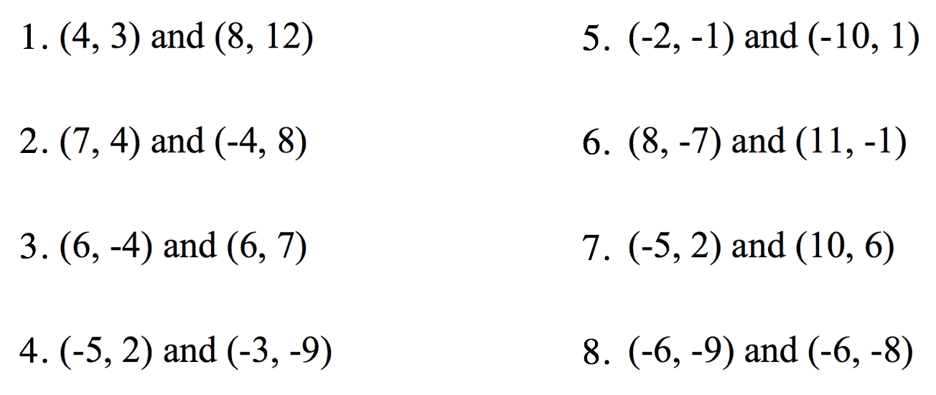
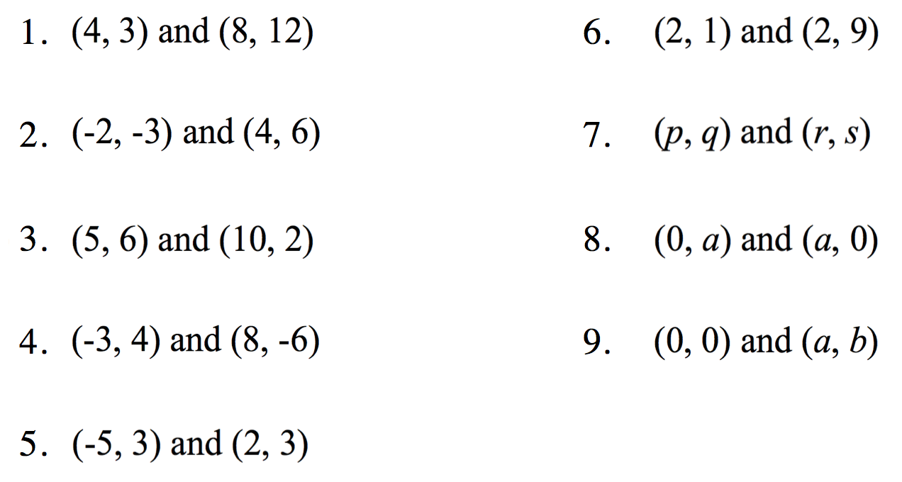
Procedural variation
Exercise C
Exercise A
Exercise B
Complete each of the exercises.
Which would be most effective with a class and which would be least effective?
Notes:
“In the first exercise, the variation of signs is controlled so that all possible pairs occur, but numbers and relative values vary, and there is little apparent system even in the variation of signs. A diagram would add little sense to the variety that is produced and it is not clear that the concept of gradient, as a slope property, would be the focus of attention. It is more likely, because the variation is in the signs, that subtracting and dividing directed numbers will be the focus.
In the second exercise, there is selective practice of various possibilities followed quickly by an invitation to write gradient as a formula, expressing a generality that the learner must already know in order to do the earlier questions. This is then followed by questions about special cases of the formula, so that we can see the author is intending generalization of gradient calculations to be the focus.
In the last exercise, variation is tightly controlled by only varying the x-coordinate of the second point. Some have found the third exercise too constrained for the development of technical fluency, even boring, while others have found that it is the most interesting of the three because it invites questions and further exploration, and includes a little shock that does not yield to an algorithmic approach. The focus is on varying gradient in a controlled way so that gradient changes from being a name for the answer to a calculation, to being a relationship, to being a property and also an arena for conjecture. By asking the highly mathematical question ‘what changes and what stays the same?’, and by examining the nature of the changes offered, we can be precise about what an exercise together with an established way of working (collection of social practices) affords the learner, and with what constraints. Each of the exercises above affords a different kind of generalization, and learners’ engagement with gradient as a concept will be influenced by what they can easily generalize from the exercise.”
Taken from Watson, Anne and Mason, John (2006). Seeing an exercise as a single mathematical object: using variation to structure sense-making. Mathematics thinking and learning, 8(2) pp. 91–111
http://oro.open.ac.uk/9764/1/06_MTL_Watson_&_Mason.pdf

Slide 9
Variation
“The central idea of teaching with variation is to highlight the essential features of the concepts through varying the non-essential features.”
Gu, Huang & Marton, 2004
Notes:
Gu, L., Huang, R., & Marton, F. (2004). Teaching with variation: A Chinese way of promoting effective Mathematics learning. In L. Fan, N. Y. Wong, J. Cai & S. Li (Eds.), How Chinese learn Mathematics: Perspectives from insiders. Singapore: World Scientific Publishing.

Slide 10
“All we need to know is that learners discern differences between and within objects through attending to variation. Teachers can therefore aim to constrain the number and nature of the differences they present to learners and thus increase the likelihood that attention will be focused on mathematically crucial variables.”
Watson and Mason, 2006
Notes:
Taken from Watson, A. and Mason, J. (2006). Seeing an exercise as a single mathematical object: using variation to structure sense-making. Mathematics thinking and learning, 8(2) pp. 91–111

Slide 11
Variation vs variety
Variety
‘Pick and mix’
Most practice exercises contain variety
Variation
Careful choice of what to vary
Careful choice of what the variation will draw attention to.
(Askew, 2011)
Strategically varying one thing at a time so that the underlying structure of the mathematics is exposed
Might sometimes appear ‘easy’
Notes:
Prompt students to attend to the variation by asking ‘What is the same and what is different?’

Slide 12
Imagine you are planning a lesson on expanding quadratics.
Discuss – what is it that you want students to attend to?
In pairs, design a sequence of questions using procedural variation which might support this
What will you vary?
What will you leave invariant?

Slide 13
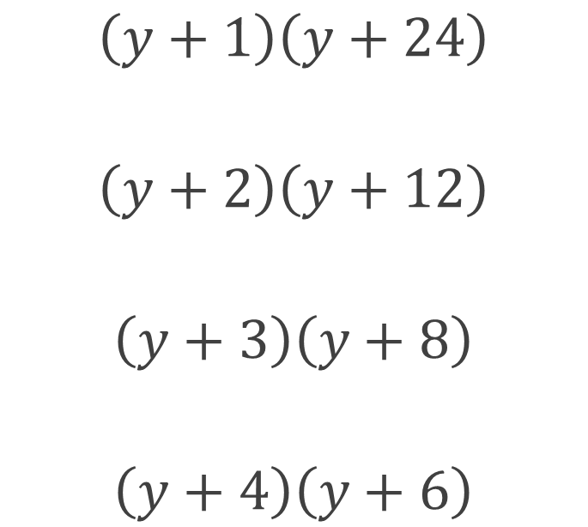
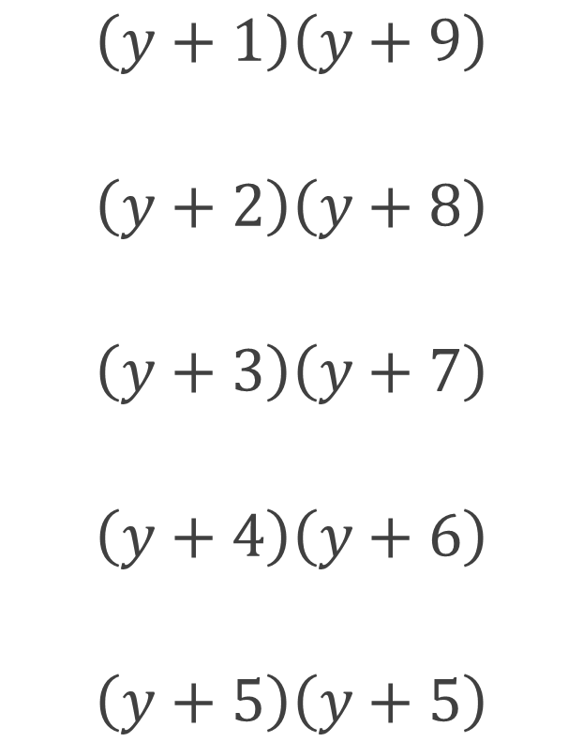
Complete and comment
$$\left(y+1\right)\left(y+9\right)$$
$$\left(y+2\right)\left(y+8\right)$$
$$\left(y+3\right)\left(y+7\right)$$
$$\left(y+4\right)\left(y+6\right)$$
$$\left(y+5\right)\left(y+5\right)$$
$$\left(y+1\right)\left(y+24\right)$$
$$\left(y+2\right)\left(y+12\right)$$
$$\left(y+3\right)\left(y+8\right)$$
$$\left(y+4\right)\left(y+6\right)$$
Notes:
Complete and comment. What do you see?
Taken from Naveen Rizvi http://conceptionofthegood.co.uk/?p=557

Slide 14
Variation is in the hands of the teacher
A well planned lesson and carefully designed set of questions are only likely to be effective if used well!
The way that the teacher sequences questions and tasks, responds to students’ ideas, makes connections, and draws attention to key relationships and structures is itself a key part of variation.

Slide 15
‘Variation is about the sequencing of the episodes, activities and exercises used… paying attention to what is kept the same and what changes, to connect the mathematics and draw attention to mathematical relationships and structure’.
NCETM
Notes:
https://www.ncetm.org.uk/teaching-for-mastery/mastery-explained/five-big-ideas-in-teaching-for-mastery/

Slide 16
Strategy 2. Concept/non-concept
A student asks you what a radius is.
What do you say/do?
Notes:
Get TT to discuss in pairs.

Slide 17
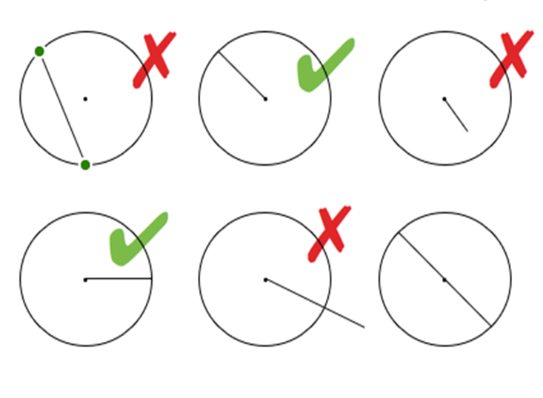
Concept/non-concept
McCrea, 2019
Notes:
Present each example stating either “This is not a radius.” or “This is a radius.”
The last example is a boundary case. A special case which is two radii with a special name – a diameter.
Taken from Making Every Maths Lesson Count by Emma McCrea.

Slide 18
“The variation theory of learning points to variation as being a necessary component in teaching in order for students to notice what is to be learned. One of the principles of variation theory is that seeing differences precedes seeing sameness: if you have never heard another language, you cannot possibly understand what Chinese is simply by listening to different people speaking Chinese. Nor can you understand what a linear equation is by looking only at linear equations.”
Kullberg, Kempe & Marton, 2017
Notes:
Kullberg, A., Runesson Kempe, U., and Marton, F. (2017) What Is Made Possible to Learn When Using the Variation Theory of Learning in Teaching Mathematics? International Journal on Mathematics Education 49 (2017): 559–569. Available at: https://link.springer.com/content/pdf/10.1007%2Fs11858-017-0858-4.pdf.

Slide 19
Concept/non-concept
Imagine you are planning a lesson on prime numbers.
Create a set of examples using concept/non-concept.
Notes:
Best done in pairs

Slide 20
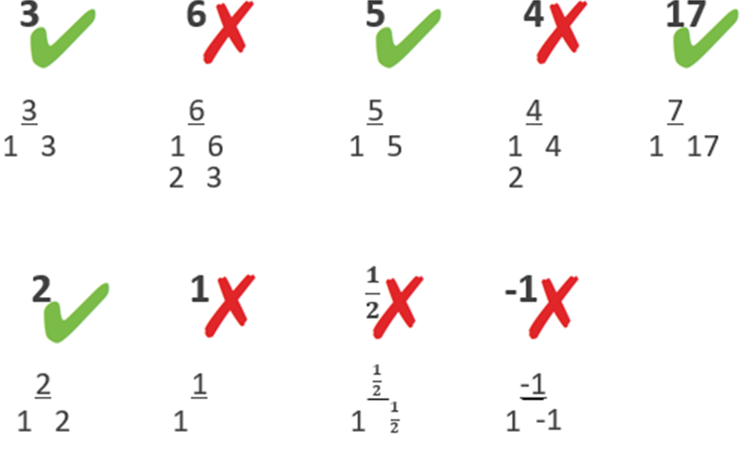
Concept/non-concept
McCrea, 2019
Notes:
Taken from Making Every Maths Lesson Count by Emma McCrea.

Slide 21
Concept/non-concept!
Exercise C
Exercise A
Exercise B
Notes:
We use concept/non-concept to help us understand what procedural variation is!

Slide 22
Big Idea: Variation
Key Messages
The central idea of teaching with variation is to highlight the essential features of a concept or idea through varying the non-essential features.
Variation is not the same as variety – careful attention needs to be paid to what aspects are being varied (and what is not being varied) and for what purpose.
When giving examples of a mathematical concept, it is useful to add variation to emphasise
  What it is (both standard and non-standard examples)
  What it is not.
When constructing a set of activities or questions it is important to consider what connects the examples; what mathematical structures are being highlighted? Students are encouraged to avoid mechanical practice and, instead, to practise the thinking process (intelligent practice).
Notes:
Give TT time to read.

Slide 23
“My choice of examples and exercises is the single most important part of my planning.”
Barton (2018, p.448)
Notes:
Craig Barton, How I wish I’d taught maths

Slide 24
Connect with the NCETM and your local Maths Hub
Check out the NCETM at ncetm.org.uk for full access to all content and resources, plus a monthly mailing – the Secondary Round-up – sent straight to your inbox.
Find your local Maths Hub via ncetm.org.uk/maths-hubs/find-your-hub/. Click through to your local hub’s page to subscribe to their mailing list and follow them on Twitter.

Slide 25

Connect with the NCETM and your local Maths Hub

Slide 26
References and more info…
Askew, M. (2011) Transforming Primary Mathematics, Routledge
Barton, C. (2018) How I Wish I’d Taught Maths, John Catt
Barton, C. https://variationtheory.com/
Friis, D. & McCrea, E. (forthcoming) Deliberate Maths: Expertly Designed Practice Sets
Gu, L., Huang, R., & Marton, F. (2004). ‘Teaching with variation: A Chinese way of promoting effective Mathematics learning’. In L. Fan, N. Y. Wong, J. Cai & S. Li (Eds.), How Chinese learn Mathematics: Perspectives from insiders. Singapore: World Scientific Publishing

Slide 27
References and more info…
Kullberg, A., Runesson Kempe, U., and Marton, F. (2017) What Is Made Possible to Learn When Using the Variation Theory of Learning in Teaching Mathematics? International Journal on Mathematics Education 49 (2017): 559–569. Available at: https://link.springer.com/content/pdf/10.1007%2Fs11858-017-0858-4.pdf
McCrea, E. (2019) Making Every Maths Lesson Count, Crown House
McCrea, P. (2017) Memorable Teaching https://ift.education/learning-paper
NCETM Five Big Ideas www.ncetm.org.uk/teaching-for-mastery/mastery-explained/five-big-ideas-in-teaching-for-mastery/
Rizvi, N. (2018) Resourcing: Applying Variation Theory http://conceptionofthegood.co.uk/?p=557
Watson, A. & Mason, J. (2006) Seeing an exercise as a single mathematical object: using variation to structure sense-making. Mathematics thinking and learning, 8(2) pp. 91–111

