Slide 1
Double number line: understanding a multiplicative relationship
Notes:
Overview
This is a suggested presentation/workshop to support a short PD session focusing on an element of mathematics that students find challenging.
This presentation accompanies Video 3 (https://vimeo.com/425039877) from the NCETM’s Mathematical Prompts for Deeper Thinking pages and focuses on students working to interpret a double number line.
This workshop might be a part of an input at a department meeting, at a PD meeting across a Maths Hub or for a group of interested teachers to work on together.
Timing
A minimum suggested time for this workshop is 40 minutes, including the video (which is 7 minutes and 57 seconds long)
Adaptation
You might choose to adapt these slides to fit the context in which you are leading the PD.
There are three key components to this workshop which we suggest should be included
Participants should have an opportunity to work on the task and predict what students will do (Slide 2)
Participants should watch the video and have a time for focused reflection on their predictions and other observations (Slides 3, 4 and 5)
Participants consider next steps in addressing issues raised in the workshop. To support this we suggest tasks from the NCETM’s Secondary Mastery PD Materials (Slide 8)
There are optional slides (Slides 6 and 7) that offer prompts to focus and catalyse discussion and conversation around some of the points that are likely to have been raised by the video.
Slide 6 includes a task from the ICCAMS project which considers different multipliers that can be used when working in multiplicative situations
Slide 7 features text from the Secondary PD Materials section exploring different representations and considers the link between the double number line and the ratio table. You might like to have copies of this document available for participants to read.
Unless otherwise stated, all of the tasks offered in this video are taken from Core Concept 3.1 Understanding multiplicative relationships from the Secondary PD Materials
https://www.ncetm.org.uk/media/mqfp3xb3/ncetm_ks3_cc_3_1.pdf

Slide 2
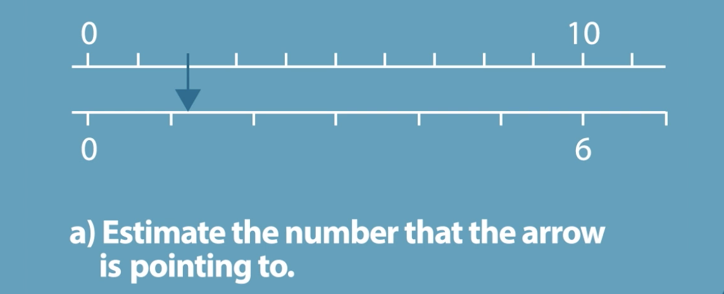
Work on this task for yourself and convince yourself of the solution.
Can you find more than one way of calculating an exact answer?
Once you’ve convinced yourself, think about some KS3 students – what do you think they’d do with this task?
This task is from page 19 of Core Concept 3.1 Understanding multiplicative relationships
Notes:
NOTE TO SESSION FACILITATOR
This slide is animated – the second paragraph will be revealed on a click.
Make sure that sufficient time is given for participants to explore the task themselves.
You might like to wait until all participants have agreed on a solution before clicking to reveal the text box.
It is important that time is given to discussing and predicting possible misconceptions so that participants are able to watch the video with that as a focus.

Slide 3
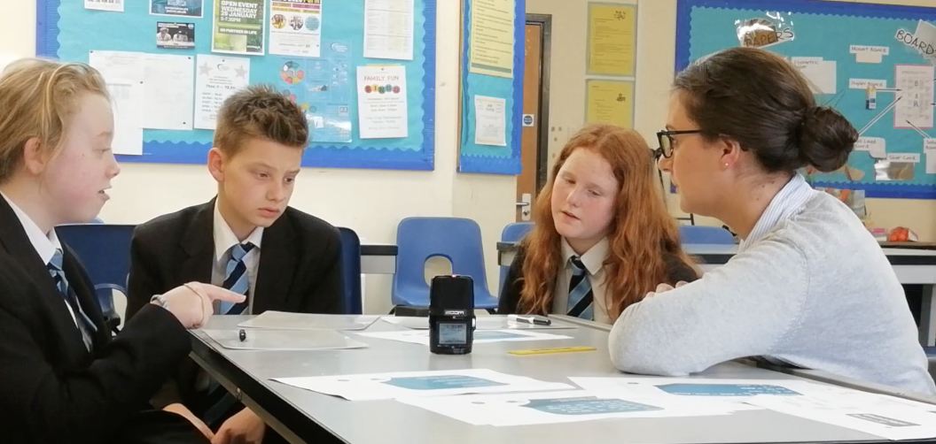
Watch the video in which three Year 8 students discuss this prompt with their teacher.
While watching, keep in mind the predictions that you made.
Do these students show the same thinking that you expected?
What strikes you about the responses and reasoning from these students?
Notes:
The slide text Watch the video is hyperlinked to the video

Slide 4
The students make sensible estimates, but find it hard identify a calculation to show that their estimate is correct.
Although they are able to halve the 10 and 6, to identify that 5 and 3 align, they don’t consider halving again, or working multiplicatively along the lines, preferring instead to count up steps of their estimate, 0.6.
Do you recognise this tendency to not think multiplicatively in your own students? Was an additive approach one of the answers that you’d predicted might be given?
When you worked on the prompt, did you work multiplicatively along the lines, perhaps noticing that 10 ÷ 5 = 2 and so calculating 6 ÷ 5 to find the missing value?
Notes:
NOTE TO SESSION FACILITATOR
The students in the video had not used a Double number line before, and it is clear from the video that they found it challenging.
The key focus here is on the double number line as a representation to support multiplicative reasoning.
Towards the end of the video (around 6:50), one of the students notes that ‘0.6 fits into six ten times’. You might like to explore with participants what they might do next if they were the teacher in that situation.
Some participants may not have worked along the lines but considered the relationship between the lines – an opportunity to explore this is given in the next slide.
You might like to have tried using a Double number line with some students so that you can share your experience with the participants at this point.

Slide 5
An alternative approach might be to consider the multiplier between the two lines of the double number line, in this case the multiplier is 0.6.
Every value on the lower line is 0.6 times the value above it.
When you worked on the prompt, did you work multiplicatively between the lines?
Notes:
NOTE TO SESSION FACILITATOR
The key focus here is on the double number line as a representation to support multiplicative reasoning.
An important use of the Double number line representation is that it allows for two different multipliers to be considered in a given situation. The previous slide considered the multiplier along the lines, but there is also a multiplier between the lines.
The awareness of this multiplier between the lines is potentially very powerful because it succinctly describes the relationship between any two corresponding numbers (on the top and bottom lines) as opposed to, when working along the line, each situation needs to be considered individually.
You might like to discuss whether the numbers chosen in this example support students in working along or between the lines? Exploring the impact of different numbers on the strategies that students use might be an action for your participants to take forward into their classrooms.
The next (optional) slide considers research suggesting that students are likely to choose the multiplier represented by working along the lines, even when the multiplier between them offers a simpler calculation.

Slide 6
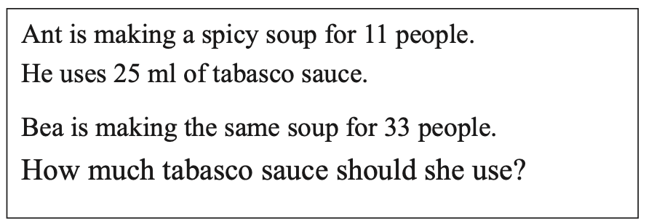
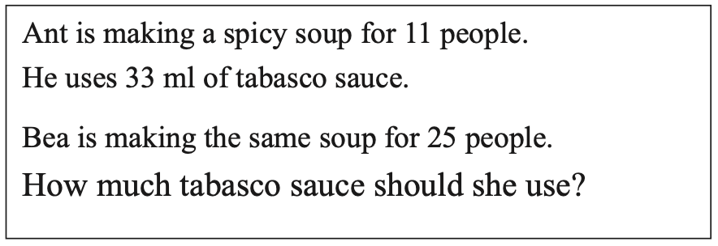
Vergnaud (1983) labelled the two different multipliers that exist in a multiplicative situation as the scalar multiplier and the functional multiplier.
On a Double number line, the scalar multiplier usually works along the lines, while the functional multiplier works between the lines.
Research suggests that students are more likely to identify a scalar multiplier, even if it presents a more challenging calculation.
Consider this item from the ICCAMS project – which situation is more challenging?
In the first situation the scalar multiplier (there are three times as many people) is straightforward, while in the second it’s the functional multiplier (there are 3 ml of tabasco sauce used per person) that offers the easier calculation.
Representing these two recipes using a double number gives
0
11
33
0
11
25
people
people
sauce
sauce
0
25
75
0
33
75
Do you think that the Double number line offers a representation that might help students to see both multipliers and make an informed choice about which to use?
Link to mini ratio test
Notes:
NOTE TO SESSION FACILITATOR
This slide is animated – the second paragraph and the Double number lines will be revealed on a click.
This is an optional slide that uses a task from the ICCAMS project (Increasing Competence and Confidence in Algebra and Multiplicative Structures).
Further details of the task are linked to on the slide.
Spicy Soup is one task from a ’mini ratio test’. The ICCAMS team “distributed items from the Mini Ratio Test, together with other such items, randomly to students within 29 classes, mostly Year 8, across a total of 14 schools. Each item was given to over 70 students.”
The first version of this task, where the scalar multiple is 3, was answered correctly by 91% of the students.
The second version, where the functional multiplier is 3, was answered correctly by 51% of the students.
The mini-ratio test is linked to in the slide.
You might like to discuss with participants whether they feel that the double number line gives an opportunity to address this.
Further analysis from ICCAMS about the use of the double number line, including more about the Spicy Soup task, can be found in this article http://iccams-maths.org/wp-content/uploads/2016/01/BCME-2014-The-use-of-alternative-double-number-lines-as-models-of-ratio-tasks-and-as-models-for-ratio-relations-and-scaling.pdf
[Vergnaud, G. (1983) Multiplicative structures. In: R. Lesh and M. Landau (eds.), Acquisition of Mathematics Concepts and Processes. London: Academic Press, 128-175]

Slide 7
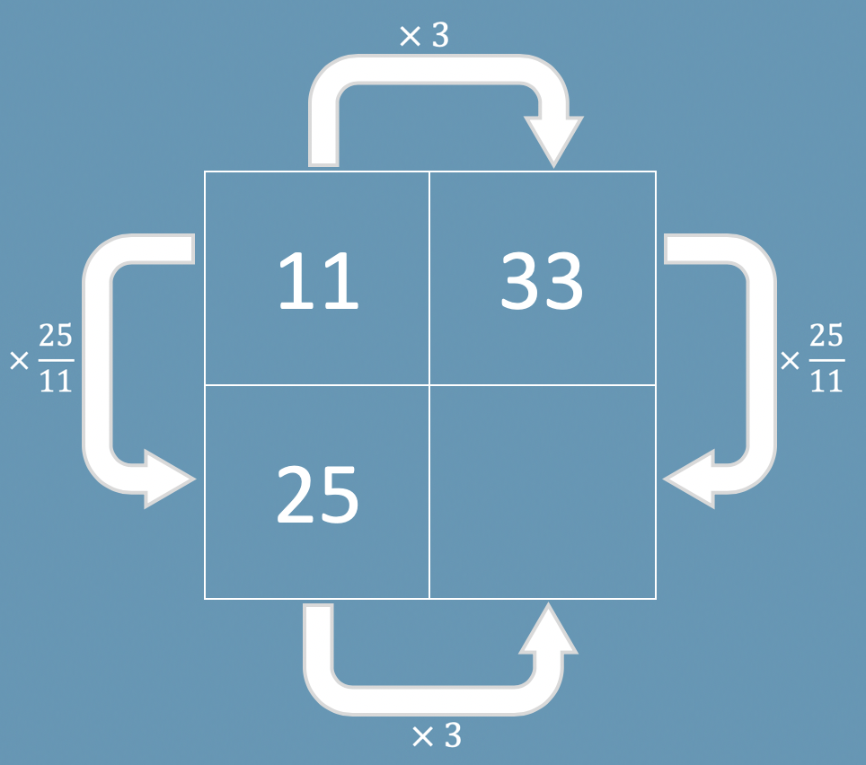
The Secondary PD Materials includes a section about different mathematical representations, and offers the following
Double number lines are a powerful way of representing multiplicative relationships and ratios, and can help students to visualise equivalent forms of the same ratio. Key to students’ success at secondary school is an ability to reason with proportions. Double number lines support such reasoning by offering a strong visual image of how proportional relationships work. When a Double number line is used to compare two different measures that are proportional, it provides a model to think with and enable conversion from one measure to the other.
The Secondary PD Materials link the Double number line representation to the ratio table representation (both exemplified below for the Spicy Soup task), stating:
While the ratio table is likely to be more efficient than the double number line, some of the structure may get lost in the compression. Furthermore, the Double number line has the advantage of offering a sense of scale
0
11
33
people
sauce
0
25
75
Link to guidance
Notes:
NOTE TO SESSION FACILITATOR
This slide is animated – the second paragraph and diagrams will be revealed on a click.
This is an optional slide that uses information from the NCETM Secondary PD Materials about the use of different representations. There is a link to this within the slide.
Participants may already be familiar with the ratio table representation (it’s known by other names, and was perhaps popularised in the Median task, Boxes, by Don Steward.
https://donsteward.blogspot.com/2019/02/boxes-resources.html)
It might be useful to discuss the ‘efficiency’ of the ratio table and compare this with the more structural representation of the Double number line.
Does each representation have its place? How would you balance the two representations?

Slide 8
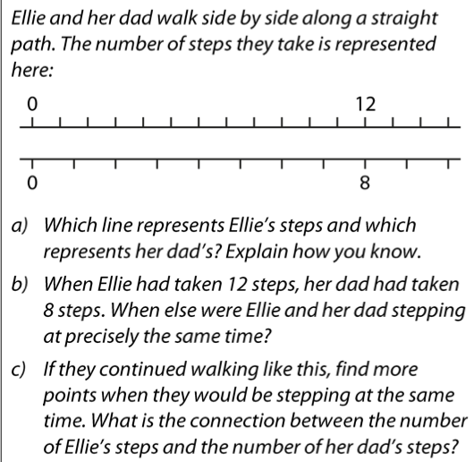
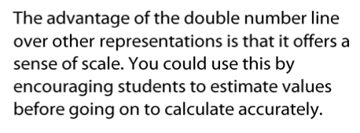
Evidence suggests that the use of pictorial representations can support students in understanding mathematical concepts.
The Secondary PD Materials suggest representations that might be used to support understanding of multiplicative relationships including Ratio tables, Line graphs and Double number lines.
The first example used to explore Double number lines is shown here.
How do you think your students would tackle this question?
Work through some of the examples 1 to 11 in the Secondary PD Materials (3.1 Understanding Multiplicative Relationships, pages 16 – 22)
Consider the benefits and challenges of the use of Double number lines as a representation for multiplicative situations.
Do you think that this representation might support students in moving from additive to multiplicative thinking?
This task is from page 16 of Core Concept 3.1 Understanding multiplicative relationships
Notes:
NOTE TO SESSION FACILITATOR
Evidence of the effectiveness of representations is offered in, for example, the EEF KS2 to KS3 Guidance document (which can be found here https://educationendowmentfoundation.org.uk/tools/guidance-reports/maths-ks-2-3/).
Offering a printed version of the relevant pages of the PD materials is recommended as it allows participants to use jottings to make sense of the Double number line (it may be worth discussing the use of jottings with the group, and whether they’d replicate this with students).
It should be noted that the use of a representation such as a Double number line is not a quick fix solution to a problem – rather it is likely that students will need time to explore and interact with any representation so that it can be connected with the mathematics being taught.
You might also like to watch Video 1 in this collection, in which students work to make sense of multiplicative situation in which a spring is being stretched.

