Slide 1
3e = 7: Understanding an Expression as an Object
Notes:
Overview
This is a suggested presentation/workshop to support a short professional development session focusing on an element of mathematics that students find challenging.
This presentation accompanies Video 2 (https://vimeo.com/419806955) from the NCETM’s Mathematical Prompts for Deeper Thinking page, and focuses on students working on two tasks
Given that 3e = 7, then 6e =___
Given that 5(3w – 7) = 30, then 3w – 7 = ___
This workshop might be a part of an input at a department meeting, at a professional development meeting across a Maths Hub, or for a group of interested teachers to work on together.
Timing
A minimum suggested time for this workshop is 30 minutes, including the video (which is 7 minutes and 13 seconds long)
Adaptation
You might choose to adapt these slides to fit the context in which you are leading the professional development.
There are three key components to this workshop which we suggest should be included:
Participants should have an opportunity to work on the task and predict what students will do (Slide 2)
Participants should watch the video and have a time for focused reflection on their predictions and other observations (Slides 3 and 4)
Participants consider next steps in addressing issues raised in the workshop. To support this we suggest tasks from the NCETM’s Secondary Mastery PD Materials. (Slides 7 and 8)
There are optional slides (5 and 6) that offer quotes from articles (a 1991 article from Anna Sfard, and a second article from 1992 by Eddie Gray and David Tall). These quotes are chosen to focus and catalyse discussion and conversation around some of the points that are likely to have been raised by the videos.
Unless otherwise stated, all of the tasks offered in this video are taken from Core Concept 2.2: Solving linear equations from the Secondary PD Materials
https://www.ncetm.org.uk/media/wbylane0/ncetm_ks3_cc_2_2.pdf

Slide 2
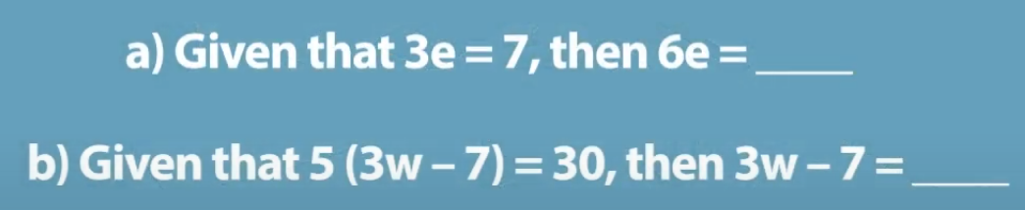
Work on these two tasks for yourself
Think about some KS3 students you have taught. What do you think they would do with the task?
What answers do you predict they would offer?
What reasoning do you think they would give to support their answers?
This task is from page 19 of Core Concept 2.2 solving linear equations
Notes:
NOTE TO SESSION FACILITATOR
Make sure that sufficient time is given for participants to explore the task themselves.
It is important that time is given to discussing and predicting possible misconceptions so that participants are able to watch the video with this as a focus.

Slide 3
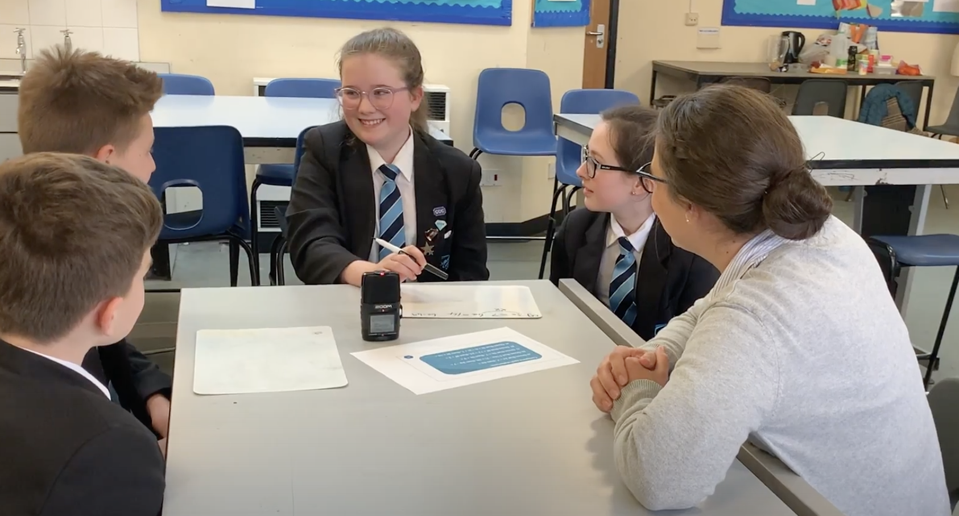
Watch the video in which four Year 8 students work on the tasks with their teacher
While watching, keep in mind the predictions that you made
Do these students show the same thinking that you expected?
What strikes you about the responses and reasoning from these students?
Notes:
The slide text Watch the video is hyperlinked to the video

Slide 4
The students in the video make a few different mistakes when working on the tasks.
To what extent do you think that these errors are because they misunderstand the algebraic notation? Are there other possible causes?
The student at the front left of the group, H, seems to be preoccupied with evaluating the expressions. He suggests that the solution to task (a) might be 2.5, and attempts to evaluate the brackets first in task (b)
Rather than looking at 3e or 3w – 7 as processes to be evaluated, Jasmine, the student nearest the teacher, identifies that these expressions can be treated as a single object and the expression as a whole can be manipulated accordingly.
Do you recognise this description of the video?
Do you agree with the description?
Notes:
NOTE TO SESSION FACILITATOR
This slide is animated – the third and fourth paragraphs will be revealed on a click.
The key focus here is the way that the same notation can suggest either a process (3e can represent the process ‘multiply a number, e, by 3’) and an object (3e can represent the result of the process of multiplying e by 3) and the challenges that this duality might pose to students.
[The example in task (a) occurs around 1:12, and the example in task (b) around 6:04.]
You might like to share an example where students in your class have shown confusion around this.
You might also like to ask participants to think of topics or units in their scheme of work where this is an important distinction (fractions are a common example, ¾ can be considered both as a process of dividing 3 by 4, and as the result of dividing 3 by 4)
You might like to have tried the tasks in the video yourself with some students so that you can share your experience with the participants.
The focus offered here is on the challenges posed by the process/object nature of mathematical notation, but you may like to categorise the mistakes made in a different way, perhaps focusing on the 3w – 7 = -4w error.
When considering the second expression, H incorrectly evaluates 3w – 7 as -4w. By seeing expressions like 3w – 7 as processes, students sometimes want to operate on them in some way to reduce them to an 'answer’ (-4w in this case).
Küchemann (1978) gathered student responses to a range of situations involving algebraic notation and categorised the ways in which the letter symbol might be understood. The type of error shown by H in this video was one of those identified, and the phrase ‘lack of closure’ was used (from Collis, 1975) to describe this.
You might like to discuss with participants whether they recognise ‘lack of closure’ as a challenge in their classrooms and consider strategies to support students in accepting a lack of closure. You might also like to consider whether this is another example of the process/object duality (i.e. H cannot accept 3w – 7 as an object in itself, so attempts to evaluate it in order to bring ‘closure’).
(The full article by Küchemann is available at https://www.researchgate.net/publication/281367139_Children's_understanding_of_numerical_variables)

Slide 5
Seeing a mathematical entity as an object means being capable of referring to it as if it was a real thing – a static structure, existing somewhere in space and time. It also means being able to recognize the idea "at a glance" and to manipulate it as a whole, without going into details… In contrast, interpreting a notion as a process implies regarding it as a potential rather than actual entity, which comes into existence upon request in a sequence of actions.
Sfard (1991)
Link to article
Notes:
NOTE TO SESSION FACILITATOR
This is an optional slide showing a quote to be used as a discussion prompt
The quote is taken from
On the Dual Nature of Mathematical Conceptions: Reflections on Processes and Objects as Different Sides of the Same Coin
Anna Sfard.

Slide 6
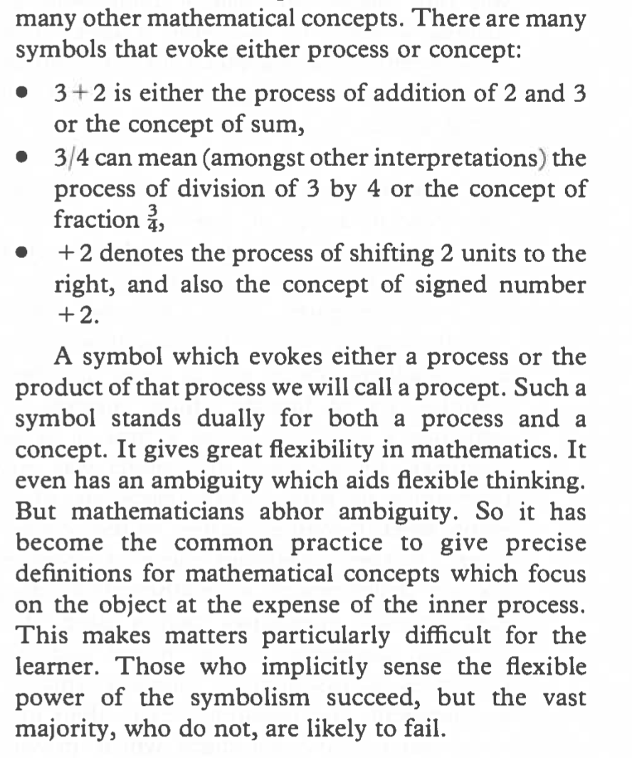
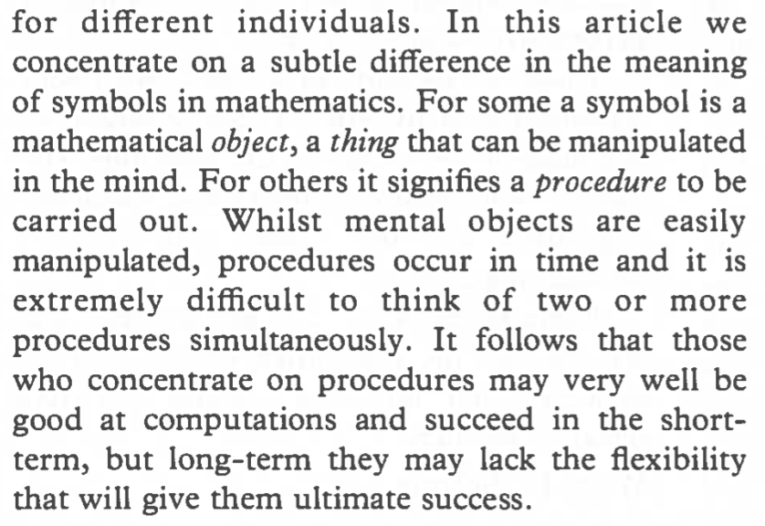
Here we will…
Extracts from Gray and Tall (1992)
Link to article
Notes:
NOTE TO SESSION FACILITATOR
This is an optional slide showing an extract to be used as a discussion prompt
This slide is animated so that, on a click, the sentence in which the term ‘procept’ is introduced is emphasised.
The extract is taken from Success and Failure in Mathematics: The Flexible Meaning of Symbols as Process and Concept by Eddie Gray and David Tall.

Slide 7
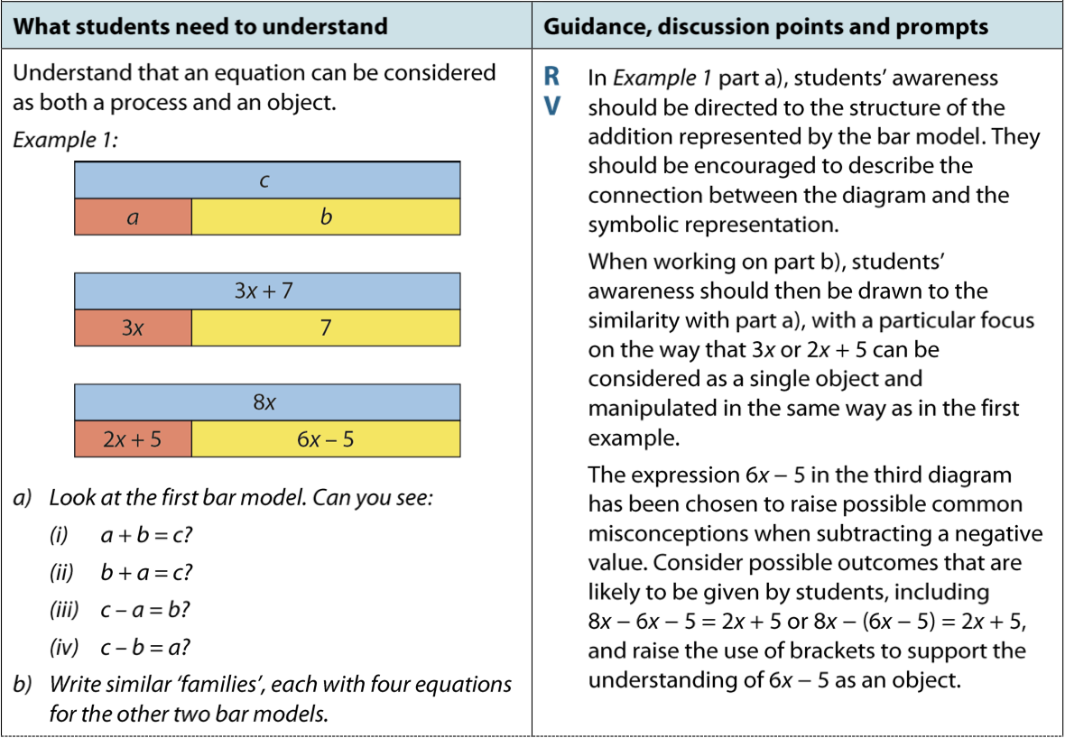
The NCETM’s Secondary Mastery PD Materials offer this task as a representation to support students in seeing an expression as an object.
Imagine using this task in your classroom.
How successful do you think this task might be at supporting students to see a process as an object? What actions might the teacher take to maximise this?
This task is from page 18 of Core Concept 2.2 solving linear equations
Notes:
NOTE TO SESSION FACILITATOR
Evidence such as the EEF KS2 to KS3 Guidance document suggests that the use of a representation ‘can help pupils engage with mathematical ideas’.
This task is taken from Page 18 of the NCETM Secondary Mastery PD Materials section 2.2 – Solving Linear Equations: https://www.ncetm.org.uk/media/wbylane0/ncetm_ks3_cc_2_2.pdf

Slide 8
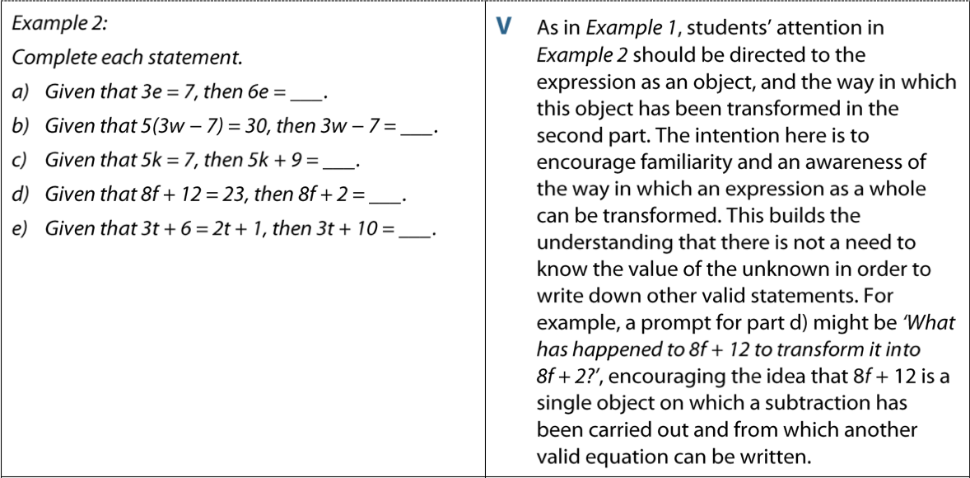
The task from the video is also from the NCETM’s Secondary Mastery PD Materials.
The full task as it appears in the materials is:
Imagine using this task in your classroom.
How successful do you think this task might be at supporting students to handle expressions flexibly and fluently? What actions might the teacher take to maximise this?
This task is from page 19 of Core Concept 2.2 solving linear equations
Notes:
NOTE TO SESSION FACILITATOR
This task is taken from Page 19 of the NCETM Secondary Mastery PD Materials section 2.2 – Solving Linear Equations: https://www.ncetm.org.uk/media/wbylane0/ncetm_ks3_cc_2_2.pdf

