Slide 1
Stretching a Spring: Understanding Multiplication as Scaling
Notes:
Overview
This is a suggested presentation/workshop to support a short professional development session focusing on an element of mathematics that students find challenging.
This presentation accompanies Video 1 (https://vimeo.com/410568143) from the NCETM’s Mathematical Prompts for Deeper Thinking page and focuses on students working on a task in which they consider stretching a spring.
This workshop might be a part of an input at a department meeting, at a professional development meeting across a Maths Hub or for a group of interested teachers to work on together.
Timing
A minimum suggested time for this workshop is 30 minutes, including the video (which is 5 minutes and 25 seconds long)
Adaptation
You might choose to adapt these slides to fit the context in which you are leading the professional development.
There are three key components to this workshop which we suggest should be included:
Participants should have an opportunity to work on the task and predict what students will do (Slide 2)
Participants should watch the video and have a time for focused reflection on their predictions and other observations (Slides 3 and 4)
Participants consider next steps in addressing issues raised in the workshop. To support this we suggest tasks from the NCETM’s Secondary Mastery PD Materials (Slide 7).
There are optional slides (Slides 5 and 6) that offer prompts to focus and catalyse discussion and conversation around some of the points that are likely to have been raised by the video.
Slide 5 includes an extract from a 2010 article by Jeremy Hodgen, Rob Coe, Margaret Brown and Dietmar Küchemann in which two researchers are discussing a problem with students.
Slide 6 includes a task from the NCETM Secondary PD Materials to work on and consider the way in which students might work additively or multiplicatively in a different context.
Unless otherwise stated, all of the tasks offered in this video are taken from Core Concept 3.1: Understanding multiplicative relationships from the Secondary PD Materials.
https://www.ncetm.org.uk/media/mqfp3xb3/ncetm_ks3_cc_3_1.pdf

Slide 2
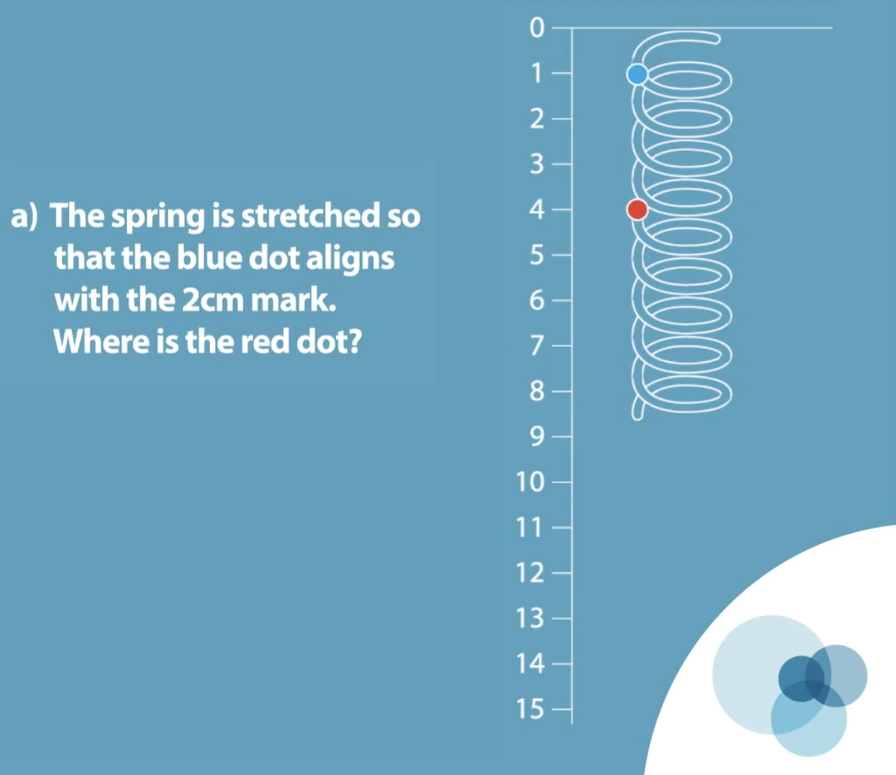
Work on this task for yourself and convince yourself of the solution.
Once you’ve convinced yourself, think about some KS3 students – what do you think they would do with this task?
What answers do you predict they would offer? What reasoning would they give?
This task is from page 9 of Core Concept 3.1 Understanding multiplicative relationships
Notes:
NOTE TO SESSION FACILITATOR
This slide is animated – the second paragraph will be revealed on a click.
Make sure that sufficient time is given for participants to explore the task themselves.
You might like to wait until all participants have agreed on a solution before clicking to reveal the text box.
It is important that time is given to discussing and predicting possible misconceptions so that participants are able to watch the video with that as a focus.

Slide 3
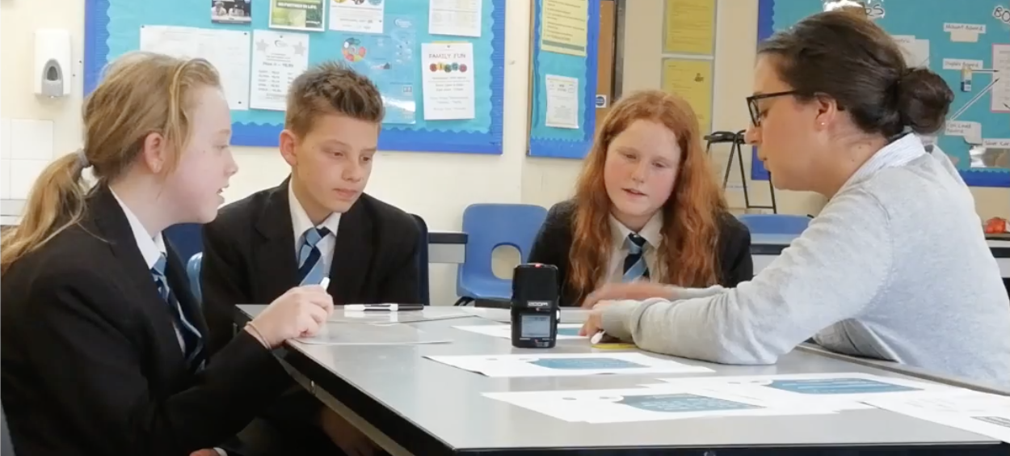
Watch the video in which three Year 8 students discuss this prompt with their teacher.
While watching, keep in mind the predictions that you made.
Do these students show the same thinking that you expected?
What strikes you about the responses and reasoning from these students?
Notes:
The slide text Watch the video is hyperlinked to the video

Slide 4
The students in the video spend a lot of time considering the situation additively, focusing both on the increase (“it’s gone up to by one… so the red dot goes up to five”) and on the constant difference.
They only consider a multiplicative approach when the teacher suggests that doubling may be a possible approach but even then, the students are apparently unconvinced.
Do you recognise this reluctance to think multiplicatively? Was an additive approach one of the answers that you predicted might be given?
Notes:
NOTE TO SESSION FACILITATOR
The key focus here is the distinction between additive and multiplicative relationships.
You might like to share an example where students in your class have worked with an incorrect additive approach, or invite participants to share their stories.
You might also like to ask participants to think of topics or units in their scheme of work where this is an important distinction.
The next [optional] slide shows a task and gives an extract from a discussion between researchers and students, offering another example of incorrect additive strategies if you’d like to use it.
You might like to have tried the Spring task yourself with some students so that you can share your experience with the participants.

Slide 5
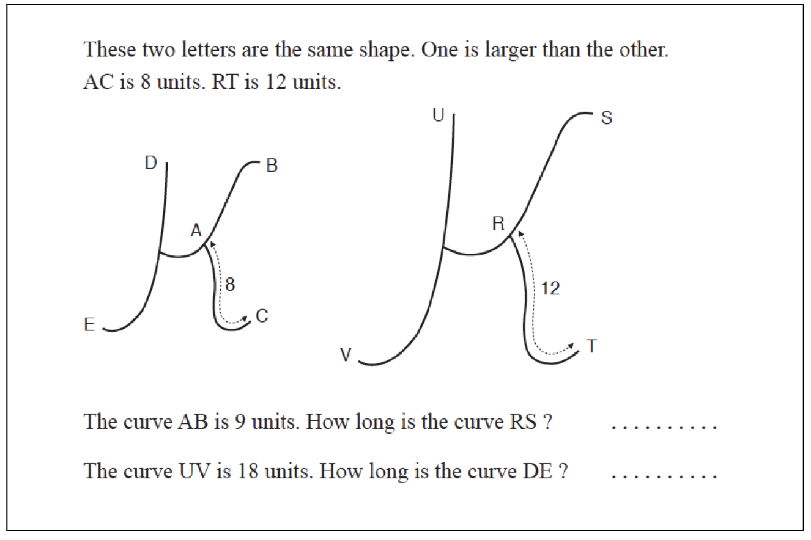
Work on this task and then read the extract of an interview between two researchers and four students
Dietmar and Margaret with Nasreen, Ahmed, Maniyan and Susan (middle set) 28/11/08 Ahmed quickly launches in with ‘13 units... 4 more there... cos that’s 9, that will be 4 more the same...’. Others agree... They all went for an addition strategy, either 9+4 or 12+, to get 13. Dietmar then suggests: ‘Say instead of this being 12 we made it 16... and this bit’s still 9...’. Nasreen sticks to the addition strategy: ‘You add 8 now’. Ahmed agrees. Margaret suggests that instead of adding 8 you could double both numbers. Three of them say no, you have to add 8.
Do you recognise this reluctance to think multiplicatively? Is this the type of response that is familiar to you with the students in your classes?
Link to article
Notes:
NOTE TO SESSION FACILITATOR
This is an optional slide that offers another example of an incorrect additive strategy should you choose to explore it.
The situation described is taken from Brown, M., Küchemann, D. E., & Hodgen, J. (2010). The struggle to achieve multiplicative reasoning 11-14. In M. Joubert & P. Andrews (E.ds.), Proceedings of the Seventh British Congress of Mathematics Education (BCME7) (Vol. 30, pp. 49-56)

Slide 6
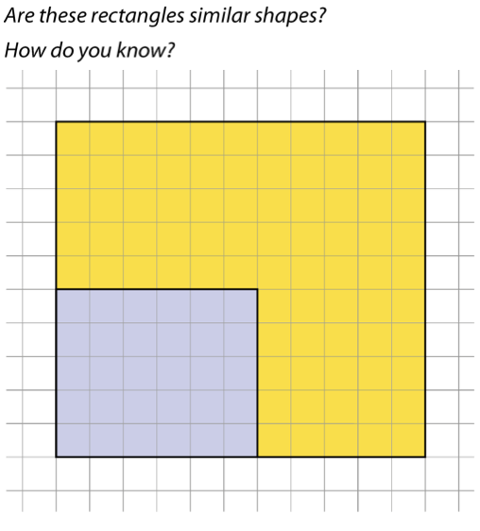
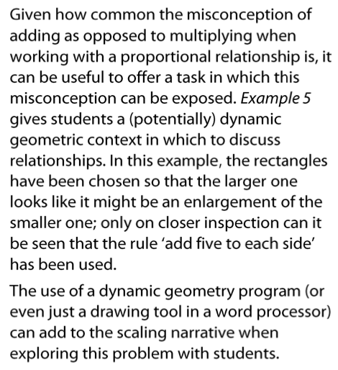
The Secondary PD Materials feature tasks and prompts to expose possible misconceptions
Predict what your students might do with this task.
Use the task with a class or group of students and listen to their responses. Does your experience match your predictions
This task is from page 12 of Core Concept 3.1 Understanding multiplicative relationships
Notes:
NOTE TO SESSION FACILITATOR
This is an optional slide.
You might like to have tried this task yourself with some students so that you can share your experience with the participants, perhaps bringing along some examples of students’ work.
The intention of this task is described in the text on the right of the screen. The text in the PD Materials also suggests the use of a line drawn through the diagonal of the smaller rectangle to show that the rectangles are not similar. This is animated on the slide in two parts. The first click will draw the diagonal in the smaller rectangle, the second click will extend the line out to the edge of the yellow rectangle.
(After one click, you might like to ask participants to predict where the line will meet the perimeter of the yellow rectangle.)

Slide 7
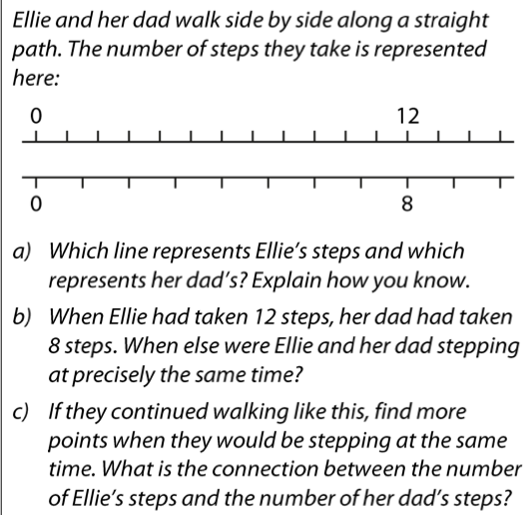
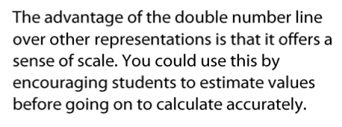
Evidence suggests that the use of pictorial representations can support students in understanding mathematical concepts.
The Secondary PD Materials suggest representations that might be used to support understanding of multiplicative relationships including ratio tables, line graphs and double number lines.
The first example used to explore double number lines is shown here.
How do you think your students would tackle this question?
Work through the examples 1 to 11 in the Secondary PD Materials (3.1 Understanding Multiplicative Relationships, pages 16 – 22)
Consider the benefits and challenges of the use of Double Number Lines as a representation for multiplicative situations.
Do you think that this representation might support students in moving from additive to multiplicative thinking?
This task is from page 16 of Core Concept 3.1 Understanding multiplicative relationships
Notes:
NOTE TO SESSION FACILITATOR
Evidence is offered in, for example, the EEF KS2 to KS3 Guidance document (which can be found here https://educationendowmentfoundation.org.uk/tools/guidance-reports/maths-ks-2-3/).
Offering a printed version of the relevant pages of the PD Materials is recommended as it allows participants to use jottings to make sense of the double number line (it may be worth discussing the use of jottings with the group, and whether they would replicate this with students).
It should be noted that the use of a representation such as a double number line is not a quick fix solution to a problem – rather it is likely that students will need time to explore and interact with any representation so that it can be connected with the maths being taught.
The double number line in particular may be best considered not as a representation to support students in reaching an answer, but rather as a representation to help them make sense of the mathematical structure that is being explored.
If the double number line is an unfamiliar representation to you then Video 3 in this collection, in which students work to make sense of a double number line for the first time, is likely to be of interest, as is the Representations section in the PD Materials which can be found at https://www.ncetm.org.uk/classroom-resources/secmm-using-mathematical-representations-at-ks3/

