Slide 1
3n or n+3: understanding the idea of a variable
Notes:
Overview
This is a suggested presentation/workshop to support a short PD session focusing on an element of mathematics that students find challenging.
This presentation accompanies Video 4 (https://vimeo.com/429273984) from the NCETM’s Mathematical Prompts for Deeper Thinking pages and focuses on students’ understanding of the idea that a letter might represent a variable.
This workshop might be a part of an input at a department meeting, at a PD meeting across a Maths Hub or for a group of interested teachers to work on together.
Timing
A minimum suggested time for this workshop is 30 minutes, including the video (which is 5 minutes and 54 seconds long)
Adaptation
You might choose to adapt these slides to fit the context in which you are leading the PD.
There are three key components to this workshop which we suggest should be included:
Participants should have an opportunity to work on the task and predict what students will do (Slide 2)
Participants should watch the video and have a time for focused reflection on their predictions and other observations (Slides 3, 4 and 5)
Participants consider next steps in addressing issues raised in the workshop. To support this we suggest tasks from the NCETM’s Secondary Mastery PD Materials (Slides 8 and 9).
There are optional slides (Slides 6 and 7) that offer prompts to focus and catalyse discussion and conversation around some of the points that are likely to have been raised by the video.
Slide 6 includes results from research into the ‘multiplication makes bigger’ misconception. While not a focus of this PD resource, you might like to explore this further.
Slide 7 features text from the Secondary PD Materials offering a different representation of the task in the video.
Unless otherwise stated, all of the tasks offered in this video are taken from Core Concept 2.2 Solving linear equations from the Secondary PD Materials
https://www.ncetm.org.uk/media/wbylane0/ncetm_ks3_cc_2_2.pdf

Slide 2
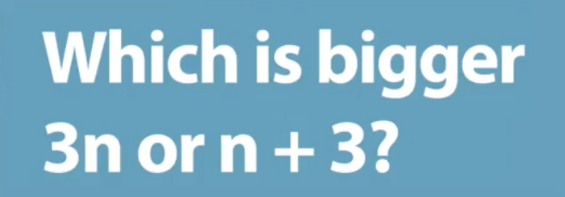
Work on this task for yourself and convince yourself of the solution.
Once you’ve convinced yourself, think about some KS3 students you teach:
How do you think they’d answer the question?
How do you think they’d justify their answer?
Link to Core Concept 1.4
Notes:
NOTE TO SESSION FACILITATOR
Make sure that sufficient time is given for participants to explore the task themselves.
It is important that time is given to discussing and predicting possible justifications and the related misconceptions so that participants are able to watch the video with that as a focus.
This task is taken from Page 12 of the NCETM’s Secondary PD Materials Core Concept 1.4: Simplifying and manipulating expressions, equations and formulae. There is a link to this document on the slide.

Slide 3
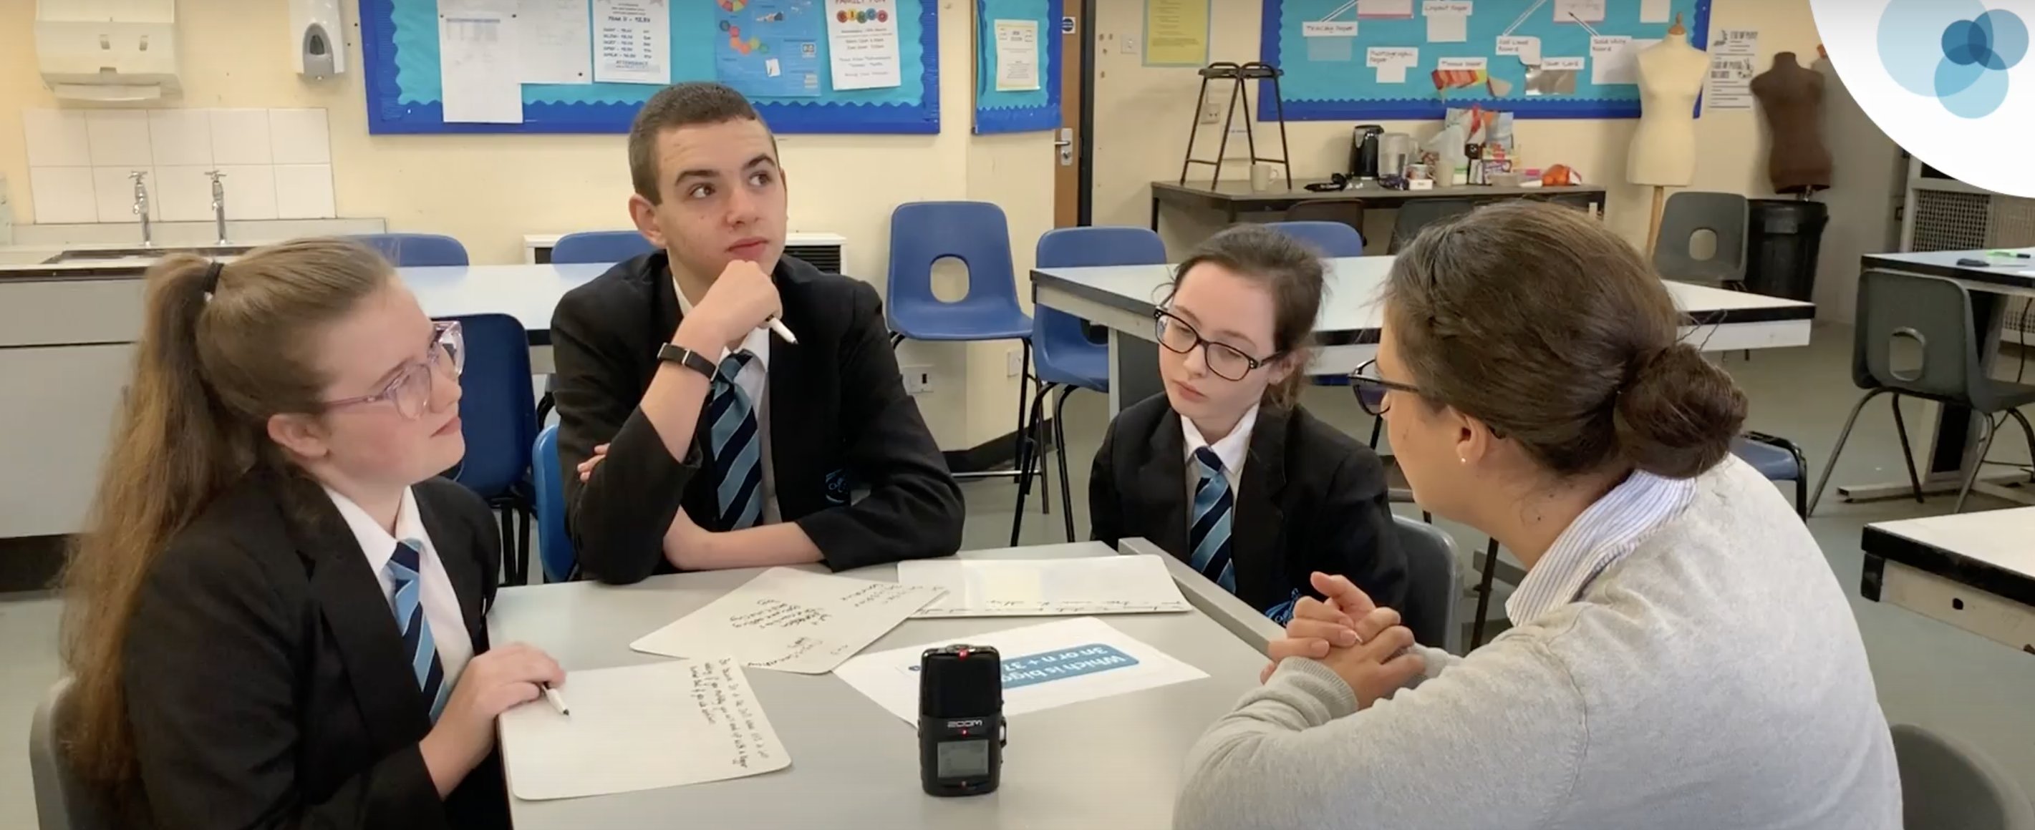
Watch the video in which three Year 8 students discuss this prompt with their teacher.
While watching, keep in mind the predictions that you made.
Do these students show the same thinking that you expected?
What strikes you about the responses and reasoning from these students?
Notes:
The slide text Watch the video is hyperlinked to the video

Slide 4
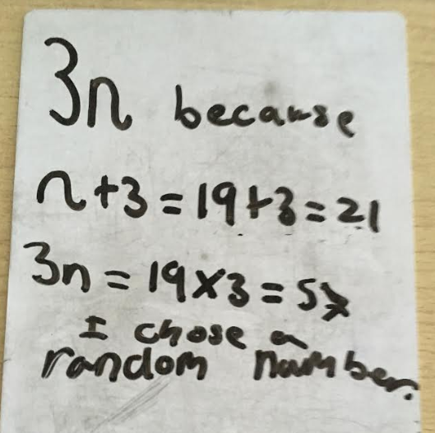
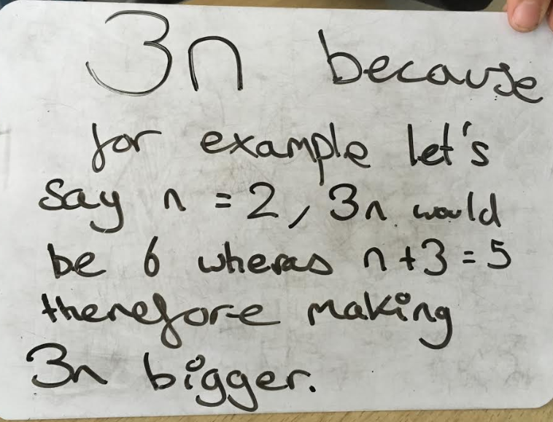
Two of the students initially state that 3n is bigger, justifying their decision by saying that multiplication makes things bigger.
Do you recognise this misconception from your own classes?
When thinking about this prompt, students often offer a ‘particular’ number to justify their decision, for example
Compare these responses with Sophia’s description of the way that she “worked up the number line”.
How is Sophia’s understanding of the letter symbol n different to the understanding suggested by the whiteboards?
Notes:
NOTE TO SESSION FACILITATOR
This slide is animated – the photographs of the whiteboards and text relating to them flies in on a click.
The two mini-whiteboards show responses selected from a class of high attaining Year 8 students.
A common misconception among students is that ‘multiplication makes bigger’. Participants might choose to discuss this and, although it is not the focus of this PowerPoint, optional Slide 6 offers a link to further reading about the multiplication makes bigger misconception.
The point at which Sophia says that she’s working up the number line is around 4:10 in the video.
Although we can’t be sure from the evidence of the whiteboards, it might be suggested that the students offering these responses have a more static understanding of the value of n. Particularly the statement ‘I chose a random number’ might be taken to indicate that n can be any number while not fully understanding that it can take a range of values while Sophia’s description of systematically changing the value, coupled with the number line imagery, might suggest a different interpretation.
You might like to have tried this task with some students so that you can share your experience with the participants at this point.

Slide 5
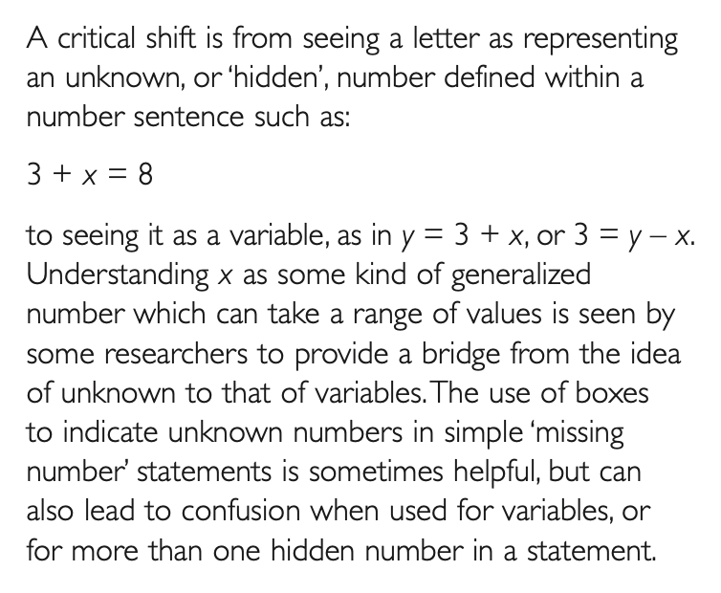
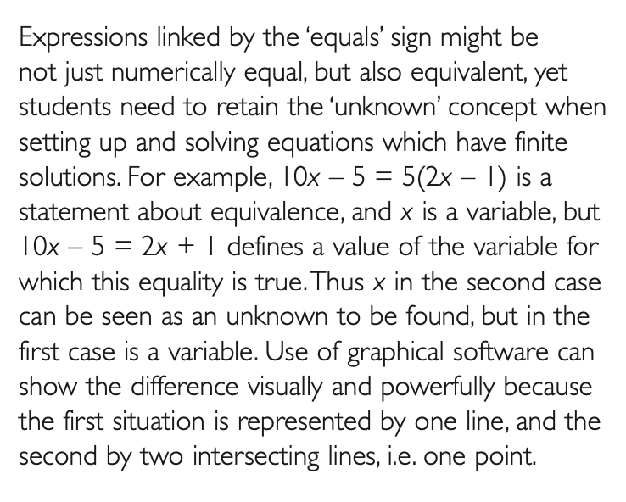
Sophia’s idea of ‘working up the number line’ might be an indication that she is viewing the letter symbol as a variable. Anne Watson, writing here in 2009, suggests that this is a ‘critical shift’ for students to make.
Link to paper here
A common explanation offered to students is that the letter ‘could be any number.’
Do you recognise this way of explaining the idea of a variable?
What might be the pros and cons of this sort of explanation in helping students to understand the idea of a letter symbolising a variable?
Notes:
NOTE TO SESSION FACILITATOR
This text is taken from Page 4 of Paper 6 in the Key Understandings in Mathematics Learning reports from the Nuffield Foundation, written by Anne Watson.
There is a link to the full paper on the slide.
You might like to explore with participants how they usually support students to understand the idea of a letter symbol standing for a variable.
Many textbooks offer exercises in which students are asked to substitute seemingly random values into expression in order to evaluate the expression.
Do the participants recognise this sort of task?
Is this sort of task helpful in building students’ understanding of a variable?

Slide 6
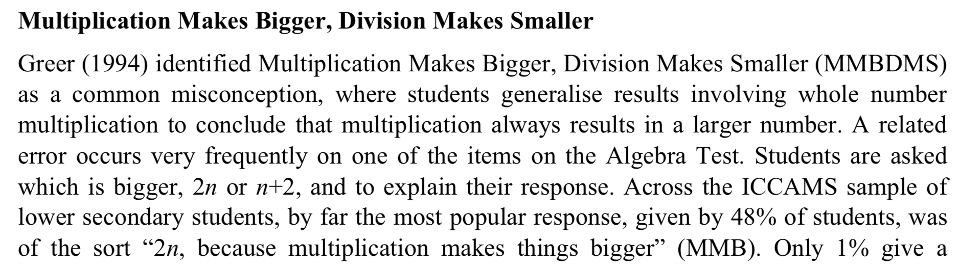
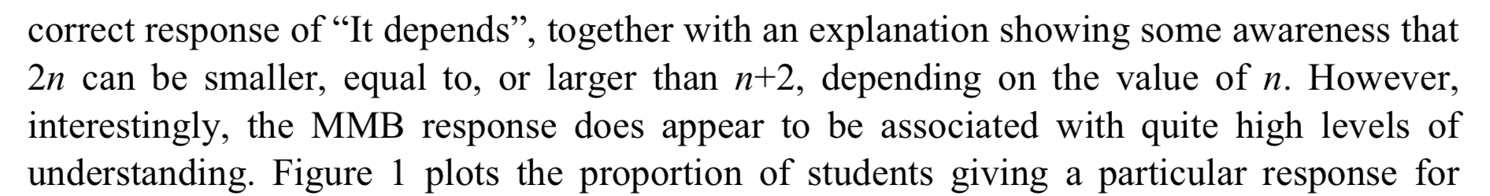
Link to paper
Notes:
NOTE TO SESSION FACILITATOR
This slide is animated – information about the results of a trial as part of the ICCAMS project is underlined on a click.
This is an optional slide that offers a way in to exploring the ‘multiplication makes bigger’ misconception.
Although this misconception is not the intended focus of this PowerPoint, some participants may wish to explore this and the paper from which this extract is taken offers a good starting point.
Note that the ICCAMS task used 2n and n+2, while the PD materials used 3n and n+3. You might like to discuss with participants whether the choice of numbers (2, 3 or any other number) is important?
It might be interesting to discuss the difference in these two tasks and maybe try them with a class to explore the impact of a change in the numbers used.
The extract is taken from Hodgen, J., Brown, M., Coe, R., & Küchemann, D. (2012). Surveying lower secondary students’ understandings of algebra and multiplicative reasoning: to what extent do particular errors and incorrect strategies indicate more sophisticated understandings? In J. C. Sung (Ed.), Proceedings of the 12th International Congress on Mathematical Education (ICME-12) (pp. 6572-6580). Seoul, Korea: International Mathematics Union.
There is a link to the full paper on the slide.

Slide 7
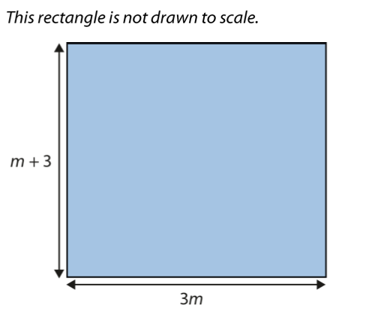
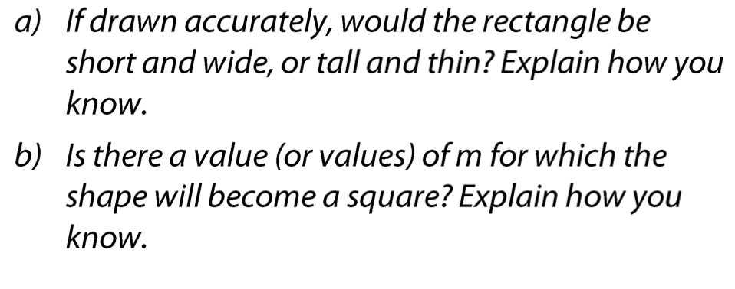
The NCETM’s Secondary PD Materials offer some tasks designed to help students think about the idea of a letter standing for a variable.
This task is taken from the materials and offers an alternative representation of the task in the video.
Link to Core Concept 2.2
Do you think that students will respond differently to the task when set in this context?
Try both tasks with your class or classes. Does one offer more insight into the letter as a variable than the other?
Notes:
NOTE TO SESSION FACILITATOR
This is an optional slide that offers a different representation of the task in the video.
You might like to work with participants to predict the impact that the change in representation makes on the way in which students tackle the task – are they more likely to view the letter symbol as a variable when presented with it in this geometrical context?
The task is taken from Page 13 of Core Concept 2.2: Solving linear equations. There is a link to this document on the slide.
You might like to have tried this task with some students so that you can share your experience with the participants at this point.

Slide 8
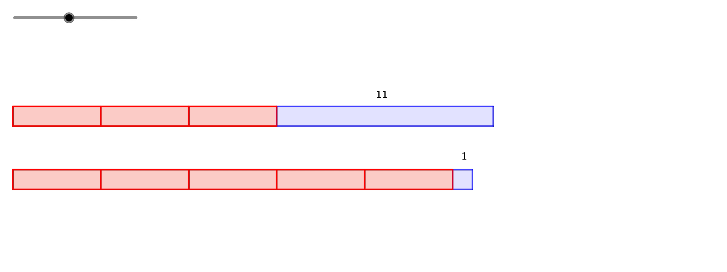
The NCETM’s Secondary PD Materials suggest the use of a range of representations to explore the idea of a letter standing for a variable.
Consider this dynamic image – do you think it offers benefits in supporting students to understand an unknown as a variable?
Geogebra file here
How would you present this task to students to develop students’ understanding of a variable?
(When) would you introduce the use of a letter symbol to represent the length of the red bar?
Notes:
SESSION FACILITATOR
This slide is animated – The image is a movie showing the way that the two bar models grow as the length of the red bars change.
You might like to discuss with participants whether they see benefits of the dynamic image compared to a static representation such s algebra tiles.
A key consideration when using this task with students is when to begin to work symbolically and creating an equation to be solved.
This may be a useful discussion point with participants – how would they ensure that students are connecting the equation 3x + 11 = 5x + 1 and the representation on the movie?
There is a link to the Geogebra file used to create the movie on the slide.
You might like to have tried this task with some students so that you can share your experience with the participants at this point

Slide 9
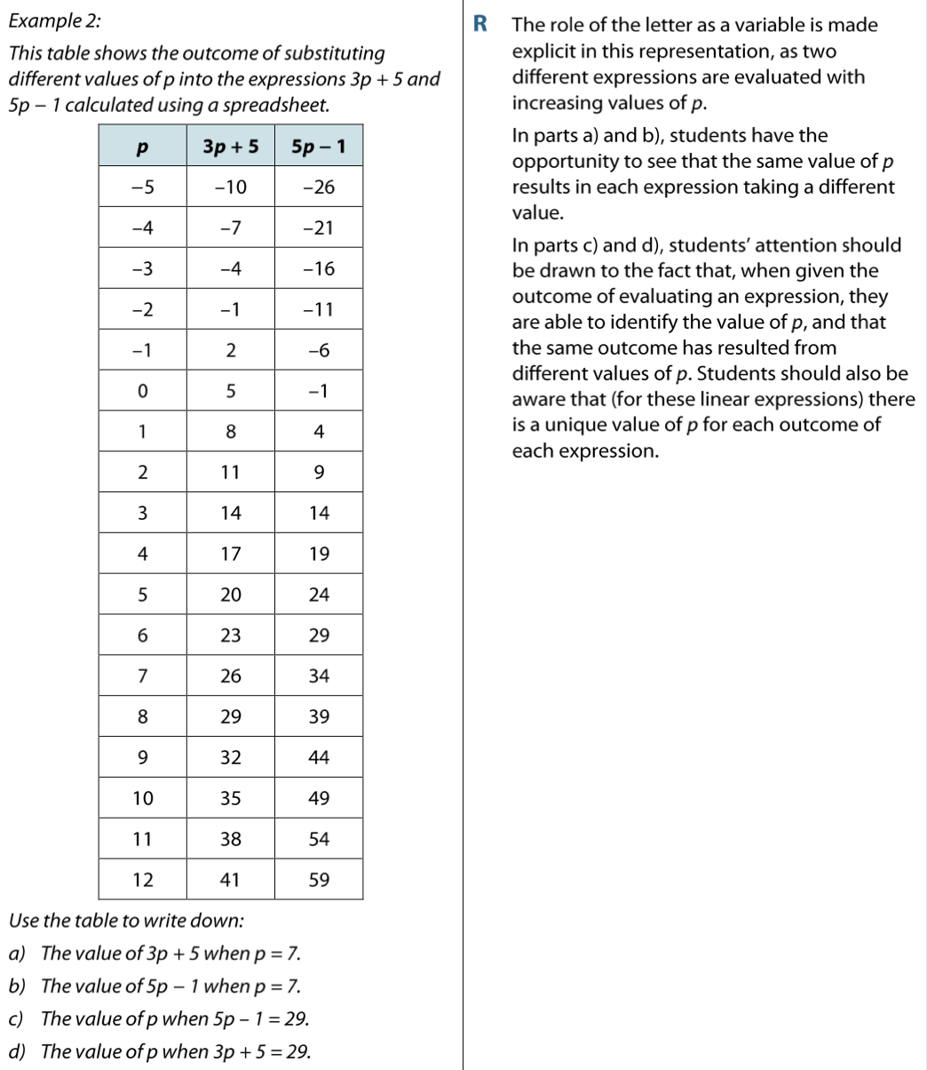
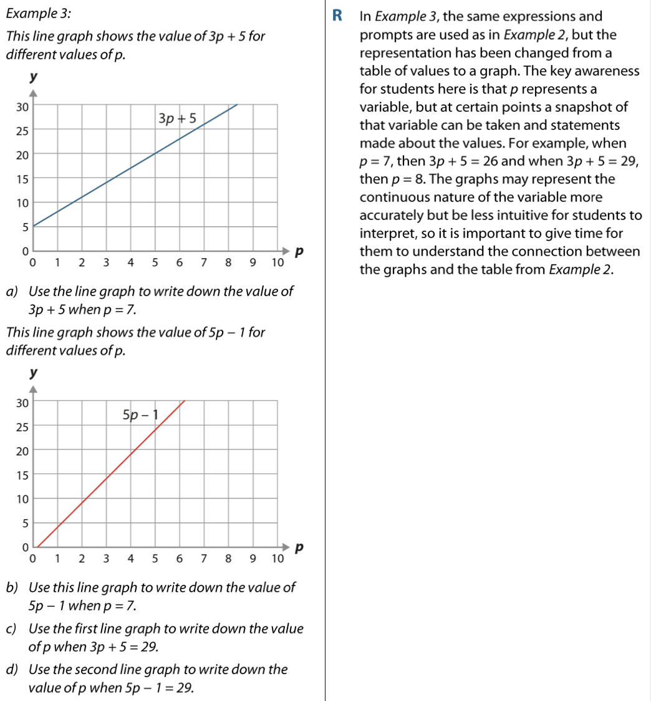
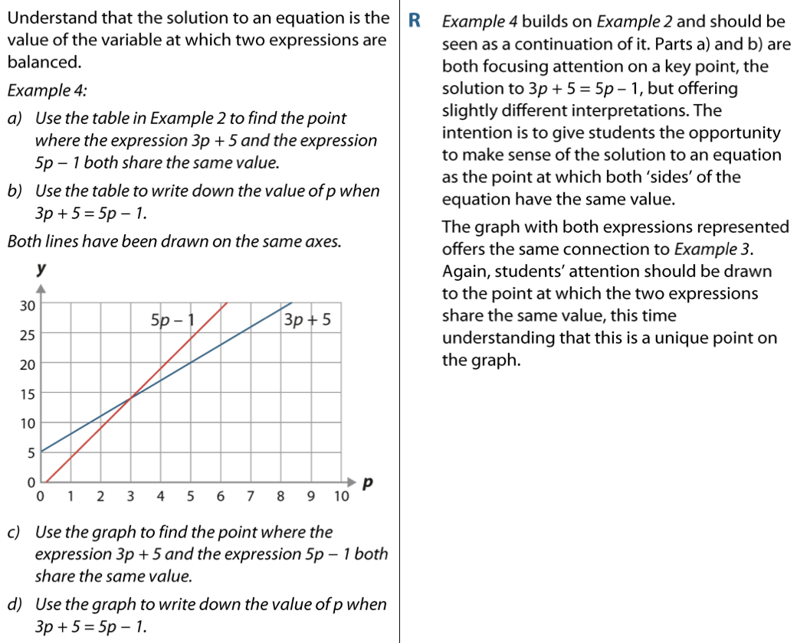
The NCETM’s Secondary PD Materials offer some other tasks designed to help students recognise the letter symbol as a variable.
Link to Core Concept 2.2
Consider the dynamic bar model image on the previous slide and these tasks.
How would you present them to students to develop understanding of the letter standing for a variable?
Notes:
NOTE TO SESSION FACILITATOR
In this slide participants are asked to consider tasks from the Secondary PD Materials.
These should be made available as a handout, or online.
The relevant tasks are from pages 11 to 16 of Core Concept 2.2: Solving linear equations: https://www.ncetm.org.uk/media/wbylane0/ncetm_ks3_cc_2_2.pdf
There is a link to Core Concept 2.2 on the slide.

